Slide 1
In-Out Formalism for Effective Actions in QED and Gravity
Sang Pyo Kim
Kunsan Nat’l Univ. & CoReLS-IBS
2nd APCTP-INPP Meeting
August 24-30, 2025

Slide 2


The Road Not Taken (Robert Frost)

Slide 3
Mathematical beauty behind particle production and Stokes phenomena [AAPPS Bulletin 23 (‘13), e-EPS (’13)]
At the James Scott Prize Lecture in 1939, P. A. M. Dirac emphasized the theory of functions of a complex variable as an interesting mathematical theory that fulfilled his criteria of beauty. He found this field to be of “exceptional beauty” and hence likely to lead to deep physical insight.

Slide 4
Outline
Motivation
Unified Picture for Spontaneous Pair Production
Effective Actions in In-Out Formalism
Gamma-Function Regularization for QED and/or Gravity Actions
QED Action & Schwinger Effect in (Anti-) de Sitter
Summary & Perspective

Slide 5
Motivation

Slide 6
Near-Horizon Geometries
Theorem (Static) [Kunduri, Lucietti, Reall, CQG 24 (‘07)]
Any static near-horizon geometry is locally a warped product of AdS₂, dS₂ or R^{1,1} and 𝐻. If 𝐻 is simply connected, this statement is global. In this case if 𝐻 is compact and the strong energy conditions holds, it must be the AdS₂ case or the direct product R^{1,1} × 𝐻.
Theorem (Rotational)
Consider a 𝐷-dimensional spacetime containing a degenerate horizon, invariant under an R×𝑈(1)^{𝐷−3} isometry group, satisfying the Einstein equations 𝑅_{𝜇𝜈} = Λ𝑔_{𝜇𝜈}. Then the near-horizon geometry has a global 𝐺 × 𝑈(1)^{𝐷−3} symmetry, where 𝐺 is either 𝑂(2, 1) or the 2D Poincare group. Furthermore, if Λ ≤ 0 and the near-horizon geometry is non-static, the Poincare case is excluded.
Enhanced symmetries enable one to solve the equations for linear perturbations in terms of hypergeometric functions: bosons, fermions, EM fields, GWs, etc.

Slide 7
Why Loops?
Now @ APCTP: one-loop QED actions in dS space
Bavarsad, SPK, Stahl, Xue, “Scalar QED effective action and renormalization group flows in dS space,” (coming soon)
Chen, Huang, SPK, “Saturation of Pauli blocking in near-extremal charged Nariai BHs,” (coming soon)
Chen, SPK, Rivera Medina, “One loop effective action for pair production in near-extremal RN BHs,” (maybe in September)
Recent interest on near-extremal BHs
Castro, Mancilla, Ioannis Papadimitrou, “Near-extremal dynamics away from the horizon,” [2507.01126] & 2nd APCTP-INPP meeting
Iliesiu, Turiaci, “The statistical mechanics of near-extremal BHs,” [JHEP 05 (2021)]
Turiaci, “Les Houches lecture on two-dimensional gravity and holography,” [2412.09538]
Debangshu Mukherjee’s talk
Many other works on near-extremal BHs

Slide 8
Schwinger Emission in (Near-) Extremal BHs in (A)dS Space [Chen, et al, since 2012]
KN BH in (A)dS
Warped AdS₃ x S¹
QED in (A)dS
(A)dS
RN in (A)dS
AdS₂ x S² : R_{S} , R_{AdS}
RN BH
AdS₂ x S² : R_{S}
KN BH
Warped AdS₃ x S¹

Slide 9
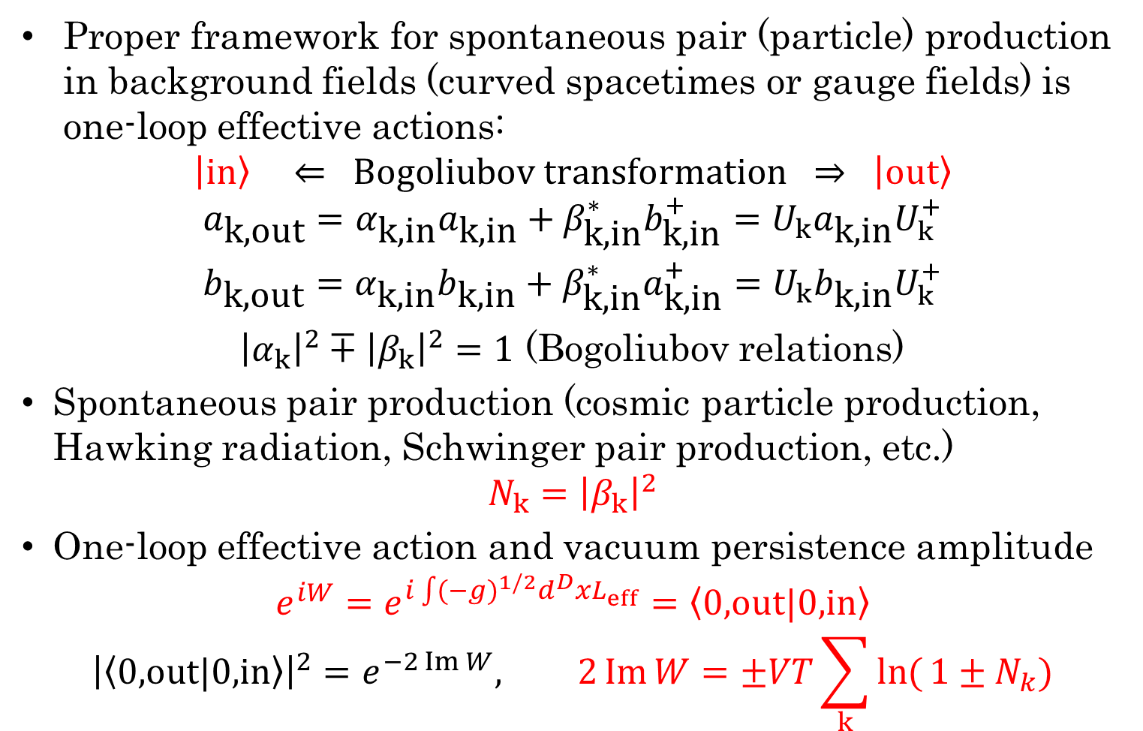
Spontaneous Pair (Particle) Production
Proper framework for spontaneous pair (particle) production in background fields (curved spacetimes or gauge fields) is one-loop effective actions:
$$\left|\left.in\right\rangle \right. ⇐ Bogoliubov transformation ⇒ \left|\left.out\right\rangle \right.$$
$$\begin{matrix}a_{\text{k}\text{,}\text{out}}=α_{\text{k}\text{,}\text{in}}a_{\text{k}\text{,}\text{in}}+β_{\text{k}\text{,}\text{in}}^{∗}b_{\text{k}\text{,}\text{in}}^{+}=U_{k}a_{\text{k}\text{,}\text{in}}U_{k}^{+} \\ b_{\text{k}\text{,}\text{out}}=α_{\text{k}\text{,}\text{in}}b_{\text{k}\text{,}\text{in}}+β_{\text{k}\text{,}\text{in}}^{∗}a_{\text{k}\text{,}\text{in}}^{+}=U_{k}b_{\text{k}\text{,}\text{in}}U_{k}^{+}\end{matrix}$$
${\left|α_{k}\right|}^{2}∓{\left|β_{k}\right|}^{2}=1$ (Bogoliubov relations)
Spontaneous pair production (cosmic particle production, Hawking radiation, Schwinger pair production, etc.)
$$N_{k}={\left|β_{k}\right|}^{2}$$
One-loop effective action and vacuum persistence amplitude
$$e^{iW}=e^{i\int{(−g)^{1/2}d^{D}xL_{eff}}}=\left\langle \text{0,}\text{out}|\text{0,}\text{in}\right\rangle$$
$${\left|\left\langle \text{0,}\text{out}|\text{0,}\text{in}\right\rangle \right|}^{2}=e^{−2\operatorname{Im}{W}}, 2\operatorname{Im}{W}=±VT\sum_{k}{\ln{(}1±N_{k})}$$

Slide 10
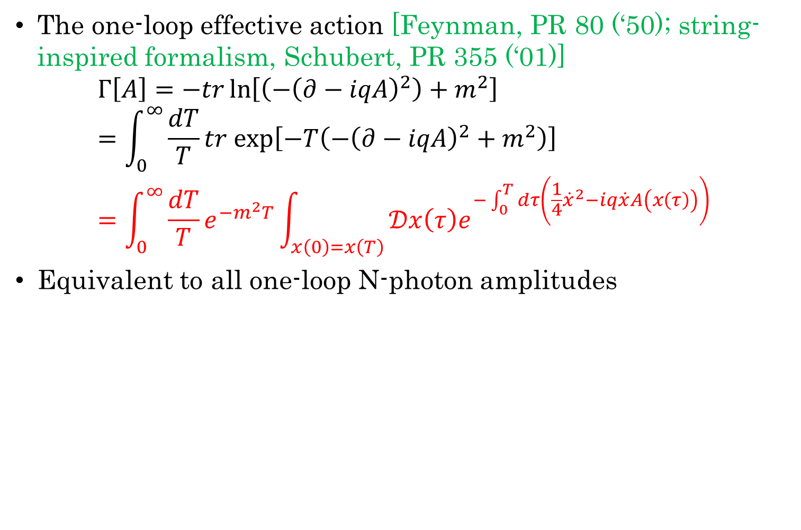
Worldline formalism for QED
The one-loop effective action [Feynman, PR 80 (‘50); string-inspired formalism, Schubert, PR 355 (‘01)]
$$Γ\left[A\right]=−tr\ln\left[\left(−{\left(∂−iqA\right)}^{2}\right)+m^{2}\right]=\int_{0}^{∞}{\frac{dT}{T}}tr exp\left[−T\left(−{\left(∂−iqA\right)}^{2}+m^{2}\right)\right]=\int_{0}^{∞}{\frac{dT}{T}e^{−m^{2}T}\int_{x\left(0\right)=x\left(T\right)}{𝒟x\left(τ\right)e^{−\int_{0}^{T}{dτ\left(\frac{1}{4}{\dot{x}}^{2}−iq\dot{x}A\left(x\left(τ\right)\right)\right)}}}}$$
Equivalent to all one-loop N-photon amplitudes

Slide 11
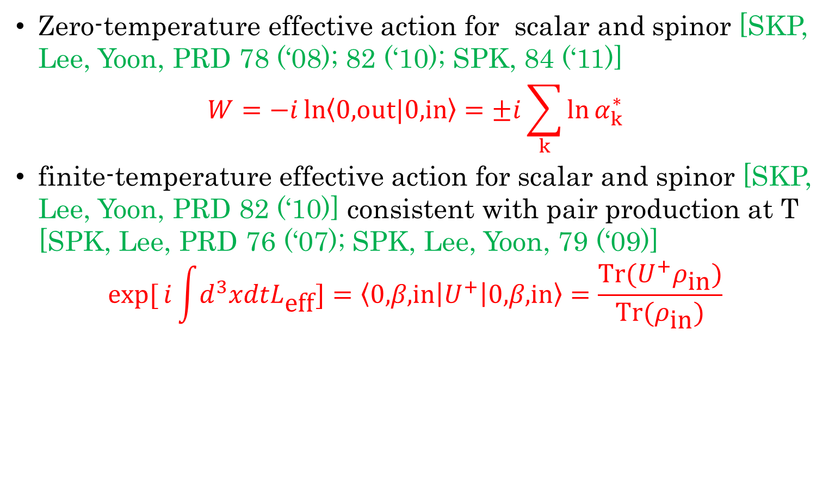
In-Out Formalism for Effective Actions (QED and/or Gravity) at T=0 & T
Zero-temperature effective action for scalar and spinor [SKP, Lee, Yoon, PRD 78 (‘08); 82 (‘10); SPK, 84 (‘11)]
$$W=−i\ln\left\langle \text{0,}\text{out}|\text{0,}\text{in}\right\rangle =±i\sum_{k}{\ln{α_{k}^{∗}}}$$
finite-temperature effective action for scalar and spinor [SKP, Lee, Yoon, PRD 82 (‘10)] consistent with pair production at T [SPK, Lee, PRD 76 (‘07); SPK, Lee, Yoon, 79 (‘09)]
$$\exp{[}i\int{d^{3}xdtL_{\text{eff}}}]=\left\langle \text{0,}β\text{,}\text{in}\right|U^{+}\left|\text{0,}β\text{,}\text{in}\right\rangle =\frac{\text{Tr}(U^{+}ρ_{\text{in}})}{\text{Tr}(ρ_{\text{in}})}$$

Slide 12
Unified Picture for Spontaneous Pair Production

Slide 13
Spontaneous Pair Production: Unified Picture [SPK, JHEP (‘07)]
Vacuum
Fluctuations/
Unruh Effects
Schwinger Mechanism/ Polarization
QCD??
QED
Hawking Radiation/
Polarization?
de Sitter
Black Holes

Slide 14
Schwinger Effect in (A)dS₂ [Cai, SPK, bosons, JHEP (‘14); Chen et al, fermions, (‘25)]
Near Horizon Geometry of Near-Extremal Black Hole:
AdS₂ × S²
Vacuum
Fluctuations
QED
Schwinger Mechanism/ Unruh Effect
de Sitter
Gibbons-Hawking Radiation

Slide 15
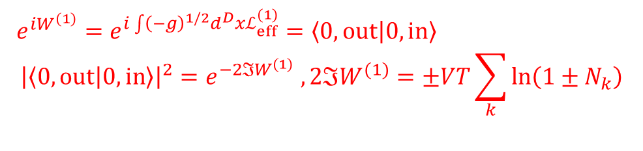
Strong Field QED: Physics and Methods
(Complex)
Effective Actions
Pair Production
& Vacuum Persistence
Worldline Instantons
Phase-Integral
(‘02), (‘06), (‘07), (‘13)
Vacuum Polarization
FeynmanWorldline Path Integral
Dirac-Heisenberg-Wigner Formalism
Schwinger-DeWitt In-Out Formalism
(’08), (‘10), (‘11), (‘14)
Monodromy
(‘22), (‘23)
$e^{iW^{(1)}}=e^{i\int{{\left(−g\right)}^{1/2}d^{D}xℒ_{eff}^{(1)}}}=\left\langle 0, out | 0, in\right\rangle$
$${\left|\left\langle 0,out | 0,in\right\rangle \right|}^{2}=e^{−2ℑW^{(1)}} ,2ℑW^{(1)}=±VT\sum_{k}{\ln\left(1±N_{k}\right)}$$

Slide 16
Effective Actions in In-Out Formalism

Slide 17
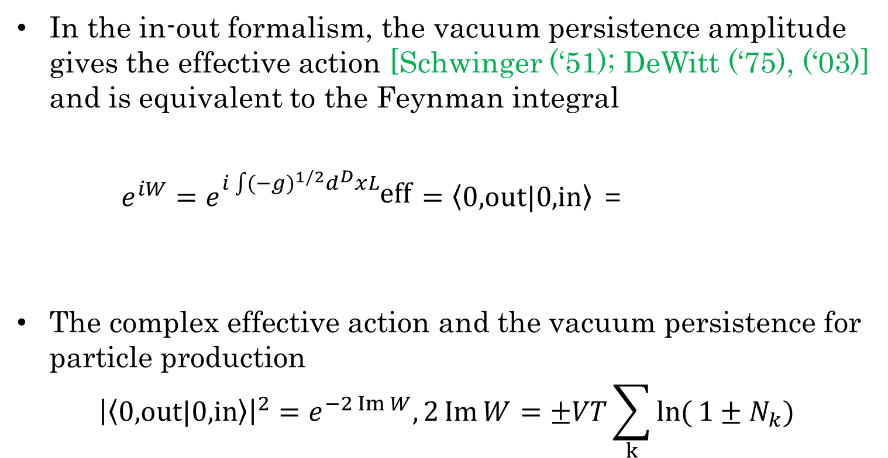
In-Out Formalism for QED Actions
In the in-out formalism, the vacuum persistence amplitude gives the effective action [Schwinger (‘51); DeWitt (‘75), (‘03)] and is equivalent to the Feynman integral
$e^{iW}=e^{i\int{(−g)^{1/2}d^{D}xL_{\text{eff}}}}=\left\langle \text{0,}\text{out}|\text{0,}\text{in}\right\rangle$ =
The complex effective action and the vacuum persistence for particle production
$${\left|\left\langle \text{0,}\text{out}|\text{0,}\text{in}\right\rangle \right|}^{2}=e^{−2\operatorname{Im}{W}},2\operatorname{Im}{W}=±VT\sum_{k}{\ln{(}1±N_{k})}$$

Slide 18
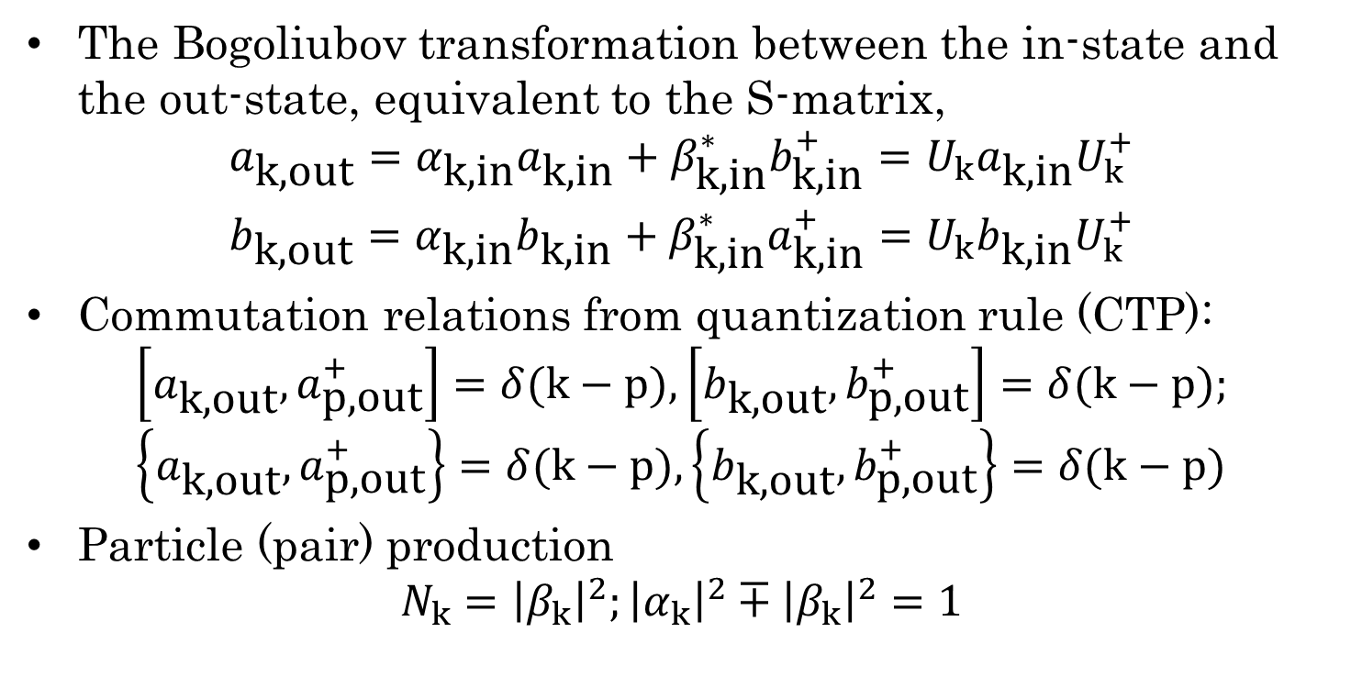
Bogoliubov Transformation & In-Out Formalism
The Bogoliubov transformation between the in-state and the out-state, equivalent to the S-matrix,
$$\begin{matrix}a_{\text{k}\text{,}\text{out}}=α_{\text{k}\text{,}\text{in}}a_{\text{k}\text{,}\text{in}}+β_{\text{k}\text{,}\text{in}}^{∗}b_{\text{k}\text{,}\text{in}}^{+}=U_{k}a_{\text{k}\text{,}\text{in}}U_{k}^{+} \\ b_{\text{k}\text{,}\text{out}}=α_{\text{k}\text{,}\text{in}}b_{\text{k}\text{,}\text{in}}+β_{\text{k}\text{,}\text{in}}^{∗}a_{\text{k}\text{,}\text{in}}^{+}=U_{k}b_{\text{k}\text{,}\text{in}}U_{k}^{+}\end{matrix}$$
Commutation relations from quantization rule (CTP):
$$\left[a_{\text{k}\text{,}\text{out}},a_{\text{p}\text{,}\text{out}}^{+}\right]=δ(k−p),\left[b_{\text{k}\text{,}\text{out}},b_{\text{p}\text{,}\text{out}}^{+}\right]=δ(k−p); \\ \left\{a_{\text{k}\text{,}\text{out}},a_{\text{p}\text{,}\text{out}}^{+}\right\}=δ(k−p),\left\{b_{\text{k}\text{,}\text{out}},b_{\text{p}\text{,}\text{out}}^{+}\right\}=δ(k−p)$$
Particle (pair) production
$$N_{k}={\left|β_{k}\right|}^{2};{\left|α_{k}\right|}^{2}∓{\left|β_{k}\right|}^{2}=1$$

Slide 19
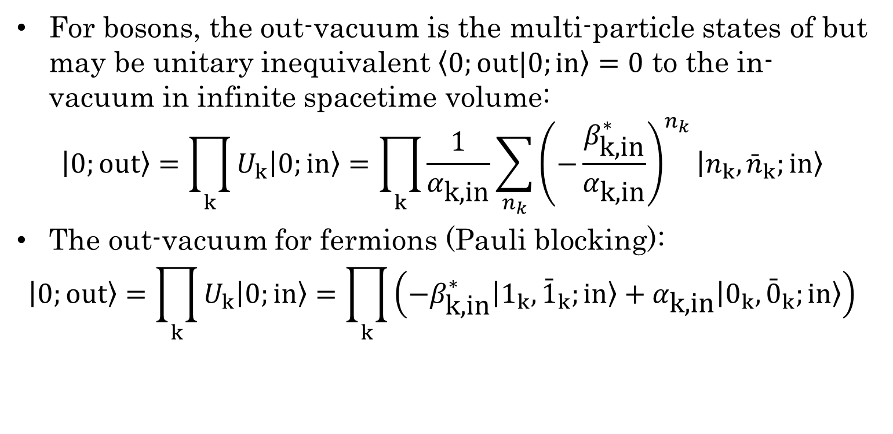
Out-Vacuum from In-Vacuum
For bosons, the out-vacuum is the multi-particle states of but may be unitary inequivalent $\left\langle 0;\text{out}|0;\text{in}\right\rangle =0$ to the in-vacuum in infinite spacetime volume:
$$\left|0;\text{out}\right\rangle =\prod_{k}{U_{k}\left|0;\text{in}\right\rangle }=\prod_{k}{\frac{1}{α_{\text{k}\text{,}\text{in}}}\sum_{n_{k}}{{\left(−\frac{β_{\text{k}\text{,}\text{in}}^{∗}}{α_{\text{k}\text{,}\text{in}}}\right)}^{n_{k}}\left|n_{k},{\bar{n}}_{k};\text{in}\right\rangle }}$$
The out-vacuum for fermions (Pauli blocking):
$$\left|0;\text{out}\right\rangle =\prod_{k}{U_{k}\left|0;\text{in}\right\rangle }=\prod_{k}{\left(−β_{\text{k}\text{,}\text{in}}^{∗}\left|1_{k},{\bar{1}}_{k};\text{in}\right\rangle +α_{\text{k}\text{,}\text{in}}\left|0_{k},{\bar{0}}_{k};\text{in}\right\rangle \right)}$$

Slide 20
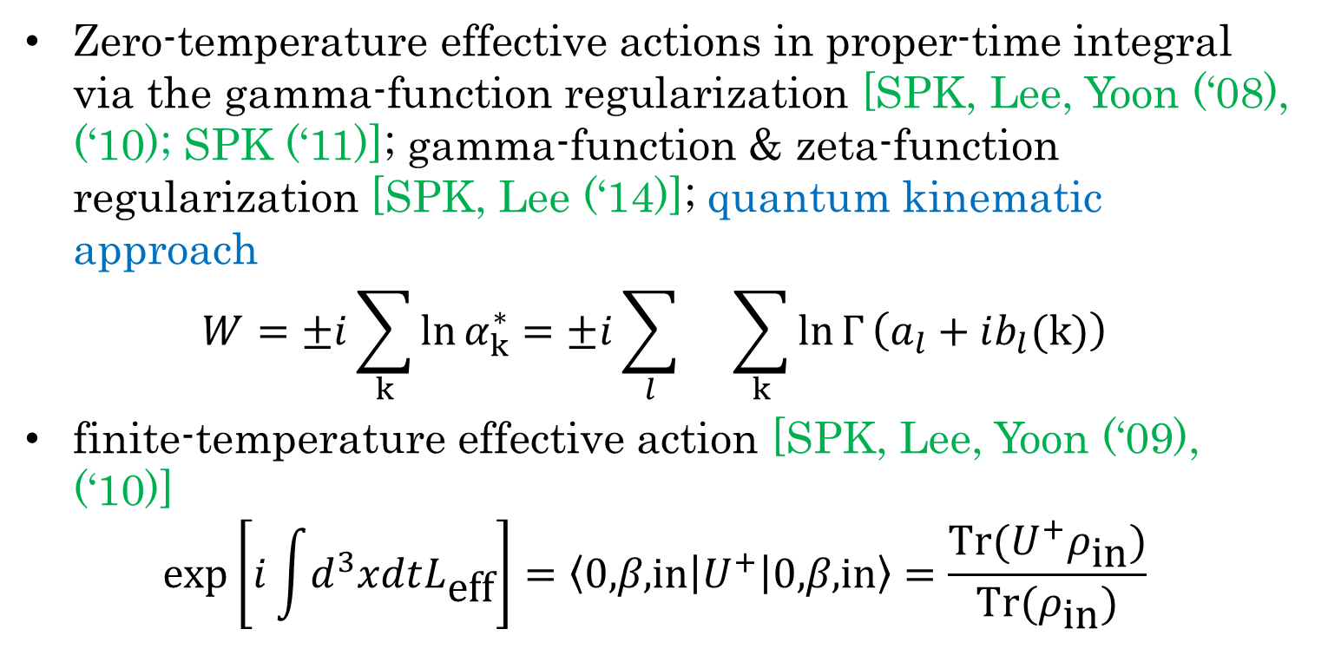
Effective Actions at T=0 & T
Zero-temperature effective actions in proper-time integral via the gamma-function regularization [SPK, Lee, Yoon (‘08), (‘10); SPK (‘11)]; gamma-function & zeta-function regularization [SPK, Lee (‘14)]; quantum kinematic approach
$$W=±i\sum_{k}{\ln{α_{k}^{∗}}}=±i\sum_{l}{}\sum_{k}{\ln{Γ}\left(a_{l}+ib_{l}(k)\right)}$$
finite-temperature effective action [SPK, Lee, Yoon (‘09), (‘10)]
$$\exp\left[i\int{d^{3}xdtL_{\text{eff}}}\right]=\left\langle \text{0,}β\text{,}\text{in}\right|U^{+}\left|\text{0,}β\text{,}\text{in}\right\rangle =\frac{\text{Tr}(U^{+}ρ_{\text{in}})}{\text{Tr}(ρ_{\text{in}})}$$

Slide 21
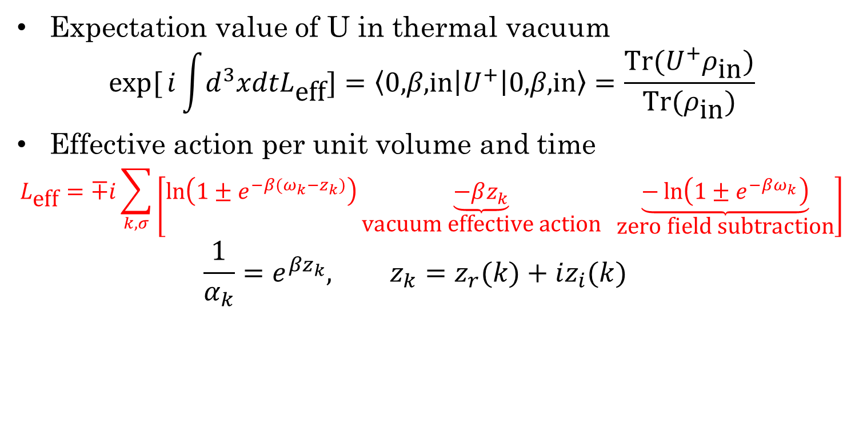
Effective Action at T
Expectation value of U in thermal vacuum
$$\exp{[}i\int{d^{3}xdtL_{\text{eff}}}]=\left\langle \text{0,}β\text{,}\text{in}\right|U^{+}\left|\text{0,}β\text{,}\text{in}\right\rangle =\frac{\text{Tr}(U^{+}ρ_{\text{in}})}{\text{Tr}(ρ_{\text{in}})}$$
Effective action per unit volume and time
$$L_{\text{eff}}=∓i\sum_{k,σ}{\left[\ln\left(1±e^{−β(ω_{k}−z_{k})}\right)\underset{\text{vacuum} \text{effective} \text{action}}{\underbrace{−βz_{k}}} \underset{\text{zero} \text{field} \text{subtraction}}{\underbrace{−\ln\left(1±e^{−βω_{k}}\right)}}\right]}$$
$$\frac{1}{α_{k}}=e^{βz_{k}}, z_{k}=z_{r}(k)+iz_{i}(k)$$

Slide 22
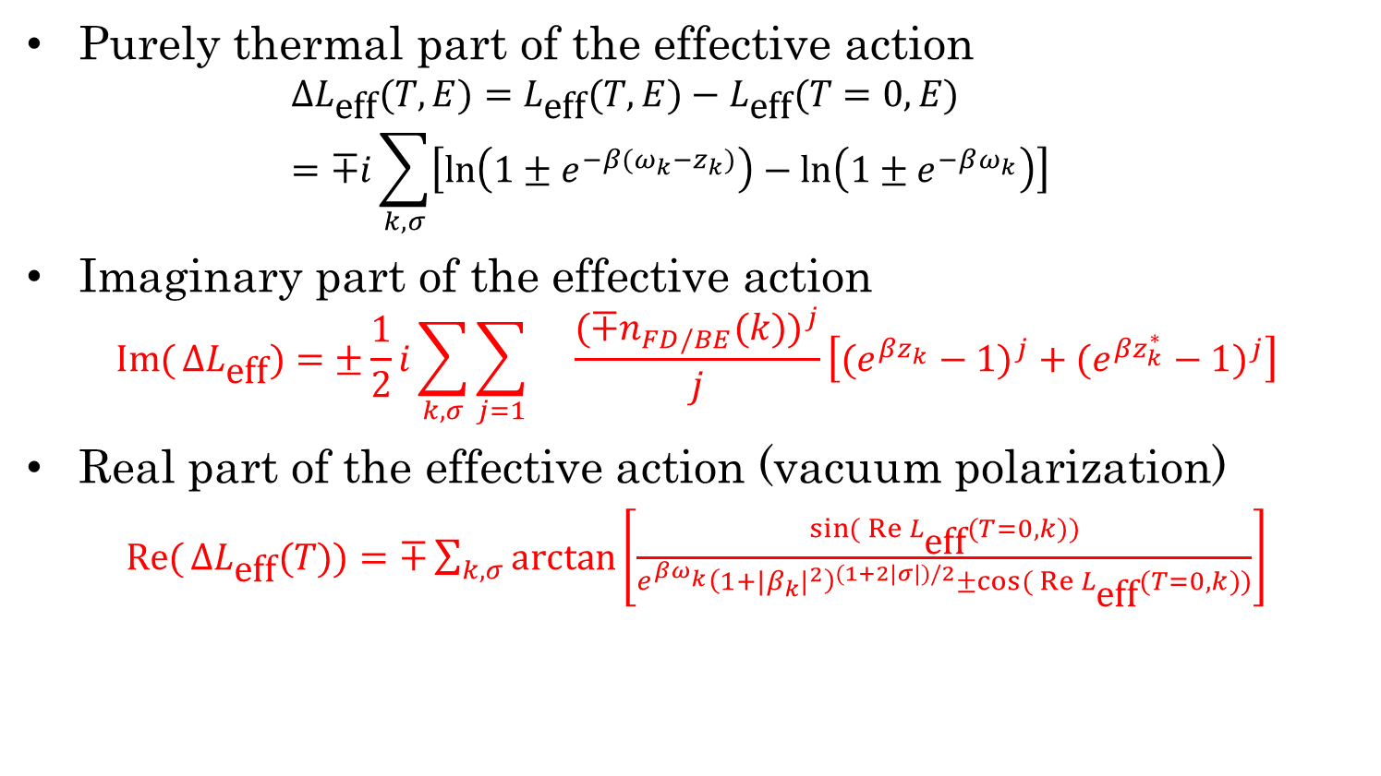
Vacuum Polarization & Persistence
Purely thermal part of the effective action
$$ΔL_{\text{eff}}(T,E)=L_{\text{eff}}(T,E)−L_{\text{eff}}(T=0,E) \\ =∓i\sum_{k,σ}{\left[\ln\left(1±e^{−β(ω_{k}−z_{k})}\right)−\ln\left(1±e^{−βω_{k}}\right)\right]}$$
Imaginary part of the effective action
$$\operatorname{Im}{(}ΔL_{\text{eff}})=±\frac{1}{2}i\sum_{k,σ}{\sum_{j=1}{}\frac{(∓n_{FD/BE}(k))^{j}}{j}\left[(e^{βz_{k}}−1)^{j}+(e^{βz_{k}^{∗}}−1)^{j}\right]}$$
Real part of the effective action (vacuum polarization)
$\operatorname{Re}{(}ΔL_{\text{eff}}(T))=∓\sum_{k,σ}{\arctan\left[\frac{\sin{(}\operatorname{Re}{L_{\text{eff}}}(T=0,k))}{e^{βω_{k}}{\left(1+|β_{k}|^{2}\right)}^{(1+2|σ|)/2}±\cos{(}\operatorname{Re}{L_{\text{eff}}}(T=0,k))}\right]}$

Slide 23
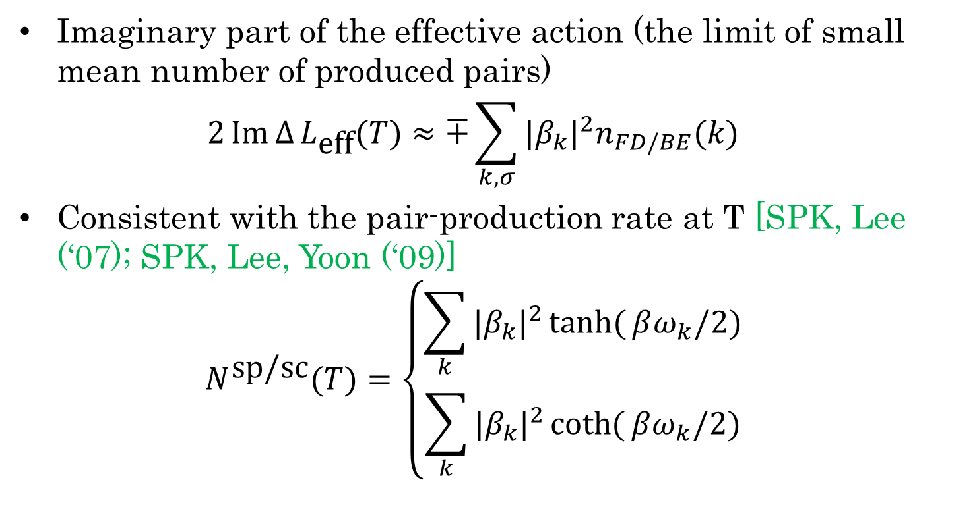
Pair Production at T
Imaginary part of the effective action (the limit of small mean number of produced pairs)
$$2\operatorname{Im}{Δ}L_{\text{eff}}(T)≈∓\sum_{k,σ}{|β_{k}|^{2}n_{FD/BE}(k)}$$
Consistent with the pair-production rate at T [SPK, Lee (‘07); SPK, Lee, Yoon (‘09)]
$$N^{\text{sp}\text{/}\text{sc}}(T)=\left\{\begin{matrix}\sum_{k}{|β_{k}|^{2}\tanh{(}βω_{k}/2)} \\ \sum_{k}{|β_{k}|^{2}\coth{(}βω_{k}/2)}\end{matrix}\right.$$

Slide 24
Gamma-Function Regularization for QED and/or Gravity Actions

Slide 25
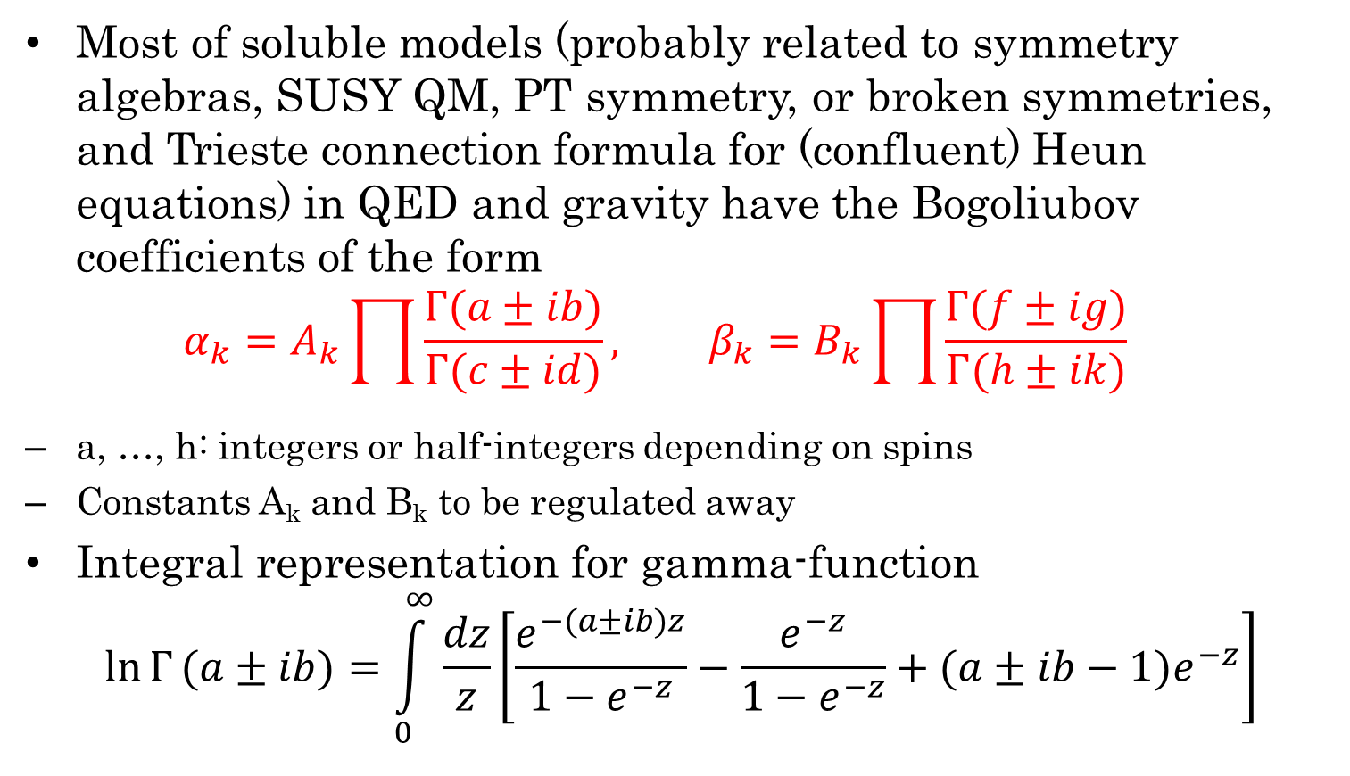
Γ-Function Regularization
Most of soluble models (probably related to symmetry algebras, SUSY QM, PT symmetry, or broken symmetries, and Trieste connection formula for (confluent) Heun equations) in QED and gravity have the Bogoliubov coefficients of the form
$$α_{k}=A_{k}\prod{\frac{Γ(a±ib)}{Γ(c±id)}, β_{k}=B_{k}\prod{\frac{Γ(f±ig)}{Γ(h±ik)}}}$$
a, …, h: integers or half-integers depending on spins
Constants A_{k} and B_{k} to be regulated away
Integral representation for gamma-function
$$\ln{Γ}(a±ib)=\int_{0}^{∞}{\frac{dz}{z}\left[\frac{e^{−(a±ib)z}}{1−e^{−z}}−\frac{e^{−z}}{1−e^{−z}}+(a±ib−1)e^{−z}\right]}$$

Slide 26
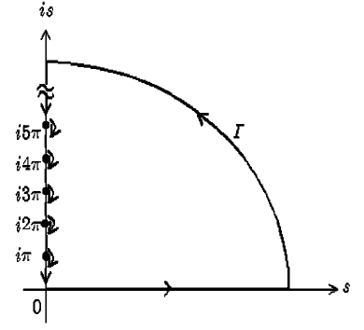
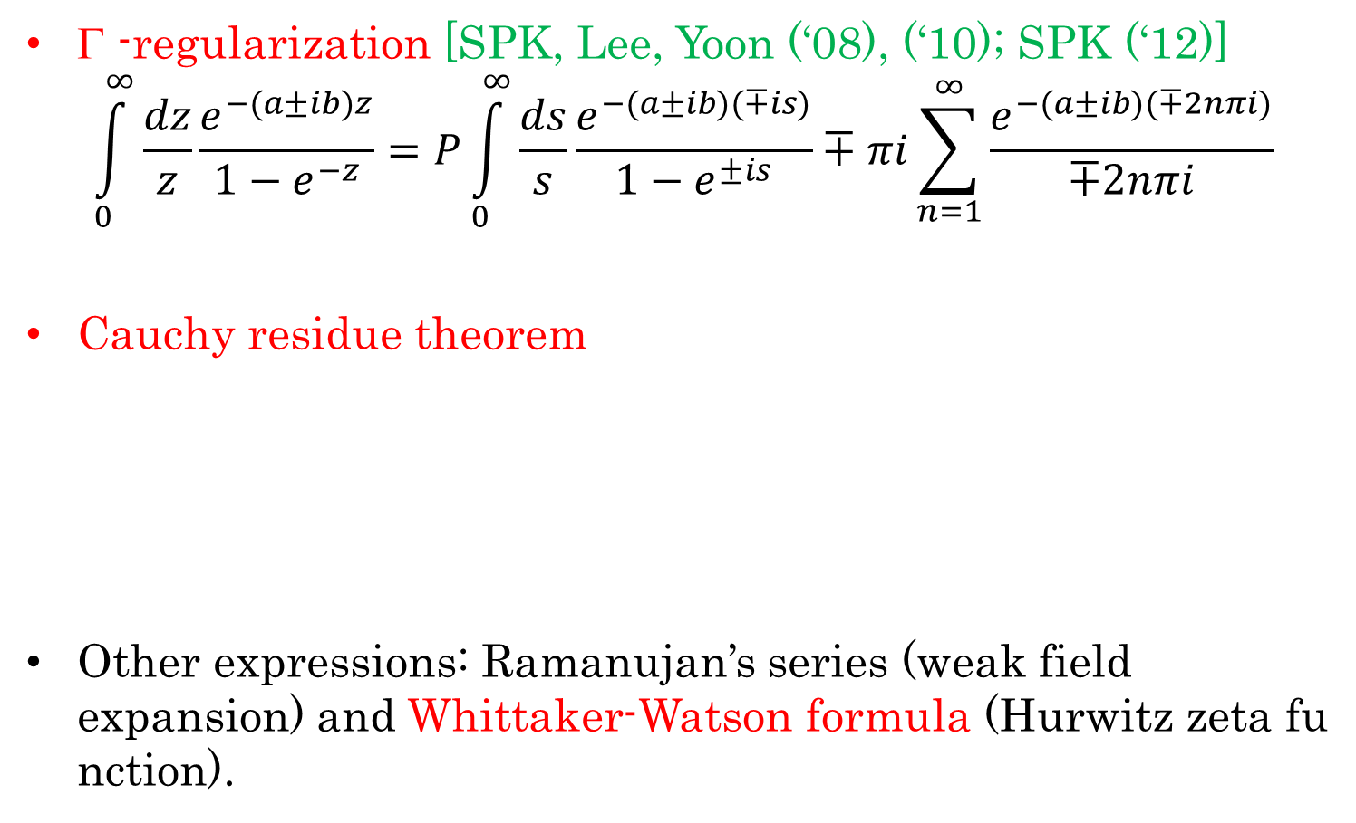
Γ-Function Regularization
Γ -regularization [SPK, Lee, Yoon (‘08), (‘10); SPK (‘12)]
$$\int_{0}^{∞}{\frac{dz}{z}\frac{e^{−(a±ib)z}}{1−e^{−z}}=P}\int_{0}^{∞}{\frac{ds}{s}\frac{e^{−(a±ib)(∓is)}}{1−e^{±is}}∓πi\sum_{n=1}^{∞}{\frac{e^{−(a±ib)(∓2nπi)}}{∓2nπi}}}$$
Cauchy residue theorem
Other expressions: Ramanujan’s series (weak field expansion) and Whittaker-Watson formula (Hurwitz zeta function).

Slide 27
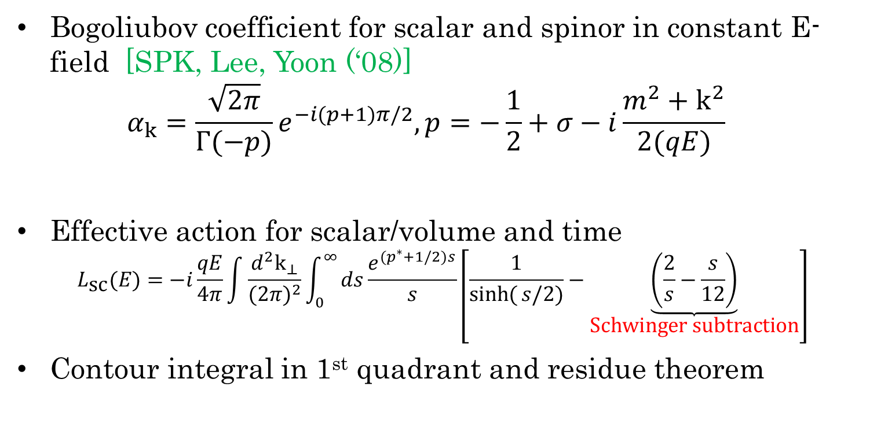
QED Action in Constant E
Bogoliubov coefficient for scalar and spinor in constant E-field [SPK, Lee, Yoon (‘08)]
$$α_{k}=\frac{\sqrt{2π}}{Γ(−p)}e^{−i(p+1)π/2},p=−\frac{1}{2}+σ−i\frac{m^{2}+k^{2}}{2(qE)}$$
Effective action for scalar/volume and time
$$L_{\text{sc}}(E)=−i\frac{qE}{4π}\int{\frac{d^{2}k_{⊥}}{(2π)^{2}}}\int_{0}^{∞}{ds\frac{e^{(p^{∗}+1/2)s}}{s}}\left[\frac{1}{\sinh{(}s/2)}−\underset{\text{Schwinger} \text{subtraction}}{\underbrace{\left(\frac{2}{s}−\frac{s}{12}\right)}}\right]$$
Contour integral in 1st quadrant and residue theorem

Slide 28
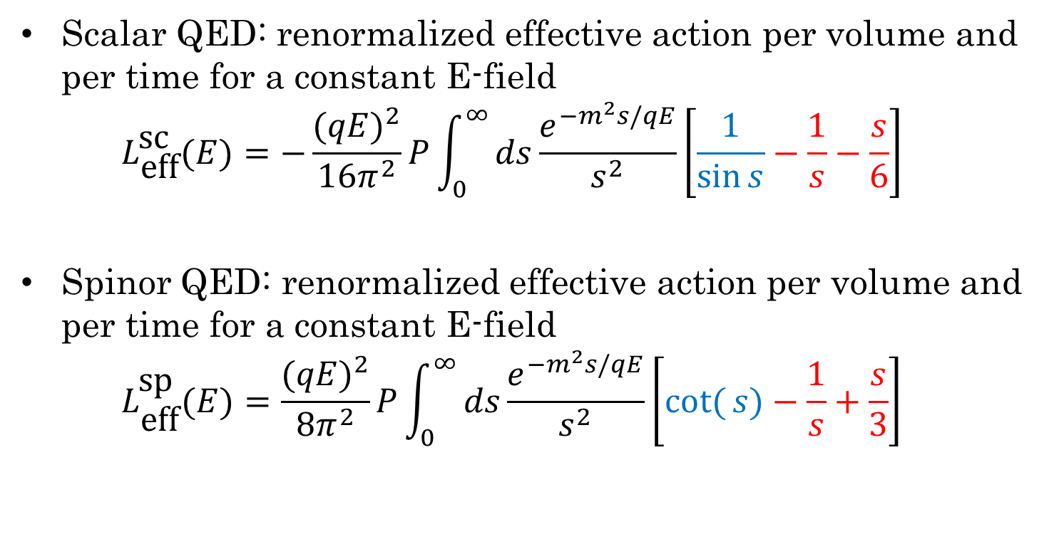
QED Vacuum Polarization
Scalar QED: renormalized effective action per volume and per time for a constant E-field
$$L_{\text{eff}}^{\text{sc}}(E)=−\frac{(qE)^{2}}{16π^{2}}P\int_{0}^{∞}{ds\frac{e^{−m^{2}s/qE}}{s^{2}}}\left[\frac{1}{\sin{s}}−\frac{1}{s}−\frac{s}{6}\right]$$
Spinor QED: renormalized effective action per volume and per time for a constant E-field
$$L_{\text{eff}}^{\text{sp}}(E)=\frac{(qE)^{2}}{8π^{2}}P\int_{0}^{∞}{ds\frac{e^{−m^{2}s/qE}}{s^{2}}}\left[\cot{(}s)−\frac{1}{s}+\frac{s}{3}\right]$$

Slide 29
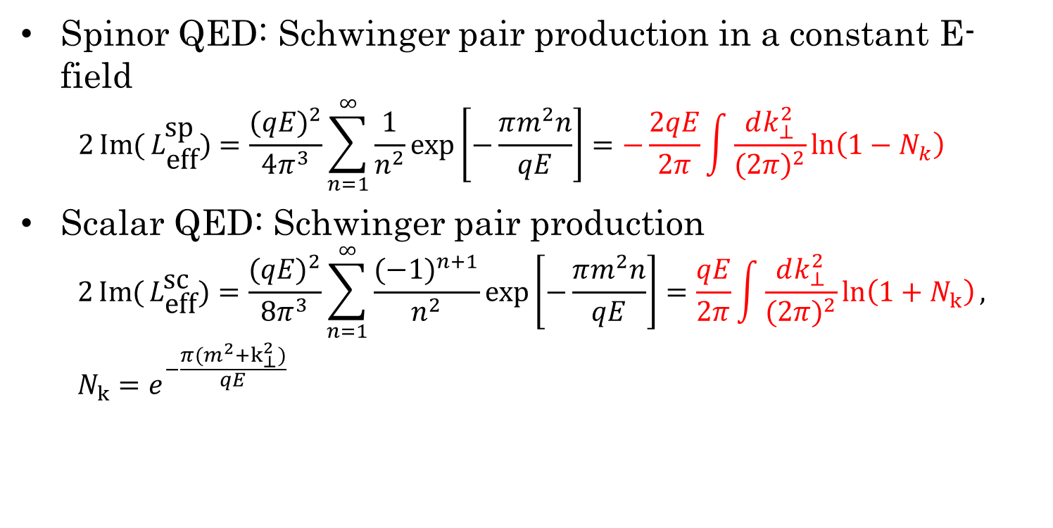
QED Vacuum Persistence & Schwinger Pair Production
Spinor QED: Schwinger pair production in a constant E-field
$$2\operatorname{Im}{(}L_{\text{eff}}^{\text{sp}})=\frac{(qE)^{2}}{4π^{3}}\sum_{n=1}^{∞}{\frac{1}{n^{2}}\exp\left[−\frac{πm^{2}n}{qE}\right]}=−\frac{2qE}{2π}\int{\frac{dk_{⊥}^{2}}{(2π)^{2}}\ln\left(1−N_{k}\right)}$$
Scalar QED: Schwinger pair production
$$2\operatorname{Im}{(}L_{\text{eff}}^{\text{sc}})=\frac{(qE)^{2}}{8π^{3}}\sum_{n=1}^{∞}{\frac{(−1)^{n+1}}{n^{2}}\exp\left[−\frac{πm^{2}n}{qE}\right]}=\frac{qE}{2π}\int{\frac{dk_{⊥}^{2}}{(2π)^{2}}\ln\left(1+N_{k}\right)}, \\ N_{k}=e^{−\frac{π(m^{2}+k_{⊥}^{2})}{qE}}$$

Slide 30
QED in (A)dS

Slide 31
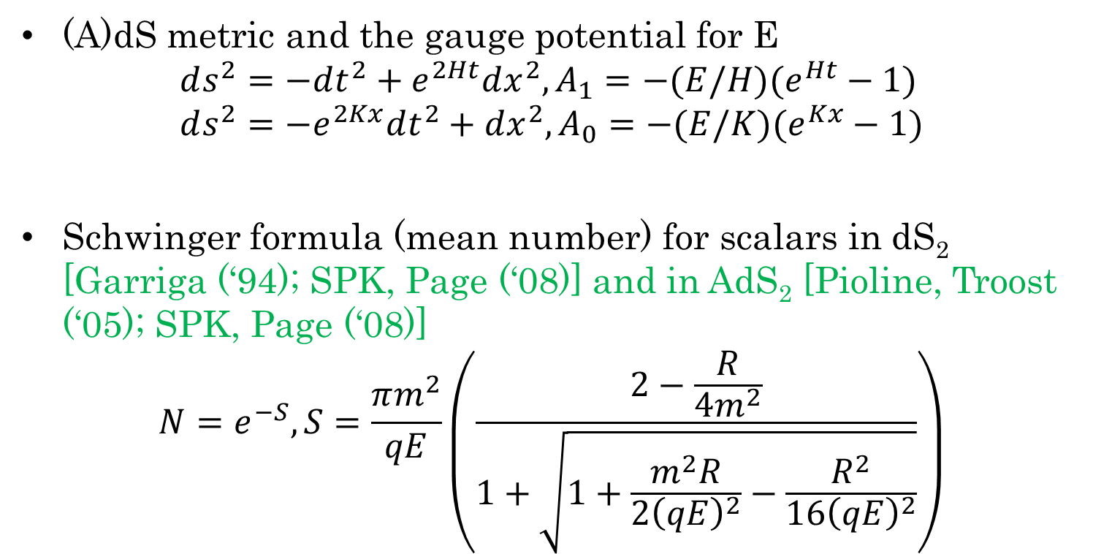
Schwinger formula in (A)dS₂
(A)dS metric and the gauge potential for E
$$ds^{2}=−dt^{2}+e^{2Ht}dx^{2},A_{1}=−(E/H)(e^{Ht}−1) \\ ds^{2}=−e^{2Kx}dt^{2}+dx^{2},A_{0}=−(E/K)(e^{Kx}−1)$$
Schwinger formula (mean number) for scalars in dS₂ [Garriga (‘94); SPK, Page (‘08)] and in AdS₂ [Pioline, Troost (‘05); SPK, Page (‘08)]
$$N=e^{−S},S=\frac{πm^{2}}{qE}\left(\frac{2−\frac{R}{4m^{2}}}{1+\sqrt{1+\frac{m^{2}R}{2{\left(qE\right)}^{2}}−\frac{R^{2}}{16{\left(qE\right)}^{2}}}}\right)$$

Slide 32
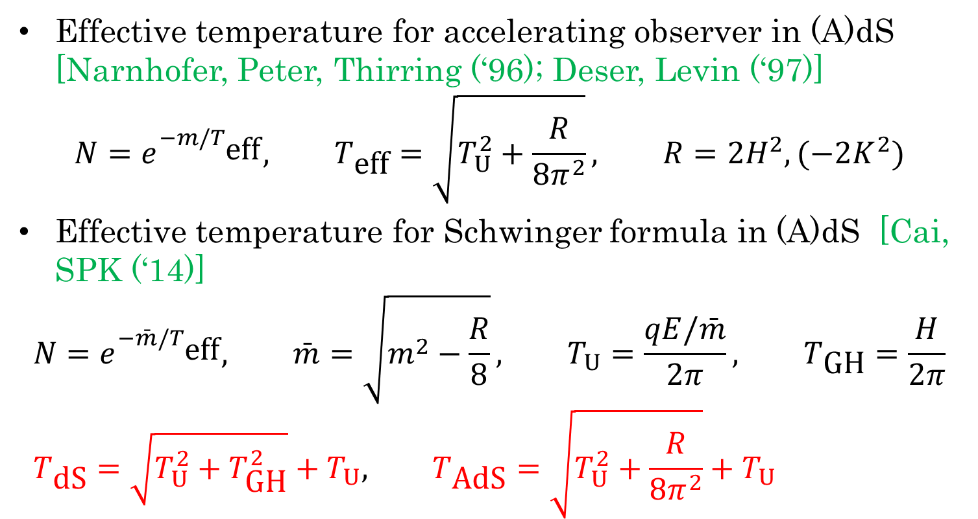
Effective Temperature for Schwinger formula
Effective temperature for accelerating observer in (A)dS [Narnhofer, Peter, Thirring (‘96); Deser, Levin (‘97)]
$$N=e^{−m/T_{\text{eff}}}, T_{\text{eff}}=\sqrt{T_{U}^{2}+\frac{R}{8π^{2}}}, R=2H^{2},(−2K^{2})$$
Effective temperature for Schwinger formula in (A)dS [Cai, SPK (‘14)]
$$N=e^{−\bar{m}/T_{\text{eff}}}, \bar{m}=\sqrt{m^{2}−\frac{R}{8}}, T_{U}=\frac{qE/\bar{m}}{2π}, T_{\text{GH}}=\frac{H}{2π} \\ T_{\text{dS}}=\sqrt{T_{U}^{2}+T_{\text{GH}}^{2}}+T_{U}, T_{\text{AdS}}=\sqrt{T_{U}^{2}+\frac{R}{8π^{2}}}+T_{U}$$

Slide 33
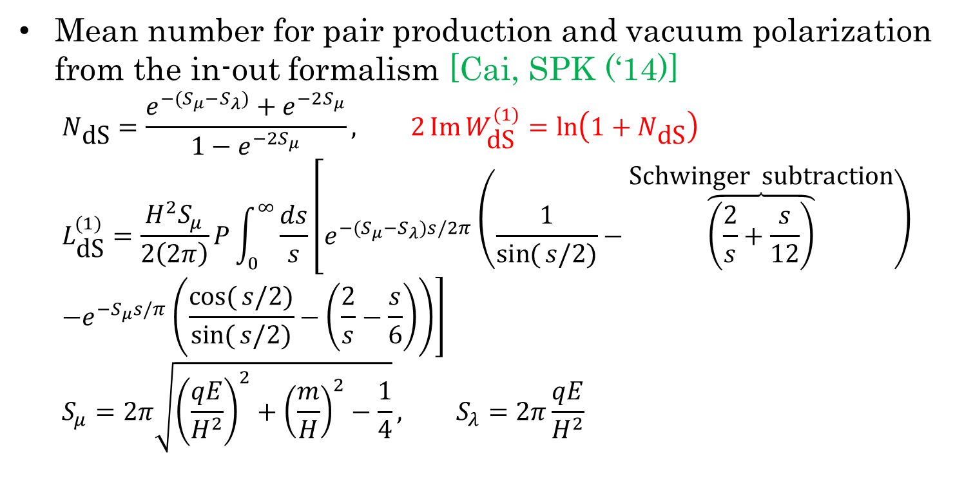
Scalar QED Action in dS₂
Mean number for pair production and vacuum polarization from the in-out formalism [Cai, SPK (‘14)]
$$N_{\text{dS}}=\frac{e^{−(S_{μ}−S_{λ})}+e^{−2S_{μ}}}{1−e^{−2S_{μ}}}, 2\operatorname{Im}{W_{\text{dS}}^{(1)}}=\ln\left(1+N_{\text{dS}}\right) \\ L_{\text{dS}}^{(1)}=\frac{H^{2}S_{μ}}{2\left(2π\right)}P\int_{0}^{∞}{\frac{ds}{s}\left[e^{−(S_{μ}−S_{λ})s/2π}\left(\frac{1}{\sin{(}s/2)}−\overset{\text{Schwinger} \text{subtraction}}{\overbrace{\left(\frac{2}{s}+\frac{s}{12}\right)}}\right)\right.} \\ \left.−e^{−S_{μ}s/π}\left(\frac{\cos{(}s/2)}{\sin{(}s/2)}−\left(\frac{2}{s}−\frac{s}{6}\right)\right)\right] \\ S_{μ}=2π\sqrt{{\left(\frac{qE}{H^{2}}\right)}^{2}+{\left(\frac{m}{H}\right)}^{2}−\frac{1}{4}}, S_{λ}=2π\frac{qE}{H^{2}}$$

Slide 34
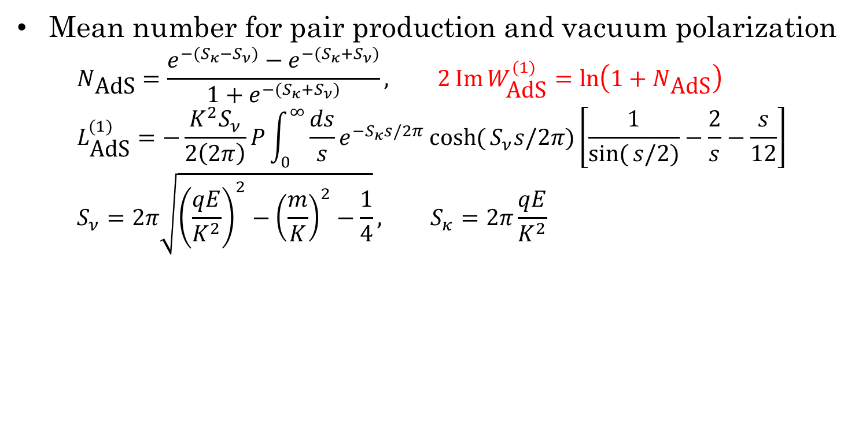
Scalar QED Action in AdS₂
Mean number for pair production and vacuum polarization
$$N_{\text{AdS}}=\frac{e^{−(S_{κ}−S_{ν})}−e^{−(S_{κ}+S_{ν})}}{1+e^{−(S_{κ}+S_{ν})}}, 2\operatorname{Im}{W_{\text{AdS}}^{(1)}}=\ln\left(1+N_{\text{AdS}}\right) \\ L_{\text{AdS}}^{(1)}=−\frac{K^{2}S_{ν}}{2\left(2π\right)}P\int_{0}^{∞}{\frac{ds}{s}e^{−S_{κ}s/2π}\cosh{(}S_{ν}s/2π)\left[\frac{1}{\sin{(}s/2)}−\frac{2}{s}−\frac{s}{12}\right]} \\ S_{ν}=2π\sqrt{{\left(\frac{qE}{K^{2}}\right)}^{2}−{\left(\frac{m}{K}\right)}^{2}−\frac{1}{4}}, S_{κ}=2π\frac{qE}{K^{2}}$$

Slide 35
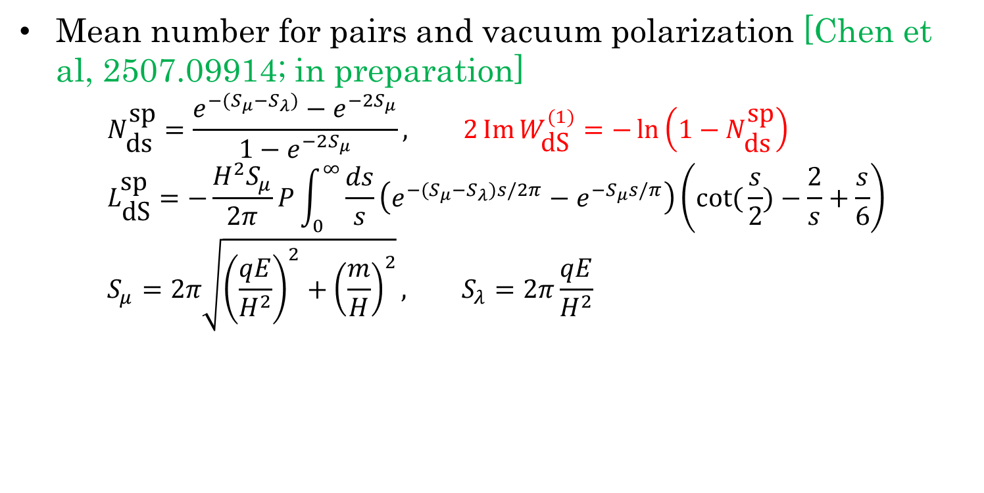
Spinor QED Action in dS₂
Mean number for pairs and vacuum polarization [Chen et al, 2507.09914; in preparation]
$$N_{\text{ds}}^{\text{sp}}=\frac{e^{−(S_{μ}−S_{λ})}−e^{−2S_{μ}}}{1−e^{−2S_{μ}}}, 2\operatorname{Im}{W_{\text{dS}}^{(1)}}=−\ln\left(1−N_{\text{ds}}^{\text{sp}}\right) \\ L_{\text{dS}}^{\text{sp}}=−\frac{H^{2}S_{μ}}{2π}P\int_{0}^{∞}{\frac{ds}{s}\left(e^{−(S_{μ}−S_{λ})s/2π}−e^{−S_{μ}s/π}\right)\left(\cot{(}\frac{s}{2})−\frac{2}{s}+\frac{s}{6}\right)} \\ S_{μ}=2π\sqrt{{\left(\frac{qE}{H^{2}}\right)}^{2}+{\left(\frac{m}{H}\right)}^{2}}, S_{λ}=2π\frac{qE}{H^{2}}$$

Slide 36
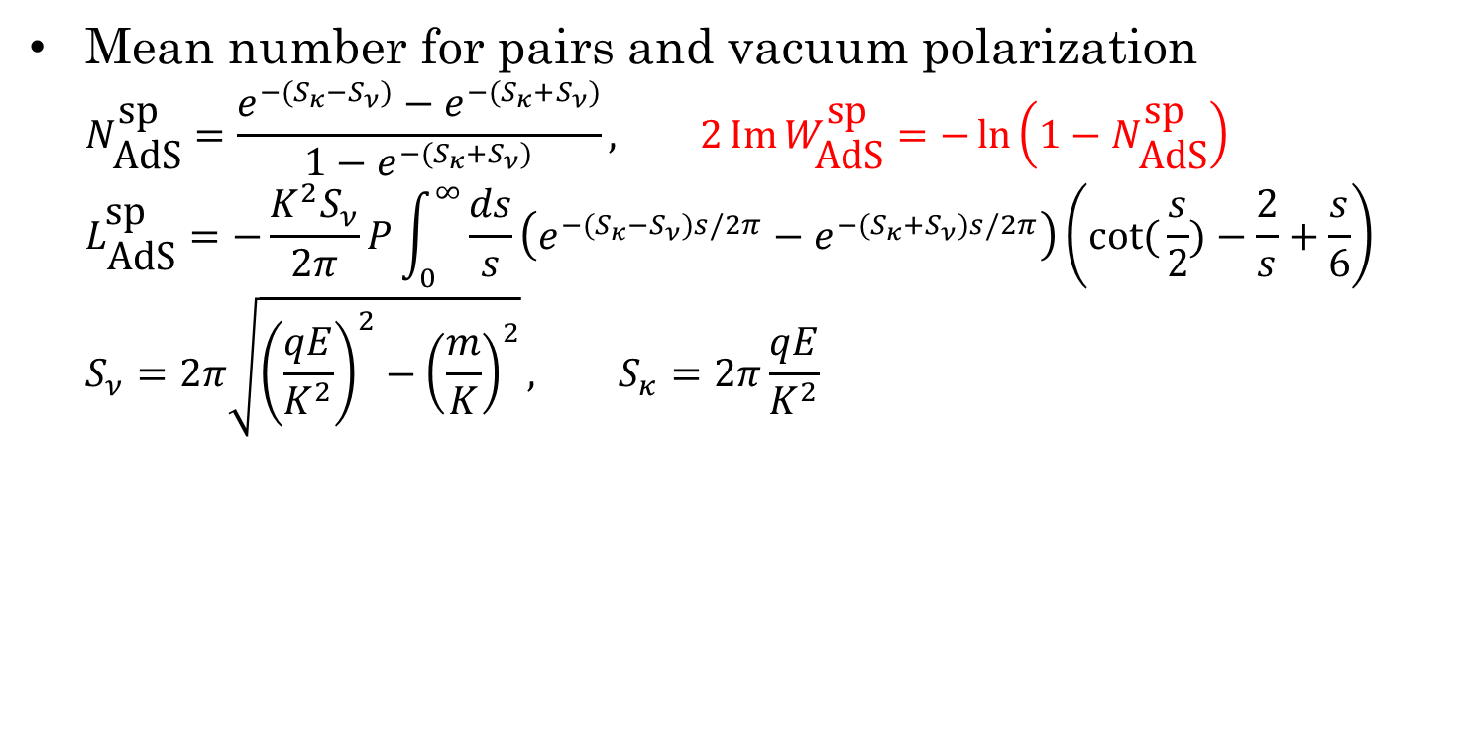
Spinor QED Action in AdS₂
Mean number for pairs and vacuum polarization
$$N_{\text{AdS}}^{\text{sp}}=\frac{e^{−(S_{κ}−S_{ν})}−e^{−(S_{κ}+S_{ν})}}{1−e^{−(S_{κ}+S_{ν})}}, 2\operatorname{Im}{W_{\text{AdS}}^{\text{sp}}}=−\ln\left(1−N_{\text{AdS}}^{\text{sp}}\right) \\ L_{\text{AdS}}^{\text{sp}}=−\frac{K^{2}S_{ν}}{2π}P\int_{0}^{∞}{\frac{ds}{s}\left(e^{−(S_{κ}−S_{ν})s/2π}−e^{−(S_{κ}+S_{ν})s/2π}\right)\left(\cot{(}\frac{s}{2})−\frac{2}{s}+\frac{s}{6}\right)} \\ S_{ν}=2π\sqrt{{\left(\frac{qE}{K^{2}}\right)}^{2}−{\left(\frac{m}{K}\right)}^{2}}, S_{κ}=2π\frac{qE}{K^{2}}$$

Slide 37
Summary & Perspective
Introduce the Schwinger-DeWitt in-out formalism for effective actions for QED and gravity.
Gamma-function regularization for strong fields
Heisenberg-Euler and Schwinger proper-time integral
QED in (A)dS spaces
Consistent with the vacuum persistence (Schwinger effect or Hawking radiation, etc)*
Higher loops?
One-loop (QED) actions in near-extremal BHs, loop corrections to near-extremal BHs, and BH thermodynamics [future works].
Seminar on BHs: September 18 (Thursday)

