Slide 1

Emergence of Meron Kekulé lattices in twisted Néel antiferromagnets
Kyoung-Min Kim
Asia Pacific Center for Theoretical Physics
Quantum Matter Theory Group
JRG Leader
APCTP August 27, 2025

Slide 2



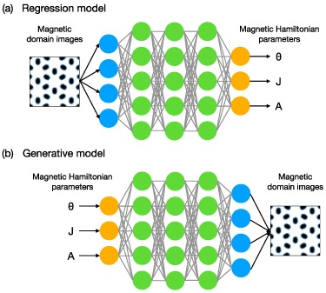
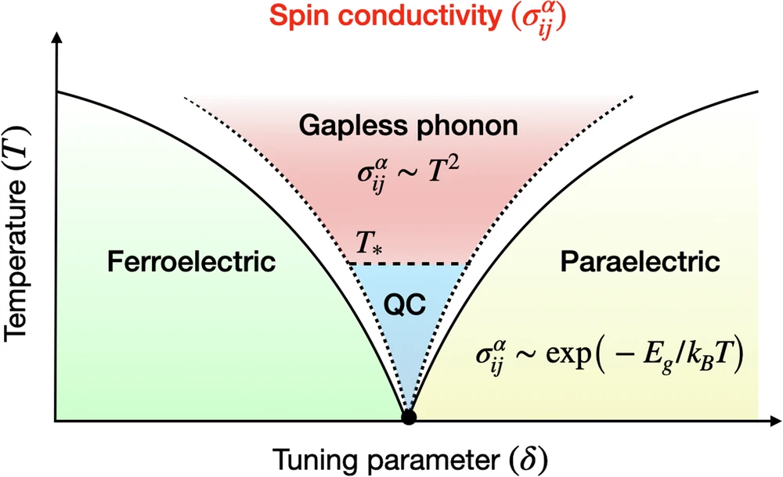
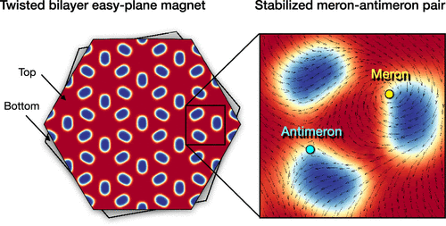
Quantum Matter Theory @ APCTP since 2025.01
APCTP @ POSTECH
Prof. Kyoung-Min Kim
Dr. Tilen Cadez
Correlated electronic systems (Quantum field theory)
Twisted magnetic layers (Atomistic spin simulation)
Deep learning
(Magnetic domain images)

Slide 3
Outline
Twist Engineering of 2D Magnetism
Meron Kekulé Lattices in Twisted Antiferromagnets

Slide 4
Outline
Twist Engineering of 2D Magnetism
Meron Kekulé Lattices in Twisted Antiferromagnets

Slide 5
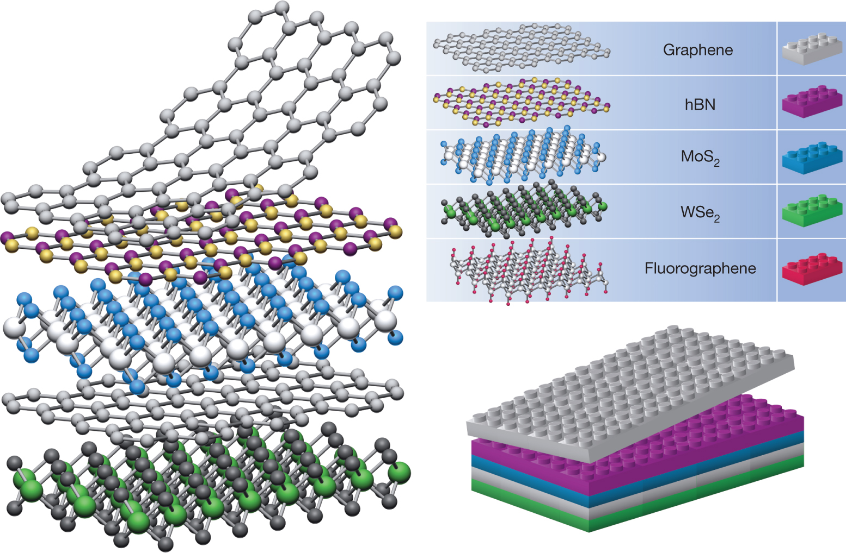
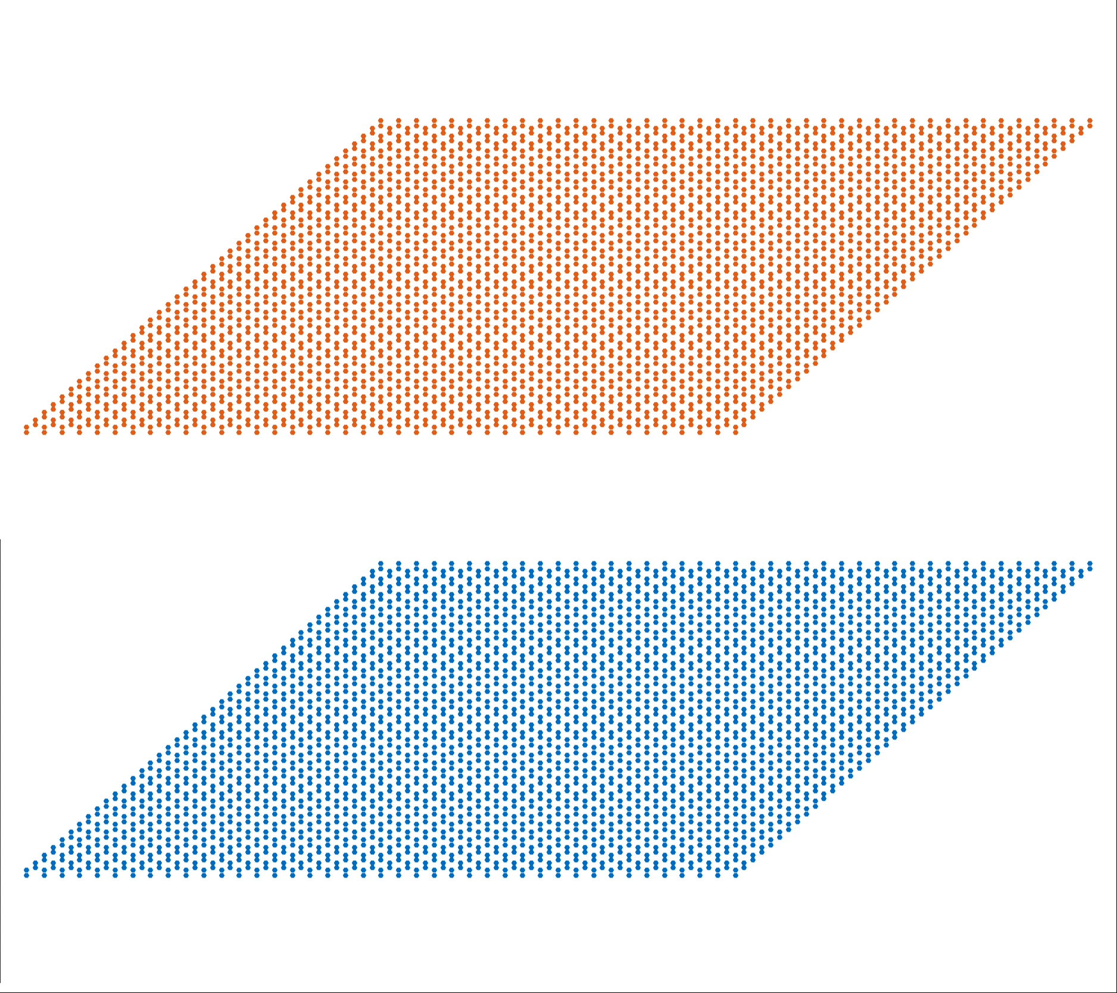
Van der Waals heterostructures
Moiré heterostructures
AK Geim & IV Grigorieva Nature 499, 419-425 (2013)

Slide 6
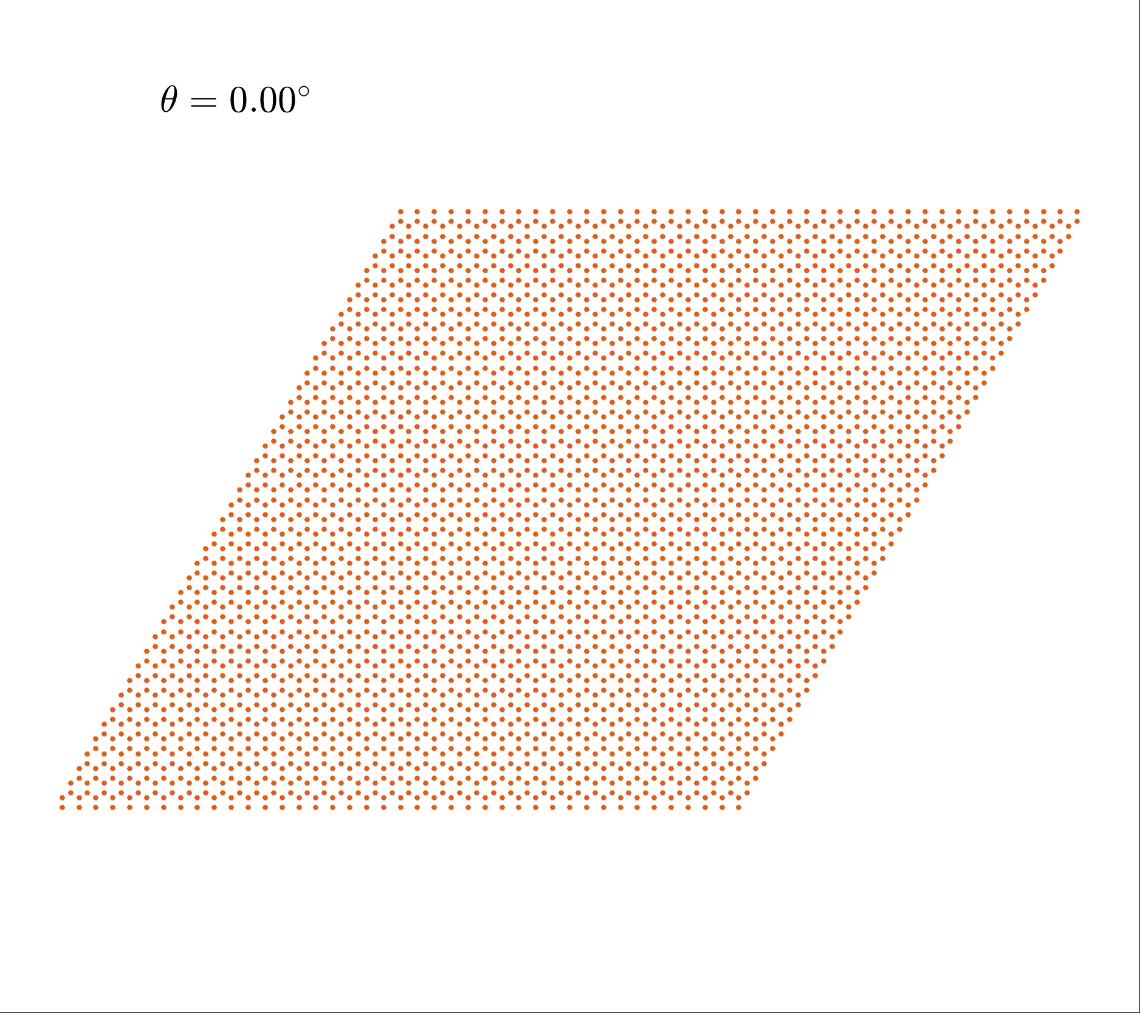
Commensurate moiré superlattices
Commensurate condition
$$θ_{1,2}$$
$$R_{1}=(1,2)$$
$$R_{2}=(2,1)$$
$$θ_{1,2}=\cos^{-1}(\frac{R_{1}⋅R_{2}}{|R_{1}||R_{2}|})≃{21.82}^{∘}$$
Twist angle
$$θ_{m,n}=arccos\left(\frac{m^{2}+n^{2}+4mn}{2m^{2}+2n^{2}+2mn}\right)$$
Moiré periodicity
$$L_{m,n}=\frac{a}{2sin(θ_{m,n}/2)}\overset{θ_{m,n}≪1}{⟶}\frac{a}{θ_{m,n}}$$

Slide 7
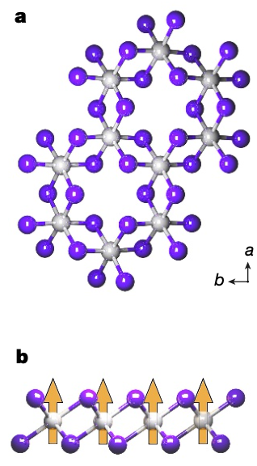
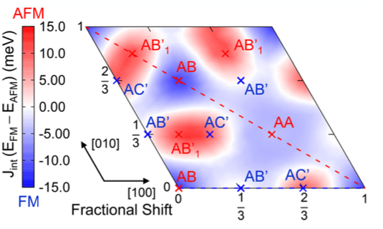
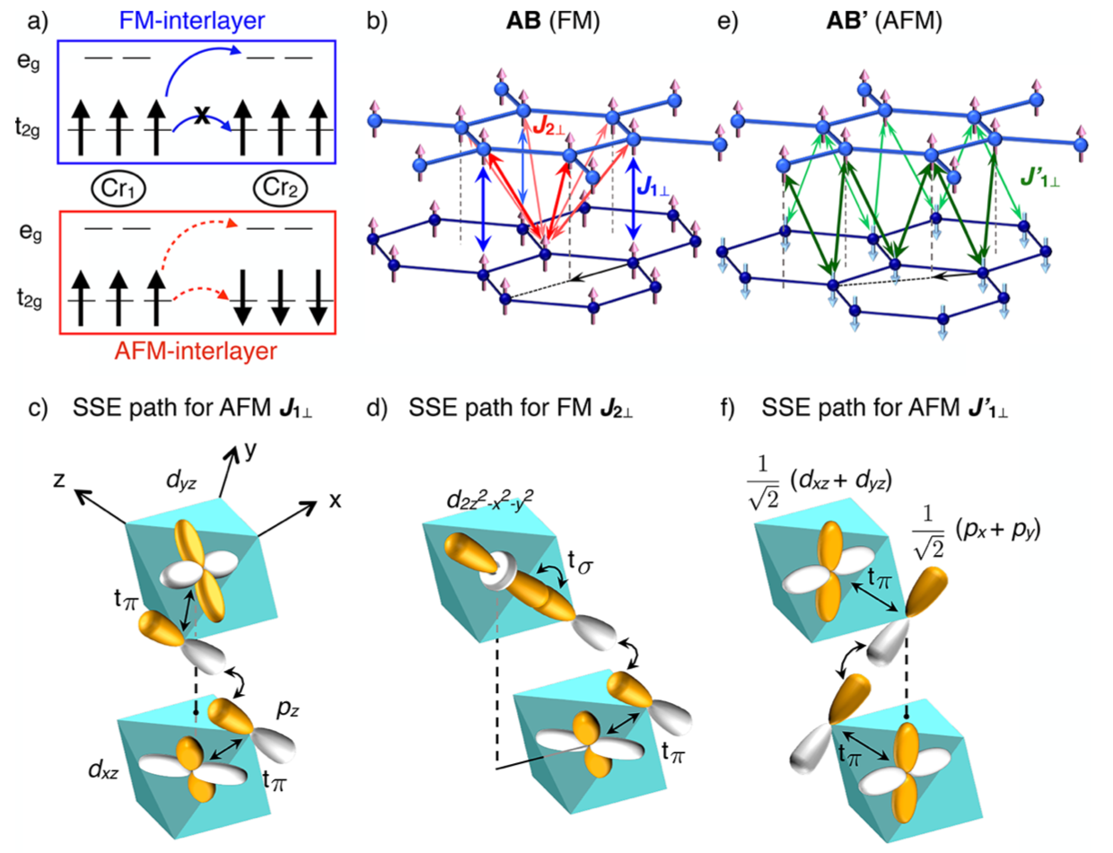
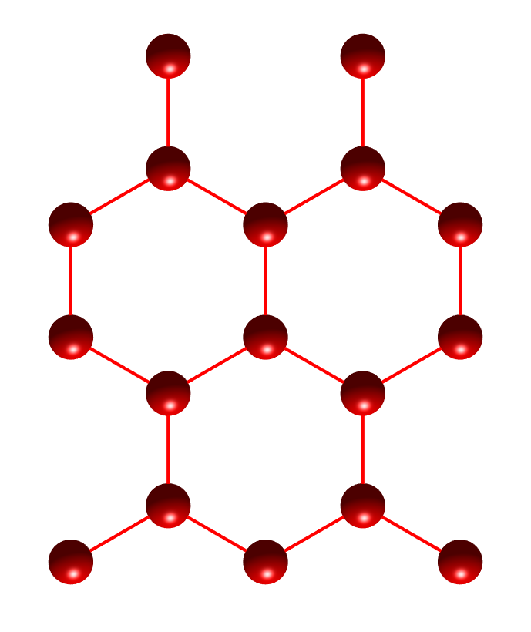
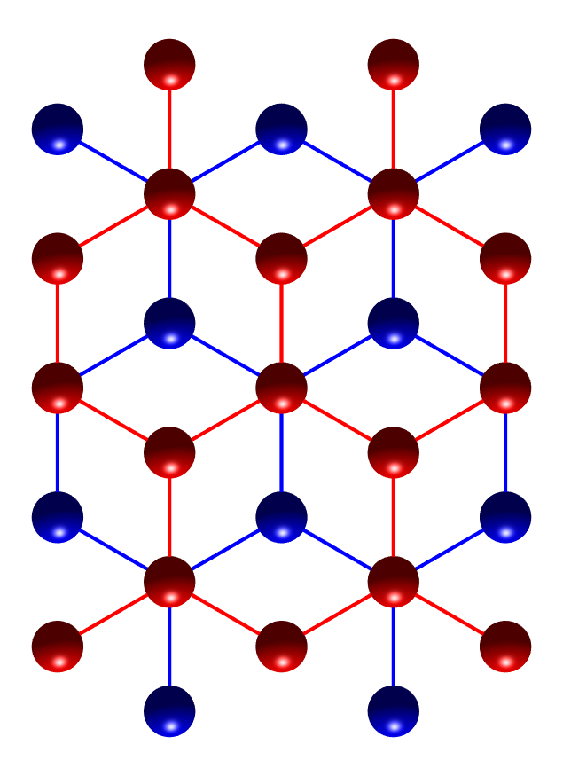
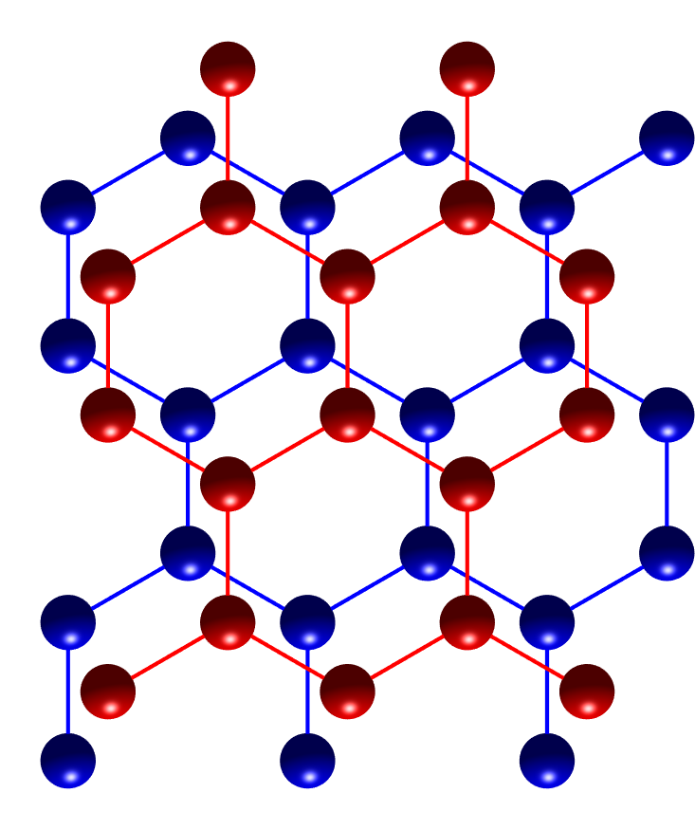
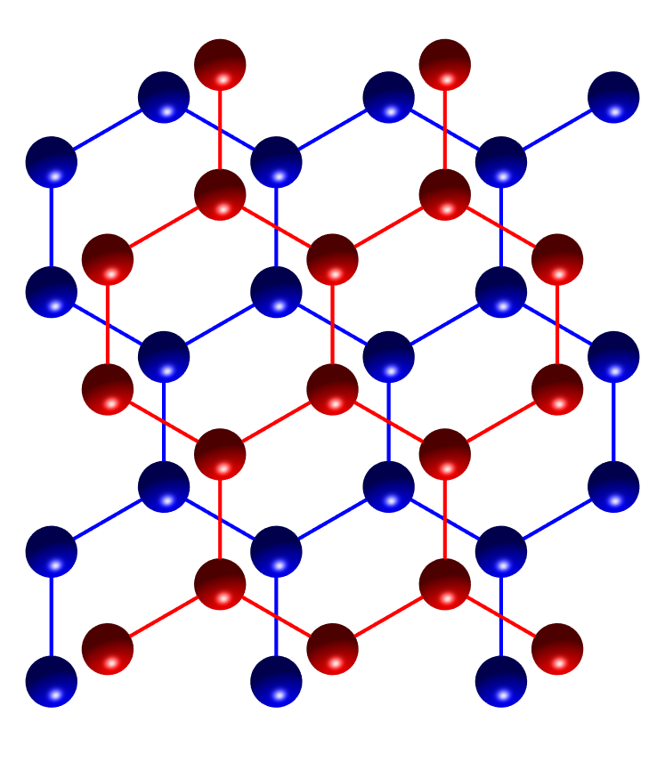
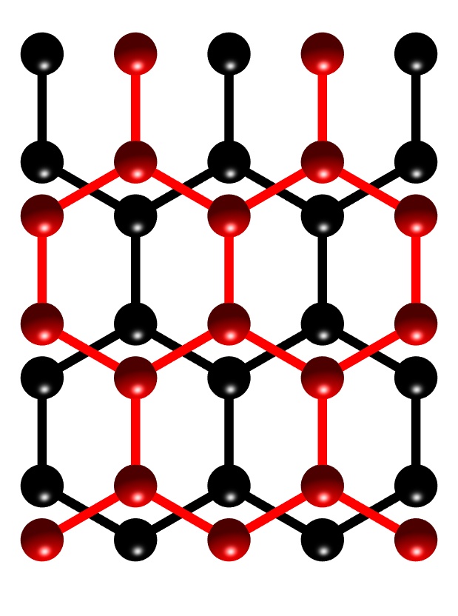
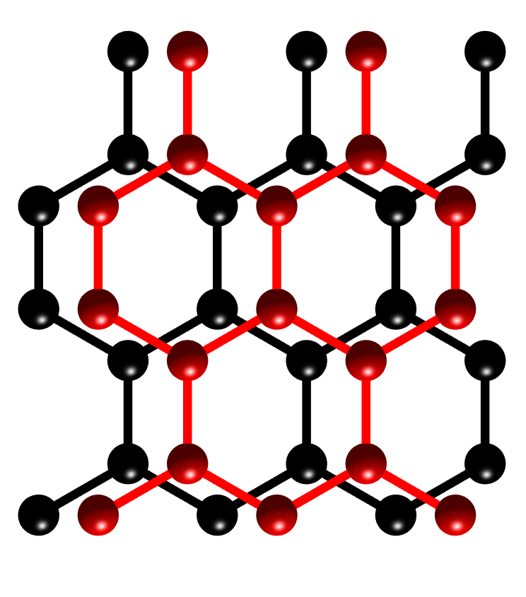
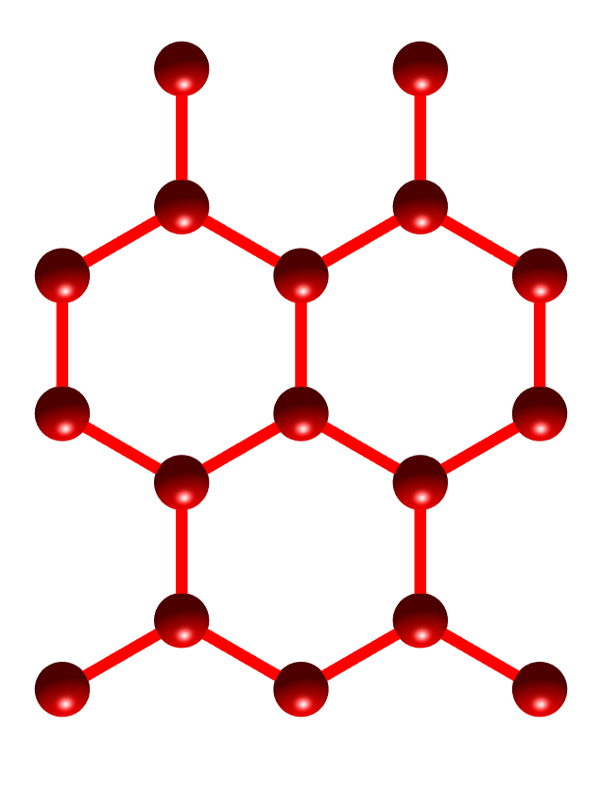
Stacking-dependent interlayer magnetism in CrI3
Stacking order $→$ Interlayer Exchange
Orbital hybridizations $→$ Interlayer Exchange
$$AA$$
$$AB$$
$$AC^{′}$$
$$AB_{1}^{′}$$
$$AB_{1}^{′}$$
$$AC^{′}$$
$$AA$$
N. Sivadas et al., Nano Letters, 18, 7658 (2018)

Slide 8
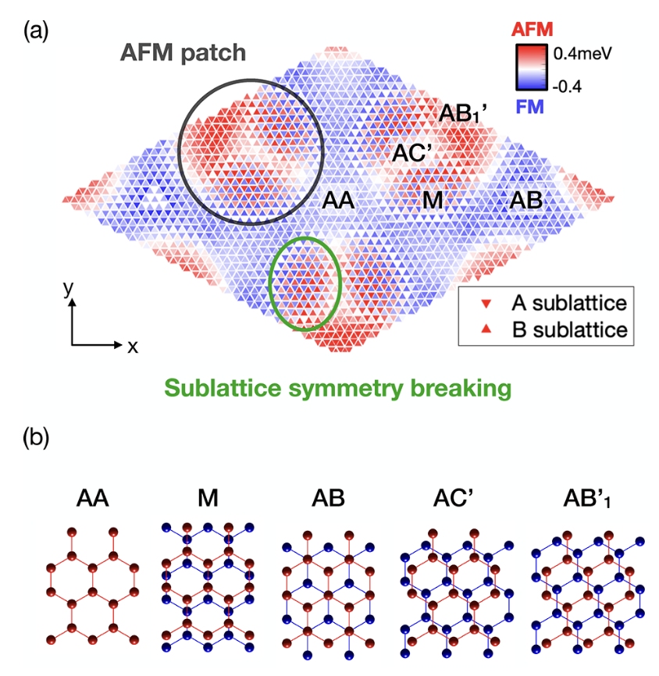
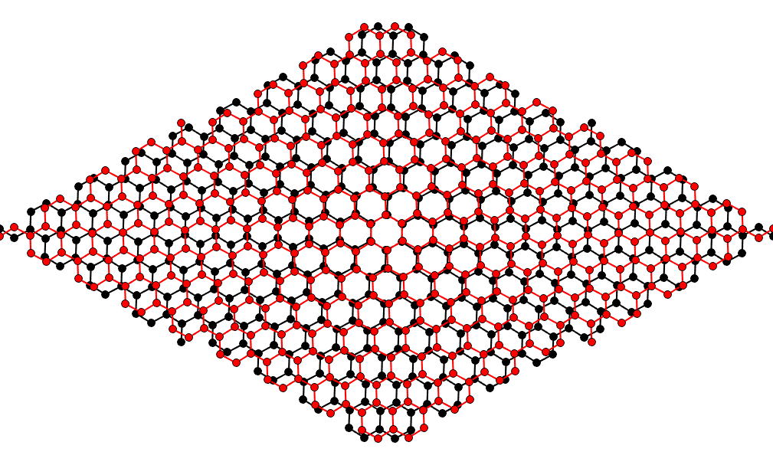
Spatial modulation of interlayer exchange
Coexistence of various stacking orders
$$AB_{1}^{′}$$
$$AB_{1}^{′}$$
$$AB^{′}$$
$$AB_{1}^{′}$$
$$M$$
$$M$$
$$AC^{′}$$
$$AC^{′}$$
$$AB_{1}^{′}$$
$$AB$$
$$M$$
$$AA$$
$$M$$
$$AB$$
$$AB_{1}^{′}$$
$$AB^{′}$$
$$AB^{′}$$
$$y$$
$$AB_{1}^{′}$$
$$M$$
$$M$$
$$AB_{1}^{′}$$
$$AC^{′}$$
$$x$$
$$AB_{1}^{′}$$
Stacking order $→$ Orbital-hybridizations $→$ Interlayer spin interactions
Intralayer spin interactions: stacking-order independent approximately

Slide 9
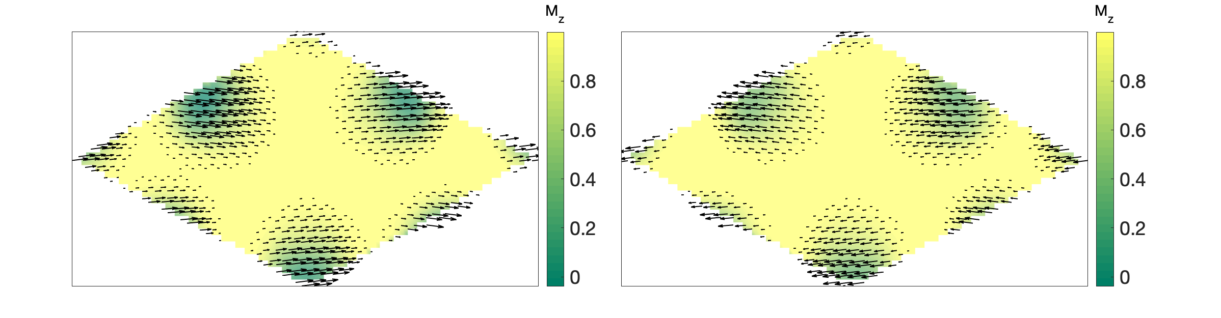
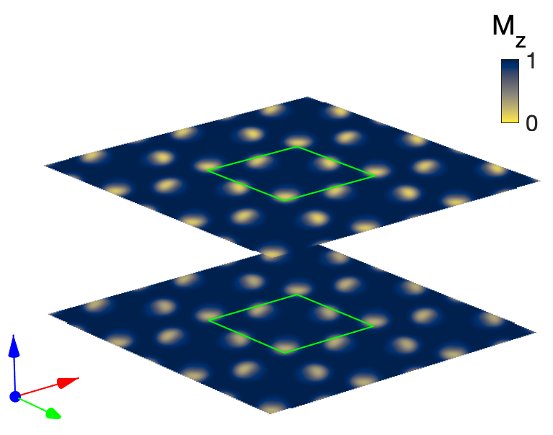
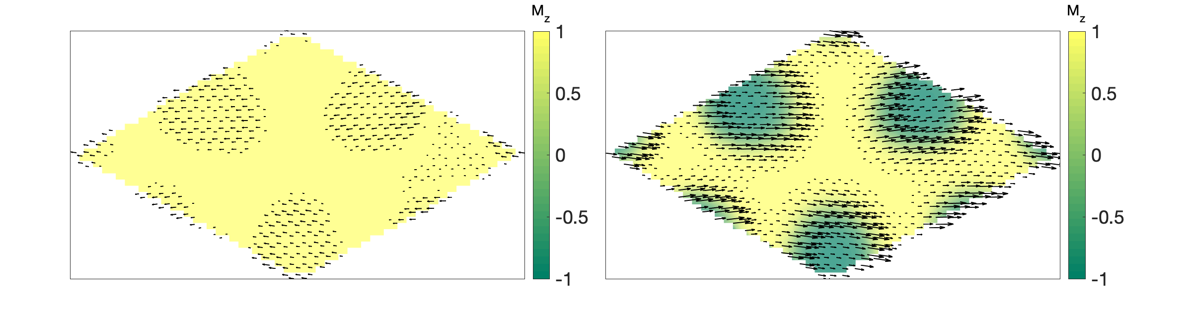
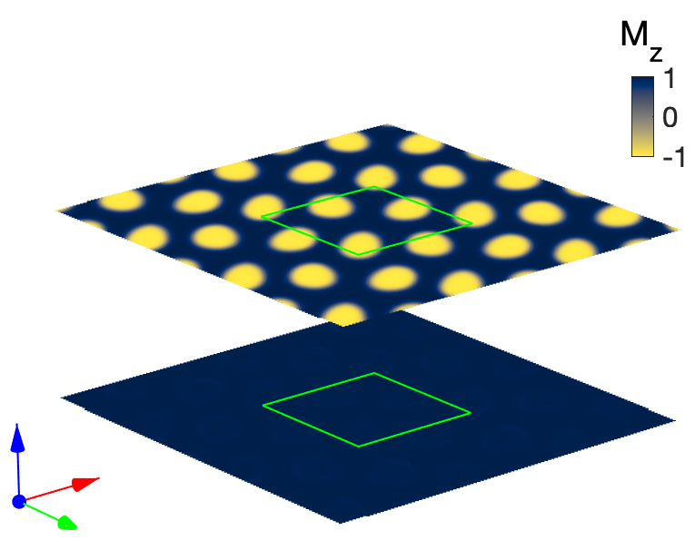
Moiré magnetism
Non-collinear domain
Bottom
Top
Bottom
Magnetic domain
Top

Slide 10
Energetic competition
NCD phase
FM
weak AFM
FM
MD phase
FM
strong AFM
FM
Gradient energy ($K∼J>0$) vs. potential energy ($V∼-NJ_{⊥}<0$)
Twist angle controls K-V competition ($N∼θ^{-2}$)
NCD for $K∼V$, MD for $K≪V$

Slide 11
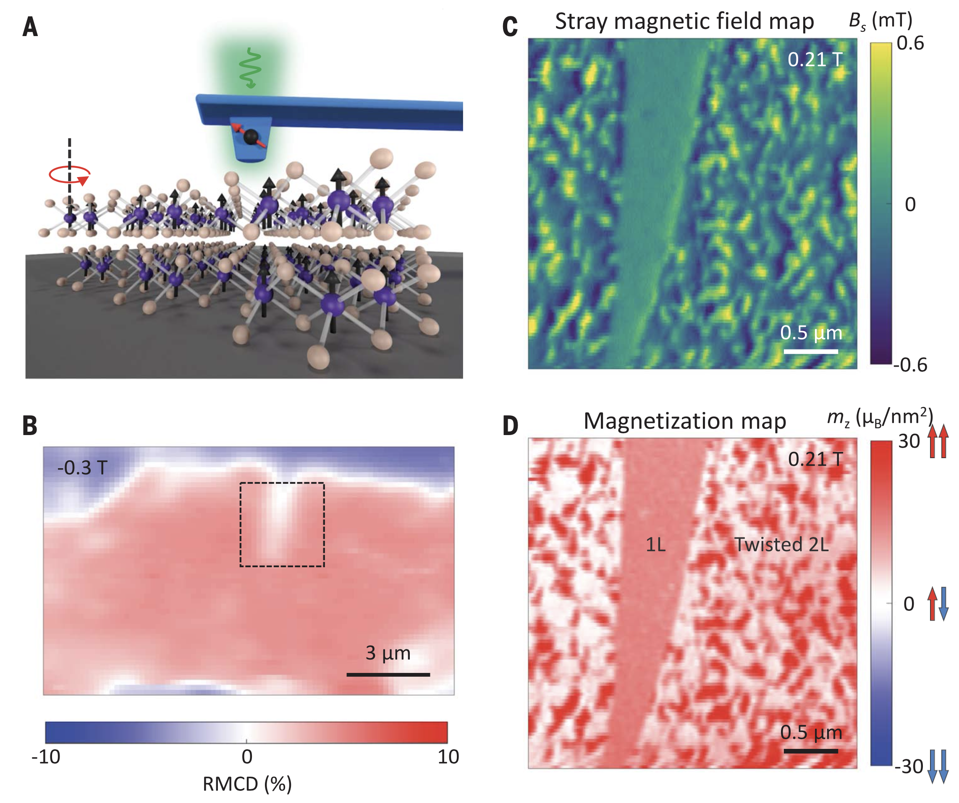
Observation of moiré magnetism
AFM measurement in twisted bilayer CrI3
Twisted 2D magnets: formation of magnetic domains
What kind of new magnetism in twisted 2D magnets?
How can we study such moiré magnets?
T. Song et al., Science, 374, 1140 (2021)

Slide 12
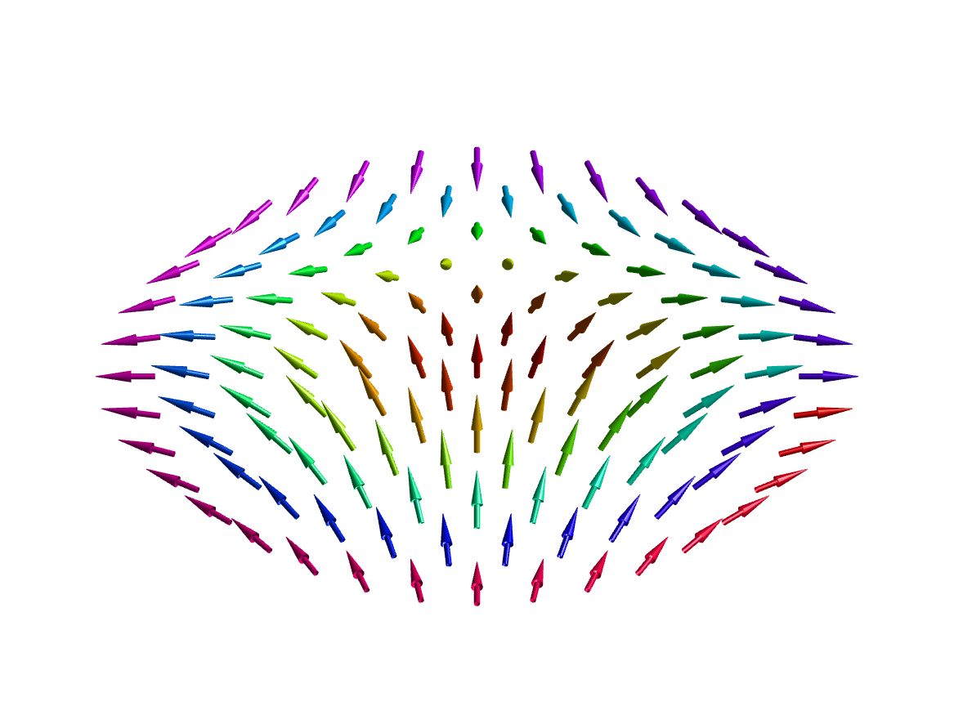
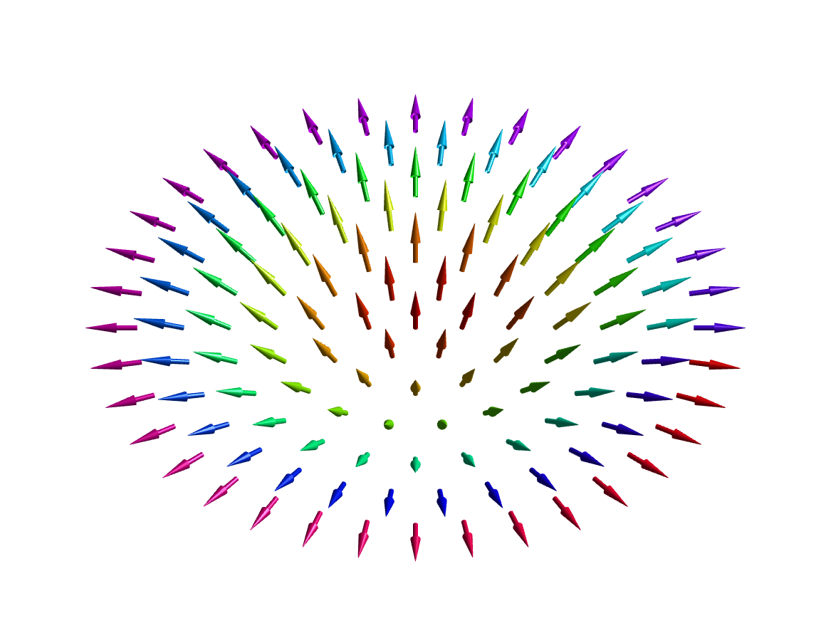
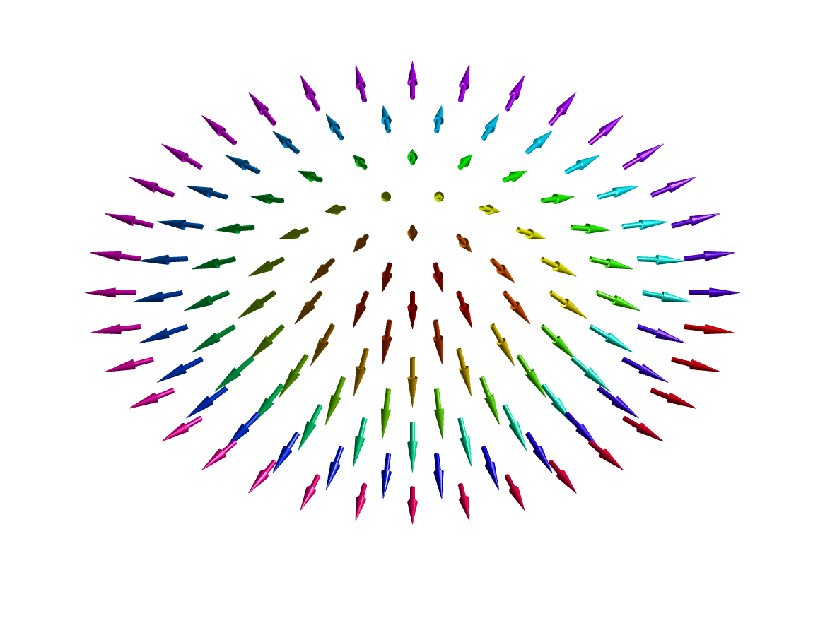
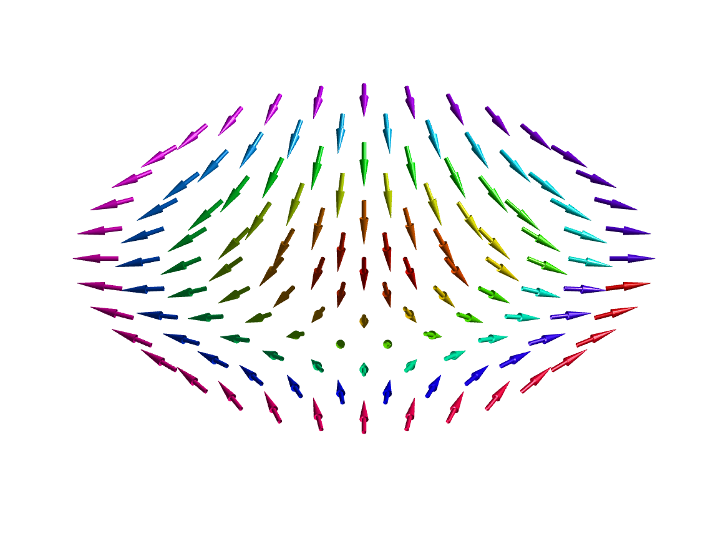
What are merons and anti-merons?
Merons: topological spin textures with a half-skyrmion number $Q=-1/2$
Skyrmion number: $Q=\frac{1}{4π}∫dx∫dyn⋅(∂_{x}n×∂_{y}n)$
$$Q=p⋅w$$
Polarity: $p=\frac{1}{2}[cosθ(r=∞)-cosθ(r=0)]$
$$n=(sinθcosϕ,sinθsinϕ,cosθ)$$
$$θ=θ(r),ϕ=ϕ(φ)$$
Winding number: $w=\frac{1}{2π}[ϕ(φ=0^{+})-ϕ(φ=0^{-})]$
Merons: $Q=-\frac{1}{2}$
Antimerons: $Q=+\frac{1}{2}$
$p=-\frac{1}{2}$, $w=1$
$p=\frac{1}{2}$, $w=-1$
$p=-\frac{1}{2}$, $w=-1$
$p=\frac{1}{2}$, $w=1$

Slide 13
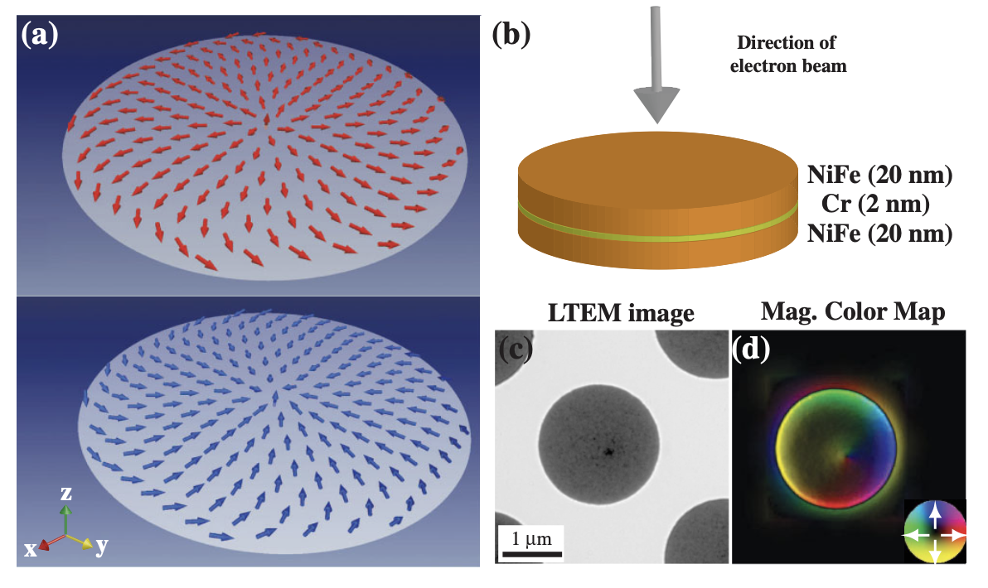
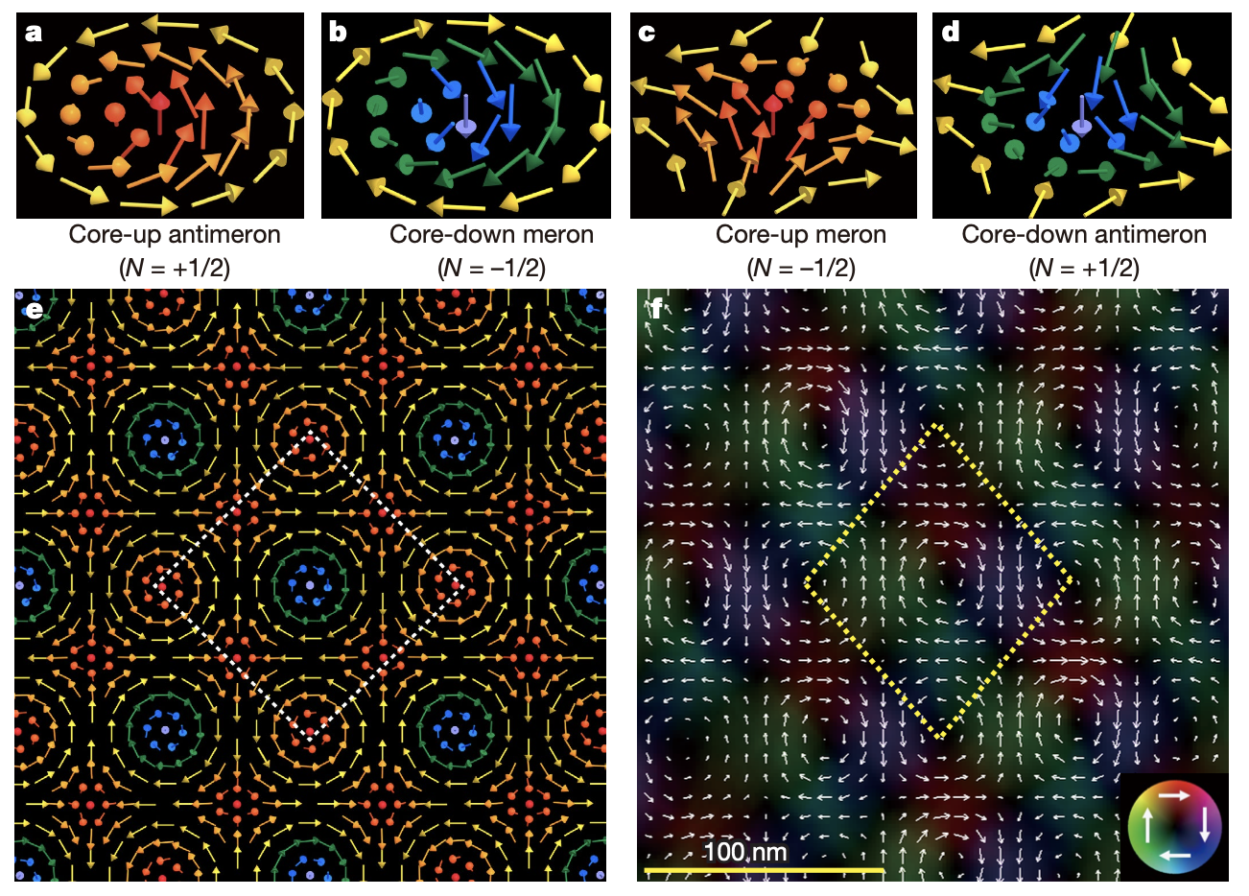
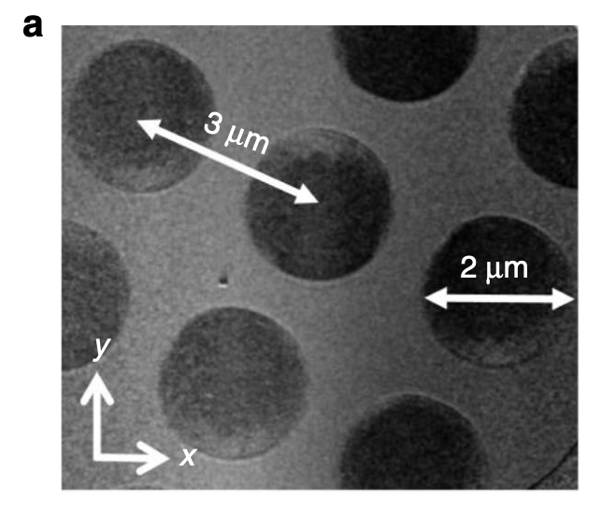
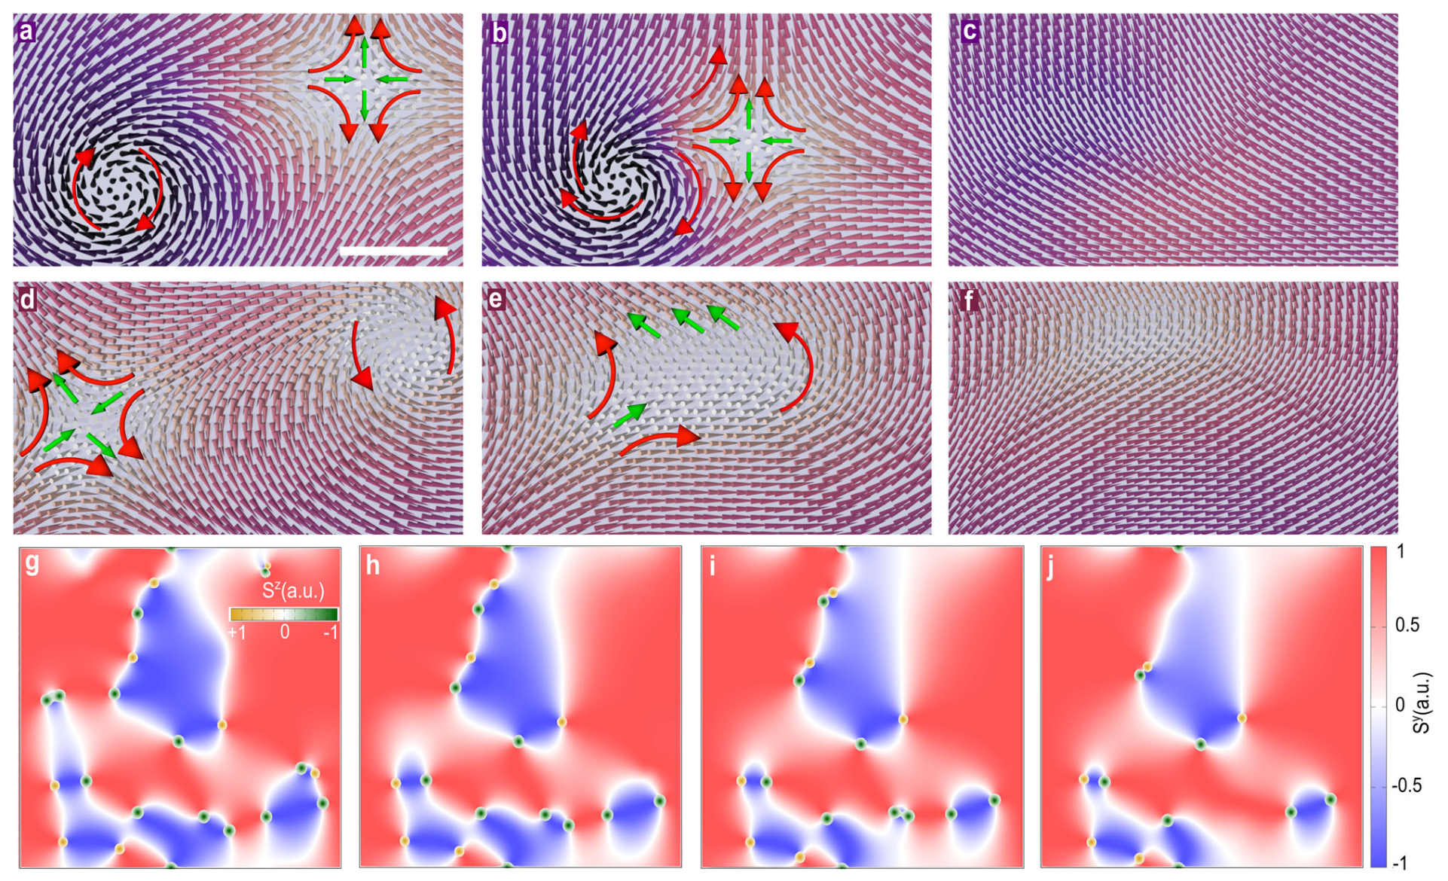
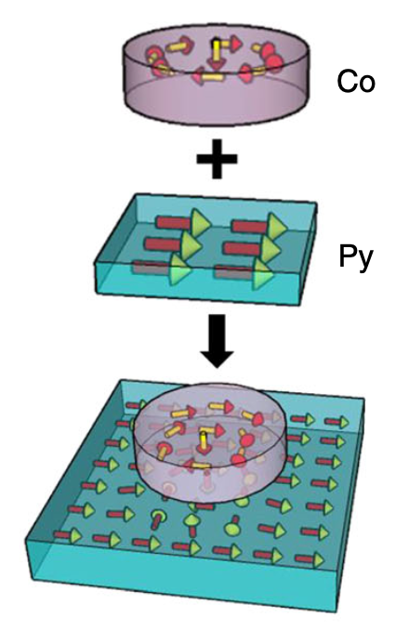
Observation of merons and antimerons in various forms
Isolated forms in magnetic disks (Exp., Py-Cr-Py)
Square lattice in a chiral magnet (Exp., Co8Zn9Mn3 )
C. Phatak et al., Phys. Rev. Lett. 108, 089901 (2012)
X.Z. Yu et al., Nature 564, 95 (2018)
Stable pairs via magnetic imprinting (Exp., Py thin film )
Unstable pairs in 2D van der Waals magnet (Theo., CrCl3)
Meron and antimeron pair-annihilate
N. Gao et al., Nature Commun.,10, 5603 (2019)
M. Augustin et al., Nat. Commun. 12, 185 (2021)

Slide 14
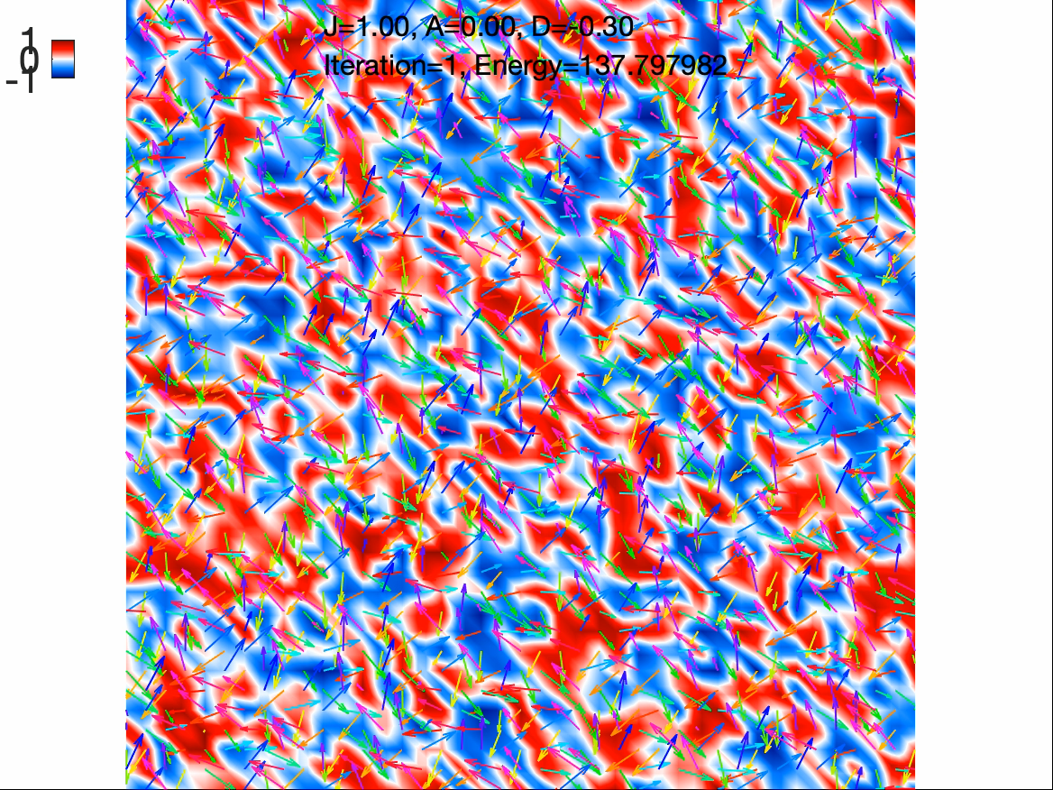
Unstable meron-antimeron pairs in conventional 2D magnets
Easy-plane ferromagnet
$$\overset{̂}{H}=-\underset{⟨i,j⟩}{∑}JS_{i}⋅S_{j}+D\underset{i}{∑}S_{i}^{z}$$

Slide 15
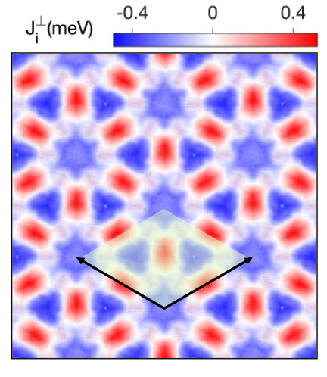
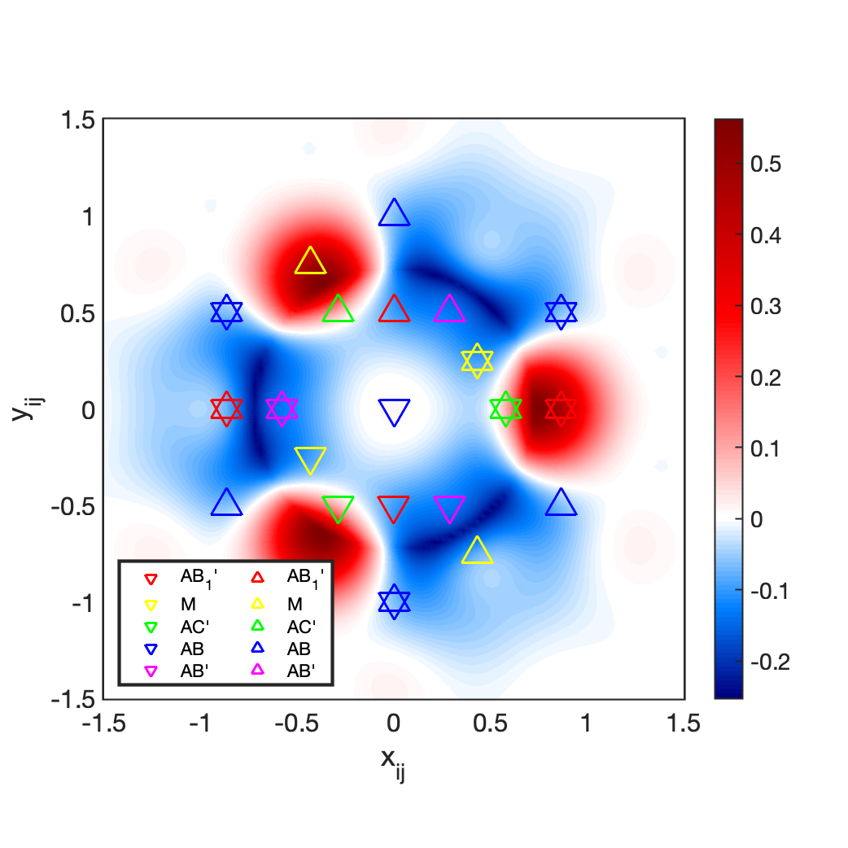
Moiré Magnets: Magnetic Domain Array Patterns
Twisted bilayer easy-plane magnets
Domain array patterns in twisted bilayer CrI3
$H=J\underset{l=t,b}{∑}\underset{⟨i,j⟩}{∑}S_{i}^{l}⋅S_{j}^{l}+A\underset{l=t,b}{∑}\underset{i}{∑}(S_{i}^{l}⋅\overset{̂}{z})^{2}+\underset{i,j}{∑}J_{ij}^{⊥}S_{i}^{t}⋅S_{j}^{b}$
$$J_{ij}^{⊥}$$
Ab-initio derived $J_{ij}^{⊥}$ (CrI3)
$$y$$
$$x$$
Using various domain array patterns, explore diverse potential topological soliton lattices.

Slide 16
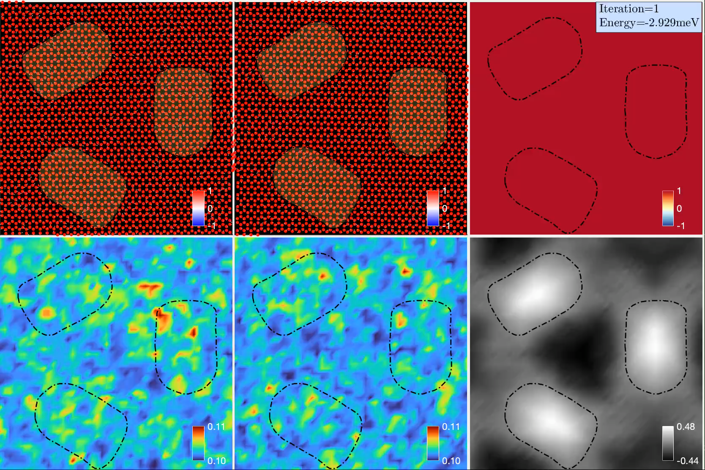
Stable meron-antimeron pairs in twisted magnets

Slide 17
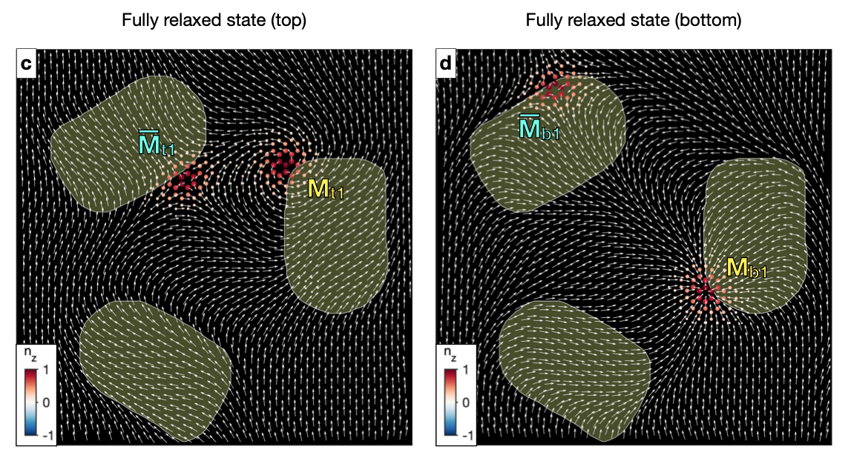
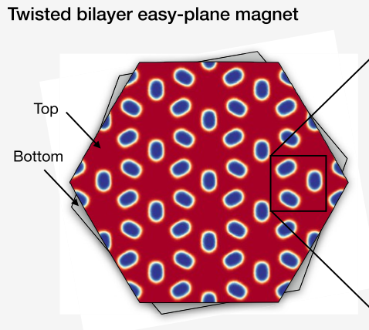
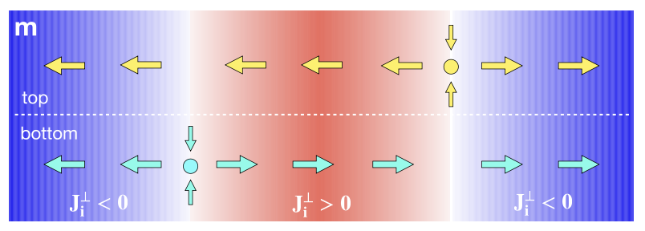
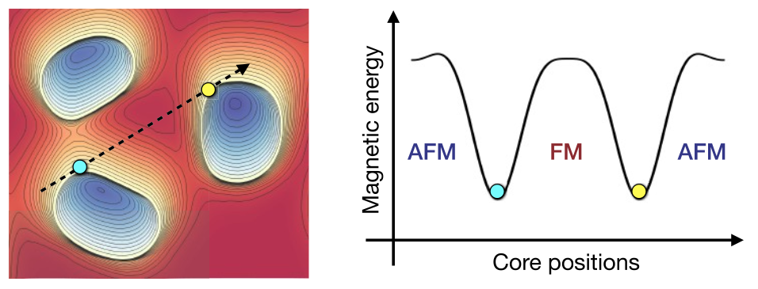
Meron Quartet
Domain array pattern $→$ Meron lattice consisting of Meron Quartet
Protection against pair annihilation
Top
Bottom
- Minimize interlayer exchange energy
Meron-antimeron pair
AFM
FM
AFM
FM
- Energy barrier preventing core movements
“Meron Quartet” = Stable double meron-antimeron pairs
One pair in each layer
Meron and antimeron in each pair are separated by domains
Each domain hosts two merons or antimerons
Crucial conditions for generating stable meron-antimeron pairs
Twisted bilayer easy-plane ferromagnets can create a meron lattice with a unique Meron Quartet configuration.
Nano Lett. 2024, 24, 1, 74–81

Slide 18
Outline
Twist Engineering of 2D Magnetism
Meron Kekulé Lattices in Twisted Antiferromagnets
npj Quantum Materials 10, 68, (2025)

Slide 19
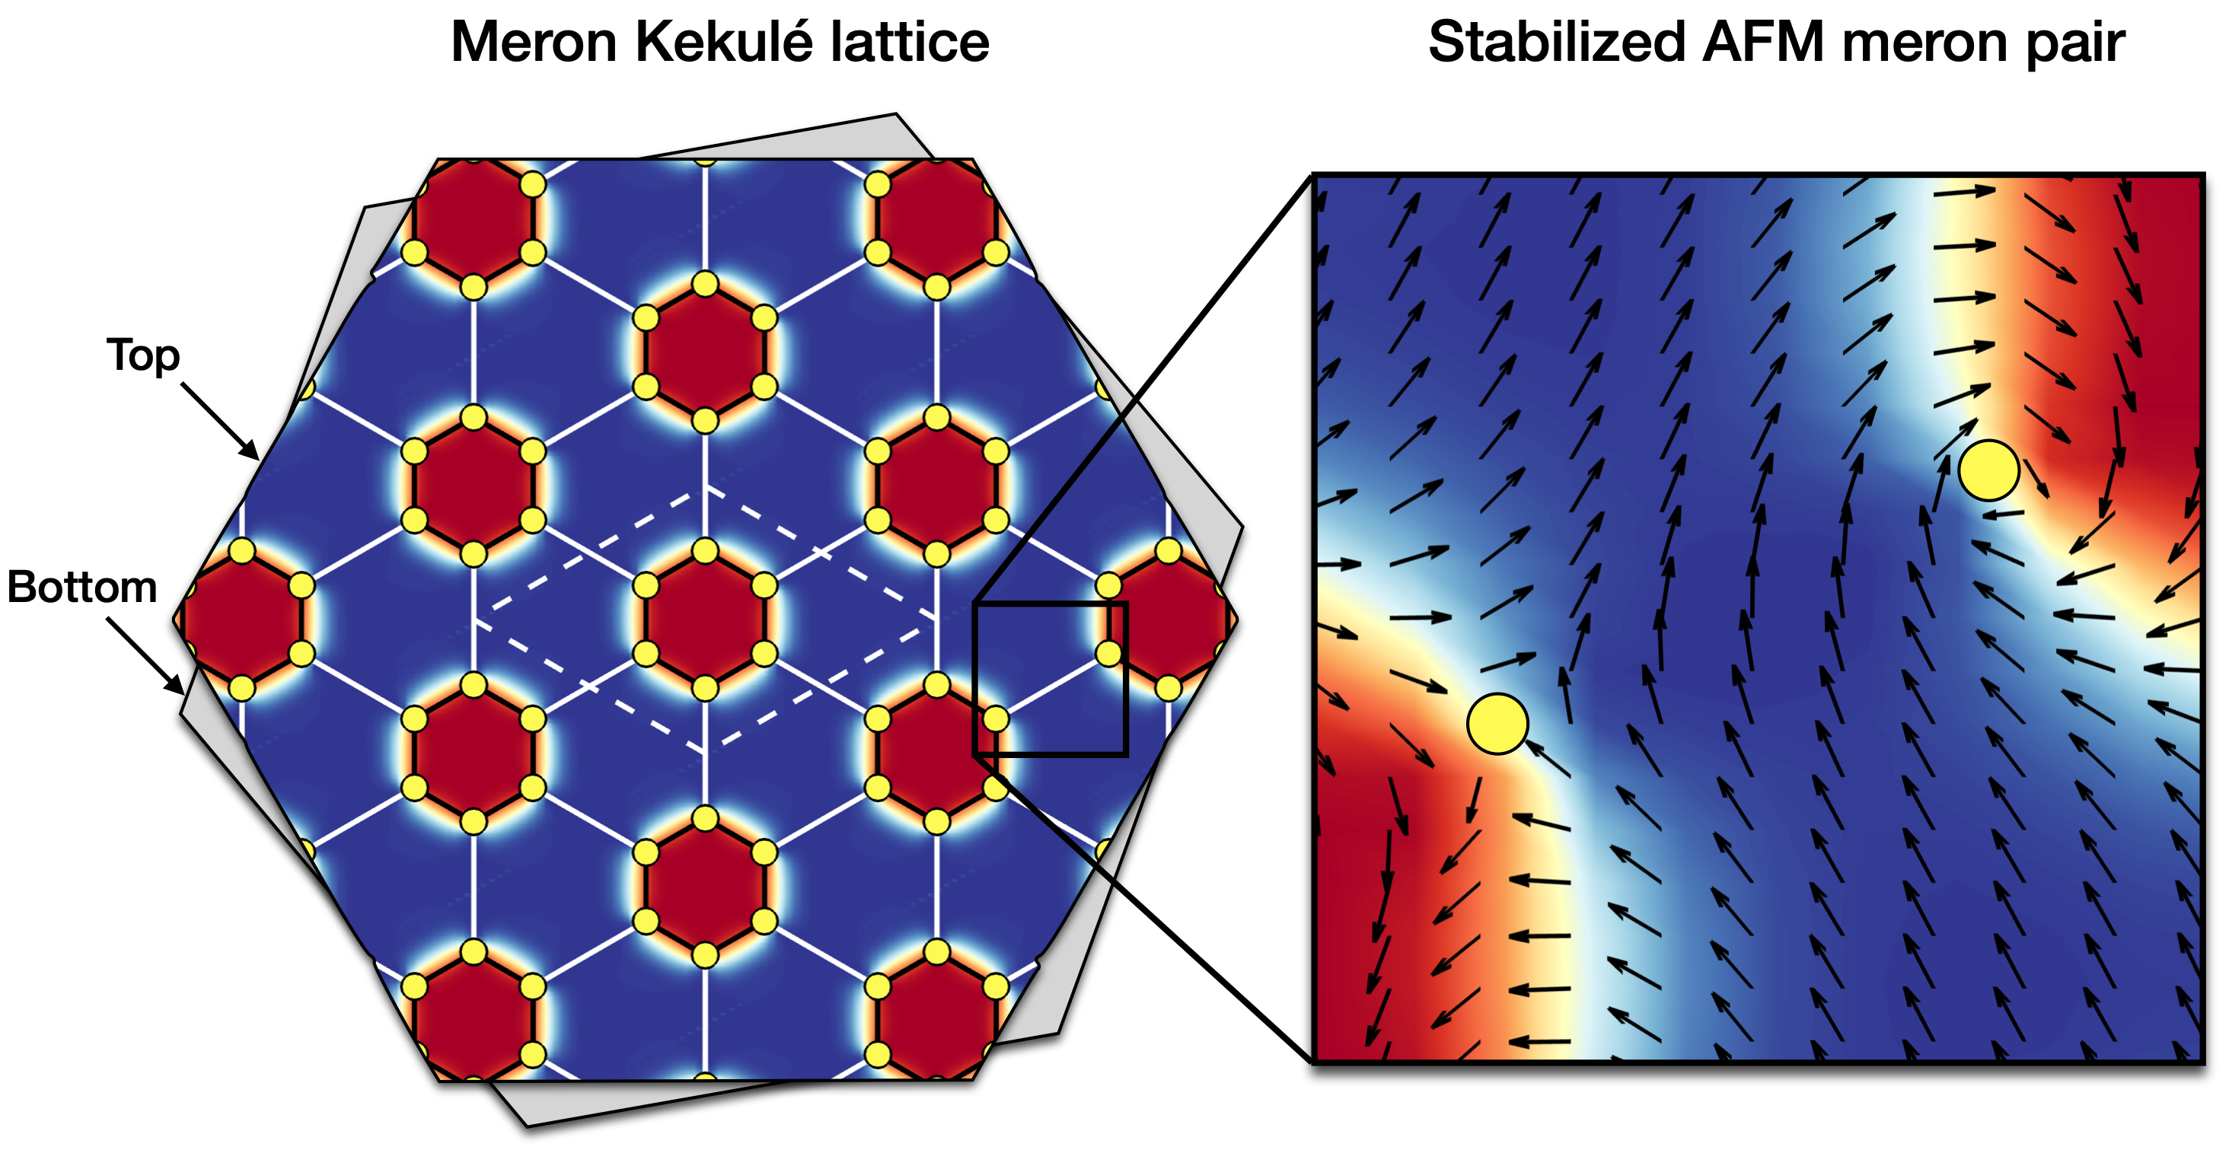
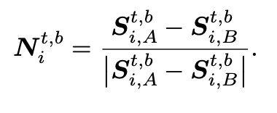
Meron Kekulé lattices in in twisted vdW antiferromagnets
Meron lattices in twisted bilayer easy-plane Neél antiferromagnets
Yellow Dots = Meron Cores
Arrows = Neél vectors
Intercell bond length ($l^{′}$)
Intracell bond length ($l$)
Meron Kekulé lattice = a distorted arrangement of meron cores ($l≠l^{′}$)

Slide 20
Spin model for a twisted bilayer Néel antiferromagnet
Top
AFM intralayer exchange + easy-plane single-ion anisotropy
$$θ$$
$H_{\text{intra}}=J\underset{l=t,b}{∑}\underset{⟨i,j⟩}{∑}S_{i}^{l}⋅S_{j}^{l}+A\underset{l=t,b}{∑}\underset{i}{∑}(S_{i}^{l}⋅\overset{̂}{z})^{2}$
Bottom
$J=1$ meV, $A=0.2$ meV
Interlayer AFM exchange coupling
$H_{\text{inter}}=\underset{i,j}{∑}J_{ij}^{⊥}S_{i}^{t}⋅S_{j}^{b}$
where $J_{ij}^{⊥}=J_{0}^{⊥}exp[-α(|r_{ij}^{tb}|/d-1)]$ with $|r_{ij}^{tb}|=\sqrt{|r_{ij}^{∥}|^{2}+d^{2}}$
$J_{0}^{⊥}=0.3$ meV, $α=15$, $d/a=1.75$

Slide 21
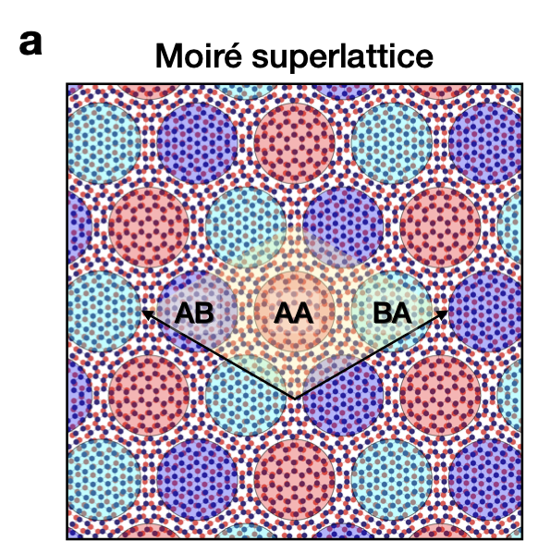
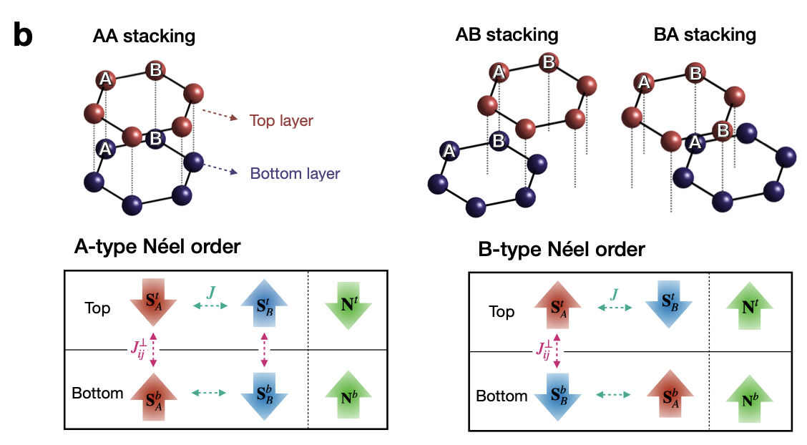
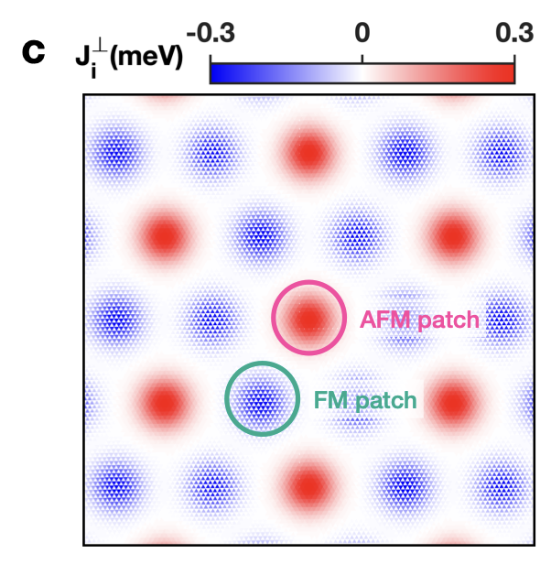
Moiré-patterned interlayer coupling
Structural modulation
Emergence of two Néel orders
Patterned interlayer exchange
$$y$$
$$x$$
AA stacking
AB stacking
BA stacking
Néel vectors:
$$|N_{i}^{l}|=\frac{S_{i,A}^{l}-S_{i,B}^{l}}{|S_{i,A}^{l}-S_{i,B}^{l}|}$$
A-type Néel order: $N_{i}^{t}⋅N_{i}^{b}=-1$
B-type Néel order: $N_{i}^{t}⋅N_{i}^{b}=+1$
Red: A-type Néel
Blue: B-type Néel

Slide 22
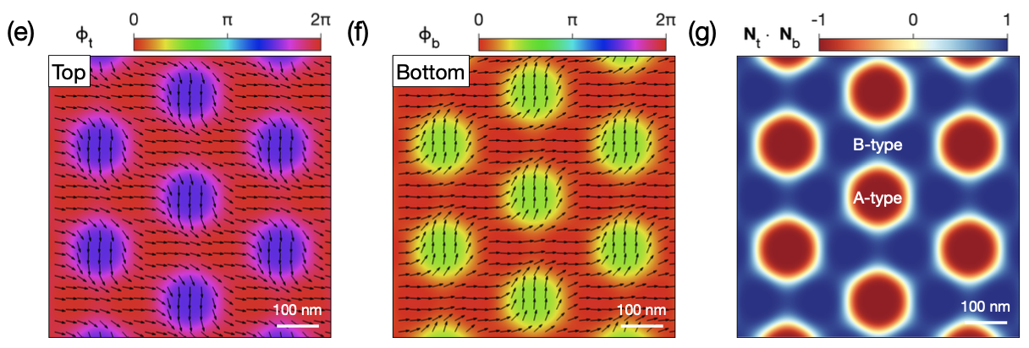
Magnetic ground state
Magnetic domain array: Periodic domain structure showing both A-type and B-type Néel orders
Parallel alignment between $N_{i}^{t}$ and $N_{i}^{b}$
Antiparallel alignment between $N_{i}^{t}$ and $N_{i}^{b}$
$$y$$
$$x$$
$N_{t}$: Néel order on the top layer
$N_{b}$: Néel order on the bottom layer
$ϕ_{t}$: Azimutal angle of $N_{t}$
$ϕ_{b}$: Azimutal angle of $N_{b}$
Arrows: In-plane components of $N_{t}$ and $N_{b}$
Red: $N_{t}⋅N_{b}=-1$ (A-type Néel order)
Blue: $N_{t}⋅N_{b}=+1$ (B-type Néel order)
Minimizes the interlayer exchange energy

Slide 23
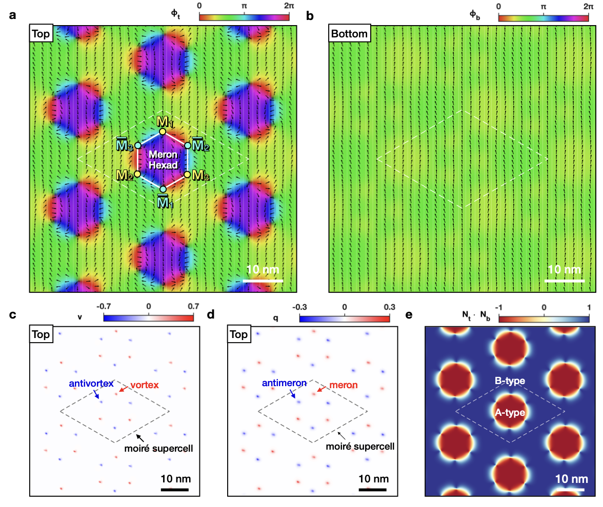


Metastable meron state
A meron lattice: Periodic arrangement of meron and antimeron cores
$$y$$
$$x$$
$ϕ_{t}$: Azimutal angle of $N_{t}$
$ϕ_{b}$: Azimutal angle of $N_{b}$
Arrows: In-plane components of $N_{t}$ and $N_{b}$
Black colors -> Meron cores
$Q=-\frac{1}{2}$ for $M_{1},M_{2},M_{3}$
$Q=\frac{1}{2}$ for ${\overline{M}}_{1},{\overline{M}}_{2},{\overline{M}}_{3}$
$w=+1$ for $M_{1},M_{2},M_{3}$
$w=-1$ for ${\overline{M}}_{1},{\overline{M}}_{2},{\overline{M}}_{3}$
Top layer
Bottom layer
Three vortices: $M_{1},M_{2},M_{3}$
Three antivortices: ${\overline{M}}_{1},{\overline{M}}_{2},{\overline{M}}_{3}$
Uniform Néel order
Three merons ($M_{1},M_{2},M_{3}$): $Q=-\frac{1}{2}$, $w=+1$, $p=\frac{1}{2}$
Three antimerons (${\overline{M}}_{1},{\overline{M}}_{2},{\overline{M}}_{3}$): $Q=+\frac{1}{2}$, $w=-1$, $p=\frac{1}{2}$

Slide 24
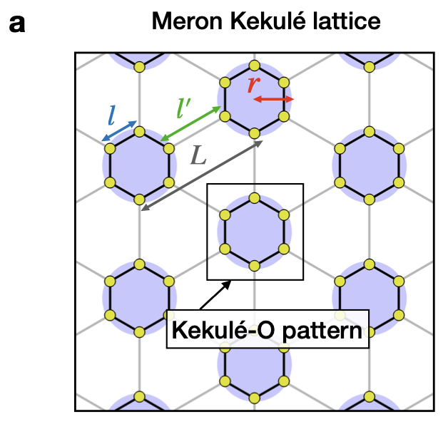
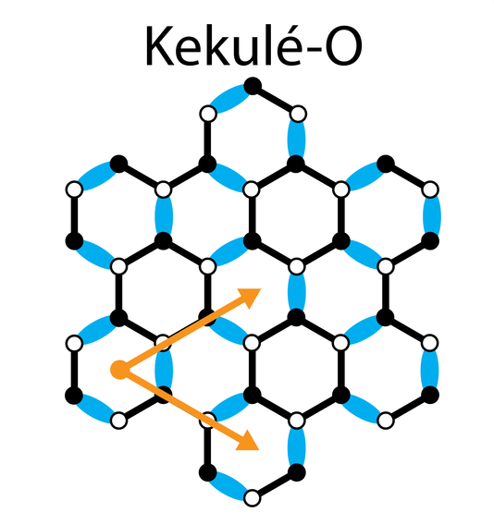
“Meron Kekulé lattice”
Kekulé lattice: a non-regular lattice structure with distortion
Kekulé lattices in graphene
Nat. Phys. 12, 950 (2016)
Kekulé lattices in phononic and photonic crystal structures
Intracell bond length $(l)$
Intercell bond length $(l^{′})$
Superlattice periodicity$(L=2l-l^{′})$
Photon. Res. 10, 999 (2022)
Phys. Rev. Appl. 11, 044086 (2019)
If $l≠l^{′}$, the meron lattice becomes a honeycomb lattice
https://www.fkf.mpg.de/
Kekulé-O structure:
a distorted honecomb lattice with $l≠l^{′}$
First example of a Kekulé lattice composed of topological solitons (merons)
However, $l≠l^{′}$, since they are determined by energetic balance between $J_{ij}^{⊥}$ and $J$

Slide 25
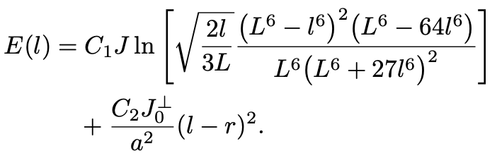


Stabilization mechanism of the Meron Kekulé lattice
Meron Kekulé lattice miminizes the interlayer exchange
Effective Moiré potential for localizing meron cores
$${J_{0}^{⊥}}/J$$
Meron Kekulé lattice
Ground state
“Potential well” for meron cores
Stabilization at large $L$ or $J_{0}^{⊥}$
KM Kim et al., Nano Lett., 24, 1, 74–81 (2024)

Slide 26


Tunability of the Kekulé structure
Manipulation of Kekulé structure
By adjusting $L$
By adjusting $α$
Stabilization condition $→$ $r≈l$
Increase of $L$ $→$ Increase of $r$
Increase of $α$ $→$ Decrease of $r$
Adjusting $r$ $→$ Manipulation of $l$
Increase of $r$ $→$ Increase of $l$
Decrease of $r$ $→$ Decrease of $l$

Slide 27

Diverse meron lattice configurations
32 distinct Meron Kekulé lattices
SO(2) spin rotational symmetry in the x-y plane
Free helicity: $ϕ_{i}^{t}→ϕ_{i}^{t}+ϕ_{0}$
Z2 spin symmetry in the z axis
Free polarity: $p=±\frac{1}{2}$ for each meron core
$M_{1},M_{2},M_{3},{\overline{M}}_{1},{\overline{M}}_{2},{\overline{M}}_{3}$
32 Meron Kekule lattice structures in total
Show minimal energy variations (difference less than 0.003%)
6 merons $(Q_{\text{tot}}=-3)$, 5 merons + 1 antimeron $(Q_{\text{tot}}=-2)$, $⋯$, 6 antimerons $(Q_{\text{tot}}=+3)$

Slide 28
Summary
Moiré-patterned interlayer coupling $→$ Stabilization of meron-antimeron pairs
Meron Kekulé lattice = Distorted honeycomb lattice of meron cores
Effective Moiré potential for meron cores as a stabilization mechanism
Tunability of the lattice structure
Polarity and helicity degrees of freedom, and different skyrmion numbers

Slide 29





Acknowledgements
Prof. Se Kwon Kim
(KAIST)
Prof. Moon Jip Park
(Hanyang Univ)
Dr. Grigory Bednik
(MIT)
Prof. Myung Joon Han (KAIST)
Dr. Do Hun Kim
(Oaklidge Nat. Lab)

Slide 30
Thank you for your attention!

