Slide 1

Magnetogenesis via plasma processes
Young Dae Yoon
Asia Pacific Center for Theoretical Physics
Department of Physics, Pohang University of Science and Technology
2nd APCTP-INPP Demokritos Workshop
08/26/25

Slide 2
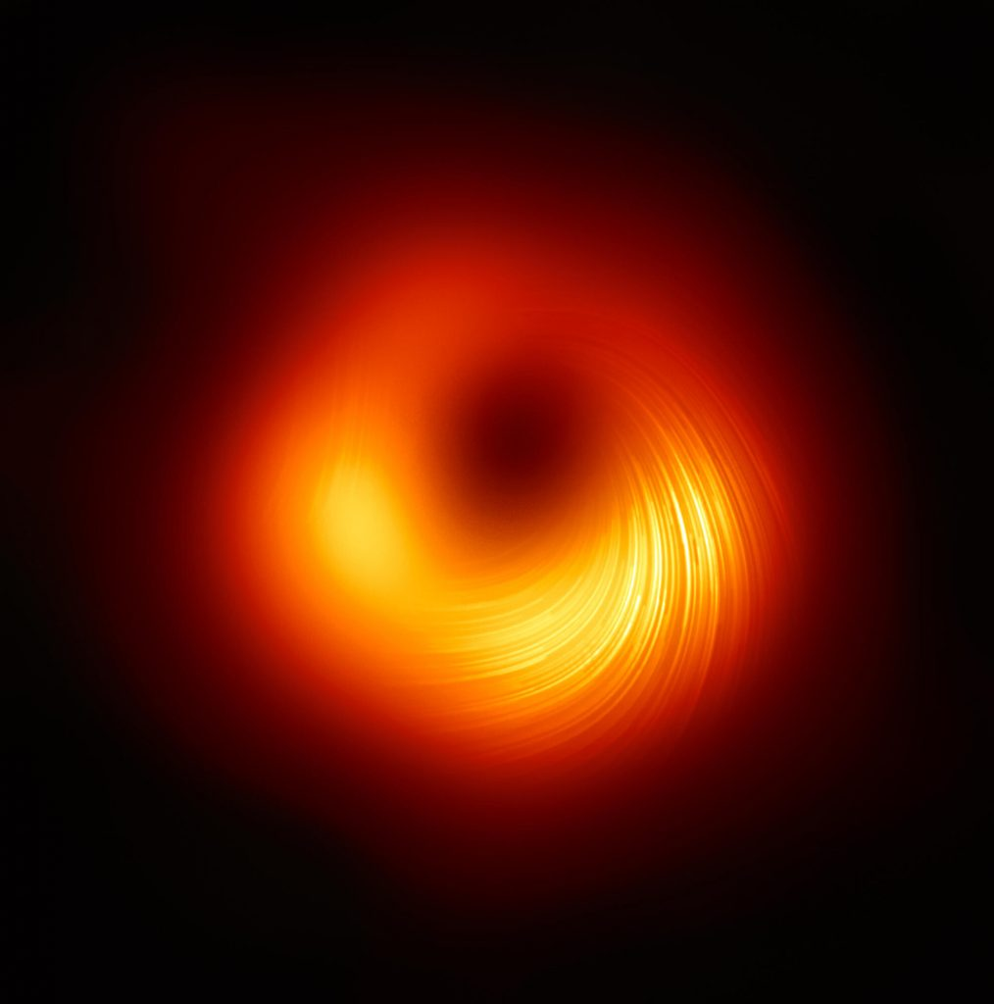
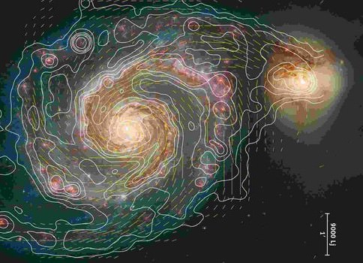
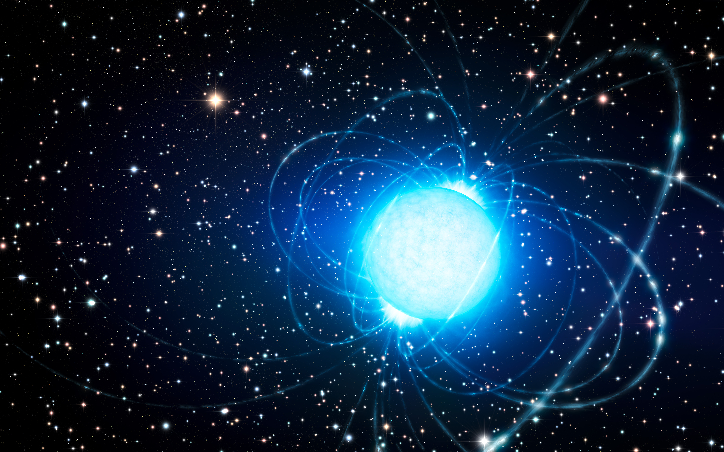
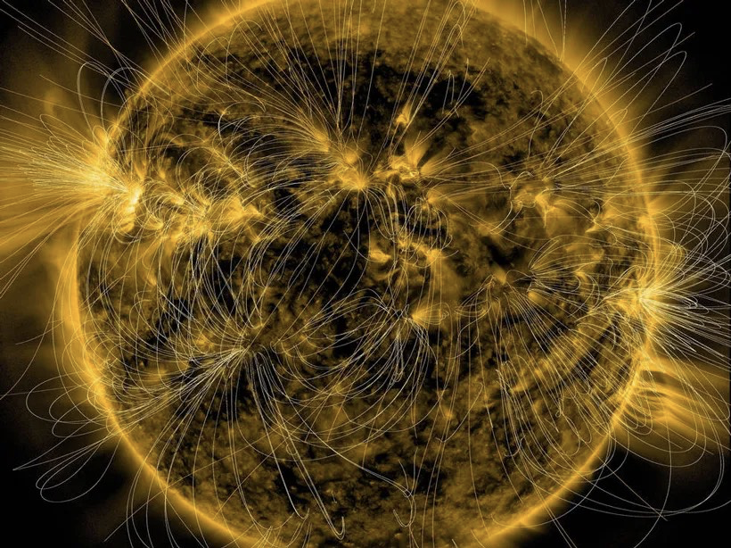
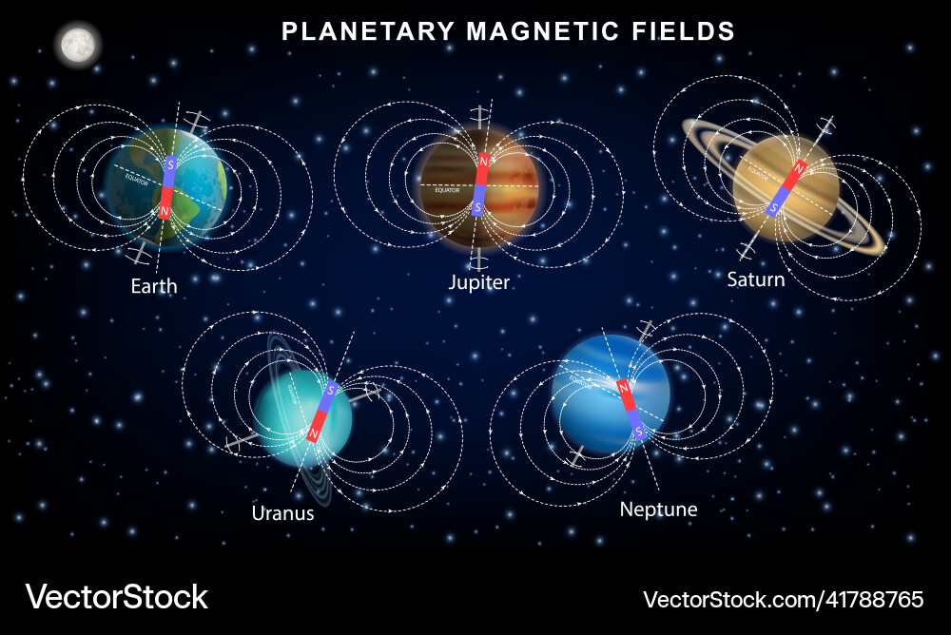
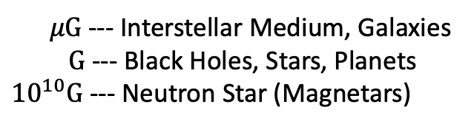
Magnetic fields in the Universe
Magnetic fields are everywhere in the Universe at all scales and strength
Black Holes
Galaxies
Neutron Stars
Stars
$μG$ --- Interstellar Medium, Galaxies
$G$ --- Black Holes, Stars, Planets
${10}^{10}G$ --- Neutron Star (Magnetars)
Standard cosmology: no magnetic fields were created at the big bang
How are cosmic/astrophysical magnetic fields generated?
Planets

Slide 3
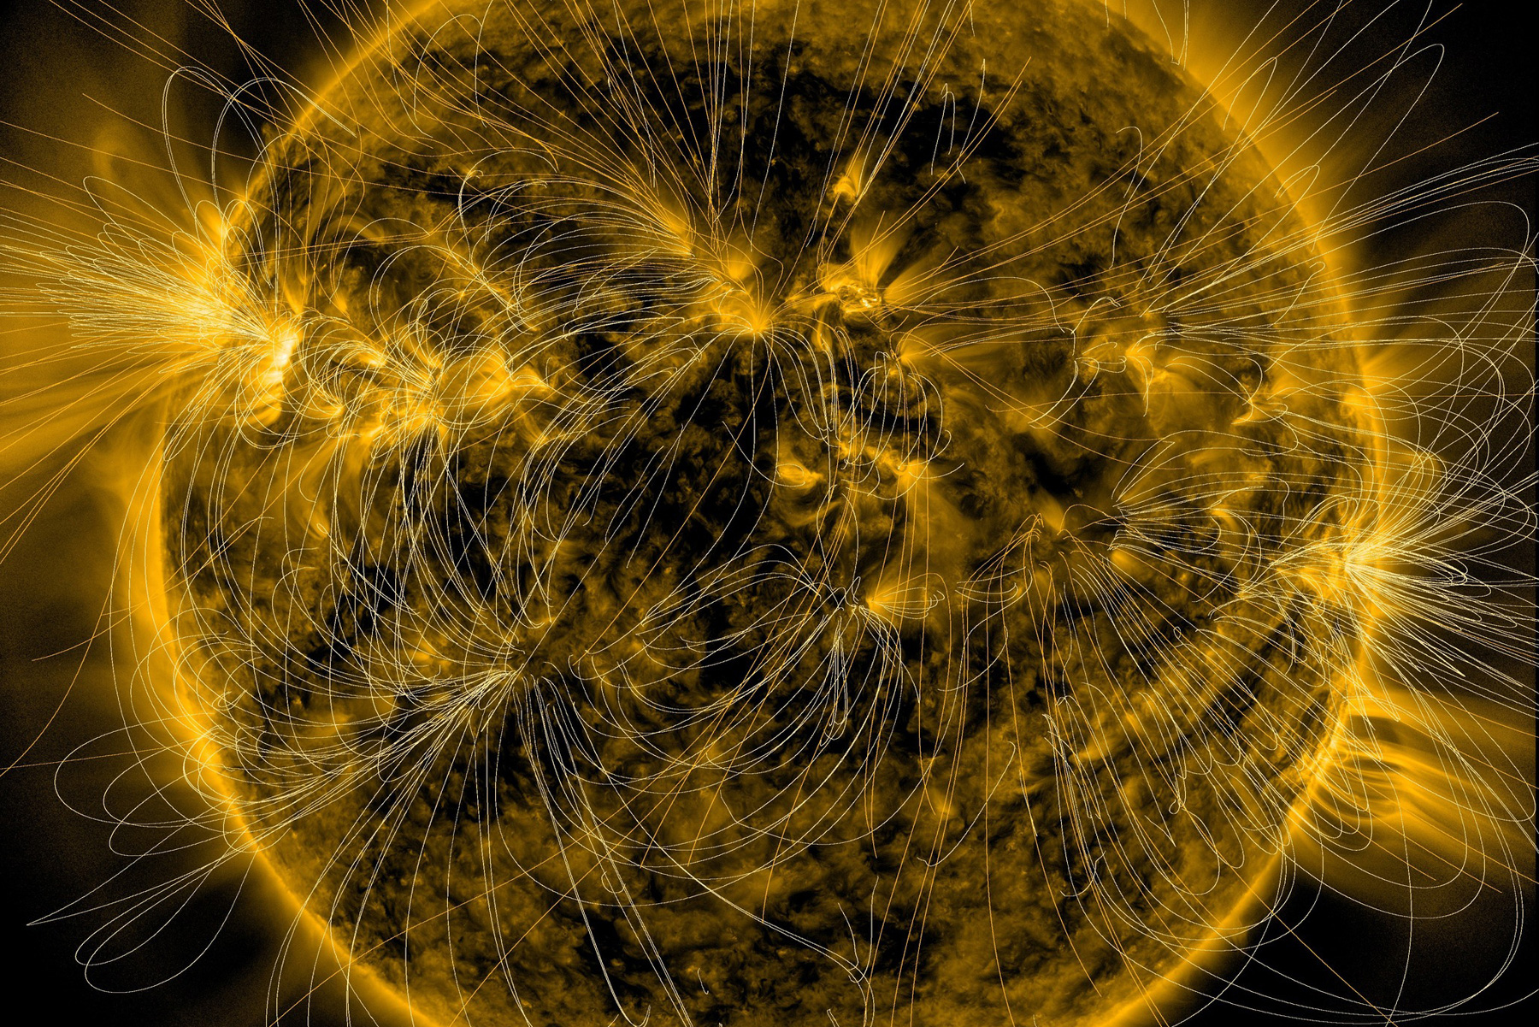

MHD
Magnetohydrodynamics (MHD) is the largest-scale description of magnetized plasmas
One important equation:
$E+U×B=0$
Take curl and use Faraday’s law
$\frac{∂B}{∂t}=∇×\left(U×B\right)$
Ideal Ohm’s law
=
MHD induction equation

Slide 4
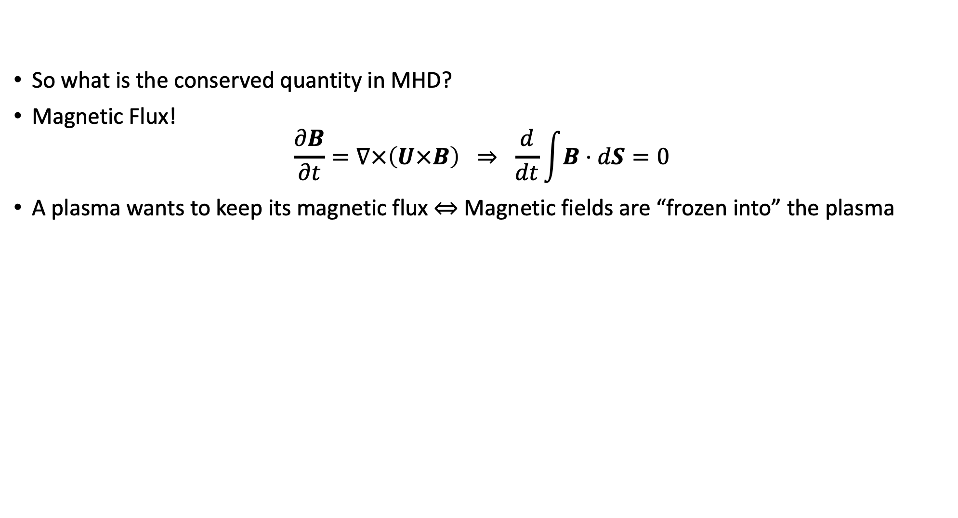
MHD
So what is the conserved quantity in MHD?
Magnetic Flux!
$\frac{∂B}{∂t}=∇×\left(U×B\right) ⇒ \frac{d}{dt}\int{B⋅dS}=0$
A plasma wants to keep its magnetic flux $⇔$ Magnetic fields are “frozen into” the plasma

Slide 5
MHD
So what is the conserved quantity in MHD?
Magnetic Flux!
$\frac{∂B}{∂t}=∇×\left(U×B\right) ⇒ \frac{d}{dt}\int{B⋅dS}=0$
A plasma wants to keep its magnetic flux $⇔$ Magnetic fields are “frozen into” the plasma

Slide 6
MHD
So what is the conserved quantity in MHD?
Magnetic Flux!
$\frac{∂B}{∂t}=∇×\left(U×B\right) ⇒ \frac{d}{dt}\int{B⋅dS}=0$
A plasma wants to keep its magnetic flux $⇔$ Magnetic fields are “frozen into” the plasma

Slide 7
MHD
So what is the conserved quantity in MHD?
Magnetic Flux!
$\frac{∂B}{∂t}=∇×\left(U×B\right) ⇒ \frac{d}{dt}\int{B⋅dS}=0$
A plasma wants to keep its magnetic flux $⇔$ Magnetic fields are “frozen into” the plasma

Slide 8
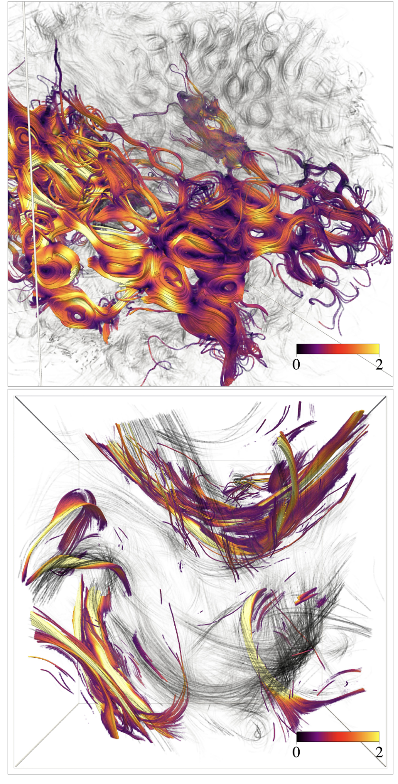
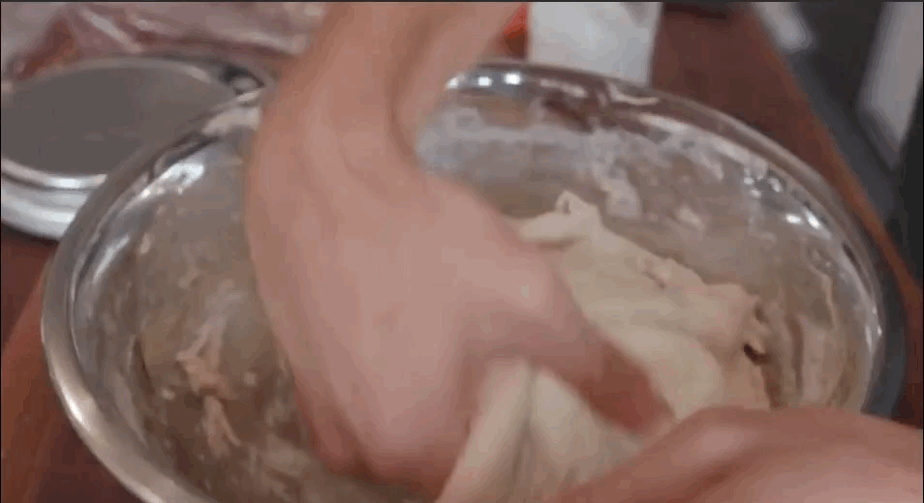
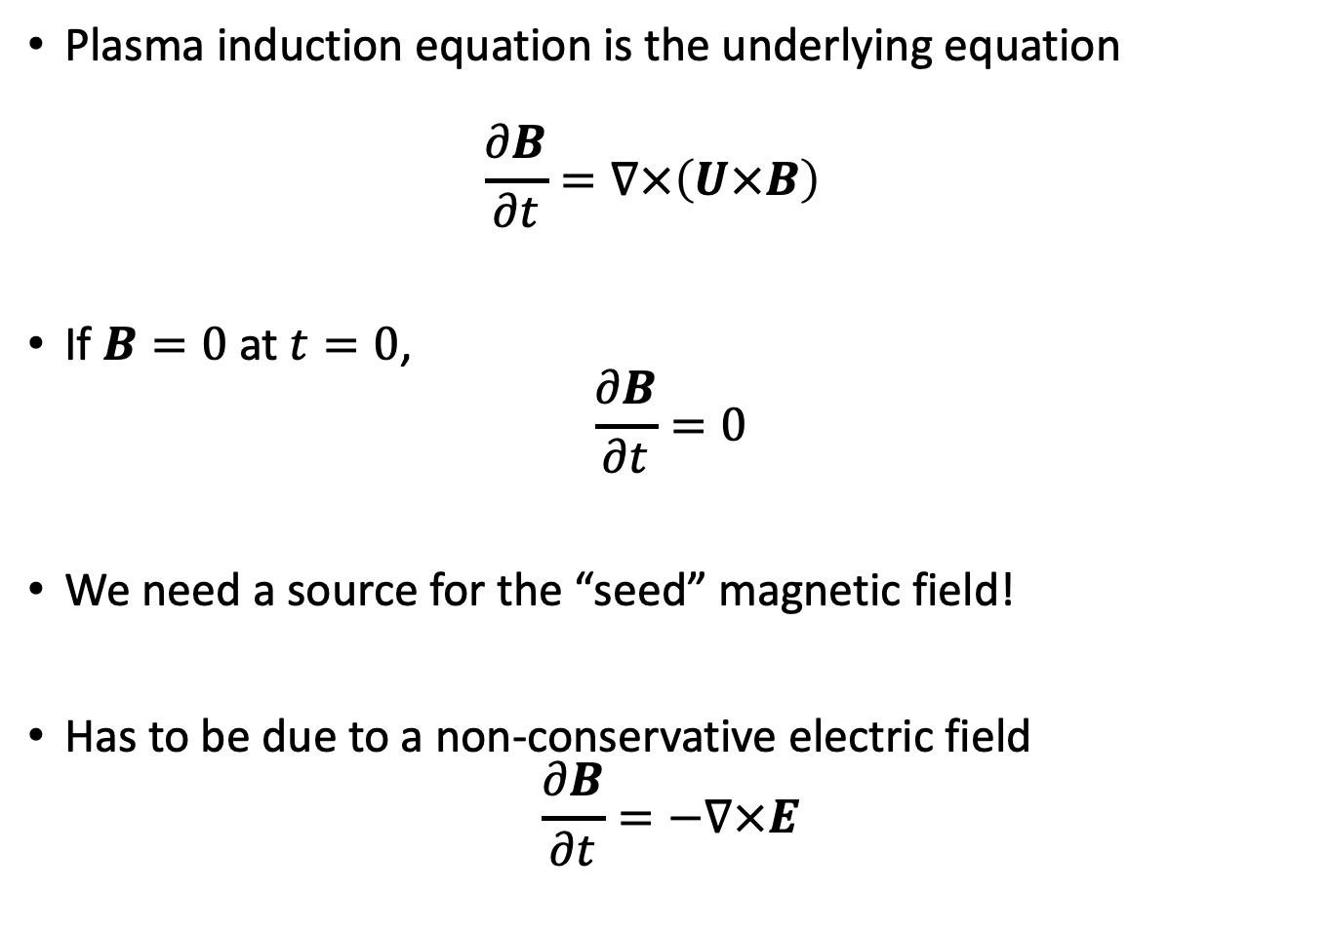
Plasma Dynamo
Plasma induction equation is the underlying equation
$\frac{∂B}{∂t}=∇×\left(U×B\right)$
If $B=0$ at $t=0$,
$\frac{∂B}{∂t}=0$
We need a source for the “seed” magnetic field!
Has to be due to a non-conservative electric field
$\frac{∂B}{∂t}=−∇×E$
Zhou+, ApJ (2023)

Slide 9
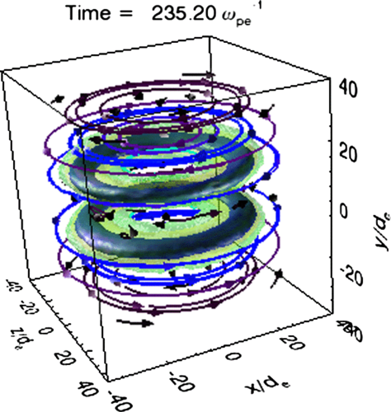
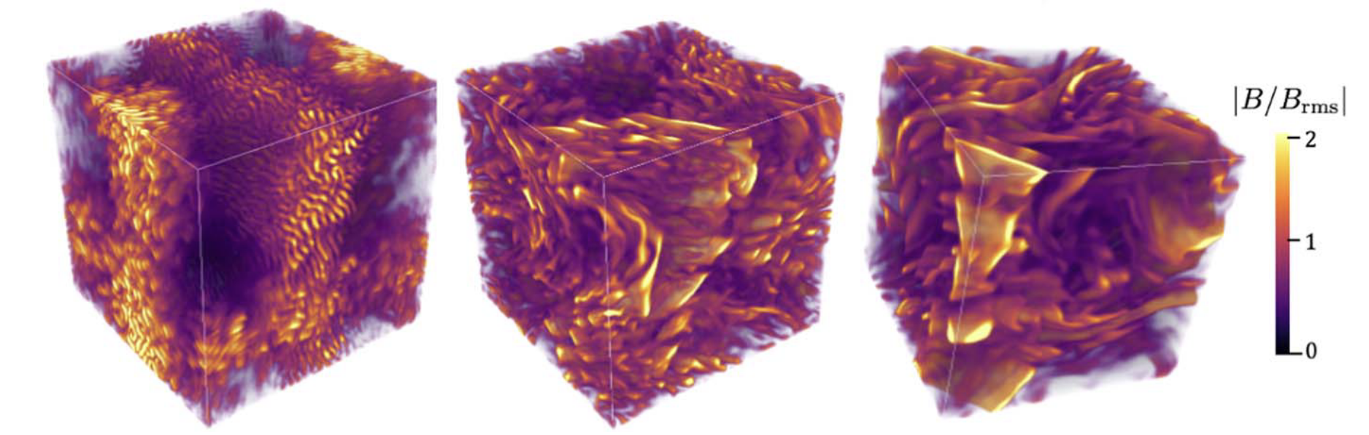
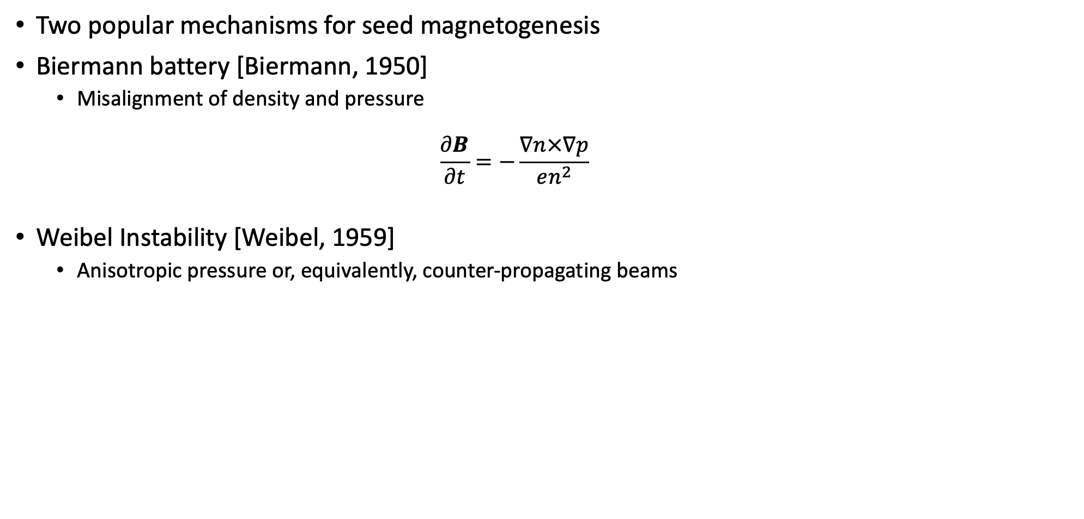


Seed Magnetogenesis
Two popular mechanisms for seed magnetogenesis
Biermann battery [Biermann, 1950]
  Misalignment of density and pressure
  $\frac{∂B}{∂t}=−\frac{∇n×∇p}{en^{2}}$
Weibel Instability [Weibel, 1959]
  Anisotropic pressure or, equivalently, counter-propagating beams
Can we generalize these mechanisms and find new mechanisms?
[Schoeffler+, PRL (2014)]
$$J$$
$$B$$
[Zhou+, ApJ (2023)]

Slide 10


Slide 11
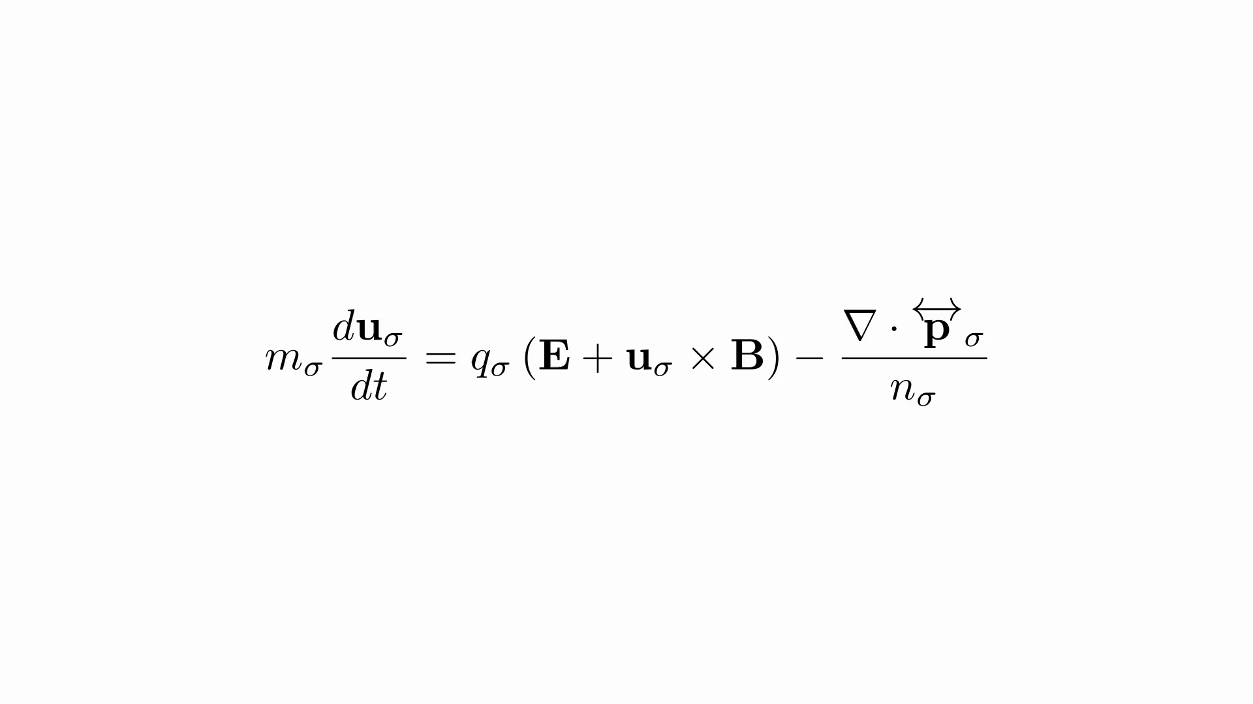

Slide 12
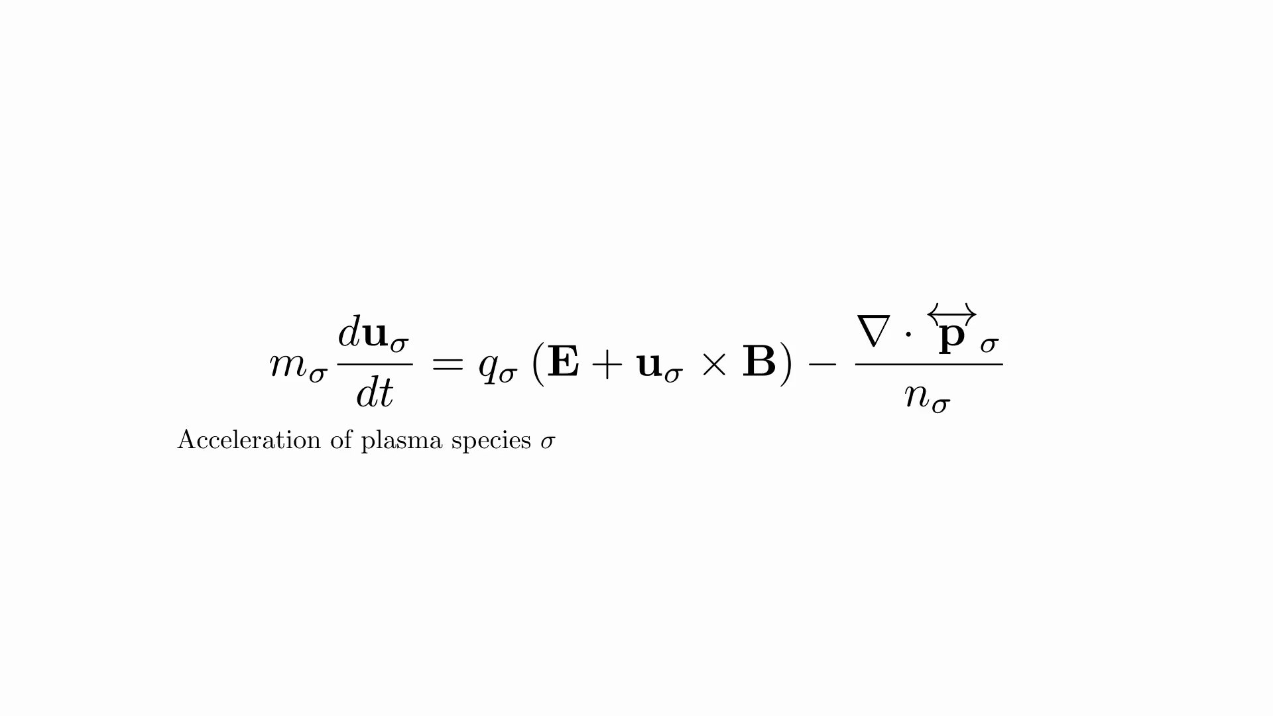

Slide 13
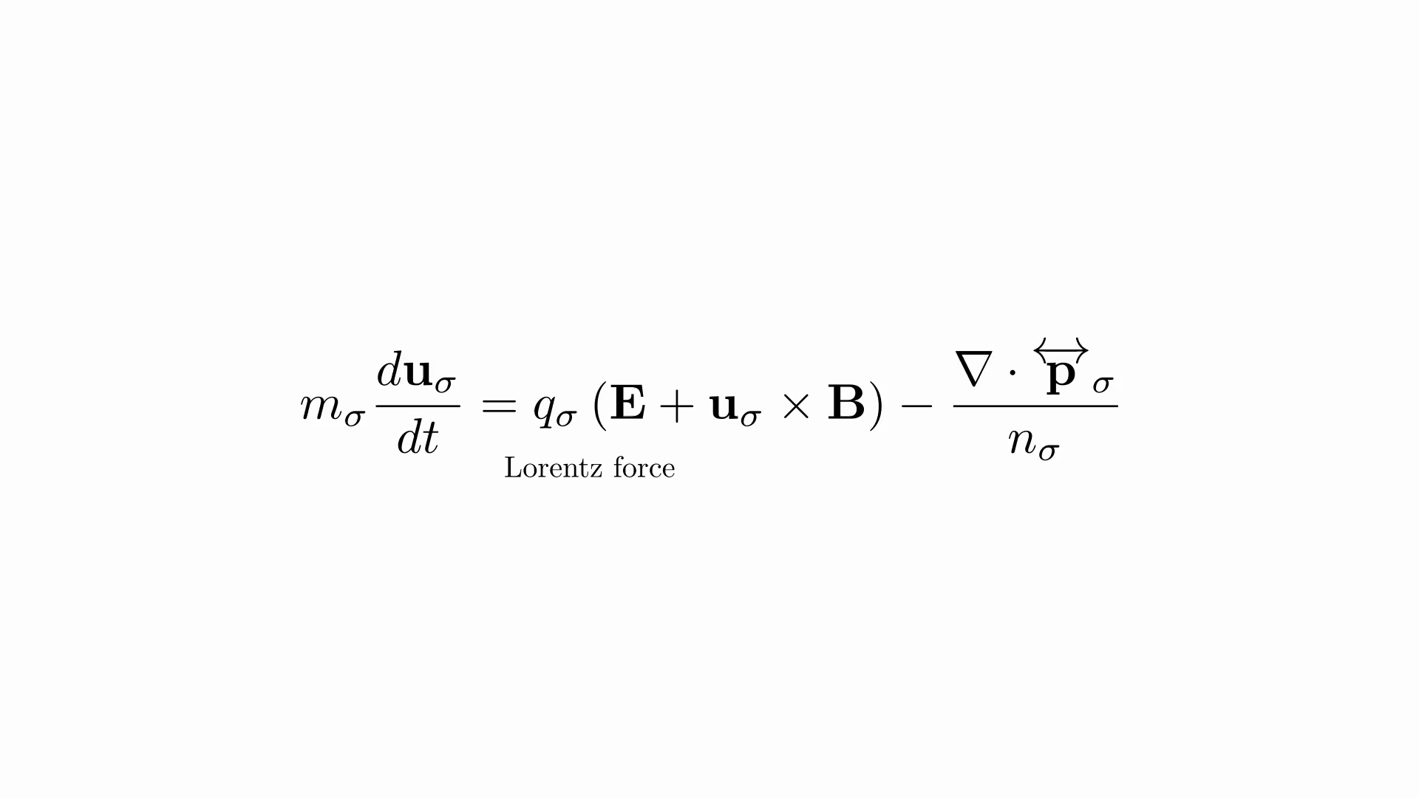

Slide 14
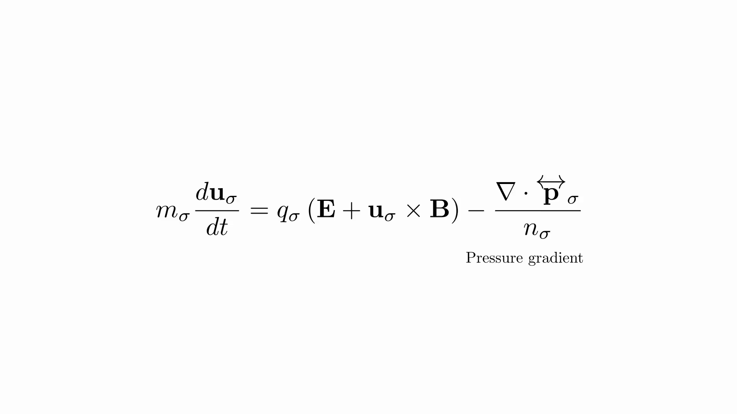

Slide 15
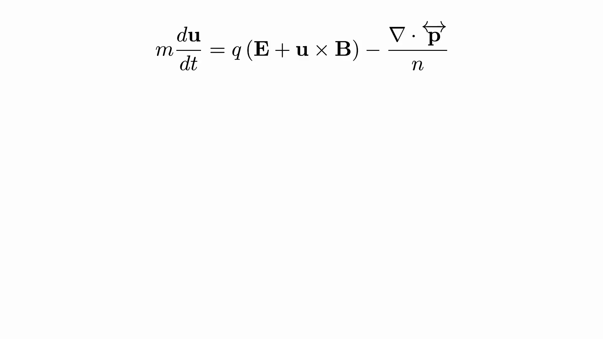

Slide 16
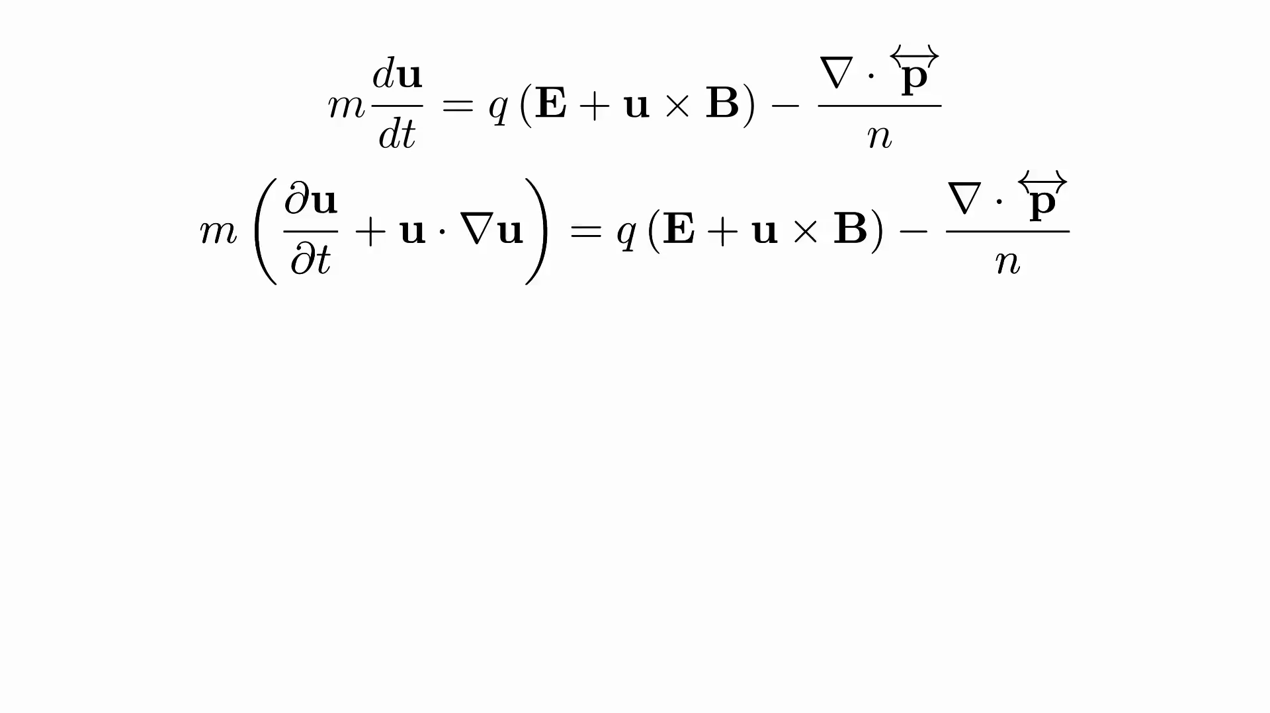

Slide 17
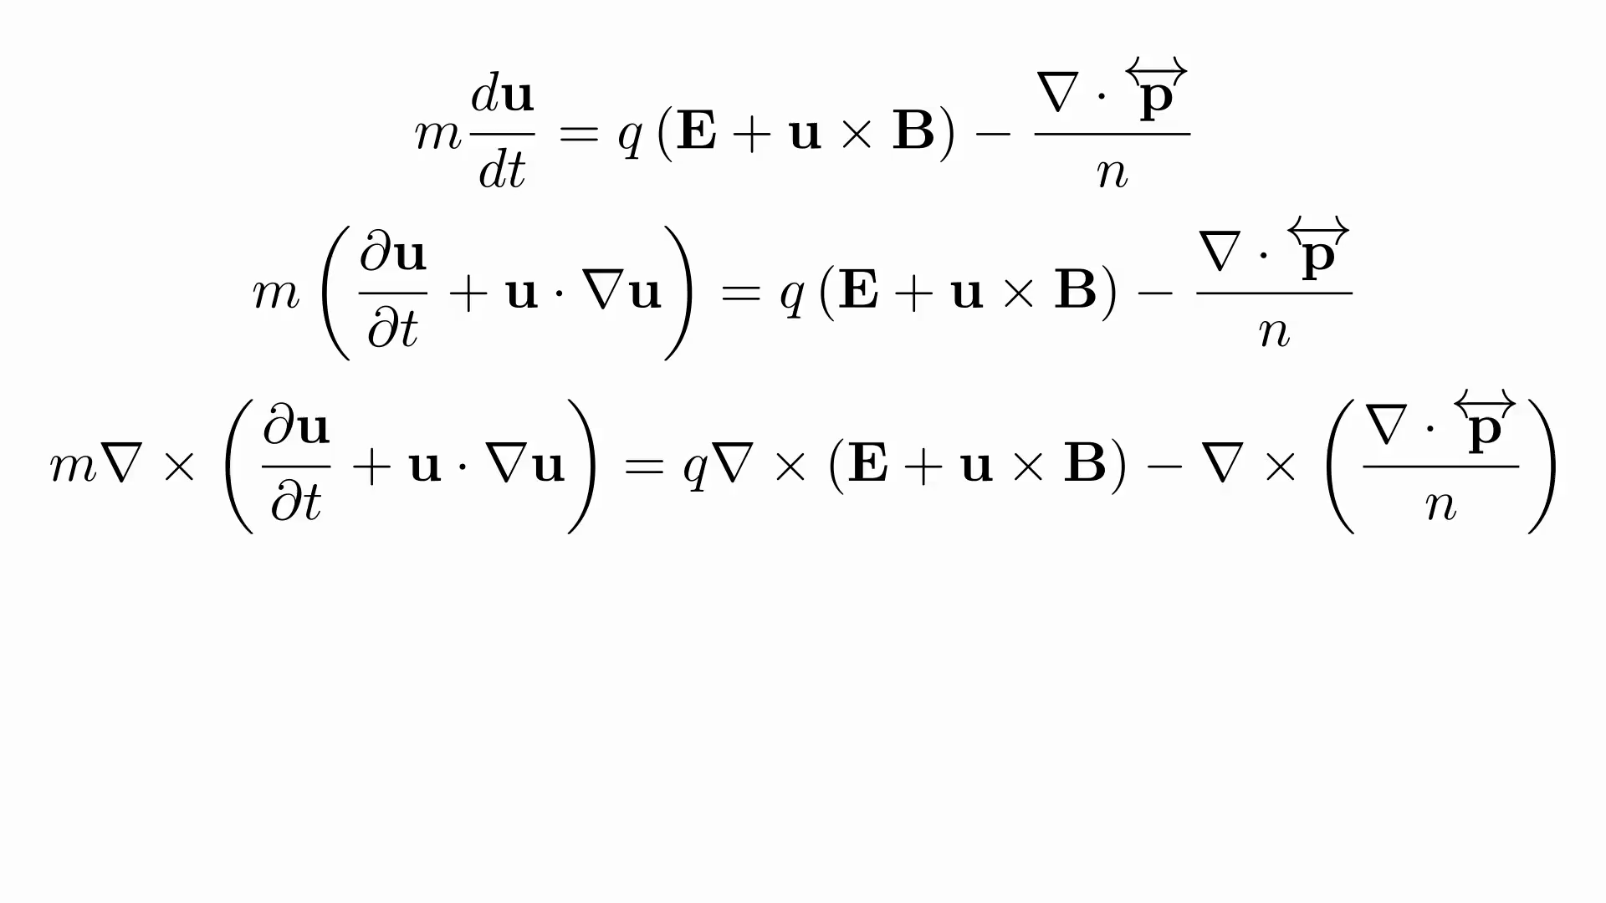

Slide 18
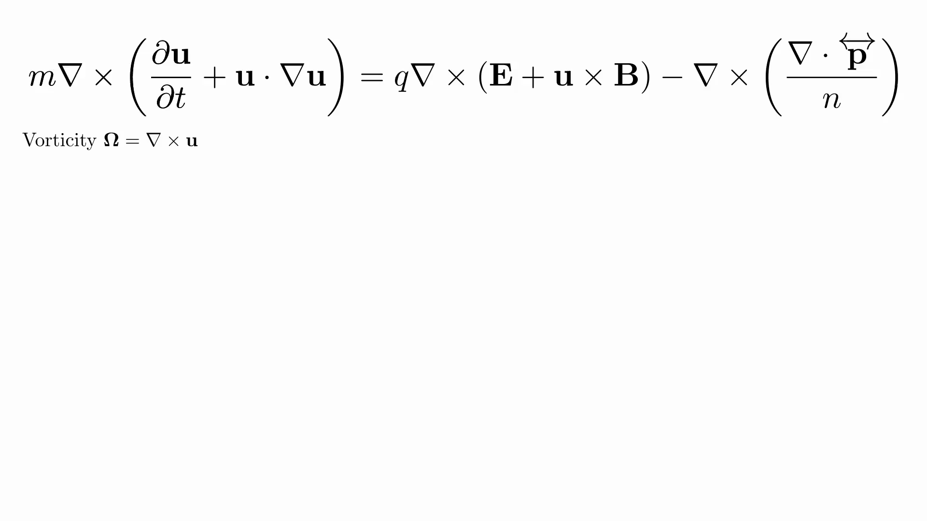

Slide 19
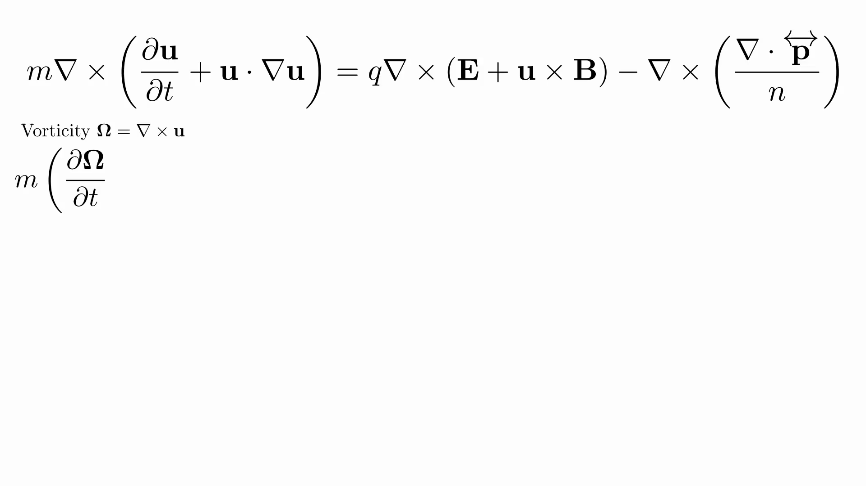

Slide 20
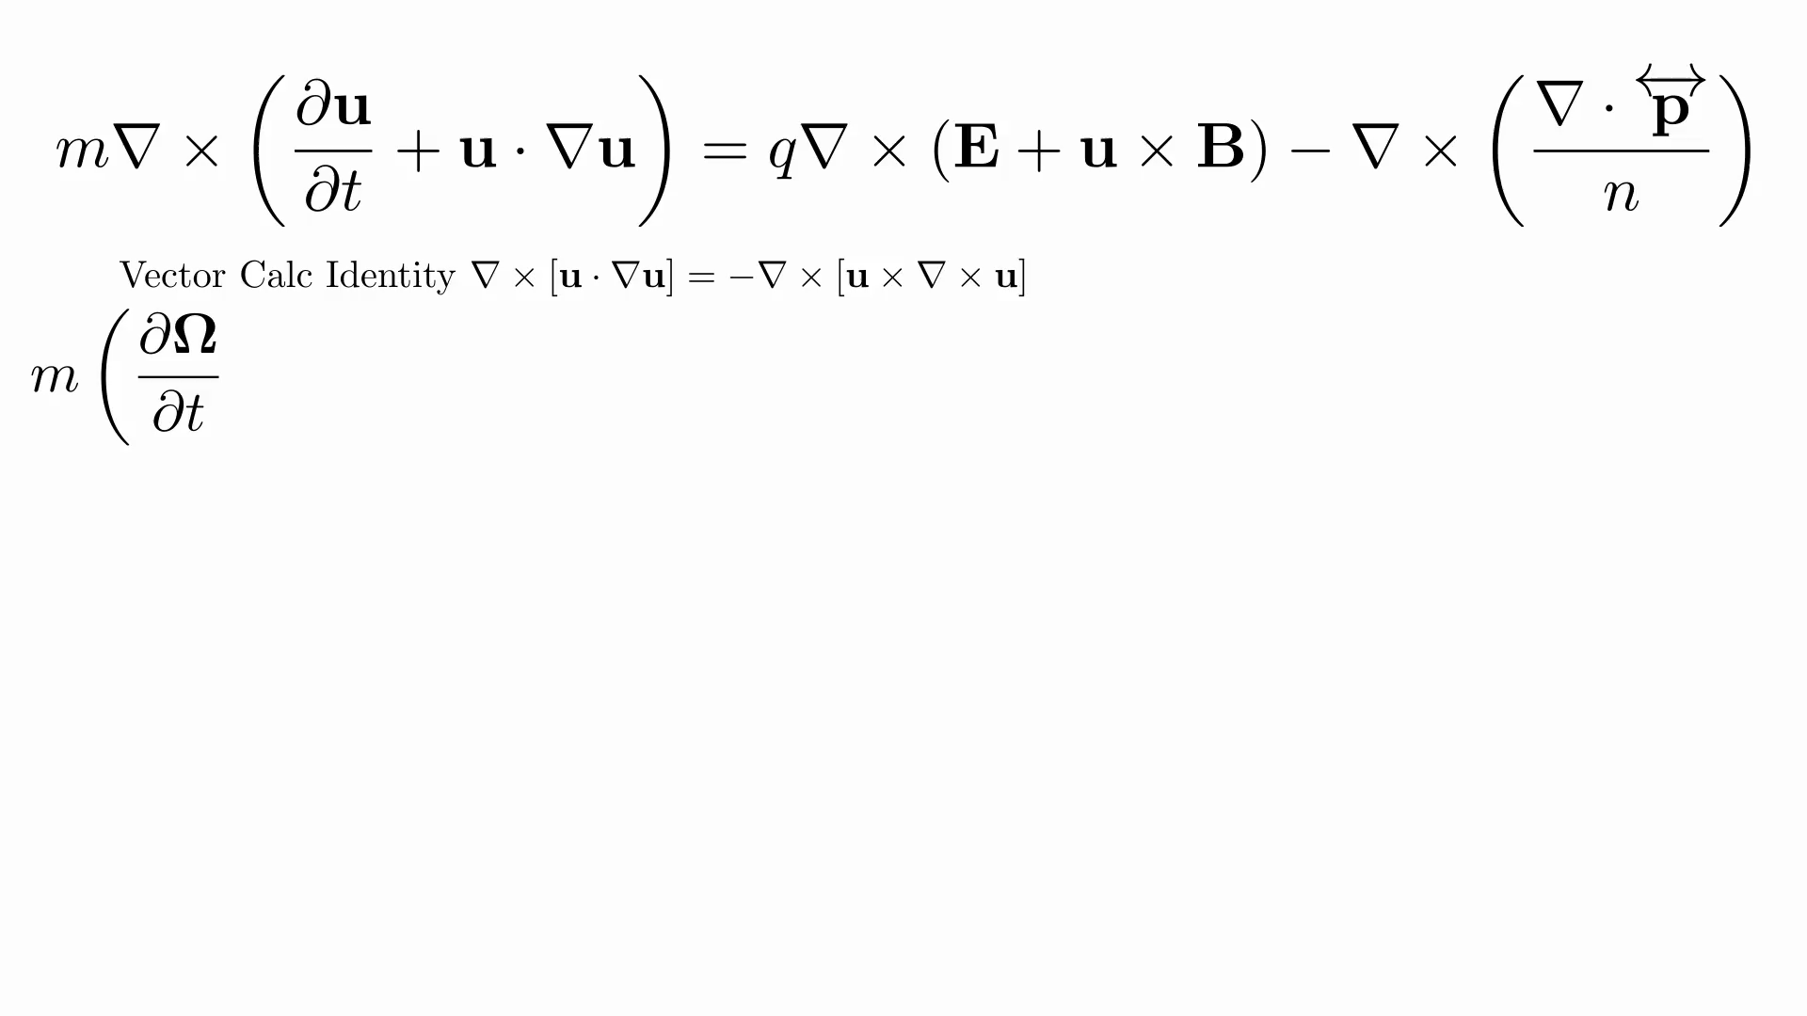

Slide 21


Slide 22
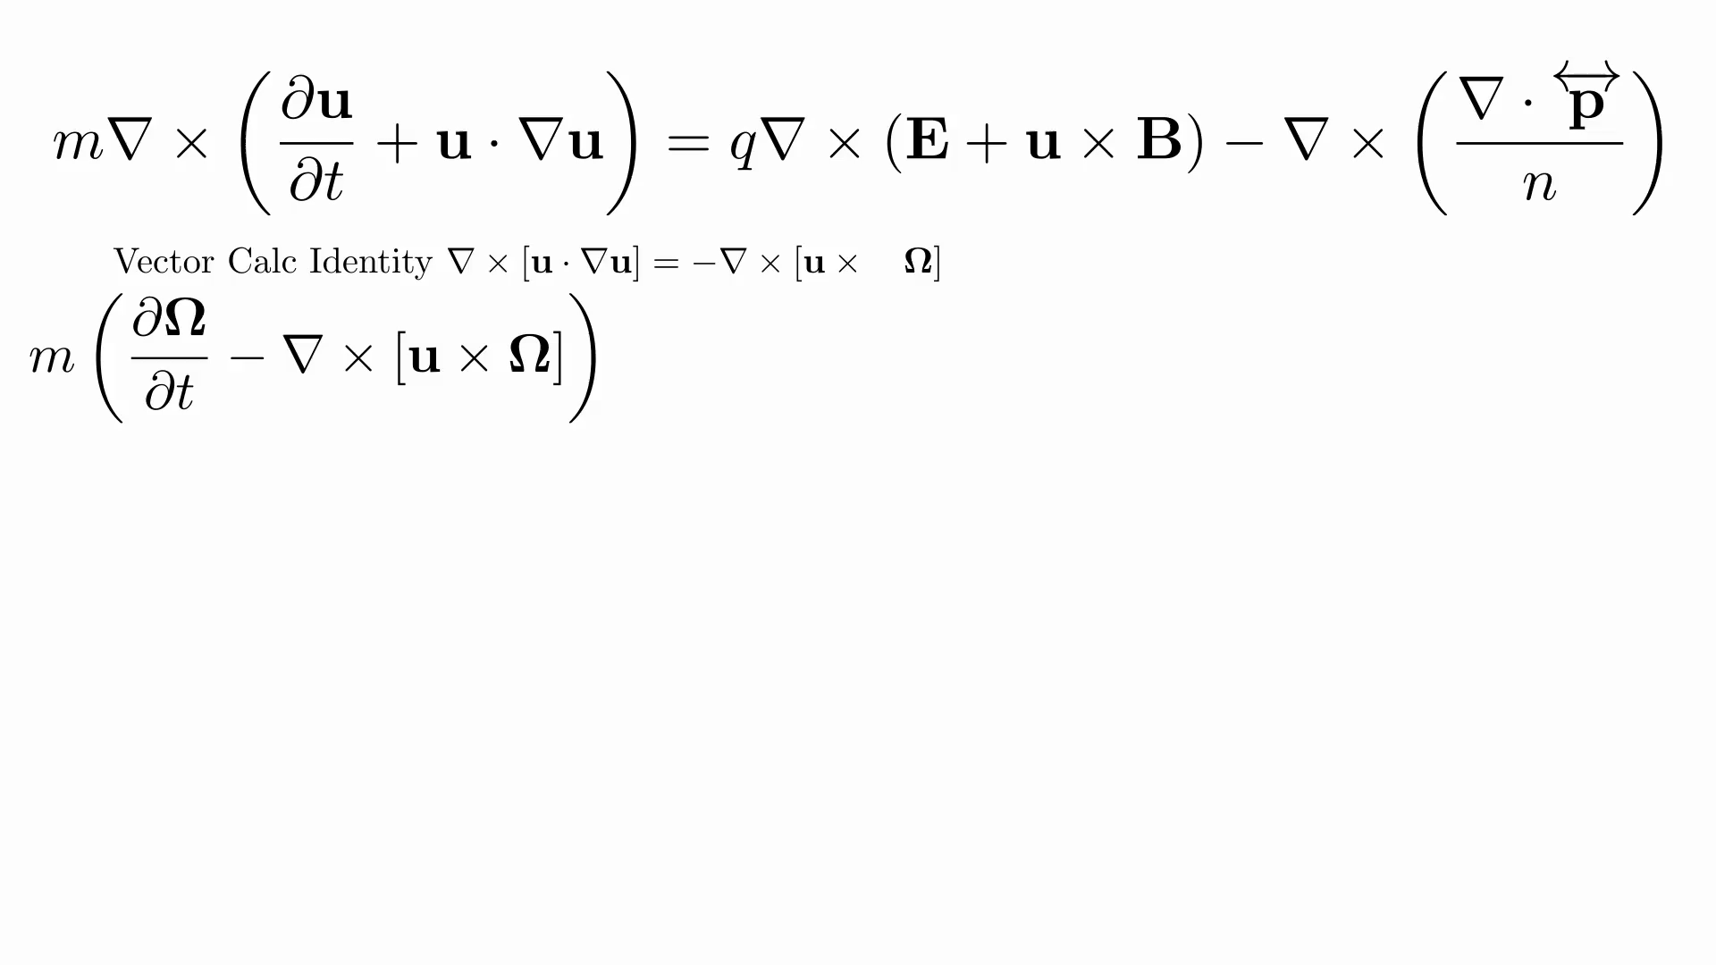

Slide 23
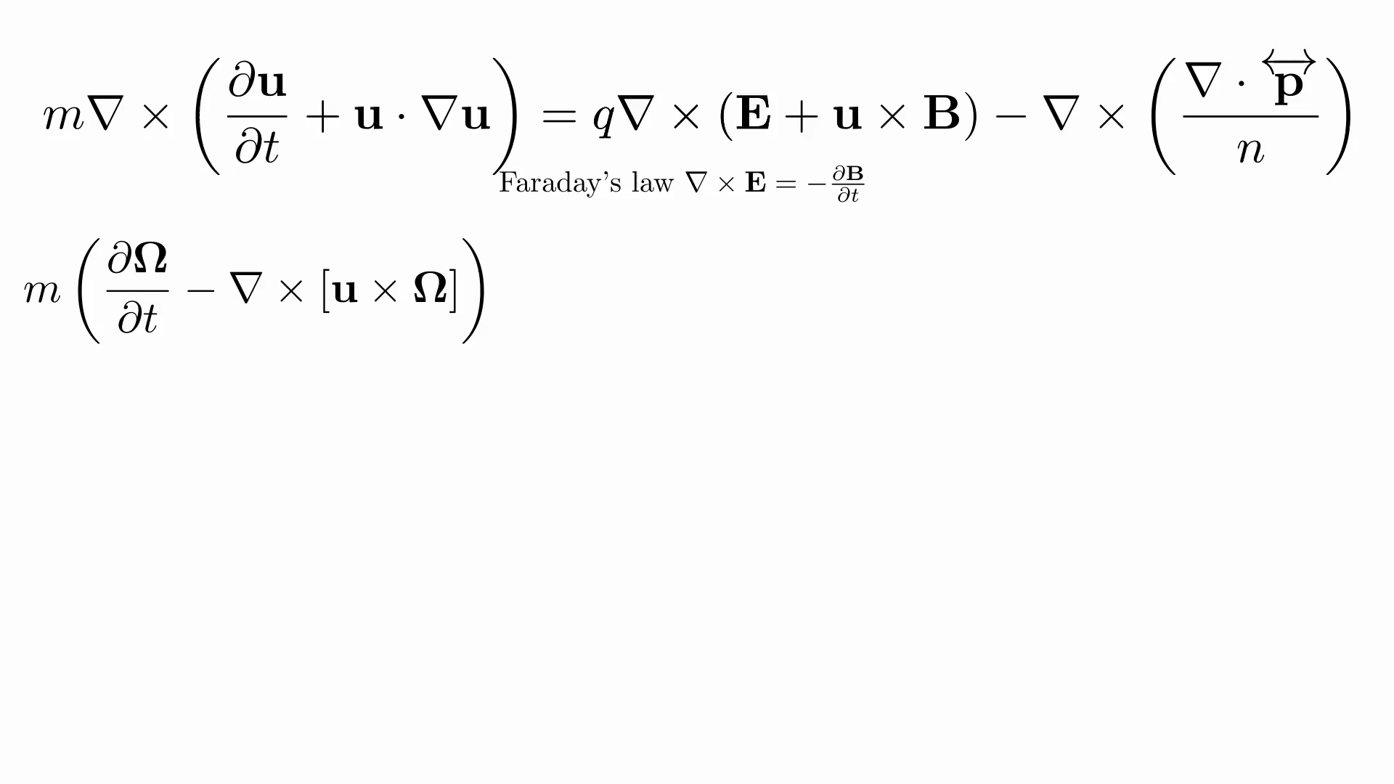

Slide 24
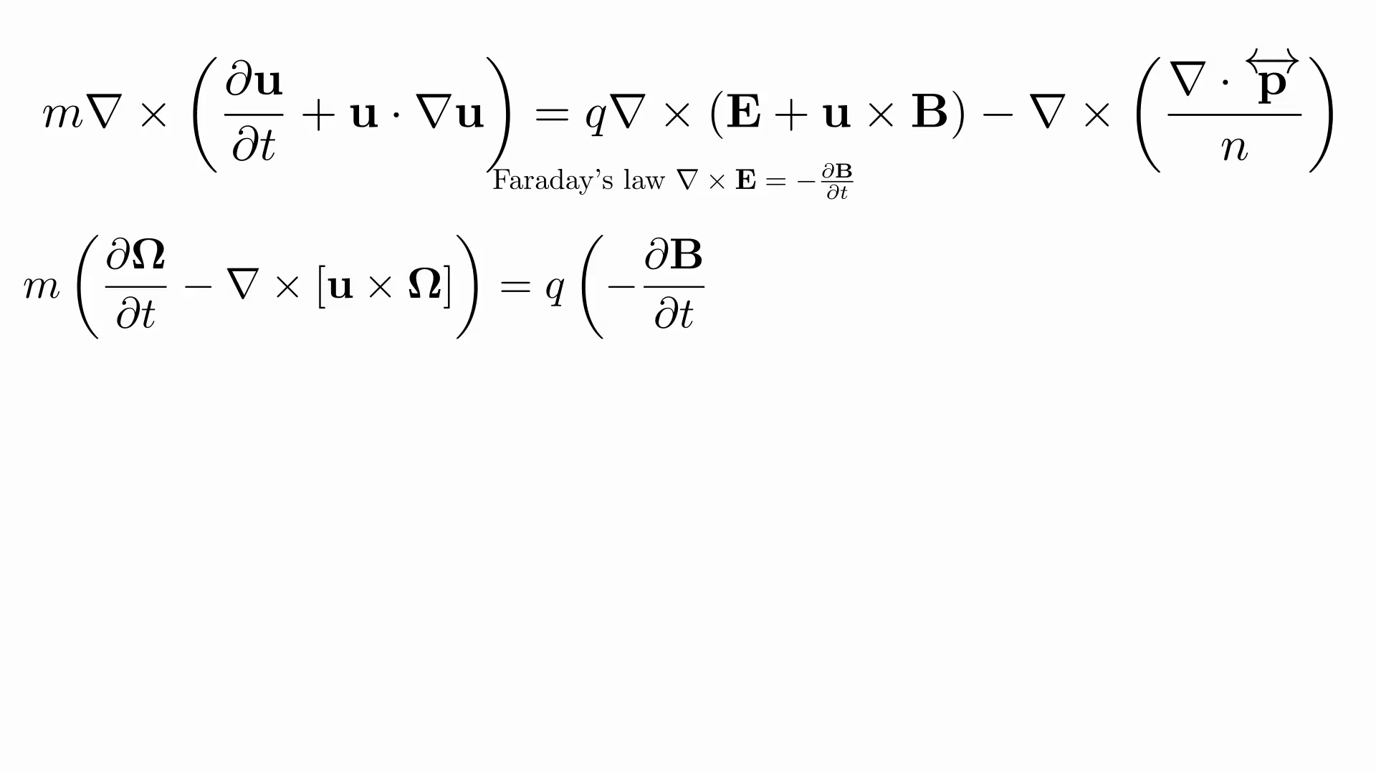

Slide 25
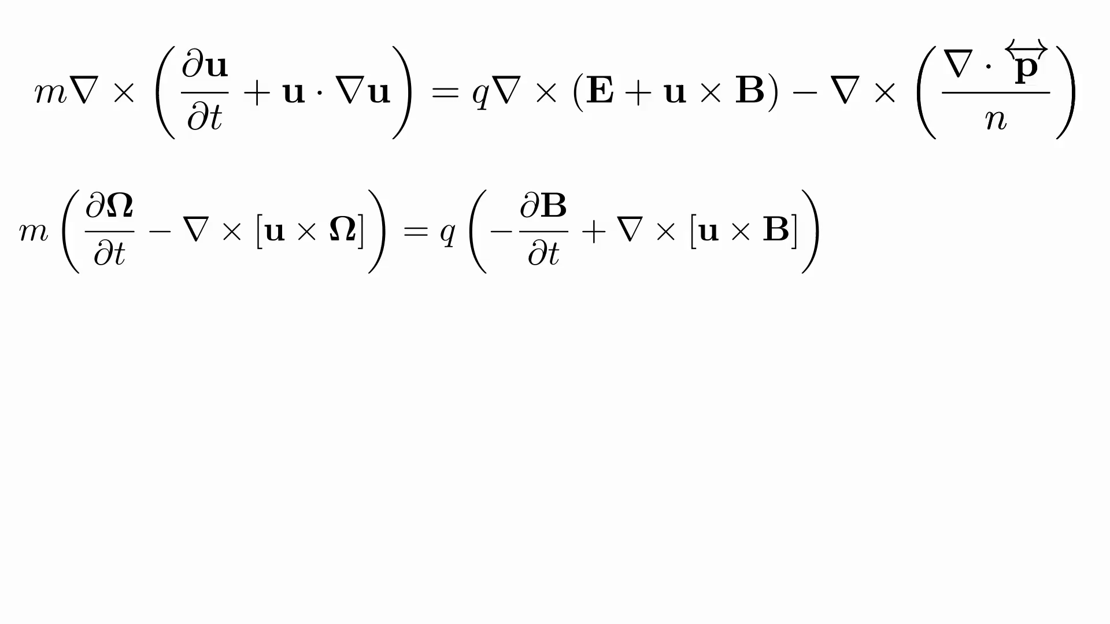

Slide 26
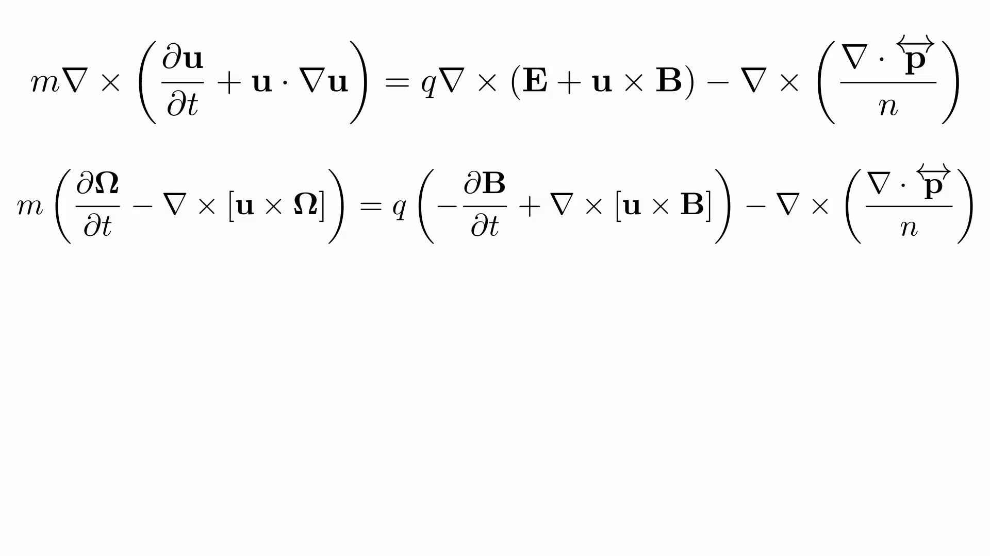

Slide 27
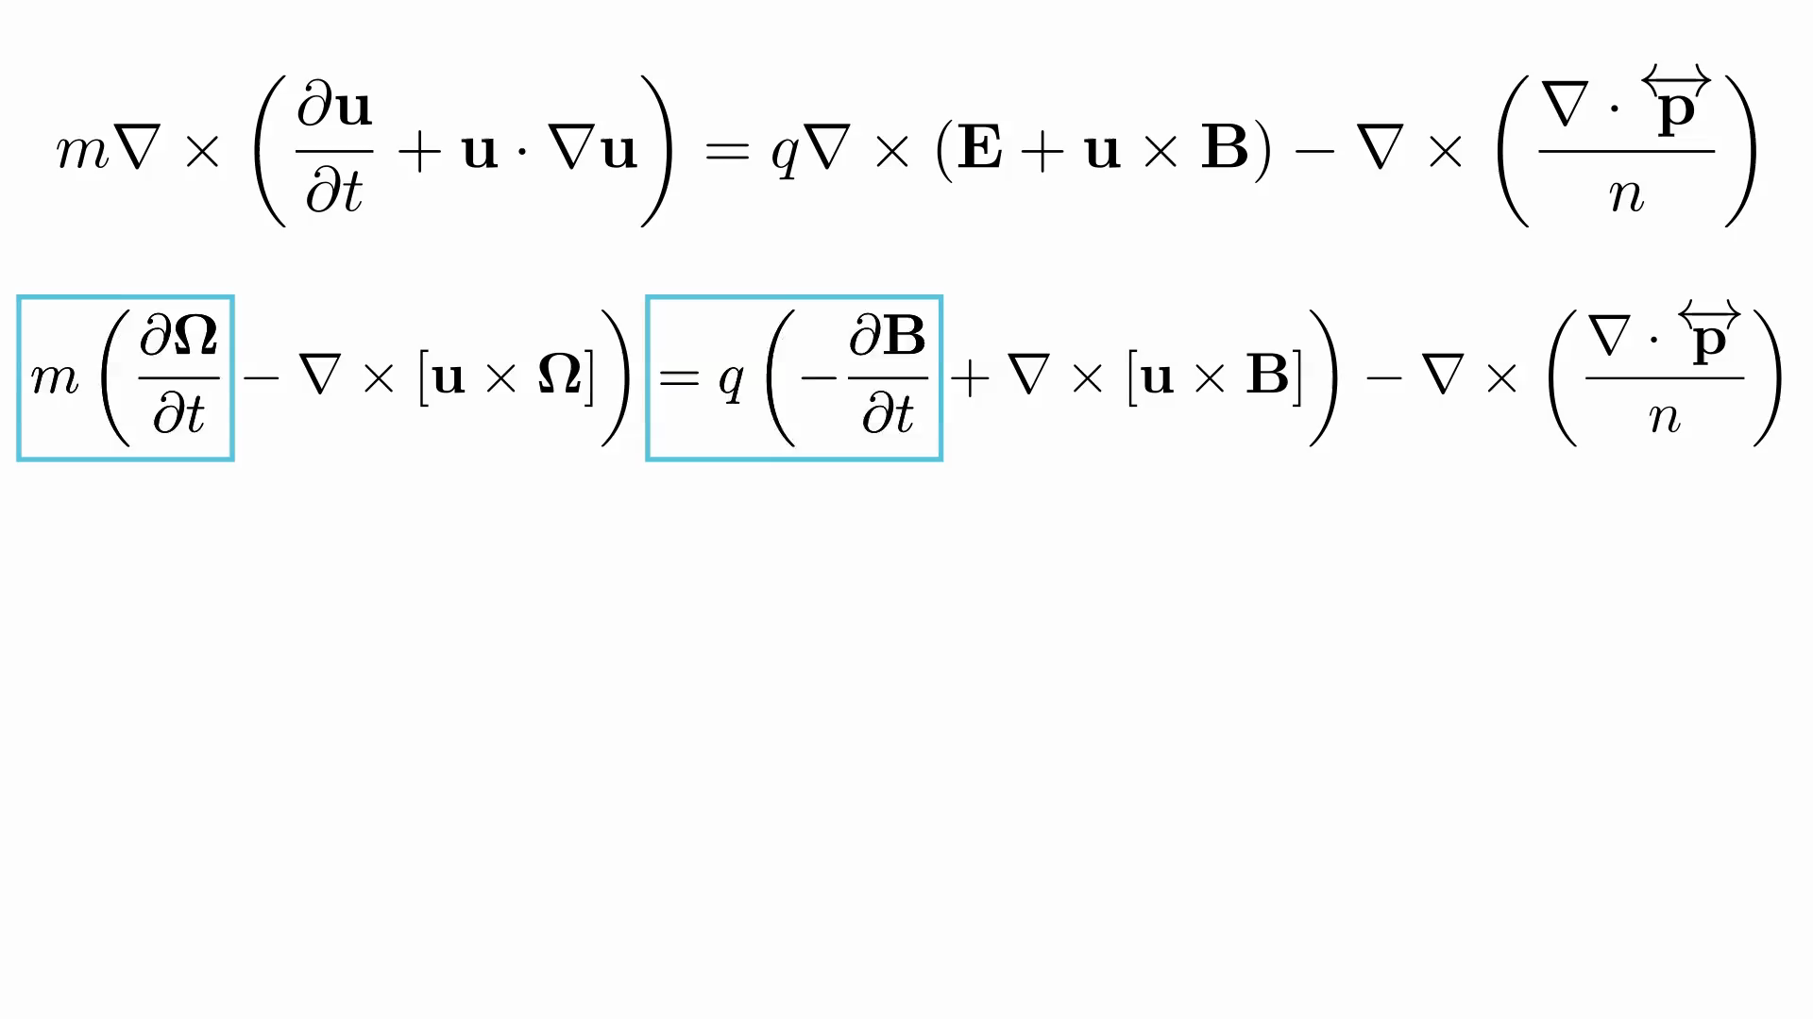

Slide 28
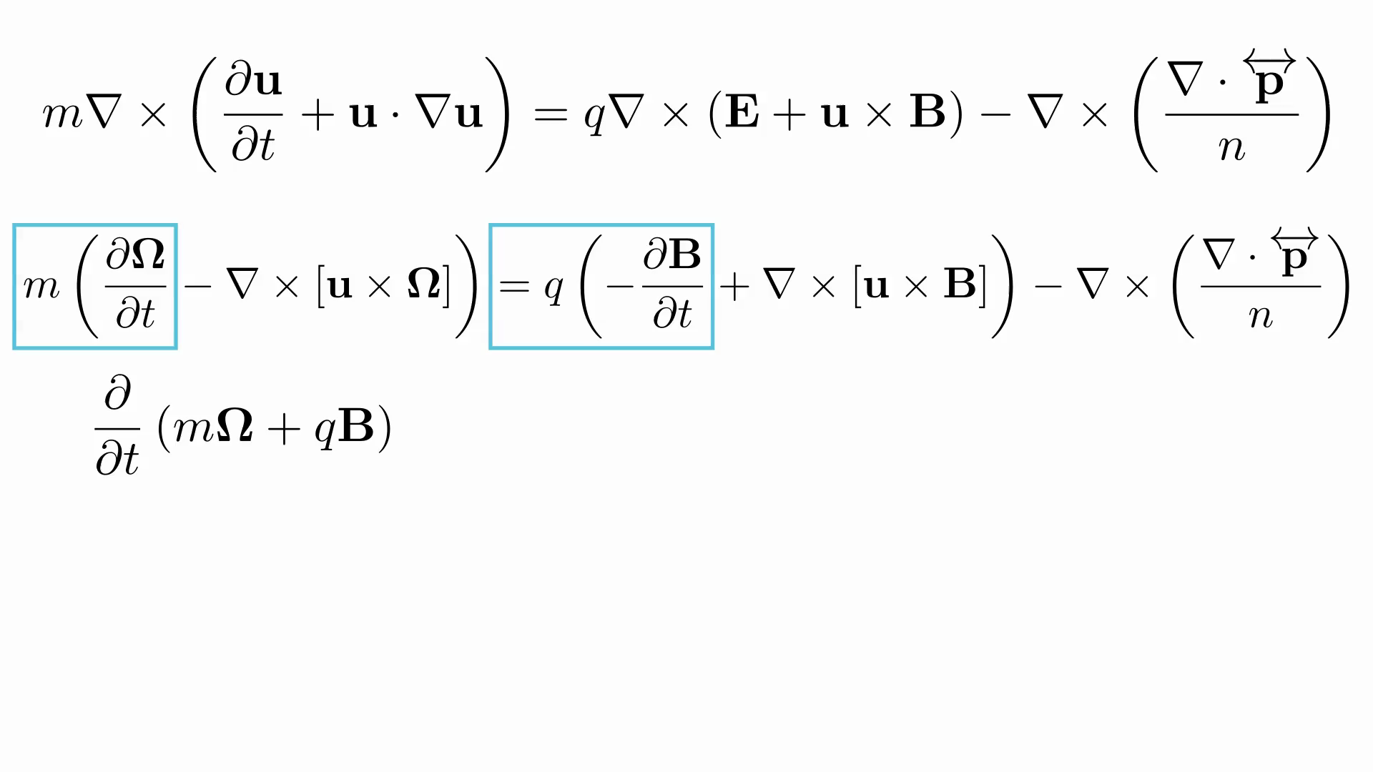

Slide 29
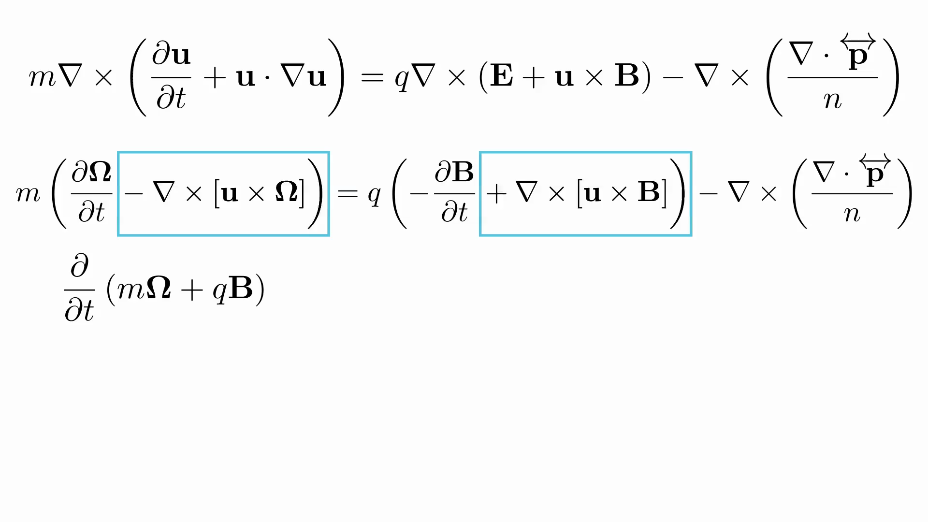

Slide 30
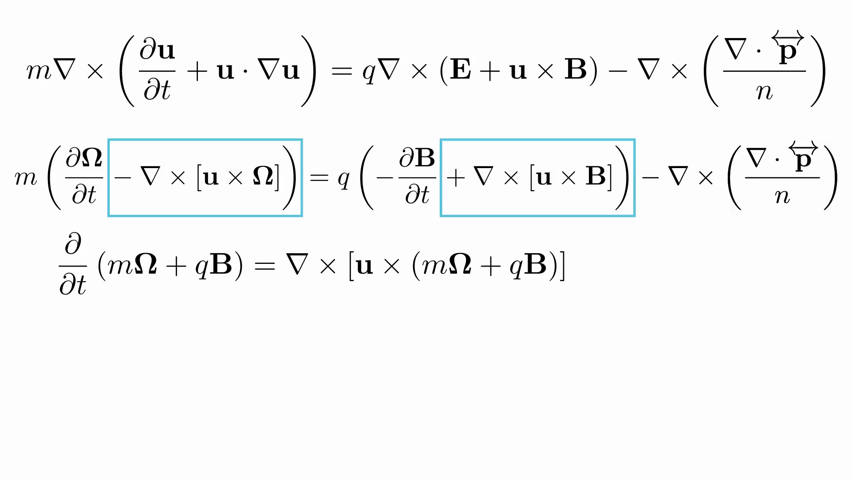

Slide 31
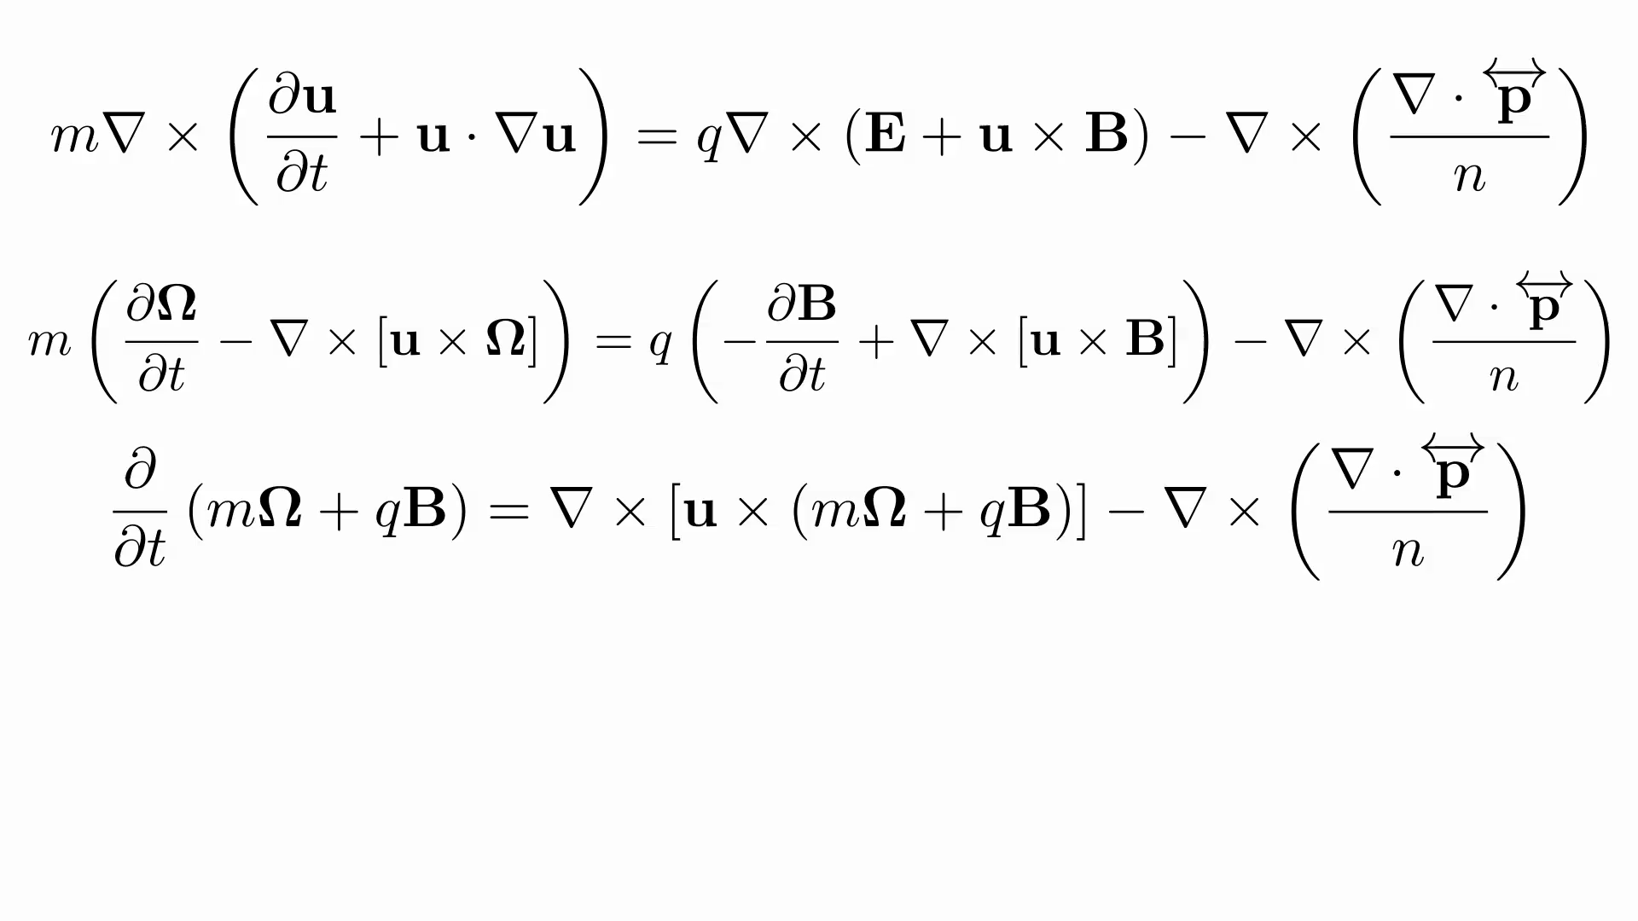

Slide 32
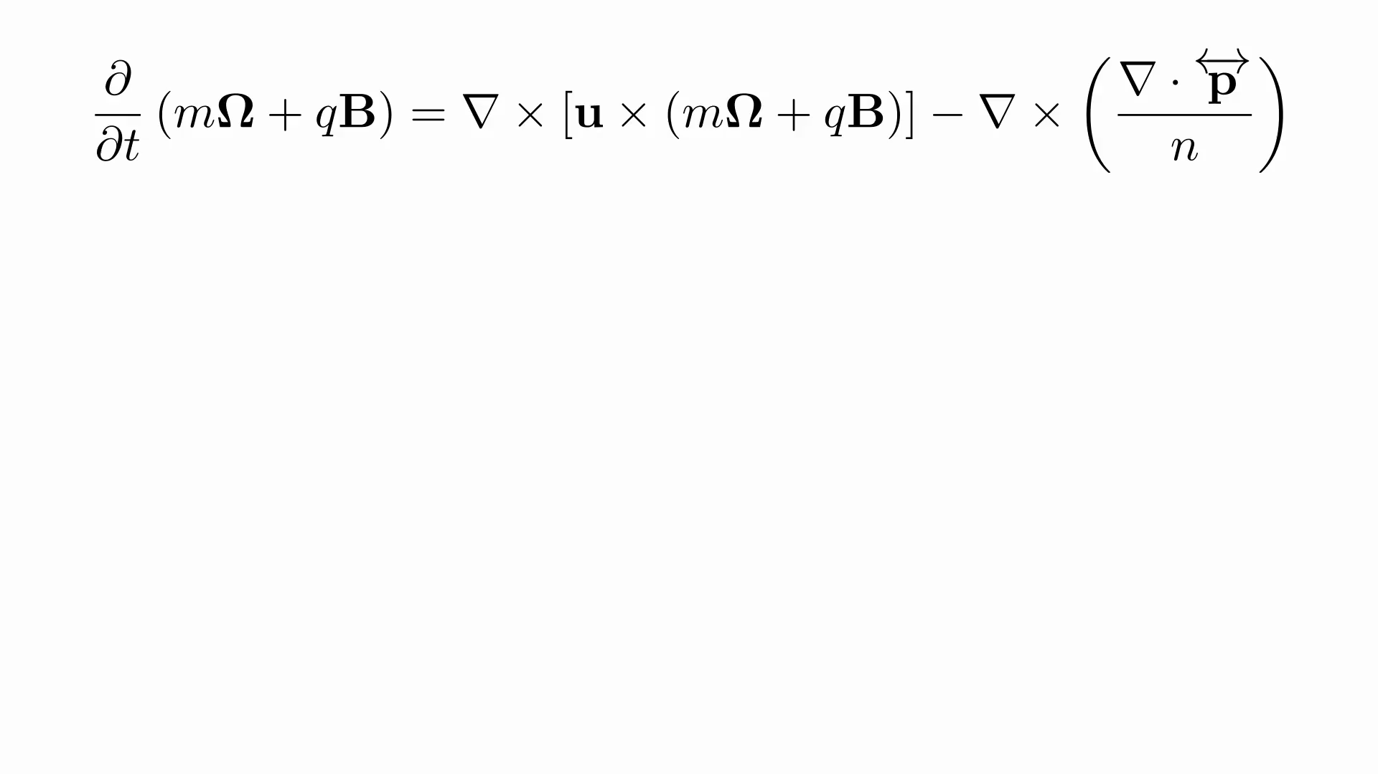

Slide 33
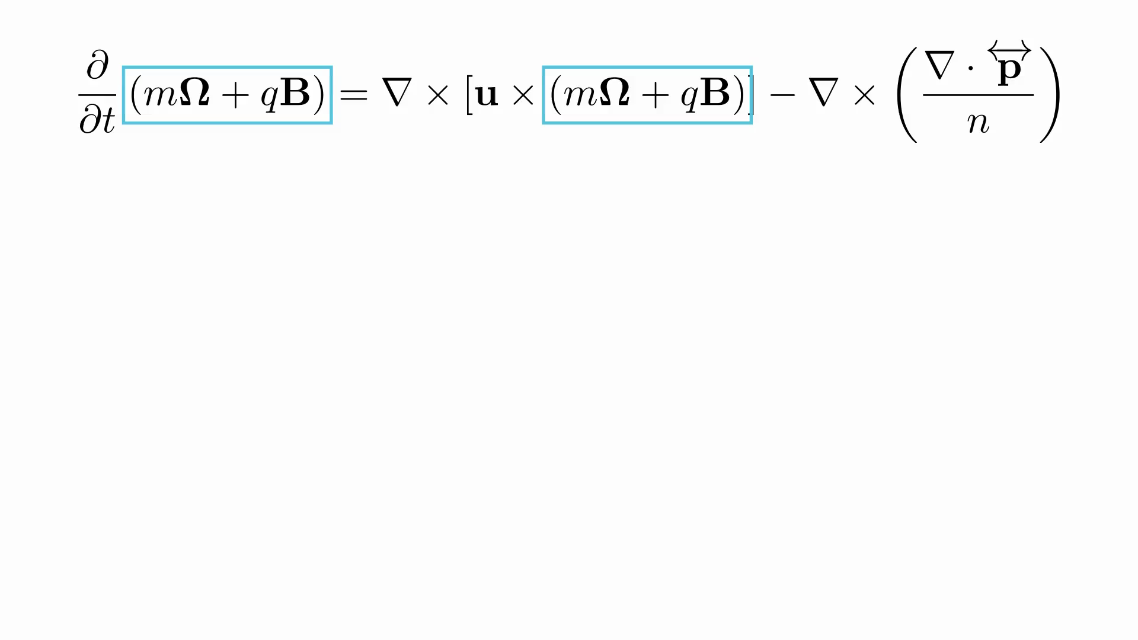

Slide 34
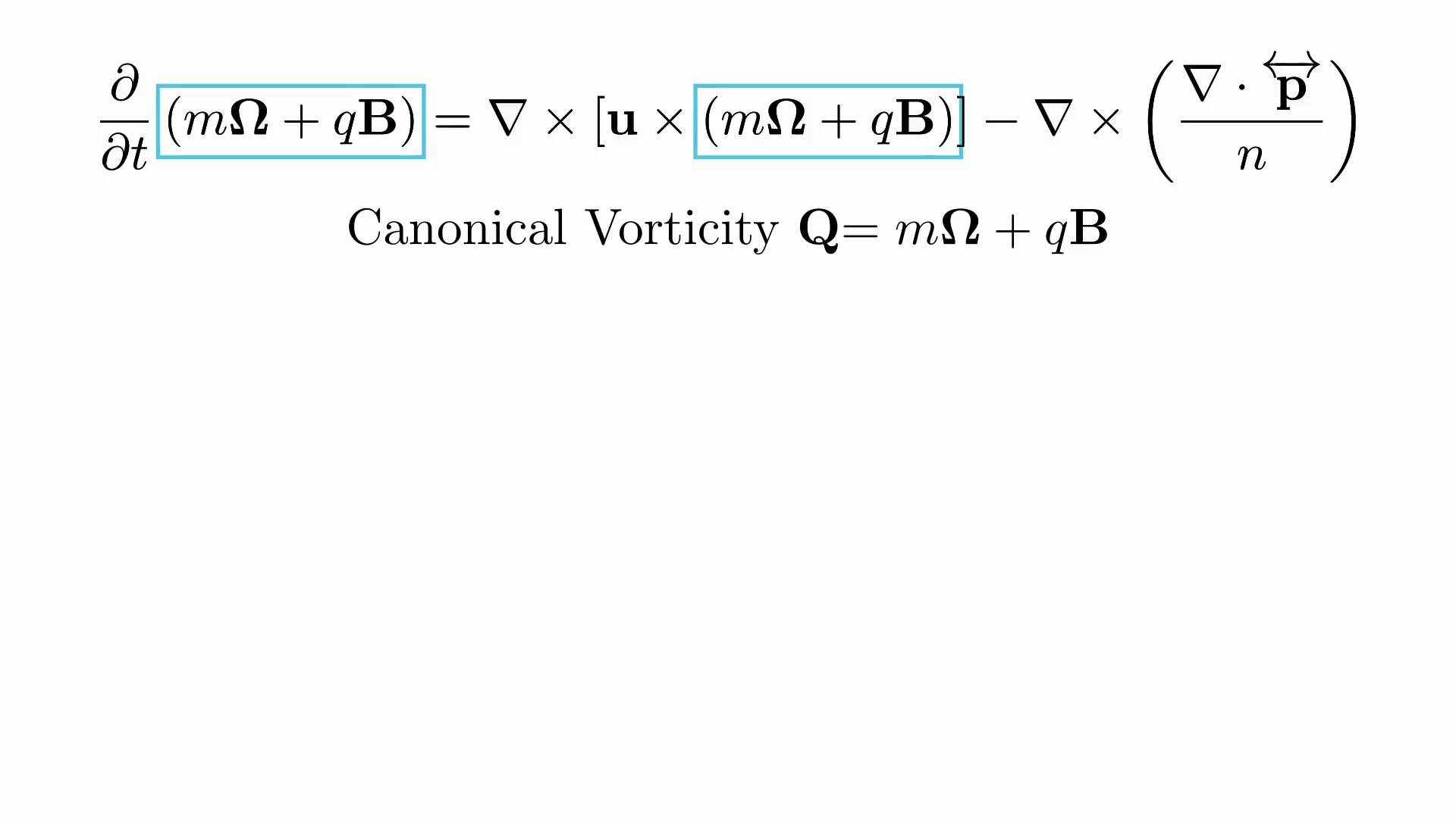

Slide 35
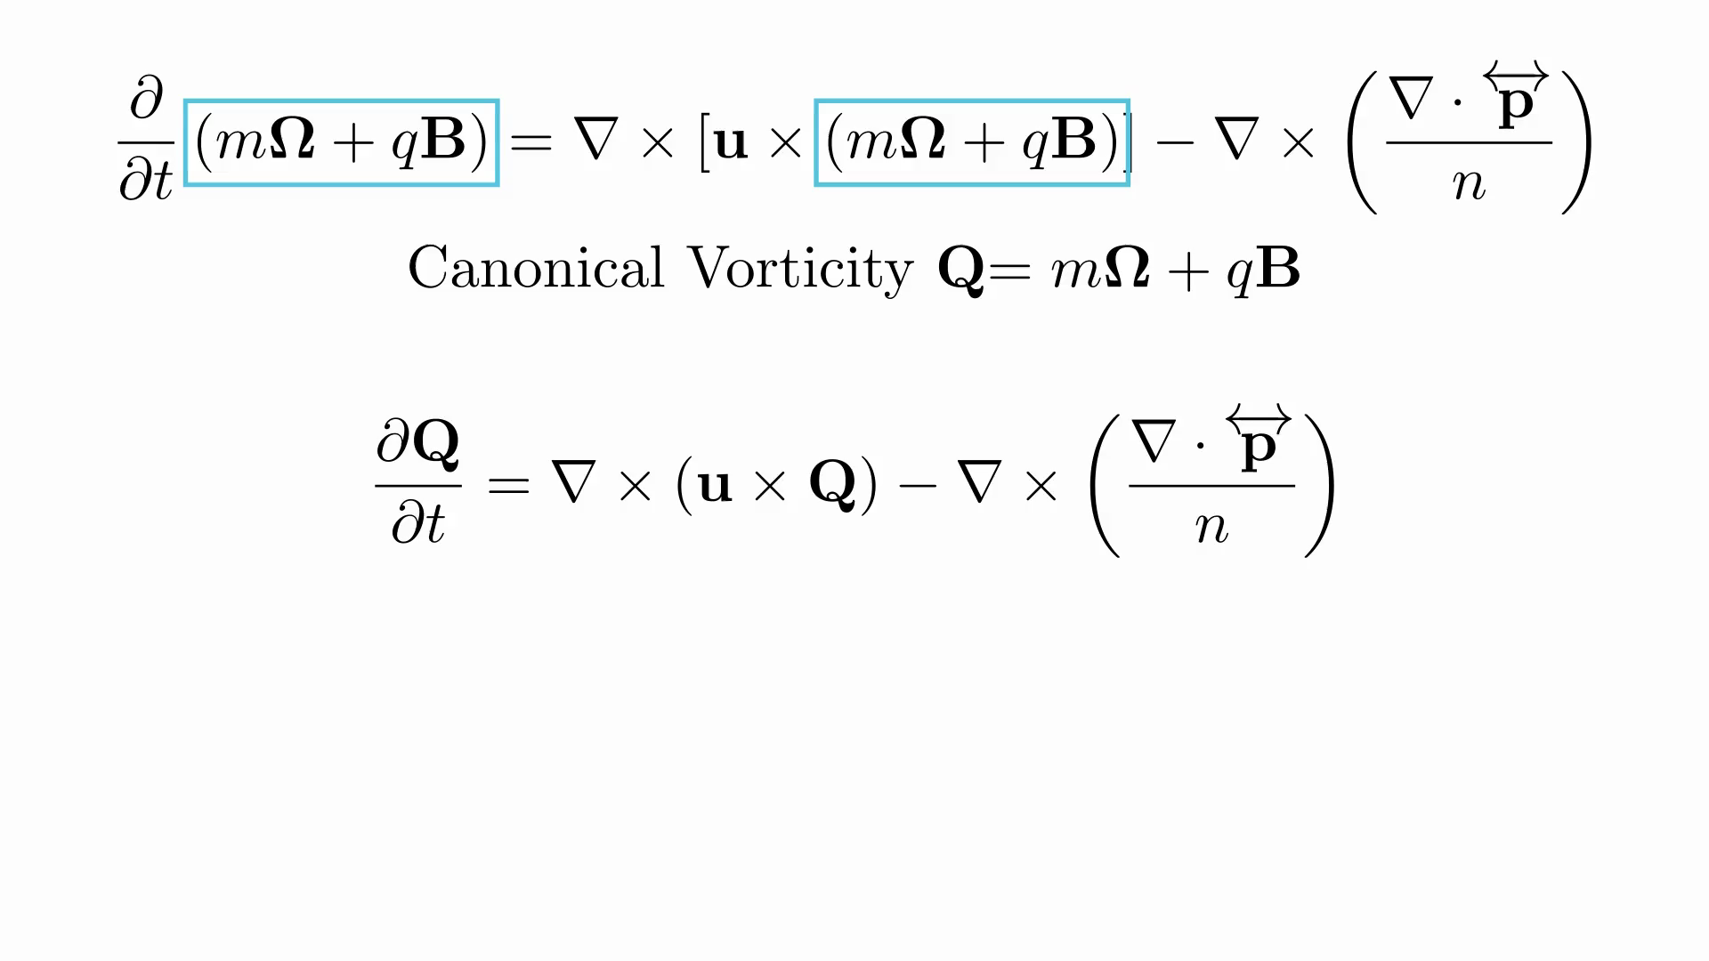

Slide 36


Magnetogenesis
Canonical induction equation
$\frac{∂Q}{∂t}=∇×\left(u×Q\right)−∇×\left(\frac{∇⋅\overset{⃡}{p}}{n}\right)$
$$Q=0$$
Sole term responsible for magnetogenesis!
Vorticity-free
Magnetic-field-free

Slide 37
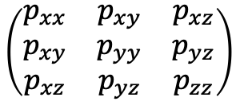
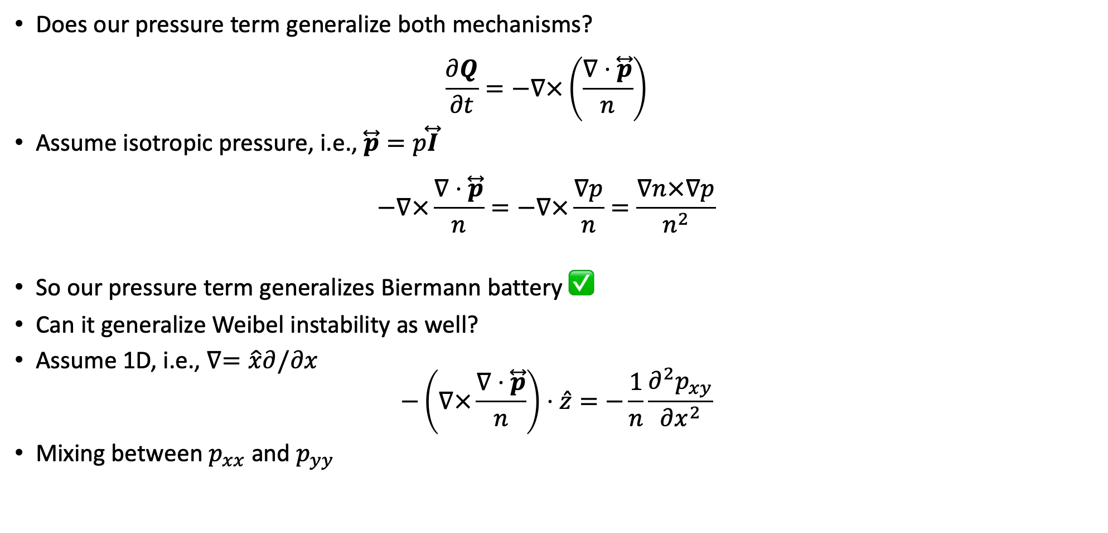
Pressure term
Does our pressure term generalize both mechanisms?
$\frac{∂Q}{∂t}=−∇×\left(\frac{∇⋅\overset{⃡}{p}}{n}\right)$
Assume isotropic pressure, i.e., $\overset{⃡}{p}=p\overset{⃡}{I}$
$−∇×\frac{∇⋅\overset{⃡}{p}}{n}=−∇×\frac{∇p}{n}=\frac{∇n×∇p}{n^{2}}$
So our pressure term generalizes Biermann battery ✅
Can it generalize Weibel instability as well?
Assume 1D, i.e., $∇=\hat{x}∂/∂x$
$−\left(∇×\frac{∇⋅\overset{⃡}{p}}{n}\right)⋅\hat{z}=−\frac{1}{n}\frac{∂^{2}p_{xy}}{∂x^{2}}$
Mixing between $p_{xx}$ and $p_{yy}$
Biermann Battery!
Diagonal
Off-diagonal
$$\left(\begin{matrix}p_{xx} & p_{xy} & p_{xz} \\ p_{xy} & p_{yy} & p_{yz} \\ p_{xz} & p_{yz} & p_{zz}\end{matrix}\right)$$

Slide 38
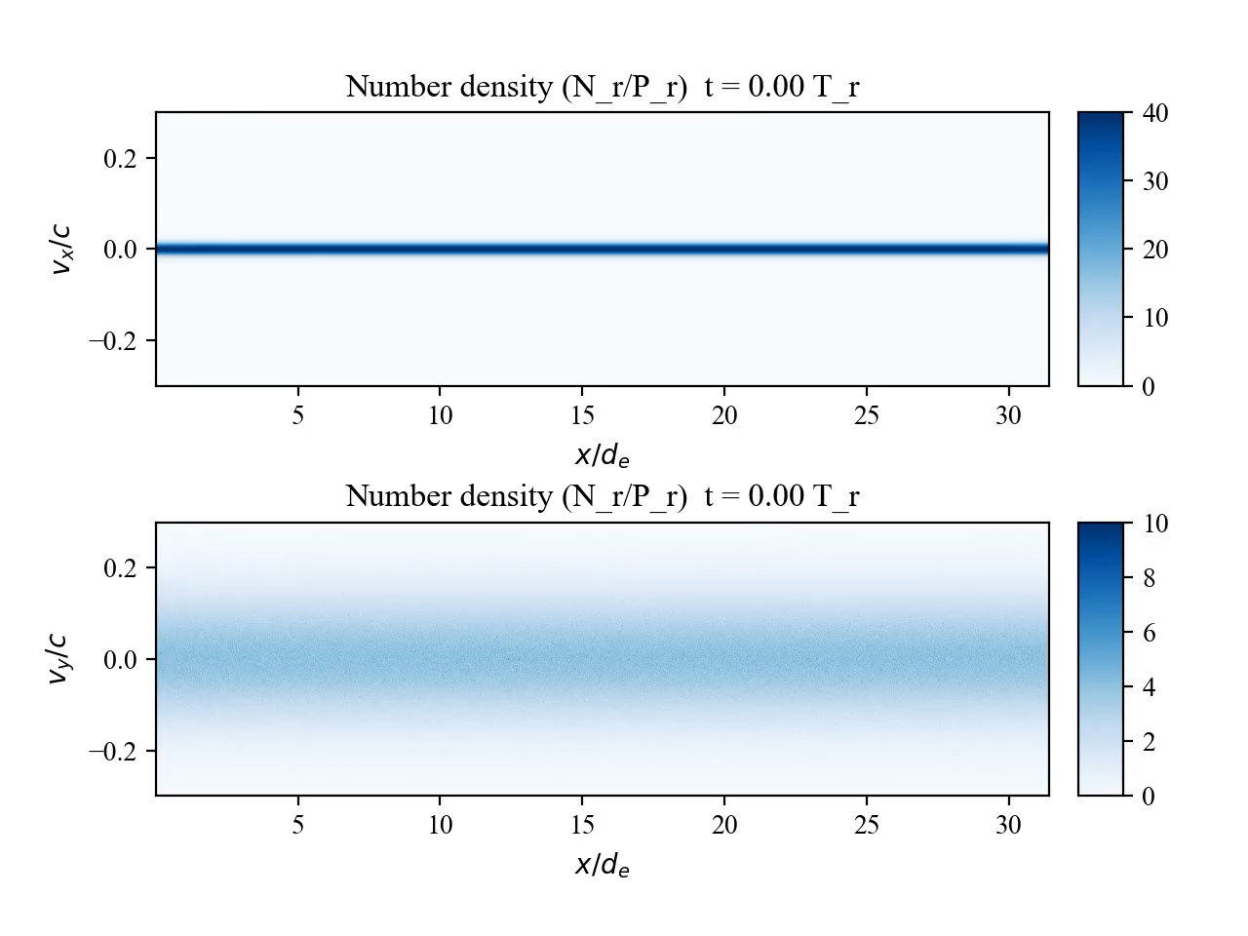

Weibel Instability
Particle-in-cell simulations of the Weibel instability
Initially, $p_{yy}≫p_{xx}$

Slide 39
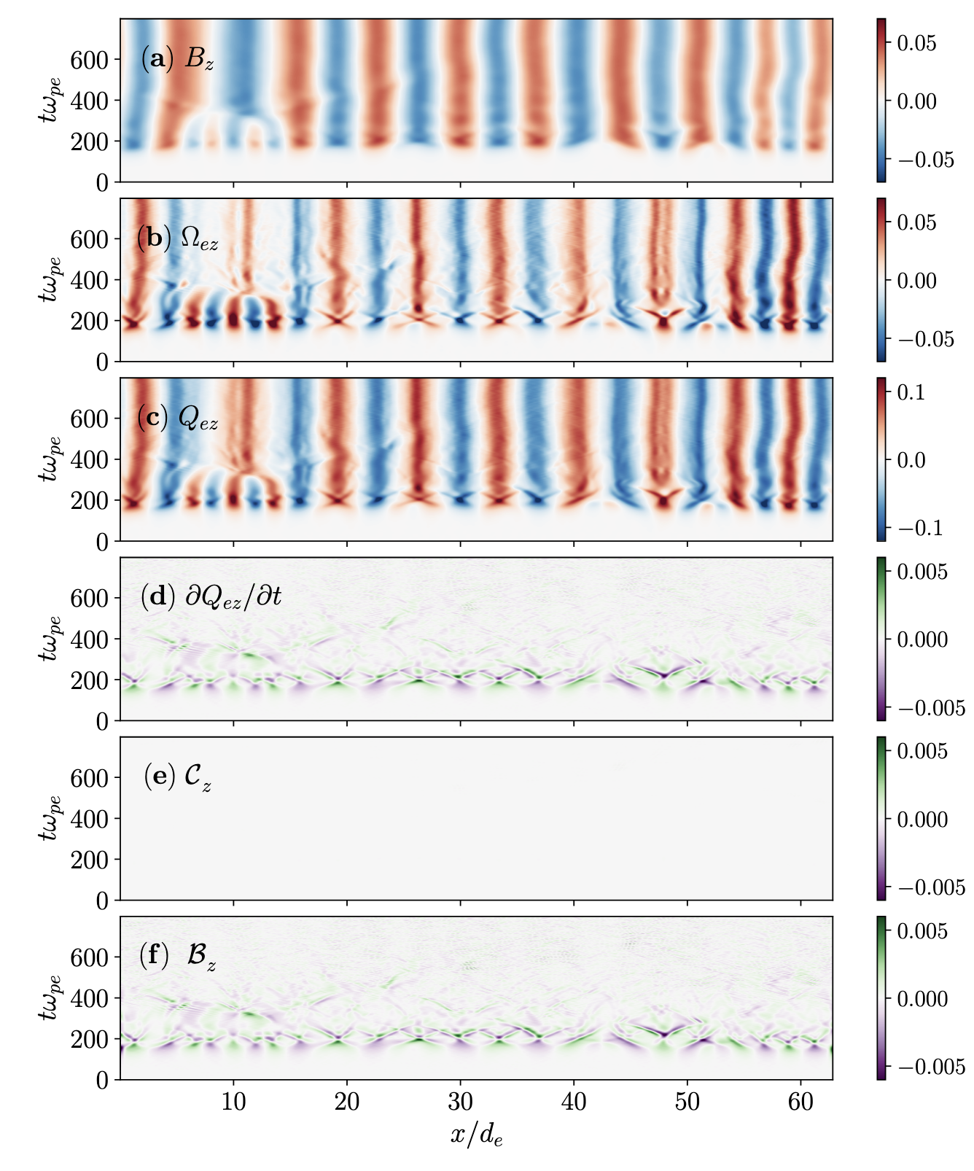
Weibel Instability

Slide 40
Weibel Instability

Slide 41
Weibel Instability

Slide 42
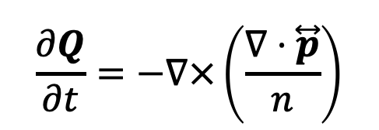
Weibel Instability
$$\frac{∂Q}{∂t}=−∇×\left(\frac{∇⋅\overset{⃡}{p}}{n}\right)$$
Canonical battery is entirely responsible for magnetogenesis

Slide 43
Weibel Instability
Competition of the terms (RMS)

Slide 44
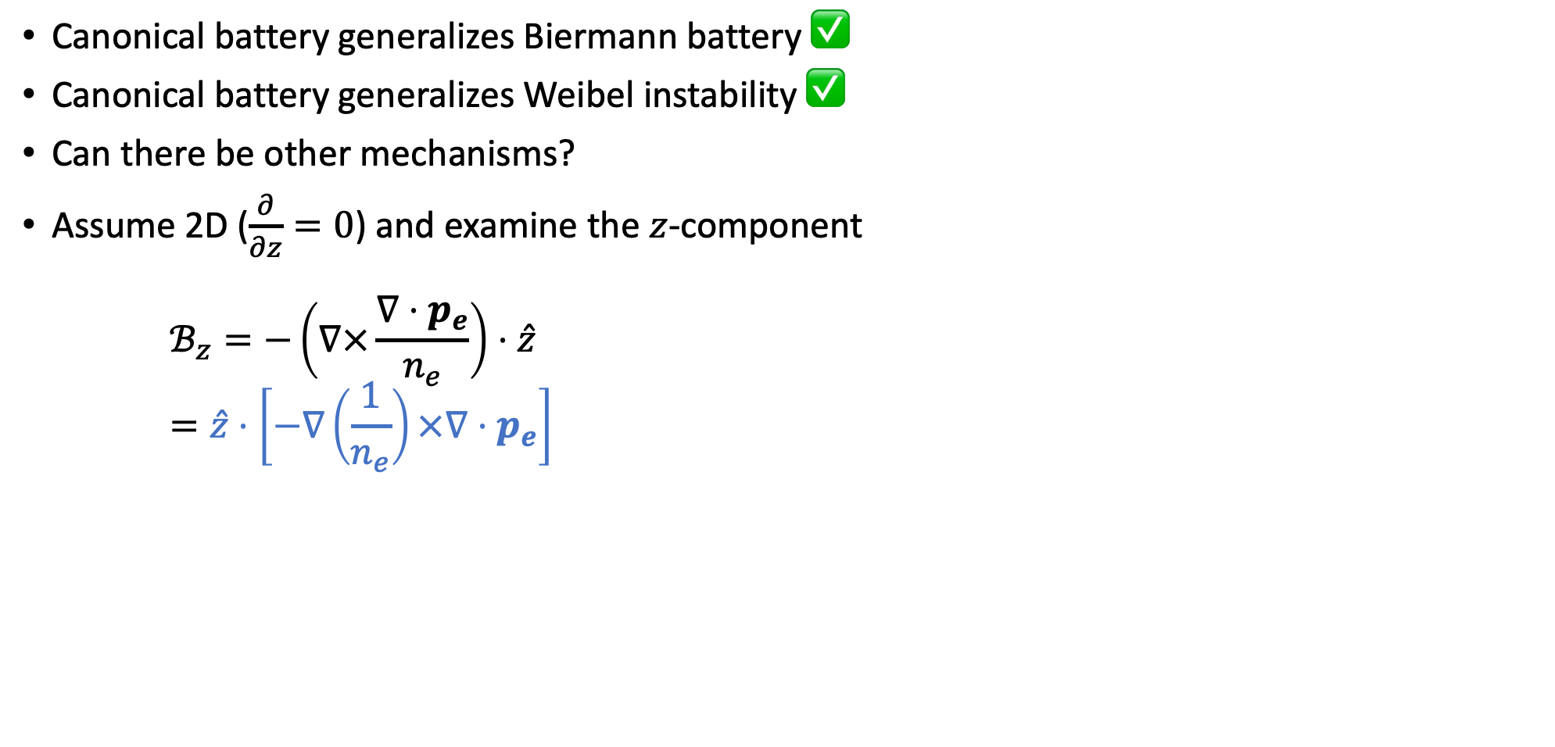
New Mechanisms?
Canonical battery generalizes Biermann battery ✅
Canonical battery generalizes Weibel instability ✅
Can there be other mechanisms?
Assume 2D ($\frac{∂}{∂z}=0$) and examine the $z$-component
$ℬ_{z}=−\left(∇×\frac{∇⋅p_{e}}{n_{e}}\right)⋅\hat{z}=\hat{z}⋅\left[−∇\left(\frac{1}{n_{e}}\right)×∇⋅p_{e}\right]$
Biermann-like term

Slide 45
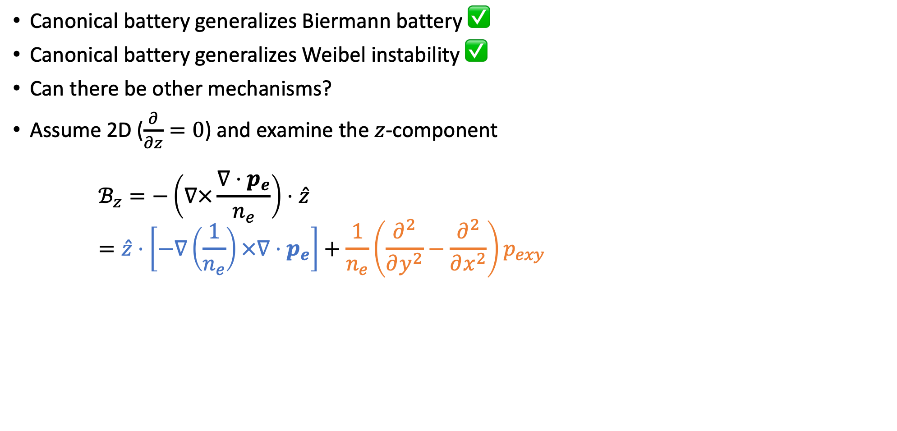
New Mechanisms?
Canonical battery generalizes Biermann battery ✅
Canonical battery generalizes Weibel instability ✅
Can there be other mechanisms?
Assume 2D ($\frac{∂}{∂z}=0$) and examine the $z$-component
$ℬ_{z}=−\left(∇×\frac{∇⋅p_{e}}{n_{e}}\right)⋅\hat{z}=\hat{z}⋅\left[−∇\left(\frac{1}{n_{e}}\right)×∇⋅p_{e}\right]+\frac{1}{n_{e}}\left(\frac{∂^{2}}{∂y^{2}}−\frac{∂^{2}}{∂x^{2}}\right)p_{exy}$
Biermann-like term
Weibel term

Slide 46
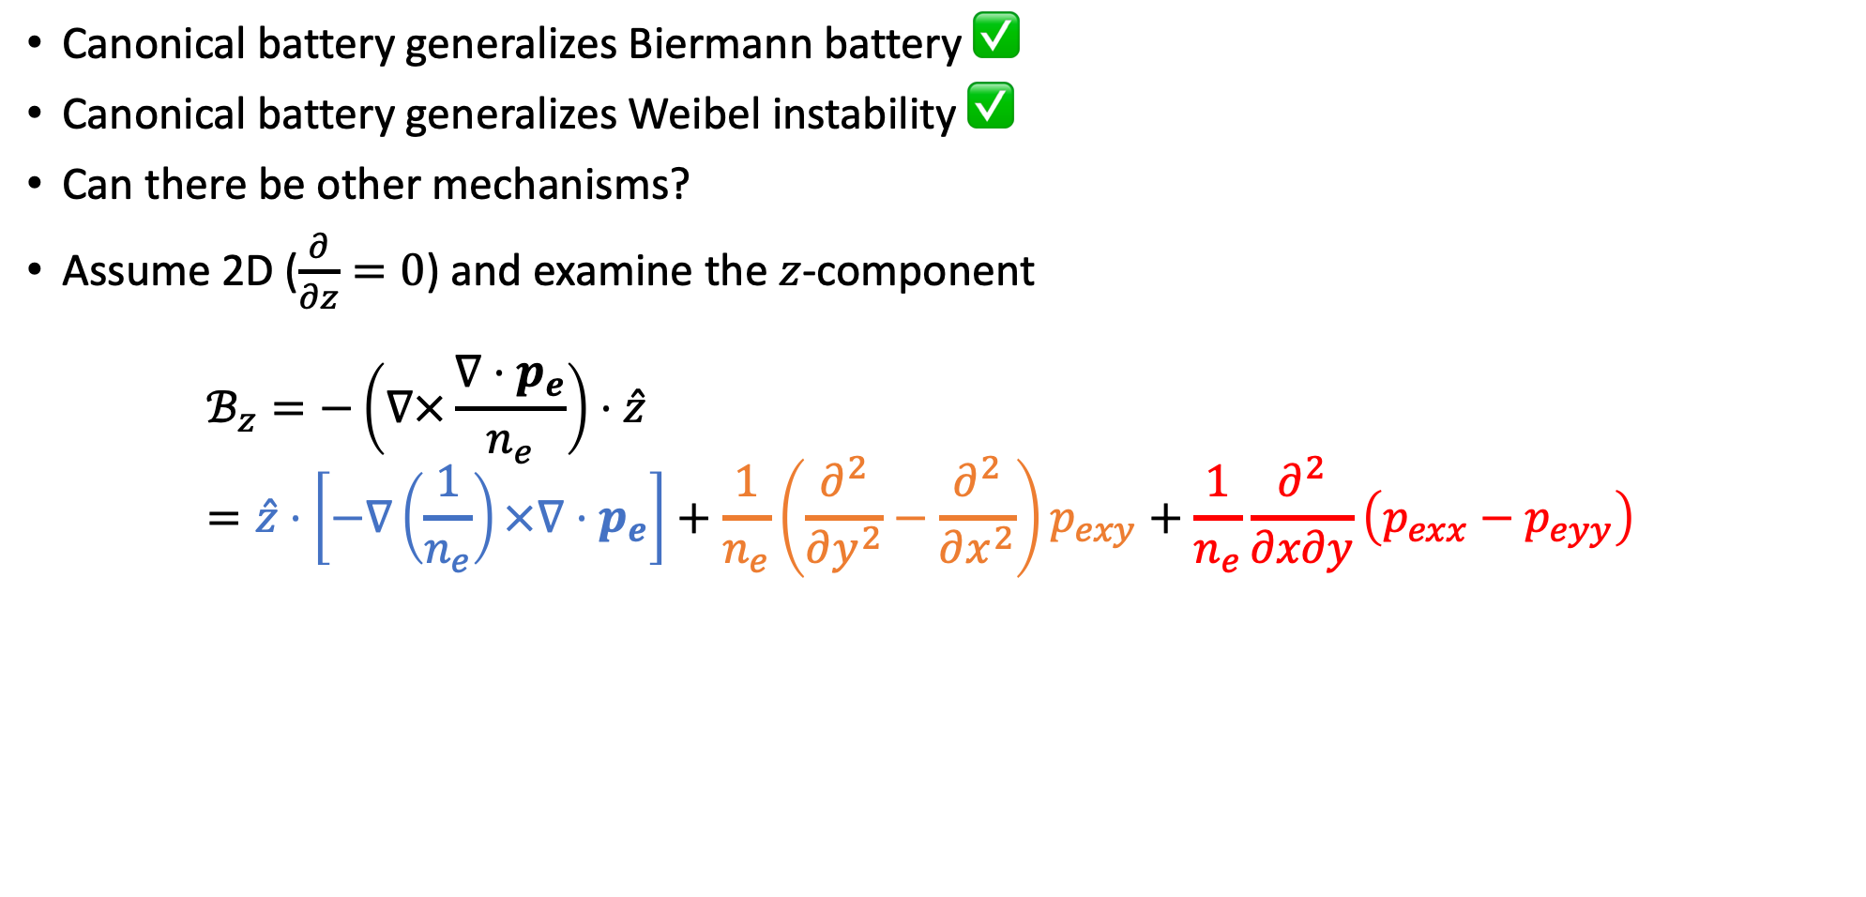
New Mechanisms?
Canonical battery generalizes Biermann battery ✅
Canonical battery generalizes Weibel instability ✅
Can there be other mechanisms?
Assume 2D ($\frac{∂}{∂z}=0$) and examine the $z$-component
$ℬ_{z}=−\left(∇×\frac{∇⋅p_{e}}{n_{e}}\right)⋅\hat{z}=\hat{z}⋅\left[−∇\left(\frac{1}{n_{e}}\right)×∇⋅p_{e}\right]+\frac{1}{n_{e}}\left(\frac{∂^{2}}{∂y^{2}}−\frac{∂^{2}}{∂x^{2}}\right)p_{exy}+\frac{1}{n_{e}}\frac{∂^{2}}{∂x∂y}\left(p_{exx}−p_{eyy}\right)$
Biermann-like term
Weibel term
New term (2D-localized pressure anisotropy)

Slide 47

2D-localized Pressure Anisotropy
Last term
$ℬ_{z}=\frac{1}{n_{e}}\frac{∂^{2}}{∂x∂y}\left(p_{exx}−p_{eyy}\right)$
Assume
$p_{exx}−p_{eyy}∼\exp\left(−\frac{x^{2}+y^{2}}{σ^{2}}\right)$
Then
$ℬ_{z}∼xy$
Quadrupole magnetic fields expected

Slide 48
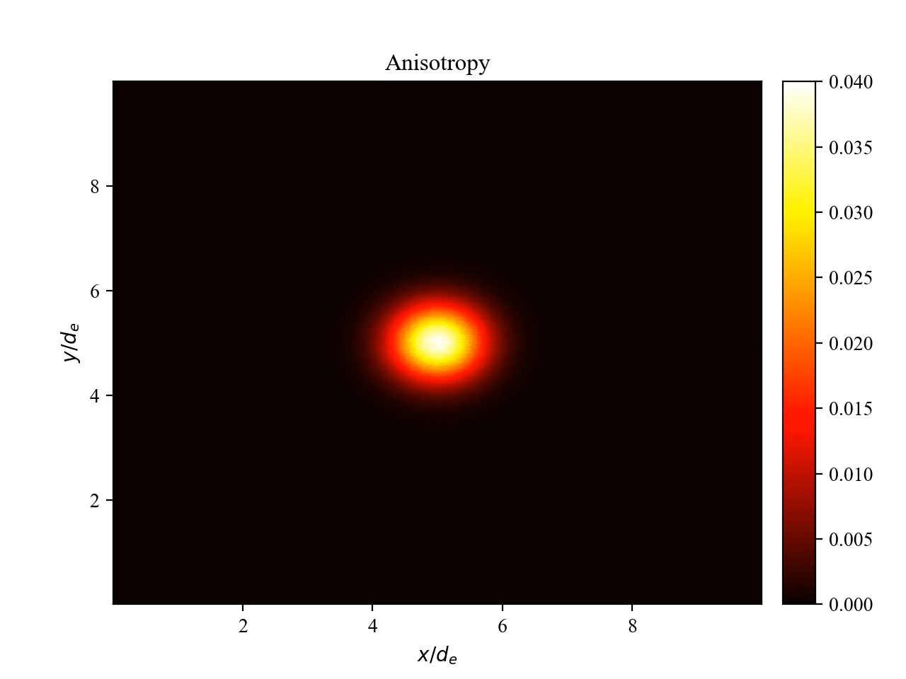

2D-localized Pressure Anisotropy
Again, verify with particle-in-cell simulations

Slide 49

2D-localized Pressure Anisotropy
Again, canonical battery term is confirmed to be the source!

Slide 50

2D-localized Pressure Anisotropy
Different spectrum from the Weibel instability
Weibel Instability
2D-localized Pressure Anistropy

Slide 51




Usage of the battery term
Usage 1: Relative Importance among mechanisms
Biermann
Weibel
$\frac{L}{d_{e}}<100$ : Biermann
Typically, $T_{diag}≫T_{off}$, so Weibel is important for $L≫d_{e}$
$\frac{L}{d_{e}}>100$ : Weibel
[Schoeffler+, PRL (2014)]

Slide 52

Usage of the battery term
Usage 2: Predict other mechanisms
  Localized density and pressure anisotropy
  $ℬ_{z}∼\left(\frac{∂}{∂y}\frac{1}{n_{e}}\right)\left(\frac{∂p_{exx}}{∂x}\right)$
  Localized density and uniform temperature anisotropy
  $ℬ_{z}∼T_{exx}\left(\frac{∂}{∂y}\frac{1}{n_{e}}\right)\left(\frac{∂n_{e}}{∂x}\right)$

Slide 53



Relativistic Battery
In the relativistic regime, the canonical induction equation includes a term purely due to relativity
$\frac{∂Q}{∂t}=∇×\left(u×Q\right)−∇×\left(\frac{∇⋅\overset{⃡}{p}}{n}\right)+\sum_{i=x,y,z}{\left[p_{i},u_{i}\right]}$
For a single-particle, velocity and momentum commute
$p=p\left(v\right)=\frac{v}{\sqrt{1−v^{2}/c^{2}}}$
For a relativistic fluid, this is not generally the case
$\left\langle p\right\rangle ∝\int{pfd^{3}p}$
$u∝\int{\frac{p}{γ}fd^{3}p}=\int{\frac{p}{\sqrt{1+p^{2}}}fd^{3}p}$
or $ε_{ijk}∂_{i}p_{l}∂_{j}u_{l}$ or $∇p_{l}×∇u_{l}$
[Laishram and Yoon, in prep.]

Slide 54

Other Batteries
Other non-ideal effects give rise to other terms
$\frac{∂Q}{∂t}=∇×\left(u×Q\right)−∇×\left(\frac{∇⋅\overset{⃡}{p}}{n}\right)+\hat{z}\sum_{i=x,y}{\left[u_{i},p_{i}\right]}+ν\left(Ω−Ω_{σ}\right)+QM+Rad$
Inter-species collisions
QED effects
Radiative effects
Relativity

Slide 55
Summary
The pressure tensor in the plasma equation of motion turns into the canonical battery term
This term is solely responsible for spontaneously generating canonical vorticity, which is a proxy for the magnetic field
This term generalizes popular magnetogenesis mechanisms and predicts new ones
Other effects may provide additional sources

Slide 56

Weibel Instability
$$\frac{∂Q}{∂t}=−∇×\left(\frac{∇⋅\overset{⃡}{p}}{n}\right)$$
Pressure term is entirely responsible for Weibel instability ✅
The canonical induction equation generalizes both 70-year-old magnetogenesis mechanisms
(and predicts new ones)
[Laishram, Yun, Yoon, Phys. Rev. Res. (2024)]

