Slide 1
Dual holography from a non-perturbative generalization of the Wilsonian RG framework
Ki-Seok Kim
POSTECH

Slide 2
What am I doing?
Nonperturbative generalization of the Wilsonian RG theoretical framework : Given an exact functional renormalization group differential equation, I reformulate its solution in a path integral representation.

Slide 3
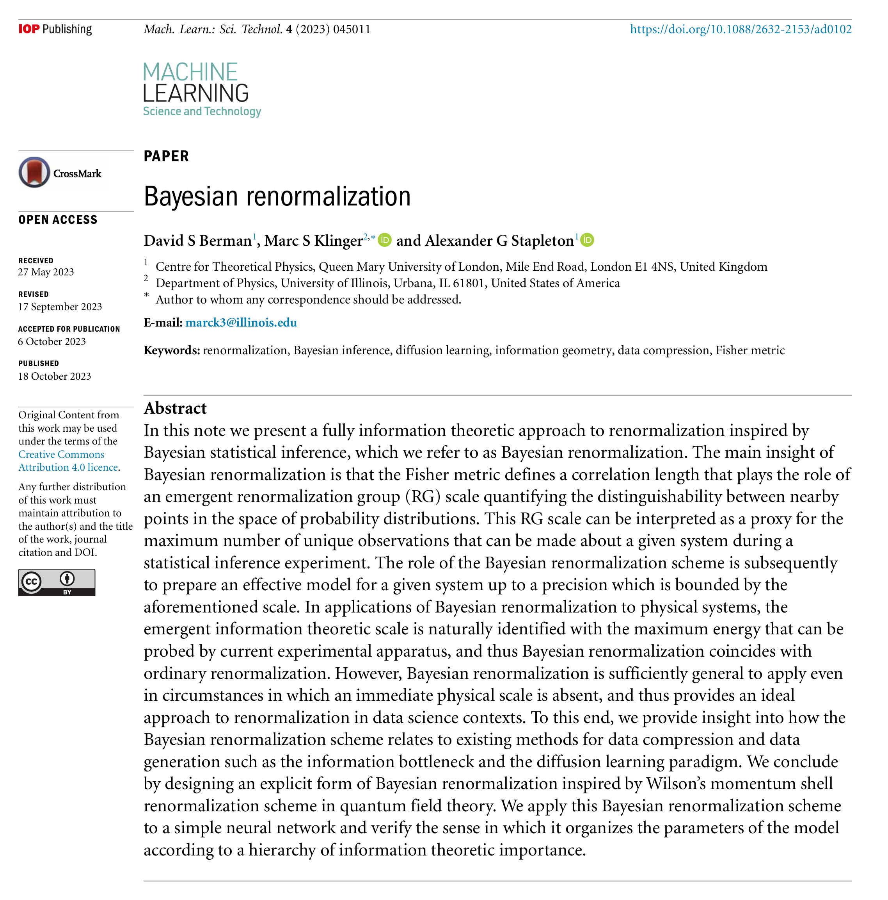
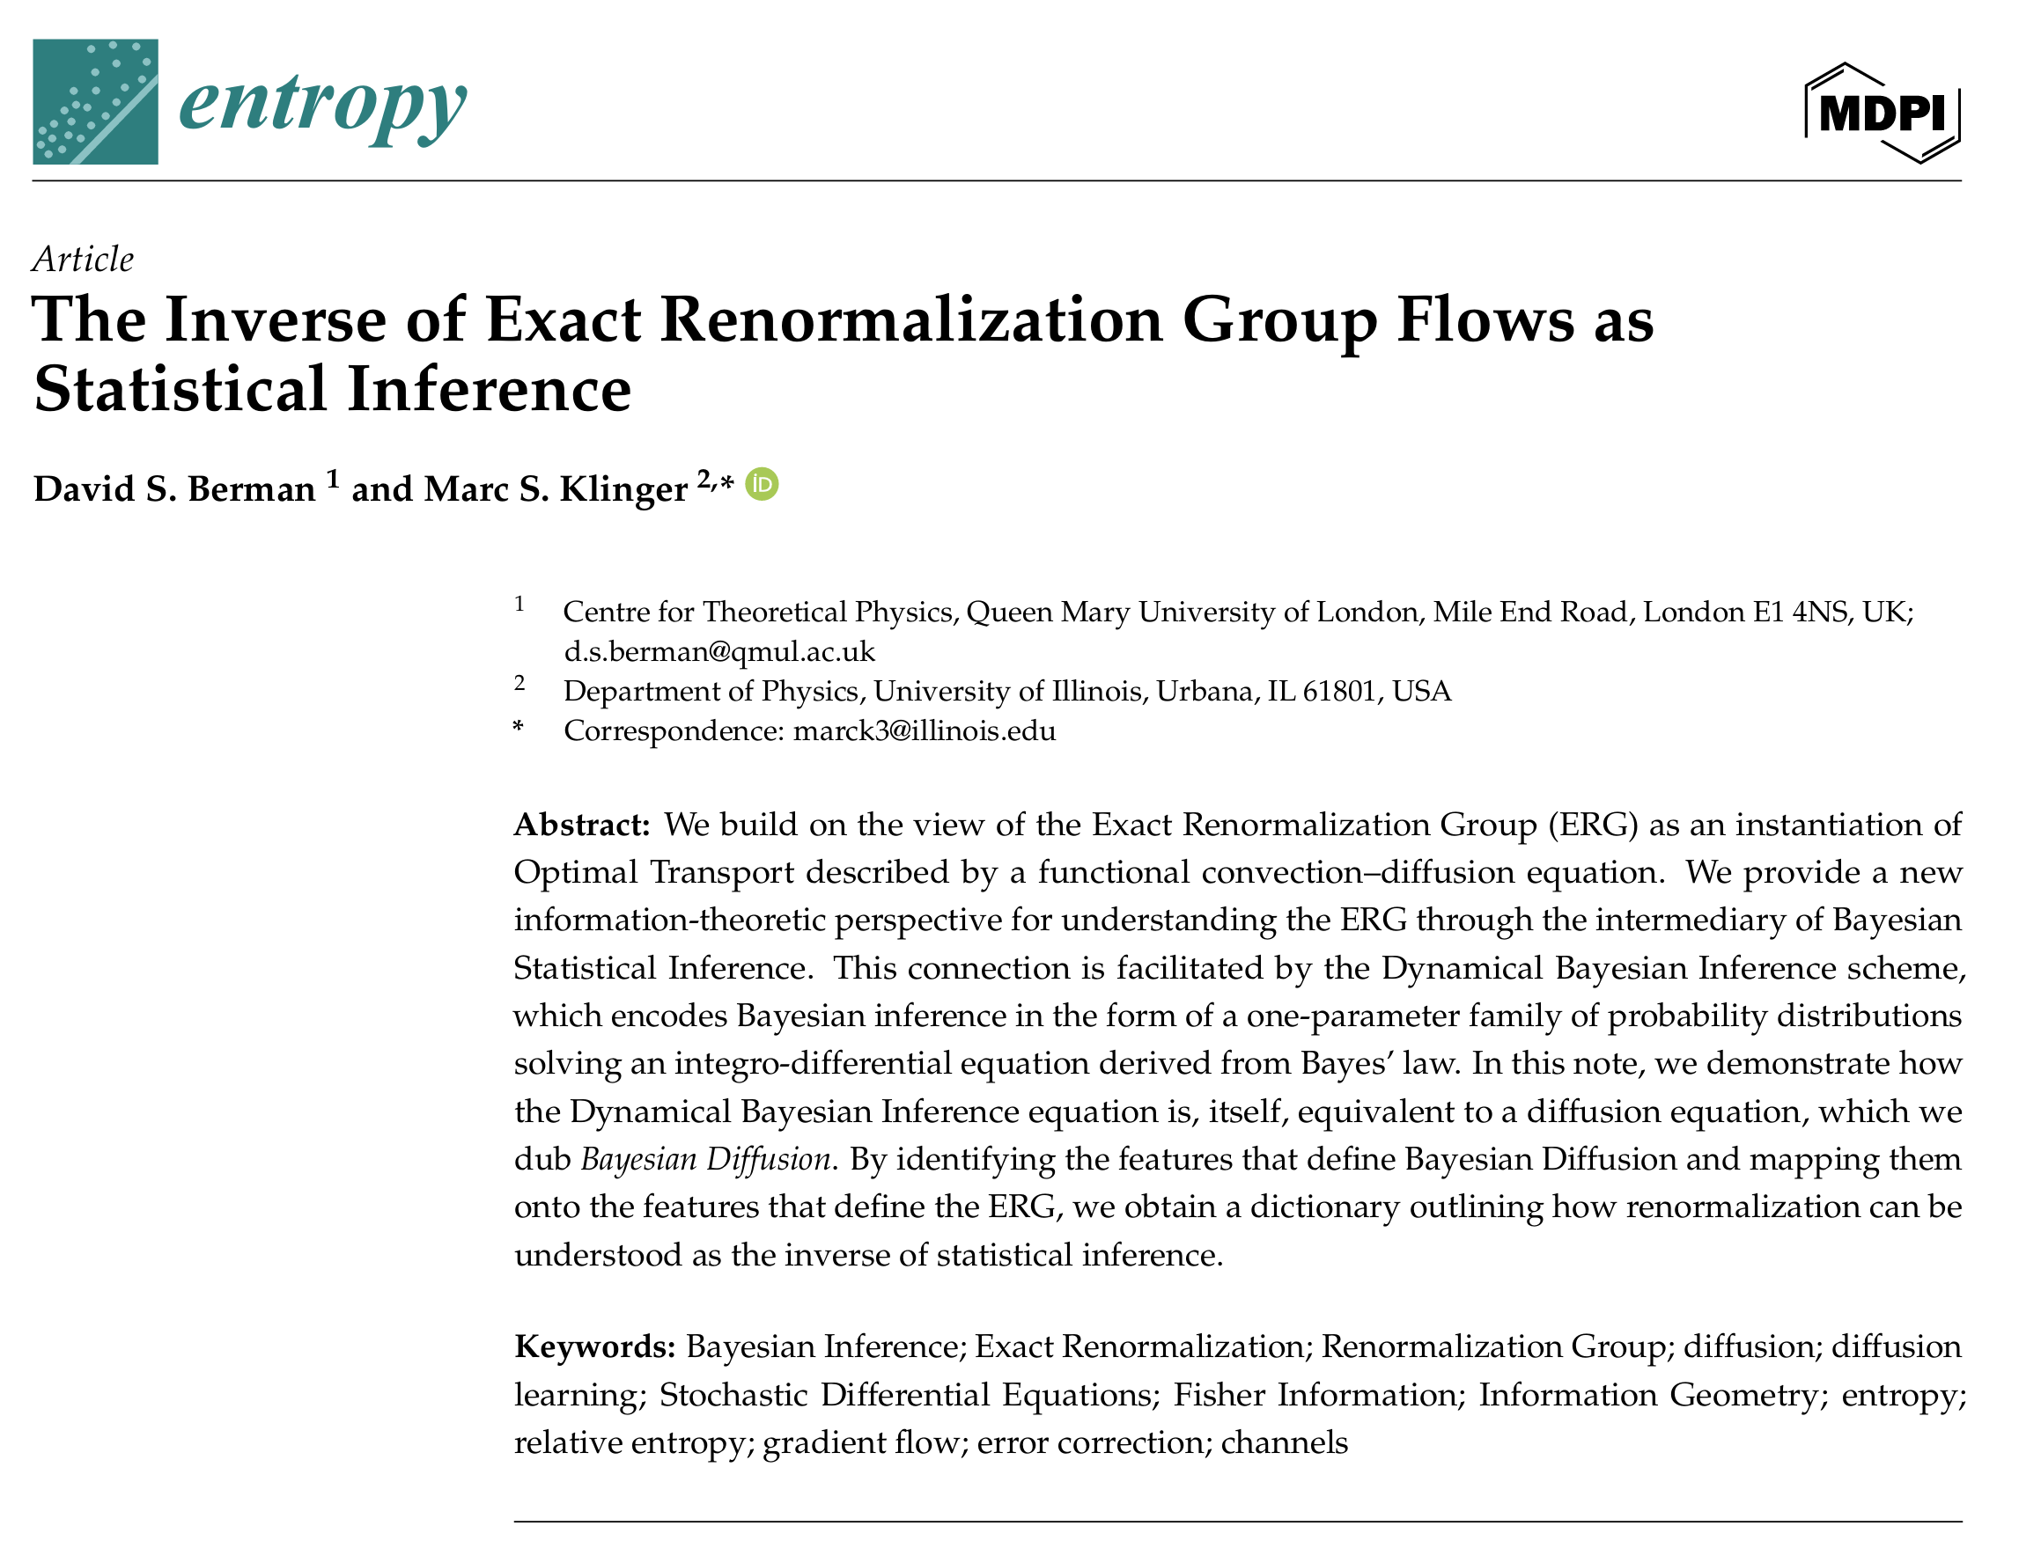

Slide 4
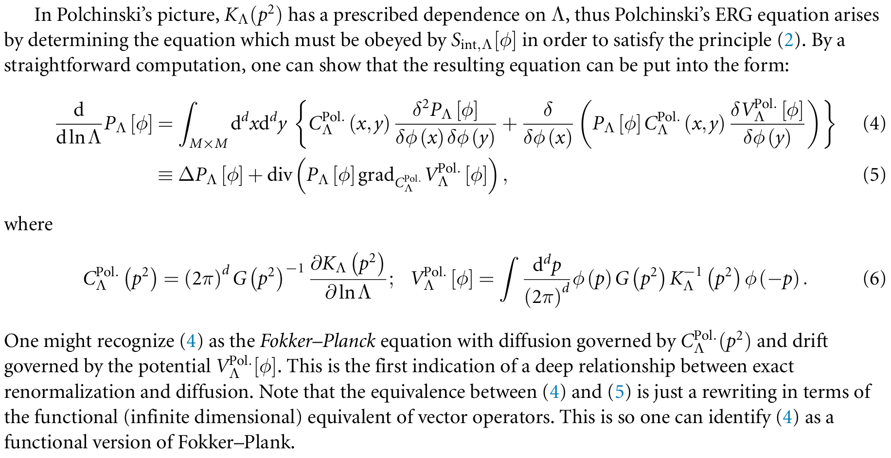
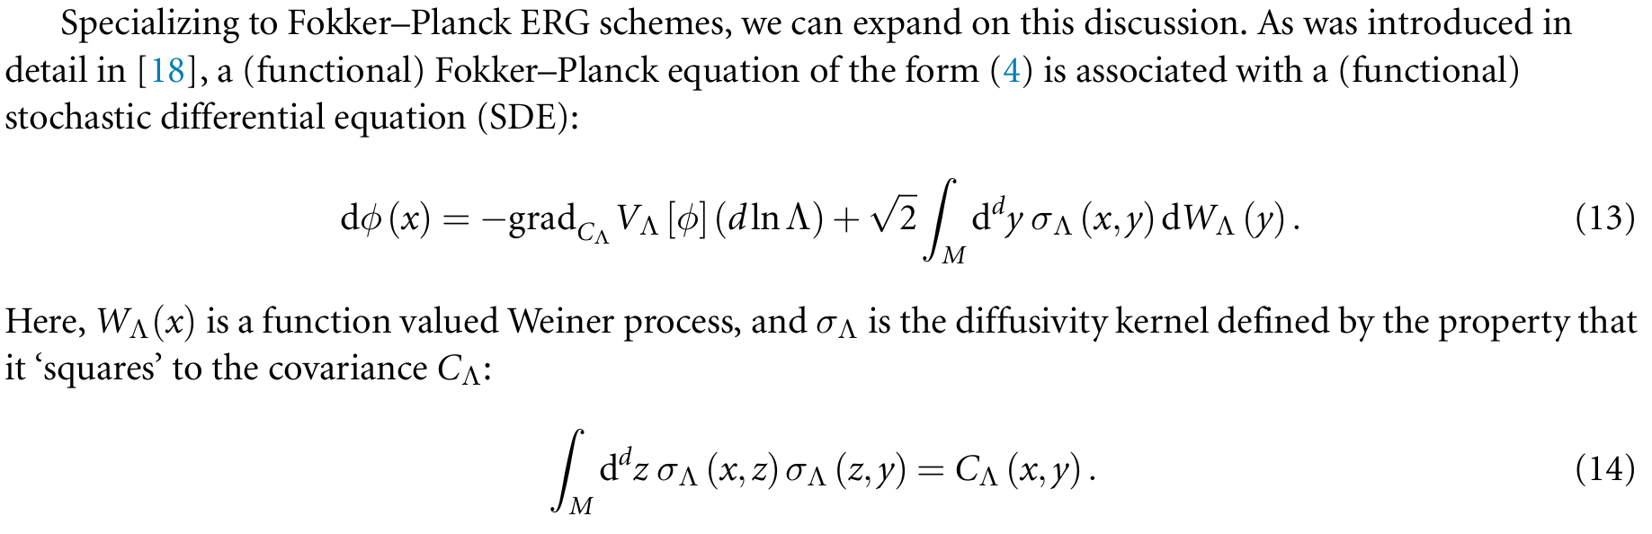


$$Functional Schrodinger equation$$
$$Heisenberg operator equation$$

Slide 5
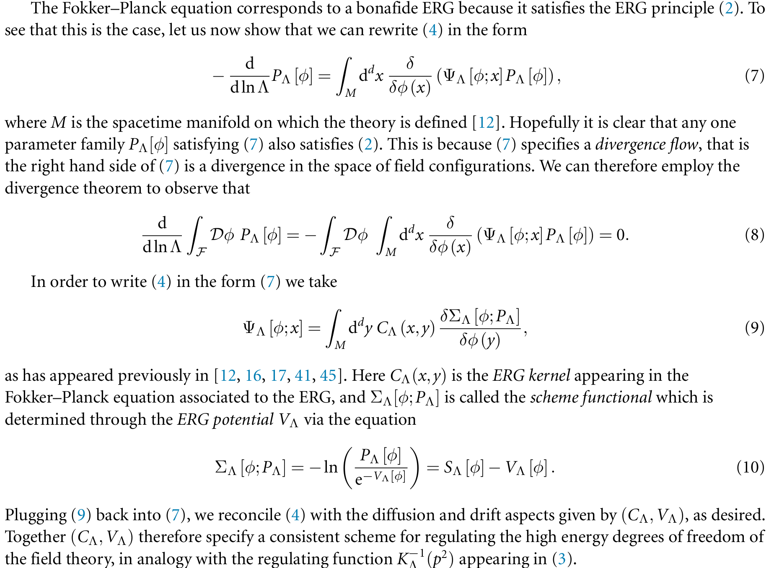
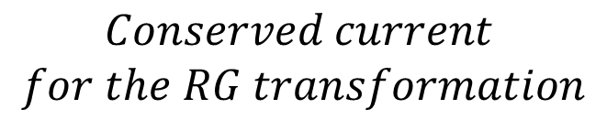
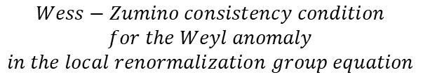

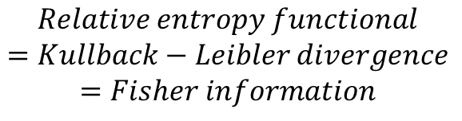
Conservation law
$$Conserved current$$
$$for the RG transformation$$
$$Gradient flow$$
$$Wess−Zumino consistency condition$$
$$for the Weyl anomaly$$
$$in the local renormalization group equation$$
$$Relative entropy functional$$
$$=Kullback−Leibler divergence$$
$$=Fisher information$$

Slide 6
The path integral formulation of the functional RG equation gives rise to a non-perturbative theoretical framework, which can be identified with emergent dual holography.
The fundamental property of the RG flow is governed by unitarity & KMS (Kubo-Martin-Schwinger) symmetry, which can be translated into N = 2 BRST symmetries. In other words, the Ward identities from these symmetries allow us to introduce a “c-function” or “relative entropy”, which shows monotonicity.
This mathematical structure guarantees consistency of the path integral formulation, which can be reformulated into the Wess-Zumino consistency condition for the Weyl anomaly in the local RG equation (Hamilton-Jacobi equation for the renormalized on-shell action in the dual holography).
We discuss this aspect based on the monotonicity of the RG flow (c theorem in 2d & a theorem in 4d) in the nonequilibrium thermodynamics perspectives, i.e., the Fokker-Planck form of the FRG equation.

Slide 7
Weyl anomaly inflow from the bulk and anomaly cancellation in the quantum effective action: A necessary consistency condition for the RG-based emergent dual holography

Slide 8
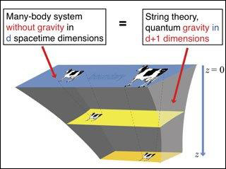
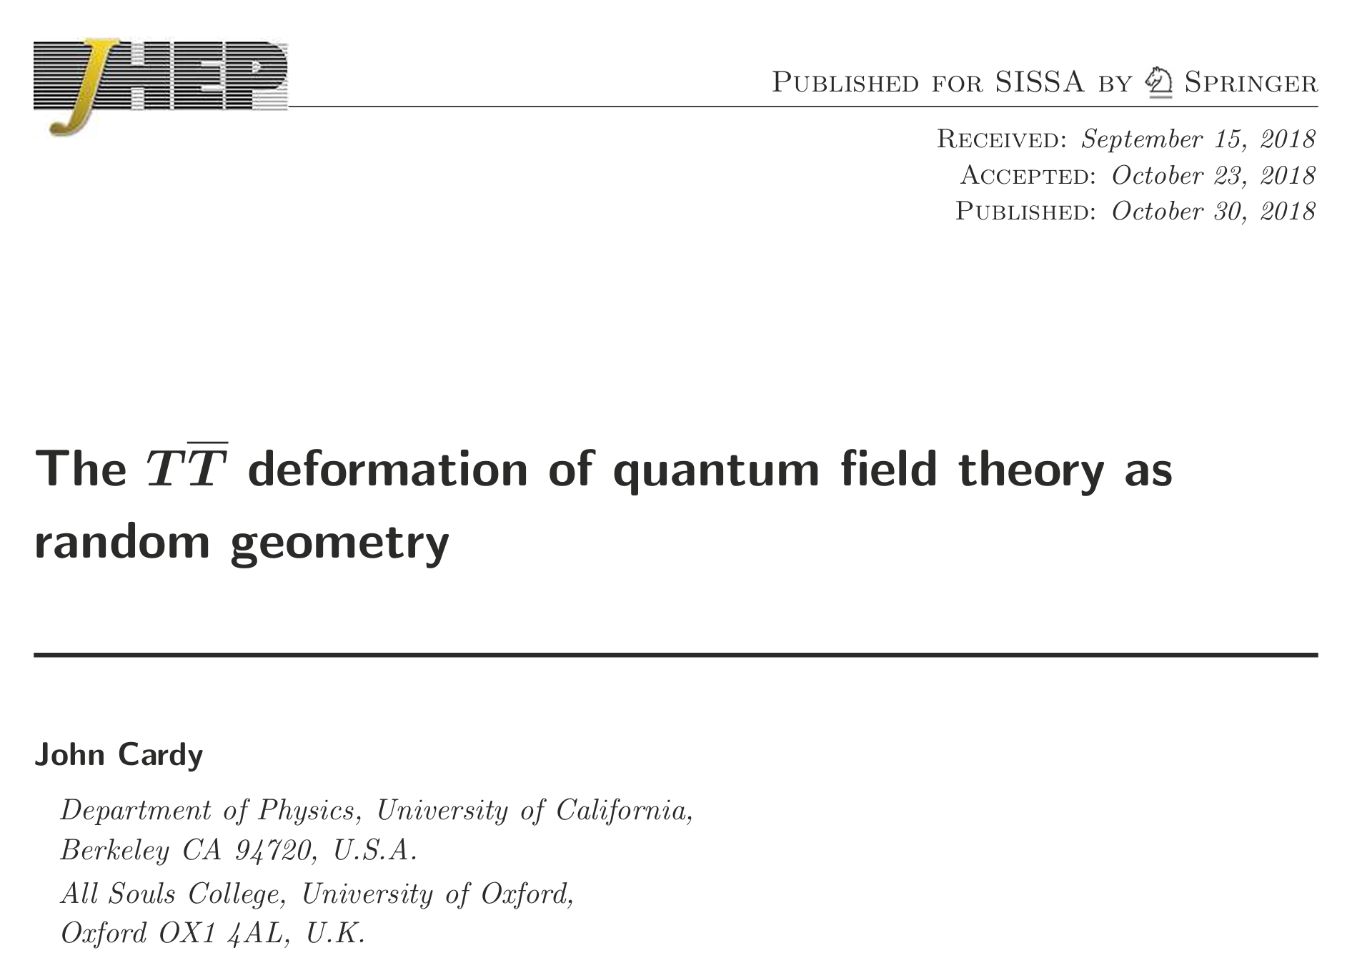
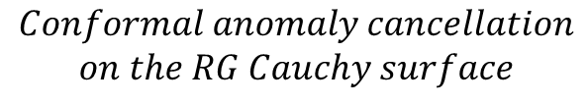

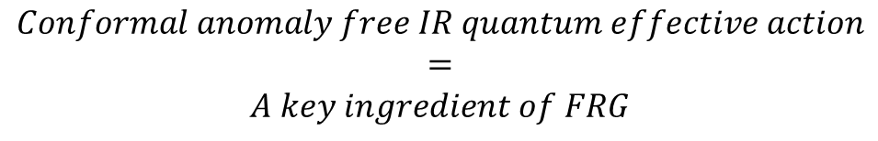
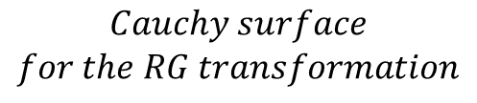
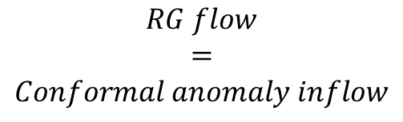

RG-based
emergent dual holography
=
RG Cauchy surface holography
$$UV$$
$$RG flow$$
$$=$$
$$Conformal anomaly inflow$$
$$IR$$
$$Conformal anomaly cancellation$$
$$on the RG Cauchy surface$$
$$Cauchy surface$$
$$for the RG transformation$$
$$Conformal anomaly free IR quantum effective action$$
$$=$$
$$A key ingredient of FRG$$
https://ocw.mit.edu/courses/8-821-string-theory-and-holographic-duality-fall-2014/

Slide 9
Brute force derivation

Slide 10

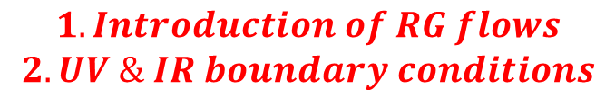
$$φ↔φ_{α}^{2} \& { g}_{μν}↔T^{μν}$$
$$1. Introduction of RG flows$$
$$2. UV \& IR boundary conditions$$

Slide 11


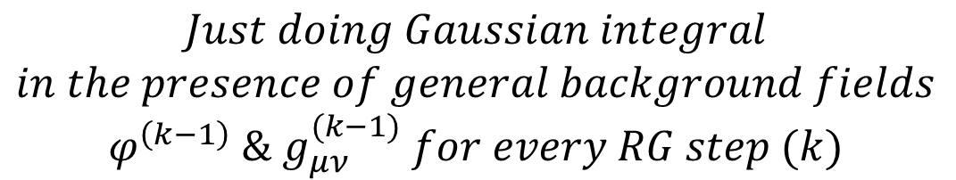
$$φ→φ^{(0)}+δφ, g_{μν}→g_{μν}^{(0)}+δg_{μν}, φ_{α}→φ_{α}+δφ_{α}$$
$$∫Dδφ→φ_{α}^{2}φ_{β}^{2}→φ^{\left(1\right)}, ∫Dδg_{μν}→T_{μν}^{2}→g_{μν}^{\left(1\right)}, ∫Dδφ_{α}→V_{eff}[φ^{\left(0\right)},g_{μν}^{(0)}]$$
$$Heat kernel calculation$$
$$φ^{(1)}→φ^{(1)}+δφ, g_{μν}^{(1)}→g_{μν}^{(1)}+δg_{μν}, φ_{α}→φ_{α}+δφ_{α}$$
$$∫Dδφ→φ_{α}^{2}φ_{β}^{2}→φ^{\left(2\right)}, ∫Dδg_{μν}→T_{μν}^{2}→g_{μν}^{\left(2\right)}, ∫Dδφ_{α}→V_{eff}[φ^{\left(1\right)},g_{μν}^{(1)}]$$
$$Heat kernel calculation$$
$$Just doing Gaussian integral$$
$$in the presence of general background fields$$
$$φ^{\left(k−1\right)} \& g_{μν}^{(k−1)} for every RG step (k)$$

Slide 12

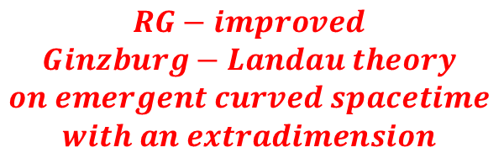
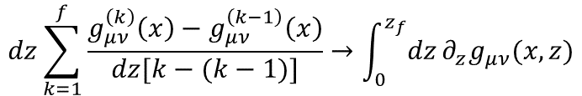
$$φ↔φ_{α}^{2} \& { g}_{μν}↔T^{μν}$$
$$dz\sum_{k=1}^{f}{\frac{g_{μν}^{\left(k\right)}\left(x\right)−g_{μν}^{\left(k−1\right)}\left(x\right)}{dz[k−(k−1)]}}→{\int_{0}^{z_{f}}{dz}∂}_{z}g_{μν}(x,z)$$
$$RG−improved$$
$$Ginzburg−Landau theory$$
$$on emergent curved spacetime$$
$$with an extradimension$$
$$1. Introduction of RG flows$$
$$2. UV \& IR boundary conditions$$

Slide 13
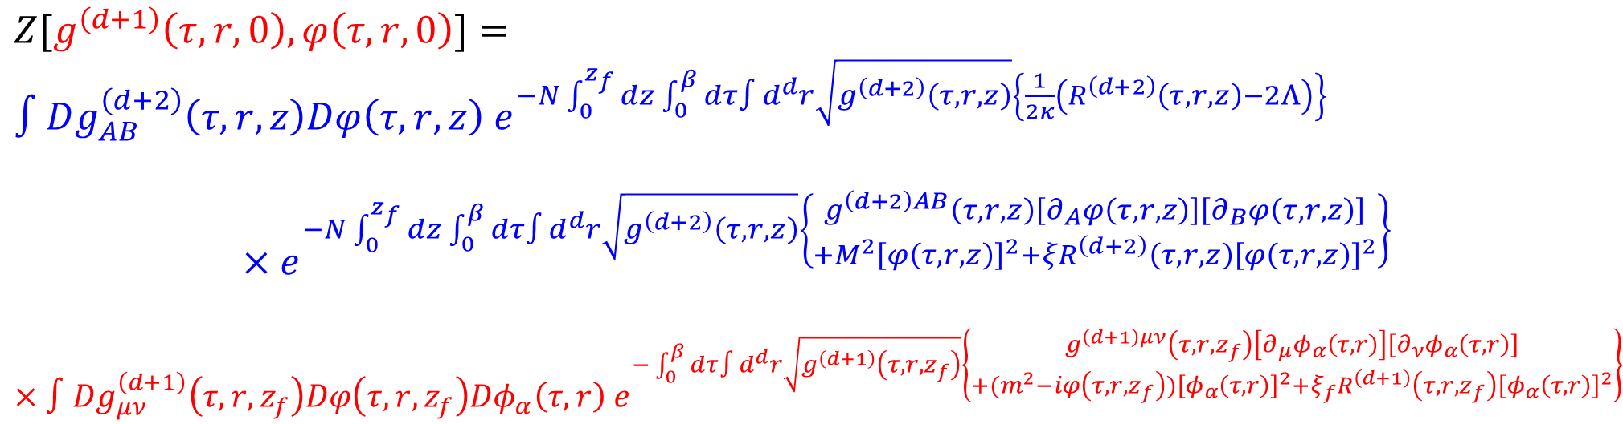

$$Z=∫Dφ_{α}\left(τ,r\right)e^{−\int_{0}^{β}{dτ}∫d^{d}r\left\{φ_{α}\left(τ,r\right)\left(−∂_{τ}^{2}−v^{2}∂^{2}+m^{2}\right)φ_{α}\left(τ,r\right)+\frac{u}{2N}{\left[φ_{α}\left(τ,r\right)\right]}^{2}{\left[φ_{β}\left(τ,r\right)\right]}^{2}\right\}}$$
$$After the RG transformation$$
$$Z=∫Dφ_{α}\left(τ,r\right)e^{−\int_{0}^{β}{dτ}∫d^{d}r\left\{φ_{α}\left(τ,r\right)\left(−{Z_{φ}∂}_{τ}^{2}−{Z_{v^{2}}v}^{2}∂^{2}+{Z_{m^{2}}m}^{2}\right)φ_{α}\left(τ,r\right)+Z_{u}\frac{u}{2N}{\left[φ_{α}\left(τ,r\right)\right]}^{2}{\left[φ_{β}\left(τ,r\right)\right]}^{2}\right\}}$$
$$These RG coefficients are determined in a nonperturbative way as follows:$$
$Z[g^{\left(d+1\right)}\left(τ,r,0\right),φ\left(τ,r,0\right)]=∫Dg_{AB}^{\left(d+2\right)}\left(τ,r,z\right)Dφ\left(τ,r,z\right){ e}^{−N\int_{0}^{z_{f}}{dz}\int_{0}^{β}{dτ}∫d^{d}r\sqrt{g^{\left(d+2\right)}\left(τ,r,z\right)}\left\{\frac{1}{2κ}\left(R^{\left(d+2\right)}\left(τ,r,z\right)−2Λ\right)\right\}}$
$$×e^{−N\int_{0}^{z_{f}}{dz}\int_{0}^{β}{dτ}∫d^{d}r\sqrt{g^{\left(d+2\right)}\left(τ,r,z\right)}\left\{\begin{aligned}g^{\left(d+2\right)AB}\left(τ,r,z\right)\left[∂_{A}φ\left(τ,r,z\right)\right]\left[∂_{B}φ\left(τ,r,z\right)\right] \\ +M^{2}{\left[φ\left(τ,r,z\right)\right]}^{2}+ξR^{\left(d+2\right)}{\left(τ,r,z\right)\left[φ\left(τ,r,z\right)\right]}^{2}\end{aligned}\right\}}$$
$$×∫Dg_{μν}^{\left(d+1\right)}\left(τ,r,z_{f}\right)Dφ\left(τ,r,z_{f}\right)Dφ_{α}\left(τ,r\right){ e}^{−\int_{0}^{β}{dτ}∫d^{d}r\sqrt{g^{\left(d+1\right)}\left(τ,r,z_{f}\right)}\left\{\begin{aligned}g^{\left(d+1\right)μν}\left(τ,r,z_{f}\right)\left[∂_{μ}φ_{α}\left(τ,r\right)\right]\left[∂_{ν}φ_{α}\left(τ,r\right)\right] \\ +{(m}^{2}−iφ\left(τ,r,z_{f}\right)){\left[φ_{α}\left(τ,r\right)\right]}^{2}+ξ_{f}R^{\left(d+1\right)}{\left(τ,r,z_{f}\right)\left[φ_{α}\left(τ,r\right)\right]}^{2}\end{aligned}\right\}}$$

Slide 14

As a result, the first-order RG flow differential equations at UV are promoted to be the second-order ones with UV & IR boundary conditions in the extremized RG path, self-consistently determined by the theoretical framework itself.
$$So what?$$

Slide 15
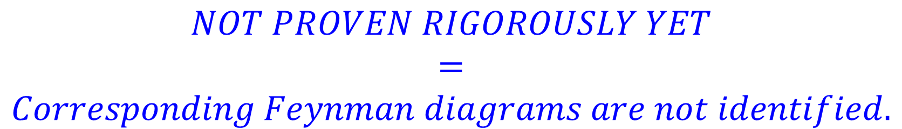
Claim: Field theoretic O(N), O(1), O(1/N), O(1/N^2), … quantum corrections are resumed and reorganized to form a holographic dual effective field theory in the large N limit.
$$NOT PROVEN RIGOROUSLY YET$$
$$=$$
$$Corresponding Feynman diagrams are not identified.$$

Slide 17
An effective Hamiltonian at UV

Slide 19

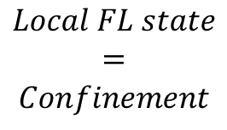
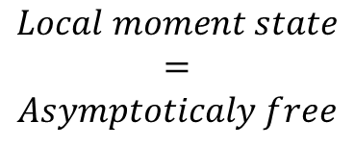
$$Local FL state$$
$$=$$
$$Confinement$$
$$T_{K}=Λ_{QCD}$$
$$Local moment state$$
$$=$$
$$Asymptoticaly free$$

Slide 20
Is there a general prescription beyond explicit and detailed implementations of the Wilsonian RG transformations? More rigorously, can I put the RG transformation into the framework of a topological quantum field theory to manifest the mathematical structure of RG? This construction should correspond to the path integral formulation of the Fokker-Planck type FRG equation.

Slide 21
Key aspects of the derivation or construction
Local approximation for the Wilsonian effective action and the RG flows
“One loop” level in every step of the RG transformations (cf. FRG looks like one-loop RG transformation. Of course, it’s not.)
RG flows as a gradient flow of an effective potential (cf. can be translated into the WZ consistency condition for the Weyl anomaly in the local RG equation)
Non-perturbative in nature: Resumed in the all-loop order of the action level
A cohomological type topological field theory construction

Slide 22
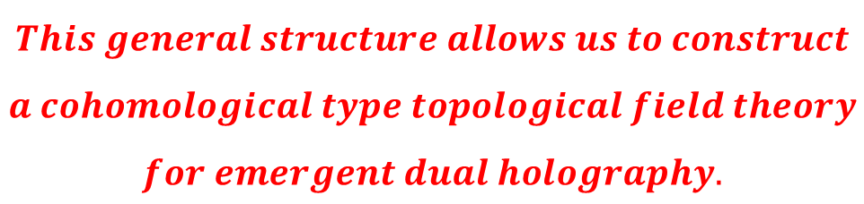
$$This general structure allows us to construct$$
$$a cohomological type topological field theory$$
$$for emergent dual holography.$$

Slide 23
A cohomological-type topological field theory construction a la Witten

Slide 24
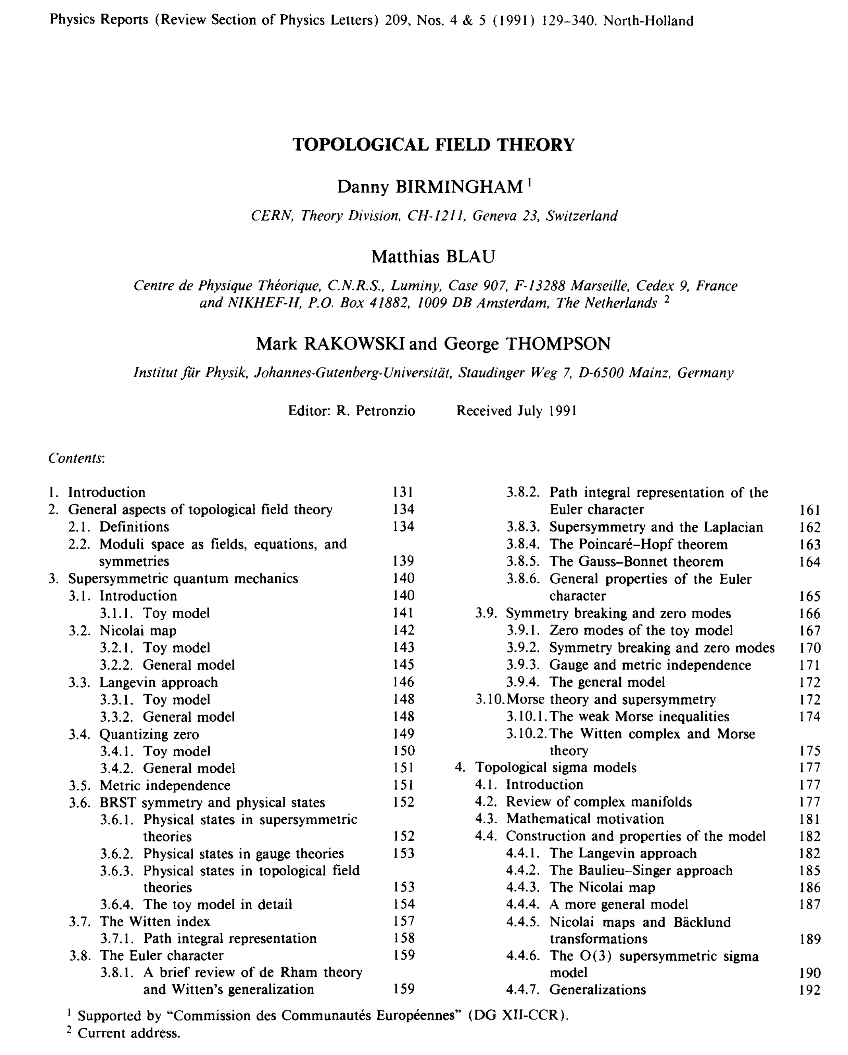
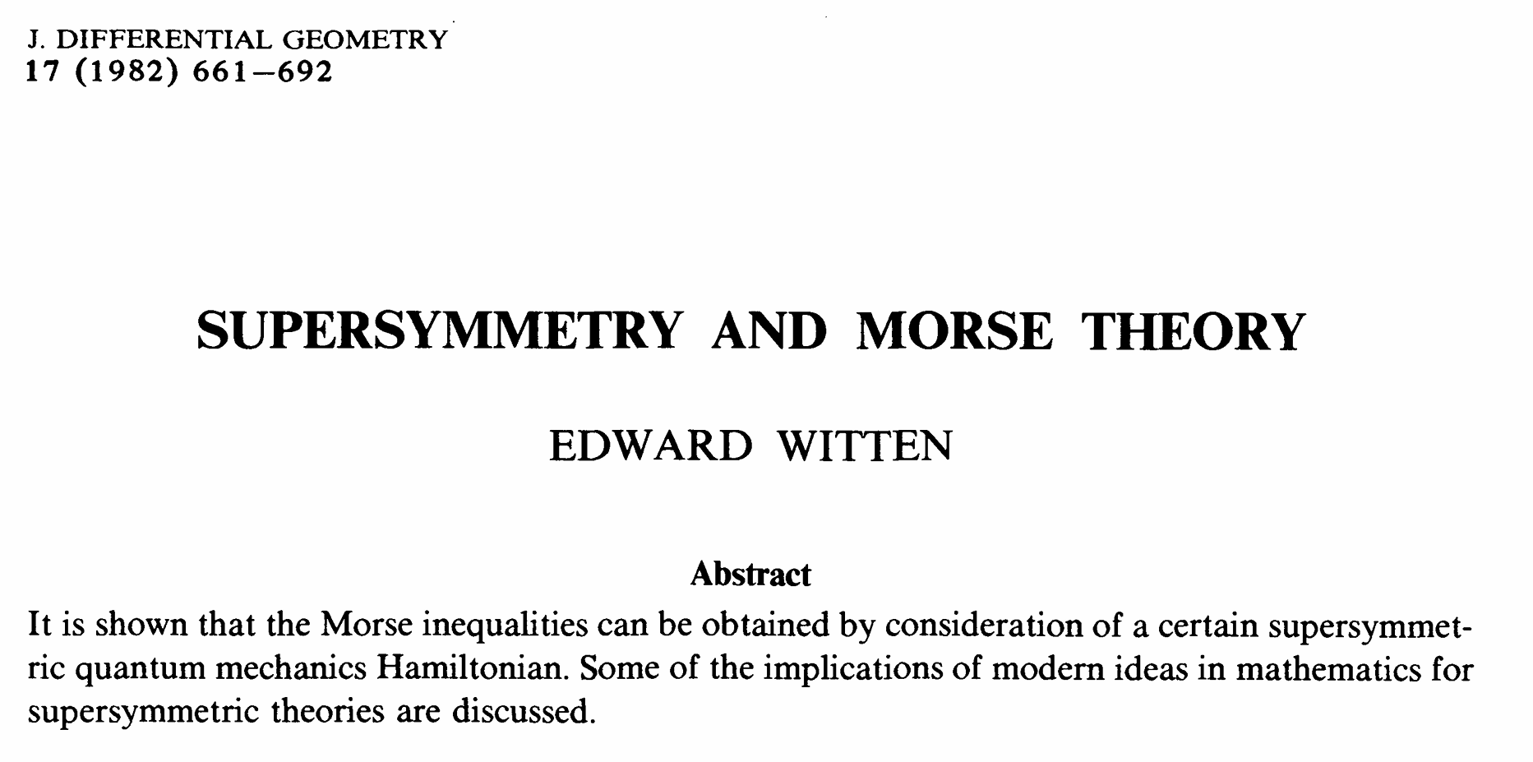
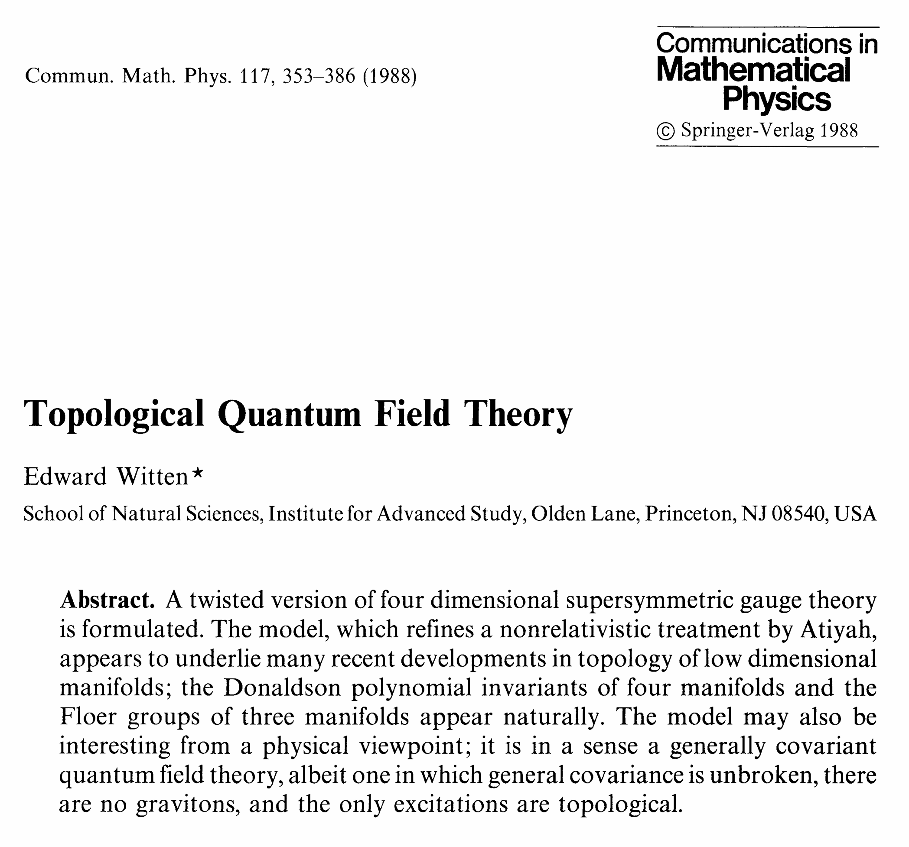

Slide 25
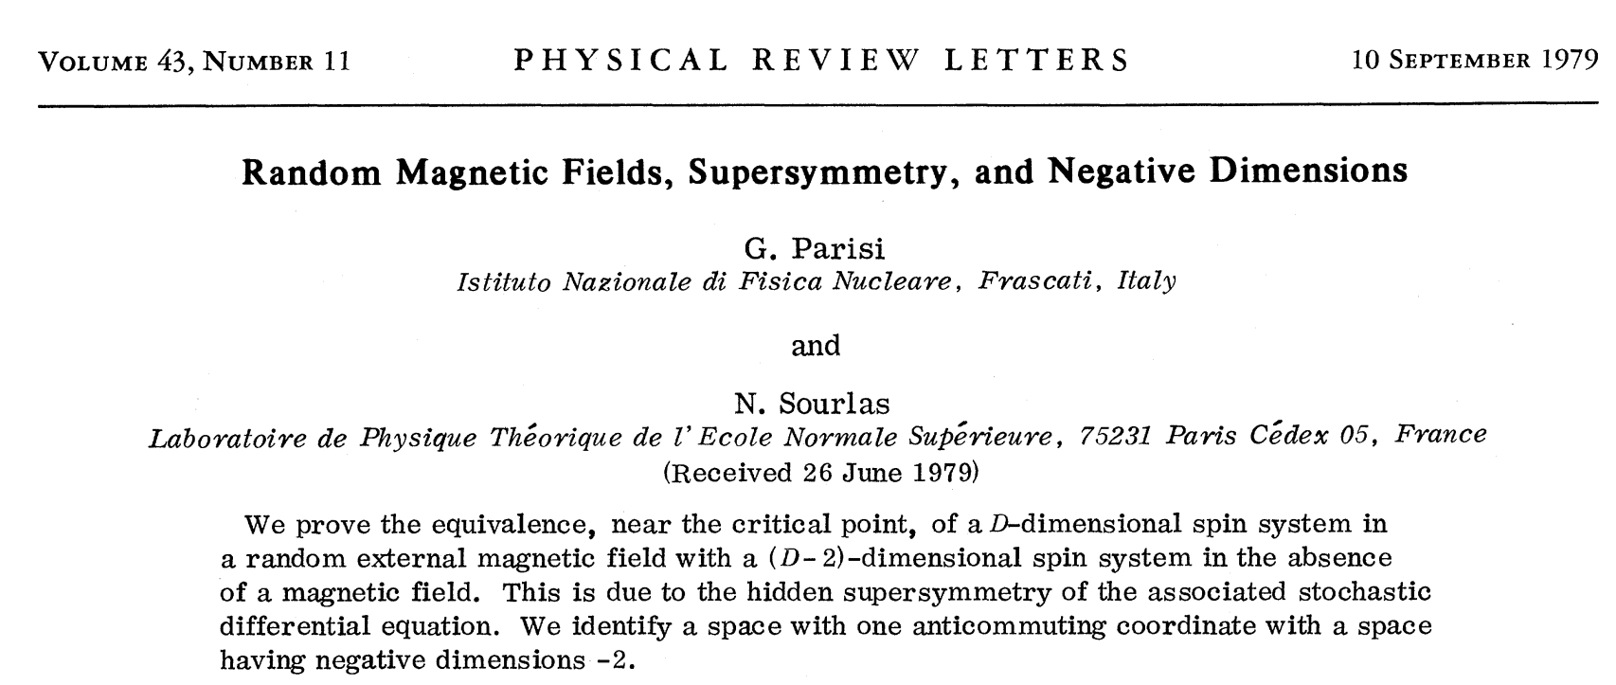
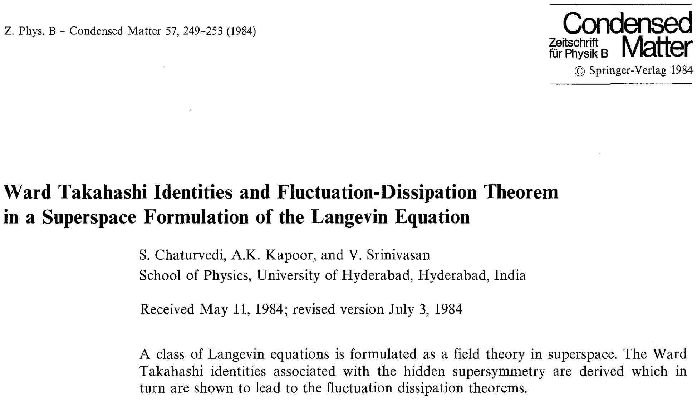
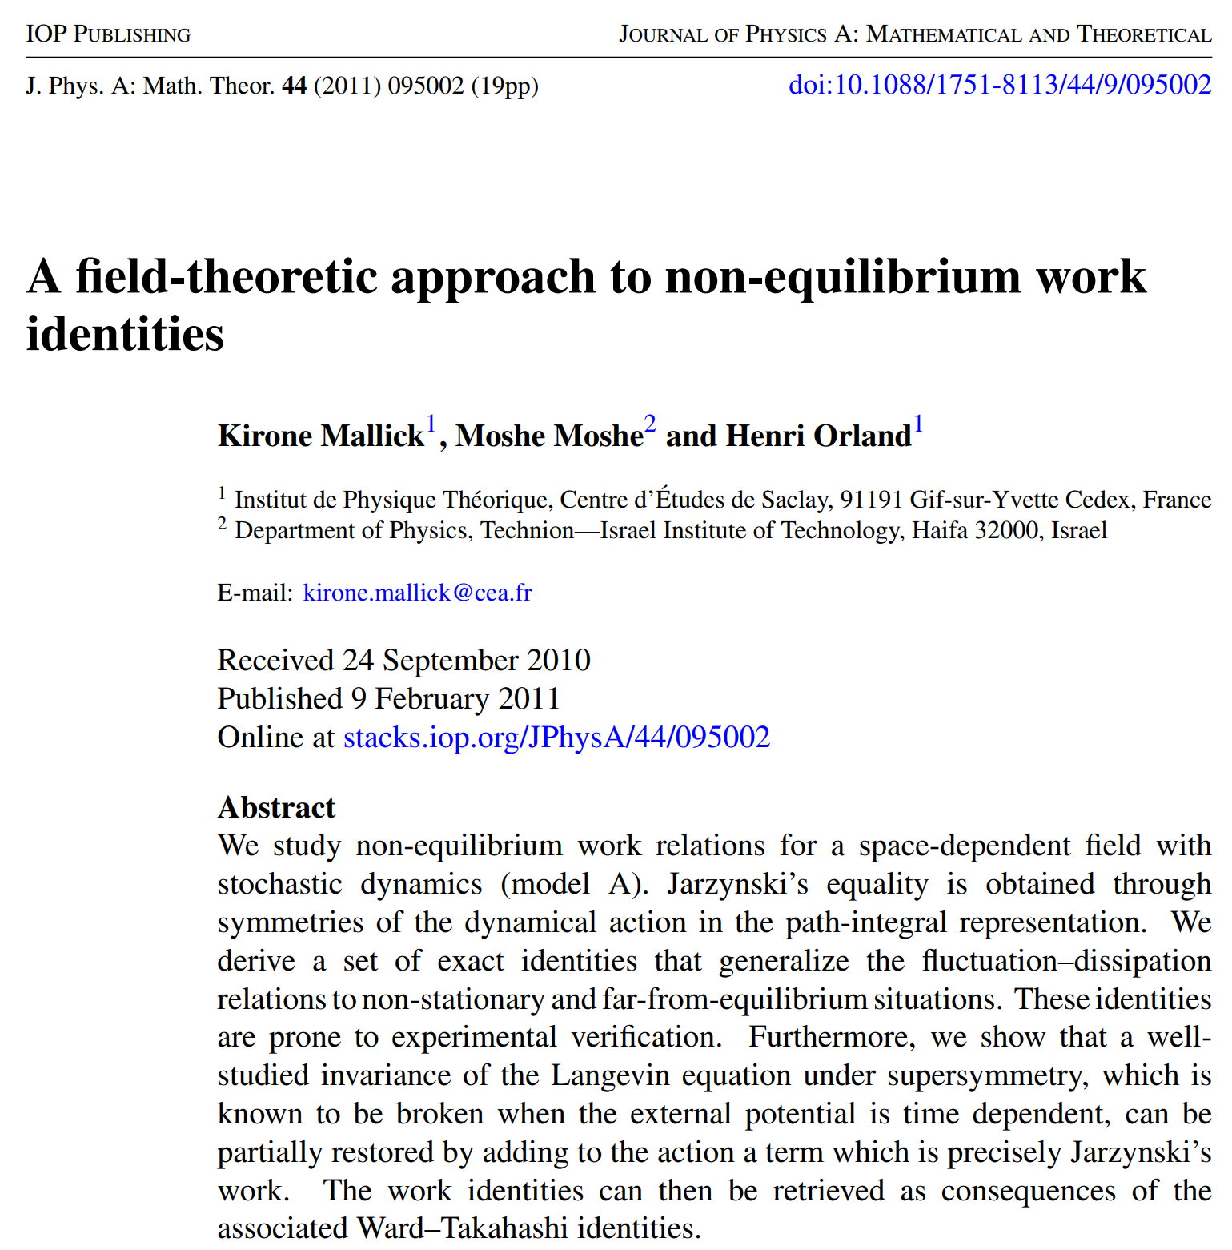
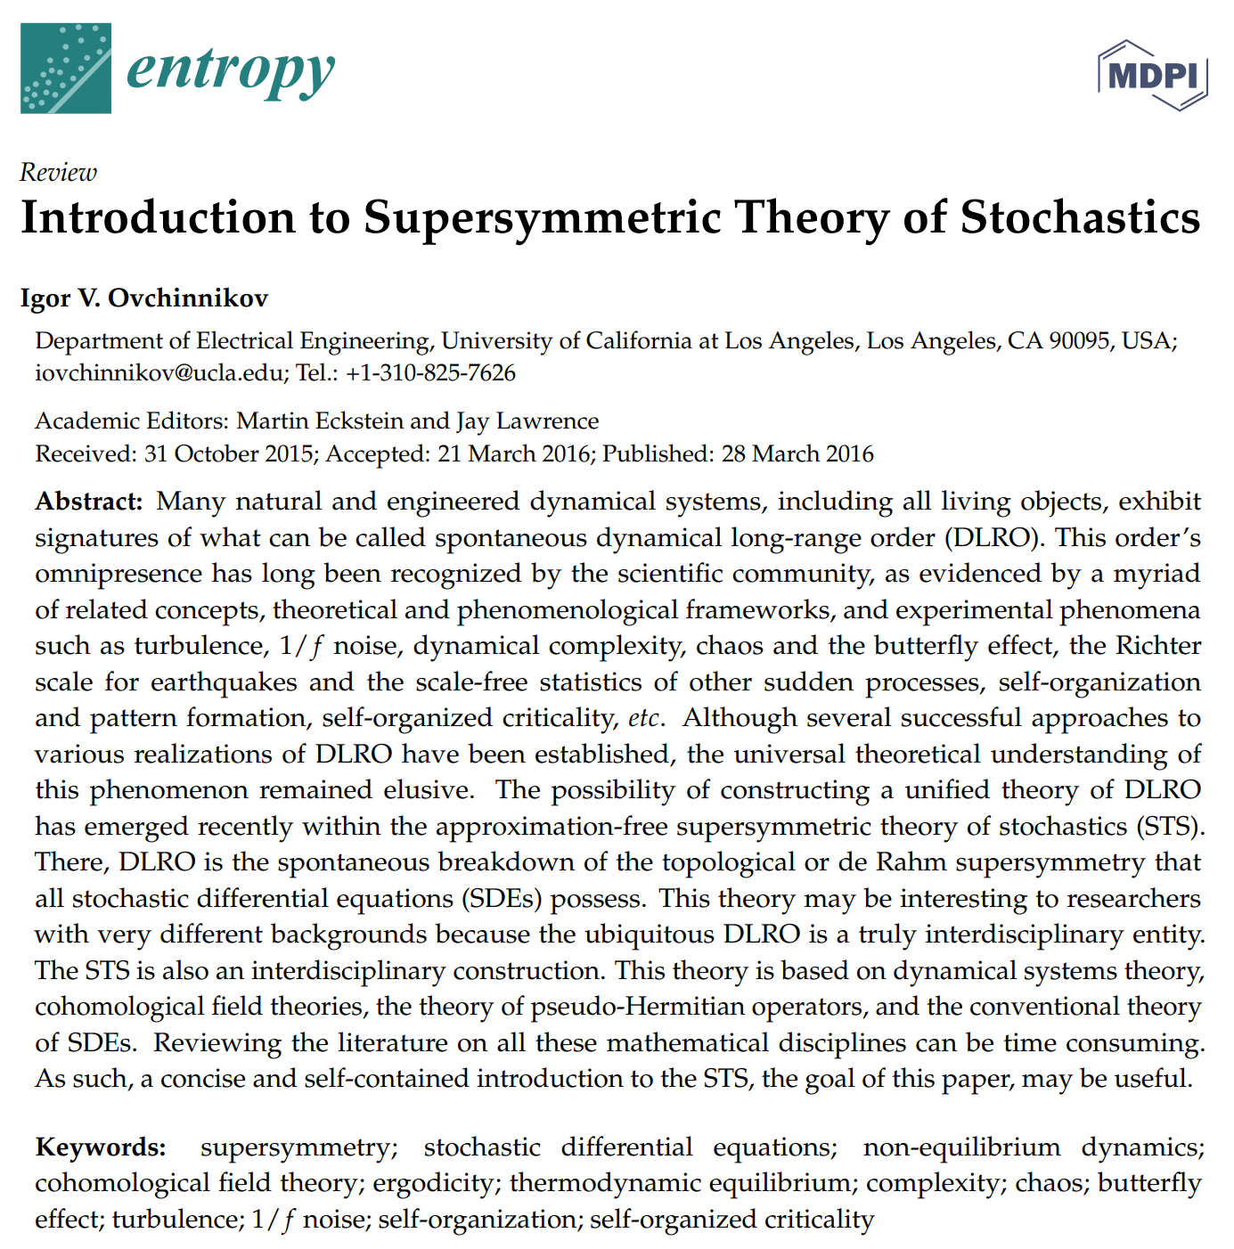
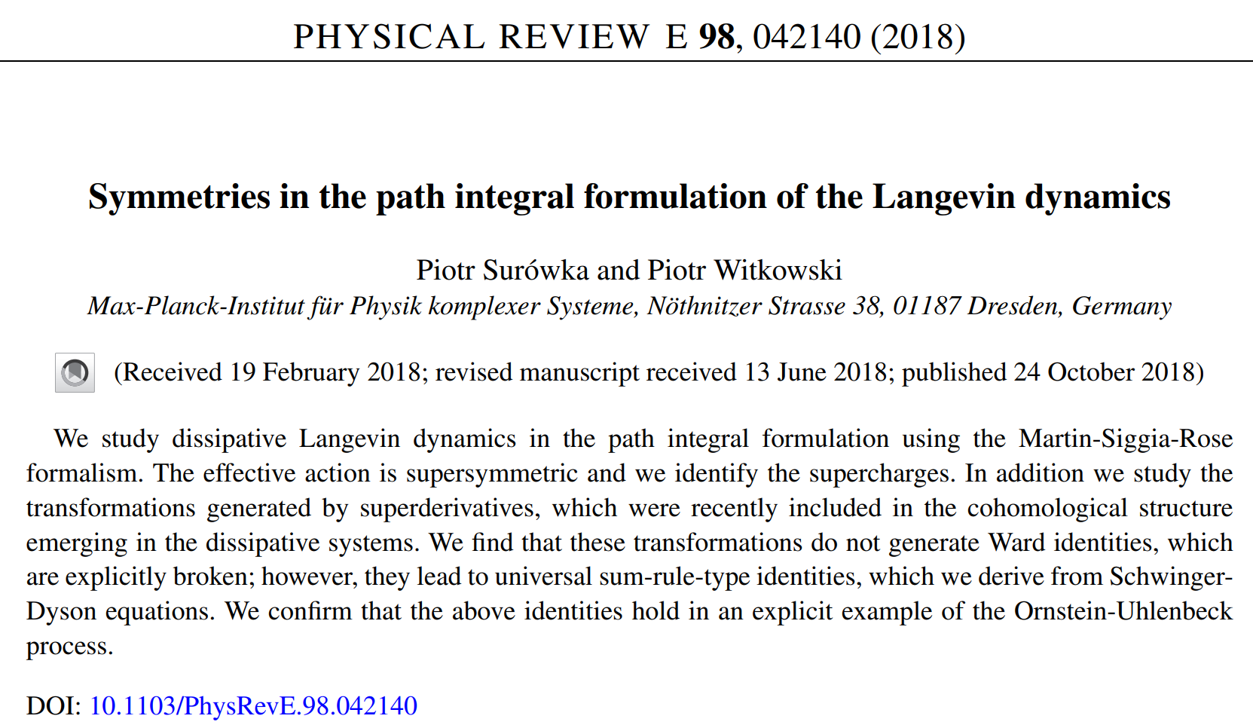

Slide 26
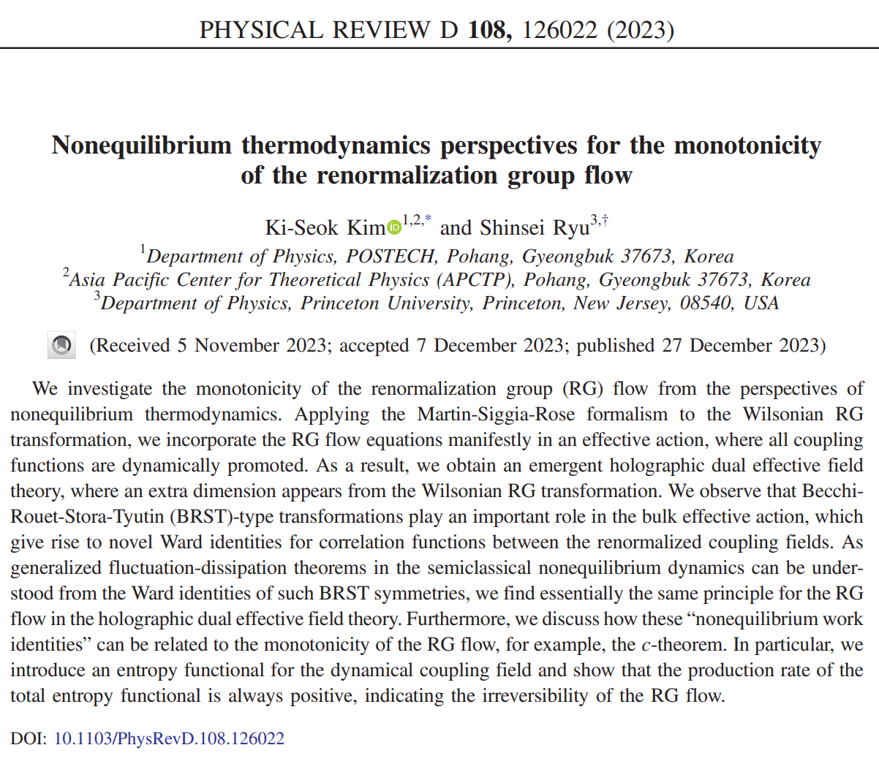

Slide 27
Remarkably, it turns out that our cohomological-type topological field theory construction for the RG-based emergent dual holography is essentially identical to Daniel Friedan, A tentative theory of large distance physics, JHEP10(2003)063, where the Fokker-Planck-type functional RG equation has been introduced.

Slide 28
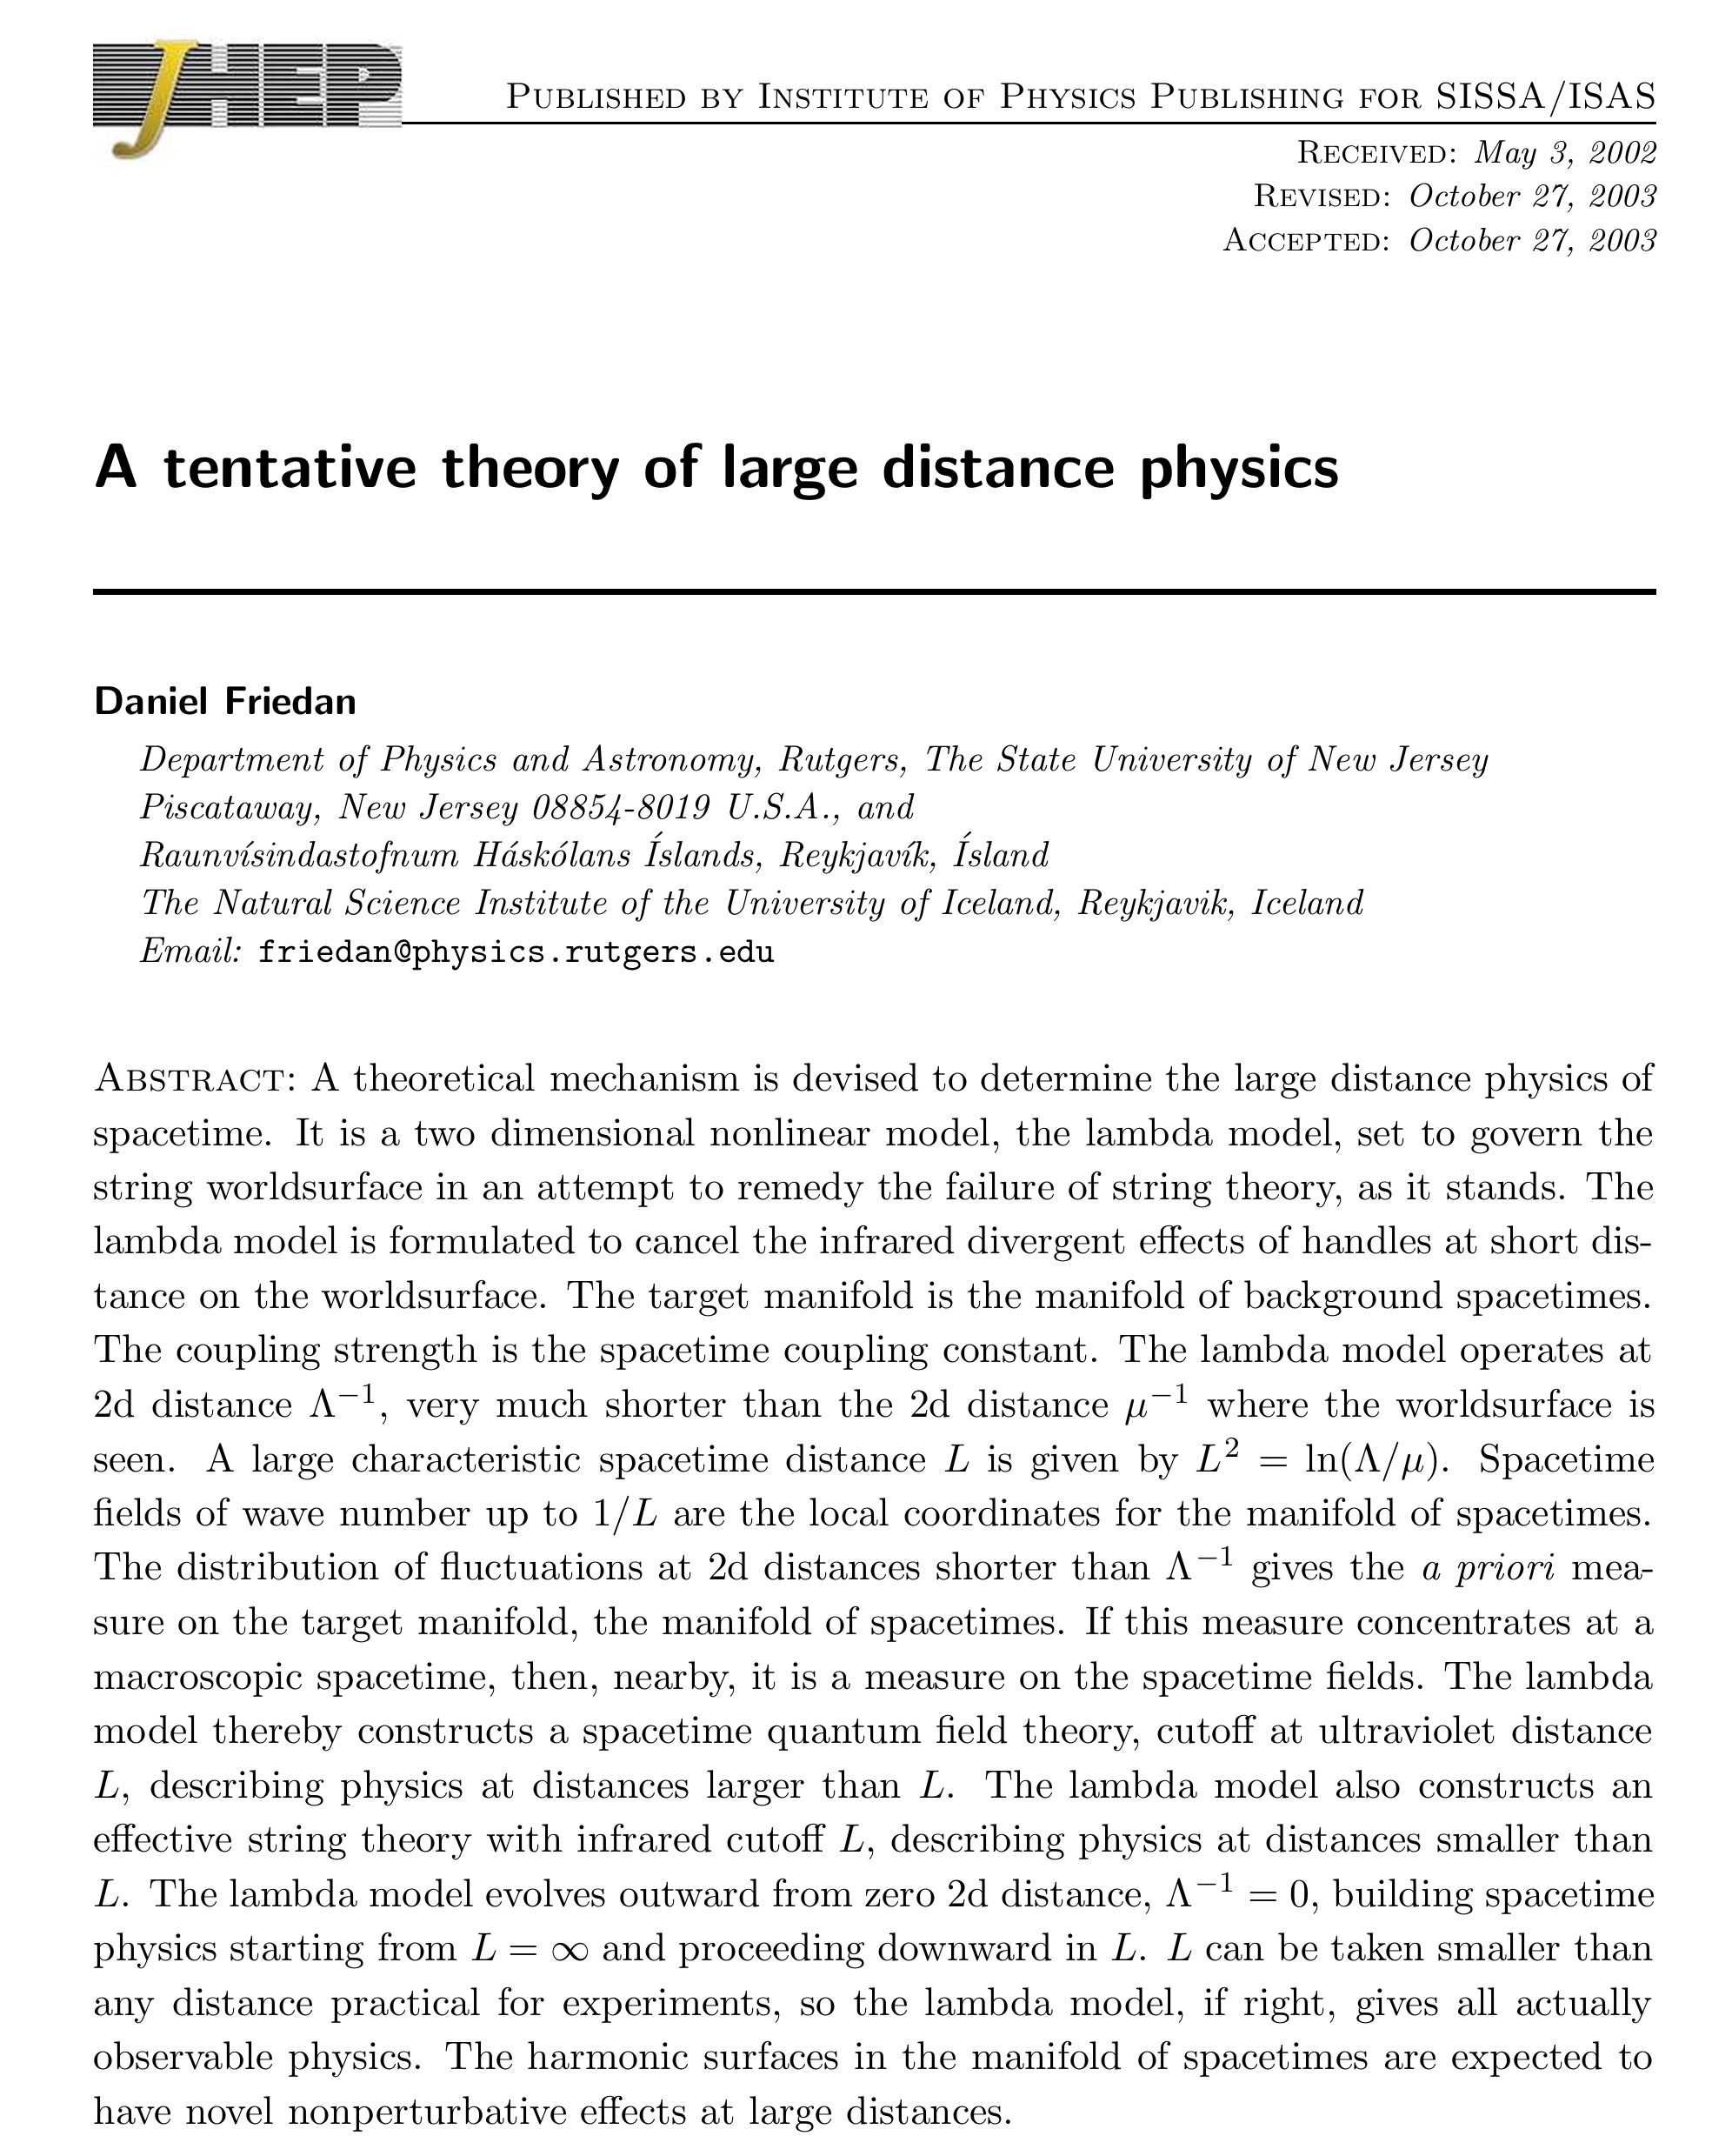
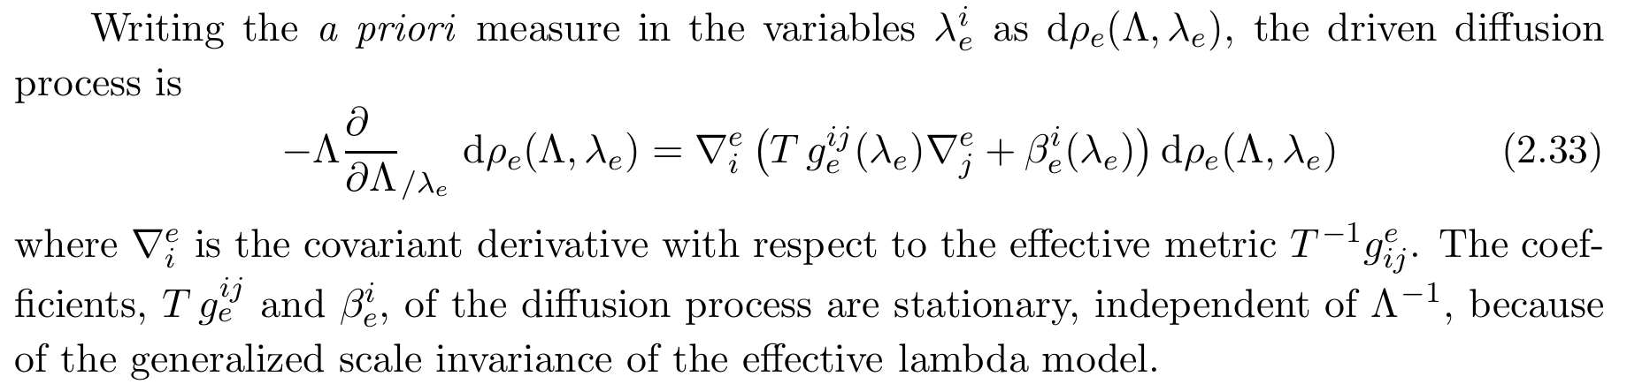
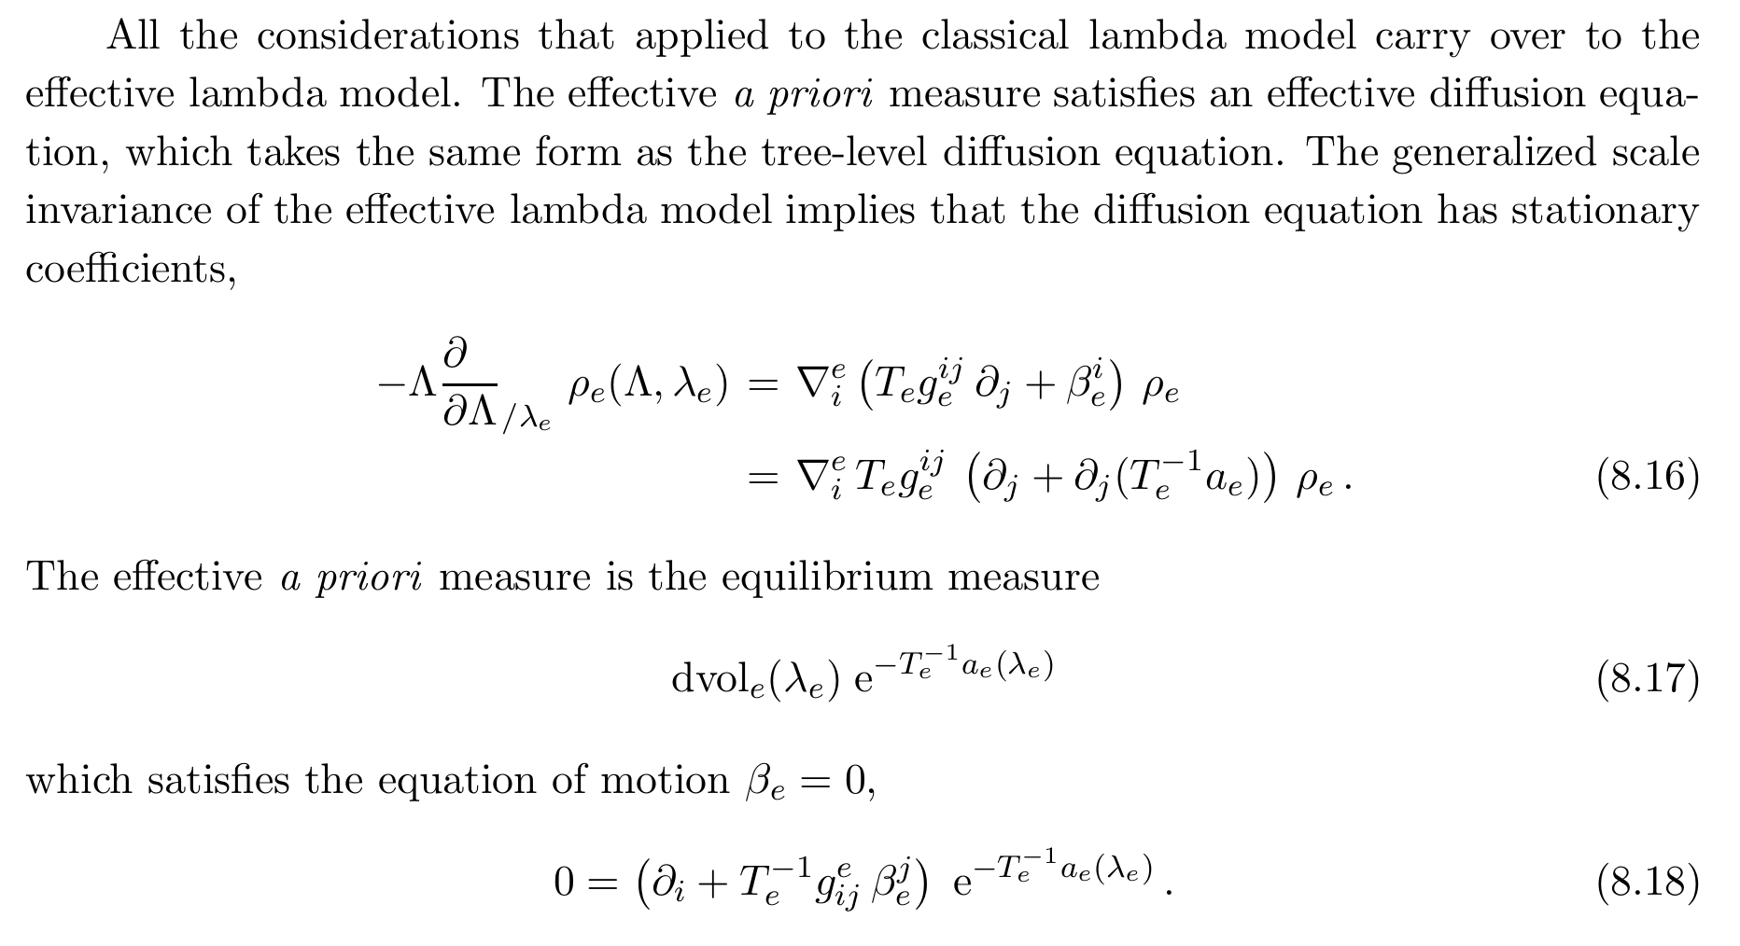

Slide 29
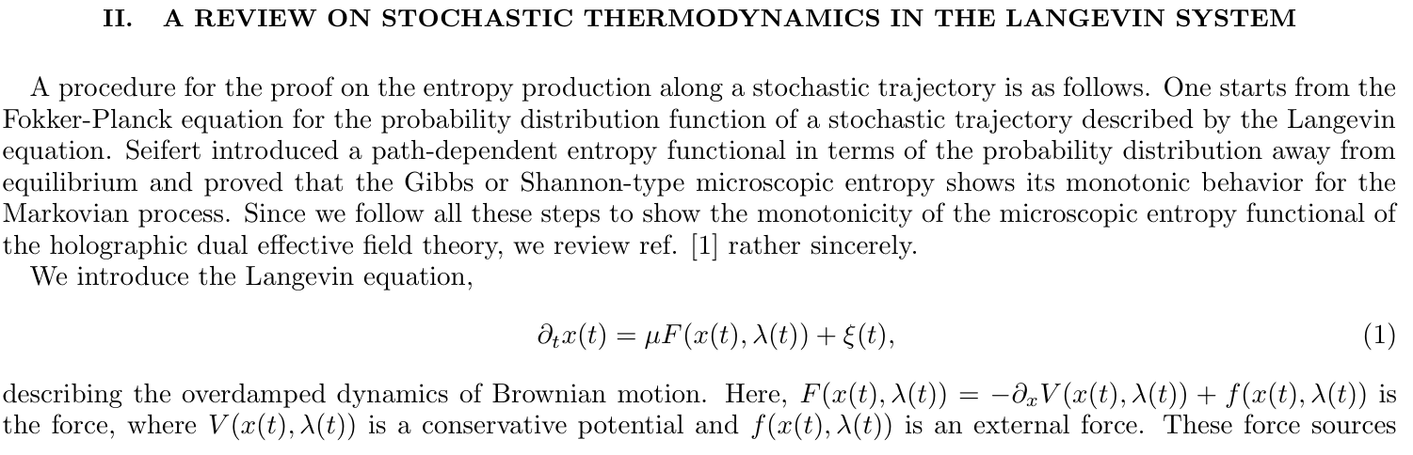
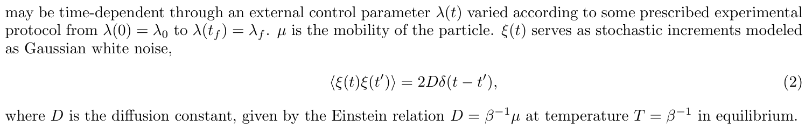

Slide 30
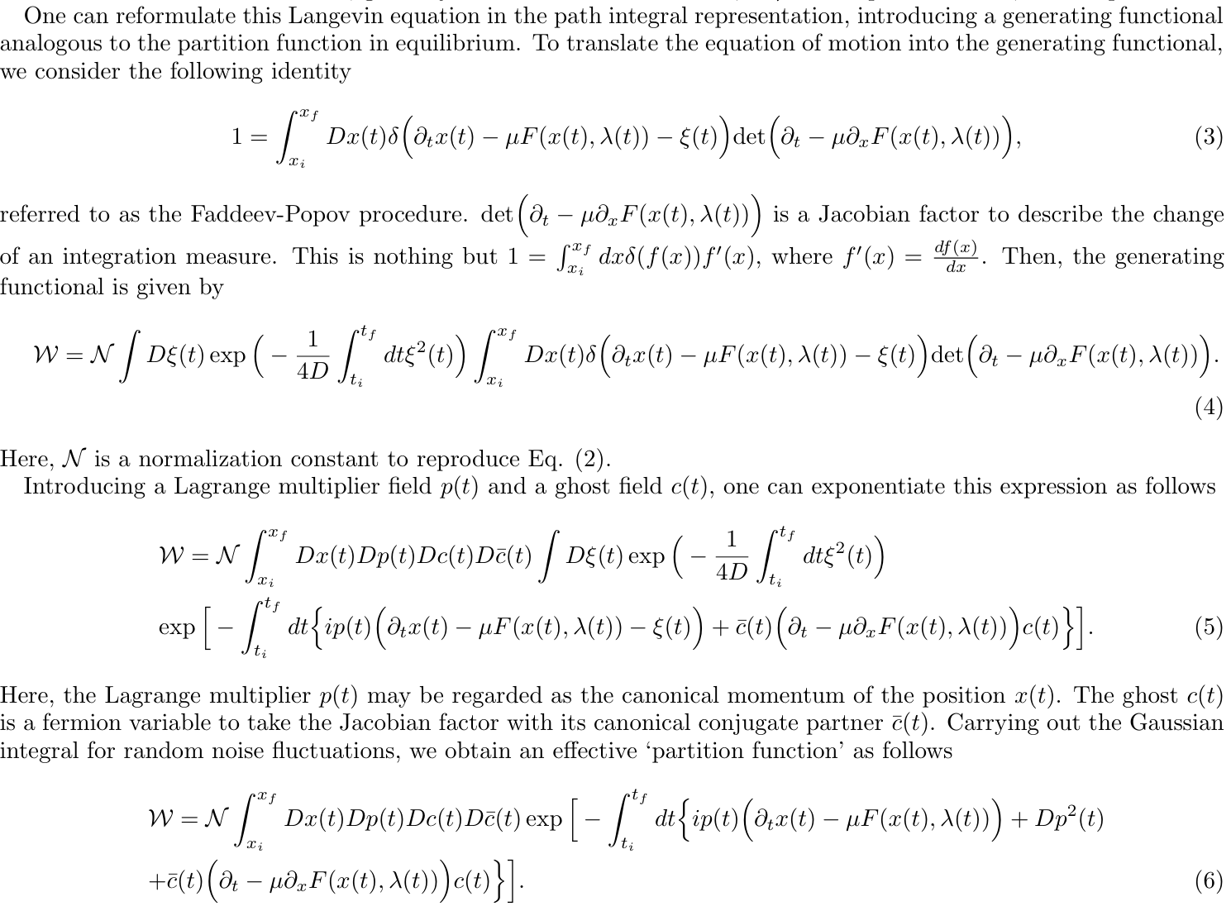
$$The path integral localizes into the Langevin eq.$$

Slide 31
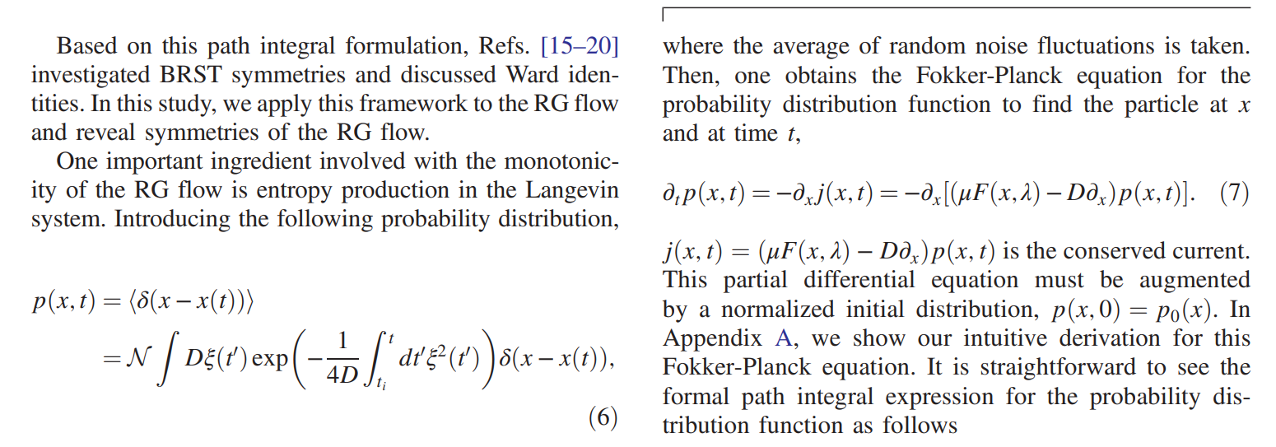
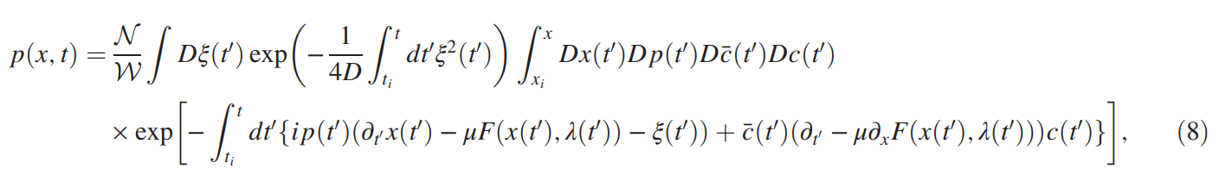

Slide 32

Wilsonian RG transformation
$$\left(1\right) Locality approx.$$
$$\left(2\right) One−loop effective action$$
$$\left(3\right) Gradient RG flow$$

Slide 33

To manifest the renormalization group flow in the level of an effective action
$$1=∫dx δ\left(f\left(x\right)\right) f′(x)$$

Slide 34
Almost similar, but not complete

Slide 35
To promote coupling functions to dynamical fields: Irrelevant (noise or TT-bar type) deformations

Slide 36
$$This construction is idential to the brute−force integral derivation discussed before.$$
$$You can check it out by discretizing the z−coordinate into the RG step \left(k\right).$$

Slide 37
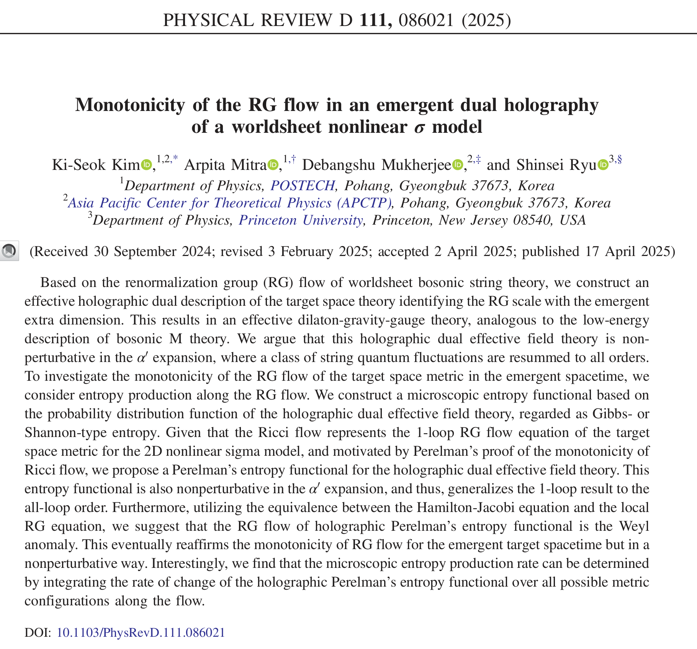

Slide 38
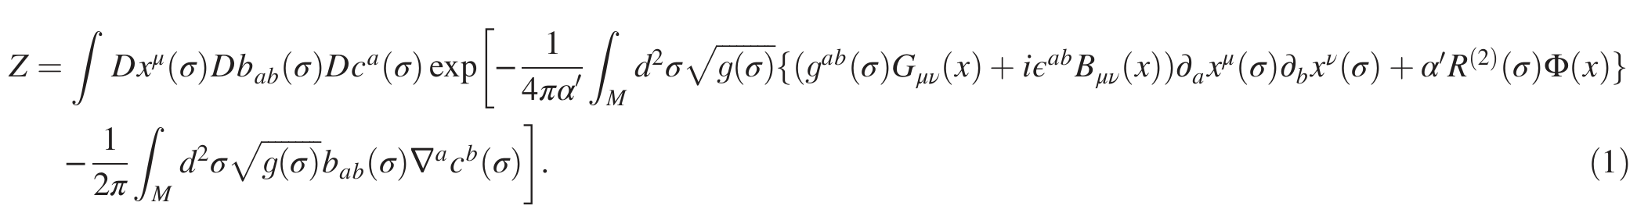
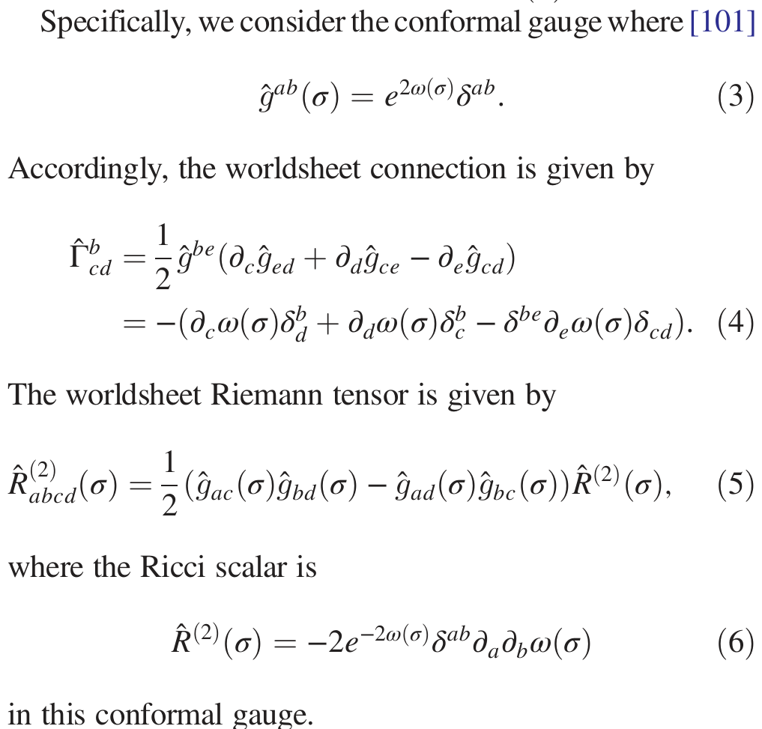
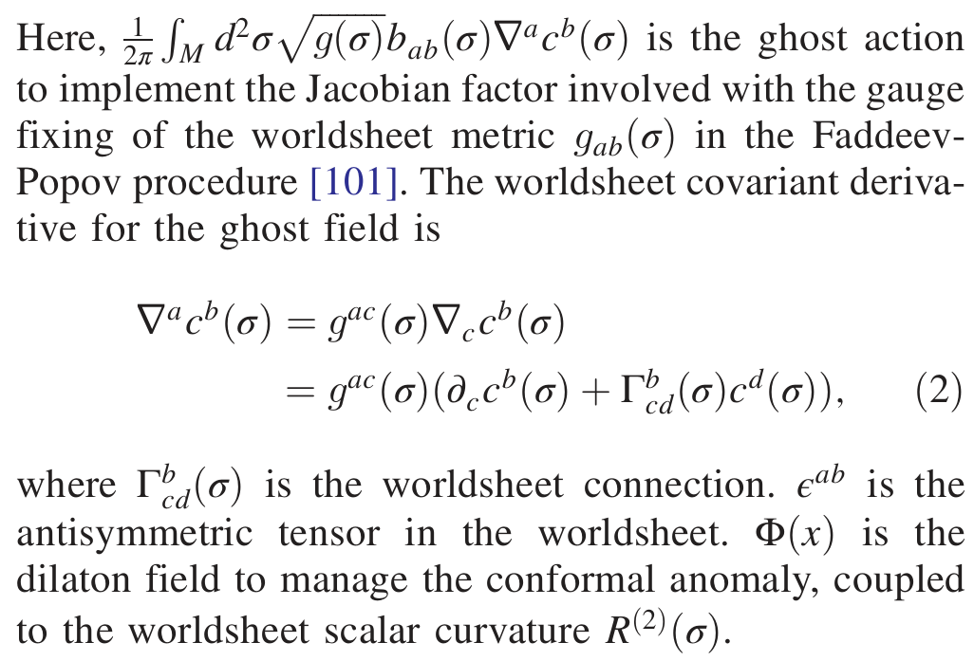

Slide 39
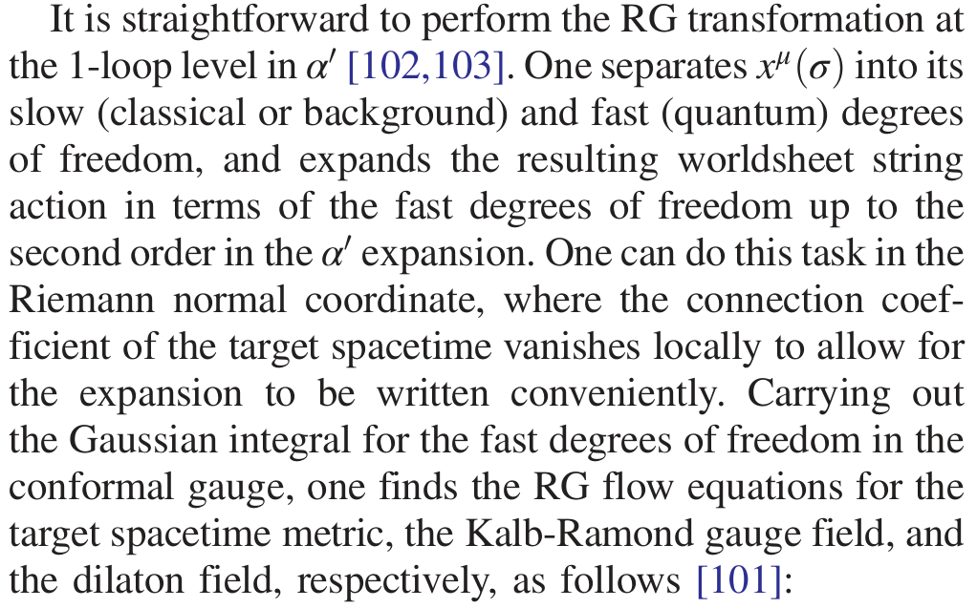
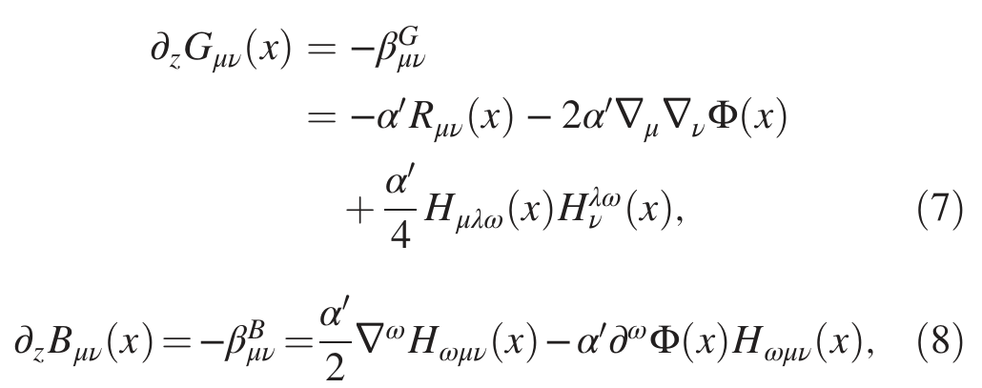
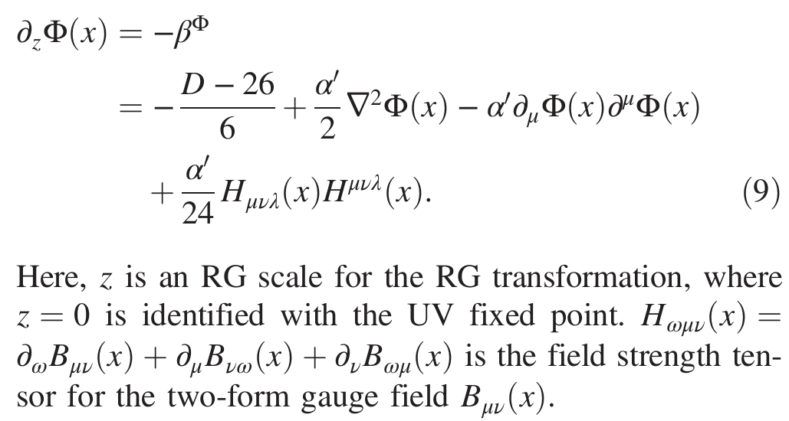
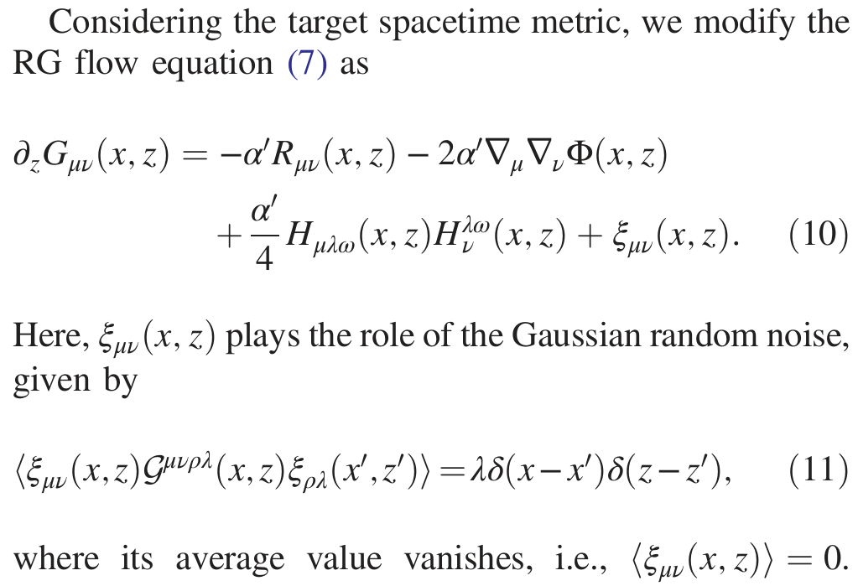
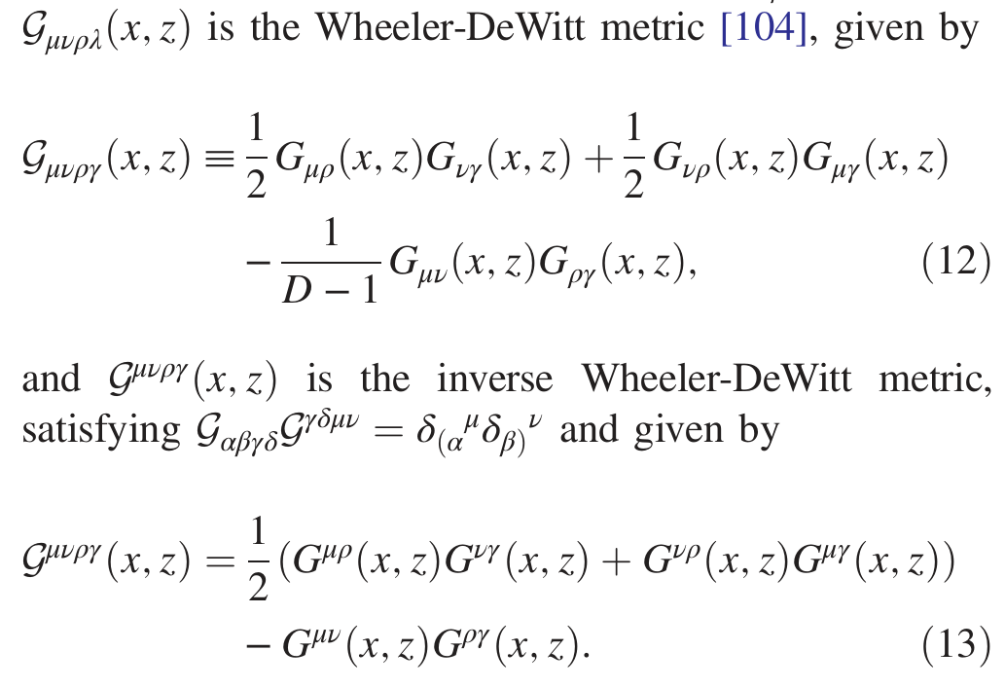


Slide 40


Slide 41



Slide 42


Slide 43


Slide 44

Physics of four types of BRST transformations
Ward identities of these four types of BRST symmetries and their explicit breaking ➔ Generalized fluctuation-dissipation theorems

Slide 45







Slide 46







Slide 47


Slide 48



Slide 49


Slide 50




$$G_{R}−G_{A}=G_{K}$$
$$Wess−Zumino consistency condition$$
$$for the Weyl anomaly in the local RG equation$$
$$Generalized fluctuation−dissipation theorem$$
$$to constrain multi−particle dynamics$$

Slide 51
Monotonicity of the RG flow
in the entropy production perspective
⬅➔
WZ consistency condition for the Weyl anomaly
in the local RG equation

Slide 52




Monotonicity of RG flow
$$UV:Tricritical Ising QCP$$
$$IR:Ising QCP$$
$$Relevant deformations$$
$$c−theorem is a No−Go theorem in dynamics.$$

Slide 53

Is there a mechanism of symmetry or topology protection as a “conventional” No-Go theorem?
$$c−theorem may be the most general$$
$$No−Go theorem in physics.$$

Slide 54





Slide 55



Relevant deformations in CFT2:
RG flows as gradient flows
$$O^{α}O^{β}∼\sum_{γ}{C^{αβγ}}O_{γ}$$

Slide 56




Zamolodchikov c−theorem in the RG-flow perspectives
$$T_{μ}^{μ}+\sum_{α}{β_{α}O^{α}=0}$$

Slide 57
We not only reinterpret the c-theorem in the perspective of entropy production but also “generalize” it beyond the one loop order.

Slide 58
Previously, the monotonicity of the RG flow (c-theorem & a-theorem) has been derived from the WZ consistency condition of the Weyl anomaly in the local RG equation.
Here, we discuss it in the entropy production perspective,
which turns out to be consistent with
the WZ consistency condition of the local RG equation.

Slide 59





Slide 60





Slide 61





Perelman’s interpretation for the 𝑍𝑎𝑚𝑜𝑙𝑜𝑑𝑐ℎ𝑖𝑘𝑜𝑣’s c-theorem
$$∂_{t}g_{ij}\left(x,t\right)=−2R_{ij}(x,t)$$
$$RG flow→Ricci flow$$
$$Zamolodchikov c−functional$$
$$for the gradient flow of the RG flow$$
$$Perelman^{′}s entropy functional$$
$$for the gradient flow of the Ricci flow$$

Slide 62



Slide 63


Slide 64






Slide 65



Slide 66




Slide 67



Slide 68


Slide 69


Slide 70



Slide 72


Slide 73


Slide 74



$$It seems to be consistent with$$
$$the WZ consistency condition of$$
$$the conformal anomaly$$
$$in the local RG equation.$$

Slide 75
Conformal anomaly inflow and
Anomaly cancellation in the quantum effective action

Slide 76



Slide 77





Slide 78





$$\frac{dV_{rg}[λ(x,z_{f})]}{d z_{f}}=\left(\frac{∂}{∂ z_{f}}+β\left(λ\left(x,z_{f}\right)\right)\frac{∂}{∂λ(x,z_{f})}\right)V_{rg}\left[λ\left(x,z_{f}\right)\right]$$
$$= A \sim −N∫d^{D}x β^{2}\left(λ\left(x,z_{f}\right)\right)$$
$$S_{rel.}=N∫d^{D}x π\left(x,z_{f}\right) λ(x,z_{f})$$
$$\frac{d S_{rel.}}{d z_{f}}=\left(\frac{∂}{∂ z_{f}}+β\left(λ\left(x,z_{f}\right)\right)\frac{∂}{∂λ(x,z_{f})}\right)S_{rel.}$$
$$\sim N∫d^{D}x β^{2}\left(λ\left(x,z_{f}\right)\right)=−A≥0$$
$$Hamilton−Jacobi eq.=Local RG eq.,$$
$$solved by Fefferman−Graham expansion$$

Slide 79

$$S_{eff}(z_{f})=N∫d^{D}x\left(π\left(x,z_{f}\right) λ\left(x,z_{f}\right)+V_{rg}\left[λ\left(x,z_{f}\right)\right]\right)$$
$$\frac{dS_{eff}(z_{f})}{d z_{f}}=\left(\frac{∂}{∂ z_{f}}+β\left(λ\left(x,z_{f}\right)\right)\frac{∂}{∂λ(x,z_{f})}\right)S_{eff}(z_{f})$$
$$= A−A=0$$

Slide 80

RG-based
emergent dual holography
=
Cauchy surface holography
$$UV$$
$$RG flow$$
$$=$$
$$Conformal anomaly inflow$$
$$S_{rel.}=N∫d^{D}x π\left(x,z_{f}\right) λ(x,z_{f})$$
$$IR$$
$$Conformal anomaly cancellation$$
$$on the RG Cauchy surface$$
$$Cauchy surface$$
$$for the RG transformation$$
$$S_{eff}(z_{f})=N∫d^{D}x\left(π\left(x,z_{f}\right) λ\left(x,z_{f}\right)+V_{rg}\left[λ\left(x,z_{f}\right)\right]\right)$$
$$Conformal anomaly free IR quantum effective action$$
https://ocw.mit.edu/courses/8-821-string-theory-and-holographic-duality-fall-2014/

Slide 81


$$S(P|\left|Q\right)=\int_{−∞}^{∞}{dφ}P\left(φ\right)log\left[P(φ)/Q(φ)\right]$$

Slide 83
$$Functional Schrodinger equation$$
$$Heisenberg operator equation$$

Slide 84


$$Conserved current$$
$$for the RG transformation$$
$$Gradient flow$$
$$S_{rel.}=N∫d^{D}x π\left(x,z_{f}\right) λ(x,z_{f})$$
$$Relative entropy functional$$
$$S_{eff}(z_{f})=N∫d^{D}x\left(π\left(x,z_{f}\right) λ\left(x,z_{f}\right)+V_{rg}\left[λ\left(x,z_{f}\right)\right]\right)$$

Slide 85





Slide 86


Holographic renormalization group (RG) and on-shell effective action

Slide 87



Slide 88



Slide 89


Slide 90


Slide 91


Slide 92


Slide 93


Slide 94


Slide 95

Conformal anomaly inflow and
Anomaly cancellation in the quantum effective action
$Eq$. (64) + Eq. (77) = Eq. (63)

Slide 96

RG-based
emergent dual holography
=
Cauchy surface holography
$$UV$$
$$RG flow$$
$$=$$
$$Conformal anomaly inflow$$
$$IR$$
$$Conformal anomaly cancellation$$
$$on the RG Cauchy surface$$
$$Cauchy surface$$
$$for the RG transformation$$
$$Conformal anomaly free IR quantum effective action$$
https://ocw.mit.edu/courses/8-821-string-theory-and-holographic-duality-fall-2014/

Slide 97

Summary
A cohomological-type TQFT construction gives the formal path integral solution of a functional RG equation given by an effective Fokker-Planck equation (for the target spacetime evolution of the world sheet nonlinear sigma model).
Our RG construction serves as a non-perturbative generalization of the Wilsonian RG framework (all loop order in $α′$).
There is Weyl anomaly inflow from the bulk to the IR boundary, being analogous to the Perelman’s entropy F-functional or the Zamolodchikov C-functional, which gives RG $β$ functions as its gradient flows. In addition, anomaly cancellation occurs for the IR quantum effective action, and thus it is conformal anomaly free. Here, we demonstrated all these aspects explicitly based on our holographic construction, which extends the previous perturbative analysis in a non-perturbative way, i.e., in the all-loop order of the $α′$ expansion. More precisely, we showed that the microscopic (Gibbs) entropy construction is consistent with the macroscopic (Perelman) one.
Monotonicity of the RG flow is protected by N = 2 SUSY (BRST symmetry), not proven in the second part.

Slide 98
Emergent dual holography from the functional RG equation:
Path integral formulation of the functional RG equation & hidden BRST-type symmetries
RG flows in the Luttinger-Ward functional approach & hidden BRST-type symmetries

Slide 99


Slide 100


Slide 101



Slide 102
To derive the semi-classical Bekenstein-Hawking entropy + quantum corrections (perturbative ?)

Slide 103



Slide 104


