Slide 1
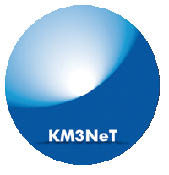

KM3NeT: Neutrino Telescopy in the Abyss
Christos Markou
Institute of Nuclear and Particle Physics, NCSR ‘Demokritos’, Athens
APCTP, 25/8/2025

Slide 2

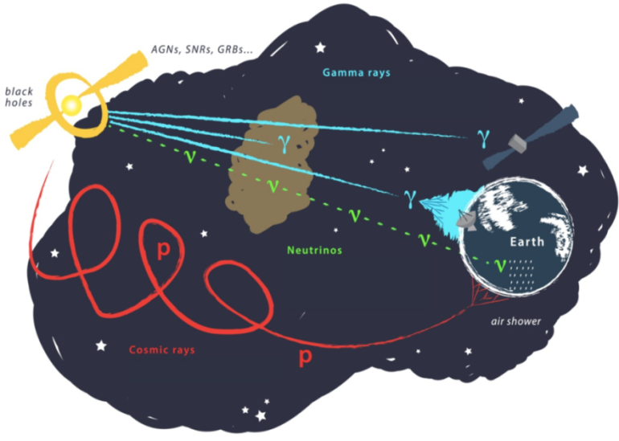
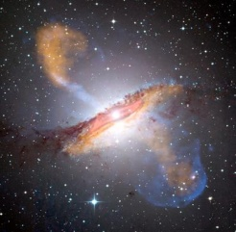
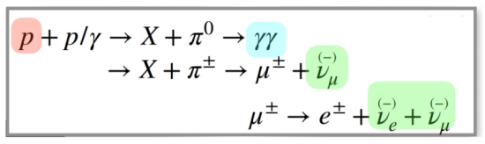
Why neutrinos?
Photons are absorbed by interstellar matter
Charged particles (protons) are affected by magnetic fields and interact with CMB
Neutrinos are the ideal messengers from astrophysical sources
Neutrino Astronomy!
Neutrino Sources
Galactic Extra-galactic
Supernovae, AGNs, Blazars,
SN relics, Black Hole mergers,
Dark Matter, Quasars, …
Nebulae, …
High-energy neutrino production via
Correlations between HE photons and neutrinos,
‘Smoking gun’ for hadronic processes
Christos Markou, APCTP, 25/8/2025

Slide 3
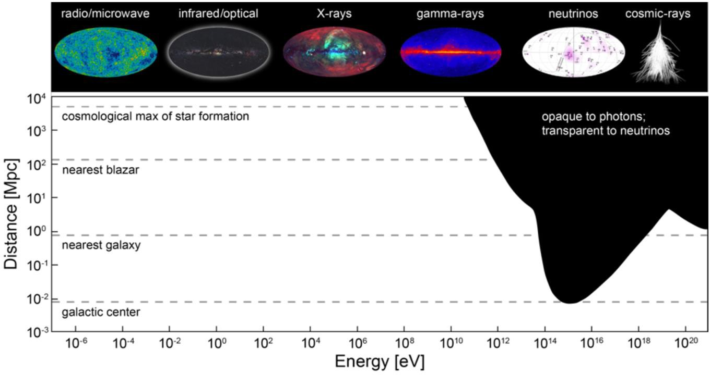
Access to the high energy / distant universe
The Universe is opaque to EM radiation above 10-100 TeV, but not to neutrinos
Christos Markou, APCTP, 25/8/2025

Slide 4
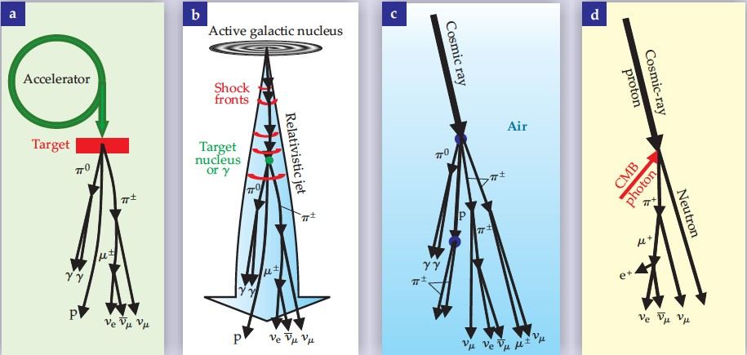
Neutrino Production mechanisms
© F. Halzen
Neutrino beam
Cosmic neutrinos
Atmospheric neutrinos
Cosmogenic neutrinos
Christos Markou, APCTP, 25/8/2025

Slide 5
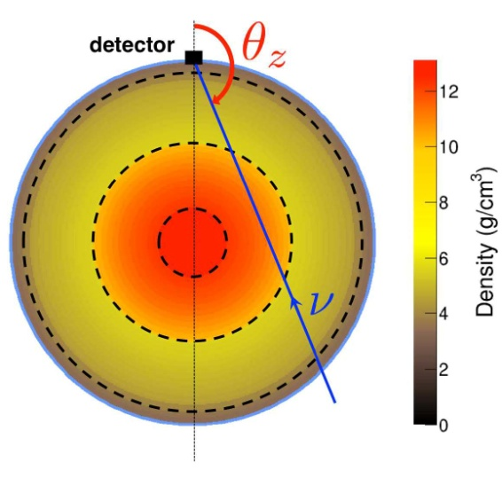
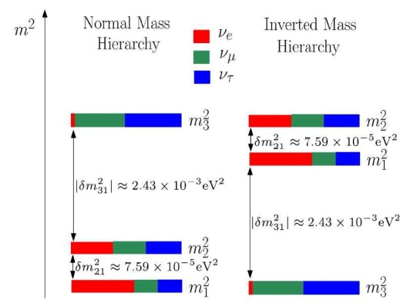
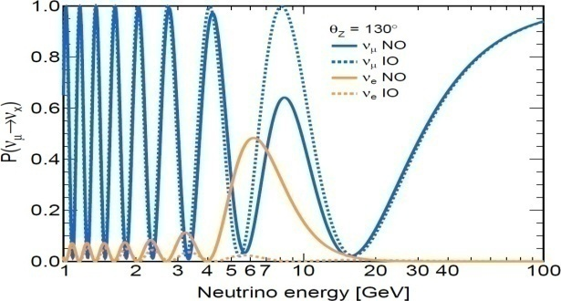
Neutrino physics
Atmospheric neutrinos are produced by the interaction of cosmic rays in the atmosphere
p+N→ X+K⁺,π⁺ →...+ μ ⁺ → e⁺ + ν_{μ} + ν_{e}
p+N→ X+K⁻, π⁻ →...+ μ⁻ → e⁻ + ν_{μ} + ν_{e}
Exploit the variable path length and energy of the incoming neutrino through the Earth to study neutrino properties
Matter effects sensitive to Δm²₃₁
Normal vs Inverted Mass Ordering (excess of ν_{e} vs ν_{e} )
Also Sterile neutrinos, Oscillations, ν_{τ} appearance,
Non Standard Interactions,…
Christos Markou, APCTP, 25/8/2025

Slide 6
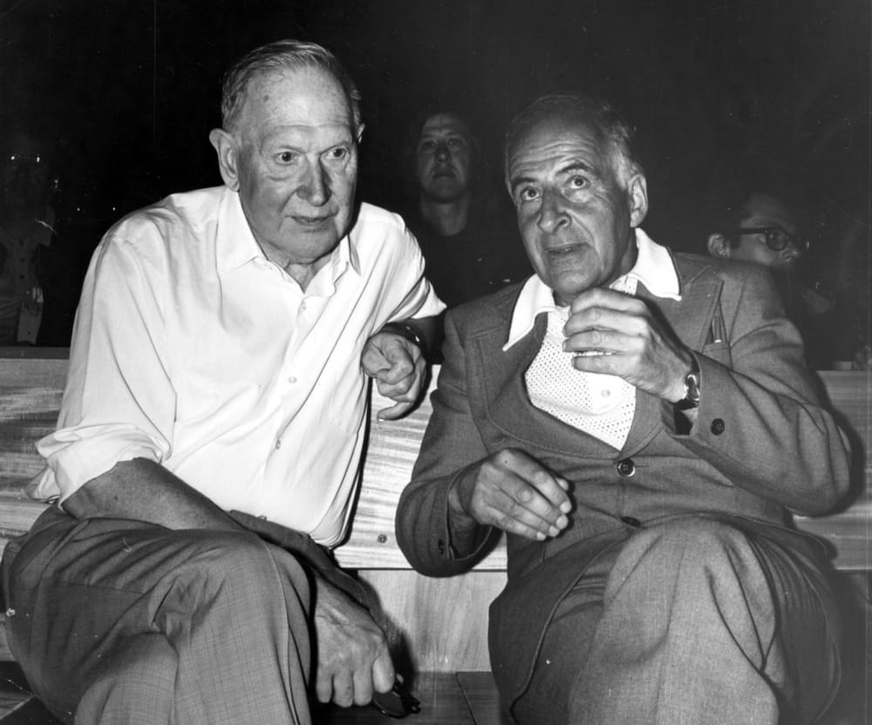
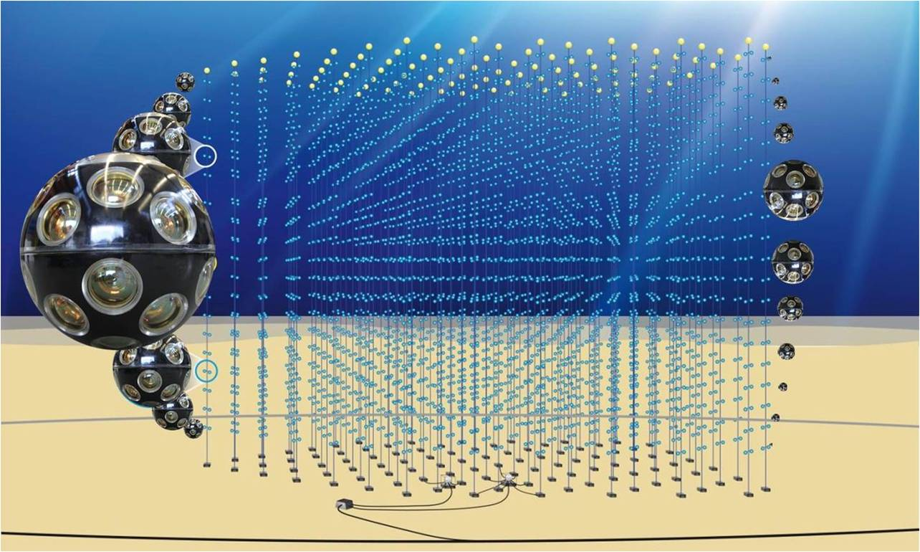
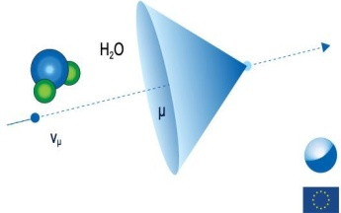
The Concept of Cherenkov Neutrino Telescopes
Moisey Markov Bruno Pontecorvo
Cherenkov: v>c/n Cos(angle)=1/n
ν_{μ}
1960 Rochester Conference
“… we propose to install detectors deep in a lake or in the sea and to determine the direction of charged particles with the help of Cherenkov radiation.”
Low interaction cross-section means huge detection volumes
Up-going (through the Earth) ν events
3D lattice of photomultipliers collecting Cherenkov photons due to relativistic charged particles from ν interactions
ν direction reconstructed using photon time & position
Christos Markou, APCTP, 25/8/2025

Slide 7
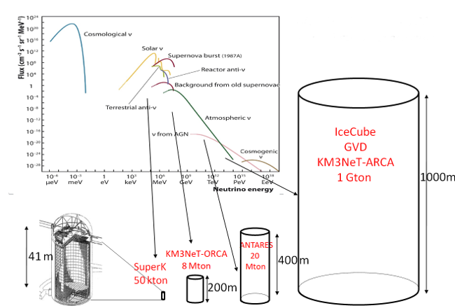
Neutrino fluxes and detector sizes
σ(νp) / σ(γp) ~ 10⁻⁵ at 1 TeV
thus need very large detectors
Christos Markou, APCTP, 25/8/2025

Slide 8
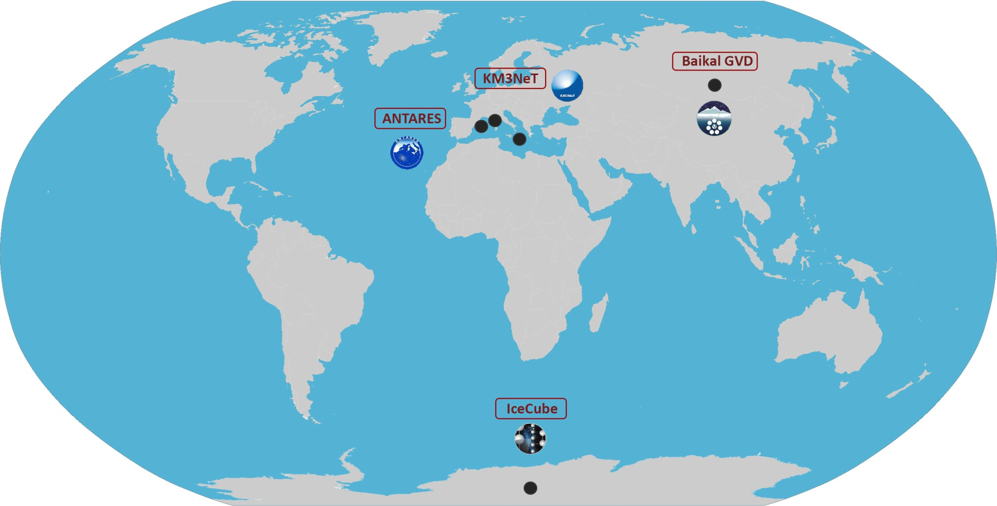

The Global Neutrino Network
Deep water,
~ 1 km³ ,
Construction
+ R&D in Canada (P-ONE) and China (TRIDENT, HUNT)
Deep water,
1 + 0,006 km³ ,
Construction
Deep water,
0,01 km³ ,
2008 - 2022
Deep Ice, ~ 1 km³ , 2011 - today
Upgrade with lower energy threshold, Construction
www.globalneutrinonetwork.org
Framework for enhanced cooperation
Christos Markou, APCTP, 25/8/2025

Slide 9
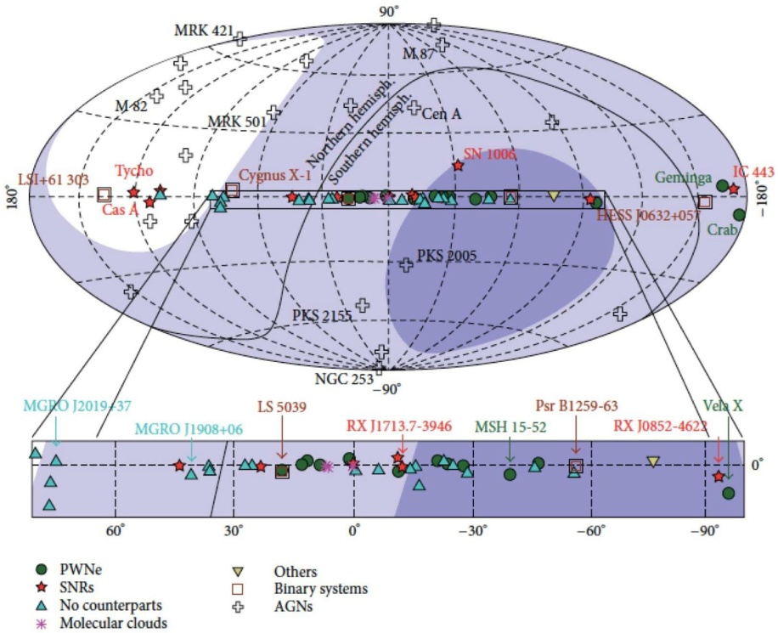
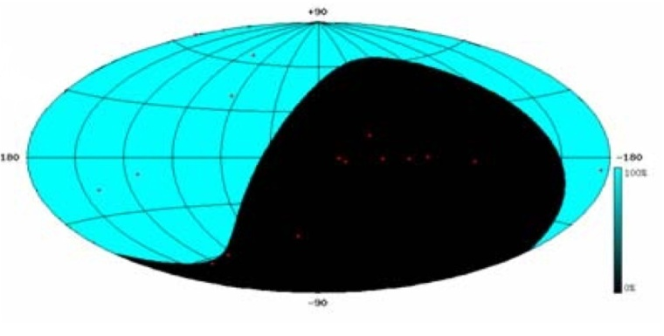
The Mediterranean Viewpoint
Visibility of the Galactic region ➔ ~ 70 % for the Galactic Centre
Optical properties of water ➔ Mapping the Southern sky with unprecedented angular resolution
From the South Pole
Visibility for up-going neutrinos E<~100TeV
Christos Markou, APCTP, 25/8/2025

Slide 10
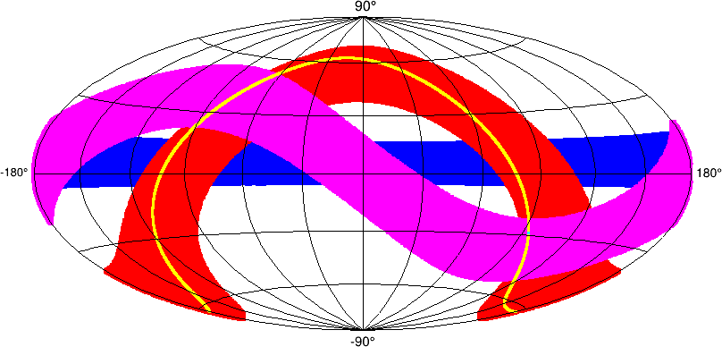
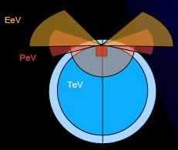
The Mediterranean Viewpoint
Instantaneous FoV at 100 PeV
Lake Baikal South Pole Mediterranean
Christos Markou, APCTP, 25/8/2025

Slide 11
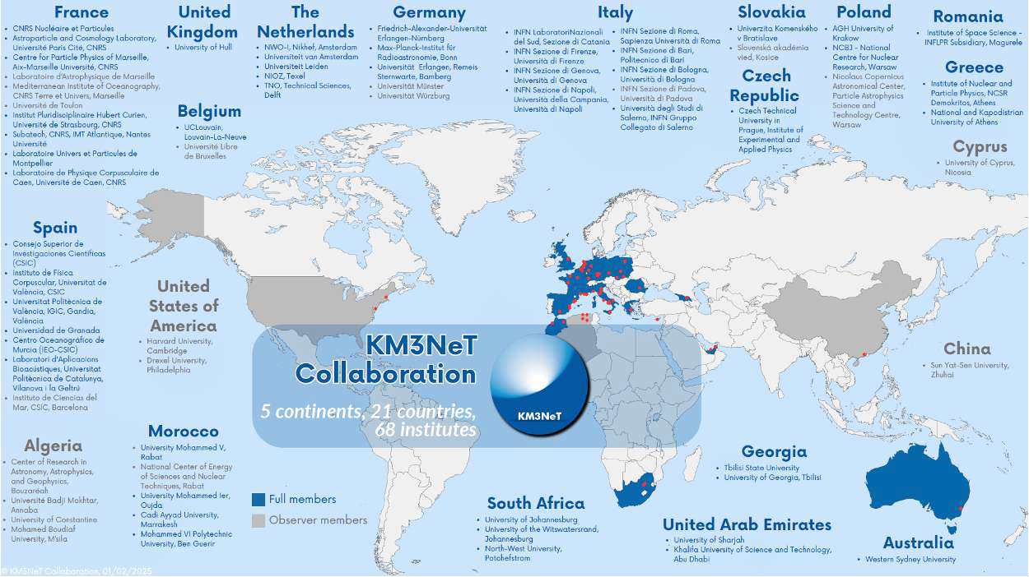
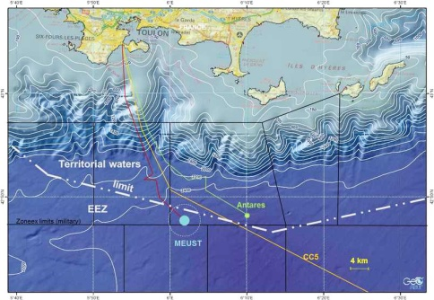

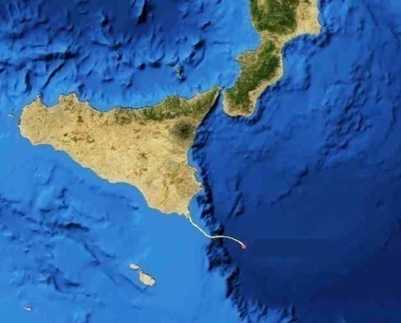
The KM3NeT Collaboration
Distributed infrastructure
in the ESFRI Roadmap
Oscillation Research with Cosmics in the Abyss
ORCA@2450m
Astroparticle Research with Cosmics in the Abyss
ARCA@3450 m
22 countries, 61 institutions, ~300 physicists
Christos Markou, APCTP, 25/8/2025

Slide 12
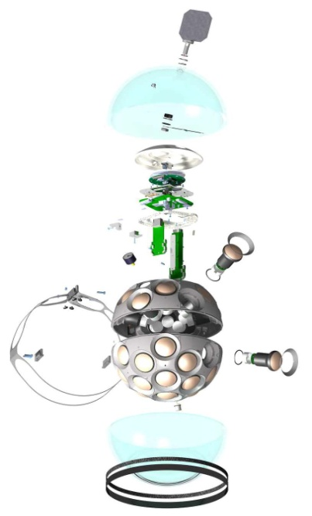
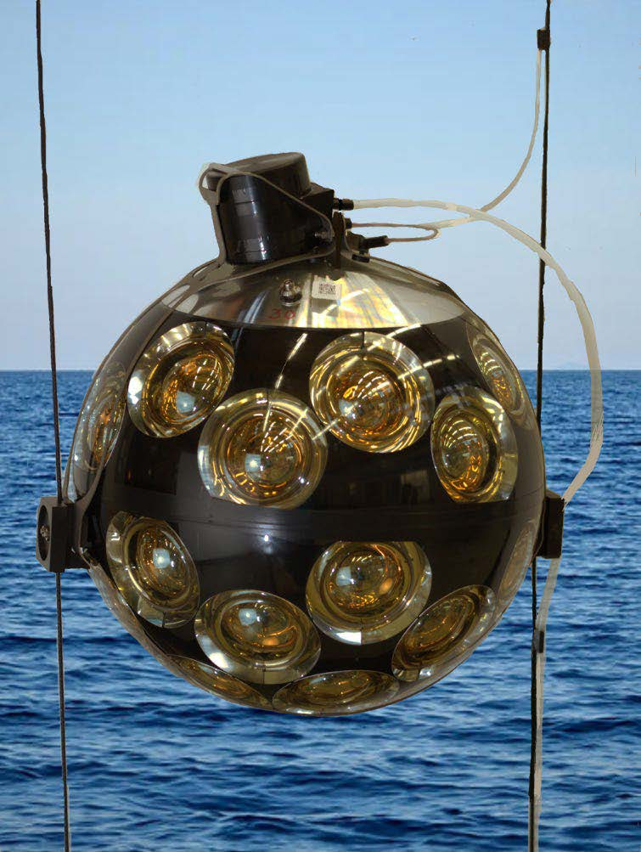
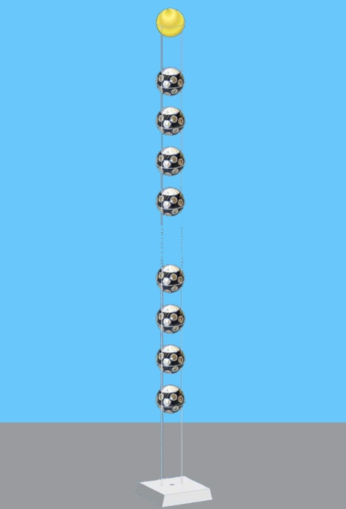
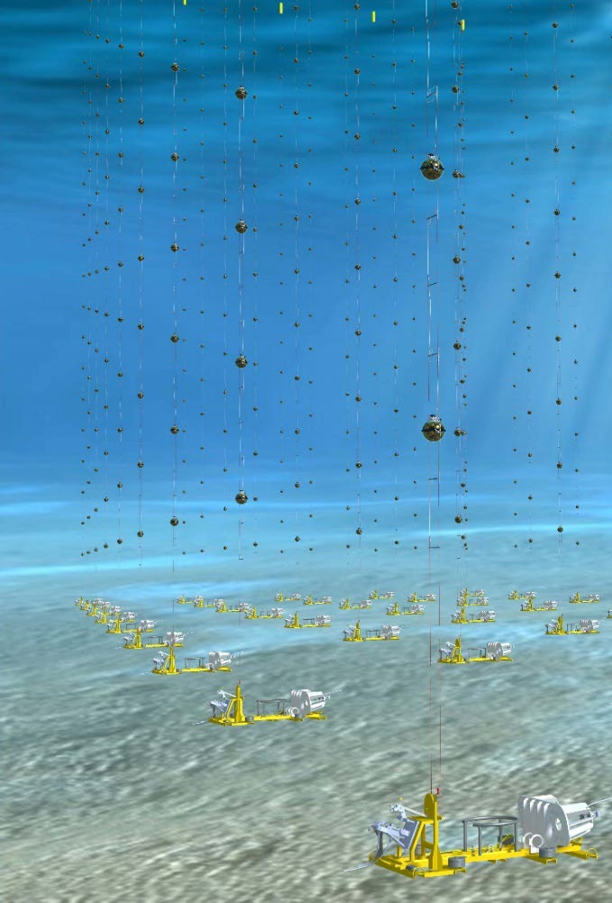
The KM3NeT Detectors
Common, modular design for both ARCA and ORCA
71 Unique Components
1 Digital Optical Module = 31 PMTs + electronics
1 Detection Unit = 18 Digital Optical Modules
1 Building Block =
115 Detection Units
Christos Markou, APCTP, 25/8/2025

Slide 13
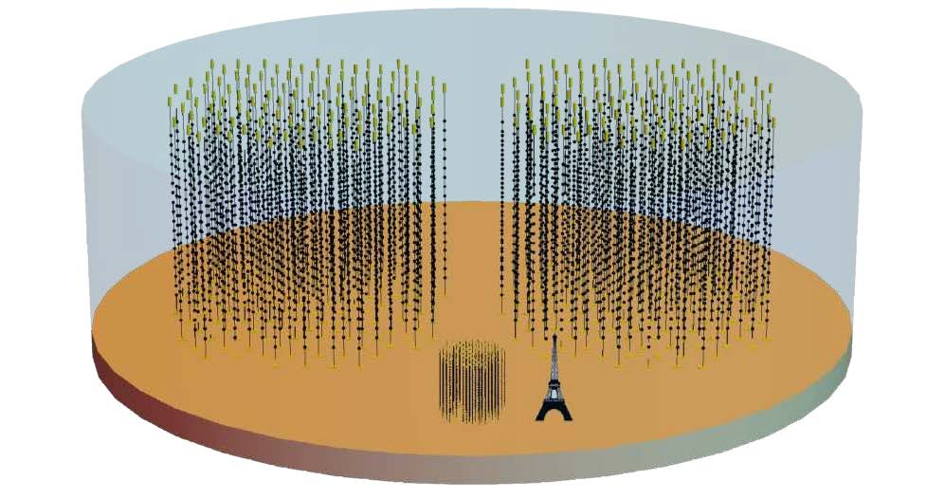
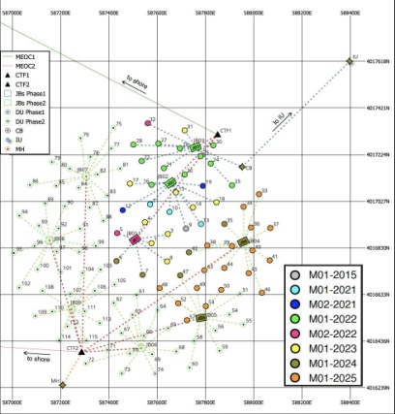
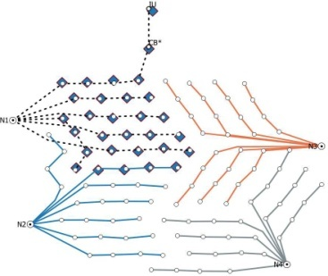
The KM3NeT Detectors
ARCA Blocks
 | ARCA | ORCA
Location | Sicily (IT) | Toulon (FR)
Depth | 3450m | 2450m
No. of DUs | 2 x 115 | 115
DU horizontal spacing | 90 m | 20 m
DOM Vertical Spacing | 36 m | 9 m
DOMs/DU | 18 | 18
PMTs/DOM | 31 | 31
Instrumented water mass | 1 Gton | 7 Mton
DUs deployed | 51 | 28
ORCA Block
ARCA Footprint
ORCA Footprint
Christos Markou, APCTP, 25/8/2025

Slide 14
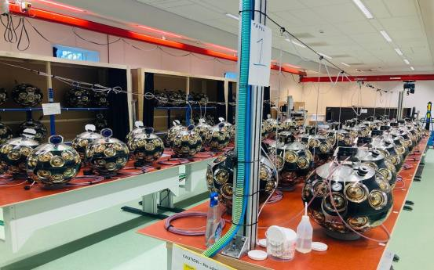
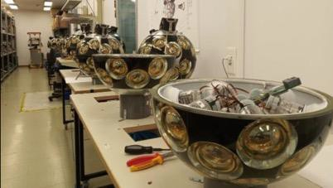
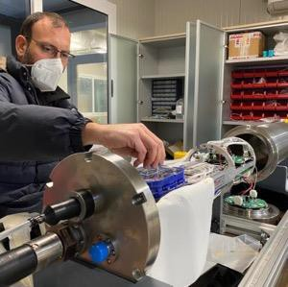
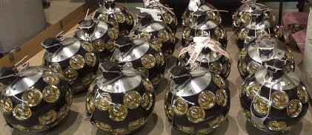
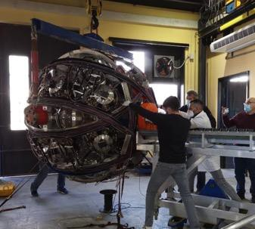
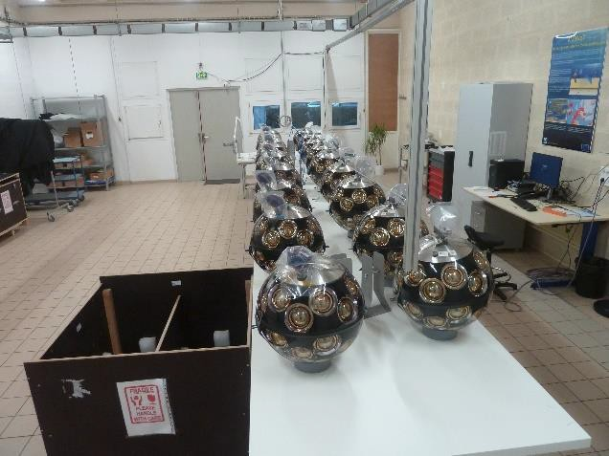
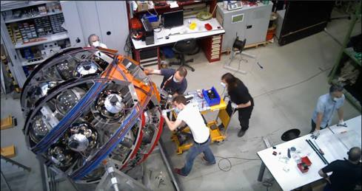
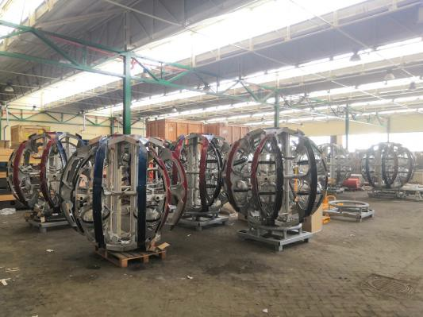
Detector construction
Amsterdam
Athens
Bologna
Erlangen
Catania
Caen
Marseille
Caserta
Caserta
Christos Markou, APCTP, 25/8/2025

Slide 15
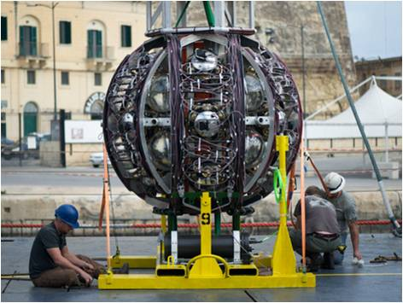
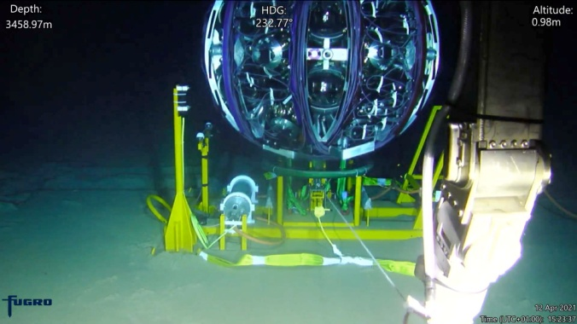
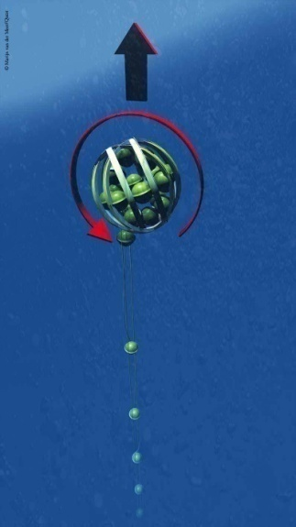
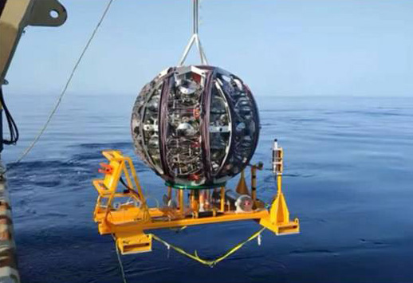
Deployment Strategy
DUs are furled onto reusable launchers
Upon lowered to the seabed via a ship crane, a ROV connects power and network cables
The launcher unfurls allowing the DU to achieve its final position
Typically, multiple DUs are installed in each sea campaign.
Video
Christos Markou, APCTP, 25/8/2025

Slide 16
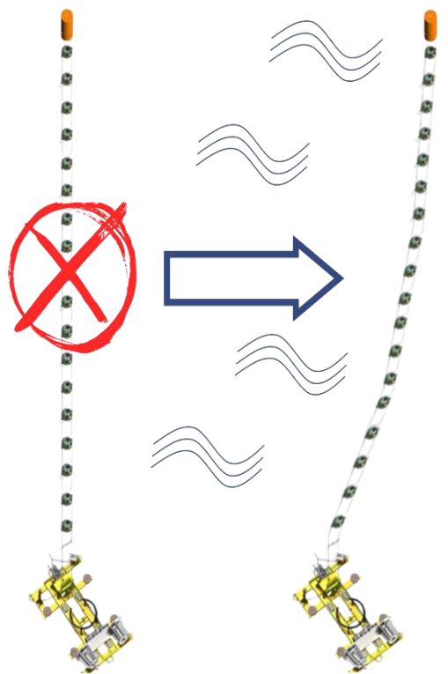
Detector Calibration
Timing calibration
  ◦ LED pulsers (nanobeacon) for inter-DOM calibration (NIM.A 1040 (2022) 167132)
  ◦ < 1ns precision for relative timing between DOMs
  ◦ individual control for each DOM, each DU base and slow control for the junction boxes at the seabed
• Position calibration
  ◦ Tilt and heading in each DOM via tiltmeter and compass
  ◦ Acoustic positioning system
  ◦ Precision better than 10 cm
results in < 0.1° precision for neutrino direction at high energy (>100TeV)
Christos Markou, APCTP, 25/8/2025

Slide 17
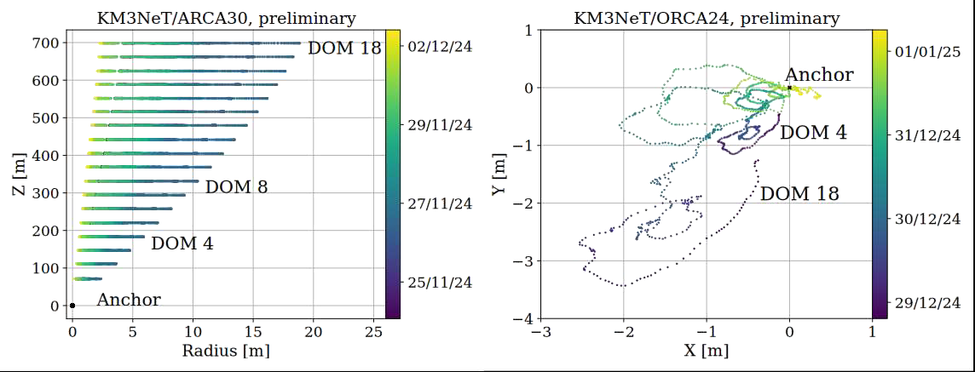
Acoustic positioning
DUs sway and change their shape under the action of currents
Acoustic beacons in known positions emit signals with characteristic waveforms
Piezo sensors on DOMs and base modules detect the signals
The map of the times of arrival of the acoustic signals is inverted to work out the current geometry of the telescope
We need pointing accuracy ~ 0.1° or better!
Christos Markou, APCTP, 25/8/2025

Slide 18
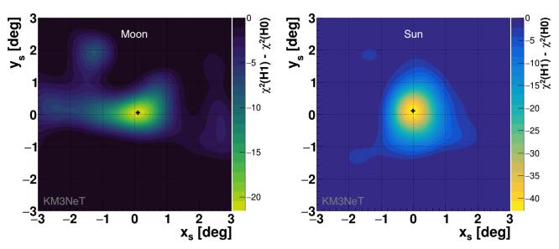
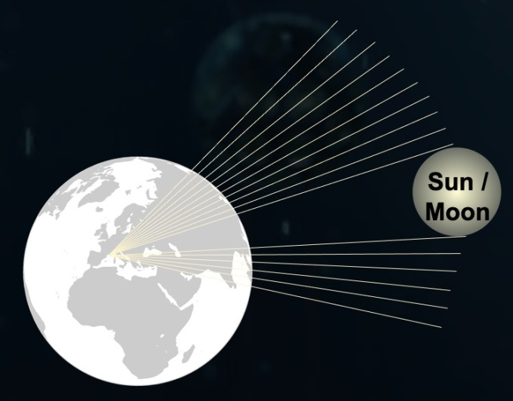
Pointing Accuracy
Exploit the deficit of the atmospheric muon flux in the direction of the Moon & Sun induced by the absorption of cosmic rays (G.W. Clark, 1957)
ORCA6 (500 days) Eur. Phys. J. C 83 (2023) 4, 344 | Sun | Moon
Statistical Significance | 6.2 σ | 4.2 σ
Resolution | 0.65º ± 0.13º | 0.49º ± 0.15º
Christos Markou, APCTP, 25/8/2025

Slide 19
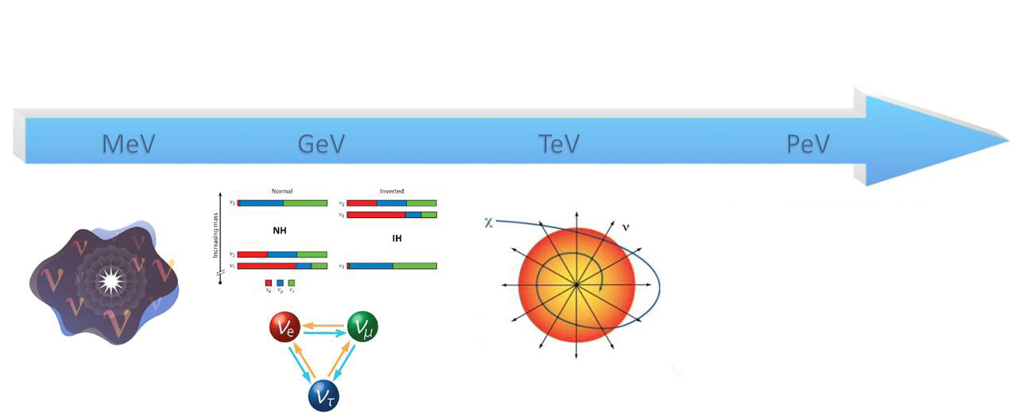
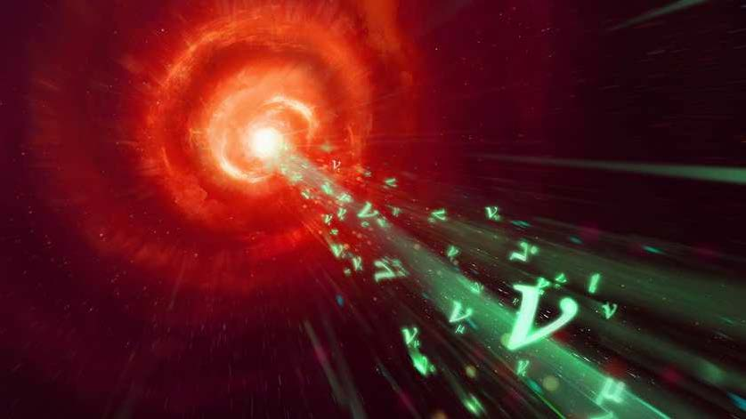
Physics Program with ORCA and ARCA
Supenovae ν oscillations Dark matter searches Cosmic neutrinos
Solar Flares ν mass ordering Exotics searches Multi-messenger Astronomy
KM3NeT/ORCA KM3NeT/ARCA
Christos Markou, APCTP, 25/8/2025

Slide 20
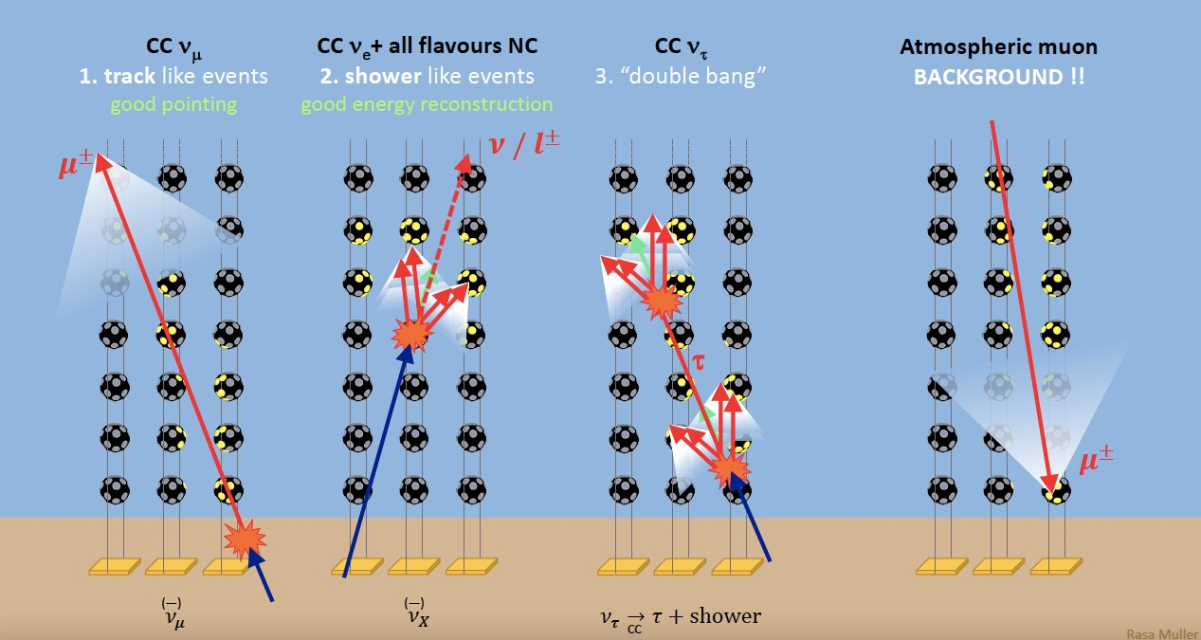
Event Topologies
Tracks @Eν>100 TeV Ang. res. below 0.1° - Energy res. ∼ factor 2
Shower @Eν>100 TeV Ang. res. below 2° - Energy res. ∼6%
Christos Markou, APCTP, 25/8/2025

Slide 21
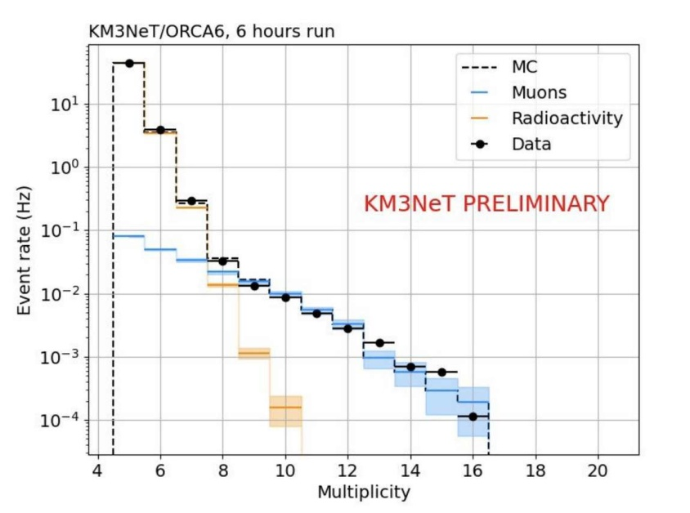
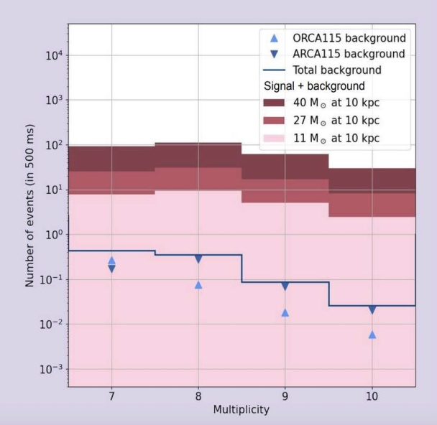
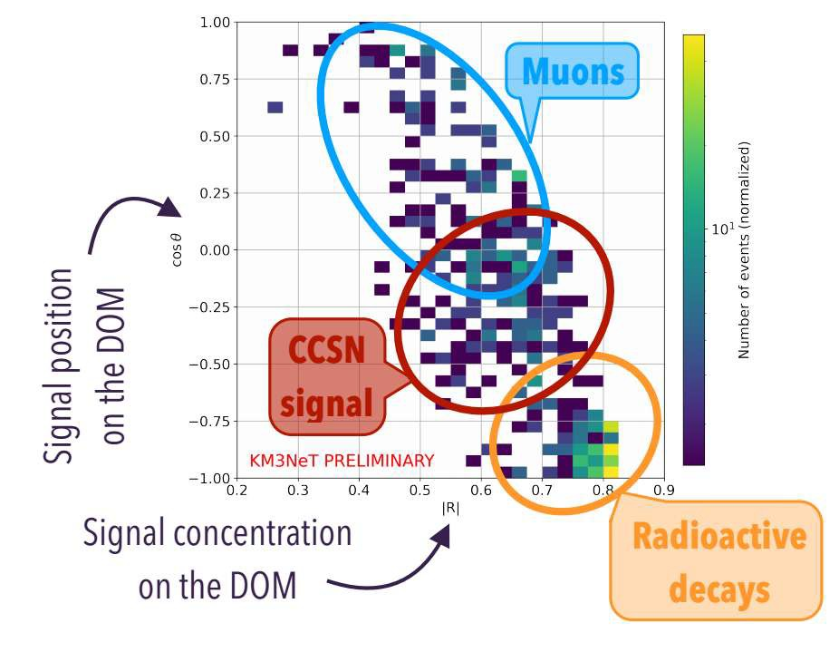


Physics Performance: Supernovae
Neutrinos with E<100 MeV expected at several stages of core collapse
Low-energy neutrino detection is based on the coincidences in single DOMs thanks to the multi-PMT DOM configuration
Background from ⁴⁰K decays, atmospheric muons and muons from ν.
Christos Markou, APCTP, 25/8/2025

Slide 22



Physics Performance: Oscillation results with ORCA6 - 11
Slight preference for IO,
but not significant
Christos Markou, APCTP, 25/8/2025

Slide 23




Physics Performance: Oscillation prospects
3 years of ORCA 115
Normal Ordering
> 4σ NMO determination in reach within this decade when combined with JUNO
Inverted Ordering
Christos Markou, APCTP, 25/8/2025

Slide 24






Physics performance: Testing new physics models with ORCA6
ν_{τ} appearance
arXiv:2502.01443
Neutrino decay
arXiv:2501.11336
Non-standard interactions
arXiv:2411.19078
Quantum decoherence
arXiv:2410.01388
Sterile neutrinos
10.22323/1.476.0155
Lorentz Invariance Violation
ICRC 2023
Christos Markou, APCTP, 25/8/2025

Slide 25




Physics performance: Point sources
Pointing capability improving with increasing telescope size
No point sources observed yet (101 candidate sources)
Sensitivity quickly improving
Pointing accuracy expectation with the full ARCA Detector
Christos Markou, APCTP, 25/8/2025

Slide 26


Physics performance: Diffuse flux
All-sky diffuse flux detection
No observation yet, sensitivity improving
Christos Markou, APCTP, 25/8/2025

Slide 27



Physics performance: Galactic Ridge
Multiple sources of high-energy CR (Cosmic Rays) in the plane of the Milky Way
High-energy neutrinos should be produced via interaction of CR with the interstellar medium
p+N→X+K⁺,π⁺ →...+ μ → e⁺ + νμ + νe
p+N→X+K⁻,π⁻ →...+ μ⁻ → e⁻ + νμ + νe
Christos Markou, APCTP, 25/8/2025

Slide 28


Physics performance: Dark Matter
Sensitivity to signals from WIMP-WIMP annihilation in the Galactic centre
Sensitivity to signals from WIMP-WIMP annihilation in the Sun
Christos Markou, APCTP, 25/8/2025

Slide 29


Nature 638 (2025) 8050, 376-382
Open Data:
https://zenodo.org/records/14860165
Event display 1, 2, 3
Christos Markou, APCTP, 25/8/2025

Slide 30
Companion papers
The ultra-high-energy event KM3-230213A within the global neutrino landscape
KM3NeT Coll., arXiv:2502.08173
On the Potential Galactic Origin of the Ultra-High-Energy Event KM3-230213A
KM3NeT Coll., arXiv:2502.08387
Characterizing candidate blazar counterparts of the ultra-high-energy event KM3-230213A
KM3NeT Coll., arXiv:2502.08484
On the potential cosmogenic origin of the ultra-high-energy event KM3-230213A
KM3NeT Coll., arXiv:2502.08508
KM3NeT constraint on lorentz-violating superluminal neutrino velocity
KM3NeT Coll., arXiv:2502.12070
+ more in the pipe-line…
Christos Markou, APCTP, 25/8/2025

Slide 31


KM3-230213A: An exceptionally high energy event
~28,000 photons, 3,672 PMTs (35% of the ARCA21 detector)
Expected atmospheric muon contamination @ 100 PeV: << 10⁻¹⁰ event/year within 2σ of reconstructed direction
Expected rate of atmospheric neutrinos >100 PeV: << (1-5) x 10⁻⁵ event/year
Christos Markou, APCTP, 25/8/2025

Slide 32












KM3-230213A: Very well reconstructed muon
1
2
3
2
3
4
5
6
1
7
4
5
6
7
Light profile consistent with at least 3 large energy depositions along the muon track
Characteristic of stochastic losses from very high energy muons
Christos Markou, APCTP, 25/8/2025

Slide 33


KM3-230213A: A horizontal muon
Christos Markou, APCTP, 25/8/2025

Slide 34


KM3-230213A: Not an atmospheric muon
Range in seawater (km)
In reality, w.e. distance much larger due to Continental shelf
Christos Markou, APCTP, 25/8/2025

Slide 35



KM3-230213A: Energy measurement
Energy is measured from the amount of light:
The neutrino Energy is higher:
( assuming an E⁻² source spectrum)
Christos Markou, APCTP, 25/8/2025

Slide 36

KM3-230213A: Global fit
KM3NeT Coll., arXiv:2502.08173
Christos Markou, APCTP, 25/8/2025

Slide 37


KM3-230213A: Galactic?
Christos Markou, APCTP, 25/8/2025

Slide 38




KM3-230213A: Origin
Four main hypotheses for KM3-230213A
1 diffuse flux
Galactic – unlikely
Blazar flare – no strong evidence +
requires reduction
of systematic pointing errors
Cosmogenic – possible if subdominant
proton acceleration is included
+ many others!
Christos Markou, APCTP, 25/8/2025

Slide 39
Summary
The KM3NeT research infrastructure is being built in the Mediterranean Sea and includes two neutrino telescope: KM3NeT/ORCA (Toulon, France) and KM3NeT/ARCA (Capo Passero, Italy)
ORCA and ARCA combine a rich neutrino physics and astrophysics scientific scope, from MeV to PeV energies
Excellent Angular resolution allows for precision multi-flavor astronomy
Location allows for the study of galactic and extra-galactic sources
ARCA/ORCA cover full energy range
KM3Net already has
Competitive measurement of neutrino oscillation parameters
First point source limits, diffuse limits
Neutrino mass ordering towards end of the decade
Exceptional >100 PeV neutrino event detected
Sky localization can be improved retroactively - stay tuned
Christos Markou, APCTP, 25/8/2025

Slide 40

Probably the most important message!
Christos Markou, APCTP, 25/8/2025

