Slide 1

NCSR “Demokritos”
Institute of Nuclear and Particle Physics
Christos Markou
25/8/2025

Slide 2
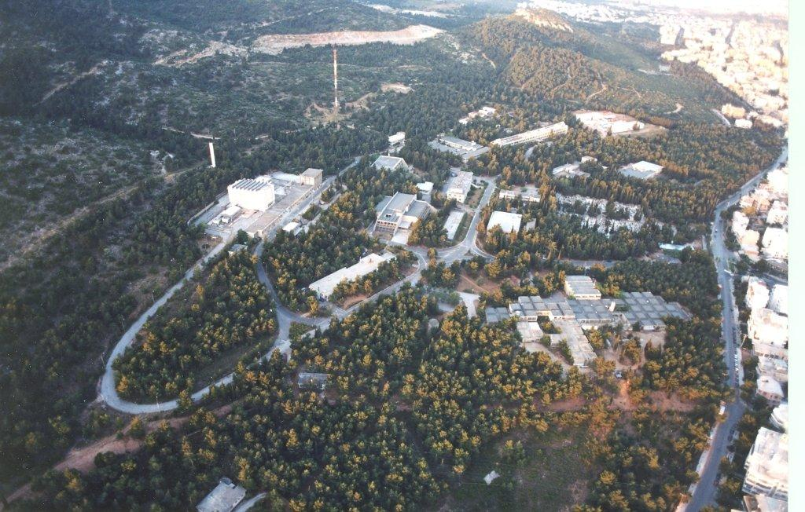
Christos Markou, 25/8/2025

Slide 3
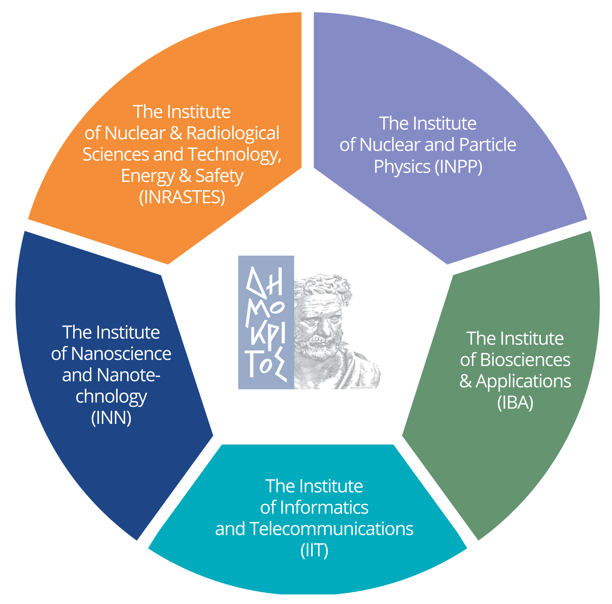

The Institutes
Christos Markou, 25/8/2025

Slide 4


Institute of Quantum Computing & Quantum Technology
New Building:
2.8 million Euros
Christos Markou, 25/8/2025

Slide 5
40%
60%
Female
Male
Christos Markou, 25/8/2025

Slide 6
SOURCE FUNDING
Annual Budget 2024: 55M€
Public Funds
Competitive Grants
Private Research Contracts
Competitive Grants
Horizon Europe
National Awards
Government Contracts
Private Research Contracts
IP Co-Development and Licensing
Spin-offs
Services
Public Funds
Salaries, Permanent Staff
Christos Markou, 25/8/2025

Slide 7
Scientific Identity, our Mission
The Institute of Nuclear and Particle Physics (INPP) is a unique research Institute in Greece in the fields of Nuclear and Particle Physics.
INPP is a, predominantly, fundamental research institution, with activities focused on the areas of High Energy Particle Physics (HEP), Nuclear Physics (NP) and Astroparticle Physics (APP), with experimental and theoretical activities in these main research areas.
The main mission of INPP is to carry out world class experimental and theoretical research, achieve and retain scientific excellence and support innovation in High-Energy Physics, Nuclear Physics and Astroparticle Physics as well as their applications .
Christos Markou, 25/8/2025

Slide 8
Personnel
17 Permanent/tenure track researchers
6 Staff scientists and technicians
2 Administrative personnel
1 Support personnel
6 research associates
24 Ph.D. candidates
19 Master and Undergraduate students
Christos Markou, 25/8/2025

Slide 9
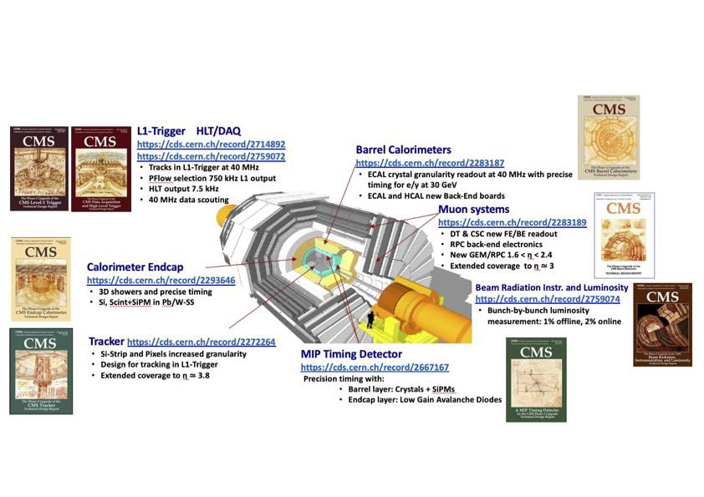
Experimental High Energy Physics – CMS
Part of the CMS in LHC since the inception
of the experiment in the 1990s.
Development of the Si modules of the
CMS Preshower of ECAL calorimeter,
the global CMS trigger emulator project
and numerous physics analyses.
Since 2016, part of the Tracker Silicon project
in view of the Phase II upgrade of the
CMS detector: development of the silicon sensors, the Data Acquisition System and the evaluation of the front-end electronics.
Christos Markou, 25/8/2025

Slide 10
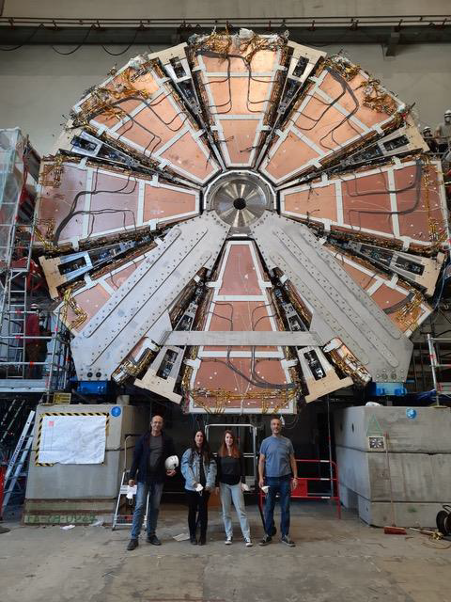
Experimental High Energy Physics – ATLAS
Contribution to the upgrade of the ATLAS
detector, and in particular the New Small
Wheel (NSW) end-cap muon detector.
Heavy involvement in the construction of
electronics for the Trigger and the DAQ,
the installation of the detector and substantial
responsibilities related to Muon software
Coordination and the sTGC Trigger
Commissioning coordination.
Christos Markou, 25/8/2025

Slide 11
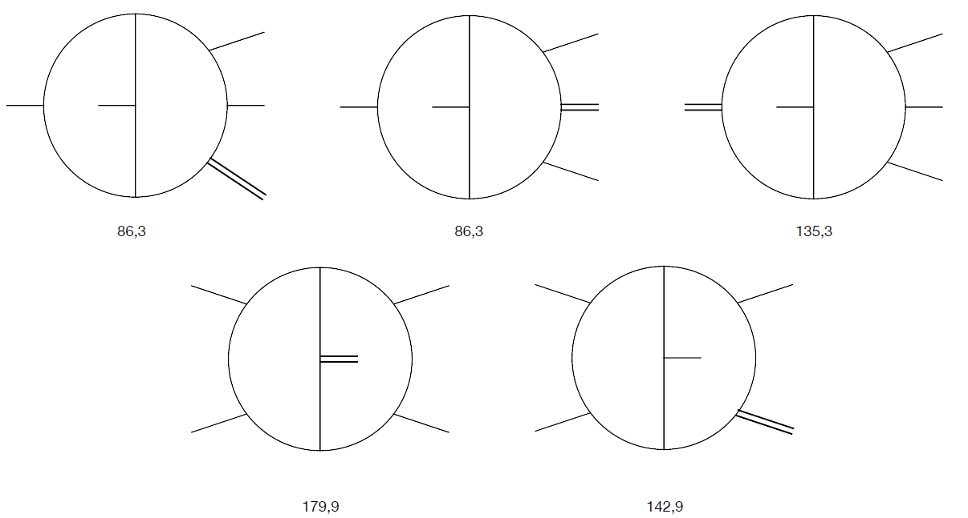
Theoretical High Energy Physics
A very broad set of research topics ranging
from Quantum Field Theory, to Scattering
amplitudes and Particle Physics
Phenomenology, String theory and Quantum
Gravity, Non-Linear Chaotic Dynamics and
Complex systems, Cosmology and Quantum
Computation and information theory.
Strong ties with our experimentalists.
Christos Markou, 25/8/2025

Slide 12
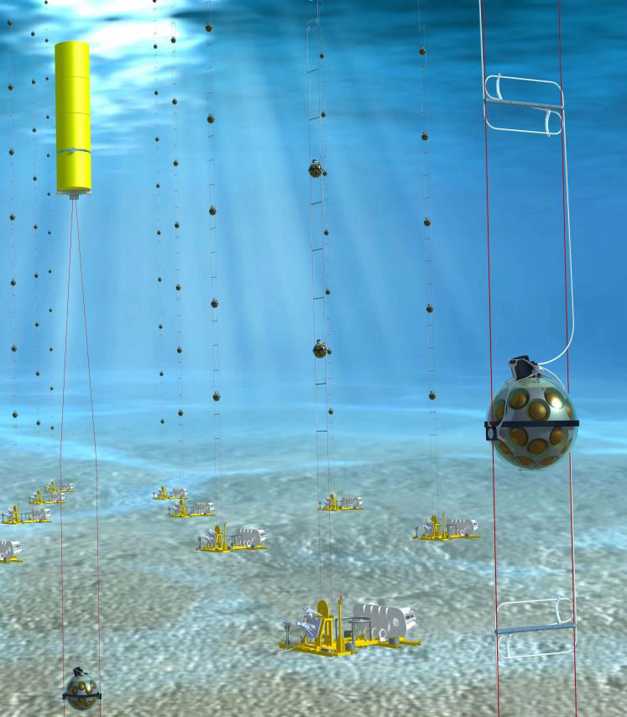
Astroparticle Physics
The group is part of the KM3NeT collaboration building a network of underwater neutrino telescopes in the Mediterranean Sea. Development, construction, testing and validation of detector components, data collection and data analysis. The INPP hosts a lab of assembly, testing and calibration of Digital Optical Modules. Active program for the development of novel neutrino detection
techniques, and synergies with geo-and
marine scientists and expansion of the experimental program.
Also in HyperK (Japan) and ANNIE (Fermilab).
Christos Markou, 25/8/2025

Slide 13
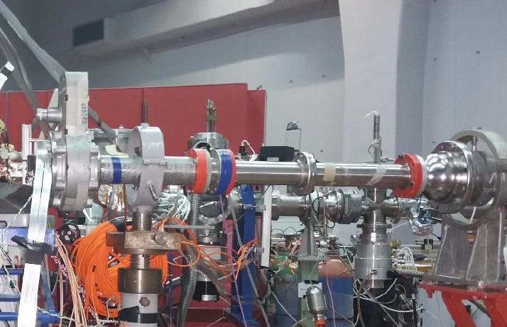
Nuclear Physics and Applications
Experimental studies on nuclear astrophysics and
nuclear structure, interactions of ion beams and
X-rays with matter. Key infrastructure are the
Tandem Accelerator (TAL) and XRF Laboratory.
Interdisciplinary applications with interest in
emerging technologies, cultural heritage,
environmental monitoring, human health, etc.
The XRF lab provides technology transfer and
on-site analytical services at museums,
archaeological sites, etc. Joint research with
national and European collaborators. TAL has undergone a major upgrade under the CALIBRA project, with a PET Cyclotron and an AMS just being added to the infrastructure.
Christos Markou, 25/8/2025

Slide 14
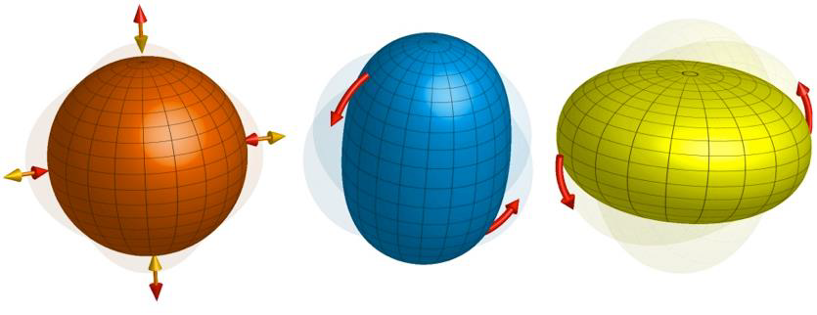
Theoretical Nuclear Physics
Focusing on the study of nuclear structure,
the Nuclear Theory Group achieved a
breakthrough in 2017 with the introduction
of the proxy-SU(3) symmetry, for calculating
the properties of medium mass and heavy
Nuclei away from closed shells.
The proxy-SU(3) symmetry has recently
produced important, parameter-independent predictions on the occurrence
of shape coexistence and has triggered experimental proposals for its verification.
Christos Markou, 25/8/2025

Slide 15
Thank you!
Looking forward to strengthening our long-term collaboration!
Christos Markou, 25/8/2025

