Slide 1
EIC International Accelerator Collaboration
Commissioning Tool Workgroup
Status Update @ IPAC’25
Yue Hao (Co-Chair) and Jean-Luc Vay (Co-Chair)

Slide 2
Commissioning Tool Working Group
26 participants from 10 institutes actively participate in the discussion
Community effort, benefit EIC and member’s home facilities
  Brew new developments to attract R&D and other off-project fundings
Kick off meeting in March 2025, followed by monthly meeting
Discussion Topics
  High level physics application(HLPA) and Virtual Accelerator (VA)
  Interfacing with EPICS control system
  Machine Portal for multiple design/beam dynamics software
  AI/ML integration and path forward to digital twins
We welcome anyone with an interest in these topics to participate

Slide 3
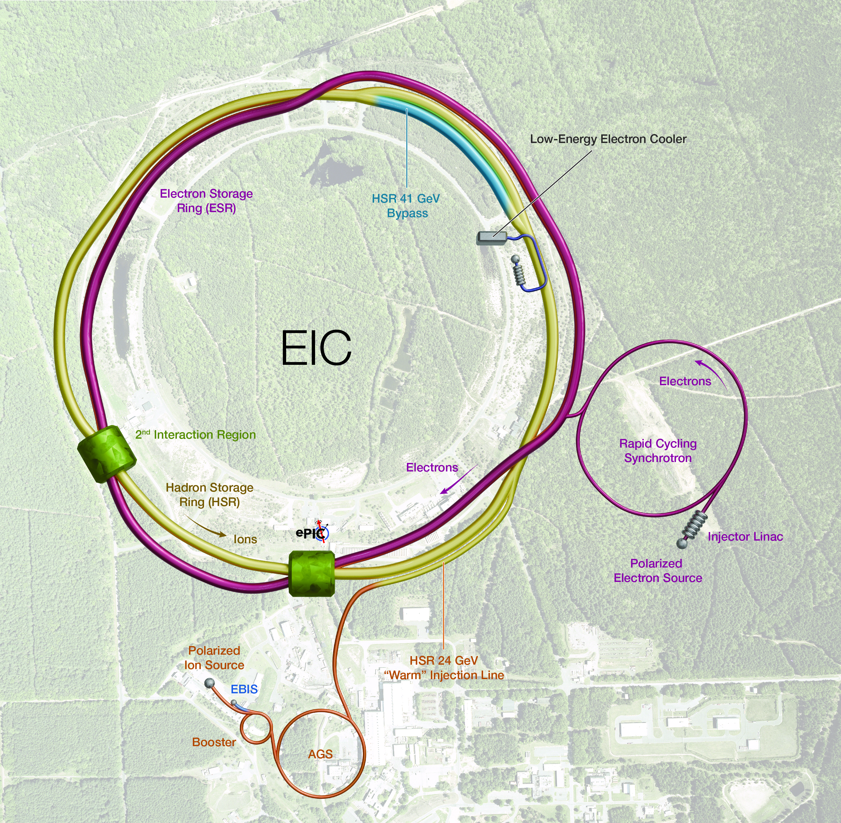
Requirement for EIC Virtual Accelerator
Facilitate efficient development, test and integration of commissioning tools:
Multi-fidelity simulations at various time-scale beam quality optimization.
Start-to-end online model with (multiple) real-time simulation tools for orbit, optics, crabbing properties and spin, injection / extraction and synchronization.
Migrate mature tools to control room applications.
    W/ a user-friendly interface to the EPICS control system.
Ready for data-driven/Machine learning model, training and inference, and development towards digital twin.

Slide 4
Plans for EIC VA
Control Room
Software, GUI
Infer
Train
USER Interface
(JupyterHub)
AI/ML applications
Machine Model
MADX
Elegant
BMAD
Beam-Beam Sim.
...
XSuite
BLAST
Deploy
EIC Virtual Accelerator
Machine Portal / Database
IOC
IOC
IOC
IOC
IOC
EIC Accelerator Complex

Slide 5
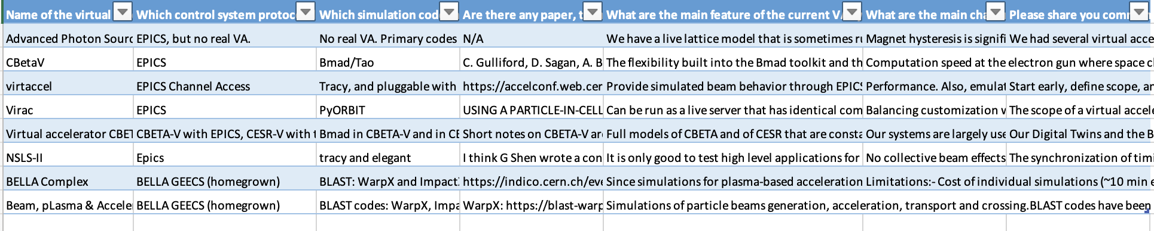
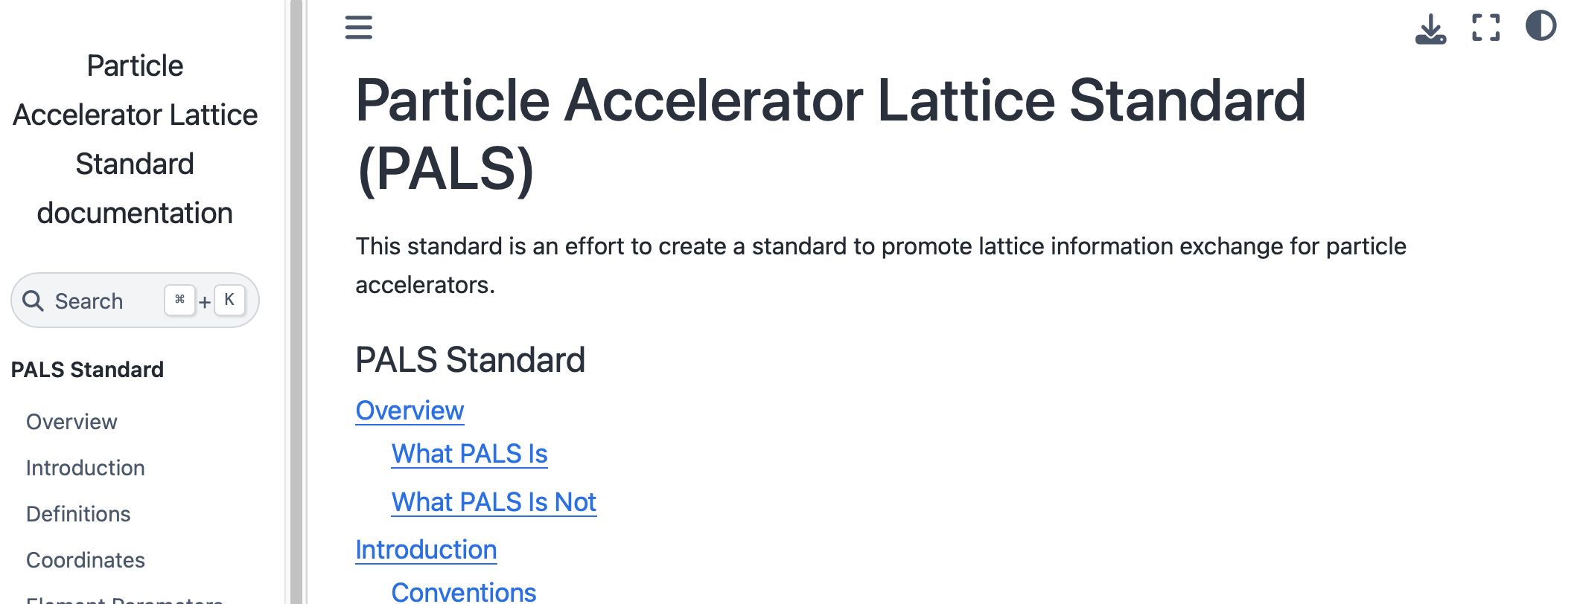
EIC VA is benefiting from the Community
EIC VA is learning from the experiences of other accelerator facilities.
EIC plans to adopt (& help develop) the new accelerator standard PALS, to fit the need of multi-physics modeling needs.
  https://github.com/campa-consortium/pals

Slide 6
Thank you!
Please reach out if you are interested in joining this effort.

