Slide 1
Electron Ion Collider Accelerator Collaboration: status and opportunities
Sergei Nagaitsev
EIC Technical Director
June 3, 2025
IPAC 2025

Slide 2
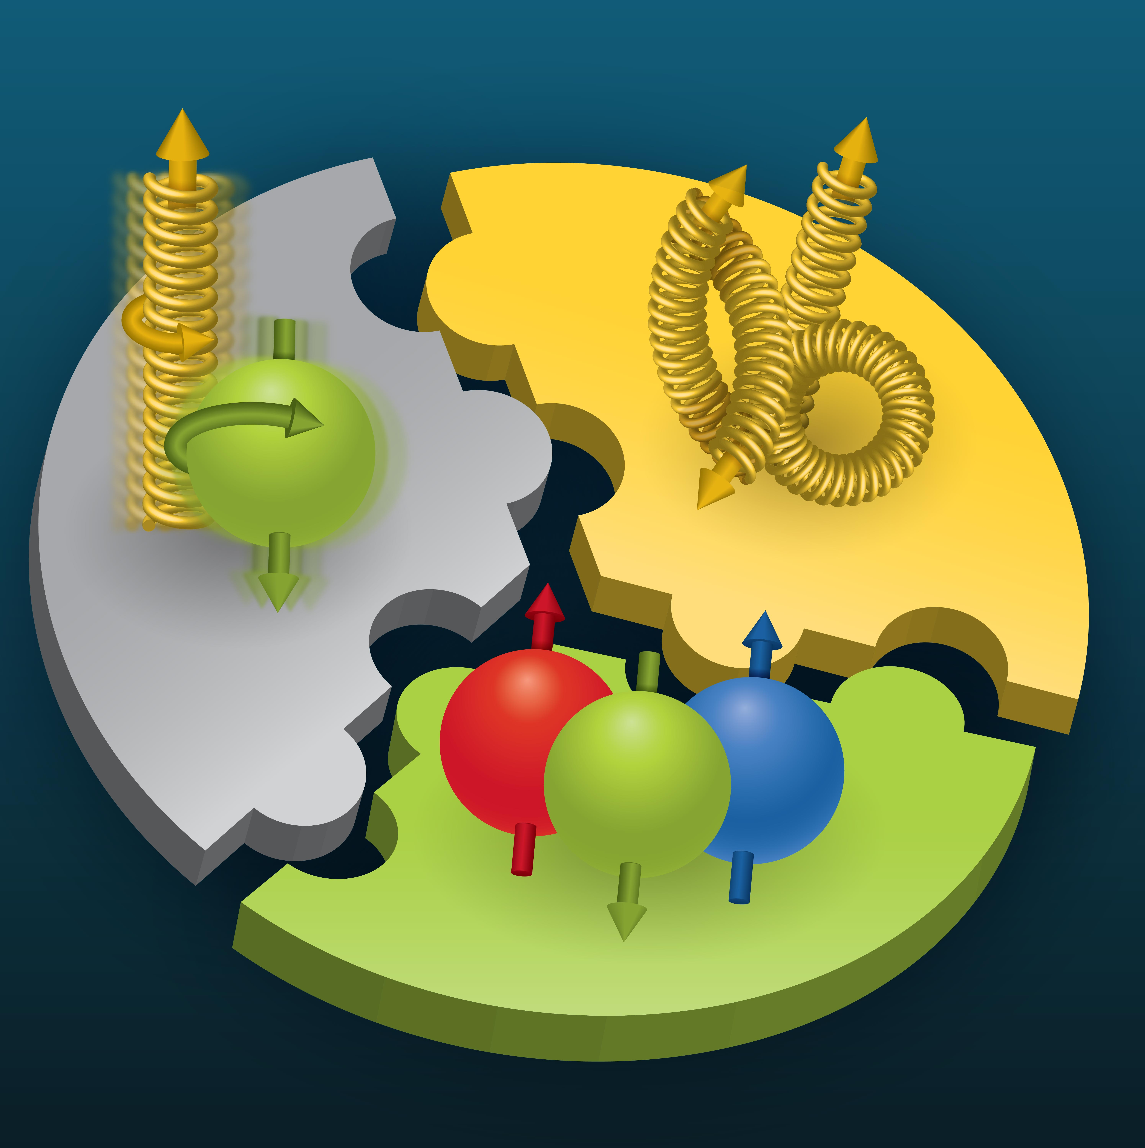

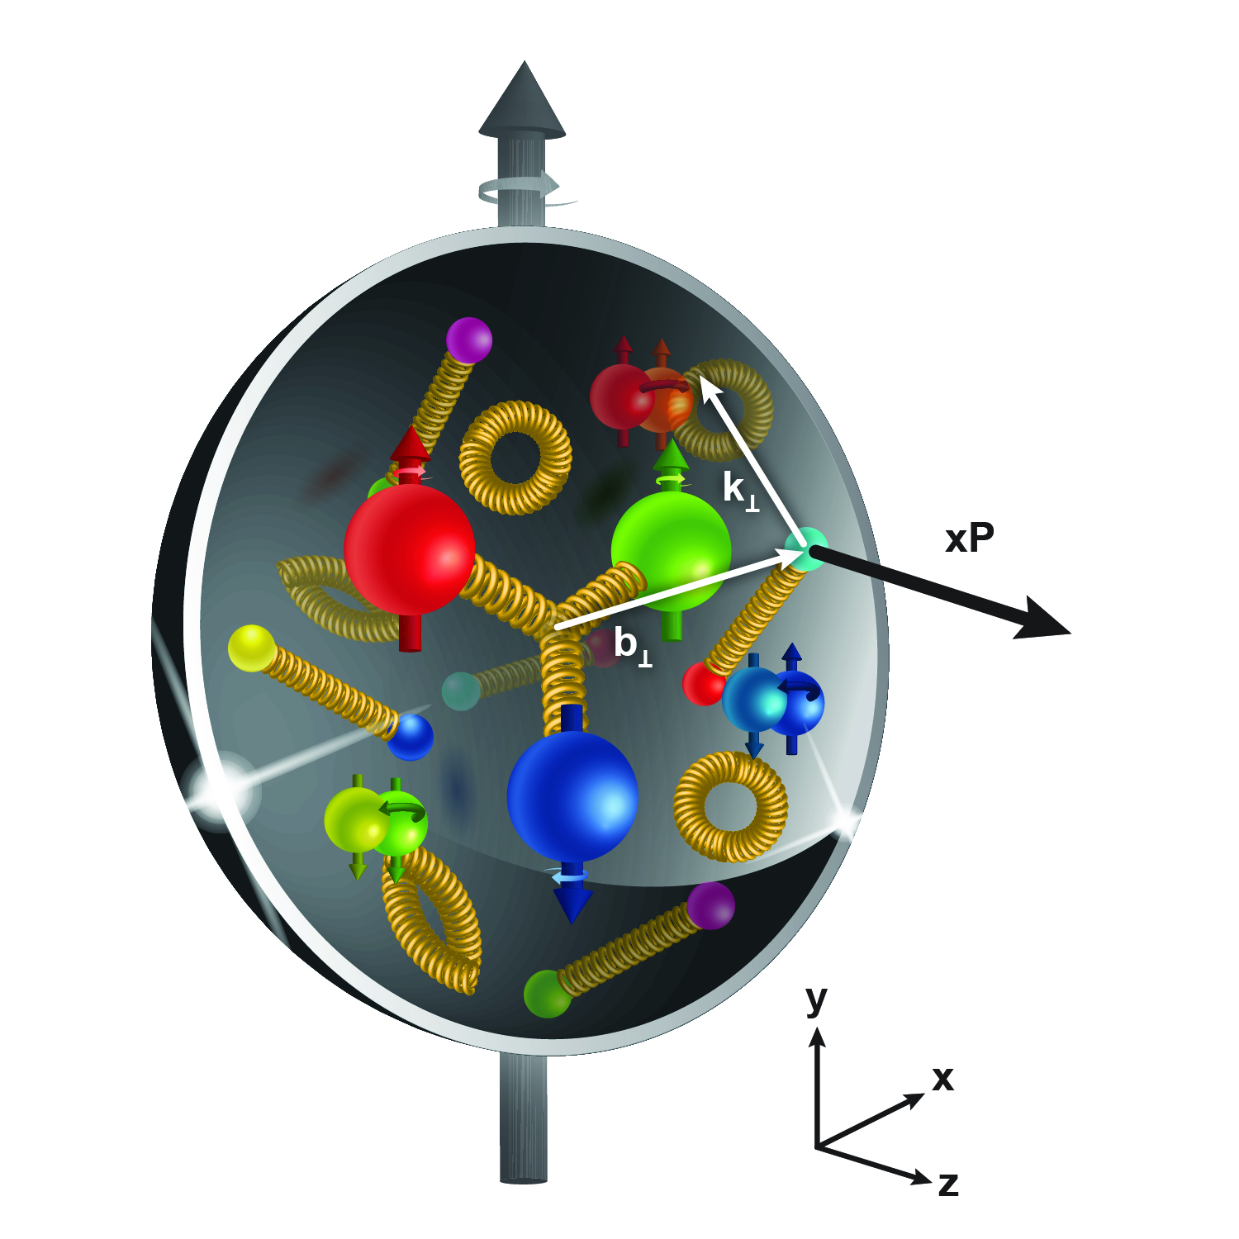
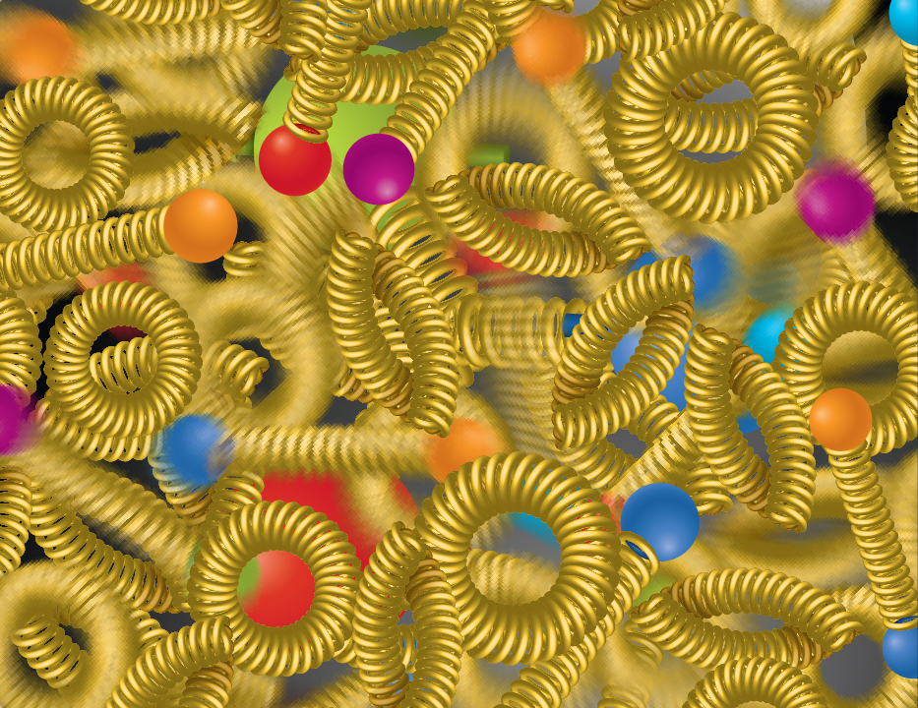
Compelling EIC Science Case
How do quarks, gluons, and orbital angular momentum contribute to proton spin?
Spin is a fundamental property of matter.
All elementary particles,
but the Higgs, carry spin.
Spin cannot be explained by a static picture, rather the interplay between the properties and interactions of quarks and gluons inside
the proton.
Does the mass of visible matter emerge from quark-gluon interactions?
Atom: Binding/Mass = 0.00000001
Nucleus: Binding/Mass = 0.01
Proton: Binding/Mass = 100
The EIC will determine an important term contributing to the proton mass, the so-called quantum chromodynamics (QCD) trace anomaly.
How can we understand QCD dynamics and the relation to confinement?
EIC will image quarks and gluons in 3D in space and momentum inside the nucleon and nuclei and uncover how the nucleon properties emerge from quarks and gluons and their interactions.
How do quark-gluon interactions create nuclear binding?
Is the structure of a free and bound nucleon the same?
How do quarks and gluons, interact with a nuclear medium?
How do the confined hadronic states emerge from these quarks and gluons?
Does gluon density in nuclei saturate at high energy?
How many gluons can fit in a proton?
How does a dense nuclear environment affect the quarks and gluons, their correlations and interactions?
=
gluon
splitting
?
gluon
recombination
National Academies of Sciences, Medicine, and Engineering, 2018 Consensus Study Report)
2

Slide 3
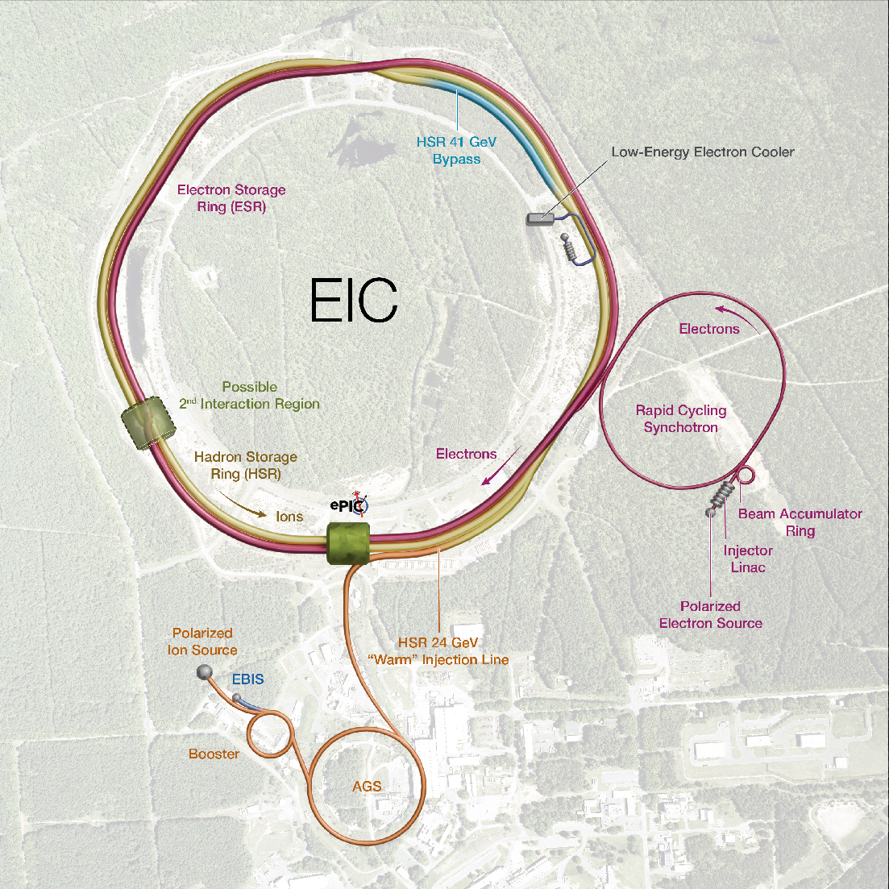
EIC at BNL
Timeline for planning purposes:
Mid-2026 → 2035
We will have several sub-projects:
Collider rings
IR
Detector
Electron Injector
Global systems

Slide 4
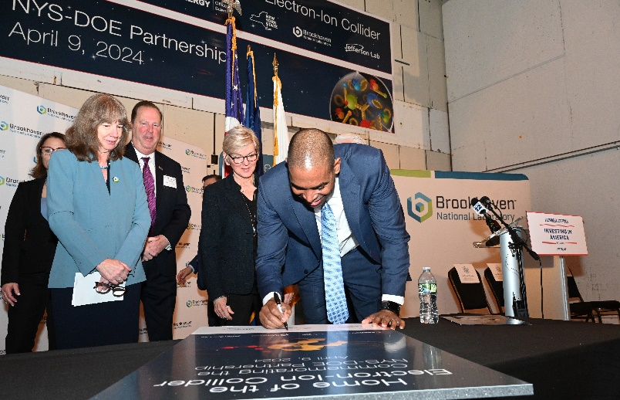
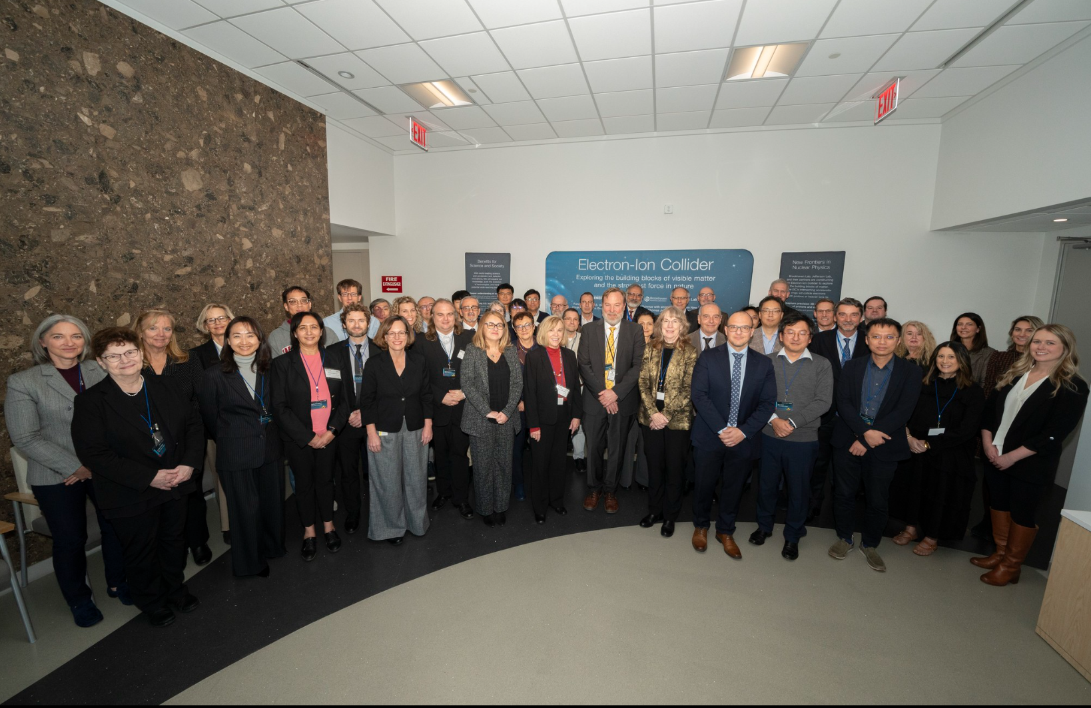

Strong Support from Partners & Collaborators
New York State committed $100M toward construction of EIC buildings and infrastructure.
EIC Accelerator Collaboration kicked off at IPAC’24 with over 150 participants expressing interest in contributing to the global EIC effort.
UK announced £58 million ($75M) for the EIC.
EIC Resource Review Board Meetings in Rome in May 2024 and at BNL in Oct. 2024. Strong participation from Canada, Czech Republic, France, India, Israel, Italy, Japan, Poland, South Korea, United Kingdom, and Taiwan. Next meeting to be held in Prague in June 2025.
In-kind contribution goals represent ~30% of the Detector and ~5% of the Accelerator
4
4
4

Slide 5
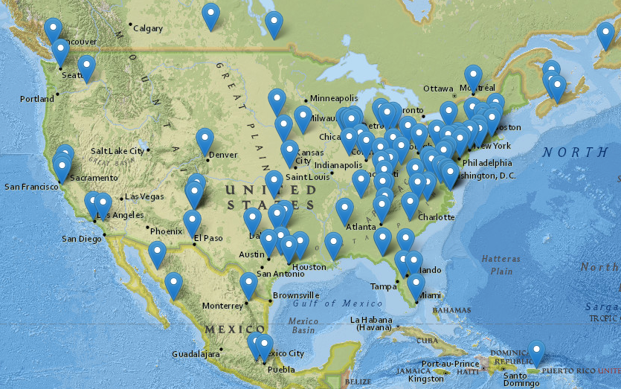
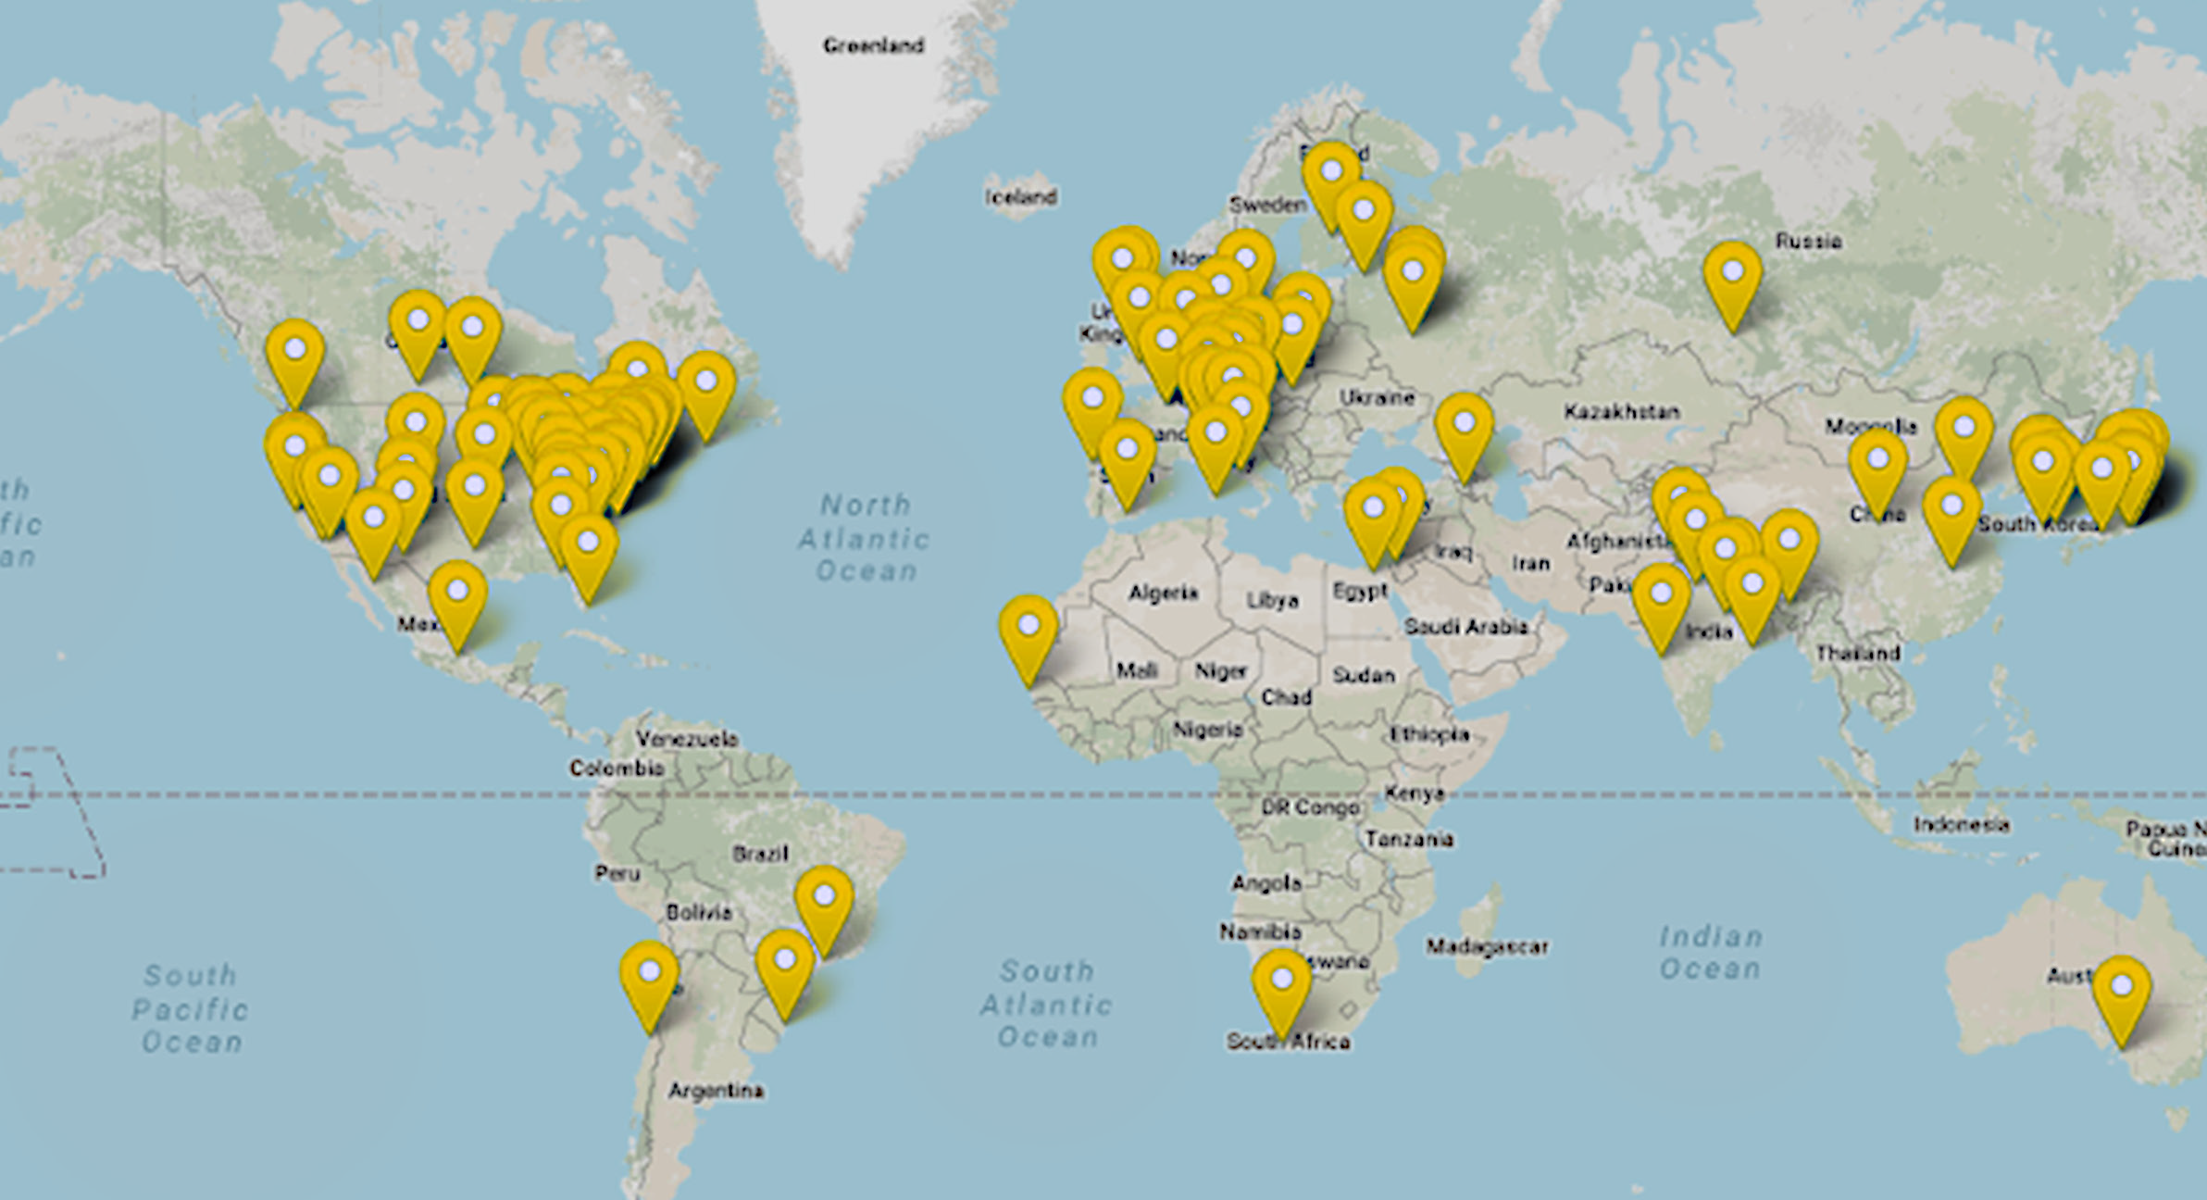
The EIC Users Group – a vibrant community
Nine national labs and 99 U.S. universities and institutions, as well as 139 international partners, will participate in the EIC.
The EIC Users Group has been growing rapidly—more than 1,400 scientists from more than 296 institutions in 40 countries around the world.
www.eicug.org

Slide 6
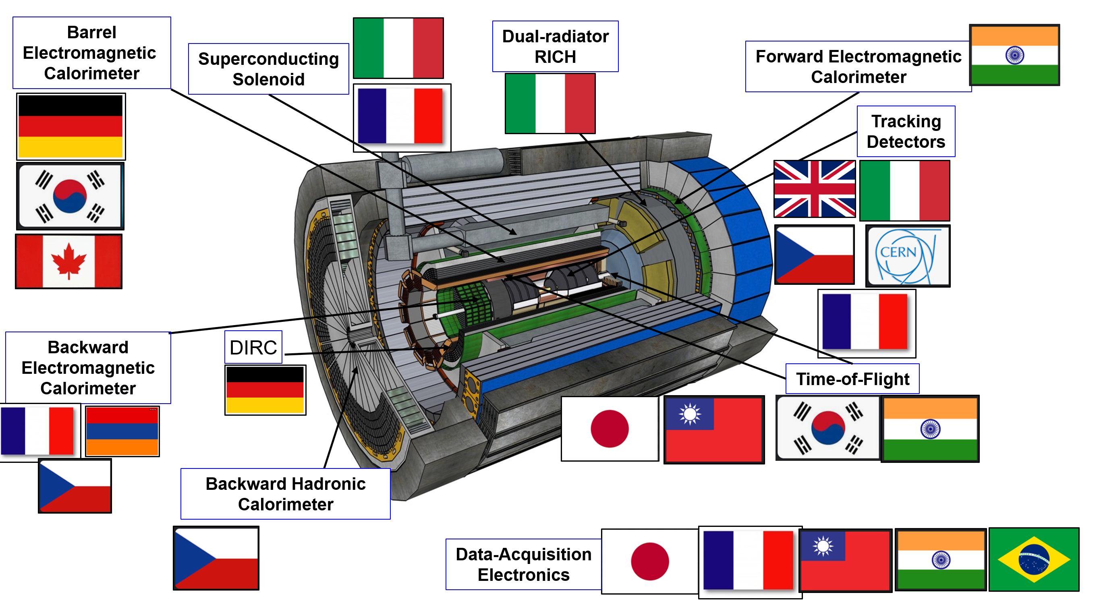
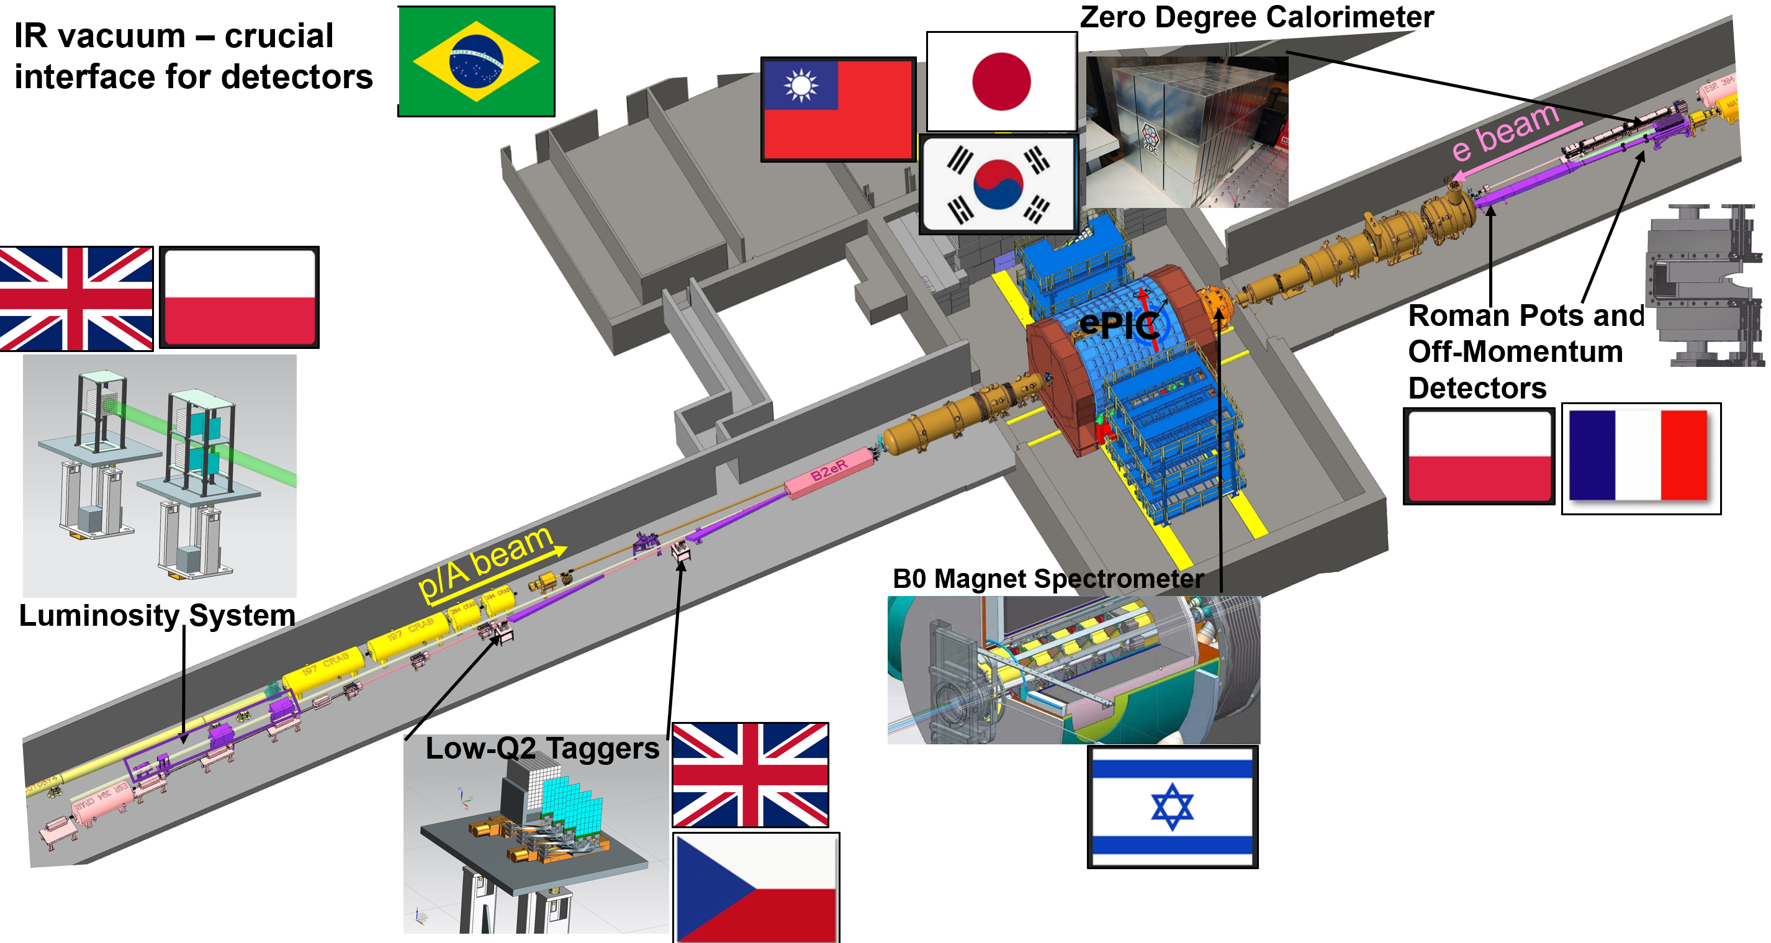
Overview of IKC for the ePIC Detector
Italy and France IKCs for the Detector Solenoid magnet, procurement and design respectively.
UK, Italy, France, Korea, Canada, and Japan have identified scope for IKCs in several Detector areas.
Other IKCs are being discussed with India, Israel, Taiwan and potentially others could follow.
6

Slide 7
Can we organize the EIC Accelerator Collaboration in a similar manner?

Slide 8
EIC Accelerator Collaboration?
EIC Accelerator Science and Technology Space
EIC Construction Project (funded by the DOE)
EIC Upgrades
In-kind contributions
Accelerator Science and Technology
Industry Partnerships
AST Education and Training

Slide 9
Funding
US Nat Labs and universities
  On-project and off-project – different approaches
  LDRDs, DOE ECA grants, FOAs
Non-US partners
CERN
Industrial partners
Every case is going to be unique. Every conversation should start with science and technology impacts, not with funding.

Slide 10
EIC Accelerator Collaboration
EIC Accelerator Collaboration missions:
  Provide a discussion forum and a collaboration vehicle for the EIC accelerator-related working groups and topics;
  Identify and create opportunities for US institutions to contribute to the EIC construction project;
  Identify and create opportunities for In-Kind contributions to the EIC project and to future upgrades;
  Identify and develop future EIC facility upgrades;
  Identify and provide accelerator research and development topics and opportunities;
  Communicate to EIC stakeholders on behalf of the accelerator R&D community;
  Communicate to various long-range planning panels.
The EIC Accelerator Collaboration will enhance the long-term evolution and performance of the EIC, and should also help us construct the EIC more efficiently.

Slide 11
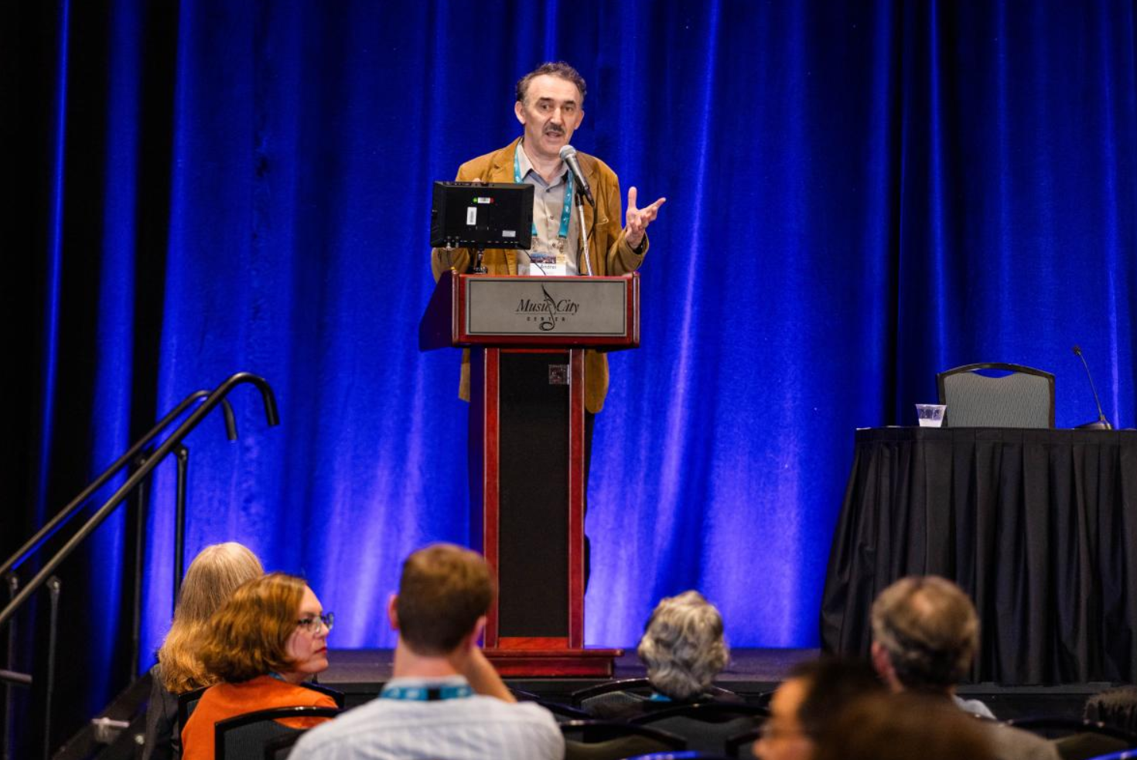
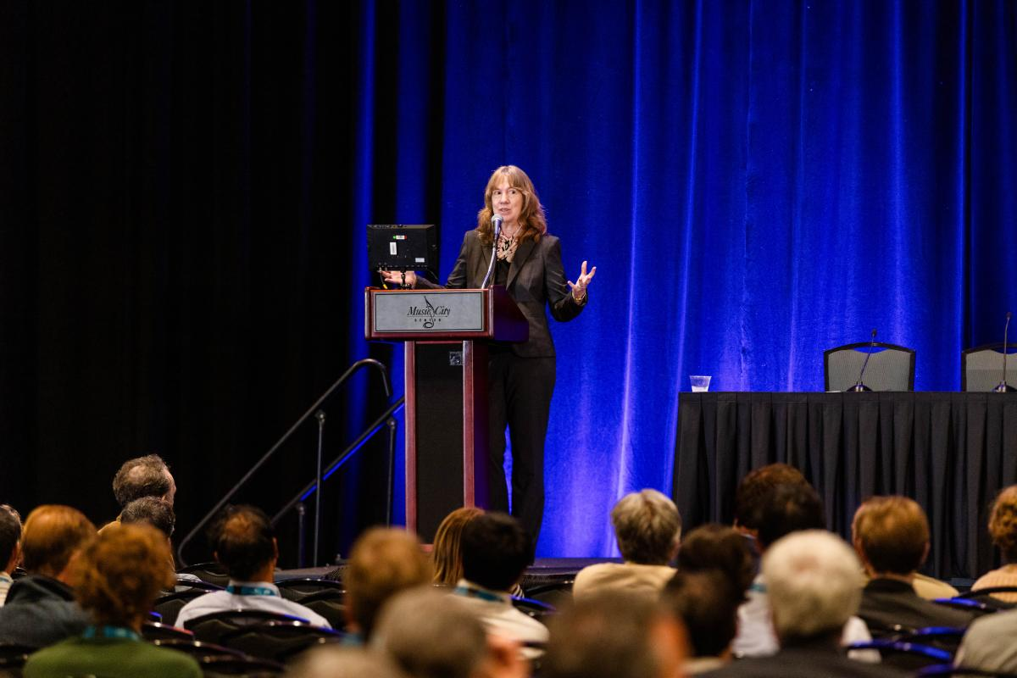
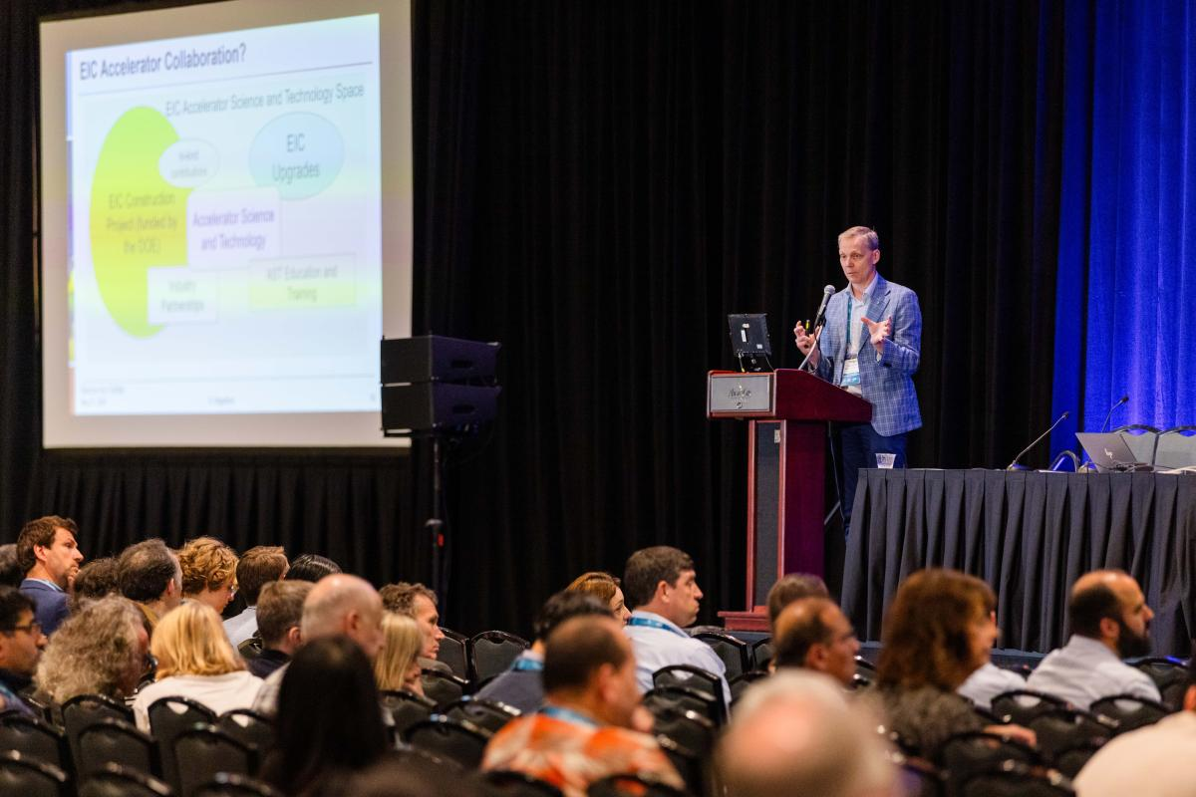
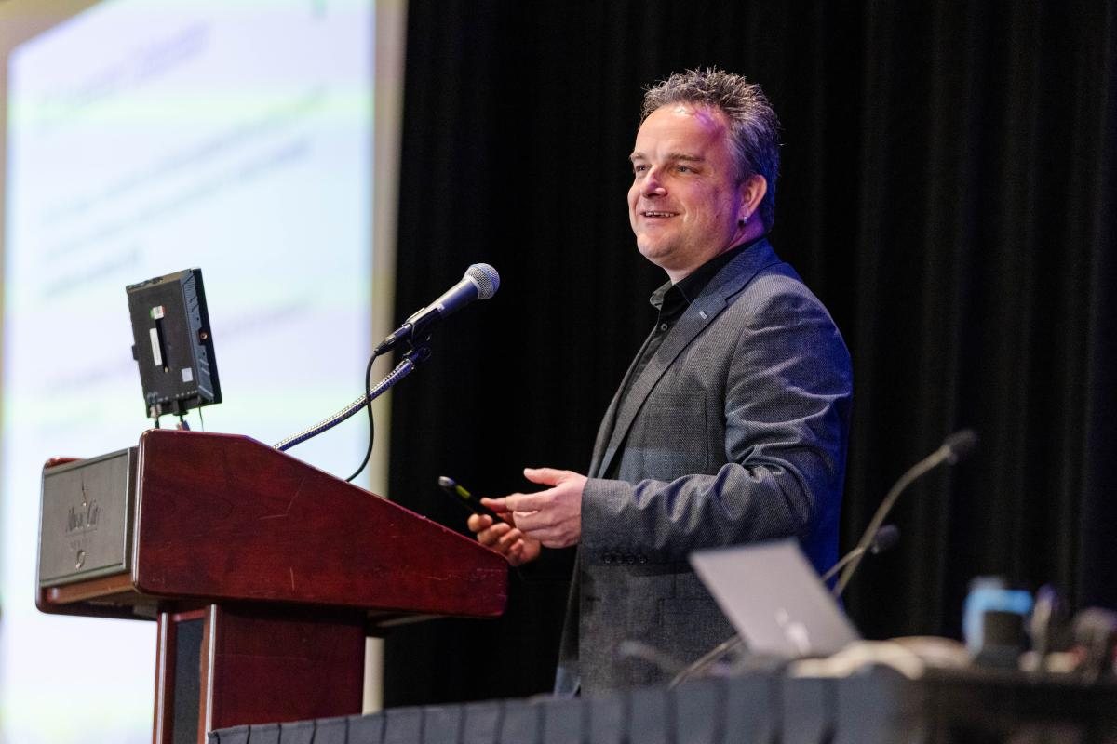
EIC Accelerator Collaboration Kick-off meeting
IPAC’24

Slide 12
Since IPAC’24
Launched 3 Working Groups, working on an ‘EIC industry forum’
Launched a new web site: www.eicac.org
Launched a common indico site for all EICAC WGs on indico.global
Contributed to the European Strategy update
New co-chair: Carsten → Tatiana

Slide 13

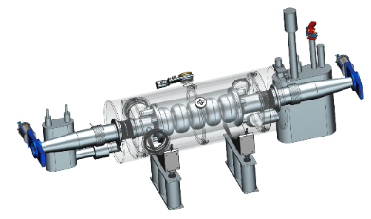
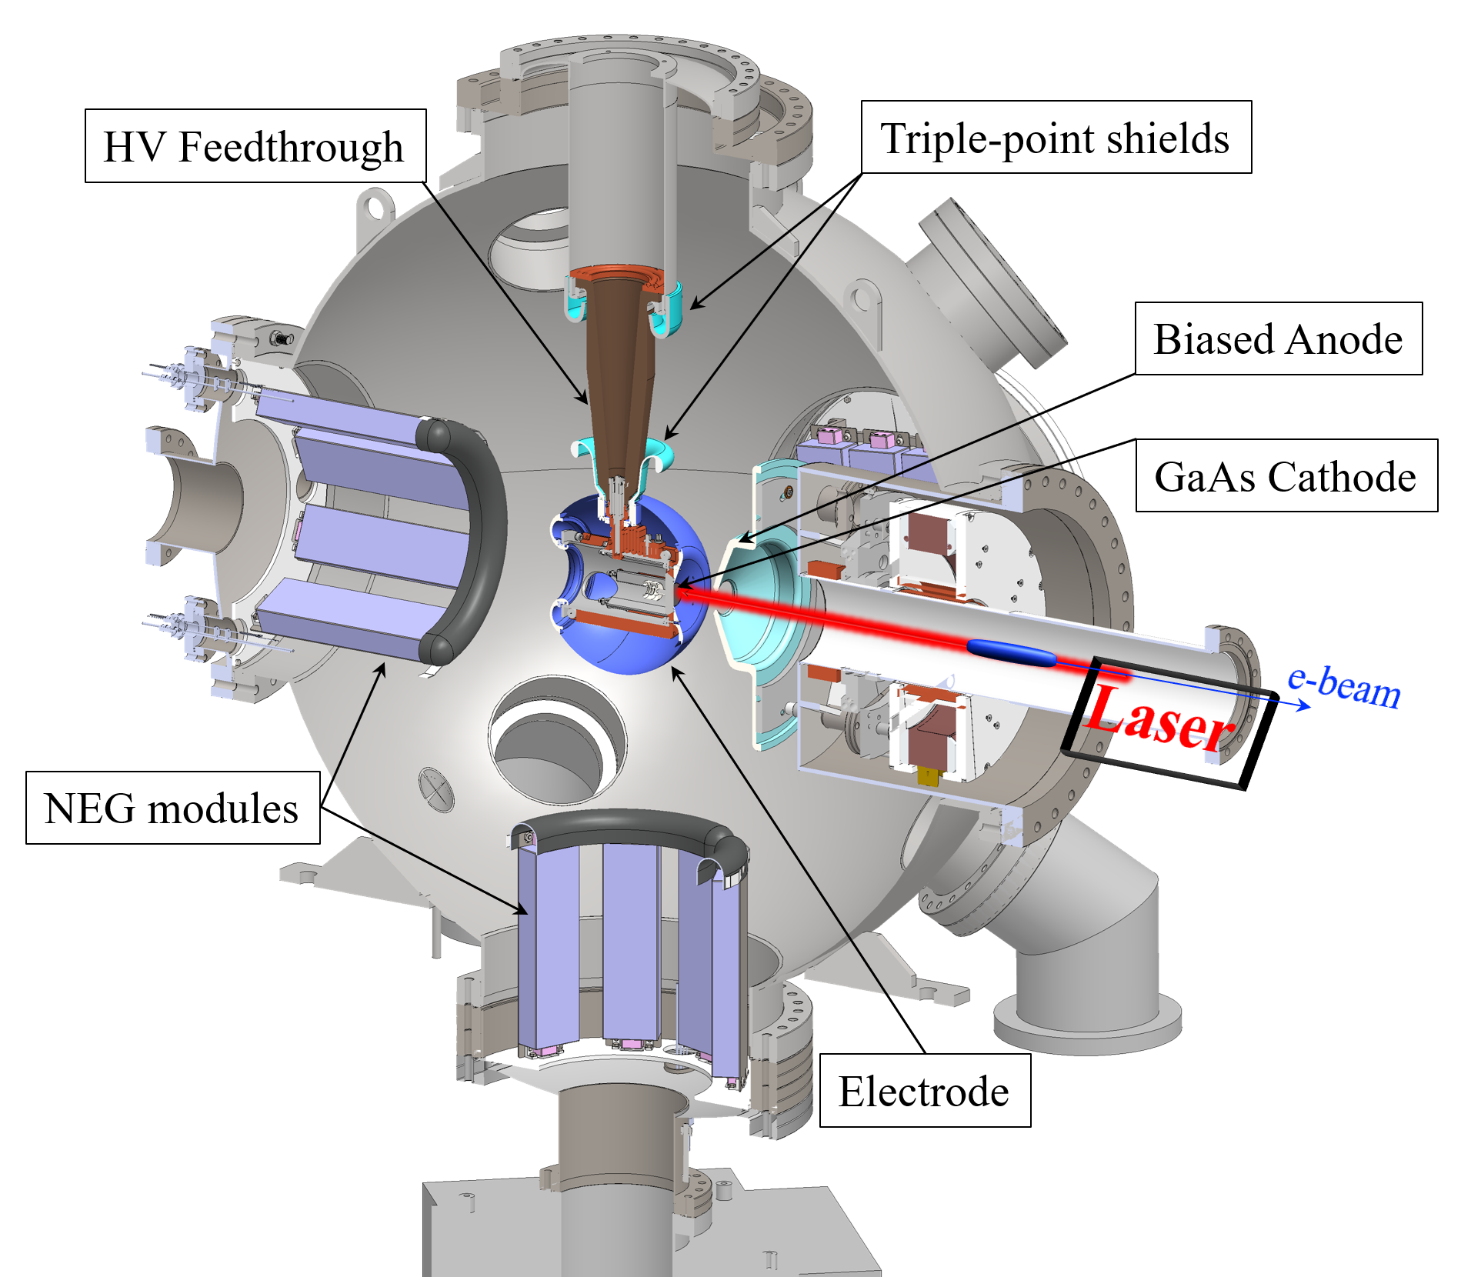
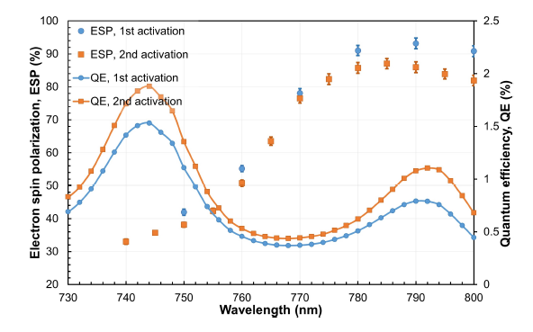

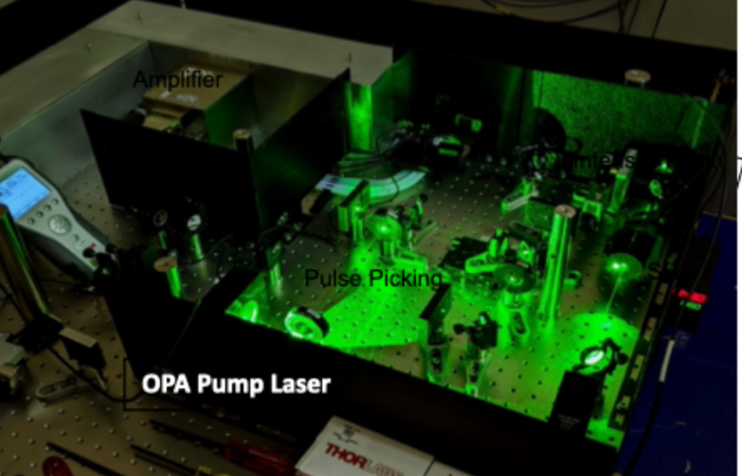
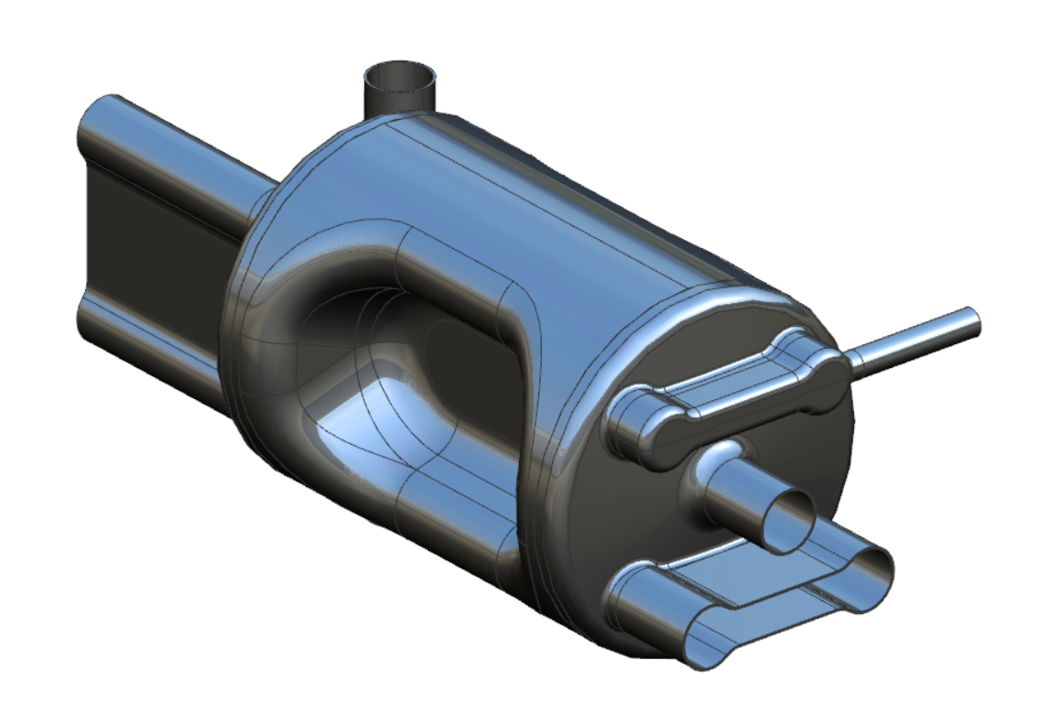
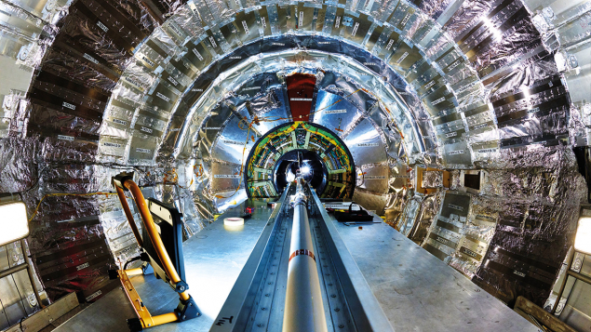



Overview of Accelerator IKC under discussions
591 MHz 5-cell CM for RCS,
2 CMs + cryo box
Laser for the Electron Source of EIC,
1 + 1 hot spare
394 MHz Crab CMs,
Be beam pipe, 200 MHz NC cavities, FLUKA, …
13

Slide 14
Potential collaboration opportunities
EIC – Future Colliders Forum: many topics
Polarized electron source (PSI)
UK interests

Slide 15
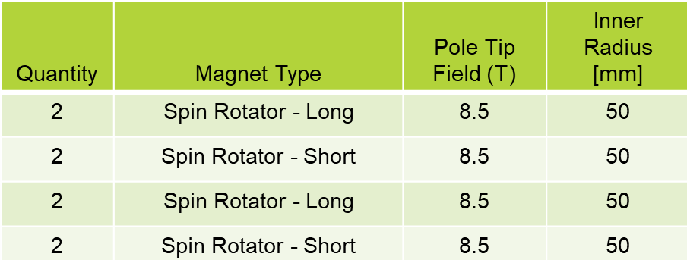
Other potential IKC opportunities
SC spin rotators (high-field solenoids)
ESR swap-out injection kickers
  High-power water-cooled strip-line
  Qty: 8 + 2 spares
ESR kicker pulsers:
  25-30 kV, 10 ns FW, 1 Hz
HSR transverse instability dampers at injection (25 GeV)
Diagnostics (various items)
RCS beam-based alignment during ramp (polarization preservation)
Controls (EPICS based and RHIC legacy)
Collimation systems

Slide 16
What is still ‘at play’ in the EIC Design and Construction?
Understanding of beam-beam interactions (ξ_{e}=0.1, ξ_{p} =0.015)
Full understanding of a 25-mrad crossing angle, compensated by crab cavities
Highly polarized electron and hadron beams, including novel polarized He3+ beams
Spin matched electron ring beam optics at 5 GeV, 10 GeV, 18 GeV
Hadron cooling at collisions to maintain hadron beam brightness
Dynamic aperture optimizations
Maintaining an option for the 2nd IR
Swap-out injection
Design and fabrication of IR SC 2K magnets
Design and fabrication of SCRF cavities and cryomodules
Cu-clad and aC coated Beam screens
Modern control system and instrumentation
Science
Technology

Slide 17
New working groups
Hadron beam cooling
  COOL25 workshop at Stony Brook, Oct 27-31, 2025
2nd IR
FCC-EIC forum
Collimation and machine protection
EIC upgrades
Optics
Collective effects

