Slide 1
EIC Accelerator Collaboration
Tatiana Pieloni, École Polytechnique Fédérale de Lausanne, Switzerland
Andrei Seryi, Jefferson Lab, USA
co-chairs of
EIC Accelerator Collaboration
IPAC 2025 Taiwan
4th June 2025

Slide 2
EIC Accelerator Collaboration
The EIC design, construction, and future upgrades offer exciting scientific and technical challenges, creating opportunities for closely connected worldwide accelerator R&D
The EIC Accelerator Collaboration will help realize the full potential of these opportunities
This will benefit the EIC project, collaboration partners, and the wider accelerator community. It will also help maximize the ultimate performance of the EIC facility on the long-term and serve as a bridge toward next-generation accelerators.

Slide 3
Outlook
Structure, Official documentation, Webpage EICAC.org and CERN Global Indico page for Collaboration and WGs materials
Details of Working groups and activities
Input to the European Strategy for HEP
Conclusions and Future plans

Slide 4
Outlook
Structure, Official documentation, Webpage EICAC.org and CERN Global Indico page for Collaboration and WGs materials
Details of Working groups and activities
Input to the European Strategy for HEP
Conclusions and Future plans

Slide 5
Institutional Collaboration Board
Lin Liu | LNLS | Brazil
Oliver Kester | TRIUMF | Canada
Guillaume Olry | IJCLab | France
Pierre Vedrine | CEA Saclay | France
Qing Qin | ESRF | France
Ralph Assmann | GSI/FAIR | Germany
Lucio Rossi | INFN Milano | Italy
Roberto Cimino | INFN-LNF | Italy
Tae Kyun Ha | Pohang Accelerator Lab | South Korea
Jose Miguel Jimenez | CERN | Switzerland
Graeme Burt | Lancaster University | UK
Carsten Welsch | University of Liverpool | UK
Nik Templeton | STFC | UK
Phil Burrows | John Adams Institute | UK
Stewart Boogert | Cockcroft Institute | UK
Georg Hoffstaetter | Cornell University | United States
Jean Delayen | Old Dominion University | United States
John Power | ANL | United States
Mei Bai | SLAC | United States
Sam Posen | Fermilab | United States
Sarah Cousineau | ORNL | United States
Soren Prestemon | LBNL | United States
Young-Kee Kim | University of Chicago | United States
Yue Hao | FRIB | United States
Established the Institutional Collaboration Board: 24 members, 24 Institutes, 9 countries.
EIC input to the European Strategy document
Planning to:
  Continue expanding the ICB
  Organizing the first meeting

Slide 6
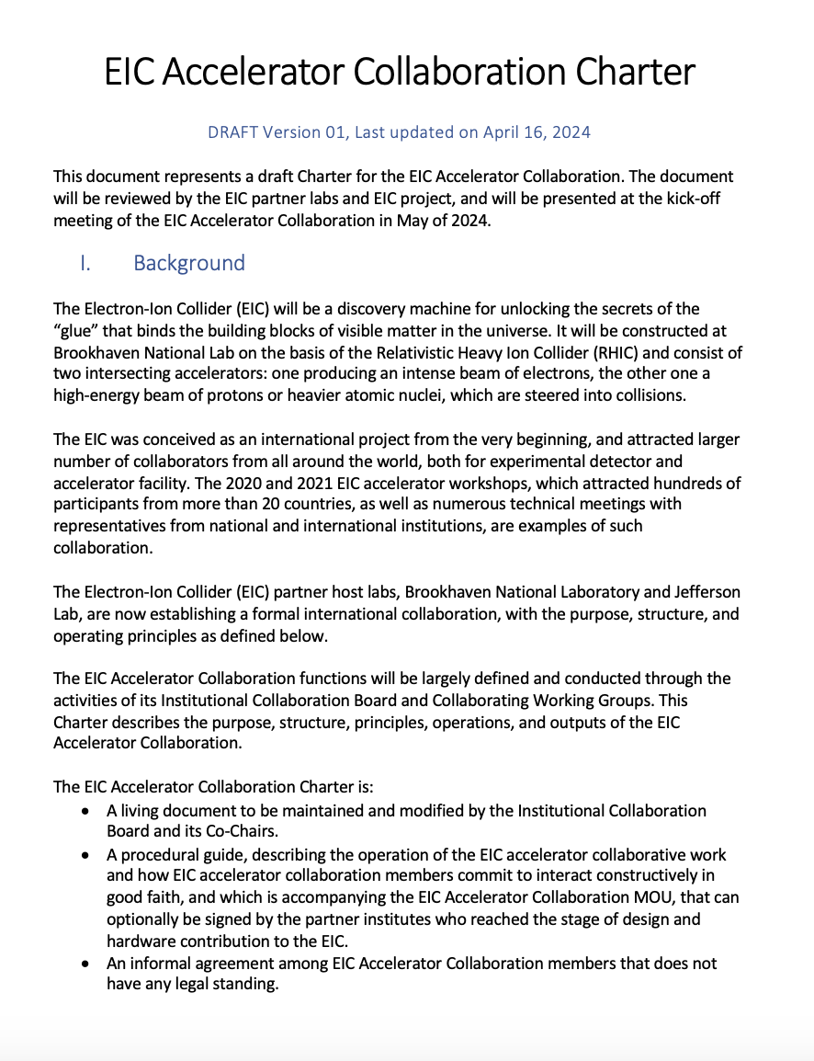
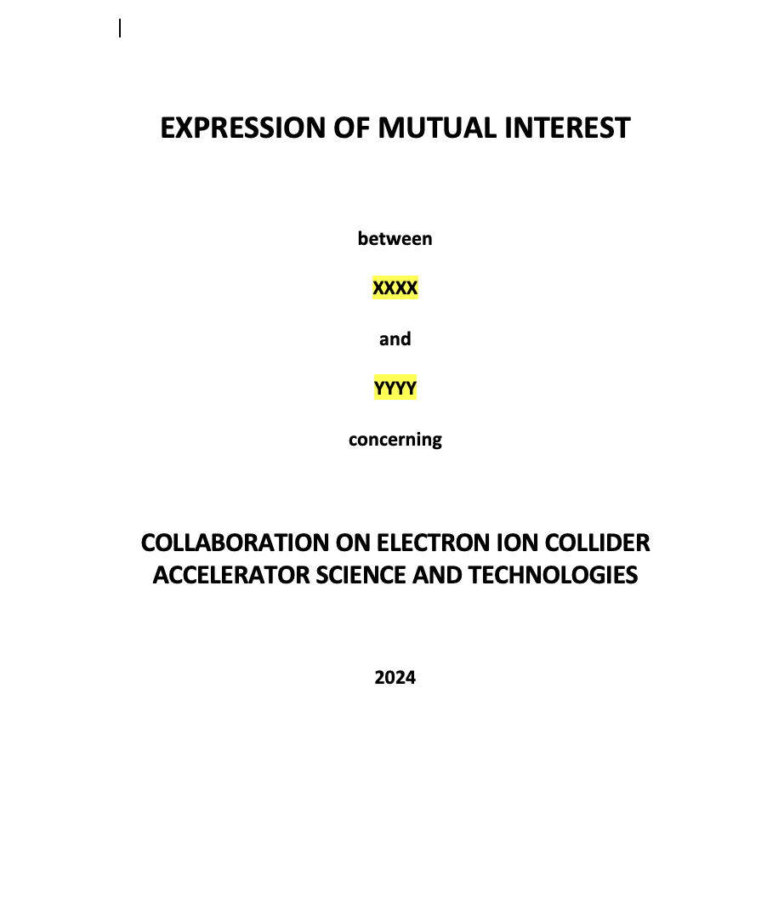
Collaboration Charter and EIC/MOU
Coll Charter
MoU/EoI doc

Slide 7
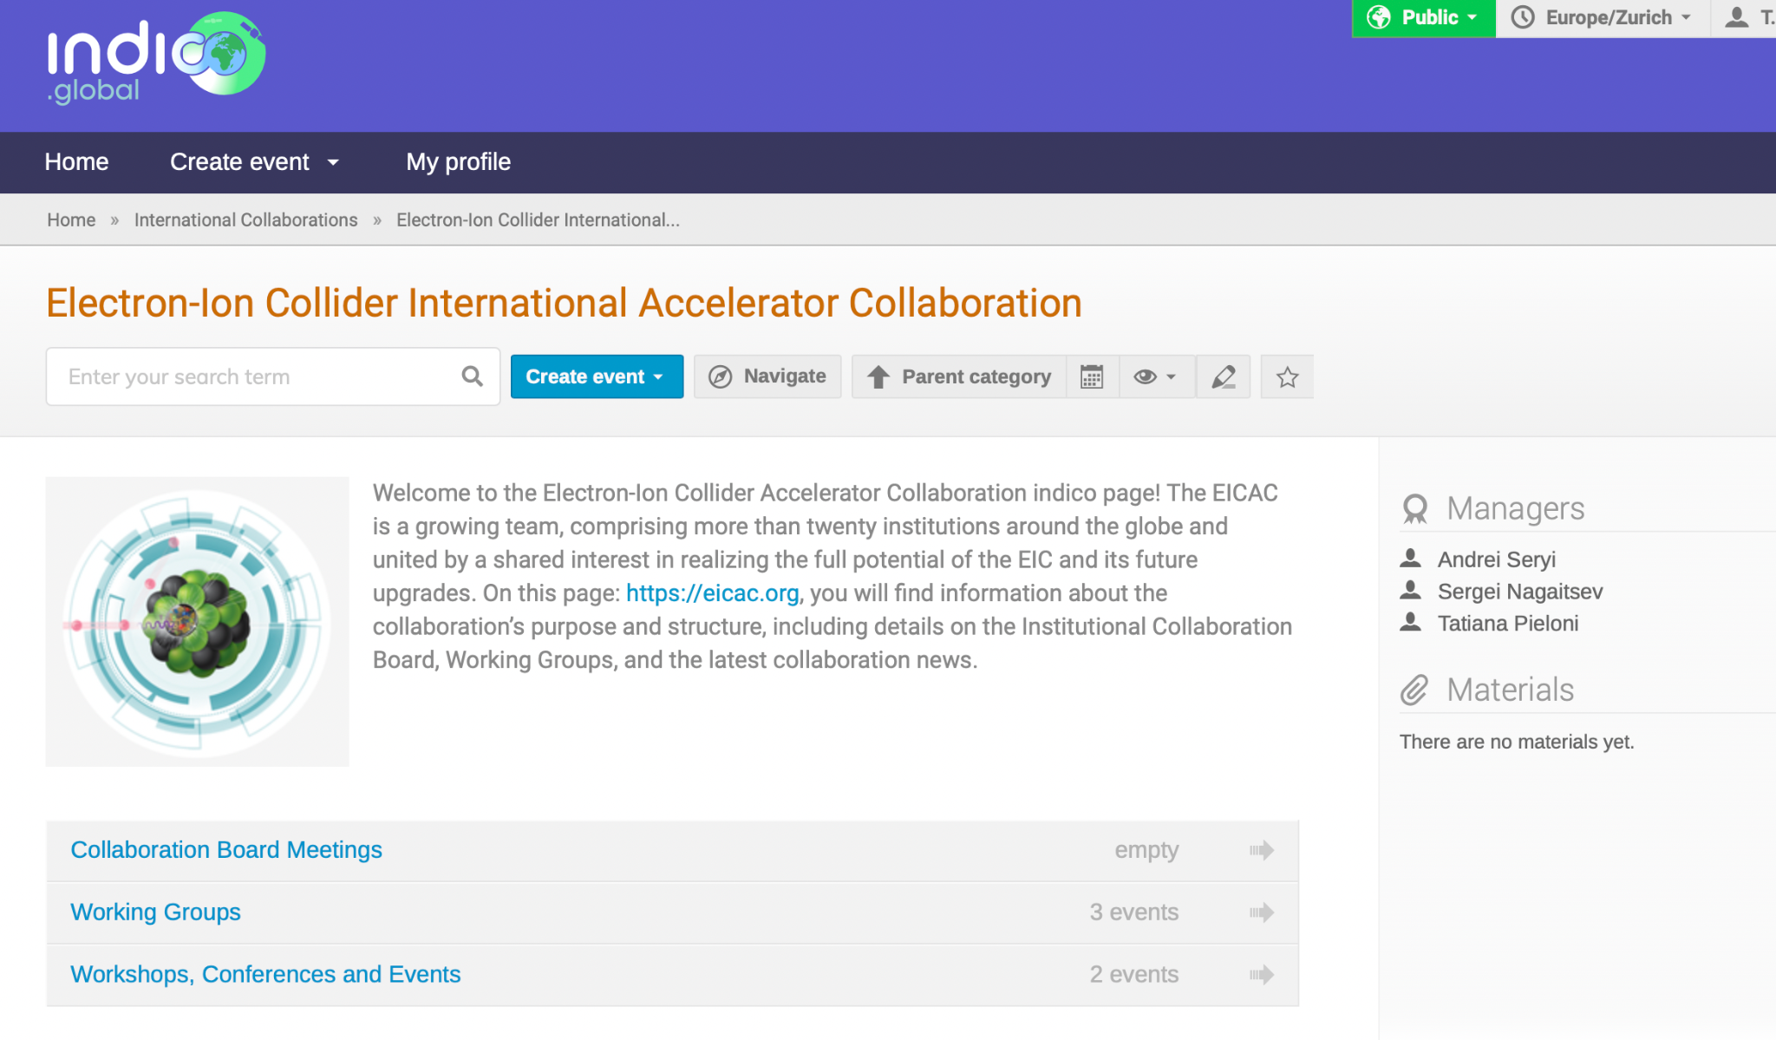
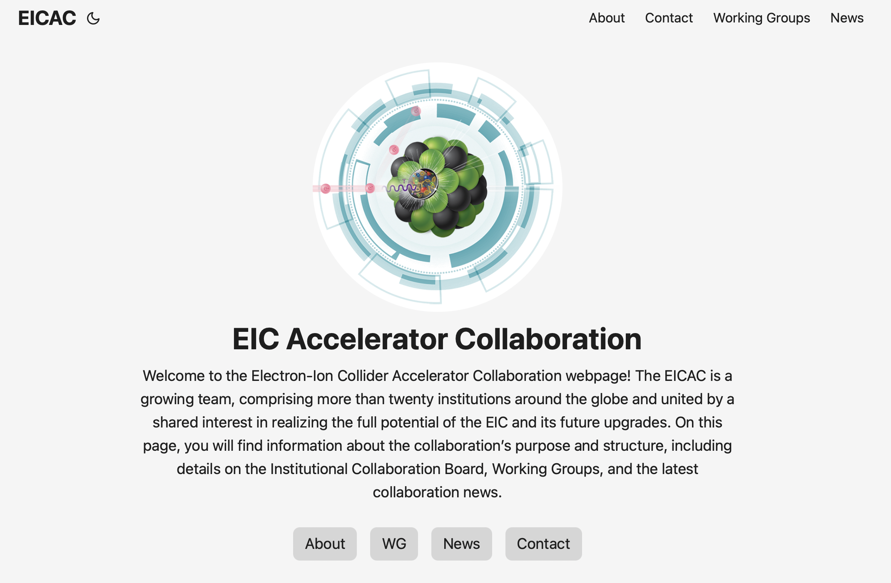
Information flow and Material Sharing
Official Webpage EICAC.org
All WG meetings and material will be migrated soon to: CERN Global Indico

Slide 8
Outlook
Structure, Official documentation, Webpage EICAC.org and CERN Global Indico page for Collaboration and WGs materials
Details of Working groups and activities
Input to the European Strategy for HEP
Conclusions and Future plans

Slide 9
Working Groups on key challenges
Beam-beam effects C. Montag (BNL), X. Buffat (CERN)
Polarized Beams and Polarimetry F. Rathmann (BNL), G. Hoffstaetter(Cornell)
EIC commissioning Tools Y. Hao (MSU/BNL), J.L. Vay (LBNL)
Second Interaction Region – recruiting group leaders and co-chair
High Energy Beam Cooling - recruiting group leaders and co-chair
Collimation and machine protection – group leaders identified
Injection and sources R&D – group leaders identified
Forum on EIC Synergies with Current and Future Projects - recruiting group leaders and co-chair
More WGs to come → Feel free to propose topics and technologies of interest

Slide 10
Polarized Beam and Polarimetry WG
Coordinators: Georg Hoffstaetter de Torqua and Frank Rathmann
Focus on important EIC-specific and general topics of polarized beams such as:
- Theory of spin dynamics in storage rings, including radiative depolarization, spin diffusion, and beam-beam forces.
- Spin simulation tools for polarized beams.
- Polarized beam manipulation and optimization techniques.
- Polarized hadron and atomic beam sources for protons, deuterons and Helios.
- Theory and technology of polarimetry, based on pp, dd and 3He-3He scattering.
- Polarized electron sources.
- Electron polarimetry based on Compton scattering.
Registered group members: 24 members from 8 institutions
Purpose:
Identify topics for polarized EIC beams that can receive significant attention from outside BNL.
Identify and form groups that attend to pertinent topics.
Identify funding sources (especially outside BNL).
Identify potential and help in manpower development.
Maintain contact to respective BNL groups and experts for polarized beams.

Slide 11
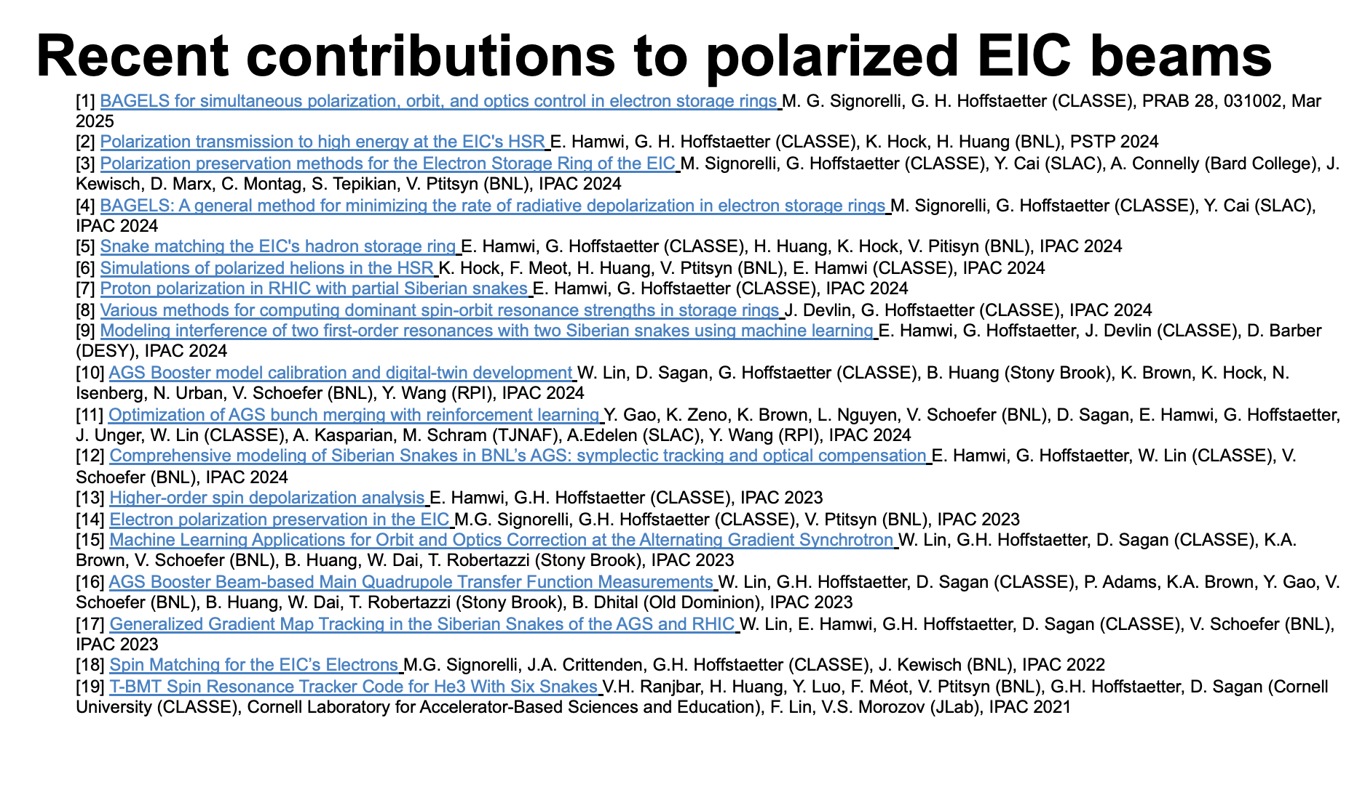

Slide 12
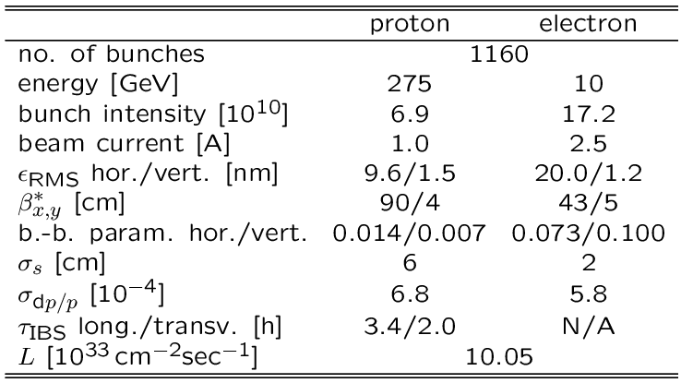
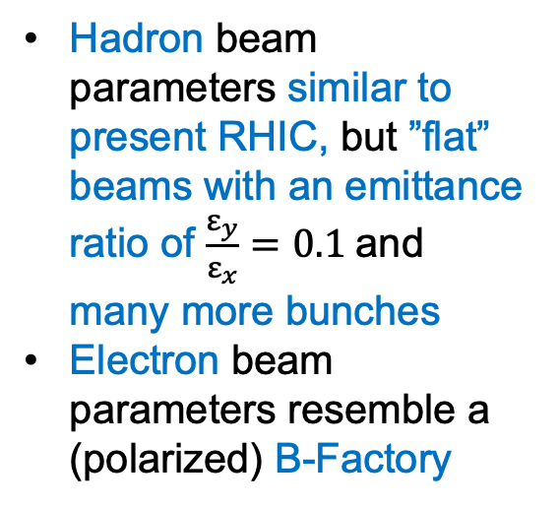
Parameters for Highest e-p Luminosity
Hadron beam parameters similar to present RHIC, but ”flat” beams with an emittance ratio of $\frac{ε_{y}}{ε_{x}}=0.1$and many more bunches
Electron beam parameters resemble a (polarized) B-Factory

Slide 13
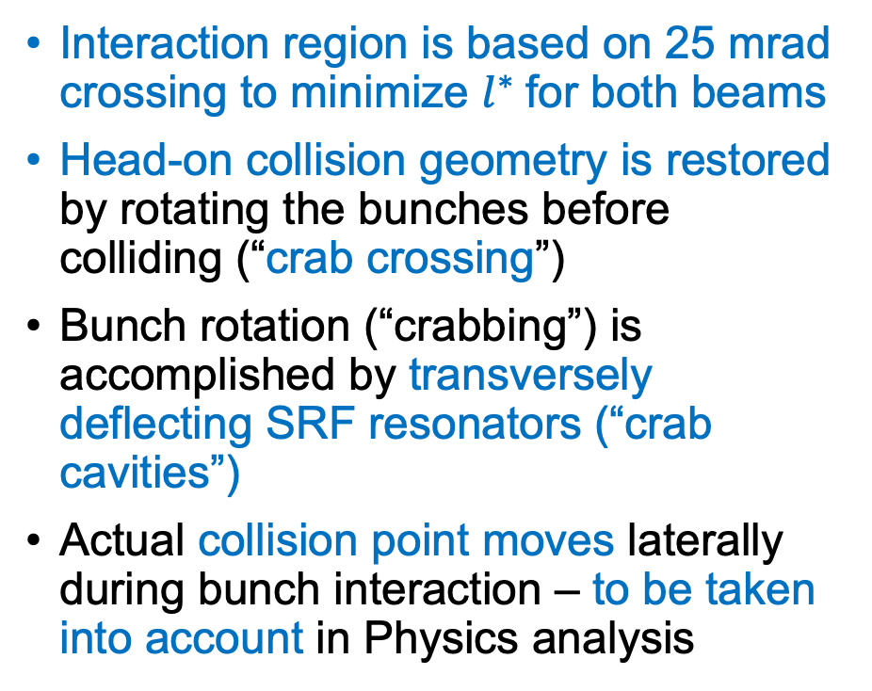
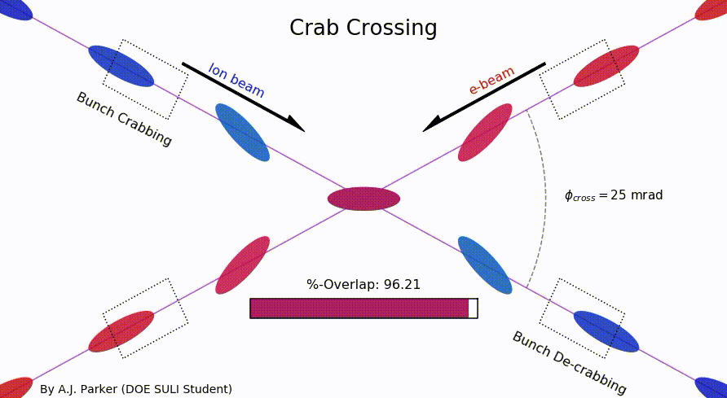
Beam-Beam Crossing

Slide 14
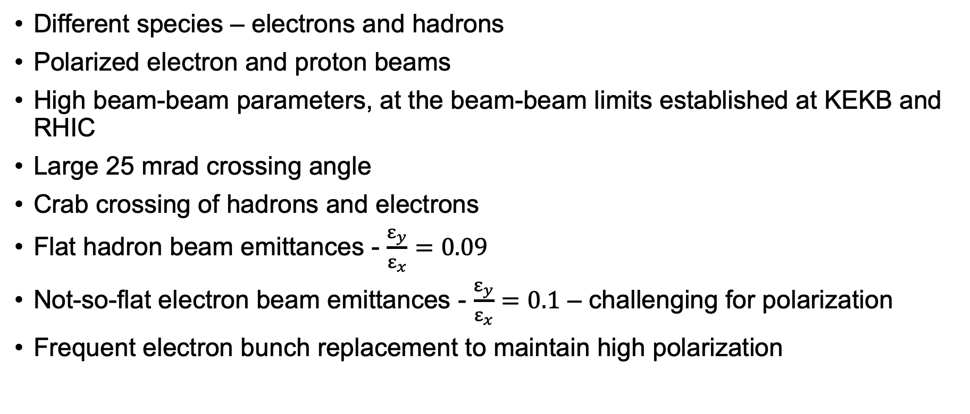
Beam-Beam Challenges in EIC

Slide 15
Purpose of the WGs
Not a review
Not a workshop
Modeled after International SuperKEKB Task Forces
Scrutinize EIC on different aspects: BB, polarization…
Provide honest feedback
All participants are invited to contribute with their own studies
→ Knowledge transfer and maximize performances

Slide 16
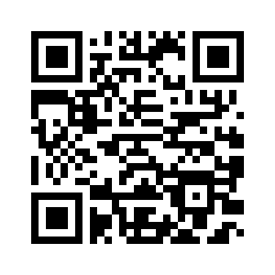
Working Groups next steps
Work on forming new WGs
Expressions Of Interests submitted (more than 120 names) will be used as initial lists to seed WGs and look for WG leaders
Co-chairs are also plan to be personally active in some of the WGs
Gather feedback from the community
Follow this QR code link to
register and share your interest →
Notes:
What do we expect from WGs? Next steps?

Slide 17
Outlook
Structure, Official documentation, Webpage EICAC.org and CERN Global Indico page for Collaboration and WGs materials
Details of Working groups and activities
Input to the European Strategy for HEP
Conclusions and Future plans

Slide 18
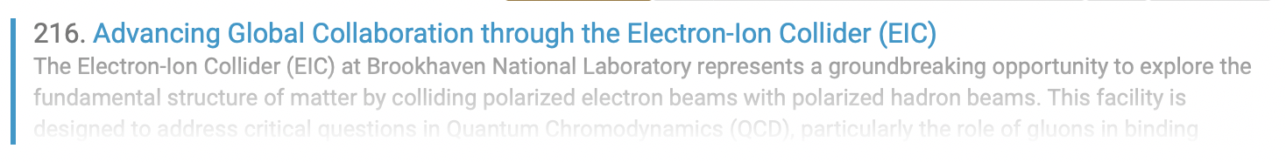
Input to European Strategy for Particle Physics
Drafted document as EIC input to the European Strategy for Particle Physics
  Scientific Research
  Accelerator Technology
  Educational Exchanges
Presentation and discussions at the APS Divisions of Particles and Fields (DPF) and Physics and Beams (DPB) Forum on 27th February
Review period among the EICAC
Submission to ESPP

Slide 19
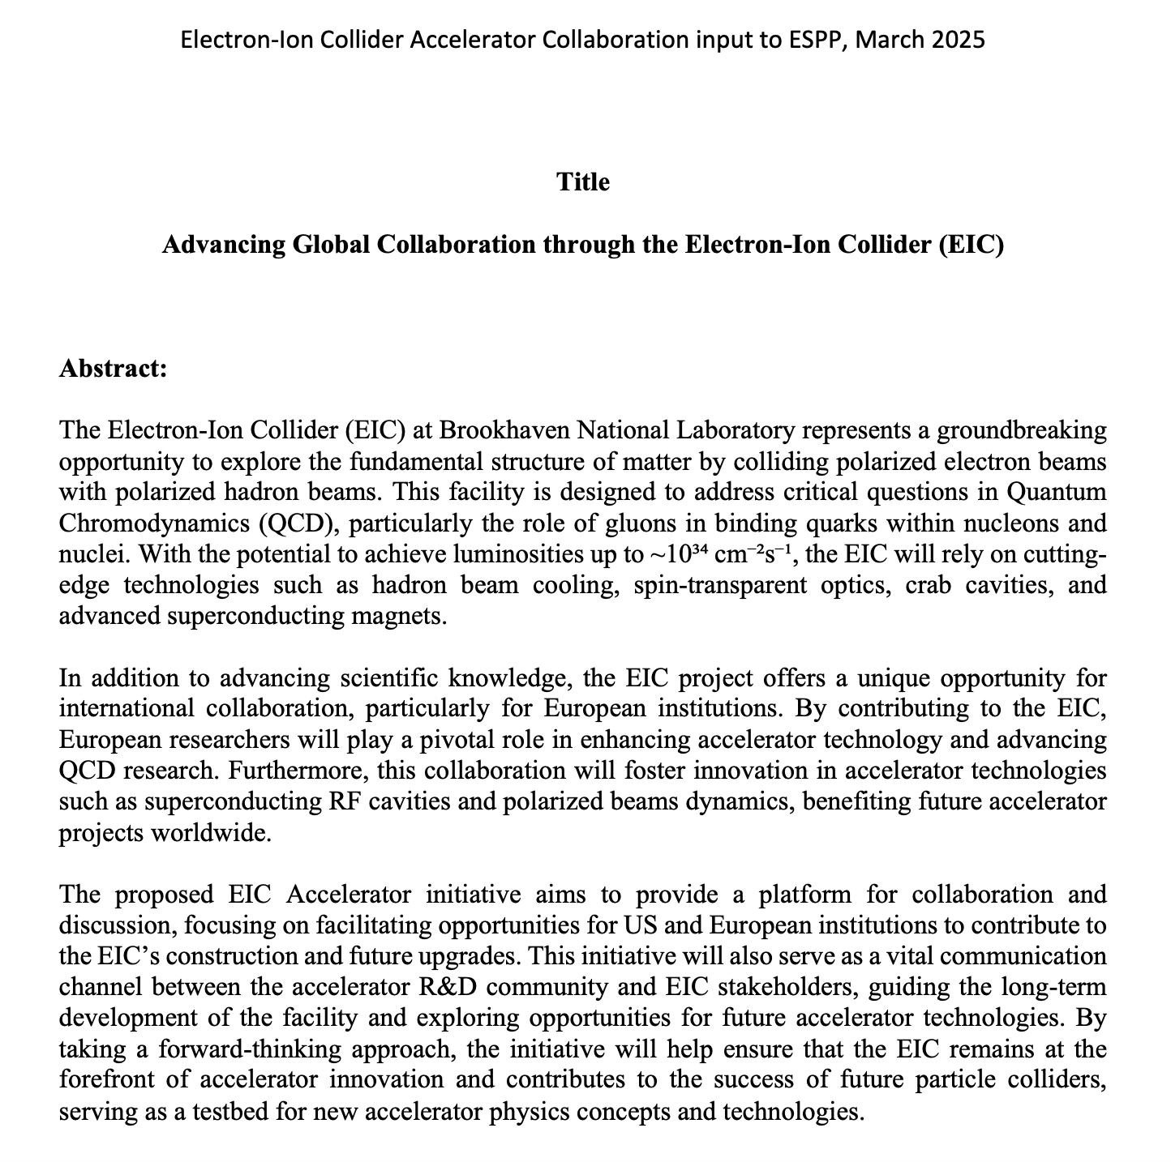
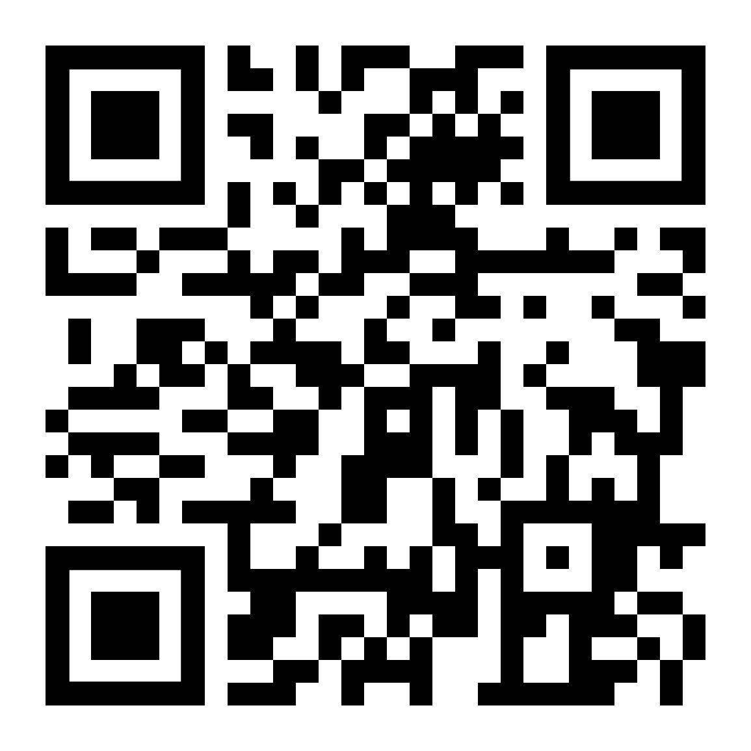
Input to European Strategy for Particle Physics
Register to endorse
https://indico.global/event/14314/
Endorsing can be done any time until European Strategy conclusions converge!
Full Document

Slide 20
Input to European Strategy for Particle Physics
We have a unique opportunity to actively shape a new facility by integrating concepts and technologies that align with the goals of the EIC and even extend them in a longer term.
This facility can become a powerful platform for advancing beam dynamics and diagnostics concepts already at the conceptual level
EIC could serve as a dedicated test bench for technology development and exploration relevant to future machines.
Valuable environment for the education and training of the next generation of operators, engineers, and physicists in both hadron and lepton operations—bridging the gap to future colliders/accelerators
This facility will not only support technical innovation but also play a crucial role in developing talent and expertise for the future of accelerator science.

Slide 21
Conclusions and future plans
The EIC is more than the next great physics machine — it’s a rare chance for the accelerator community to shape the future, gain hands-on experience, and invest in the technologies and talent that will carry us toward the Future.
EIC Accelerator Collaboration has been established and ICB meetings will kickoff
Working Groups on key technological challenges have been created and are operational
New WGs have been identified and reach for chairs and co-chairs are on-going (i.e. Instrumentation and Diagnostics, EIC and Future Accelerators forum, Injectors R&D…)
EIC contribution to European Strategy has been submitted
Identify new partners scientific interests and facilitate collaboration
  In-kind contributions: technology opportunities
  Design and R&D studies: opportunity to bust the EIC reach and explore concepts for Future accelerators (instrumentation, collimation strategies…)

Slide 22
Thank you!
The Future is Now!
Follow the QR code link to
register and share your interest →

