Slide 1
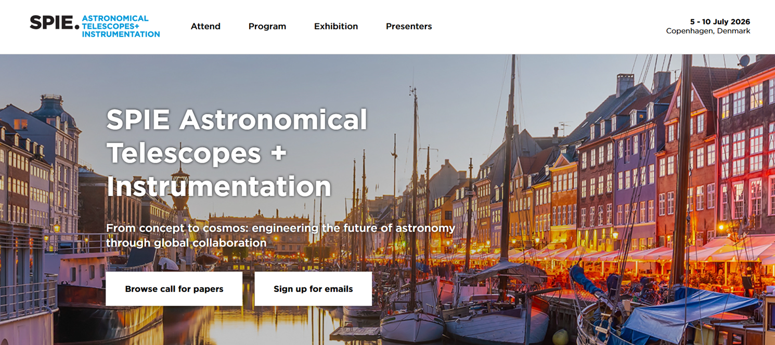
SPIE 2026 - Project Switzerland booth
Work in Progress !
Focus on «business»: Arrive and take your ready-to-use stand, Participating companies can concentrate on developing and maintaining the customer relationships.
Clear identification - Swiss branded: Attractive booth design that creates an inviting atmosphere featuring company logos and dedicated individual company visuals.
Reserved 20 m2 open space setup: for 6 to 10 companies
Registration deadline: mid-February

