Slide 1
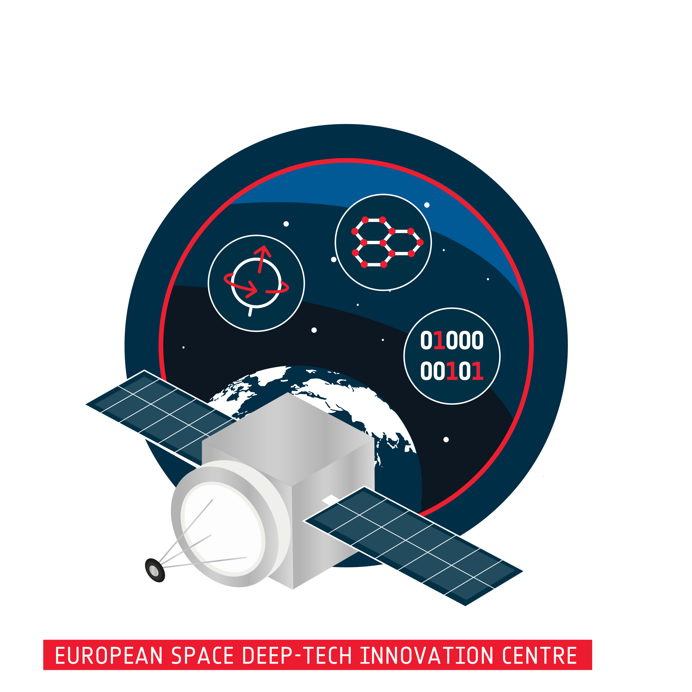


ESDI
&
Phi-Lab
Technologies of Tomorrow for
the World Today
Dr. Jennifer Wadsworth, Phi-Lab Program Manager
SIAPS, 20.01.26
Notes:
who has interacted with or is familiar with esdi?

Slide 2
A deep-tech centre of excellence in Switzerland under the leadership of ESA, implemented in partnership with PSI
WHAT IS ESDI?
Notes:
Who has heard of ESDI?

Slide 3

An ESDI platform for fostering novel, use-driven, interdisciplinary research via funded programmes
WHAT IS
Phi-Lab?
Notes:
ESA PHI-LAB NET
Bridging the Gap between Groundbreaking R&D and Commercialisation

Slide 4
ESDI MISSION:
BRING MORE OF SWITZERLAND'S COMMERCIALLY RELEVANT
AND
SCIENTIFICALLY EXCELLENT
DEEP-TECH TO ESA AND ITS MEMBER STATES (AND VICE VERSA)
Notes:
Concretely, what are will trying to do?
…
At opening tasked with not just N prizes, but nobel prize winning unicorns
This, in a nutshell, represents our ambition

Slide 5



DEEP-TECH: a knowledge-rich technology at the frontier of science and engineering, PUSHING THE BOUNDARIES OF THE POSSIBLE forwards.
PHI-LAB FOCUS TOPICS:
Materials Research
Quantum Technologies
Data
Notes:
Deep tech?
…
IN OTHER WORDS:
DEEP-TECH IS INHERENTLY CHALLENGING, COSTLY, AND RISKY – AND IT IS TRANSFORMATIVE, ESPECIALLY FOR SPACE
This is exactly what ESDI and the Phi-Lab is interested in. Sub-topics of Q, materials, data science

Slide 6
​ | Practical Use​ No​ | ​ Yes​
Quest for fundamental understanding​ ​ Yes​ | Pure basic research​ Bohr​ | Use-inspired basic research​ Pasteur​
No​ | ​ | Pure applied research​ Edison​
Source: Stokes, Donald E. 1997. Pasteur's quadrant: basic science and technological innovation. Washington, D.C: Brookings Institution Press.​
Notes:
Phi-Lab’s areas (aside from thematic areas) :
emerging scientific/technical fields at inflection points that offer novel solutions to critical problems in the space domain (and Earth).
Challenge: “use-inspired”
Academics to think more on applications, users, commercialisation
Industry to think more about more abstract, fundamental research aspects, not pure-application
Pasteur’s sweet spot is what we’re aiming for in Phi-Lab programs
top-down & bottom-up approach, neglectedness

Slide 7


PHI-LAB Programmatic Nrs
Call duration max. 2y
Funding per call: ~CHF 2-4m
Max. funding per project CHF 990k
1st Phi-Lab Phase: ~5 Calls (2 p.a.)
Total Program funding: ~CHF 14.5m
Potential additional financial “Boost” of select, outstanding projects
Funding also available for Industry
Notes:
Example: First call total budget 3.5mCHF (not incl matched funds from participating orgs)
Includes funding for participating industry
Expected funding per project: 600k-750k, was case for Q

Slide 8

QUANTUM CALL 2025
“Q-CPR”
The Challenge:
at least 10x improvement in Compactness, Performance, or Reliability
Notes:
Quantum sensors can detect minute changes in gravity, magnetic fields, and time, and other quantities with atomic precision,
Yet demand sophisticated infrastructure: typically room-sized setups,complex electronics, and constant expert oversight.
high cost and operational complexity create significant barriers to commercial adoption, despite their transformative potential across industries
10x improvement The harsh space environment serves as an ideal testbed for space and earth applications

Slide 9
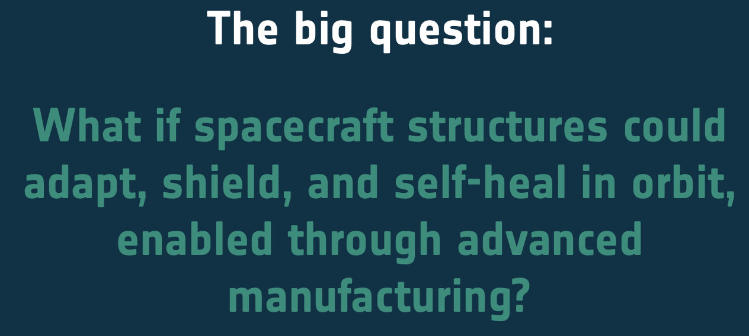

MATERIALS CALL 2025
“AM-XTREME”
The Challenge:
Demonstrate a step change in AM for autonomous spacecraft integrity in extreme conditions
Notes:
In the last years, many advances have happened for AM (e.g. Additively manufactured superconductor, complex multi-material and 4D printed structures..etc). Now the next step is to demonstrate new technologies in AM under extreme conditions, and make sure, a path to commercialization is viable! From brackets to adaptive skins, re-entry panels, and self-healing components that thrive under extremes. The goal is a step change: next-generation AM that redefines what can be built for space and terrestrial use.

Slide 10
DATA CALL 2026
Call for Ideas (not proposals!) Deadline Feb 27th
Workshop (Feb/Mar)
Call for proposals (April)
Selection (Summer 2026)
Program Kick-Off (Autumn 2026)

Slide 11


| jennifer.wadsworth@psi.ch |
| www.esdi.ch |
| www.esdi.ch/phi-lab |
Submit a Data Idea
Subscribe to
our Newsletter

