Slide 1

Possible remote sensing instruments for the next decades
Nicolas Thomas

Slide 2
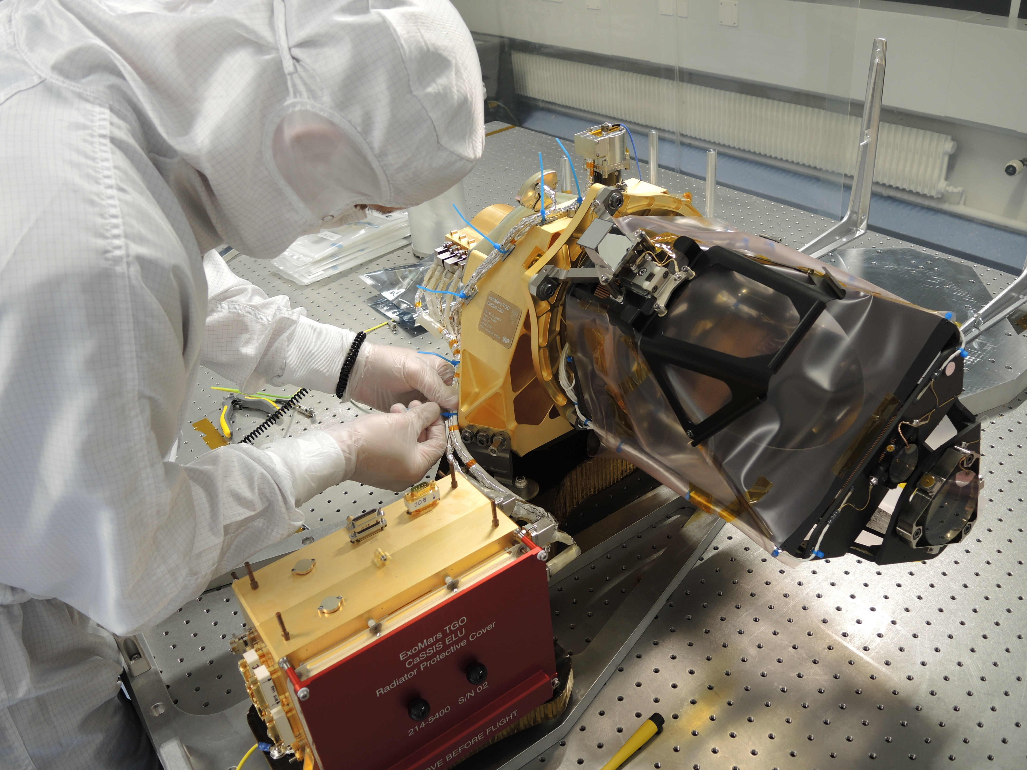
CaSSIS integration at Uni Bern
11.5 μrad/px
18 kg; 17.3 W

Slide 3
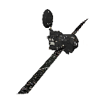
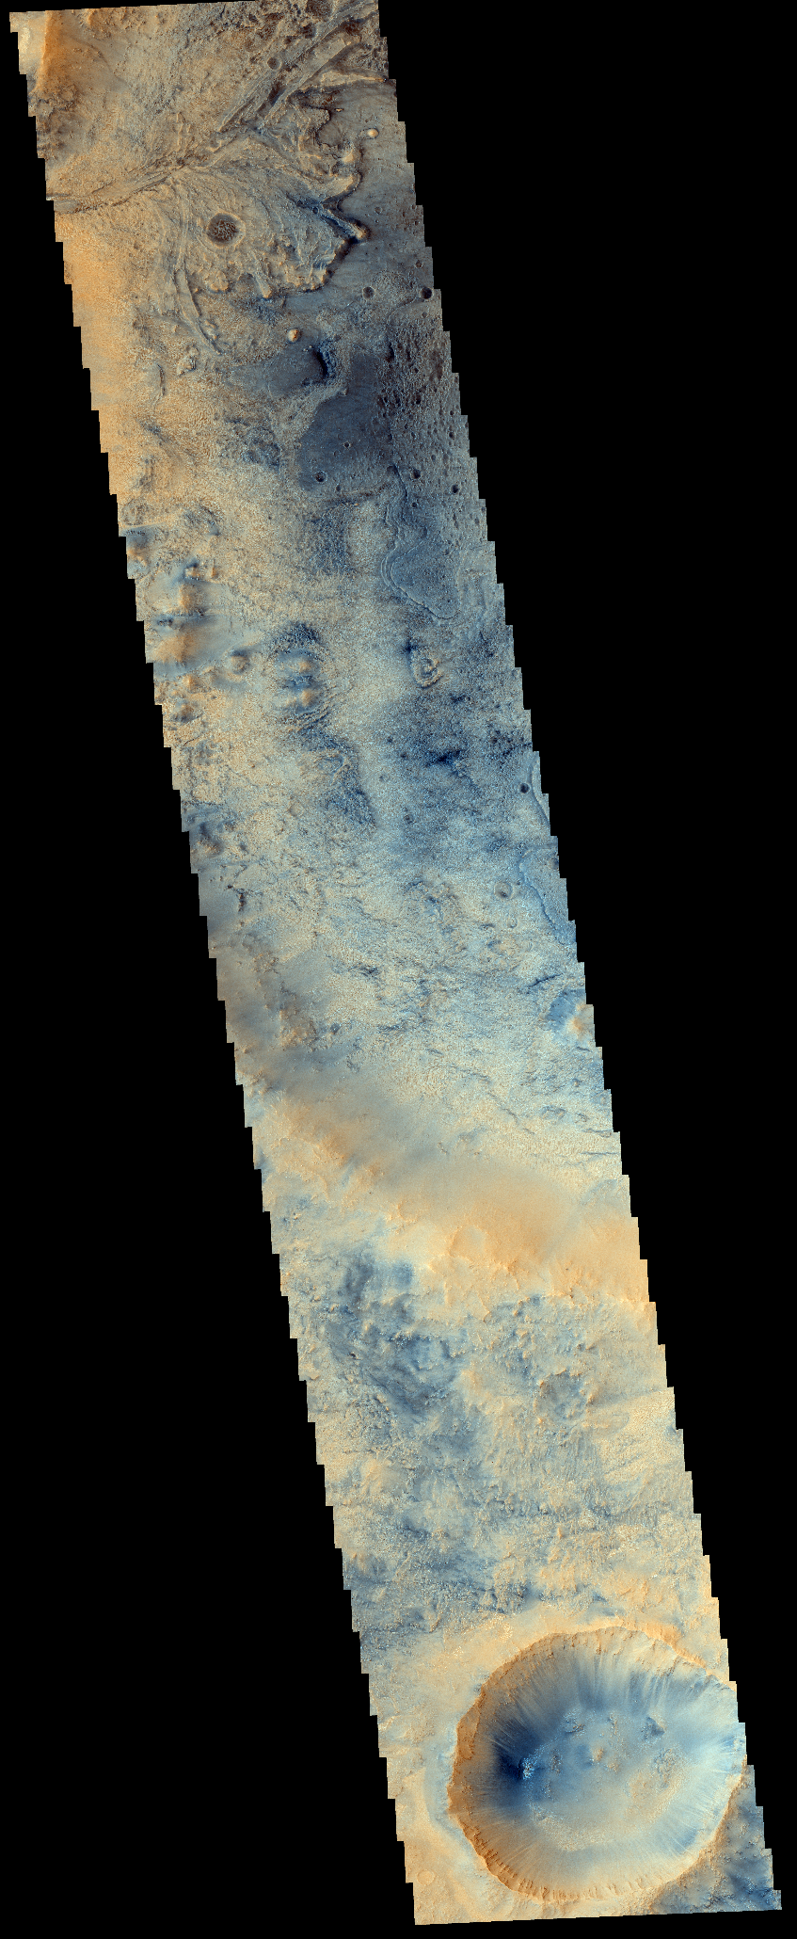
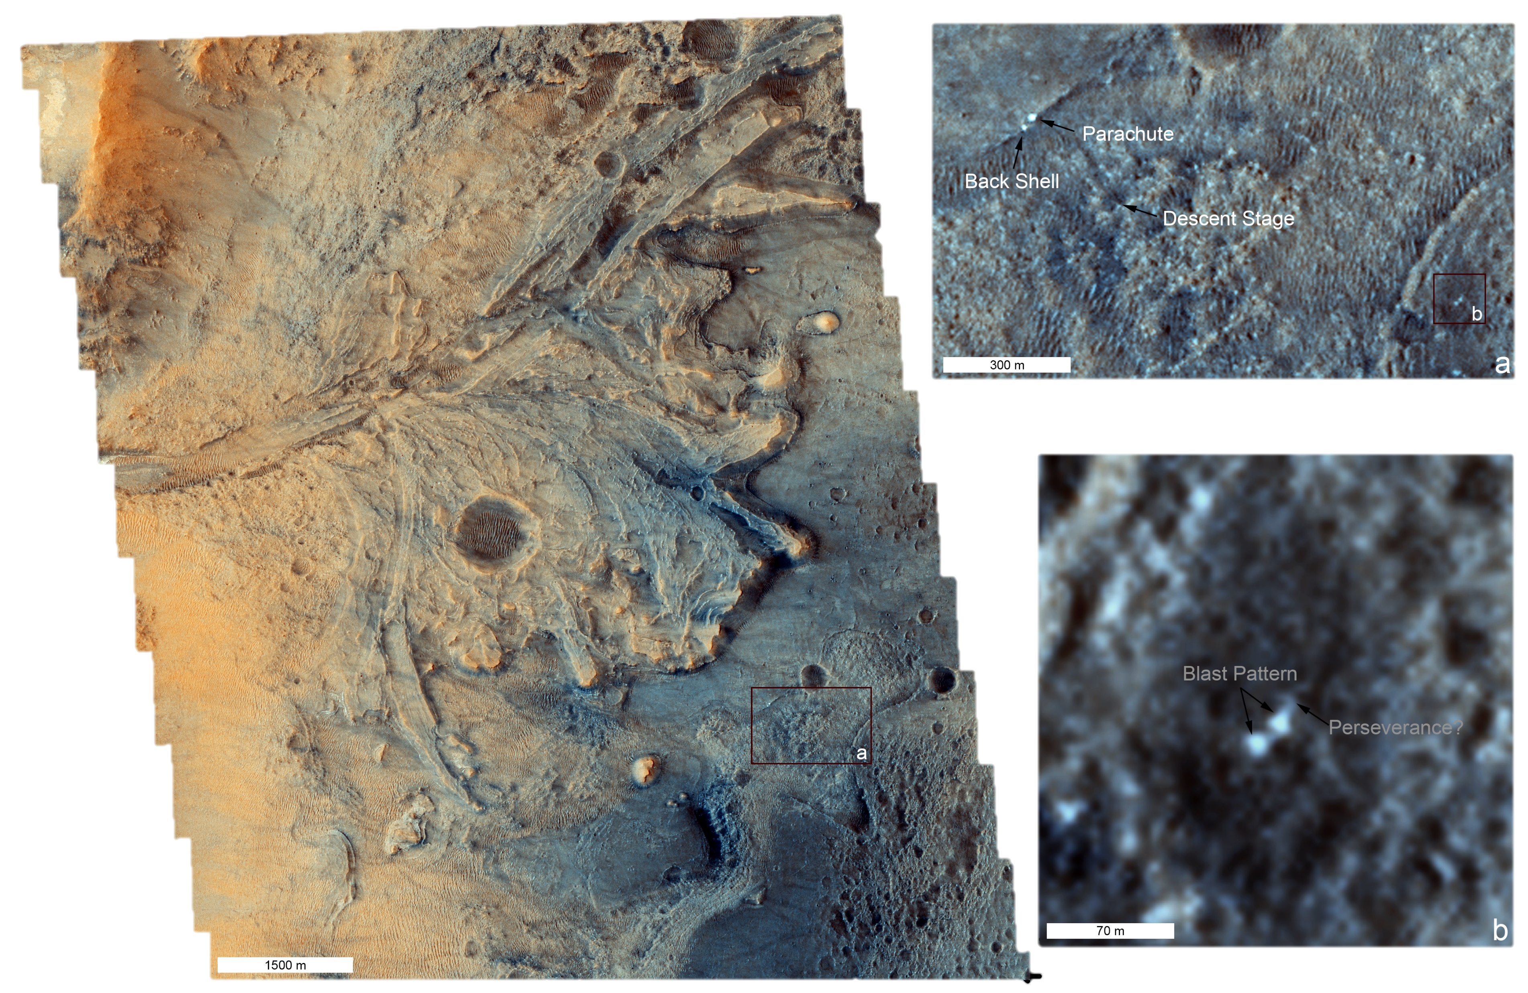
Acquisition: 03/25 Emission: 10.804 Latitude: 18.6196
Filters: PAN-RED-NIR-BLU Loc. Sol. Time: 12:53:10 Longitude: 77.3691
Incidence: 16.015 Ls: 22.31 Near: Jezero crater
Phase: 14.762 Target ID: - Mars2020 – Perseverance rover
MY36_014886_164

Slide 4
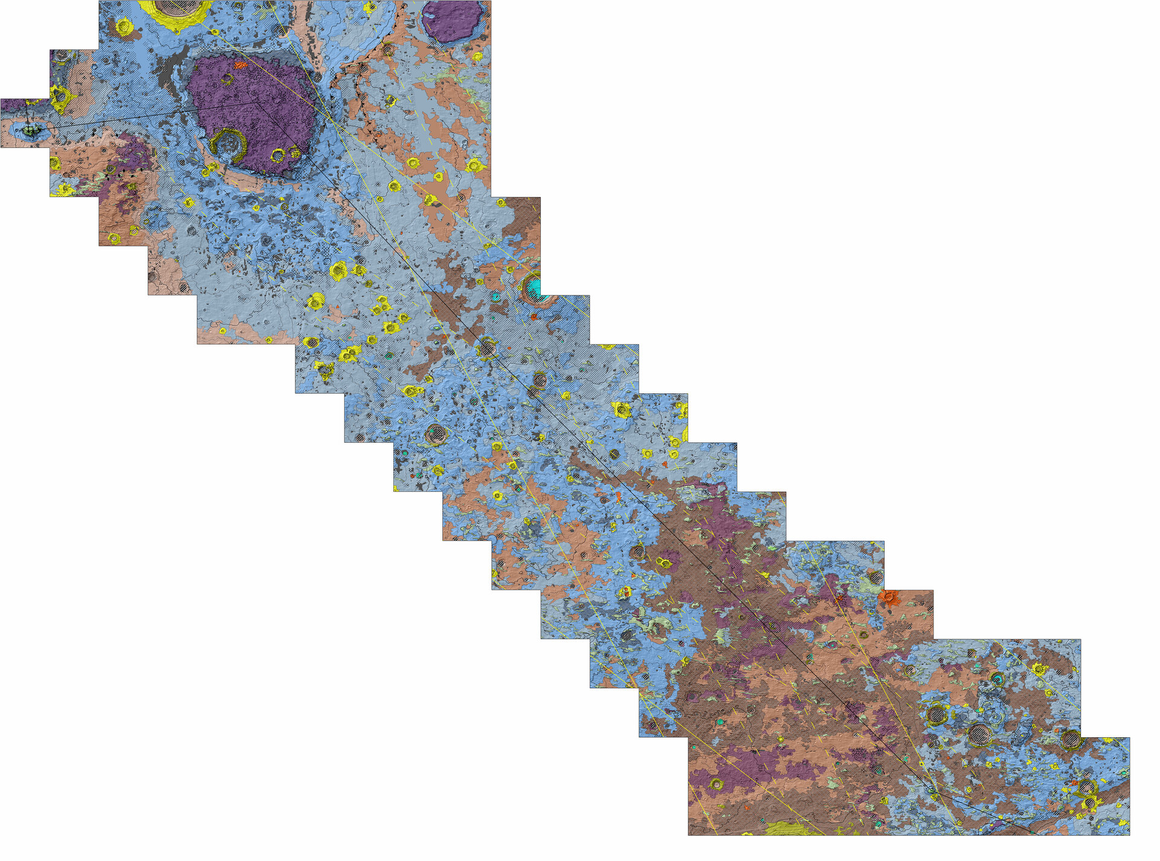
Map of Oxia Planum – the landing site for ExoMars. Unit definition performed using CaSSIS data (inter alia).

Slide 5
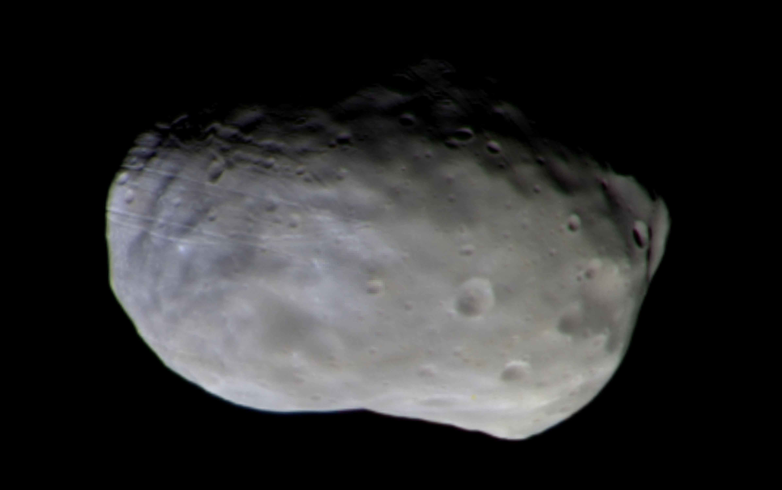
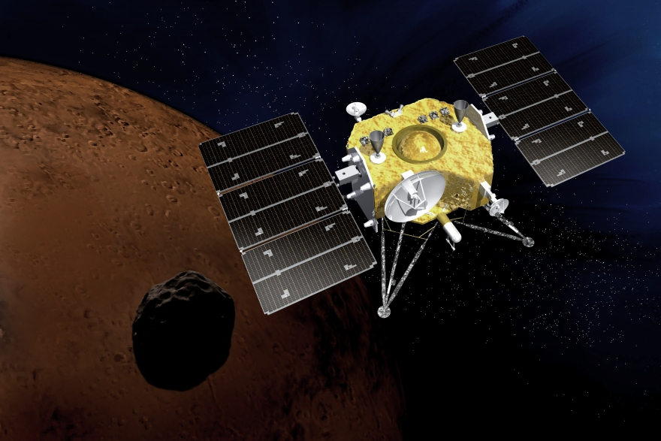
Phobos
Target of JAXA’s MMX

Slide 6
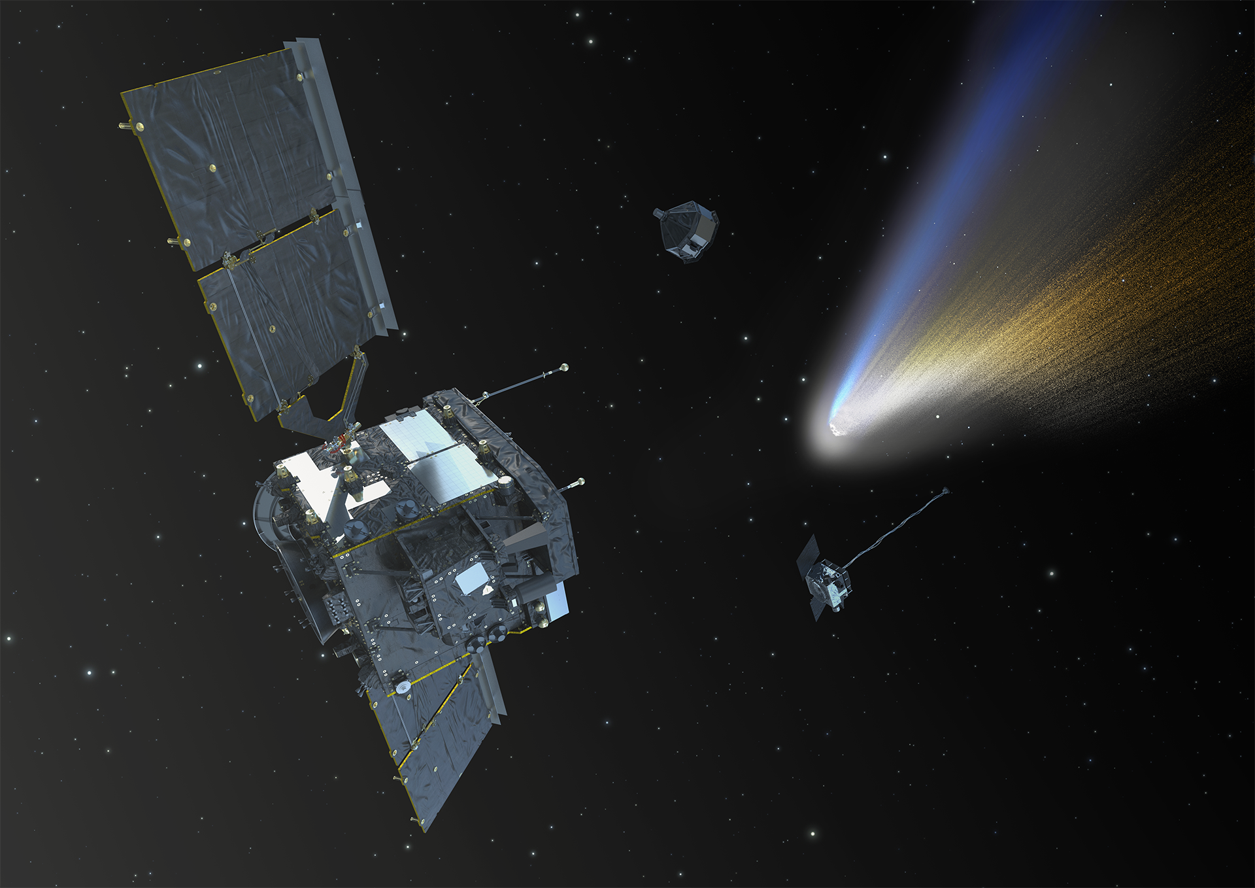
Comet Interceptor
A joint mission to a dynamically new comet
3I/ATLAS seen from Mars by CaSSIS

Slide 7
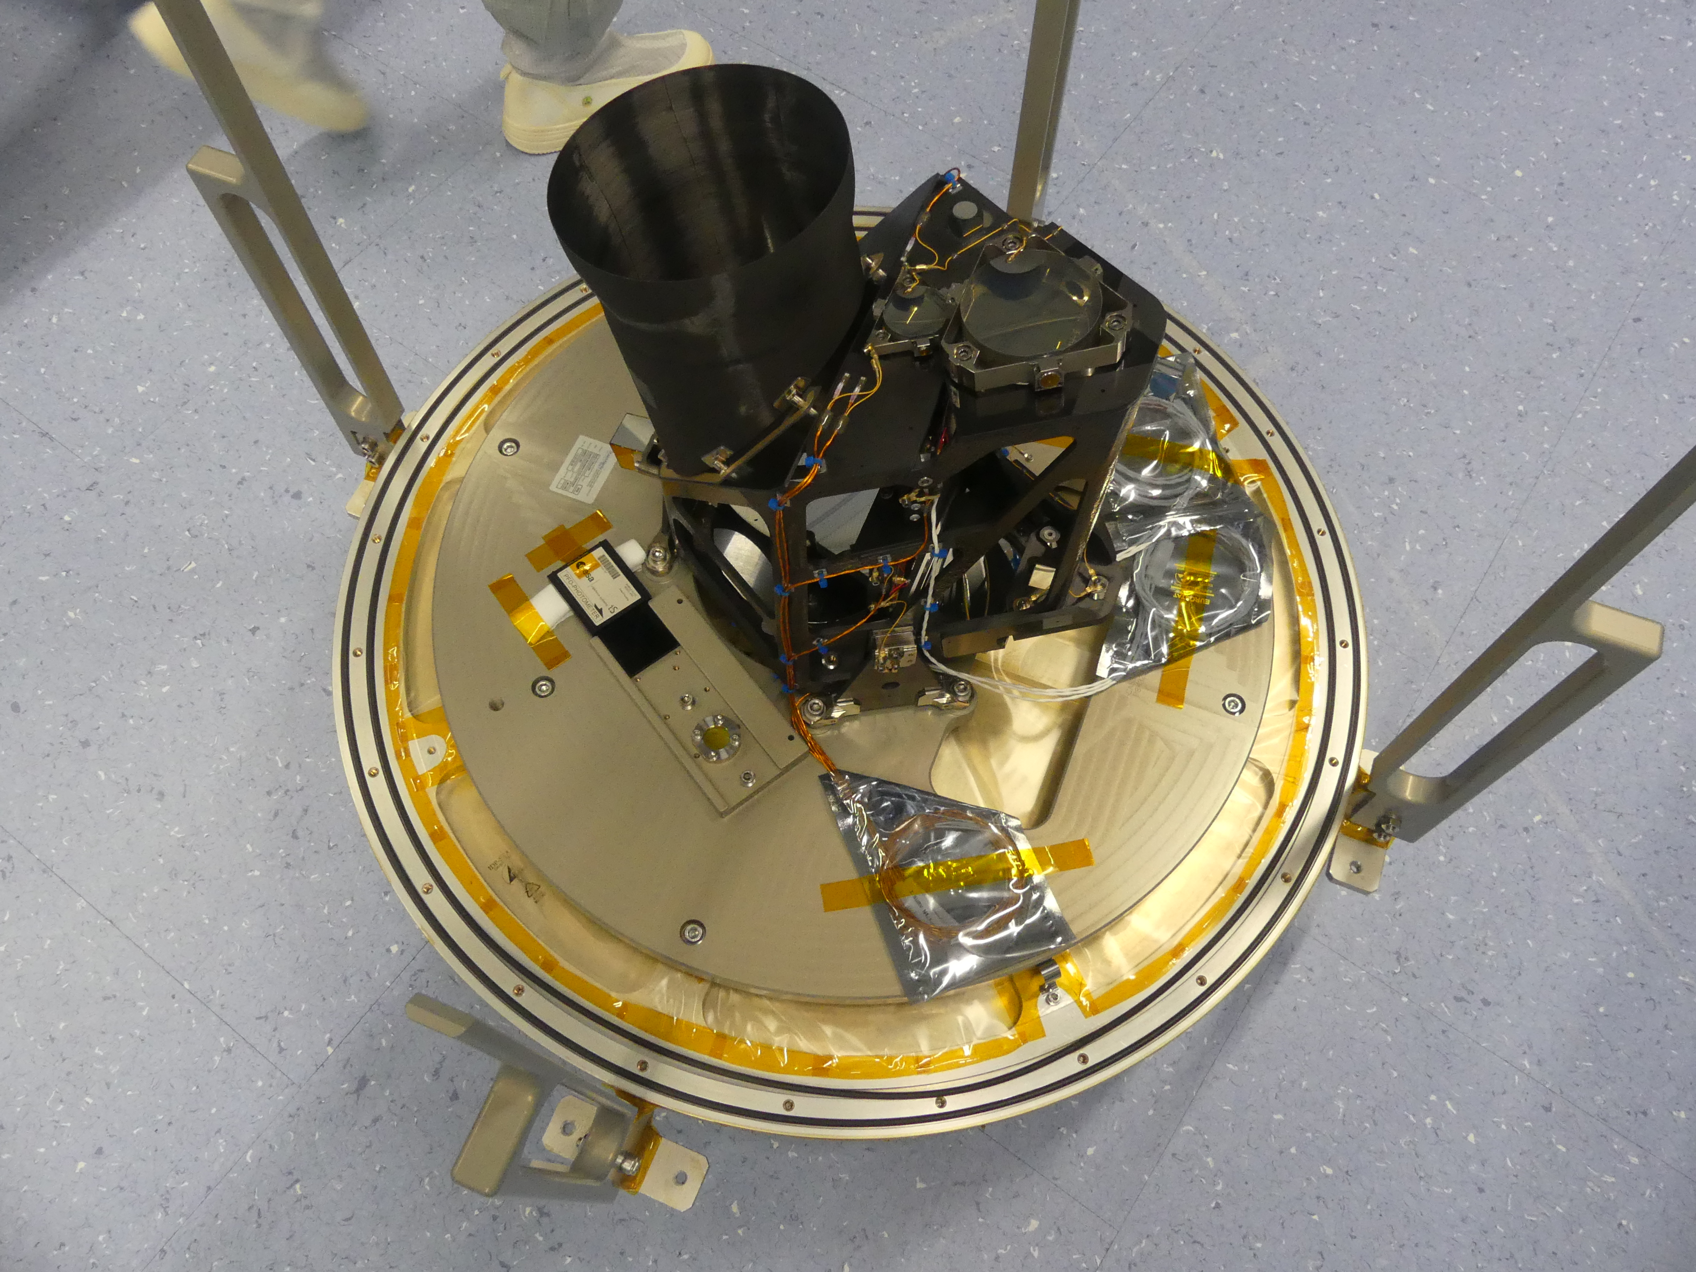
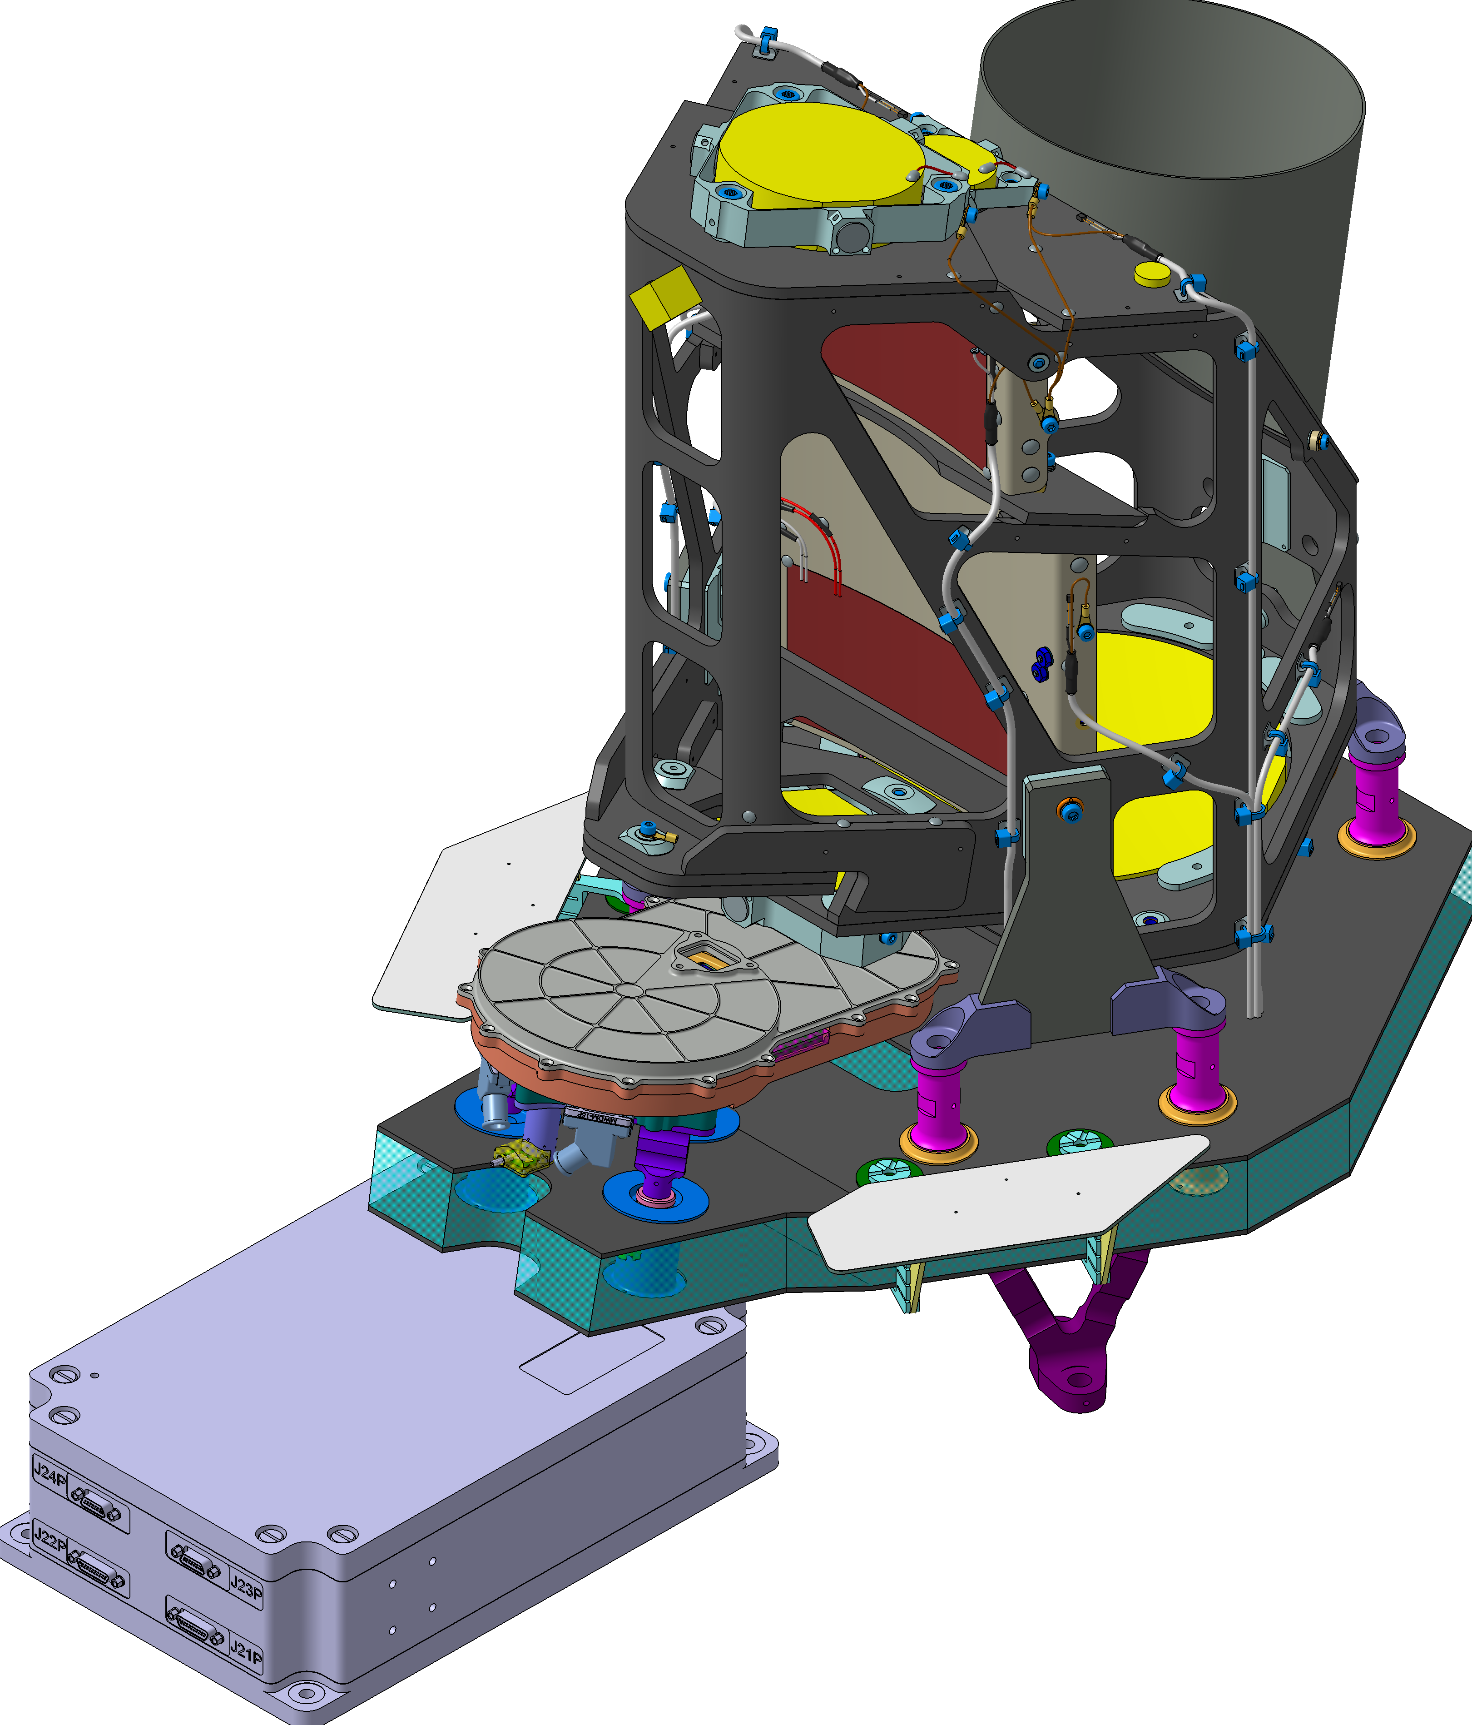
CoCa
Visible camera system
Based on CaSSIS/TGO-JANUS/JUICE heritage
8 m/px from 1000 km
4 colour filter imaging
Framing rate of 1 image/s
Large redundant intermediate storage.
Telescope developed in CH industry.
Elements from D, H, E, (UK).
Stares at a Rotating Mirror Assembly (B and CH industry) to track the nucleus during the fly-by.
CoCa PFM Telescope delivered (Dec. 2025) to UBE

Slide 8
stuff
This is all fine and good but it is old shit…..
…. so where could remote-sensing on planetary exploration missions go in the next 10+ years?
…. and where could we lead…..:☺

Slide 9
Quasi-classical high-resolution imagers and spectrometers
Lightweight near-object systems
Landed systems for (mainly) non-destructive diagnostics
Mars (ZefERO/
CAIMAN)
Enceladus (COLIME)
Small bodies (SUBICE)

Slide 10
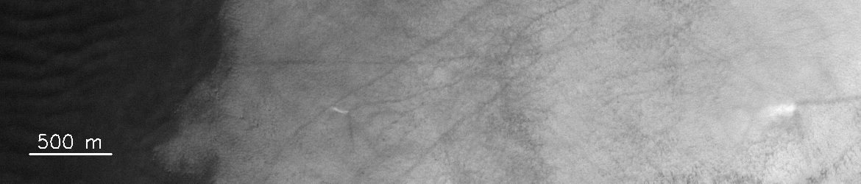
Quasi-classical high-resolution imagers and spectrometers
CAIMAN – A concept for a “CaSSIS 2.0”
Maintaining high resolution imaging capability at Mars is seen as crucial for future manned missions.
Dynamic processes on Mars also require monitoring.
Taking CaSSIS to the next scientific level.
TDI imaging extending into the infrared using a rotating mirror for stereo.
Monolithic mirror structure for improved stability and performance.
Need for substantial onboard pre-processing/compression.
Improve resolution x2
Double the wavelength range
Double the filter discrimination
Triple the swath width
At least x5 stereo coverage
10x the data rate

Slide 11
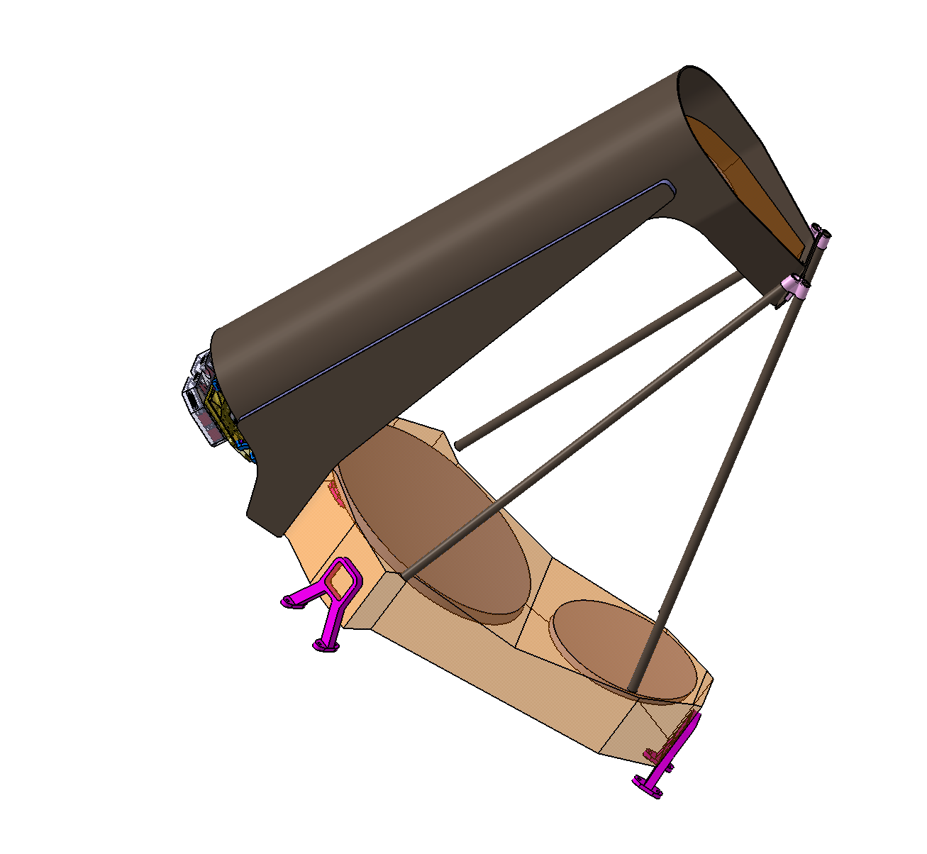
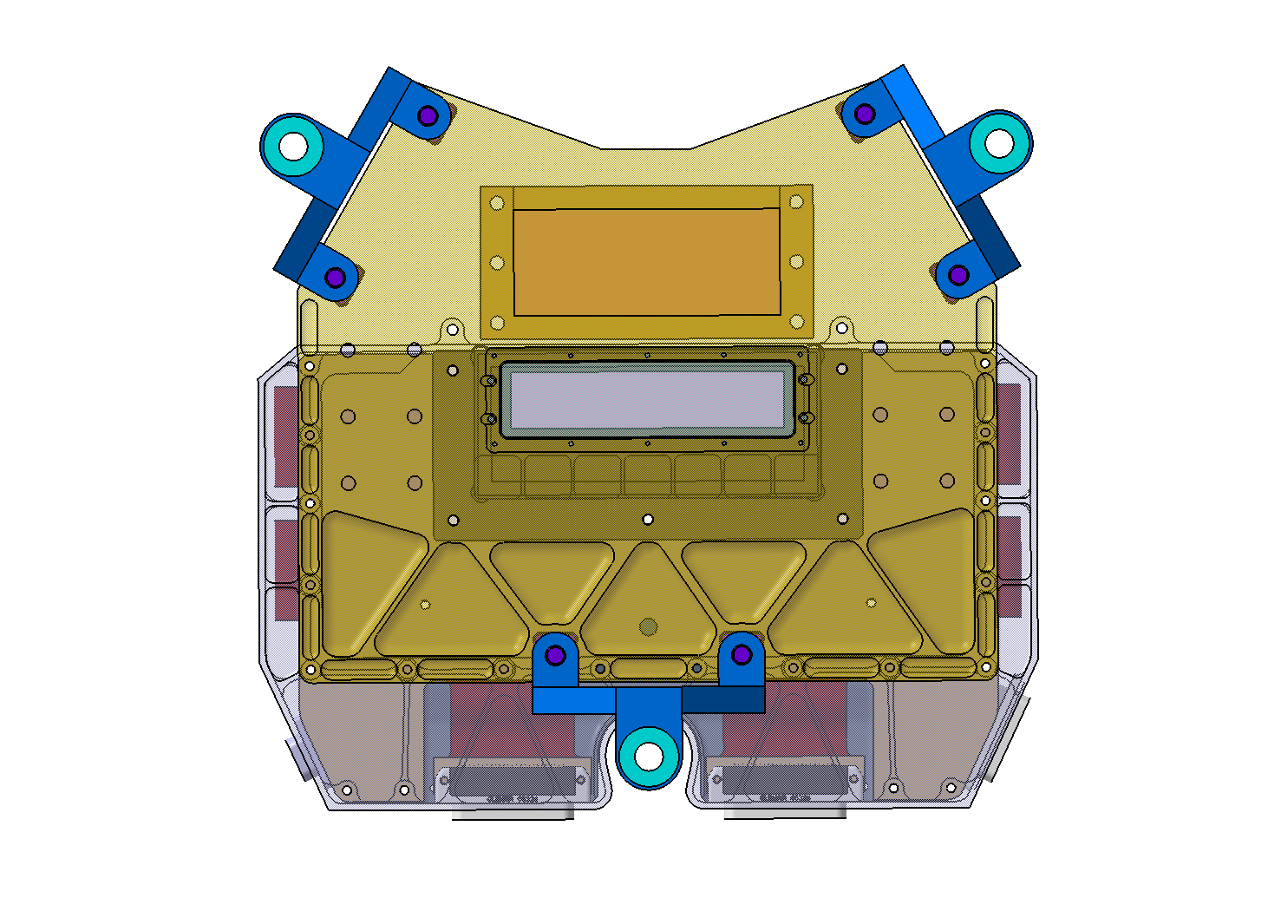
Quasi-classical high-resolution imagers and spectrometers
CAIMAN – A concept for a “CaSSIS 2.0”
CAIMAN – A concept for a “CaSSIS 2.0”
Multi-detector FPA
Monolithic mirrors
Imaging at
2.5m/px in VIS and
7.5m/px out to >=1.9 μm
We are currently looking at developing this concept for the ZefERO mission in ESA/HRE.

Slide 12
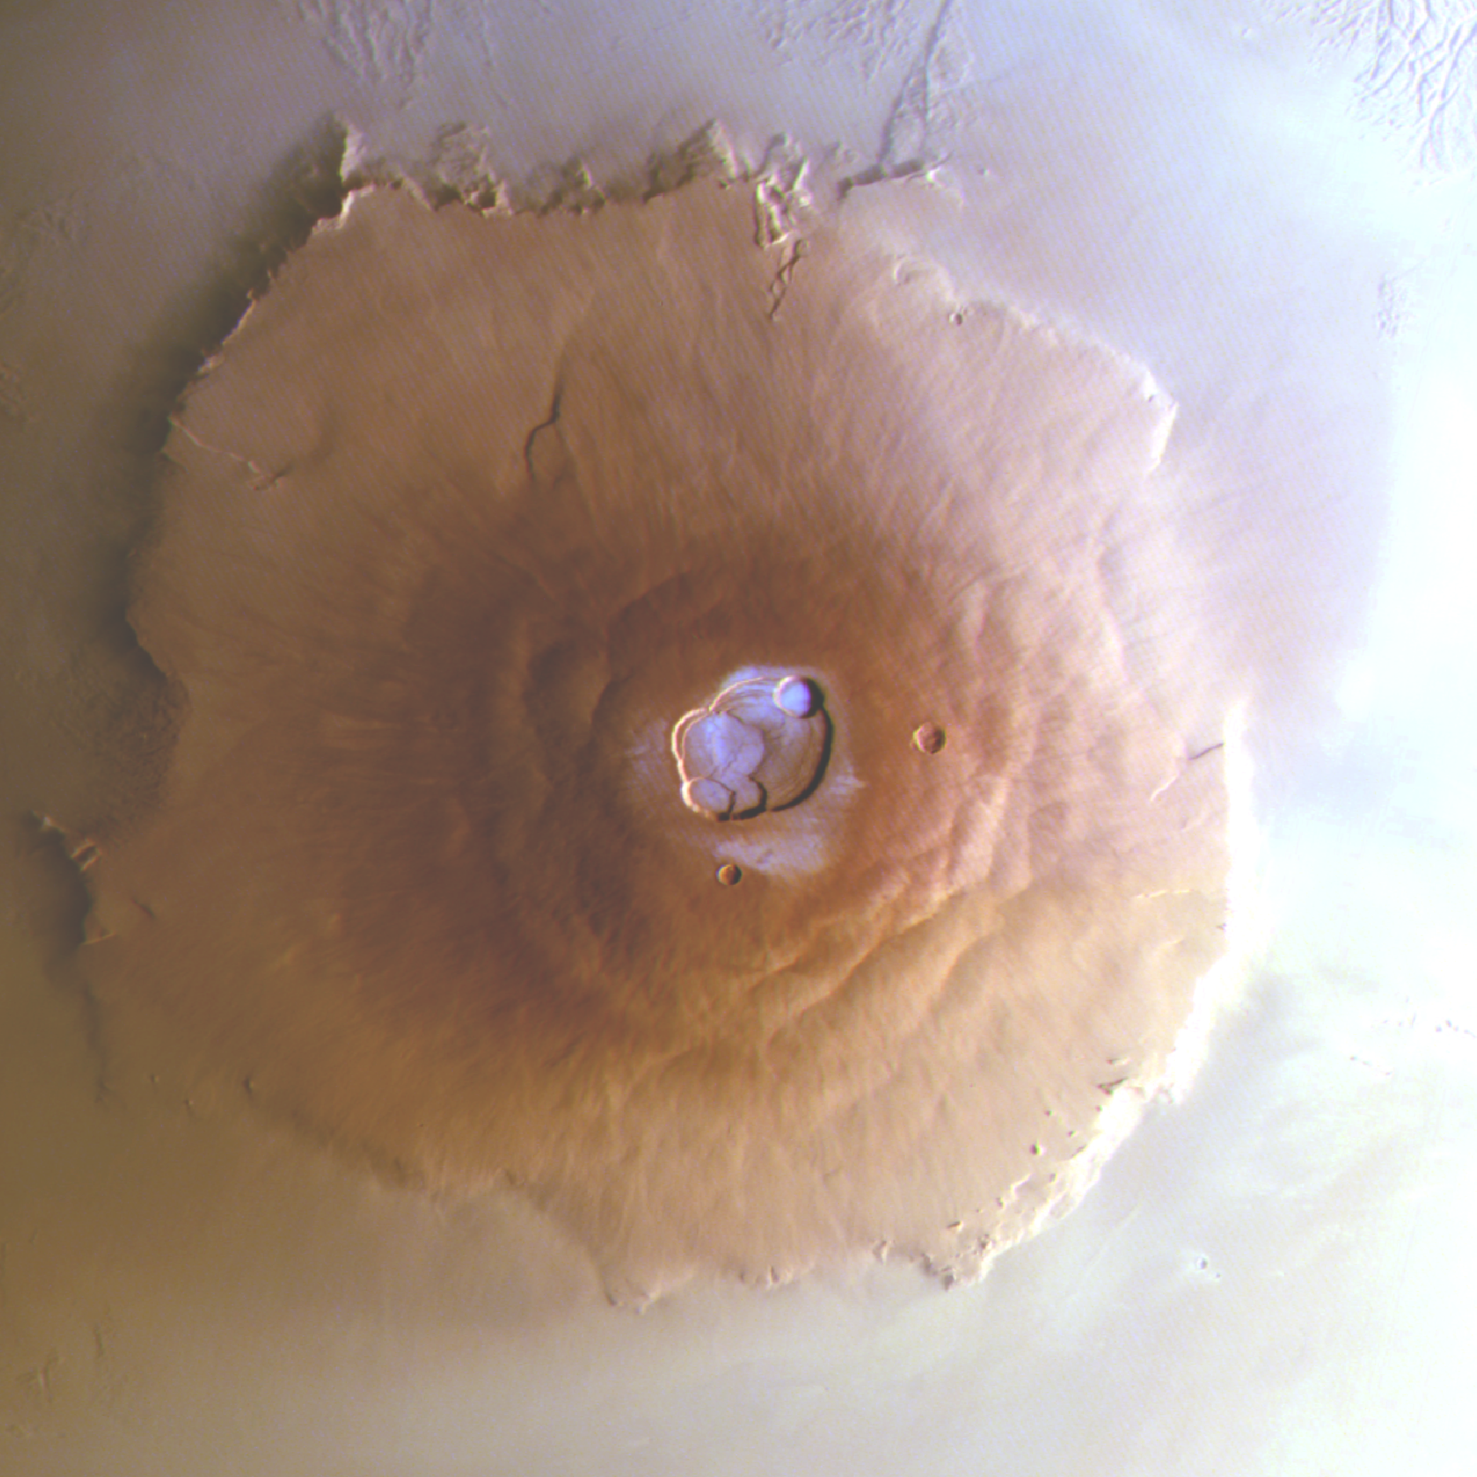
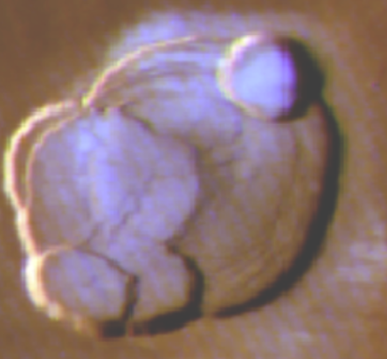
Quasi-classical high-resolution imagers and spectrometers
ILLUMINATI – Nighttime processes
CAIMAN – A concept for a “CaSSIS 2.0”
Dynamic processes on Mars at night and during permanent polar darkness are fundamentally interesting for numerous reasons.
High power lasers to illuminate surfaces from orbit can allow targeting of specific areas of interest.
Condensation on Martian volcanoes first detected by CaSSIS.
100 km

Slide 13
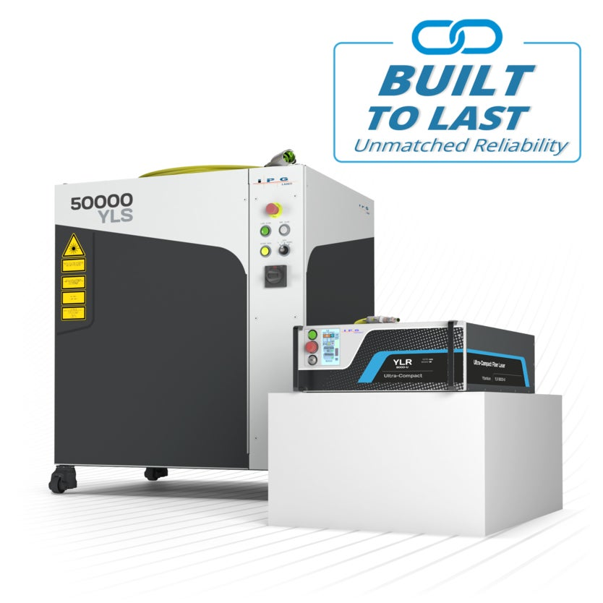
Quasi-classical high-resolution imagers and spectrometers
ILLUMINATI – Nighttime processes
CAIMAN – A concept for a “CaSSIS 2.0”
Study by Uni Bern and Beyond Gravity suggests that this is plausible.
SNR budgets are challenging but NOT ridiculous.
3-6 kW CW fibre lasers at 1060-1080 nm for short duty cycles.
1550 nm and 2 micron lasers are also plausible.
Miniaturization and space qualification needs to be addressed.
Timescale
Next 10-15 years

Slide 14
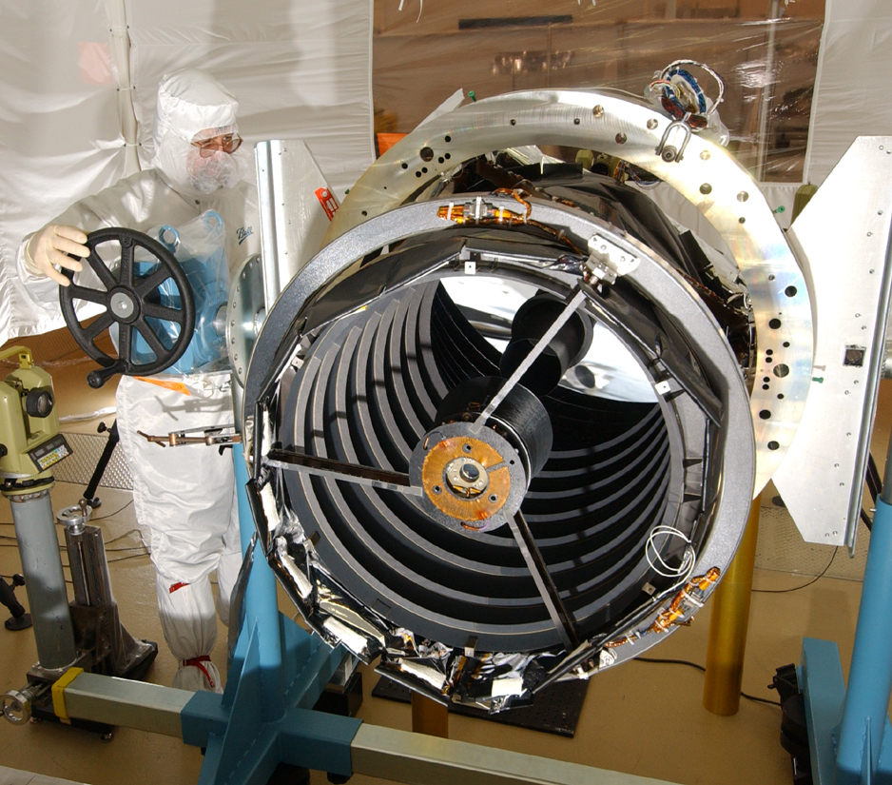
Quasi-classical high-resolution imagers and spectrometers
Other areas
CAIMAN – A concept for a “CaSSIS 2.0”
Ultra-high resolution push-broom imaging (1 microrad) is still beyond what Europe can do for interplanetary flight today. (total instrument mass < 60 kg)
There are instrumentation problems but also spacecraft stability issues!!
Planetary sciences needs 1-6 micron wavelength (small pixel) detector technologies for interplanetary flight – especially in imaging spectroscopy – CH teams have a real interest here.
HiRISE on MRO is still the state of the art 20 years after launch!
Lynred Snake detector and board from TASCH under test at UBE.

Slide 15
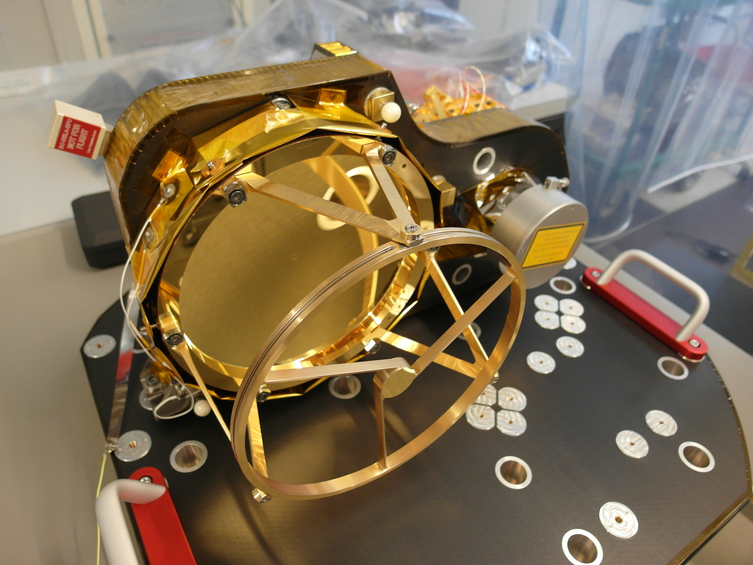
Quasi-classical high-resolution imagers and spectrometers
Other areas
CAIMAN – A concept for a “CaSSIS 2.0”
LiDARs and high power lasers remain of extreme interest to the atmospheric sciences community.
Some of the BepiColombo/BELA heritage remains relevant.
UV instrumentation has not been a major priority in Solar System missions in recent years but this might change. (Exoplanet astronomy is pushing this as seen in the Waltzer F-class proposal.)
Sub-mm wave instrumentation is pushed hard in Germany and CH has an interest.
ASIDE: Scientifically a European SAR development for Mars is also attractive.
BepiColombo Laser Altimeter

Slide 16

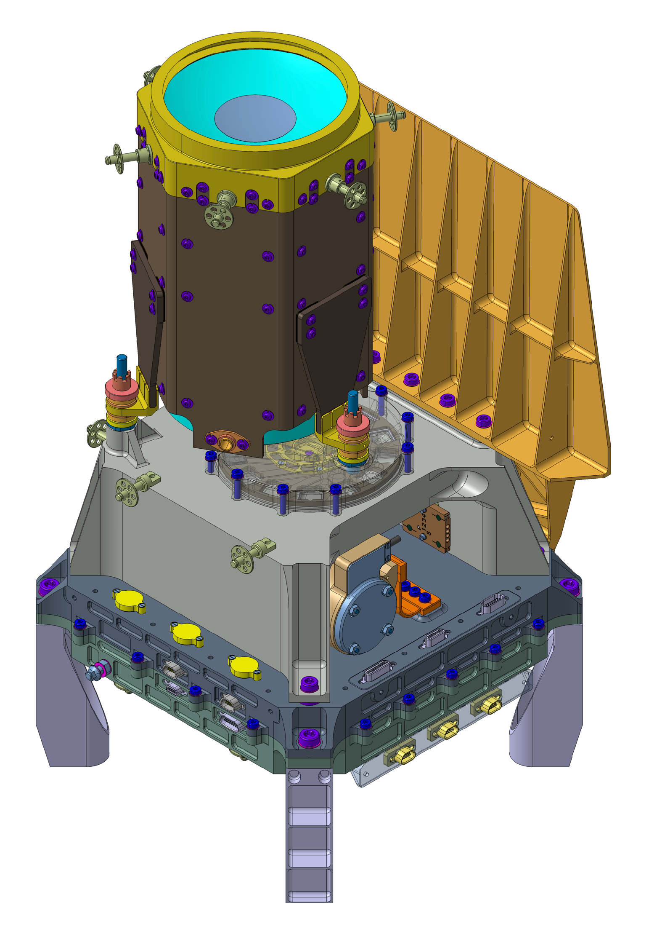

Lightweight near-object systems
CHANCES for RAMSES
Monolithic structure (including electronics)
Lightweight (CFRP + AlBeMet)
Vis-SWIR (InGaAs CMOS)
6 broadband filters (3 Vis, 3 NIR)
Linear polarisation (2 crossed filters)
Adjustable focus (through filter thickness)
Launch to Apophis
in 2028
400mm FL, 80mm aper., f/#=5, 1° FoV
~ 4 kg, 30x20x20 cm, 20W
Specifically constructed for rendezvous imaging and maximizing information return for landing site selection on small bodies.

Slide 17

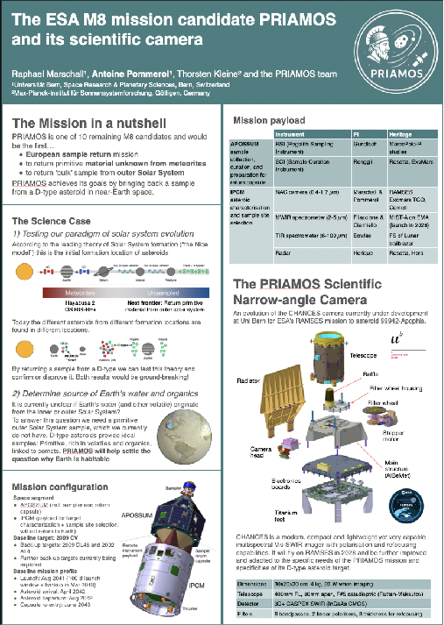
Lightweight near-object systems
Future evolution for PRIAMOS
Larger field of view or a combined WAC
Continuous refocusing down to ~100s of metres distance
Filters and spectral range adapted to a D-type asteroid
Improved polarisation capabilities
Improved electronics: high cadence, fast compressor (lossless and lossy), on-board storage and processing
One of 10 missions down-selected for phase 2 in ESA’s M8 call
See poster by Marschall, Pommerol et al. (this conference))
Similar system could be envisaged for landing site identification on Enceladus (e.g. COLIME, NF Eagle proposal).

Slide 18
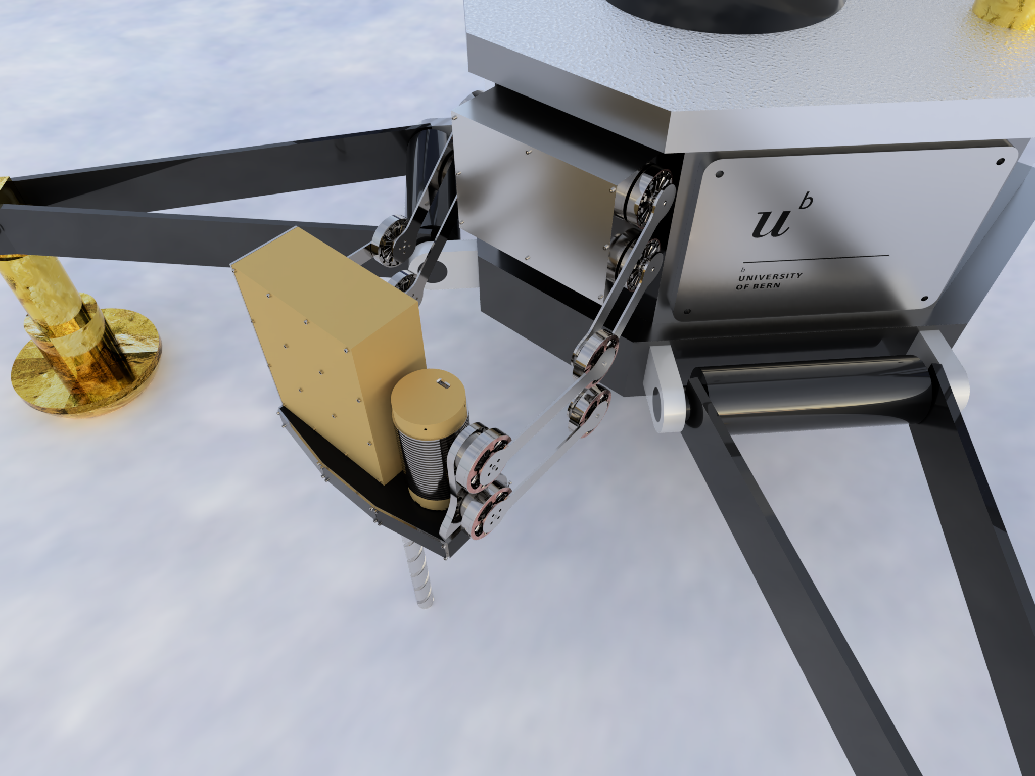
Miniaturization and Implementation
Landed systems for (mainly) non-destructive diagnostics
There are strong desires in the science community to develop new for flight instrumentation.
There are now programmes available to support this (e.g. OSIP, MARVIS).
Work is on-going to test possible implementations.
Examples include
THz TDS (see talk by Stoeckli)
Miniaturized (bore-hole) spectrometers
Scanning Electron Microscopy
There are challenges in how these devices can be brought to the surfaces/sub-surfaces to be examined.
There are going to be opportunities to expand our capabilities in these areas.
Why?
Investigation of sub-surface (unprocessed) material to constrain Solar System formation.
Determination of the extent of sub-surface resources for future exploration.

Slide 19
Quasi-classical high-resolution imagers and spectrometers
Higher spatial resolution, improved discrimination between different mineralogical units, atmospheric remote sensing.
Driving mass down, data transfer/ processing rates up, extending the wavelength range and resolution.
Lightweight near-object systems
Higher spatial resolution, improved discrimination between different mineralogical units, for landing site identification.
Maximizing performance of R-S systems with max. mass of <=10kg.
Landed systems for (mainly) non-destructive diagnostics
Growing knowledge of the properties of planetary surfaces, the sub-surface and local “atmospheres”.
Expansion of the palette of diagnostic tools.

