Slide 1
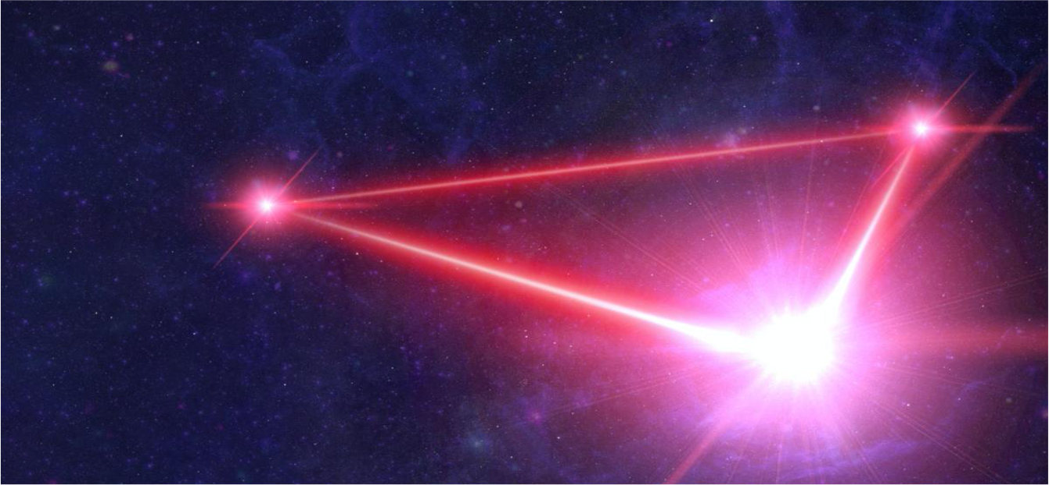
LISA – Laser Interferometer Space Antenna
D. Giardini & Luigi Ferraioli, ETH Zurich
SIAPS 22.1.2026

Slide 2



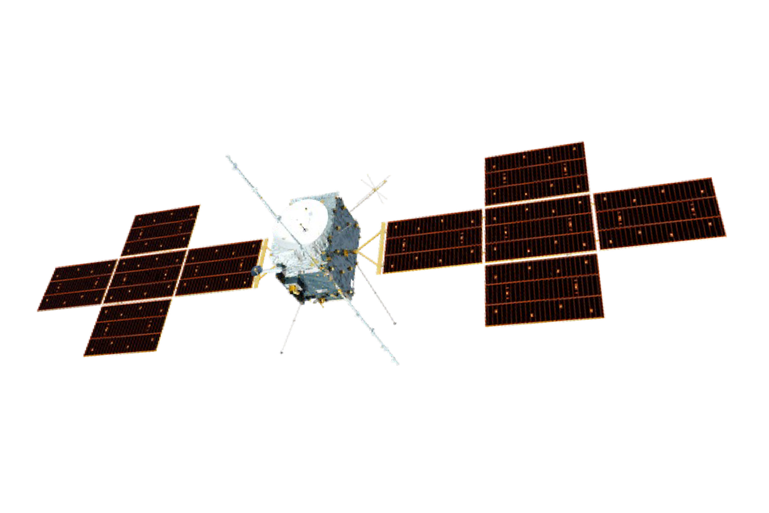
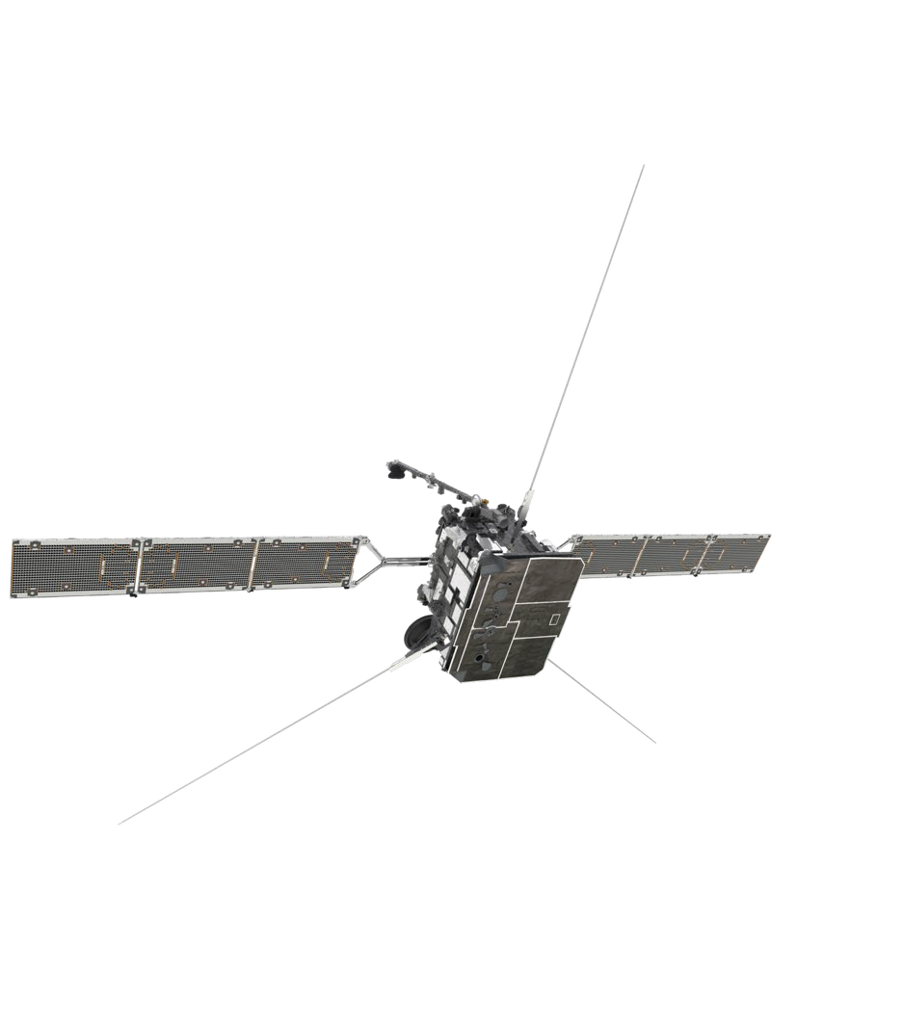
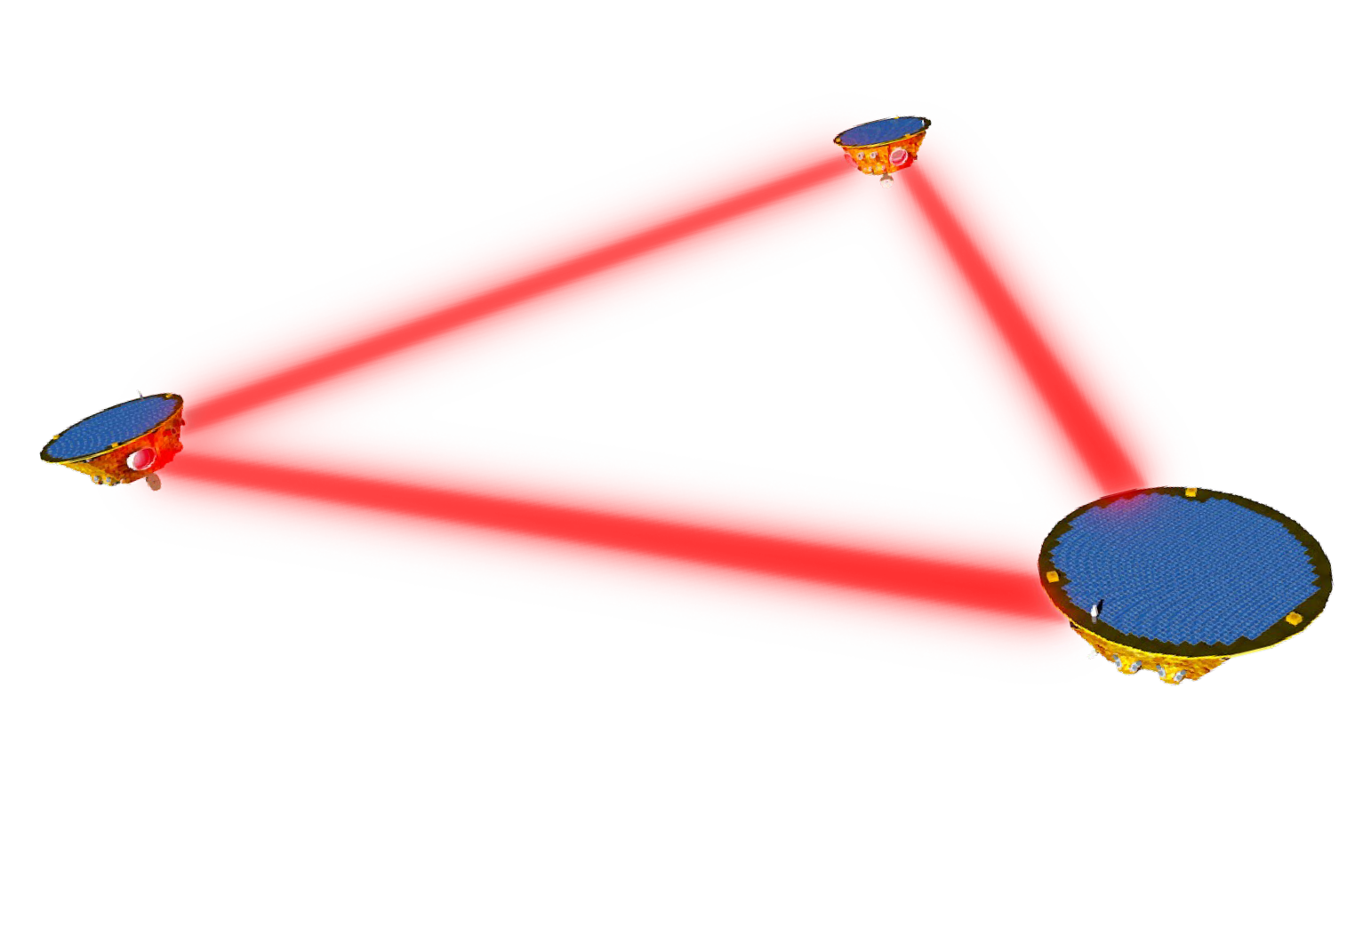
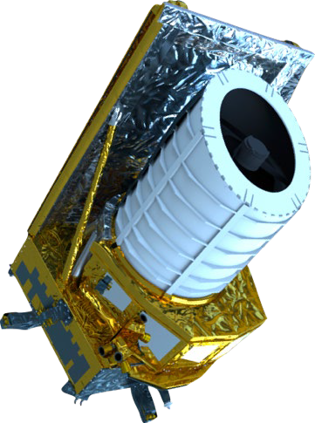
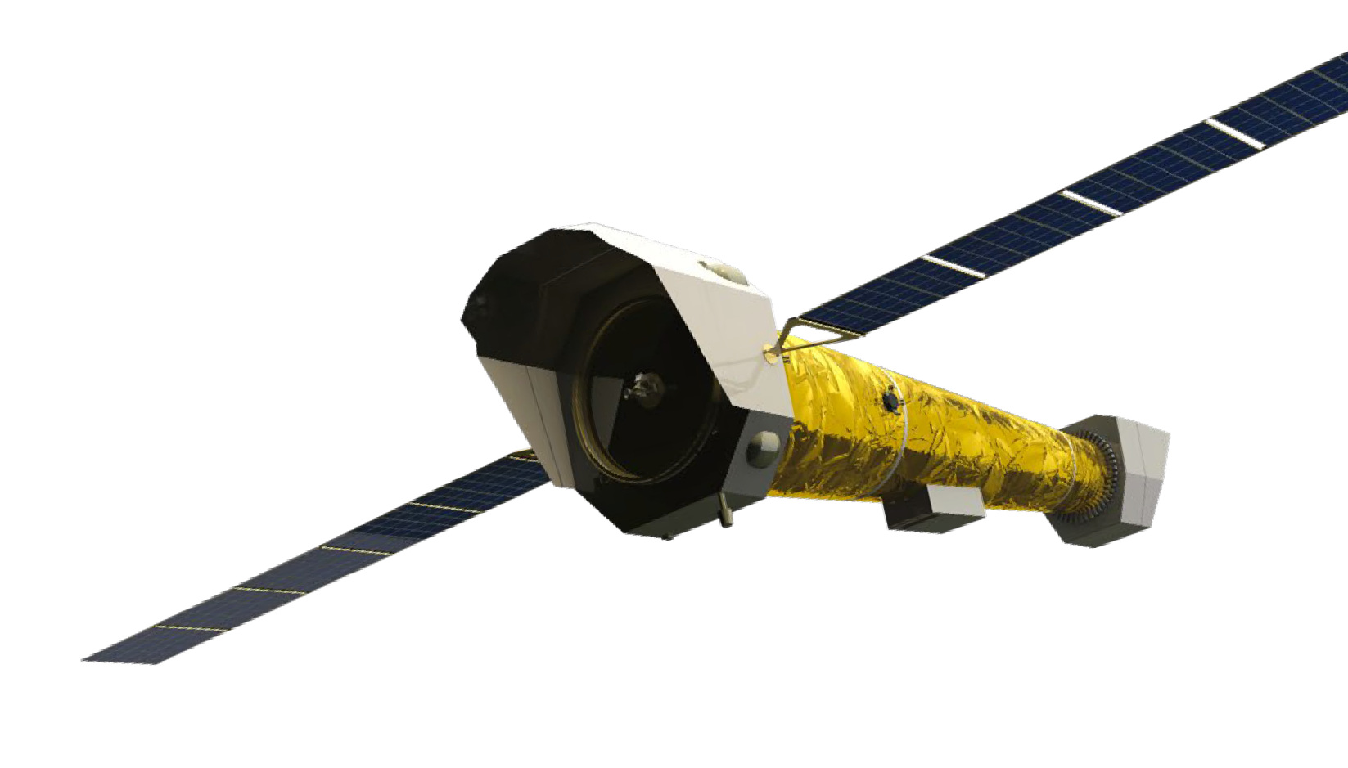
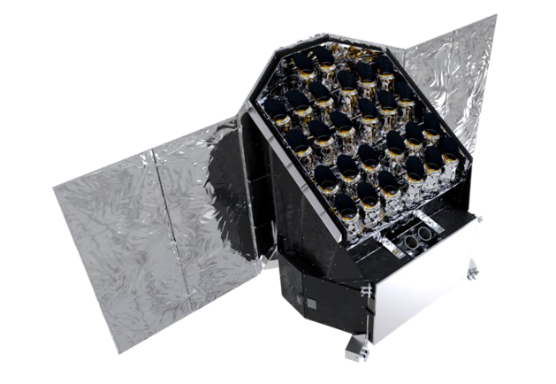
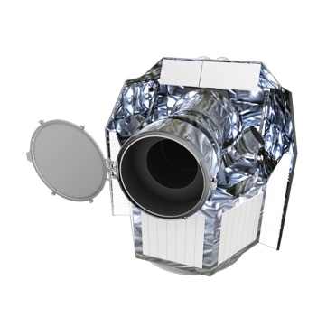
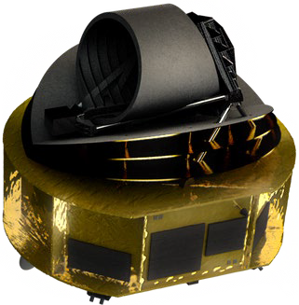
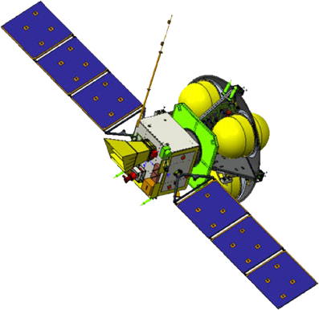
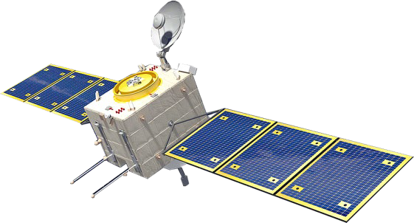
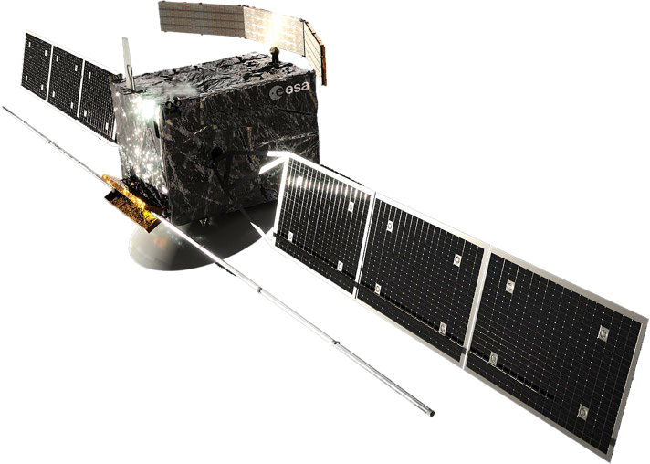
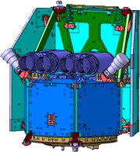
Cosmic Vision Plan
In orbit
Medium-class Missions
Large-class Missions
In orbit
JUICE [2023]
In orbit
In development
M1: Solar Orbiter [2020]
LISA [2035]
Development starting in 2027
In development
In orbit
In development
M2: Euclid [2023]
In development
NewAthena [2038]
In development
In development
M3: PLATO [2027]
S1: CHEOPS [2019]
SMILE [2026]
Development starting in 2026
M4: Ariel [2031]
Small and Fast Missions
F1: Comet Interceptor [2029]
M5: Envision [2031]
F2: ARRAKIHS [2031]
4

Slide 3
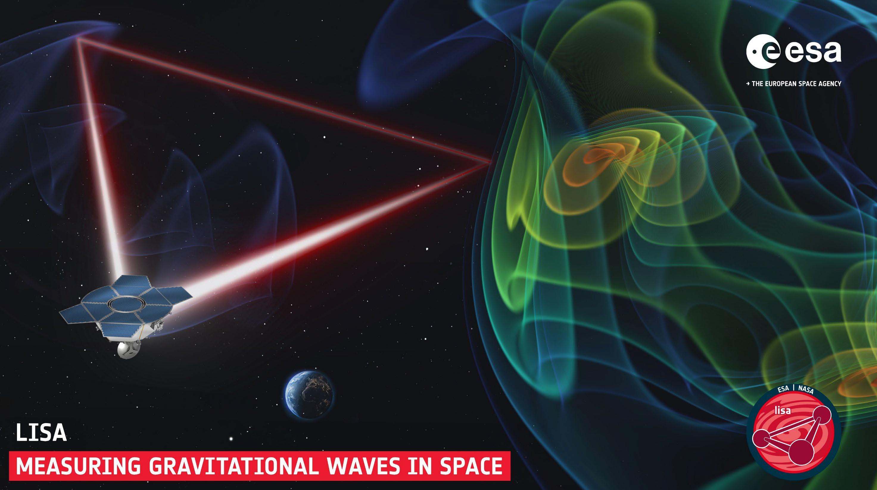
Produced by

Slide 4
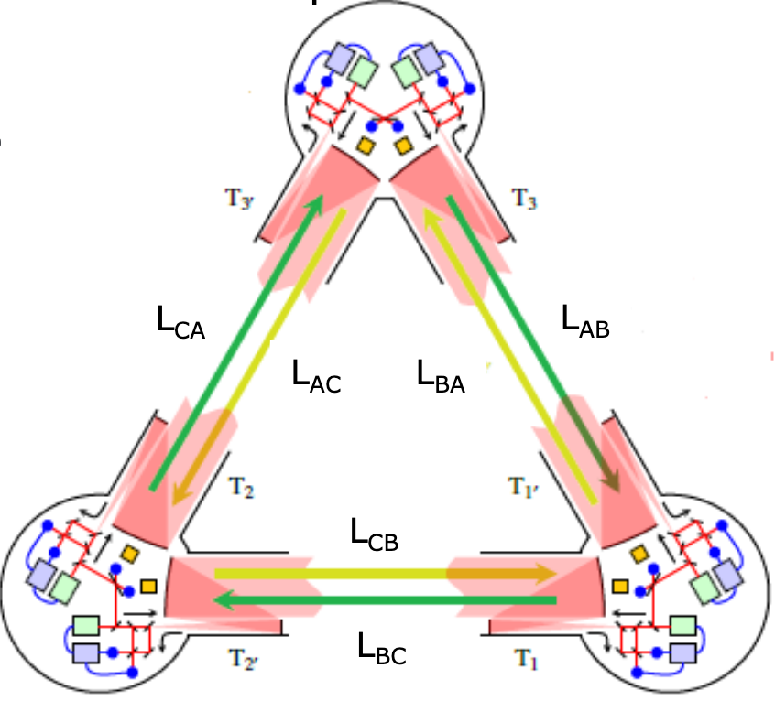
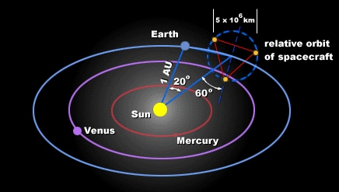
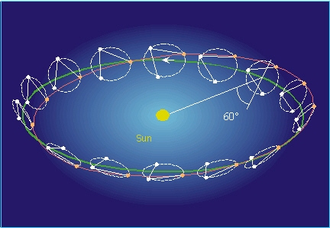
LISA
Triangular configuration with 3 spacecrafts with 2 masses each
Earth-like orbit around the Sun
On-ground data processing critical to remove dominating noise sources
Optical readout on selected degrees of freedom and electrostatic readout on all axes
Electrostatic actuation to steer TM motion
Goal: measure TM distance with few femtometer precision over 2.5 million miles distance

Slide 5
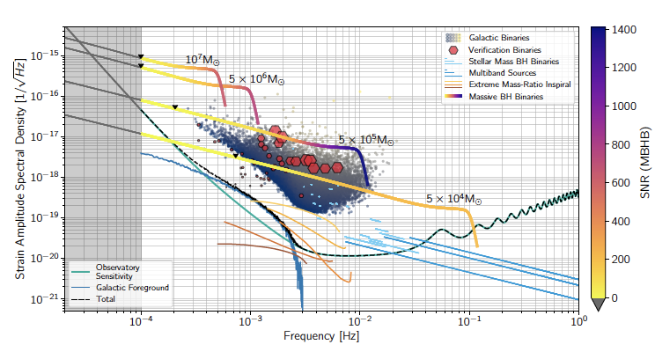
LISA GW sources
GW sources
Galactic Binaries (GB), 30 mil of which 25’000+ detection target, incl. 26 known VB
Stellar BHB (sBHB) or Stellar-Origin Binary Black Hole (SBBH), 10-100/yr
Massive Black Hole Binaries (MBHB) or Super-Massive BHB (SMBHB), 10-1000/yr
Intermediate Mass Black Hole Binaries (IMBHB) ?
Extreme Mass Ratio Inspiral (EMRI), 1-1000/yr
Intermediate Mass Ratio Inspiral (IMRI) ?
Stochastic GW Backgrounds, ?
Bursts

Slide 6
LISA timeline
1970’-1980’ first ideas and proposals
1990-2005 concrete planning
2015-2016 LISA PathFinder
2016 Publication of first GW detection by LIGO
2017 LISA Phase A
2024 LISA L3 adoption
2035 Launch
2035-2036 Position and commissioning
2037-2048 Operation

Slide 7
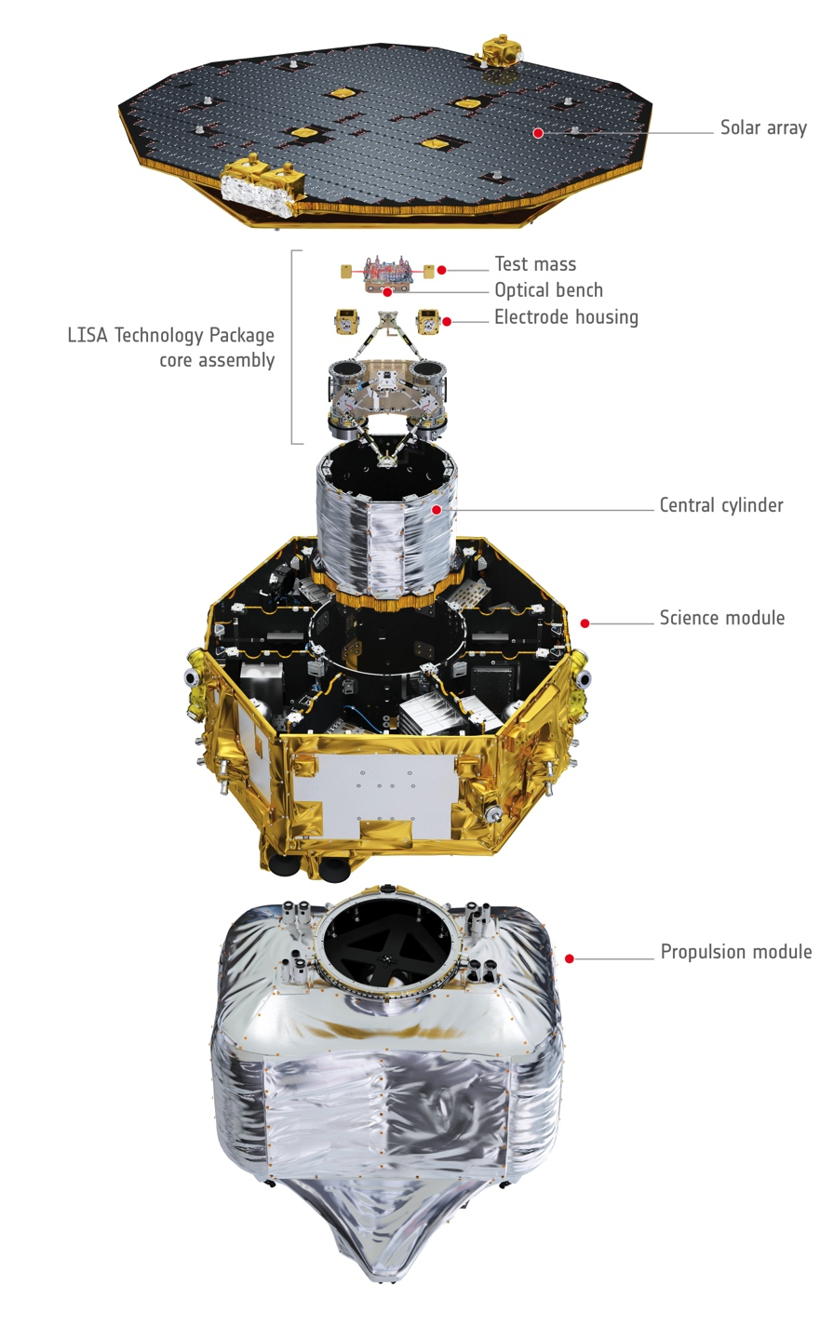
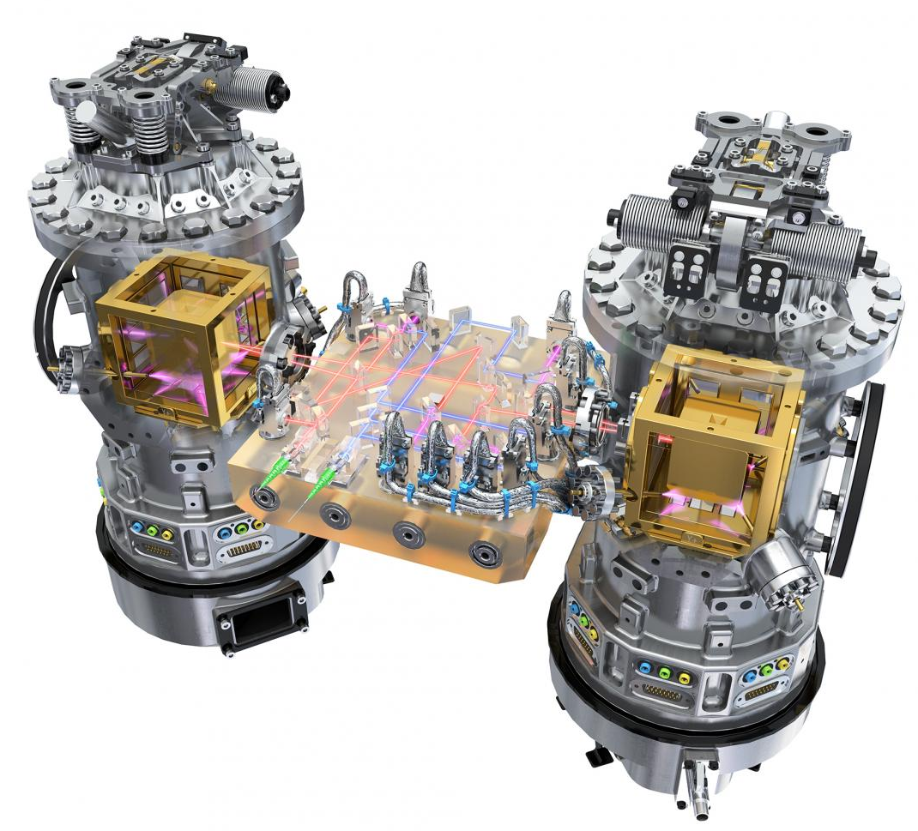
LISA PathFinder

Slide 8
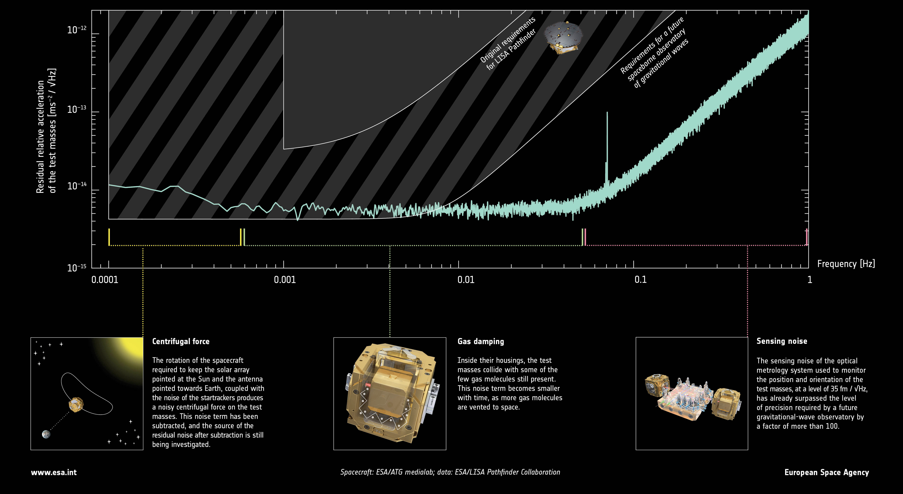
LISA PathFinder: final performance

Slide 9
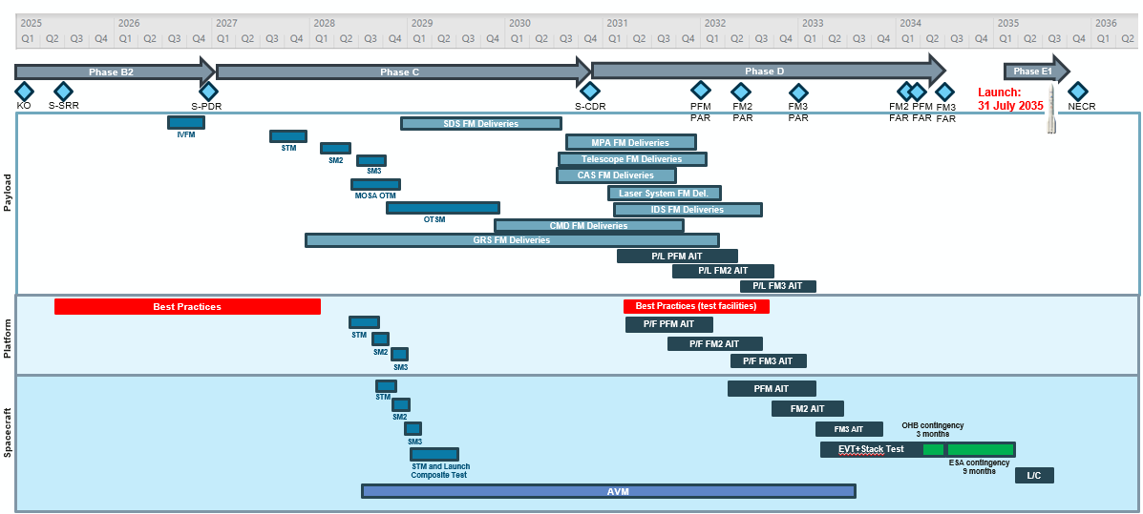
Overall Project Schedule

Slide 10





























Industrial Consortium Status
ESA
Science Directorate
Kicked-off
Nego on going
SPB Planned
ITT on going
CORE TEAM
LISA S/C Prime
Project Office
Programme Industrialization
System Engineering
Mission Analysis & Operations
System Verification
MTP and Electrical Architecture
LISA Core Assembly (LCA)
Design, Development and AIT
Mechanisms & Launch Adapter
Spacecraft STM, PFM FM1 FM2 AIT
Contamination control
MGSE - OGSE - EGSE
DFACS Design and Development
Data Handling and Timing
On Board SW
TT&C Architecture
FDIR
Performance Models and Analysis
Support to Science
LISA Core Assembly (LCA)
Avionics Validation Model
SCOE Procurement
MLTS
(Lead)
MLTS
(Subco)
MLTS
(Subco)
LCA
Structure
Radiators
Tanks
SCSW
(Lead)
SCSW
(Subco)
SCSW
(Subco)
USO
SIS
DH SCOE
PRE SELECTED
P/F Harness
PCDU
MLI
DCCM
Central Tube
Propulsion
HGA
HGA
(Subco)
DFACS SCOE
HGA
(Subco)
TTC SCOE
HGA
(Subco)
TTC SCOE
(Subco)
CRS
(Lead)
OGSE
Self Gravity
TM/TC FE
RFSC
Structure Equipment
Thermal Equipment
Solar Array S/S
Propulsion Elements (several)
LCA
Contamin.
Damping System
Payload Harness
RF S/S Lead
LGA
XBT
TWTA
RFDNA
Purging Device
Gravitation al Masses
LCA
Therm. HW
Launch Adapter
S/C AIT
Wave Guides
Star Tracker
Fine Sun Sensor
OBC
RTU
BP
S/C Transport Container
S/C Test Facil. STM
S/C Test Facil. PFM
Magnetic TF
MGSEs
Battery
CCS
SCOEs
Launch EGSE
LCA Test Facility
Payload OGSE
LCA
Container

Slide 11
LISA Payload / Instrument (LCA) – Product Tree

Slide 12
Procurement Planning
Subsystem / Family | Procurement Item | Issuing Company | ITT/FRQ Issue Date
Propulsion S/S | Cold Gas Impulsive Thruster | TAS-UK | Jan 2026
Propulsion S/S | Isolation Valves | TAS-UK | Jan 2026
Propulsion S/S | Power Processing Unit | TAS-UK | Q1 2026
Facilities | LCA Test Facility | OHB | Q1 2026
Data Handling & Timing S/S | RTU | TAS IT | Q1 2026
Loose Item | Payload Harness | OHB | Q1 2026
Services | S/C AIT | OHB | Q1 2026
Mechanical GSE | S/C Transport Container | AIT Lead | Q1 2026
Electrical GSE | SCOEs | OHB | Q1 2026
Electrical & Power S/S | Battery | OHB | Q2 2026
Electrical & Power S/S | High Stability Heater Control | OHB | Q2 2026
Mechanical GSE | MGSEs | AIT Lead | Q3 2026
Platform TC S/S | Thermal Elements | OHB | Q2-2027
Facilities | S/C Test Facilities STM | AIT Lead | 2027
Facilities | S/C Test Facilities PFM | AIT Lead | 2031
Facilities | S/C Magnetic Test Facility | AIT Lead | 2032

Slide 13
Swiss contributions to LISA
Hardware: GRS Front-End Electronics
Ground-segment: pipelines for global fit and alerts, national PC for Distributed Data Processing Center (DDPC)
Research: GW modeling, simulation and detection; participation in Mock-Data Challenges
Governance:
LISA PF ExeCom, LISA ExeCom and Board, LISA Consortium Council
DDPC
Performance & Operation Team
Science Team Committees and Working Groups

Slide 14
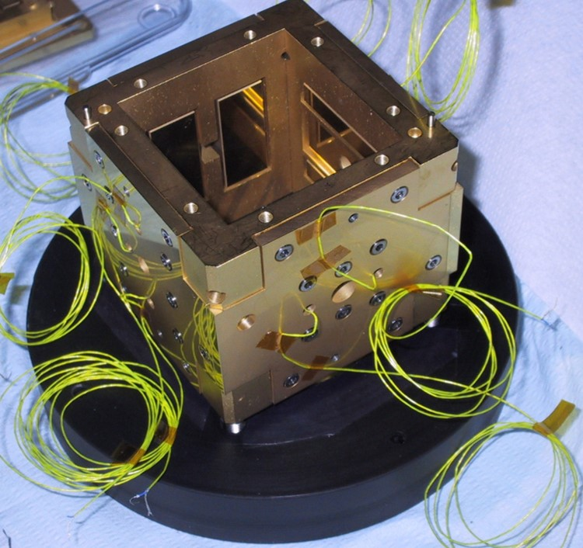
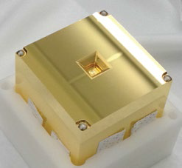
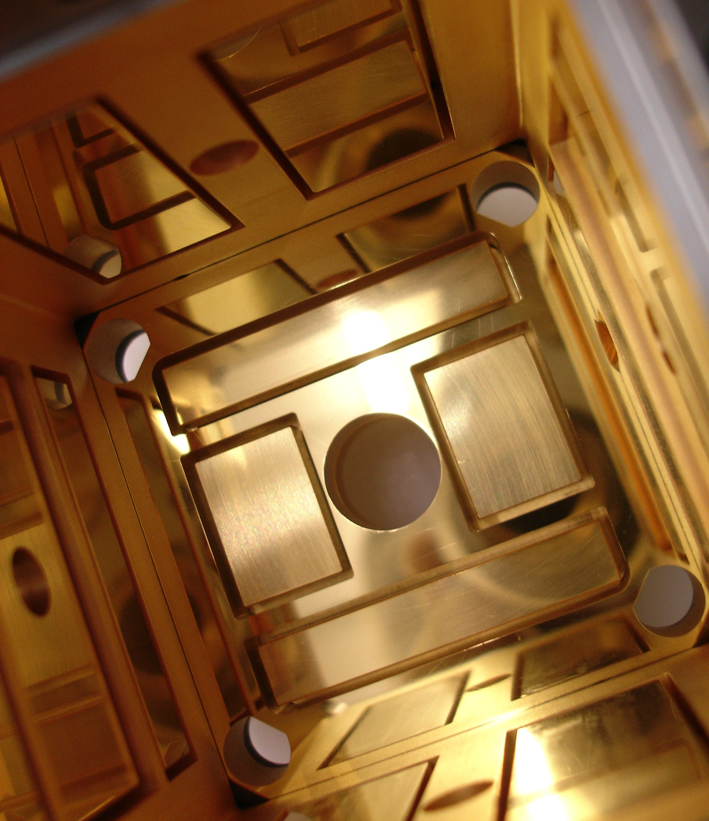
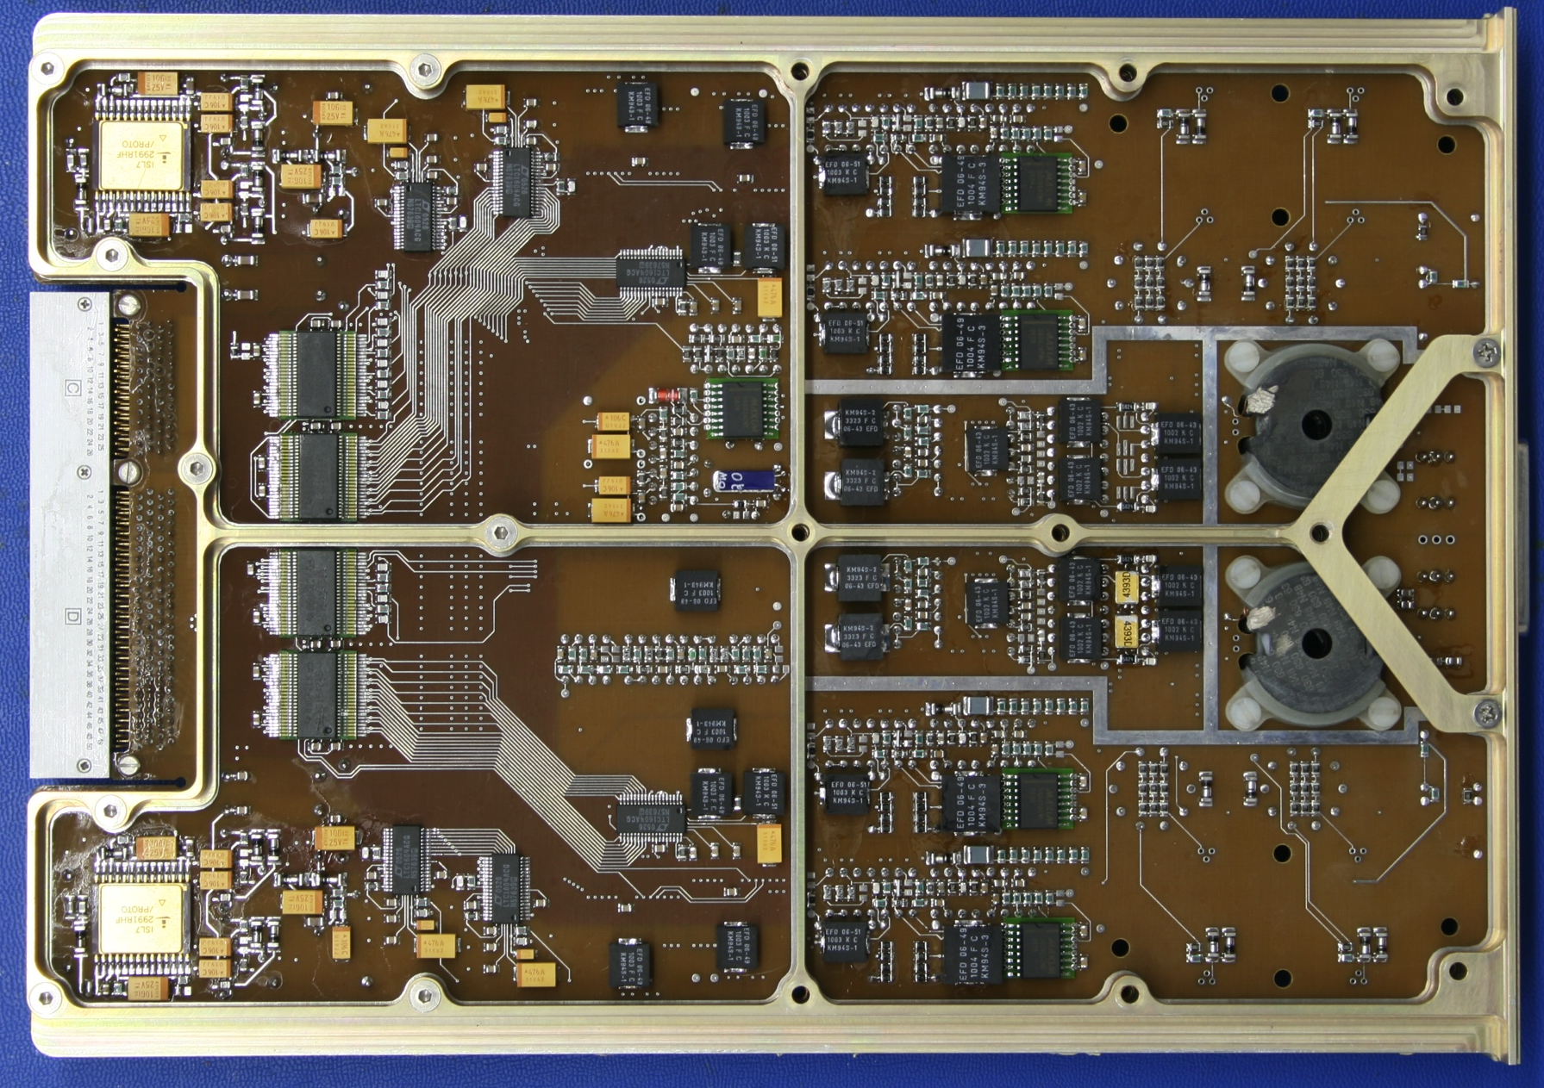
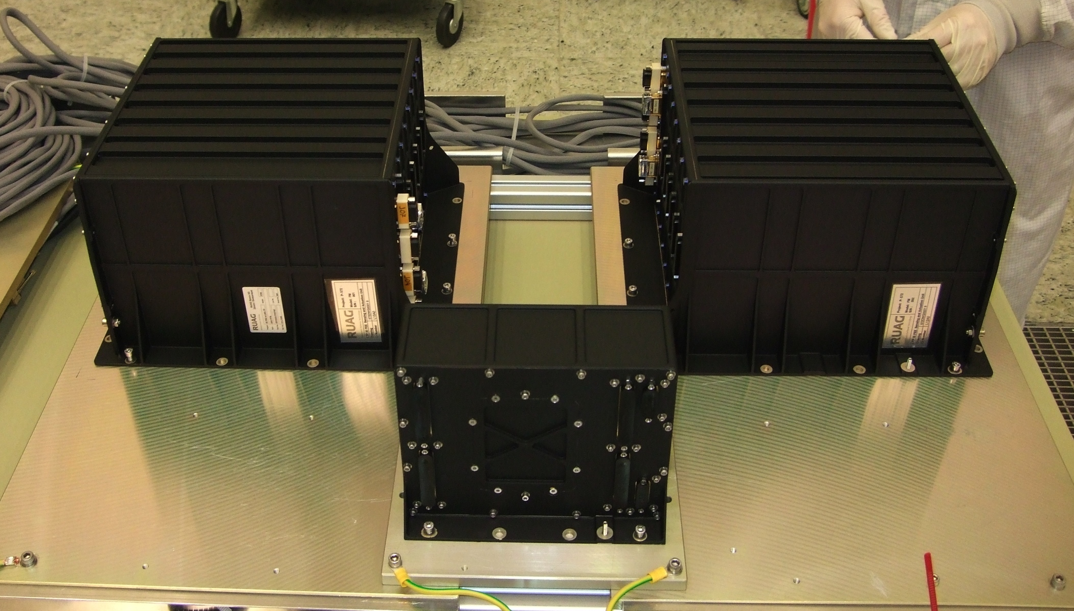
Swiss hardware contribution
Front-End Electronics of the Gravitational Reference System
2 EM, 1 QM, 6 FM, 2 FS
240 kg of space-qualified electronics

Slide 15
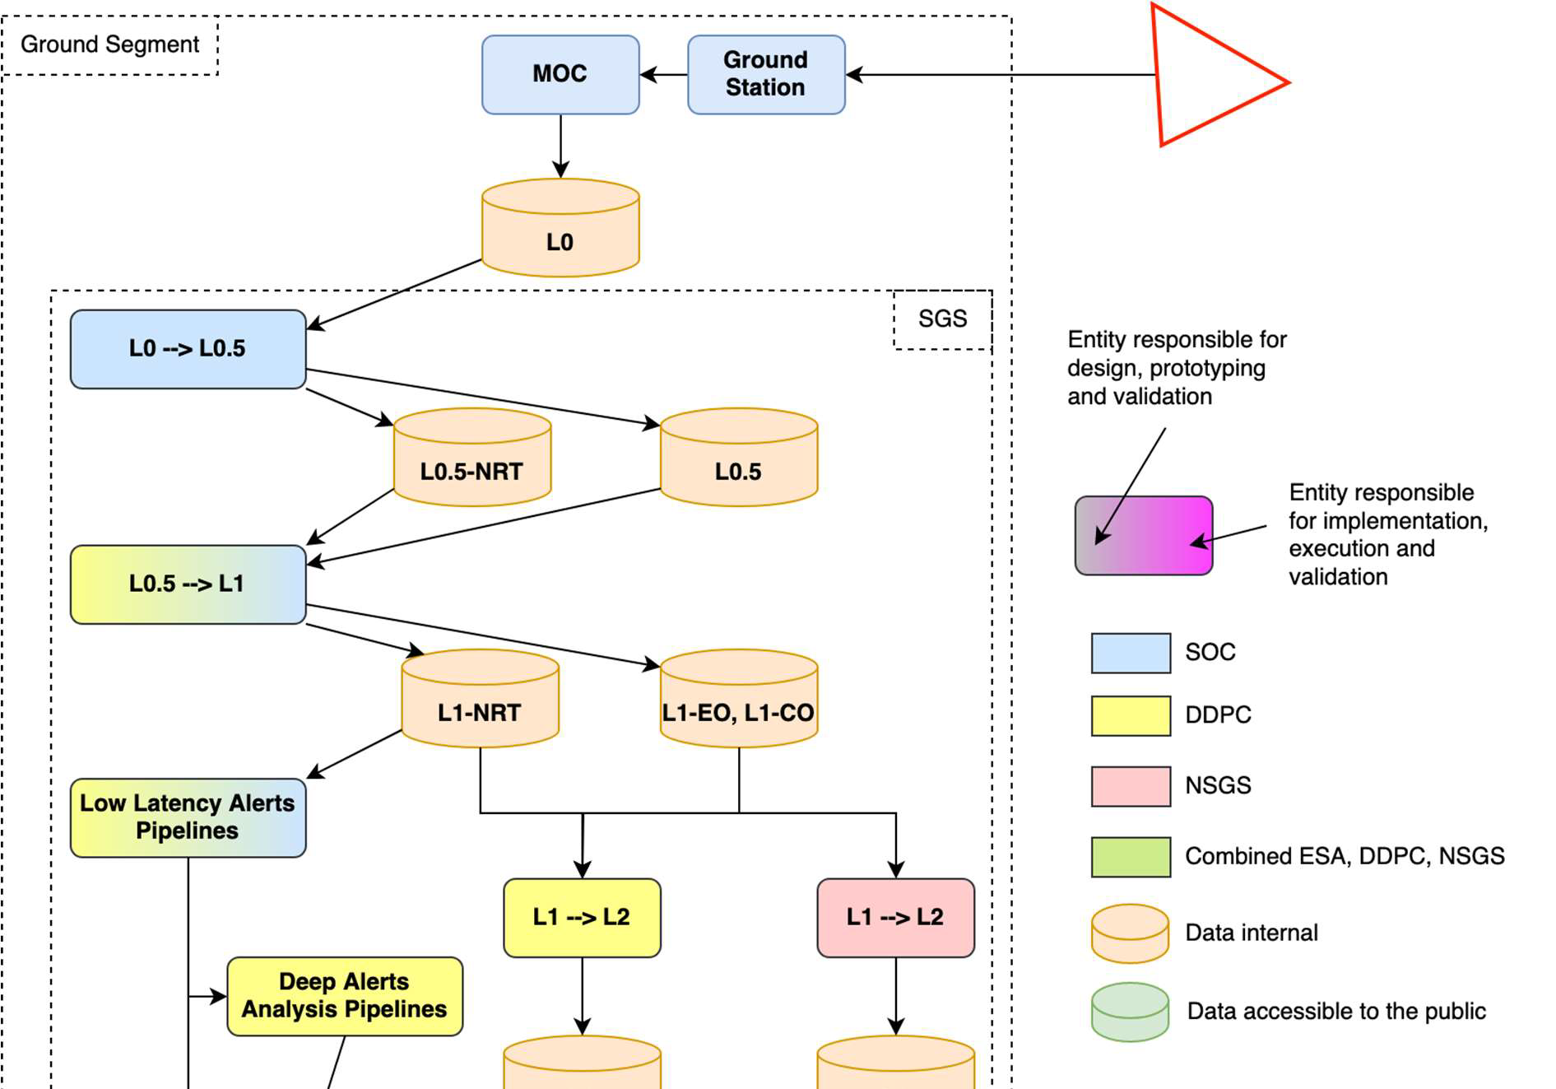
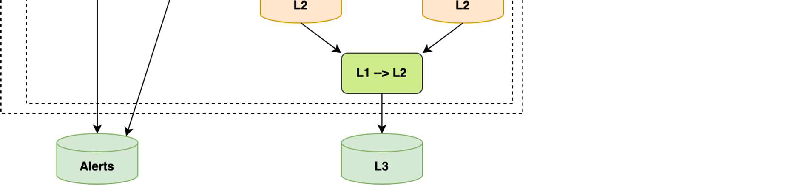
LISA data and products
L0: raw and spacecraft data
L0.5: payload data
L1: noise-corrected and calibrated TDI streams (Time-Delay Interferometry, multiple)
LLAP: Low-Latency Alerts Pipeline from L1-NRT (Near Real Time)
L2: multiple global fits and source identification
L3: official LISA catalogue of identified sources

Slide 16
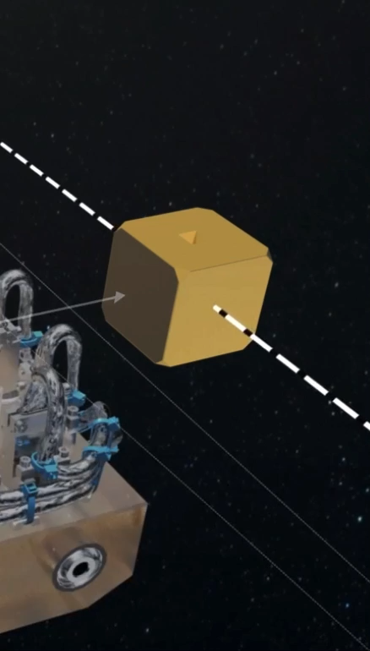
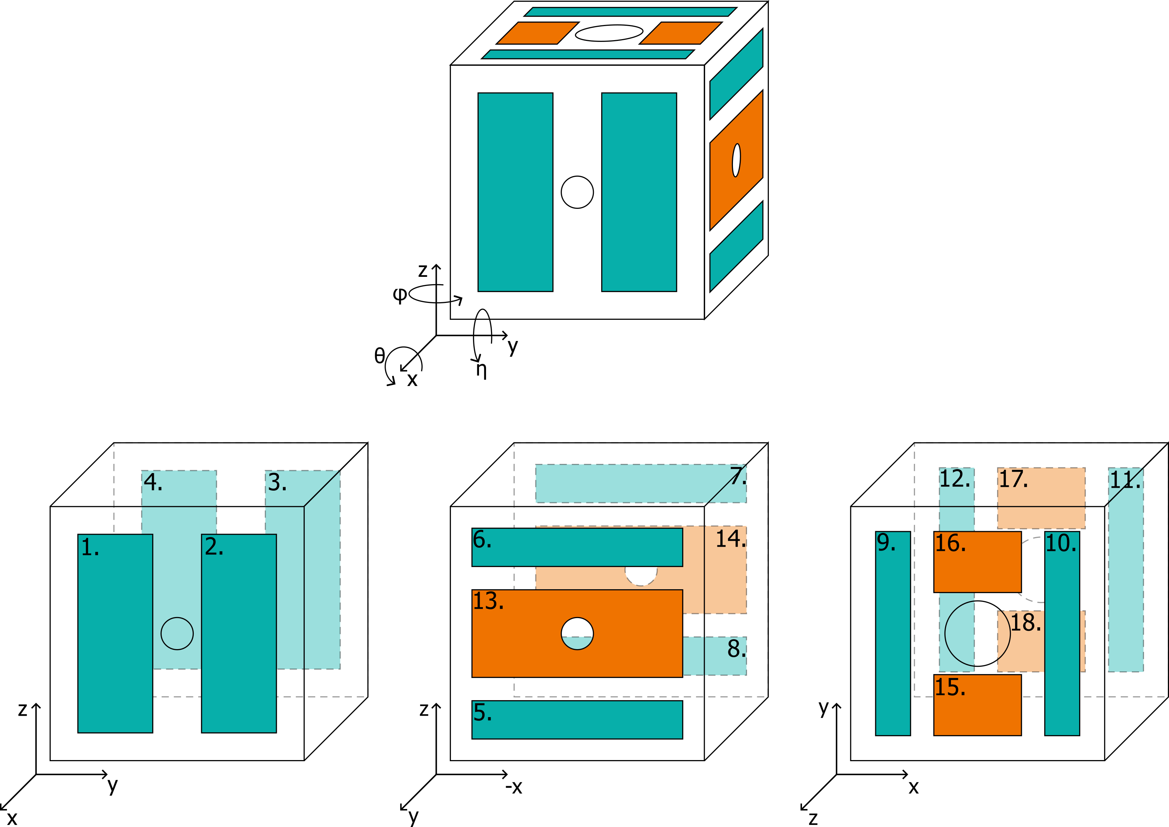
LISA Gravitational Refernce Sensor Front-End Electronics (GRS FEE)
The GRS Test Mass is floating within the GRS vacuum enclosure
The spacecraft is controlled to leave the TM free along one degree of freedom (actually following the motion of the mass). Along the other degrees of freedom the motion of the mass is controlled and the mass actuated
The motion is measured with an optical system for one translational and two rotational degrees of freedom. Along the other degrees of freedom the motion measurement is provided by the GRS FEE capacitive readout system
The GRS FEE is the electronics to control the GRS TM. It provides voltages to steer the motion of the mass and it measure the TM motion via capacitive sensing

Slide 17
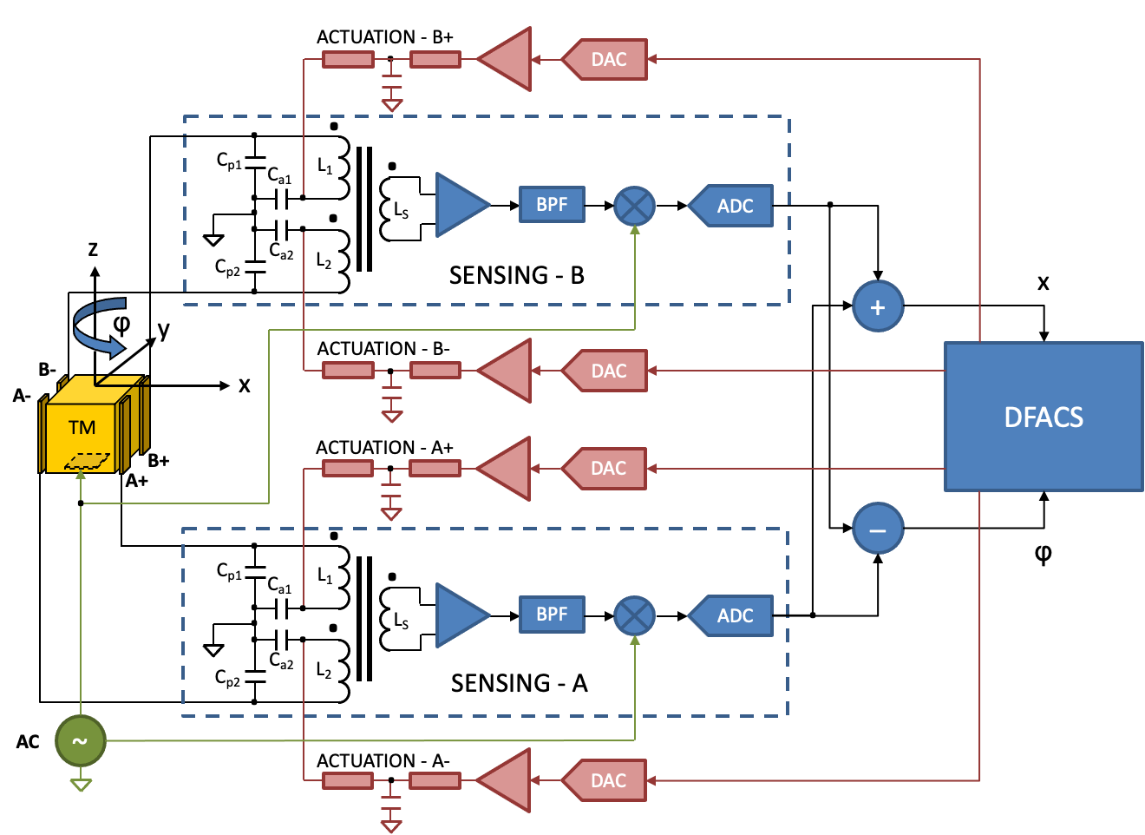
LISA Gravitational Refernce Sensor Front-End Electronics (GRS FEE)
Sensing and Actuation Circuit diagram
Actuation commands are received by the on-board computer which is running the Drag-Free and Attitude Control System (DFACS).
The GRS FEE process the actuation commands and generates the voltages that are applied to the TM electrodes
The sensing of non-optical channels is implemented by a capacitive readout. The differential capacitance between opposing couples of electrodes and the TM is measured by the sensing channels of the GRS FEE
Actuation and sensing electrodes are the same on the TM

Slide 18
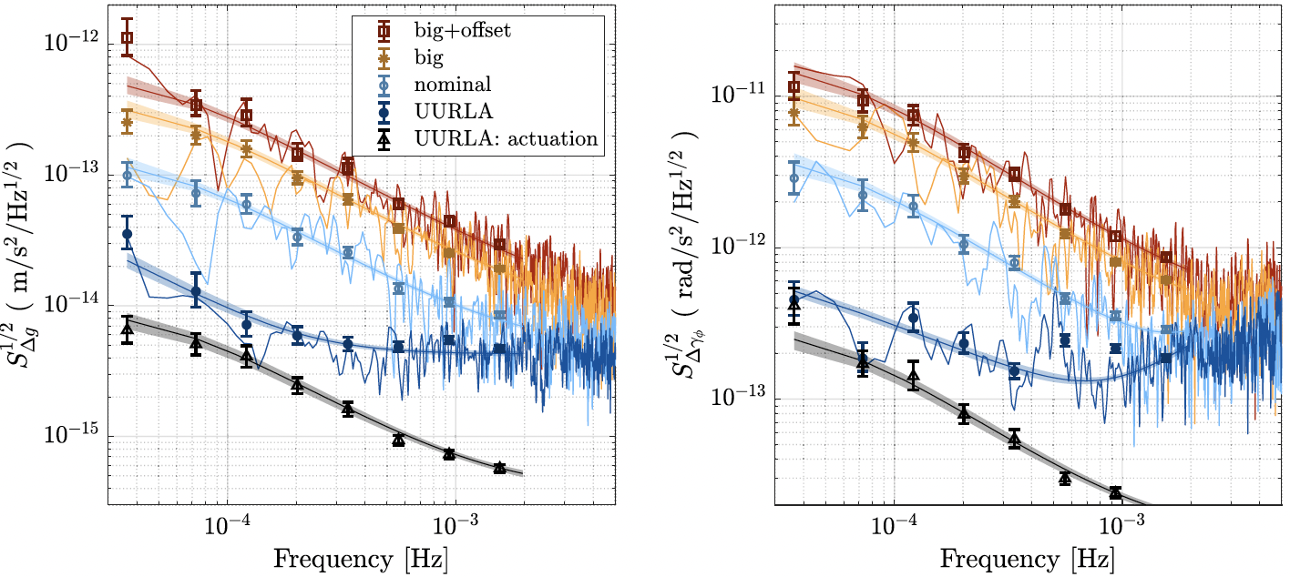
LISA Gravitational Refernce Sensor Front-End Electronics (GRS FEE)
TM Actuation is implemented with AC voltages (60 – 300 Hz) providing a quasi-DC force/torque at low frequency
The mass is pulled in the direction of stronger voltages. Both force and torque can be applied by the implemented scheme for the electrodes and the actuation voltages
The actuation provided by the GRS FEE delivers TM control with ~nN force and fN/Hz^{1/2} precision (~10 nrad/s² with ~10 frad/s² Hz^{1/2} precision) in a frequency band [10⁻⁴ – 1] Hz
LPF Measurements from M. ARMANO et al. PHYS. REV. D 109, 102009 (2024)

Slide 19
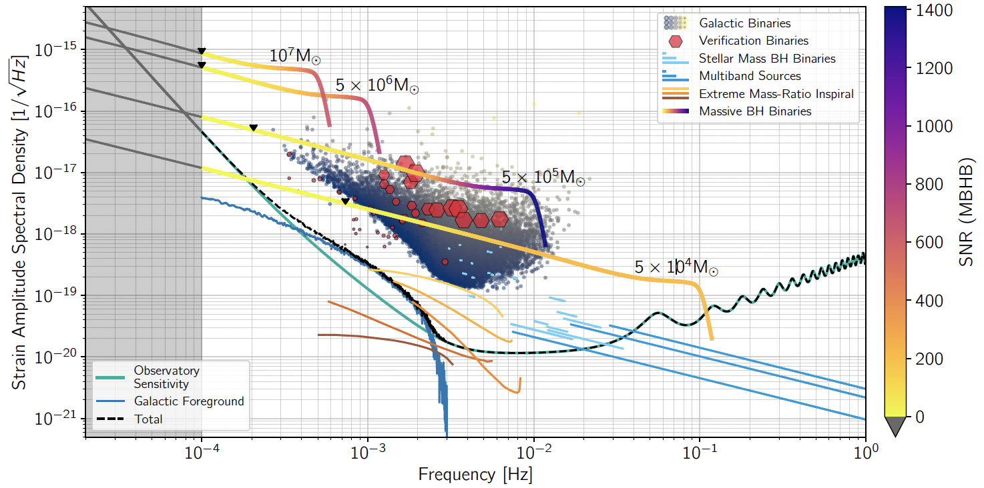
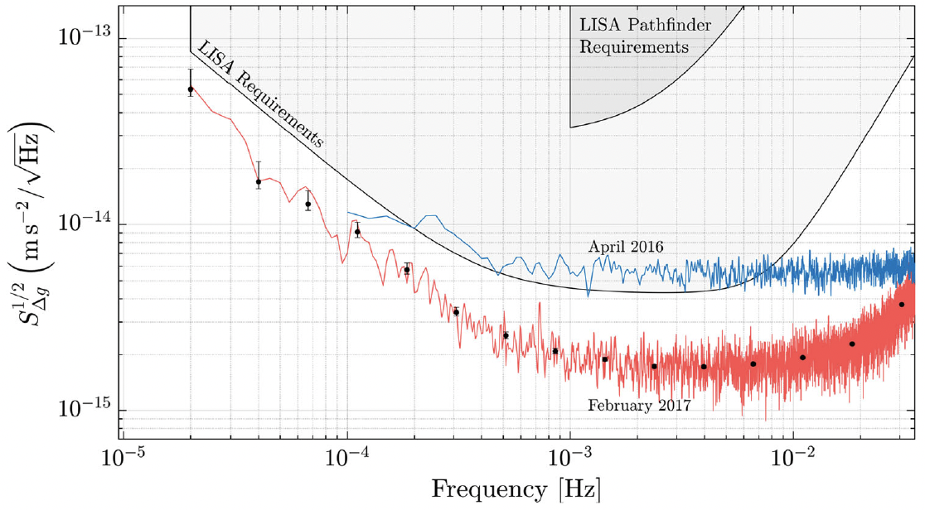
LISA Gravitational Refernce Sensor Front-End Electronics (GRS FEE)
TM Actuation is critical for LISA science at low frequency
Noisy actuation voltages provides force/torque noise also on the non-actuated degrees of freedom
The noise amplitude of the leading term is proportional to the amplitude of the AC voltage applied to the TM electrodes
The great success of LISA Pathfinder at low frequency was obtained with very low actuation authorities (stable mass required small forces to control)
Ref. LISA Red Book arXiv:2402.07571
Region of the LISA sensitivity affected by actuation noise
LPF residual TM acceleration noise. PHYSICAL REVIEW LETTERS 120, 061101 (2018)

Slide 20
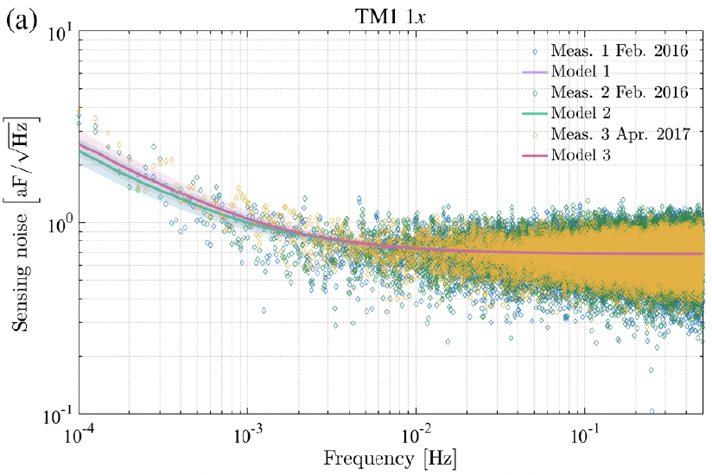
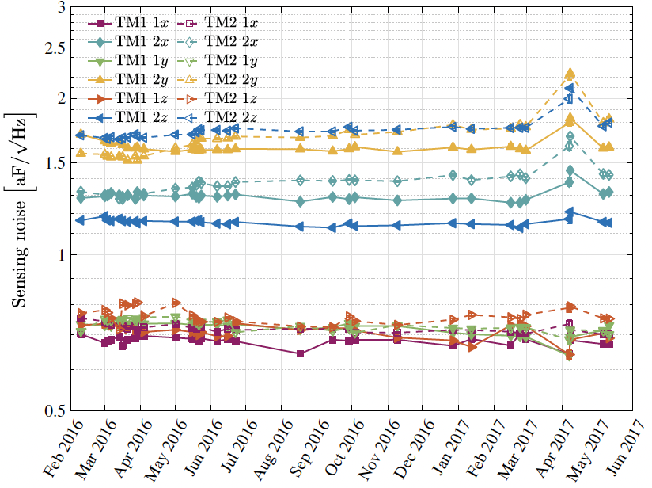
LISA Gravitational Refernce Sensor Front-End Electronics (GRS FEE)
Sensing scheme:
Differential capacitance sensed by the transformer bridge working at resonance, transimpedance amplification, carrier demodulation and analog to digital conversion.
The motion of the TM provides an amplitude modulation on the carrier at 100 kHz, which is them demodulated in the FEE
The sensing system is capable of TM position sensing in a range up to 200 μm with nm/Hz^{1/2} precision with mm gaps between electrodes and TM
Right
Measurement from LPF. Low frequency is dominated by the injection voltage noise while high frequency is dominated by the thermal noise of the sensing bridge
Left
Evolution of the noise level during the LPF mission operations
Source
PHYSICAL REVIEW D 96, 062004 (2017)

Slide 21
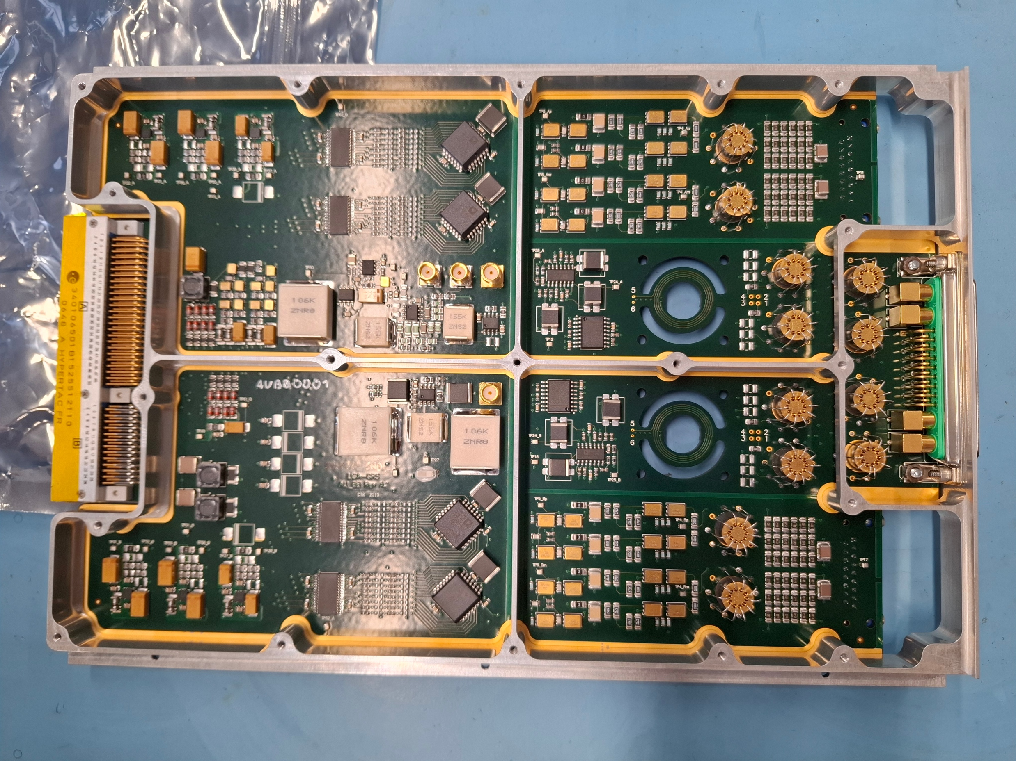
LISA Gravitational Refernce Sensor Front-End Electronics (GRS FEE)
LISA GRS FEE Work in Progress
Departures from LPF Heritage are driven by:
The need for more efficient AIT or better reliability
Changes of requirements
LPF Lesson
AIT Optimization and Reliability
  LPF GRS FEE partitioning scheme is changed in order to have one GRS FEE unit per GRSH
Approach to validate unit performances.
An elegant BB model is manufactured and currently being tested.
Requirements Changes
  Higher actuation AC voltage in WR mode
  Higher actuation AC voltage in HR mode
  New system clock frequency and synchronization scheme
  New system DFACS cycle frequency
  Longer GRS FEE to GRSH harness
Lesson Learned
  Need for better actuation accuracy
  Actuation to sensing cross-talk
  Actuation lock anomaly

