Slide 1

ESA Clocks, Detectors, and Optical Communications for Space Science Missions
Dr. Sinda Mejri
Sinda.Mejri@esa.int
European Space Agency
22/01/2026

Slide 2
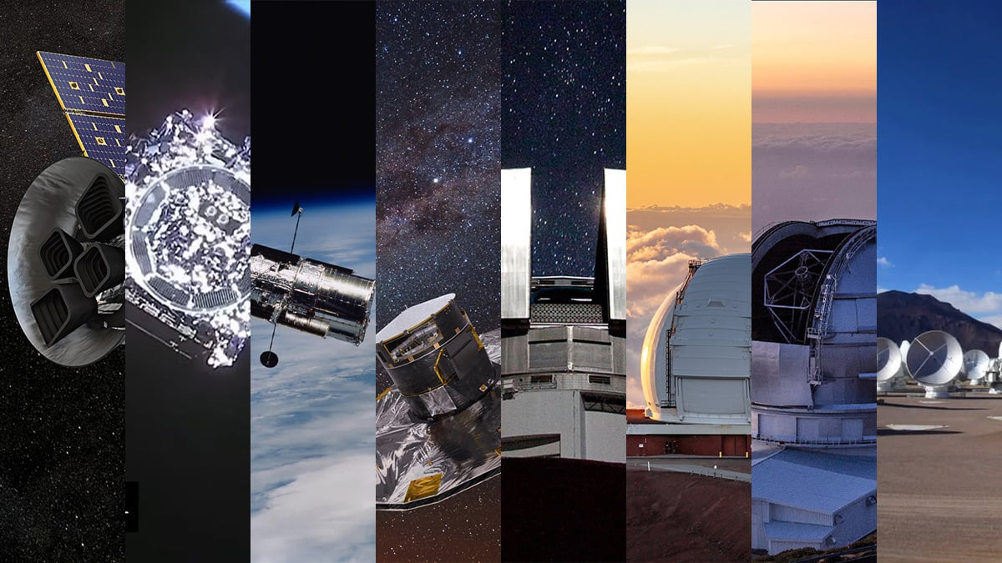
Why space science missions are pushing technology — and ESA’s role
Faints signals: Science targets operate at the limit of photon detection and noise, leaving minimal
performance margin.
Distributed measurements: Modern missions rely on spatially separated assets requiring long-term coherence
across systems
Missions' lifetime: now last decades, not years, stressing stability and reliability far beyond classical design margins
ESA’s role:
  Translate science requirements into coherent end-to-end systems
  De-risk critical technologies from component to infrastructure

Slide 3
Clocks, Time & Frequency

Slide 4
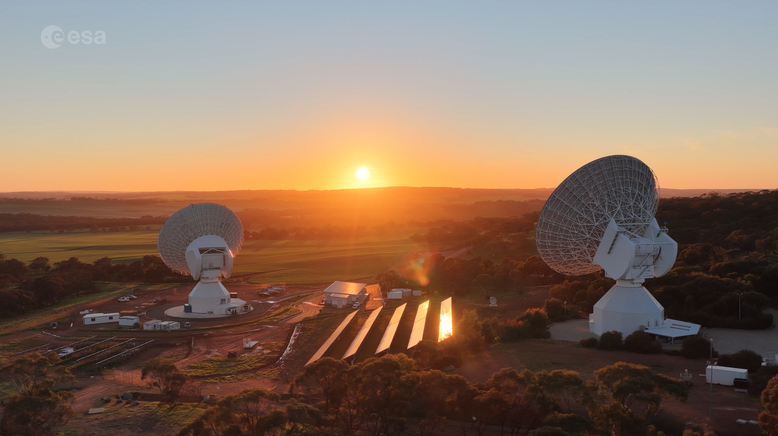
Clocks: the invisible backbone
VLBI, pulsar timing, navigation
Long-term stability & coherence
Scaling to future infrastructures (e.g. SKA-like systems)
Ground time/frequency distribution
Interfaces with comms & navigation

Slide 5
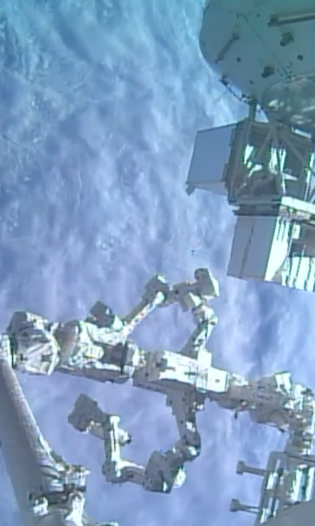
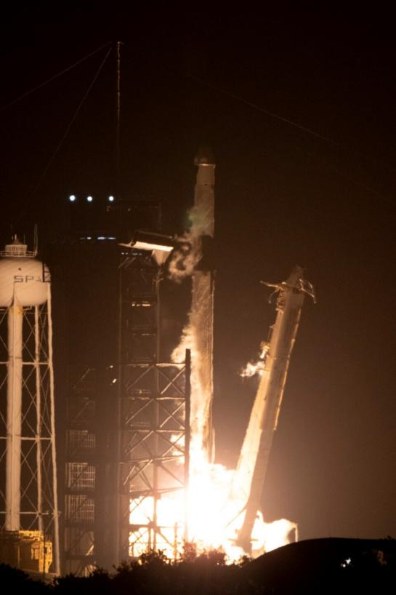
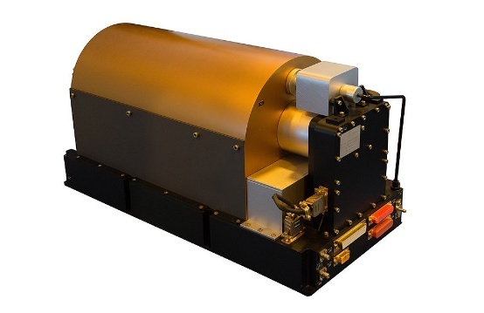
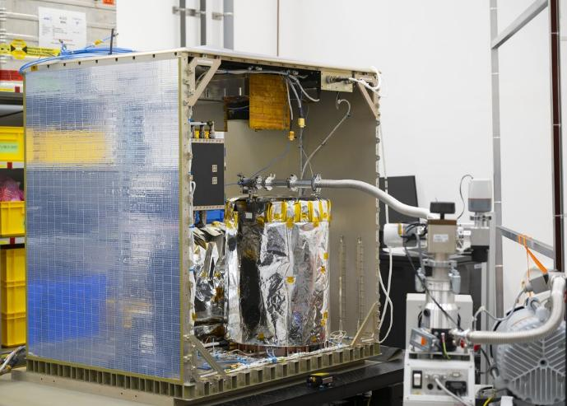
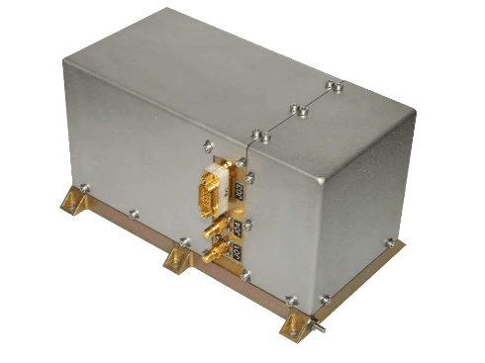
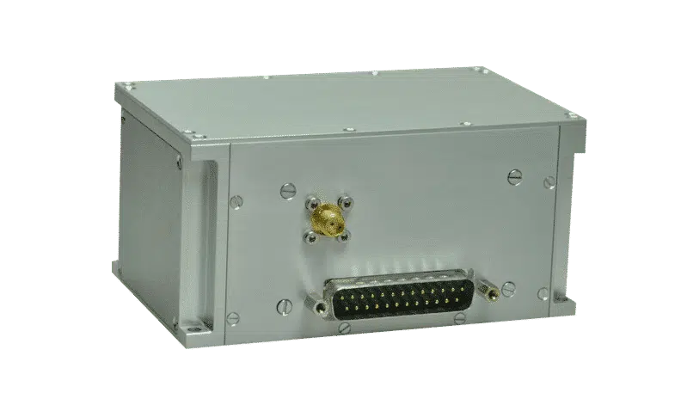
Swiss clocks in orbit – Galileo and ACES
The Atomic Clock Ensemble in Space – ACES
Galileo 1st GEN and 2nd GEN clocks
Rubidium Atomic Frequency Standard (RAFS)
Passive Hydrogen Maser (Physical Package)
21/4/2025: ACES
lift off
Space Active
Hydrogen Maser
Notes:
Installed outside the ISS, ACES is ready to explore the nature of time, test general relativity and pave the way for a redefinition of the second

Slide 6
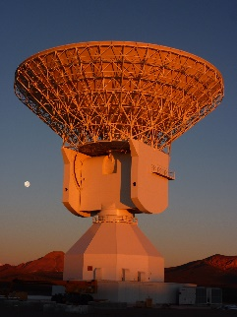
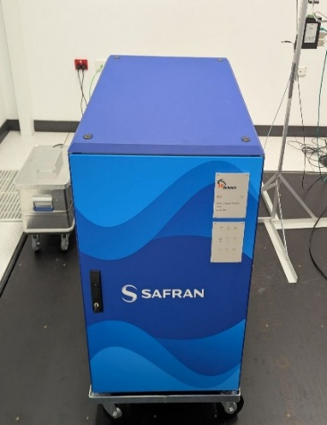
Active Hydrogen Maser-Swiss leadership in Ground Clocks
Developed with Swiss industry under ESA GSTP → All-European solution for strategic autonomy.
Backbone clock for ESA Deep Space Stations, VLBI, Galileo Precise Timing Facility, and Timing Labs.
Flagship project:
  Closing key technology gaps
  Reducing reliance on non-European sources
  Reinforcing Europe’s strategic autonomy
  ESA acting as anchore costumer and provide flagship environment for validation

Slide 7
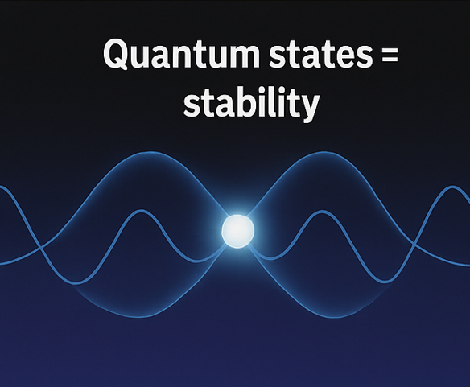
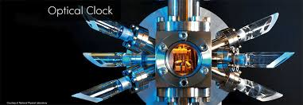
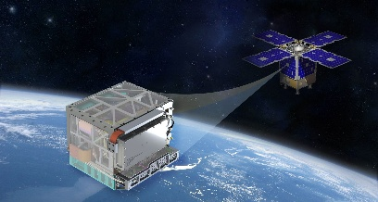
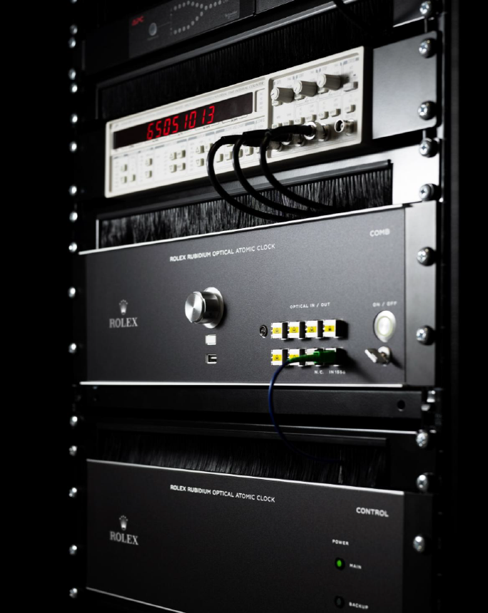
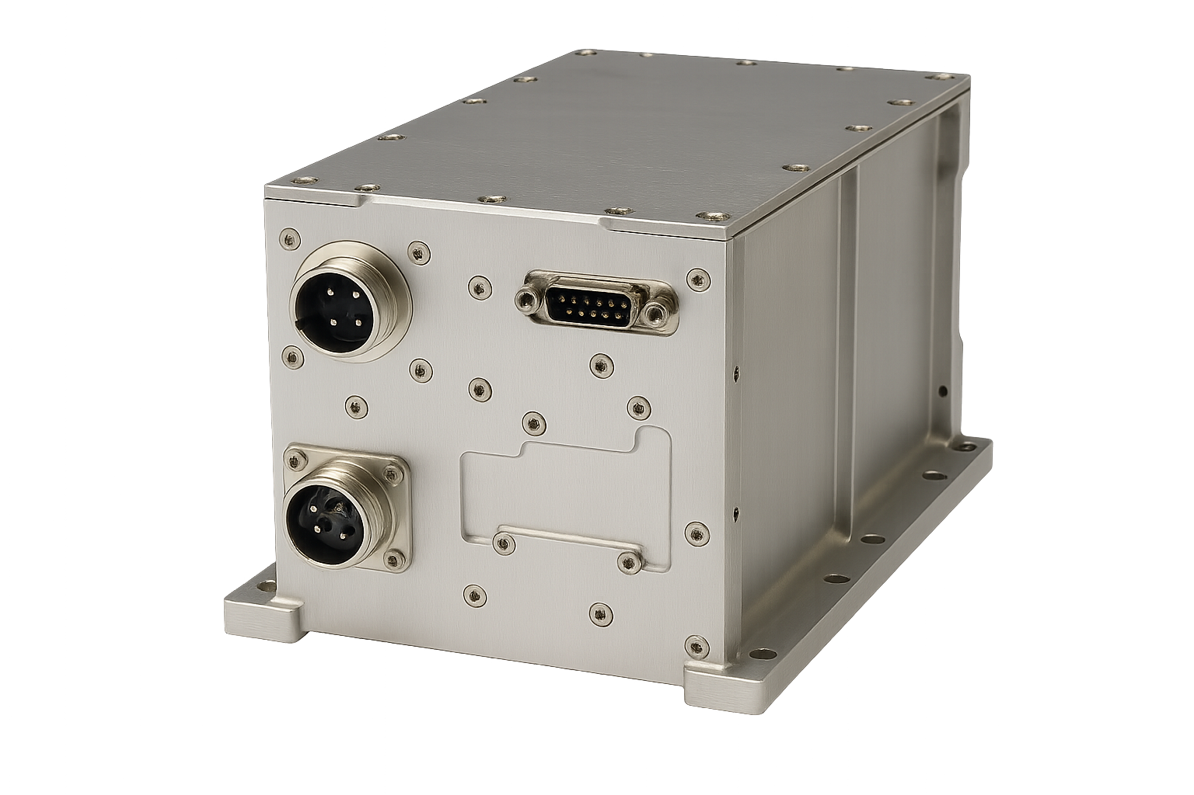


Next Generations of Clocks-Optical and Quantum based
Ion trapping e.g. Mercury Ion Clock
Quantum basis: Mercury ions confined by electromagnetic field
Breakthrough stability: NASA/JPL Mercury Ion Clock in orbit: < 1 ns drift / 10 days.
Opportunity for Swiss industry: Build on JPL Mercury Ion clock → Mercury Ion Clock for Ground and Space application (on-going activities under ESA GSTP program)
Optical clock
Very well established in labs and National Metrology institutes.
Orders of magnitudes better than RF => driving the redefinition of the second
Talk of Fabien Droz, Rolex Quantum,
‘’ INDUSTRIAL OPTICAL ATOMIC CLOCK FOR SCIENCE’’

Slide 8
Optical communications

Slide 9
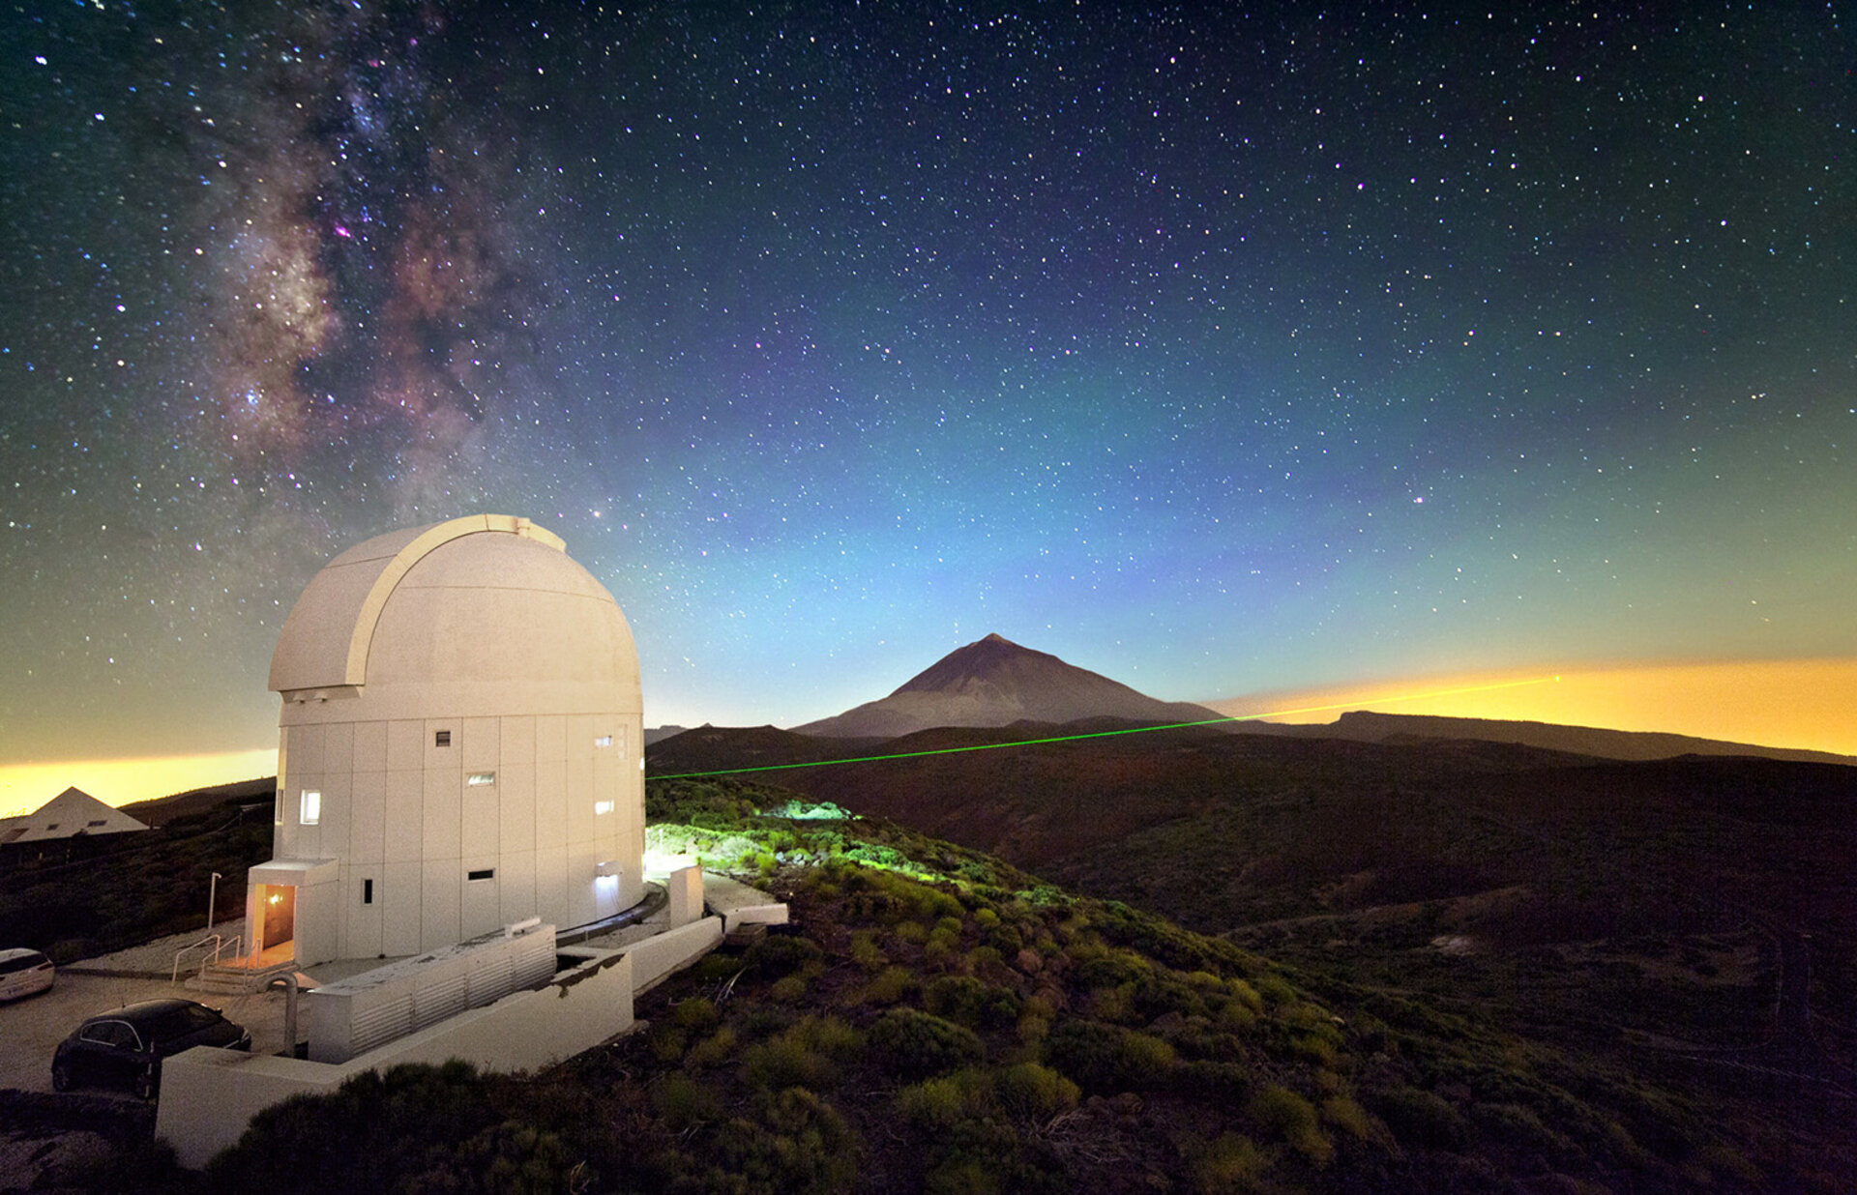

Optical communications: benefits and system constraints
Why optical communications
Bandwidth — spectrum abundance, no ITU licensing
SWaP — compact and lightweight terminals
Security — low probability of interception and interference
What it requires
Availability management — mitigation of cloud coverage
Atmospheric compensation — wavefront distortions
Technology maturation — limited space heritage

Slide 10
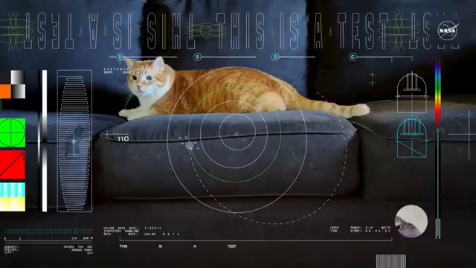

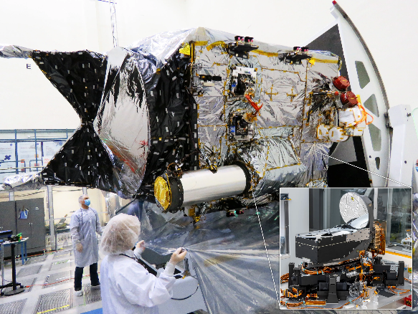
Psyche DSOC Demo – First Demonstration of Deep-Space Optical Communication beyond Moon distance
A stepping stone for future operational missions.

Slide 11
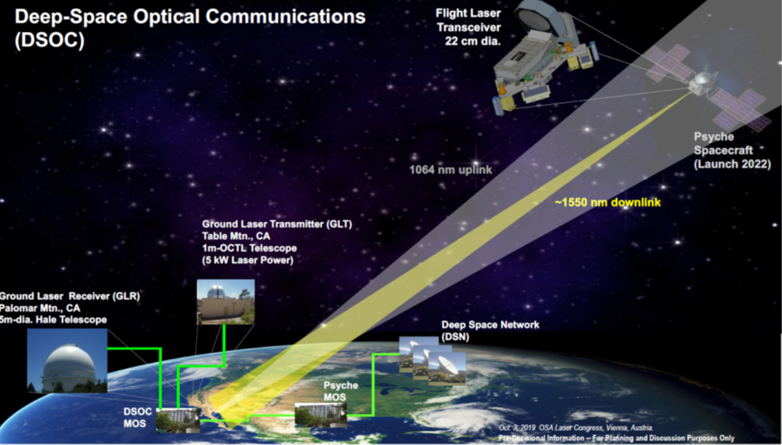
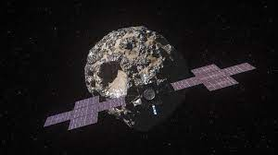
NASA/JPL infrastructure for PSYCHE demo
ESA optical links in 2025
Psyche mission - Arizona State University, NASA JPL (launch : October 2023)
Deep Space Optical Communication (DSOC) terminal hosted on the Psyche spacecraft
Ground receiver and Ground beacon transmitter in California (Palomar Mtn. and Table Mtn.)
ESA/NASA joint technology demonstration
Objective: Demonstration of Interoperability of Deep Space Optical Communication

Slide 12
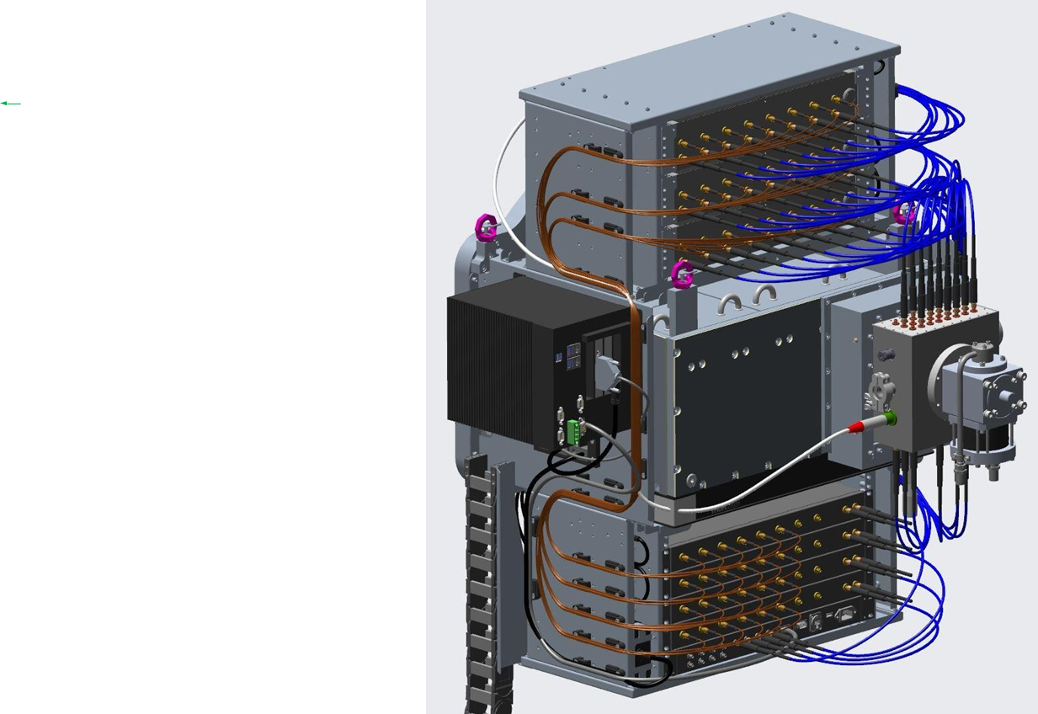
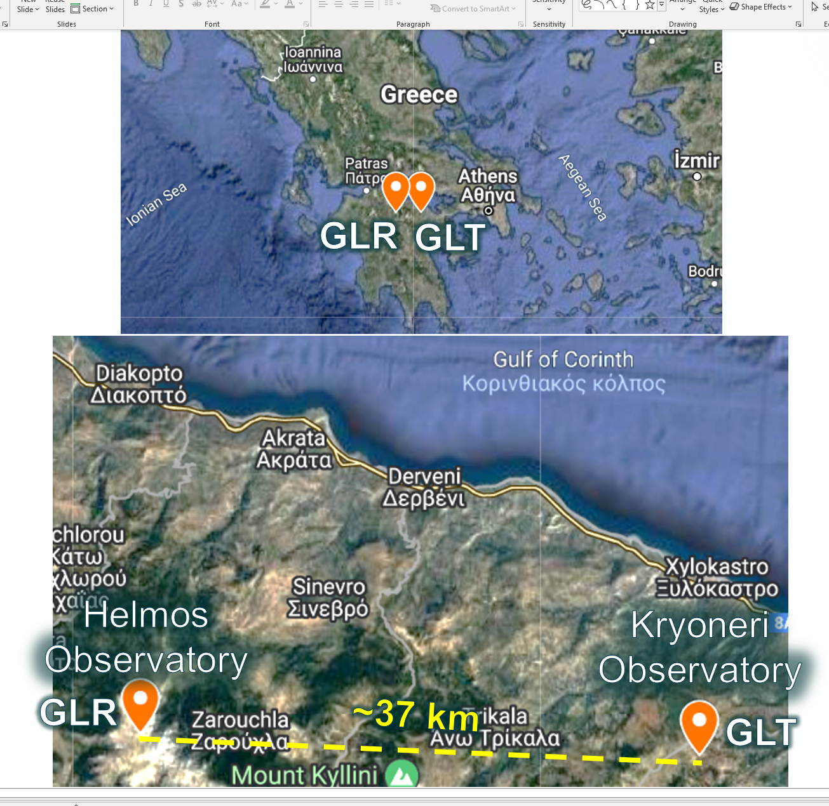
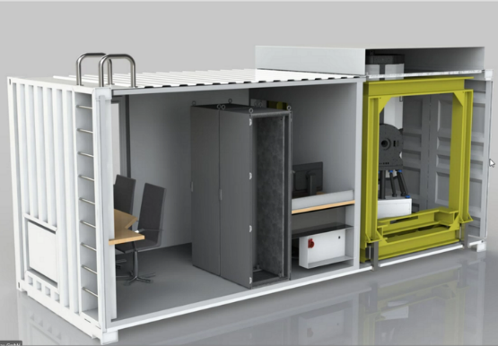
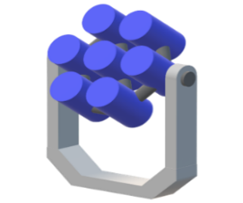





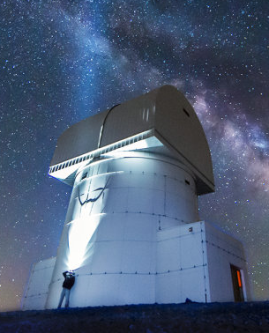


ESA Ground infrastructures for PSYCHE Demo
Ground Laser Receiver
Ground Laser Transmitter

Slide 13
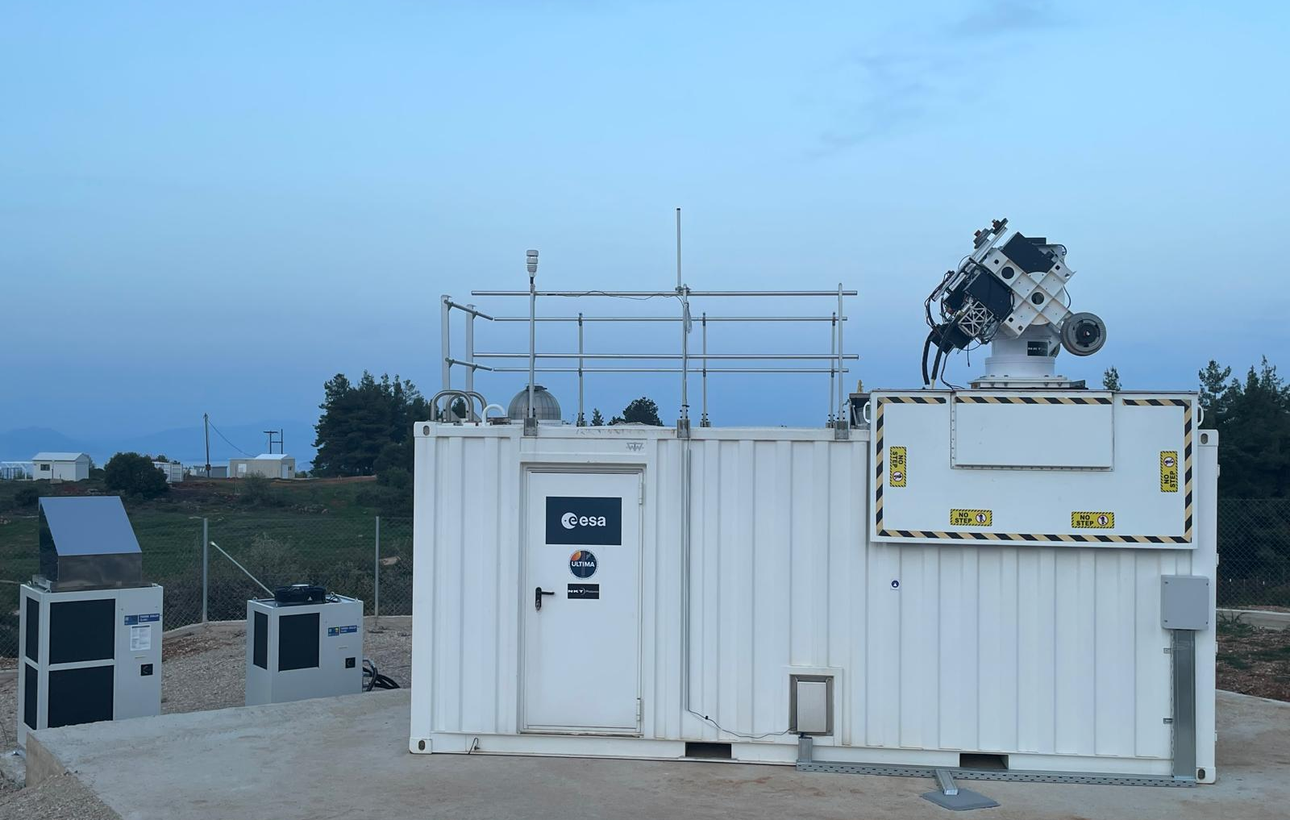
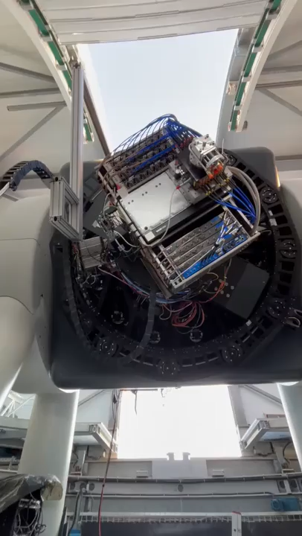
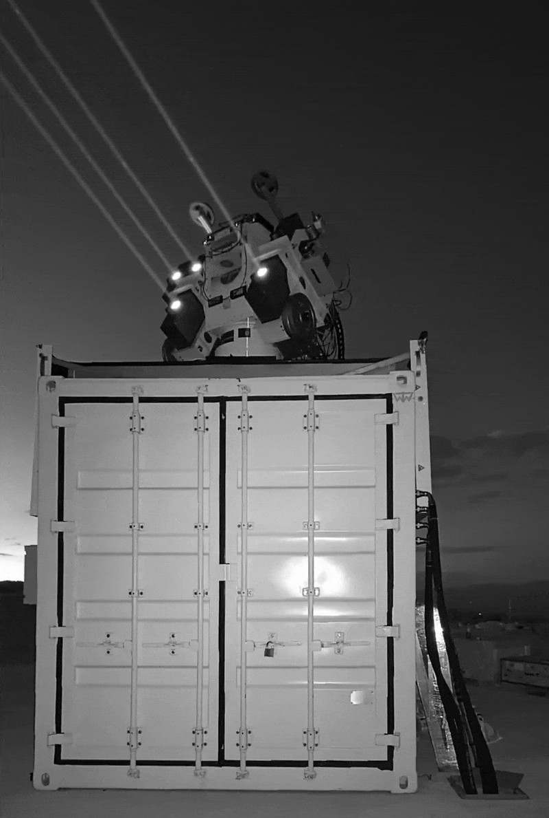
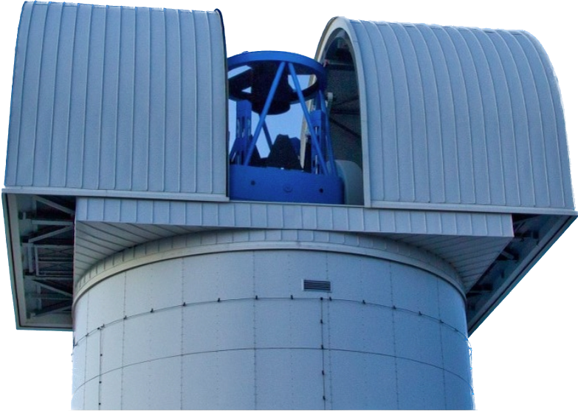
Europe’s first Deep Space Optical Communications at Mars distance

Slide 14
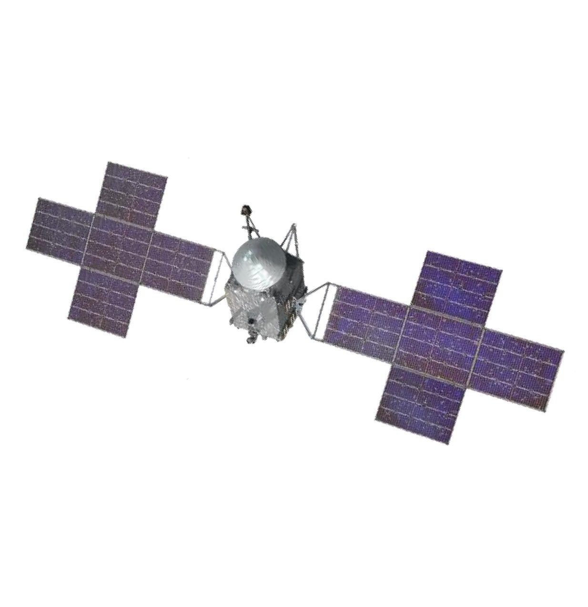


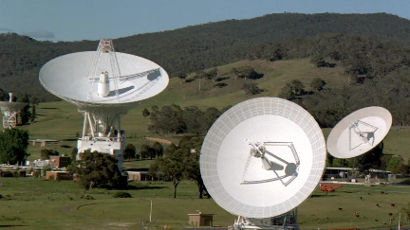

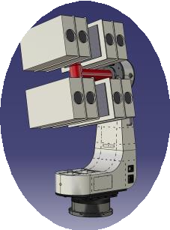

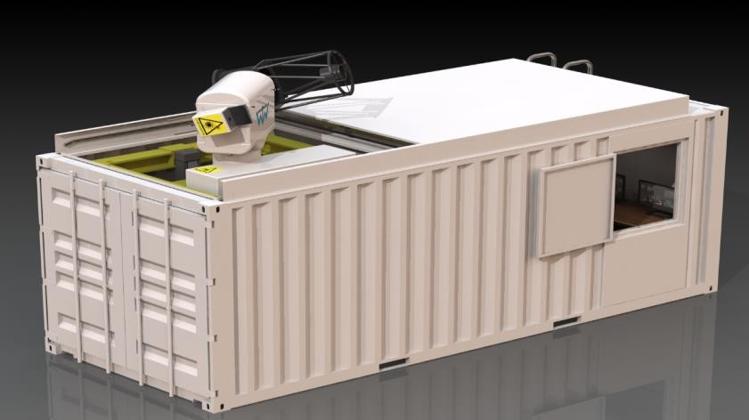
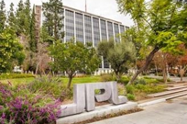
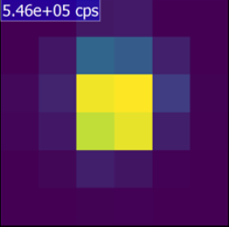
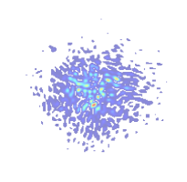
CONOPS of ESA Demonstration
(2) FLT acquires/Tracks uplink
(8) FLT adjusts downlink pointing
(3) FLT points-ahead to GLR
X-band
(1) GLT transmits uplink beacon
(6) GLT performs downlink pointing scan
(7) GLT uplinks command to correct pointing
Deep Space Network (DSN)
Ground Laser Receiver (GLR)
(4) GLR acquires downlink
(5) GLR tracks/decodes downlink
DSOC Mission Operation System
PSYCHE Mission Operation System
Ground Laser Transmitter (GLT)
HPE Modem
. . . 1 0 1 1 0 0 0 . . .

Slide 15
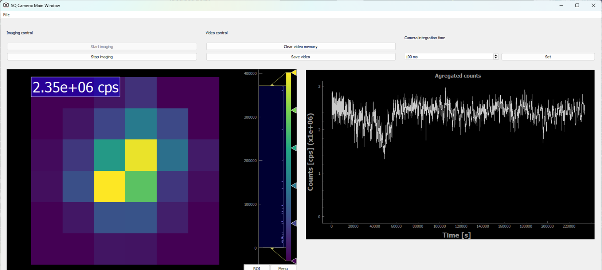
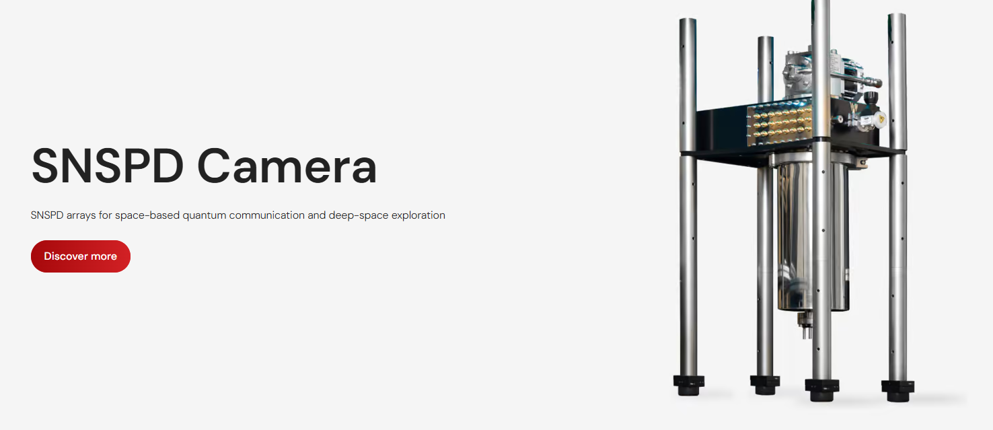
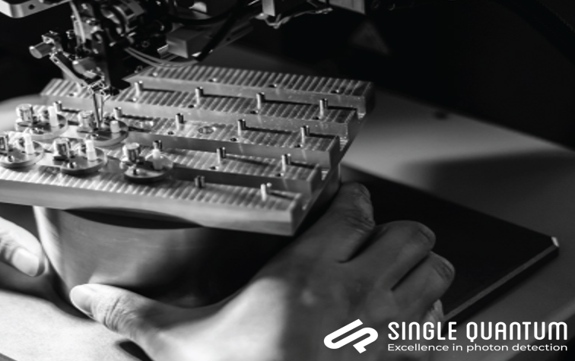
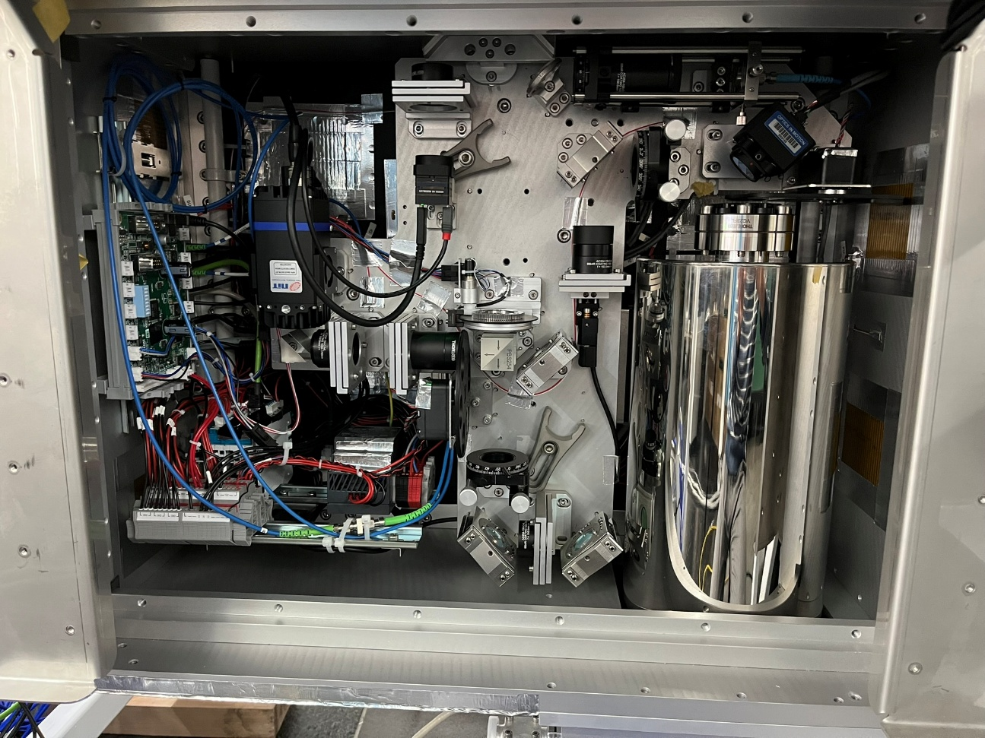
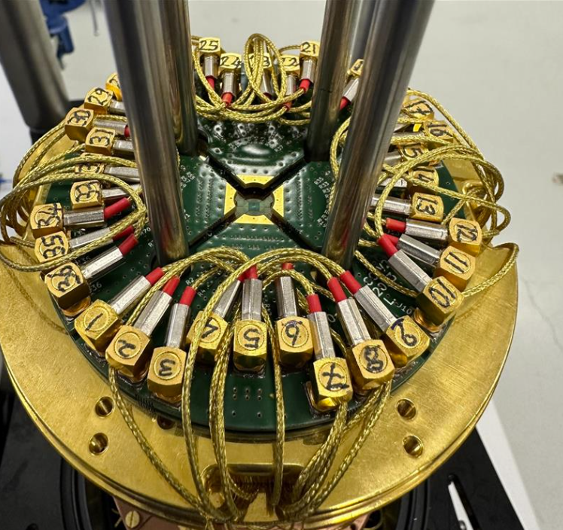


100 % successful ESA passes with PSYCHE
Superconducting Nanowire Single Photon Detectors

Slide 16




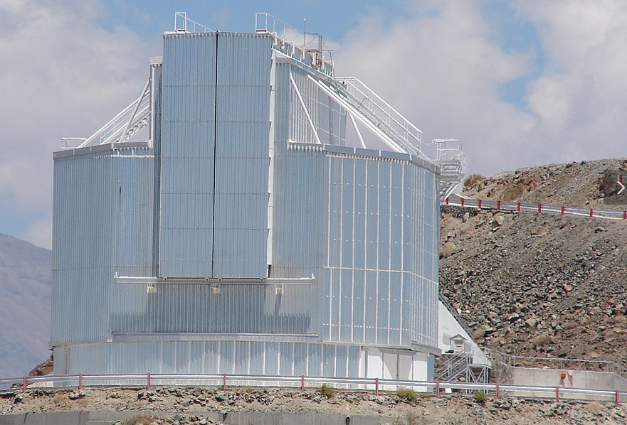
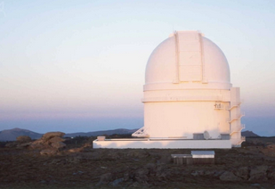
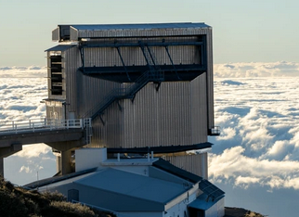
Adaptation of Large Telescope for Deep Space Communication
Adaptation of the Ground Laser Receiver (GLR) for use with 3m+ class telescopes
Establishing the necessary provisions and procedures to ensure its compatibility as a visitor instrument
Cross-disciplinary benefits (Deep Space Com and astronomy)
The use of new Single-Photon-Detection technology (e.g, ultra-sensitive IR astronomy, fast transient sources, exoplanet transit studies).
ESO NTT will be hosting ESA Ground Laser Receiver in Q1 2026
ESO NTT
Calar Alto
TNG
Notes:
Mention co-location benefit: Combines astronomical infrastructure with deep space comms capability

Slide 17
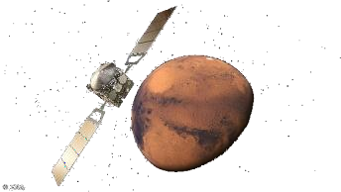
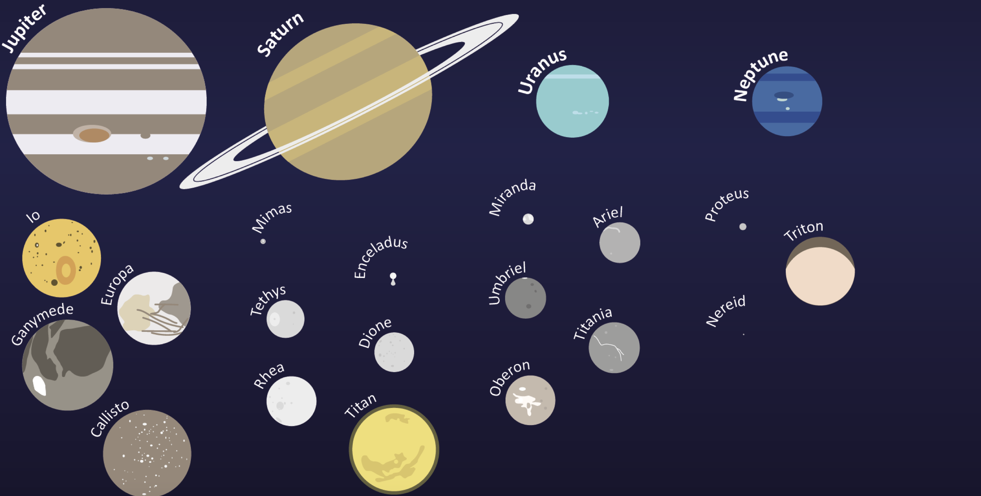
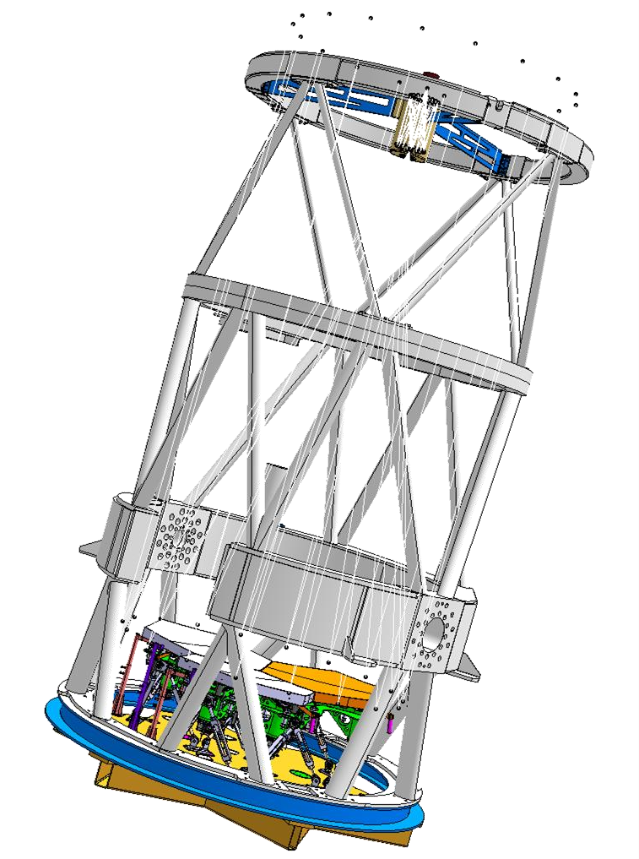
System Study for Voyage 2050 – Deep-Space Optical Links Beyond 4.2 AU
ESA’s Space Science Programme up to 2050.
Cosmic Vision - ESA’s Jupiter Icy Moons Explorer: Ganymede, Callisto and Europa
Voyage 2050 - a dedicated mission to other icy moons, especially Titan or Enceladus in the Saturnian system

Slide 18
DETECTORS

Slide 19
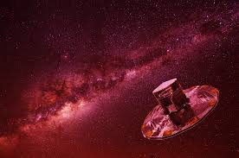
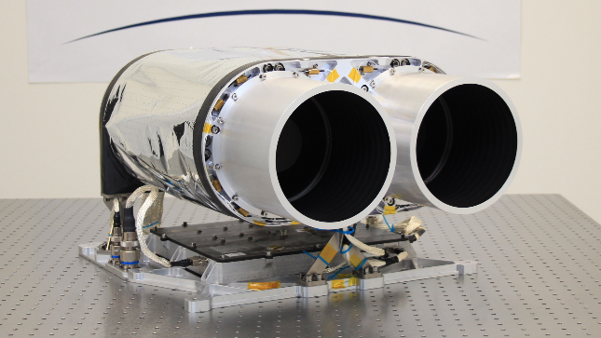
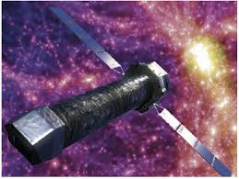

Detector technology under mission-driven pressure
What science missions are demanding
  Larger, high-quality focal plane arrays with performance beyond today’s state-of-the-art
  Operation at the limits of noise, stability, radiation, and temperature
  Increasing emphasis on compact, low-power, long-lifetime instruments
Technology evolution in response
  CMOS image sensors increasingly adopted across science missions→ Performance limits still being actively understood, as previously with CCDs
  Infrared focal planes: growing interest in linear-mode APDs (SWIR)→ Potential SNR advantage over current market leaders→ On-sky demonstrations and maturation planned in the near term
Notes:
GaiaNIR (2030–2040s): near-IR astrometry where the detector remains a critical unresolved building block
Arrakhis: baselining scientific CMOS, replacing classical CCD approaches
Enceladus-class missions: extreme miniaturisation and cold operation constraints
Athena: dedicated developments required for advanced X-ray focal planes

Slide 20

Swiss-led detector activities: concrete examples
4QD APD detector for integrated tracking & data
High-performance III-V APDs at 1550 nm
Objective
Enable compact, cost-efficient ground receivers by
combining high-rate data reception and optical tracking
within a single detector architecture.
+ data)Removal of dedicated tracking sensors and optics
Why it matters
Reduces optical complexity and alignment effort
Enables simpler, scalable ground stations for science and space links
Objective
Demonstrate next-generation III-V APDs at 1550 nm with improved bandwidth, noise, and radiation performance over state-of-the-art InGaAs devices.
Why it matters
Improves sensitivity and robustness of ground-based optical instruments
Supports long-lifetime science and communication infrastructures

Slide 21

GSTP Element 1 compendia 2026-2028

Slide 22


GSTP E1 Develop - Compendia 2026 - 2028
Published on ESA-star: https://esastar-publication.sso.esa.int/news/details/11170
Campaign for expressing interest through OSIP, to help align conversations
between ESA, national delegates, and industry – thanks to those who participated!
 |  | Proposed Budget | Duration (months) | Program | Current Status
1 | Infrared Detector for Next Generation Sounder Instruments | 1500k | 18 | GSTP compendium | Proposed in GSTP Element 1 Develop Compendia 2026-2028
2 | Detector array for EO Lidar Applications | 1000k | 18 | GSTP compendium | Proposed in GSTP Element 1 Develop Compendia 2026-2028
ESA UNCLASSIFIED - For ESA Official Use Only - no distribution beyond DWG and CTB groups

Slide 23


Slide 24
Thank you for your attention!

