Slide 1
ESA L4 Mission to Enceladus:
Technology Development Challenges
Swiss Innovation for Astrophysics and Planetary Science
Sven Wittig, L4 Technology Coordinator, ESA
January 20-22, 2026, Bern

Slide 2
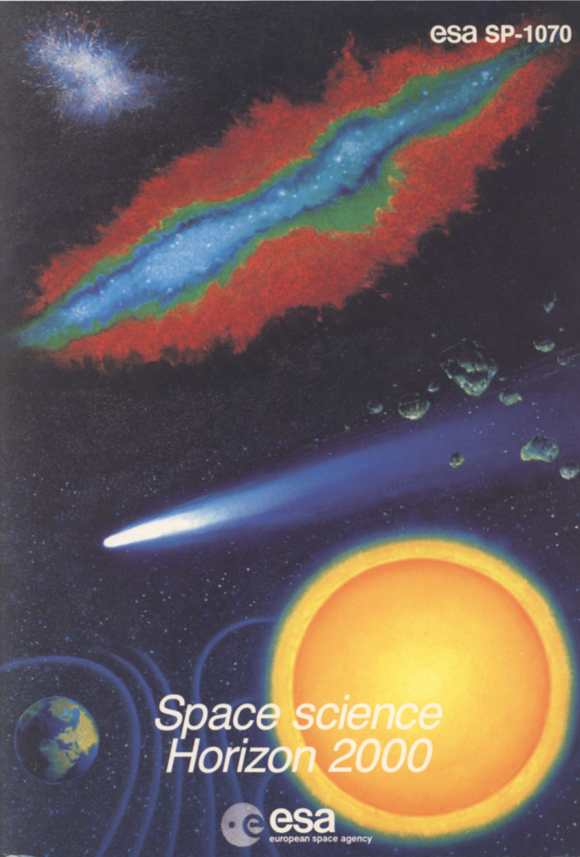
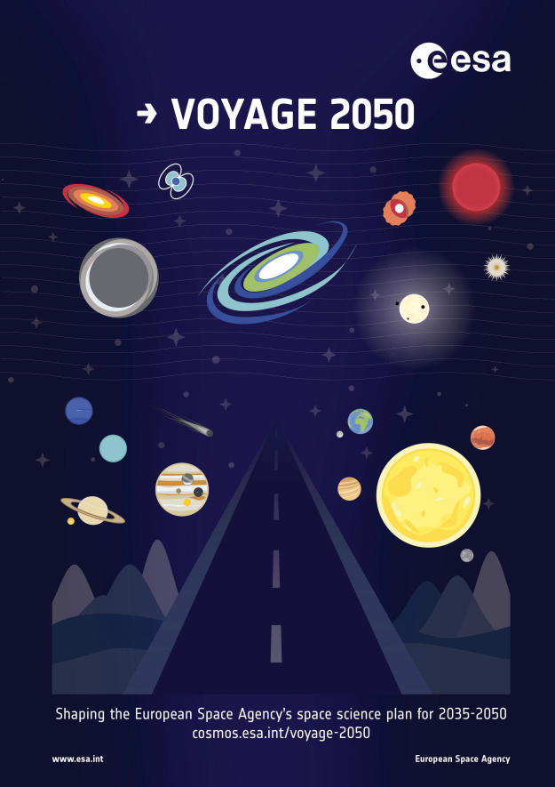
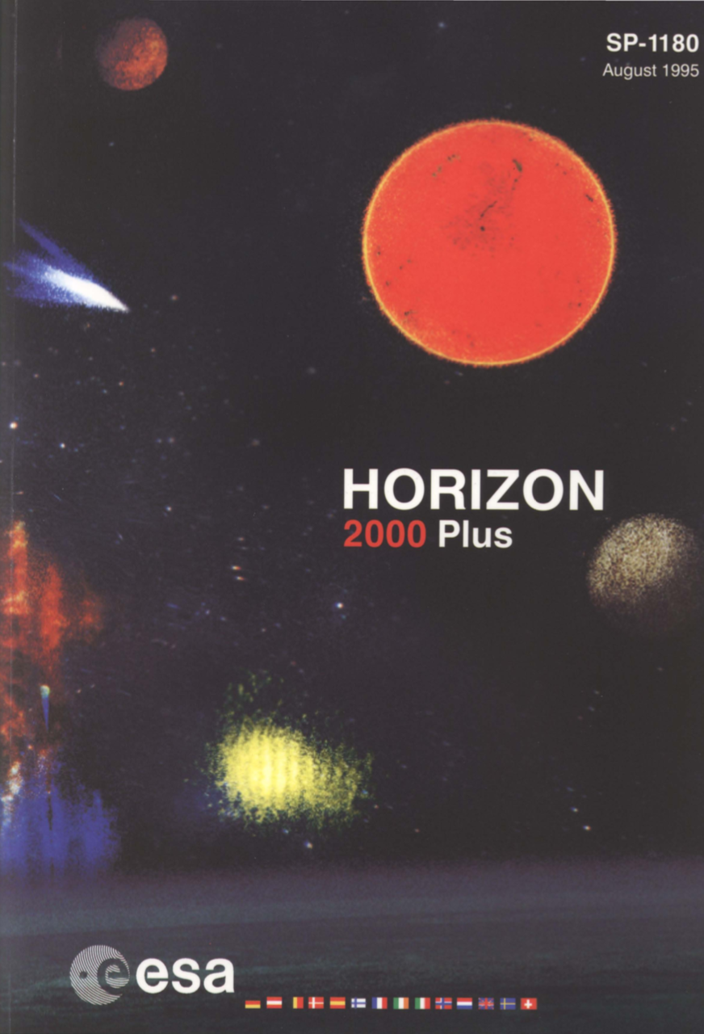
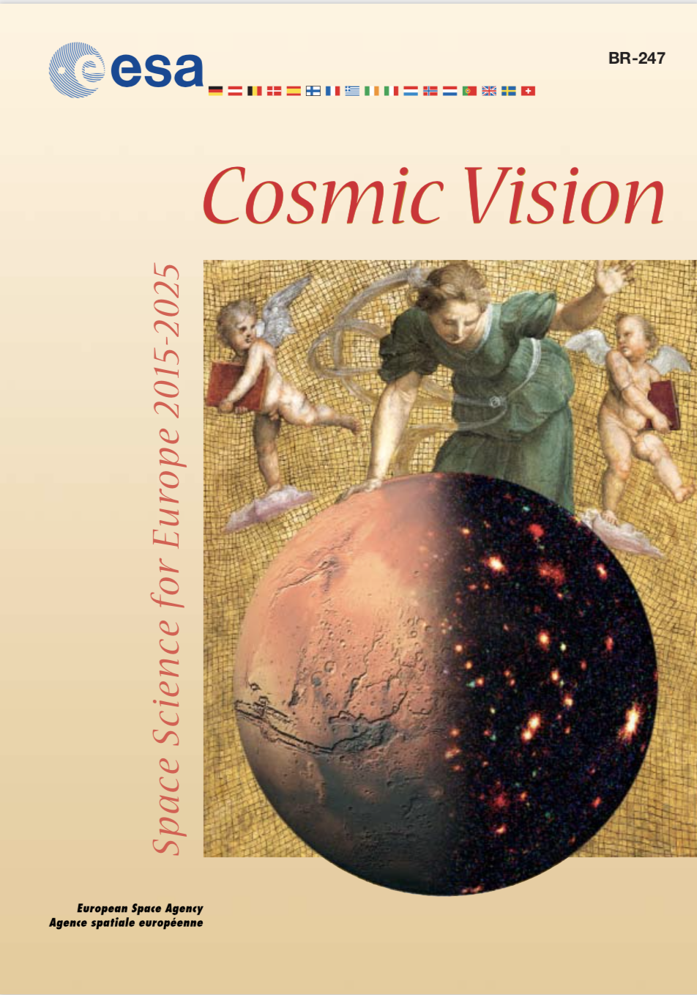
ESA Science Programme – Strategic Planning
Cornerstone missions: SOHO Cluster/Cluster II XMM-Newton Rosetta Herschel
Medium-sized missions: Huygens (Cassini) INTEGRAL Planck
Gaia
LISA Pathfinder
BepiColombo
1984
L-class missions:
JUICE [L1] Athena [L2] LISA [L3]
M-class missions:
Solar Orbiter [M1] Euclid [M2];
PLATO [M3] ARIEL [M4];
EnVision [M5]
S/F-class missions:
CHEOPS [S1] Comet Interceptor [F1]
ESA-CAS mission: SMILE
1995
2021
2005

Slide 3
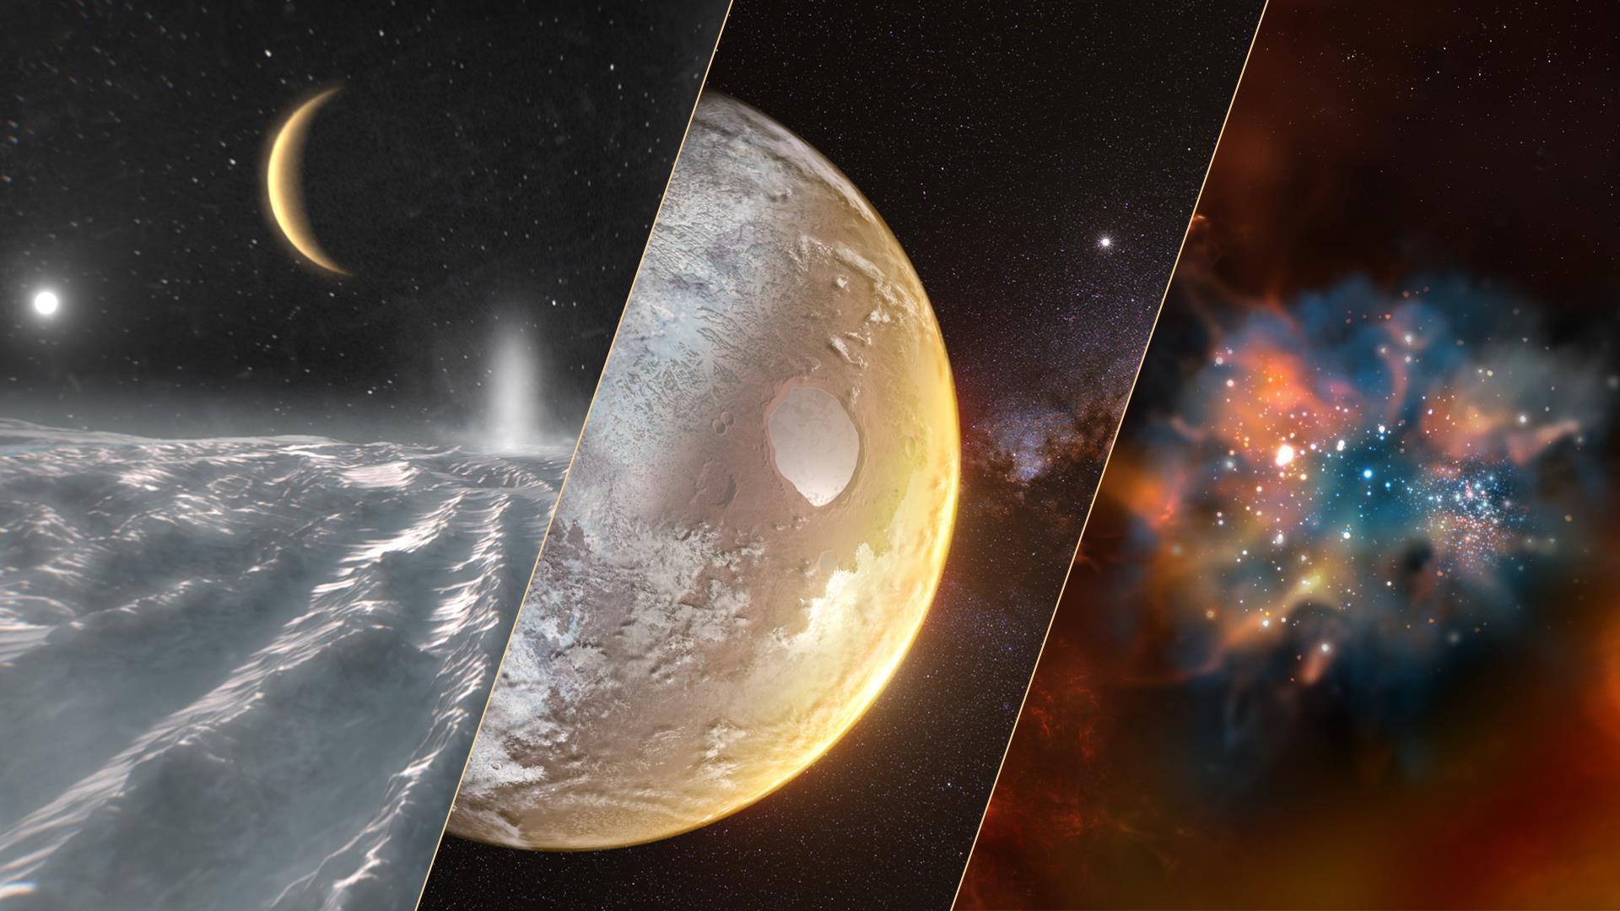
ESA VOYAGE 2050 PROGRAM
Moons of the giant planets
From temperate exoplanets to the Milky Way
New physical probes of the early Universe

Slide 4
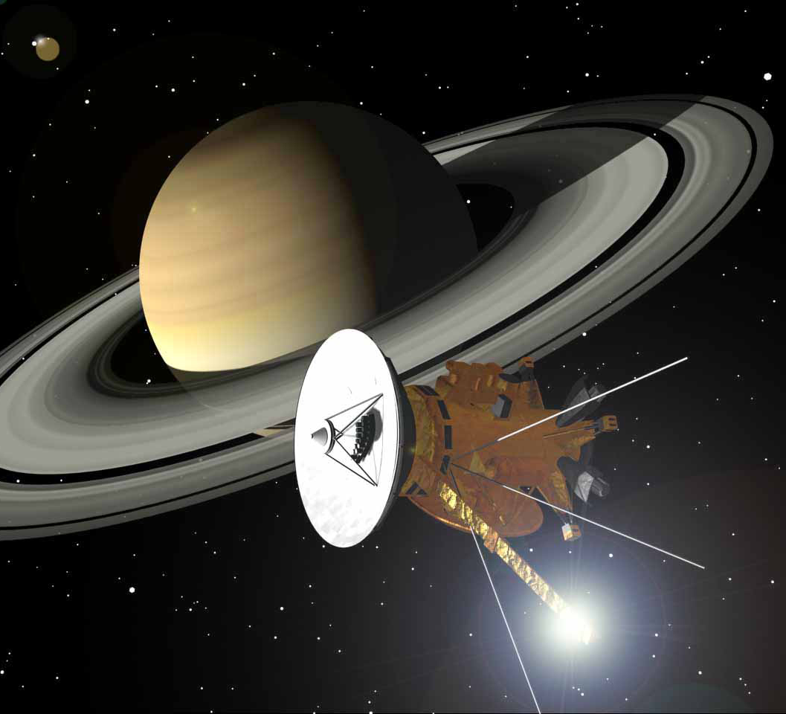
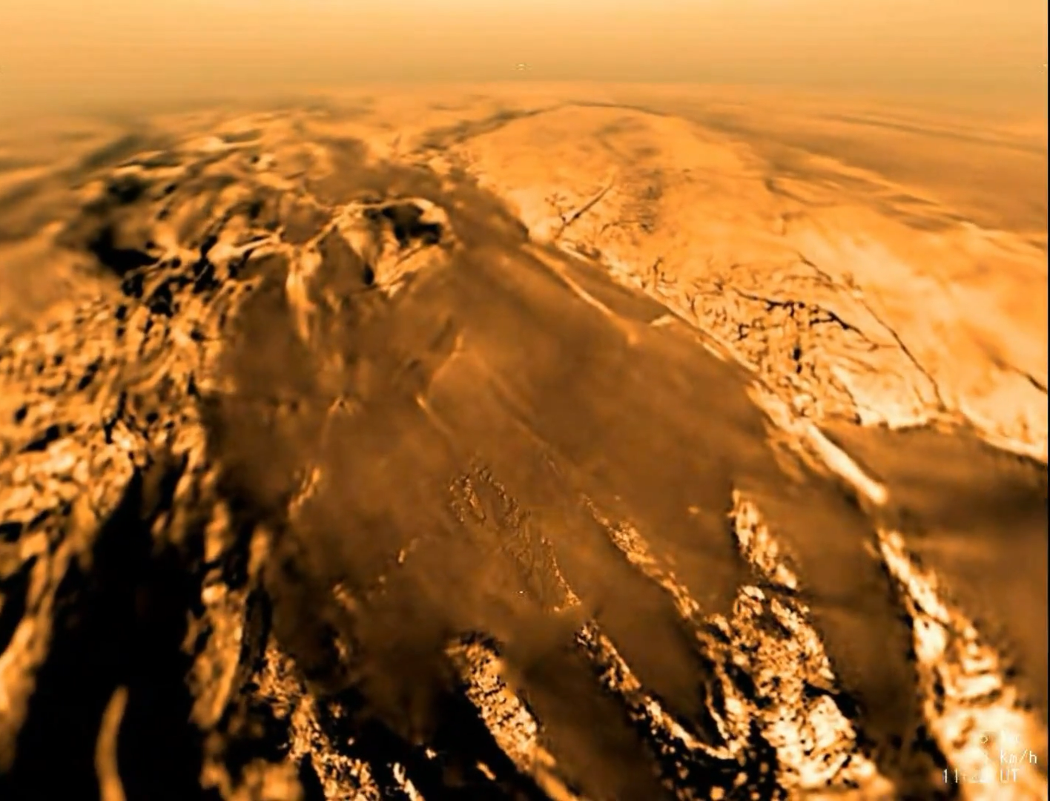
Cassini - Huygens
Credit: Cassini, NASA/JPL/Space Science Institute
Notes:
The Cassini-Huygens was cooperative project between NASA and ESA (and the Italian Space Agency, ASI) which launched in 1997. NASA supplied the main spacecraft, the orbiter Cassini, and ESA supplied the lander, Huygens. In 2005 the Huygens probe descended into the atmosphere of Titan, Saturn's largest moon.

Slide 5
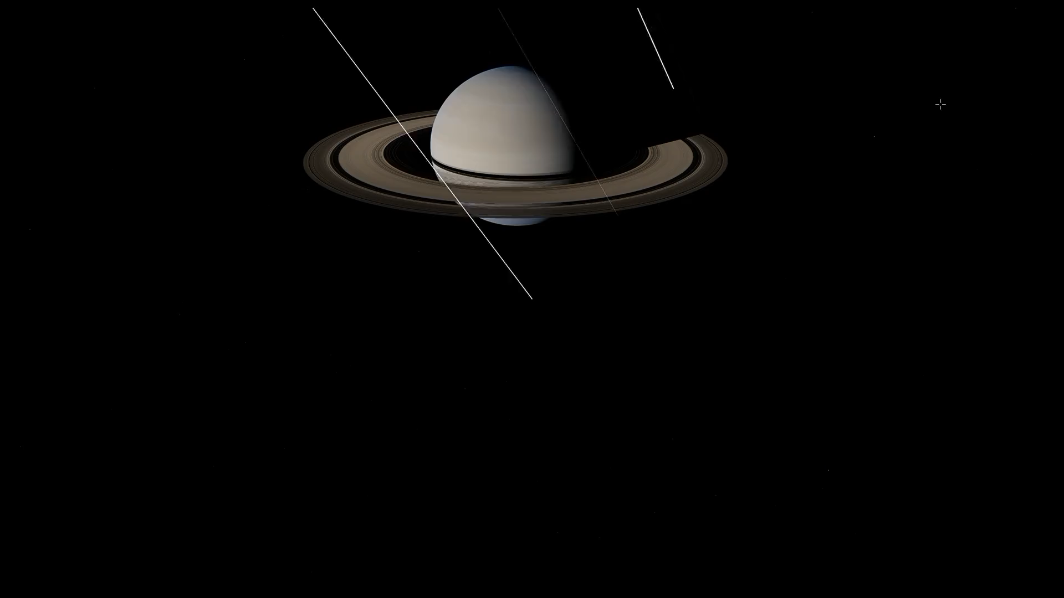

Slide 6
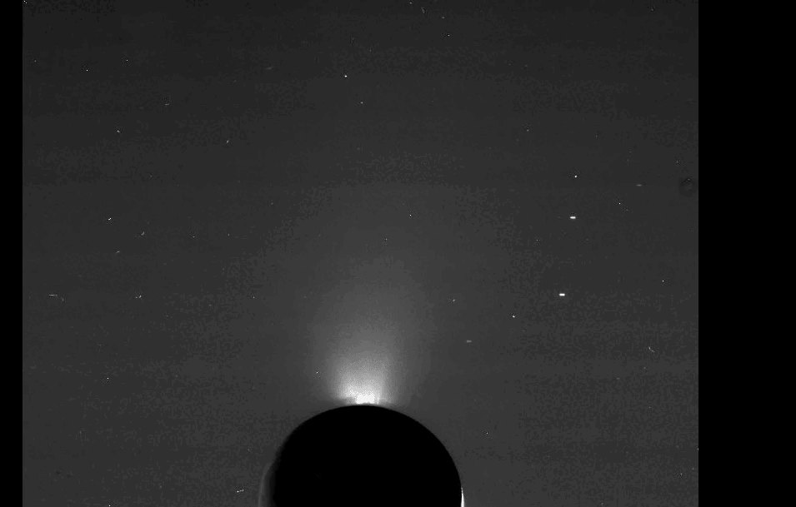
Credit: Cassini, NASA/JPL/Space Science Institute

Slide 7
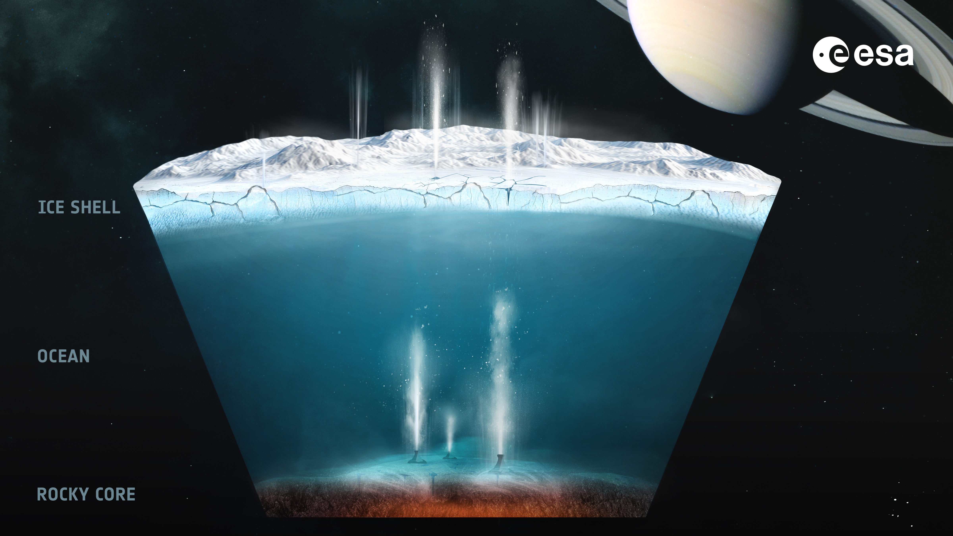



ENCELADUS
504 km diameter (6x smaller than Earth’s moon)
Surface gravity: 0.0116 g (1% of Earth gravity)
Mean surface temperature: -198°C
Geologically active, plumes observed on south pole
Sub-subsurface liquid ocean containing the six elements critical for life as we know it
Liquid water
Source of energy
Habitability
Elements (CHNOPS)

Slide 8
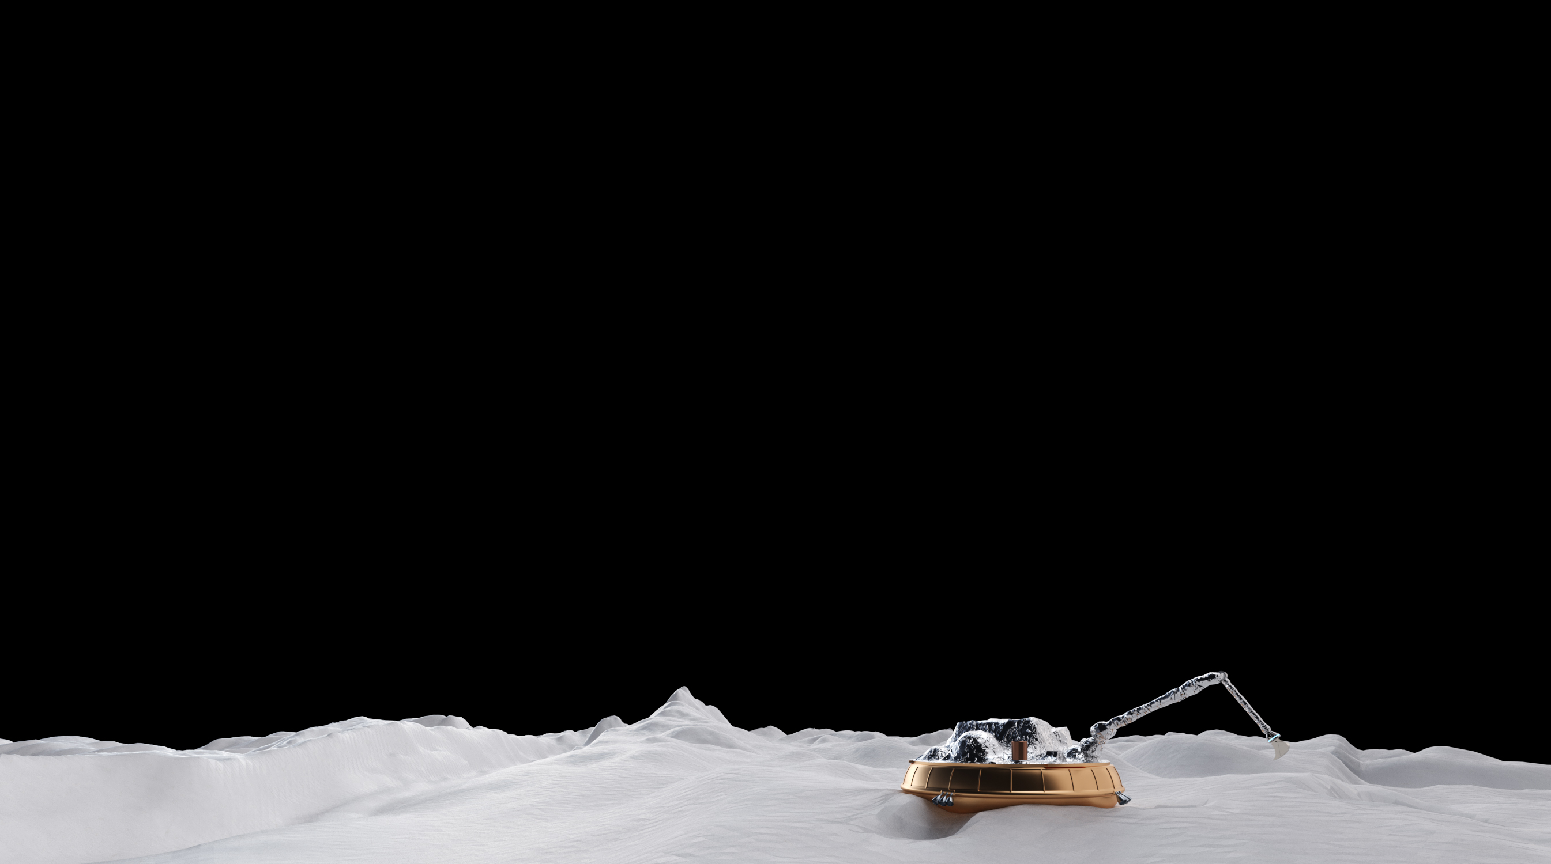
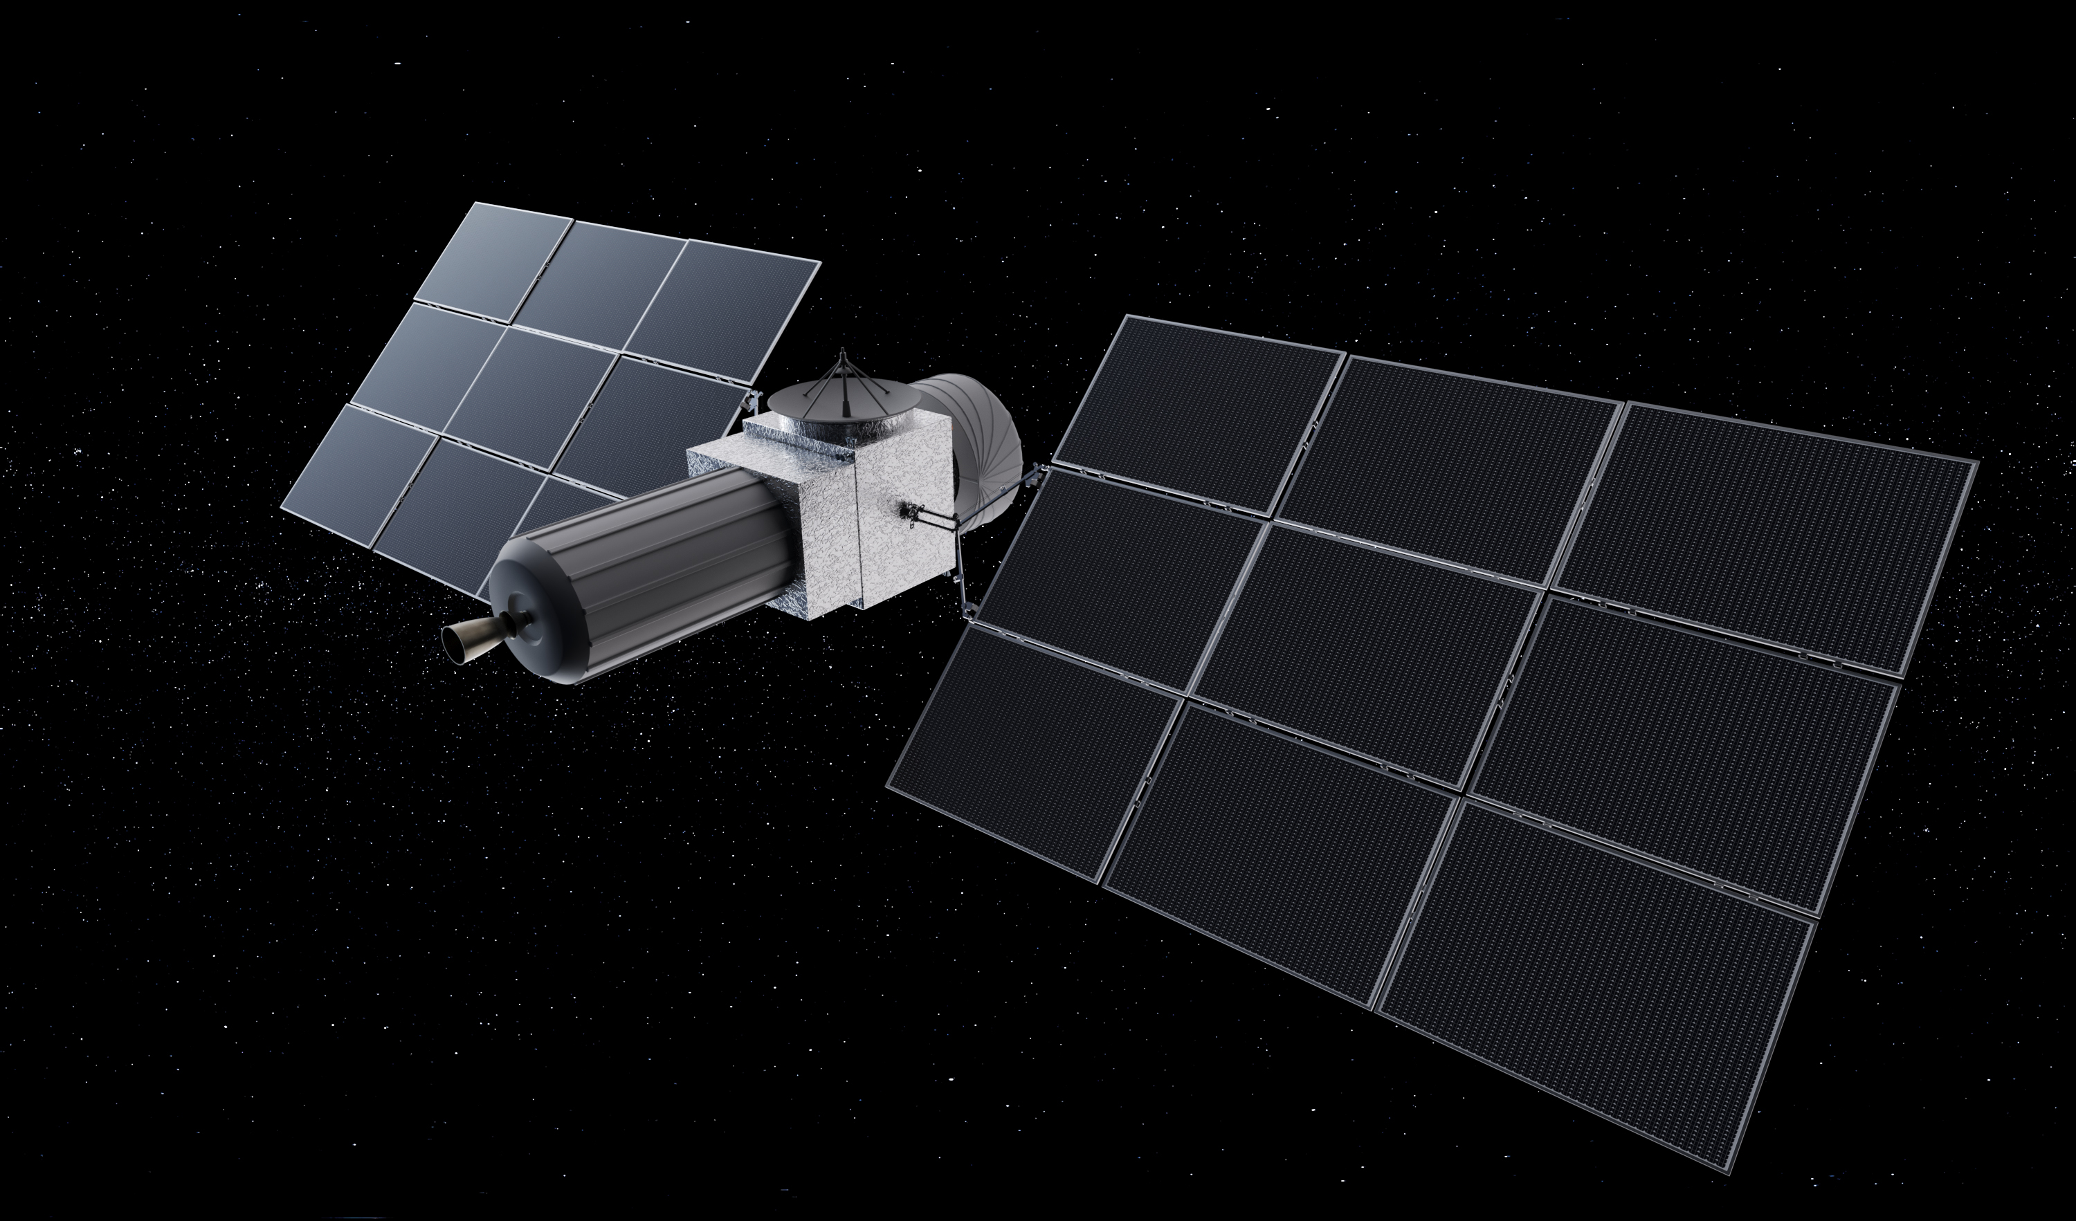
L4: THE MISSION TO ENCELADUS
Mission objectives:
Sampling of the plumes with an orbiter
Soft landing on the South pole of Enceladus, perform several weeks of in-situ science on ground including the collection and analysis of a significant surface sample
Include fly-bys of other moons (i.e. Titan, Mimas, Rhea, …)
Orbiter
Lander

Slide 9
THE MISSION TIMELINE
Mission adoption
2034
Tour of Saturn moons, plume sampling
3 years
Launch
2040s
Mission definition phase
2025 - 2034
Today
2026
Implementation phase
2035 - 2040
Arrival at Saturn
2050s
Landing on Enceladus
Several weeks on the surface

Slide 10
Technology
Development Challenges

Slide 11
L4 Moons of the Giant Planets
It will be cold, dark and far far away from home
˜10 years transfer time
10 AU distance to earth
80 minutes at light speed
Enceladus surface temperature as low as – 200 °C

Slide 12
L4 Technology Needs and Building Blocks
Propulsion
Systems
Large
Solar Arrays
Radioisotope Power Systems
Coms
RF and Optical
Energy
Efficiency
Energy
Generation
Fuel Cells
Cryogenic
Electronics
Scientific
Instruments
Reliability
Modelling
& Tools
Cryogenic sample handling mechanisms
Thermal Management
Energy
Storage
Autonomous Landing Technologies
In-Orbit Rendezvous
Battery
Systems

Slide 13
How to land and survive on the surface

Slide 14
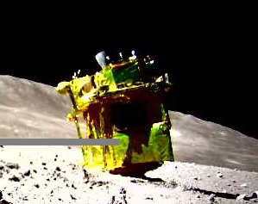
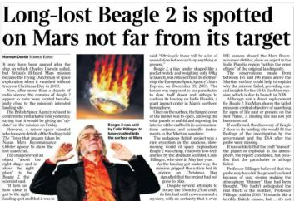
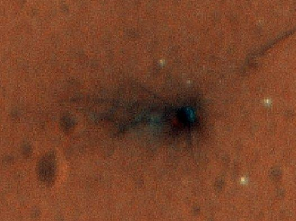
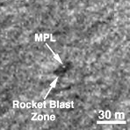
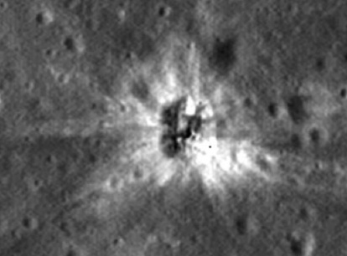
Autonomous Landing
Japan SLIM
It’s difficult, very difficult:
Historically 60% of all planetary/lunar landing attempts have failed
UK
NASA Mars Polar Lander
ESA Schiaparelli
Russia Luna-25

Slide 15
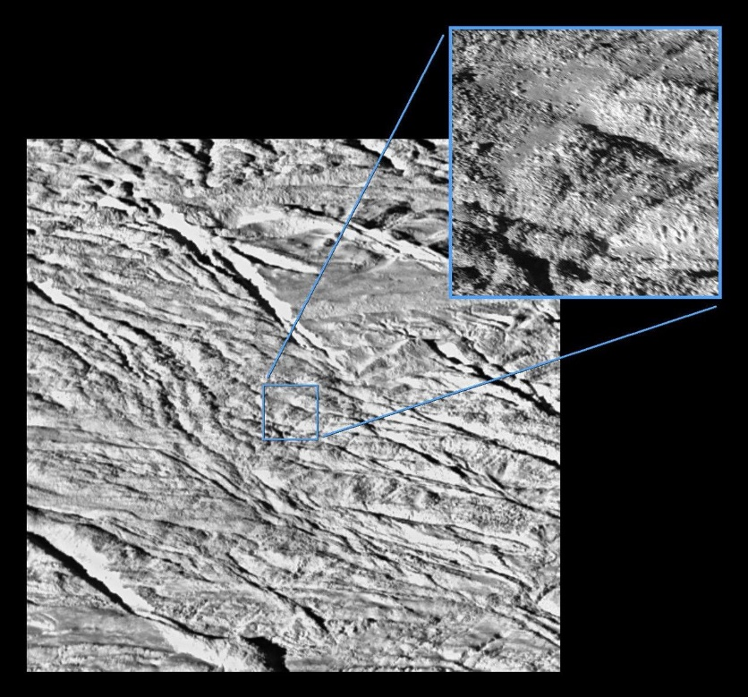
The Surface challenge
Landing on snow and ice is a unique challenge for the Enceladus lander vs e.g. Moon and Mars
We only have remote sensor data regarding the surface conditions: Highest resolution ~4m
Icy and rocky surface:
  “The surface is dominated by ice blocks between 10 and 100 meters across”
  Ice formation on Enceladus very different
  from earth

Slide 16
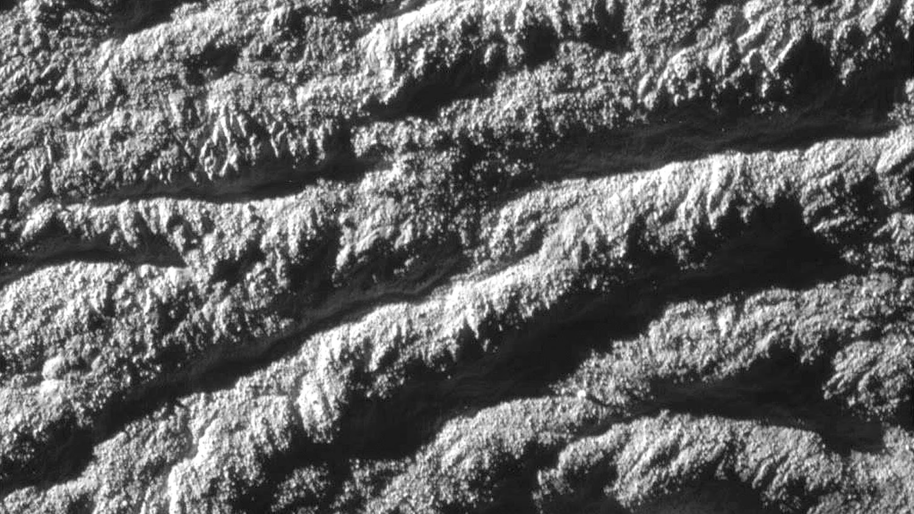
200m
Credit: Cassini, NASA/JPL/Space Science Institute

Slide 17
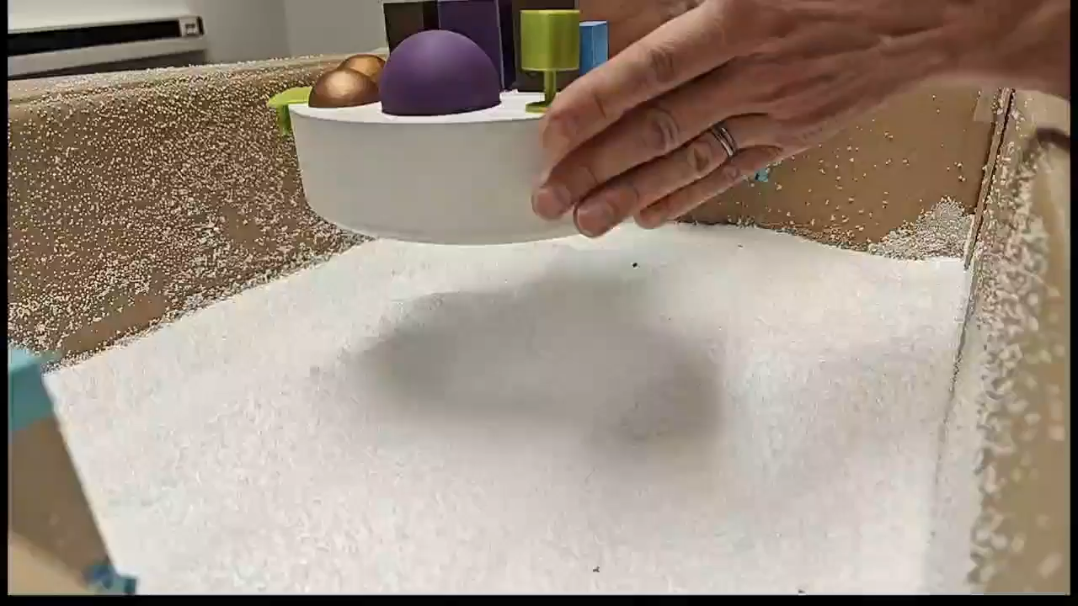
The Surface challenge
Landing on snow and ice is a unique challenge for the Enceladus lander

Slide 18
Remote Sensing the Surface Structure
Can we measure (sub-) surface properties (e.g. density) with
RF or LIDAR sensors from the lander during descend?
Reflection Spectrum A
Can we use this information
to guide the lander to a safer location?
lander
Reflection Spectrum B
Is it possible to use the same device for
Communication
Altitude measurement
Surface condition sensing
Location A
Location B

Slide 19
Surviving on the Surface
Vacuum
600 kg
2.5m
~20 C ?
Surface
battery
Instruments
battery
OBC
battery
Ice Shield
Sink in depth depends on
surface properties and lander residual velocity
Ice/Snow at 100K
Need to demonstrate surface survival and operation over the full 2 – 4 weeks in a relevant environment (surface temperature at ~100K)
Find balance between too cold and too hot

Slide 20
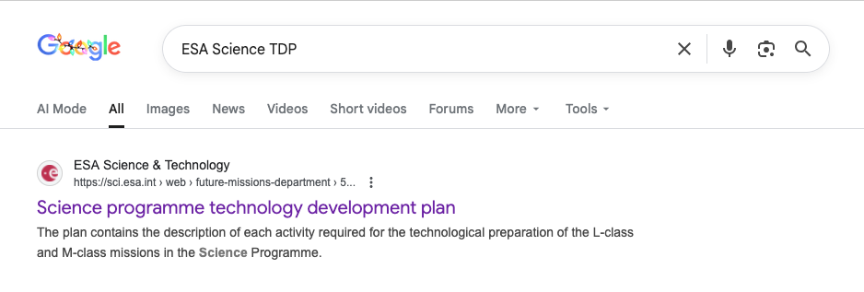
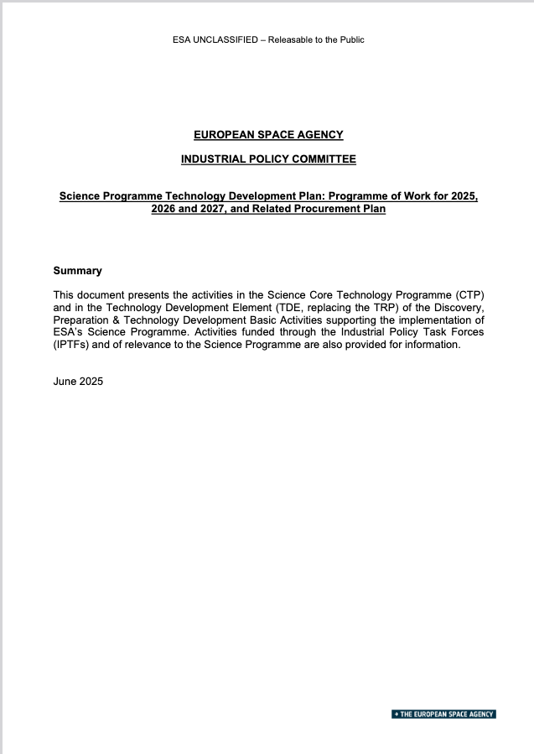

All L4 and SCI Activities Full Details
https://sci.esa.int/web/sci-ft/-/47731-european-space-agency-science-programme-technology-development-plan-programme-of-work
Update to current version with new activities soon

Slide 21
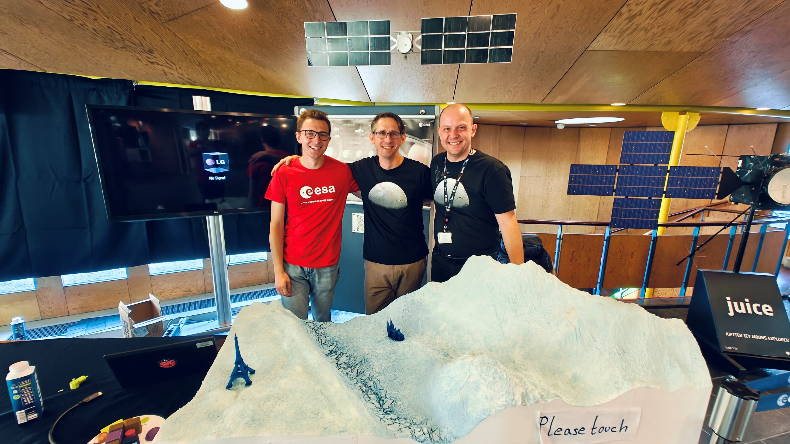
Thank you!

