Slide 1

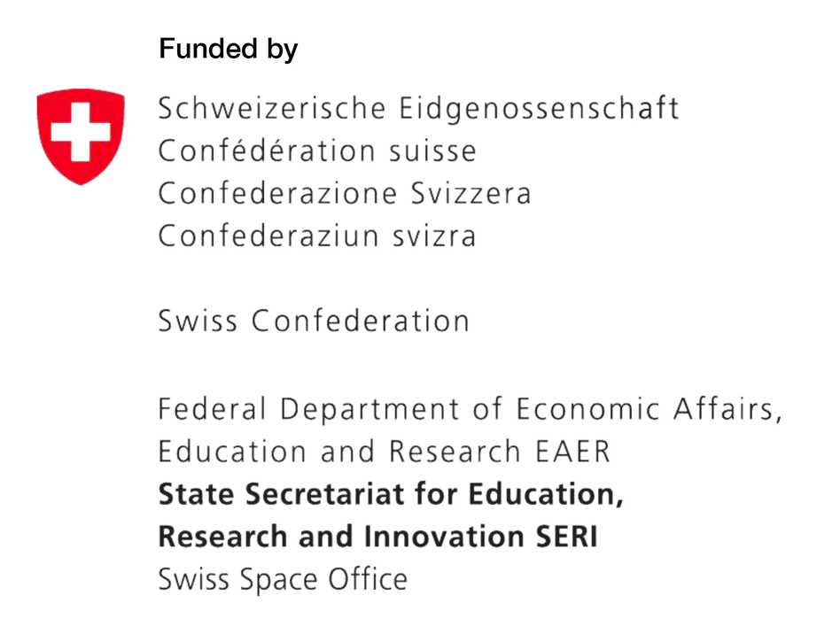
ESA challenges and opportunities for Switzerland
Deborah Müller
Space eXchange Switzerland

Slide 2
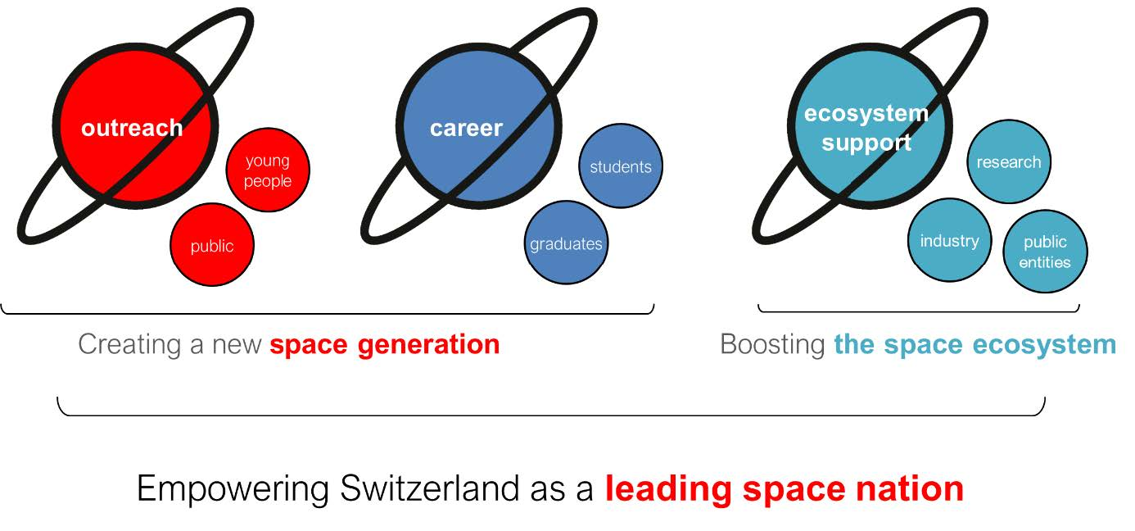
Space eXchange Switzerland and its mission

Slide 3

Innovation
Career
Outreach
SXS Impact in Numbers
212 consultations carried out by the scientific NPOC to advance the use of Earth Observation satellite data and related applications
Since 2022
11 Booths to inspire the young generation and the public
Space Clubs
116 sessions organised
GROW the next generation of space experts | ENGAGE with the public | BOOST the Swiss space ecosystem
3 Swiss pavilions at the International Astronautical Congress (IAC)
49 entities actively involved in the European Harmonisation process
698 Swiss students applications to ESA entry level programs (6-fold increase) and close to 80 Movetia grants attributed

Slide 4







Space eXchange Switzerland
Professional outreach events
Technology harmonization business with ESA
A national platform for the promotion of space in Switzerland funded by the Swiss Space Office (SSO) of the State Secretariat for Education, Research and Innovation (SERI).
It is implemented by five Swiss universities for the entire Swiss space ecosystem.
https://www.space-exchange.ch/
Commercialisation of space solutions
National point
of contact
(NPOC)
for Earth Observation
data
Support
for careers
related
to Space
Professional training for Space industry
Notes:
Increase competitiveness of European industry
better-coordinate research and development (R&D) activities among all actors in the European space sector,
25 YEARS OF HARMONISATION
48 SPACE TECHNOLOGY HARMONISATION TOPICS
~10 TOPICS/YEAR
30+ COUNTRIES INVOLVED
1,000+EUROPEAN SPACE ENTITIES INVOLVED THROUGH OPEN CONSULTATIONS

Slide 5
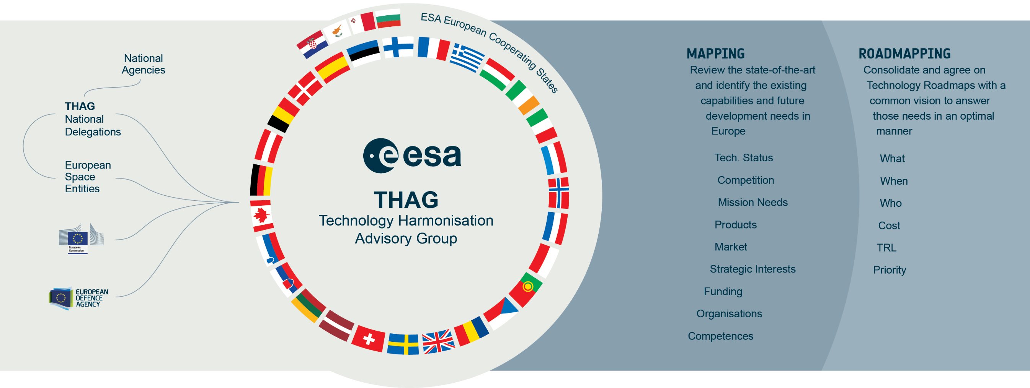

ESA Technology Harmonisation Advisory Group (THAG)
ESA Strategic Objectives | Your Benefit by participating
Fill strategic gaps and minimise unnecessary duplications | Market intelligence of what exists in the space business Match with your internal roadmap, consolidate your strategy, find new opportunities Where to play and How → Mapping activities
Consolidate European strategic capabilities | State-of-the art Technology landscape overview, benchmarks and trends Insight into future needs, priorities and technology transfer opportunities Bring in your industrial or scientific perspective and influence the decision-makers Boost your visibility on the European Landscape
Achieve a coordinated and committed European Space technology policy and planning | Understand the needs in future technology developments Identify the non-dependance technologies and support industrialization of new technologies Access European and ESA experts in your field Top-Down view
Contribute to continuity and coherence between technology and industrial Policies | Shape future policy development Understand the geopolitical influence on technology developments and future mission programmes
Notes:
Increase competitiveness of European industry
better-coordinate research and development (R&D) activities among all actors in the European space sector,
25 YEARS OF HARMONISATION
48 SPACE TECHNOLOGY HARMONISATION TOPICS
~10 TOPICS/YEAR
30+ COUNTRIES INVOLVED
1,000+EUROPEAN SPACE ENTITIES INVOLVED THROUGH OPEN CONSULTATIONS

Slide 6
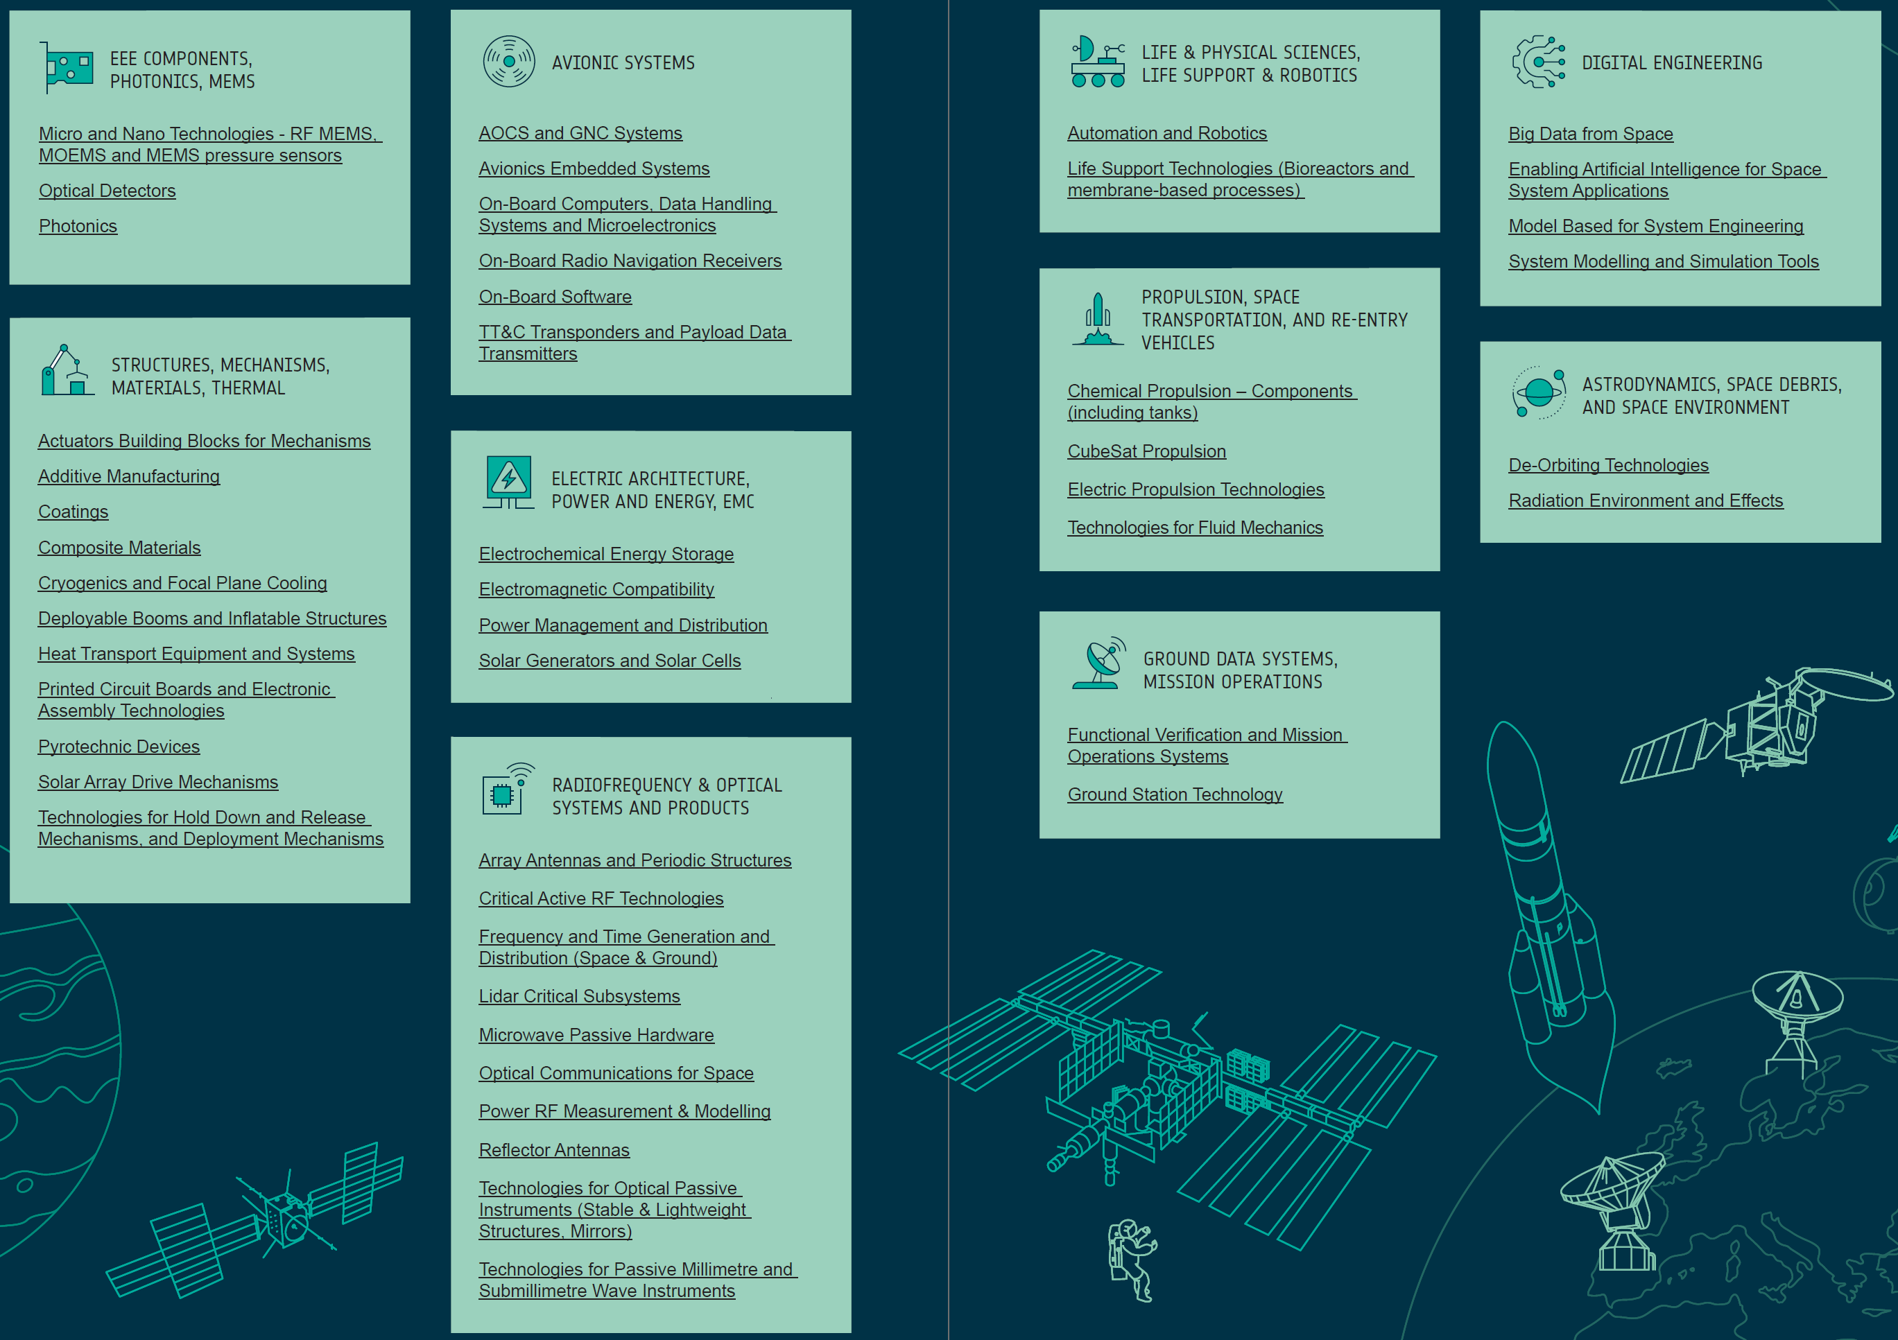
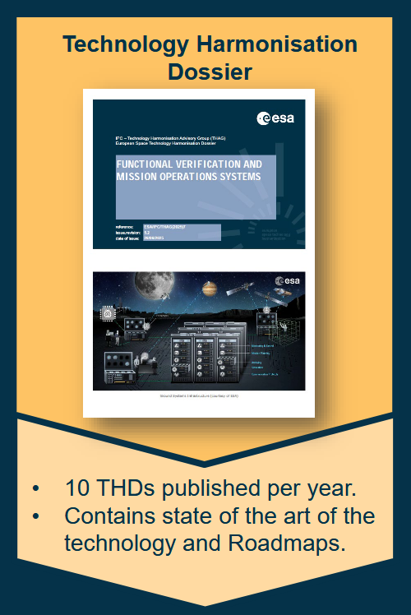
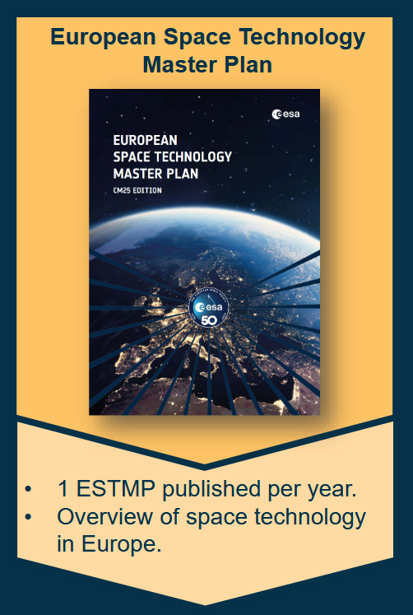
Cycle 2 - 2026
Consultation process starts Q2
Cycle 1 - 2026
currently in consultation process
Notes:
Cycle 1 - Consultation Phase
Actuators Building Blocks for Mechanisms
Pyrotechnic Devices (within release mechanisms)
Printed Circuit Boards and Electronic Assembly Technologies
Precision mechanism dossiers :
Actuators Building blocks for mechanism
SADM
Technologies for Hold Down, Release, Separation and Deployment Mechanisms
Cryo:
Cryogenics and Focal Plane Cooling
Additive Manufacturing
Micro and Nano Technologies – MEMS Pressure Sensors, MOEMS and RF-MEMS
Cycle 2
Ground Station Technology
On-Board Computers, Data Handling Systems and Microelectronics
Avionics Embedded Systems
On-Board Software
Radiation Environment and Effects

Slide 7
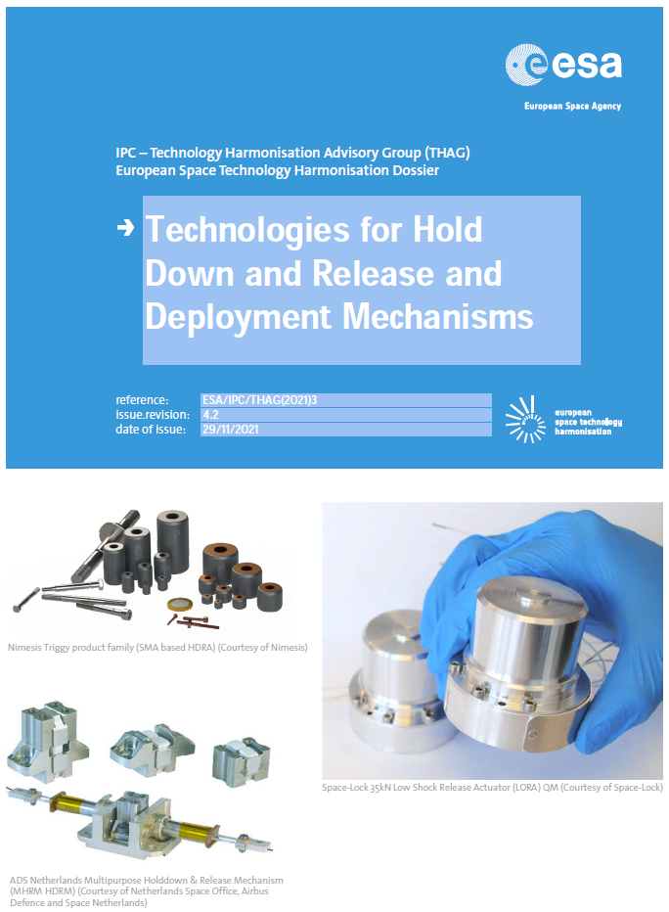
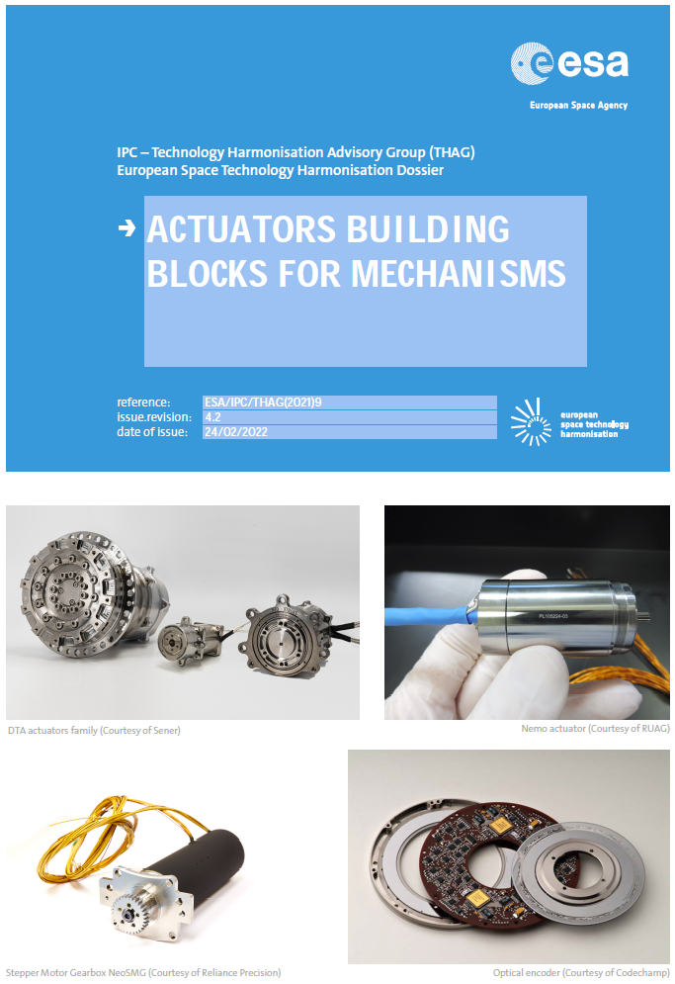
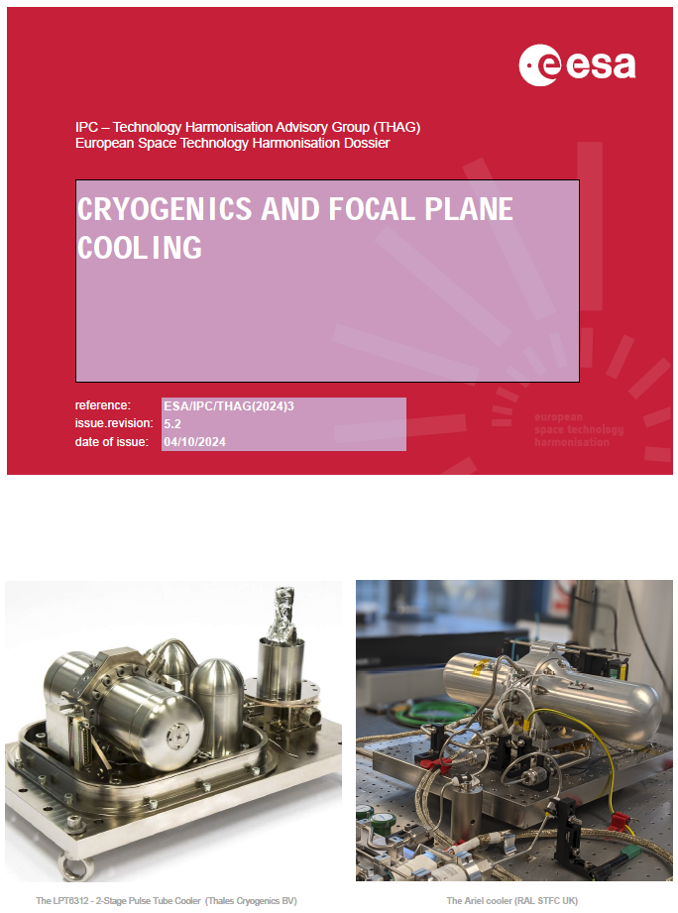
Technology Harmonisation Dossiers
Opto-mechanics, precision mechanisms, vacuum & cryo
Actuators Building Blocks for mechanisms
Actuators based on electric motors:
  Electrical motors: brushed motors, brushless motors, stepper motors
  Transmission stages
  Position and speed sensors: switches, low accuracy position sensors, high accuracy position sensors, speed sensors
Piezo-actuators
  Smart material actuators
  Shape memory alloy actuators
  Other smart material actuators
Limited stroke actuators
Technologies for Hold Down, Release, Separation and Deployment Mechanisms
Hold Down and Release Mechanisms:
  Clamp bands and dispensers
  Non-explosive release actuators (Magnetic clamp, Pin puller / pusher, Shape Memory Alloy, Fusible wire / split spool, Thermal cutter, Bi-metallic actuator
Deployment Mechanisms
  Dampers (viscous, melting alloy, Eddy current, magneto-rheological fluid)
  Shape Memory Alloy
  Escapement mechanism speed regulator
  Tape spring
  Magnetic bearing
Cryogenics and Focal Plane Cooling
Radiators
Thermoelectric coolers
Cryostats
Active cooling systems from 2K to 190K
  Stirling cooler
  Pulse Tube cooler
  Joule Thomson expansion cooler
  Solid Sate cooling (e.g. laser-coolers)
  Reverse Turbo-Brayton cooler
  Microcooling
Sub-Kelvin cooler:
  Adiabatic Demagnetisation Refrigerators (ADR)
  Dilution Refrigerator
  3He-sorption pump cooler
Cooler drive electronics
Cryogenic System Equipment: equipment required to integrate the above mentioned cooling systems with the detectors and the Spacecraft
  Cryogenic technologies for space transportation
  Cryogenic insulation solutions
  Propellant management
  Cold/Liquid Gas storage and transfer
Cryogenics Heat Pipe and Loop Heat Pipes (for this one see the topic Heat Transport Equipment and Systems)
Notes:
https://technology.esa.int/page/harmonisation

Slide 8
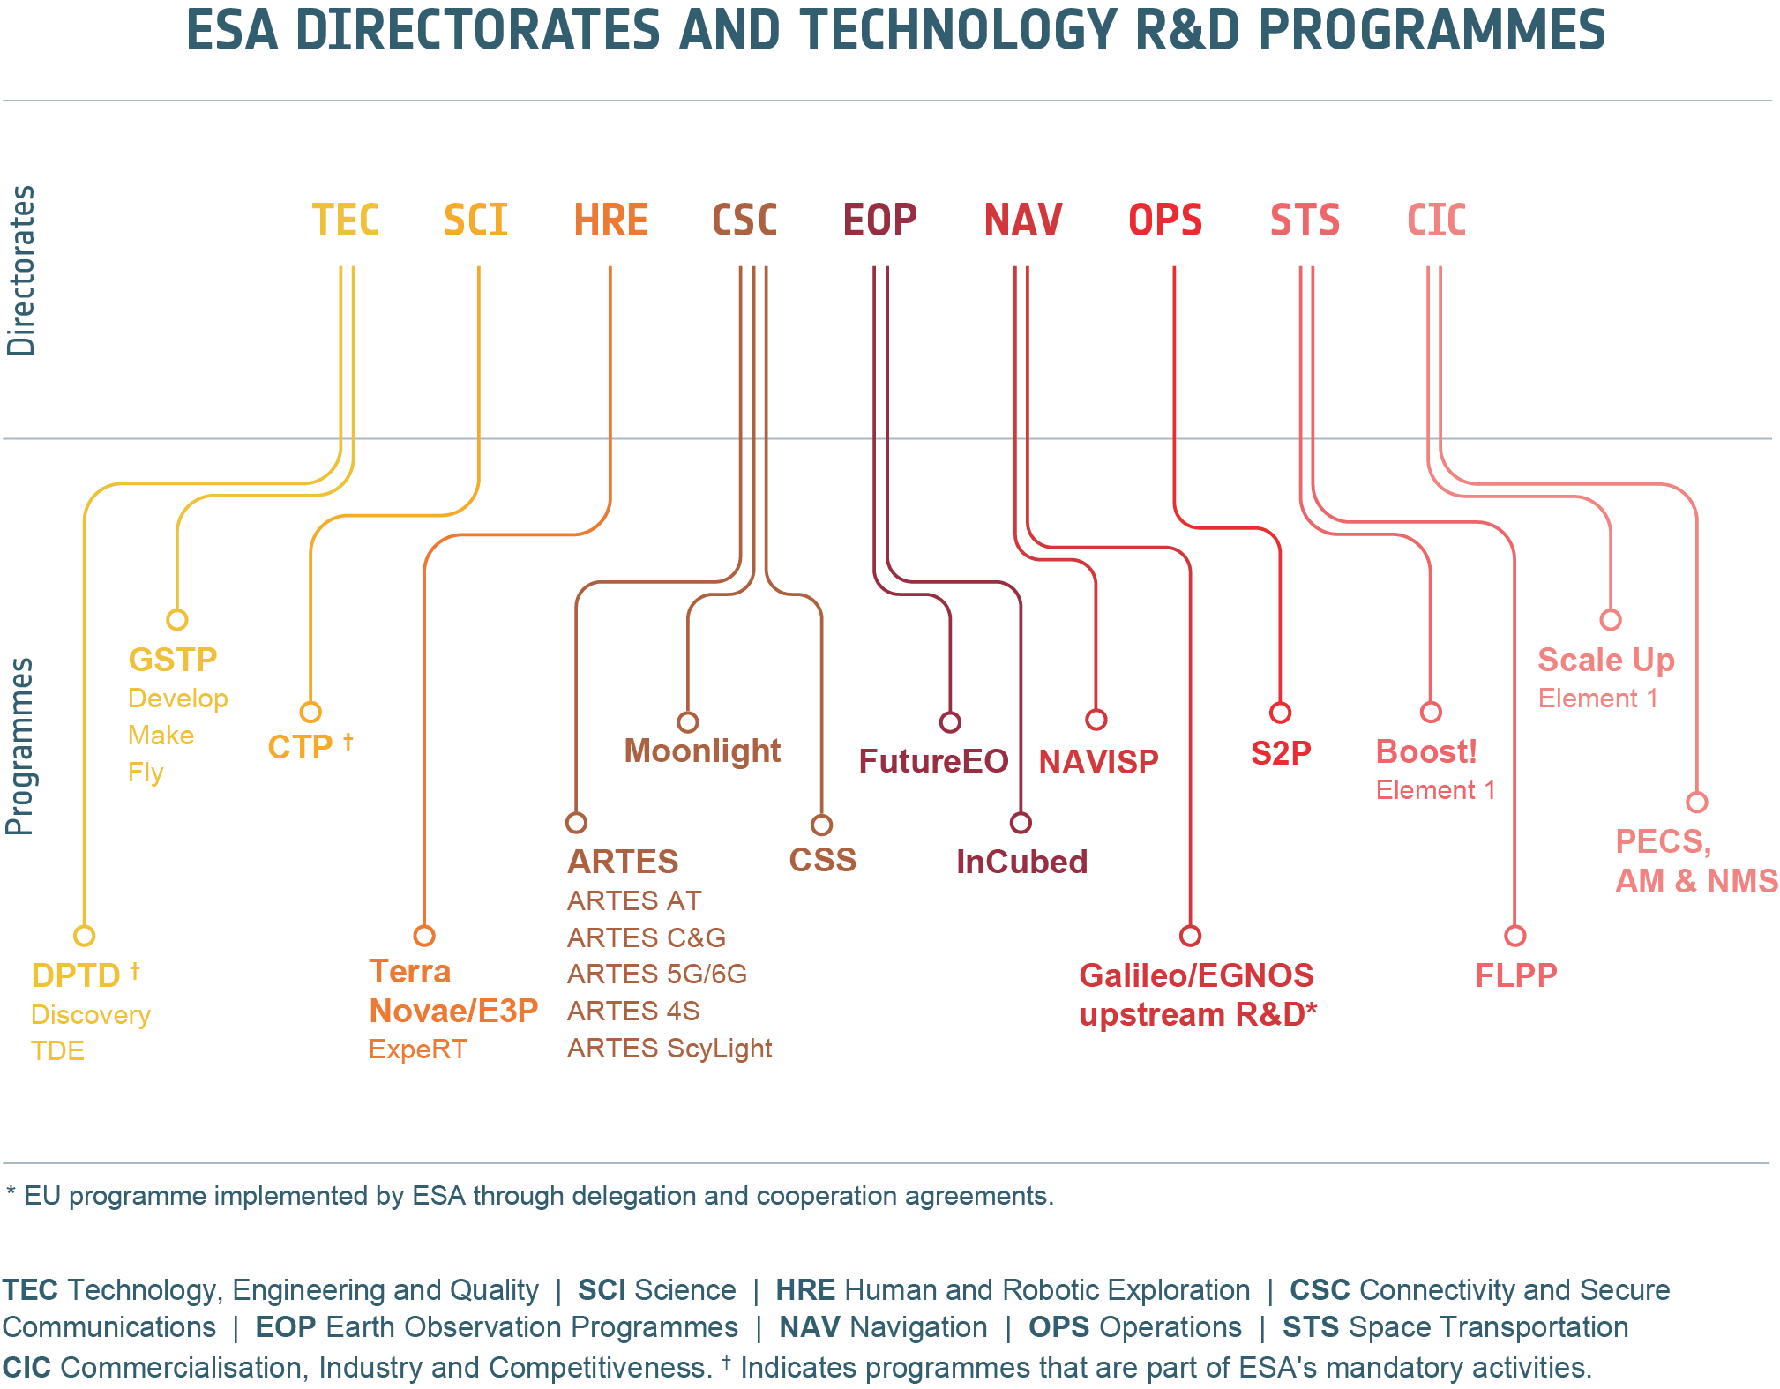



ESA Mandatory Programmes | ESA Optional Programmes
CTP DPTD - Discovery (OSIP) DPTD – TDE Science missions | PRODEX GSTP Terra Novae / E3P ARTES, Moonlight, CSS Future EO, ERS NAVISP S2P Boost!, FLPP ACCESS = Scale Up + BASS
without delegation support | need of the delegation support
ERS
E1, E2
ACCESS
(Scale-Up + BASS)
Source: https://technology.esa.int/program/technology-programmes
Notes:
https://technology.esa.int/program/technology-programmes
Science Core Technology Programme (CTP)
OSIP
Technology Development Element (TDE)
CSS =Civil Security From Space
S2P =Space Safety
Scientific Experiment Development Programme
ERS = European Resilience from Space for Earth Observation
(PRODEX)

Slide 9
Specificities CM25
22.3 b€ (+31% from CM22, +17% accounting for inflation)
ESA Strategy 2040:
  Protect our planet and climate
  Explore and discover
  Strengthen European autonomy and resilience
  Boost European growth and competitiveness
  Inspire Europe
New named programme: ACCESS = Scale-up + BASS
New opened programme: European Resilience from Space for Earth Observation (ERS) programme integated into Earth Observation:
  Element 2 Cluster 1 - ALPSTAR (14 M€)
“Post CM25 (ESA Council at Ministerial Level 2025) Info Session”
Date: 26th of February 2026
Location: Bern and remote (on-site participation is encouraged)
Organised by SSO, information will follow by mail
Domain | Programme | Switzerland subscription at CM25 (M€) | What it enables (opportunity type)
SCI | PRODEX | 567.06 | Payload/instrument development + exploitation support for ESA missions
TEC | GSTP Element 1 | 10.00 | ESA-driven technology maturation up to qualification
TEC | GSTP Element 2 | 4.00 | Industry-driven, co-funded product development via OSIP channel
TEC | GSTP Element 3 | 3.00 | In-orbit demonstrations
TEC | GSTP – EEE component | 4.00 | Critical electronic components (sovereignty / qualification)
TEC | GSTP – Resilience & Security component | 1.50 | Security/resilience technologies (anti-spoofing/jamming/cyber, etc.)

Slide 10
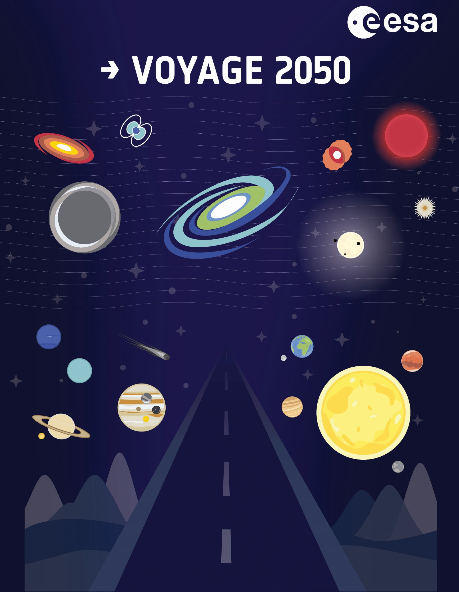
Specificities CM25 – Science Programmes
Funding uplift for the Science Programme → 3.5% annual increase above inflation for 2026–2028, a total of €3,787M over 5 years.
Forward science pipeline – will of flagship science missions and avoiding mission gaps, transition from Cosmic Vision to Voyage 2050 (ESA’s Space Science plan 2035-2050).
Next missions in the pipeline:
  Small & Fast mission: SMILE (2026), Comet Interceptor (~2029), ARRAKIHS (~2030/31)
  Medium-class missions: PLATO (2027), EnVision (~2031), Ariel (~2031)
  Large-class mission: LISA (~2035), NewAthena (~late 2030)
Timing for Voyage 2050 pipeline:
  Active calls for M8 A/B and F3 A/B between 2026–2028
  M7 selection targeted for mid-2026
  Exploratory for mini-F missions
  Multiple “best practices” prime bid windows across 2026–2028
  L4 Technology Preparation between 2026–2030+ (Saturn/Enceladus, long-lead instrument miniaturization)
Flag: NASA cooperation uncertain and risky, to take into account in planning
Notes:
Programmatic caveat:
the adopted 3.5% is lower than the originally proposed 4.5%, which ESA notes as a ~€90M shortfall over five years, and they

Slide 11
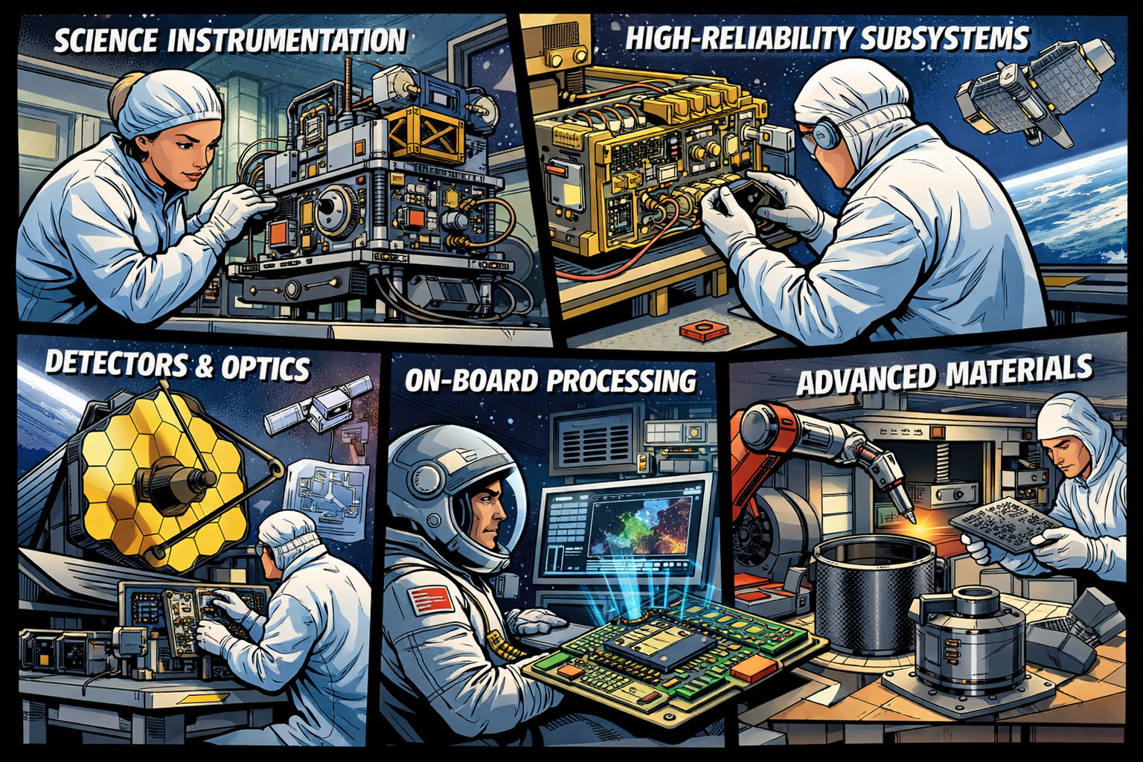
Science Programmes – Swiss contribution
Lead / co-lead science instrument development, payload avionics, on-board SW, calibration chains, GSE, and operations support for ESA science missions.
Sustain multi-mission heritage and continuity (repeatable subsystems, detectors, read-out chains, precision mechanisms, thermal stability concepts).
Treat PRODEX not only as hardware, but also as a science operations + data exploitation funding vector (pipelines, processing, calibration).
Enable more “mission pull” for technology and payload supply chains in following topics:
    high-reliability subsystems for deep space (radiation, cryogenic, long-life mechanisms)
    Detectors / optics chains and precision mechanisms
    Autonomy / on-board processing (ties into TEC AI topics)
    Advanced materials and manufacturing (ties into TEC materials/ISRU topics)

Slide 12


Specificities CM25 – Technology Programmes
Key strategic pillars for ESA:
  Sovereignty (reducing critical dependencies outside of Europe)
  Boosting industrial competitiveness
  Pushing high-impact domains (e.g. AI, quantum, propulsion, sustainability)
GSTP funding uplift by +66% versus the previous cycle
From development to flight via GSTP elements:
  GSTP Element 1 – Develop: ESA-driven priorities → CH 10M€
  GSTP Element 2 – Make: Industry-driven developments with a simplification/speed, market-oriented products → CH 4M€
  GSTP Element 3 – Fly: In-orbit demonstrations, including a CubeSat framework, to build heritage → CH 3M€
New emphasis in GSTP “Resilience & Security” component, additional to existing critical-capabilities / non-dependence working groups in EEE technologies
  GSTP EEE component: EEE Components that match the current European risk posture, critical electronic parts for European independence in Supply chain → CH 4 M€
  GSTP Resilience and Security component: strongly emphasis on security/cyber and sovereignty as cross-cutting needs → CH 1.5 M€
TEC focus areas include VLEO, Quantum, AI, Security/Cyber, mid-size satellite industrialisation (M-IND), serialisation/industrialisation, EEE critical components, Zero Debris & in-orbit servicing, advanced manufacturing, phased arrays, advanced propulsion, optics+radar, RF, navigation, nuclear energy, cryogenic/deep space/radiation, material science and ISRU.
DPTD Discovery via OSIP remains the lowest-barrier entry for early-stage concepts (without national delegation support).
DPTD Preparation and TDE cover competitive studies (aligned with ESA roadmaps) and enabling technology development at low TRL (1-4)

Slide 13
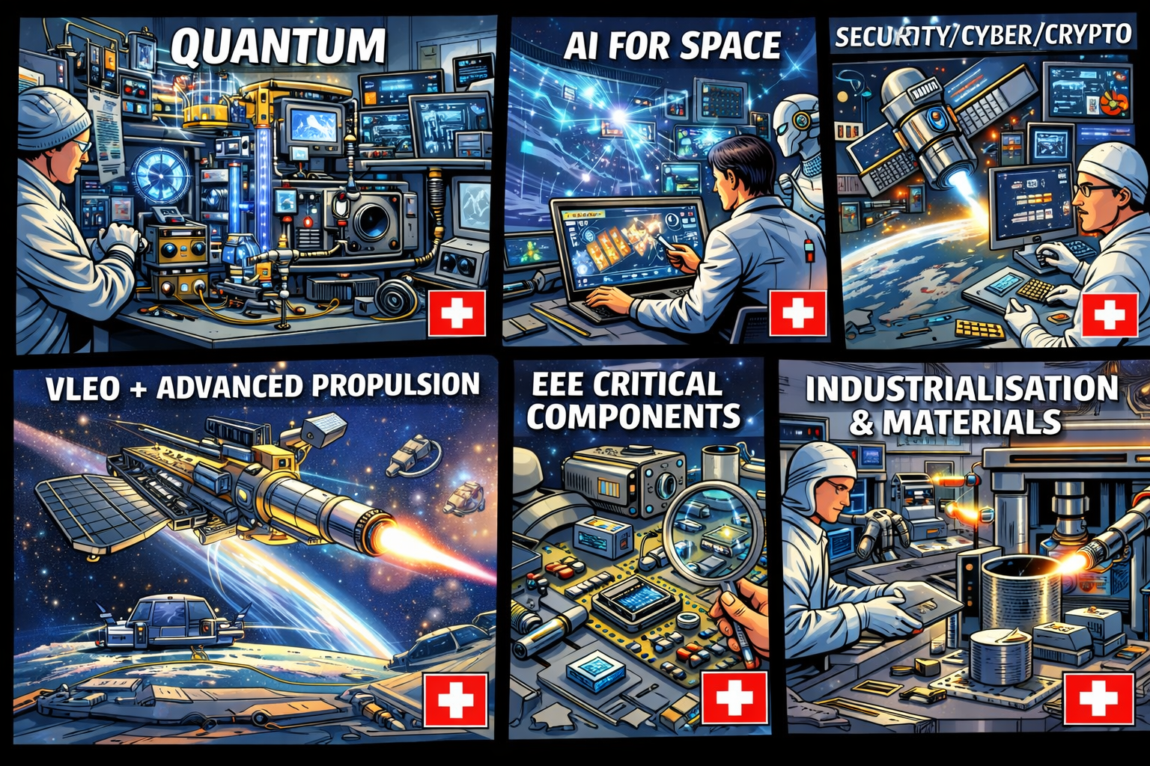
Technology Programmes – Swiss contribution
Swiss entities with matching competence should target the following topics:
Quantum: photonic building blocks, clocks, sensors, time/frequency transfer.
AI for space: mission design/optimisation, operations agents, on-board analytics, supply-chain optimisation.
Security/Cyber/Crypto: “secure-by-design” building blocks and productisation logic.
VLEO + advanced propulsion: technology enabling faster cycles and new mission envelopes.
EEE critical components (non-dependence, qualification, supply stability).
Industrialisation/serialisation production (M-IND), standardised subsystems (interfaces/architectures), Swiss precision manufacturing, quality and obsolences management.
Materials, advanced manufacturing, sustainability, ISRU (radiation, cryogenic-deep space qualified as explicit TEC focus lines).
GSTP E1 Compendia | GSTP E1 Specific Areas
Generic technology domains: GNC, AOCS & Pointing Avionics RF Systems Power Systems EMC & Space Environment Optics & Optoelectronics Robotics Life Sciences Structures, Mechanisms and Materials Thermal Systems End-to-End Systems Future Engineering Ground Segment | Cyber security VLEO Serialisation/Standardis Sub-Systems & Platforms Advance Data Handling Architecture (ADHA) and Advanced Power Architecture (APA) M-IND (mid-size satellites 100-500kg for LEO constellations)
Targeted technology domains: Quantum Technologies Innovative Propulsion Artificial intelligence Sustainable Space (Ecodesign, Zero Debris, Circular Economy)

Slide 14

Key Take-aways
  Harmonisation:
    Useful to support your business and let the Space ecosystem about your portfolio
  Contacts:
    Delegate for Technology Harmonisation:
    julien.bonnaud@space-exchange.ch
    Delegate for Technology Harmonisation and Commercialisation:
    deborah.mueller@space-exchange.ch
  Useful information:
    Technology Harmonisation Dossier (THD): per topic
    European Space Technology Master Plan (ESTMP): per year
    Need any support, searching for partner from industry or academia, innovation ideation, ESA contacts, access to European space ecosystem…..then contact us

Slide 15
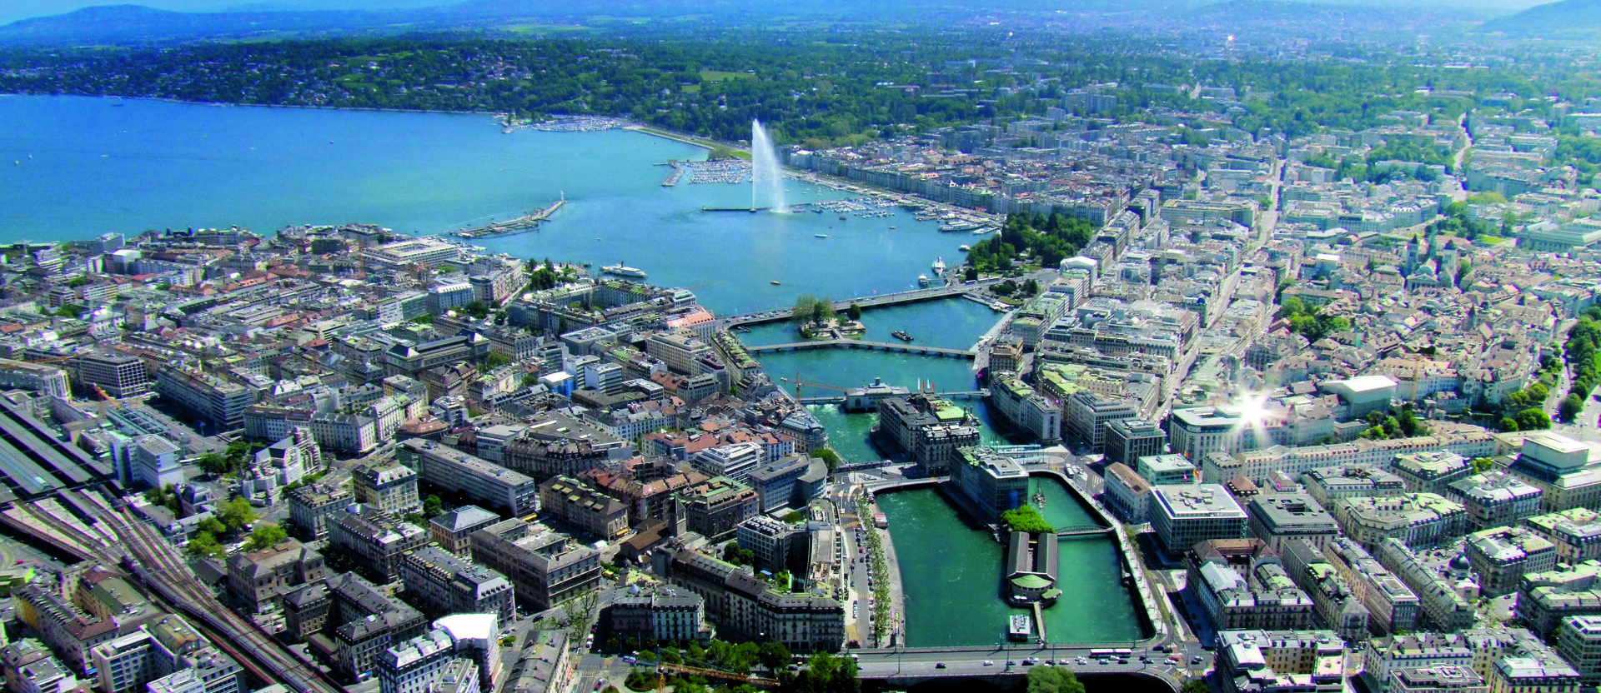


IAC 2029 in Geneva !
International Astronautical Congress
Please support our bid with your contact:

Slide 16

Let’s stay in touch!
Register to our mailing list and Beacon Newsletter on www.space-exchange.ch
info@space-exchange.ch
deborah.mueller@space-exchange.ch

