Slide 1
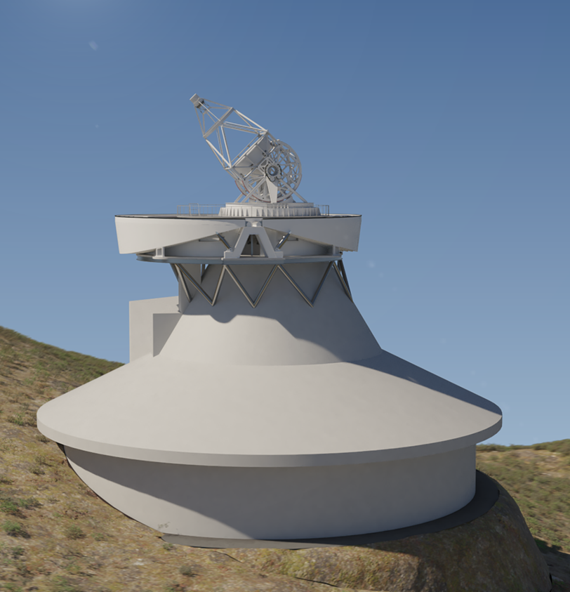
European Solar Telescope: A New Frontier for Swiss Science and Technology
Svetlana Berdyugina
IRSOL / USI
Consortium:
USI, IRSOL, FHNW, SUPSI, HEIG-VD, ETHZ/EAWAG, ZHAW, UNIBE, PMOD/WRC, ETHZ/CSCS
Swiss Innovation for Astrophysics and Planetary Science (SIAPS), January 20-22, 2026, Bern

Slide 2

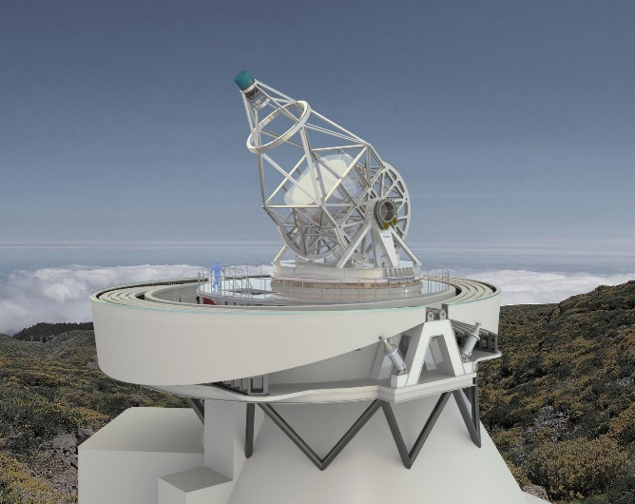
European Solar Telescope (EST)
Next-generation telescope for the 21st century solar physics
4.2-m aperture, Gregorian optical configuration
MCAO, Active M1, Adaptive 0.8m M2, open dome, 44m tall
Multi-wavelenghth high-resolution spectropolarimetry (7 imaging spectropolarimeters in 4 channels 350–1800 nm)
Roadmaps:
ESFRI Roadmap 2016: EU Research Infrastructure
AstroNet Roadmap 2022-2035: EST is of high priority for ground-based observations (on par with CTA)
SCNAT Astronomy Community Roadmap 2024 Update for 2029-2032: “Participation of Switzerland in EST should be secured.”

Slide 3
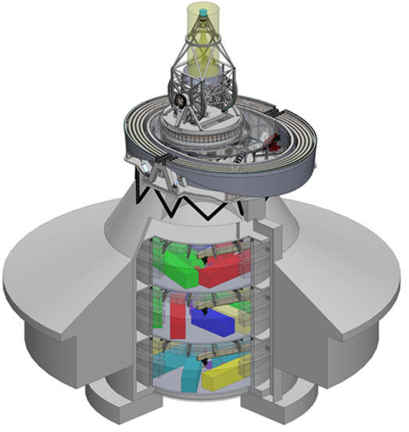
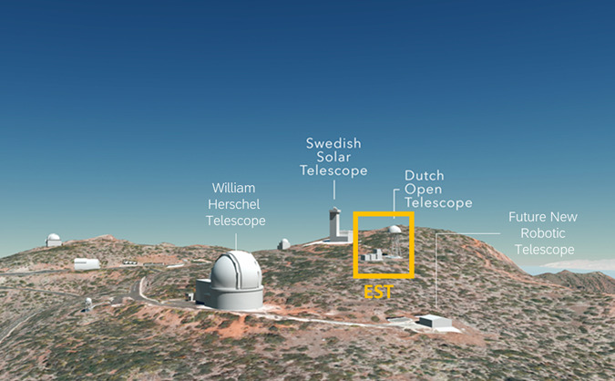
Observatorio del Roque de Los Muchachos, La Palma

Slide 4
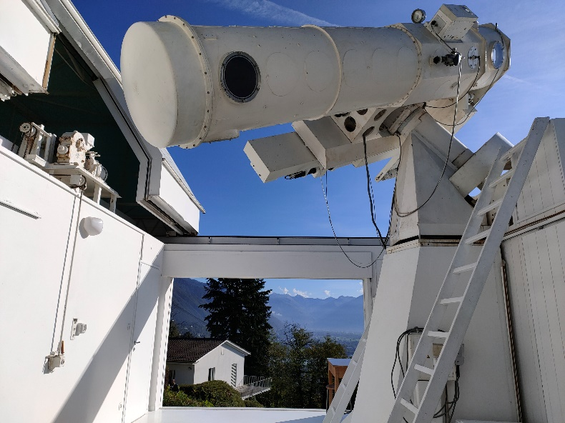
Swiss solar telescope vs EST: “A quantum leap”
IRSOL: 0.45m + Swiss technology EST: 4.2m

Slide 5
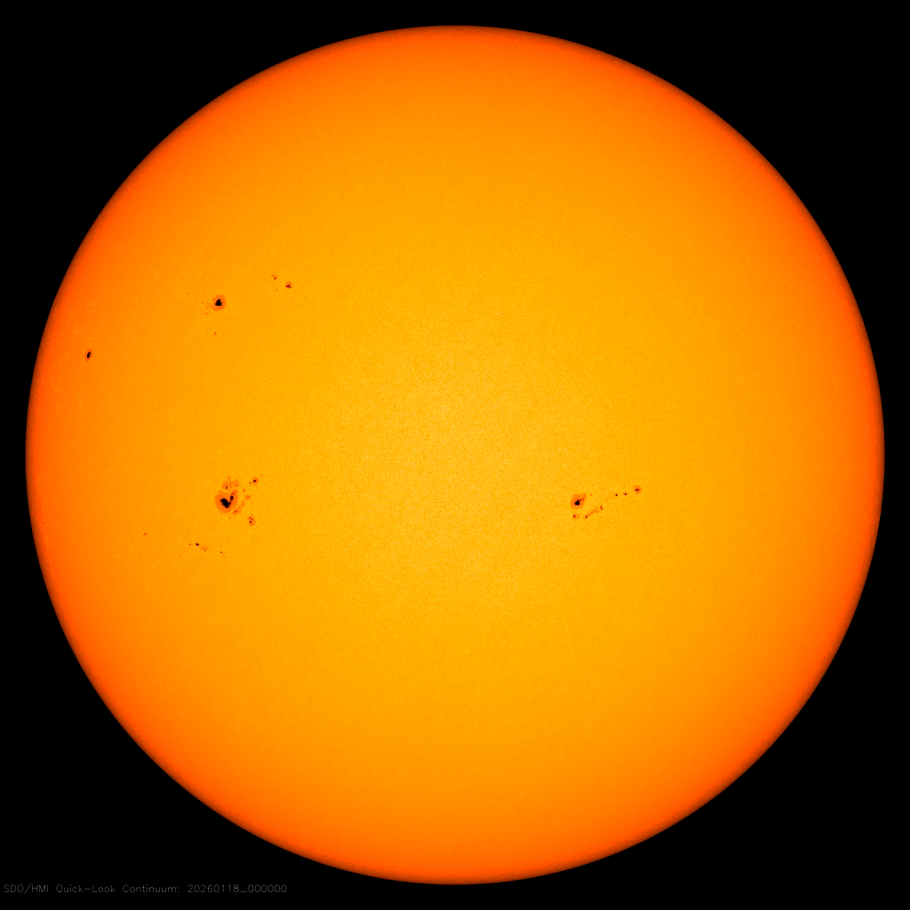
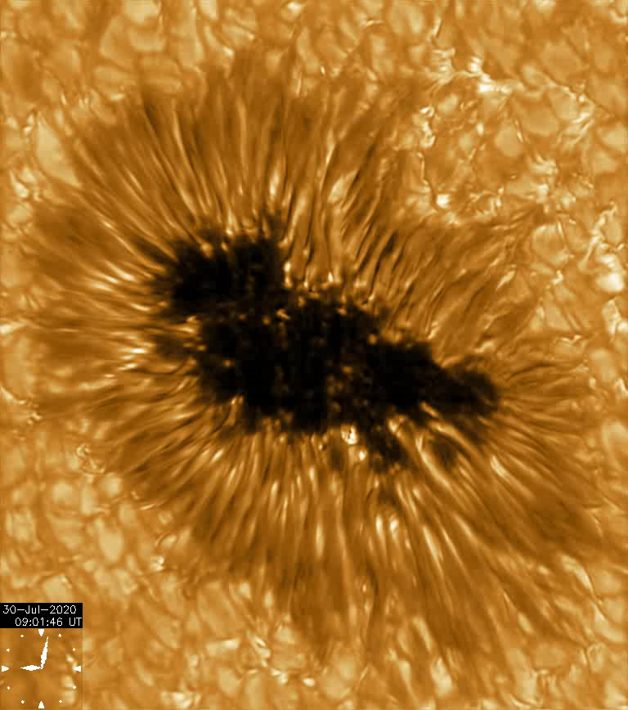
The Sun: Closest star that supports Life on Earth
SDO/HMI 6173 A
GREGOR, 1.5m, 7055 A

Slide 6
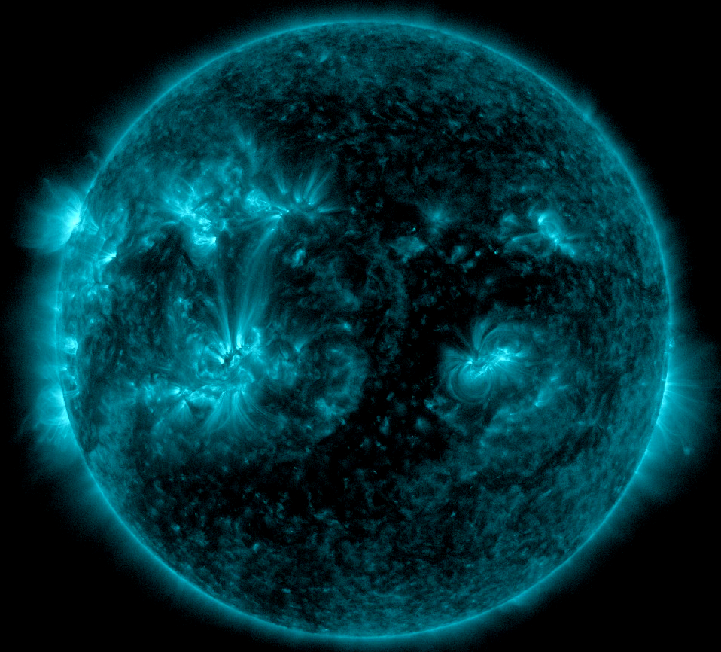
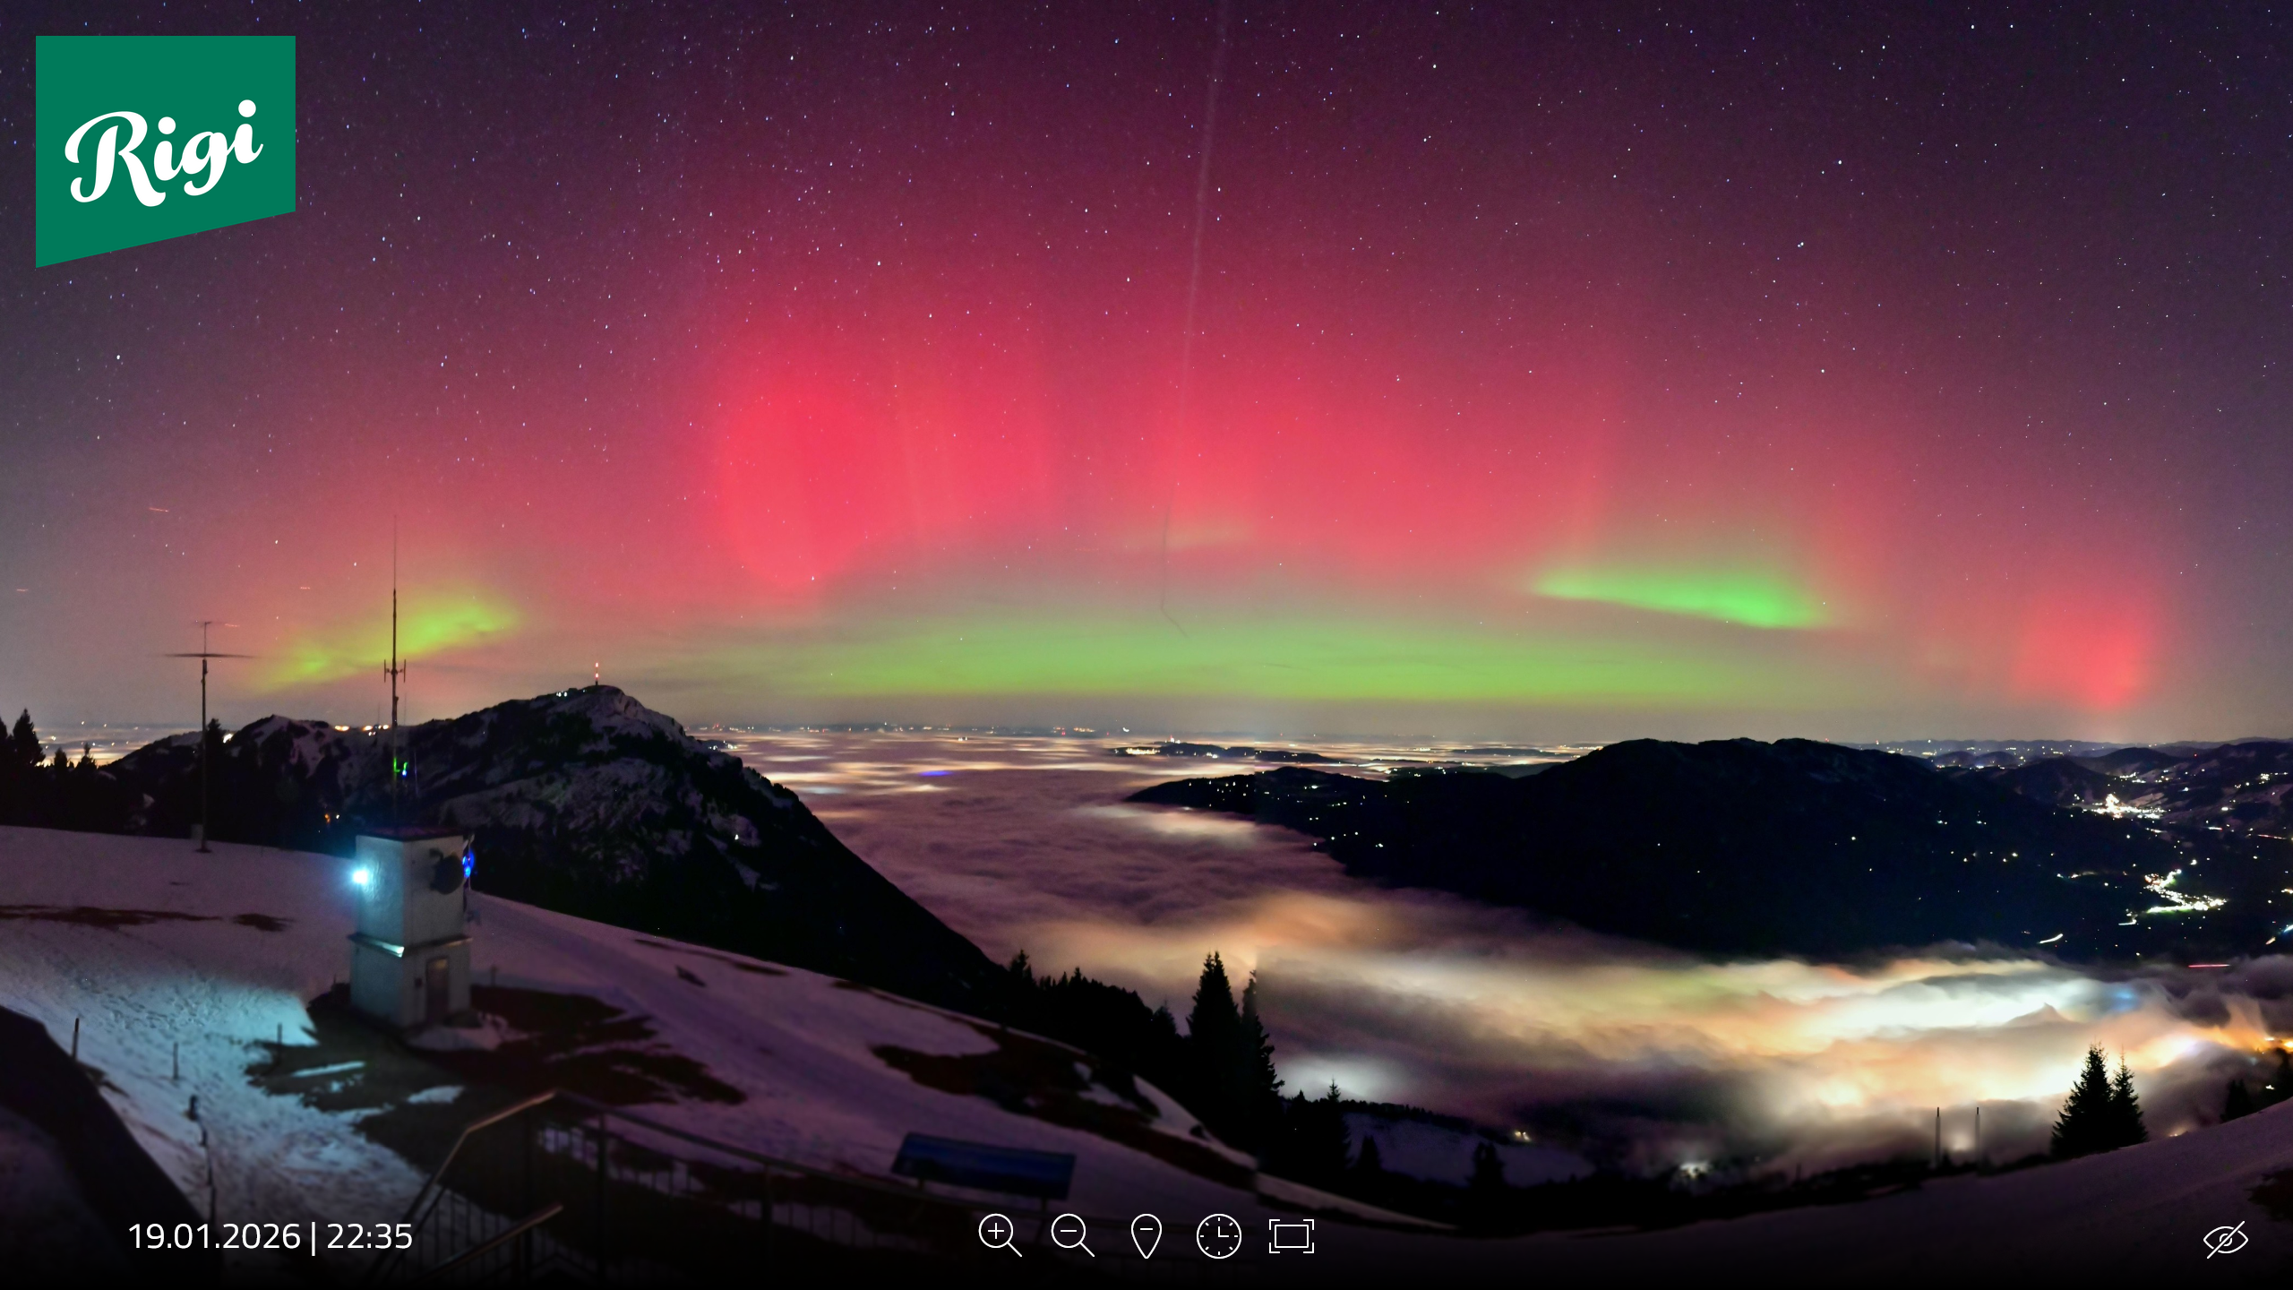
The Dark Energy of the Sun: Magnetic Fields
Jan 18, 2026: X1.9 Flare, lasted 6h!
Jan 19, 2026: G4, Kp=8.7, 24h+
SDO/AIA 131 A

Slide 7
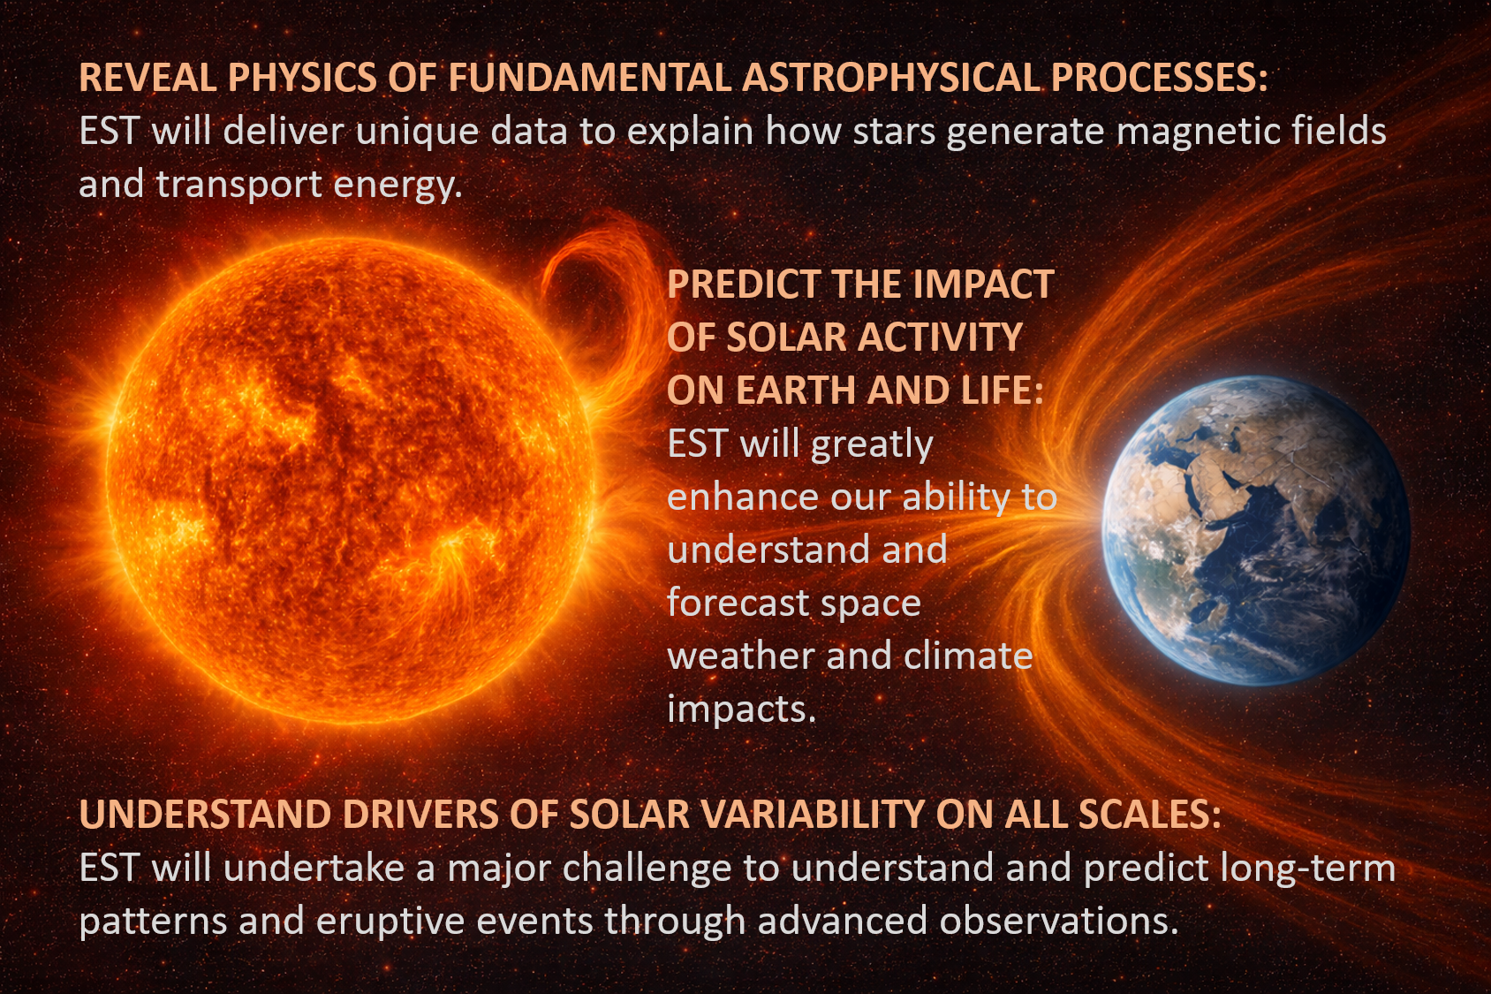
EST Scientific Goals
1
1
3
2

Slide 8
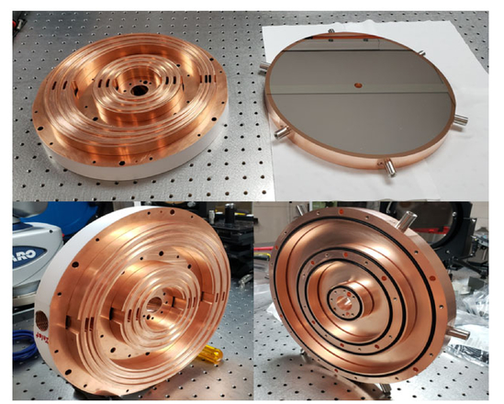
Technological Challenges
1. Heat
4m mirror: ~12 kW
Heat stop in F1 reduces it to 300 W:
Reflector: ~98% is rejected (outside FOV)
Absorber: active cooling by liquid
T ~ +4C of the ambient level
Chriselle et al. (2022), DKIST, 4m, off-axis

Slide 9
Technological Challenges
2. Atmospheric Turbulence
Phase errors of a few micrometers in the optical, within 20 km of the Earth atmosphere
Single-conjugate AO (CAO): isoplanatic angle of a few arcsec << FOV
EST Multi-conjugate AO (MCAO): 5 DMs, FOV Ø~1’, res 0.03’’ (~20km on the Sun)
Schmidt D., et al. (2017), BBSO, 1.8m, off-axis

Slide 10
Technological Challenges
3. Polarimetric sensitivity
Standard polarimetric precision ~ 0.1%, accuracy > 1%, modulation < 30 Hz
Induced spurious polarization due to seeing (>100 Hz) and evolution of solar features
IRSOL’s ZIMPOL polarimetric precision & accuracy ~ 0.001%
Fast modulation: 42 kHz using FLC or PEM
Slow modulation: < 1Hz beam swapping using a rotating retarder
System calibration every ~20 min to remove cross-talks using polarizers and retarders in the beam
4. Sensors for high-precision polarimetry
Synchronous demodulation on the ZIMPOL CCD (custom electronics & software, SUPSI)
ZIMPOL for biopharmaceutic studies of chiral enantiomers using polarimetry
Joint Patent ETHZ & IRSOL (2019)
NG Sensor – Innosuisse project 2025-2027 by SUPSI, IRSOL, ENANTIOS AG.

Slide 11
Technological Challenges
5. Multi-Dimensional data
Multi-dimensional data cubes: [x,y,λ,(I,Q,U,V),t]
Not all dimensions can be sampled simultaneously
FPI: Scanning in λ and modulating Stokes (I,Q,U,V)
→ fast 2D [x,y] imaging
SlitSpec: Scanning in x and modulating Stokes (I,Q,U,V)
→ fast 2D [x, λ] imaging (or IFU mosaic)
Evolution of [<I,Q,U,V> at (x,y,λ)]_{Δt} in t → goal to reduce Δt

Slide 12
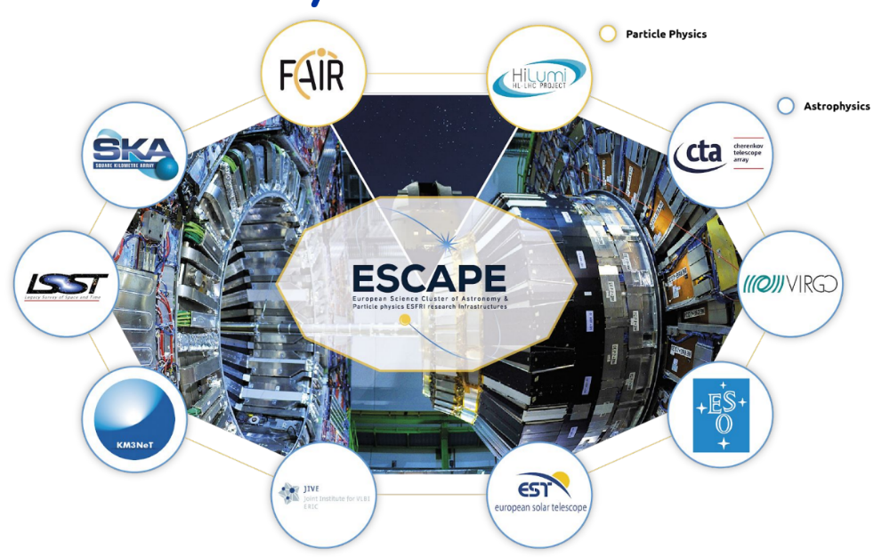
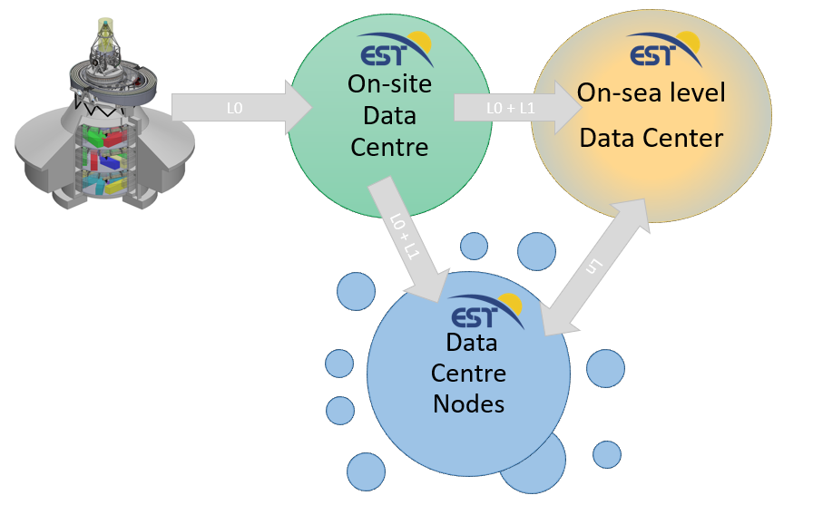
Technological Challenges
5. Multi-Dimensional data
Multi-dimensional data cubes: [x,y,λ,(I,Q,U,V),t]
Not all dimensions can be sampled simultaneously
FPI: Scanning in λ and modulating Stokes (I,Q,U,V)
→ fast 2D [x,y] imaging
SlitSpec: Scanning in x and modulating Stokes (I,Q,U,V)
→ fast 2D [x, λ] imaging (or IFU mosaic)
Evolution of [<I,Q,U,V> at (x,y,λ)]_{Δt} in t → goal to reduce Δt
6. Data rate
Currently: ~ few TB/day raw data (Level 0), << TB processed data (Level 1: calibration & image reconstruction)
EST: 1-2 PB/day raw data, ~6-10 ExaB/30yrs → CPU/GPU and storage, AI applications

Slide 13
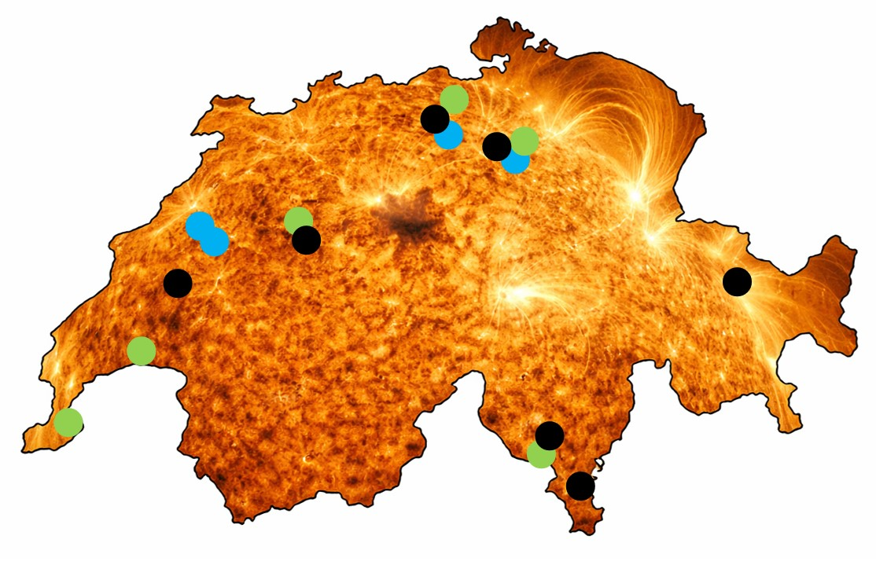
Swiss EST Partnership
Consortium:
22 groups (incl 12 Profs) at 10 universities and research institutes / facilities:
USI, IRSOL, FHNW, SUPSI, HEIG-VD, ETHZ/EAWAG, ZHAW, UNIBE, PMOD/WRC, ETHZ/CSCS
Industrial Interest:
CSEM, ARCoptix, Ateleris, Enantios
Collaborators:
MeteoSwiss,
CERN-ESCAPE, SKAO
Academic Interest:
Swiss groups in space physics, astrophysics, Earth science
Swiss Virtual Institute for Solar Science
SVISS
www.sviss.ch/est/

Slide 14
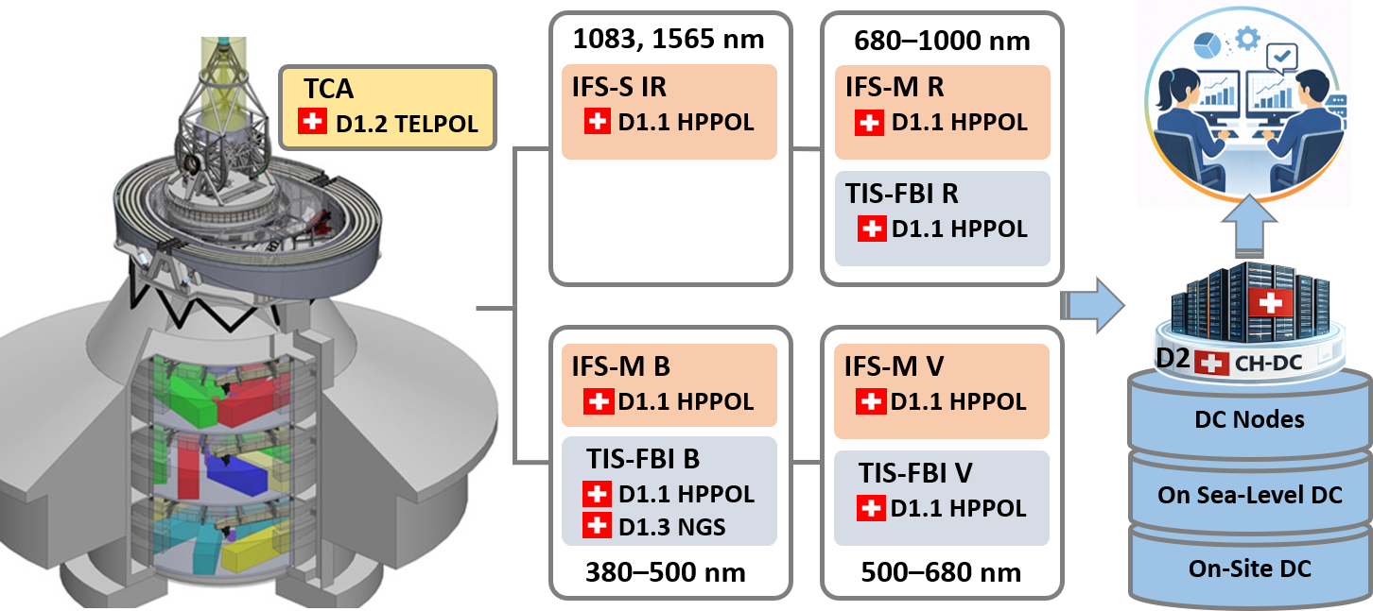
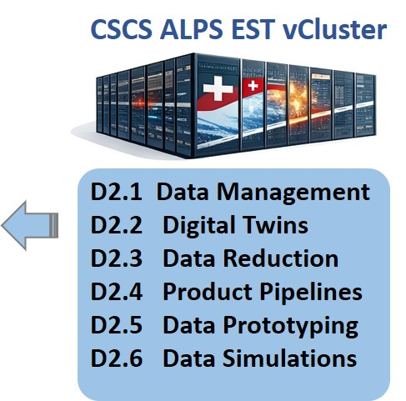
Swiss Contribution to the EST
D1 - Instrumentation:
TELPOL calibration unit, HPPOL modulators, New Generation Sensor (NGS)
D2 - Swiss Node DC at CSCS: Data management, storage, processing, prototyping,etc.
Telescope Instruments DC

Slide 15
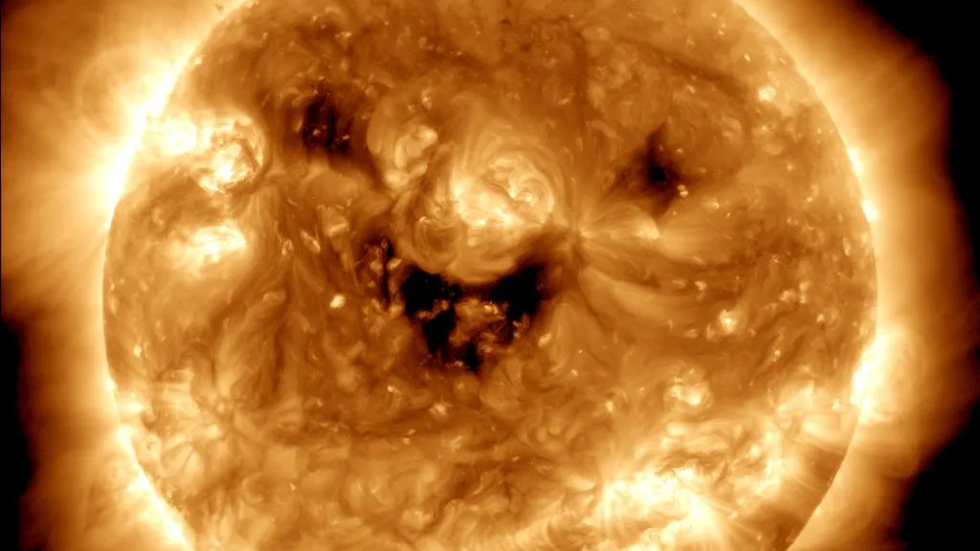
Thank You!

