Slide 1
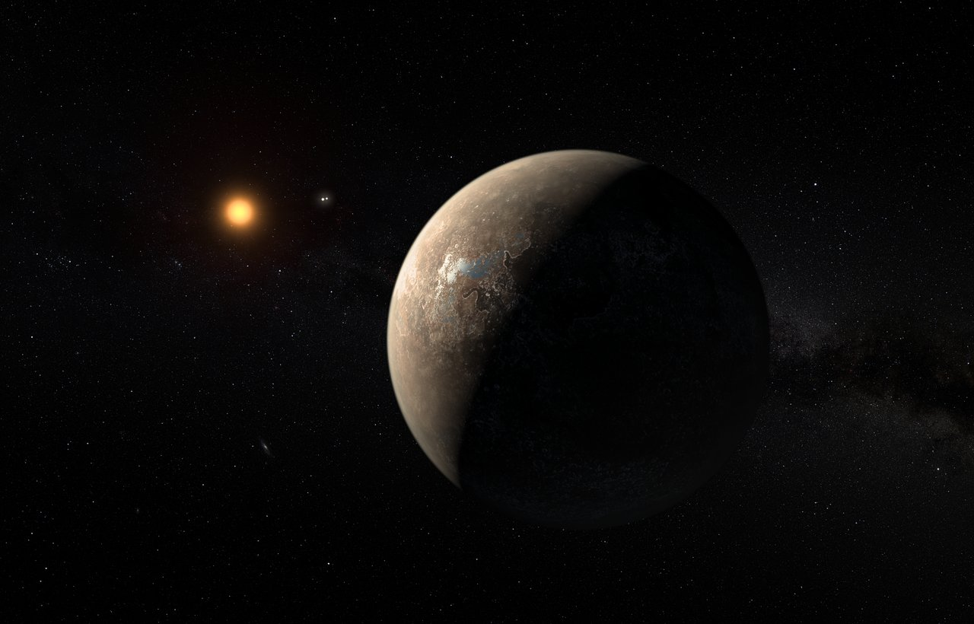

Characterizing Earth siblings
RISTRETTO/VLT: a demonstrator for PCS/ELT
N. Blind
C. Lovis (PI), B.Chazelas, M. Shinde, I. Dinis, L. Genolet, I. Hughes, M. Sordet, R. Schnell, S. Rihs, A. Crausaz, L. Hoerner, N. Restori, B. Wehbe, J.-R. Delorme, J. Kühn

Slide 2
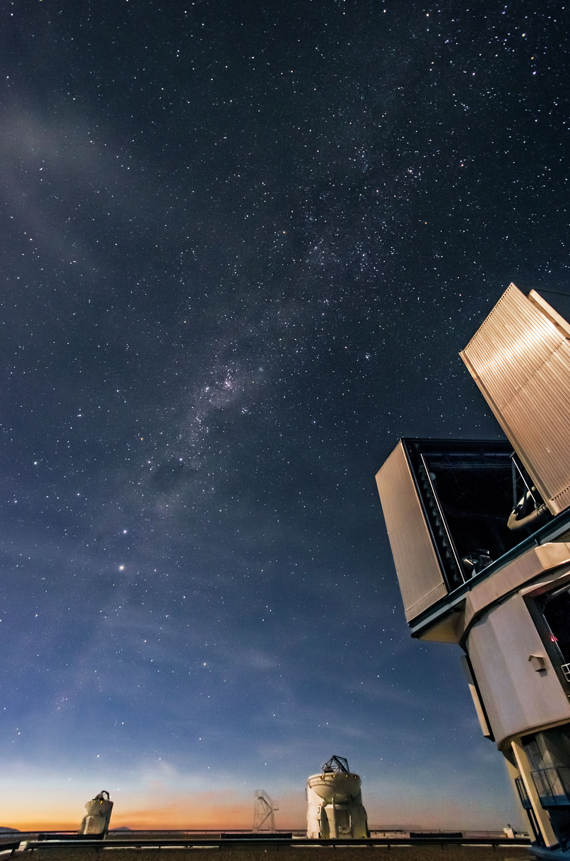
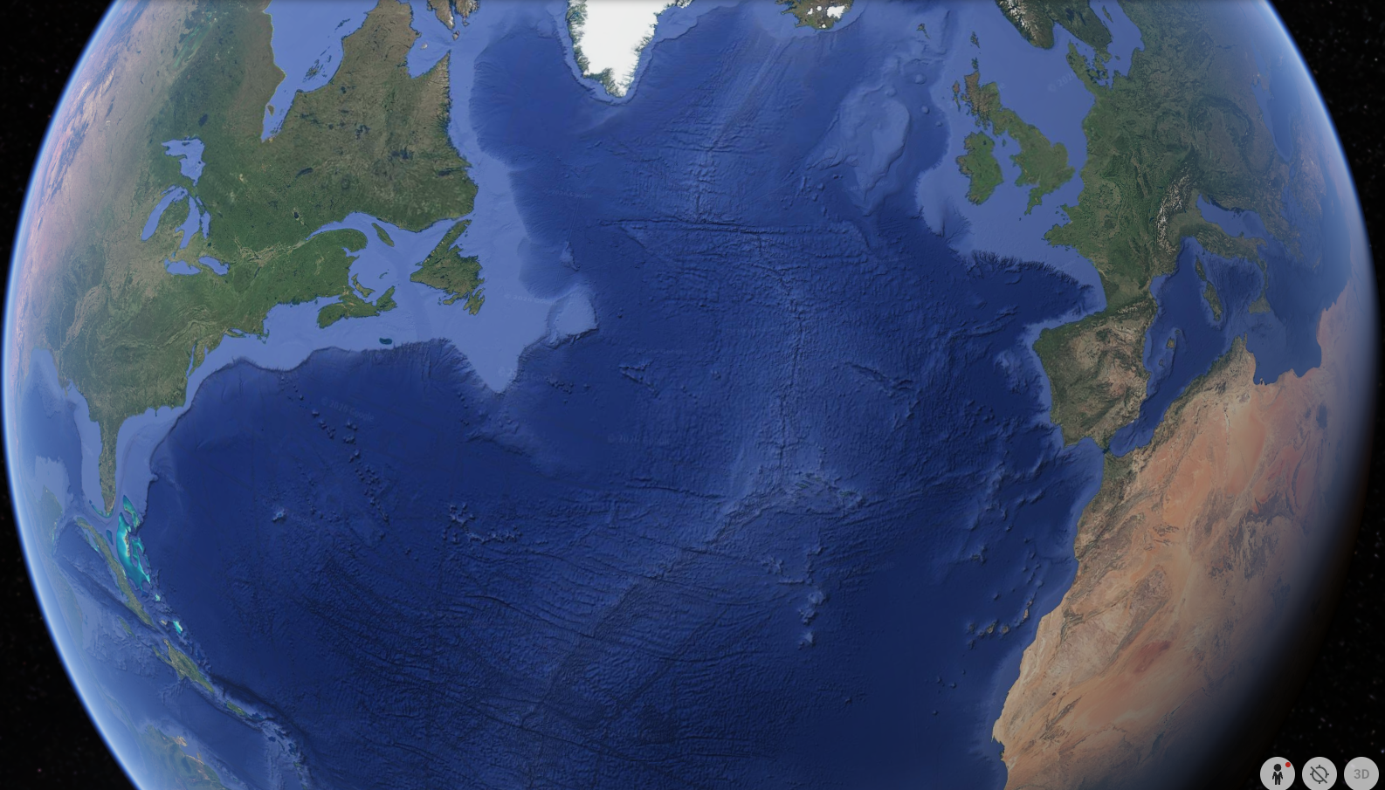
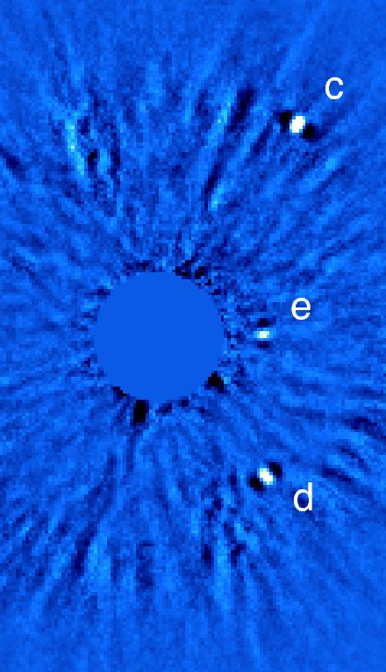
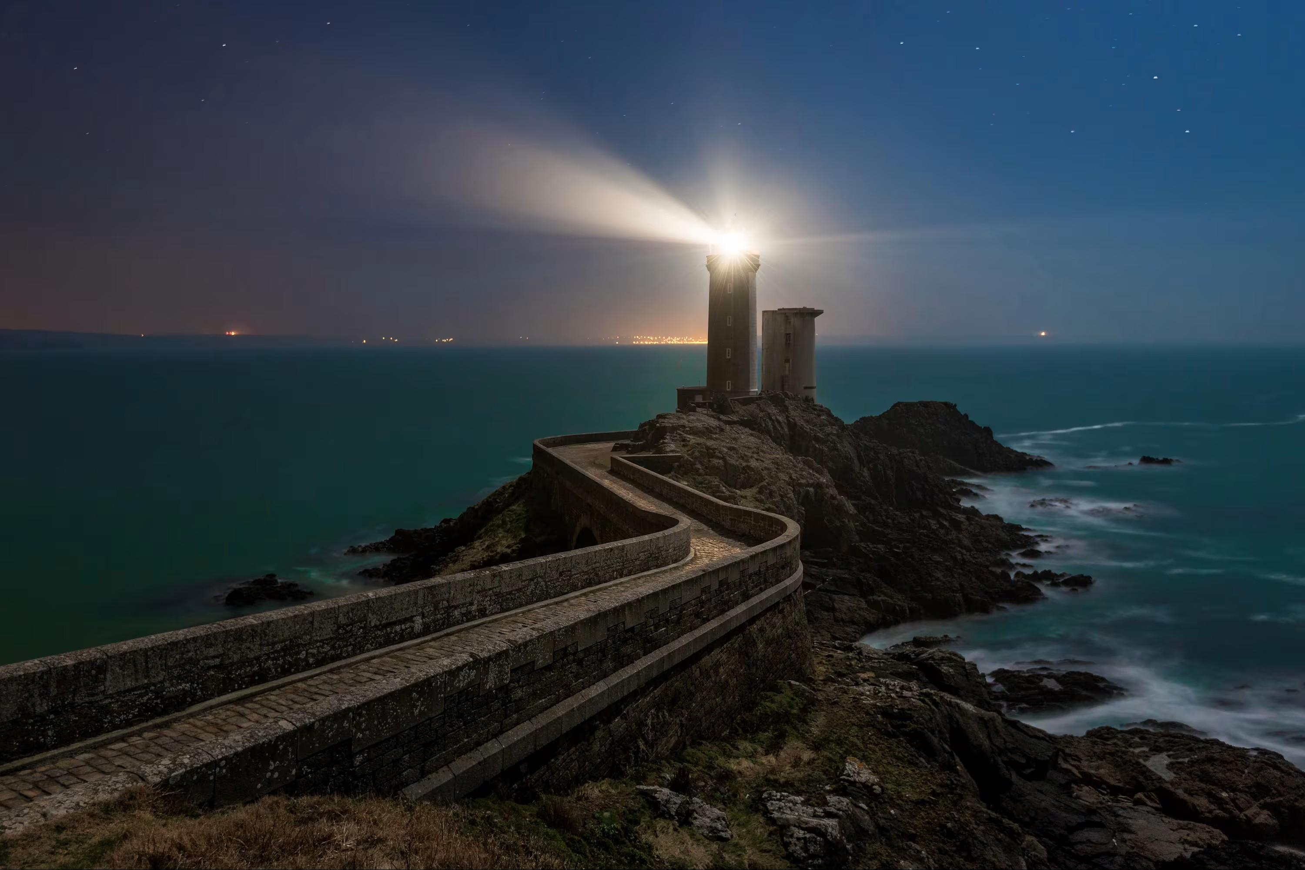
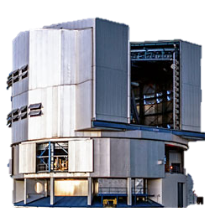
Techniques
Systems
R&D
Science
What we try to do...
We look at…
The lighthouse?
No! The bug flying around!
→ Contrast > 10⁸
Is it a firefly? Or a butterfly?
© Erwan Le Roux
Notes:
THE firefly because we know it is here from its gravitational pull on the lighthouse!

Slide 3

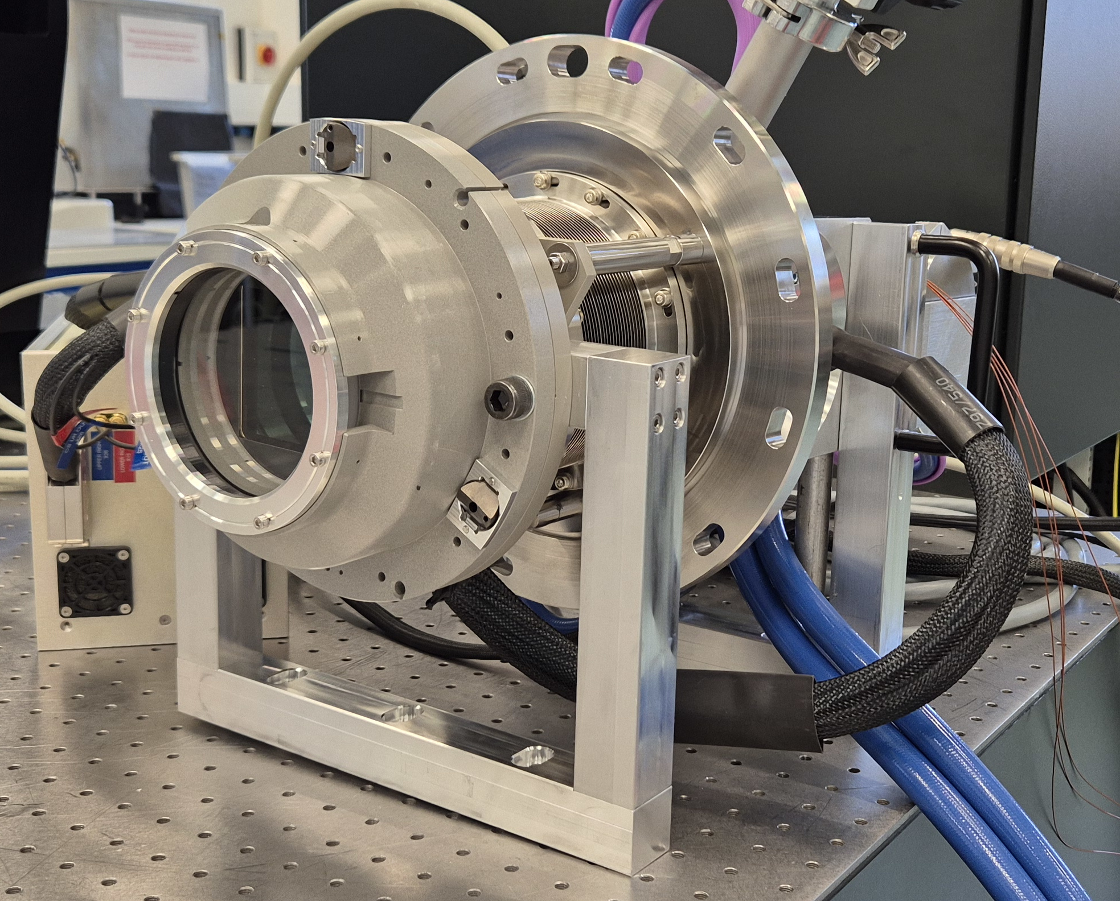
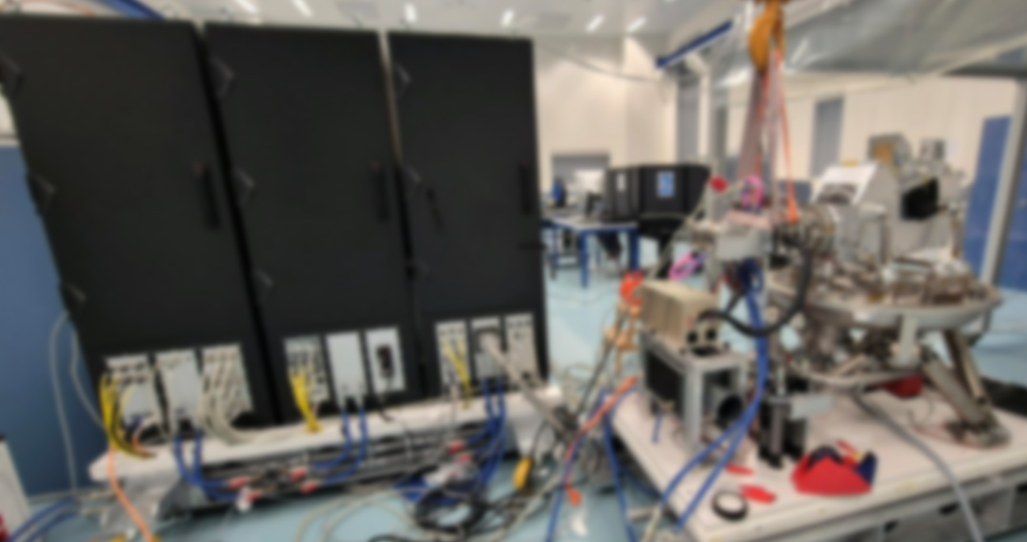
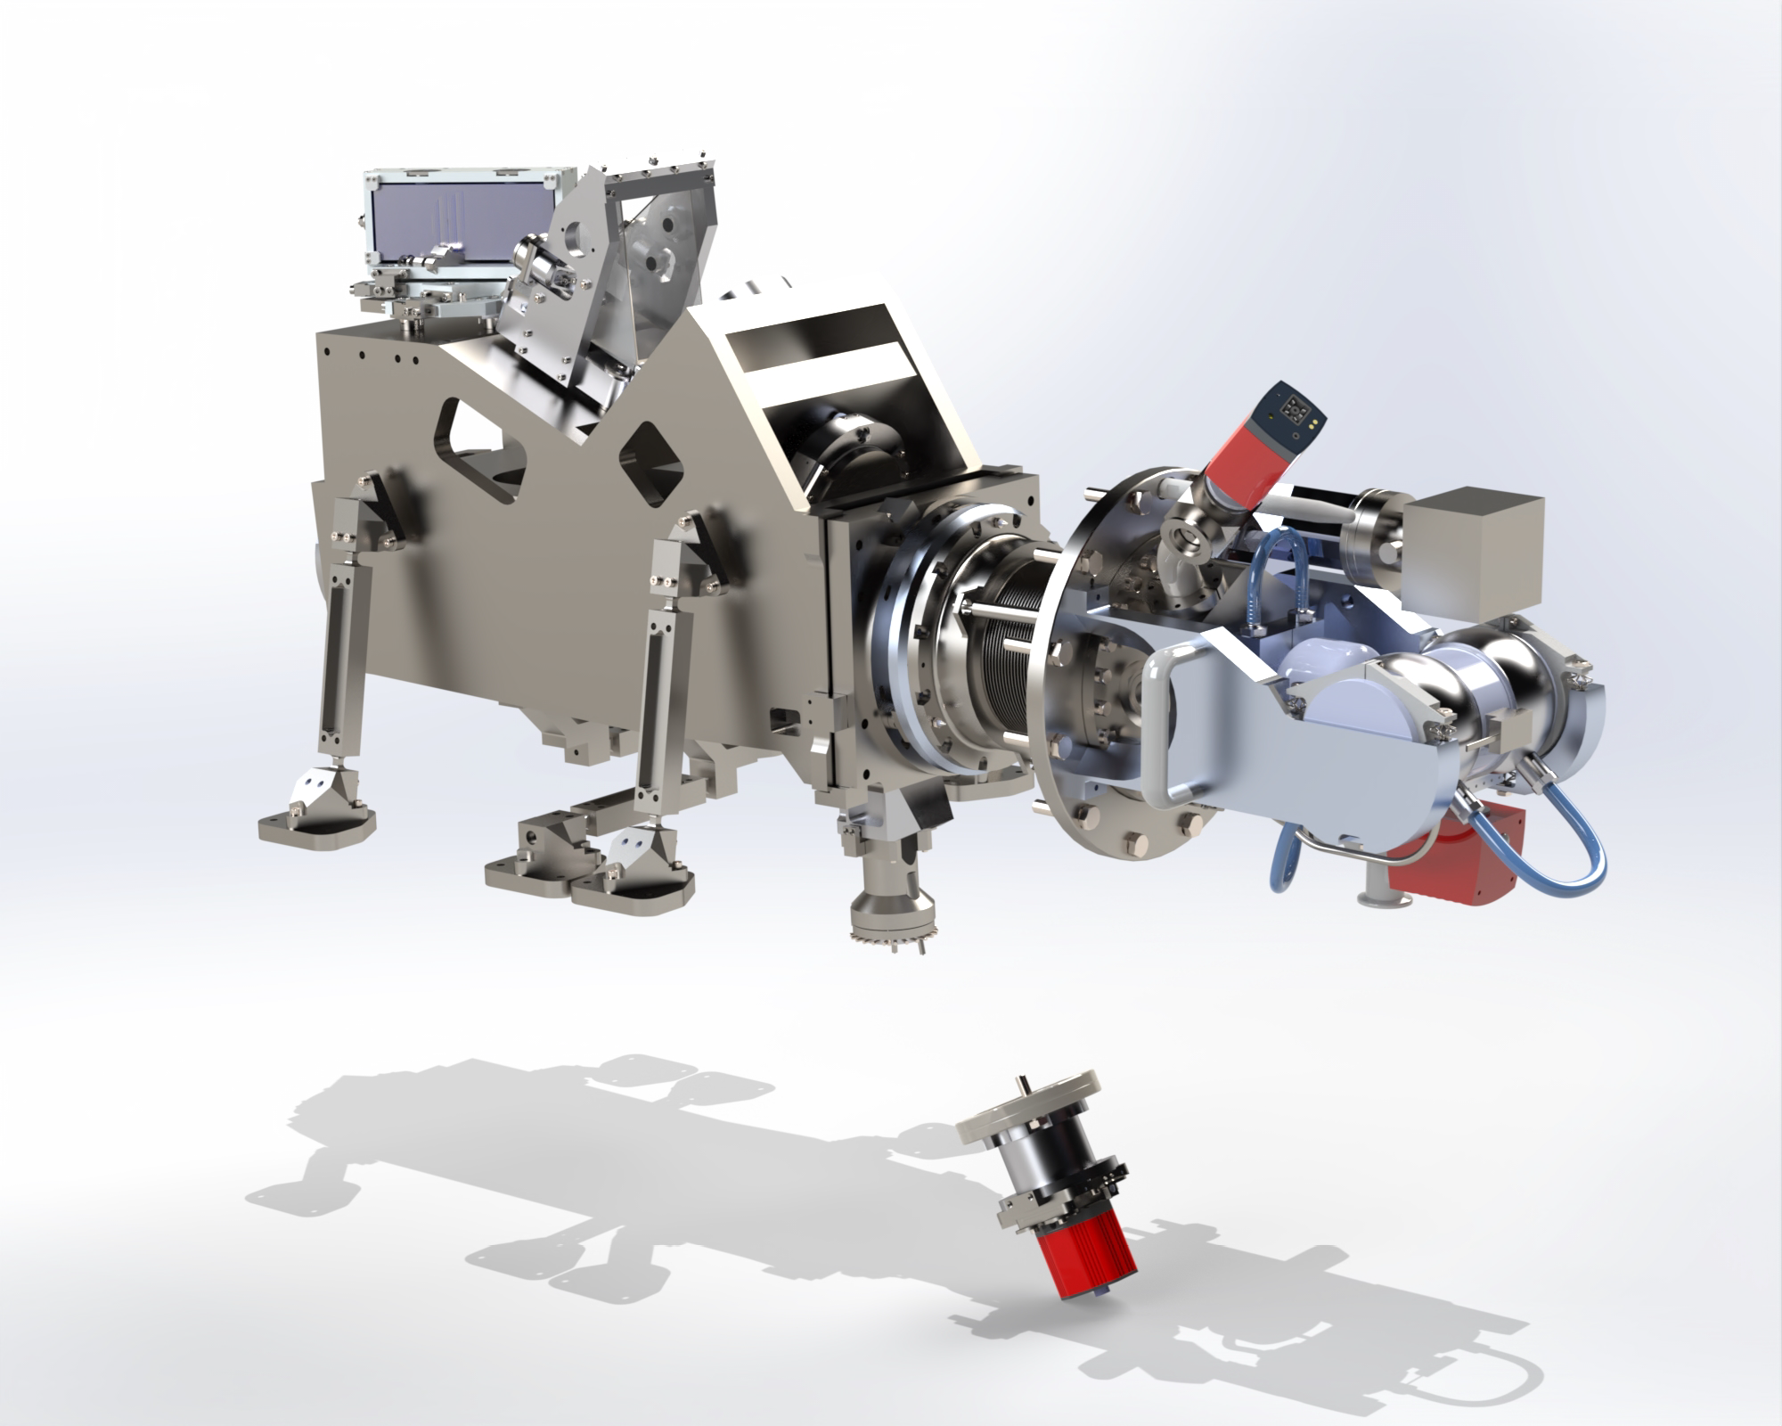
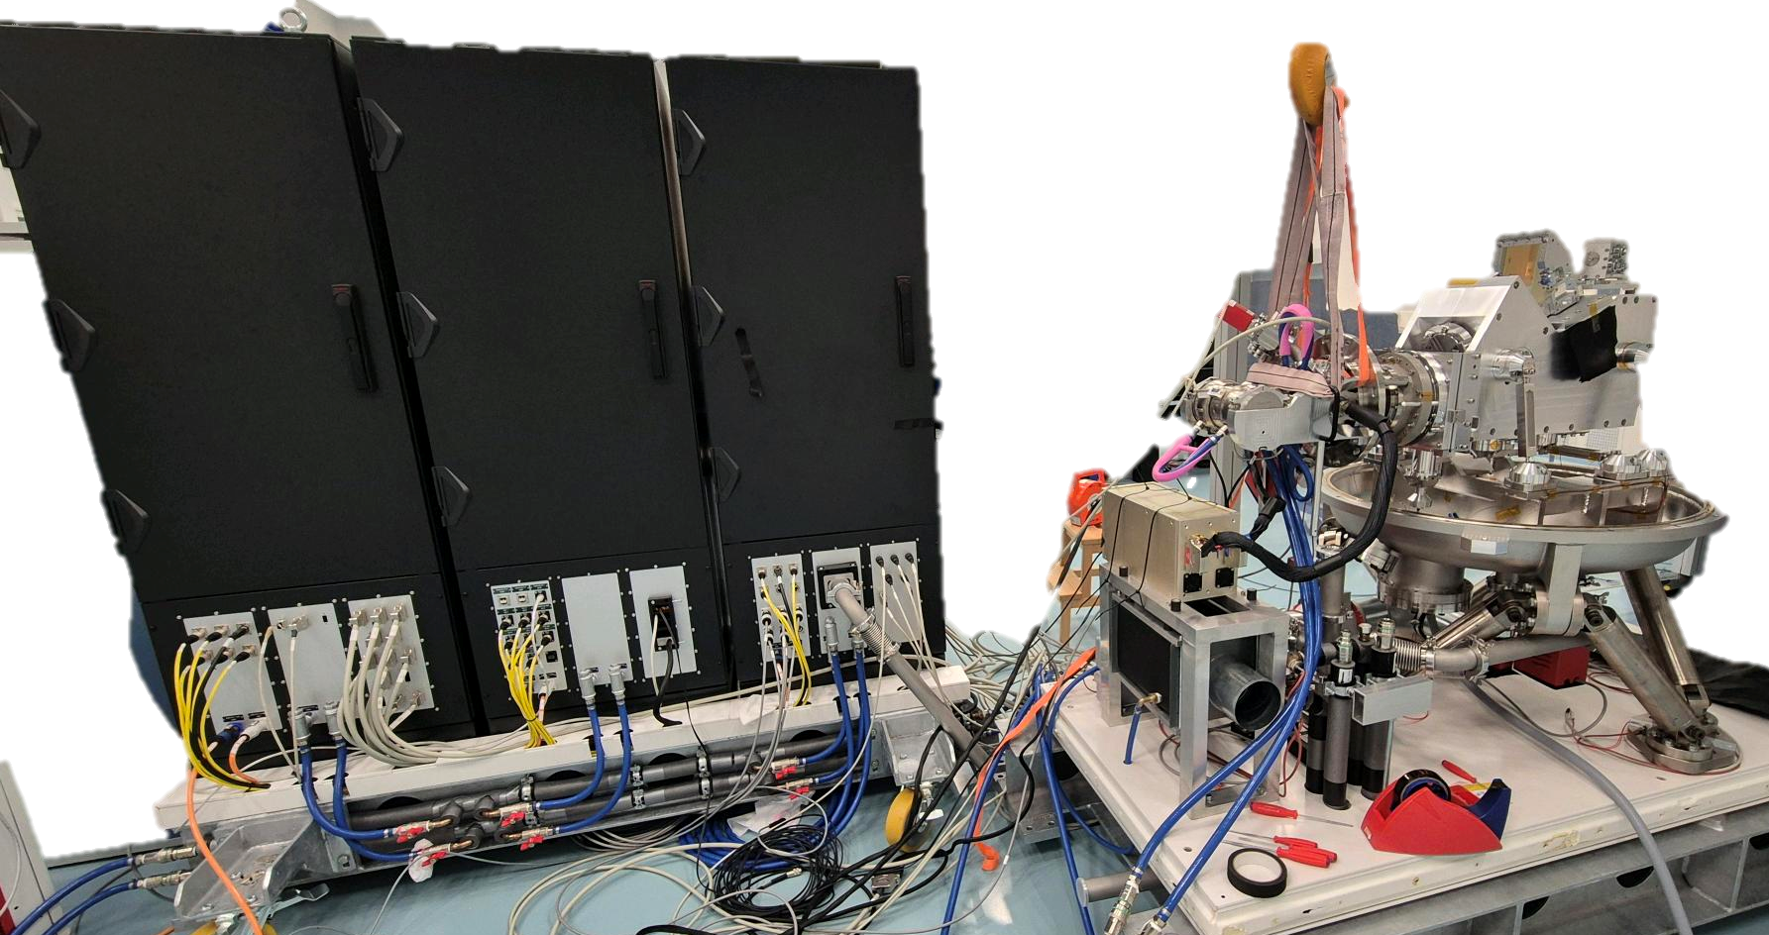
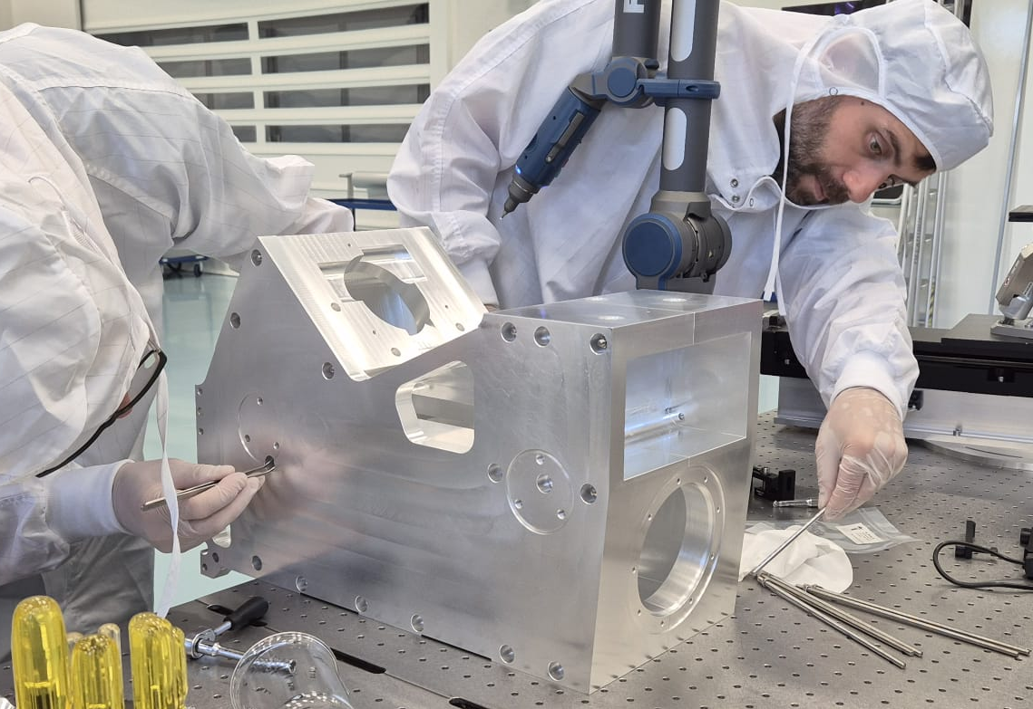
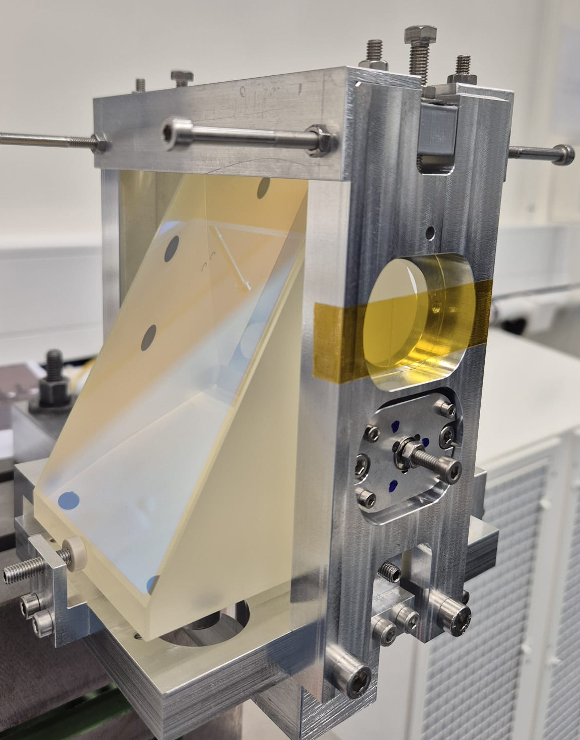
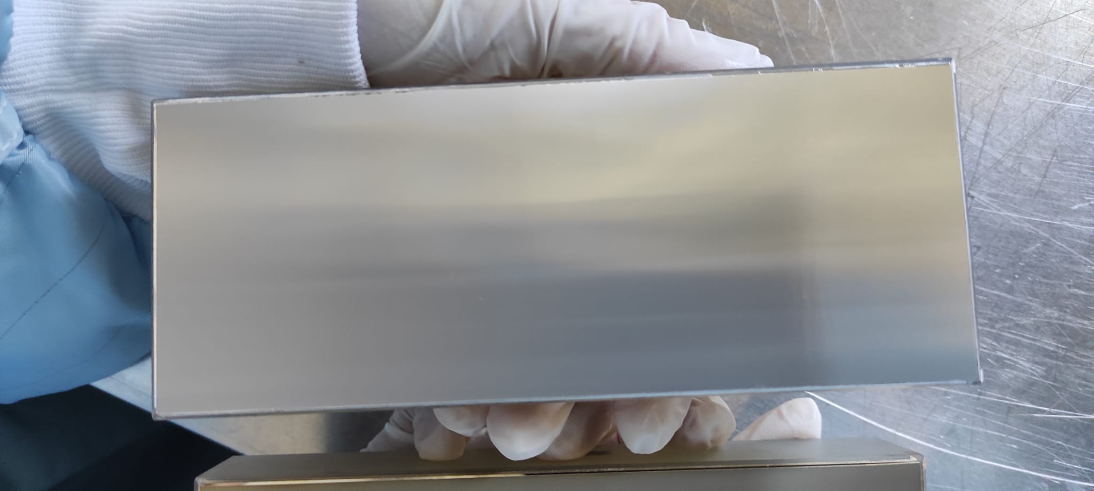
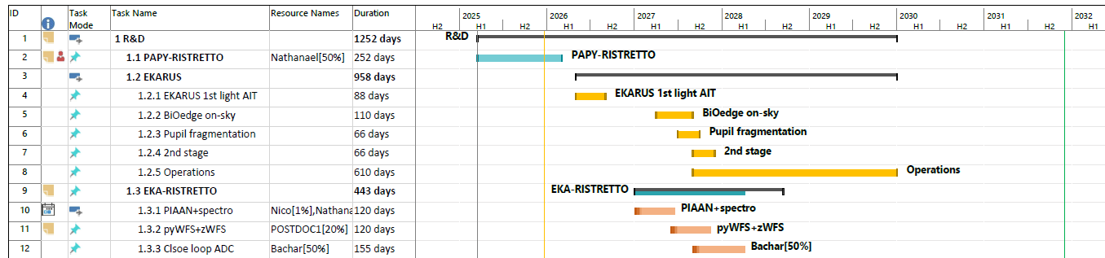
: a demonstrator for PCS/ELT
This is challenging, but the technology is there for 8m class.
So, we build it.
Spectrograph nearly finished
See Bruno Chazelas poster
Front-End: system architecture review in Feb. 2026
Science ~ Q4 2031
SAR
PDR
FDR
PAE
Science

Slide 4
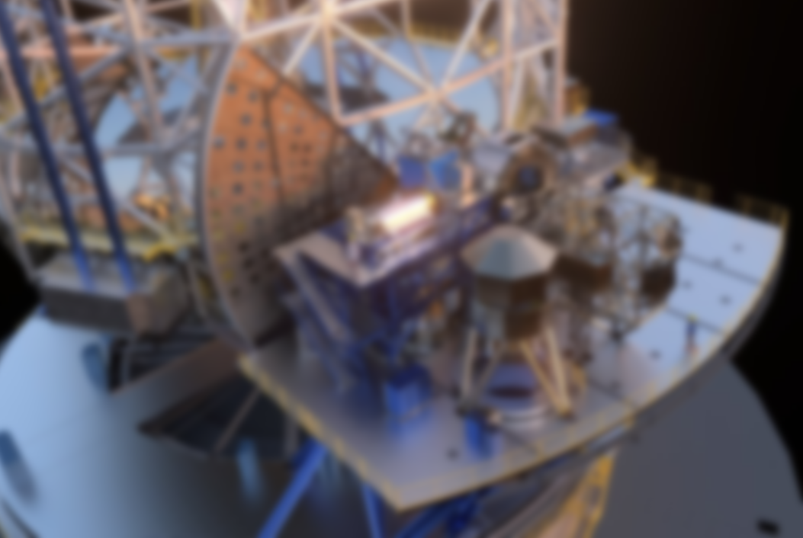

: a demonstrator for PCS/ELT
Scalability
D^{x}
Permanent improvement of Technology Readiness Level
PCS/ELT
Research
TRL1
Basic principle
TRL2
Technological concept
TRL3
Proof of concept
TRL
Development
TRL4
Lab validation
TRL5
Validation in relevant environment
TRL6
Demonstration in relevant environment
Deployment
TRL7
Prorototype demo in operationnal environment
TRL8
System complete and qualified
TRL9
System proven in opetration
NDLR - This is not PCS. PCS does not even have a logo.

Slide 5
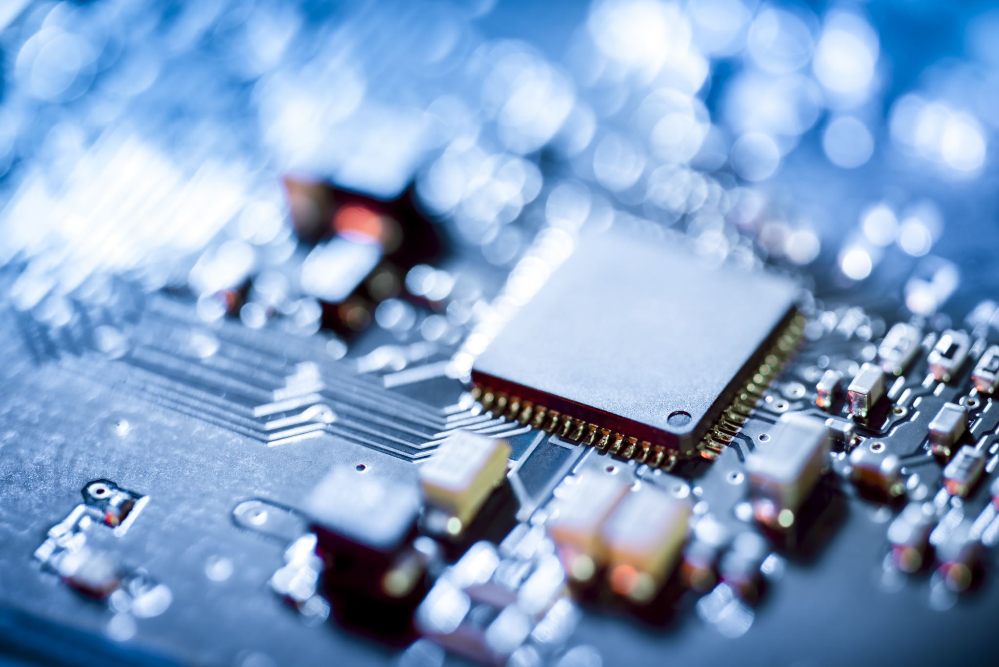
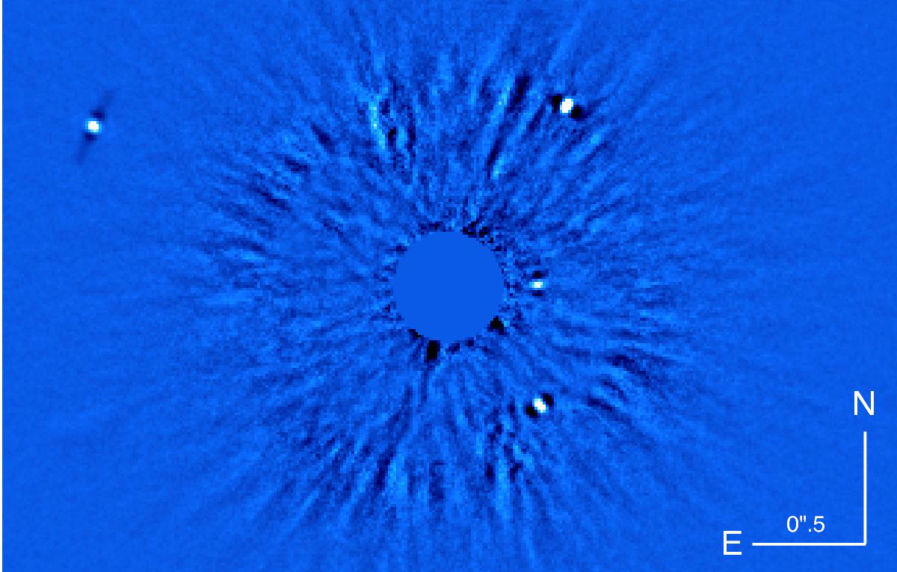
Techniques
« Research »
Technologies
« Industry »
Science
Systems
« Development »
: a demonstrator for PCS/ELT
Emerging science
Rebound effect
Scalability
D^{x}
Permanent improvement of Technology Readiness Level
PCS/ELT
Research
TRL1
Basic principle
TRL2
Technological concept
TRL3
Proof of concept
TRL
Development
TRL4
Lab validation
TRL5
Validation in relevant environment
TRL6
Demonstration in relevant environment
Deployment
TRL7
Prorototype demo in operationnal environment
TRL8
System complete and qualified
TRL9
System proven in opetration
NDLR - This is not PCS. PCS does not even have a logo.

Slide 6
Science
Techniques
« Research »
Systems
« Development »
Technologies
« Industry »

Slide 7
Science
Techniques
Systems
Technologies
Spectroscopy
High Angular Resolution
High Contrast

Slide 8
Techniques
Systems
Technologies
Large telescope
High Angular Resolution
eXtreme Adaptive Optics
Spectroscopy
High Contrast

Slide 9
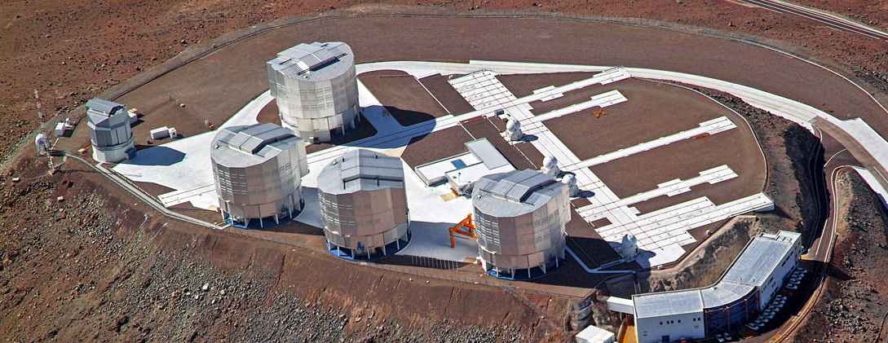
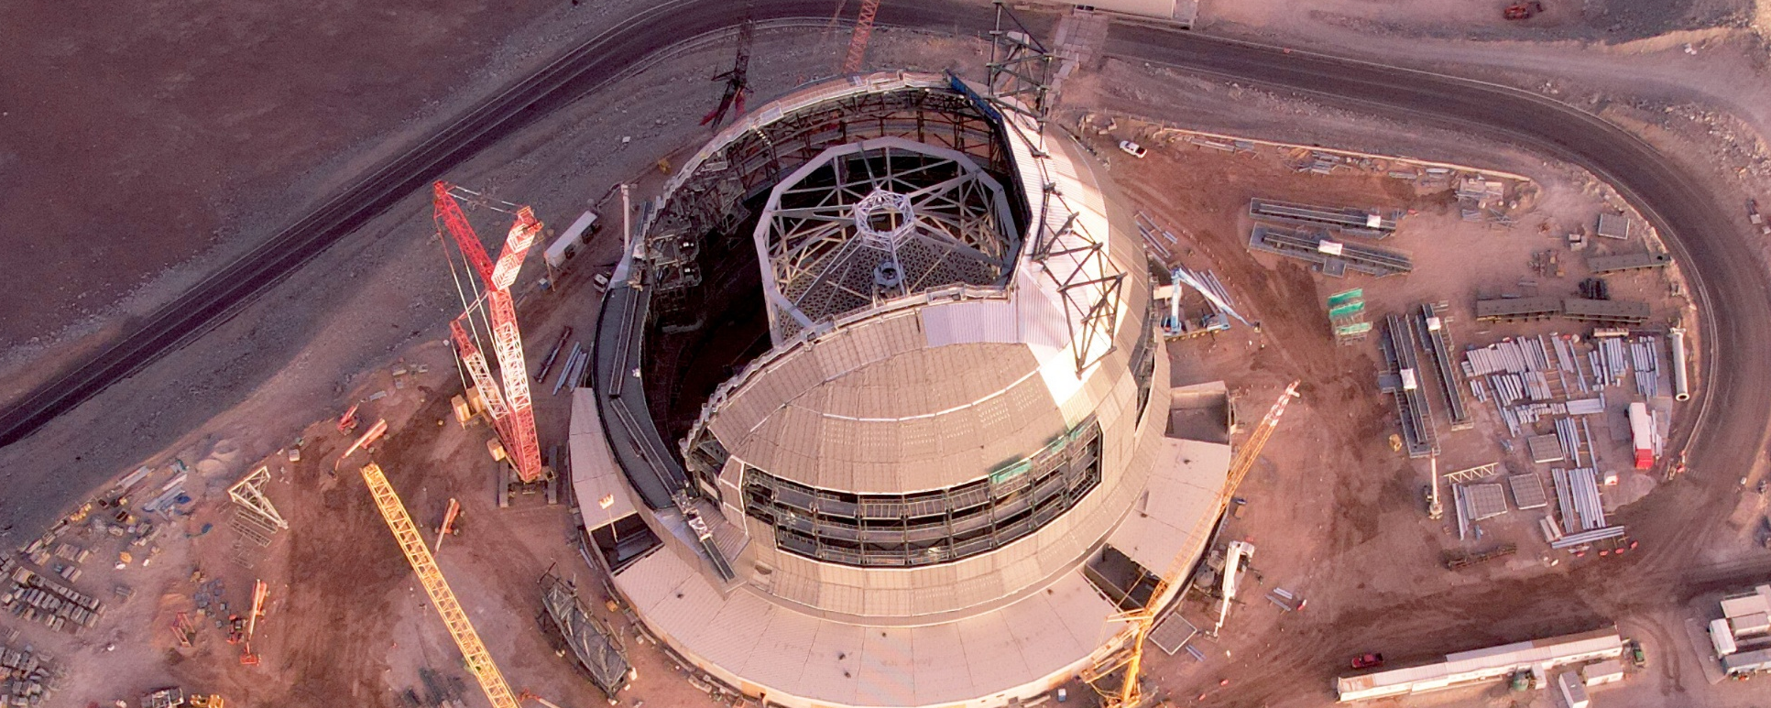
Techniques
VLT (8m)
High Angular Resolution
Large telescope
ELT (39m)
Systems
« Development »
Technologies
« Industry »
Spectroscopy
High Contrast
eXtreme Adaptive Optics
Notes:
Big leap forward
Bigger difference than Hubble vs VLT

Slide 10
Techniques
VLT (8m)
High Angular Resolution
Large telescope
ELT (39m)
Spectroscopy
Systems
« Development »
Technologies
« Industry »
High Contrast
eXtreme Adaptive Optics
Notes:
Big leap forward
Bigger difference than Hubble vs VLT

Slide 11
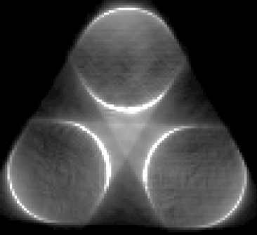
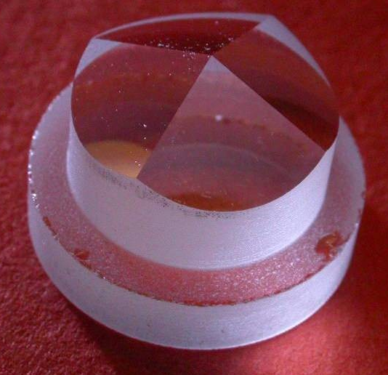
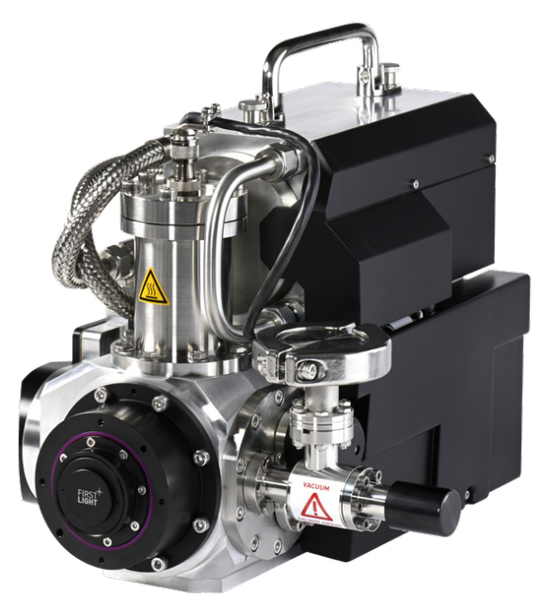
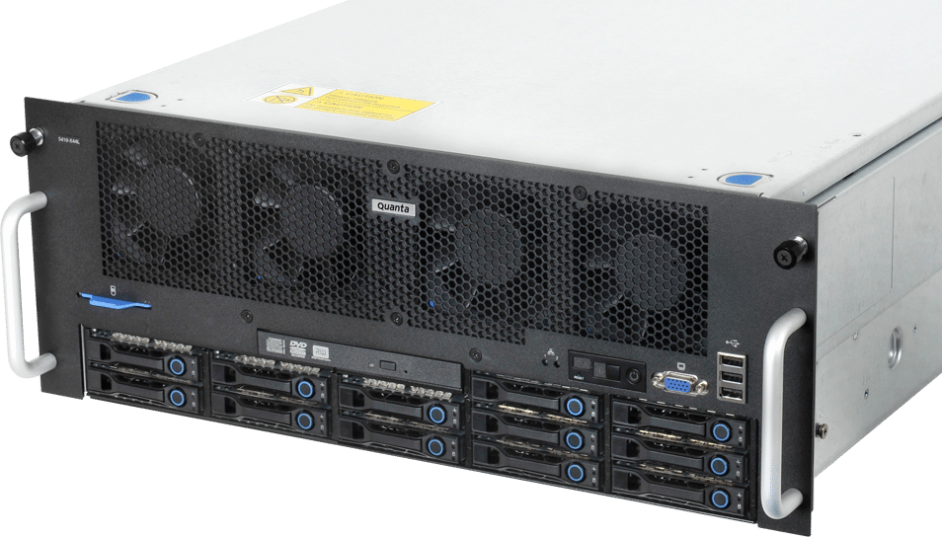

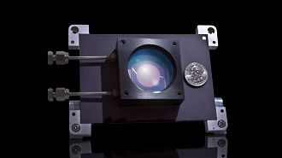
Large telescope
Techniques
Systems
Technologies
Wave Front Sensor
D¹⁻²
5
Photon-counting, fast detectors
D²
7
High Angular Resolution
eXtreme Adaptive Optics
Real Time Calculator
Deformable mirror
D⁴
3
7
D²
Optimal
controller
5
D²
Integral Field Unit
Spectroscopy
Coronagraph
High Contrast

Slide 12
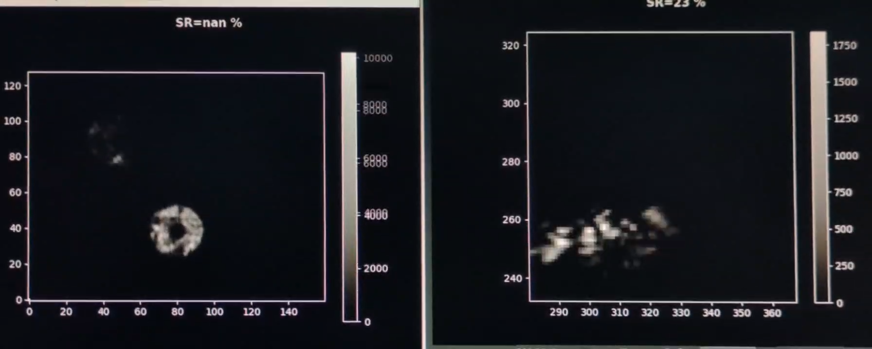
Large telescope
Techniques
Systems
Technologies
Concepts demo at PAPYRUS/OHP during summer 2025
Wave Front Sensor
D¹
Photon-counting, fast detectors
D²
High Angular Resolution
eXtreme Adaptive Optics
Deformable mirror
Real Time Calculator
D²
D⁴
Optimal controller
New Wave Front Sensor on-sky demo
Muskan Shinde talk today@13:45
New optimal controller on-sky demo
Isaac Dinis talk today@14:10
5
5
D²
Integral Field Unit
Coronagraph
Spectroscopy
High Contrast

Slide 13
Large telescope
Techniques
Systems
Technologies
eXtreme Adaptive Optics
High Contrast
Coronagraph
Integral Field Unit
High Angular Resolution
Spectroscopy
eXtreme Adaptive Optics

Slide 14
Large telescope
Techniques
Systems
Technologies
eXtreme Adaptive Optics
D⁰⁻¹
High Contrast
Coronagraph
Integral Field Unit
High Angular Resolution
Spectroscopy
eXtreme Adaptive Optics

Slide 15
Large telescope
Techniques
Systems
Technologies
Micro Lens Array & slicer
eXtreme Adaptive Optics
High Contrast
Coronagraph
Single-mode fiber bundles
Integral Field Unit
Mode selective photonic lantern
High Angular Resolution
Spectroscopy
eXtreme Adaptive Optics

Slide 16
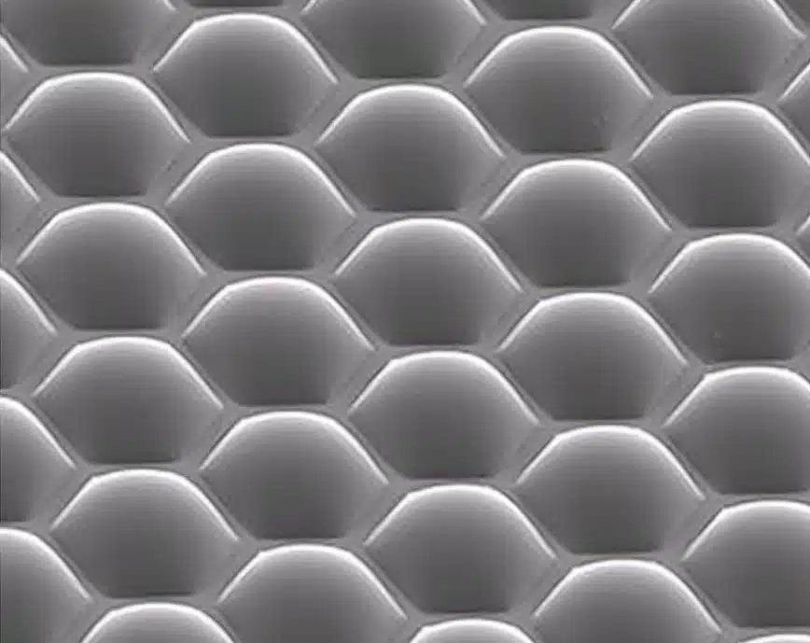
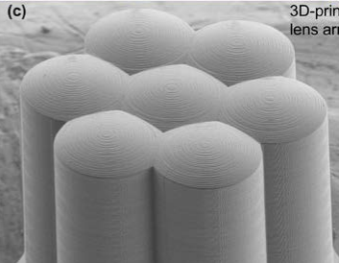
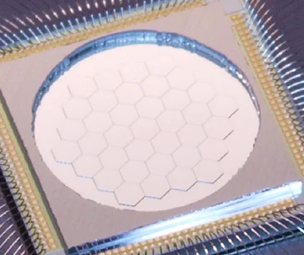
Large telescope
Techniques
Systems
Technologies
Micro Lens Array & slicer
eXtreme Adaptive Optics
D⁰
Photolitography, etching
2PP 3D printing
Segmented DM
4
5
3
High Contrast
Coronagraph
D⁰
Single-mode fiber bundles
Integral Field Unit
Mode selective photonic lantern
High Angular Resolution
Spectroscopy
eXtreme Adaptive Optics

Slide 17
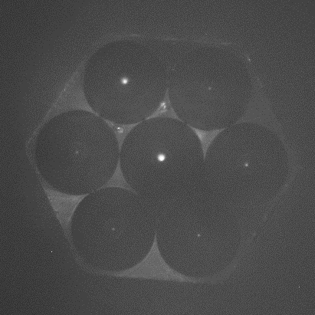
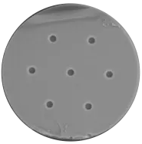
Large telescope
Techniques
Systems
Technologies
Micro Lens Array & slicer
eXtreme Adaptive Optics
D⁰
Single-mode fiber bundles
D⁰
High Contrast
Coronagraph
Fiber bundle & V-groove
Multicore fiber
7
6
D⁰
Integral Field Unit
Mode selective photonic lantern
High Angular Resolution
Spectroscopy
eXtreme Adaptive Optics

Slide 18
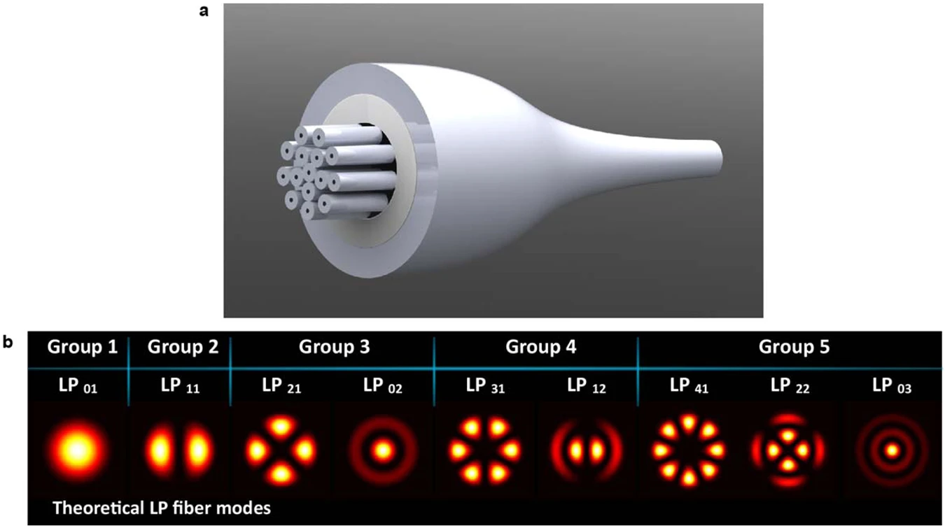
Large telescope
Techniques
Systems
Technologies
Micro Lens Array & slicer
eXtreme Adaptive Optics
D⁰
Single-mode fiber bundles
D⁰
High Contrast
Coronagraph
Mode-selective
photonic lantern
D⁰
Multimode to singlemode
multiplexing
3
D⁰
Integral Field Unit
High Angular Resolution
Spectroscopy
eXtreme Adaptive Optics

Slide 19
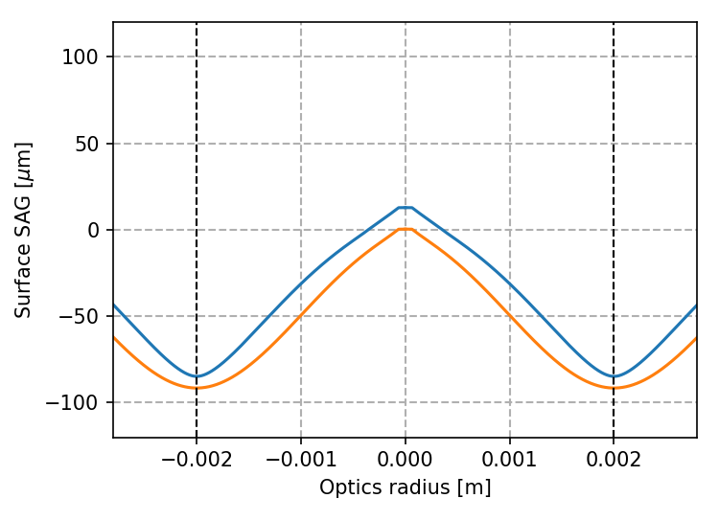
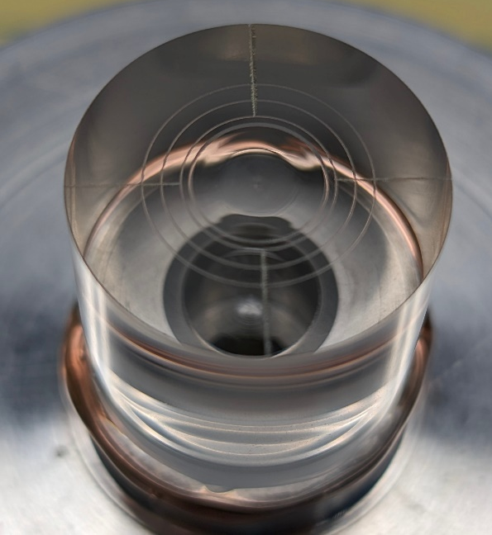
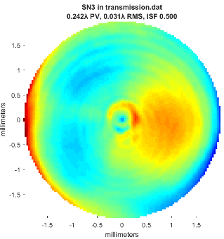
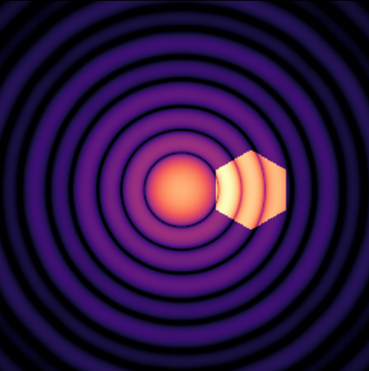
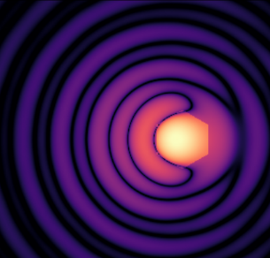
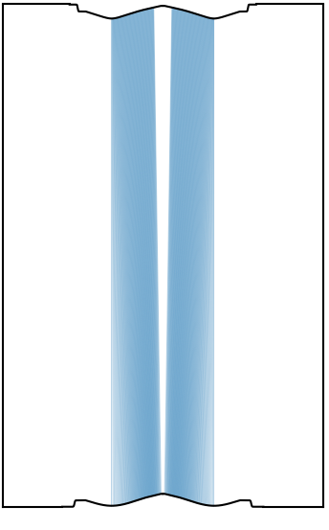
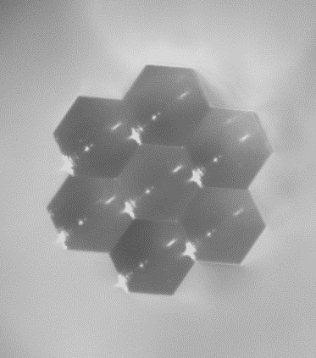
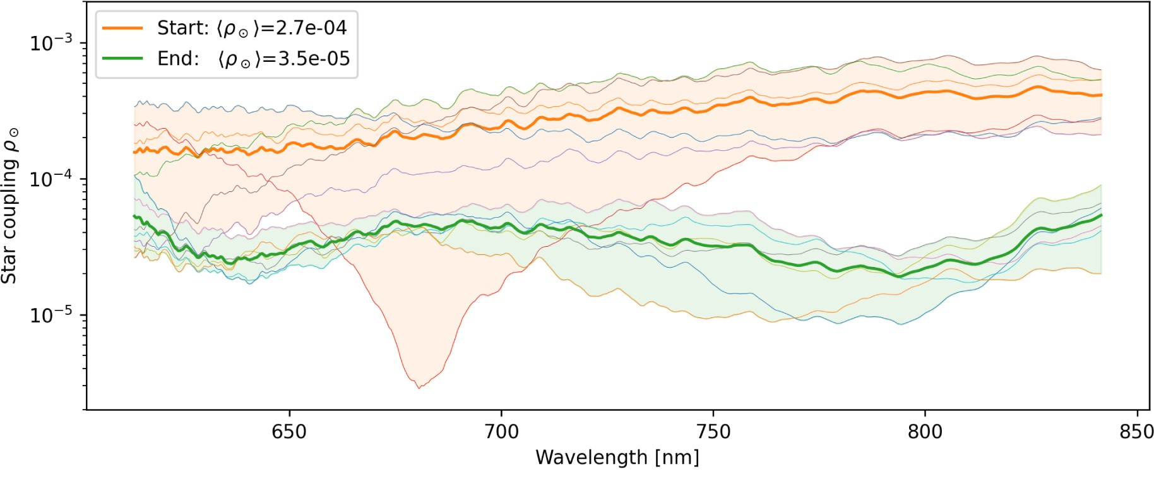
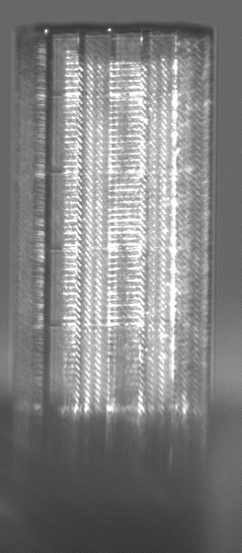
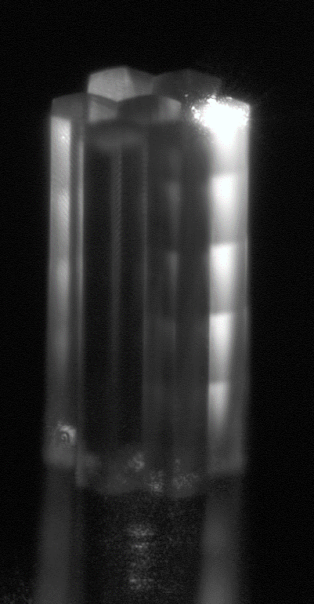
Large telescope
Techniques
« Research »
Technologies
« Industry »
Techniques
« Research »
Systems
« Development »
Phase Induced Amplitude Apodizer and Nuller
High transmission, high dispersion coronagraphy at 2λ/D
Blind et al., A&A, 704 (2025) A141
D⁰
6
PIAA: a double aspherical pupil reshapping lens
(similar to a reversed laser beam shaping lens)
Coronagraph
T = 70%
Star
Planet
High Contrast
High Contrast
IFU: making use of 2-photon polymerization 3D-printing with 100nm accuracy for single-mode fiber coupling
Singlemode fiber bundle
3D printed micro-lens array
Contrast ~ 3x10⁻⁵
125um
750um
High Angular Resolution
Spectroscopy
eXtreme Adaptive Optics

Slide 20
High Contrast
Large telescope
Techniques
Systems
Technologies
Spectrograph
Spectroscopy
Single-mode fiber

Slide 21
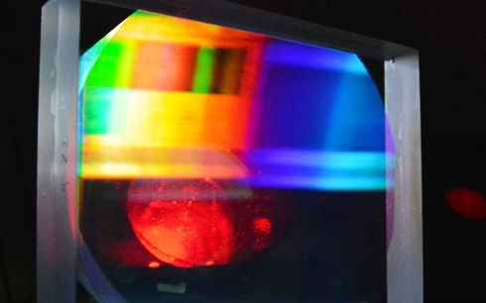
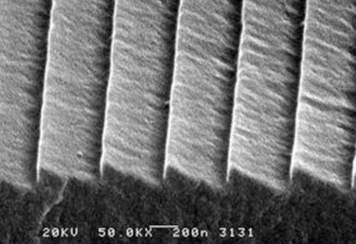
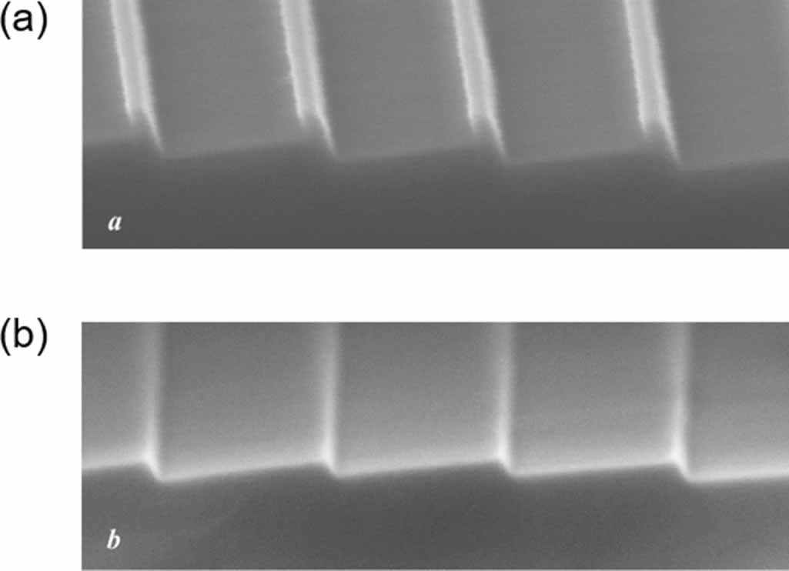
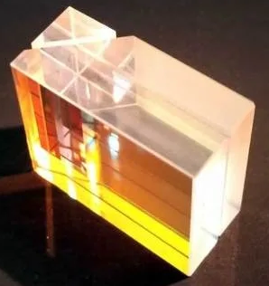
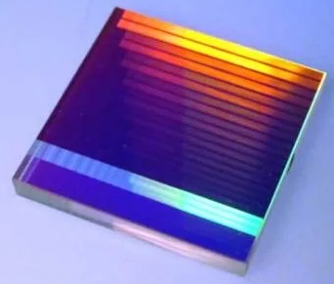
Techniques
Systems
Technologies
Diffraction element
D⁰
D⁰
Ruled grating
Volume Phase Holographic
7
7
Spectrograph
e.g. RISTRETTO
e.g. NIGHT
Spectroscopy
Wet etching grating
Virtually Imaged Phased Array
7
>5
5
e.g. NIRPS
Single-mode fiber
Detectors & cryogeny
D⁰
7
Vacuum
D⁰
7

Slide 22
Techniques
Systems
Technologies
Diffraction element
D⁰
D⁰
Ruled grating
Volume Phase Holographic
7
7
Spectrograph
e.g. RISTRETTO
e.g. NIGHT
Spectroscopy
Wet etching grating
Virtually Imaged Phased Array
7
>5
5
e.g. NIRPS
Single-mode fiber
Detectors & cryogeny
D⁰
7
Detector unit for astronomical applications at UNIGE --- Ludovic Genolet talk today@16:40

Slide 23
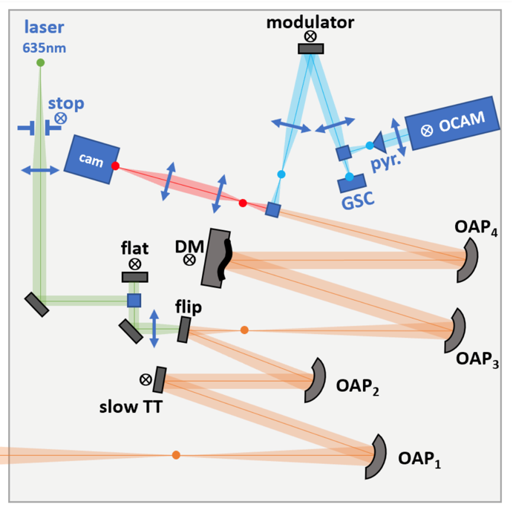
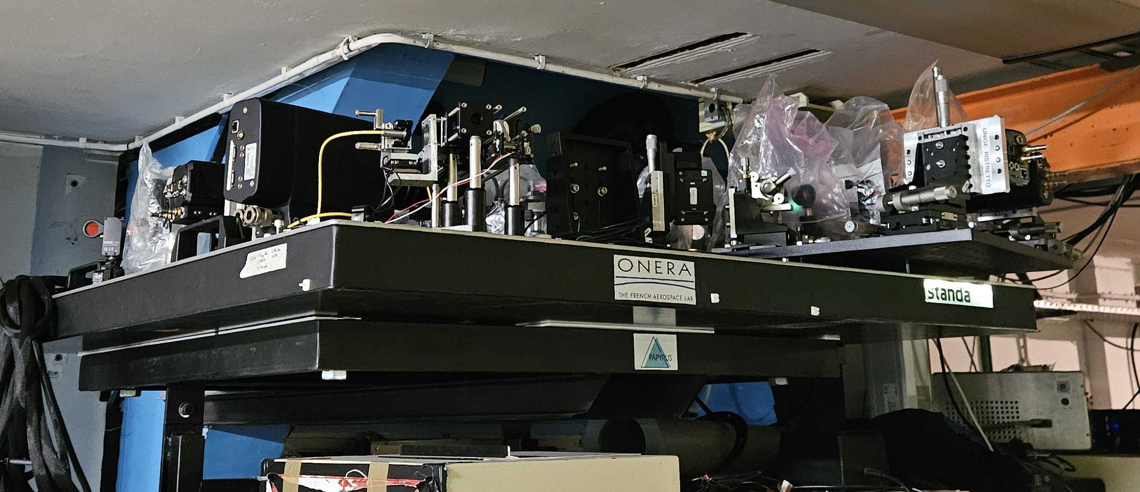




Need for a sky access and an XAO-assisted platform in Europe
A. Alagao, B. Neichel, V. Chambouleyron, J.-F. Sauvage, R. Fétick, T. Heritier, T. Fusco
PAPYRUS@OHP - 2020-03/2026
7
EKARUS@ASIAGO – 2027-…
5
Integration of RISTRETTO R&D in EKARUS
Research
TRL1
Basic principle
TRL2
Technological concept
TRL3
Proof of concept
Development
TRL4
Lab validation
TRL5
Validation in relevant environment
TRL6
Demonstration in relevant environment
Deployment
TRL7
Prorototype demo in operationnal environment
TRL8
System complete and qualified
TRL9
System proven in opetration
ADC
PDR
FDR
PAE
Science

Slide 26
Manufacture
Micro Lens Array
D⁰
D⁰
Singlemode Fibers
D⁰
Integral field Unit
D⁰
Systems & hardware
Detectors
Liquid Crystals
Aspheres
Spectrograph
D⁰
Lithography,
Etching
Coronagraph
D⁰
Metasurfaces
Techniques
Spectroscopy
Science
Atopsheric Dispersion Corrector
High contrast
Characterizing Earth siblings
D¹
High angular resolution
D²
eXtreme Adaptive Optics
Large telescope
Wavefront sensor
D²
Fast EMCCD
D⁴
Real Time Calculator
D²
Deformable Mirrors

Slide 27
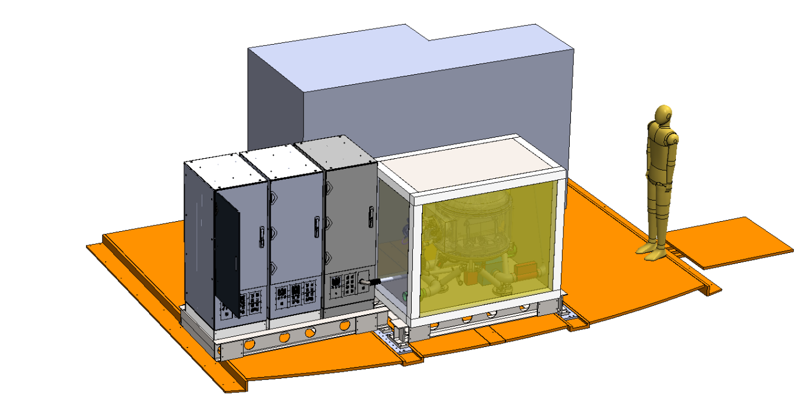
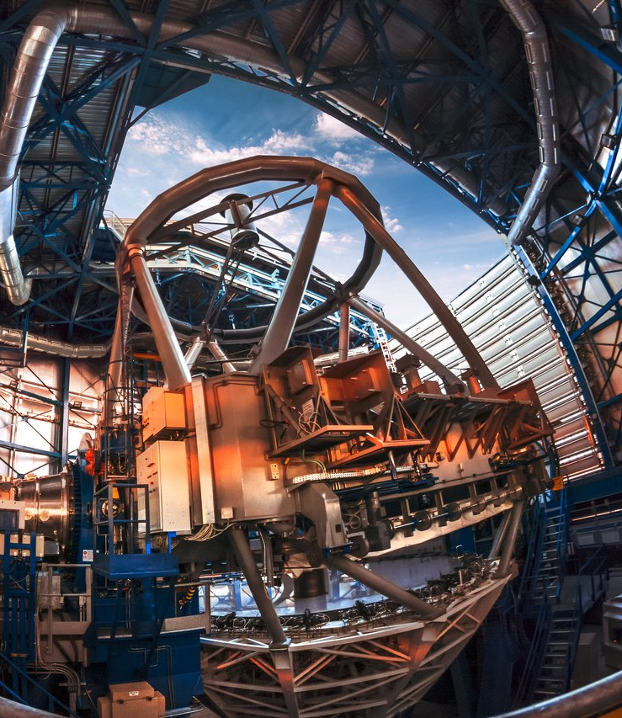


Requirements driven by Prox Cen b case
    Mounted on an 8m telescope
    Stand-alone XAO
    Spectrograph: R ~ 135.000, λ=620-840nm
    IFU: 7-spaxels, coupled to Single Mode Fibers
Planet coupling > 50% at 37mas
Contrast coupling < 10⁻⁴
Total transmission > 5%
3s-pyramid prototype
2 λ/D = 37mas
8-10m telescope
XAO with NIR (850-1800nm) WFSs
7-spaxel coronagraphic IFU
620-840nm VIS high-resolution spectrograph

