Slide 1
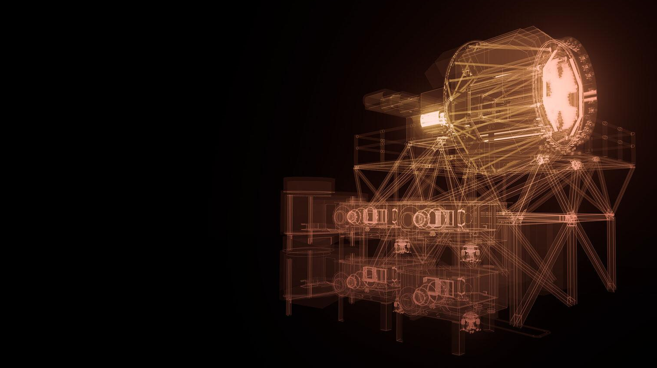
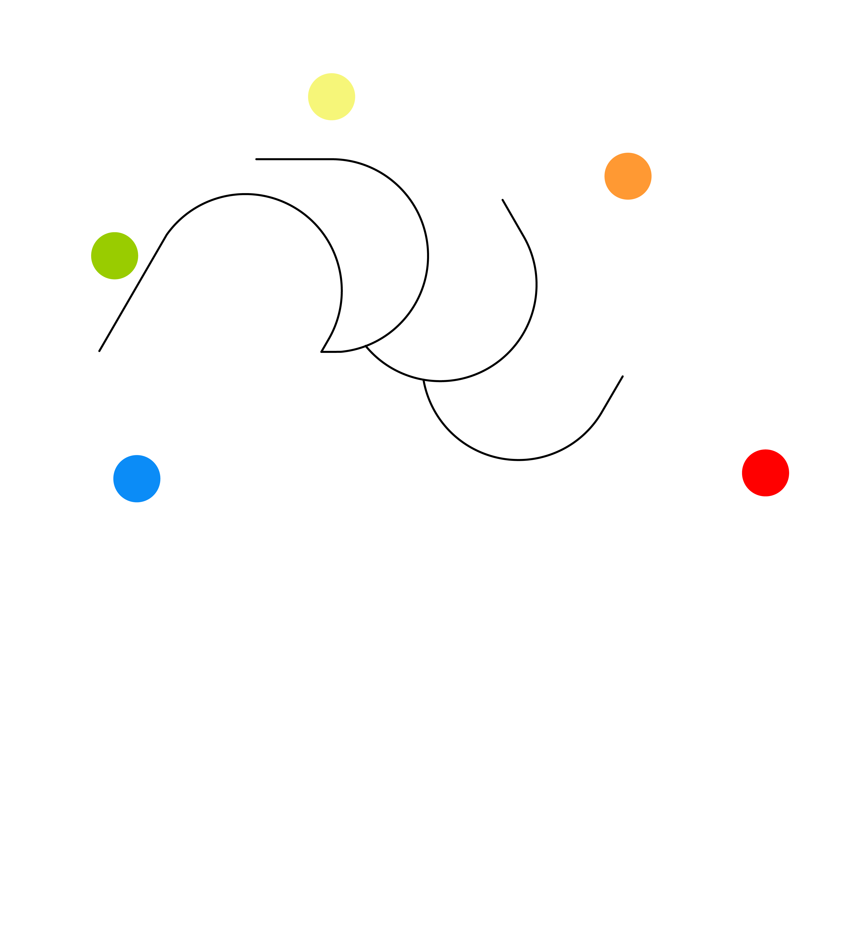


MOSAIC at ELT: robotic mirror positioner
Maxime Rombach
EPFL – LASTRO – Astrobots
Mechanical engineer
maxime.rombach@epfl.ch
SIAPS 2026
Template presentation from Alondra Sola

Slide 2
MOSAIC – a brief introduction
What is MOSAIC?
POS modes
POS design
POS prototypes & key specs
Timeline

Slide 3
MOSAIC – a brief introduction
What is MOSAIC?
POS modes
POS design
POS prototypes & key specs
Timeline

Slide 4
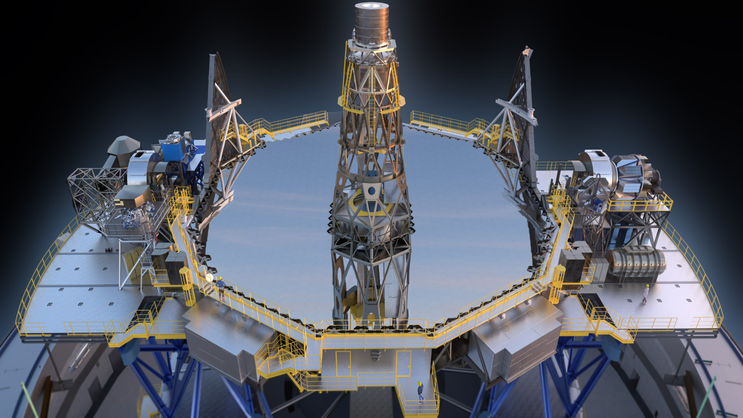
MOSAIC: the multi-object spectrograph
MOSAIC specs:
Mass:
- 40 tons
Height:
- 8m
Footprint:
- 8m x 11m
HARMONI
MOSAIC
MICADO
METIS
ANDES
Artist’s impression of the ELT instruments (2021) Credit: ESO

Slide 5
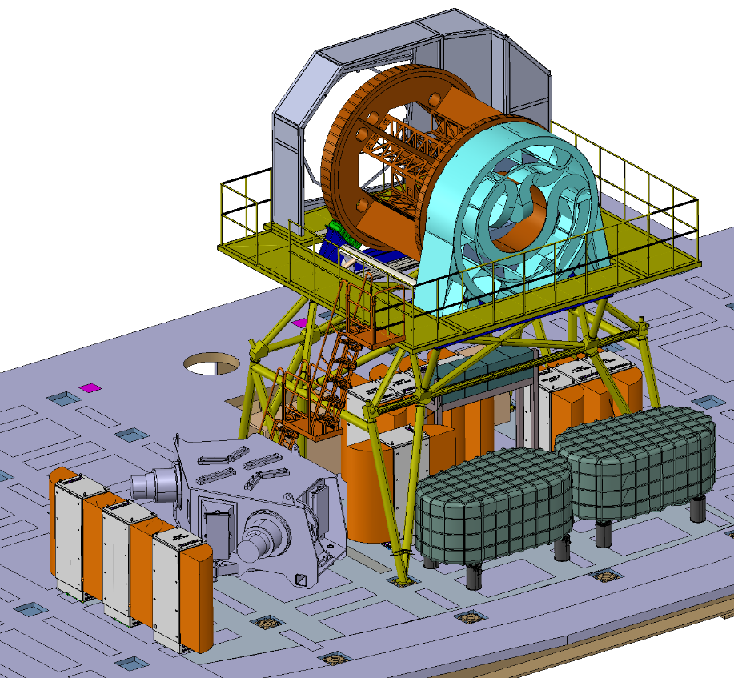
MOSAIC: the multi-object spectrograph
Incoming sky-light
Multi-Object spectrograph
2 channels: VISible (VIS) and Near-InfraRed (NIR)
Low resolution only for NIR
Both High and low res for VIS
Wavelength range: 0.39 a 1.8 um
Up to 260 observed objects in parallel

Slide 6

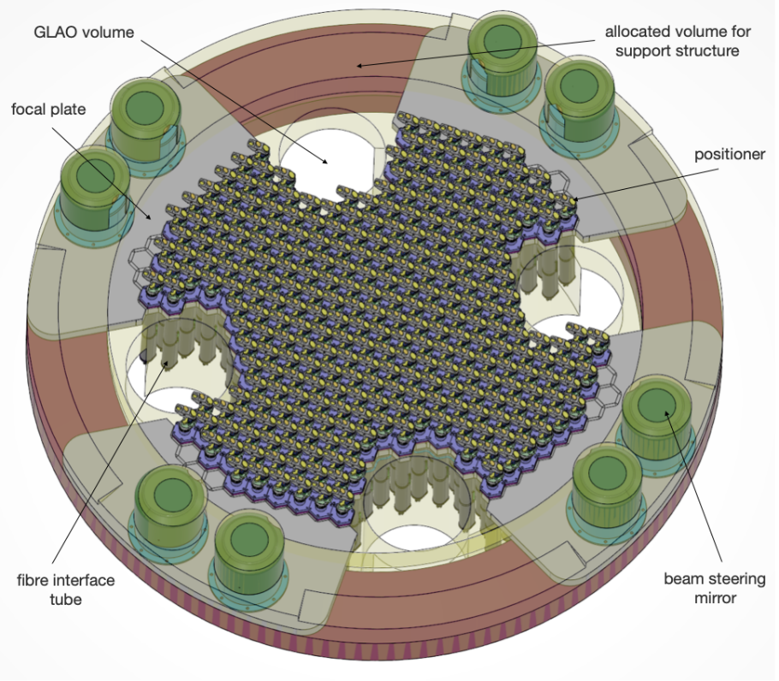
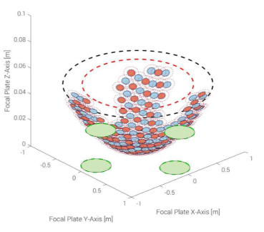
MOSAIC Focal plane
300 robotic positioners

Slide 7
MOSAIC – a brief introduction
What is MOSAIC?
Positioner (POS) modes
POS design
POS prototypes & key specs
Timeline

Slide 8
MOS mode:
GLAO
LGS
ELT Focus : FP1
NGS
NIR or VIS HR / LR Fiber bundle
ADC
FP2
Telecentric design : pointing at pupil center 37.8m from FP1
MOS optical path
FP1’
ICOS Rotation axis
Z axis
X axis
FP2.1 / FP2.2 / FP 2.3
NIR or VIS HR / LR Fiber bundle
ADC
FP1’
NGS
GLAO
LGS
Front-End Optical model
Nightime
Last revision v5.6 :
Date:23/01/2025 by D. Chapuis

Slide 9
mIFU mode:
ORSS – adjust IFU optical path length
FP2.4
mIFU Fiber bundle
IFU - BSM Beam Steering Mirror
GLAO
LGS
ELT Focus : FP1
NGS
ADC
Telecentric design : pointing at pupil center 37.8m from FP1
IFU - Pick-off mirror
FP1’
ICOS Rotation axis
Z axis
X axis
mIFU optical path
ADC
NGS
GLAO
LGS
Front-End Optical model
Nightime
Last revision v5.6 :
Date:23/01/2025 by D. Chapuis
mIFU Fiber bundle
IFU – BSM Beam Steering Mirror
ORSS – adjust IFU optical path length
FP2.4

Slide 10
MOSAIC – a brief introduction
What is MOSAIC?
POS modes
POS design
POS prototypes & key specs
Timeline

Slide 11
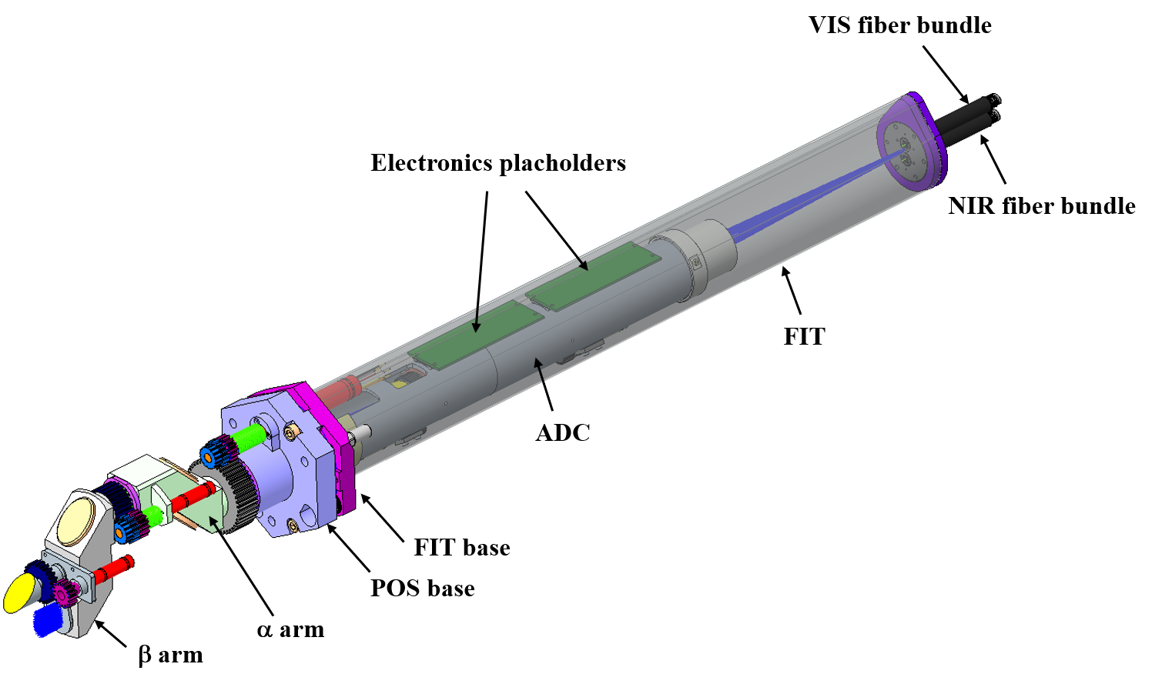
MOSAIC positioners
Ø94 mm
600 mm

Slide 12
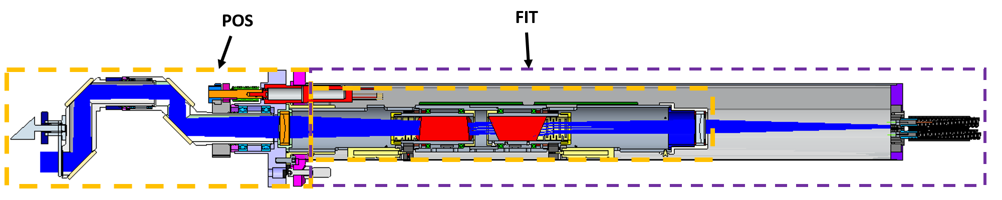
MOSAIC positioners: SCARA + ADC
57mm
28.5mm
600 mm
ELT light beam diameter: 15mm

Slide 13
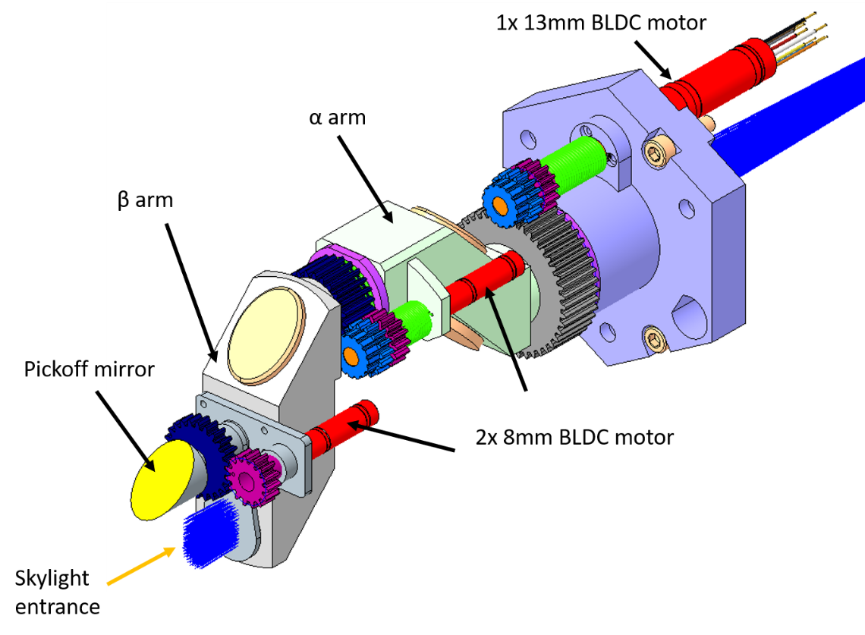
MOSAIC positioners: SCARA
Kinematics:
- Alpha arm length: 28.5 mm
- Beta arm length : 57 mm
3 BLDC motors:
1x 13mm; gear ratio: 1526:1
2x 8mm; gear ratio: 1024:1
Optics:
4x elliptical mirrors
90 mm hexagonal base

Slide 14
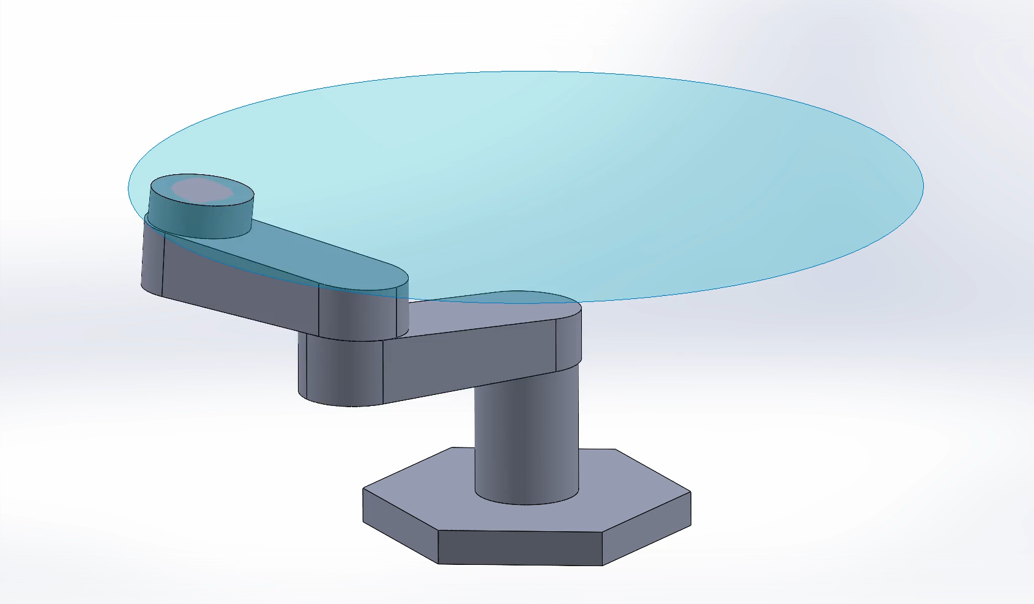
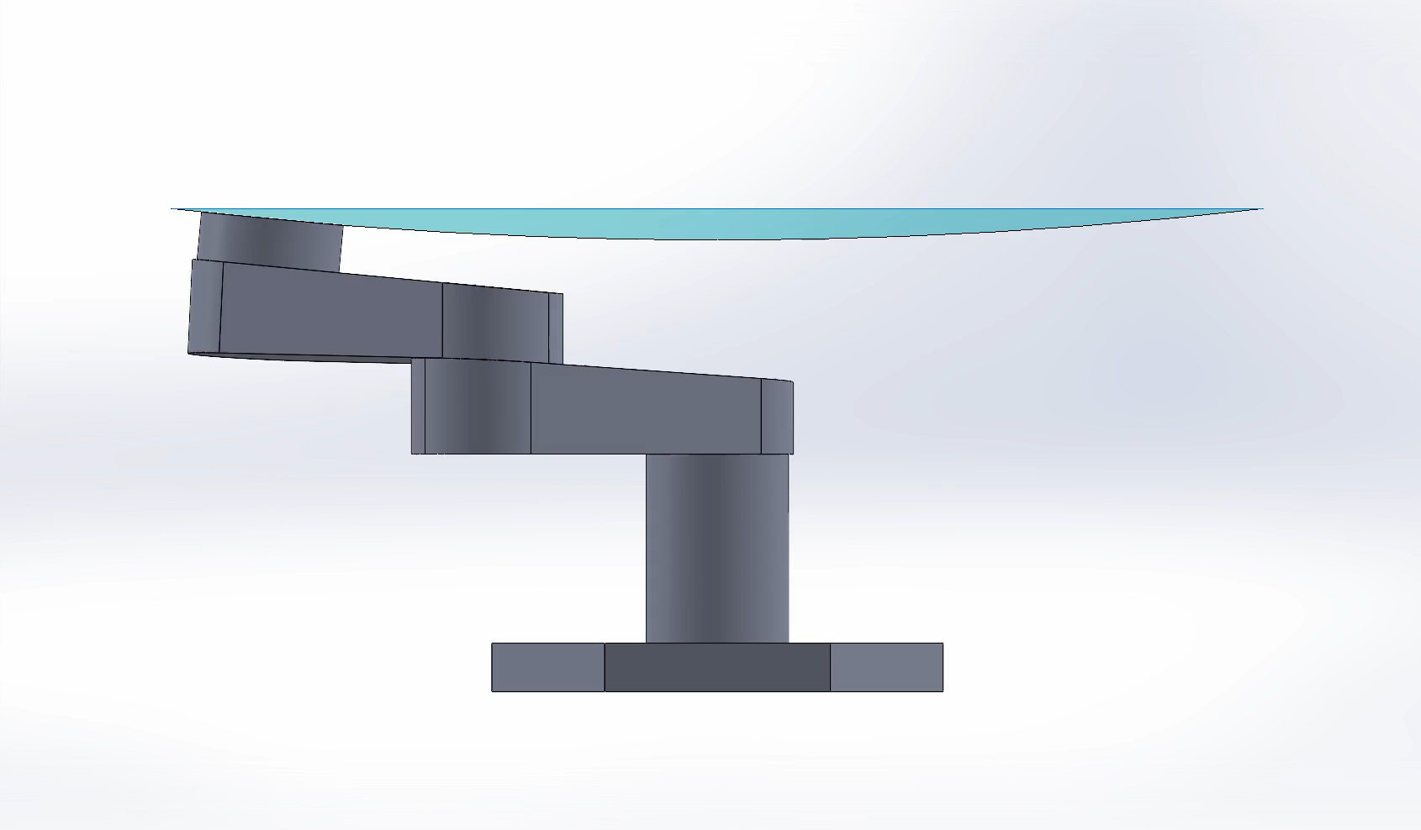
MOSAIC positioners: SCARA
MOSAIC positioner workspace compensating for ELT’s non telecentricity
Goal: point to the telescope pupil 37m away
Alpha angle = 0.041° / Beta angle = 0.083°
Credit: Markus Thurneysen (HEPIA)

Slide 15
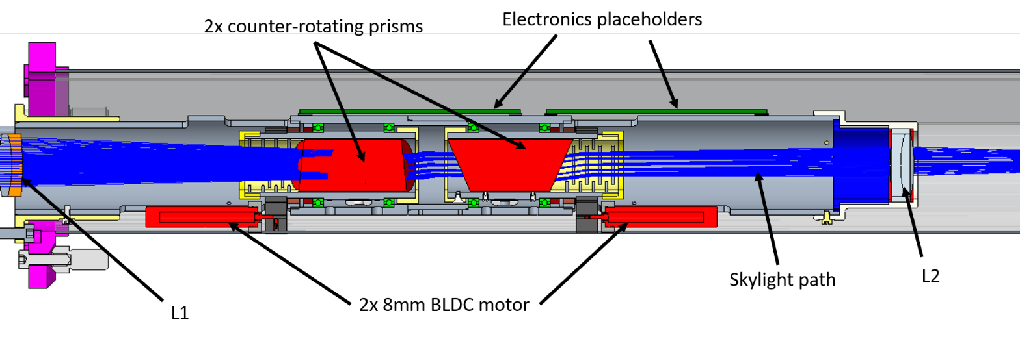
MOSAIC positioners: ADC
Optics
2x prisms
2x lenses
Motors:
2x 8mm motors; gear ratio: 1024:1

Slide 16
MOSAIC – a brief introduction
What is MOSAIC?
POS modes
POS design
POS prototypes & key specs
Timeline

Slide 17
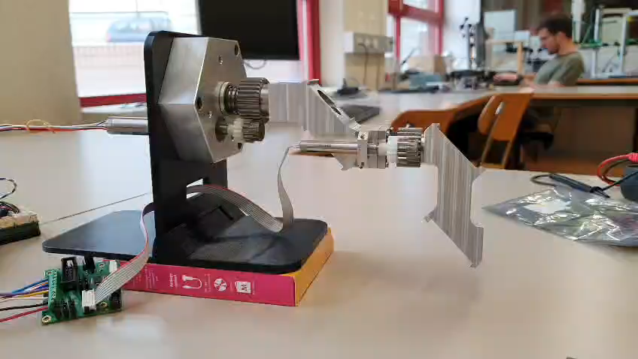
MOSAIC positioners: Prototypes

Slide 18
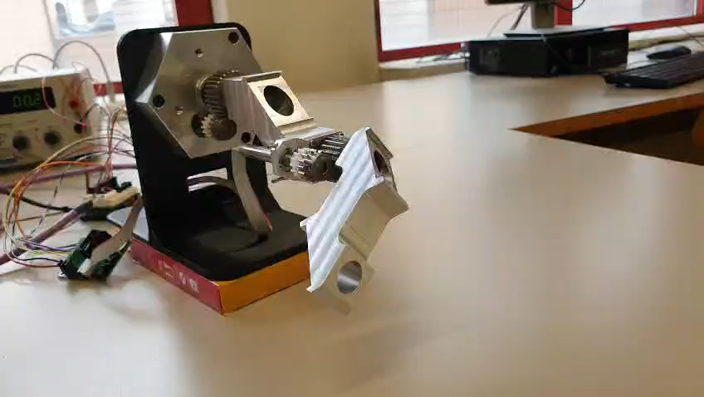
MOSAIC positioners: Prototypes

Slide 19
MOSAIC positioners: summary
Total positioners: 300
Motors:
1x 13mm motor – gear ratio: 1526:1 – hall sensors
4x 8mm motots – gear ratio: 1024:1 – hall sensors
- 5 motors / positioner
Optics:
4x elliptical mirrors
2x lenses (identical)
2x prisms

Slide 20
MOSAIC positioners: summary
Key specs (TBC):
Total arms accuracy (alpha+beta): 20um
Prisms angular accuracy: ± 0.5°
Pick off mirror accuracy: 30 arcseconds
Max speed: 1RPM
Mirrors angle tolerance: ± 0.01°
Mass: max 1.5kg

Slide 21
MOSAIC – a brief introduction
What is MOSAIC?
POS modes
POS design
POS prototypes & key specs
Timeline

Slide 22
MOSAIC positioners: timeline
POS PDR
MOSAIC PDR
MOSAIC FDR
IRR
First light
Jan 2027
Dec 2027
August 2031
March 2033
2035

