Slide 1
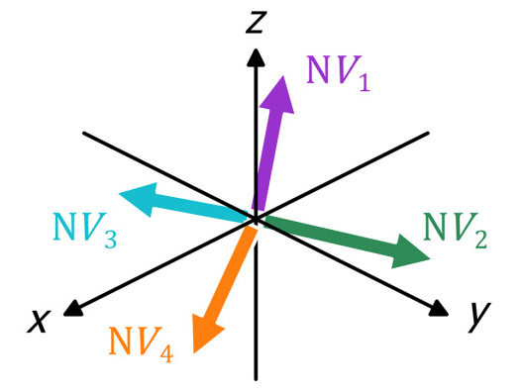
Quantum Mini-Magnetometer qmM
Joseph Moerschell / 22.01.2026
HES-SO Valais-Wallis
Industrie 23, 1950 Sion
joseph.moerschell@hevs.ch
058 606 87 67

Slide 2
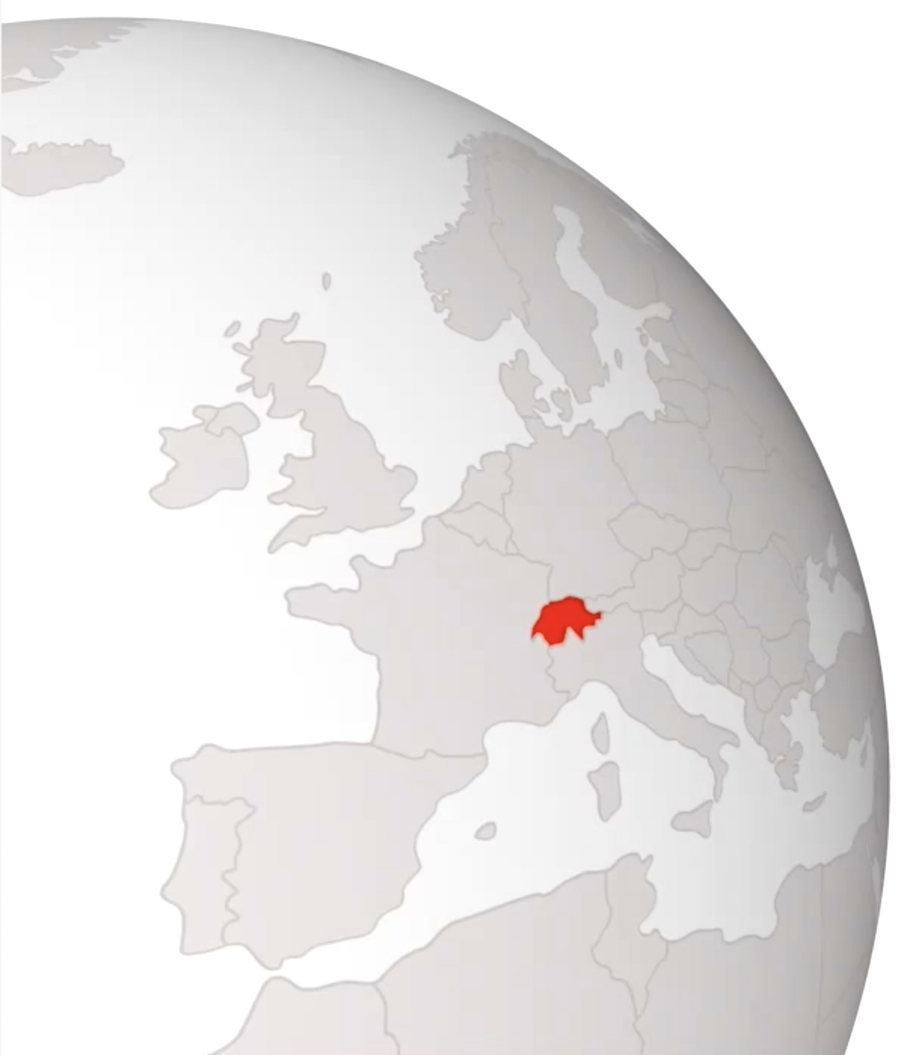
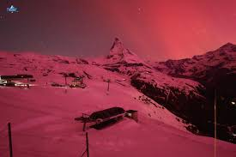
Improve on-line magnetosphere measurements
Instrument designed either as add-on payload to a larger mission platform, or a as main payload of a 3U-Cubesat
Today : stations of ground for terrerial magnetic field monitoring
Performant magnetosphere models but not many real-time measurement inputs available
Real-time magnetic strom estimation and prediction important for
RF comm equipment reliability
GNSS localization and timie synchronization quality
Recognition of NEMP and potential other military geomagnetic disturbance
Add higher altitude (e.g. red aurora borealis = 400km) measurements on trajectory but with reduced time resolution, e.g. once per day for one satellite

Slide 3
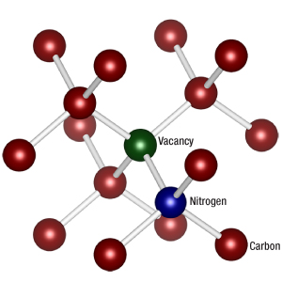

Diamonds with color centers
Diamond lattice is tetrahedral : orientation of NV pair can have 4 directions
Nitrogen atom negatively charged NV— creates a controllable spin state
±1 spins states can be separated by a magnetic field parallel to NV axis (Zeeman effect)
Spin maintained at excitation
0 spin falls back with 637n…800nmm fluorescence,
±1 spins fall partly (some %) back with 1046nm emission

Slide 4
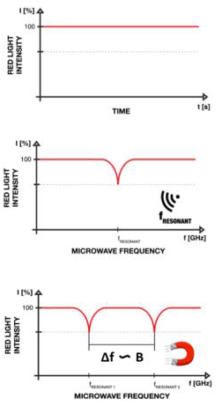
Optically detected magnetic resonance ODMR
Direct fall-back: constant fluorescence
With 2.87GHz RF excitation: increased dark state fall-back
Under external magnetic field : Zeeman split, ca. 2.8MHz/Gauss
With higher magnetic bias: 4 pairs of frequencies corresponding to projection of magnetic field onto NV center axes
Simultaneous detection of vector components of magnetic field
Absorption lines can be detected with various methods, e.g. excitation scan or random excitation.

Slide 5
Closed-loop readout
Adjust RF excitation frequency to obtain magnetic resonance detected via emission signal
At magnetic resonance, 637nm photoluminescence is reduced (absorption), and 1042nm photoluminescence is generated (emission)
Use magnetic field bias of some mT
Tunable excitation, e.g. 100kHz sinusoidal variation around center frequency above 2.87GHz corresponding to magnetic bias field
Magnetic field variation translates into timing variation of emission
Feedback control of center frequency to adjust to outer magnetic field
Increase sensitivity through optical amplification of emitted signal (→ laser)
Realizes single spin detection, time division multiplexing to address several spins (vector measurement)
B
Δf
532nm
Excitation
NV
Diamond
1046nm
Emission
Optical
Cavity
Photo
Detector
T_{s}
f_{center}
t_{light}
t
Tunable
RF excitation
Feedback
Controller
Timing
Measurement
B measurement

Slide 6
Requirements
Bandwith required for
1km trajectory resolution :
approx. 7Hz
From : C. Deans, T. Valenzuela, M. Bason, Quantum Magnetometry for Space, International Conference on Space Optics, Dubrovnik, 2022

Slide 7
Magnetometer proposal
Fibre-tip mounted NV diamond
Wire coil for bias magnetic field and RF excitation
Classic ODMR read-out , vector measurement
J. Homrighausen, F. Hoffmann, J. Pogorzelski, P. Glösekötter, M. Gregor,
Microscale fiber-integrated vector magnetometer with on-tip field biasing
using N-V ensembles in diamond microcrystals,
Physical Review Applied 22, 034029, 2024

Slide 8
Platform integration
Envisaged integration with 3U Cubesat platform
3-axes orientation stabilized platform
2 sensing heads per direction, for platform magnetic field discrimination
3 booms for redundancy, ease of calibration, direction measurement performance improvement
Boom can be flex-PCB with integrated optical fibers, length >1m
Boom unrolled from platform during commissioning, e.g. using shape memory alloy actuation
Triangular rigidification structure in deployed state to increase precision of sensing head orientation : pyramid configuration
Edges of triangular plane structure used as communication antenna
Triangular surface of rigidification structure used as PV panel

Slide 9
Performance comparison
kHz
From : C. Deans, T. Valenzuela, M. Bason, Quantum Magnetometry for Space, International Conference on Space Optics, Dubrovnik, 2022
Improve to 100pT/rtHz
With only one sensor

Slide 10
Performance comparison
Flux gate magnetometers on CSES (China Seismo-Electromagnetic Satellite, 730kg) : +70μT range, 18pT/rtHz noise, 5ppm/°C drift, 1nT/month stability, vectorial measurement
Main competitor for compact space application: optically pumped magnetometer (Rb vapor).
Projected size of sensing head approx. 35 x 25 x 25mm, 50g
Processing unit 500g, 1W power consumption
Sensitivity 100fT/rtHz, 100μrad/rtHz
Possibly delicate flight qualification of vapor cell
Estimates for NV diamond magnetometer:
Projected size of sensing head approx. 15 x 10 x 10mm, 5g
Processing unit 500g, 1W power consumption
Sensitivity 100pT/rtHz, 100μrad/rtHz
Sensitivity improvement with active readout method to be determined
Solid state passive sensing head less delicate to flight qualify
Robustenss and small sensing head of NV diamond based sensors are key to very smalll sattellite integration.

Slide 11
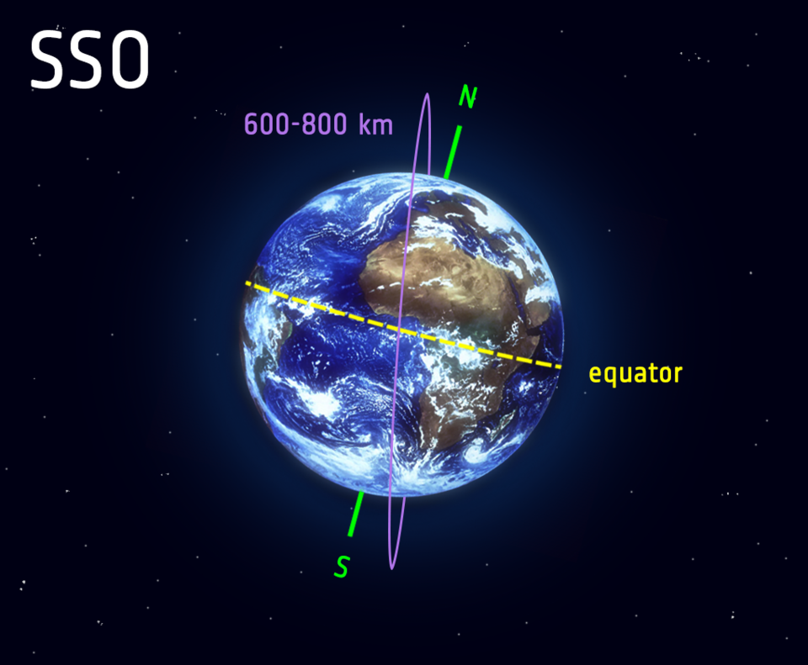
Mission proposal
Polar sun-synchronous orbit : any point of the Earth observed at same time of day across the year
Complementary information to INTERMAGNET, Swarm and GOES
Compared to Earth stations, much slower sampling time (100min per location instead of 1sec), but complete Earth coverage
With 1sec sampling time, Earth surface resolution 6.7km in latitude, but only 24° in longitude, i.e. 1830km at Swiss latitude
Possibility to fly several satellites to reduce sampling time or improve longitude sampling resolution
Geostationary communication link (e.g. EDRS) for continuous data transmission, or link to LEO satellite network, e.g. Starlink
Lifetime in LEO orbit = 5…7 years

Slide 12
Some literature
J. Homrighausen, F. Hoffmann, J. Pogorzelski, P. Glösekötter, M. Gregor, Microscale fiber-integrated vector magnetometer with on-tip field biasing using N-V ensembles in diamond microcrystals, Physical Review Applied 22, 034029, 2024
C. Deans, T. Valenzuela, M. Bason, Quantum Magnetometry for Space, International Conference on Space Optics, Dubrovnik, 2022
M. Bähr, M. Jahn, Ch. Heinze, K. Neckermann, J. Meijer, Th. Ortlepp, Compact All-Optical Quantum Sensor Device Based on Nitrogen Vacancy Centers in Diamond, Phys. Status Solidi A 2023, 220
E. Bourgeois, A. Jarmola, P. Siyushev, M. Gulka, J. Hruby, F. Jelezko, D. Budker, M. Nesladek, Photoelectric detection of electron spin resonance of nitrogen-vacancy centres in diamond, Nature Communications, 2015
D. Hopper, H. Shulevitz, L. Bassett, Spin Readout Techniques of the Nitrogen-Vacancy Center in Diamond, Micromachines 2018, 9, 437
B. Zhou, B. Cheng, X. Gou, L. Li, Y. Zhang, J. Wang, W. Magnes, R. Lammegger, A. Pollinger, M. Ellmeier, Q. Xiao, X. Zhu, S. Yuan, Y. Yang, X. Shen, First in‑orbit results of the vector magnetic field measurement of the High Precision Magnetometer onboard the China Seismo‑Electromagnetic Satellite, Earth, Planets and Space (2019) 71
Q. Hu, K. Huang, X. Mao, G. Ran, X. He, Z. Lin, T. Hu, S. Ran, Design of high sensitivity magnetometer based on Diamond Nitrogen-Vacancy Centers and Weak Signal Output Module, Diamond & Related Materials 151 (2025) 111858

