Slide 1


InP/InGaAs for Integrated Astrophotonics between 4 and 18 μm
Exoplanets and Habitability Group
Quantum Optoelectronics Group
SIAPS 2026
David Eglin – PhD Student
daeglin@ethz.ch
22.01.2026, Bern

Slide 2
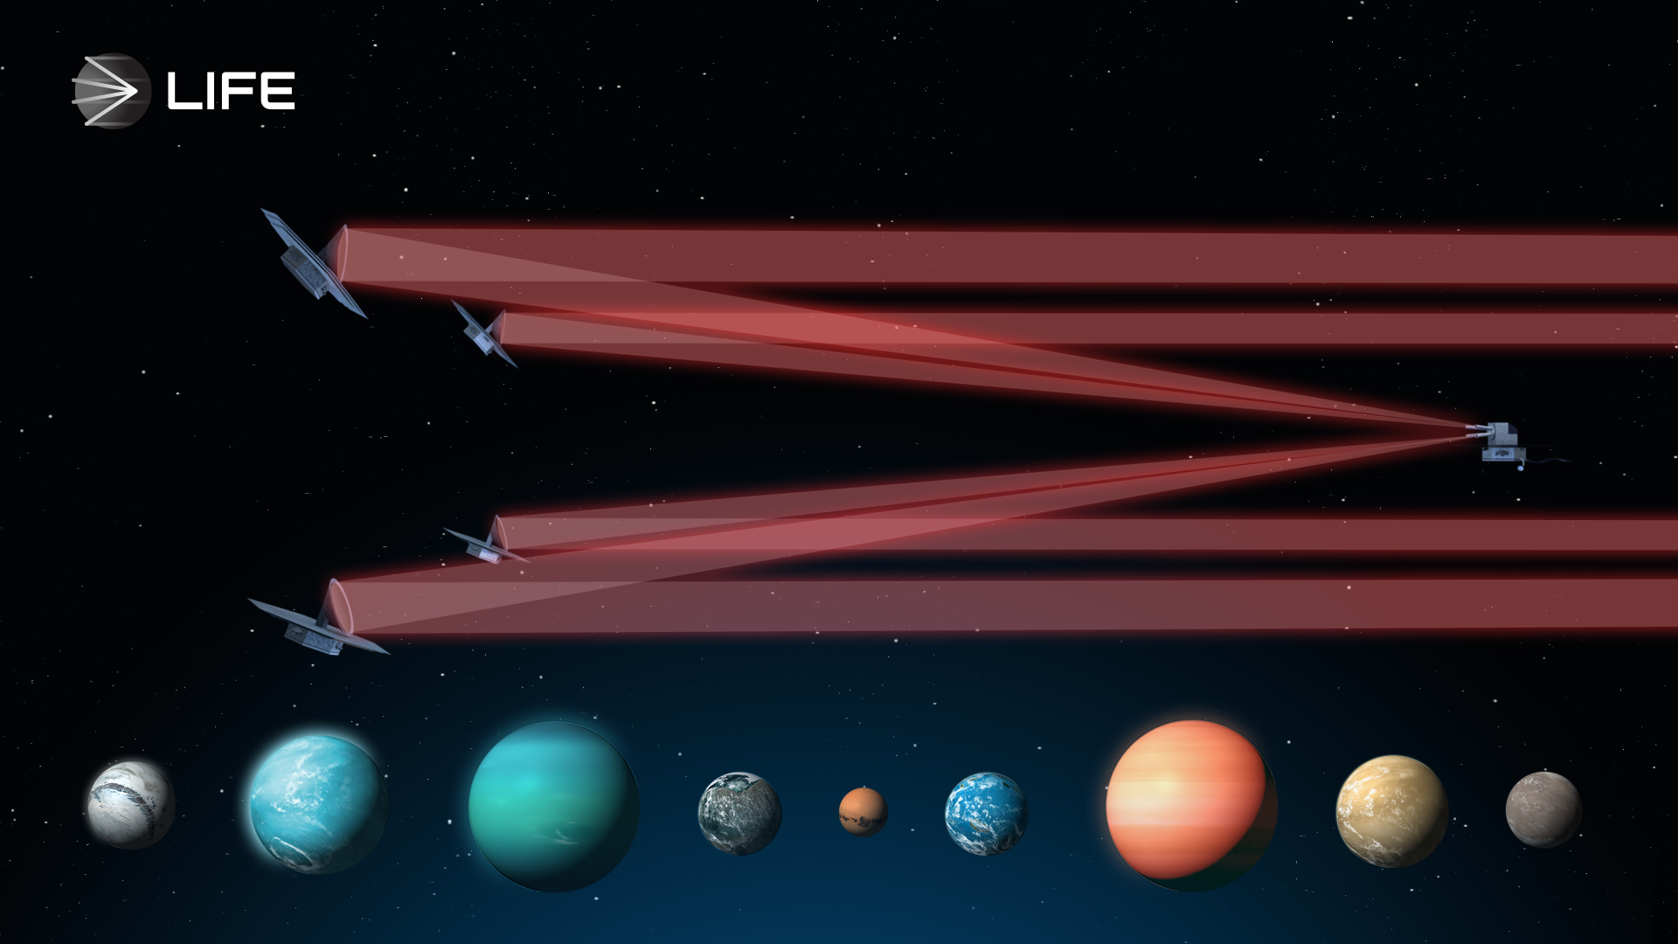
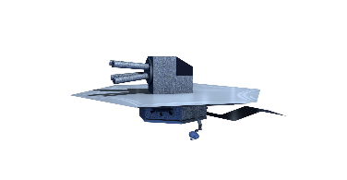
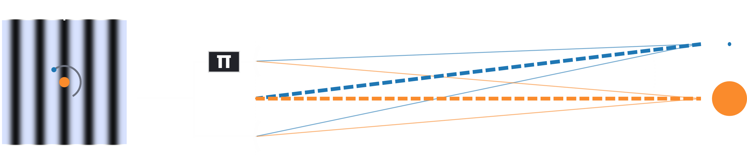

The Large Interferometer for Exoplanets (LIFE)
A proposed space mission
Characterisation of Earth-like exoplanets
Thermal emission 4-18 μm
Nulling interferometry
Bracewell nulling interferometer
Notes:
~3 m apertures
10-600 m baseline
Targets < 30 pc (100 lyrs)

Slide 3
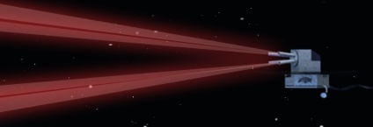




The Large Interferometer for Exoplanets (LIFE)
A proposed space mission
Characterisation of Earth-like exoplanets
Thermal emission 4-18 μm
Nulling interferometry
~3 m apertures
targets < 30 pc (100 lyrs) away
beam combiner
Glauser et al., SPIE (2024)
10-600 m baseline
Bracewell nulling interferometer
Bracewell, Nature (1978)
► Phase reversal ► Beam combination

Slide 4
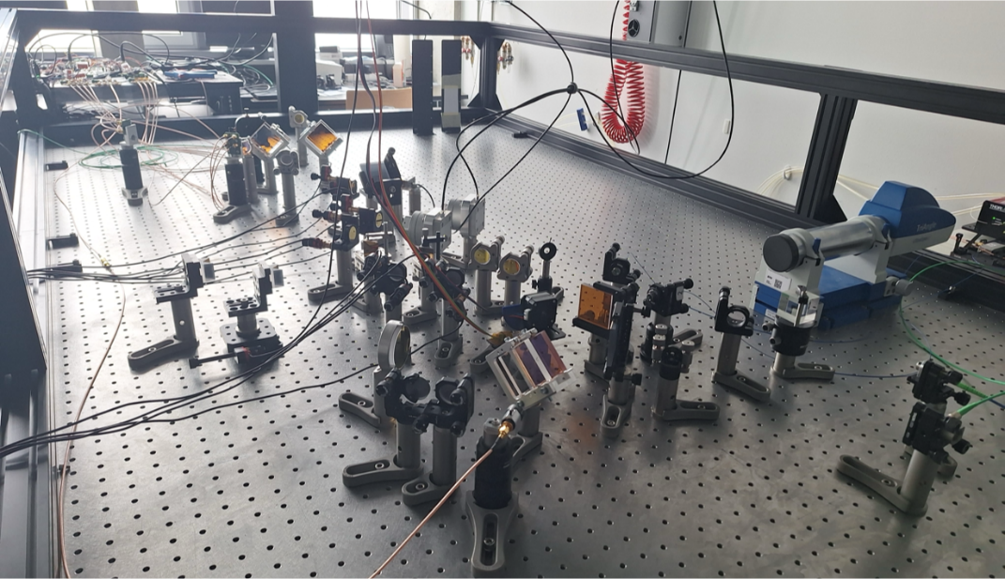


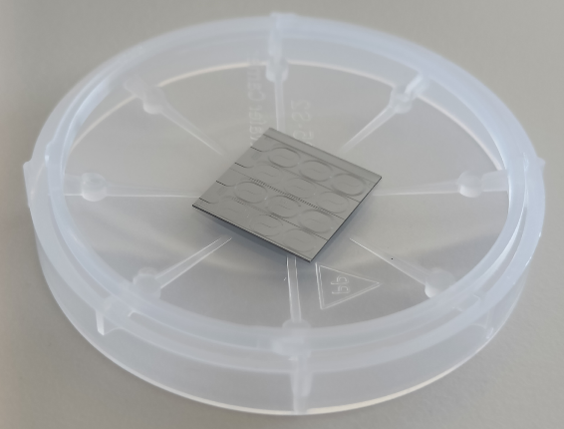

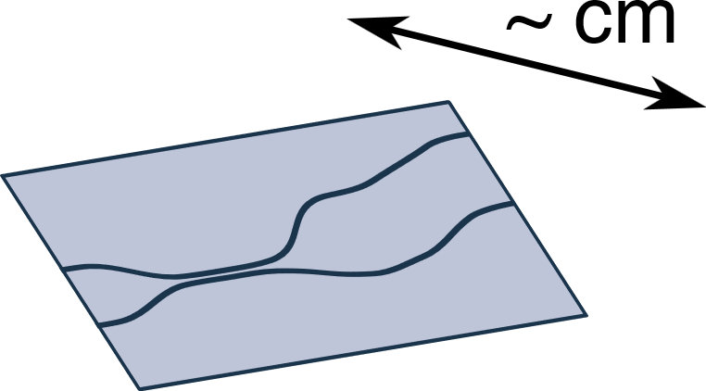
The Nulling Interferometer Cryogenic Experiment (NICE) – on chip
Bulk-optics demonstration of the LIFE requirements
Photonic implementation:
10⁻⁵ null depth ✓ | 20% photon conversion ✓
15 K ✗ | 1 nm RMS OPD drift ✓
4-18 μm ✗
Ranganathan et al., SPIE (2024)
10⁻⁵ null depth | 40% throughput
15 K | 1.4 mrad phase mismatch
4-18 μm | 0.3% intensity mismatch

Slide 5
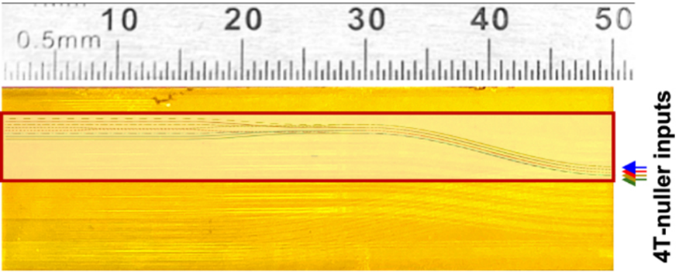
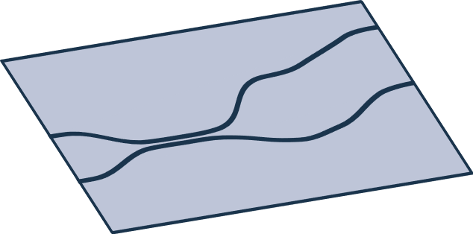
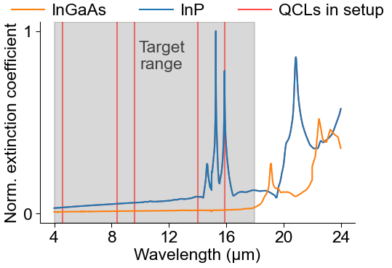
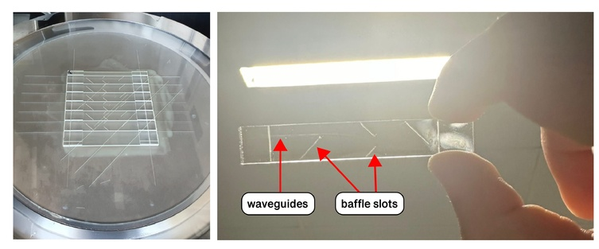
Existing on-chip nullers
Our requirements
ASGARD/NOTT (VLTI)
LIFE
10⁻⁴ null | ~37% | 3.5-4 μm
10⁻⁵ null | 40% | 4-18 μm
→ Different material:
InP/InGaAs
Sanny et al., A&A (2026)
GLINT (Subaru telescope)
10⁻³ null | <87% (sim.) | 1.45-1.7 μm
Klinner-Teo et al., SPIE (2022), Spalding et al., SPIE (2024)
Notes:
GLS glass (chalcogenide glass, gallium lanthanum sulphide), ULI (ultrafast laser inscription)
Borosilicate glass

Slide 6
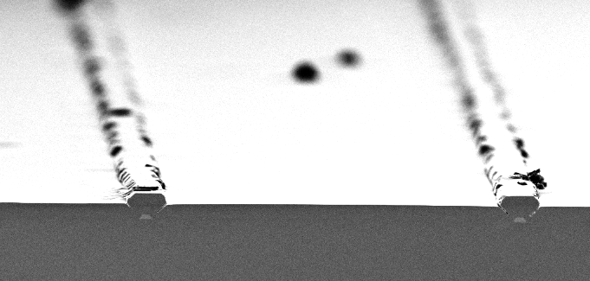
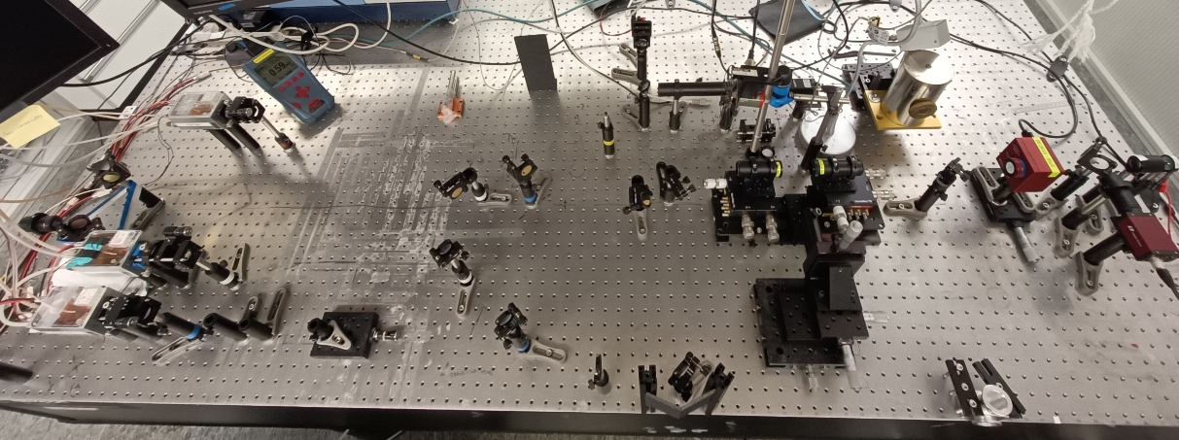
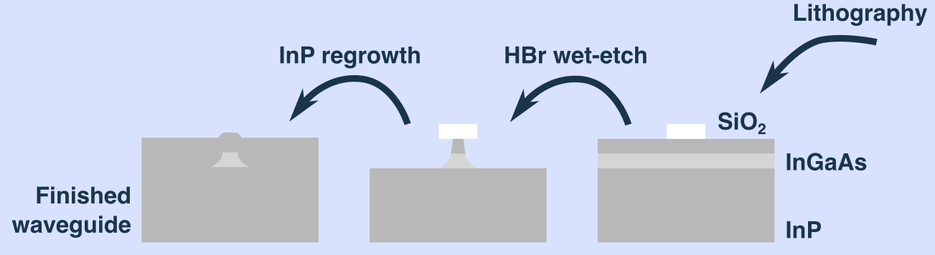
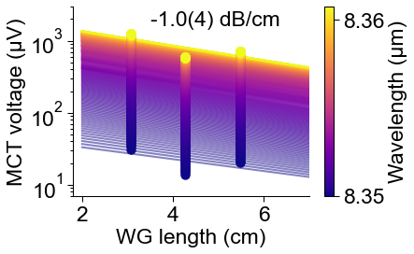
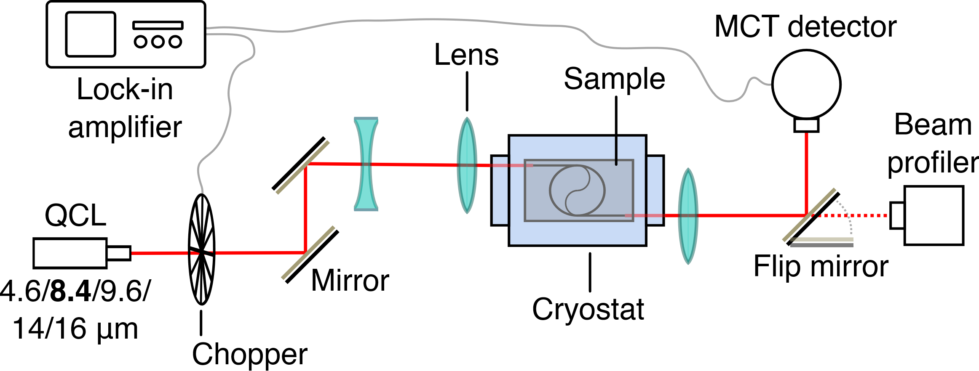
InP/InGaAs waveguides: Fabrication and characterisation
10 μm
Notes:
Lens/WG NA mismatch (~0.33/1.4) Spot size ~50 μm
Coupling efficiency $≲3\%$
1 dB = 20%

Slide 7
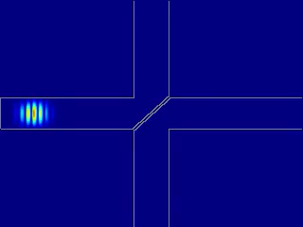
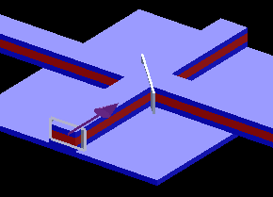
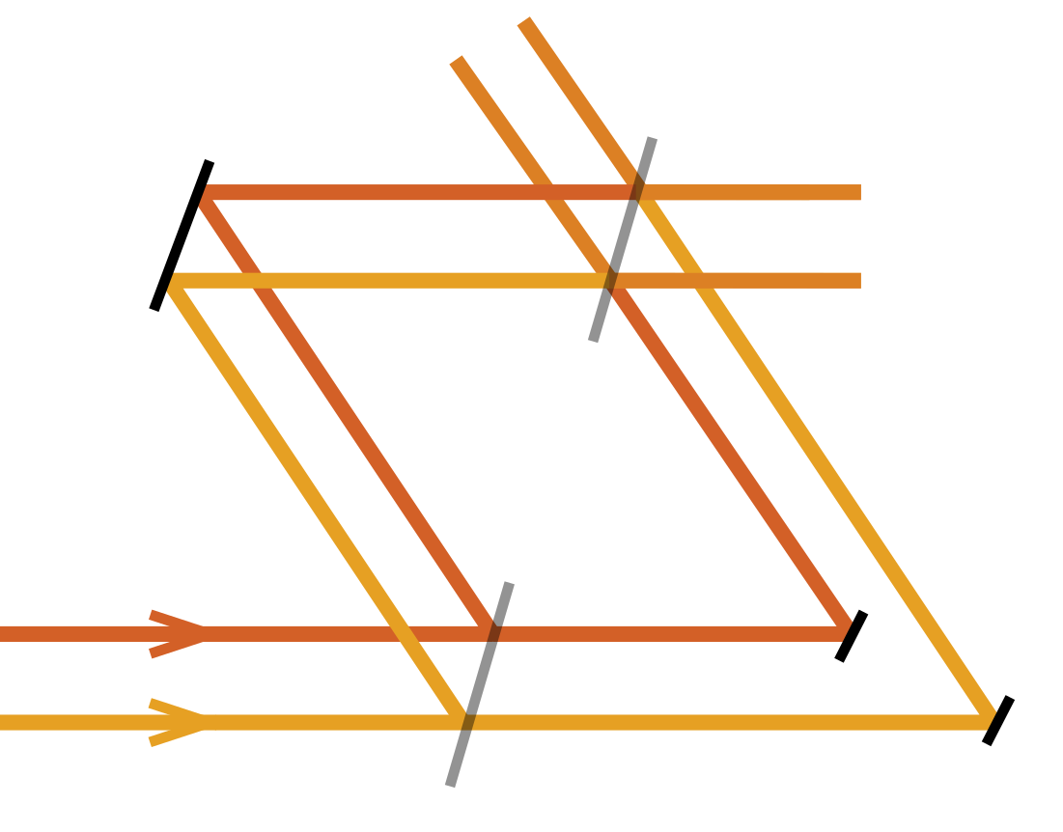
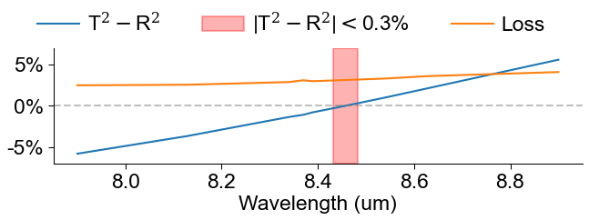




Outlook: Achromatic phase shift “Bulk-optics-approach”
Photonic beam splitter
Possible nulling scheme
$$\left(\begin{matrix}R & iT \\ iT & R\end{matrix}\right)$$
$π/2$ phase difference
InP
InGaAs
$$iTR+iRT$$
~50 nm bandwidth
$$R^{2}−T^{2}$$
Notes:
Beam splitter equivalent to directional coupler

Slide 8
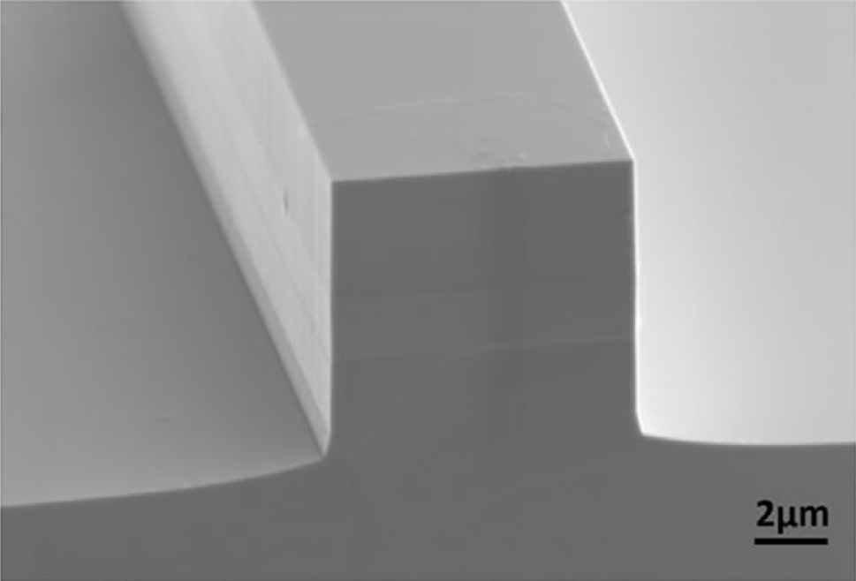
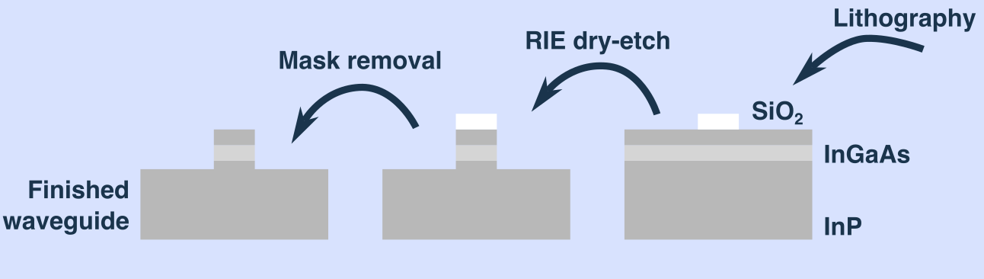
Outlook: Dry-etch process
Wet-etch
Pattern control
Exposed surface: degradation & impurities
Dry-etch
InP
InGaAs
InP
0.5 dB/cm <5 μm
Zhang et al., Appl. Phys. Lett. (2022)

Slide 9





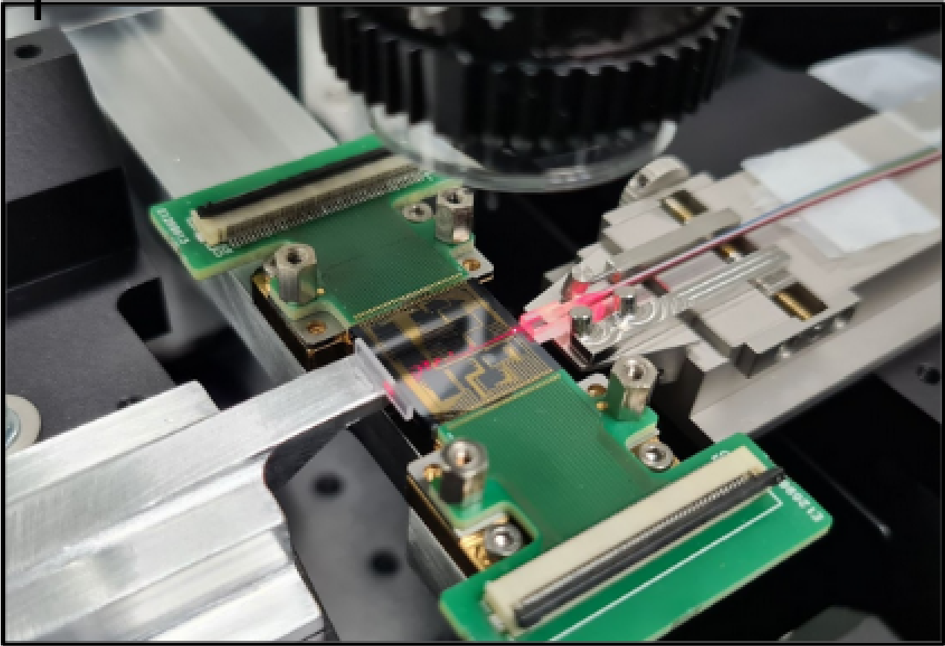

Summary
Many thanks to…
…and the Exoplanets & Habitability and Quantum Optoelectronic groups at ETH Zurich!
Developments in astrophotonics allow on-chip nulling today
InP/InGaAs: promising for photonics-based LIFE mission
Wavelengths >11 μm and cryo have not yet been explored
We report waveguide losses and develop achromatic nulling schemes compatible with LIFE
Sascha Quanz
Jérôme Faist
Adrian Glauser
Contact:
David Eglin
daeglin@ethz.ch
PhD Student
Cvetojevic et al., A&A (2022)

