Slide 1
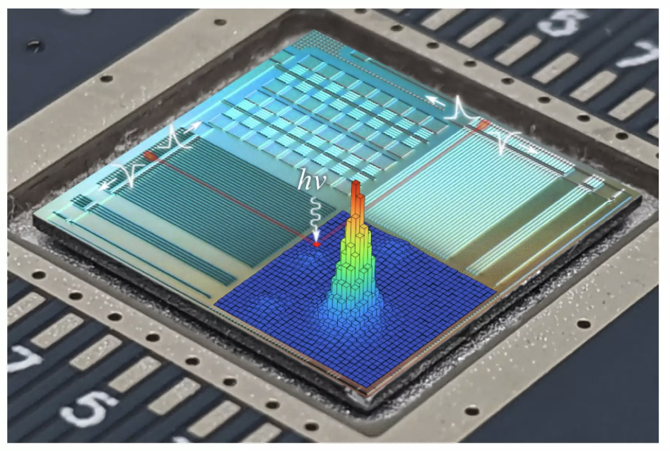
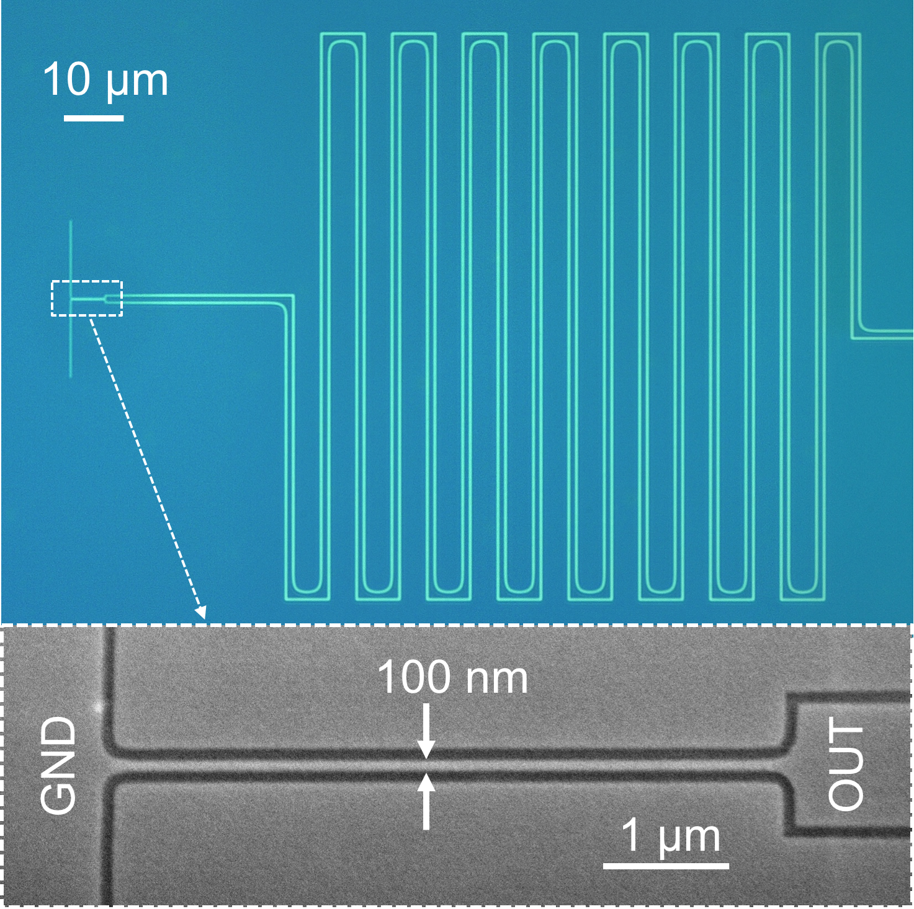
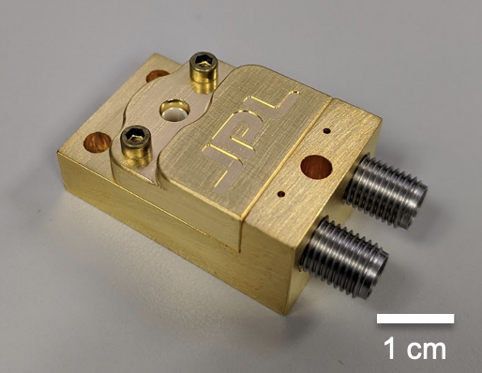

22nd January 2026
Superconducting nanowire detectors towards astronomy applications
Boris Korzh
Quantum Technologies Group
Department of Applied Physics
University of Geneva, Switzerland
boris.korzh@unige.ch

Slide 2
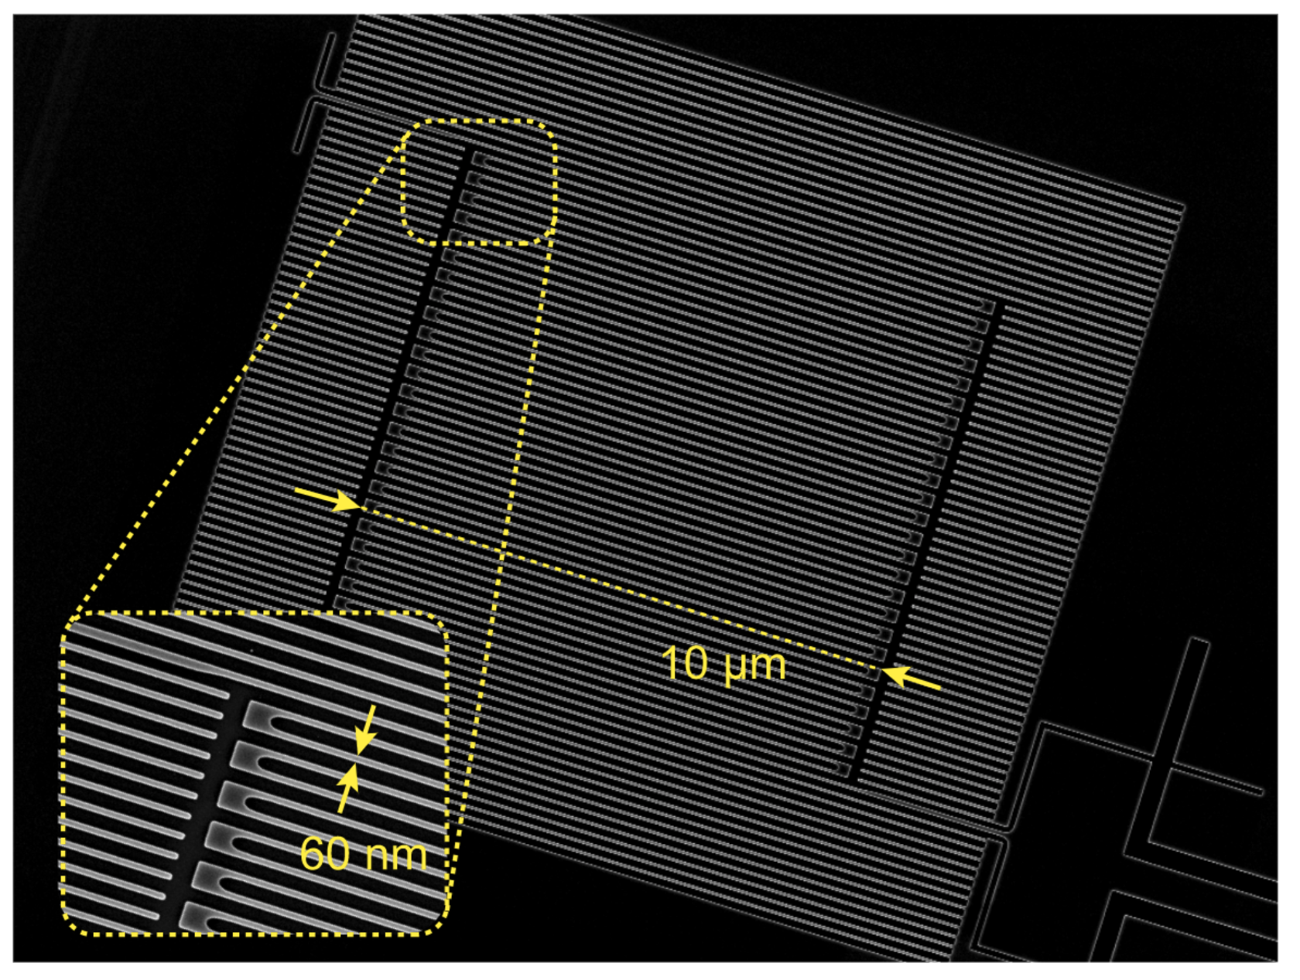
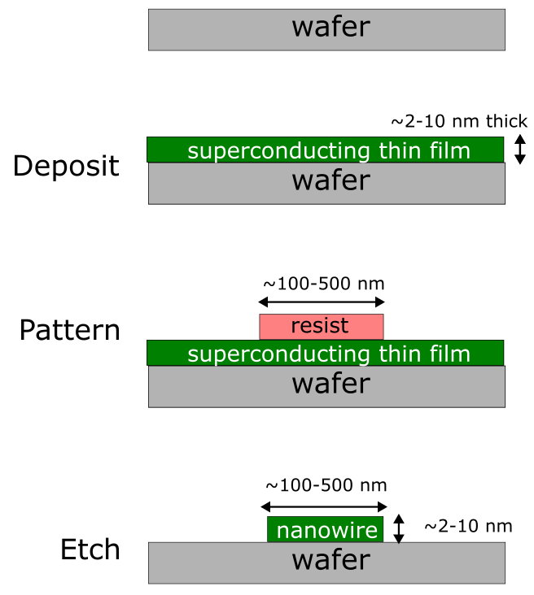
Superconducting nanowire single-photon detector (SNSPD)
No need for full ‘Foundry’ process like SPADs
→ Easier to tailor the devices for astronomy community
Some select fabrication facilities (Academic and National Lab):
Jet propulsion Lab, CA, USA
NIST, Boulder, CO, USA
MIT Nano, MA, USA
NICT, Japan
EPFL, CMi, Switzerland
TU Delft, Netherlands
Münster, Germany
KTH, Sweden
SIMIT, China
Nanjing, China
…..
Nanofabrication
Single-pixel detector
Goltsman, et al, APL 79, 705 (2001)
Notes:
Really visualize the SNSPD and this forms the story

Slide 3
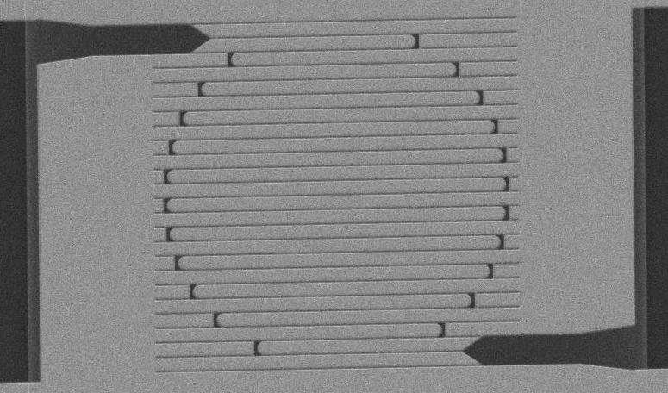
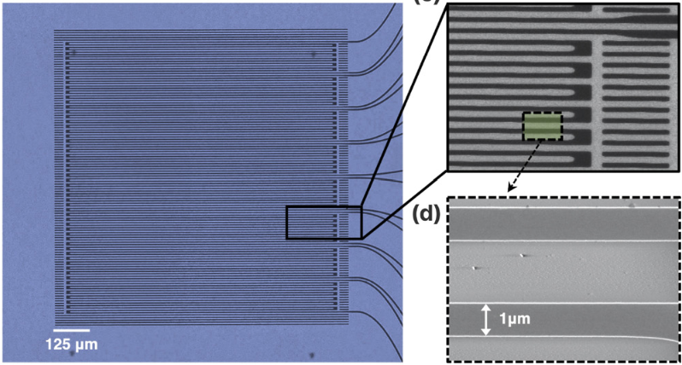
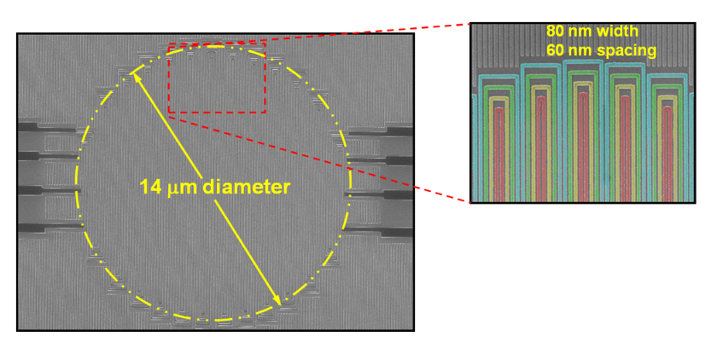
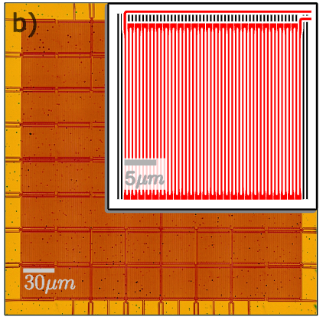
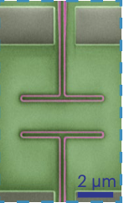
Different formats
Large collection area / spectroscopy
Linear arrays
Single-pixel
Quantum science
Interleaved pixel
Pixel array
Waveguide
Fast count rates
Imaging
Notes:
Really visualize the SNSPD and this forms the story

Slide 4
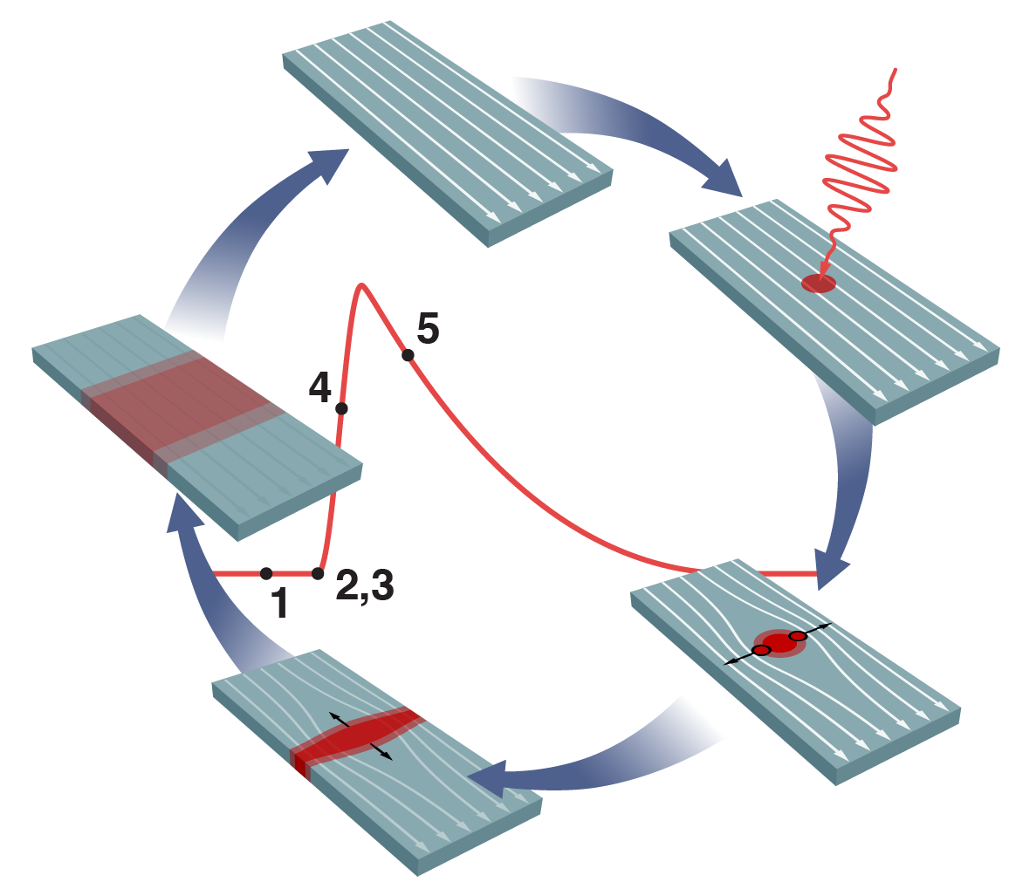
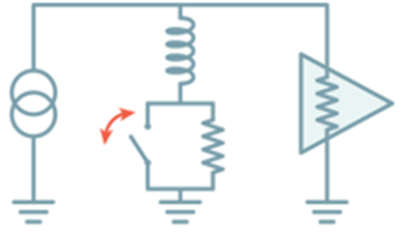
Superconducting nanowire detector mechanism
1. Current-biased superconducting nanowire
1
2
2. Photon absorption & Hotspot formation
5
3. Suppression of superconductivity
4. Normal domain growth – Fully digital
3
5. Recovery
4
Typically operating at 0.3-5 kelvin
Allmaras, Modeling and Development of Superconducting Nanowire Single-Photon Detectors, Ph.D. Dissertation, Caltech (2020)
Notes:
Let me show you how it works Add general pictures of nanowires
- For reference

Slide 5
Advances in superconducting nanowire detectors
Timing jitter | Intrinsic photon number resolution | Efficiency | Array size | Maximum count rate | Dark count rate | Active area | Cut-off wavelength
18 ps | None | 93% | 64 | 1 Gcps | 4 /s/mm² | 0.001 cm² | 5 μm
1 ps | 10 | 99 % | 10⁷ | 10 Gcps | 1x10⁻⁶ /s/mm² | 1 cm² | 100 μm
Records in 2016
[4,5]
Current records for isolated devices
3-5 photons
1.5 Gcps
4x10⁵
[3]
[3]
[7]
[6]
0.1 cm²
[1]
[2]
29 μm
2.6 ps
4x10⁻⁵ /s/mm²
98%
Expected performance by 2030
Quantum science
Remote sensing
Astronomy
Biomedical imaging
High energy physics
[4] Craiciu et al, Optica 10, 183 (2023)
[5] Resta et al, Nano Letters (2023)
[6] Chiles et al, PRL 128, 231802 (2022)
[7] Taylor et al, Optica, (2023)
[1] Korzh et al, Nature Photonics 14, 250 (2020)
[2] Reddy et al, Optica 7, 1649 (2020)
[3] Oripov et al, Nature 622, 730 (2023)
Notes:
Let’s take a look at advanced since the 2015 Bell test
In fact, I contributed to 6/8 current records for SNSPDs
Including the factor of >5 factor improvement in timing resolution
As well as other important metrics for Quantum Science
→ including intrinsic photon number resolution, array size and maximum count rate
We are on verge of the next revolutionary breakthrough in quantum optics by → access to multiple metric simultaneously
→ This is the main main of this Starting grant - to group these metrics into a single device for the first time
+ impact QC and QI
Understanding of all of these metric individually is important for bringing them together
→ I am well positioned to do this, given my contributions in the field so far

Slide 6
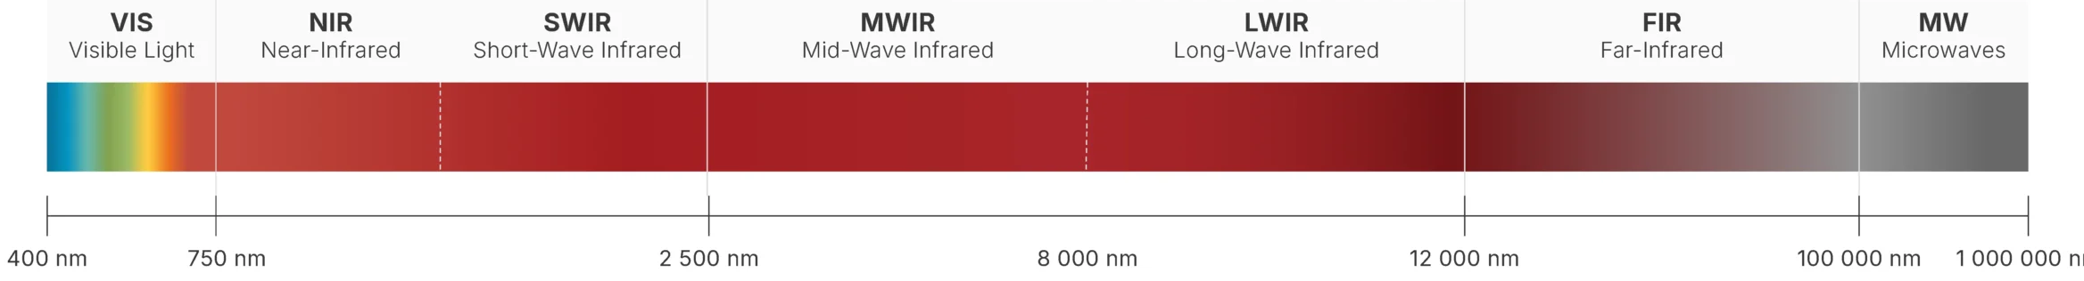
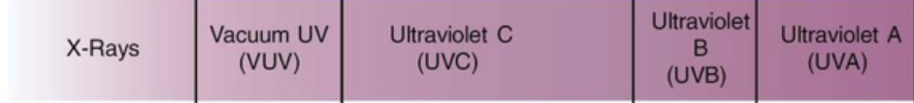
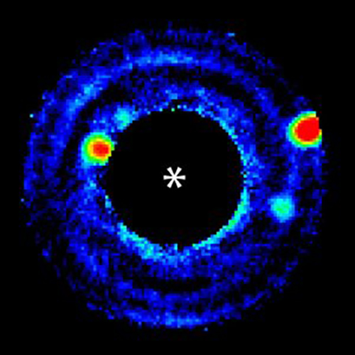
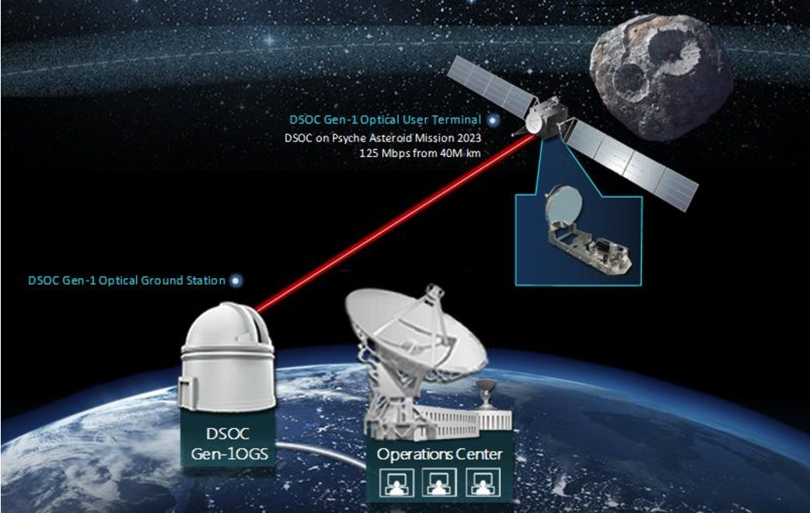
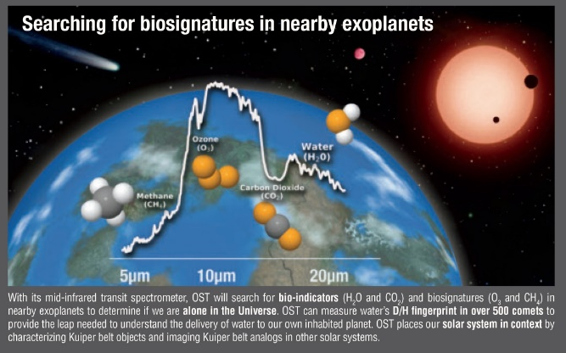

Established and potential SNSPD Applications
2017
2013
2017
2020
2023
Now
10 100
200 nm
280 nm
315 nm
Far-UV astrophysics
Quantum computing
Exoplanet imaging,
Stelar intensity interferometry
Deep space optical comm,
Quantum comm
Physical chemistry
Exoplanet spectroscopy
Notes:
Highlight the focus At the end I’ll come back to talk about this etc, how we are seeing ourselves in that domain Highlight what lead to a publication

Slide 7
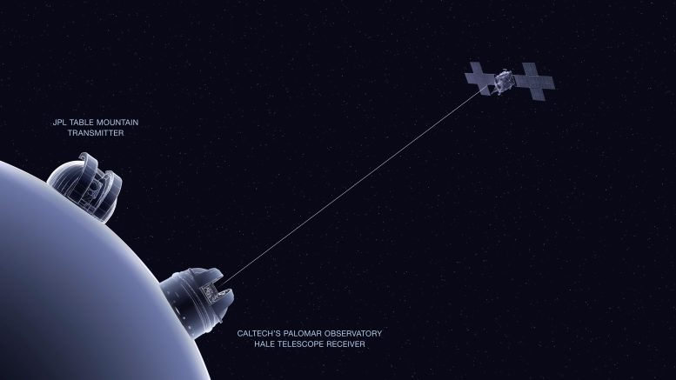
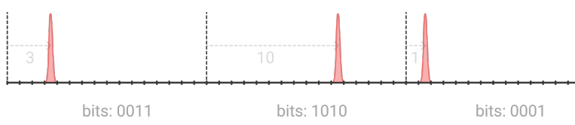
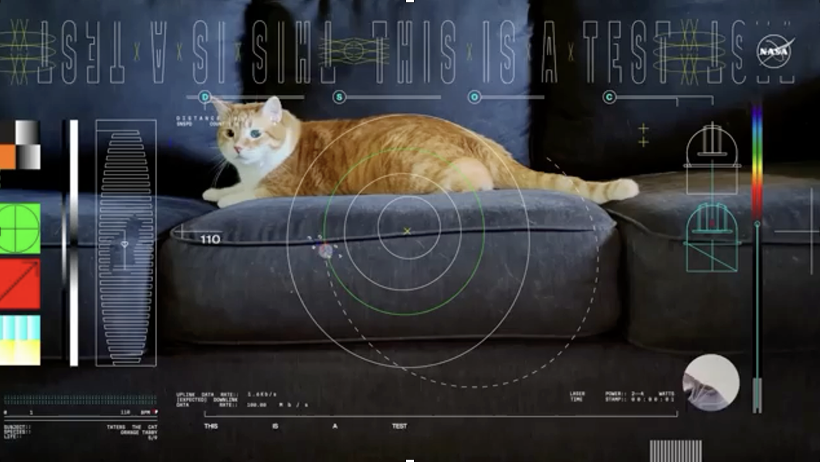
NASA Deep Space Optical Communication
~10 exa-photons / sec (10¹⁹)
Received from 30 Million kilometers!
~1 mega-photons / sec (10⁶)
Wollman, Allmaras, Beyer, Korzh, Runyan, Narváez, Farr, et al. 2024. “An SNSPD-Based Detector System for NASA’s Deep Space Optical Communications Project.”
7
Notes:
State how many photons we start with and at the end
4W and then ~10 photons?

Slide 8
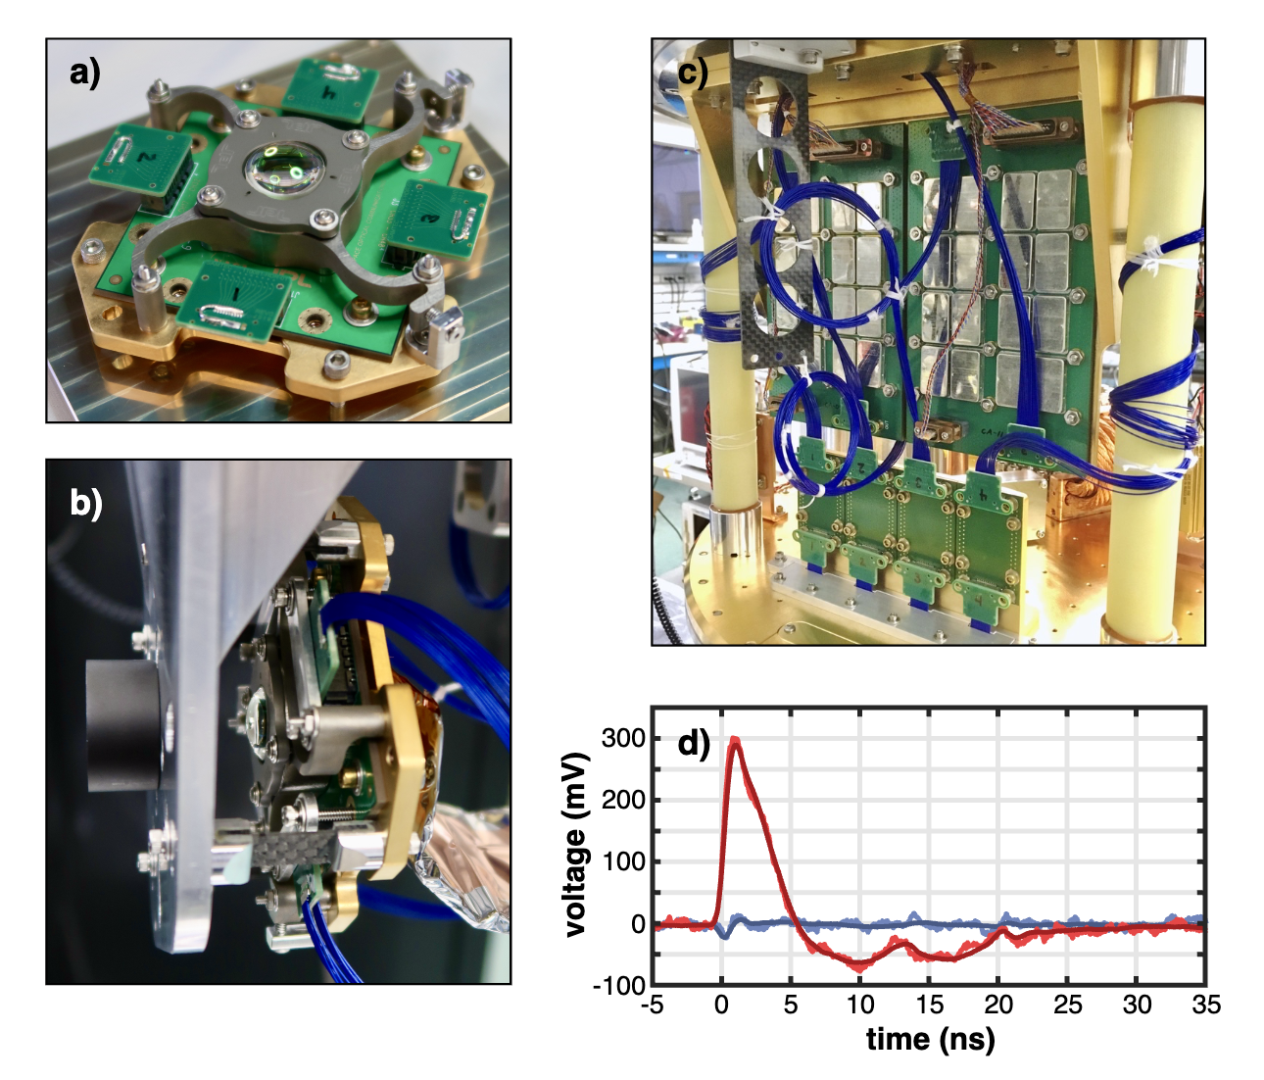
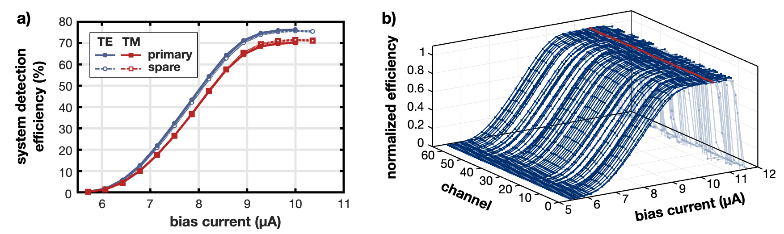
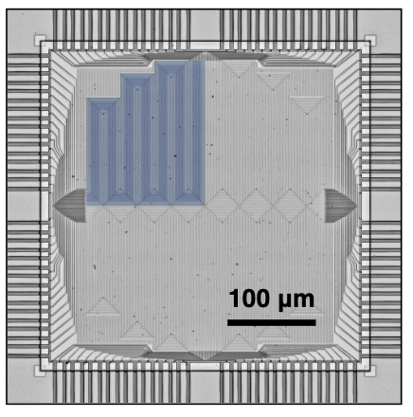
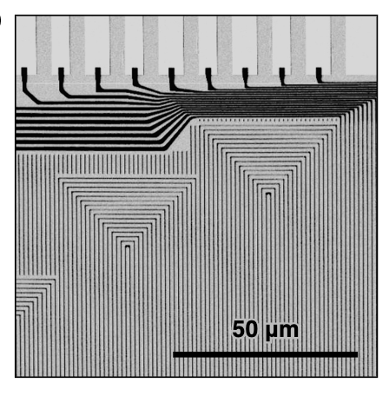
Engineering challenges solved
Scalable cryogenic readout electronics
High yield of large area detectors
High-density cryogenic RF cabling
Wollman, Allmaras, Beyer, Korzh, Runyan, Narváez, Farr, et al. 2024. “SNSPD-Based Detector System for NASA’s Deep Space Optical Communications Project.” Optics Express 32 (27): 48185.

Slide 9
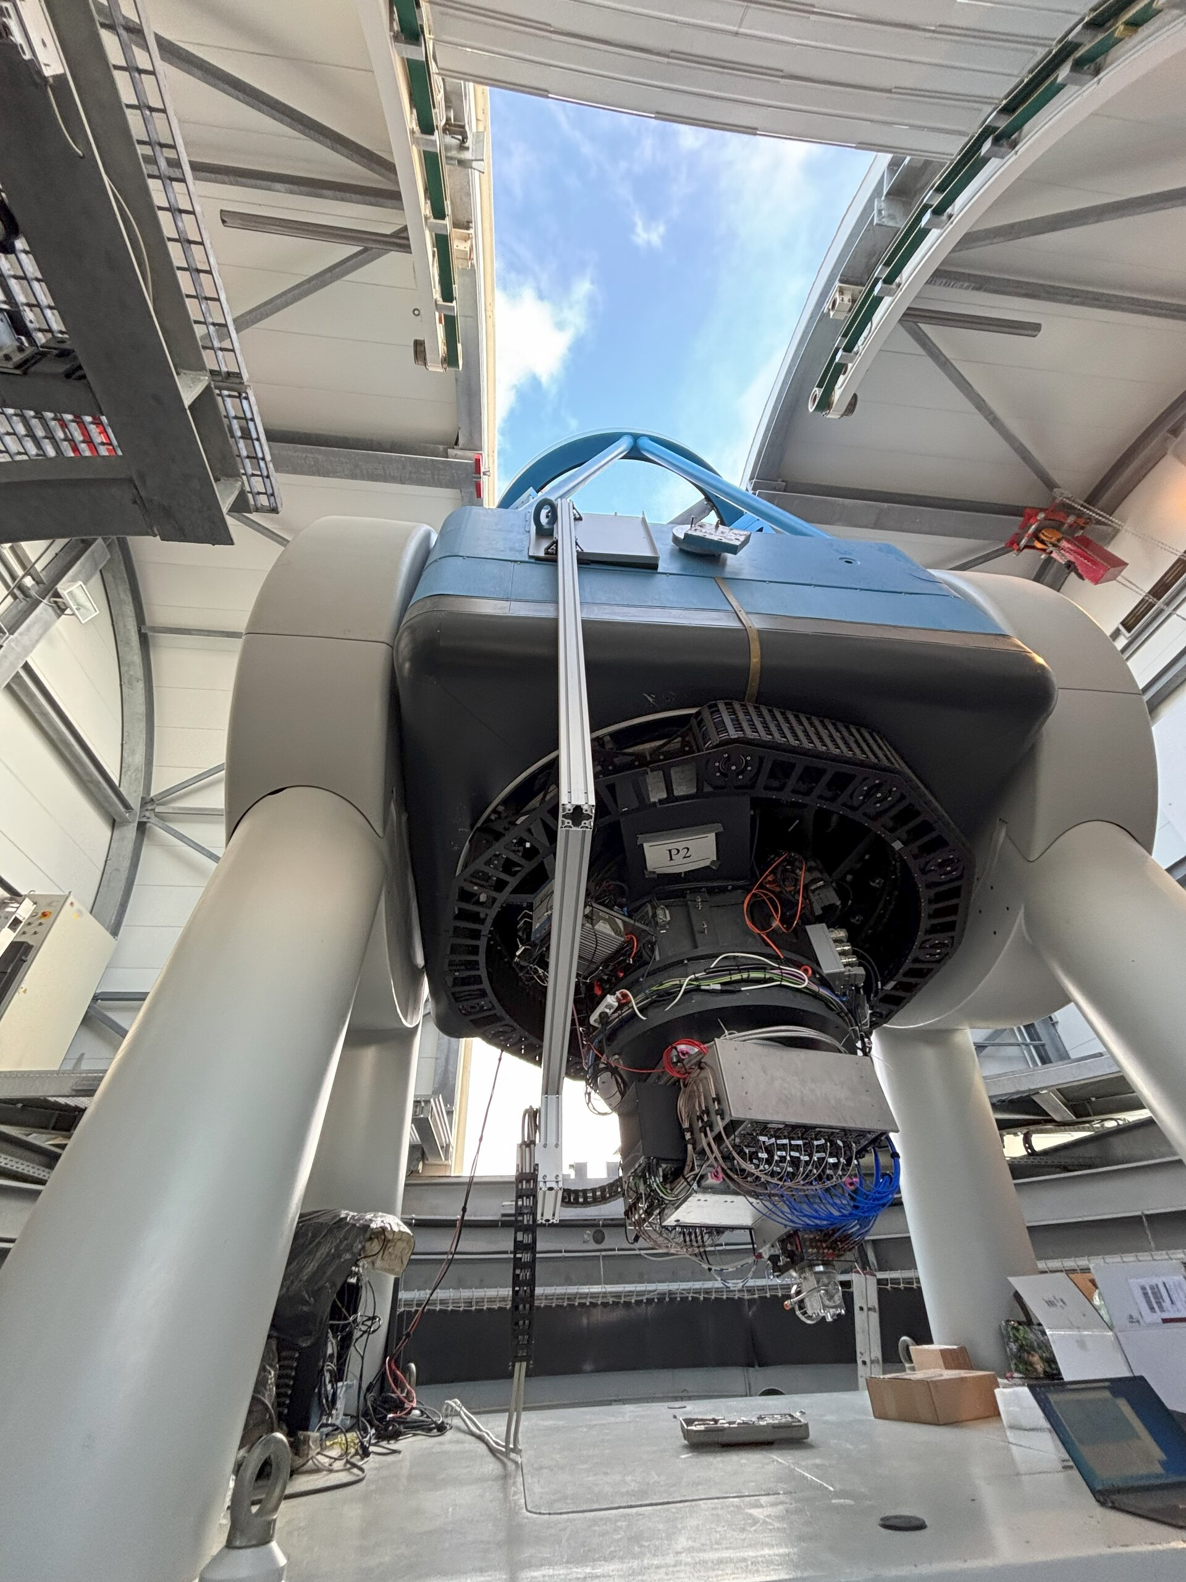

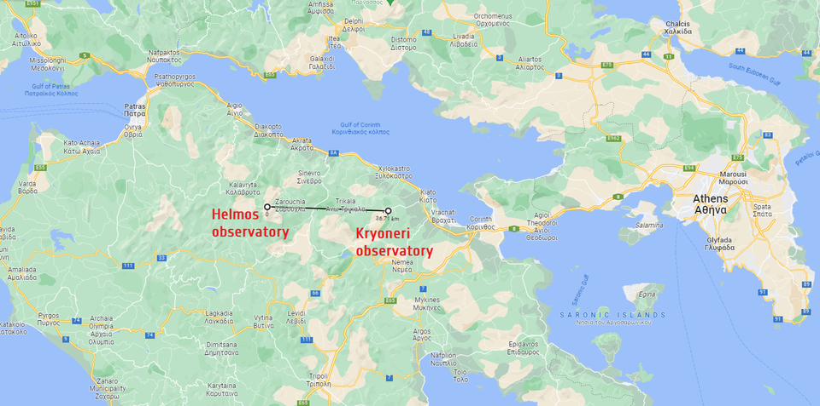

In first receiver in Europe
Link closed from 300 Million kilometers!
https://www.esa.int/Enabling_Support/Operations/ESA_wraps_up_300-million-kilometre_optical_communication_campaign
Swiss industry involvement:
Notes:
- Example to illustrate how detectors can impact quantum communication
- QKD --> Alice sends ...
- key secured by laws of physics
- These states are encoded in timing of photons
- dark counts and timing --> errors
- Developed a record low dark count rate
- Build a specific system to leverage this → to this day it is the record for semiconductor device In future, for secure communication → need to increase distances
→ Need to increase beyond single –inks → quantum repeaters

Slide 10

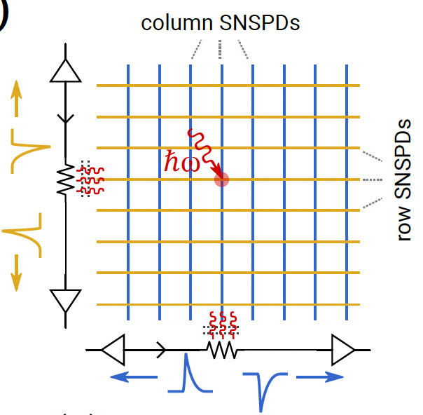
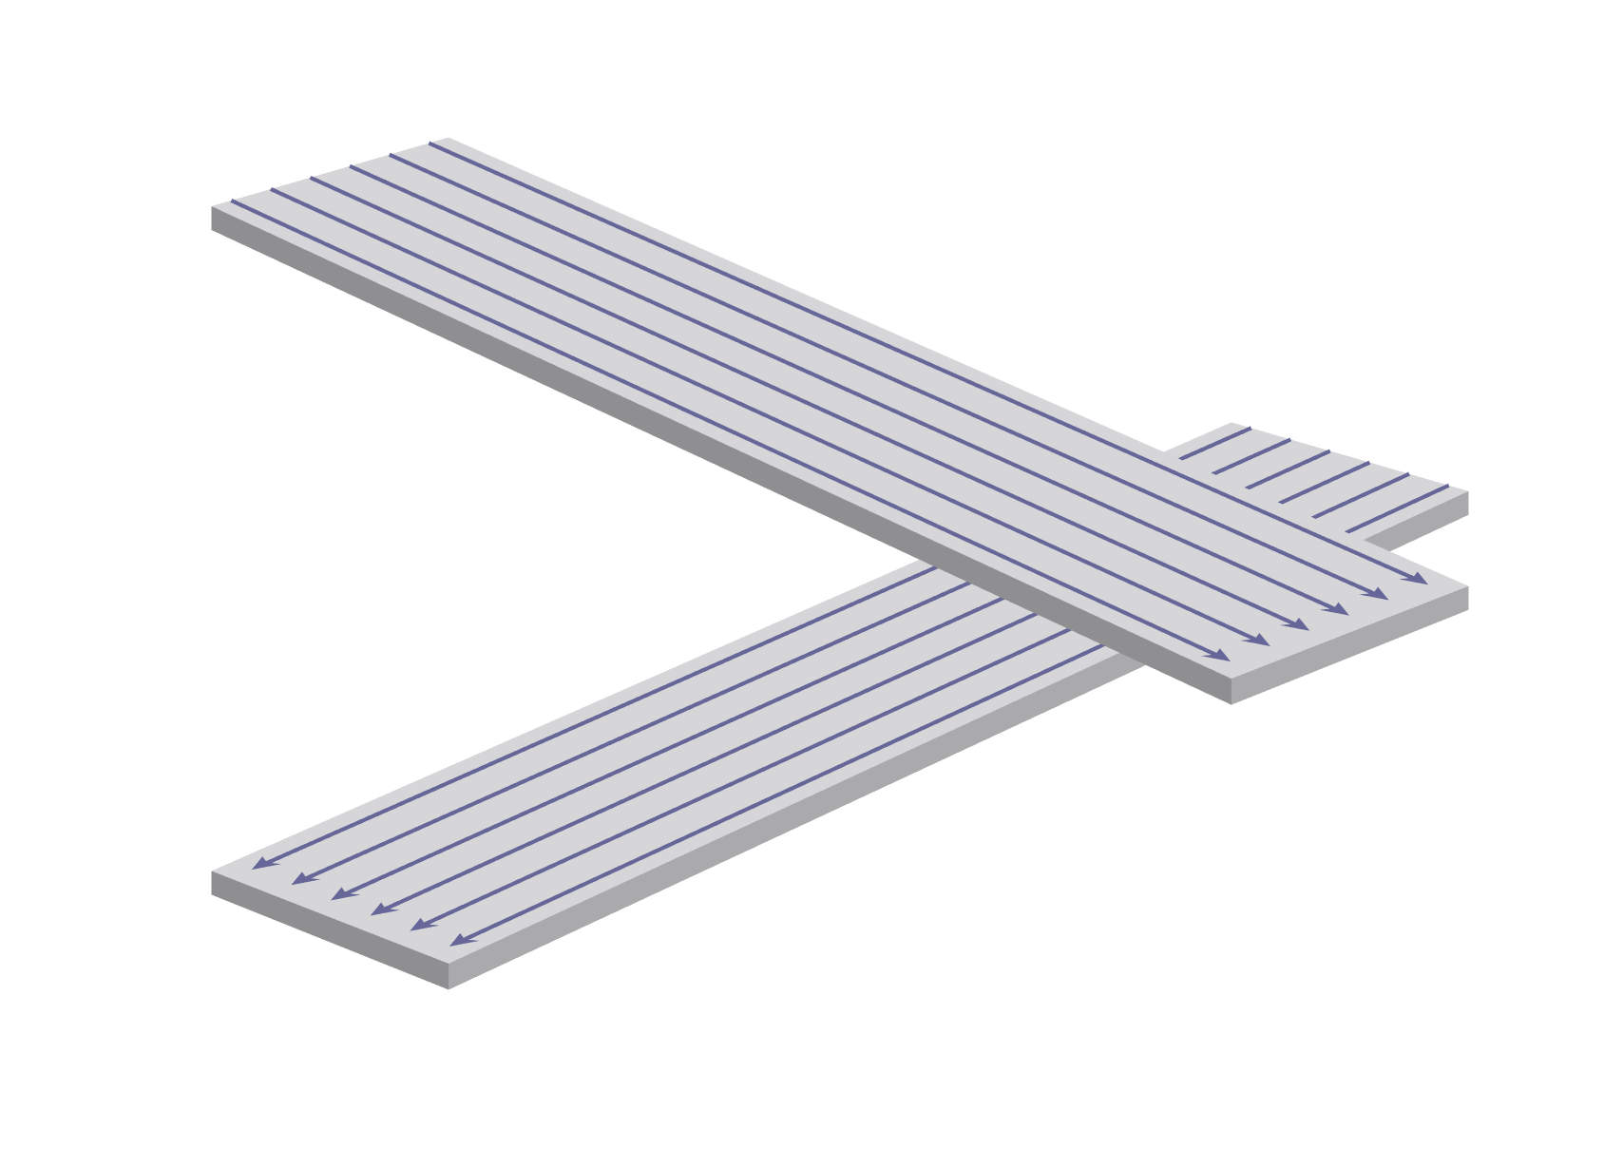
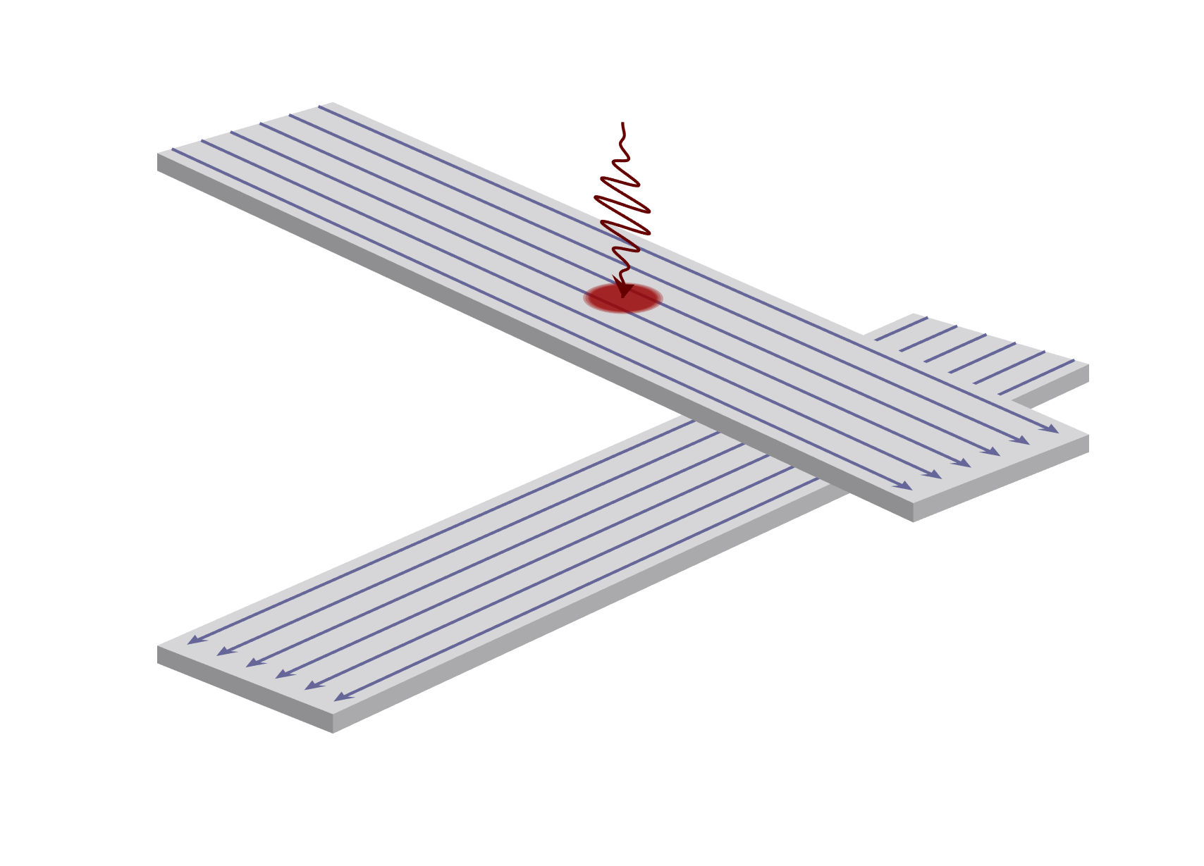
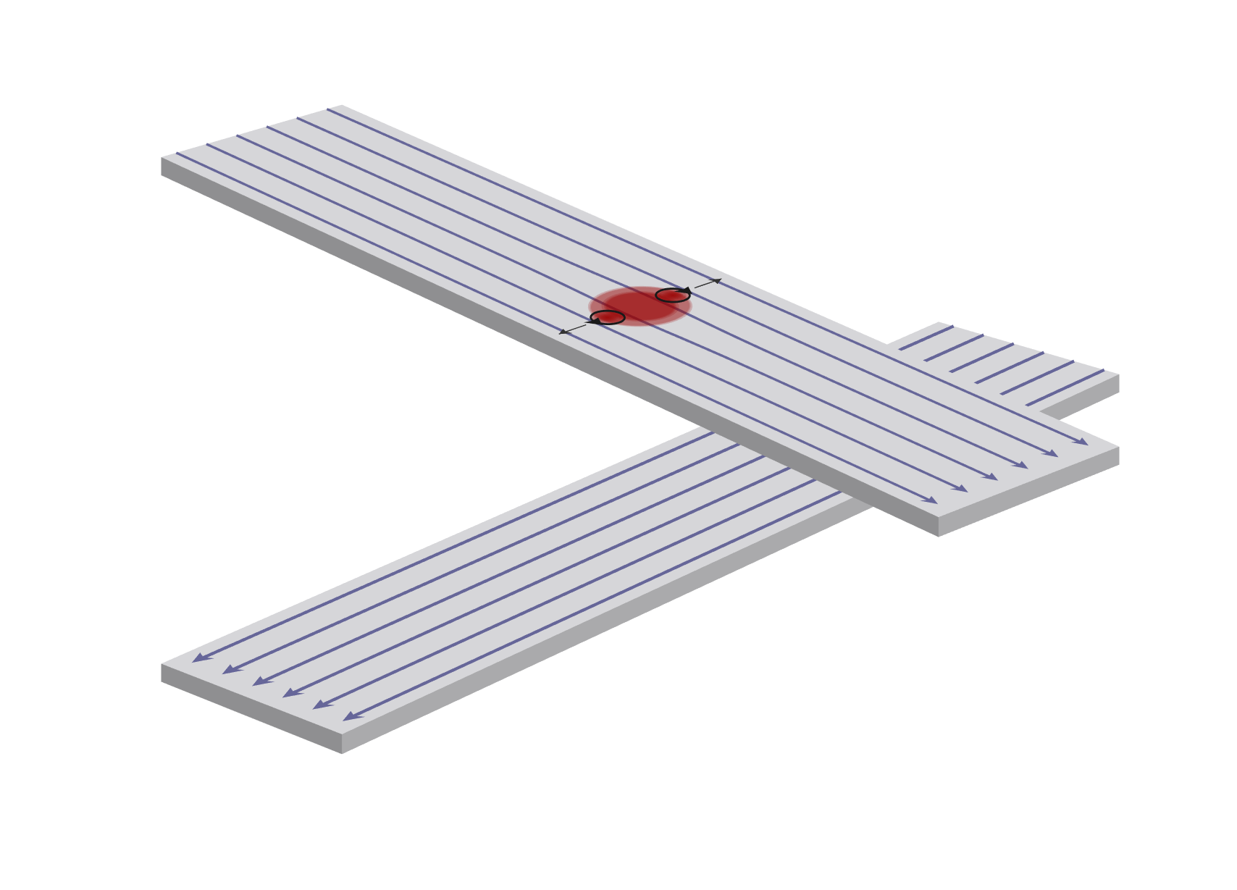
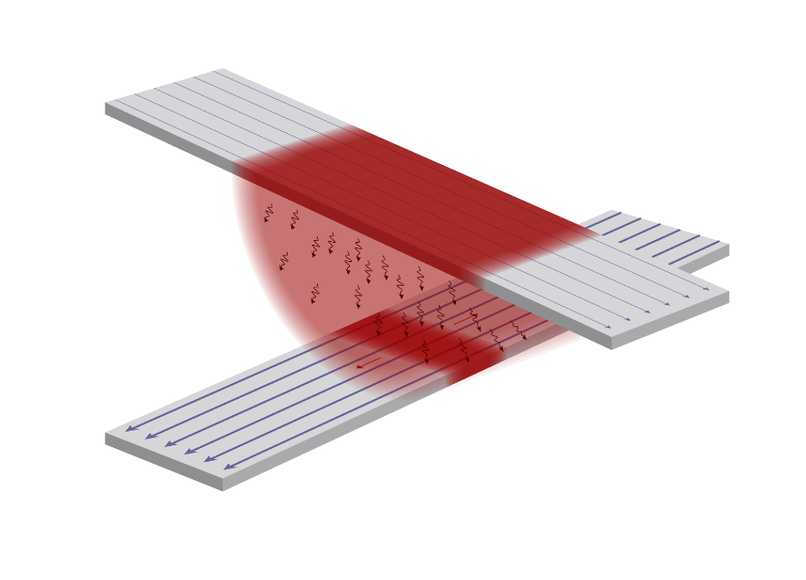
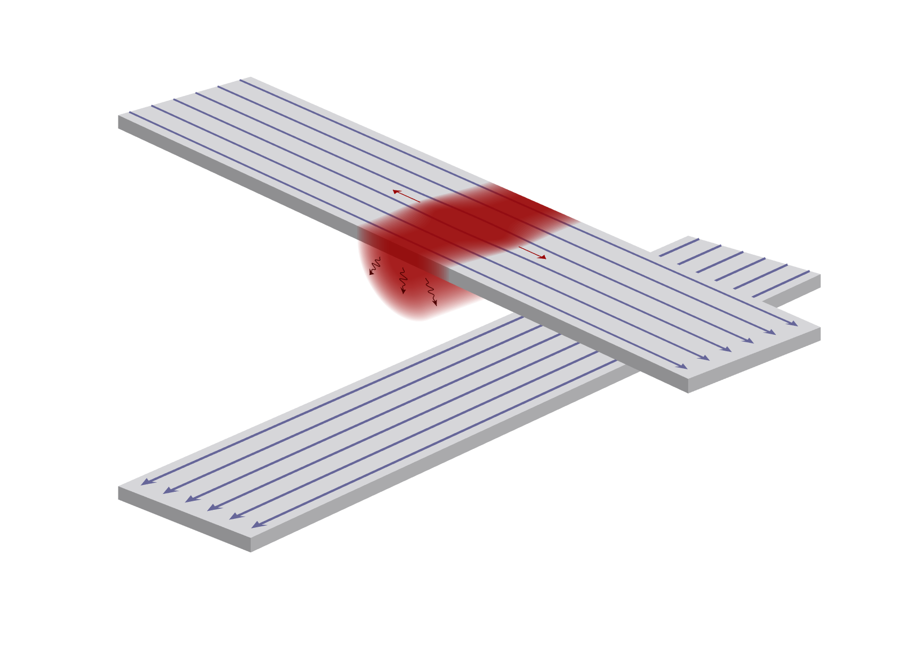
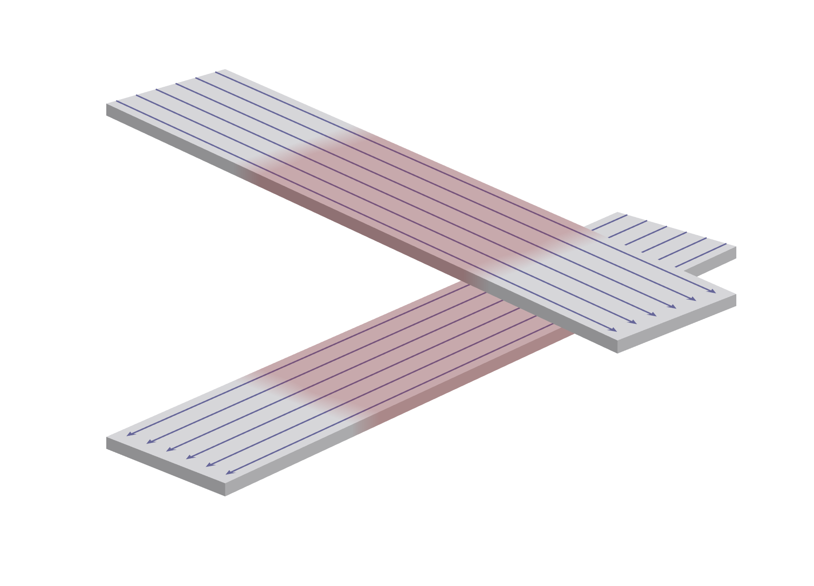
Thermal coupling between layers
Layer 1: SNSPDs = columns
Layer 2: SNSPDs = rows
On-demand read out
1 photon → 4 clicks
→ Zero read noise!
McCaughan, Zhai, Korzh, Allmaras et al, APL 121, 102602 (2022)
Allmaras, Wollman et al, Nano Letters 20, 2163–2168 (2020)

Slide 11
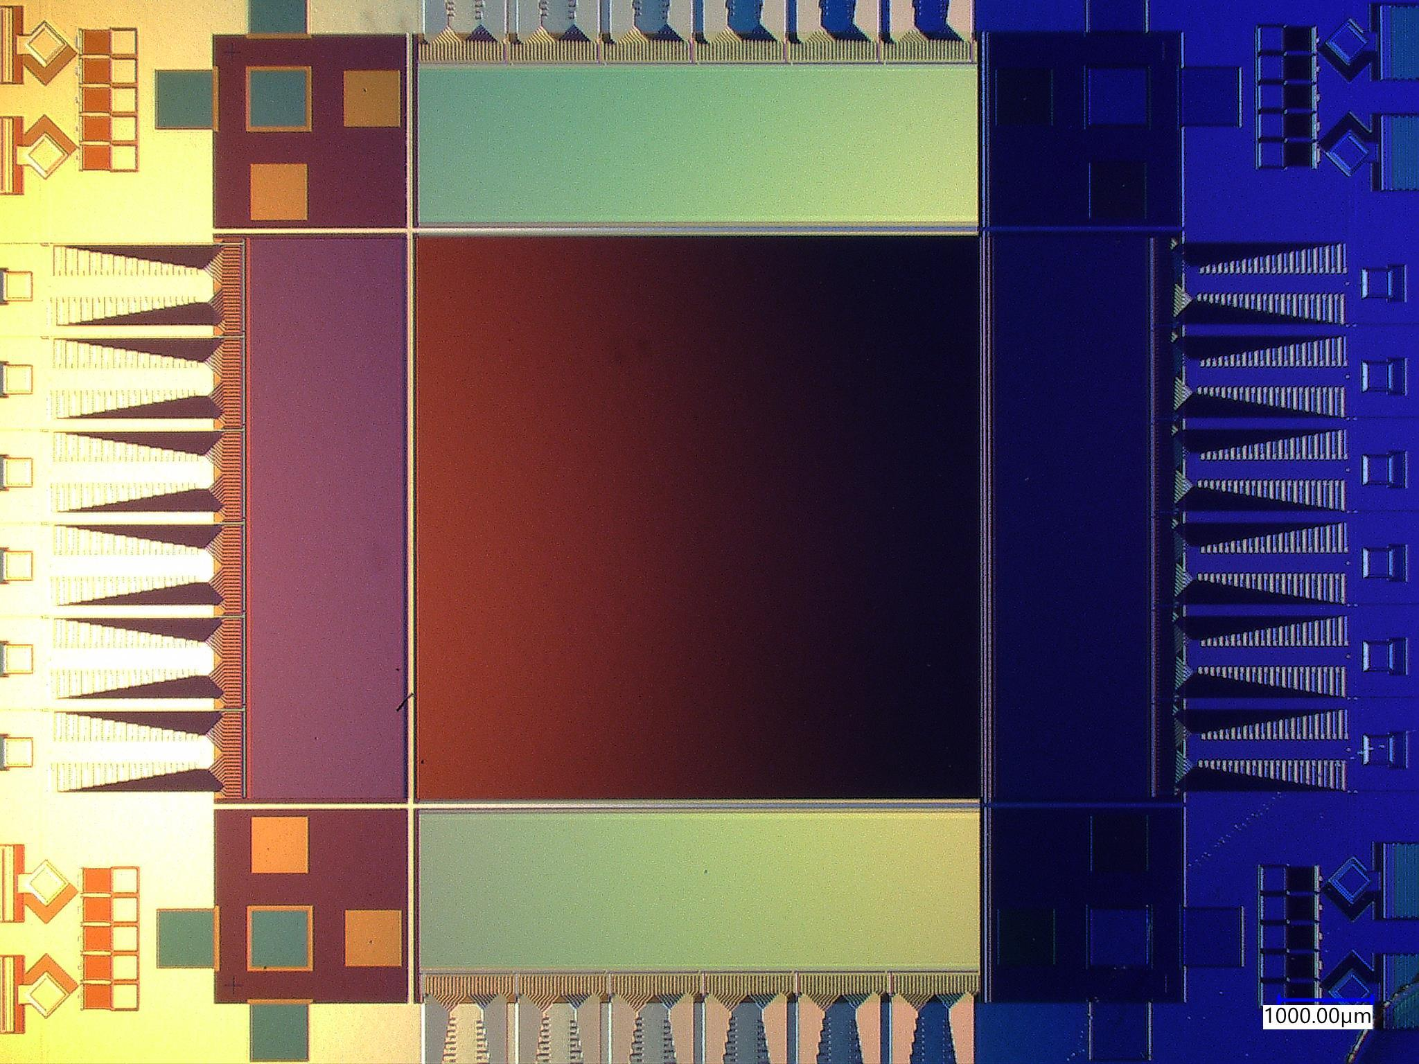
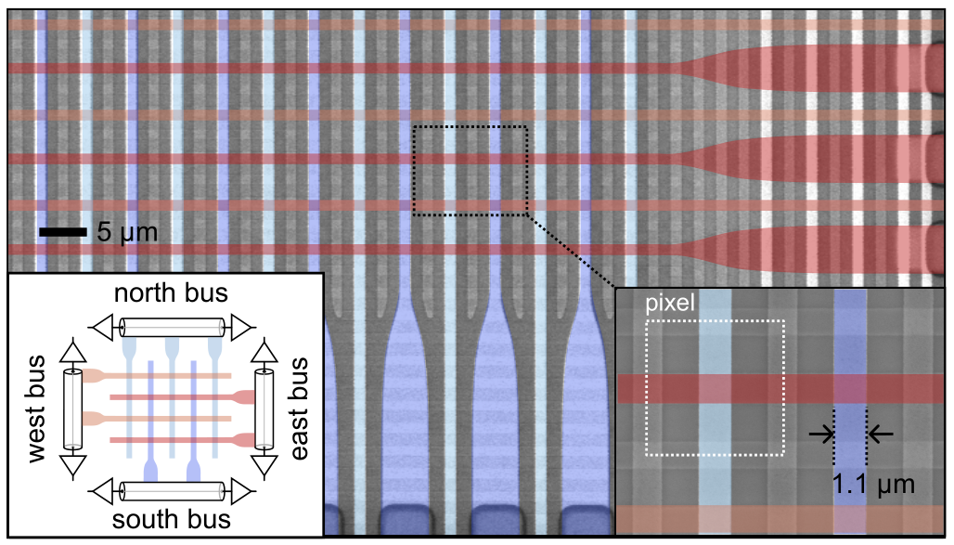

400,000 pixel camera
Gen 1. (proof-of-concept) performance:
Designed for UV-Vis
4-10% efficiency
Only due to prototype design decisions
Maximum count rates: 100 kcps
0.13 counts/sec background rate
Initially developed for photon starved applications:
Far/deep-UV Astrophysics, Earth-like exo-planet imaging
Fabricated at
Oripov, Rampini, Allmaras, Shaw, Nam, Korzh, and McCaughan, Nature 622, 730 (2023)

Slide 12
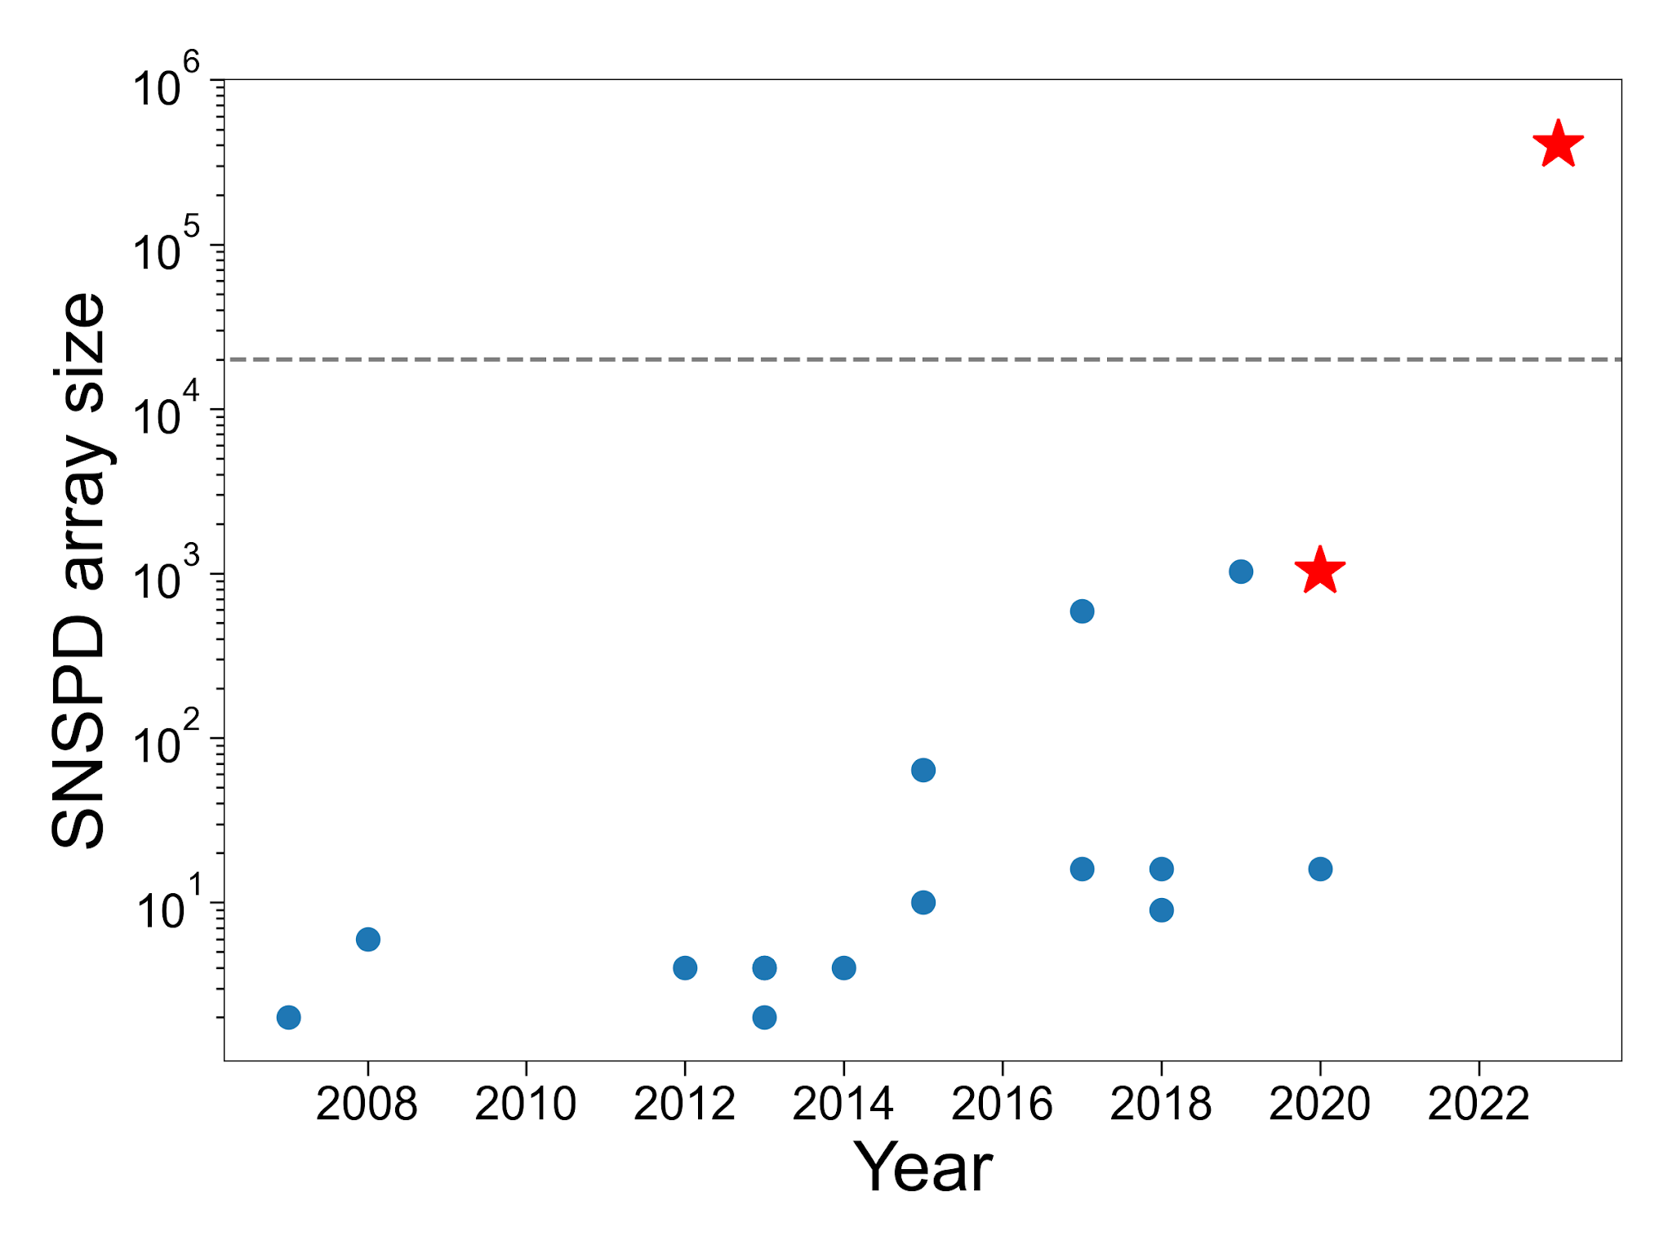
400,000 pixel camera
Largest superconducting camera by x20
MKID camera
Future work
Boost efficiency
Increase count rates for practical applications
Fabricated at
Oripov, Rampini, Allmaras, Shaw, Nam, Korzh, and McCaughan, Nature 622, 730 (2023)

Slide 13
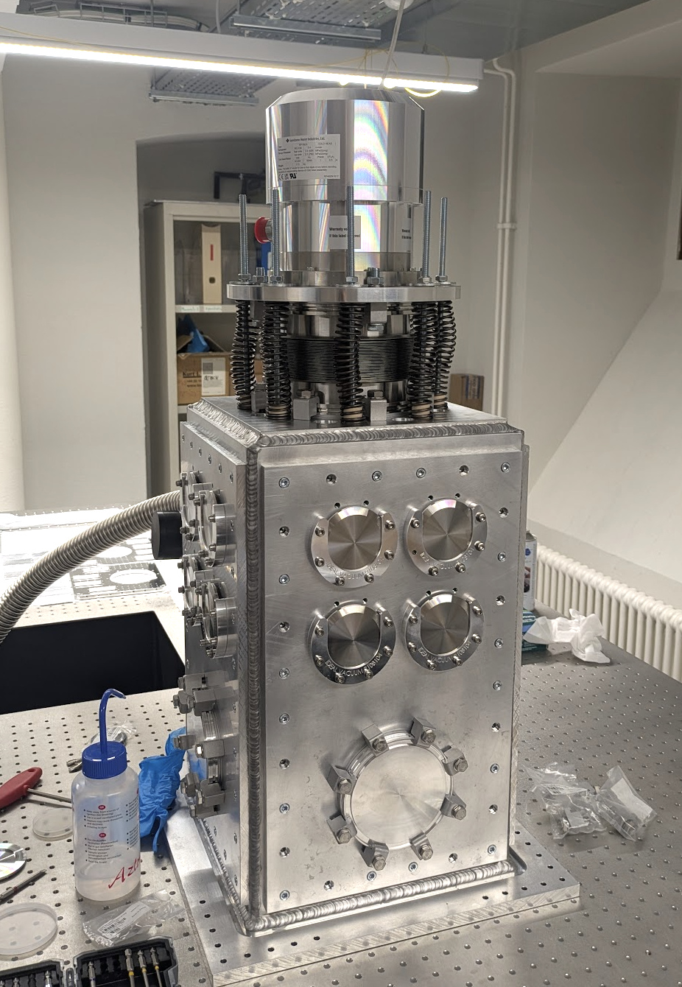
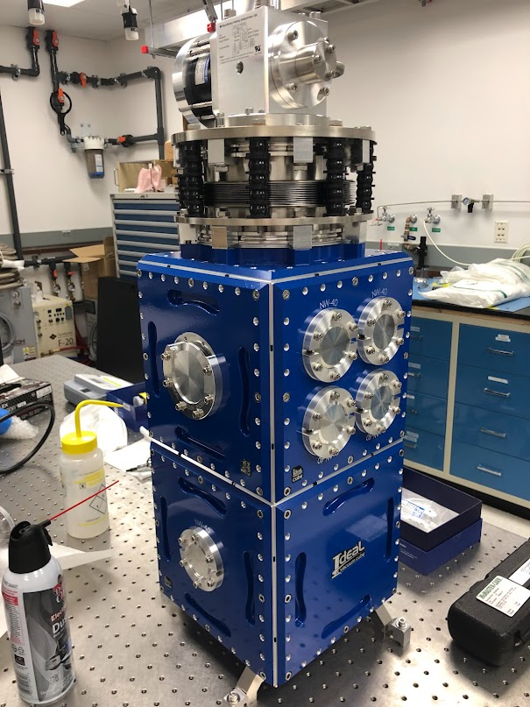
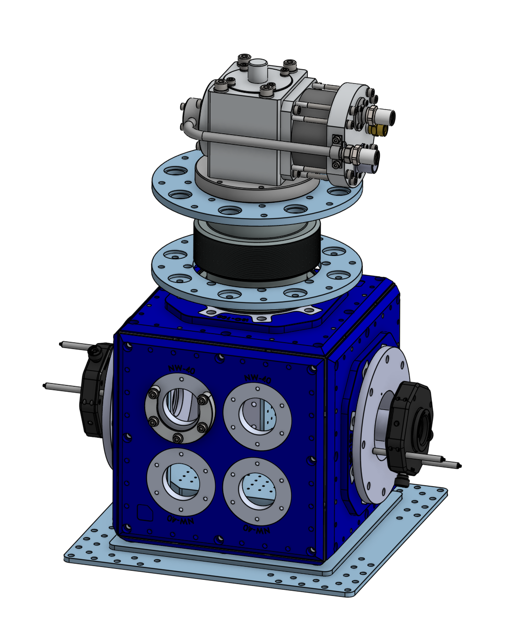
Practical closed-cycle cryogenics
‘Bottom referenced’ cryostat with panels
Compact version for 1 kelvin operation (>1 micron wavelengths)
23 cm
2 kelvin version is sufficient for <1 micron wavelengths
Direct coupling to optical table
Vibration isolation included
Designed & Fabricated at UNIGE
Mueller, Korzh, Runyan et al, Optica 8, 1586 (2021)

Slide 14
Summary
SNSPDs are fully digital and easy to customize
Single pixel devices:
Timing jitter <5 ps RMS
High efficiency for 375-1550 nm demonstrated
Up to 29 um sensitivity demonstrated
Fast count rate arrays have been instrumented on telescopes for deep-space optical communication
Being deployed at ground stations in Switzerland and internationally for space-to-ground quantum communication
2D arrays
Proof-of-principle (Gen. 1) 400,000 pixels have been demonstrated
Gen. 2 arrays will boost efficiency and count rates
1D arrays – in development
Will combine good timing resolution and high count rates
1 mm
Notes:
Condense this

Slide 15
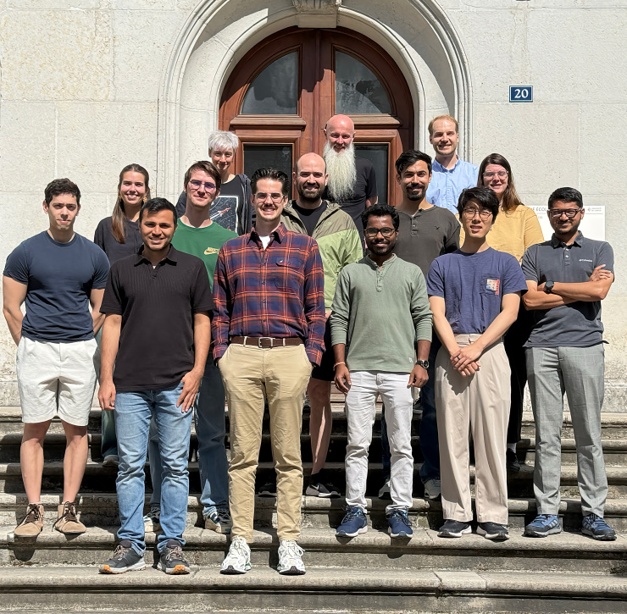

Slide 16
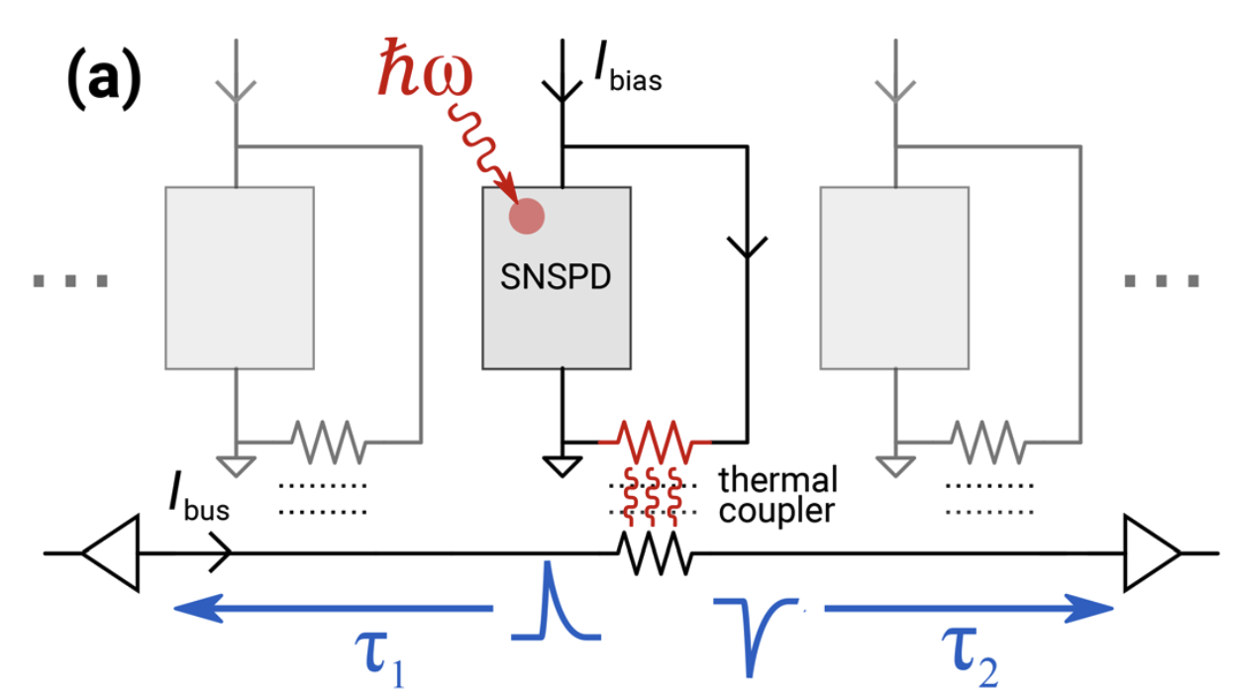


Second: Efficient multiplexing in time-domain
Time-of-flight difference in a superconducting bus
v_{ph} ≈ 0.01c (3 μm/ps) velocity helps us out this time!
→ 10 ps timing resolution enables 15 μm pixels to be resolved
McCaughan, Zhai, Korzh, Allmaras et al, APL 121, 102602 (2022)

Slide 17
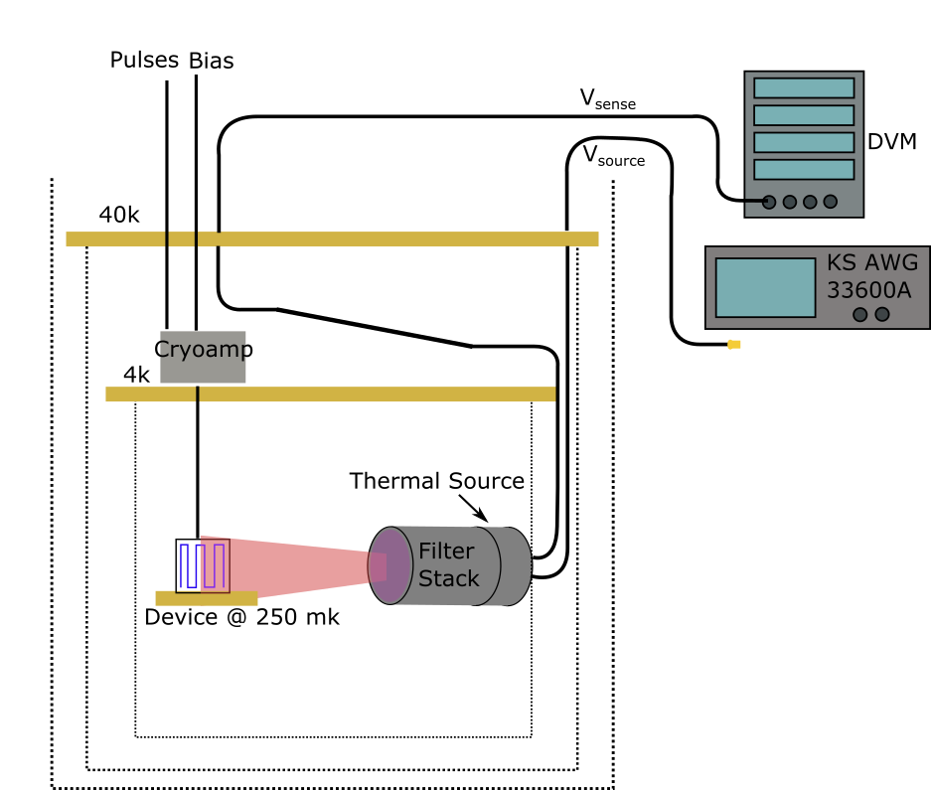
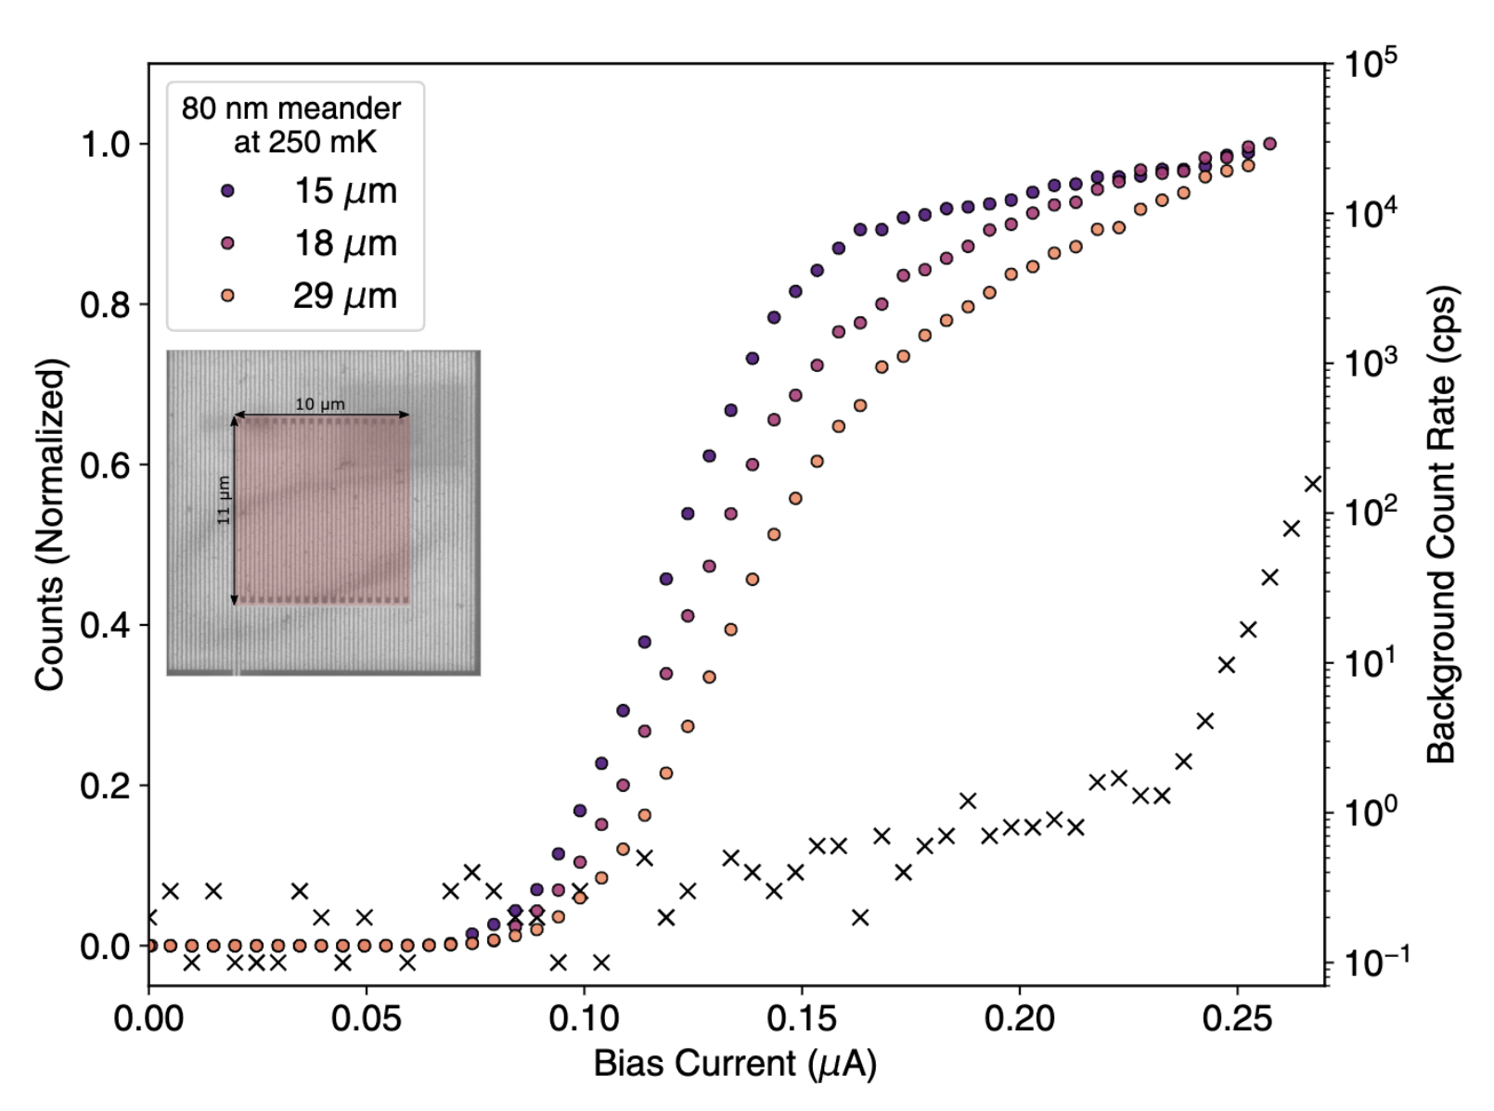
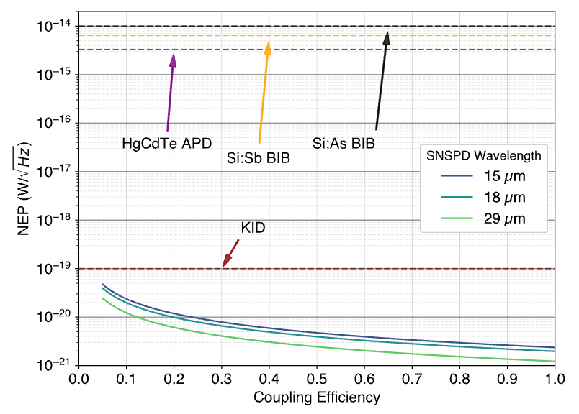
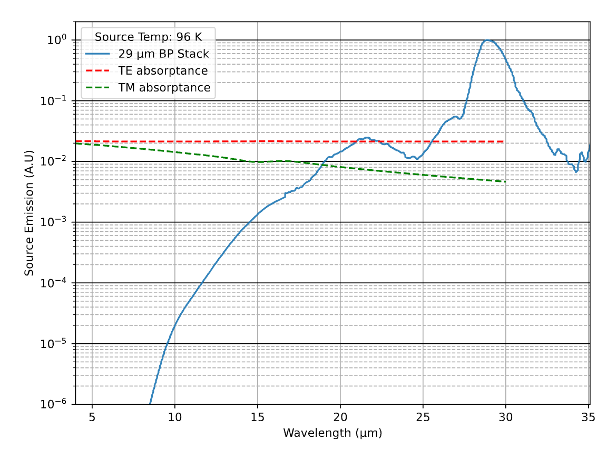
Far-IR – 43 meV (29 μm)
Taylor et al. 2023. “Low-Noise Single-Photon Counting Superconducting Nanowire Detectors at Infrared Wavelengths up to 29 Μm.” Optica 10: 1672.
Notes:
Really visualize the SNSPD and this forms the story

Slide 18
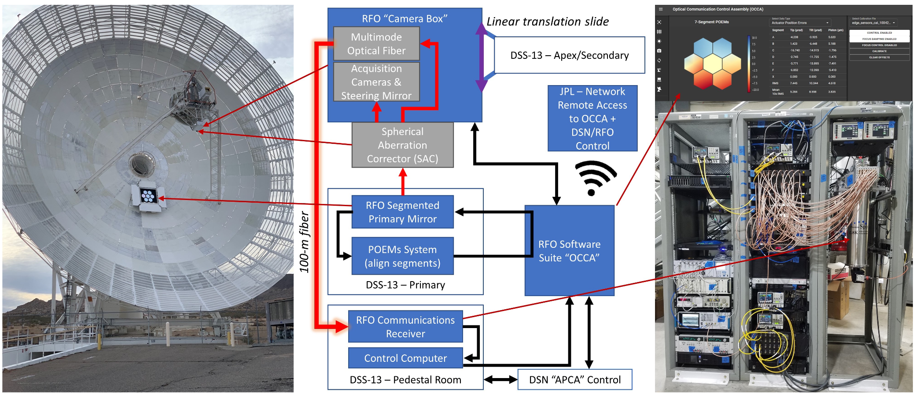
2nd Ground receiver in California - Goldstone
Allmaras, J., Korzh, B., Beyer, A., & Wollman, E. (2023). Large-area SNSPD array for RF/optical hybrid 7-segment pathfinder receiver. https://www.spiedigitallibrary.org/proceedings/Download?urlId=10.1117%2F12.2655467

