Slide 1
THz Time Domain Spectroscopy
for In-Situ Space Exploration
Linus Leo Stöckli, SIAPS 2026

Slide 2

Exploration

Slide 3


Slide 4


Slide 5


Slide 6
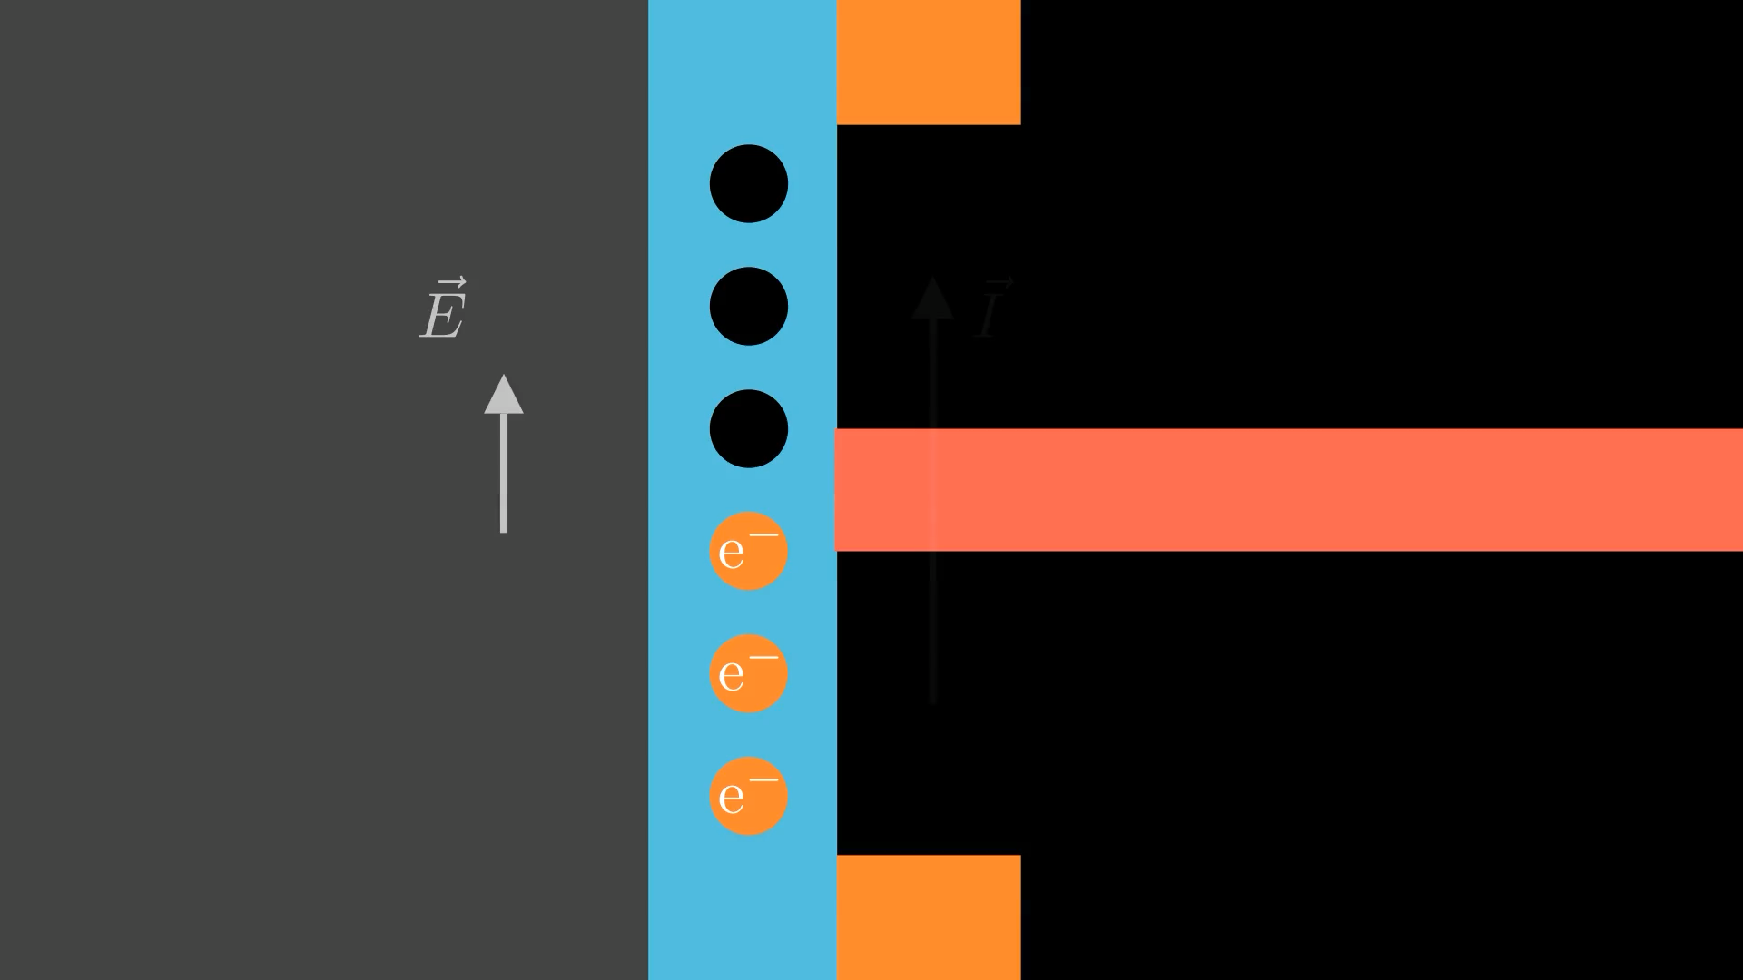

Slide 7
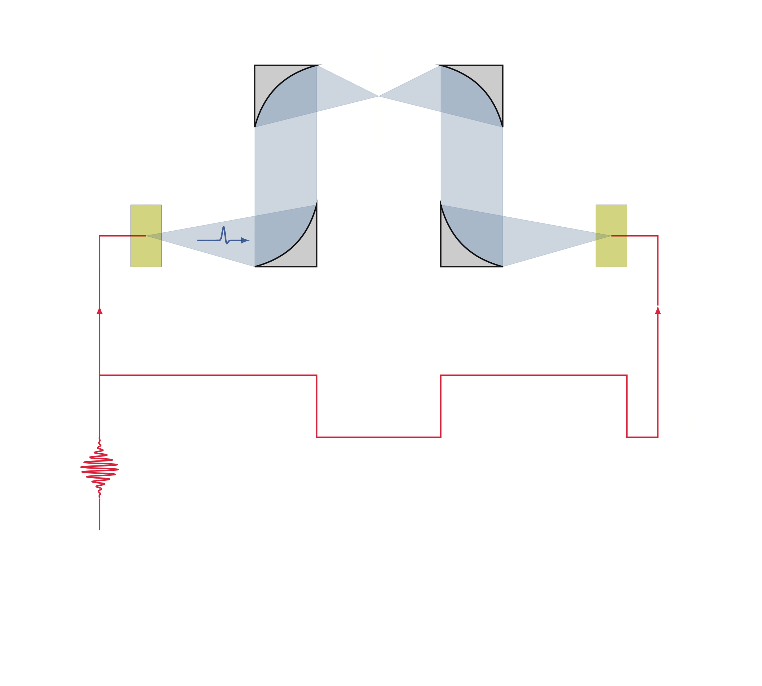
THz Spectrometer
Pulsed Laser (fs)
Photoconductive Antennas
Slow Delay Line
Fast Delay Line

Slide 9
THz Time Domain Spectroscopy
Time Domain Measurements (TOF)
FFT
  Phase
    Complex Refractive Index
  Absorption Coefficient
    Insights into Lattice Dynamics, Phonons, Free Charges

Slide 10

COCoNuT
Characteristic Observation of Cometary Nuclei using THz spectroscopy

Slide 12

Design
Spectro - Goniometer
32° - 180°, 0.5° steps
104 mm x 104 mm, 0.01 mm steps

Slide 13
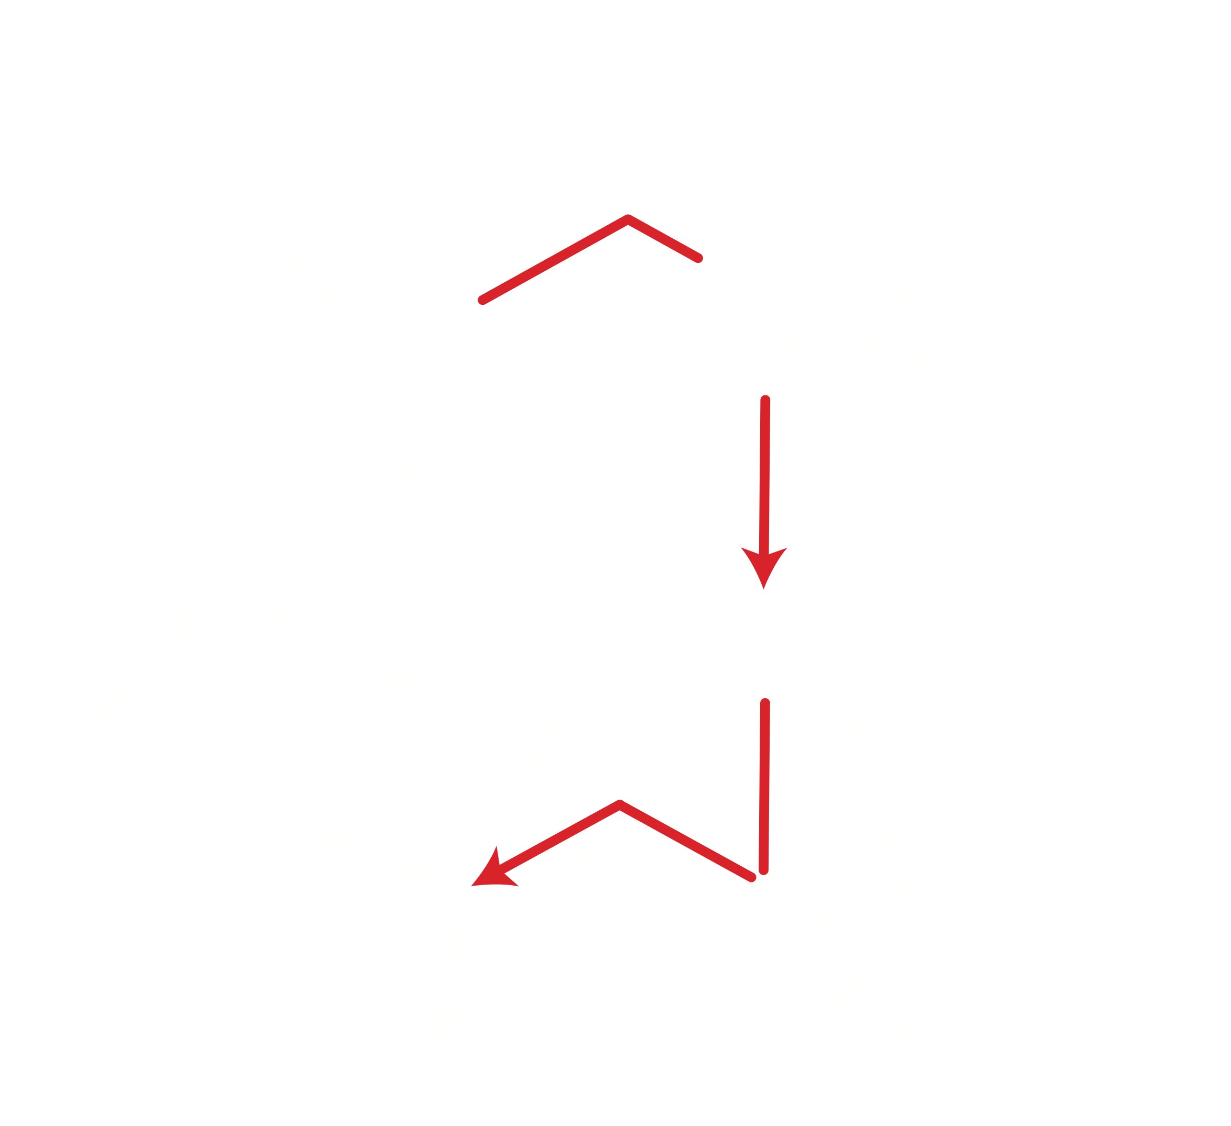
Design
Spectro - Goniometer
32° - 180°, 0.5° steps
104 mm x 104 mm, 0.01 mm steps

Slide 14
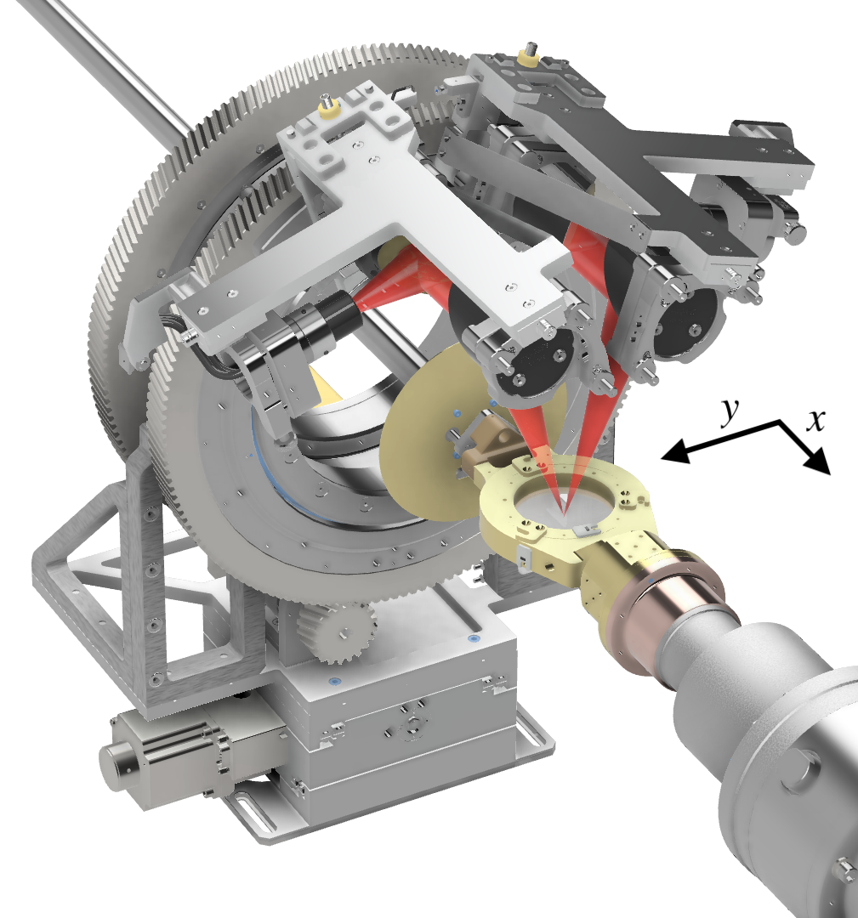
Design
Spectro - Goniometer
32° - 180°, 0.5° steps
104 mm x 104 mm, 0.01 mm steps

Slide 15
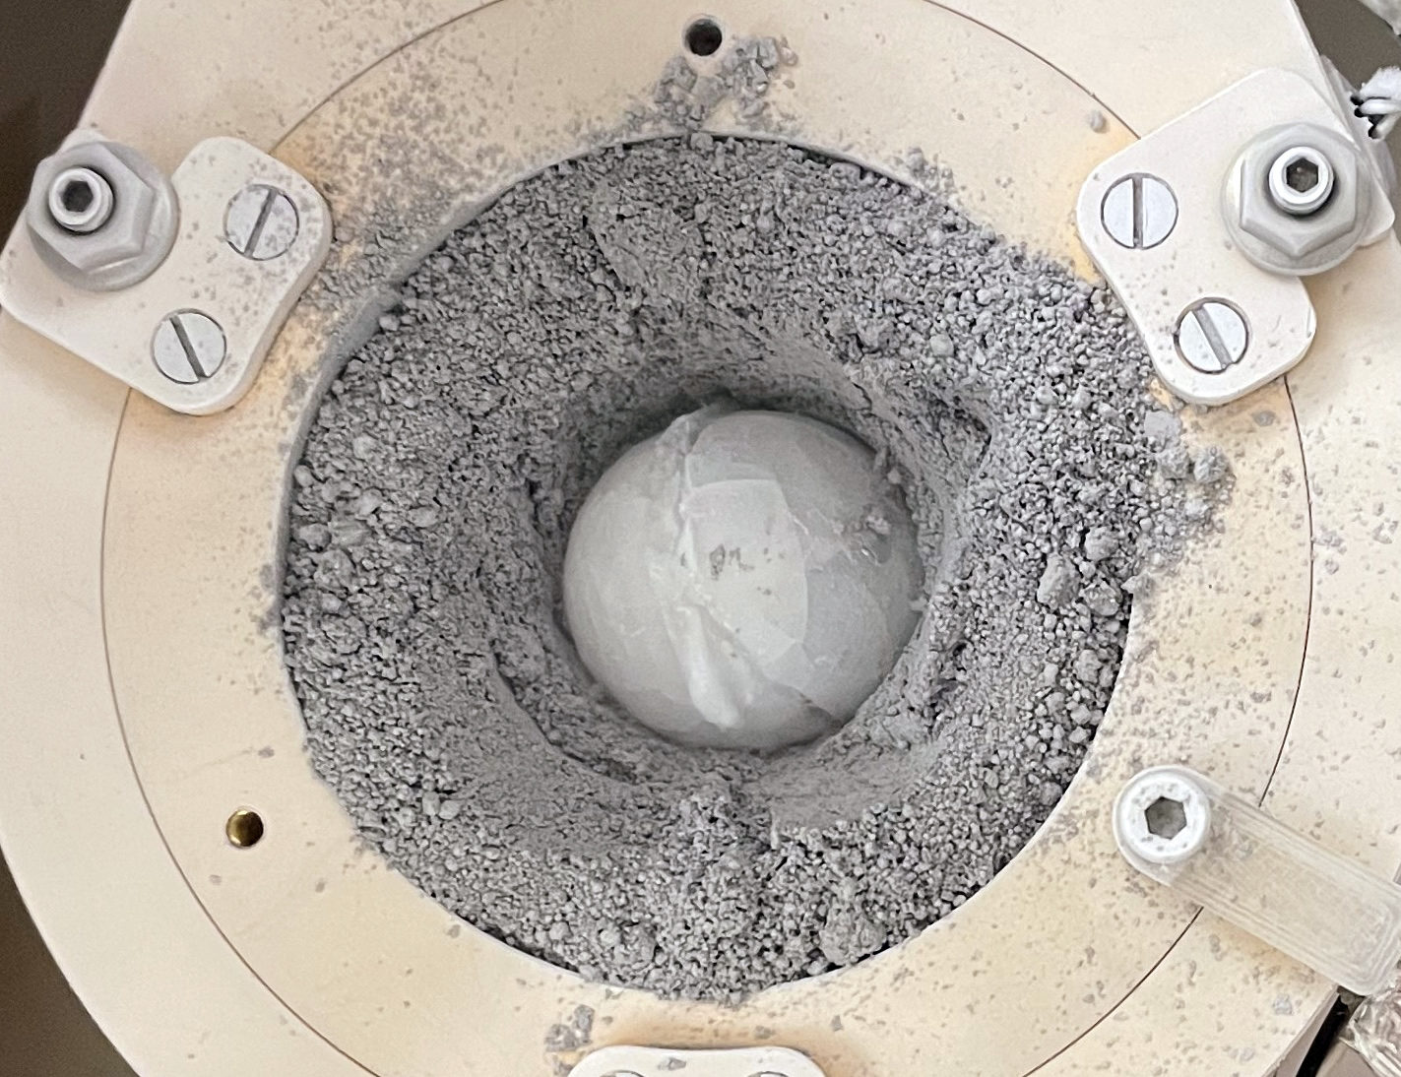
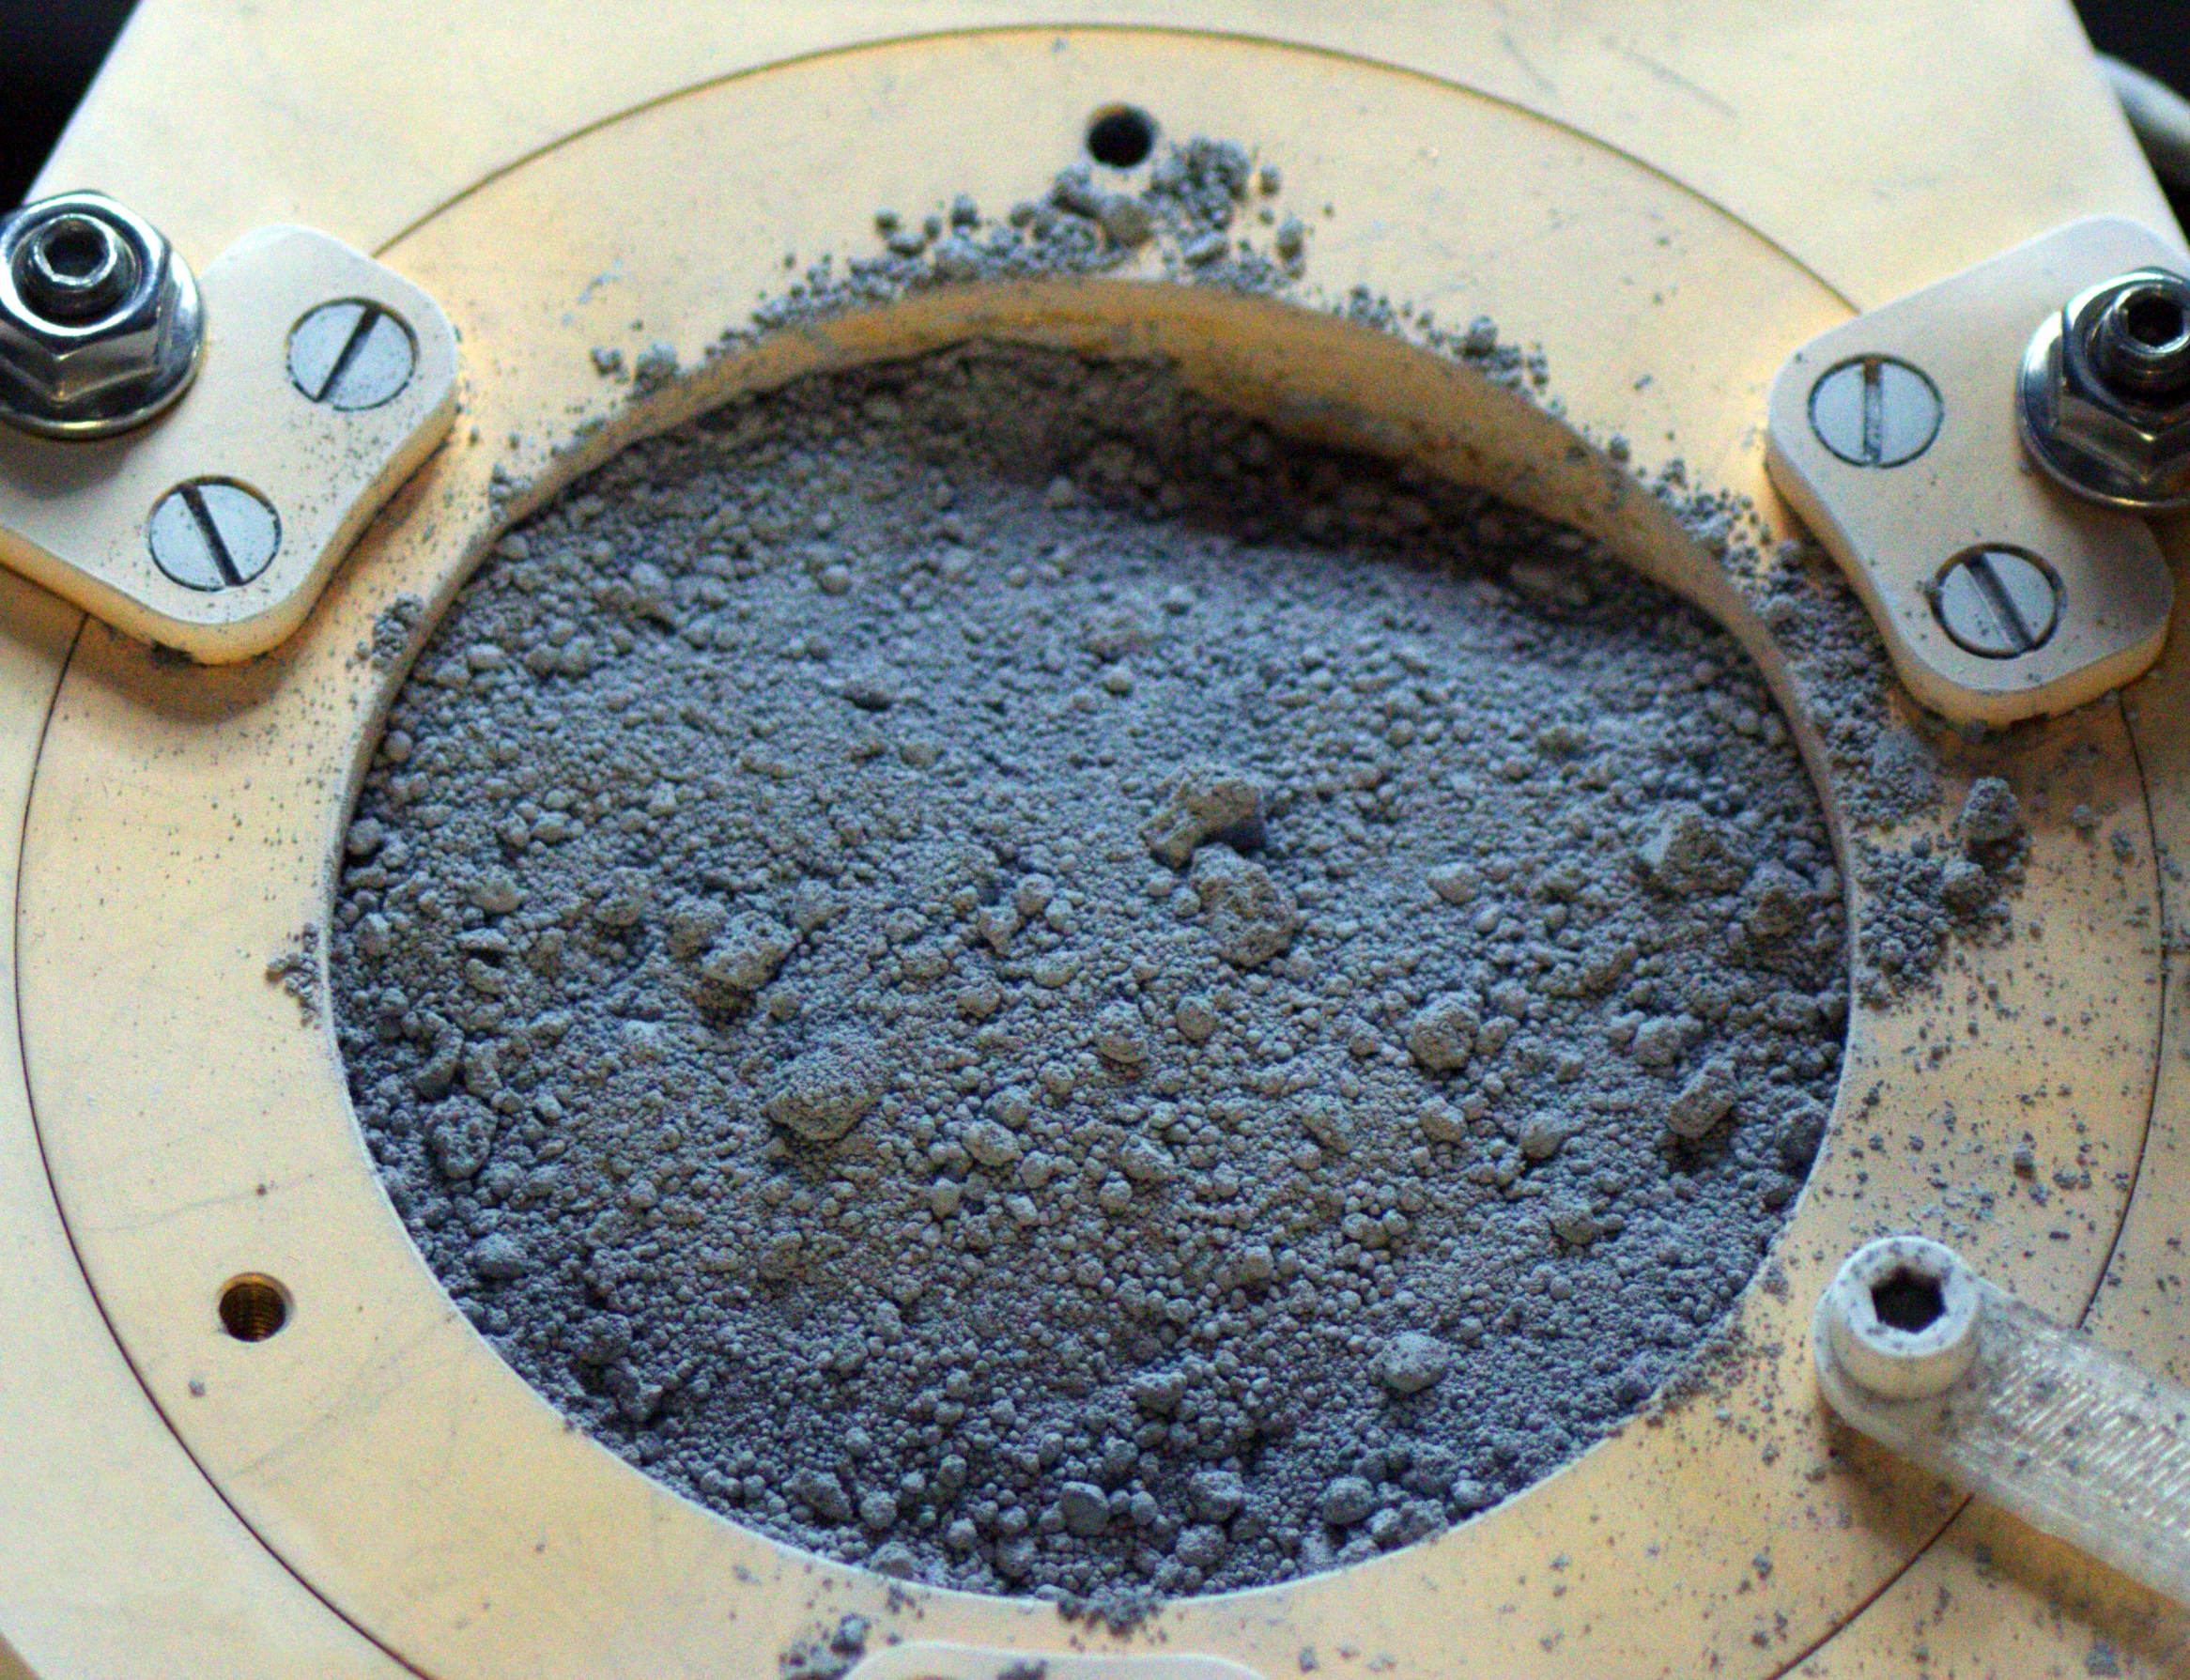
Detecting Pebbles
Surface and Sub-Surface
Pebble in sample holder
Covered with 2 - 3 mm CoDA-T3
Transmission and reflection

Slide 16
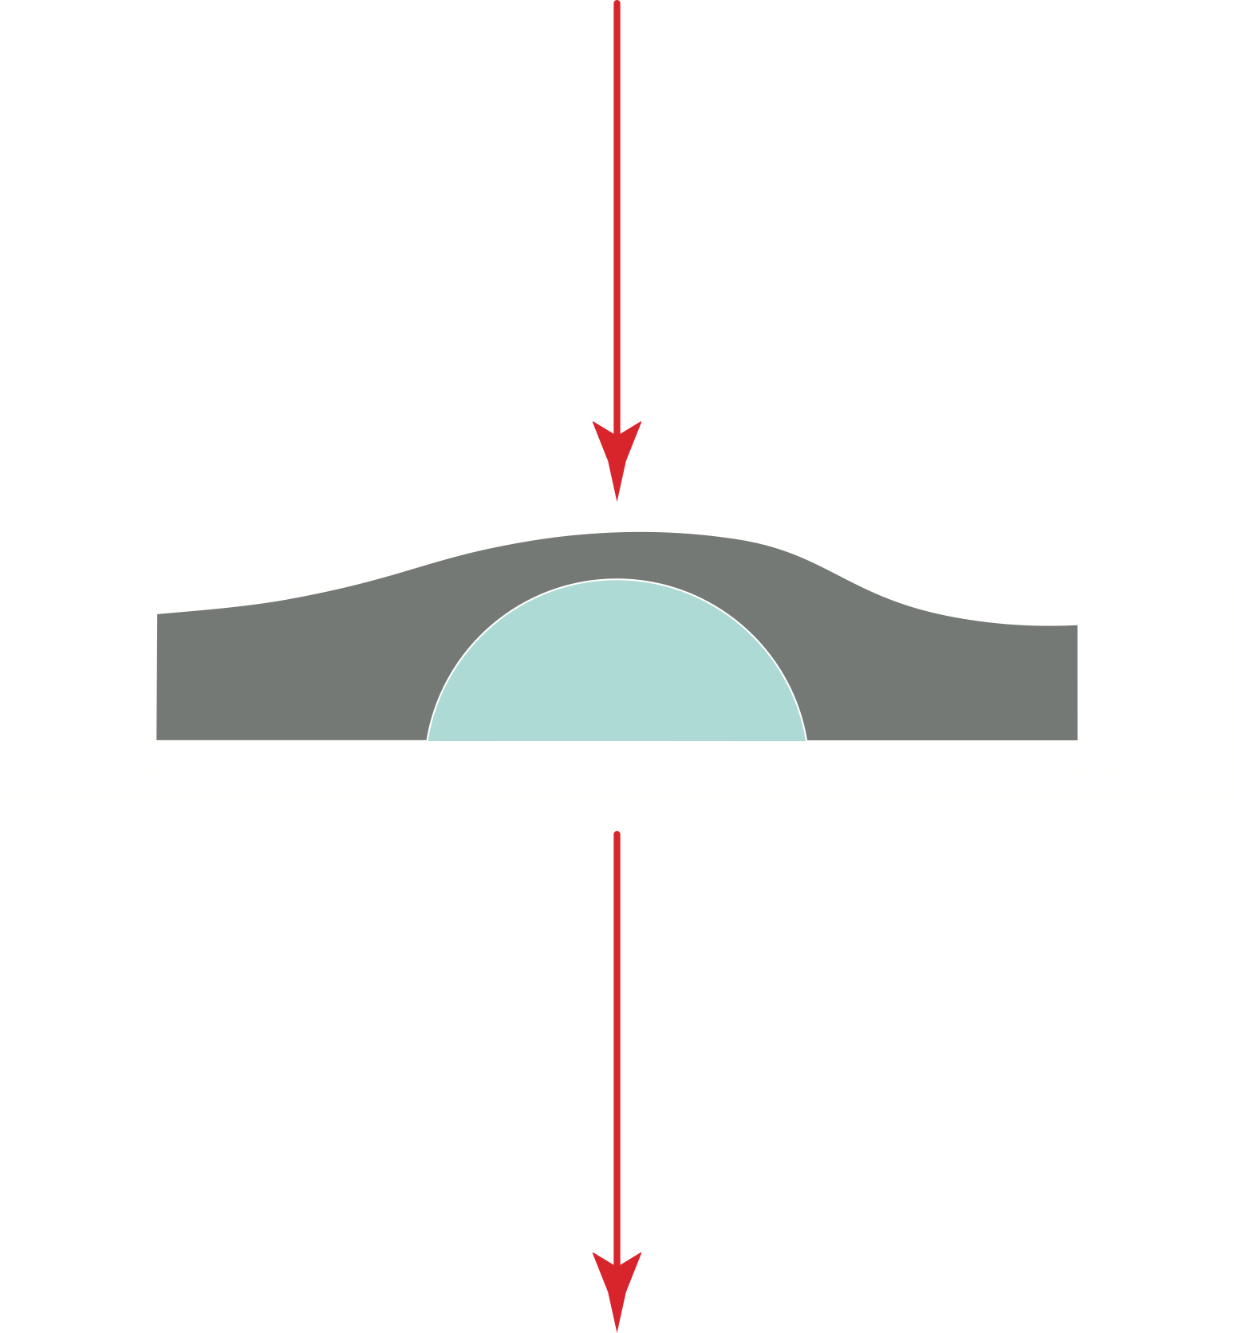
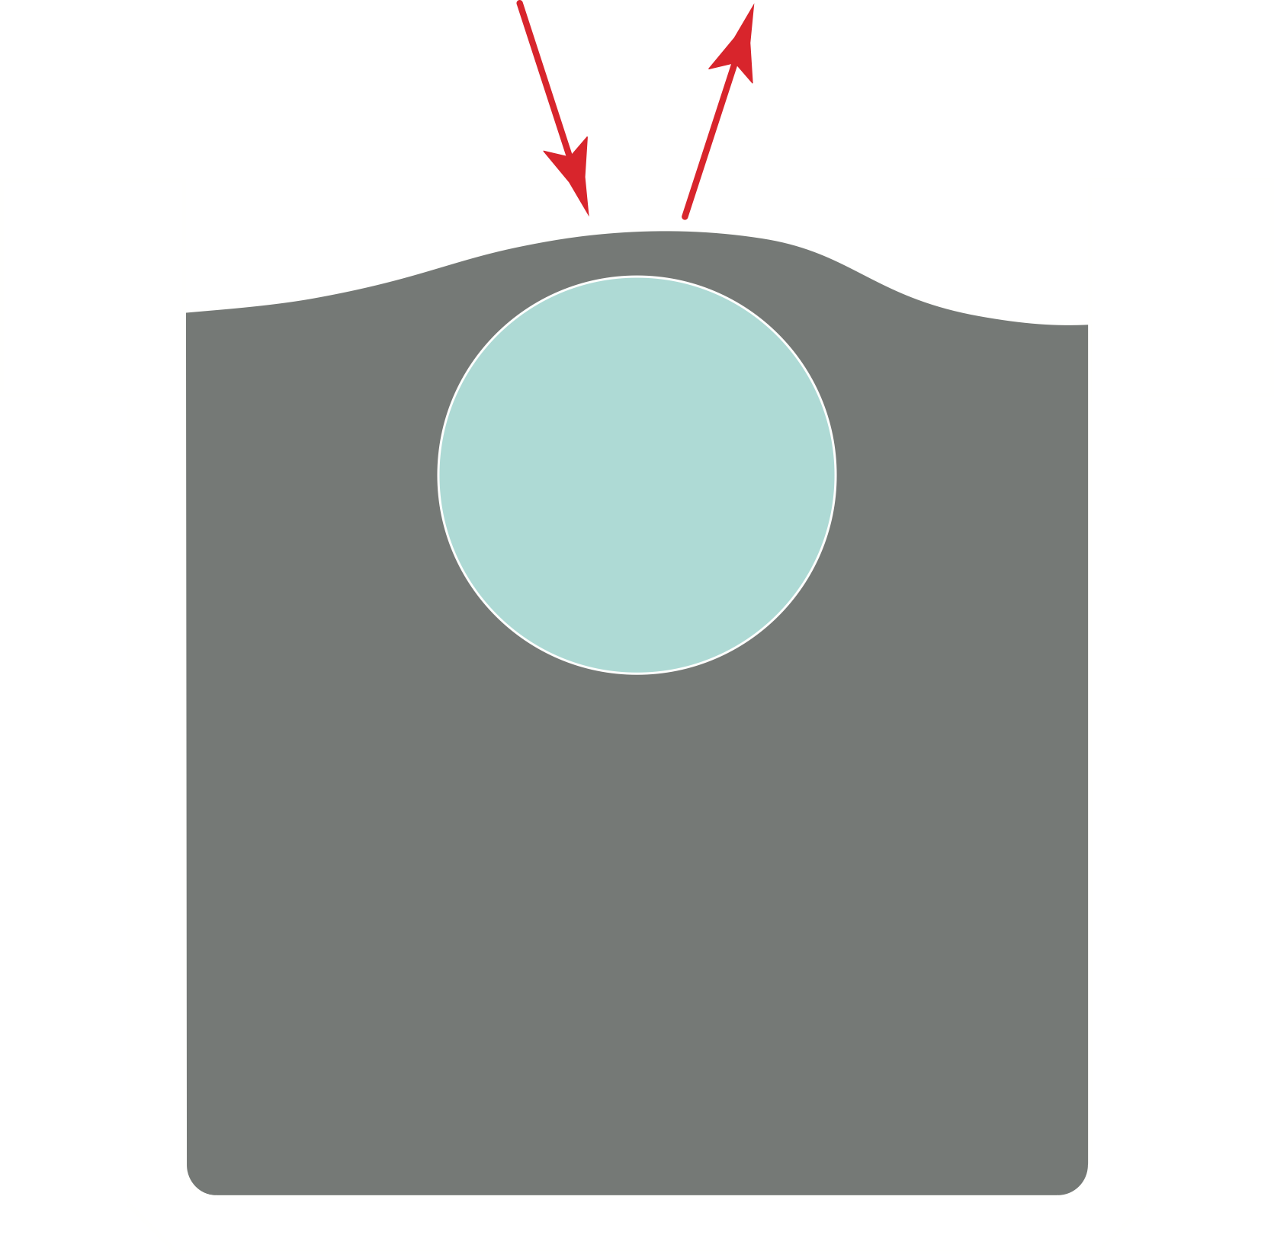
Detecting Pebbles
Surface and Sub-Surface
2mm Silicon window

Slide 17
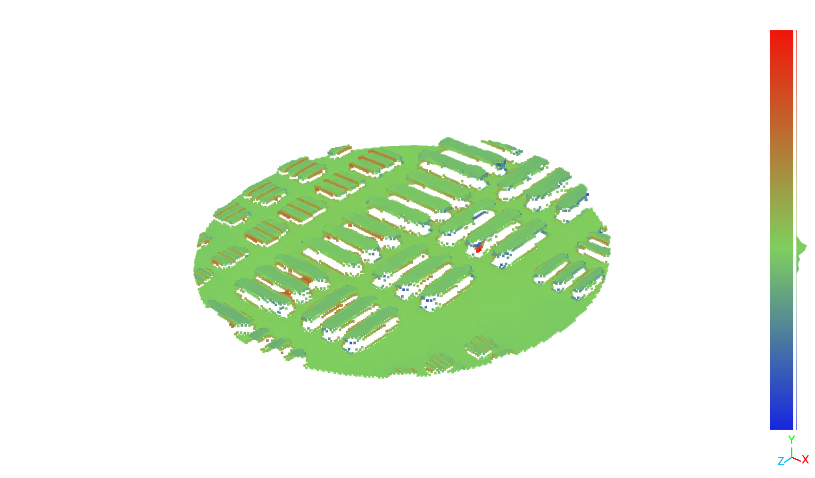
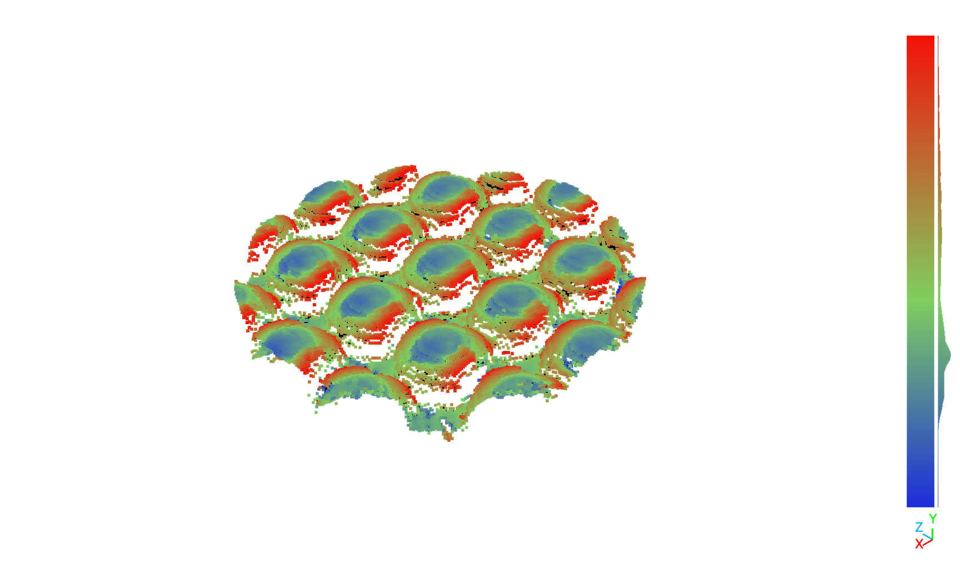
THz Tomography
Surface

Slide 18
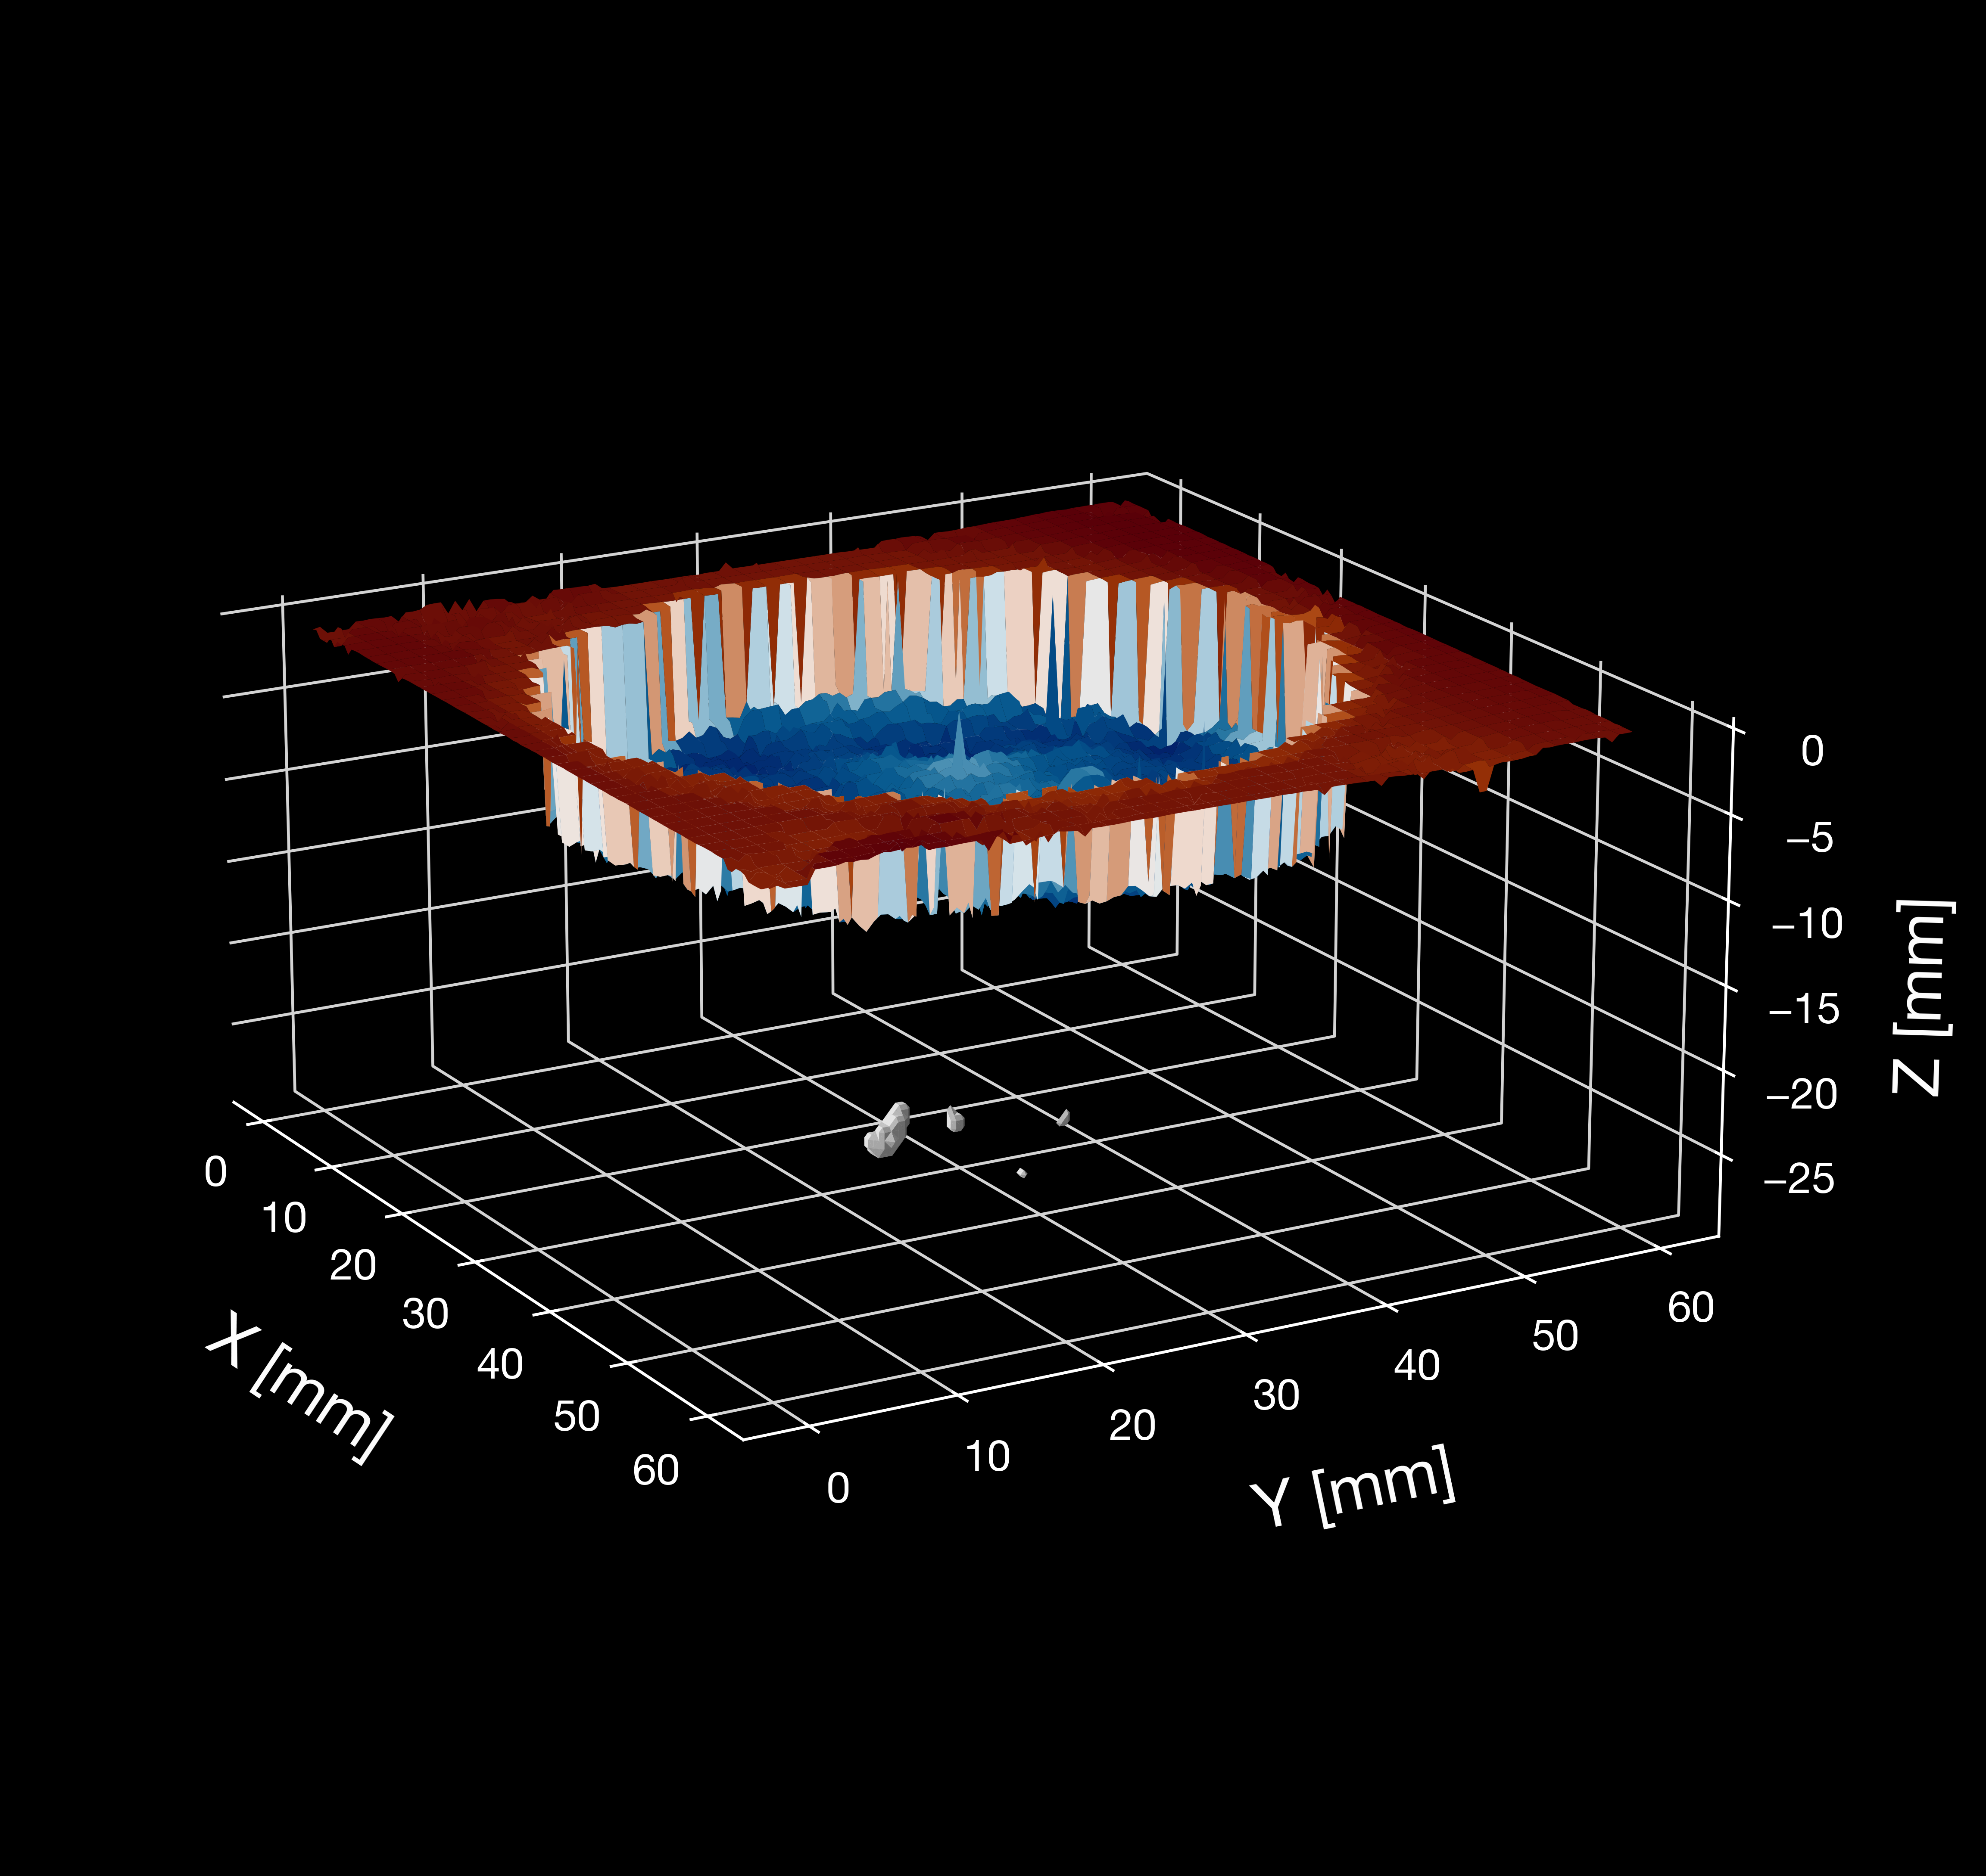
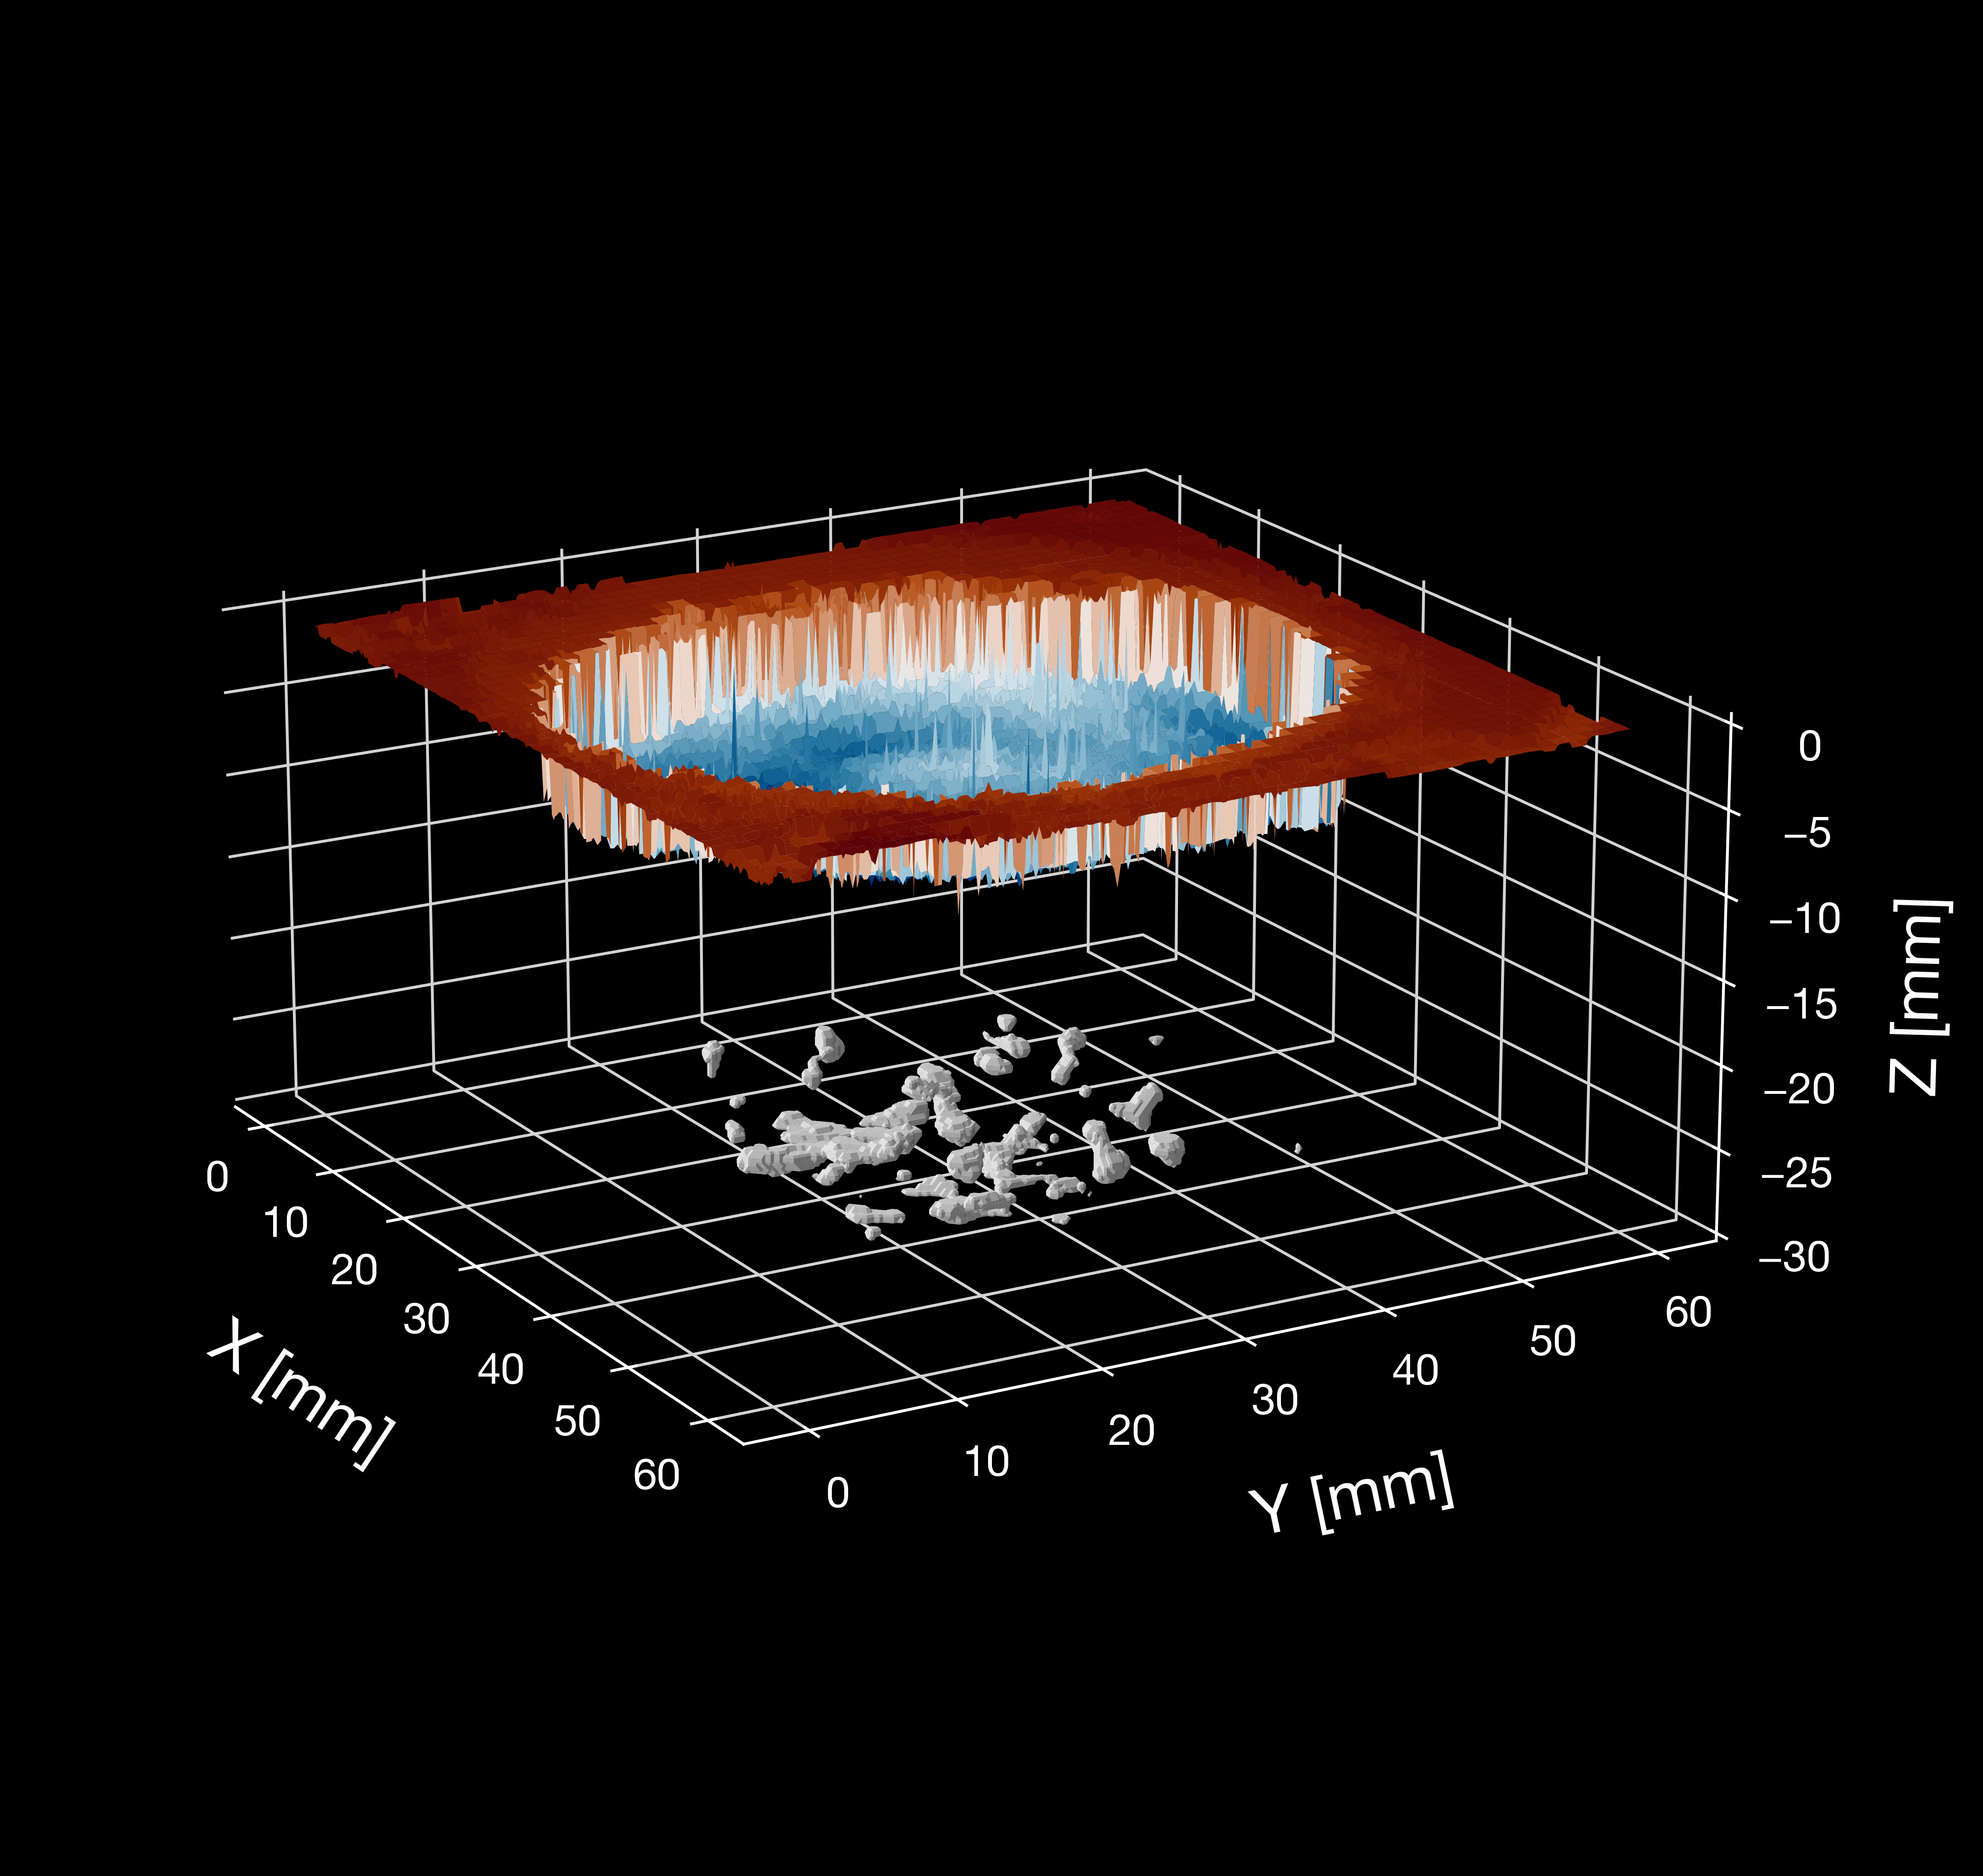
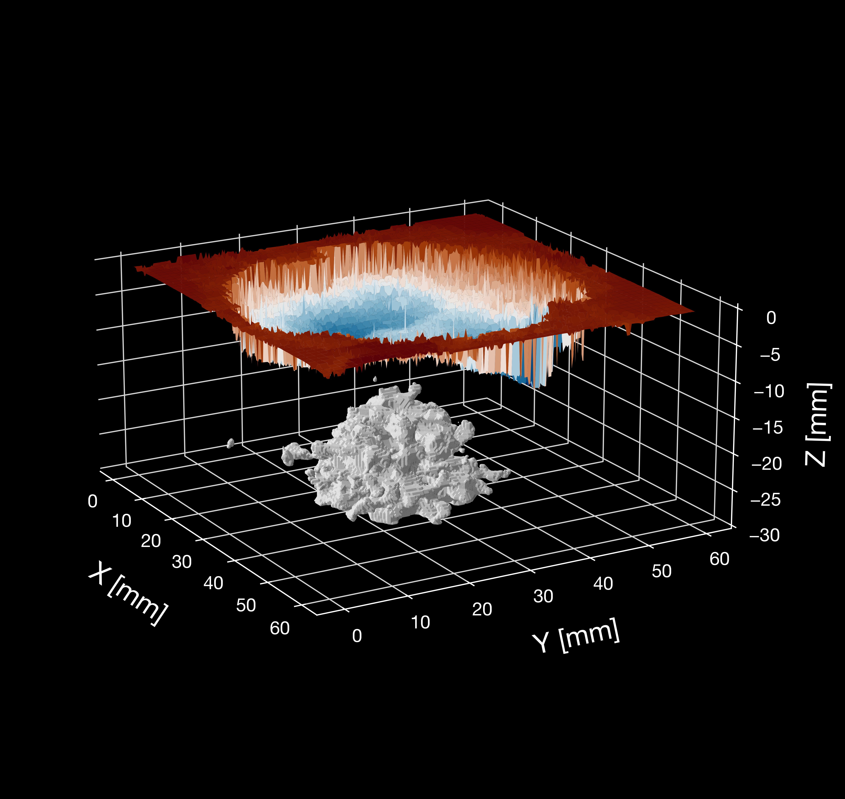
THz Tomography
Sub-Surface
Control
SPIPA-B
Solid Ice

Slide 19
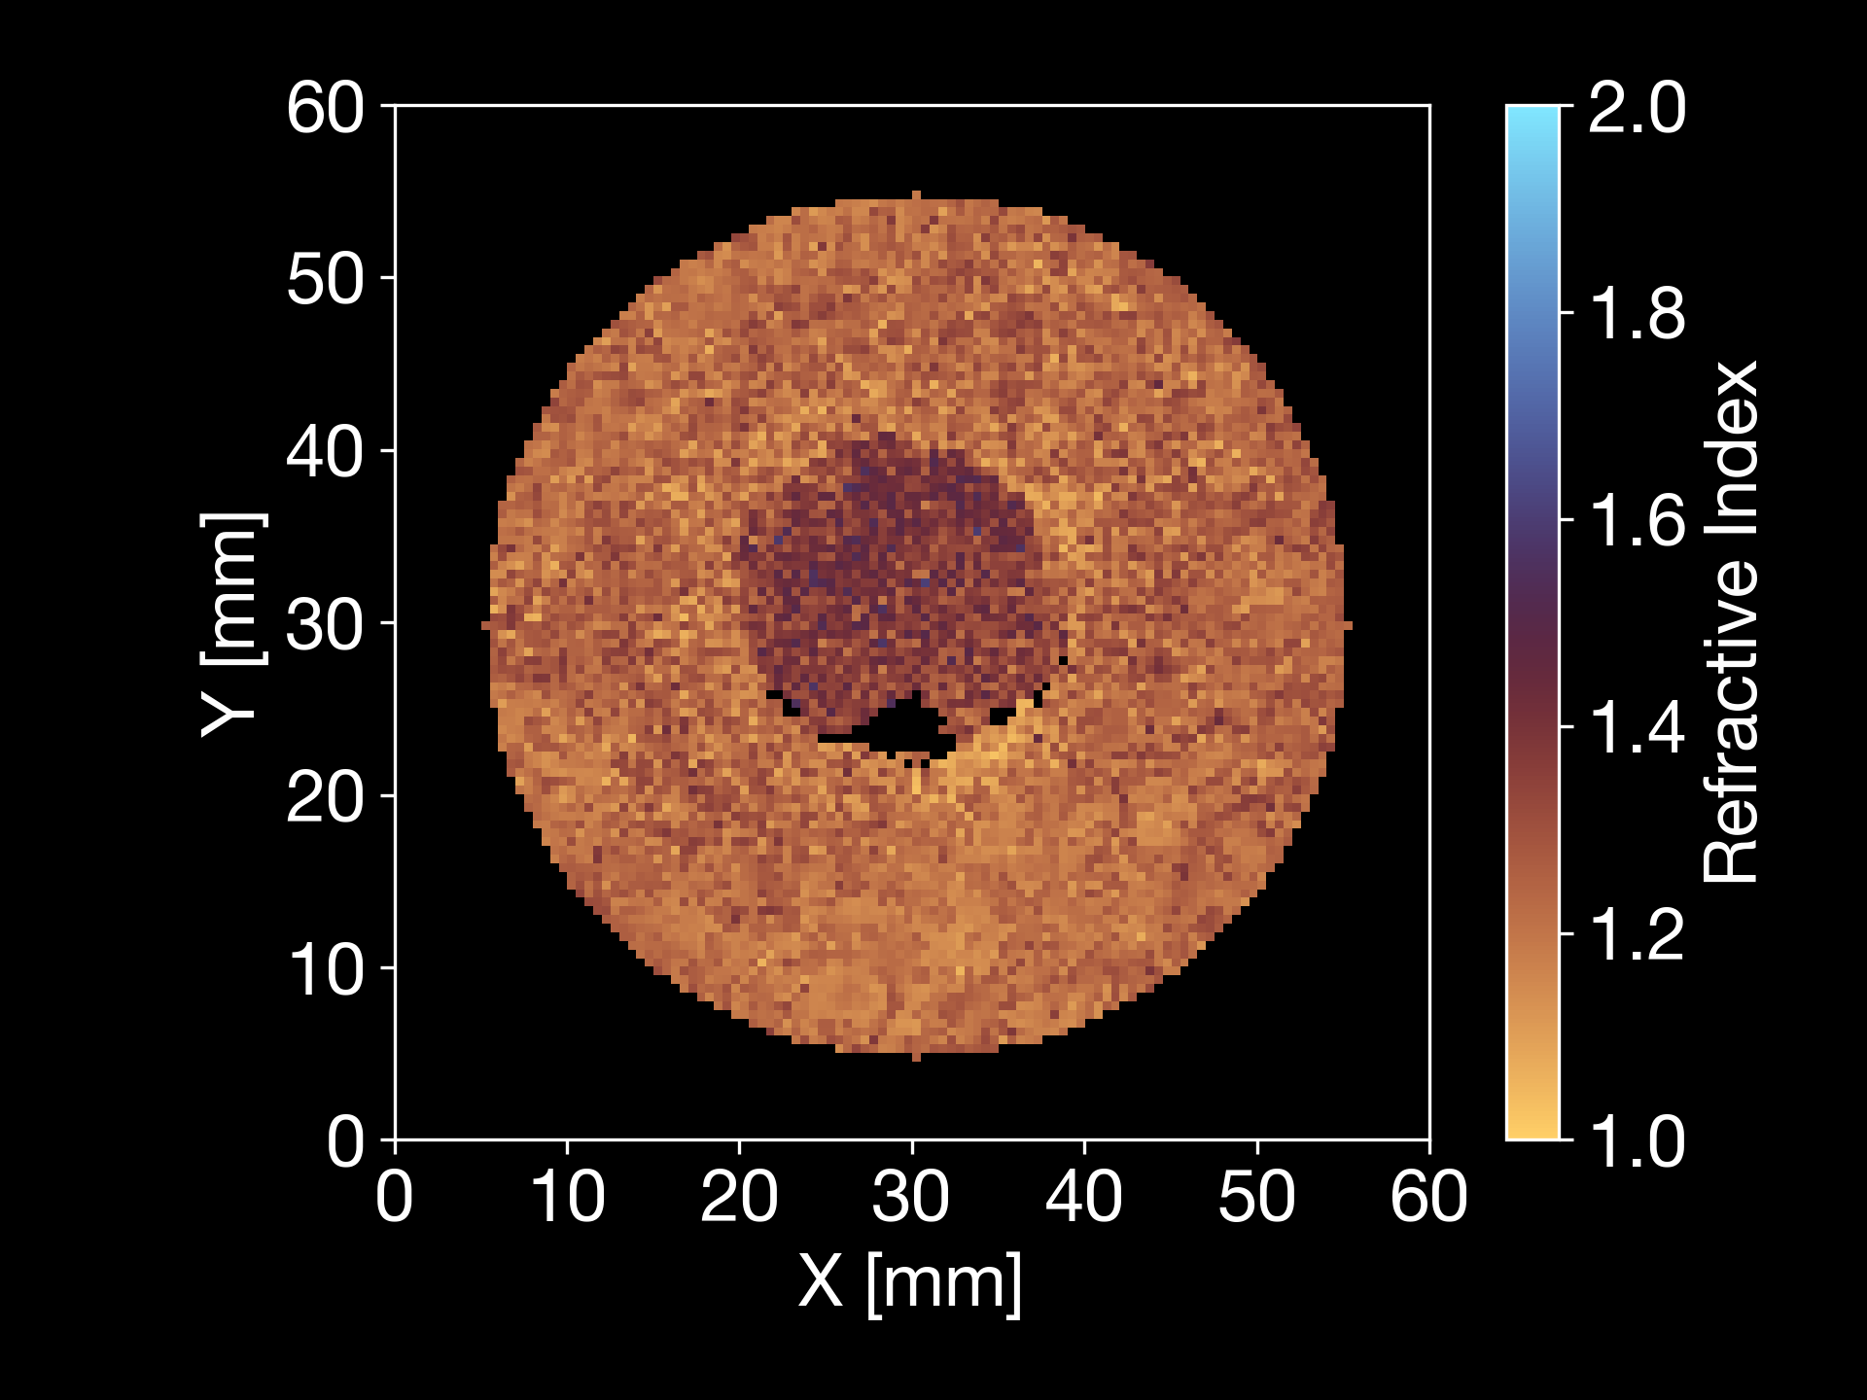
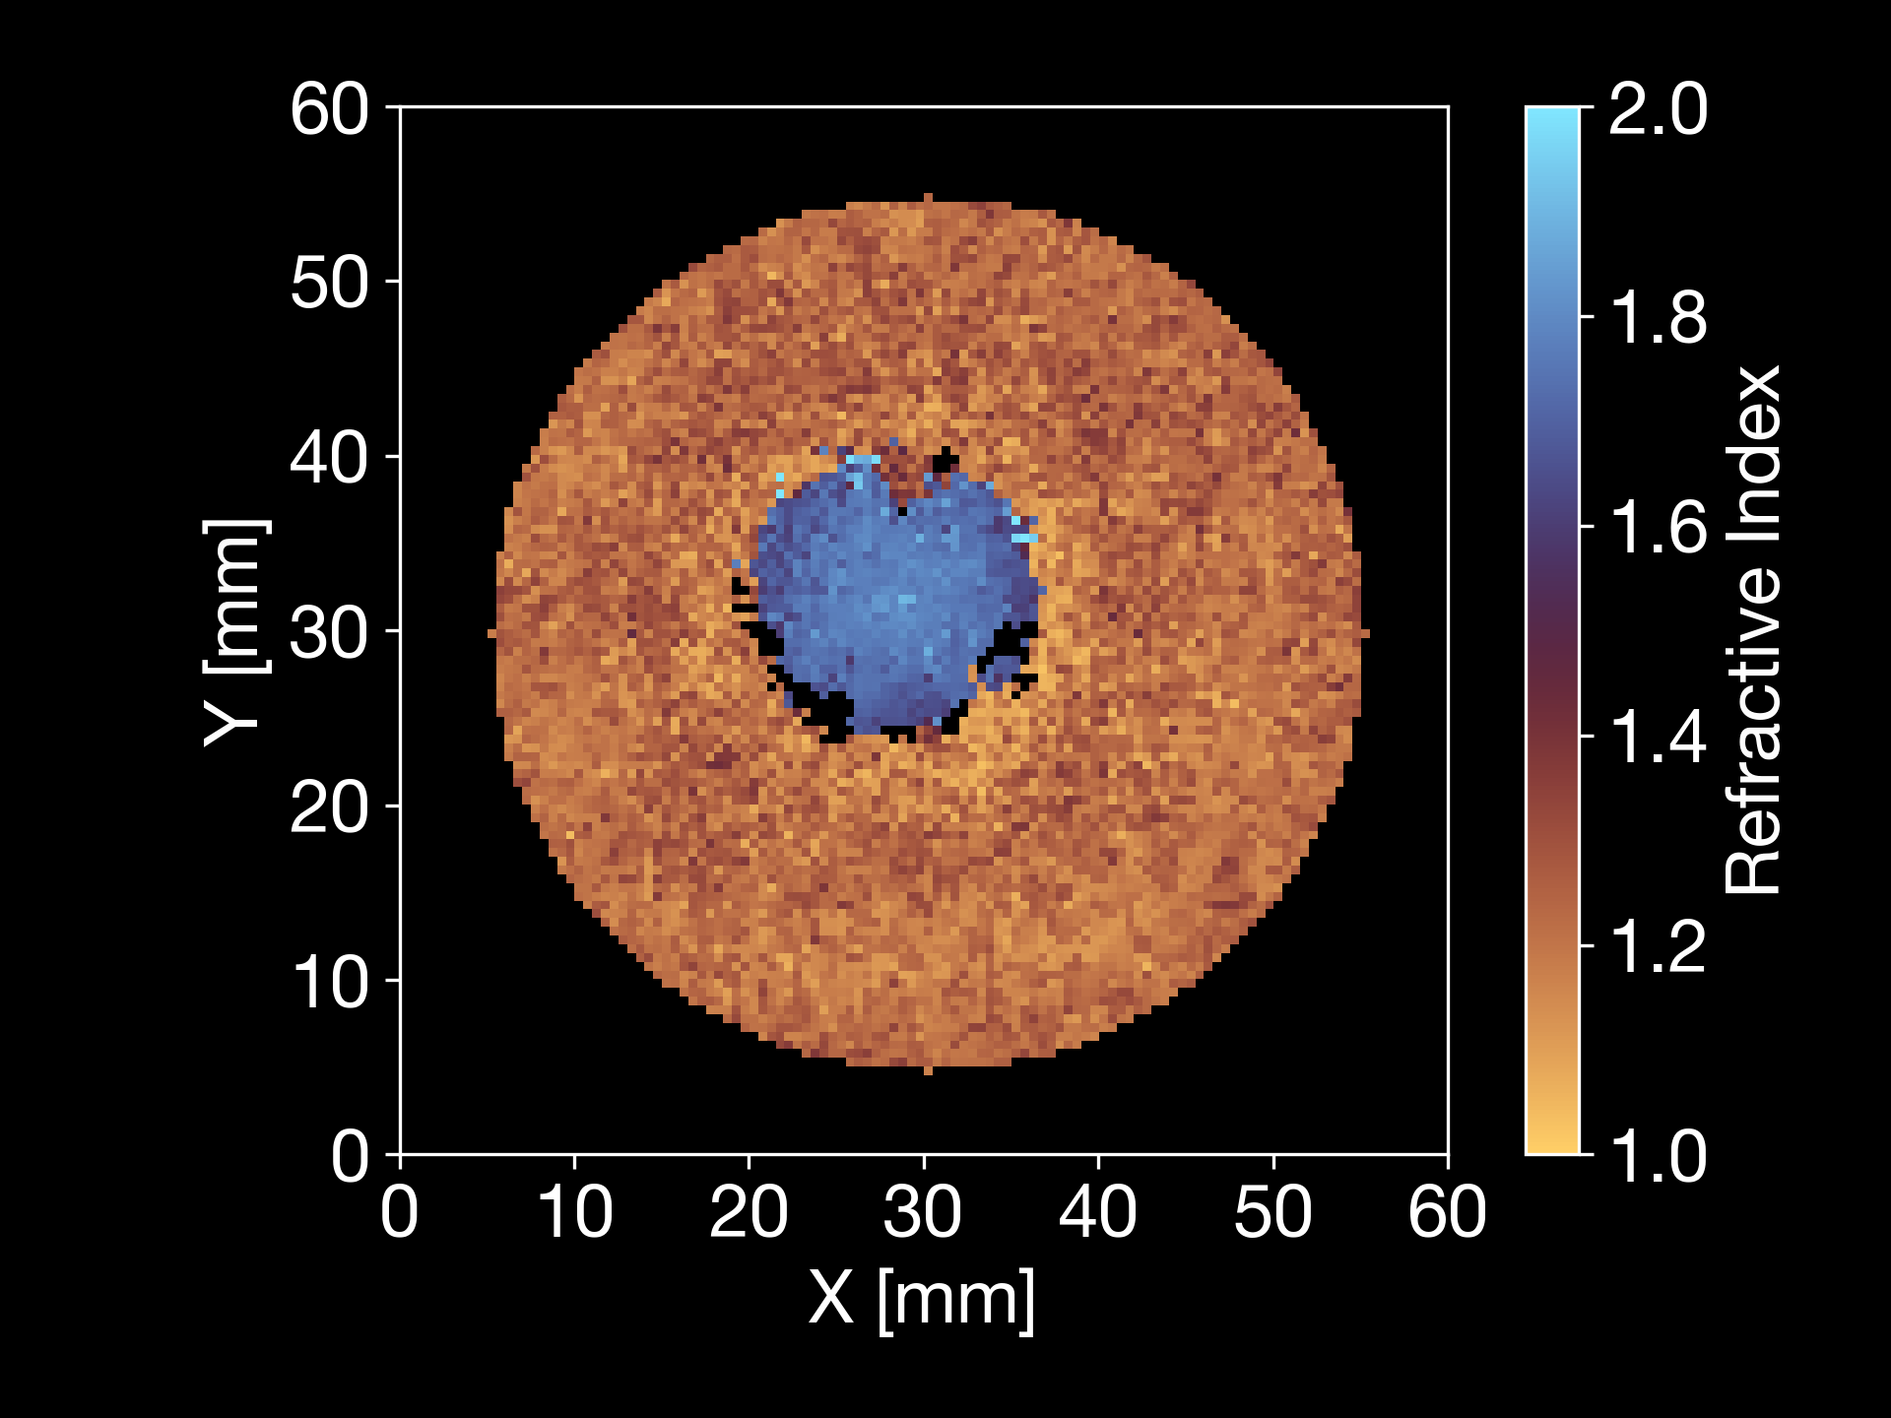
THz Tomography
Sub-Surface
SPIPA-B
Sub-Surface Extraction
Transmission
Refractive Index
Solid Ice

Slide 20
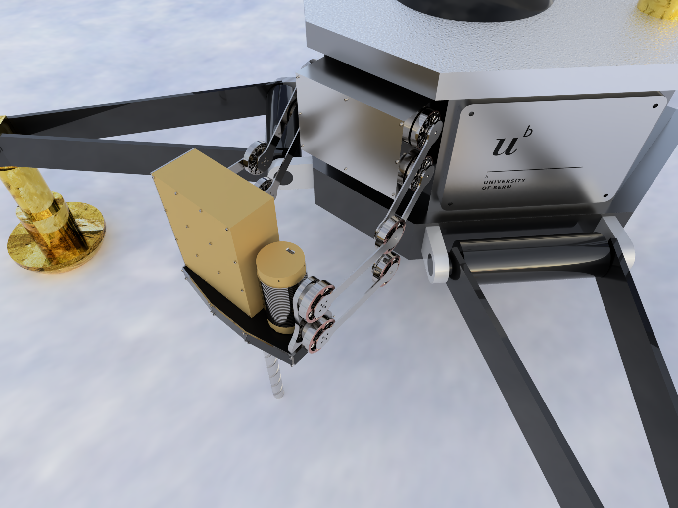

Slide 21
-

