Slide 1
Vibration-free gas bearing turbo compressors and expanders for cryogenic applications
21.01.2026 – SIAPS Bern – Patrik Fröhlich
Notes:
Good afternoon guys, this presentation is about

Slide 2
Motivation
Decentralized, small scale hydrogen liquefaction
Close to end-use application (fueling-stations for low to heavy duty trucks, energy storage for grid stabilization, military and civil drones) allows for short term storage → no ortho-para conversion required (up to 40 % lower energy consumption)
Prevent boil-off (zero boil-off)
Cooling for quantum computing
Super conducting cables, motors/generators and magnets
Cryogenic cooling for physical experiments and medical
➔ Reverse turbo Brayton cycle cryocooler
Most efficient and therefore preferred technology
High efficiency and higher cooling power per cryocooler weight and size
Low specific power (lower than 80 W/W possible at 20 K cooling temperature)
Cryo fan: recirculation and transport of cryogenic gases
Compressors and expanders with gas bearings are key
Notes:
Applications gemäss Abstract
CEL: 80 W compressor power per W cooling power (INTERN: vs. PulseTube approach: 130W/W) -> Bluefors/Cryomech fragen

Slide 3
Gas bearing turbo compressor technology
Notes:
Aerodynamics: Process gas is compressor in continuous fluid flow machine: compressor inlet, acceleration by impeller, collection and pressure increase in volute, outlet.
Two radial gas bearings, one axial gas bearing
Permanent magnet motor to drive impeller: rotor magnet, stator winding fully separated from rotor and process gas.
No rotating sealings: process gas is also present in bearing area
Gas bearing: The pressure increases by rotation and displacement
Lowest extra premium due to highest efficiency
Small size and weight due to high-speed operation
Maintenance free, contamination free
No lubrication, no oil
No rotating sealings
Robust – several 100 000 start-stop cycles
Low amount of wetted materials and therefore no outgassing or compatibility issues
Compatible with helium, neon, hydrogen and other rare and non-rare gases
Contamination free
Vacuum compatible, helium leak tight
Low micro-vibration emission due to the continuous flow operation: < 0.2 N
Cryofan and expander can be fully immersed into cryogenic temperatures down to 15 K and below
Wide operating and start/stop temperature range – from ambient down to 15 K and less
Re-start capability at full cryogenic temperatures

Slide 4
Reverse turbo Brayton cryocooler (rtB)
No vibration decoupling required due to ultra-low micro-vibrations emitted by reverse brayton cycle
High efficiency
High cooling power per cryocooler weight and size
Low specific power (W/W cooling power)
Key components: compressors, expanders and recuperator
Hydrogen liquefaction
Zero boil-off
Quantum computing
Super conducting cables, motors, generators, magnets
Physical experiments
Medical applications
Notes:
Heatsink = Radiator (für Space)
CEC: NICHT Space:
For cryogenic applications, compressors and expanders are key components.
Applications are reverse Brayton cycles to generate the cryogenic temperatures, heat pump cycles to dissipate the waste heat, and cryo fans recirculation and transport of cryogenic gases.
In todays presentation I will show you why gas bearing turbo compressors are the preferred choice for cryogenic applications.
Space Cryogenics Workshop / ICEM:
Future space missions require more and higher complexity air and gas handling, and for this compressors and expanders are becoming key components.
Applications are reverse Brayton cycles to generate the cryogenic temperatures, heat pump cycles to dissipate the waste heat, and cryo fans for recirculation and transport of cryogenic gases.
In todays presentation I will show you why gas bearing turbo compressors are the preferred choice for such space cryogenic applications

Slide 5
Reverse turbo Brayton cryocooler (rtB)
No vibration decoupling required due to ultra-low micro-vibrations emitted by reverse brayton cycle
Compressor and expander (as separate units) including converter as separate units to
achieve higher system efficiency by energy recovery
avoid thermal coupling between compressor and expander
gain additional degrees of freedom for:
control
integration in the cryogenic system
Notes:
Heatsink = Radiator (für Space)
CEC: NICHT Space:
For cryogenic applications, compressors and expanders are key components.
Applications are reverse Brayton cycles to generate the cryogenic temperatures, heat pump cycles to dissipate the waste heat, and cryo fans recirculation and transport of cryogenic gases.
In todays presentation I will show you why gas bearing turbo compressors are the preferred choice for cryogenic applications.
Space Cryogenics Workshop / ICEM:
Future space missions require more and higher complexity air and gas handling, and for this compressors and expanders are becoming key components.
Applications are reverse Brayton cycles to generate the cryogenic temperatures, heat pump cycles to dissipate the waste heat, and cryo fans for recirculation and transport of cryogenic gases.
In todays presentation I will show you why gas bearing turbo compressors are the preferred choice for such space cryogenic applications

Slide 6
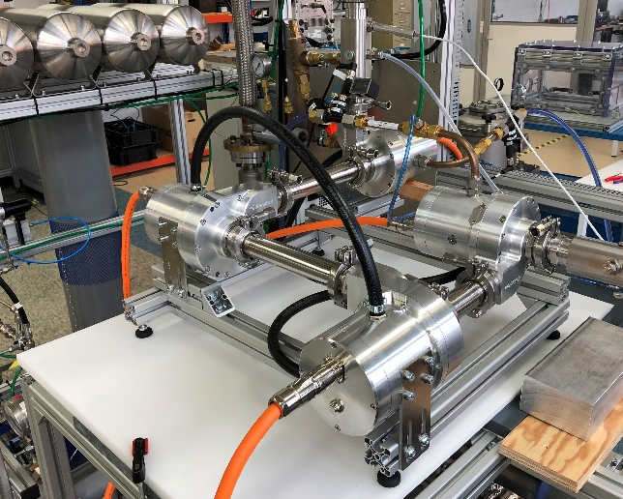
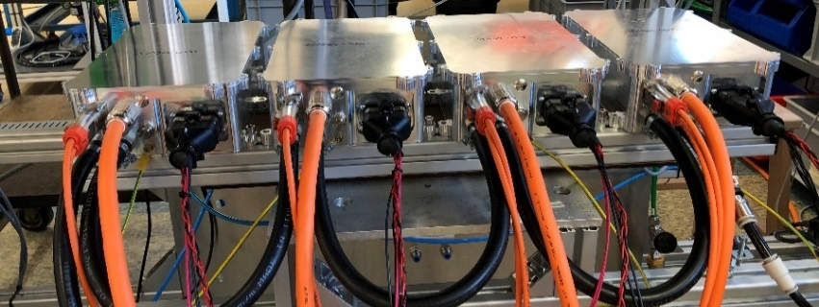
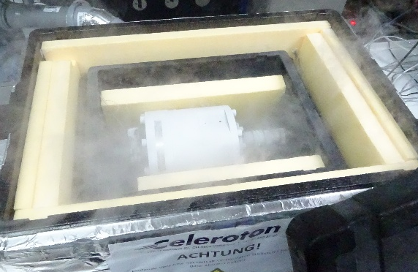
rtB: Multi-stage compressor system and expander
4-stage turbo compressor system
Single-stage cryo expander@20 K

Slide 7
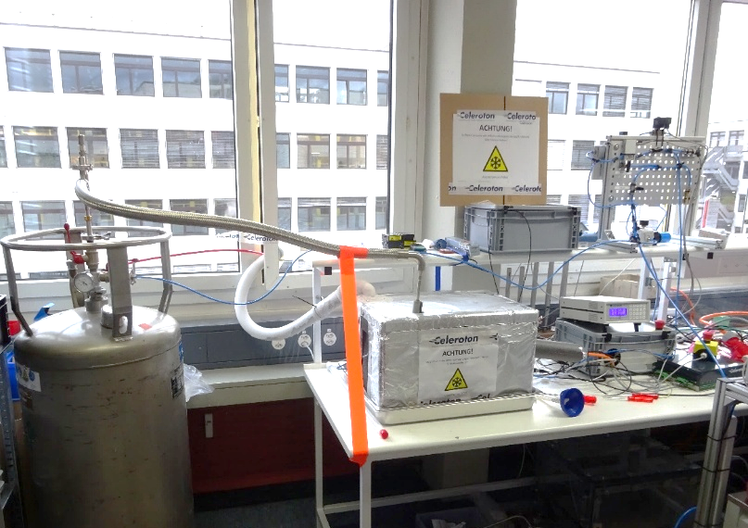
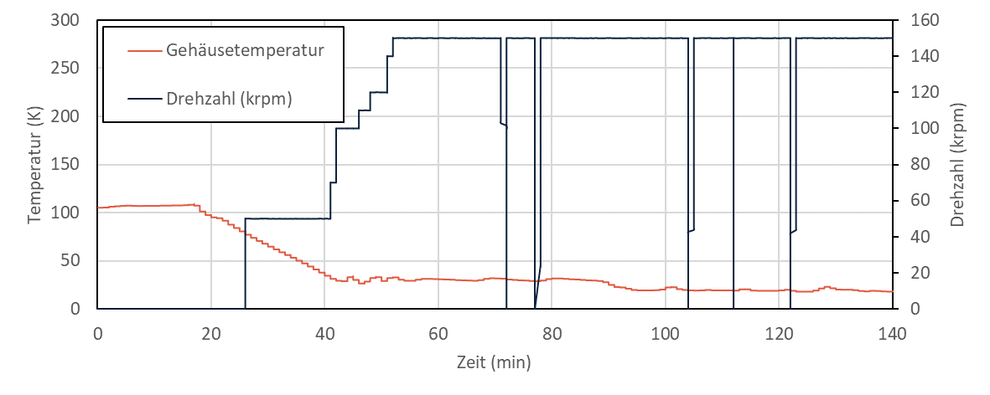
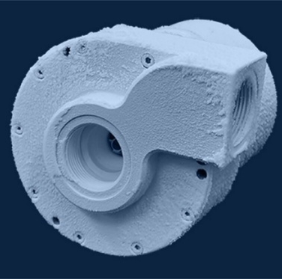
Validation – Operation at cryogenic temperatures
Cool-down from ambient temperature to 20K (shown below: 100K to 20 K)
Stop/start @ 20 K
Notes:
Pre-cooling with liquid nitrogen -> fill bottom with liquid helium
Orange: housing/motor temperature
Red: gas temperature above motor housing
zwei Messstellen am Gehäuse und im Raum über dem Gehäuse sowie die Drehzahl; zum schnelleren Abkühlen ist Letztere zunächst niedrig und wird mit sinkender Temperatur erhöht
Startpunkt: Wechsel von LN2 zu LHe. Temperatur sinkt von ca. 100 K auf ca. 13 K am Gehäuse bzw. 15 K im «Gasraum». Grund für die Temperaturdifferenz ist, dass der Motor näher am LHe ist bzw. die Gas-Messstelle über dem Motor ist.
Schön sieht man die Start/Stopps bei ca. 72, 78, 105, 111 und 122 min. «stop and restart capability < 20 K
Kalibrierte Dioden und Auswerteelektonik von lakeshore

Slide 8

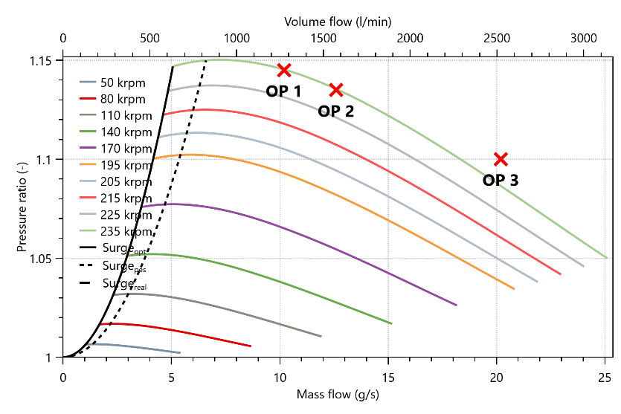
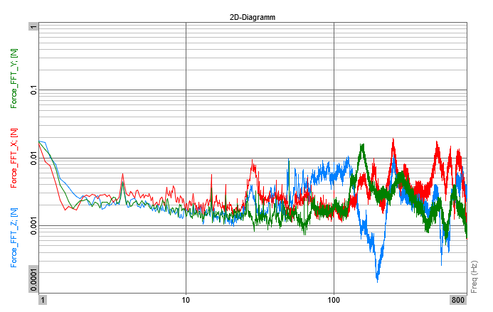
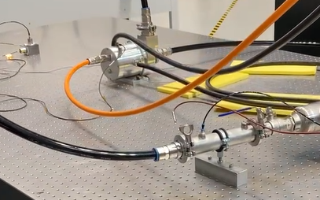
Micro-vibration measurement of a gas bearing turbo compressor/expander
Measurement setup with a gas bearing turbo compressor:
Electrical input power: 2 kW
Operation in helium
Speed: 232 krpm (3’866 Hz)
Acknowledgement: measurements at ESO HQ
1
Force X
Force Y
Force Z
0.1
Force (N)
0.01
0.001
Highest force at 1-800 Hz (relevant frequency range): 0.02 N
0.0001
1
10
100
800
Frequency (Hz)

Slide 9









Conclusion – Gas bearing technology USPs
Standardized solution
Oil-free
Cryogenic operation
Compressor-inverter system
Leak-tight
Efficient
Service life
Vibration-free
Compact and lightweight
Notes:
This brings me to the end of my presentation. To summarize and conclude

Slide 10
Thank you!

Slide 11
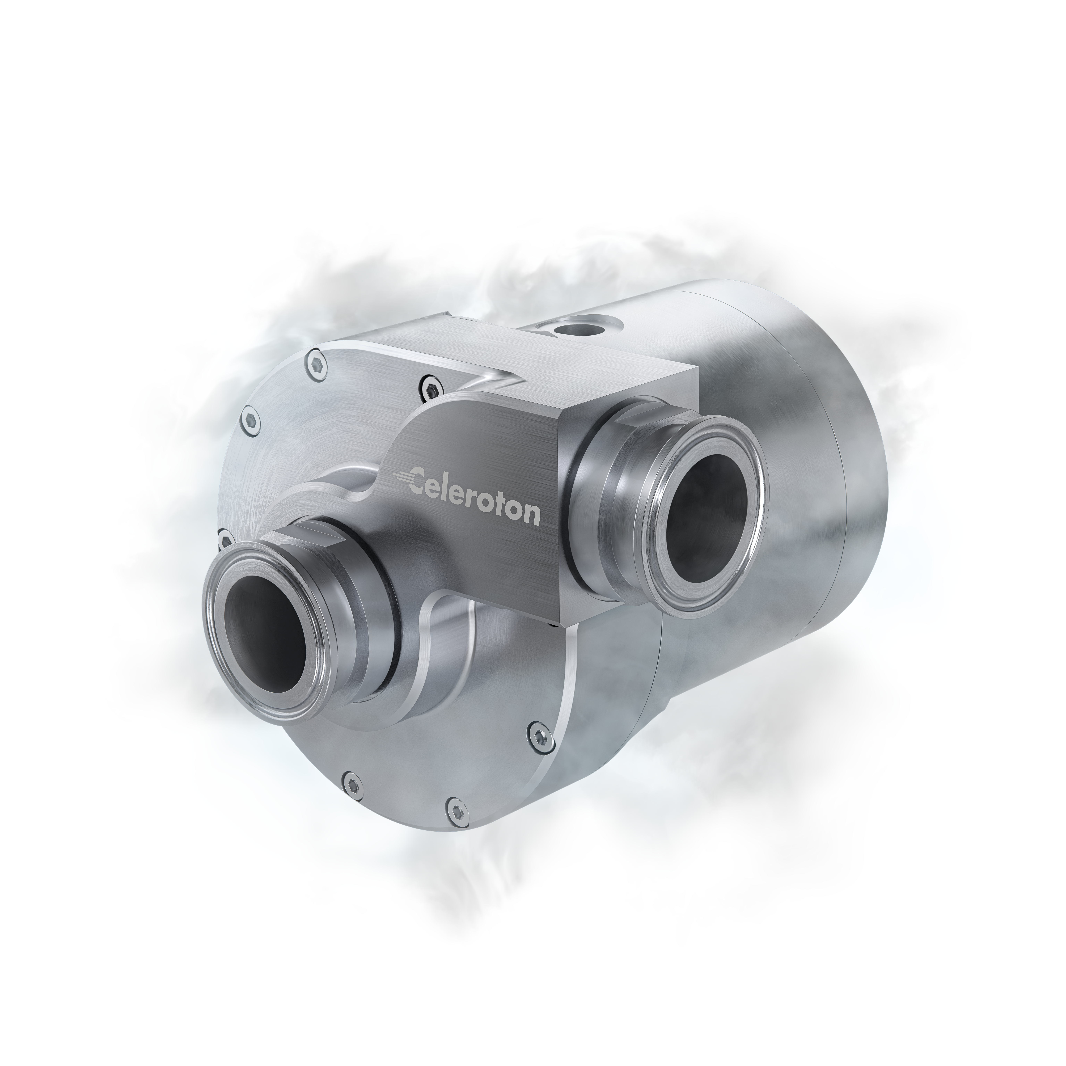
Expanders and Compressors for Cryogenics
Celeroton solution
Minimize operating cost with best efficiency
Small size and weight due to high-speed operation
Reliable & Robust
Maintenance-free for years
Several 100,000 start/stop cycles
Endures harsh vibrations during operation
Self stabilizing contactless bearing – no control needed
Helium leak-tight and vacuum compatible
Compatible with He, Ne and other gases
Minimal wetted surfaces and materials
Wide operating temperature range of cryofan and expander
From ambient down to <20 K
Re-start capability at cryogenic temperatures
Minimum vibration emissions due to continuous flow
Application examples
Reversed Brayton cycle Cryocoolers
for direct or indirect gas liquification and zero-boil-off
for cooling of superconducting magnets
for cooling of scientific instrumentation
Cryofan
Cryogenic Pumps
Turbo compressor
Turbo expander
Cryogenic industrial Systems
Helium Liquefiers, Process Systems and Refrigerators
Notes:
Vibration: klarer Vorteil in Brayton-Cycle im Vergleich zu Pulse Type und Stirling

Slide 12
Gas Bearing Technology - Advantages
Lowest extra premium due to highest efficiency
Small size and weight due to high-speed operation
Maintenance free, contamination free
No lubrication, no oil
No rotating sealings
Robust – several 100 000 start-stop cycles
Low amount of wetted materials and therefore no outgassing or compatibility issues
Compatible with helium, neon, hydrogen and other rare and non-rare gases
Contamination free
Vacuum compatible, helium leak tight
Low micro-vibration emission due to the continuous flow operation: < 0.2 N
Cryofan and expander can be fully immersed into cryogenic temperatures down to 15 K and below
Wide operating and start/stop temperature range – from ambient down to 15 K and less
Re-start capability at full cryogenic temperatures

