Slide 1
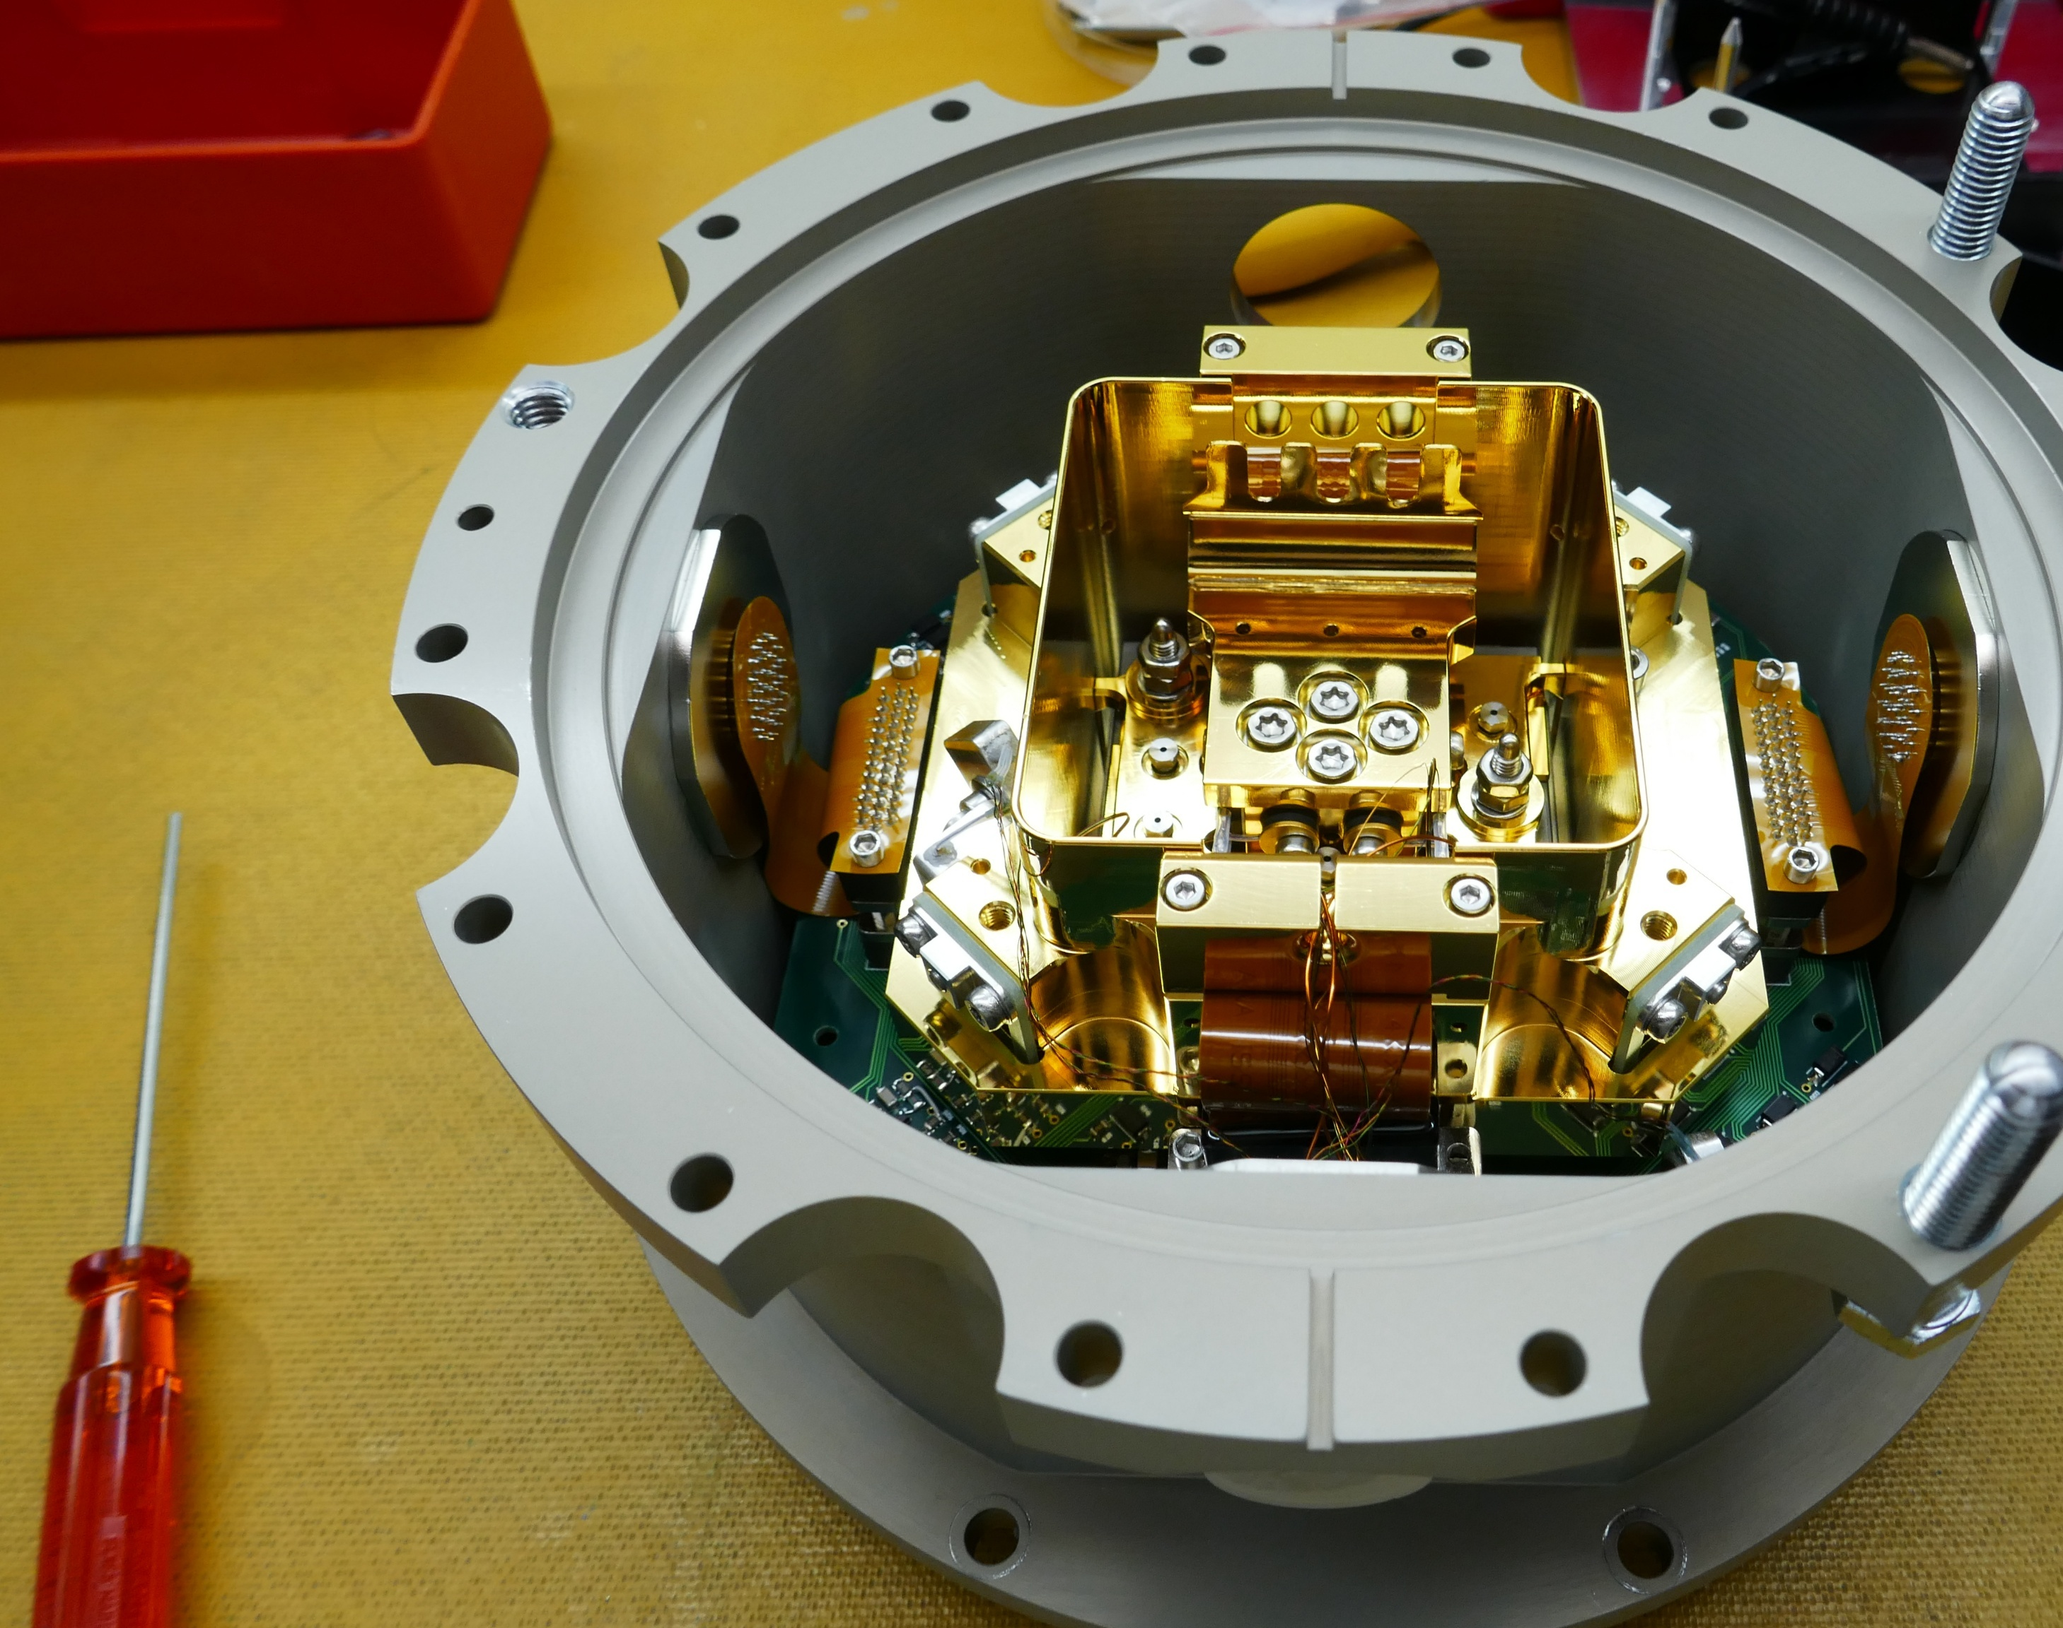


Detector unit development at Geneva Observatory
Ludovic Genolet
On the behalf of the Instumentation team

Slide 2
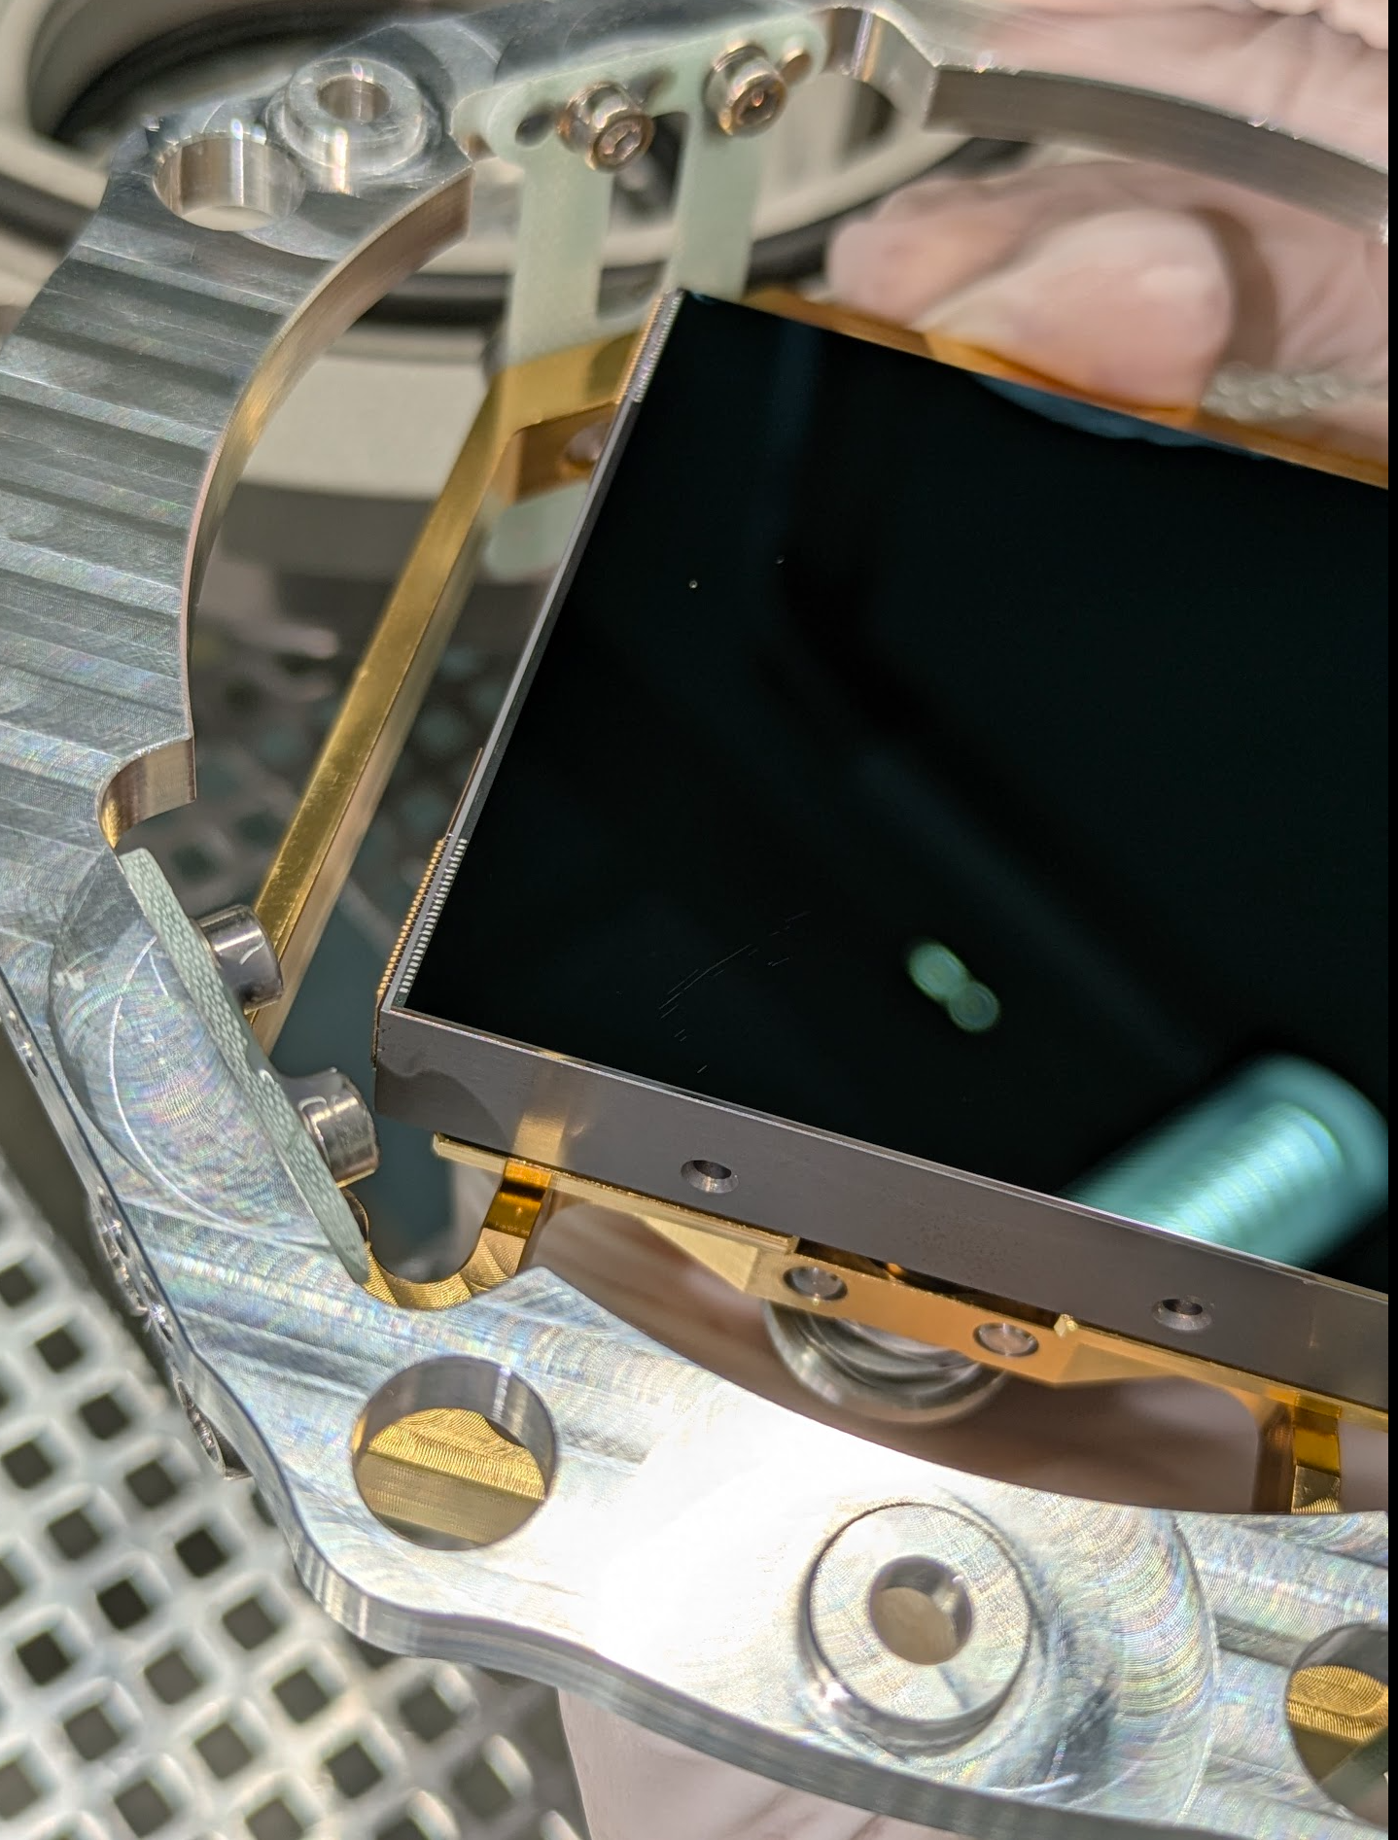
Detector unit : definitions
Detector unit is a cryostat that contains a detector
Cryostat is vacuum-tight container that keeps components at very low temperatures
Detector is a sensor that receives photons from celestial sources and converts them into measurable signals from which images or spectra can be derived.
Charge-coupled device is a light-sensitive sensor in which a 2D pixel array converts incident photons into electric charges.

Slide 3
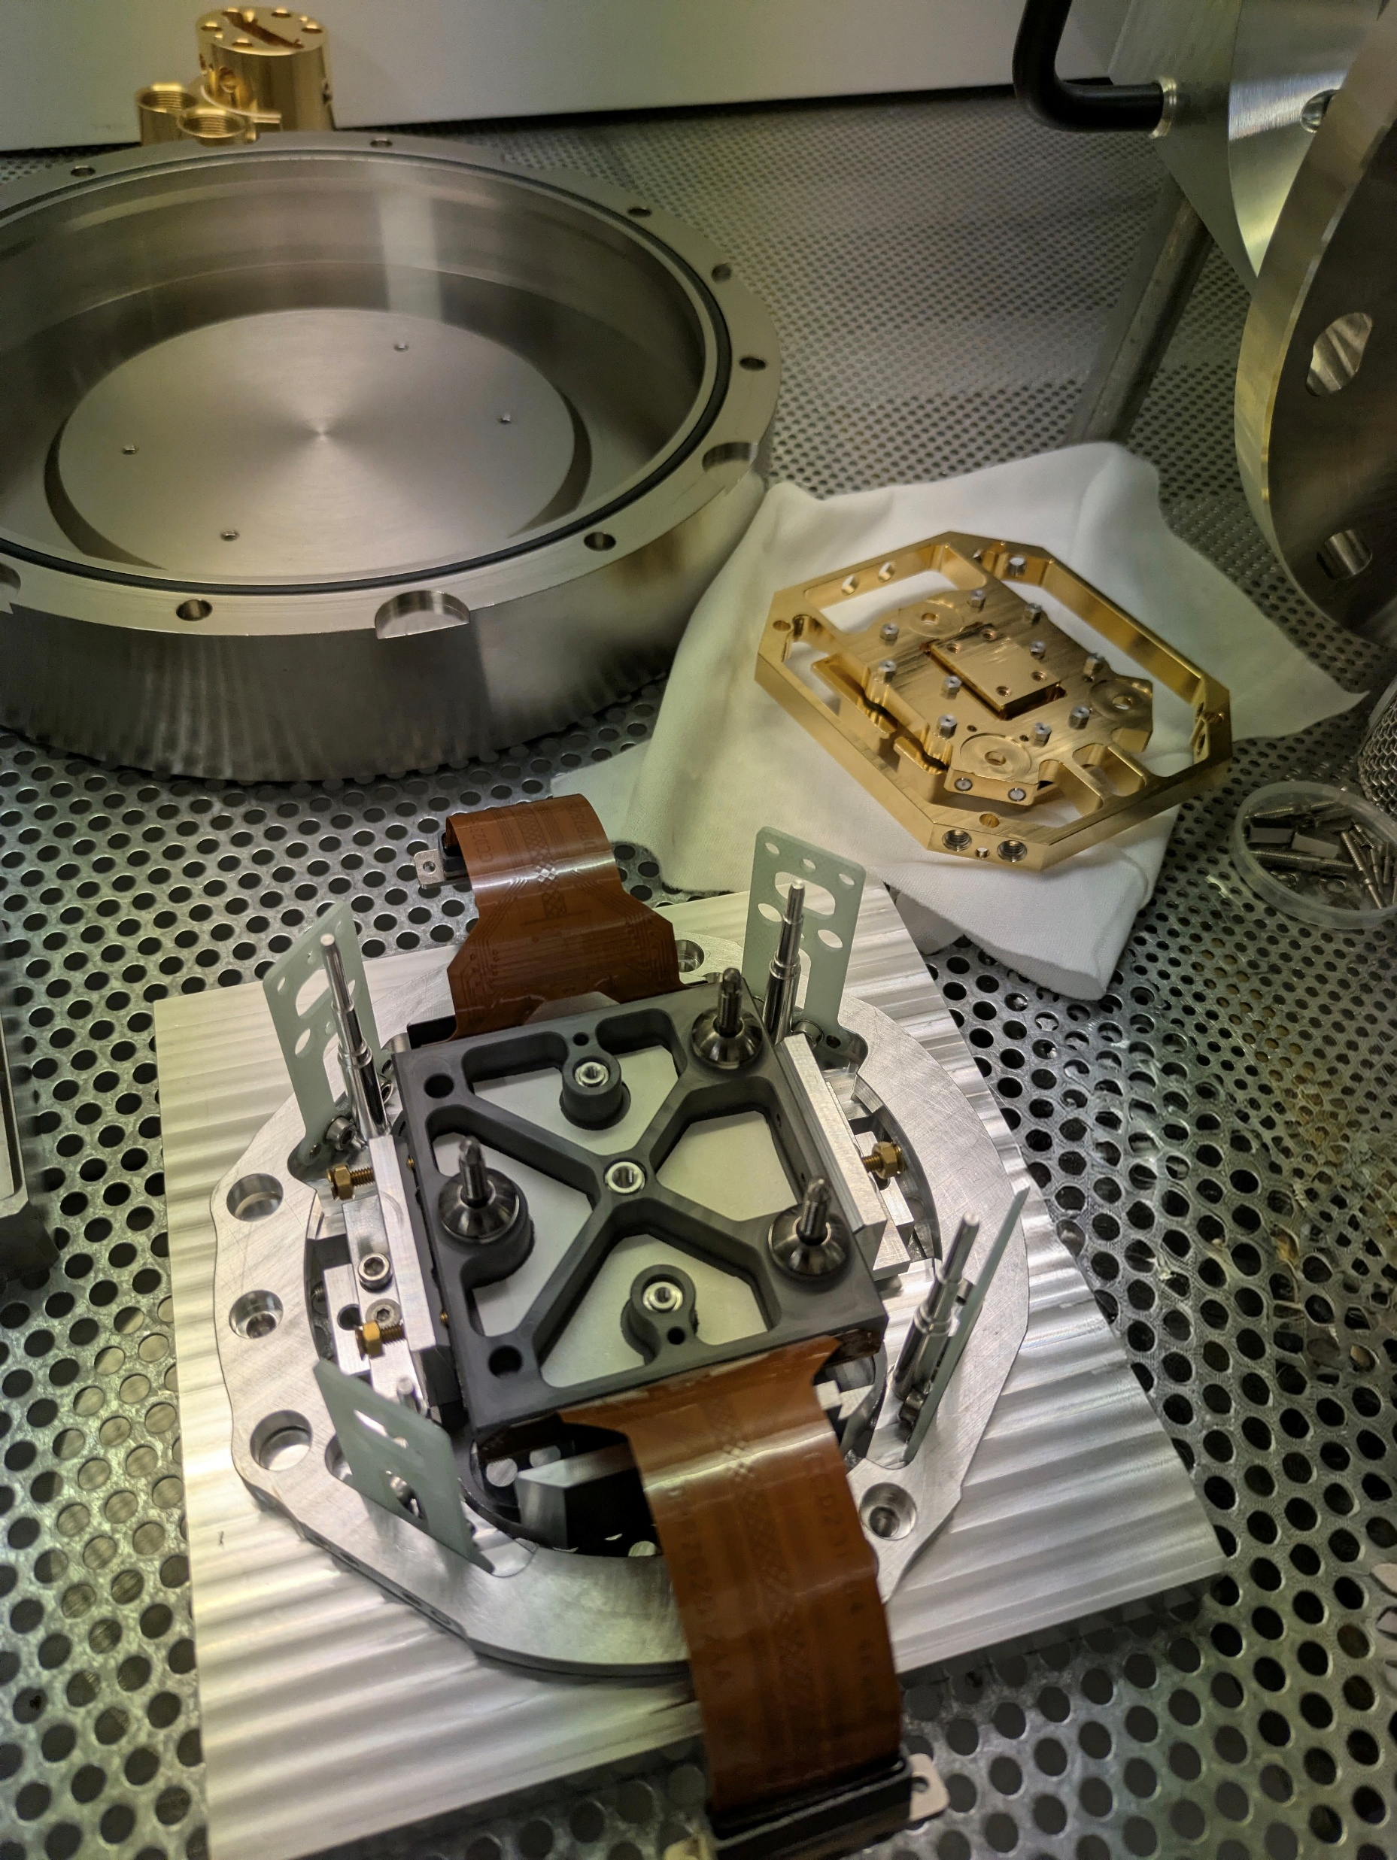
Typical requirements
Detector temperature : -120°C
  Minimise thermally generated noise (dark current)
Temperature stability : +/- 10m°C
Pressure stability : <1e-4 mbar
Low maintenance : 2 days/year

Slide 4
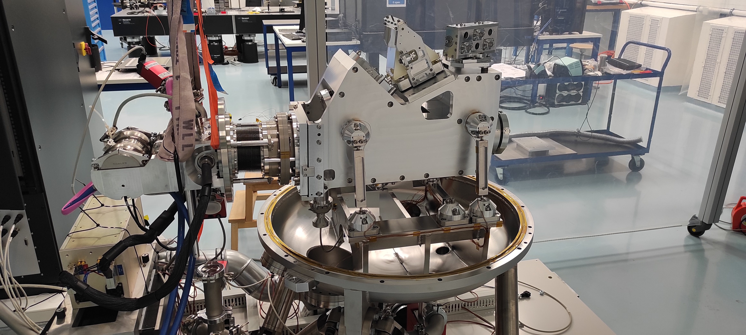
Detector unit application
Detector
  Single CCD (4k x 4k and 9k x 9k pix)
Type of instruments
  Imager :
    ECAM
  Spectrograph :
    RISTRETTO
    HARPS SOUTH
    ANDES

Slide 5
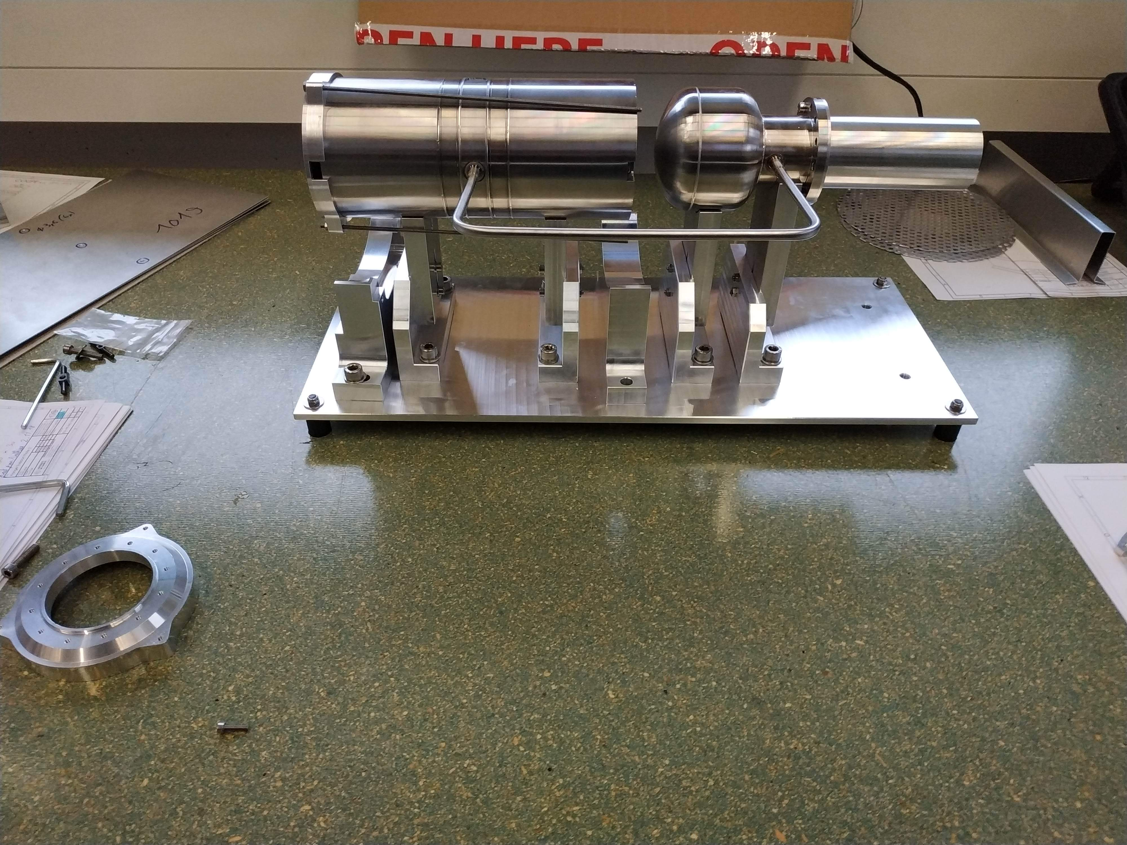
From liquid Nitrogen to cryocooler
ECAM cooled by LN2 bath : manual refilling twice a day
New cooling system required for remote observations
Trade-off : pulse tube cryocooler LPT9310 promising candidate
Main remaining uncertainty : sensitivity of the telescope to vibrations → measurement campaign
ECAM with a cryocooler in operation for 6 years without problems
Notes:
My personel journey in the world of detector unit started when I got the request from my management to upgrade an existing detector unit, called ECAM to make it compatible with remote observations from Geneva.
ECAM is an imager installed on our telescope located in the Atacama desert in chile.
The detector was cooled down with a LN2 bath. It worked perfectly fine but it required manual refilling twice a day. It was highly incompatible with remote obsercations.

Slide 6
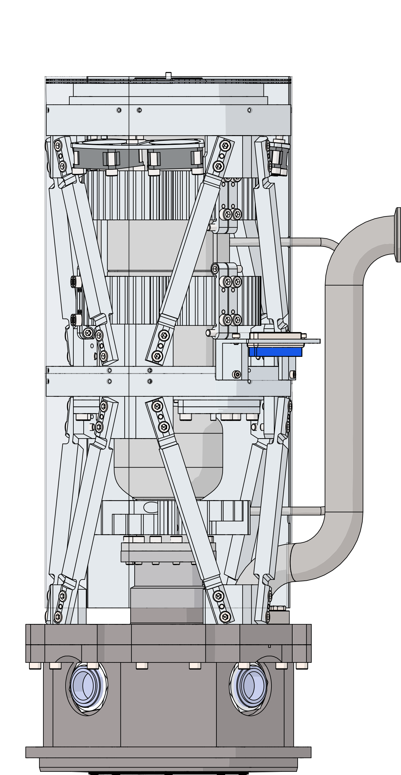
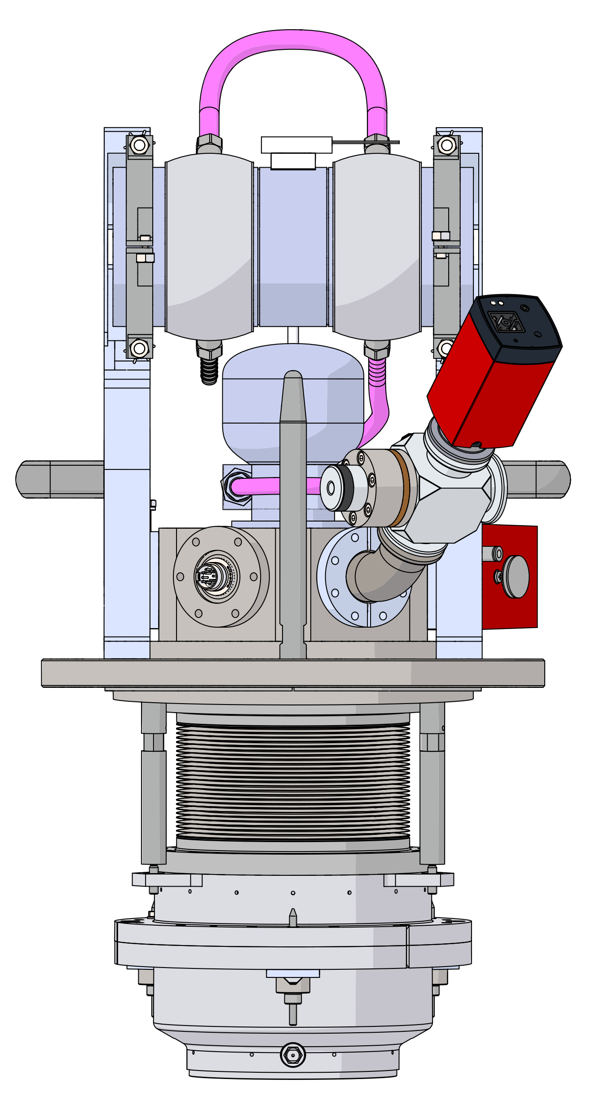
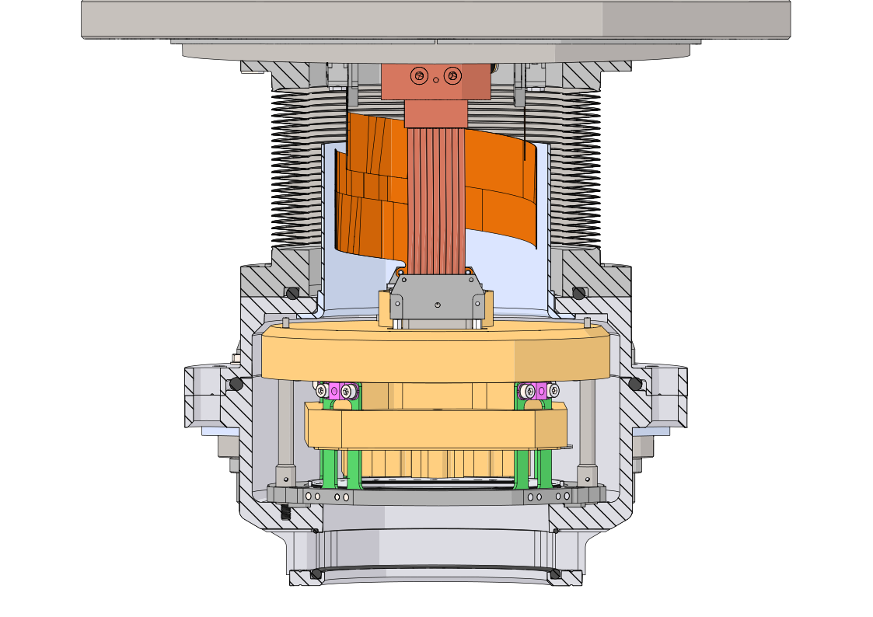
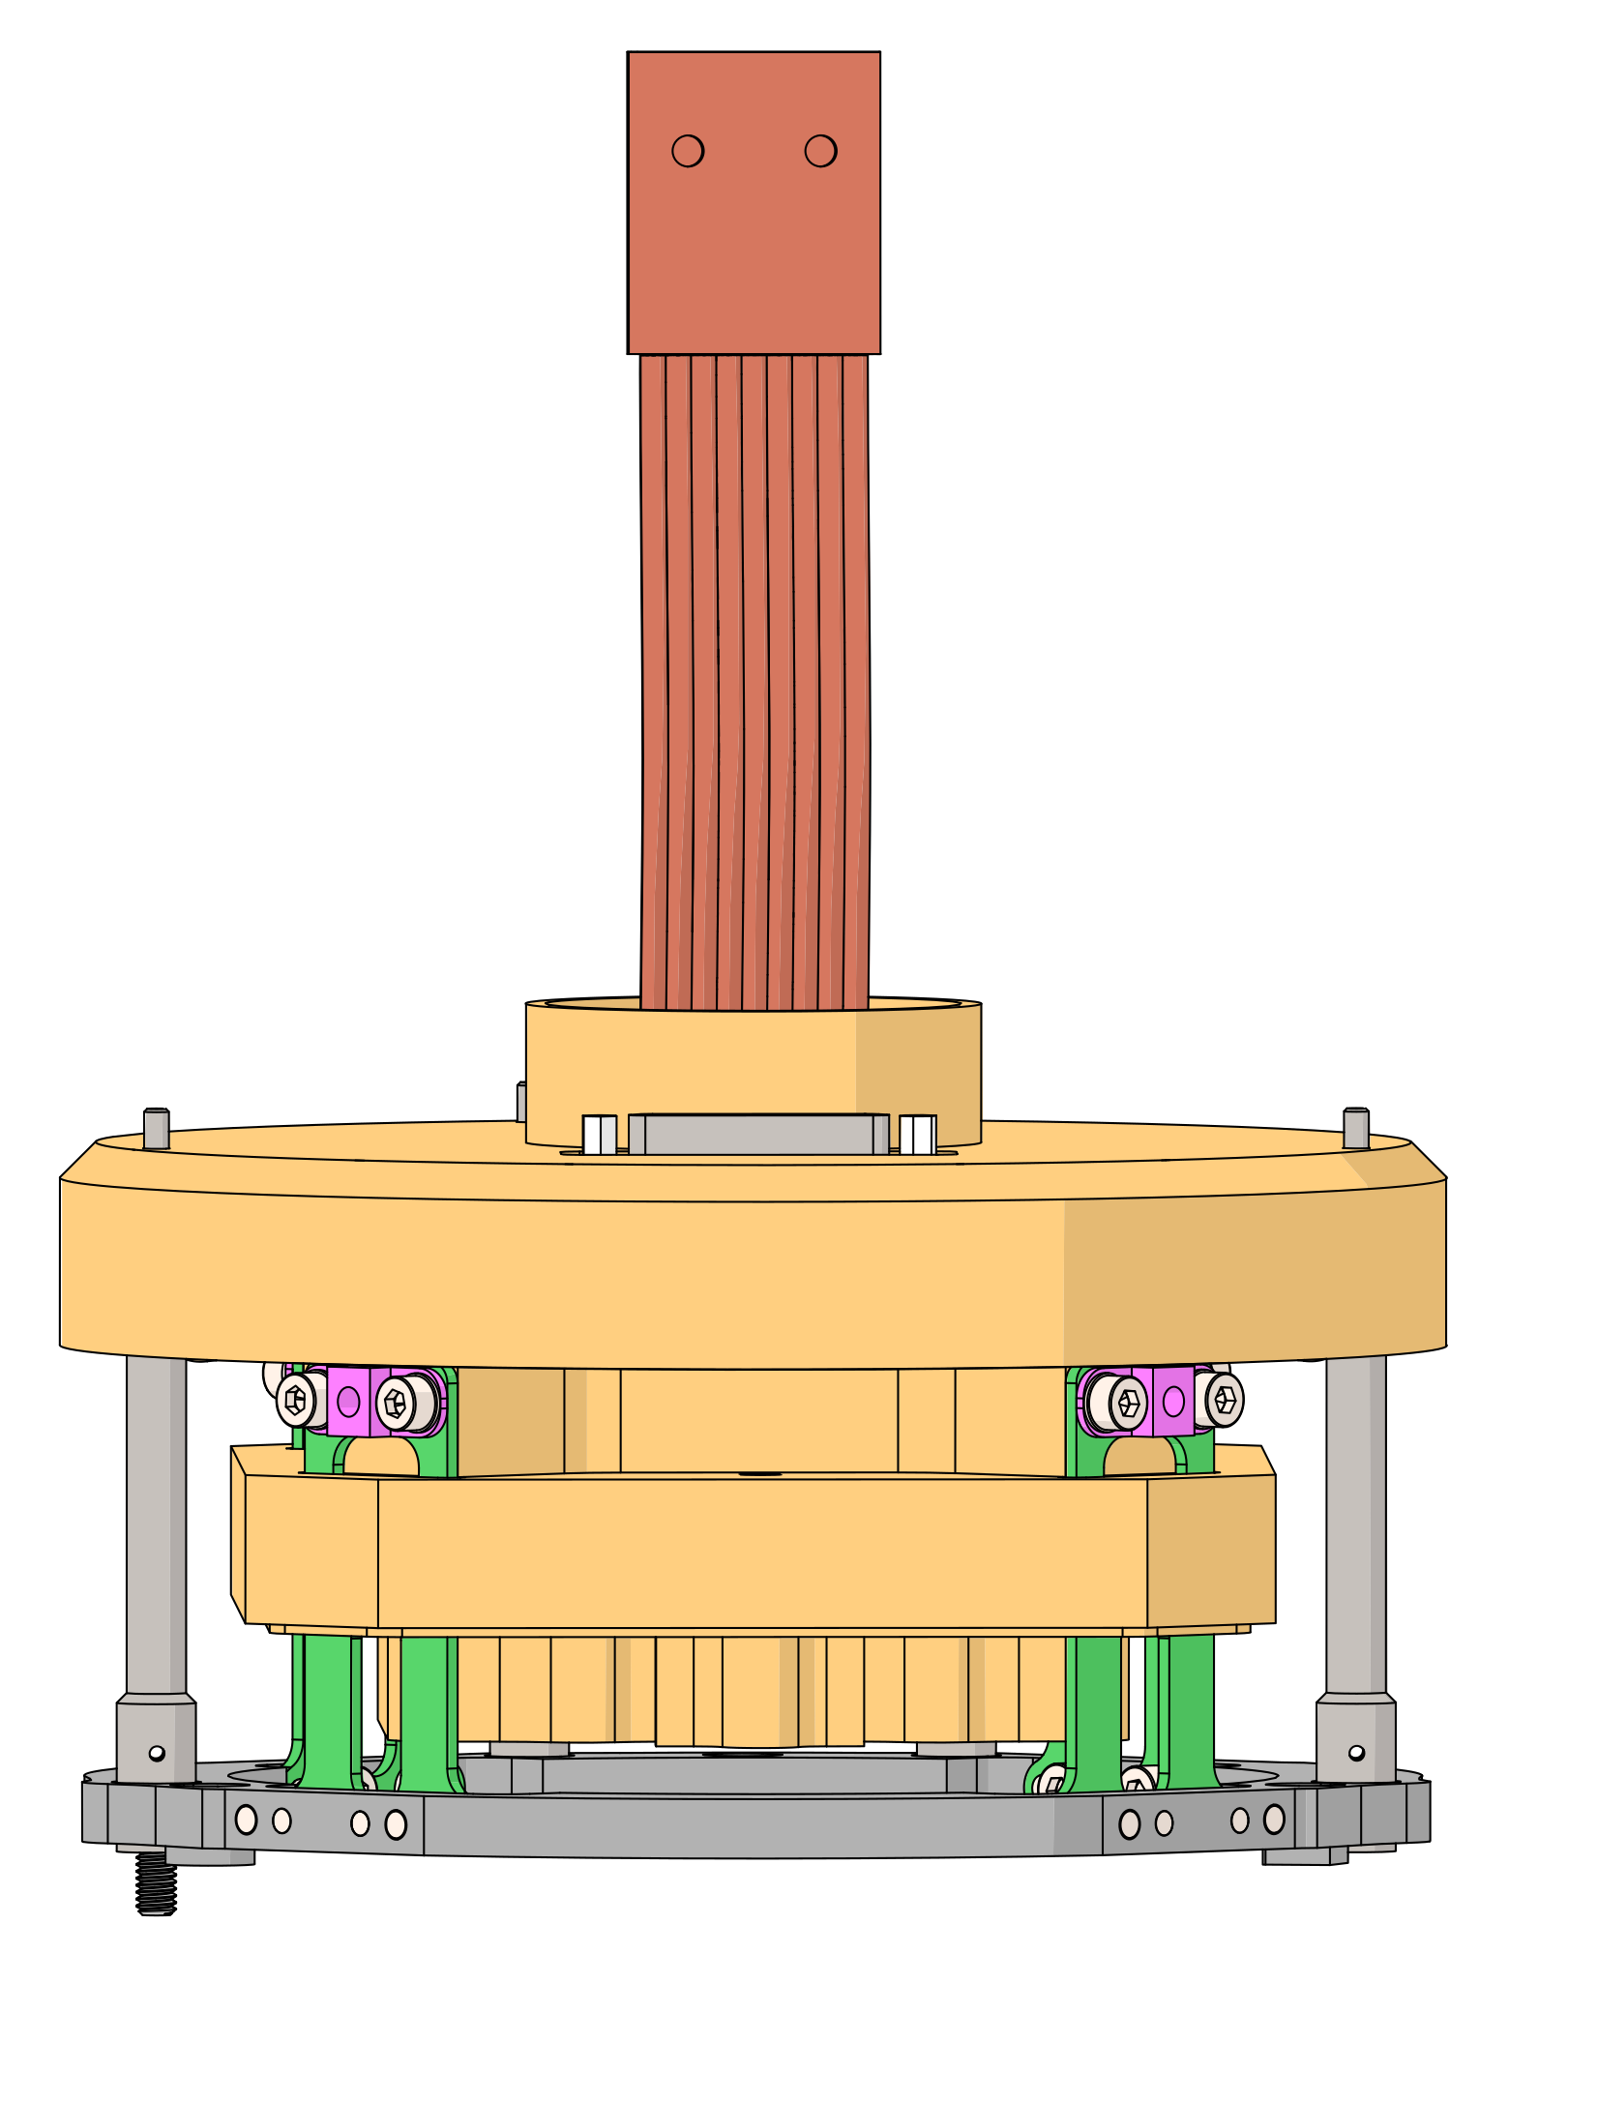
Detector unit: design
Cryocooler assembly
Cryostat
CCD assembly

Slide 7
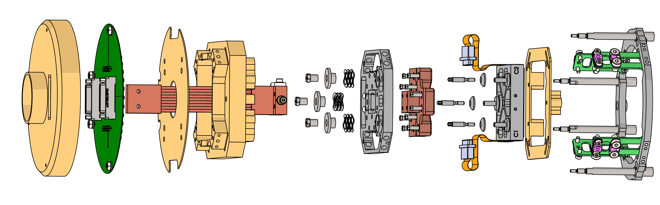
CCD assembly
Mechanical support of the CCD
CCD cooling
Cold parts surrounded by radiation shields to limit radiative heat loads
Radiation shield
Cold block
CCD
PCB
Thermal strap
CCD frame
GFRP sheet

Slide 8
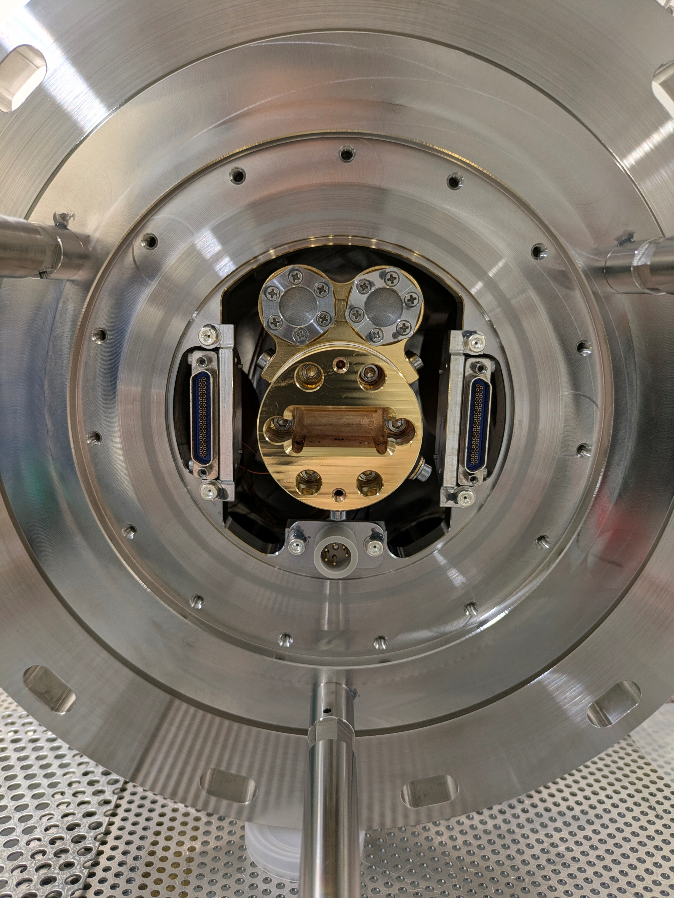
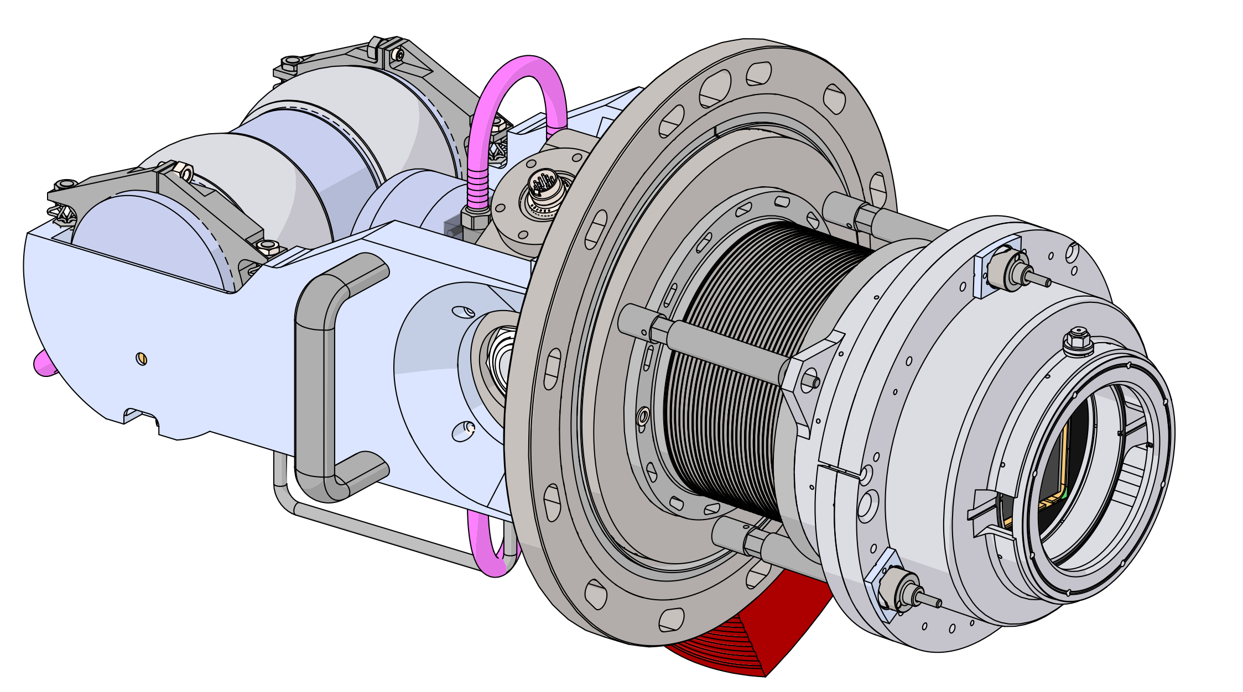
Cryocooler assembly
Passive decoupling : mini wire rope suspensions
Active vibration reduction
Getter : activated charcoal at the cold tip

Slide 9
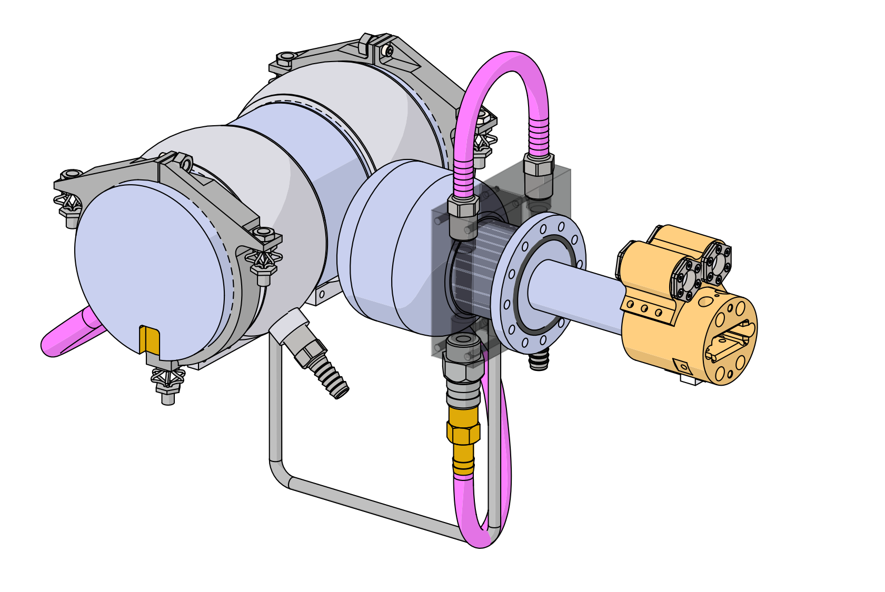
Cryocooler assembly
Passive decoupling : mini wire rope suspensions
Active vibration reduction
Getter : activated charcoal at the cold tip
Getter
Wire rope suspension

Slide 10
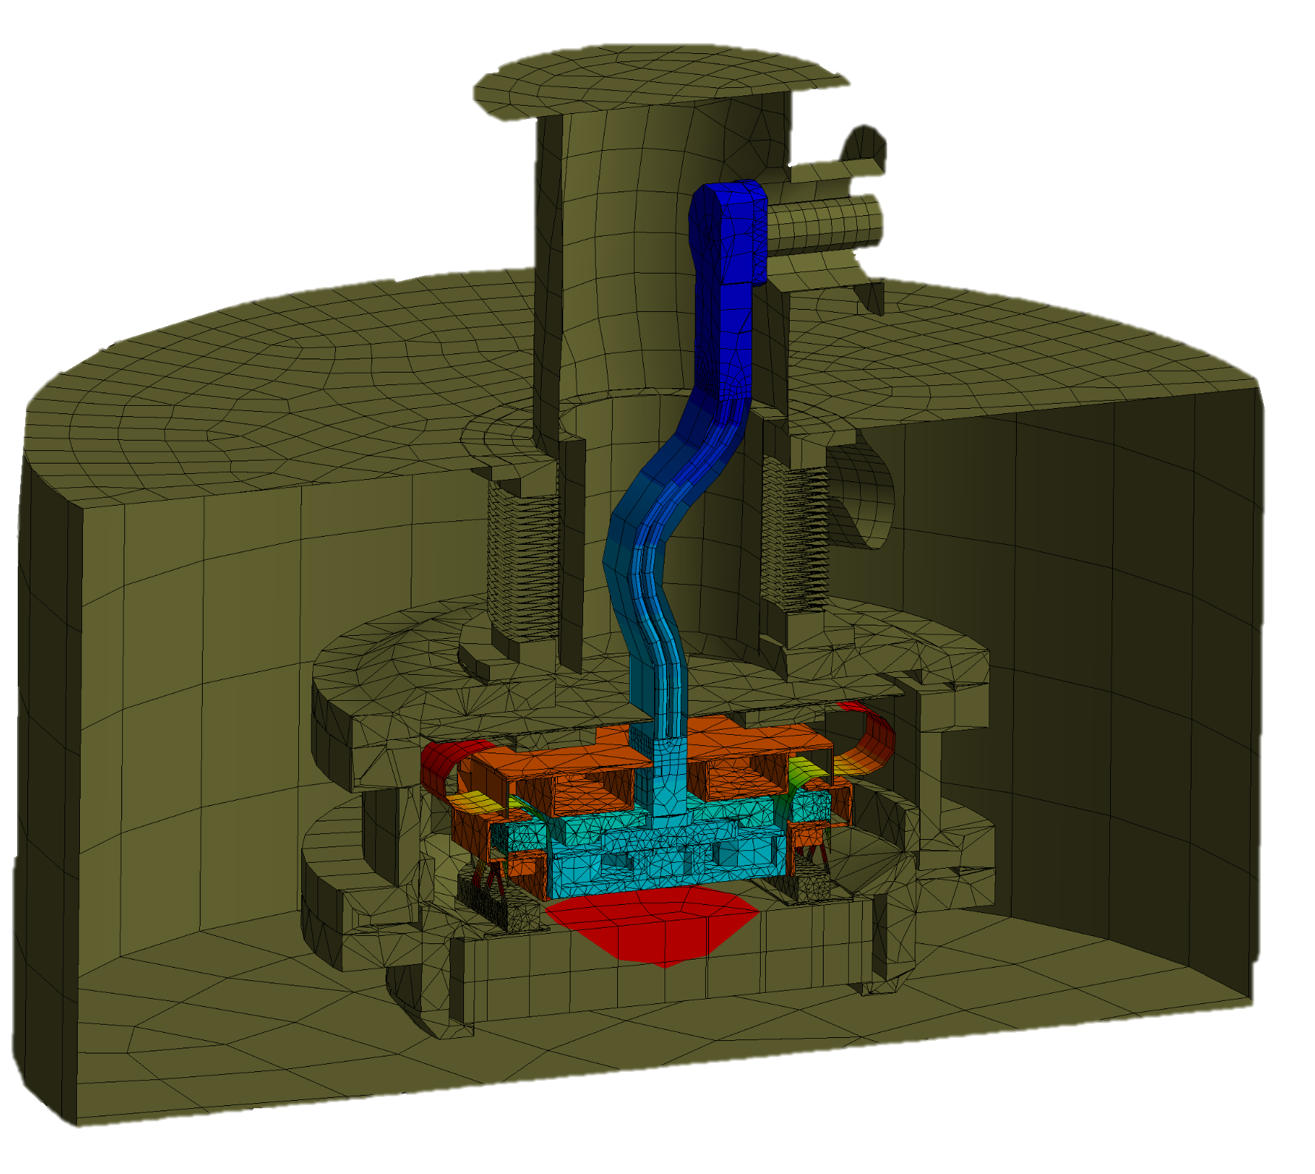
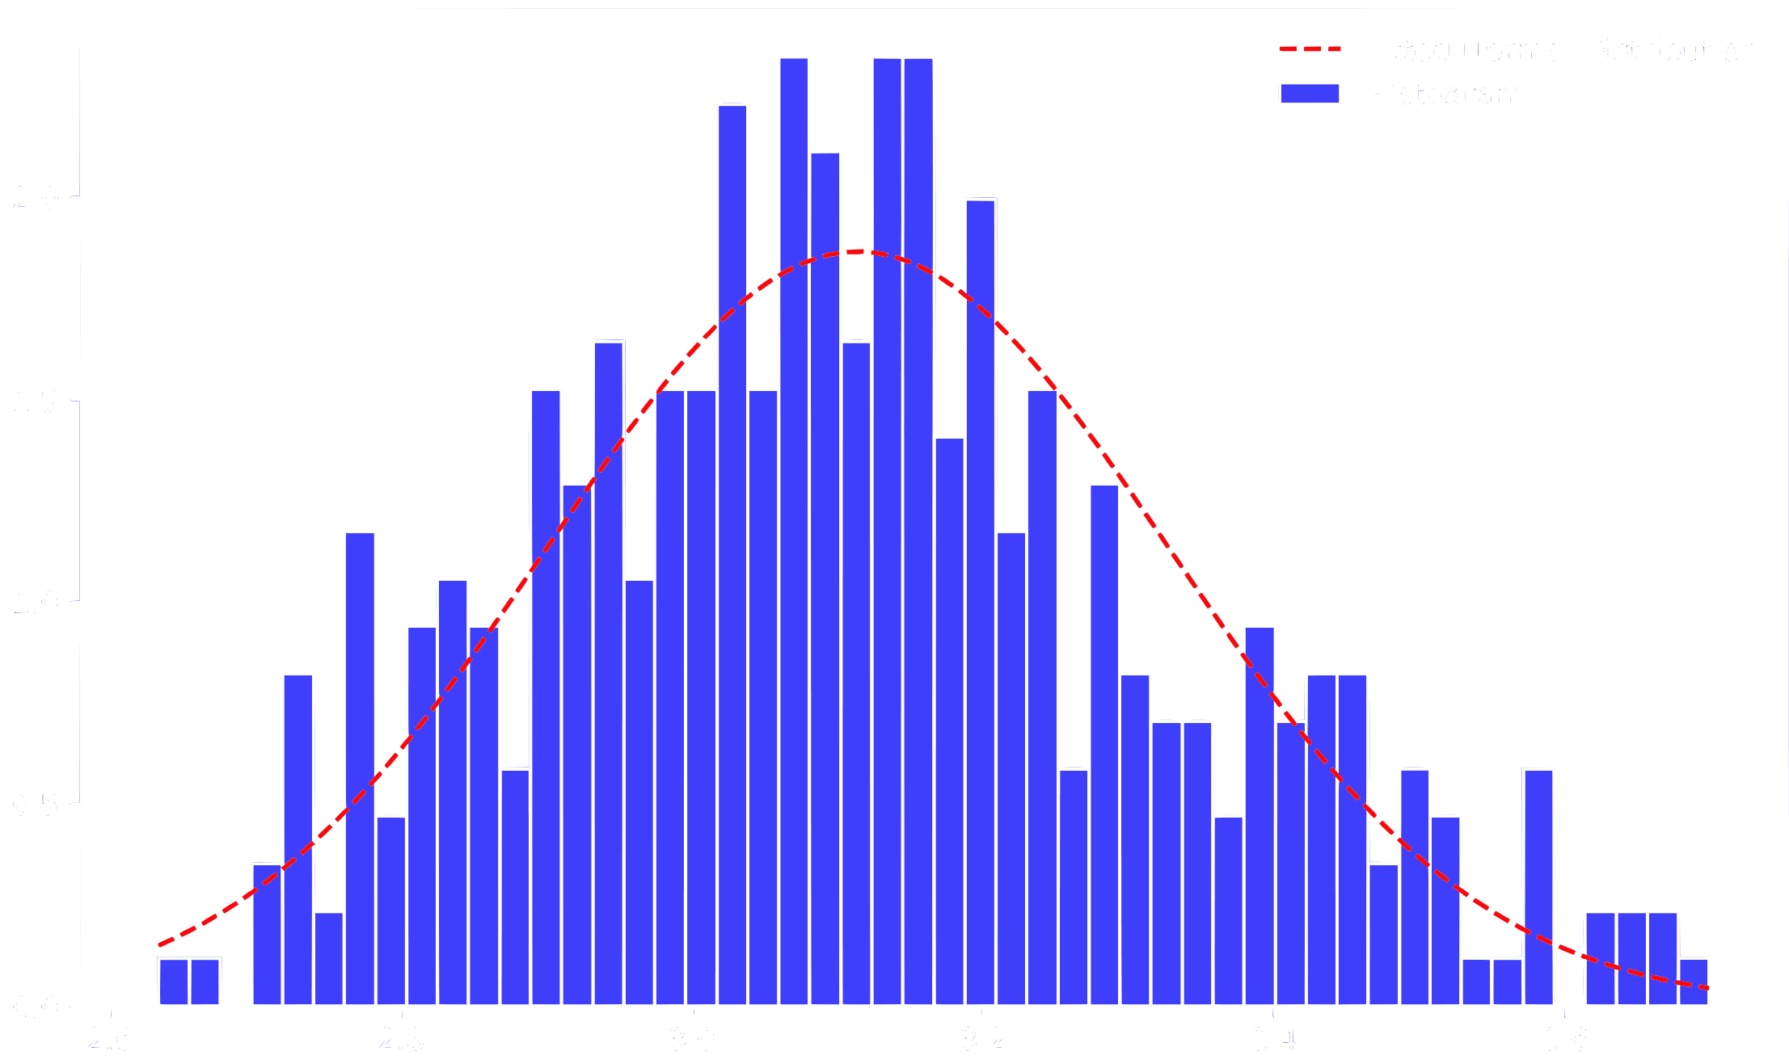
Design justification
Thermal analyses
  Steady-state (incl. sensitivity analysis)
  Transient
Structural analyses
  Quasi-static acceleration
  Modal
  Harmonic response (FRFs)

Slide 11
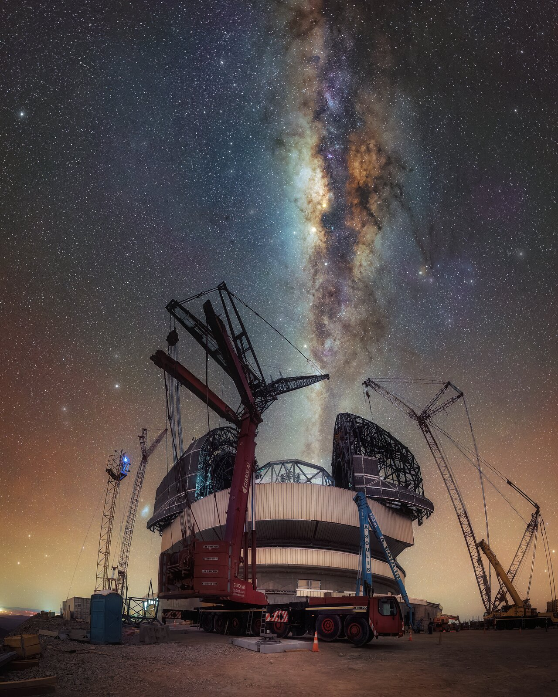
Future detector unit : ANDES (ESO ELT)
5 detector units (9K x 9K pixels CCD)
Cooling system : Stirling cryocooler (ESO standard : Cryotel GT)
Subsystem PDR completed
Start prototyping
© C.Letelier / ESO

