Slide 1


An overview of the Nulling Interferometer Cryogenic Experiment (NICE)
Dr. Jonah Hansen, along with the work of the NICE team: Thomas Birbacher, Emilie Bouzerand, David Eglin, Germain Garreau, Adrian Glauser, Ryan Meierhofer, Julio Pino, Oliver Pitz, Eckhart Spalding, Sascha Quanz
Swiss Innovation for Astrophysics and Planetary Science
Bern, Switzerland
January 21, 2026

Slide 2

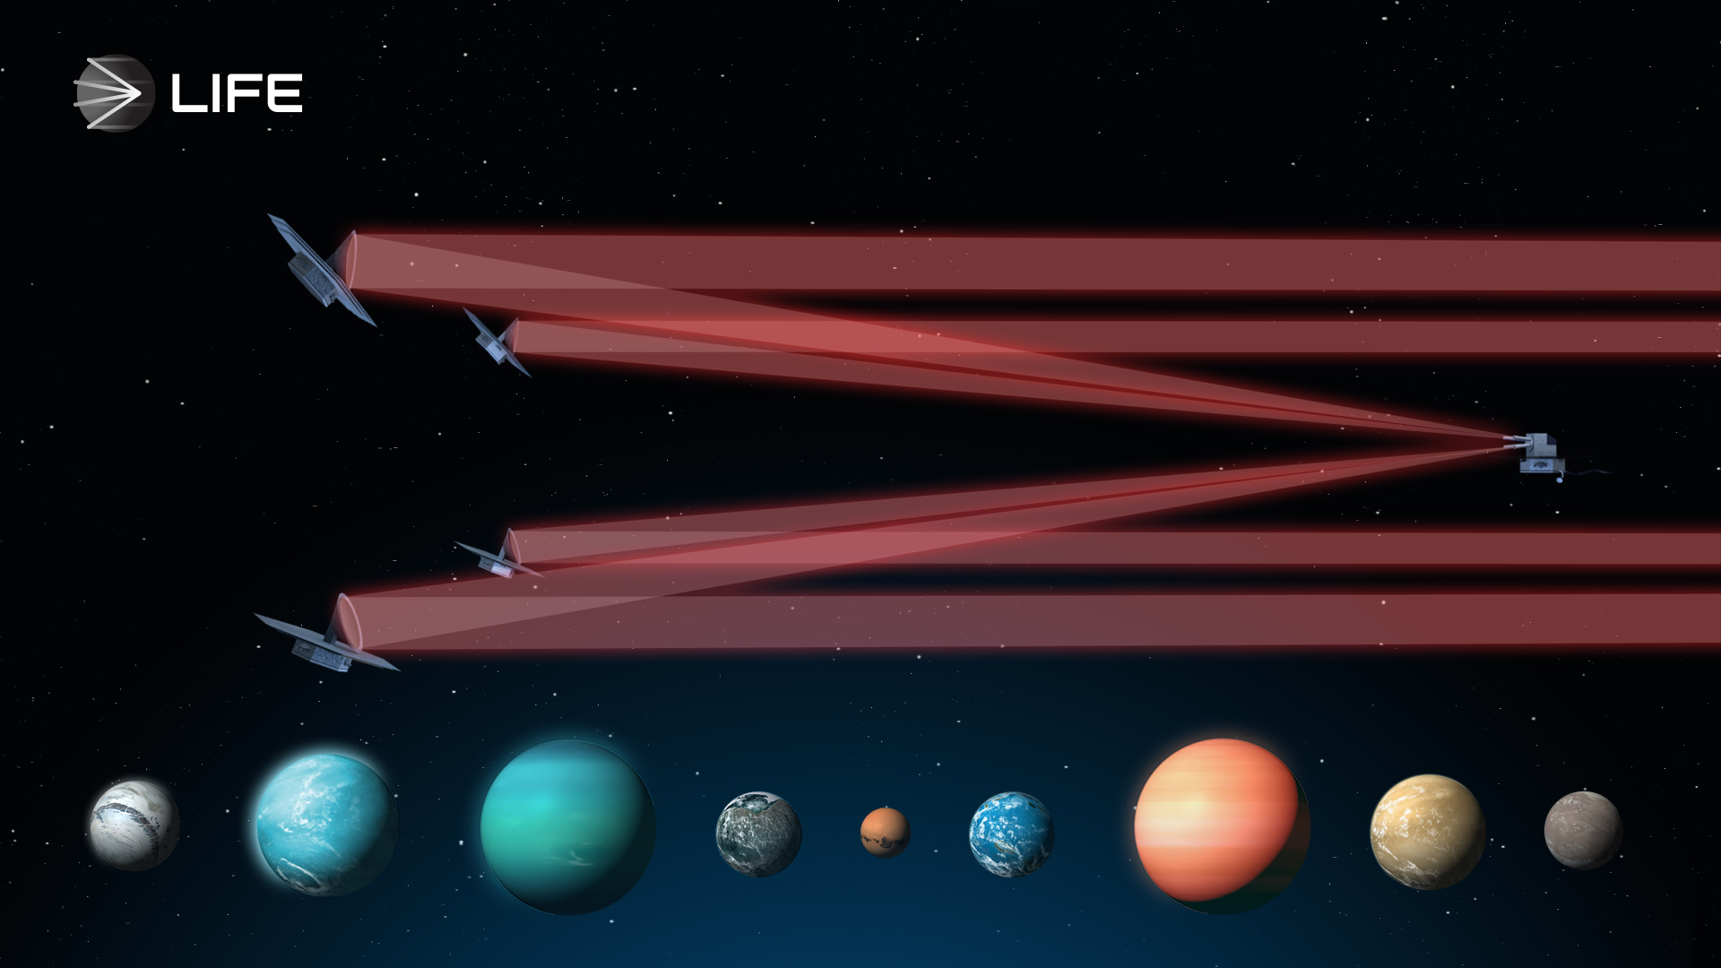

LIFE – The Large Interferometer For Exoplanets

Slide 3
Key technologies needed for maturation
From a space-based High Contrast Imaging R&D discussion in Heidelberg last year:
Formation flying
Nulling at the required temperature and sensitivity
Dealing with over an octave of wavelength coverage
Spatial filtering
Vibrations, stability and fringe tracking
Cryogenic DMs
Integrated optics
Detectors
<number>

Slide 4
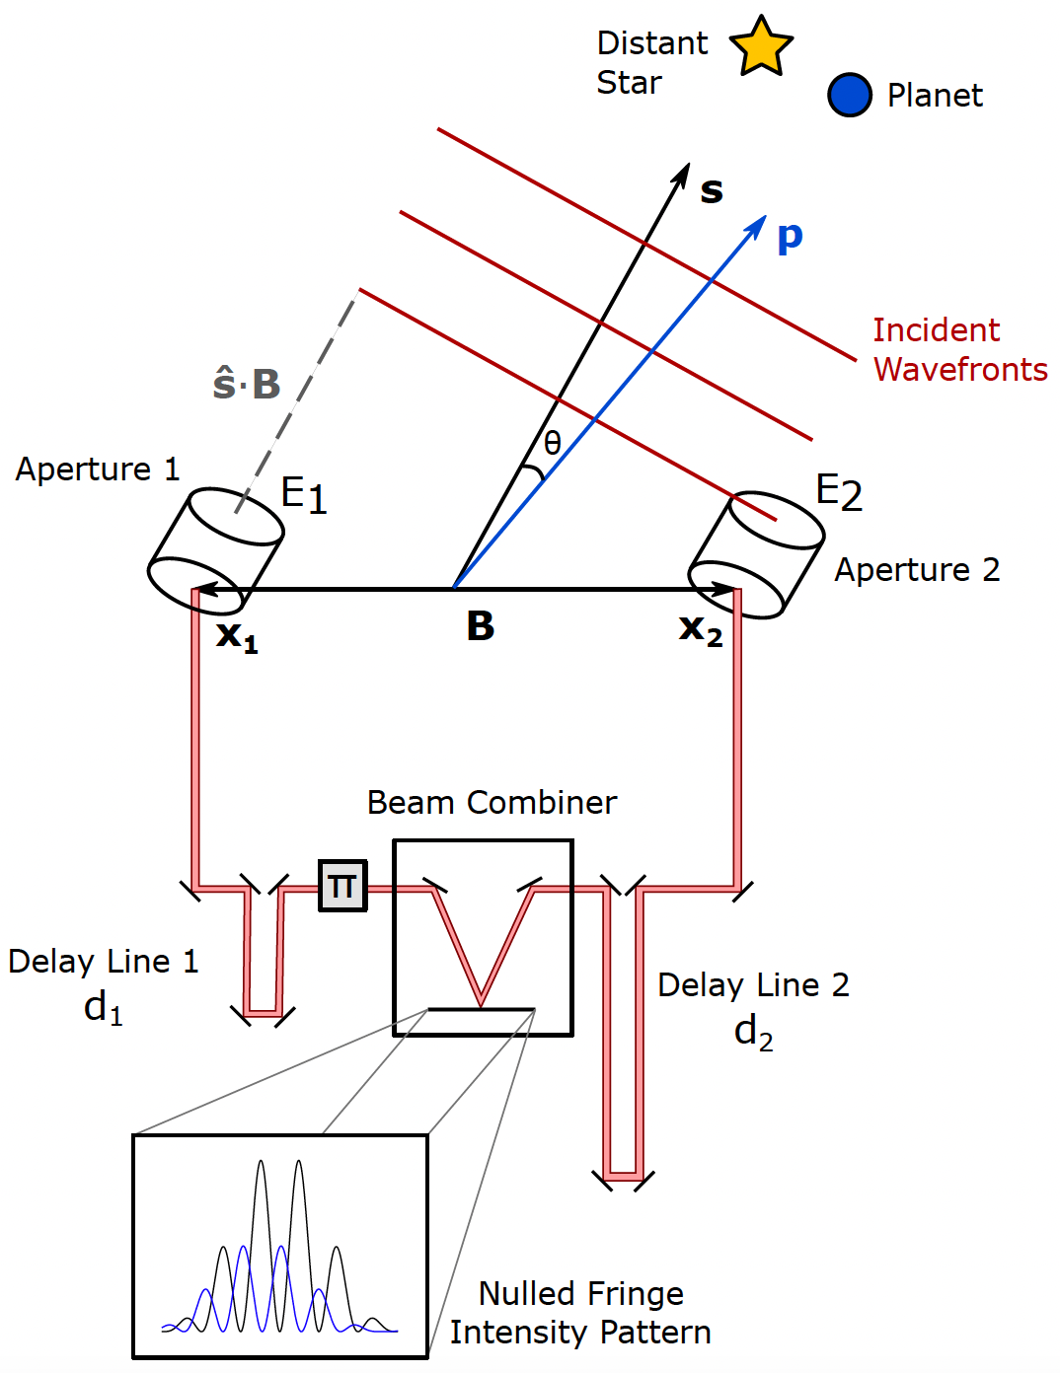
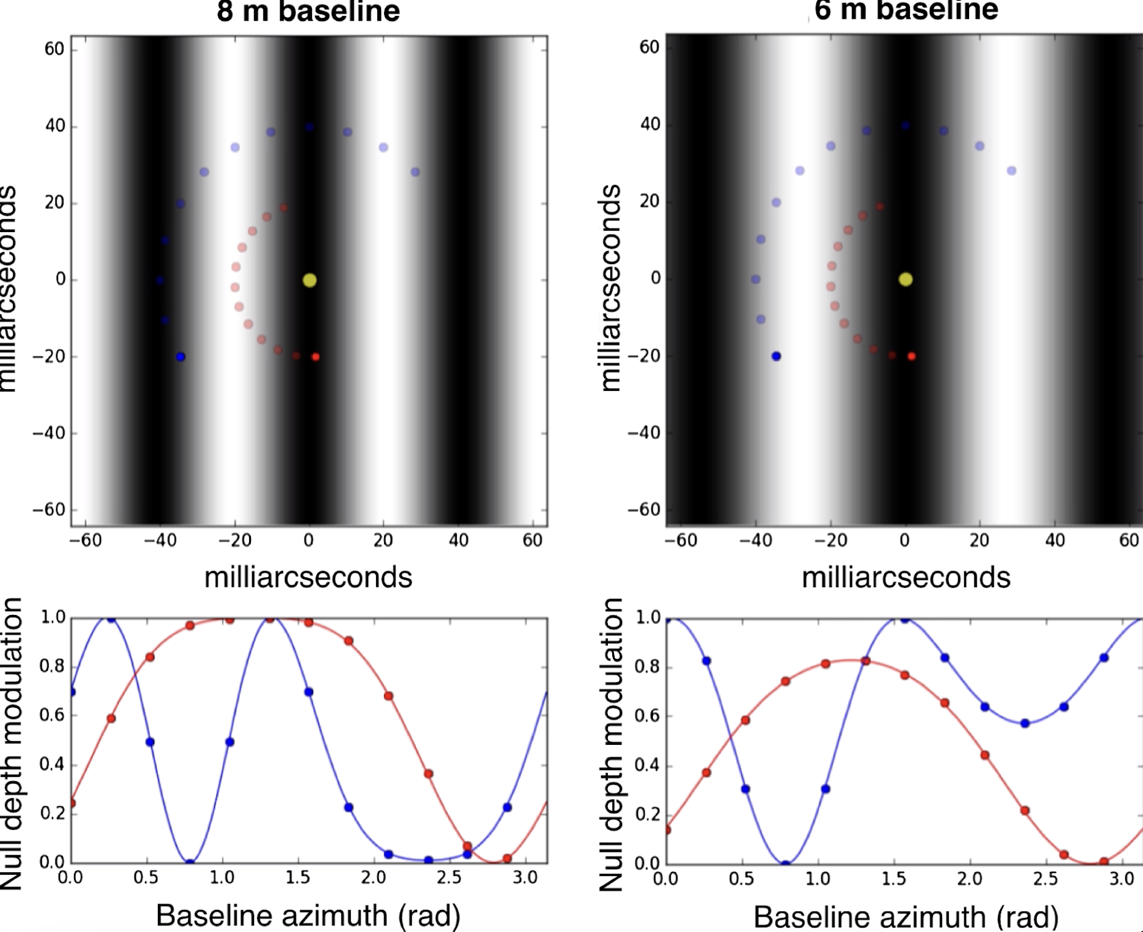
Nulling basics
Credit: J. Hansen
Credit: T. Lagadec
<number>

Slide 5
The Nulling Interferometer Cryogenic Experiment (NICE)
Phase 1:
Ambient
4µm wavelength
Monochromatic Single polarisation
2 beams
Phase 2:
Ambient
4µm wavelength
10% bandpass Dual polarisation
2 beams
Phase 3:
Ambient
4µm wavelength
10% bandpass Dual polarisation
2 beams with planet signal
The “Warm Stage”
Phase 4:
Cryogenic at 15K
4 & 10µm wavelength
10% bandpass Dual polarisation
2 beams with planet signal
Phase 5:
Cryogenic at 15K
4 & 10µm wavelength
>10% bandpass Dual polarisation
4 beams with planet signal
Phase 6+:
Cryogenic at 15K
4 &10µm wavelength
Use as a testbed for other technologies and LIFE development
The “Cold Stage”
A testbed and experiment designed to demonstrate LIFE’s measurement principle
Overall aim is to demonstrate nulling interferometry with:
>10% bandpass at 4 and 10µm,
A mean raw null depth of 1e-5, with a stability of 1e-8 from ~150-300 μHz
An OPD stability of < 2nm RMS,
An intensity stability of <0.1%,
Photon conversion efficiency (throughput + detector) of 20-30%
Functioning at cryogenic temperatures of ~15K
Notes:
2.5min

Slide 6
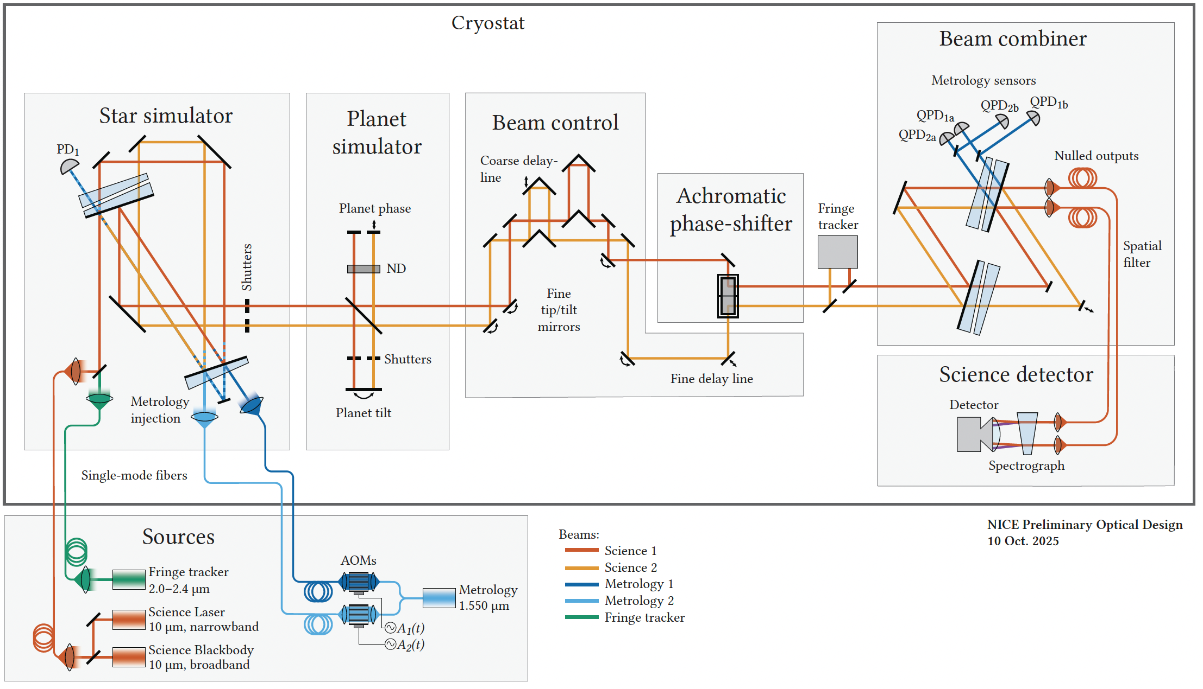
The Nulling Interferometer Cryogenic Experiment (NICE)
A testbed and experiment designed to demonstrate LIFE’s measurement principle
Credit: T. Birbacher
Overall aim is to demonstrate nulling interferometry with:
>10% bandpass at 4 and 10µm,
A mean raw null depth of 1e-5, with a stability of 1e-8 from ~150-300 μHz
An OPD stability of < 2nm RMS,
An intensity stability of <0.1%,
Photon conversion efficiency (throughput + detector) of 20-30%
Functioning at cryogenic temperatures of ~15K
Notes:
2.5min

Slide 7
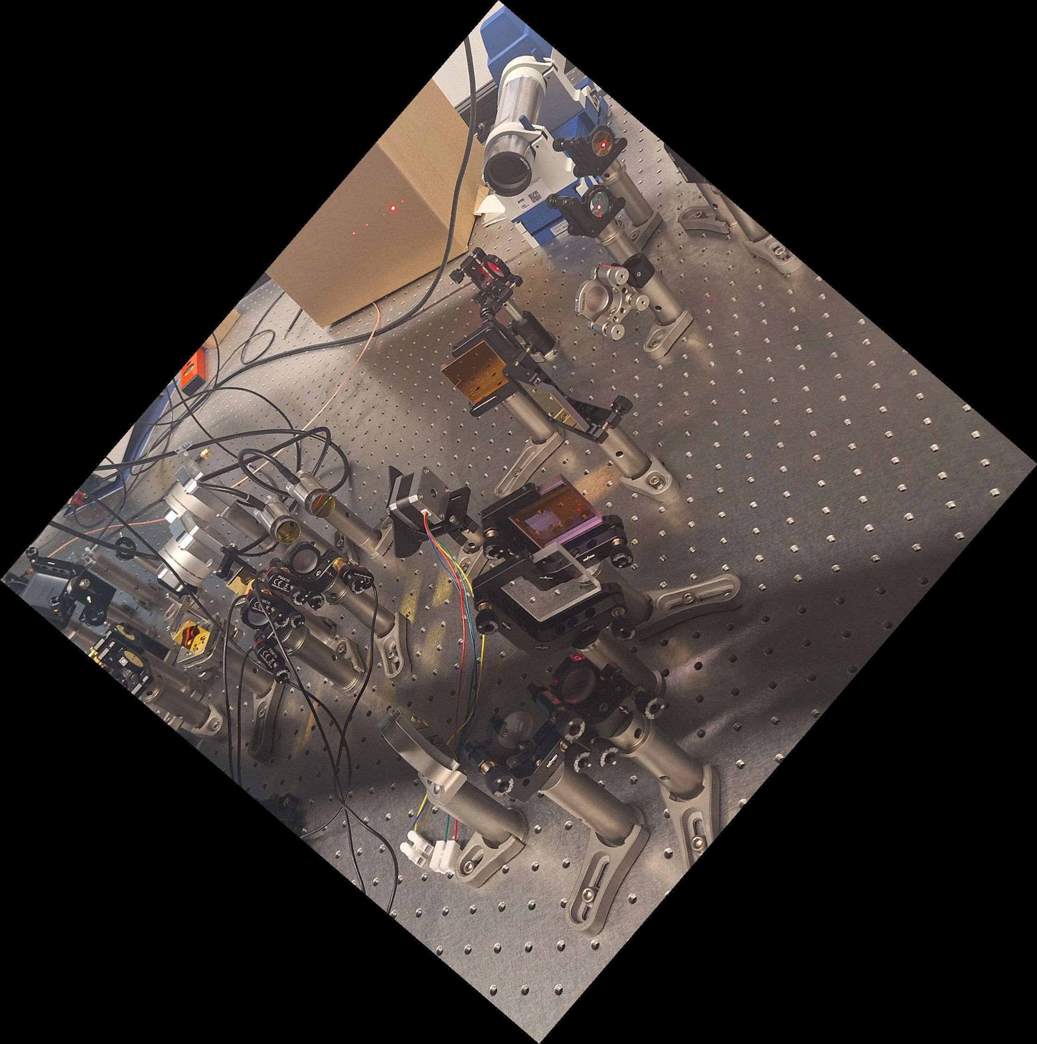
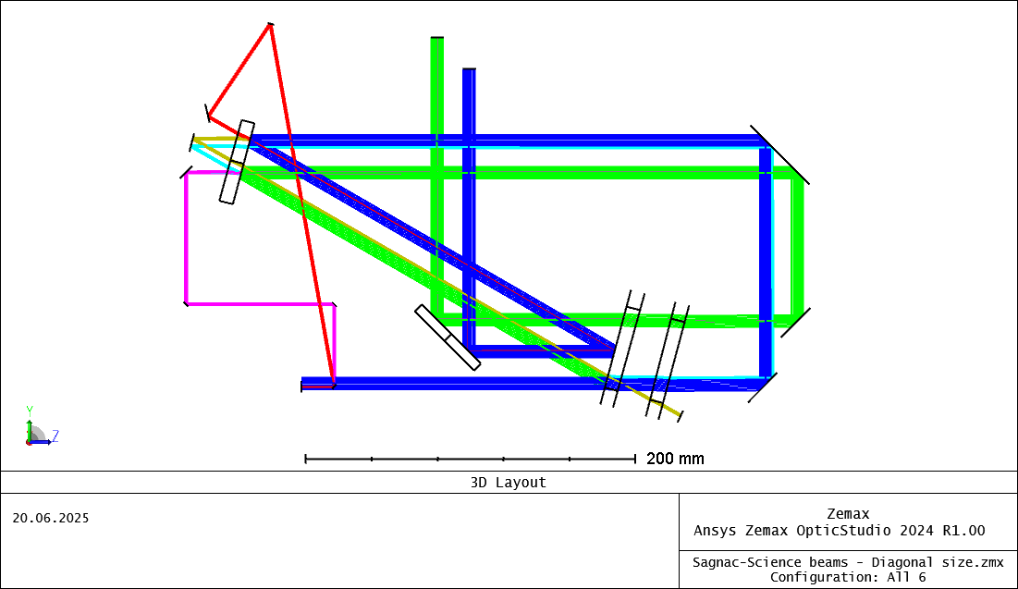
The Nulling Interferometer Cryogenic Experiment (NICE)
Star Simulator
Purpose: Split the beam into two components with equal phase, amplitude and polarisation as a function of wavelength (Sagnac splitter)
Credit: J. Pino
Notes:
2.5min

Slide 8
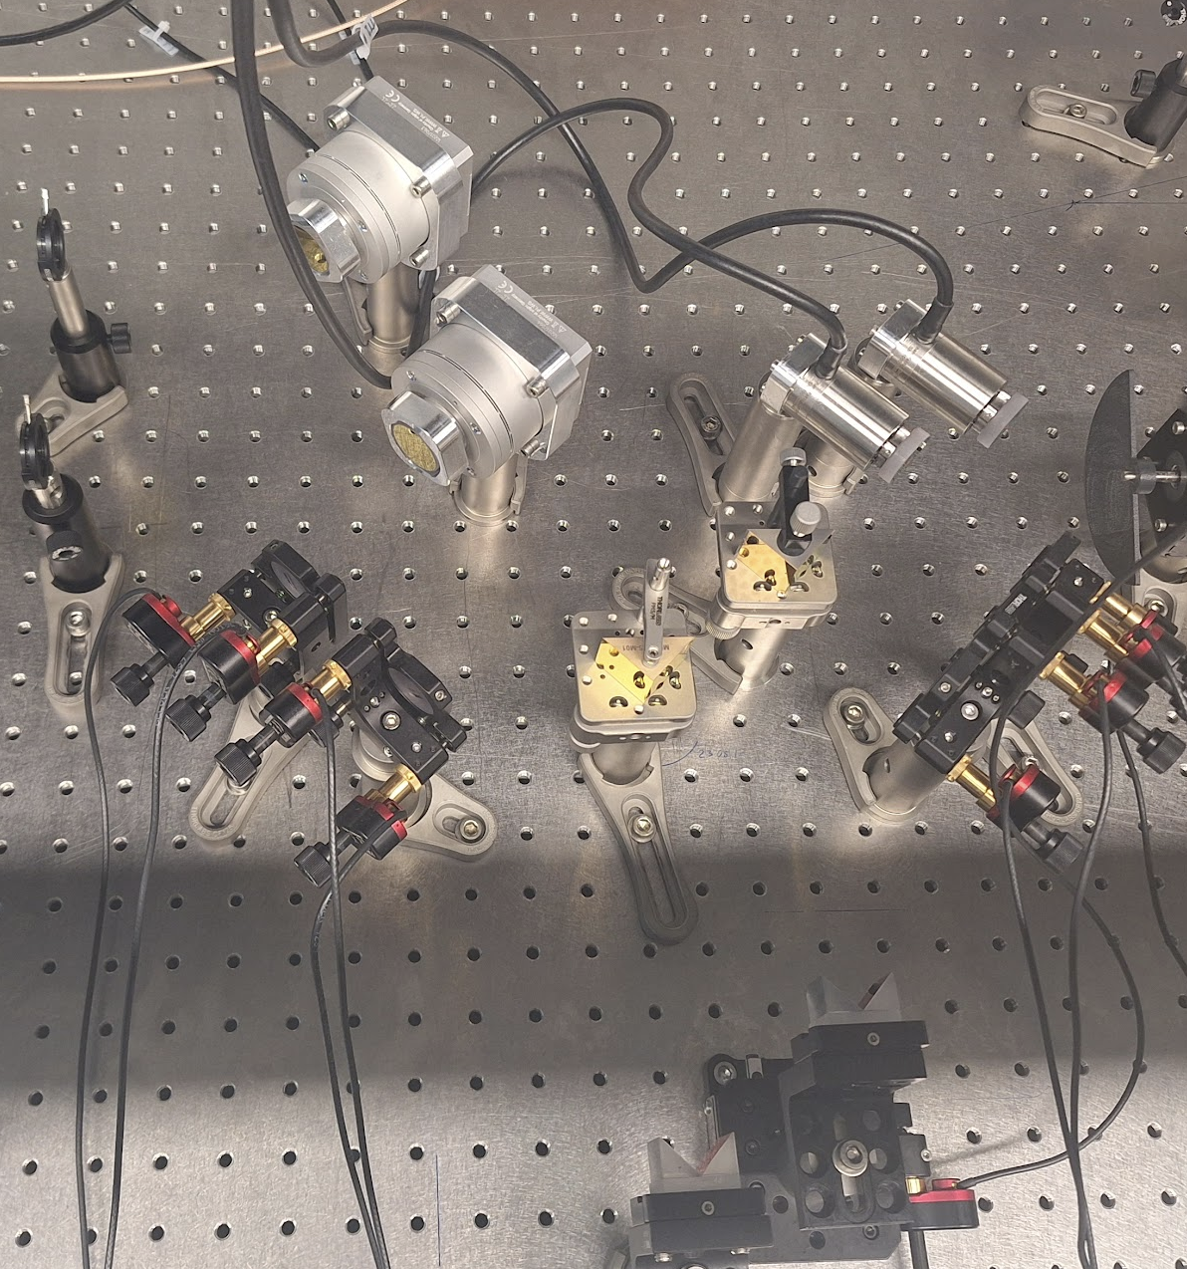
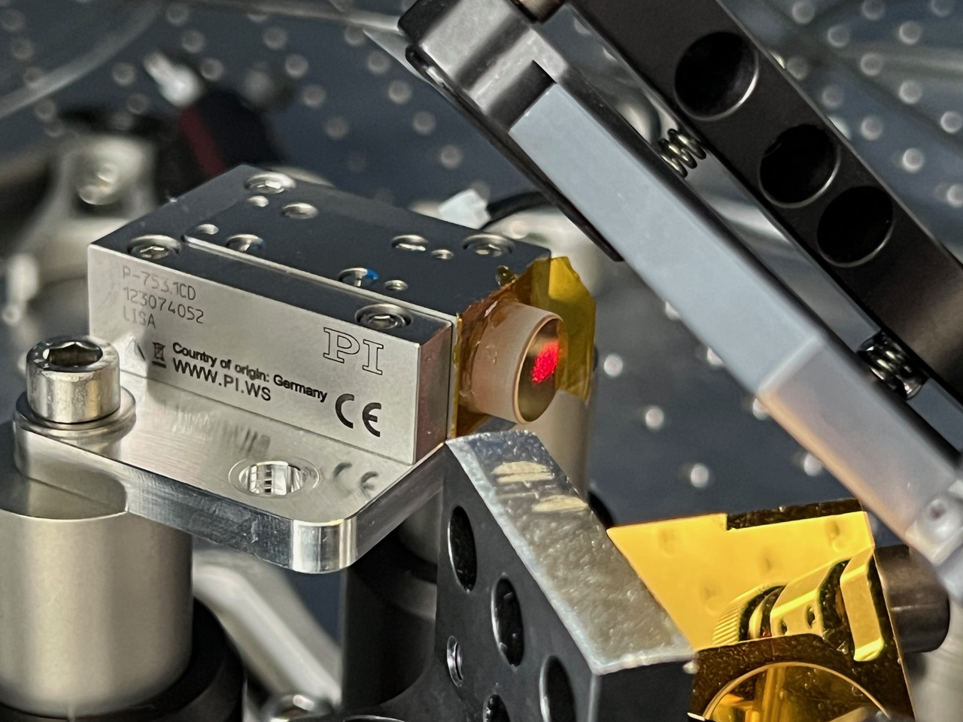
The Nulling Interferometer Cryogenic Experiment (NICE)
Purpose: Control the beams’ OPD, tip/tilt and position using fine and course piezo stages
Star Simulator
Control Stage
Notes:
2.5min

Slide 9
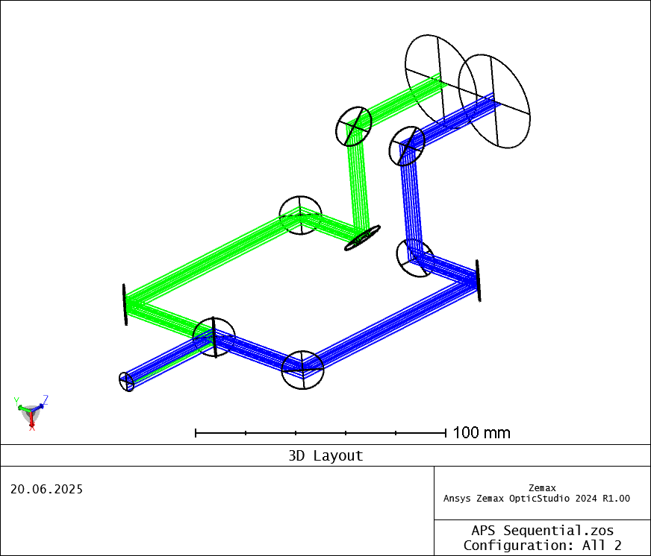
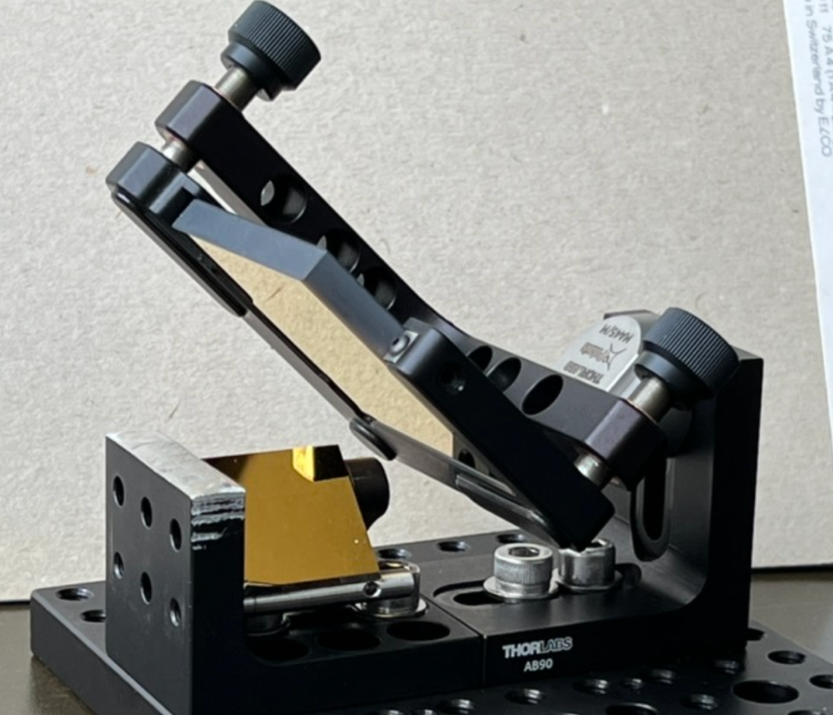
The Nulling Interferometer Cryogenic Experiment (NICE)
Credit: J. Pino
Star Simulator
Control Stage
Achromatic Phase Shifter
Purpose: Perform a polarization flip to induce a π phase shift at all wavelengths
Credit: T. Birbacher
Notes:
2.5min

Slide 10
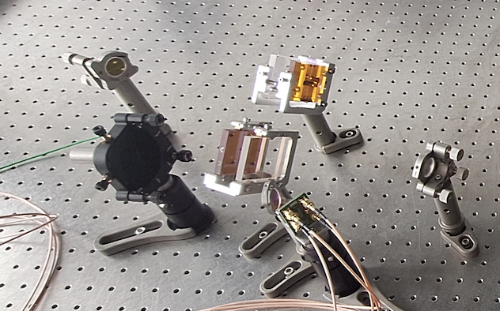
The Nulling Interferometer Cryogenic Experiment (NICE)
Purpose: Combine the beams in a symmetric fashion to be resistant to chromatic effects, and then spatially filter the beam to remove OPD fluctuations across the pupil.
Finally, sample the beam with a spectrograph and detector
Star Simulator
Control Stage
Achromatic Phase Shifter
Beam Combiner (MMZ)
Notes:
2.5min

Slide 11
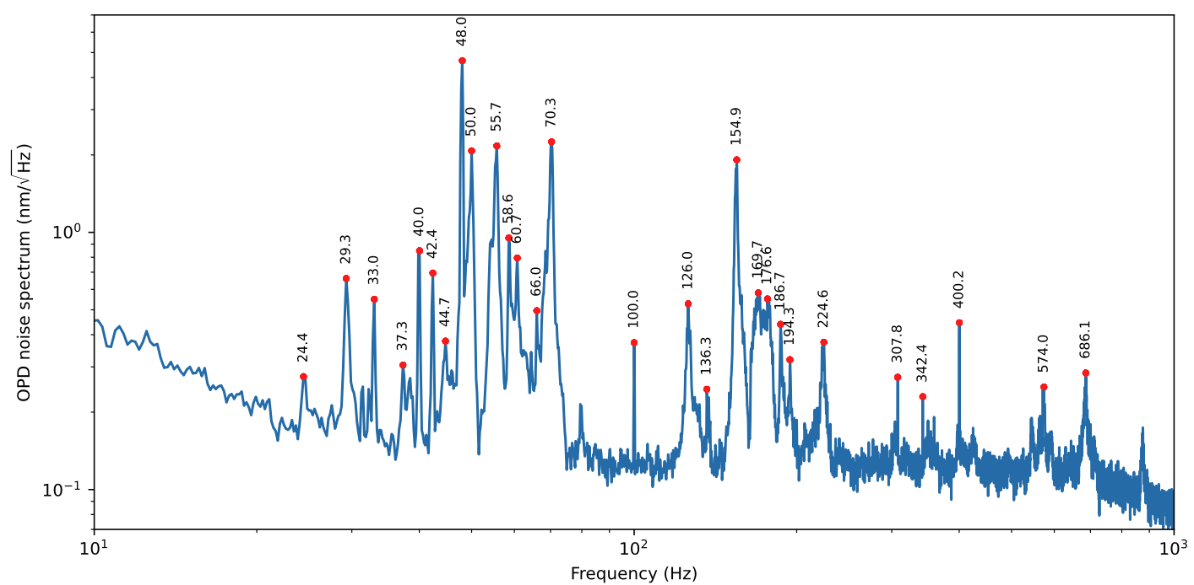
The Nulling Interferometer Cryogenic Experiment (NICE)
Star Simulator
Control Stage
Achromatic Phase Shifter
Beam Combiner (MMZ)
Metrology System
Purpose: Provide a measurement of OPD and beam alignment using a separate heterodyne interferometry setup
Credit: T. Birbacher
Notes:
2.5min

Slide 12
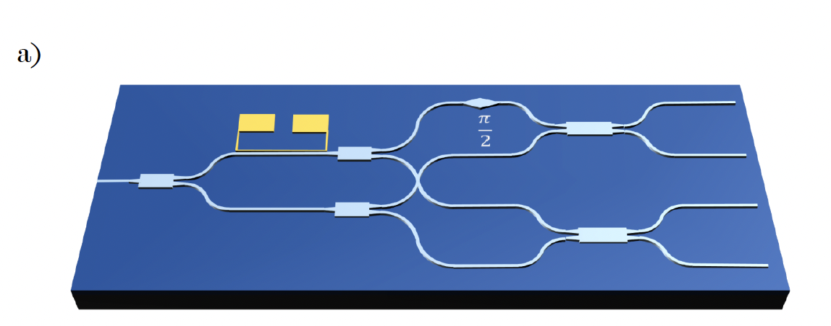
The Nulling Interferometer Cryogenic Experiment (NICE)
Star Simulator
Control Stage
Achromatic Phase Shifter
Beam Combiner (MMZ)
Metrology System
Planet simulator and Fringe Tracker (currently absent)
Purpose: Mimic a planet signal, as well as provide a ground-truth measurement of OPD.
Physical implementation of these components is not finalised.
Credit: O. Pitz
Notes:
2.5min

Slide 13
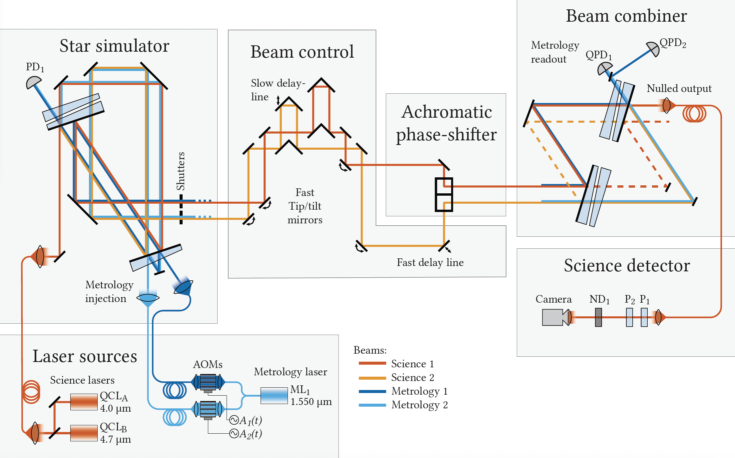
The Nulling Interferometer Cryogenic Experiment (NICE)
Our first implementation is an ambient optical table, known as the “warm bench”
Subject to very strong vibrations from the lab building, and significant IR background
In the process of migrating from OTS elements and mounts to custom integrated structures

Slide 14
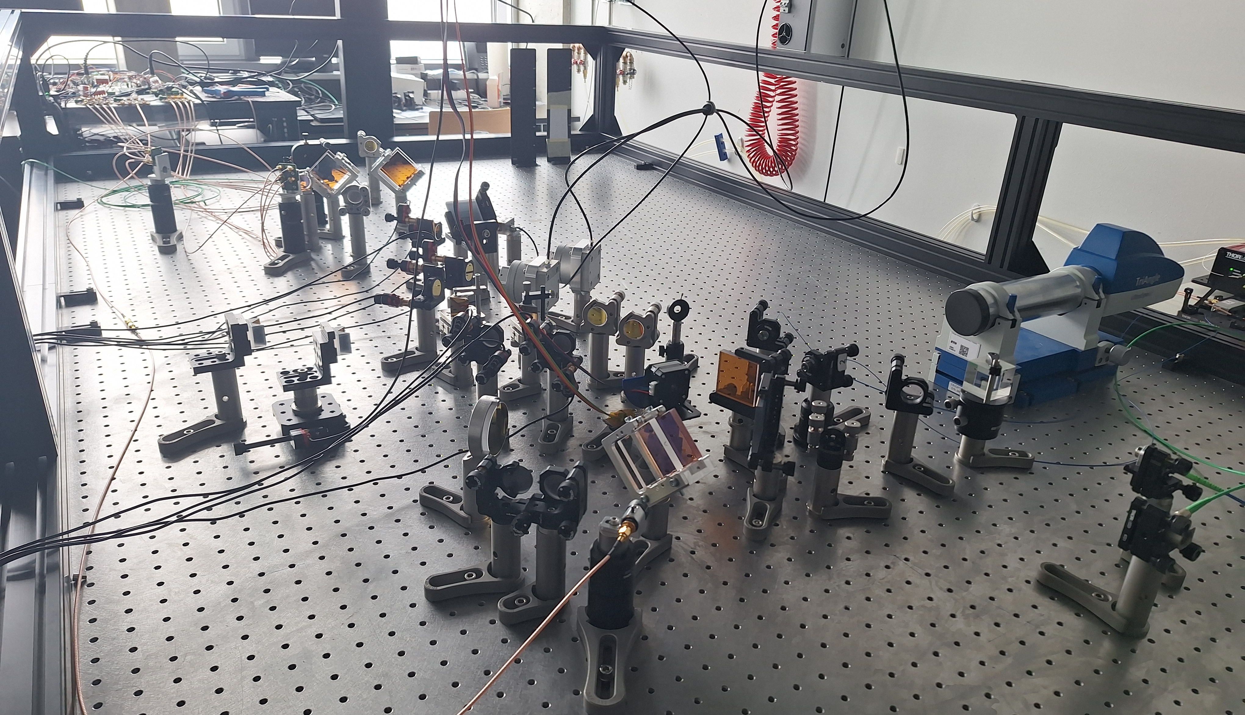
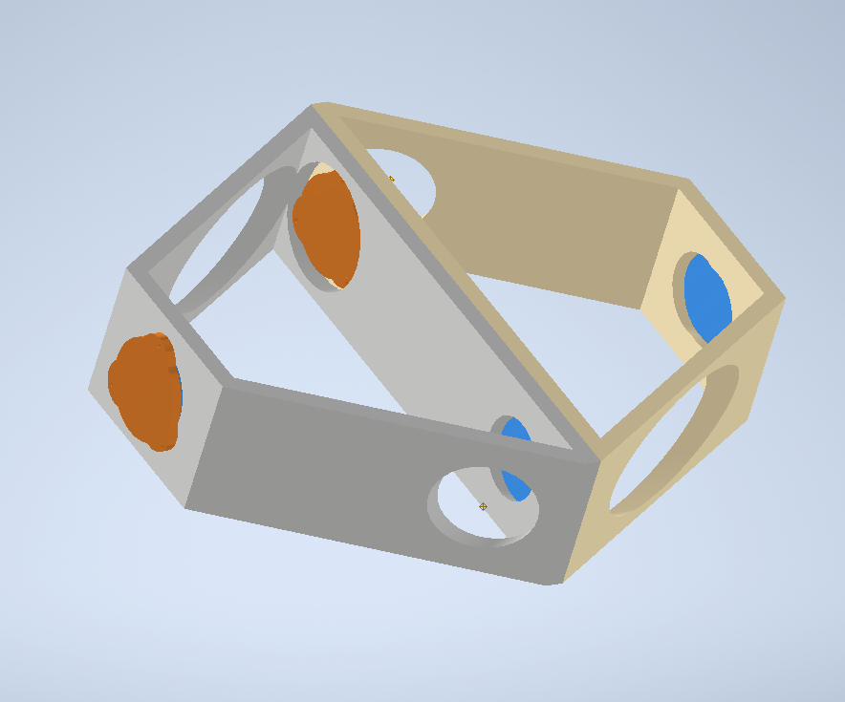
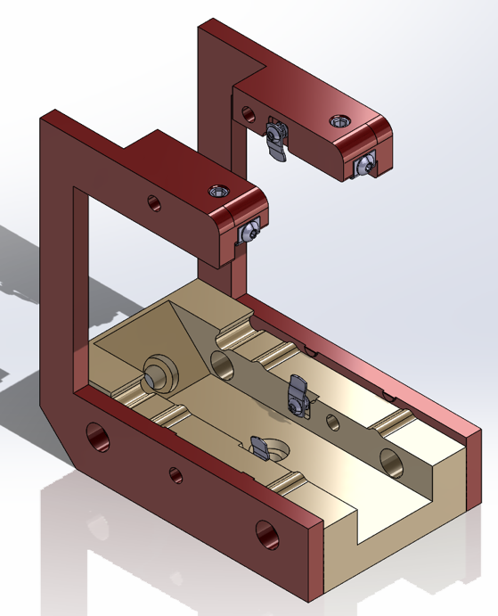
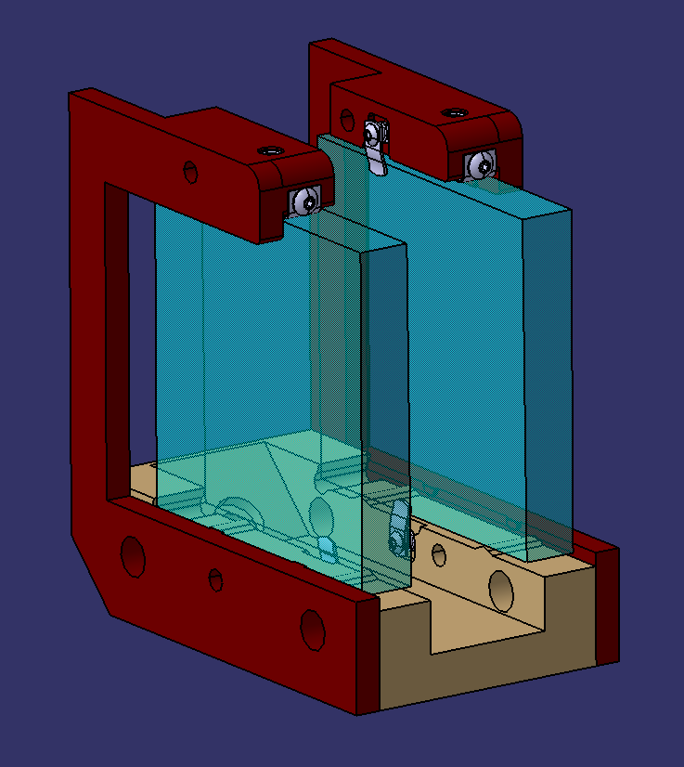
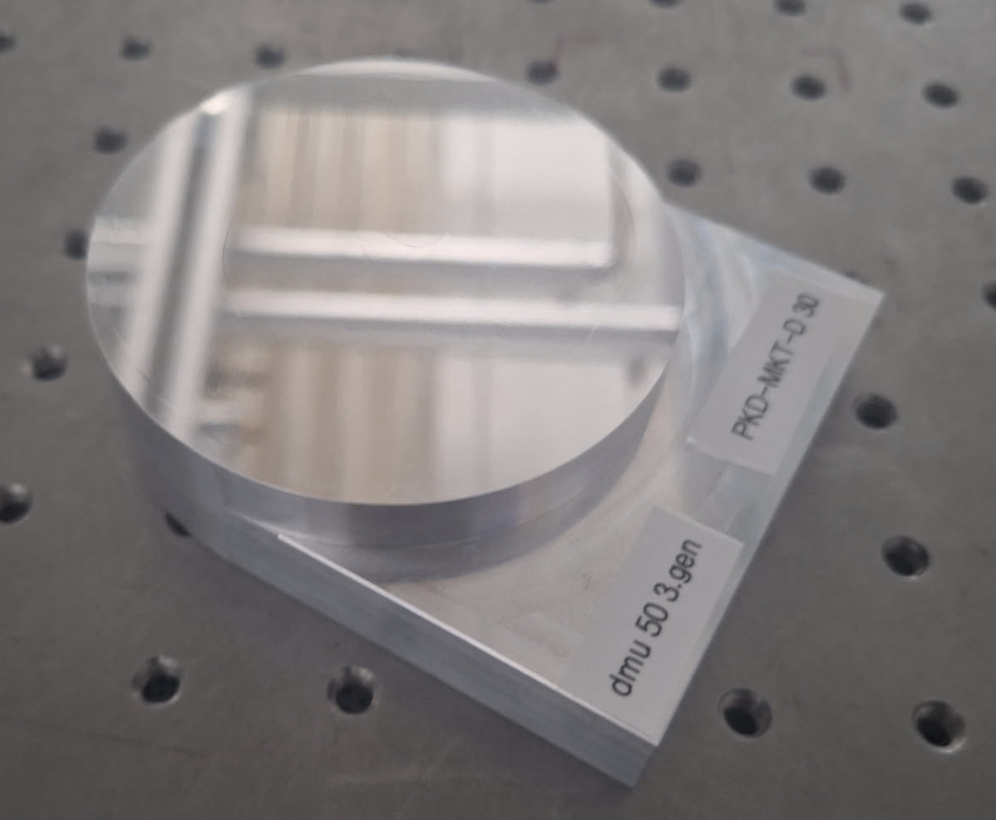
The Nulling Interferometer Cryogenic Experiment (NICE)
Our first implementation is an ambient optical table, known as the “warm bench”
Subject to strong vibrations from the lab building, and significant IR background
In the process of migrating from OTS elements and mounts to custom integrated structures
Credit: A. Glauser
Credit: J. Pino

Slide 15
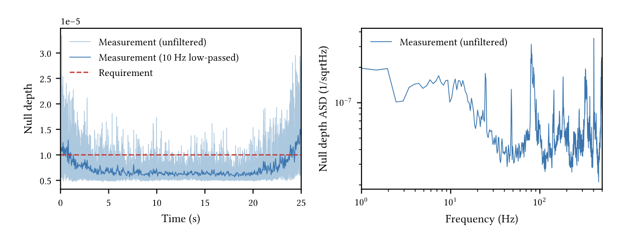
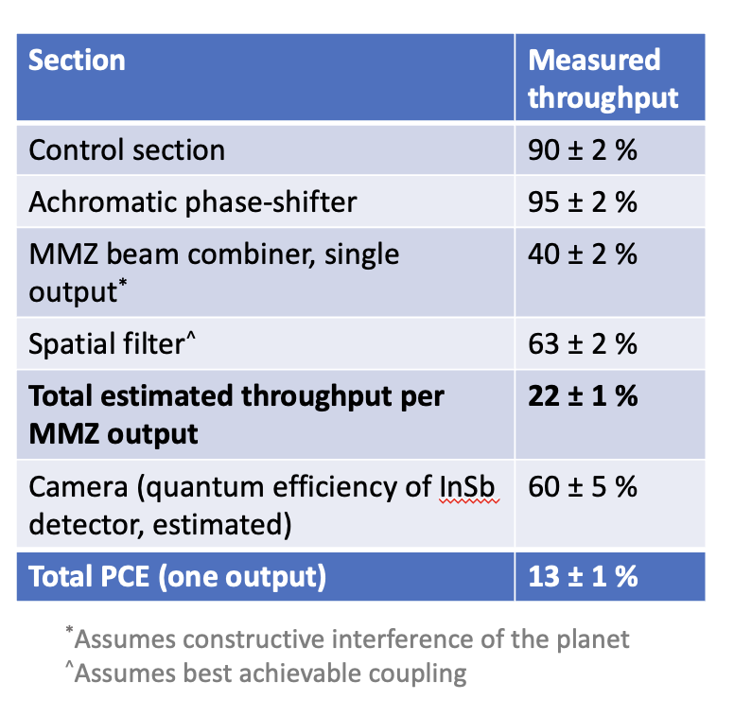
The Nulling Interferometer Cryogenic Experiment (NICE)
Warm bench results:
<1e-5 mean null depth over 20s
OPD at <2nm rms
Limitations due to parasitic cladding modes in the spatial filter
Throughput measured at 13% for one output => Meets requirement if replicable on second output
Credit: T. Birbacher

Slide 16
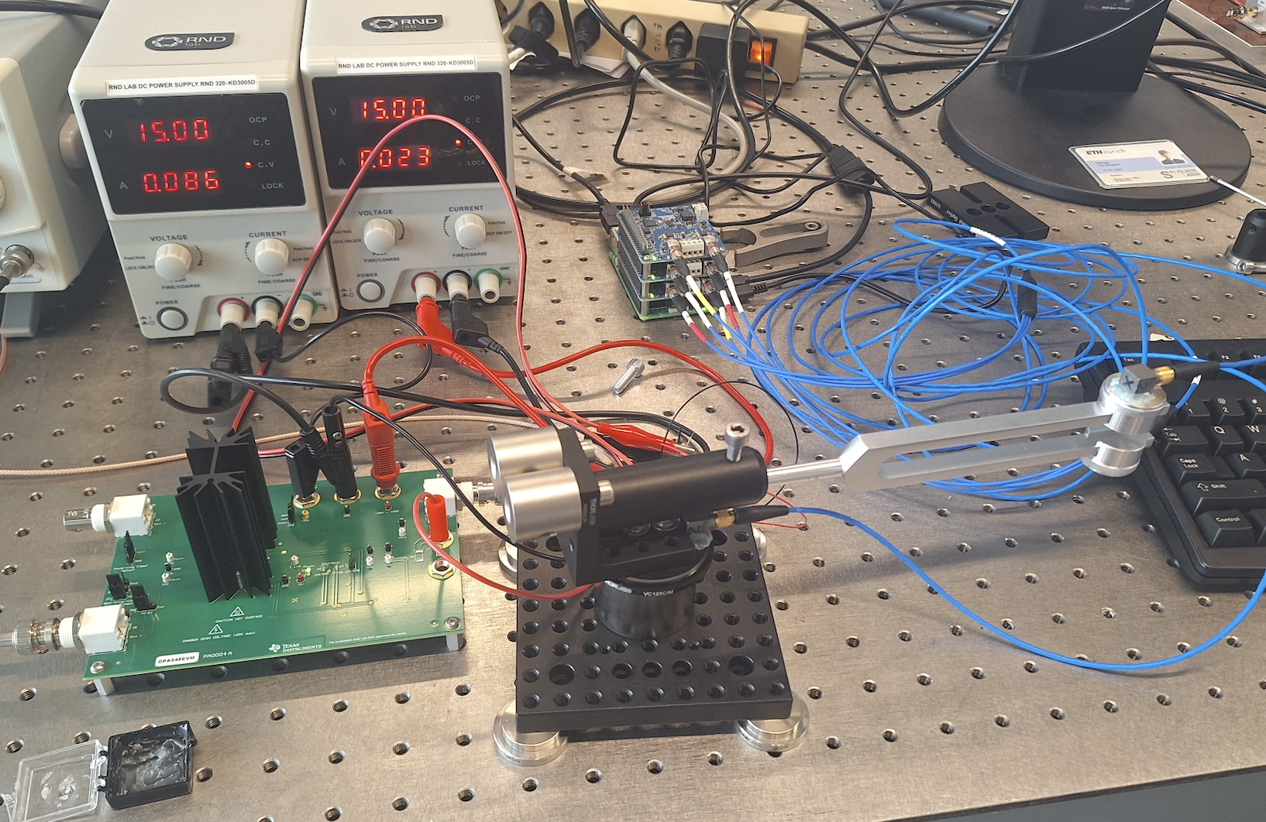
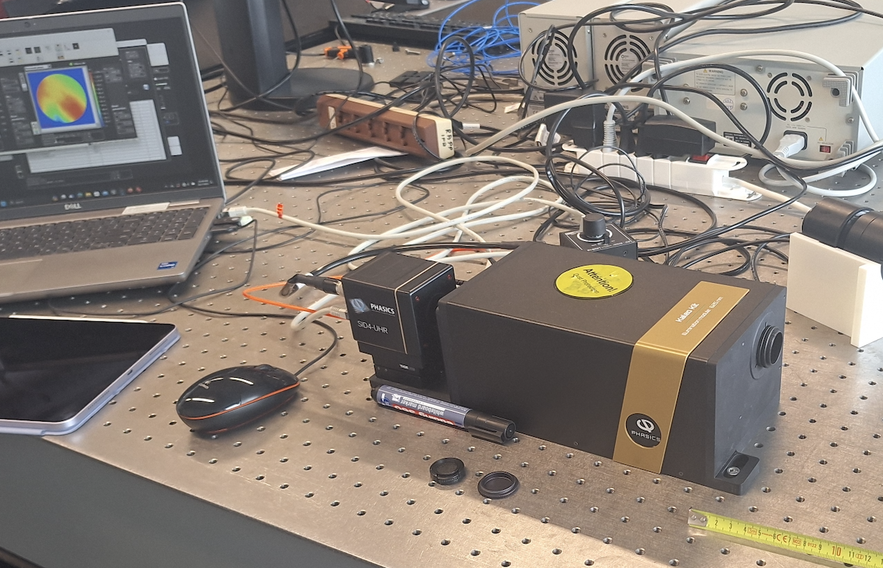
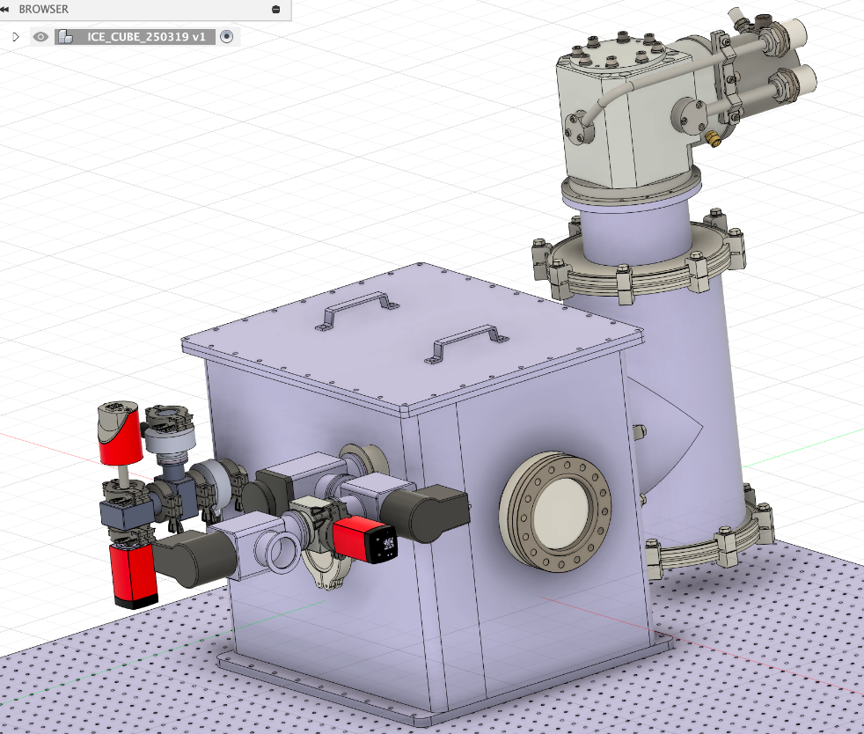
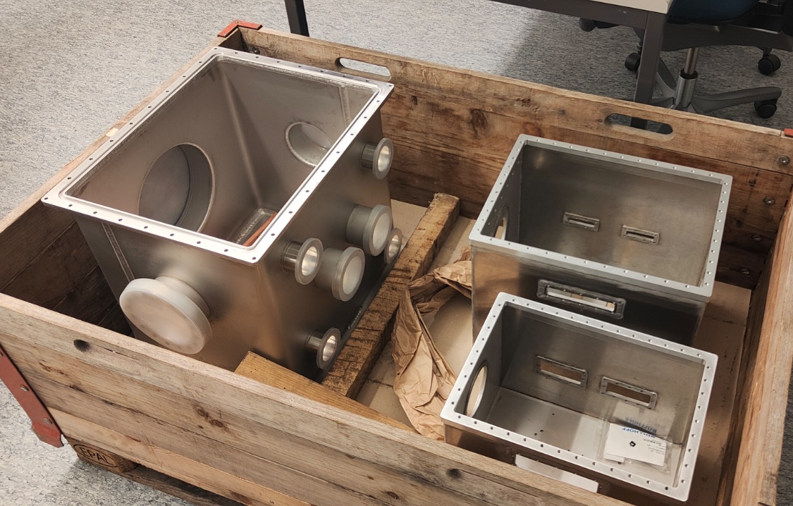
The Nulling Interferometer Cryogenic Experiment (NICE)
Cryogenic preparation is also beginning, with a test cryostat being designed and manufactured to identify best mounting and material choices for LIFE
Preliminary experimental setup to identify minute deformations during cooldown
Cryostat should be ready to begin testing in the coming months
Credit: E. Bouzerand

Slide 17
Thank you!
Dr. Jonah Hansen, along with the work of the NICE team: Thomas Birbacher, Emilie Bouzerand, David Eglin, Germain Garreau, Adrian Glauser, Ryan Meierhofer, Julio Pino, Oliver Pitz, Eckhart Spalding, Sascha Quanz
Swiss Innovation for Astrophysics and Planetary Science
Bern, Switzerland
January 21, 2026

