Slide 1
Motorized Mounts for the Folding Mirrors of the VLT's BlueMUSE Instrument
Speaker: Gloria Mellinand

Slide 2
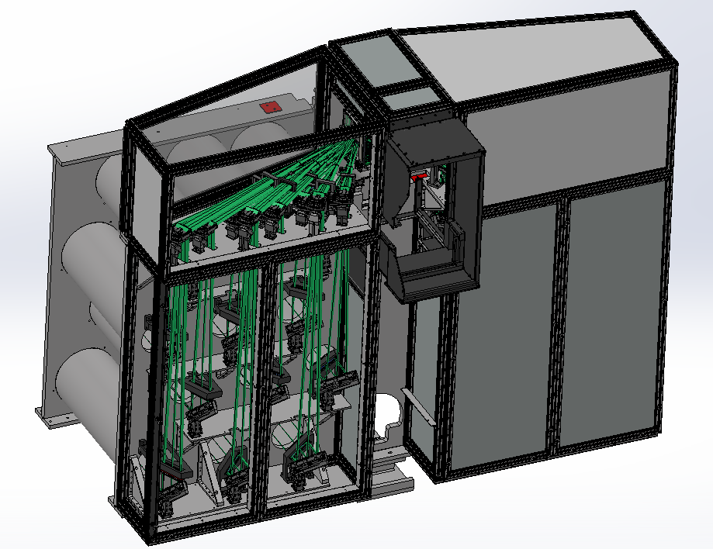
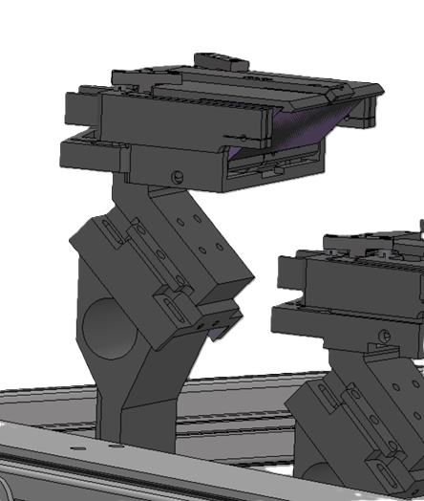
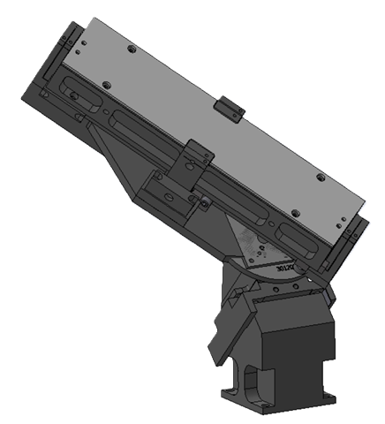
BlueMUSE’s Folding Mirrors
Folding Mirror 1 (FM1)
16 FM1 instead of 26 for MUSE
Direct light path
Maintenance calibration and positioning of mirrors
2 Degrees of Freedom - Tip and Tilt
Manual adjustment on MUSE
FM1
Folding Mirror 2 (FM2)
16 FM2
3 Degrees of Freedom - Tip, Tilt, Vertical Translation
FM2
Figure: MUSE Design (BlueMUSE keeps the same overall architecture with 16 path instead of 24)

Slide 3
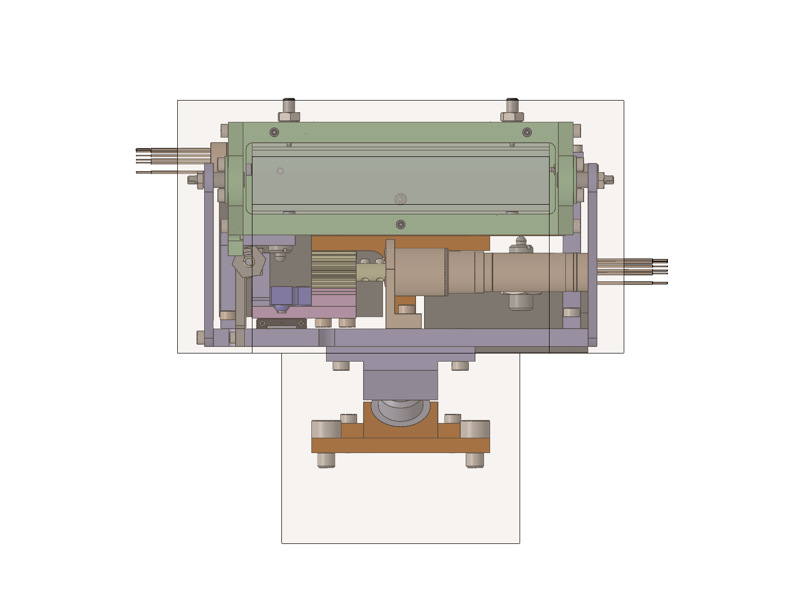
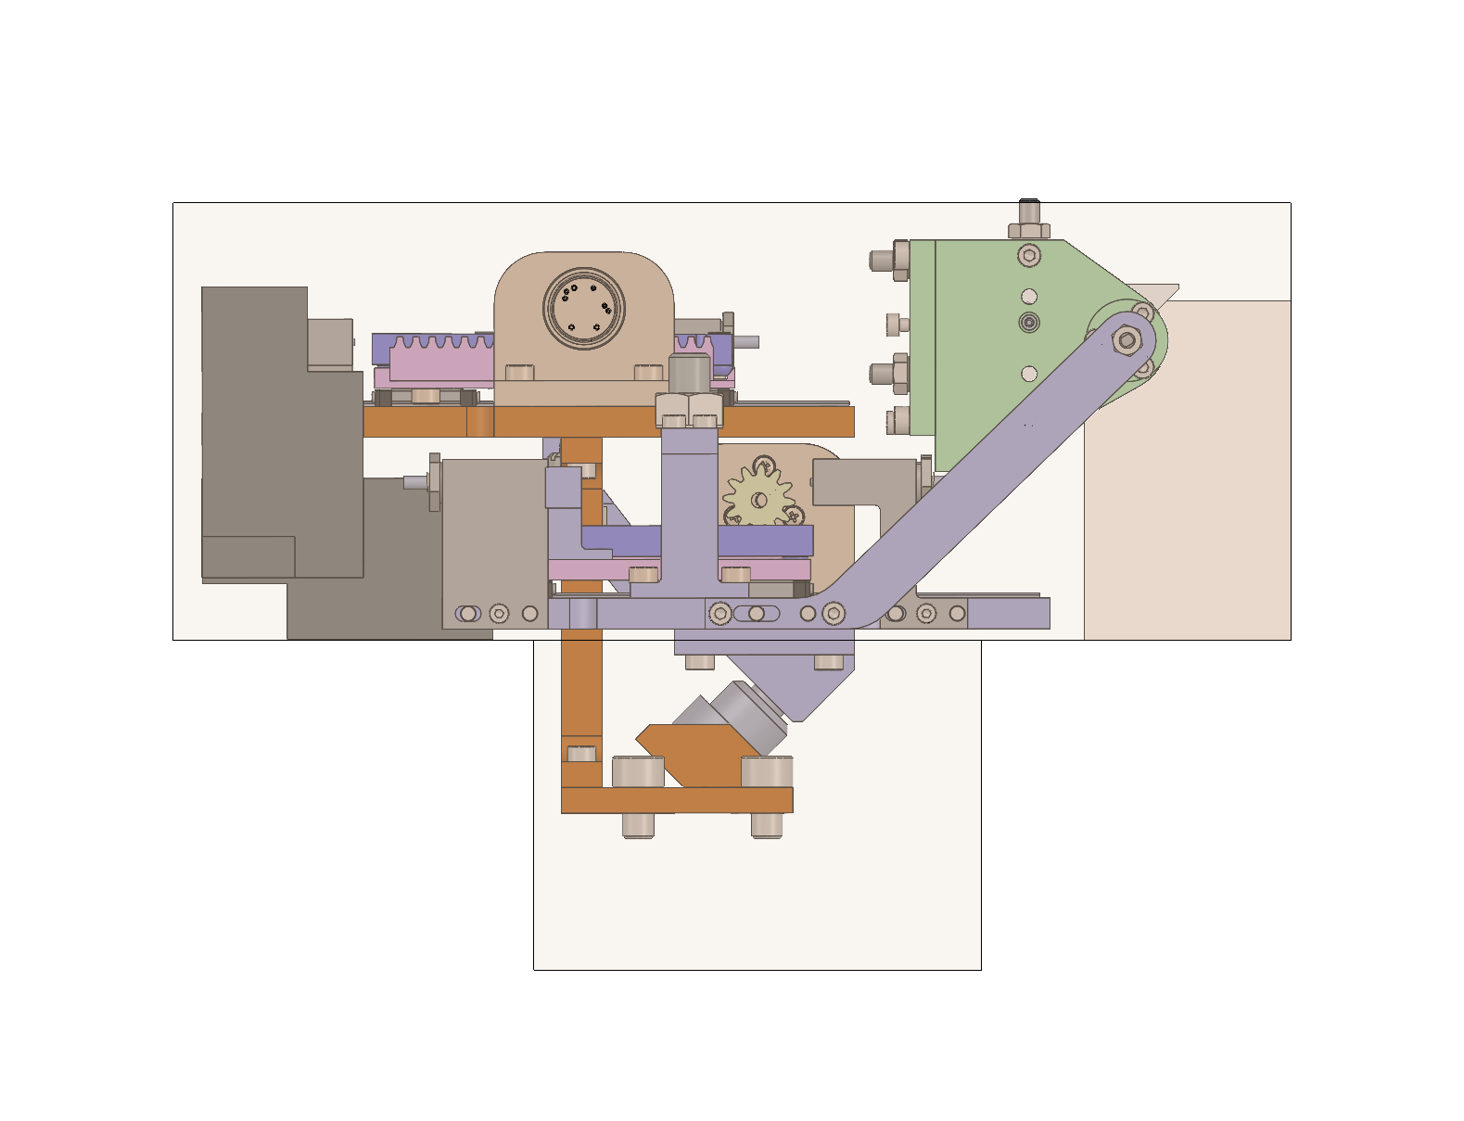
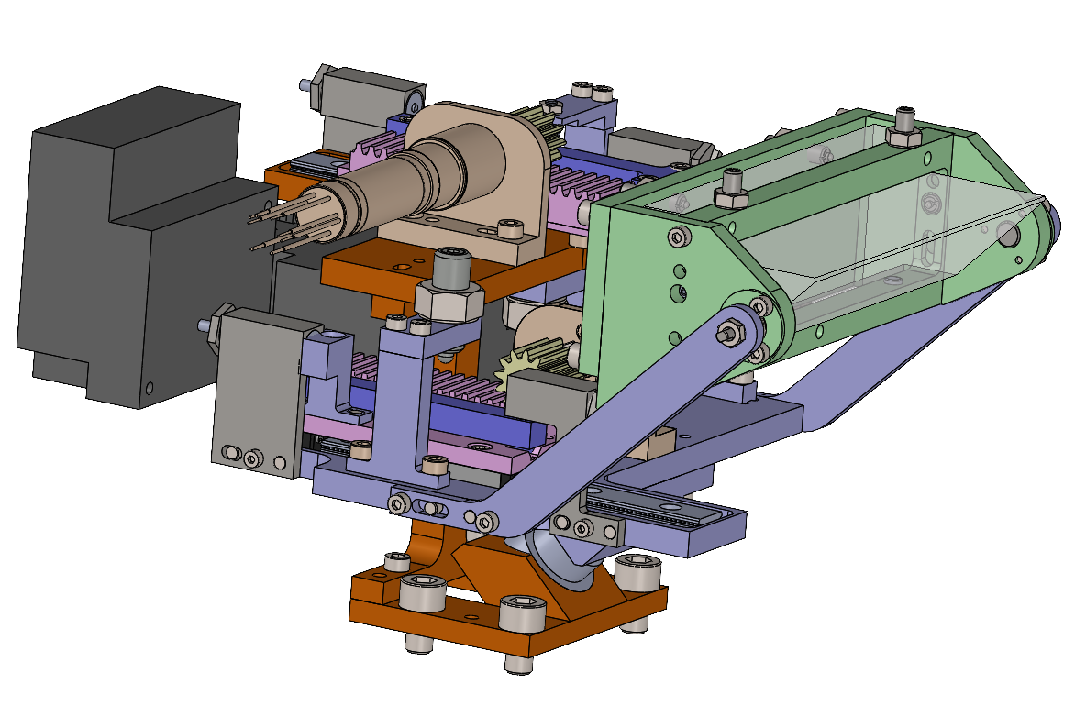
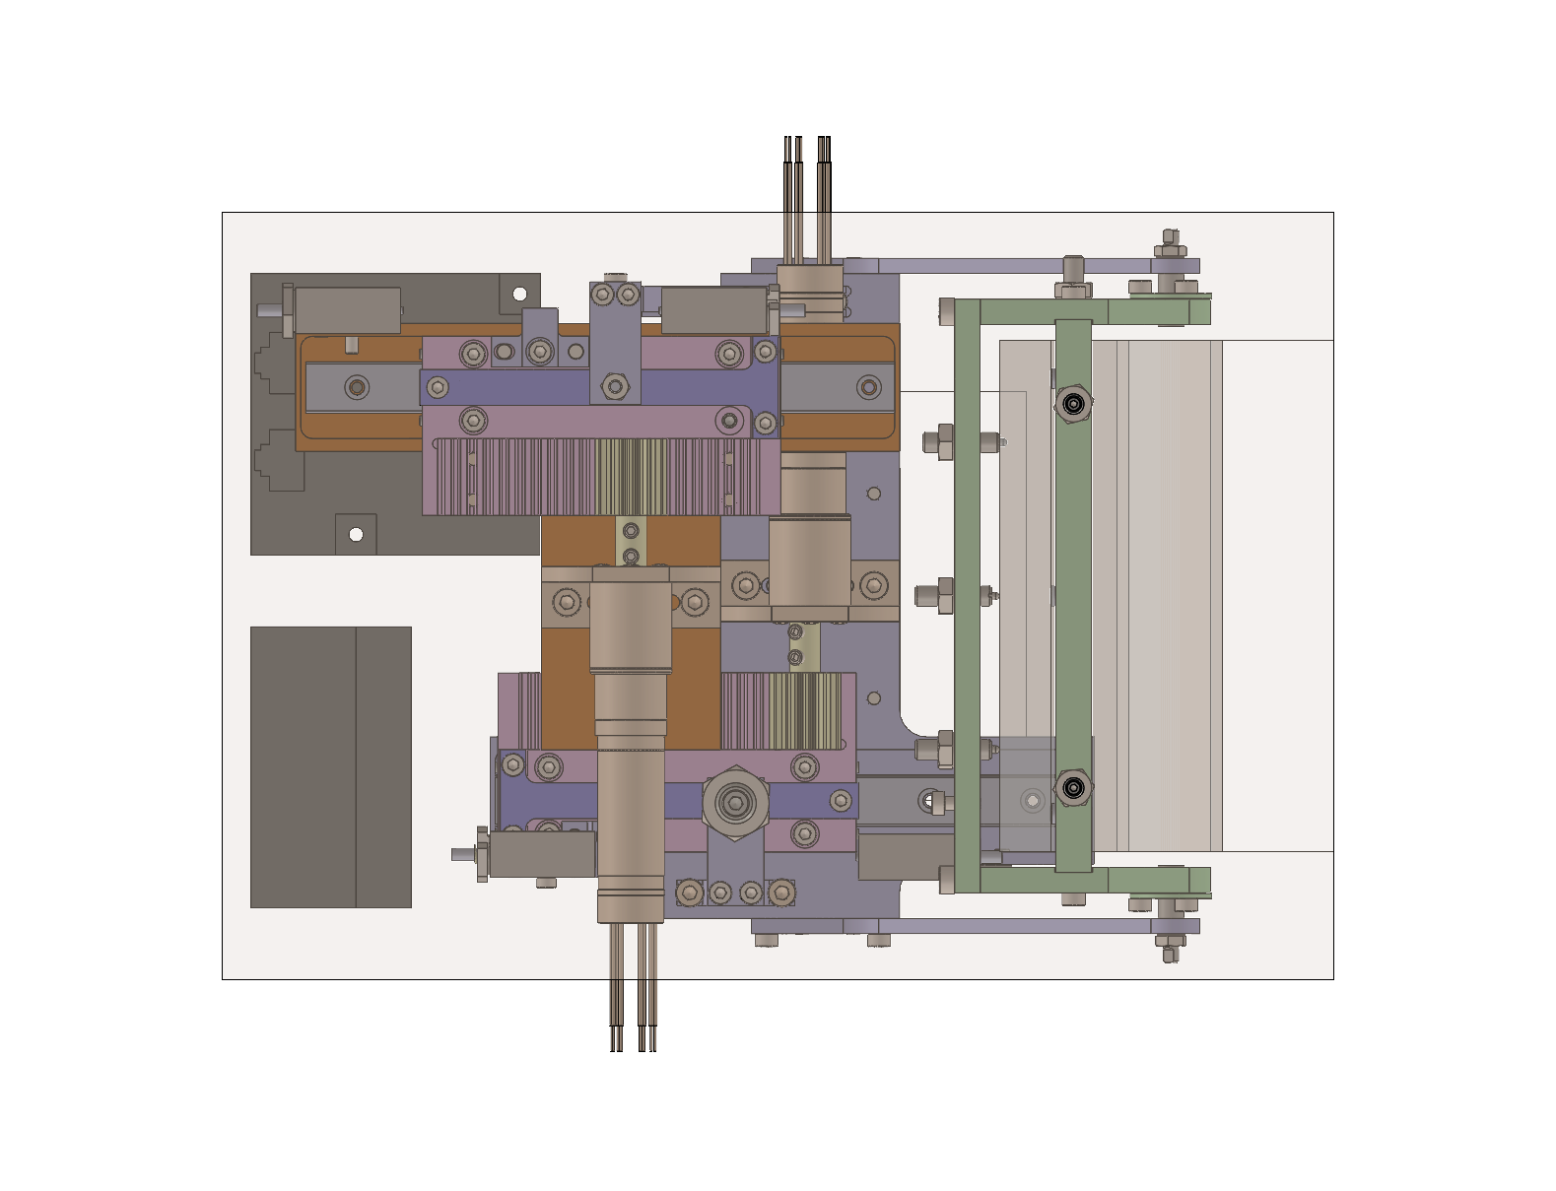
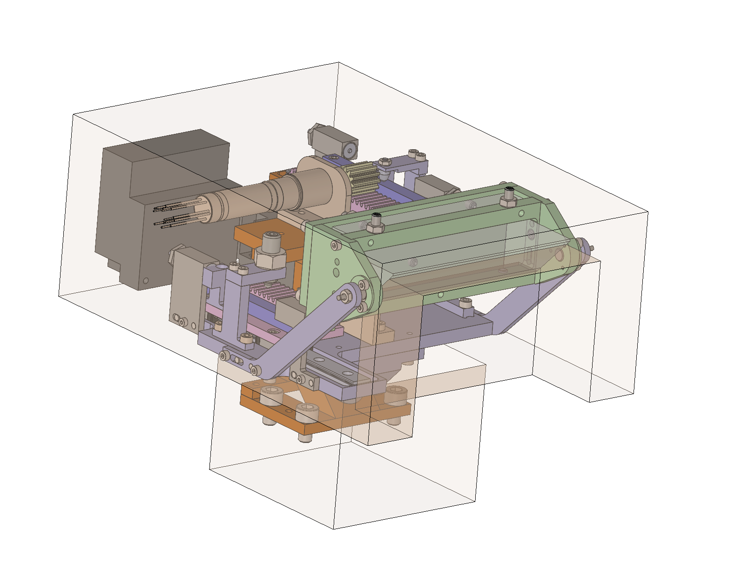
FM1 Overview - Volume
Prototype material :
Machined part: stainless steel
Mirror: fused silica (to be machined in zerodur)
Slope: 3 options : Stainless steel / Glass / Ceramic
Volume:
Pre-design for prototype: fits the envelop allocated for MUSE, with FM1 mirror size similar to MUSE
202.5 mm
77 mm
64 mm
80 mm
158 mm

Slide 4
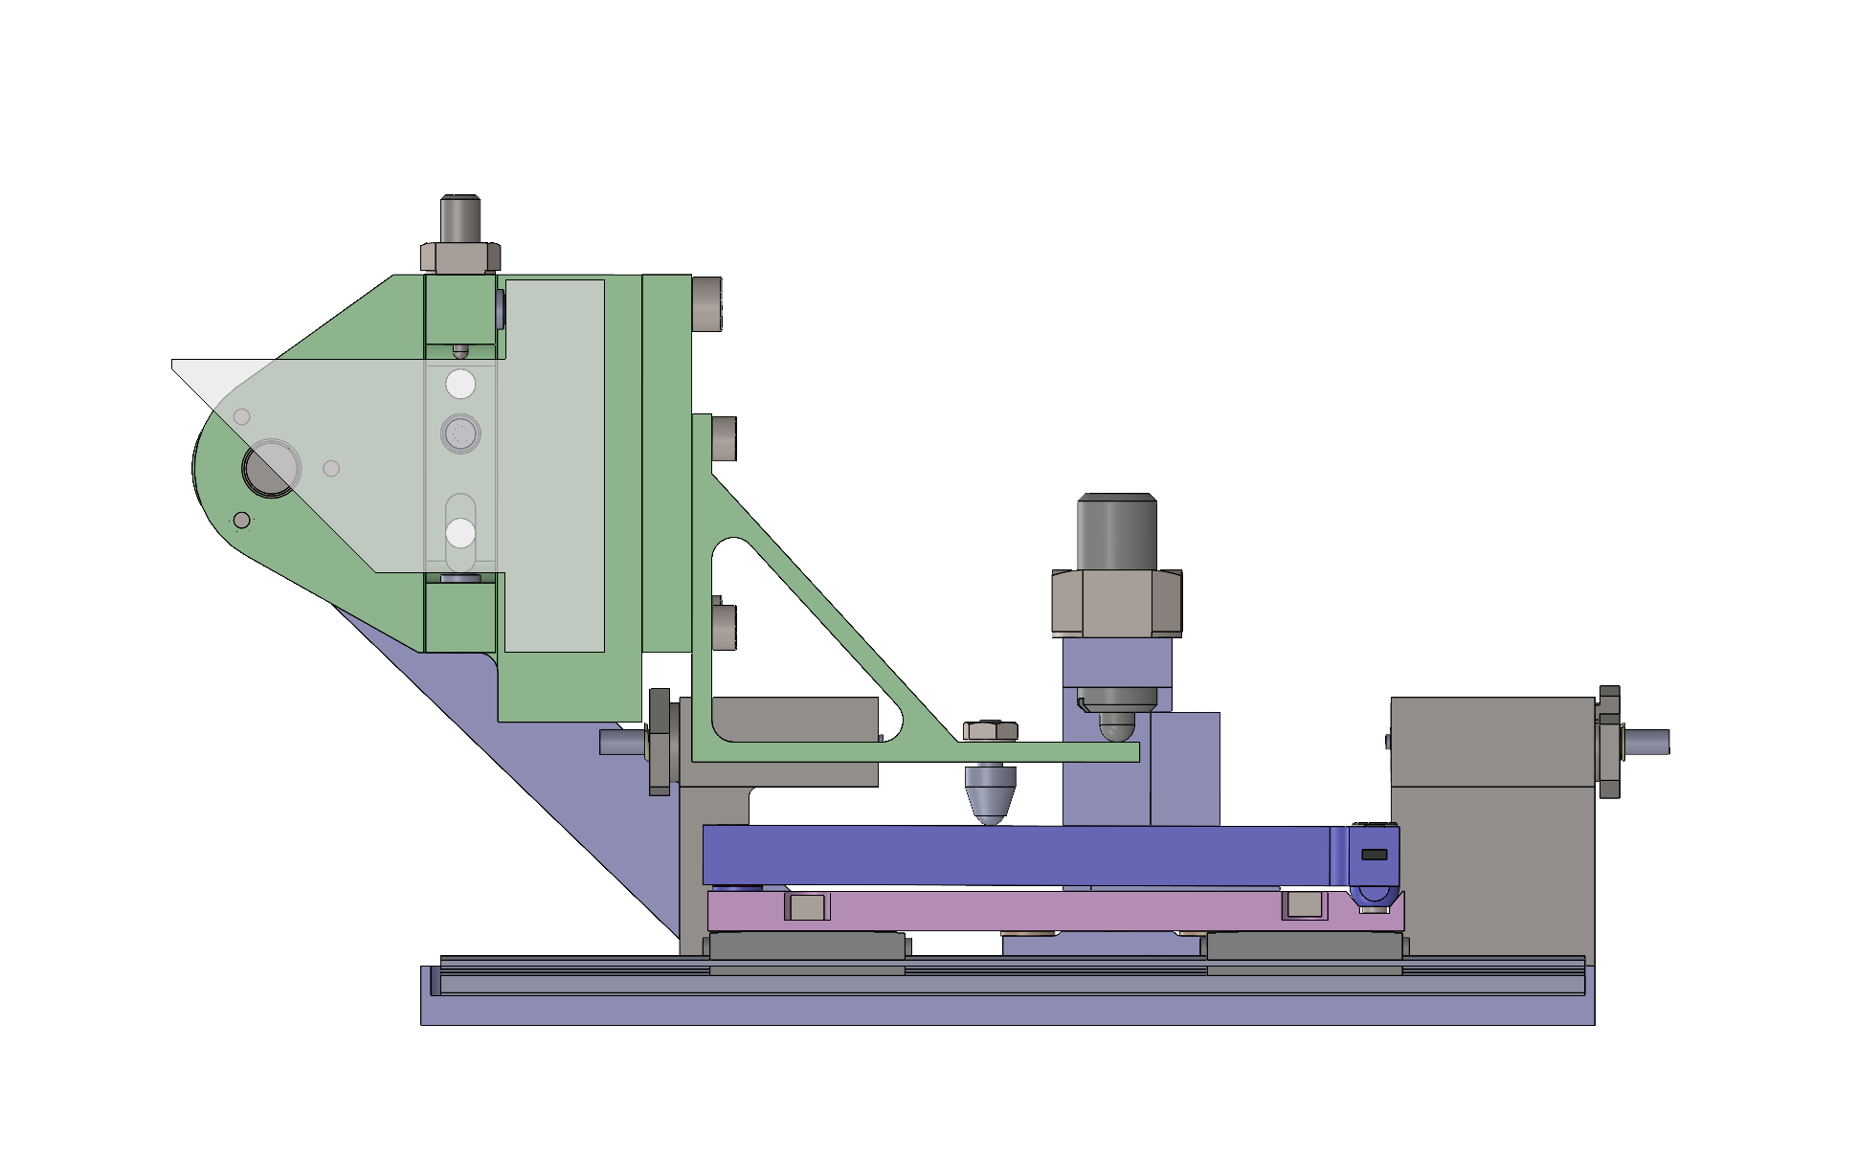
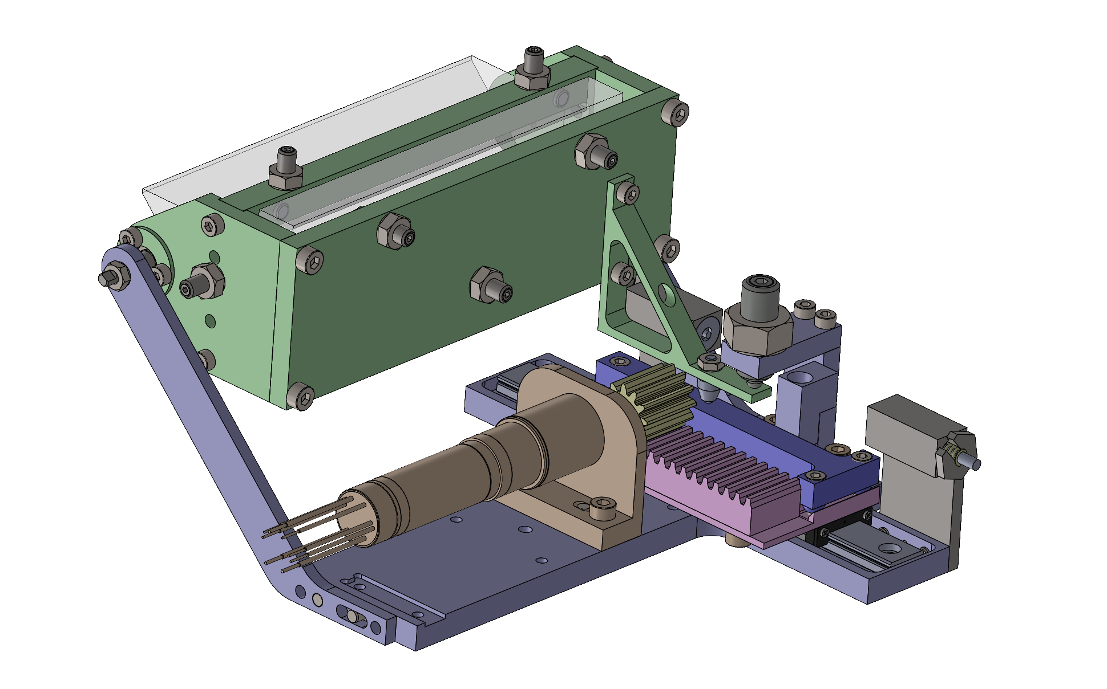
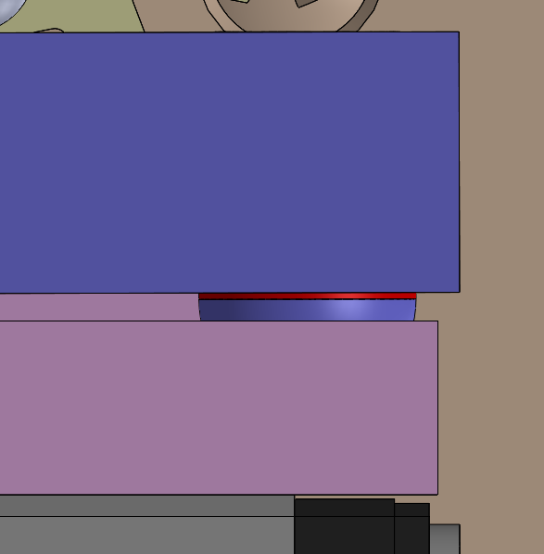
FM1 Design
FM1 Tilt
Req Title | Req Value | Design theoretical performance
Nominal position manual alignment accuracy | 0,1 deg | M2,5 screw : ⅓ turn accuracy to reach 0,1 deg
Range | 5 arcmin (±2,5 arcmin) | 6 arcmin (adjustable)
Repeatability (precision) in one step | 5 arcsec | Theory : 0,001 arcsec with encoders + reductor + slope
Mount Stability during operation | 5 arcsec | To be assessed in thermal transient mode
Resolution : Combination of motor gearbox reduction and slope give a reduction of 0.153”/rad between motor rotation (1) and mirror rotation (4)
Backlash : calibrated and managed with a look-up table
Lever arm
Spring to ensure permanent contact
Hard Stop
4
3
1
Limit Switch
Tilt rotation axis
Contact ball - height manually adjustable and blocked with a locknut
2
Ceramic Slope with height difference of 150 μm between higher and lower point
Motor with relative encoder & gearbox of 261 reduction ratio
Pinion /Rack
Hepcomotion mini rail and carts
150μm thick washer (replaceable to adjust the range)

Slide 5
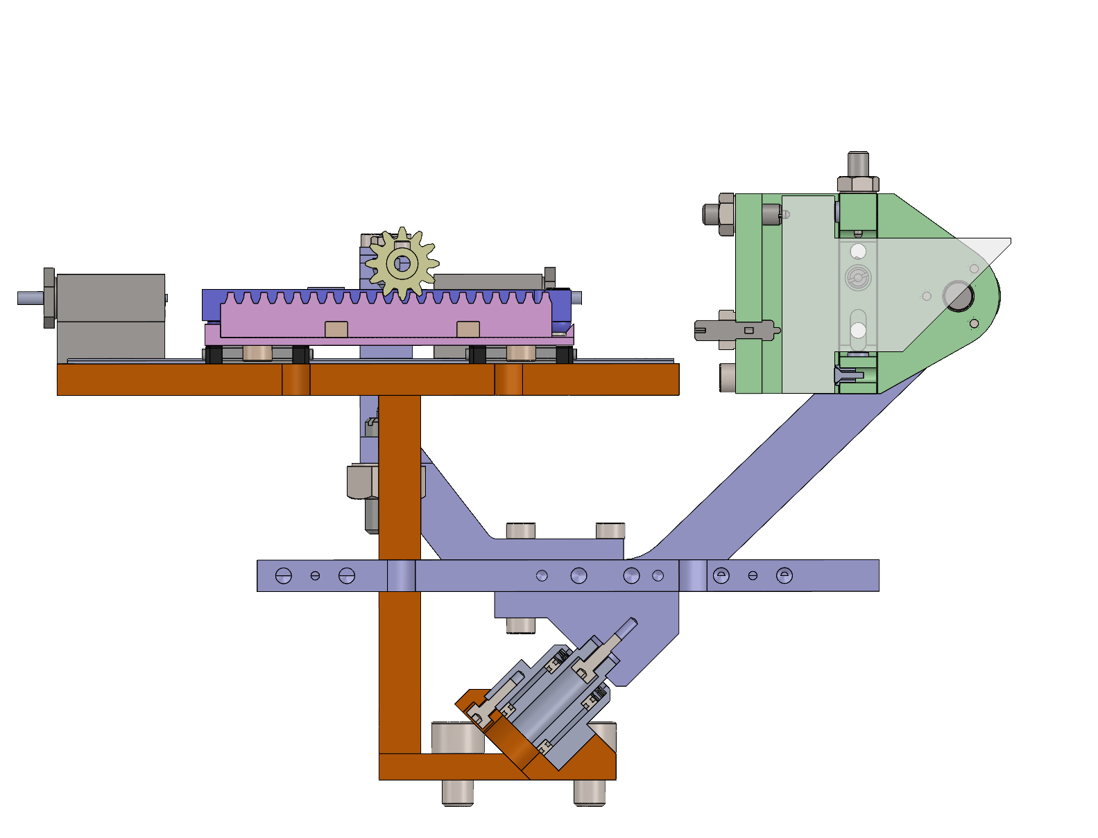
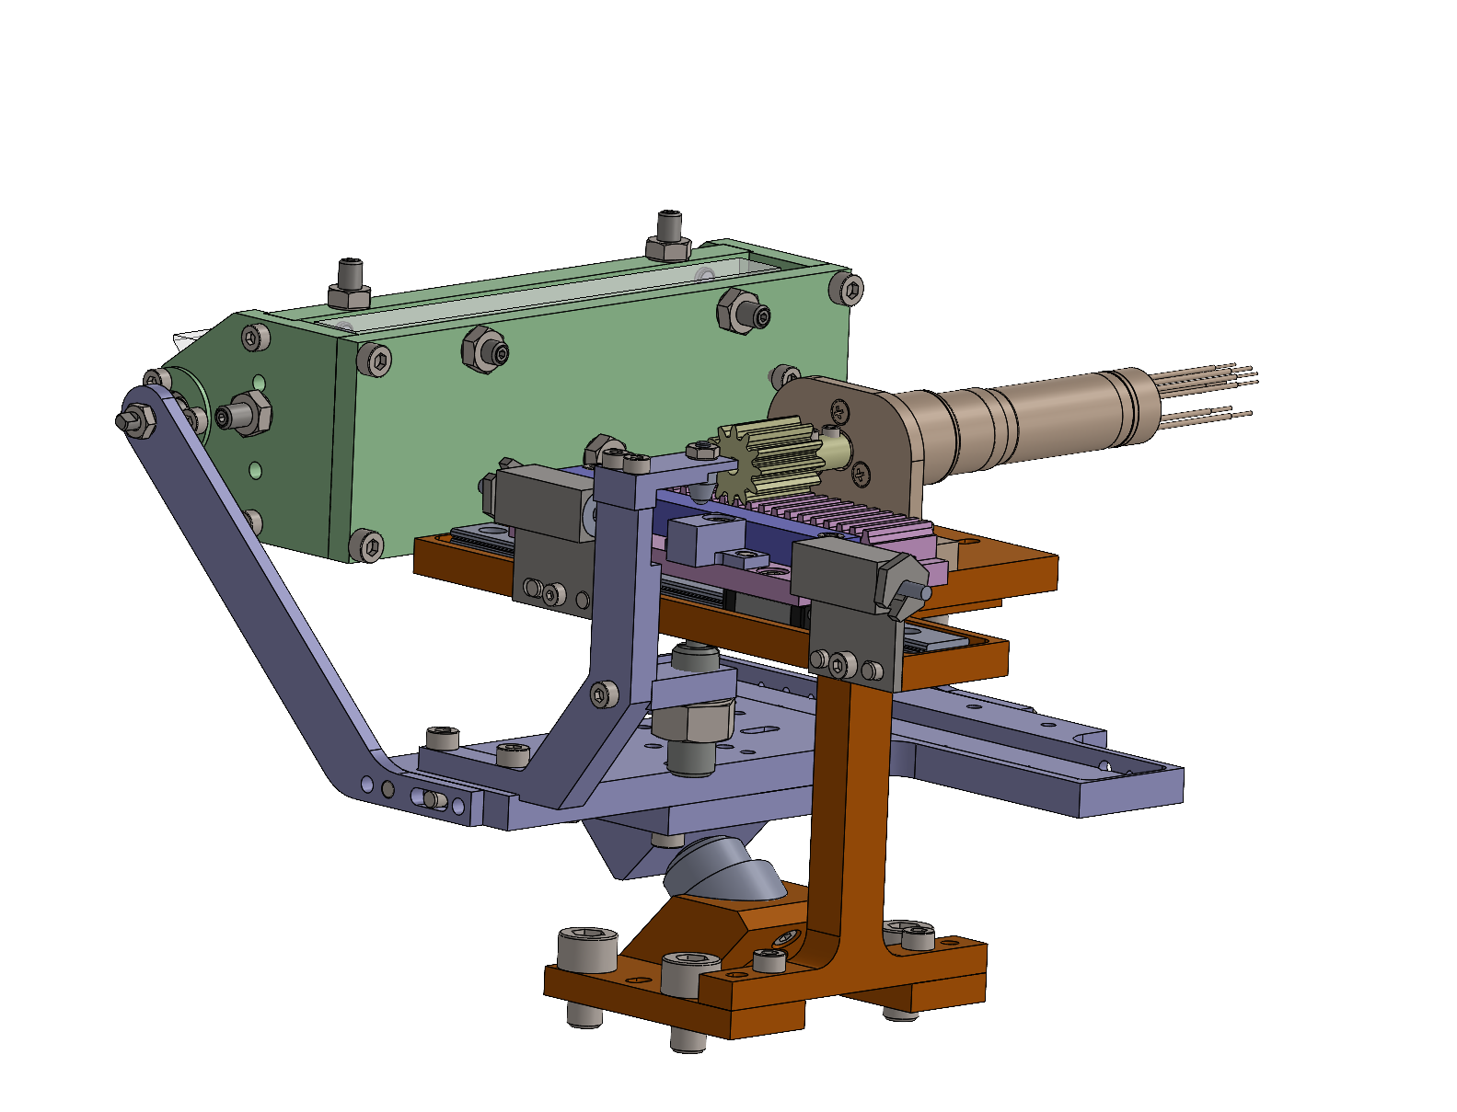
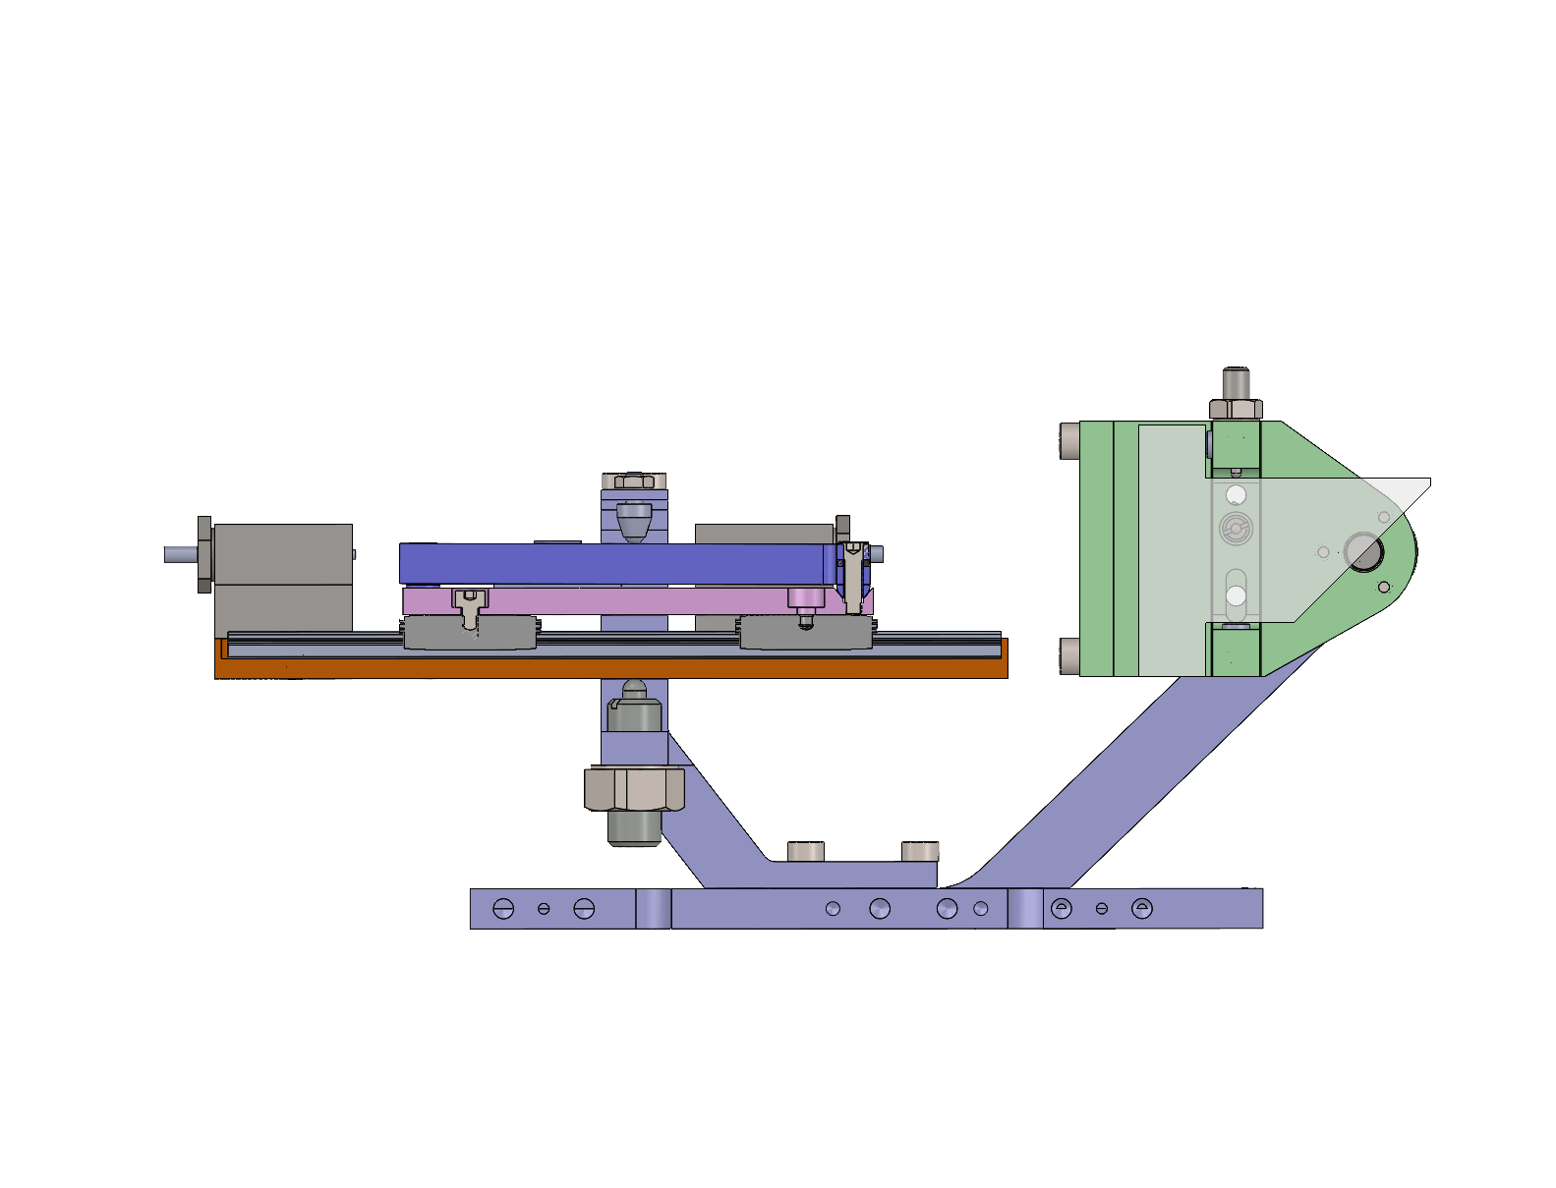
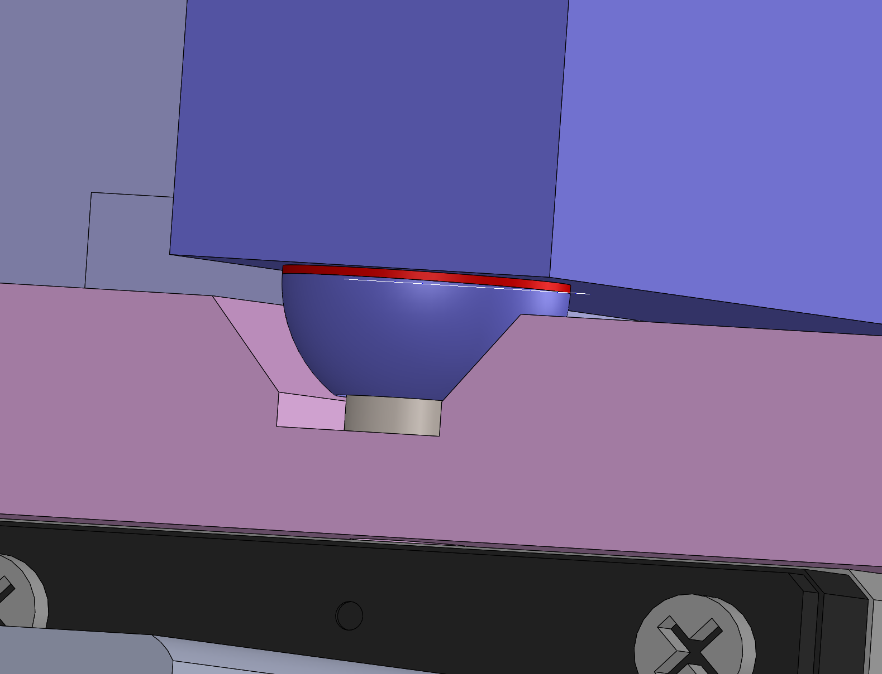
FM1 Design
FM1 Tip - Same concept as FM1 tilt
Motor with relative encoder & gearbox of 261 reduction ratio
Req Title | Req Value | Design theoretical performance
Nominal position manual alignment accuracy | 0,1 deg | M2,5 screw : ⅓ turn accuracy to reach 0,1 deg
Range | 5 arcmin (±2,5 arcmin) | 5.8 arcmin (adjustable)
Repeatability (precision) in one step | 5 arcsec | Theory : 0,001 arcsec with encoders + reductor + slope
Mount Stability during operation | 5 arcsec | To be assessed in thermal transient mode
Pinion /Rack
Limit Switch
Lever
Tip rotation axis
Hard Stop
Ceramic Slope with height difference of 150 microns between higher and lower point
150μm thick washer (replaceable to adjust the range)

Slide 6
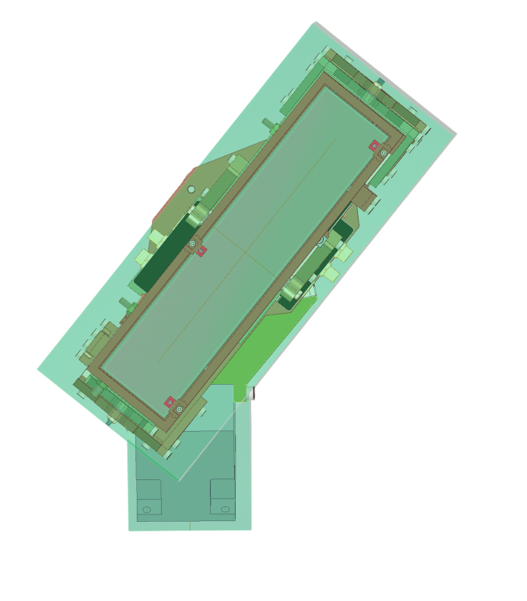
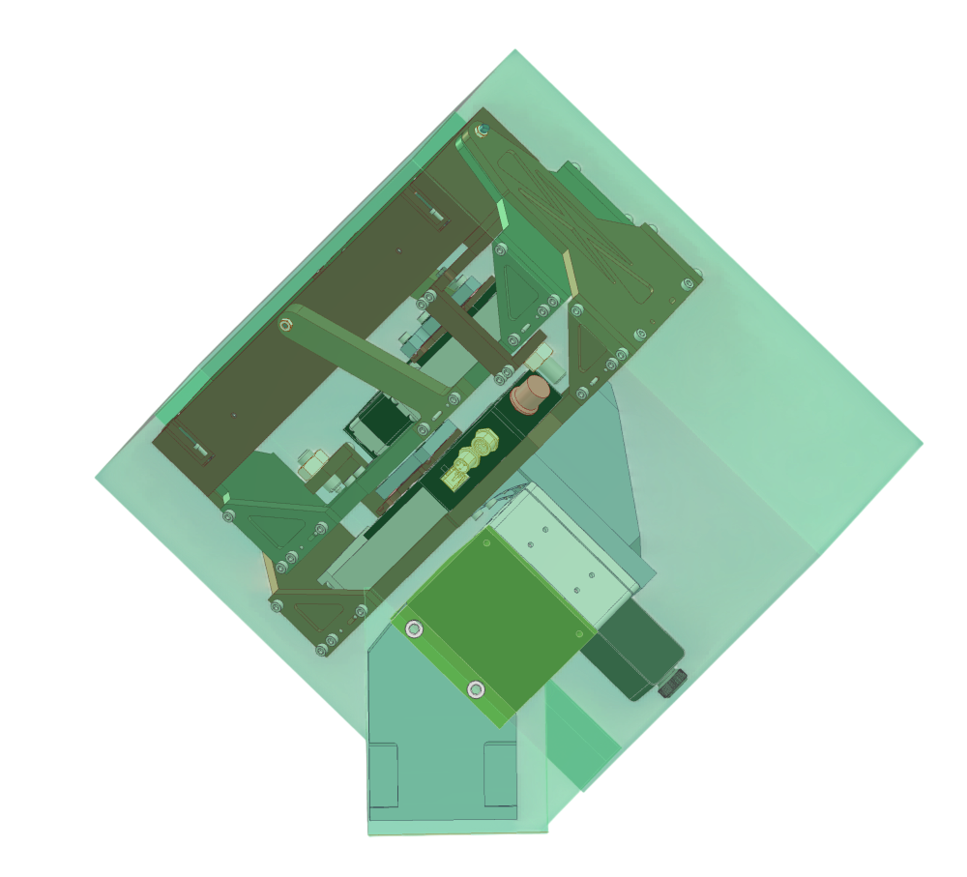
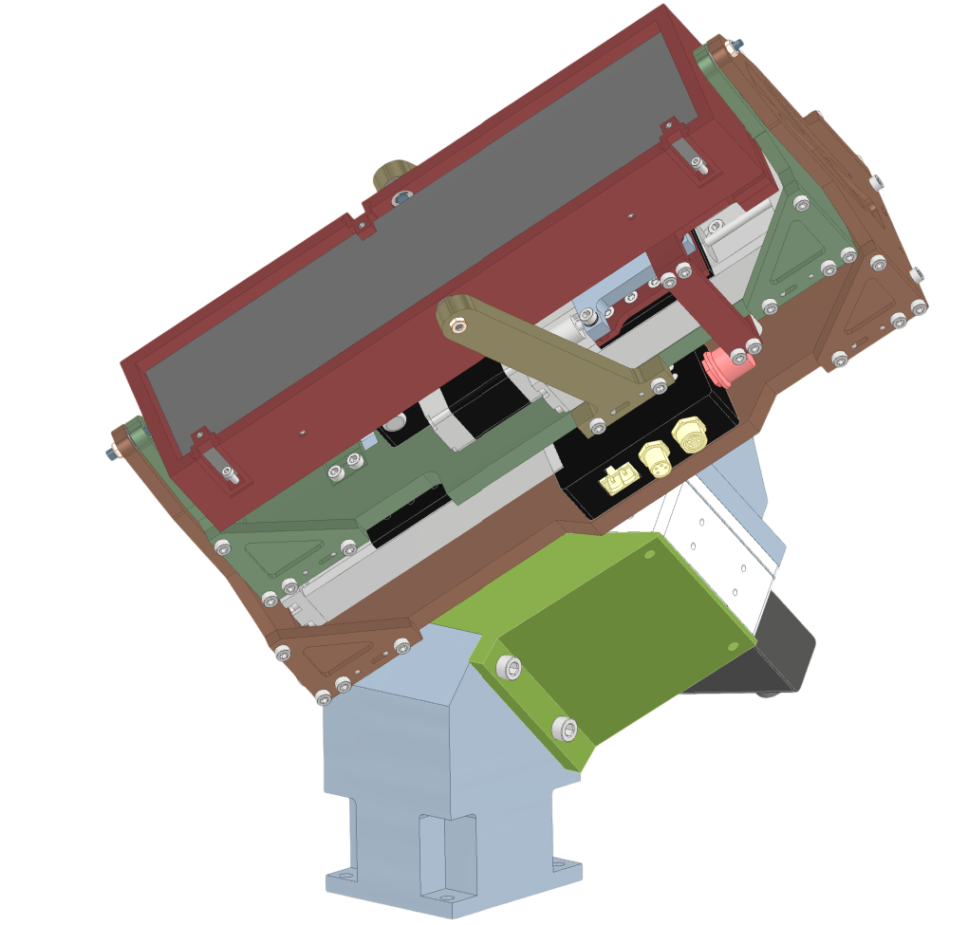
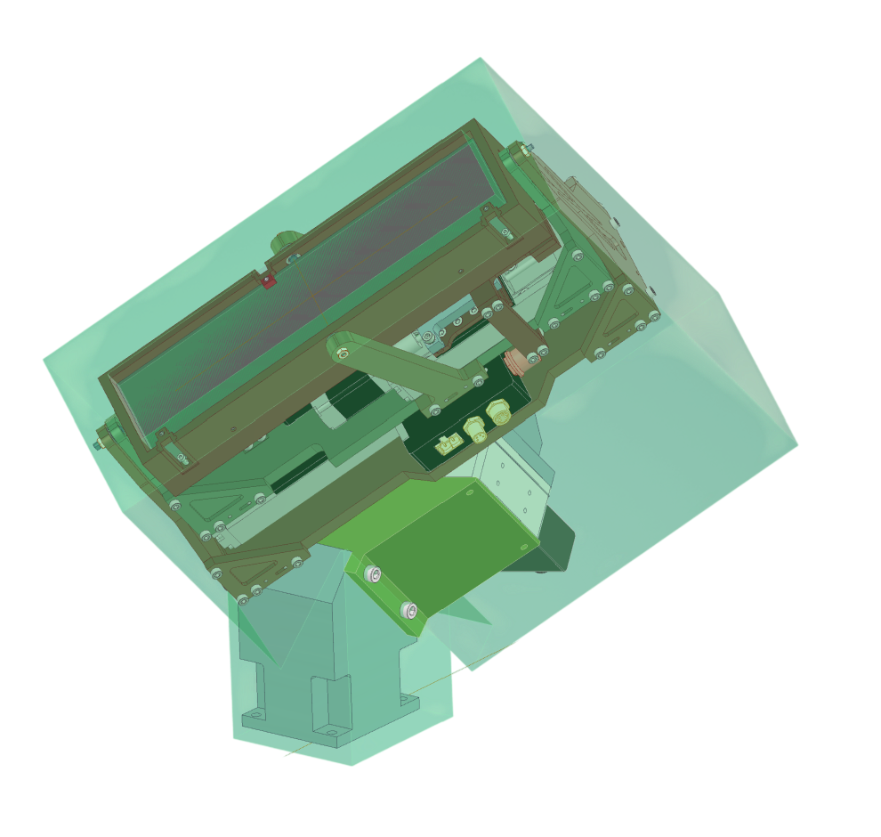
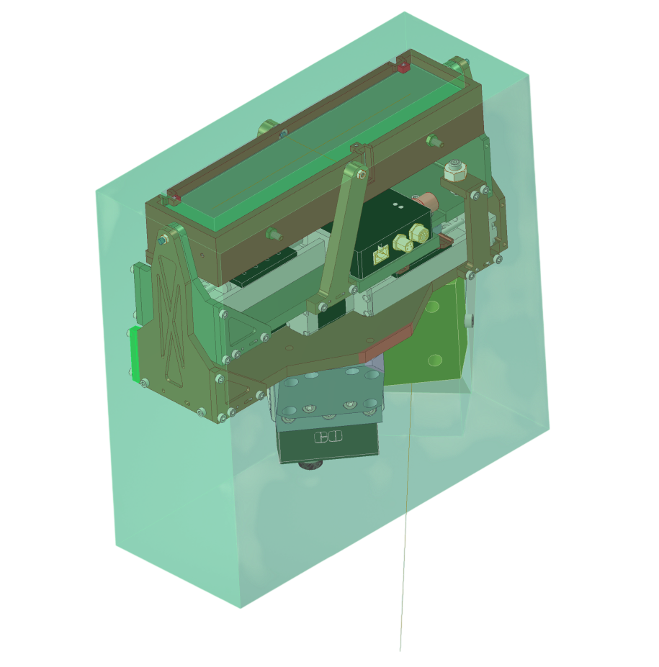
FM2 overview - Volume
Volume:
Pre-design for prototype: exceeds the envelop allocated for MUSE in depth, with FM2 mirror size similar to MUSE
Prototype materials :
Machined part: stainless steel
Mirror: to be machined in zerodur
Slope: ceramic
110 mm
135
263 mm
270 mm
51
70
61
72
39
63
51
67
75 mm
83 mm

Slide 7
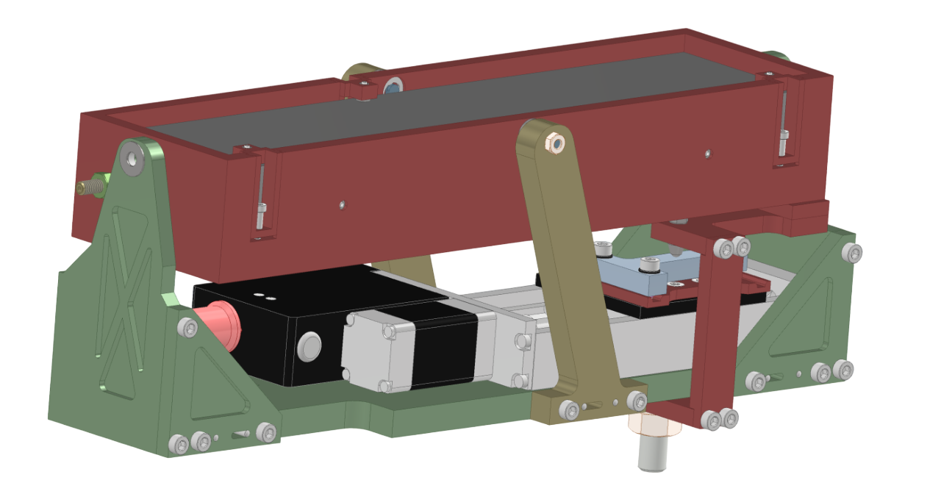
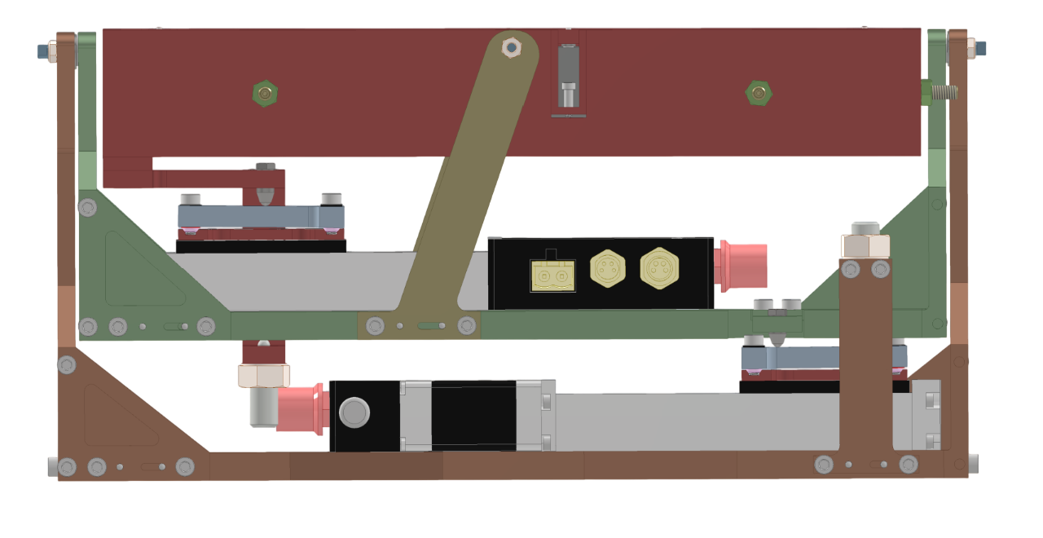
FM2 Design
FM2 Tip
Req Title | Req Value | Design theoretical performance
Nominal position manual alignment accuracy | 0,1 deg | M2,5 screw : ⅓ turn accuracy to reach 0,1 deg
Range | 10 arcmin | 10.5 arcmin (adjustable)
Repeatability (precision) in one step | 10 arcsec | Theory : 0,09 arcsec with linear stage + slope
Mount Stability during operation | 10 arcsec | To be assessed in thermal transient mode
Combination of linear stage and slope give a theoretical reduction ratio of 0.00172”/rad
Backlash : calibrated and managed with a look-up table
Motorized linear stage (stepper) - 50mm travel
Tip rotation axis
Mirror casing
4
3
Contact ball
1
Ceramic slope
2
Bracket
Spring to ensure permanent contact

Slide 8
FM2 Design
FM2 Tilt
Req Title | Req Value | Design theoretical performance
Nominal position manual alignment accuracy | 0,1 deg | M2,5 screw : ⅓ turn accuracy to reach 0,1 deg
Range | 10 arcmin | 10.5 arcmin (adjustable)
Repeatability (precision) in one step | 10 arcsec | Theory : 0,09 arcsec with linear stage + slope
Mount Stability during operation | 10 arcsec | To be assessed in thermal transient mode
Same concept as tip mechanism - ball contact + slope
Backlash : calibrated and managed with a look-up table
Motorized linear stage (stepper) - 50mm travel
Tilt rotation axis
Mirror casing
4
Spring to ensure permanent contact
3
Contact ball
1
Ceramic slope
2
Bracket

Slide 9
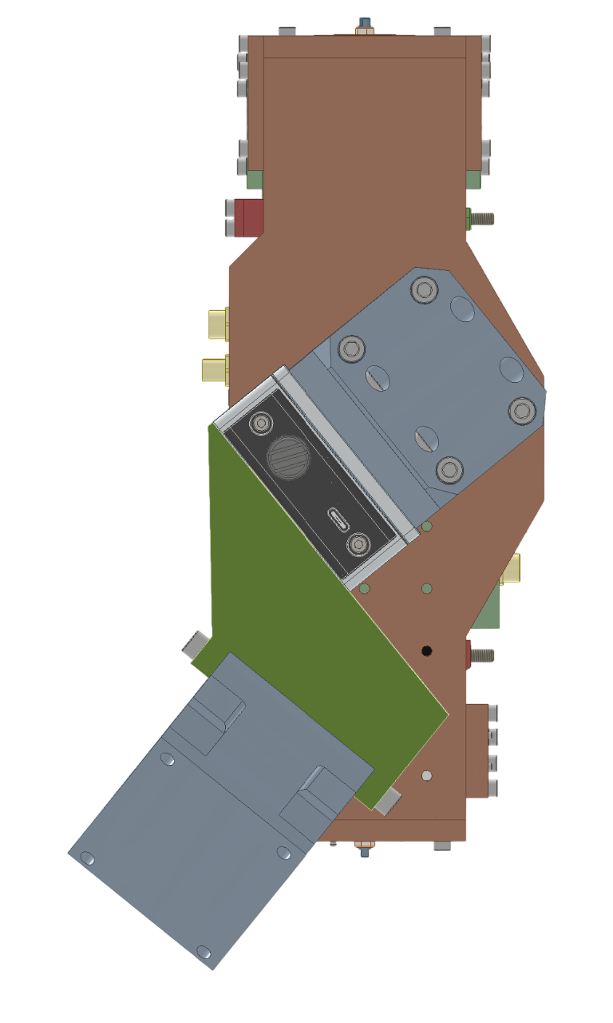
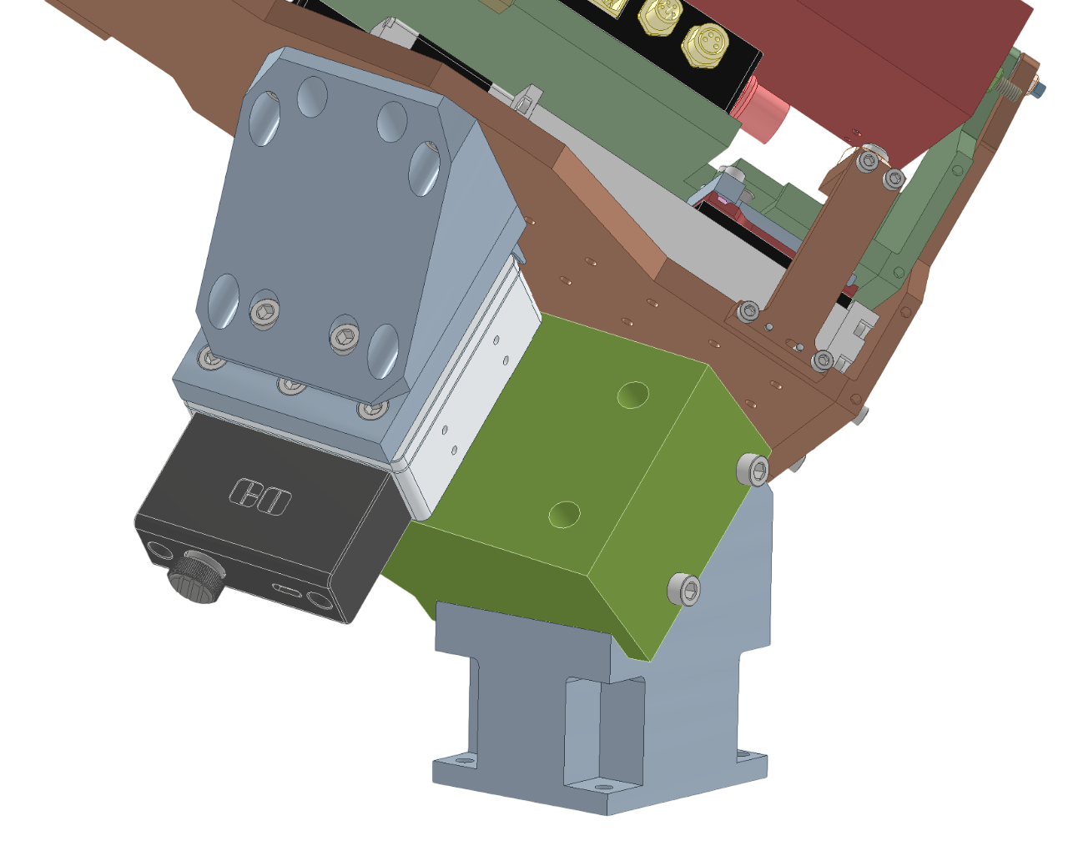
FM2 Design
FM2 Translation
Linear translation - Stage accuracy: 5μm; stage repeatability: 2μm; travel: 15mm
Backlash : calibrated and managed with a look-up table
Req Title | Req Value | Design theoretical performance
Nominal position manual alignment accuracy | 0,1 deg | M2,5 screw : ⅓ turn accuracy to reach 0,1 deg
Range | 2 mm | 15 mm (adjustable)
Repeatability (precision) in one step | 20 um | Theory : 2 um
Mount Stability during operation | 20 um | To be assessed in thermal transient mode
Orientation bracket
51
Linear stage
Base orientation - 135
Base

Slide 10
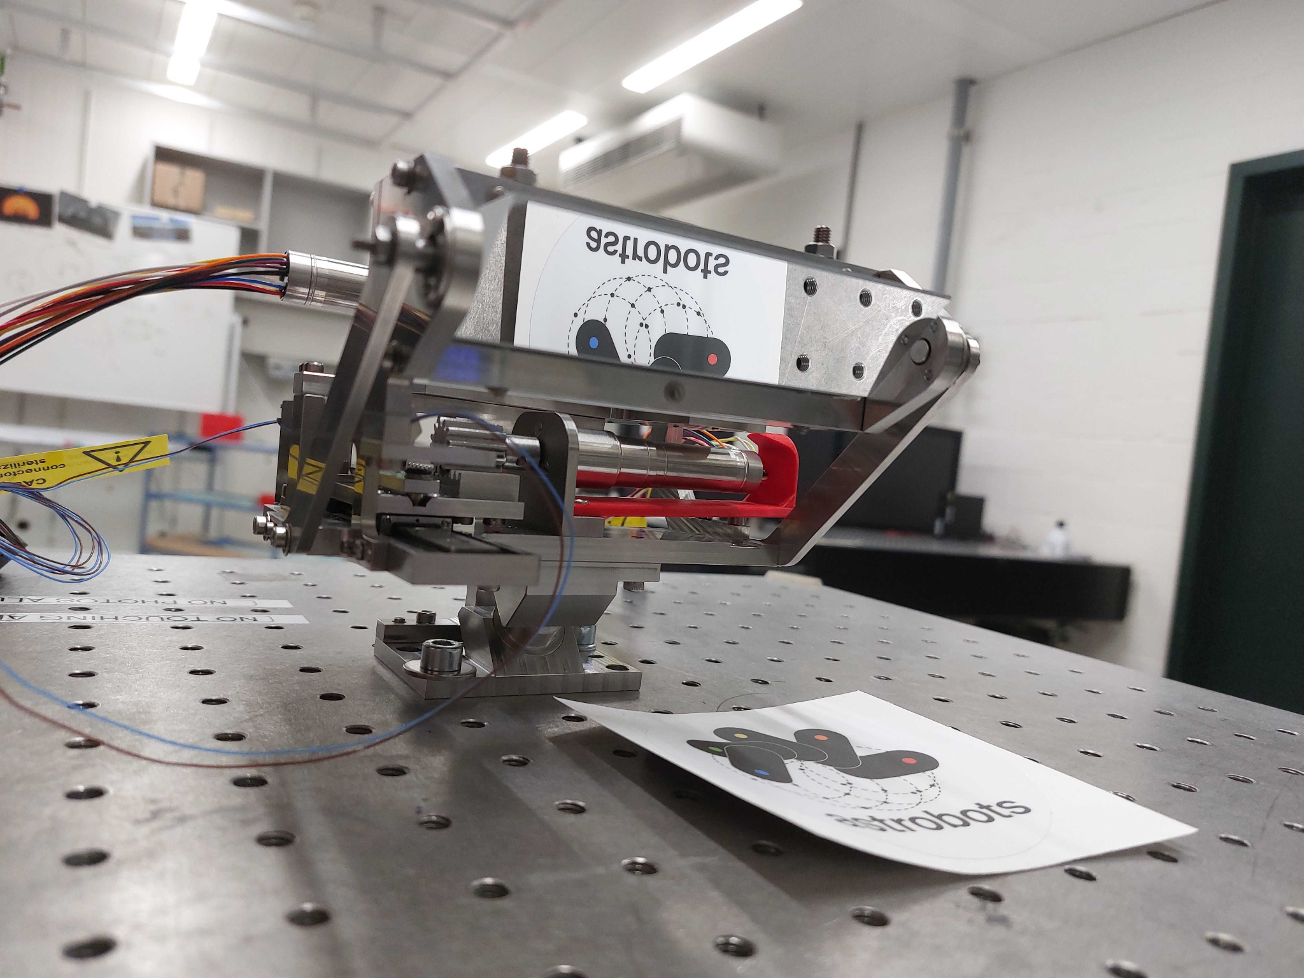
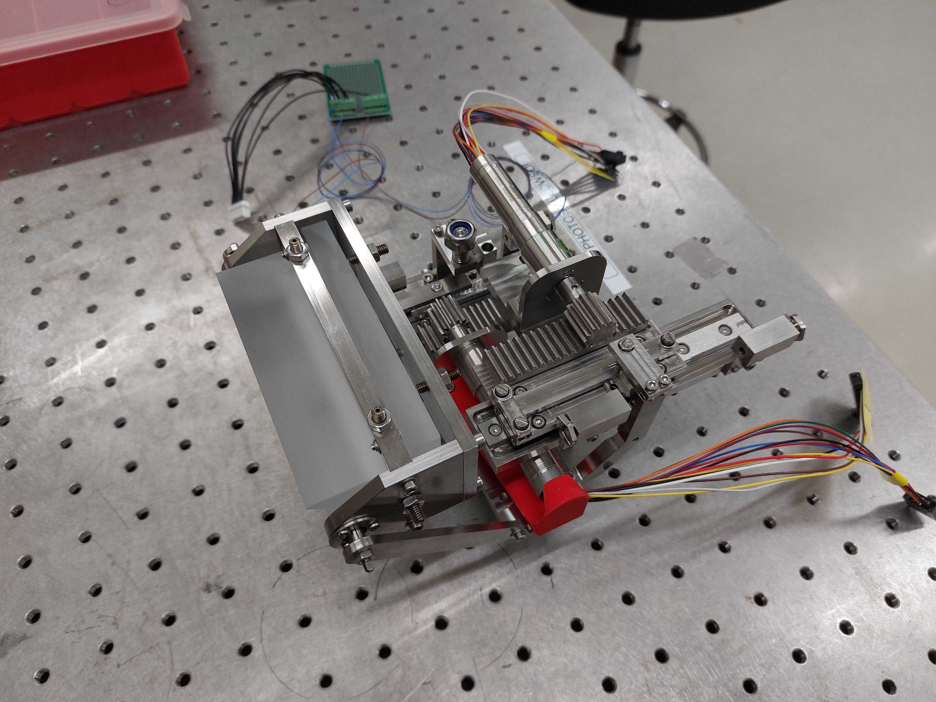
FM1 Prototype

Slide 11
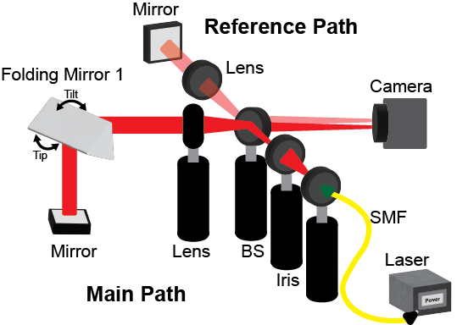
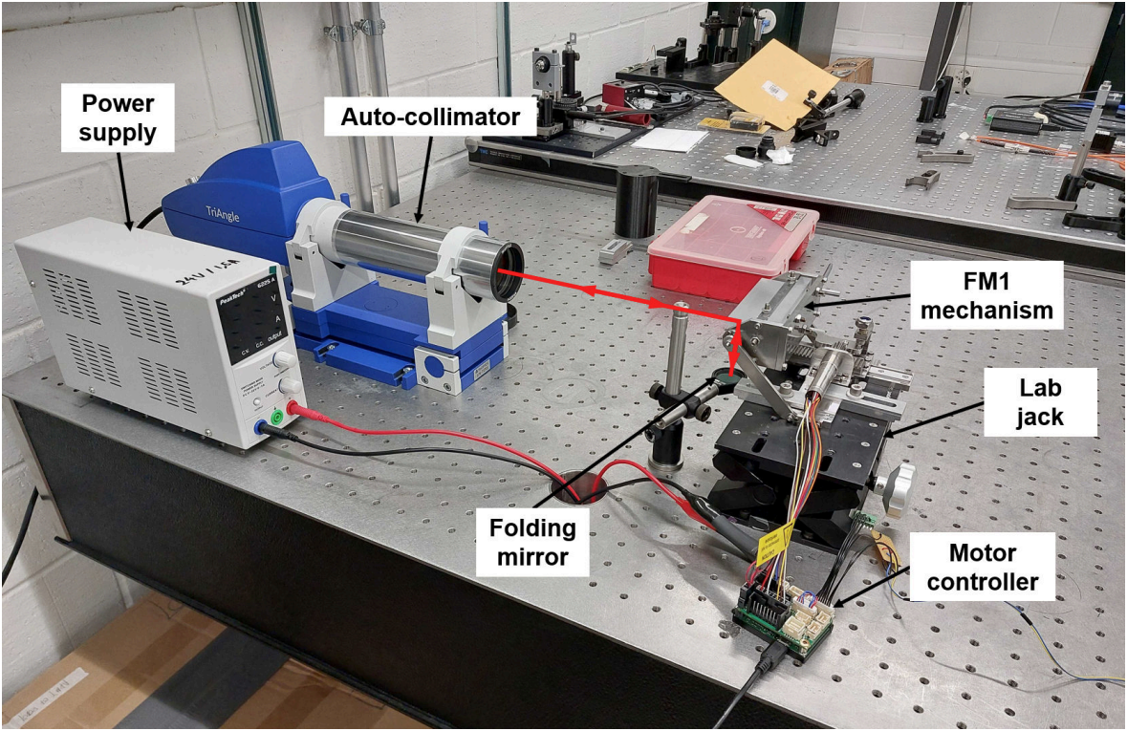
FM1 Test Bench
Repeatability requirement | Stability requirement | Thermal stability requirement
The FM1 mechanism shall reach a target position with a precision of < 5” in one pass. | The FM1 mechanism shall maintain a stability of < 5″ on its tilt (resp. tip) axis. | The FM1 mechanism shall maintain its stability requirement when subjected to a temperature variation of ±2°C over a course of 12h
Autocollimator

Slide 12
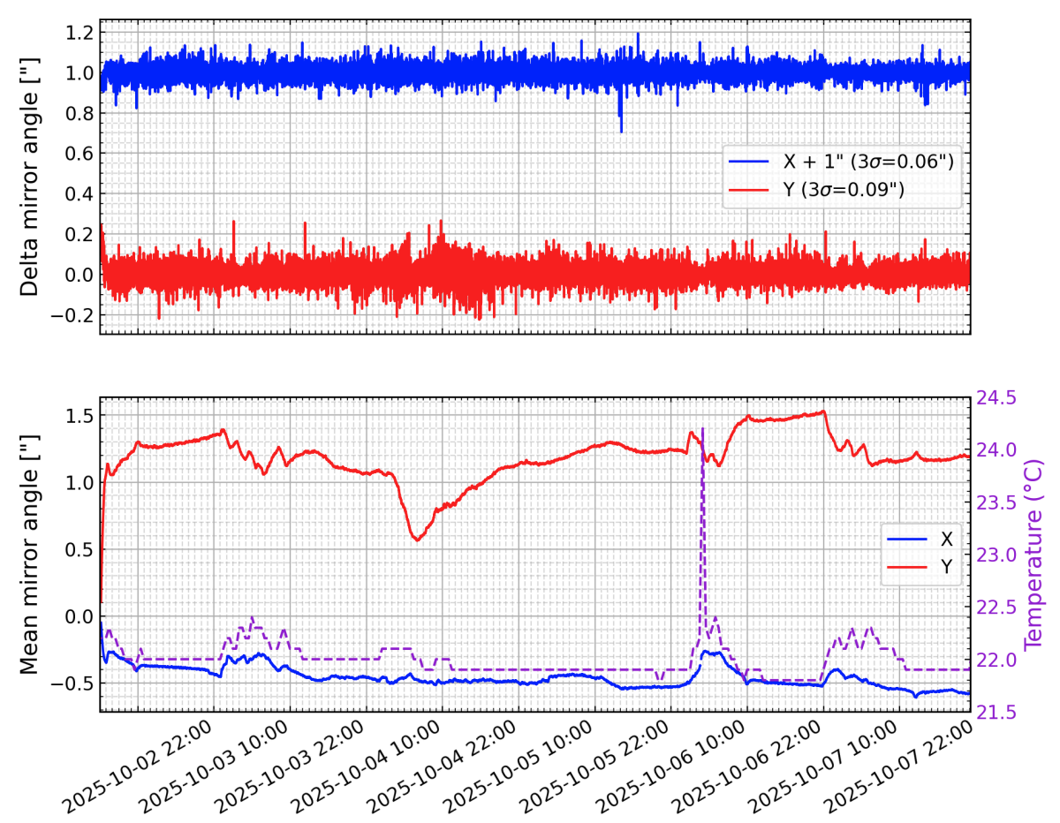
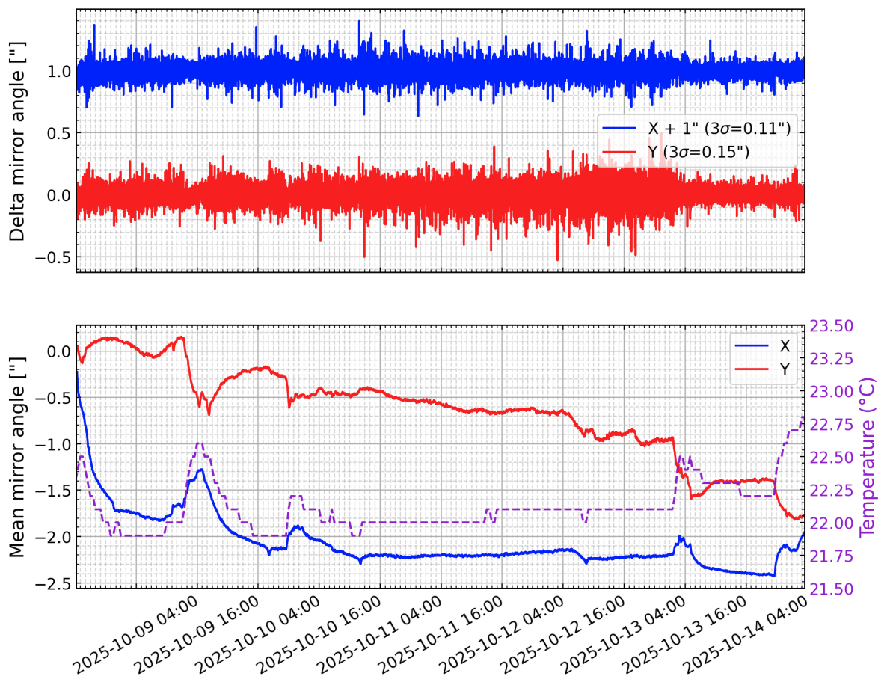
FM1 Stability Test Results
Stability of the testbenches without thermal control for 140h (subject to ambient changes)
With FM1
Without FM1
At stable ambient temperature (+- 0,5°C) , the system is compliant to stability requirements (achieves +- 1,5 arcsec)

Slide 13
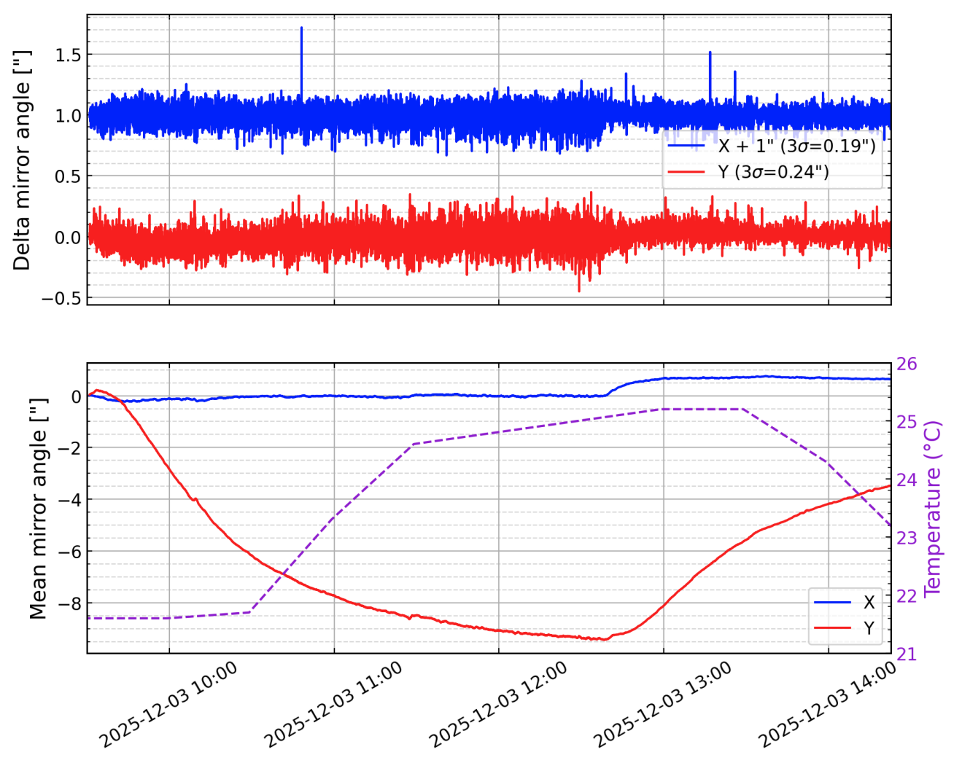
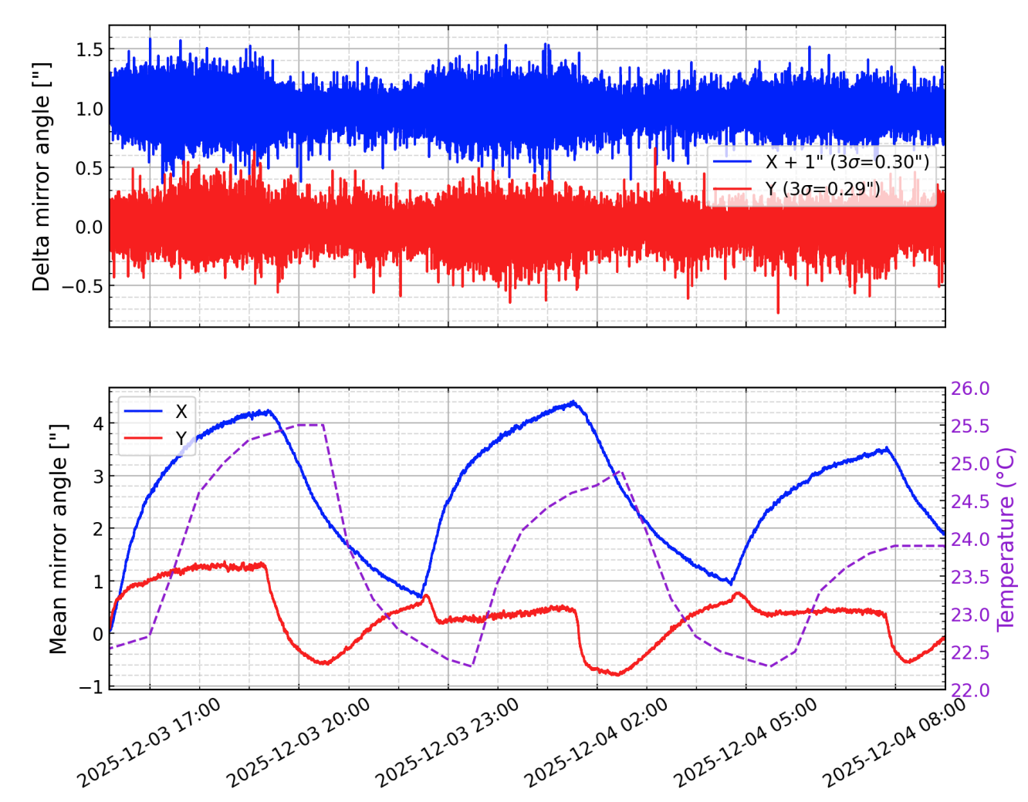
FM1 Thermal Stability Test Results
Cycles from Ambient Temperature to + 3.6°C (almost covers the range +- 2°C requirement)
With FM1
Without FM1
Stability of test bench + FM1 reaches mean mirror angle of -9,5 arcsec. Will be further analyzed with an INVAR reference mirror and improved thermal distribution.

Slide 14
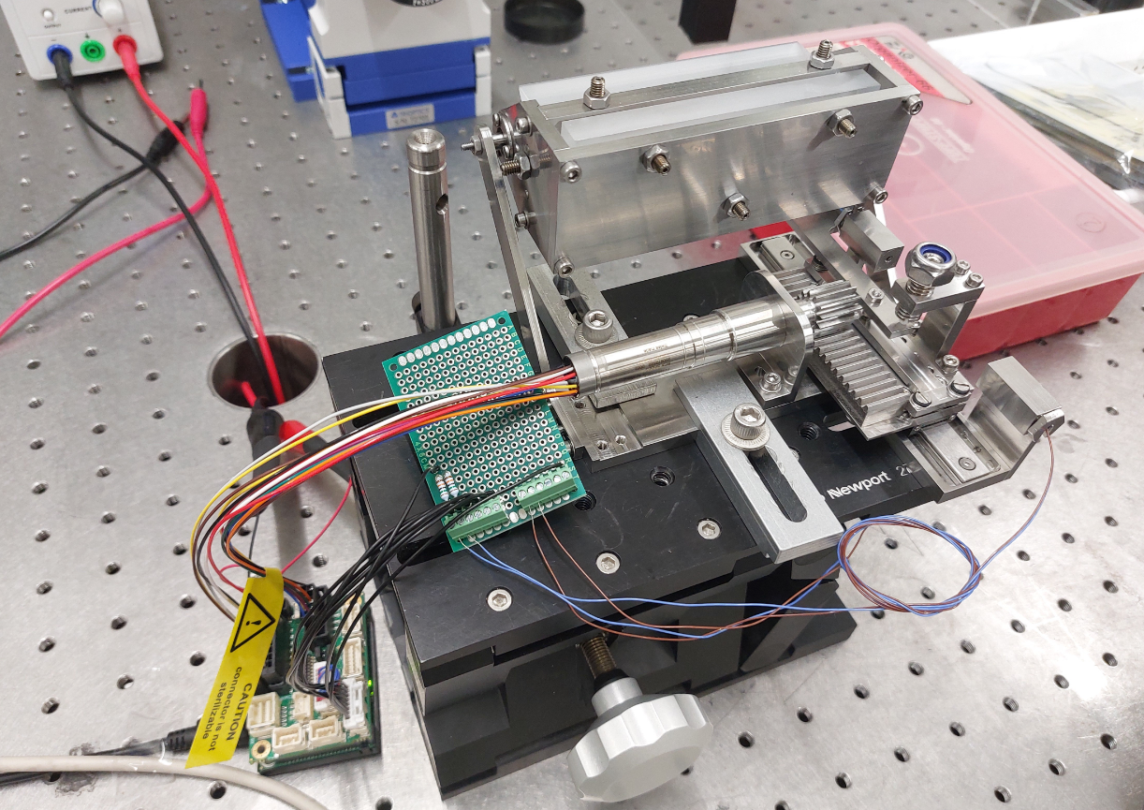
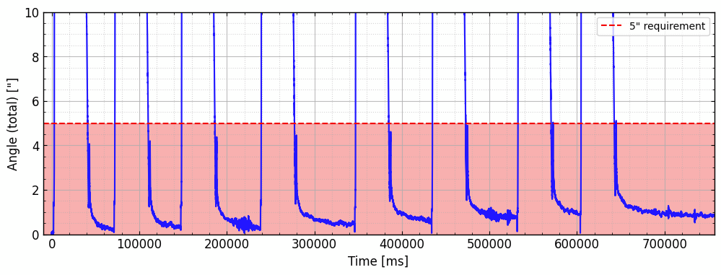
FM1 Tilt - Homing repeatability
Limit switches
Repeated sequence: ‘Homing + 80” motion’
=> Target reached within 1” (compared to 5” requirement)
Tiny drift after multiple cycles, likely cause by slope erosion => Should be fixed with ceramic slope

Slide 15
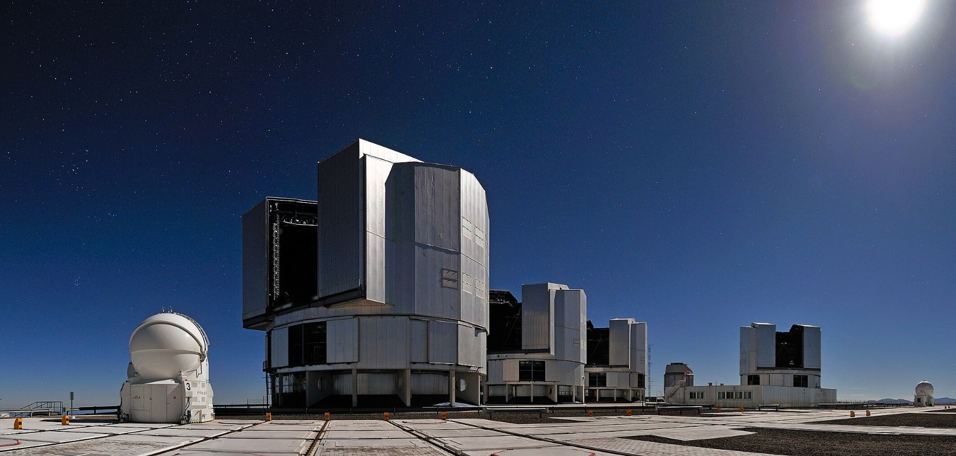
Summary
Future Work:
Improvement of thermal stability testbench (invar reference mirror, add heaters, convection, temperature sensors)
FM1 design: implement linear table to minimize play, perform thermal analysis
FM2 design: improve tip and tilt compactness in design
Stability and repeatability tests on FM2
Conclusion
Design and functional prototype of FM1, design of FM2
FM1 meets stability at ambient temperature and repeatability requirements
Stability of FM1 exceeds the 5” requirement when heated to + 3.6°C, still under investigation

Slide 16
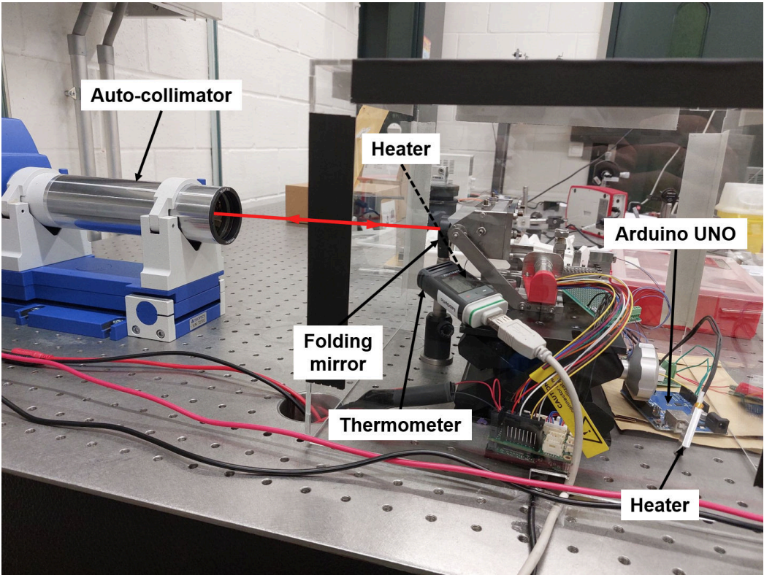

FM1 Test Bench - Stability
Thermal control and log
Arduino UNO controls heaters at 6h 50% duty cycle
Temperature logging by portable thermometer with 0.1°C resolution every 30min
Stability - Test bench alone
Folding mirror in front of FM1 reflects light directly to the autocollimator (light does not reach FM1 in this setup)
17h measurement, autocollimator log every second
Noise decoupled from mean motion

Slide 17
FM1 and FM2 Requirements
Title | Definition | FM1 Tip | FM1 Tilt | FM2 Tip | FM2 Tilt | FM2 Translation
Nominal position manual alignment accuracy | Necessary accuracy of mirror nominal position manual alignement to fall within the automatic alignment range | 0,1 deg | 0,1 deg | 0,1 deg | 0,1 deg | 100 μm
Range | The system minimum alignment range | 5 arcmin (±2,5 arcmin) | 5 arcmin (±2,5 arcmin) | 10 arcmin (±5 arcmin) | 10 arcmin (±5 arcmin) | 2mm (±1 mm)
Repeatability (precision) in one step | The precision obtained in the same environmental conditions, with the same command, after system calibration (errors are random) | 5 arcsec | 5 arcsec | 10 arcsec | 10 arcsec | 20μm
Mount Stability during operation | With the system off, measure of displacement during 12h with +/- 2°C cycles | 5 arcsec | 5 arcsec | 10 arcsec | 10 arcsec | 20μm
Long term Mount Stability | With the system off, measure of displacement during XX weeks with YY thermal cycles (+/- ZZ°C) | TBD | TBD | TBD | TBD | TBD

Slide 18
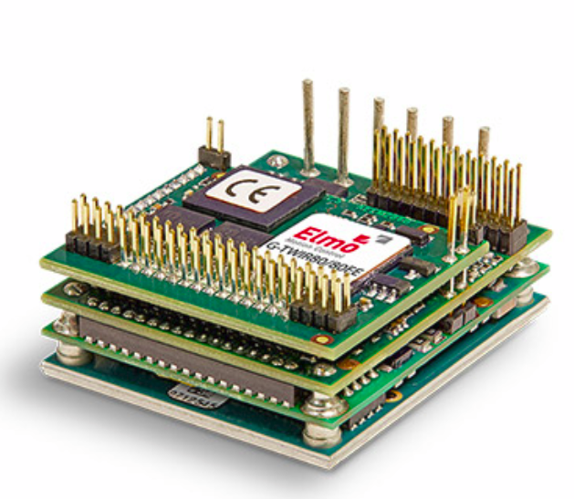
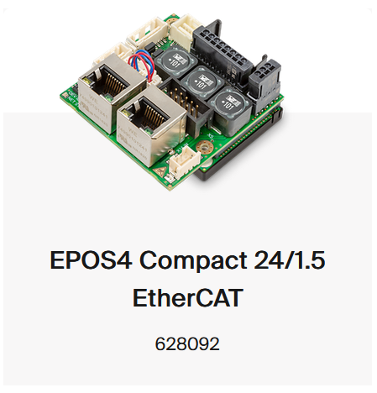
FM1 Design
Ethercat controllers by Maxon or by Elmo, under study
Significant volume in the envelop
Ethercat stepper drive for FM2
EPOS 4 Detailed picture / simplified model in CAD

