Slide 1
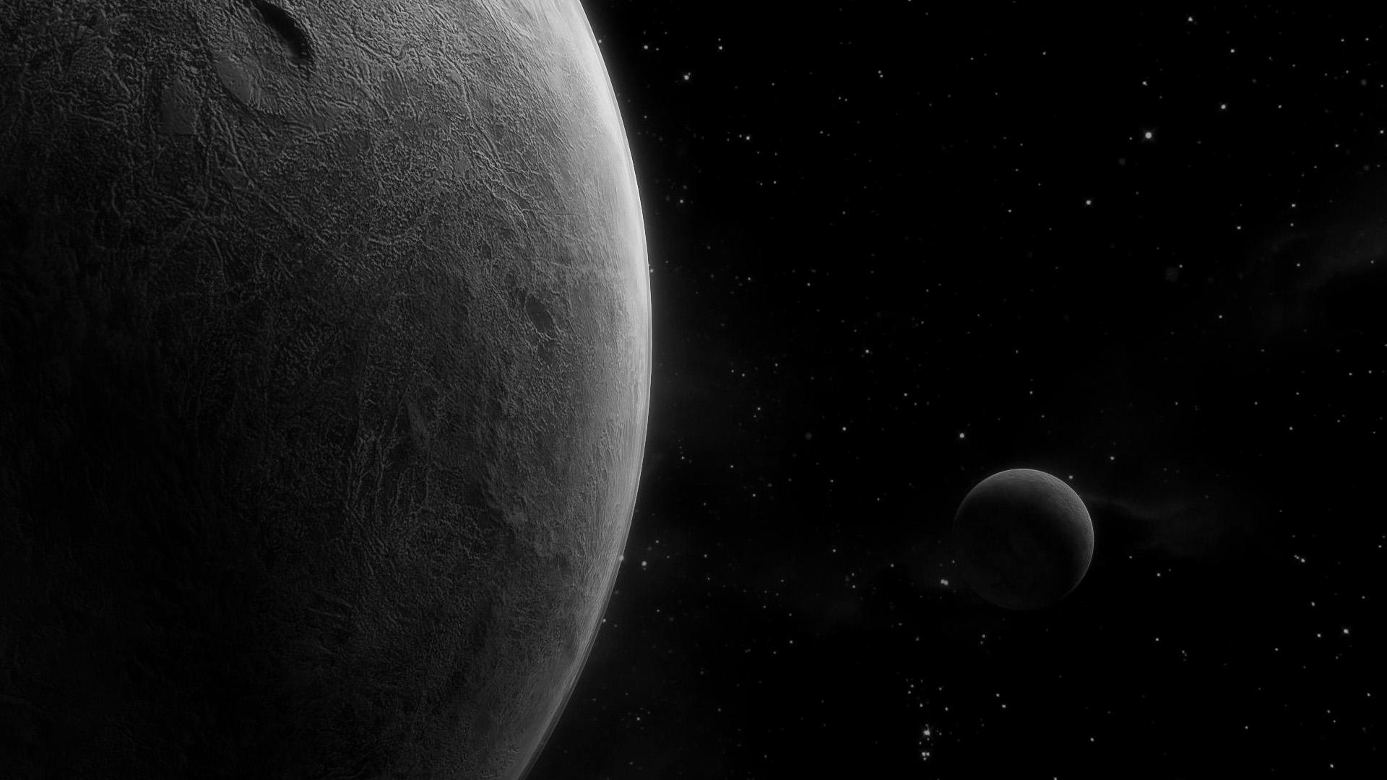

DD4AO
On-Sky Performance of a Novel Data-Driven AO Control Strategy
Isaac Dinis

Slide 2
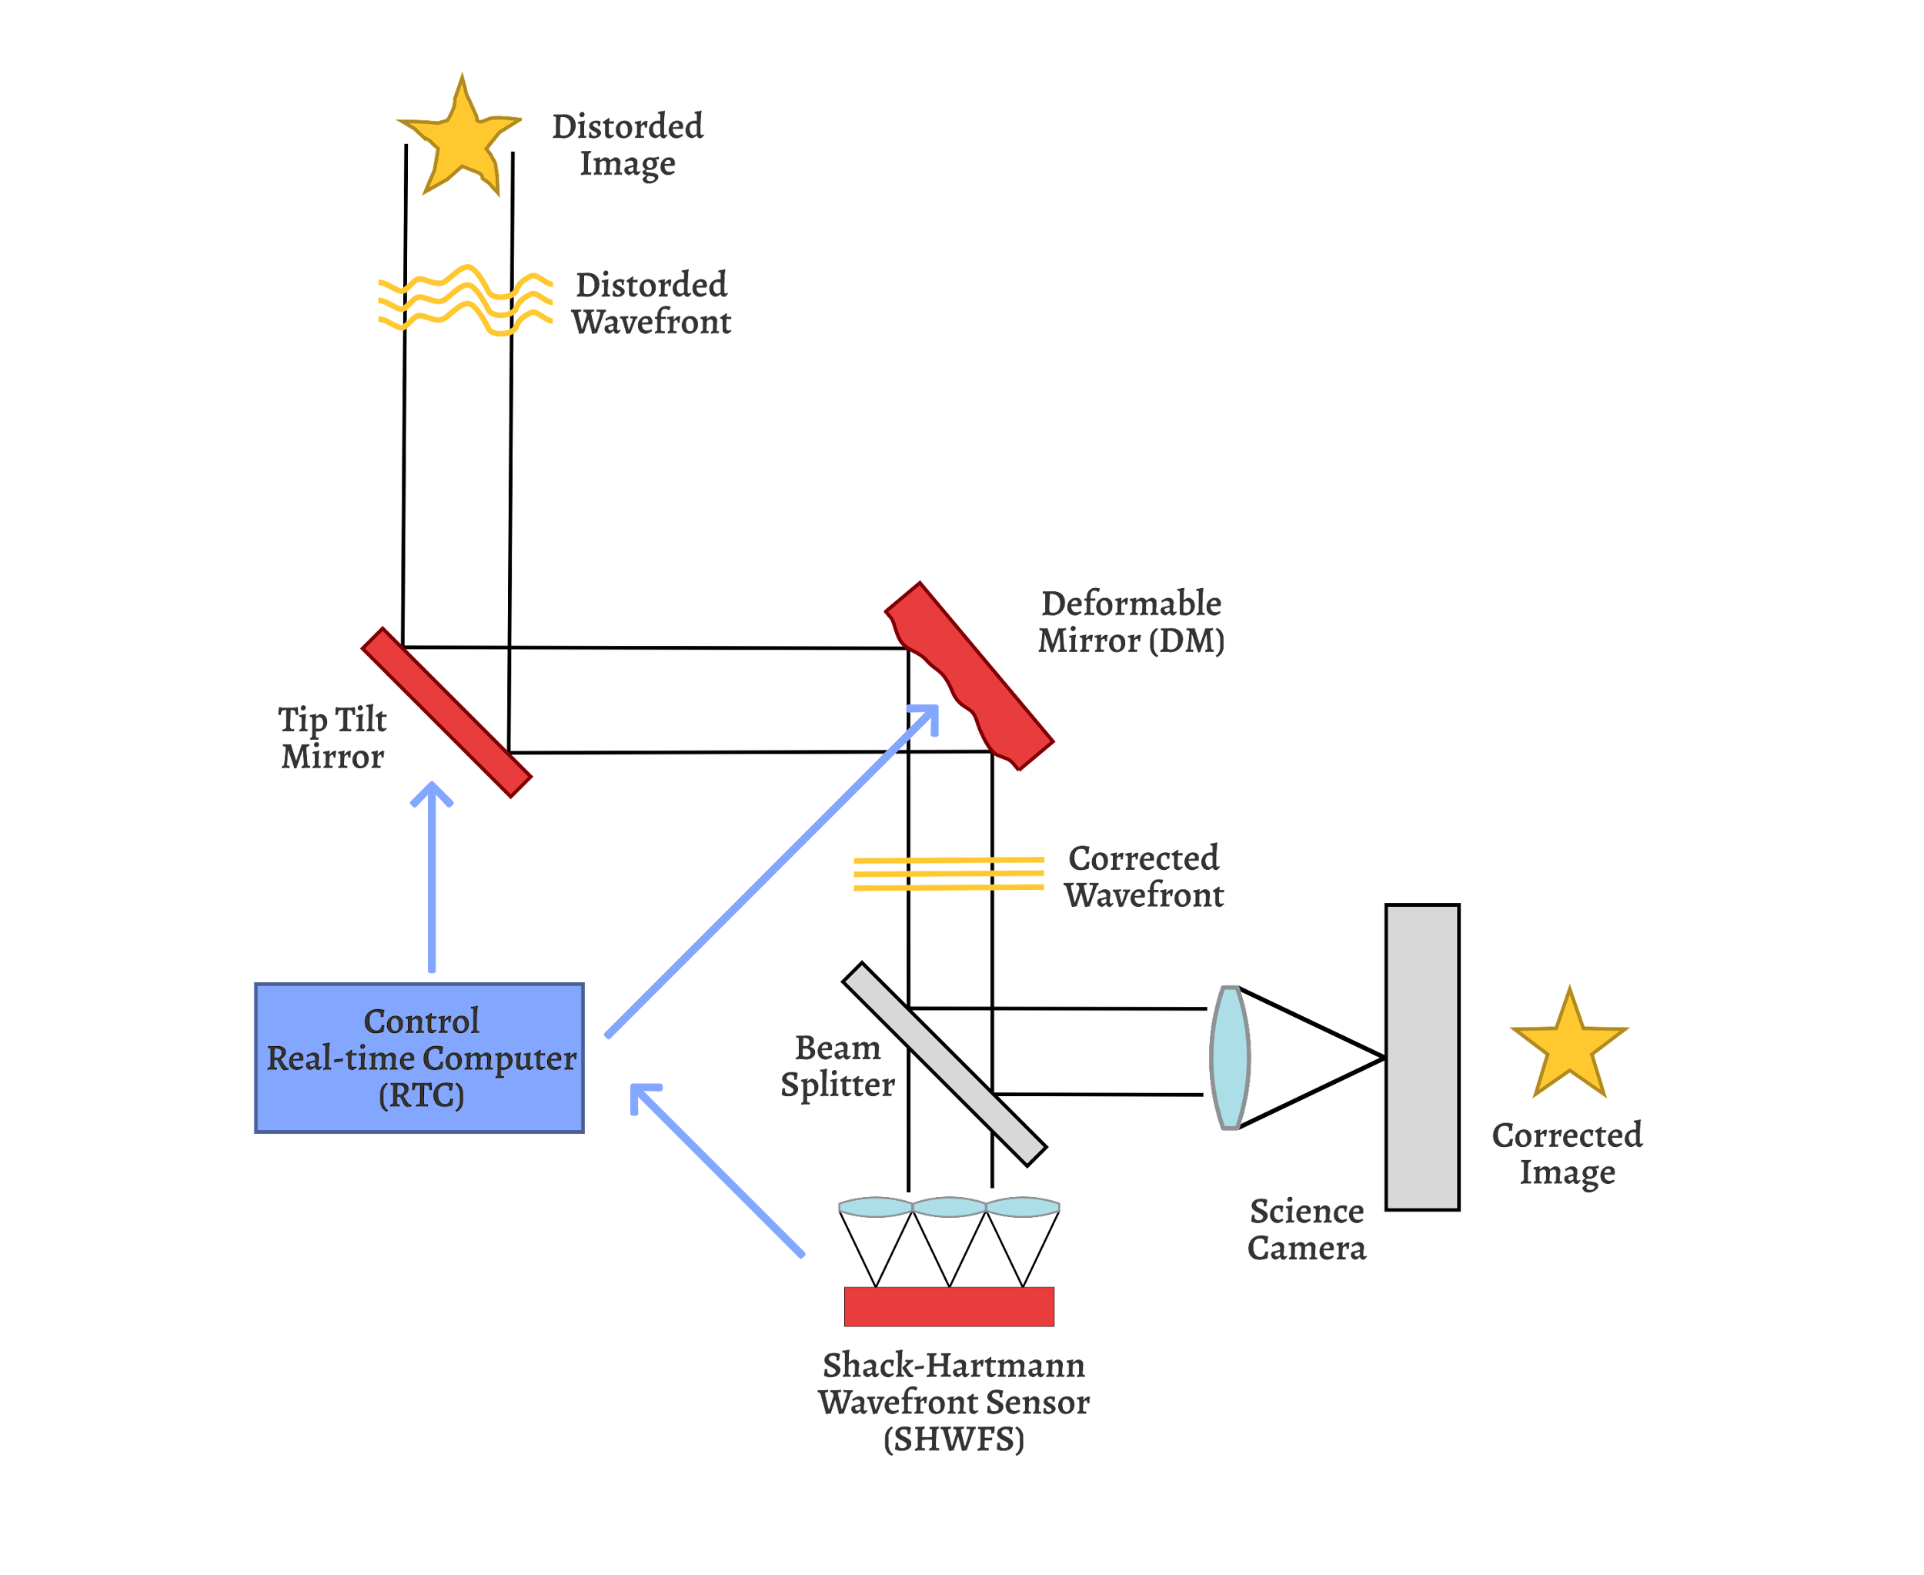
Introduction
DD4AO is currently involved in two VLT XAO instruments: SAXO+ and RISTRETTO.
It applies a data-driven control approach to adaptive optics, based on the controller presented in Karimi and al. (2017), developed at the Laboratoire d’Automatique, EPFL.
AO Loop scheme

Slide 3
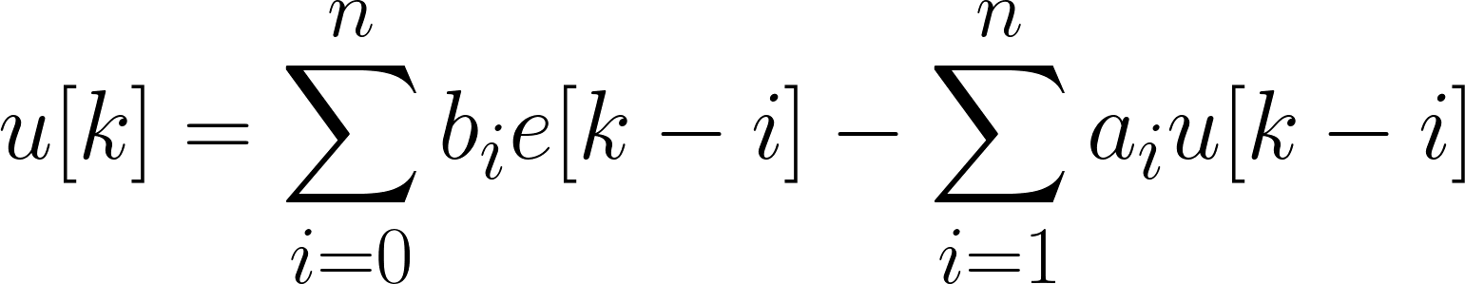
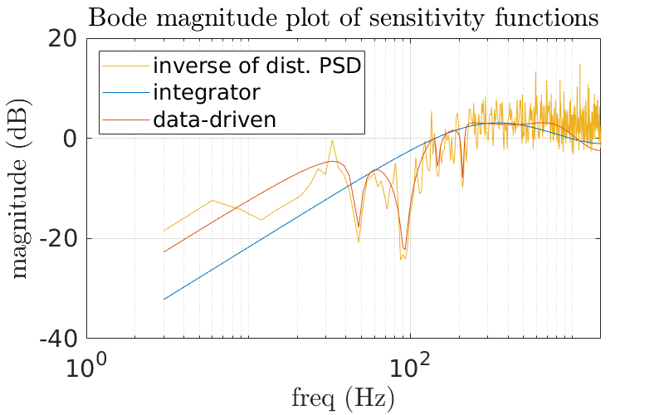
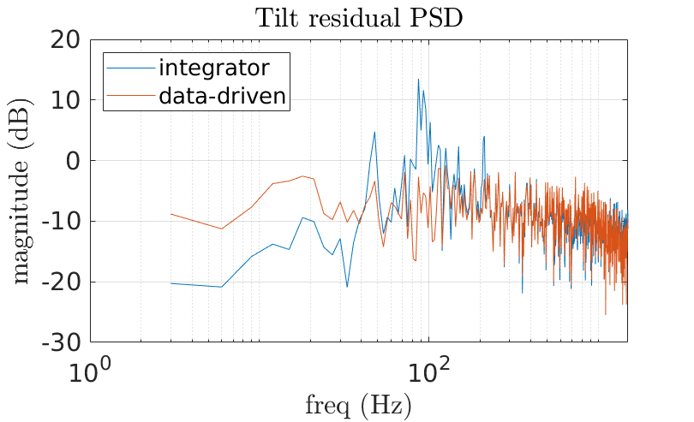
Introduction
(Integrator)
(Infinite Impulse Filter IIR)
From
To
Higher order (horizon) → fits more complex disturbances
Drawback: no longer tunable by hand
Solution: formulate a convex optimization problem solved computationally

Slide 4
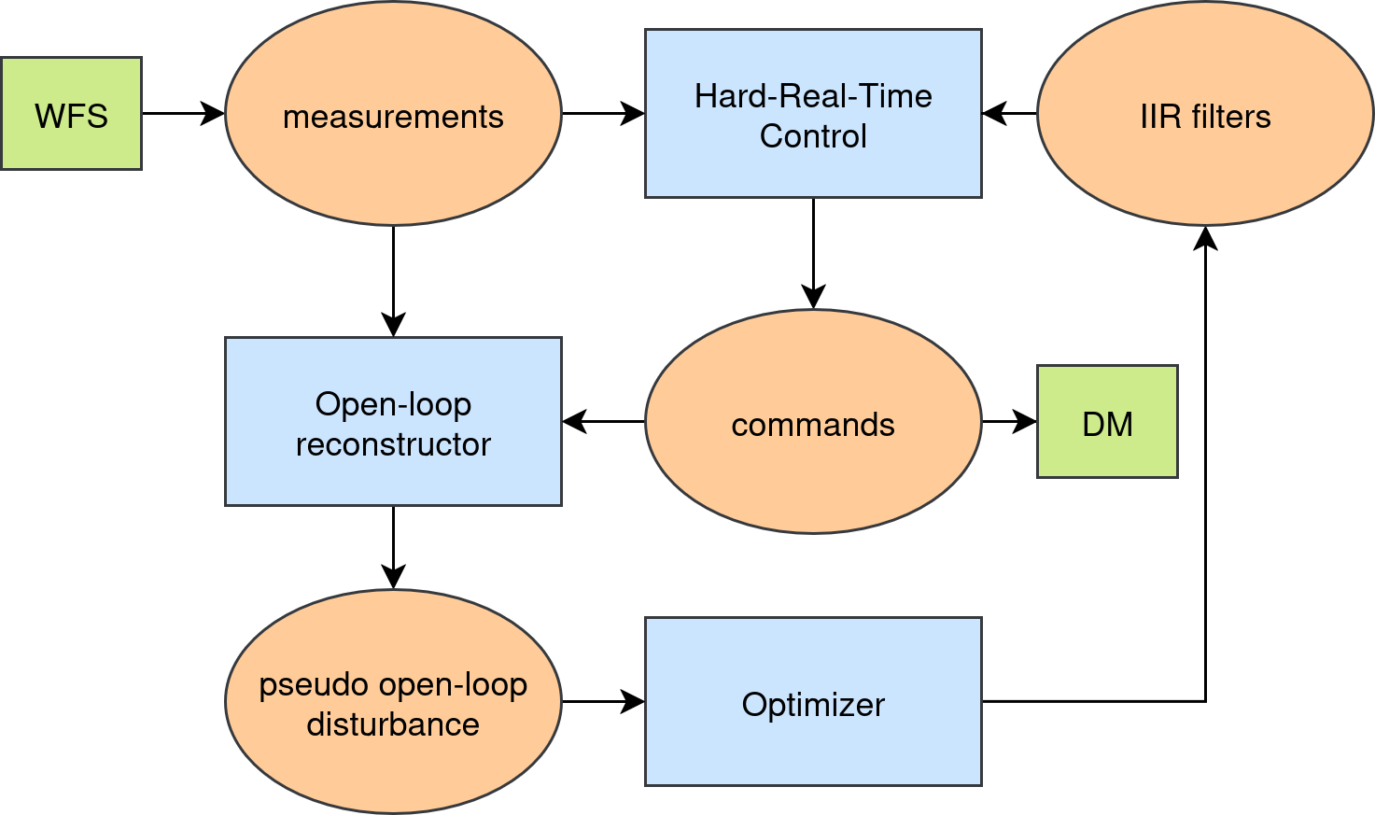
DD4AO PIPELINE
Three main processes:
• HRTC → computes commands (low latency)
• Optimizer → updates the IIR filters (~20 s interval)
• Open-loop reconstructor → estimates POL disturbance from telemetry

Slide 5

PAPYRUS
AO bench on the T152 telescope at Observatoire de Haute-Provence (OHP)
Wavefront sensors:
• 4-sided visible pyramid (500 Hz)
• 3-sided unmodulated IR pyramid (1 kHz)
Deformable mirror: Alpao 17×17 actuators
Real-time control: DAO RTC

Slide 6
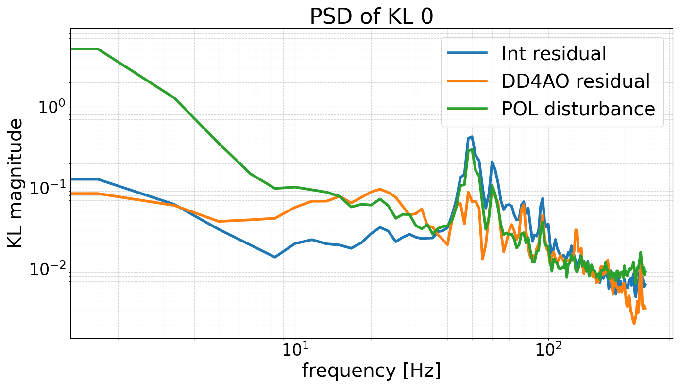
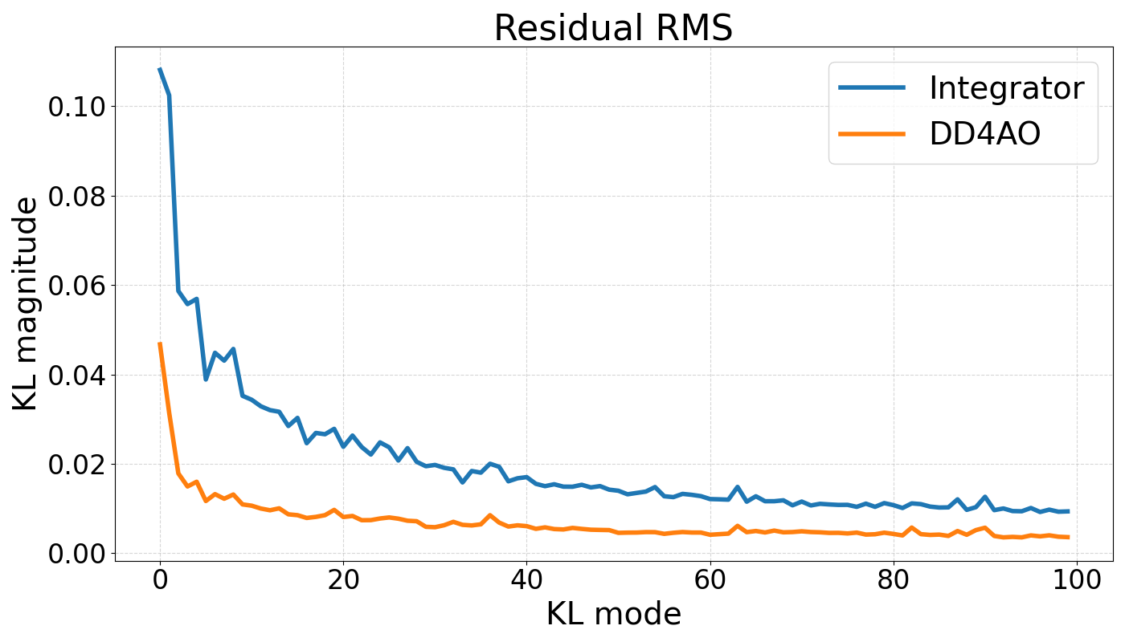
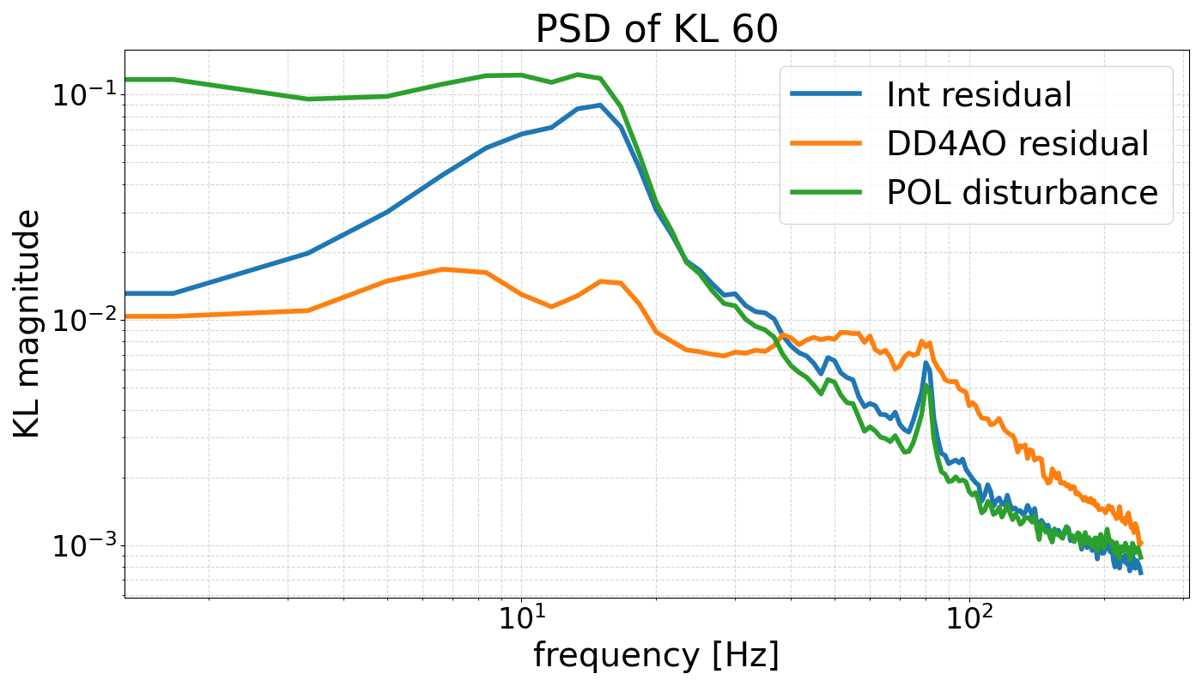
ON BENCH (4 sided)
The optical bench exhibits fast turbulence and a natural vibration spectrum
These conditions highlight the performance difference between the integrator and DD4AO

Slide 7
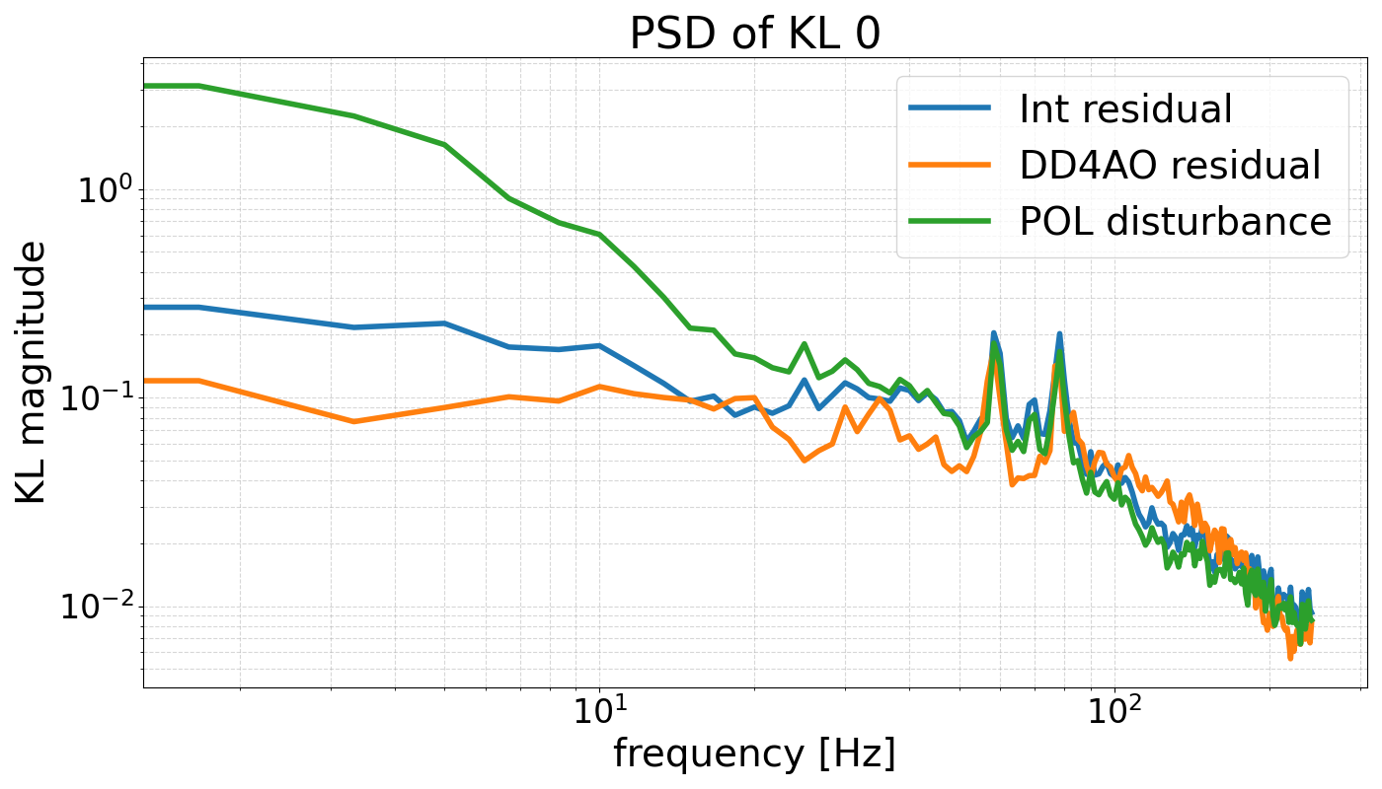
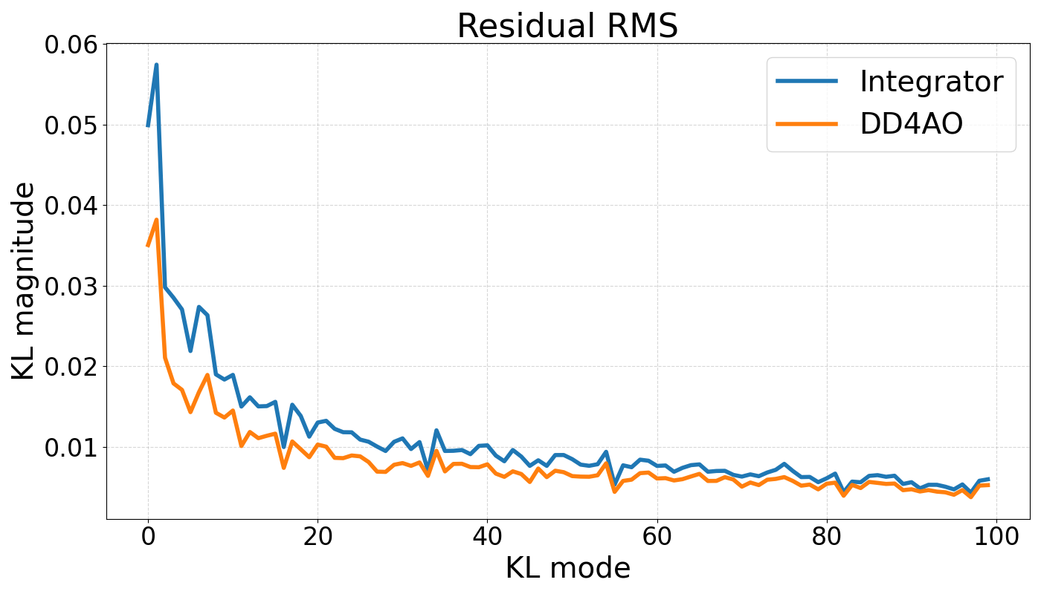
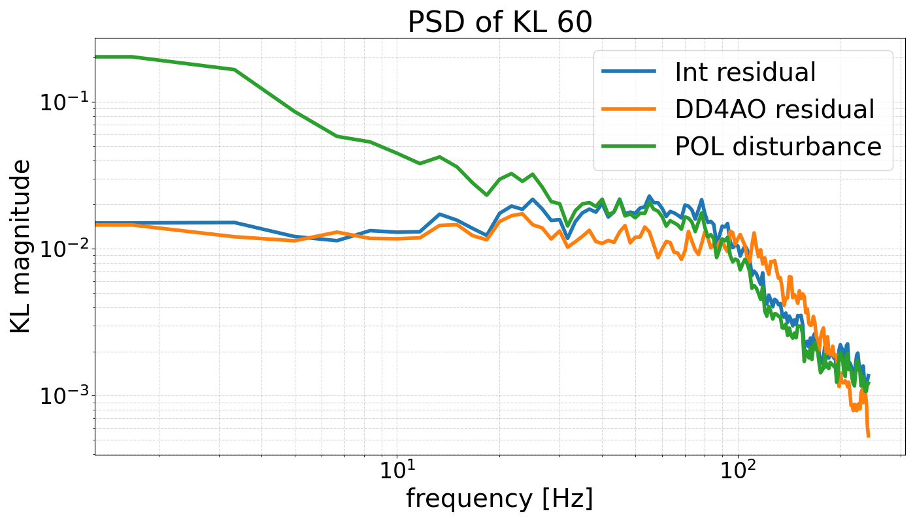
ON SKY (4 sided)
Performance improvement of DD4AO still observed, though less significant
Integrator rejection function closely matches the disturbance PSD
Vibration amplitudes are too small to significantly impact performance

Slide 8
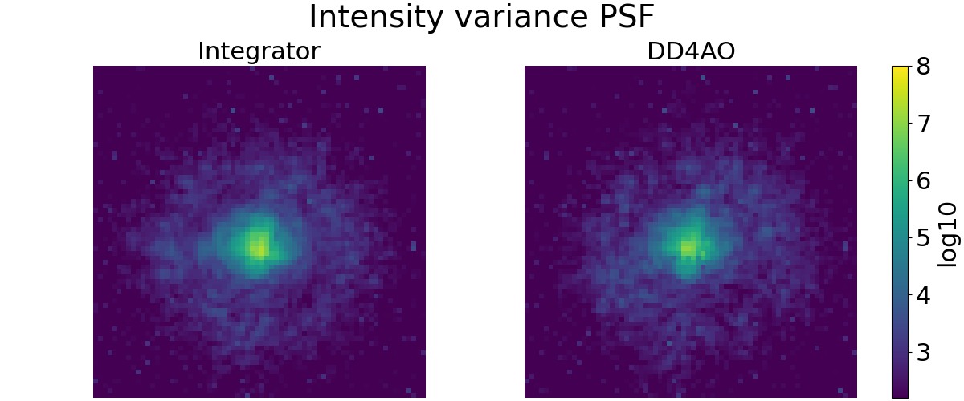
ON SKY (4 sided)
PSF errors are dominated by NCPAs
Low wind and absence of vibrations during observations make the integrator nearly optimal under these conditions

Slide 9
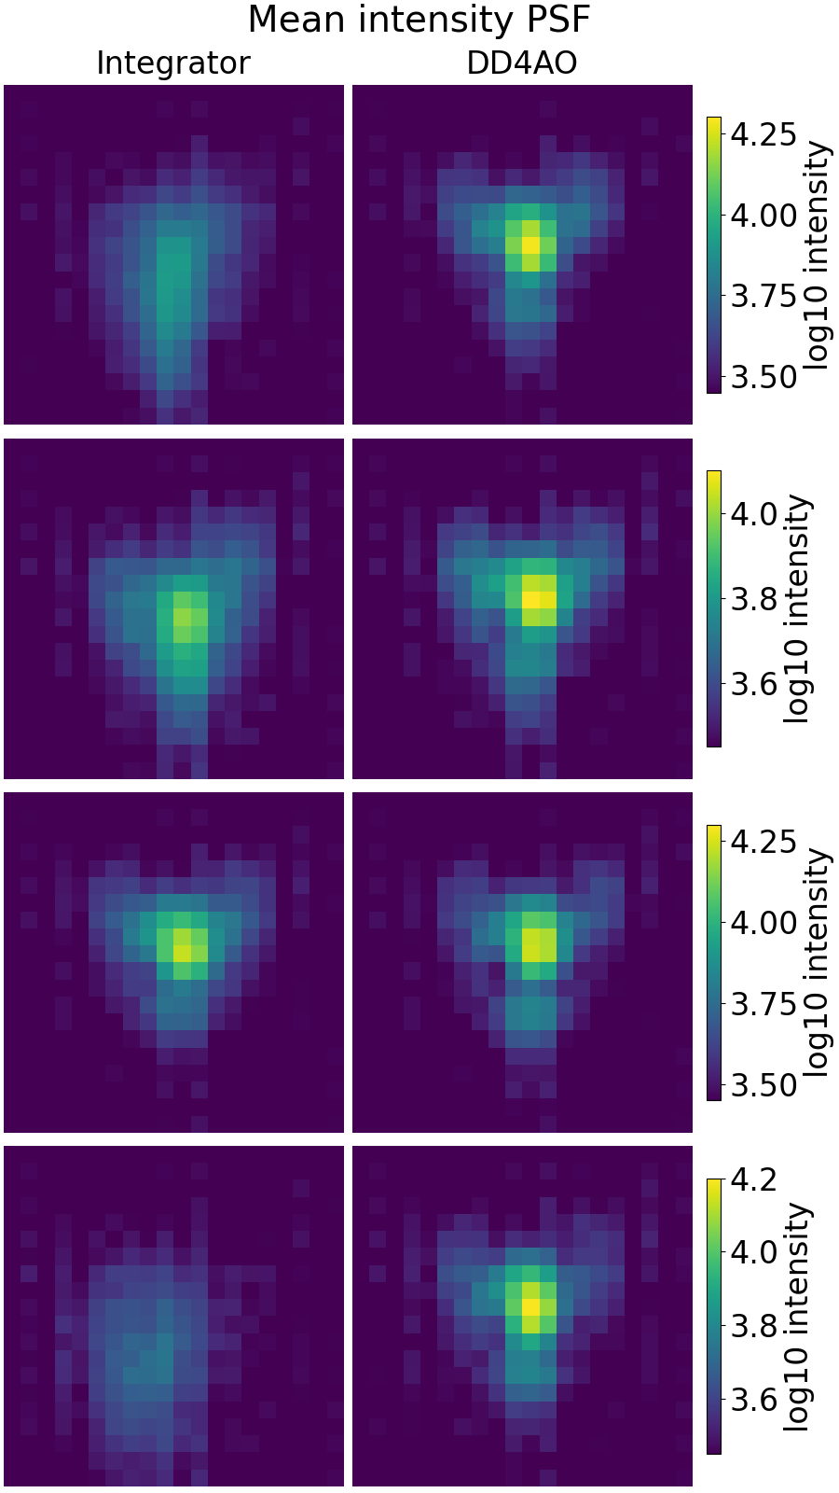
ON SKY (3 sided)
In the three-sided pyramid configuration, a significant improvement is observed in the PSF comparison
Cause remains uncertain, but a calibration issue is suspected to explain the reduced integrator performance

Slide 10
CONCLUSION And future work
First on-sky results are very promising for DD4AO
Demonstrated robustness and superior performance compared to the integrator
Conduct longer exposure tests (~1 min) to further evaluate stability and adaptivity

