Slide 1

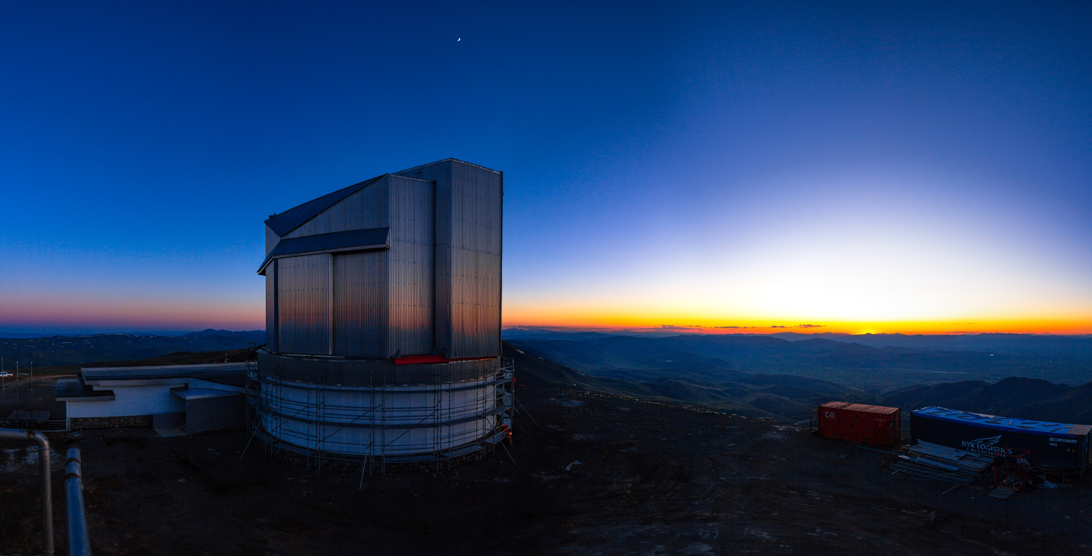





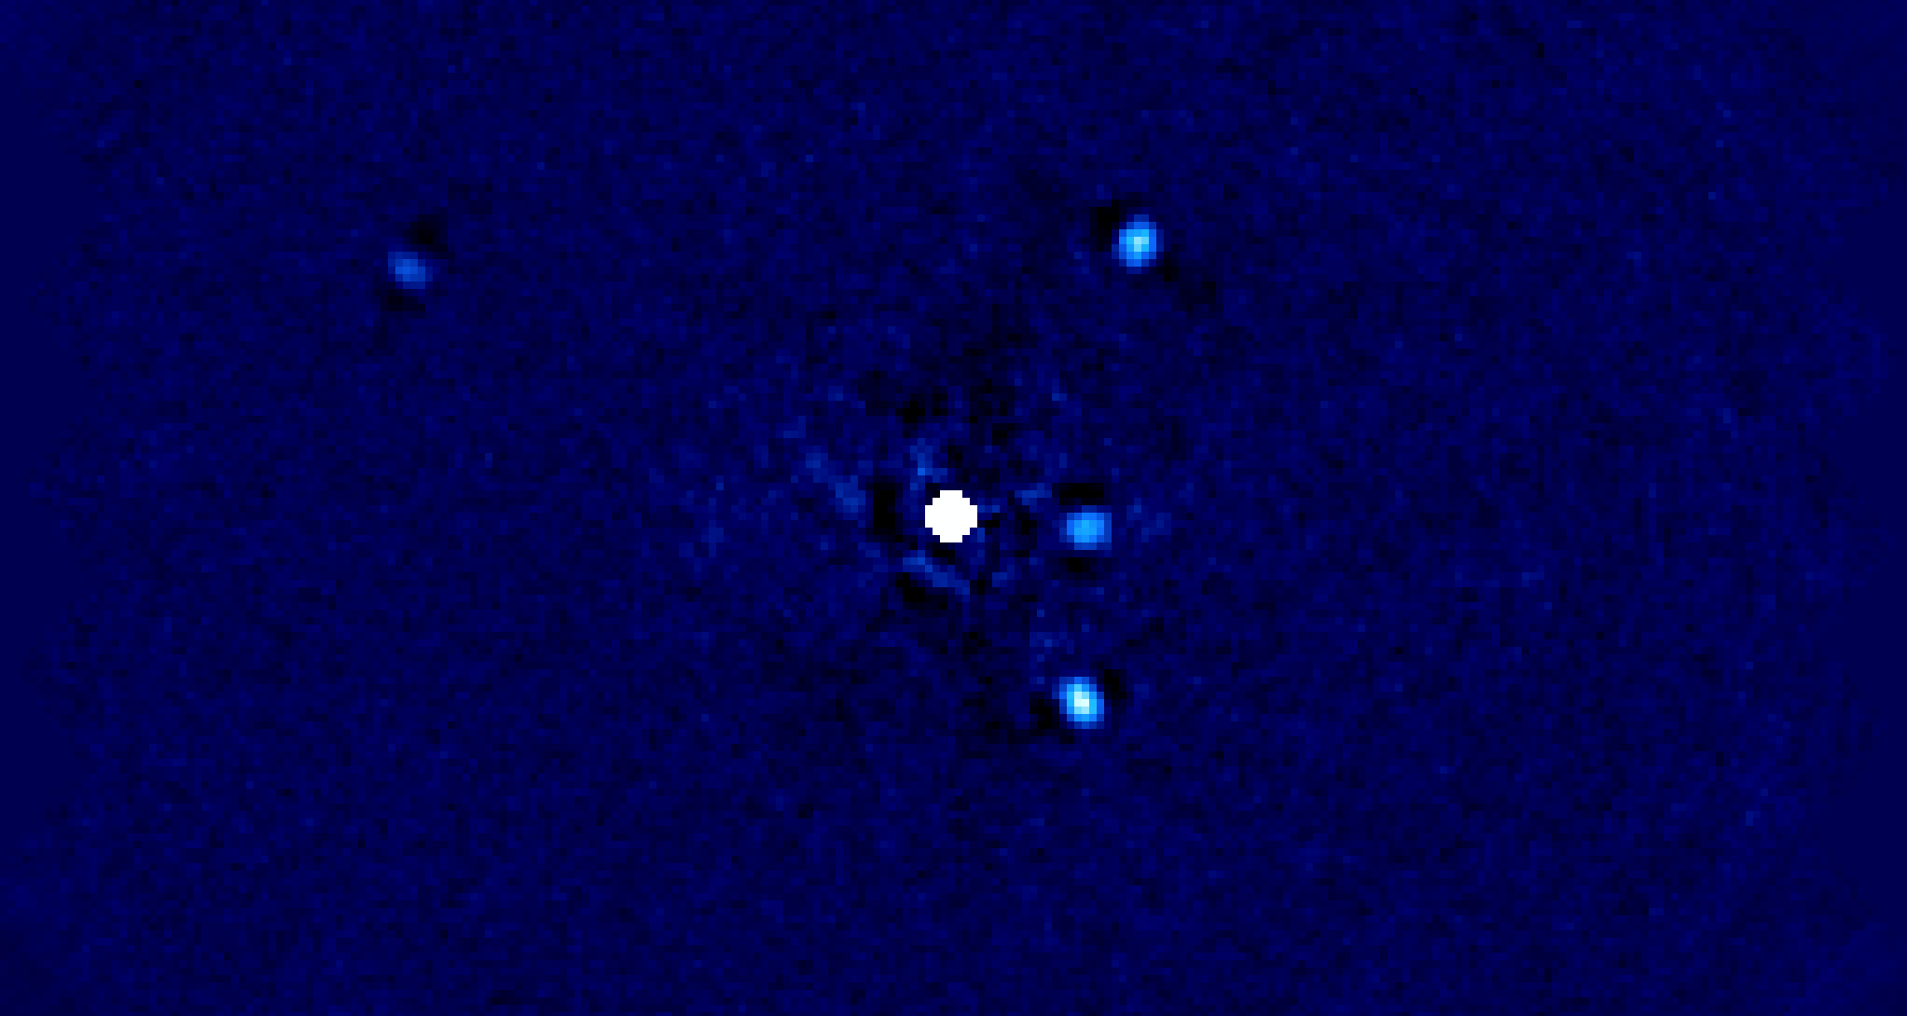
Developing astronomical instruments for direct imaging of exoplanets
*
J. G. Kühn, L. Marquis, R. Tandon, L. Lin - Division of Space Research and Planetary Sciences, University of Bern
L. Jolissaint, A. Baur, J. de Figueirero - HES-SO HEIG-VD Yverdon

Slide 2
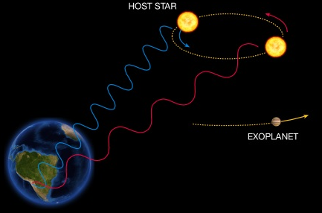
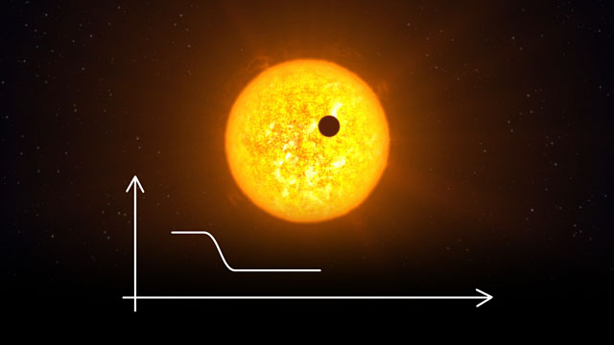

How to find exoplanets ?
Radial velocity (RV) → provide mass
Transit → provide size, possibly
transmission atmospheric spectroscopy
High-contrast Direct Imaging:
  Probe wider orbits
  High-resolution spectroscopy of the atmosphere
  Interaction between planets and disks, i.e. planet formation
Other techniques: micro-lensing, astrometry, interferometry
> 1150 found !
> 4600 found !
< 50 found…

Slide 3
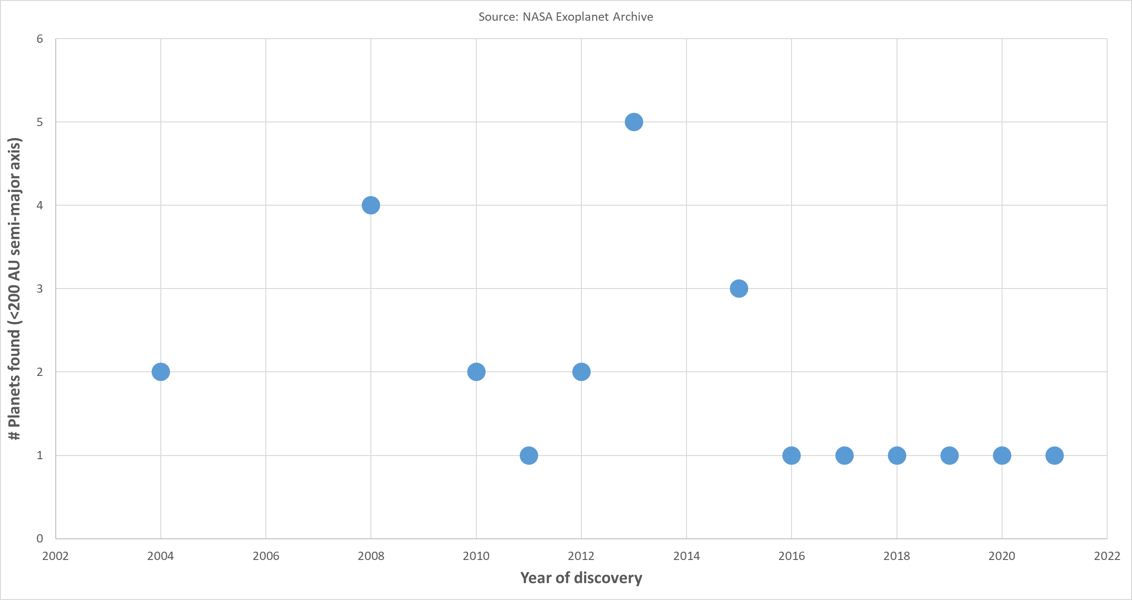
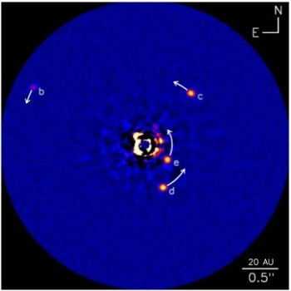
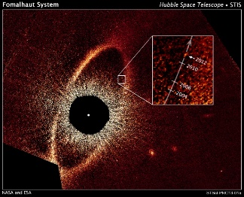
Indeed… Direct Imaging is difficult…
2nd-generation XAO systems
GPI @Gemini
HR8799
SPHERE @VLT

Slide 4


HR8799 @LBT (L’)
Objectives of RACE – GO project
“Rapid Active Coronagraphy of Exoplanets from a Ground-based Observatory”
Breakthrough on direct imaging instrument capabilities by
  Developing new detection schemes for active or adaptive exoplanet imaging with the PLACID instrument
  Use latest technology to do it faster than the atmosphere turbulence (< 10ms)
Validate and exploit the approach on-sky with the 4-m DAG telescope equipped with a XAO system
Visit www.racego.eu to learn more
Notes:
Now let me introduce the objective of my project, aimed at providing a breakthrough contribution that I think is urgently needed. CLICK First, I want to develop a viable scheme for what is called Coherent Differential Imaging, or CDI, taking advantage of the fact that starlight residuals such as speckles are both spatially and temporally coherent with the host star photons, whereas any off-axis astrophysical source is not. CLICK Second, I want to use the latest technology to do this fast enough to freeze the fast speckles at speed the relevant to the atmospheric coherence time, less than 10 ms that is. CLICK Finally, I intend to validate and exploit the approach on-sky thanks to 60 guaranteed time observing nights on 4-m ground based telescope equipped with an extreme AO system. NEXT SLIDE.

Slide 5
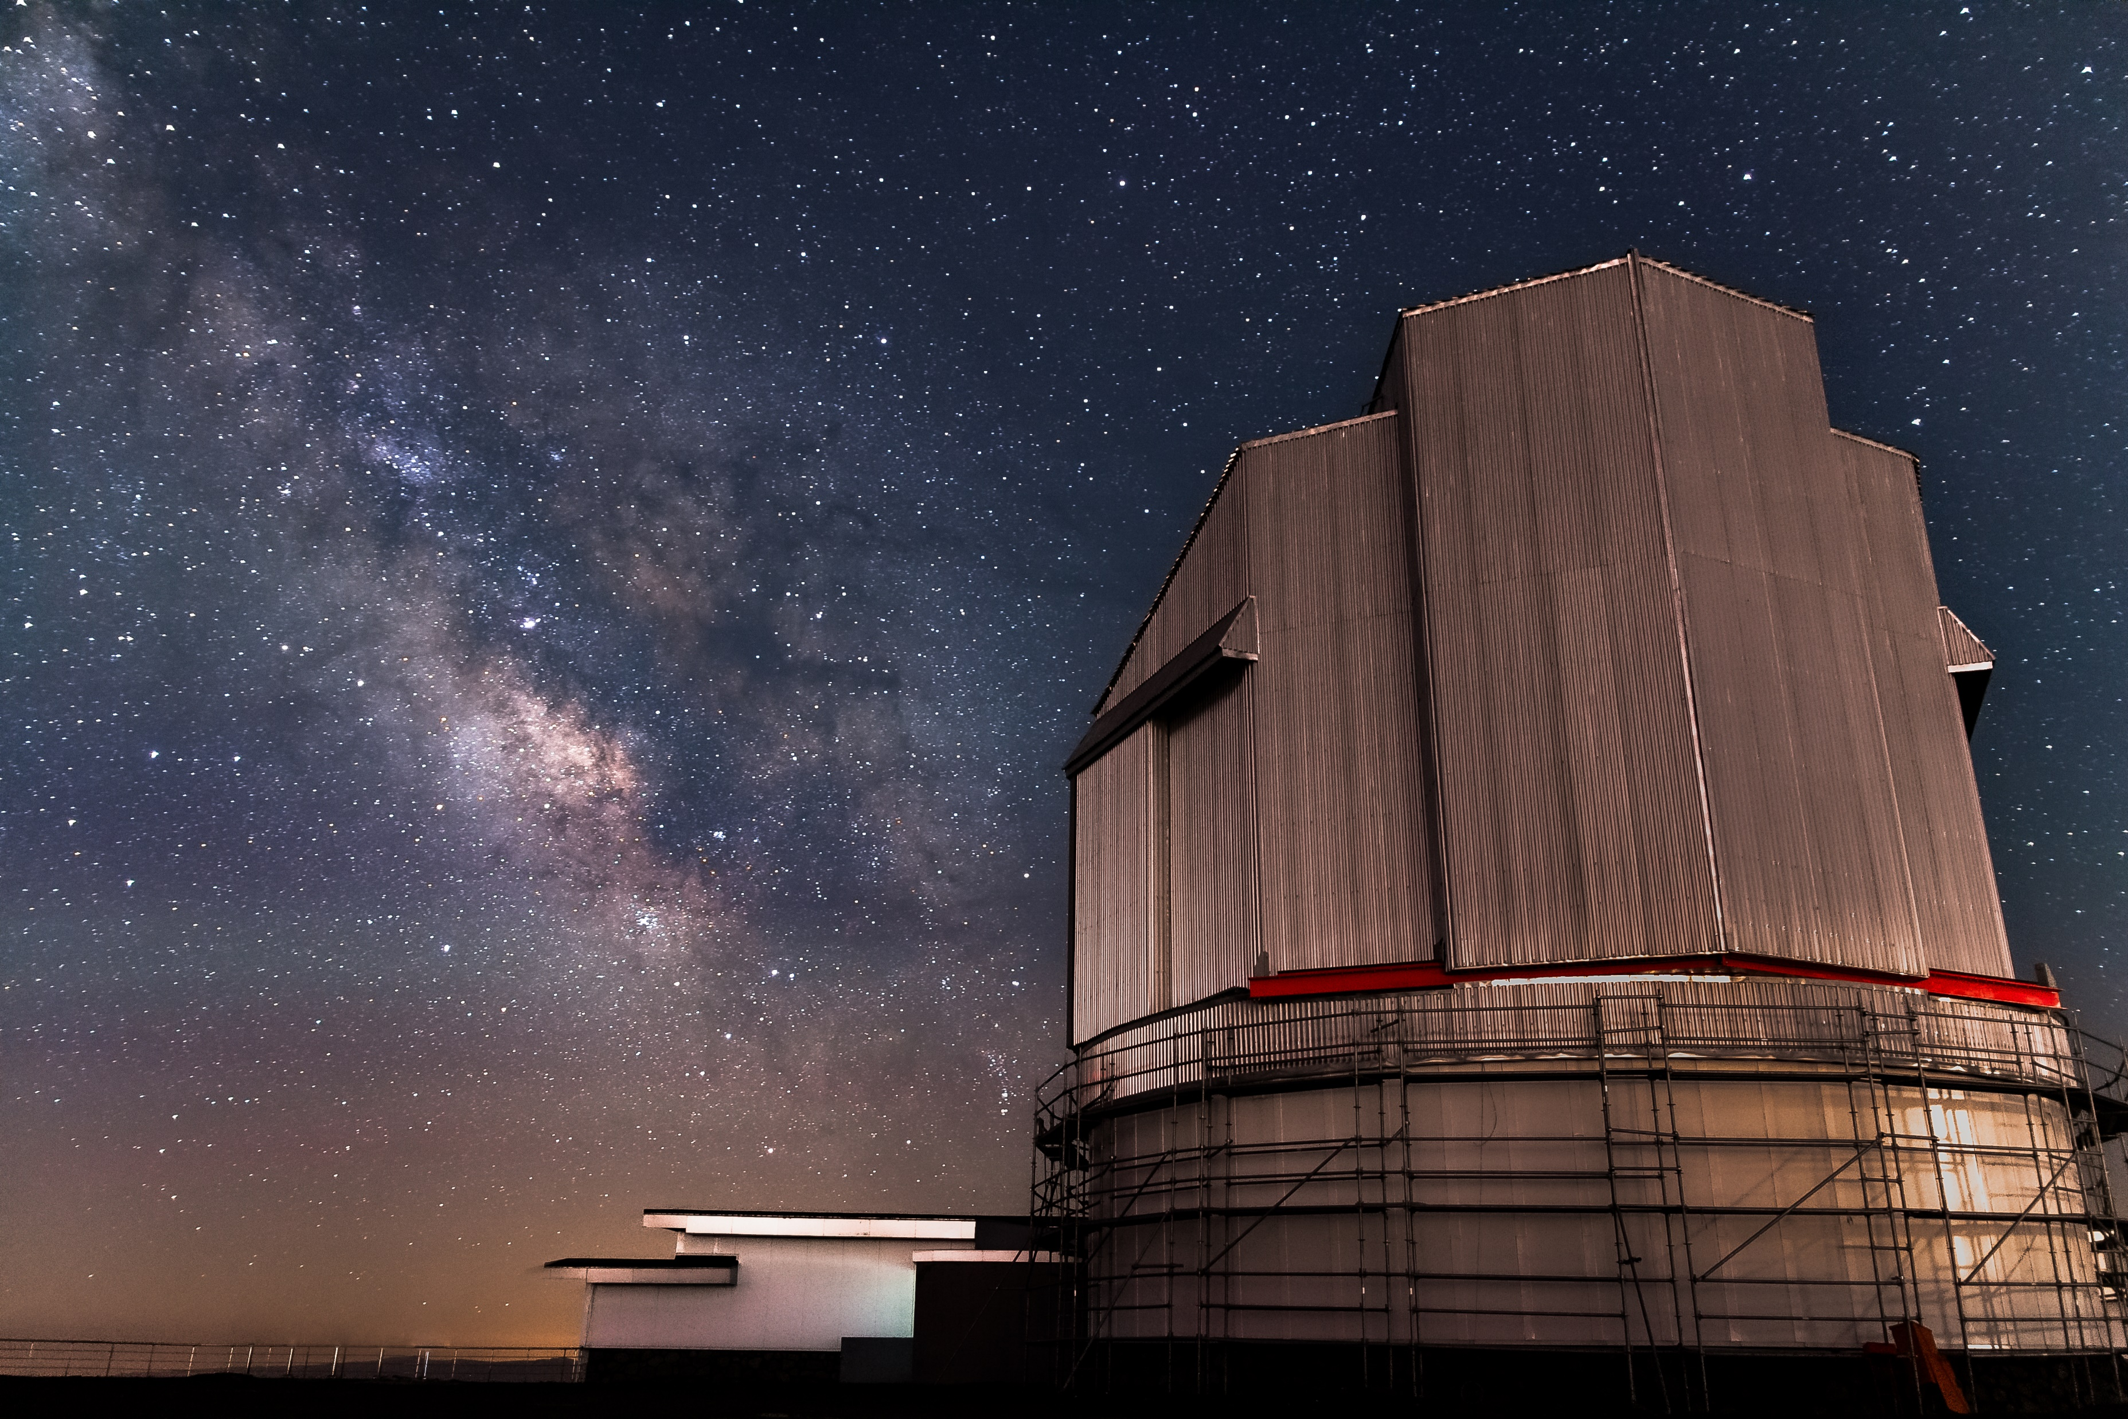
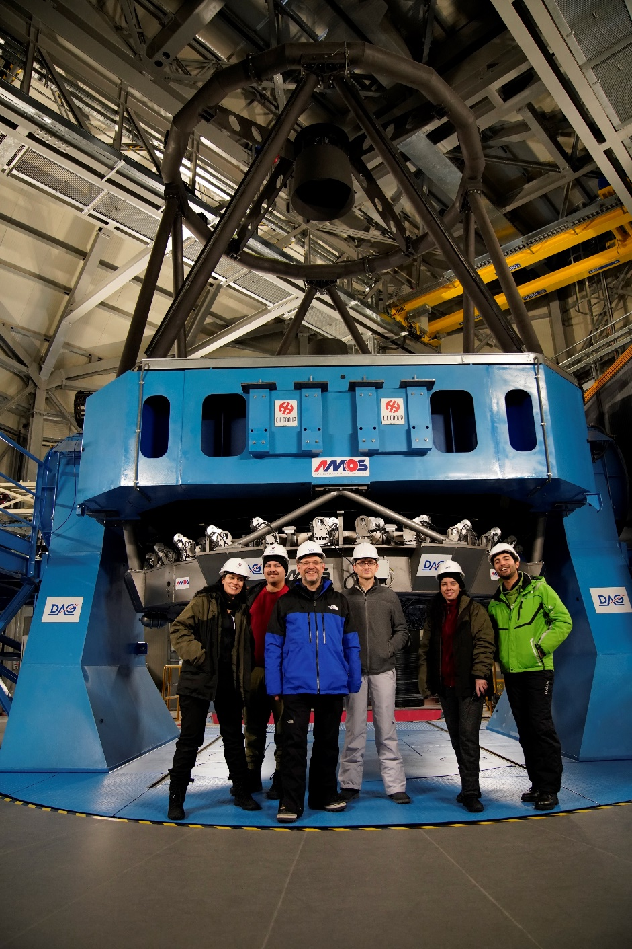





The 4-m DAG telescope
East Anatolia Observatory (DAG) is the new national observatory of Turkey
  Ritchey-Chrétien architecture
  4-m primary mirror and two Nasmyth foci
  Official delivered this spring, it is now in service!
Visit www.racego.eu to learn more

Slide 6
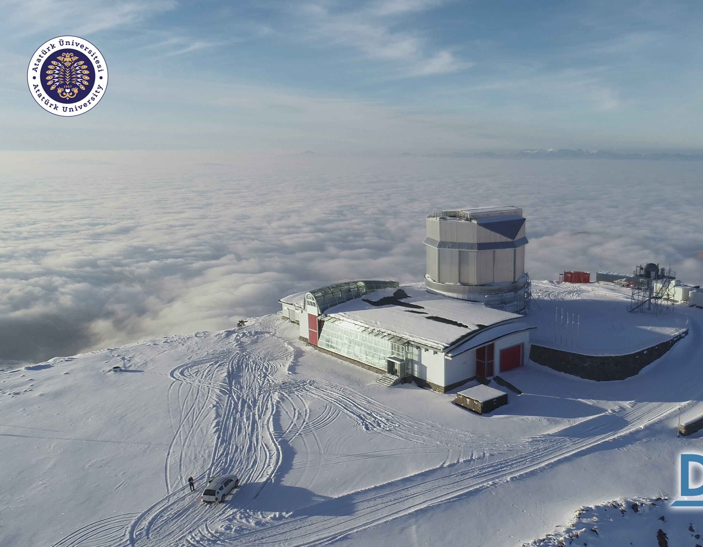
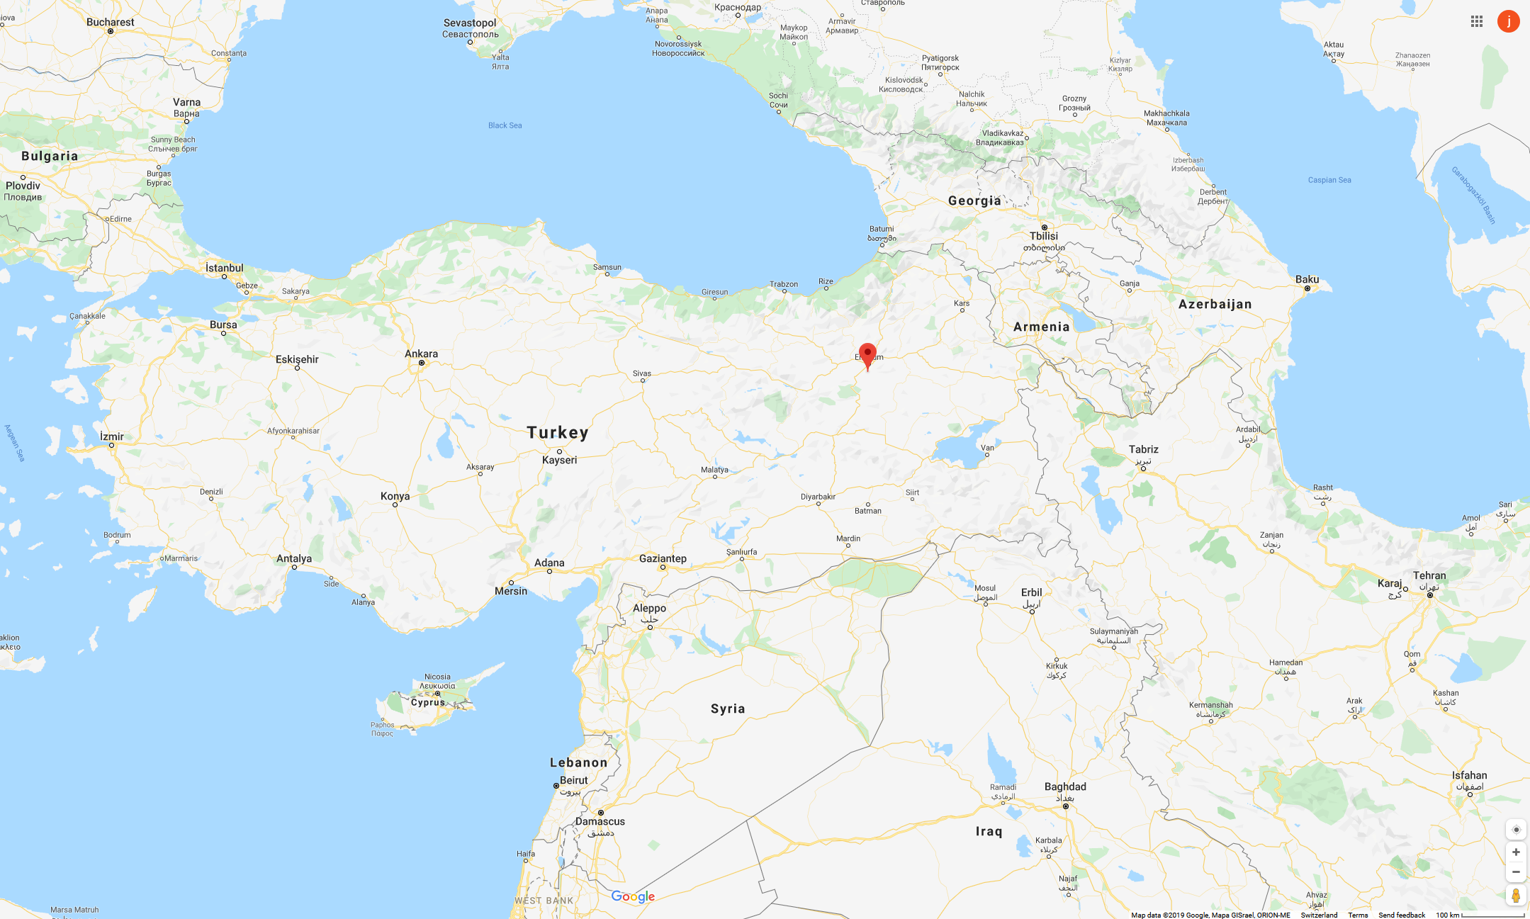
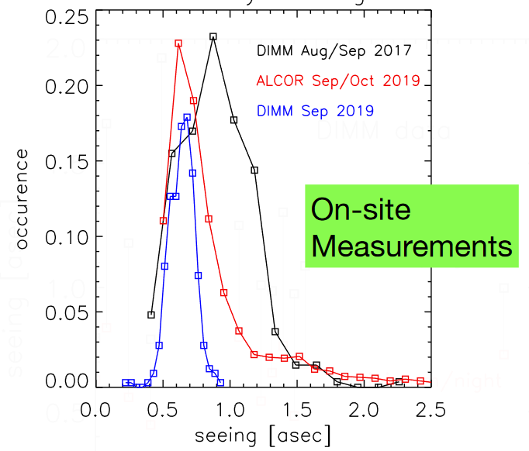
The DAG observing site
“Karakaya Ridge”
Altitude: 3100m ASL
Clear nights ratio: 260/365
Median seeing: 0.9’’
Driving distance from Erzurum: ~90mn

Slide 7
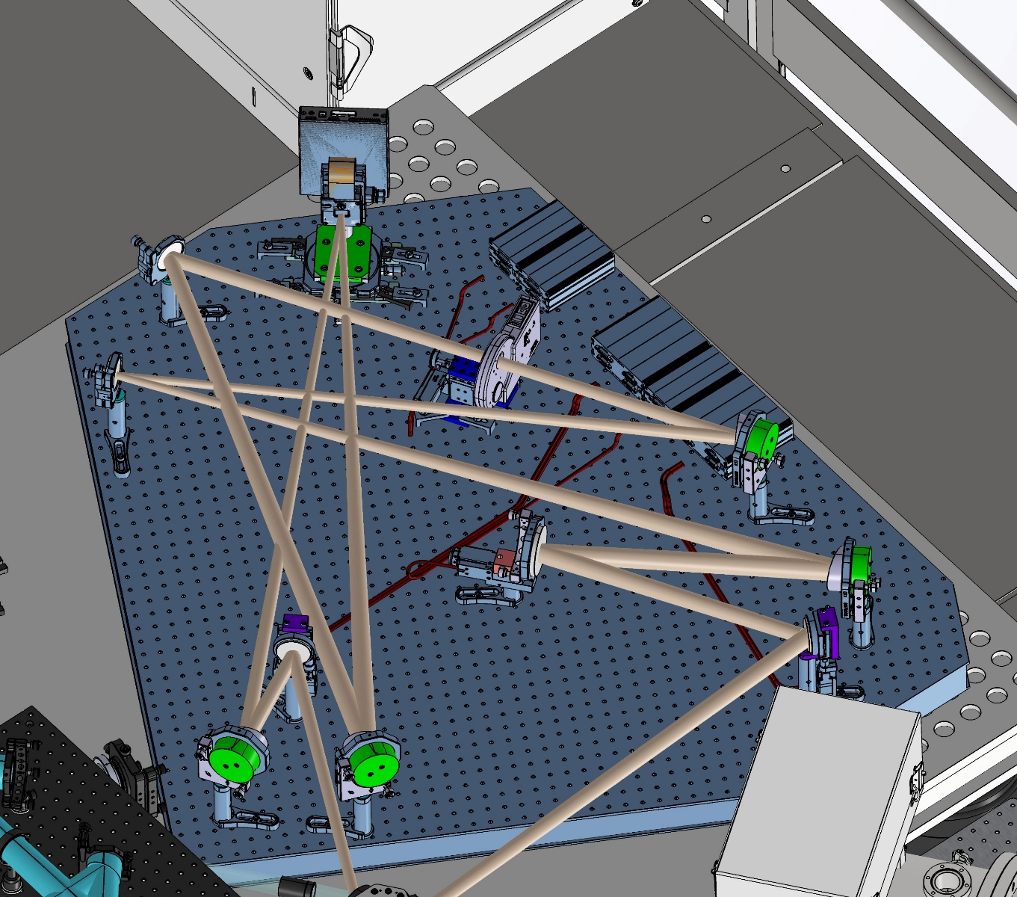

The PLACID instrument
Programmable Liquid-crystal Active Coronagraphic Imager for the DAG telescope (PLACID)
  Worldwide first SLM-based active coronagraph
  H-Band (1.65 µm) and Ks-Band (2.2 µm)
  Delivered March 2024, installed January 2025, AIV activities since July 2025
  “First light” by the summer of 2026
Adapting to observing conditions in real-time
  Self-calibration of optical aberrations
  Coherent Differential Imaging (CDI)
  Multiple star coronagraphy (binary stars…)
Image credit: ATASAM / DAG
Consortium

Slide 8
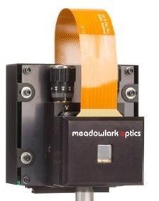
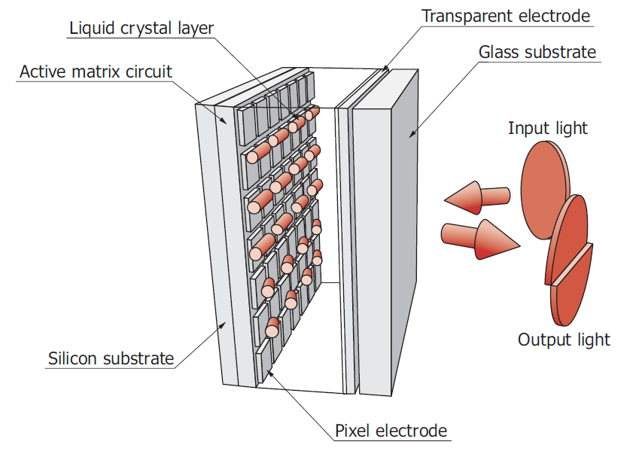
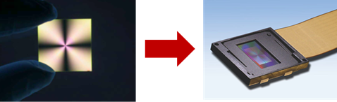

The heart of PLACID: a SLM
Each pixel of a Spatial Light Modulator (SLM) display panel can locally delay the optical path (phase) of incoming light
  Dynamically adjustable birefringence
  Only works with polarized light
Any phase pattern can be programmed
  µm-sized pixels provide excellent sampling, also in the focal-plane
  Video-rate or beyond
A first: a SLM in place of classical phase mask coronagraph
Image credit: AVR optics

Slide 9
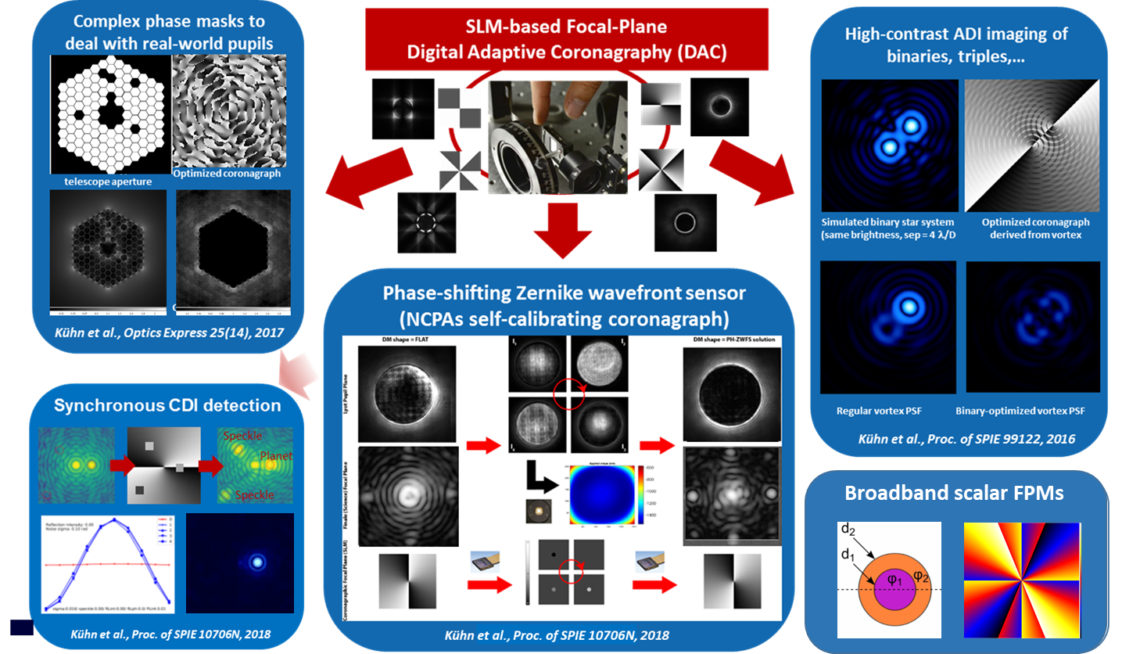
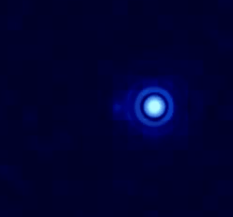
Why the PLACID instrument ?
On-sky platform for high-contrast imaging R&D ahead of the ELTs
  On-sky prototyping of new phase mask designs and
  advanced observing modes
  Open to collaborations with the community
  ELT/PCS R&D “on-sky testbed”, also for HWO
Niche science (binary/triple stars)
+ TESS, PLATO, GAIA follow-ups in the North
Education, mentoring and outreach tool for
the nascent Turkish exoplanet community

Slide 10
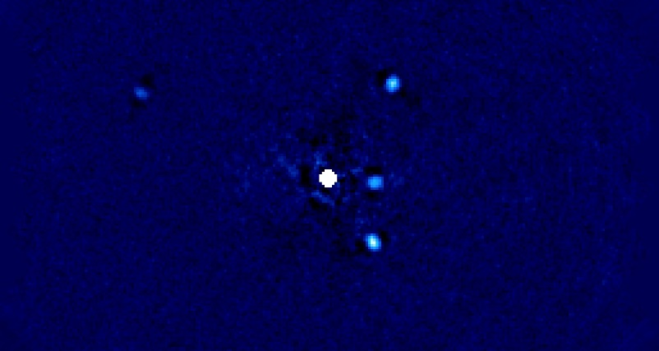

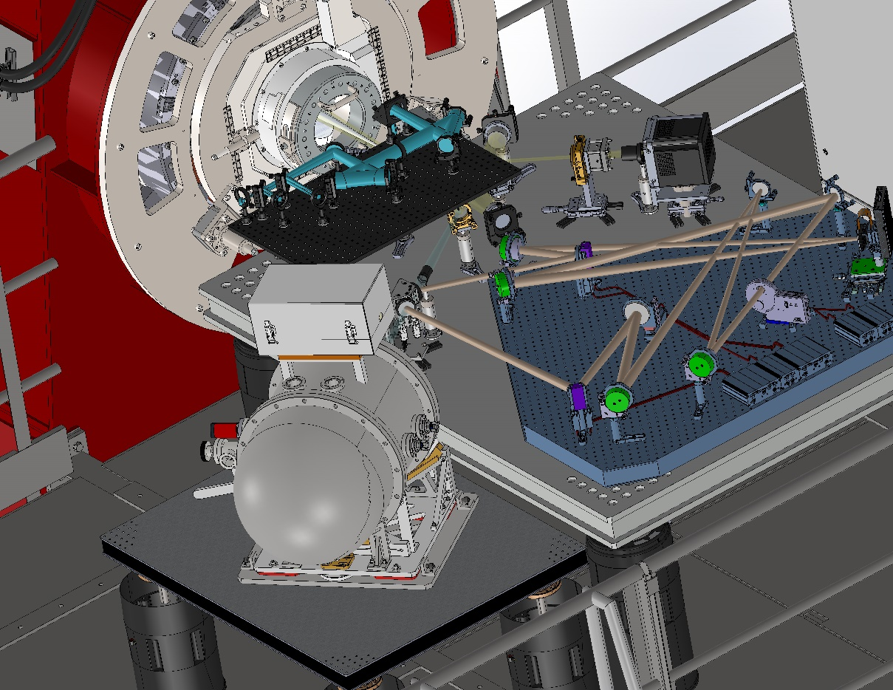
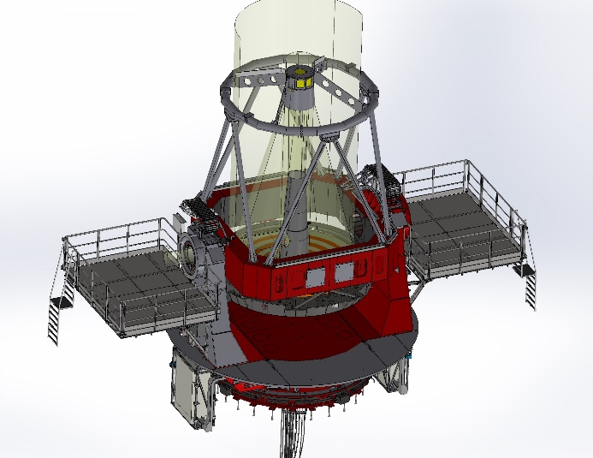


The DAG NIR XAO Nasymth
The PLACID instrument
  World’s first SLM-based active high-contrast instrument
  Near-infrared: H-band (1.65 μm) and Ks-band (2.2 μm)
  Versatile instrument for exoplanet direct imaging
PLACID will operate downstream of TROIA
  «TuRkish adaptive Optics system for Infrared Astronomy»
  Extreme AO with pyWSF
  and 468-DM from ALPAO
… and upstream of DIRAC
  «DAG InfRAed Camera»
  Teledyne H2RG detector

Slide 11
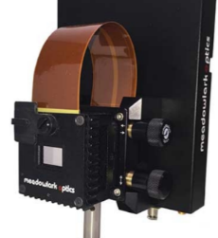
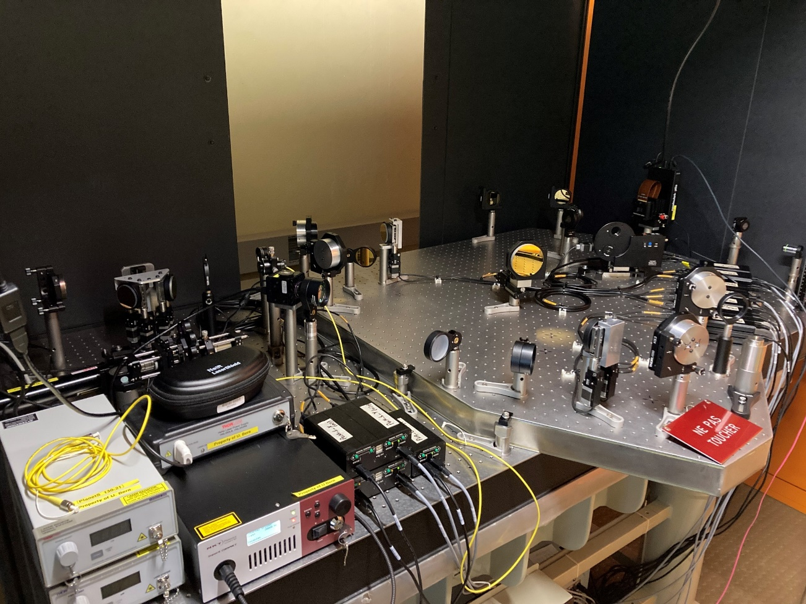
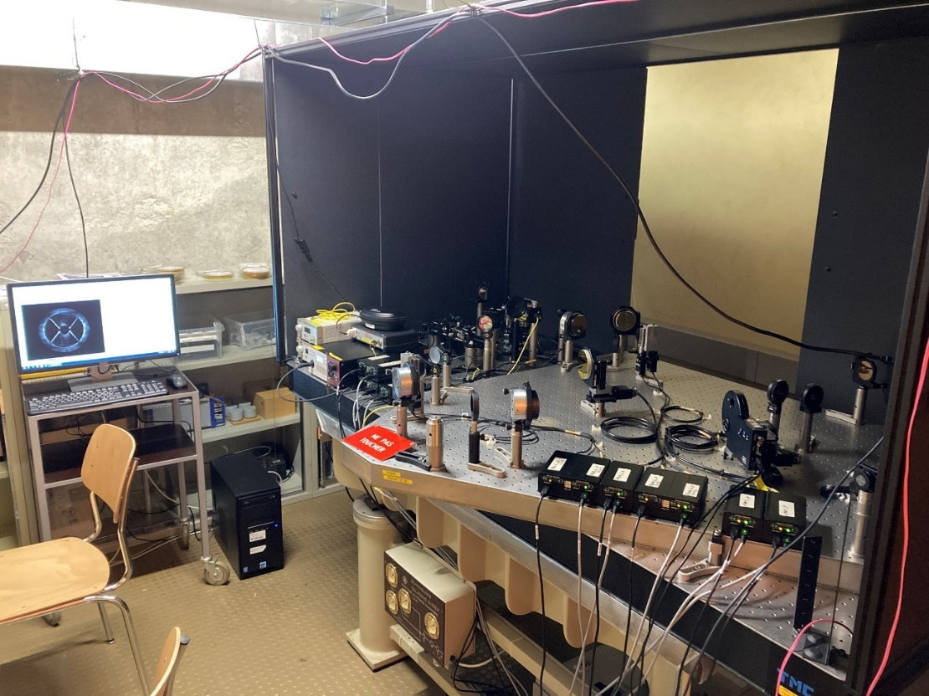
Factory Acceptance Review (Dec’22)
SLM

Slide 12
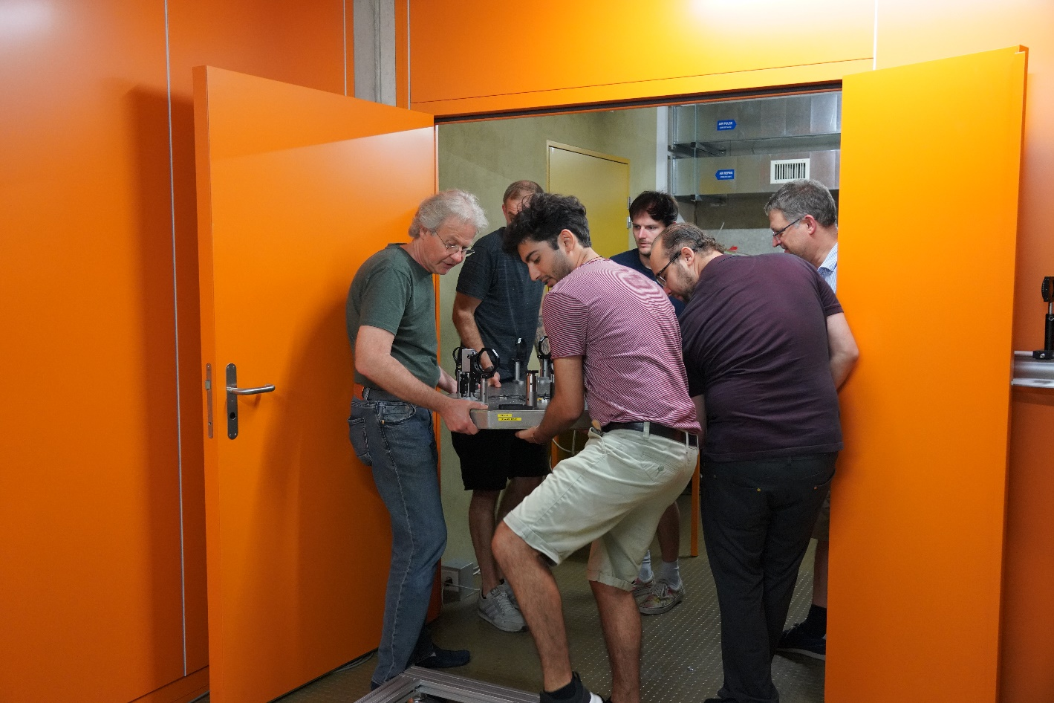
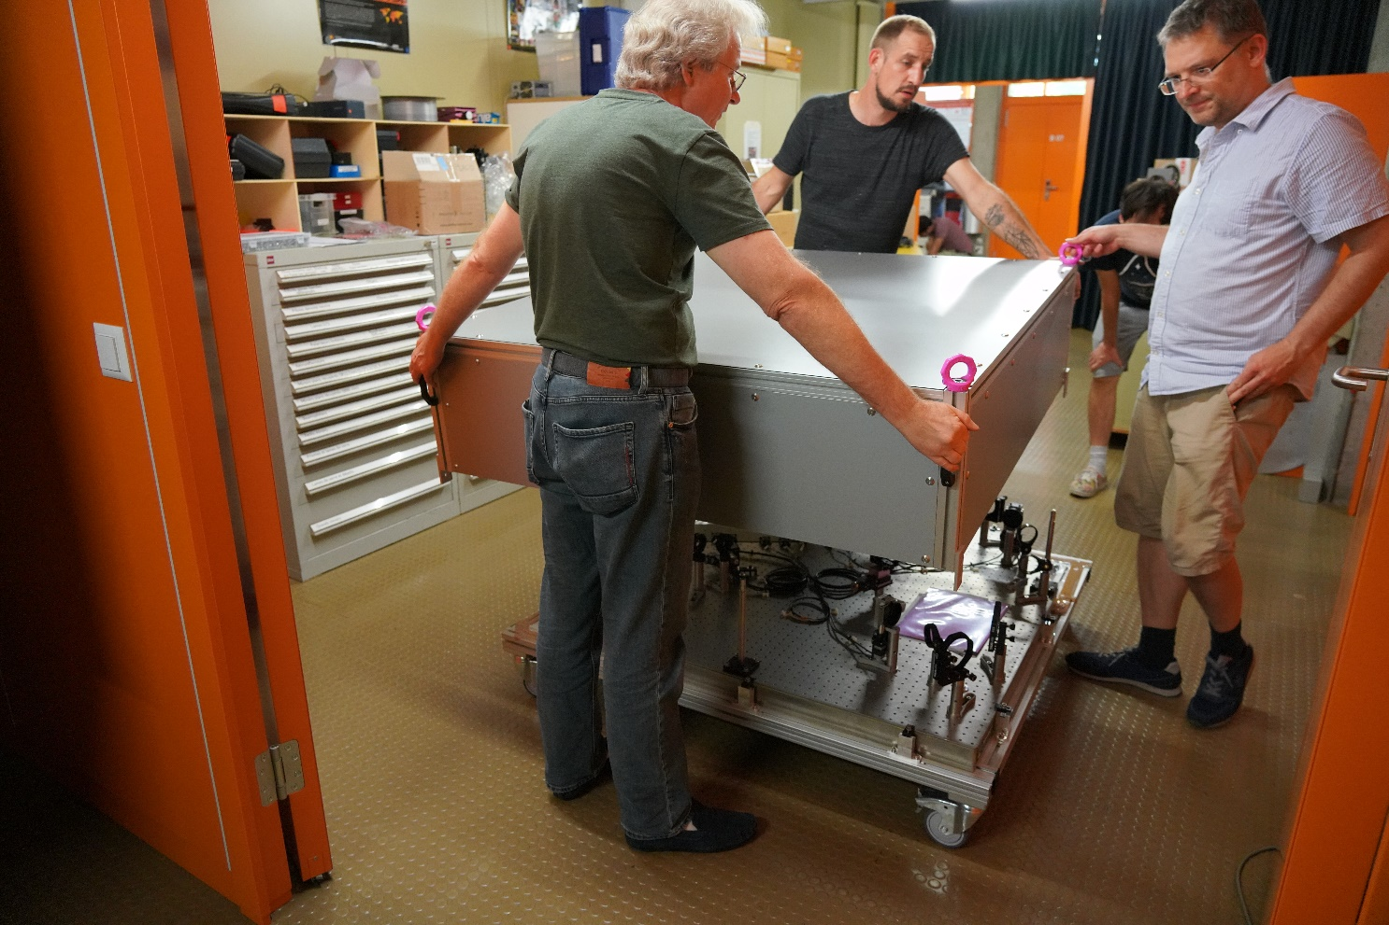
Packing and Delivery Readiness (Aug’23)

Slide 13

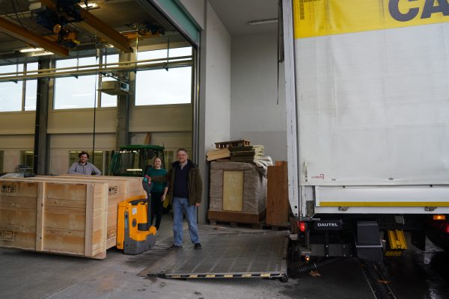


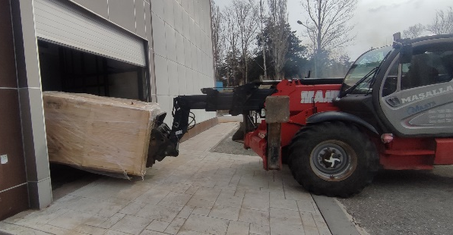
Shipping to Turkey (Feb’24)
ZRH
IST
DXB
Feb 23, 2024
March 9, 2024

Slide 14
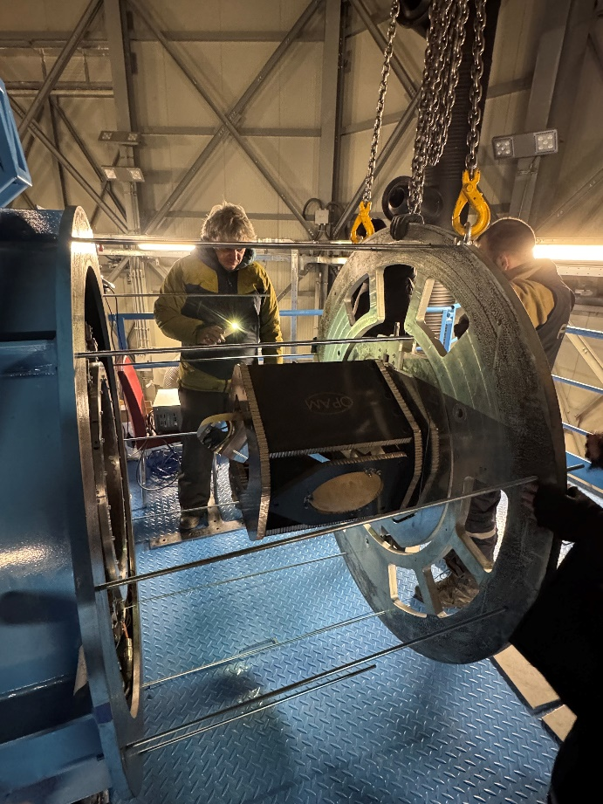
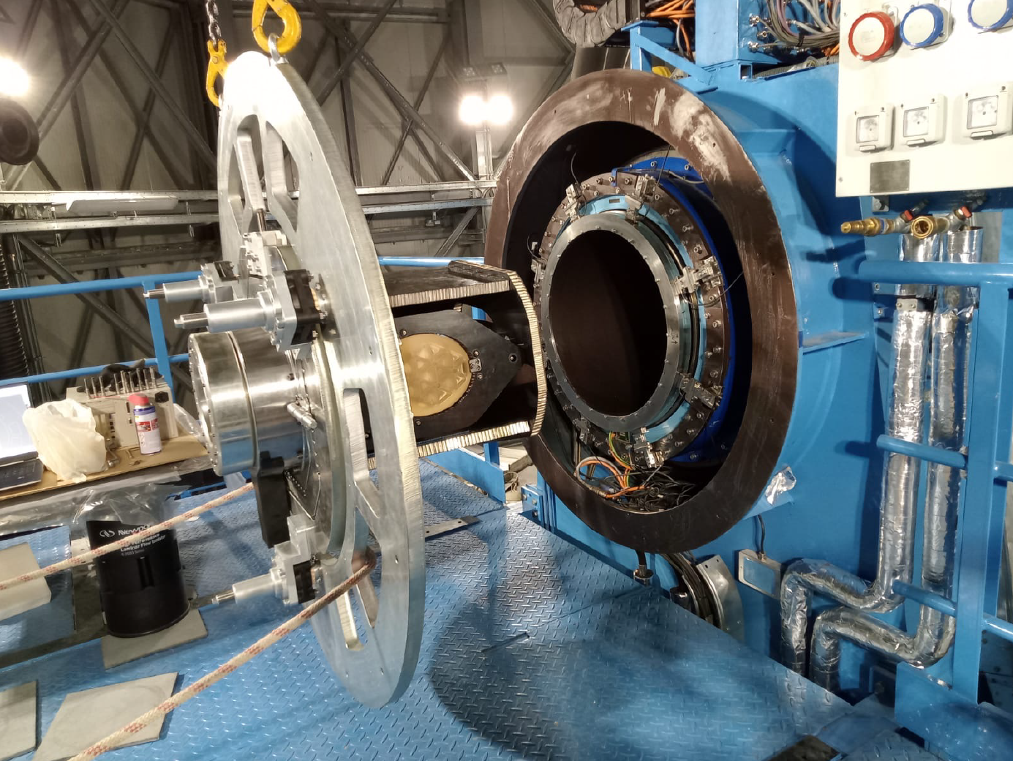
KORAY derotator installation (Sept’24)
Image credit: HEIG-VD/ ATASAM / DAG
Image credit: HEIG-VD/ ATASAM / DAG

Slide 15

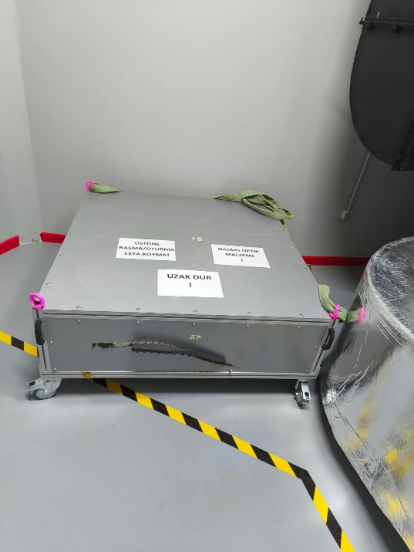
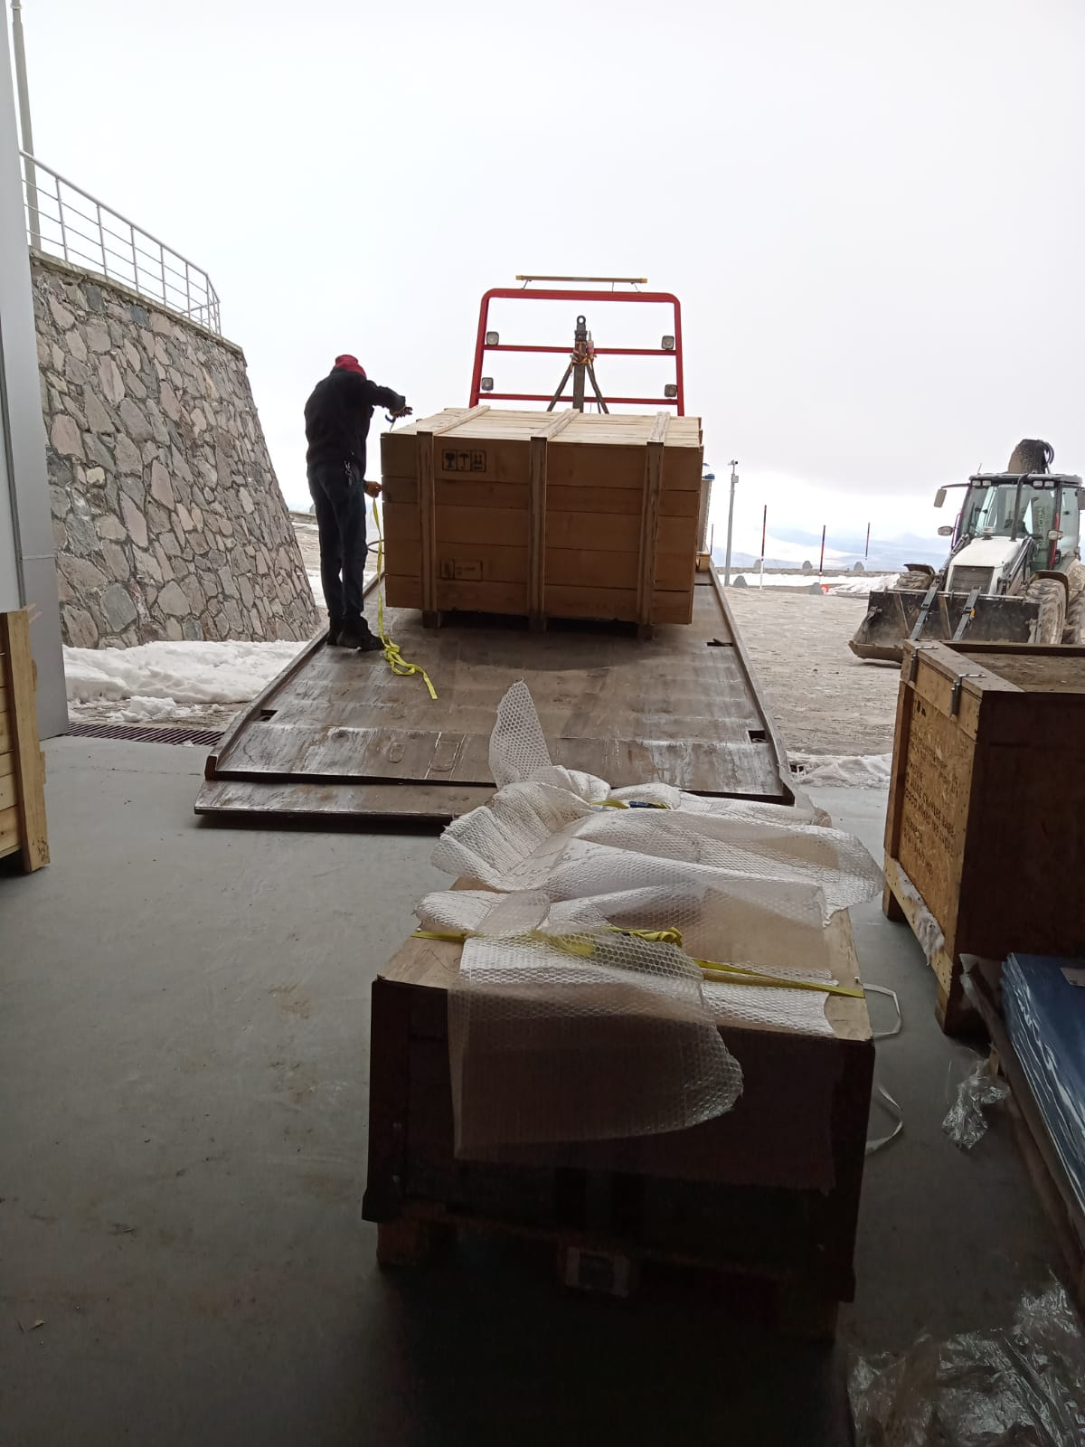
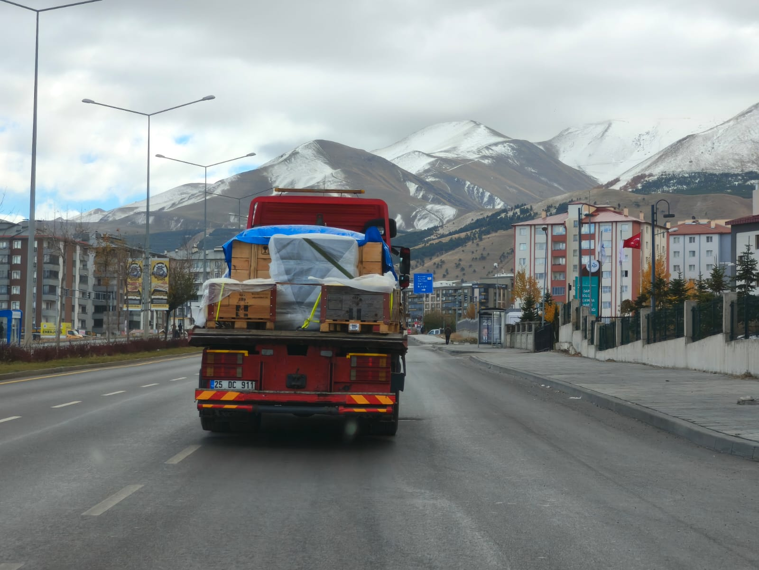
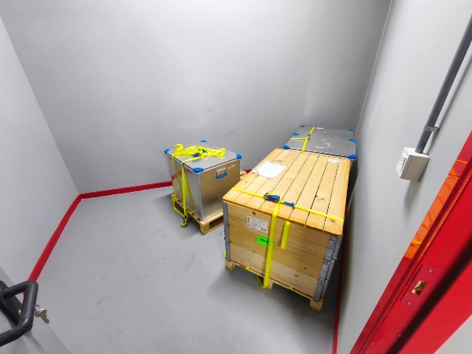
Transport to summit (Nov’24)

Slide 16
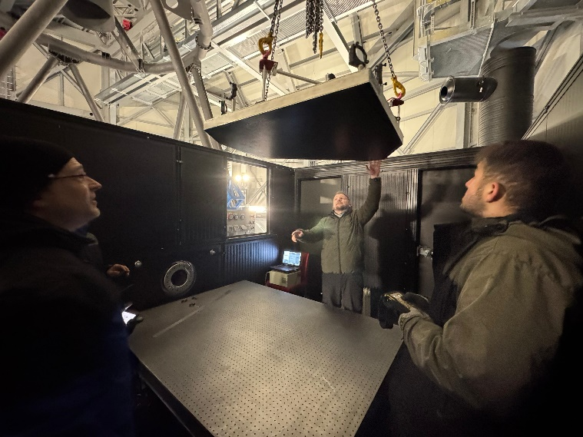
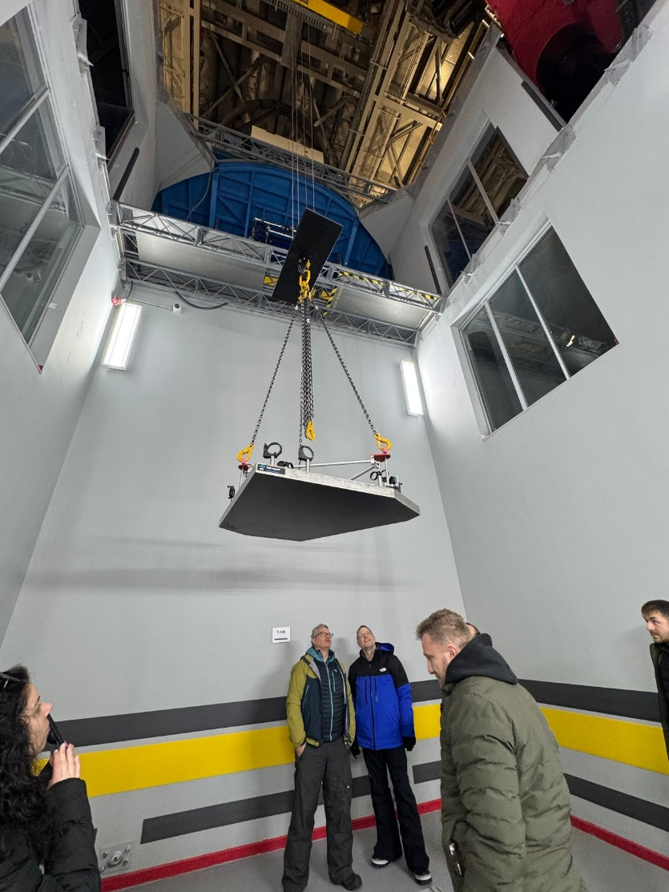
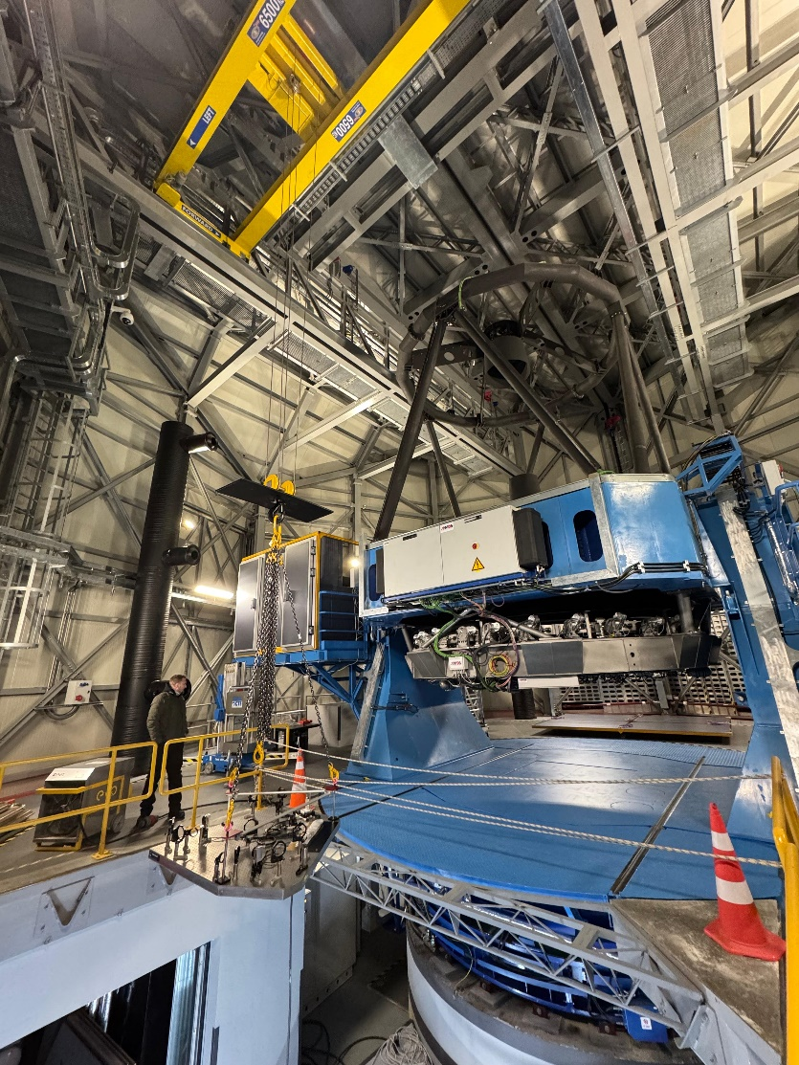
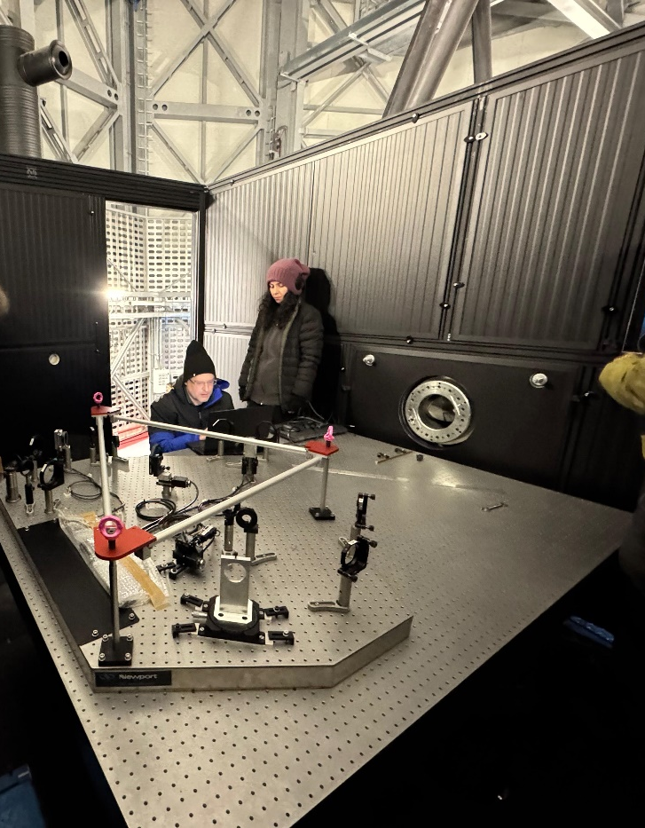
Installation on telescope (Feb’25)

Slide 17
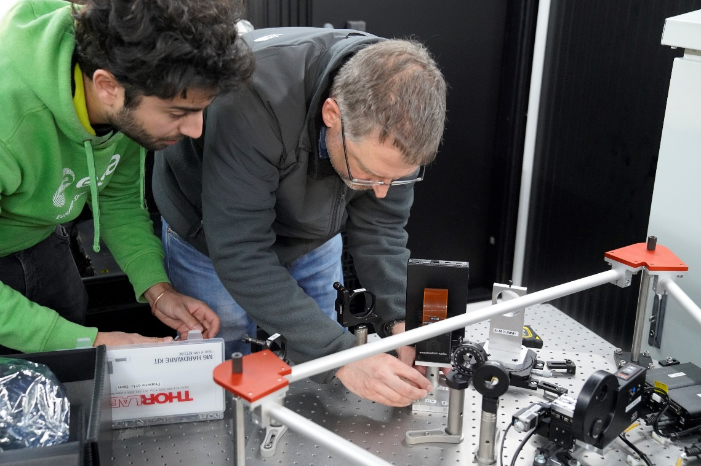
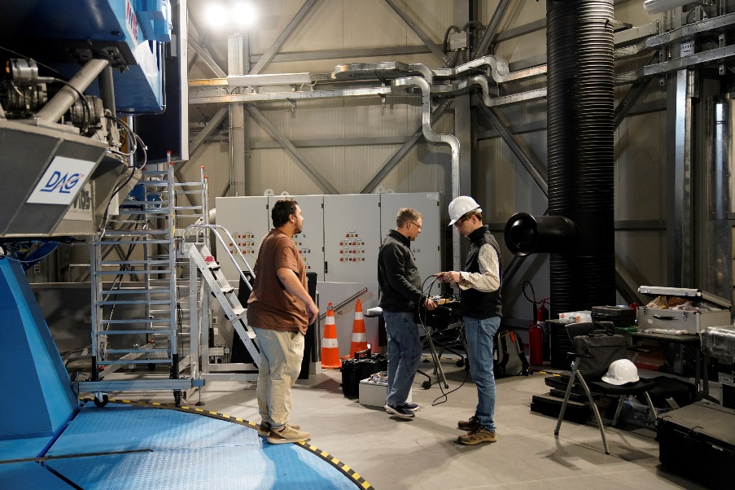
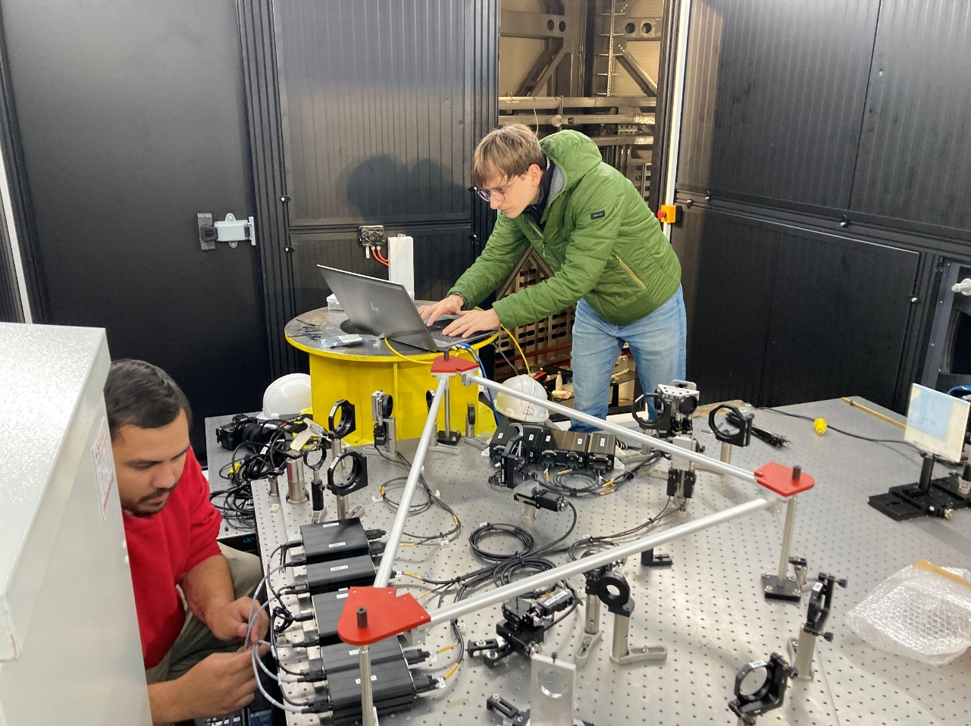
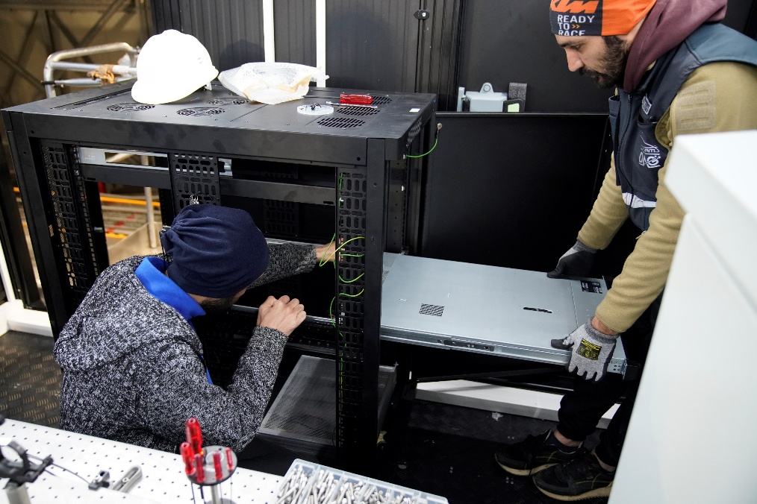
Cabling and Control interfacing (July’25)

Slide 18
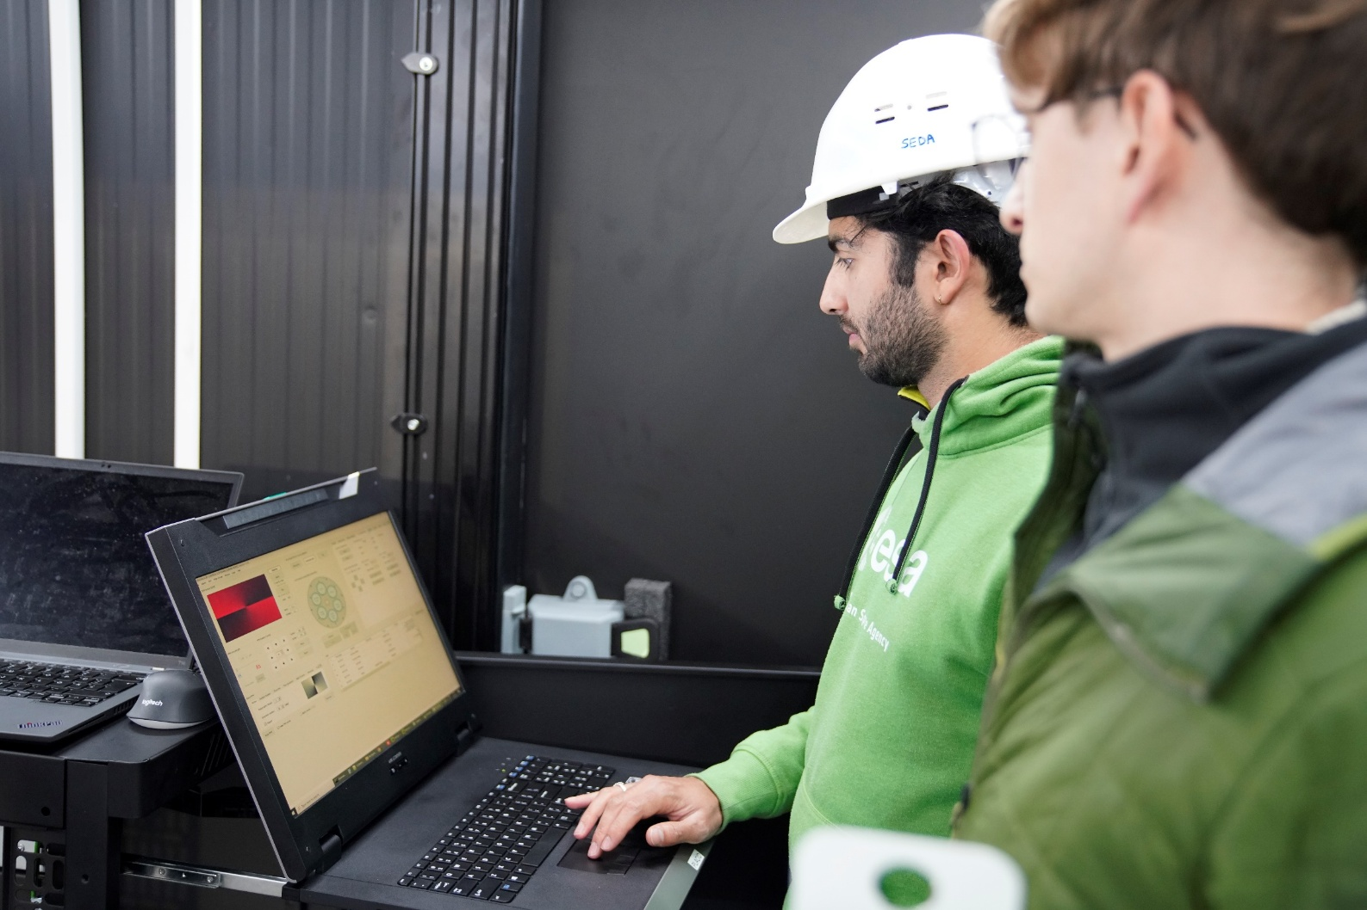
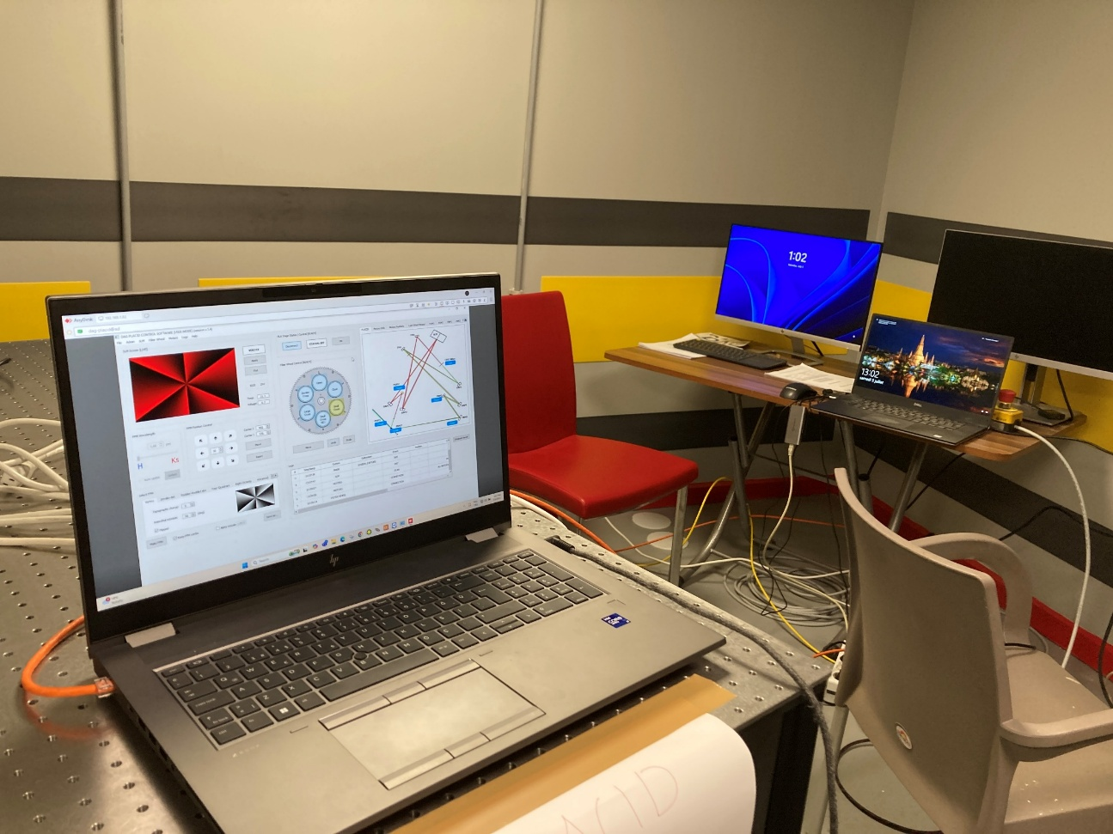
Cabling and Control interfacing (July’25)

Slide 19
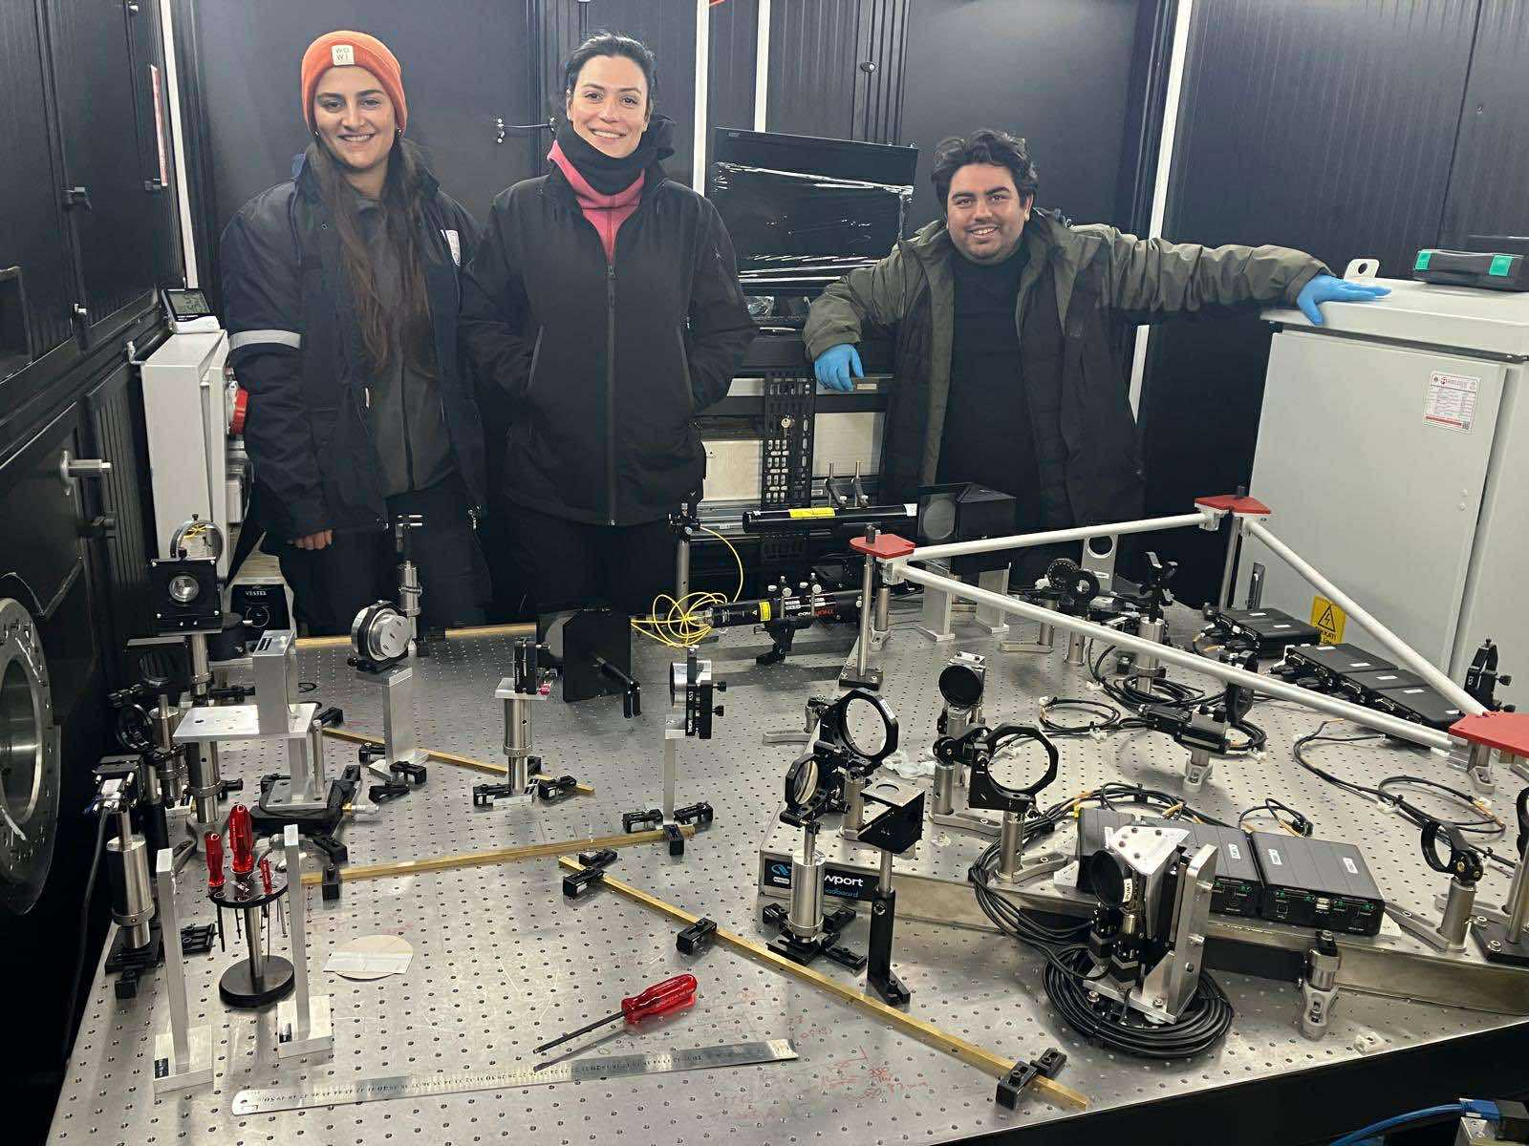
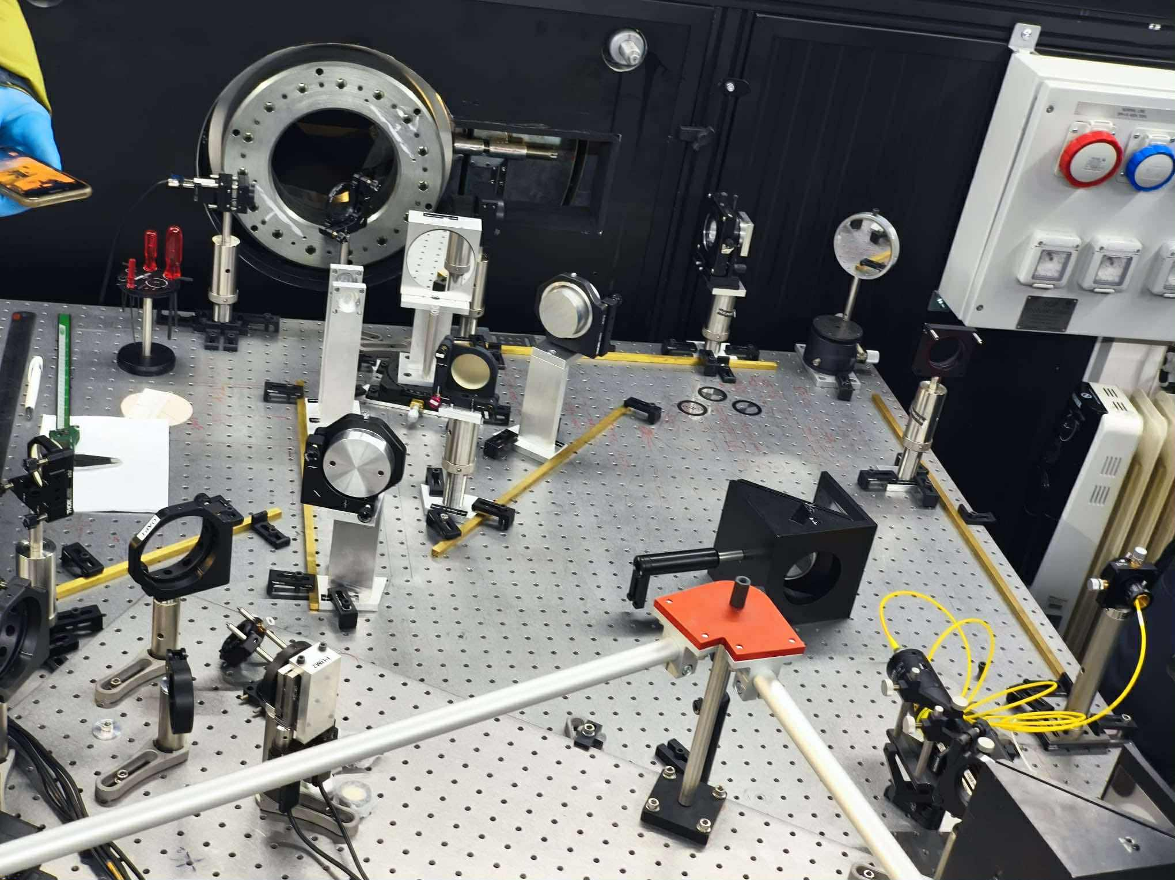
Start of TROIA XAO alignment (Oct’25)

Slide 20
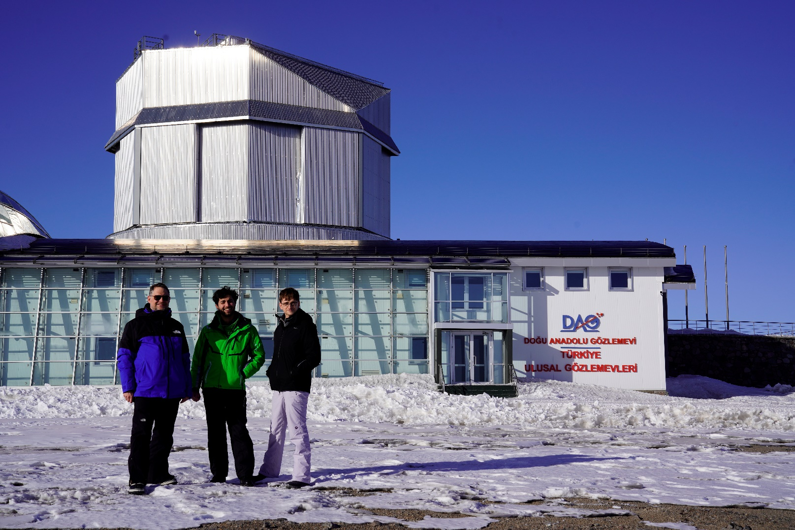
We are going back next month to align PLACID !
= PLACID first light by this summer

Slide 21

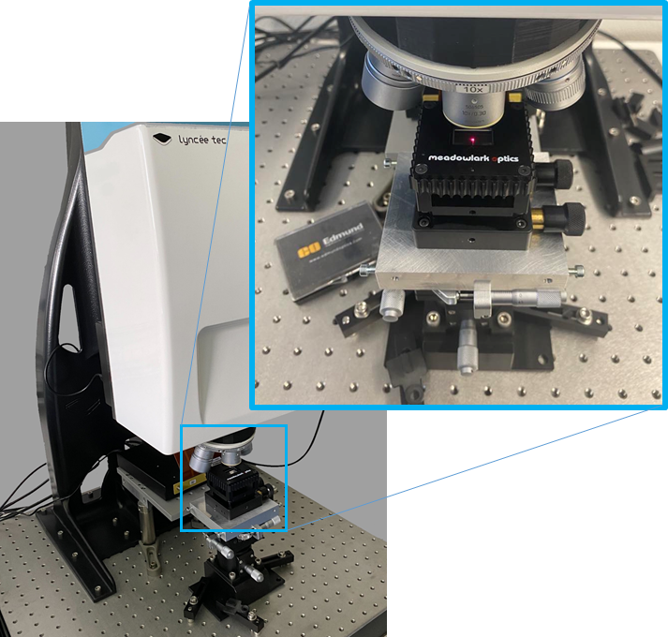
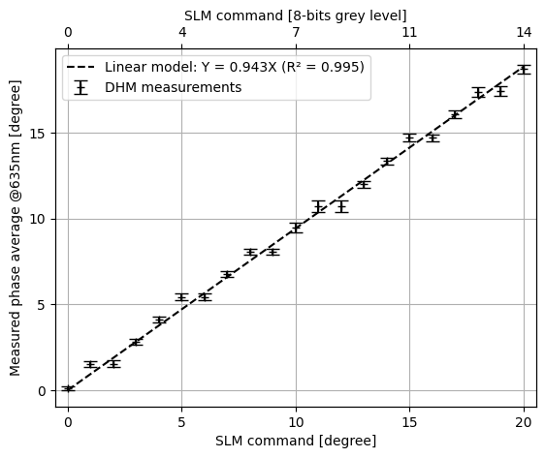
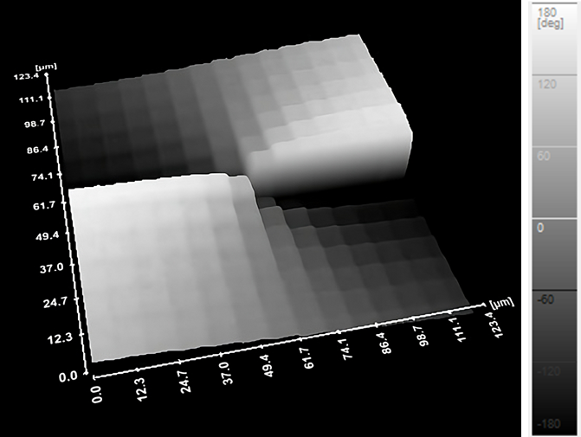
Other projects of interest in the context of SIAPS (1/2)
Technology Platform #TP-2024-SF13
HOLOMIX: Holographic Microscopy Interferometric Characterization of SLMs
Goal is to employ a Digital Holographic Microscope (DHM) to characterize SLMs panels down to sub-pixel scales, with interferometric precision and at 200 frames/s

Slide 22





Other projects of interest in the context of SIAPS (2/2)
MARVIS
TESSA: A new adaptive optics (AO) system for the 80-cm ZimMAIN telescope in Zimmerwald
Main science goal is space debris tracking (trajectory, attitude) and space situational awareness (SSA) in the visible
Extra NIR channel to conduct on-sky R&D of key components (e.g. fiber injection devices) + teaching/training tool
PI: L. Kleint (UBE - AIUB)
Co-I: J. Kühn (UBE – WP)
Co-I: M. Salzmann (EPFL)
Industry partner: R. Spinner / s2a systems
AO dev. Lead: J. Hagelberg (ex- KalAO PI)
Seeing monitor project: L. Jolissaint
KalAO, the fast cadence AO system for the 1.2-m Swiss Euler telescope, La Silla, Chile
(University of Geneva)
Image credit: AIUB
Credit: Hagelberg et al., SPIE (2024) + U. Geneva

Slide 23


Thank you for your attention
Acknowledgments
SERI ERC CoG «RACE-GO» grant #MB22.3084
Visit www.racego.eu to learn more
Notes:
Hi everyone! Thanks for the introduction. Let me now talk to you about imaging exoplanets. NEXT SLIDE

Slide 25



PLACID as a R&D pathfinder instrument for the ELTs…
We will need precision engineers !

