Slide 1




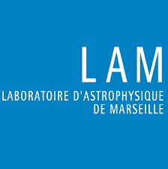

Extreme Adaptive Optics for RISTRETTO: First light of the Unmodulated Infrared Pyramid Wavefront Sensor
Muskan Shinde
PhD student, Geneva Observatory
Supervisors: Christophe Lovis and Nicolas Blind
Credit: ESO/ R. Wesson
Notes:
Hello, everyone! I’m Muskan Shinde, a PhD student from the Geneva Observatory. I am working on developing an extreme AO system for RISTRETTO, which is an instrument to do high-resolution spectrograph to study atmosphere of exoplanets.
Now, why do we need adaptive optics in the first place?

Slide 2
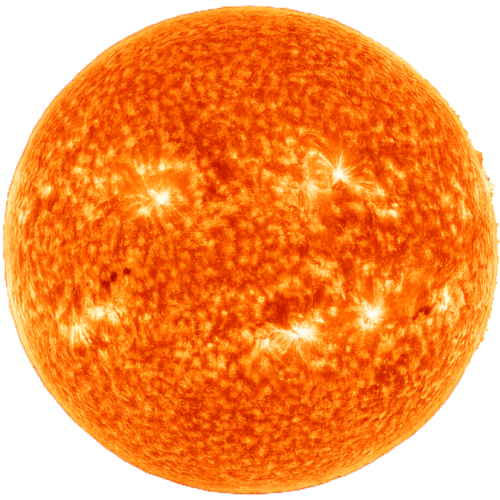
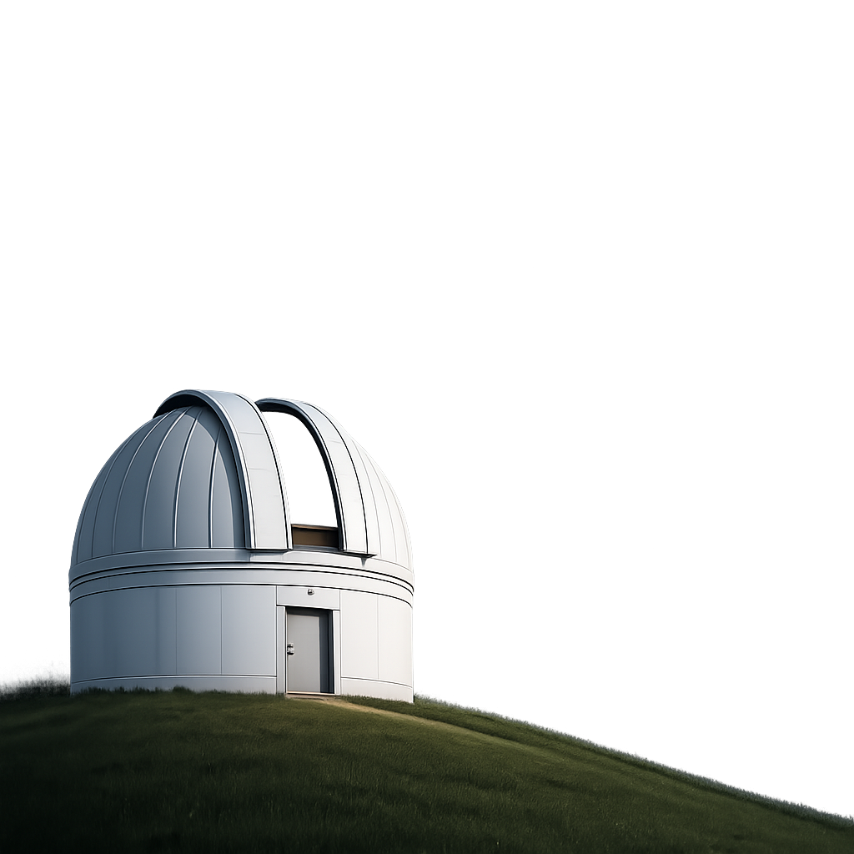
Earth’s Turbulent Atmosphere!
Atmosphere
Star
undistorted wavefront
distorted wavefront
Earth
Notes:
It’s because when observing with an instrument on ground, the Earth’s turbulent atmosphere comes is between. When the light travels though space it’s mostly undistorted, but as it pass through the earth’s atmosphere, it gets distorted.

Slide 3
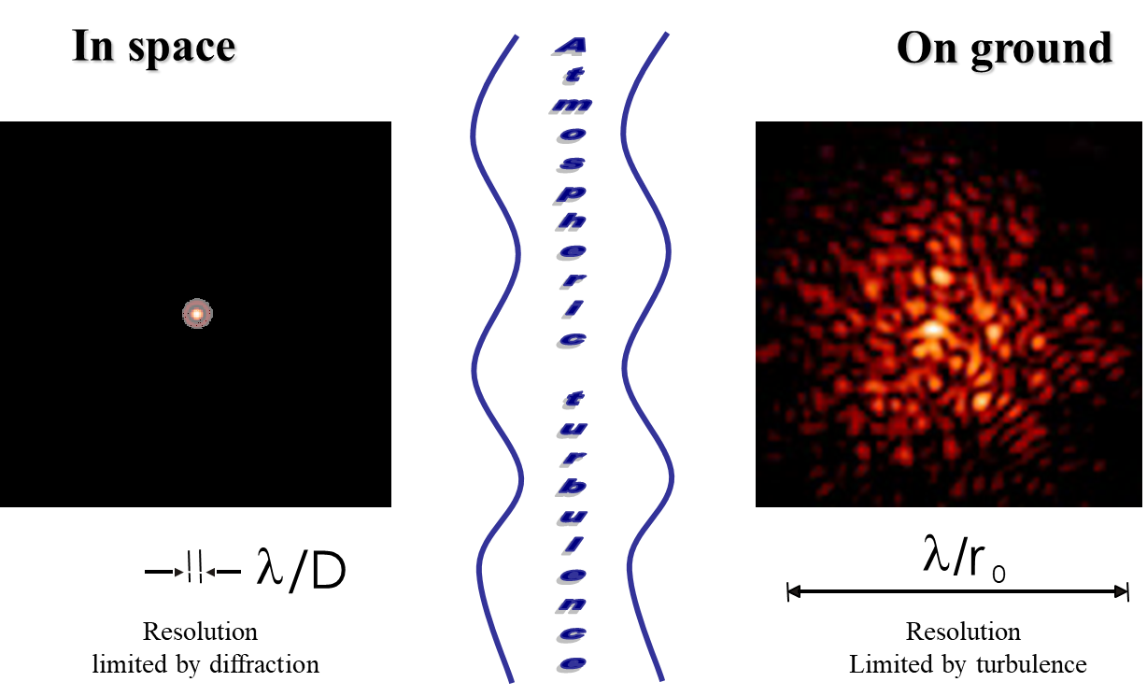
The Curse of Turbulence
In Space
Atmospheric
On Ground
Turbulence
Limited by diffraction
Limited by turbulence
Notes:
As a result of which the image of point source which would look like this in space, now looks like on ground this with a lot speckles on ground. And since the turbulence is varying over time, these speckles are also rapidly varying over time. And if we want correct it, an adaptive optics system is needed to correct this distortion and go from this speckled image to here the diffraction limited image. Let’s understand how the system does it.

Slide 4
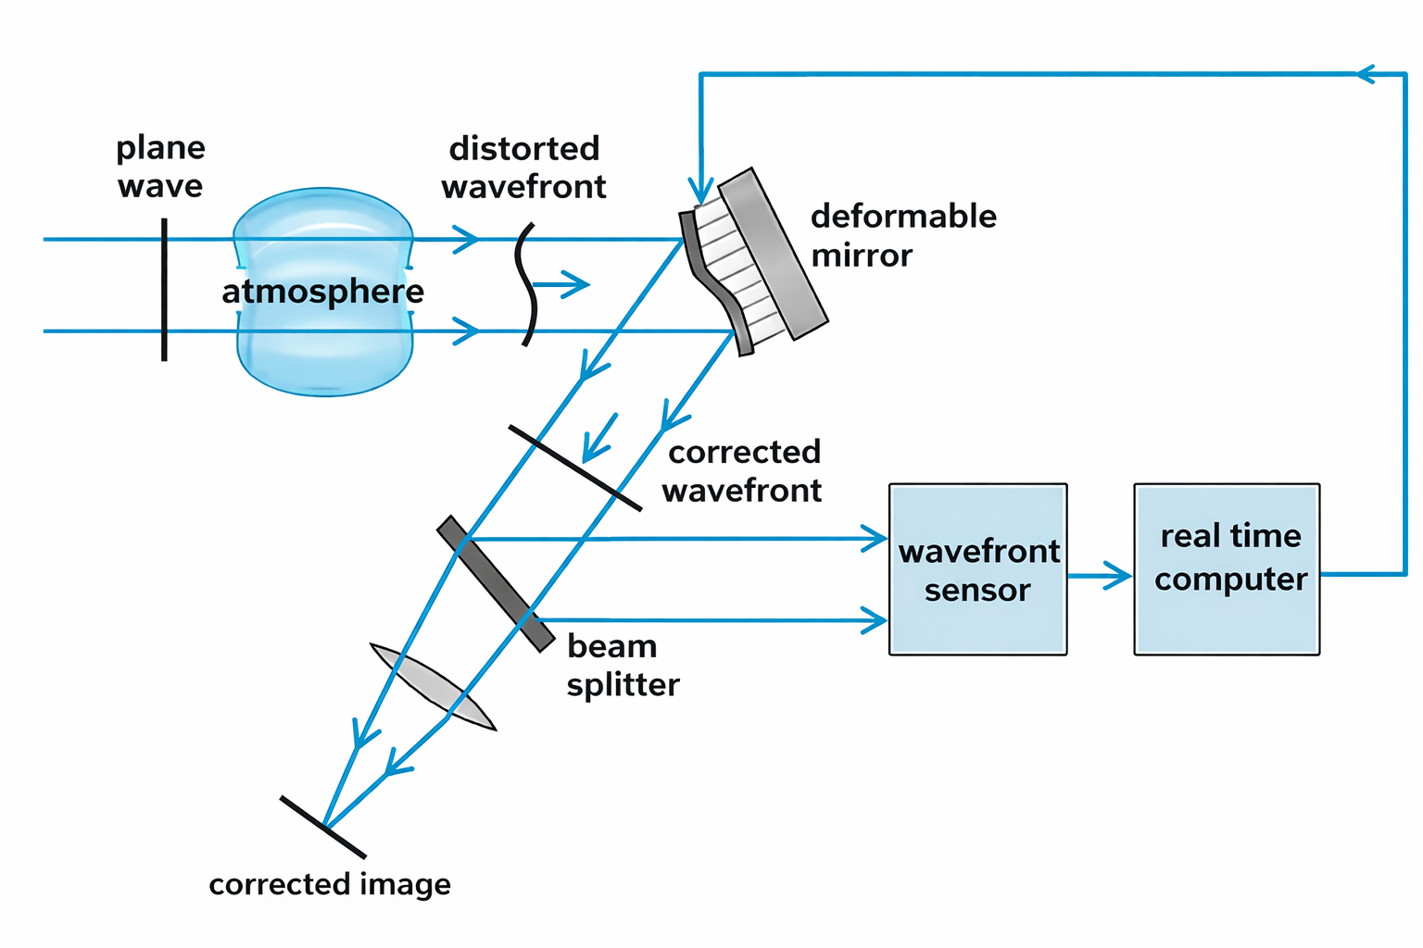

Adaptive Optics (AO) System in a nutshell…
AO
loop
Notes:
Here is a basic working of an AO system. It has 3 key components: a wavefront sensor (WFS) that measures the wavefront distortions induced by the turbulent atmosphere, a real time control system that processes the information measured by WFS, computes the correction and control the deformable mirror which dynamically applies the correction to the distorted wavefront. The entire system runs in real time at the speed of few kHz.
At the heart of the system is the wavefront sensor which drives the performnce of the whole system, and it the part of the project I’m working on. In this talk I will present the development of wavefront sensor for RISTRETTO.

Slide 5
Adaptive Optics (AO) System in a nutshell…

Slide 6
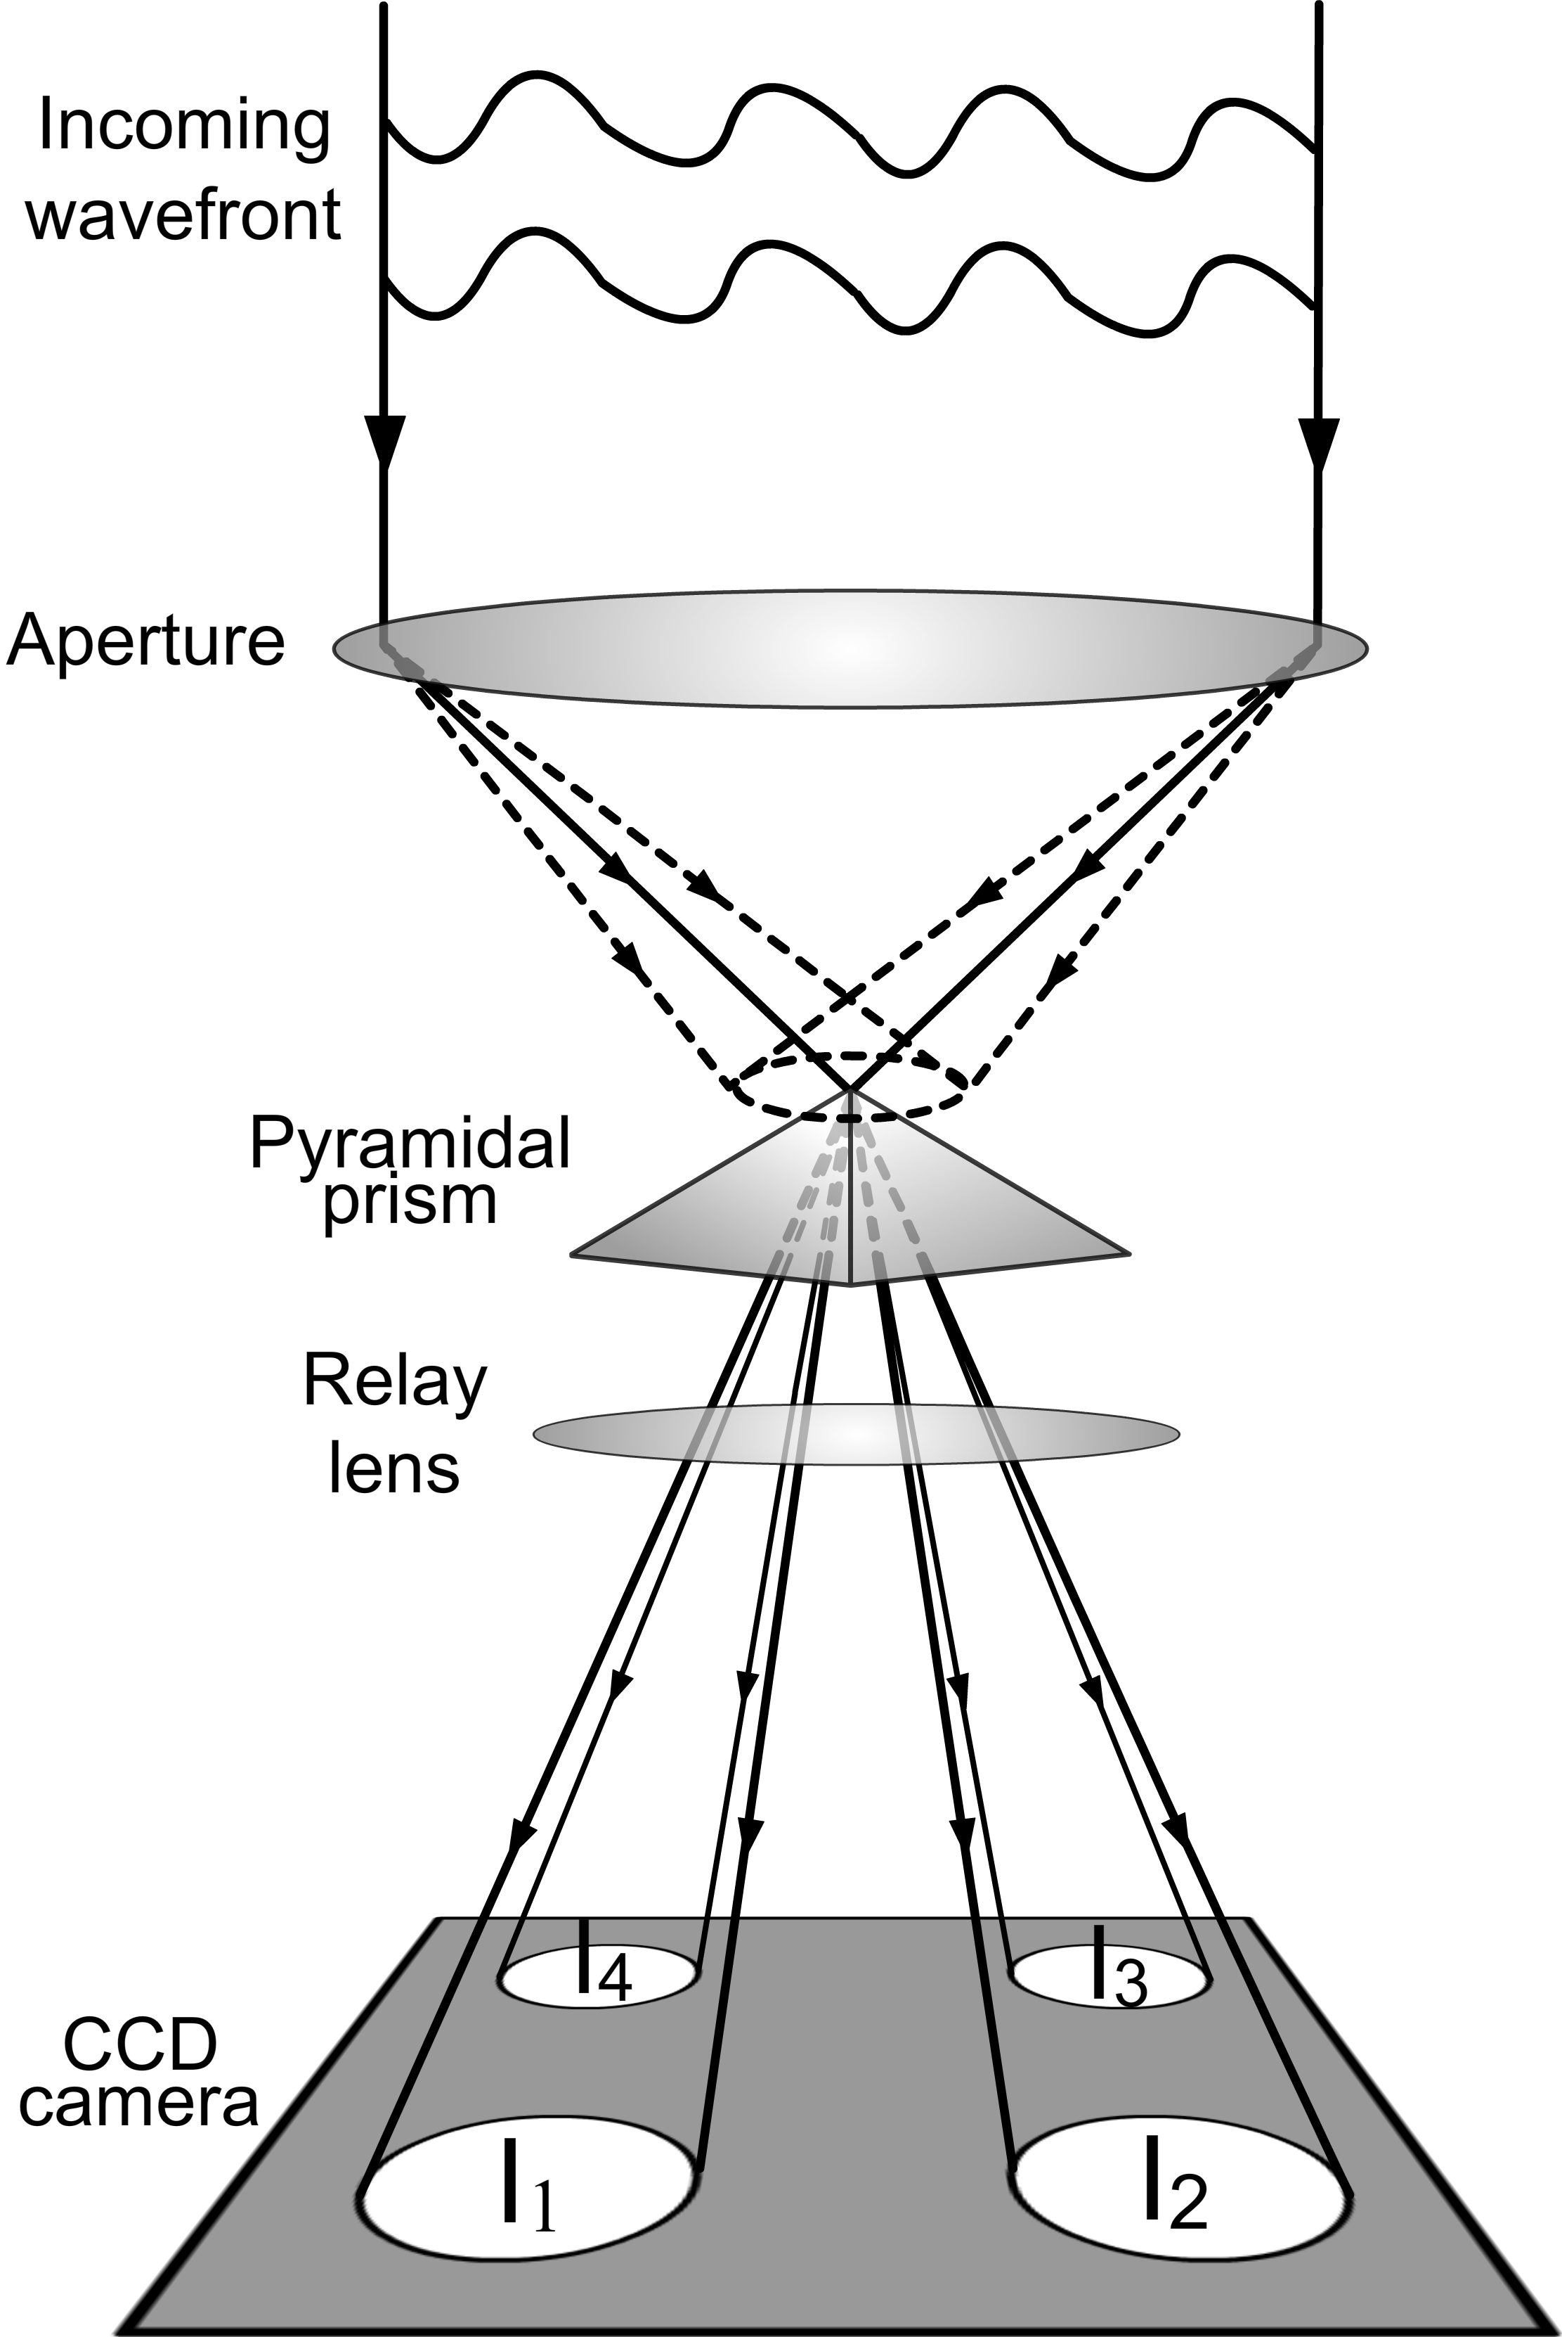
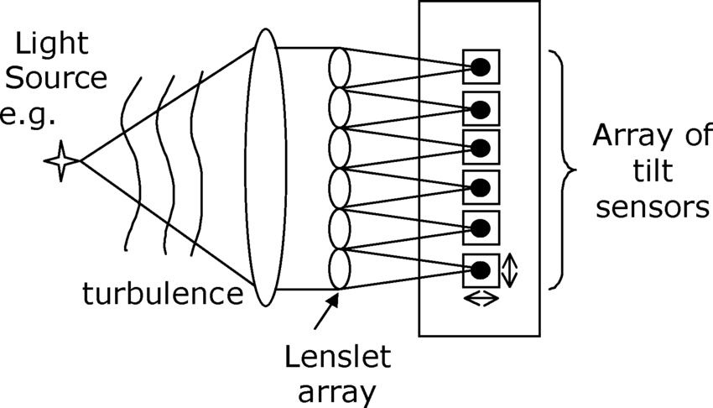
Wavefront Sensors:
Shack-Hartmann WFS (SHWFS)
Pyramid WFS (PWFS)
dynamic/linearity range
sensitivity
Credit: B. Hean Pui et al 2005
Credit: The Optical Society
Notes:
There are several types of sensors used for WFSing. On the left is the more classical Shack-Hartmann WFS. It performs local wavefront sensing, has high dynamic range so it can work high levels of turbulence, but its sensitivity is very low. In contrast, the relatively newer class of WFS, like the PyWFS on the right, measures the phase of the wavefront globally, and is much more sensitive. Therefore, most AO projects are starting to incorporate the PyWFS. For RISTRETTO also it is a good candidate, so we will focus on it.

Slide 7

Credit: PadovAdOpt/Mike Pan
Credit: PadovAdOpt/Mike Pan
Notes:
Now let’s have a close look at the working of a PyWFS. It contains a pyramidal prism placed at a focal plane with its tip centered on the focal point, It splits the light into several components depending on the sides of the pyramid and corresponding pupil images are formed on the detector through a relay lens. The variation in intensity of these images is used to extract information about the wavefront phase.
The approach makes the sensor very sensitive. However, there is one limitation.

Slide 8
Linearity of the Pyramid WFS
I(aϕ_{i})
(intensity measured
By the pyramid wfs)
aϕ_{i}
(turbulence
amplitude)
PyWFS response curve for a given spatial frequency $φ$_{i}
Notes:
It’s linearty range is small. Here you can see a plot showhing that. for a particular spatial frequency or phase mode, it’s phase amplitude ox the x axis and the intensity measured by the PyWFS on the yaxis. We that it’s response gets saturated for amplitude above a certain value and it cannot measure it anymore.

Slide 9
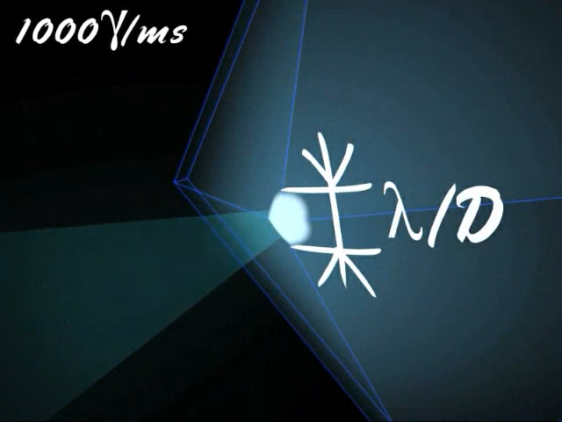
How to increase linearity? Modulation!
Credit: PadovAdOpt/Mike Pan
Notes:
To overcome this problem, the standard solution is to apply a modulation. It is done offseting the psf from the tip of the pyramid to the side, and moving in circular pattern around the pyramid. And on the detector we see intensity moving from one pupil image to another. This modulation process increase the linearity range.

Slide 10
How to increase linearity? Modulation!
But Modulation…
Decreases sensitivity
Achieving loop speeds > 1 kHz difficult
Notes:
But it also decreases the sensitivity of pyramid. And achieving speeds greater than 1kHz is difficult because we are limited by the operation speed of the tip tilt mirror. So in the last few years there have been a push to get away from this modulation, to a configuration called an unmodulated pyramid.

Slide 11
How to make unmodulated Pyramid WFS work?
Notes:
So comes the question of how to make the unmodulated PyWFS work? This is an active field of research, with people trying different appproaches to increase its linearity range. With the most recent studies trying machine learning methods to do so.

Slide 12
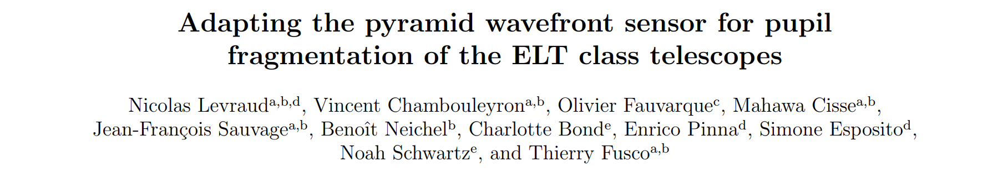
How to make unmodulated Pyramid WFS work?

Slide 13
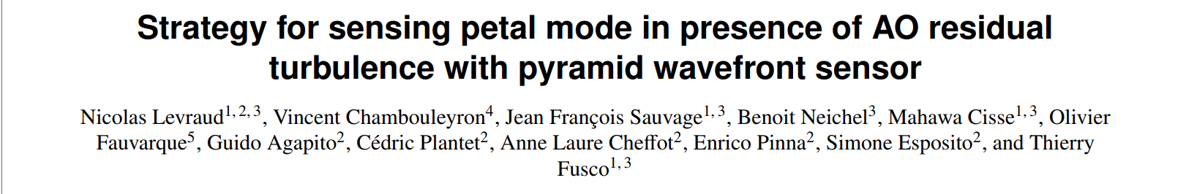

How to make unmodulated Pyramid WFS work?

Slide 14
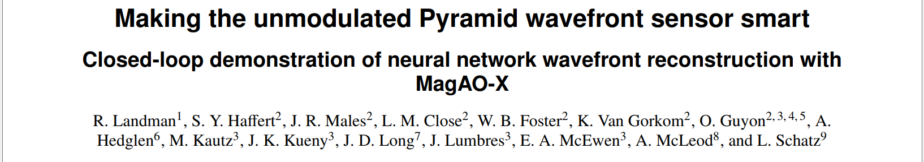
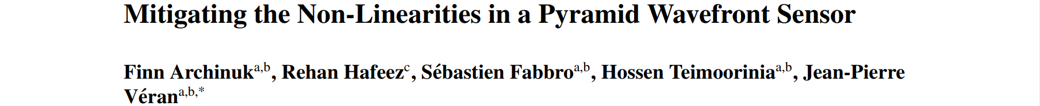
How to make unmodulated Pyramid WFS work?

Slide 15
Our solution:
I(aϕ_{i})
(intensity measured
By the pyramid wfs)
λ = 1400 nm
λ = 700 nm
aϕ_{i}
(turbulence
amplitude)
Linearity range increases proportional to wavelenght.
Notes:
We also tried various methods to make it work, and came up with a rather simple solution. of going to longer wavelengths. The linearity range scales directly as the wavelegth. So if we double the wavelenght the linearity range would double. This what is shown in the plot. The if we go from blue curve at 700nm to infrared curve to 1400 nm, the linearity range increases by a factor.

Slide 16
So for RISTRETTO we use…
Infrared Unmodulated Pyramid WFS
Notes:
So for RISTRETTO, we decided to test the infrared unmodulated pyramid wavefront sensor.

Slide 17
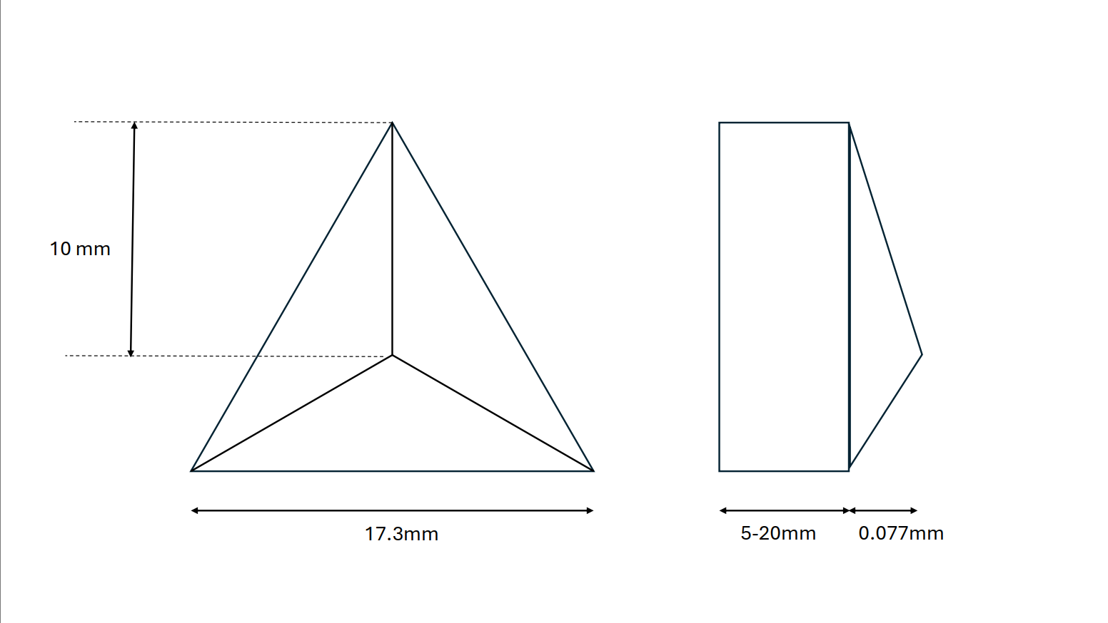
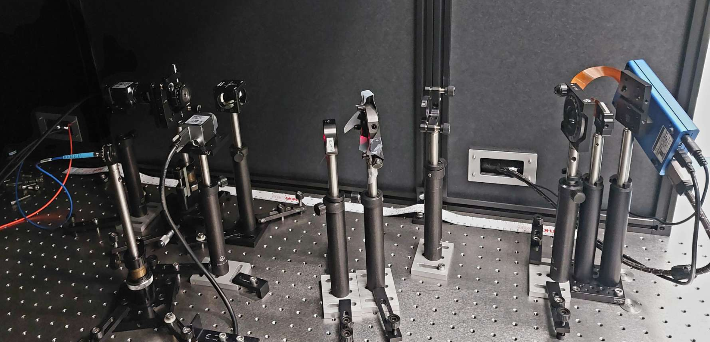
Tests in Lab
Pyramid
Camera
Beamspliter
Pupil stop
Polarizer
SLM
Laser
Focal-plane
camera
Notes:
We designed a prototype for the infrared pyramid and setup an adaptive optics bench in lab to test it. If you would like to know more details about the bench you are were welcome to come talk to me. We made various tests with this pyramid under varying turbulence conditions and it was a able to provide a good AO correction.

Slide 18
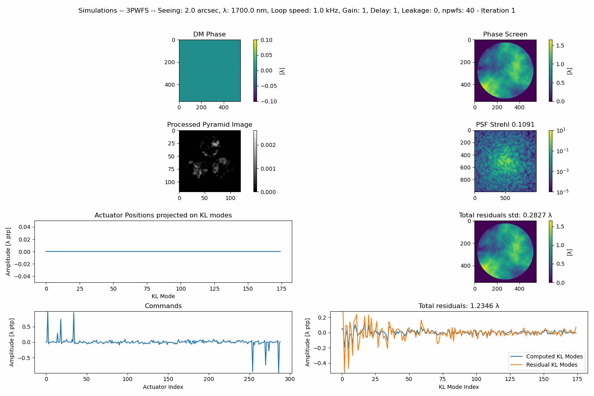
Tests in Lab
Pyramid
Camera
Beamspliter
Pupil stop
Polarizer
SLM
Laser
Wavelength = 1400 nm
Seeing = 2”
Loop speed = 1kHz
Focal-plane
camera
Notes:
Here I would like to show an example of the AO system working at median turbulence conditions. On the left we see what is measured by the pyramid wavefront sensor, and the right we see the psf being corrected. Intially the light is spread all over the psf, but with the system running it is providing a correction to the psf, with energy being concentrated more in the core and the strehl ratio reaching 90%.
The tests in lab looked quite positive so we decided to take the next step and test it in a real system on sky.

Slide 19

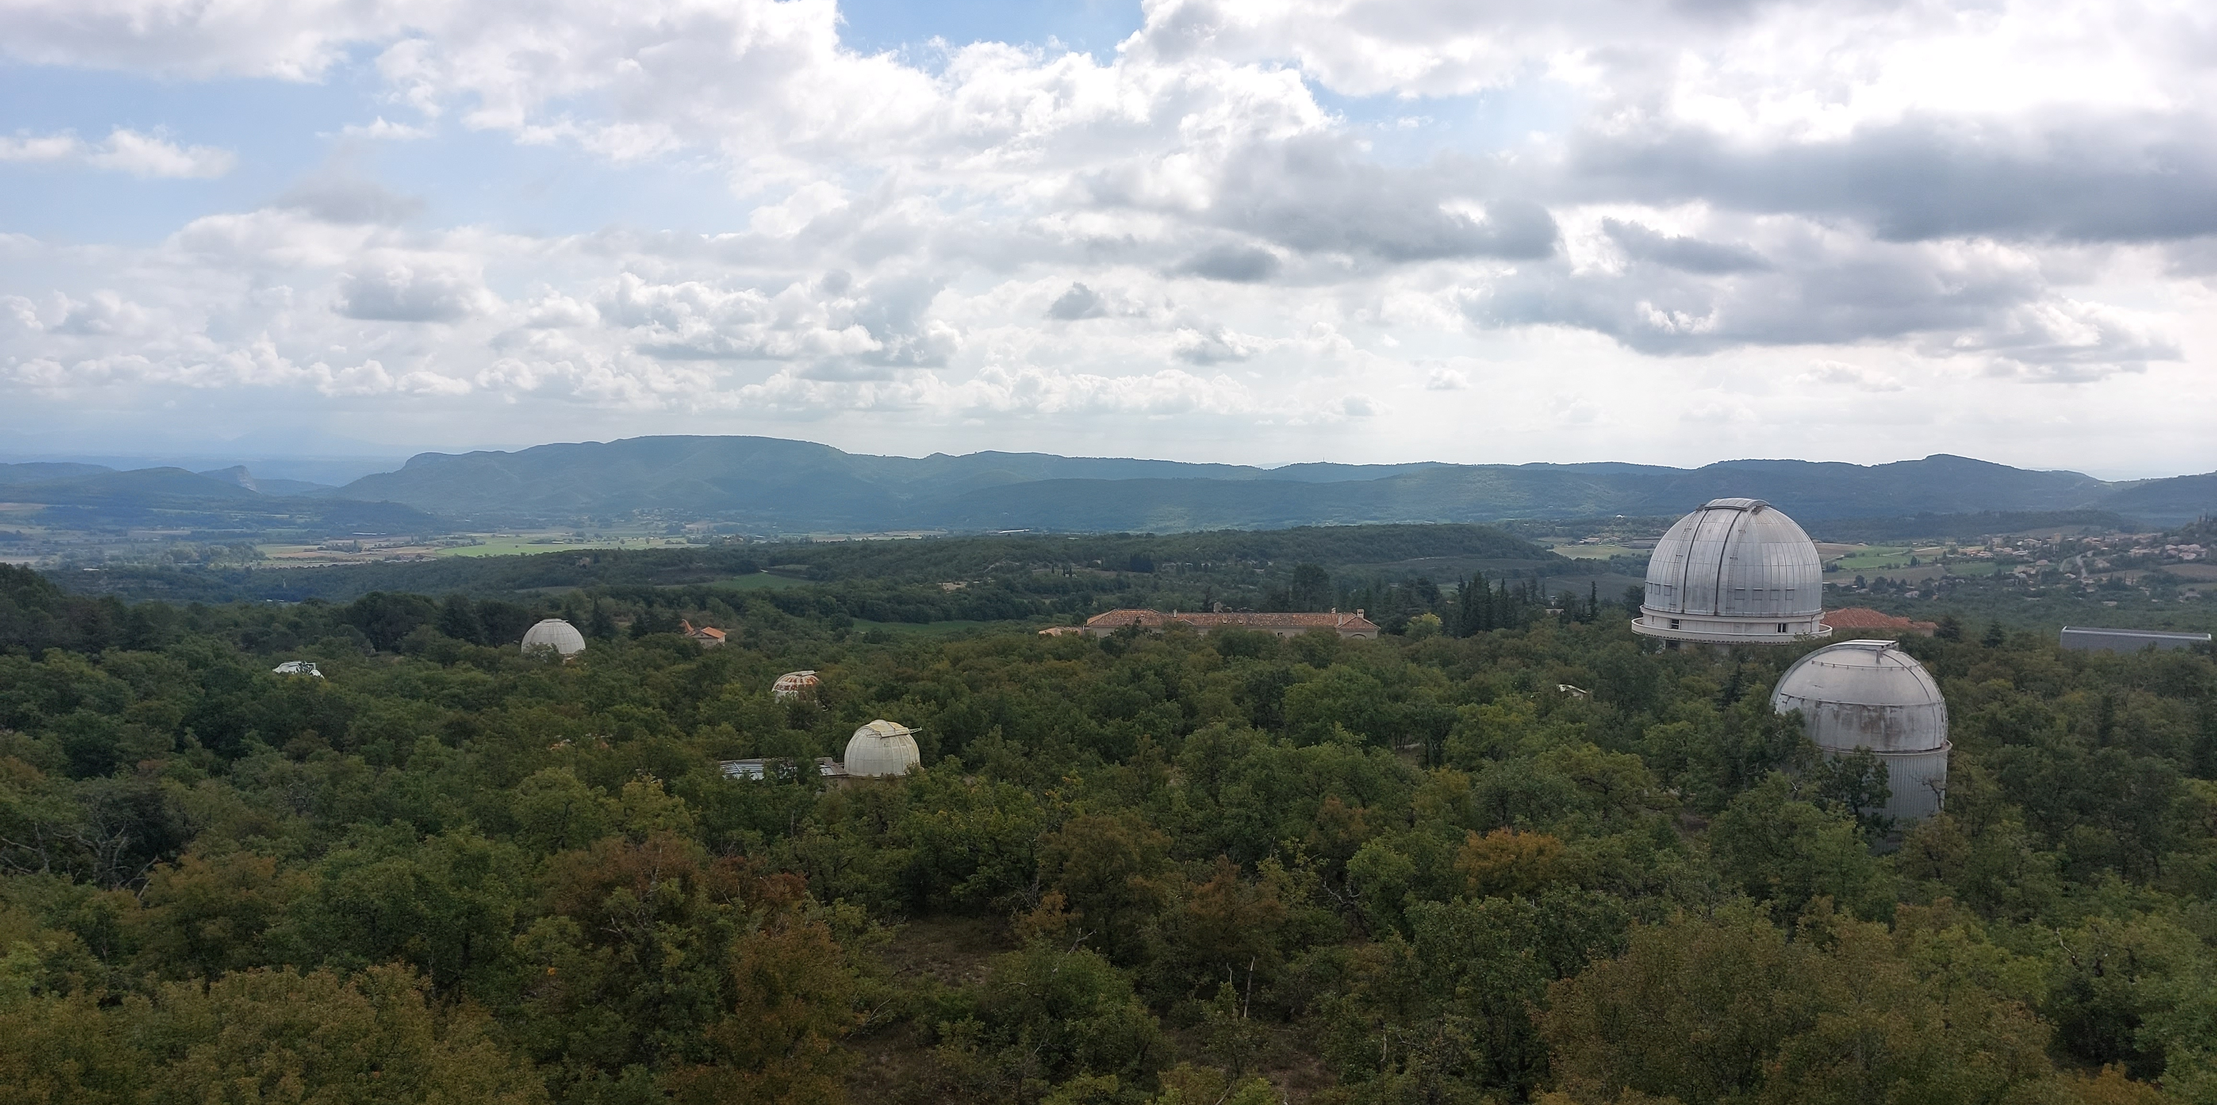
On Sky Tests!
Observatoire de Haute Provence (OHP)
Notes:
Last summer we got the opportunity to do tests at the Observatoire de Haute Provence (OHP) in France.

Slide 20
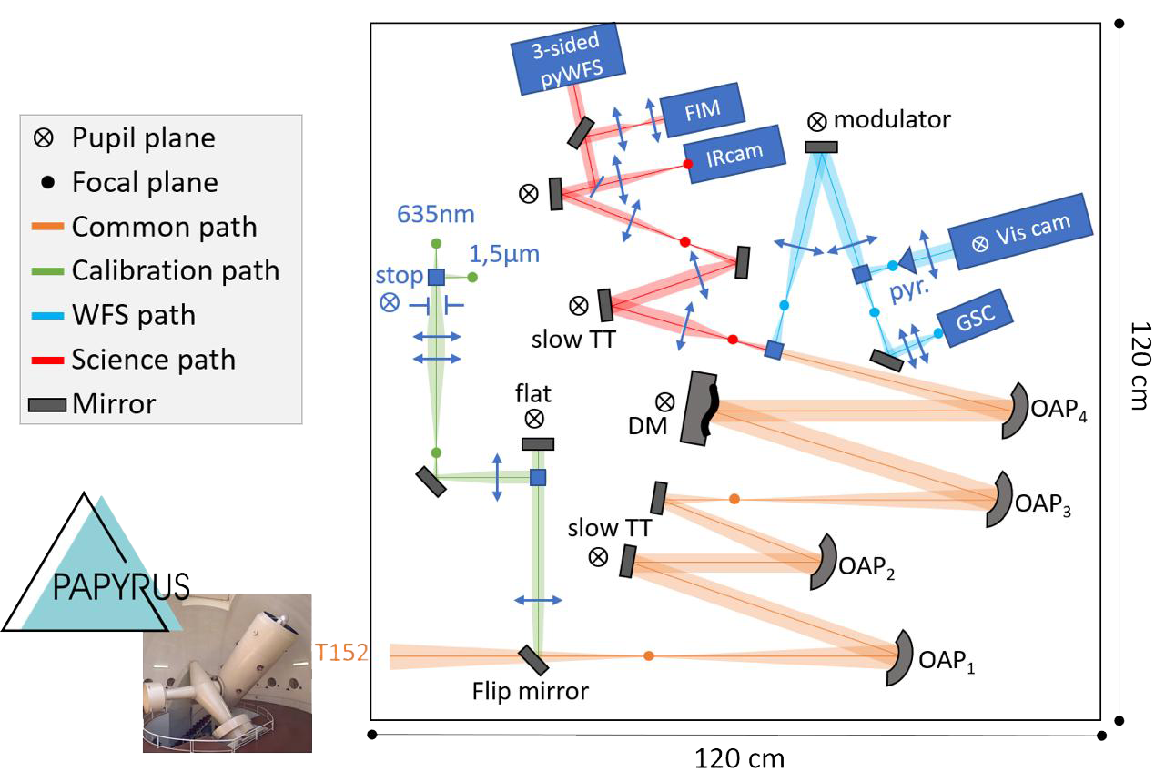
PAPYRUS bench
Visible Pyramid WFS
Modulated
4-sided
Infrared Pyramid WFS
Unmodulated
3-sided
Visible PWFS path
IR PWFS path
Credit: Angelie Alagao/LAM
Notes:
At 1.52 m telescope there, they have a adaptive optics bench called PAPYRUS installed, that has the standard modulated PWFS working in the visible. We made an new installation of the inrared arm to test the umdolulated pyramid. And we choose a 3 sided pyramid due to manufacturing reasons. The installation was such that both pyramids could work in parallel with a easy switch between them for direct comparison.
4-sided, visible: 630-690 nm
3-sided, IR: 1350-1450 nm

Slide 21
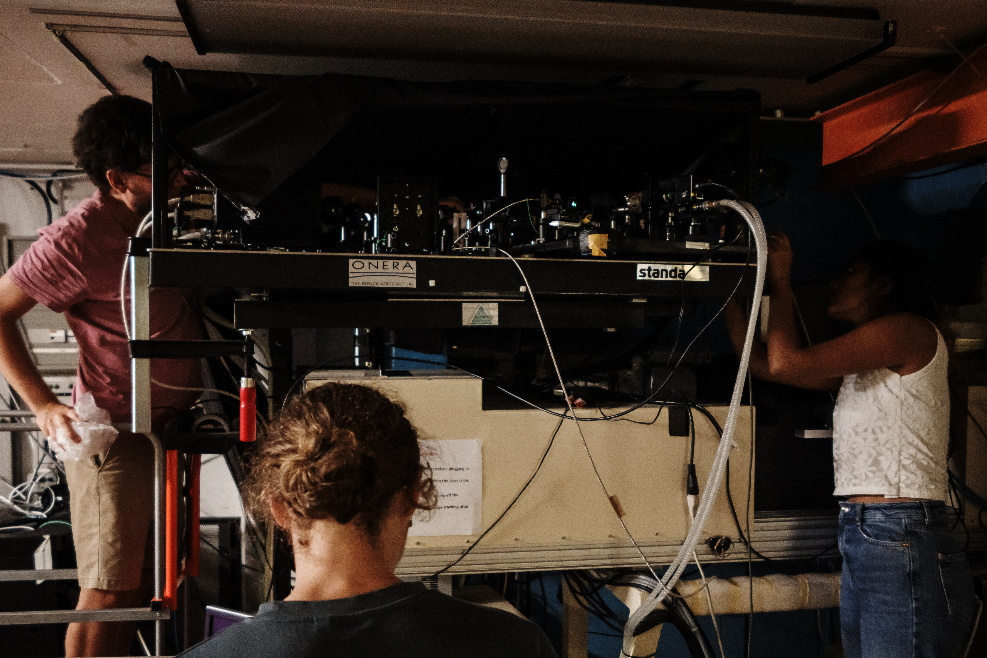
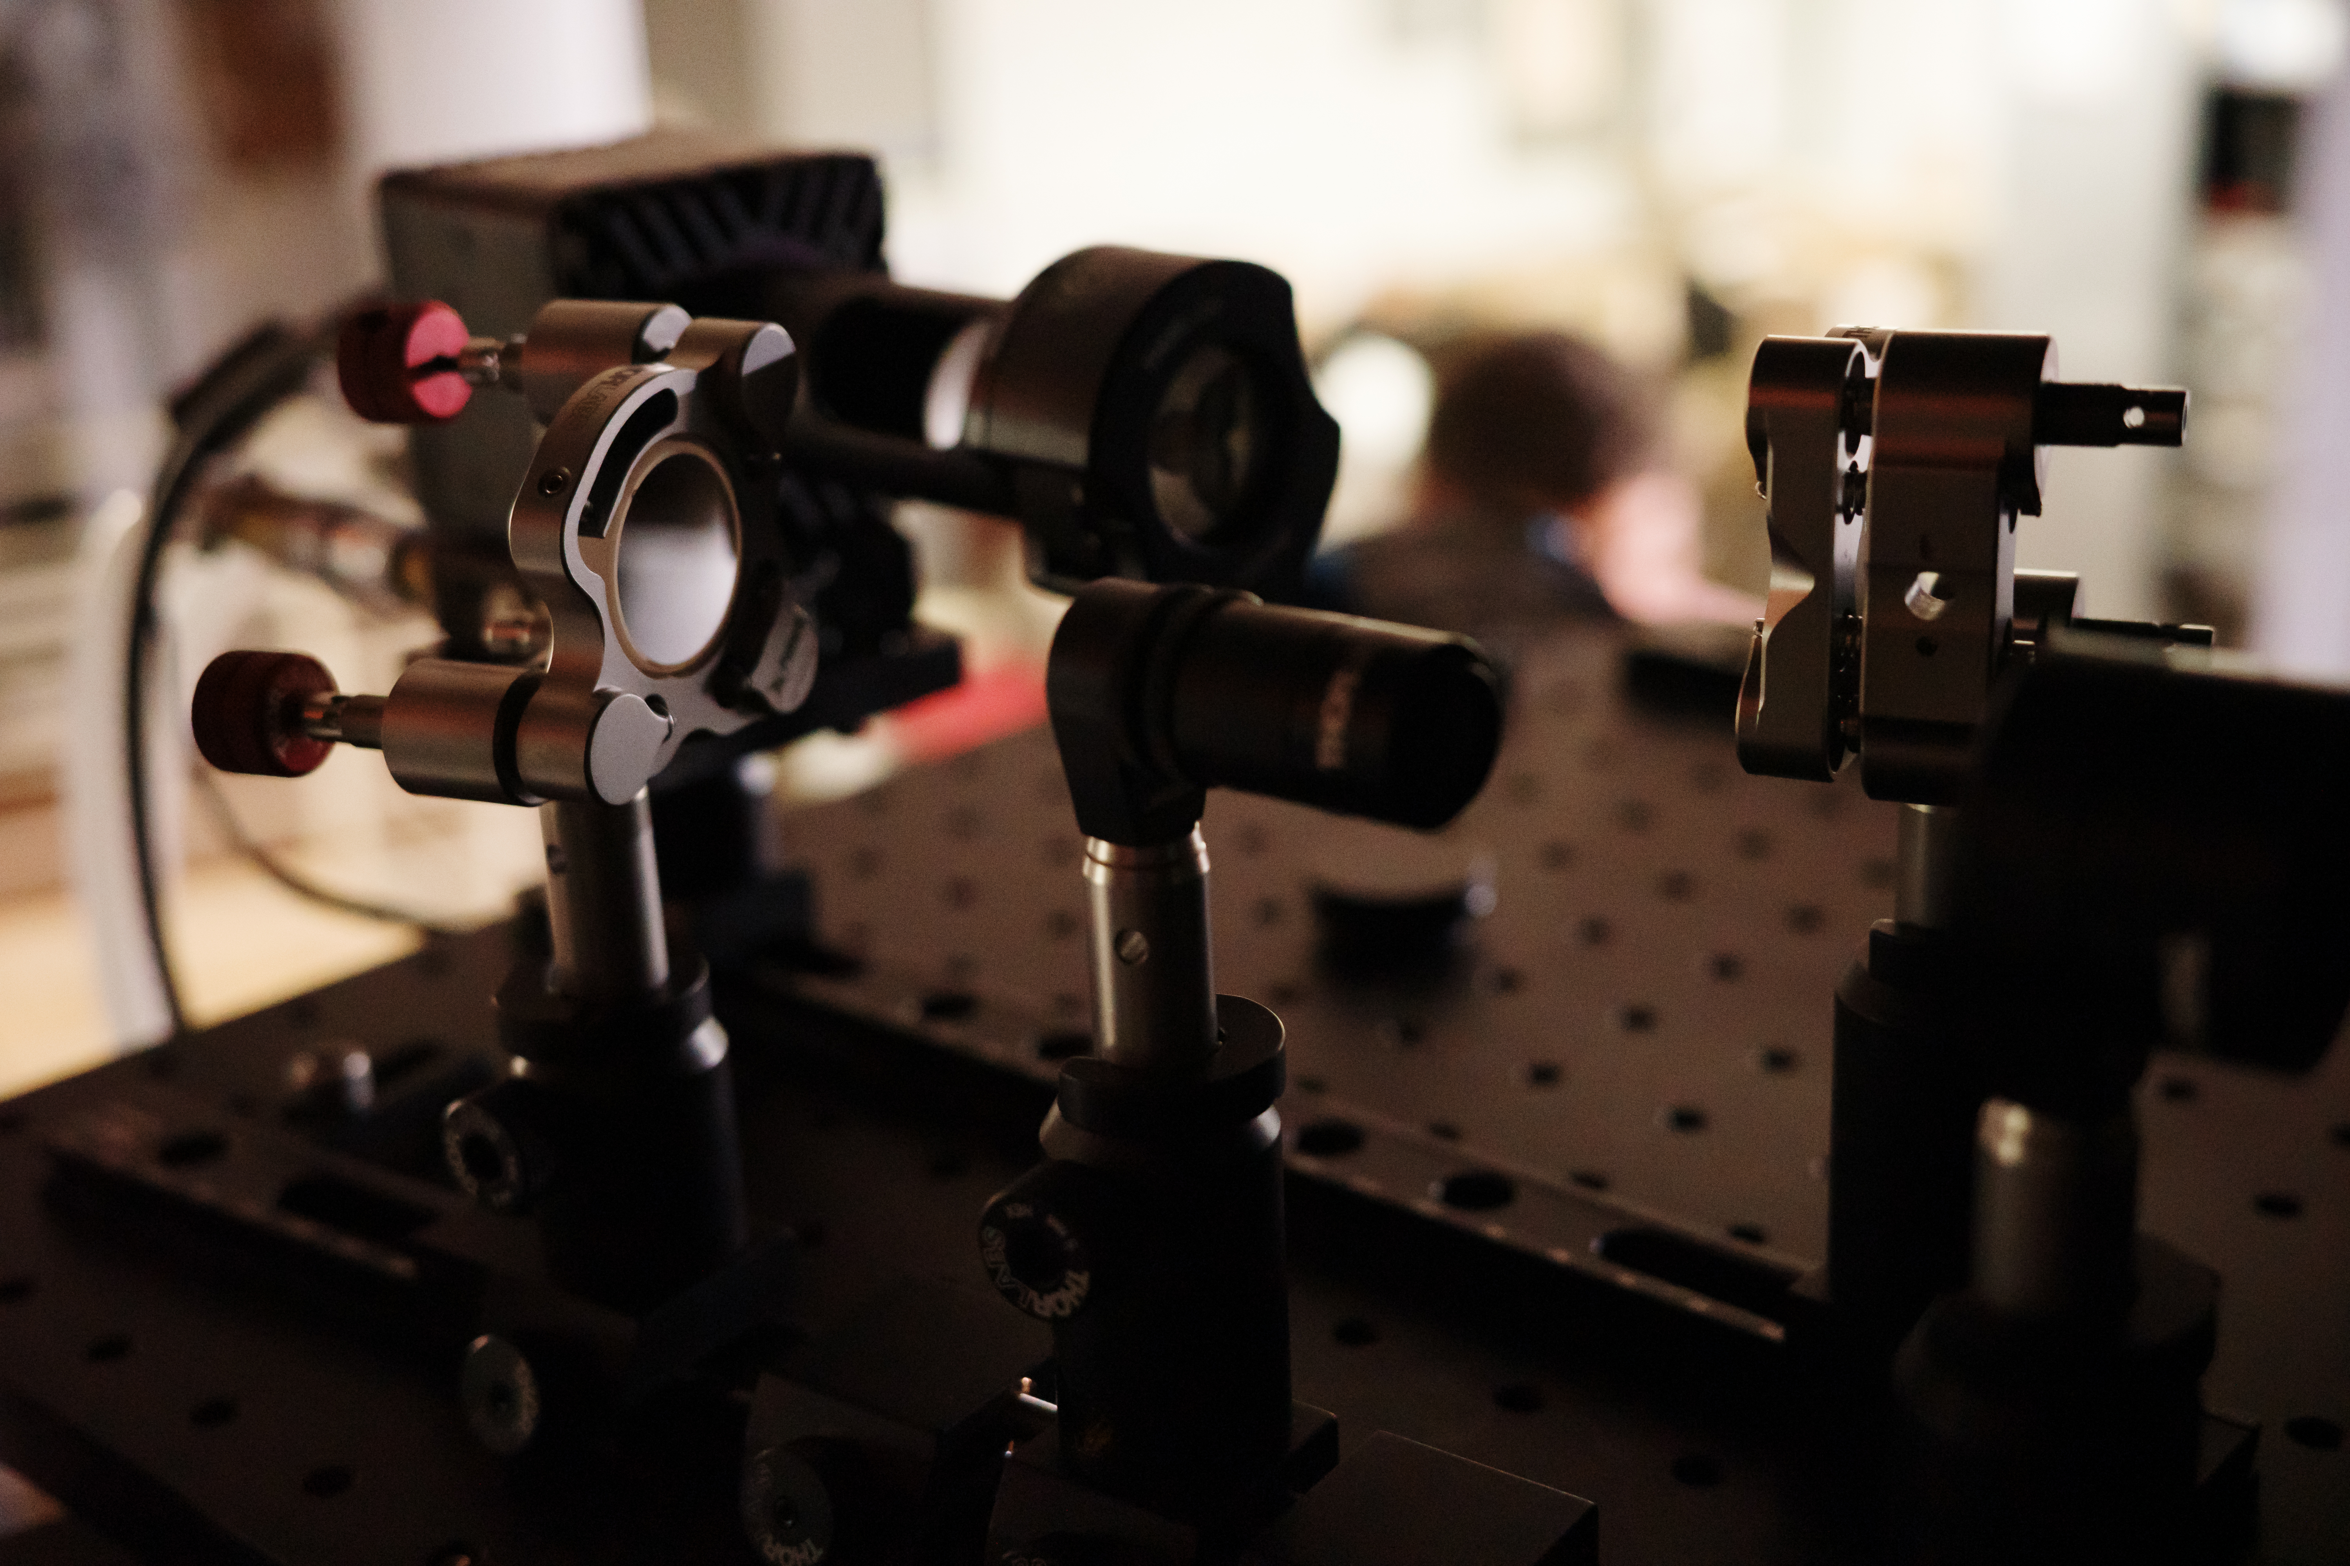
The Infrared PWFS @ PAPYRUS bench
IR PWFS
Credit: Nicolas Blind
Notes:
Here are some pictures of the installtion. in the the bottom picture We can see the IR pyramid installed. Ready to observe.

Slide 22
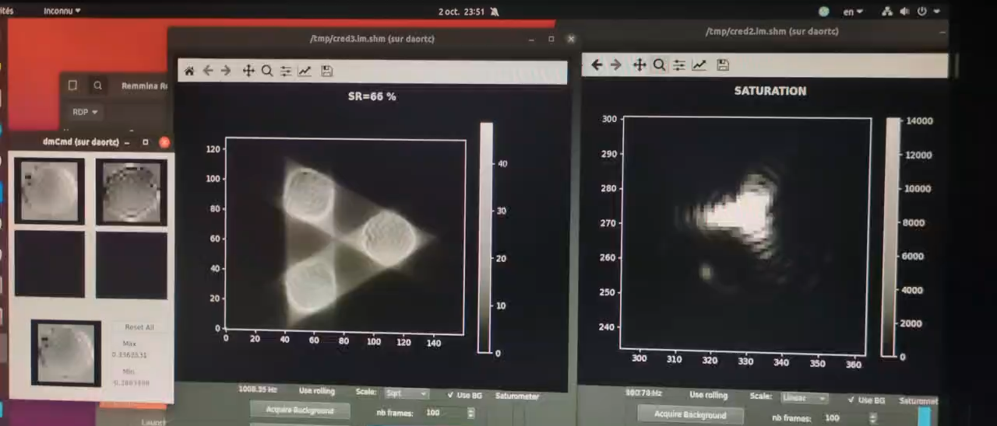
AO system calibration
PSF Camera
PWFS camera
Notes:
But before starting to observe the first step is to calibrate the system. We try to find a connection between what is measured by wavefront sensor and what needs to be send to the deformable mirror to correct for it.
The process can be seen in the video here. We send a series of spatial frequencies to the DM and record the reponse of wavefront sensor, as seen on the camera in the middle with 3 pupils.
Once the calibration is complete, it is time to go on sky.

Slide 23
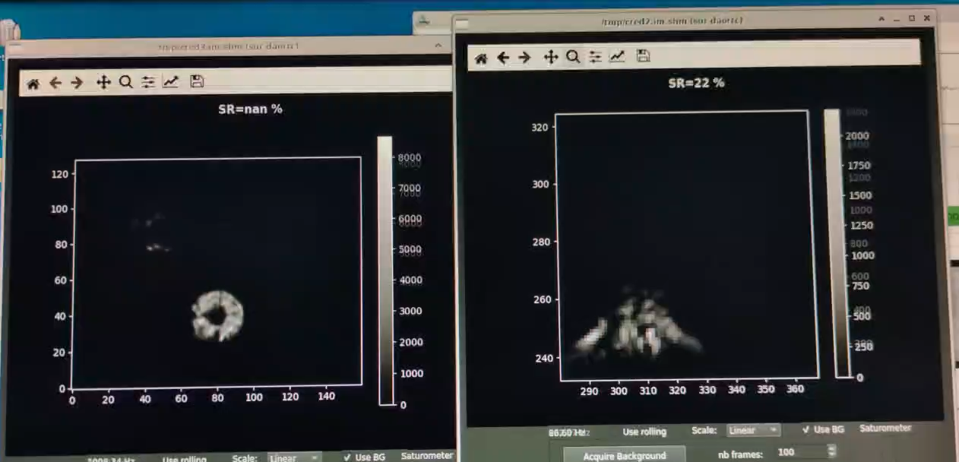
Closed AO loop On Sky!
PSF Camera
PWFS camera
Notes:
And finally, the AO system in action on sky. On the left we have the wavefront sensor camera and on the right we the psf camera.
First the psf without any AO correction or open loop, then the psf when correcting with the irfrared pyramid.

Slide 24
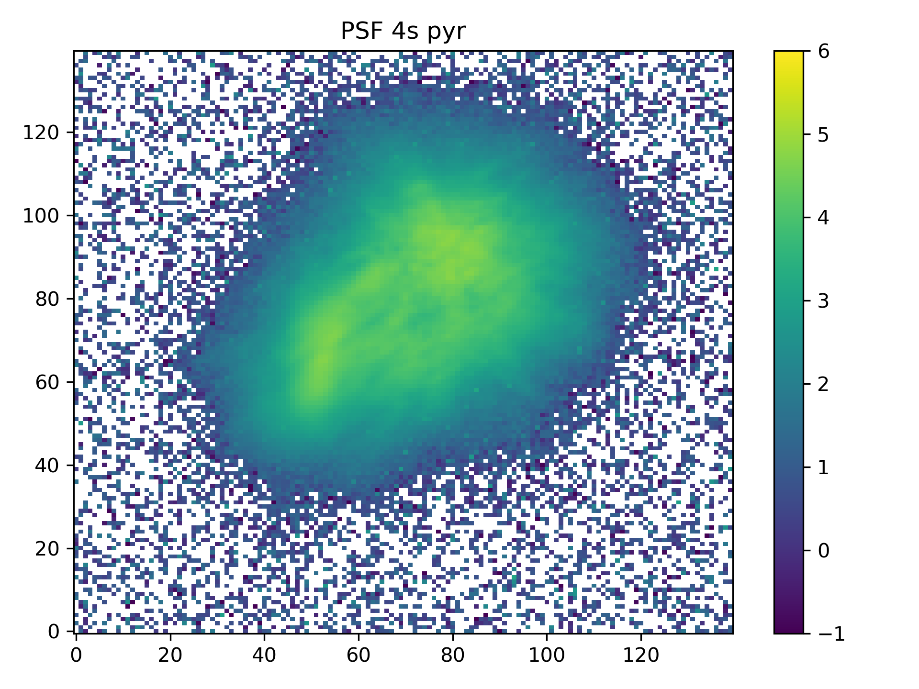
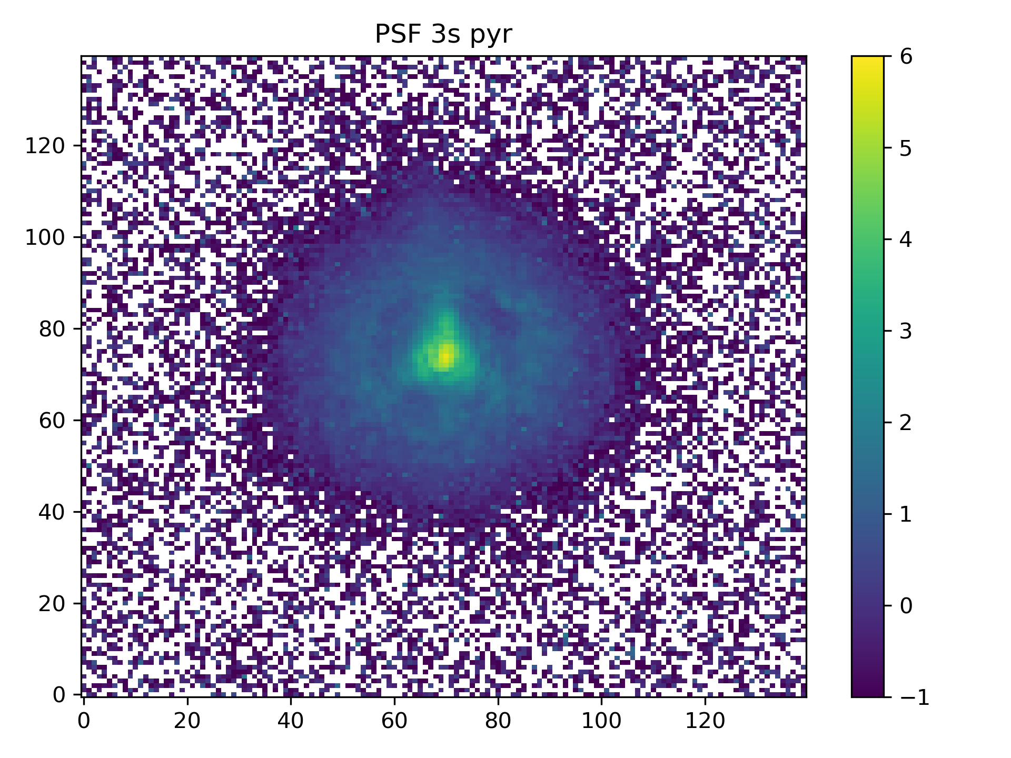
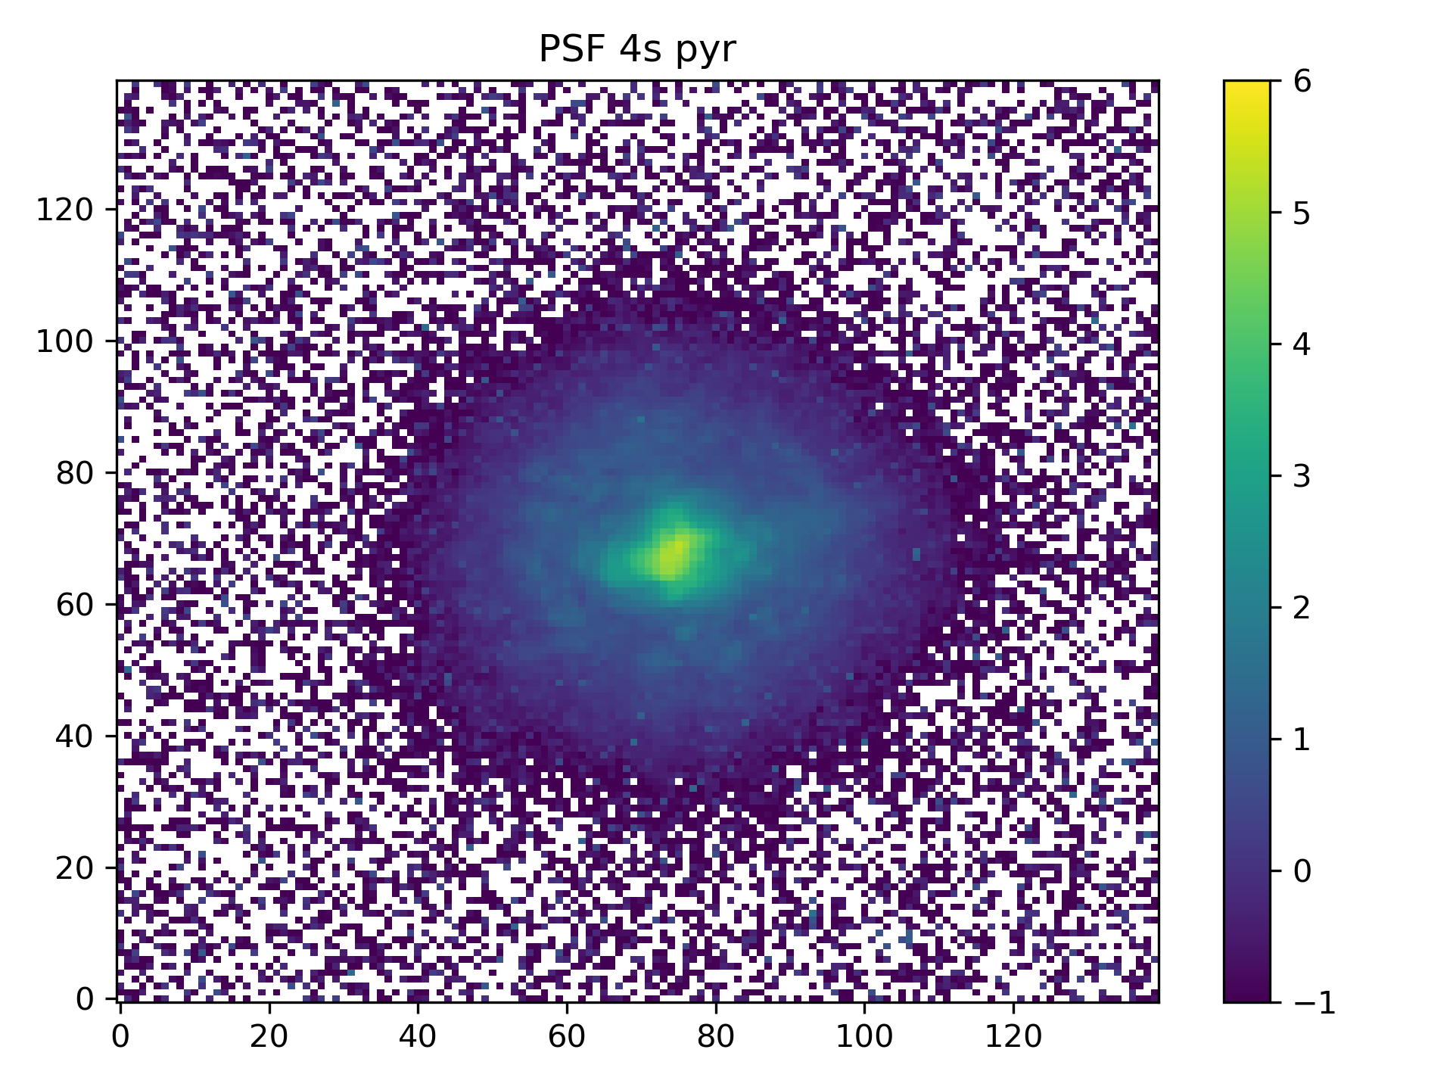
Closed loop PSFs
Closed loop
(with AO correction)
Open loop
(without AO correction)
Infrared PWFS
Visible PWFS
Encircled energy: 1.65%
Encircled energy : 68.87%
Encircled energy : 34.08%
Notes:
Tohave a closer look at the results we have integrated psf from the observations.
The first one is open loop psf, without AO correction and we have around 2% energy in the peak. Then we have closed loop psfs with ao correction with Infrared and visible Pyramid, and the energy in the peak for the infrared pyramid psf almost twice as high as the standard visible pyramid psf. This means we will have double the light for the same target with the Infrared modulated pyramid.
To conclude, not only the lab results looked promising, but also we could demostrate the performance on sky.

Slide 25

Key Takeaways
Unmodulated Pyramid WFS is highly effective for measuring atmospheric turbulence.
Operating in the infrared provides the advantage of increased linearity of the sensor.
We successfully closed the loop on sky using an unmodulated infrared Pyramid WFS.
On-sky performance of the infrared unmodulated PWFS was nearly a factor of two better than the visible modulated PWFS under same conditions.
Email: Muskan.Shinde@unige.ch
LinkedIn: www.linkedin.com/in/muskan-shinde-097334190/
Notes:
Successfully closed the AO loop on sky with the unmodulated infrared Pyramid WFS. Working in infrared, we had several advantages: more linear, less optical gain (= sensitivity gain), less cross-talks.
The performance of the IR PWFS was almost twice times better than that of the VIS PWFS on average. This gain is mainly due: operation at an infrared wavelength, a higher loop speed, high sensitivity because of it being unmodulated.

Slide 26
Thank you!

Slide 27
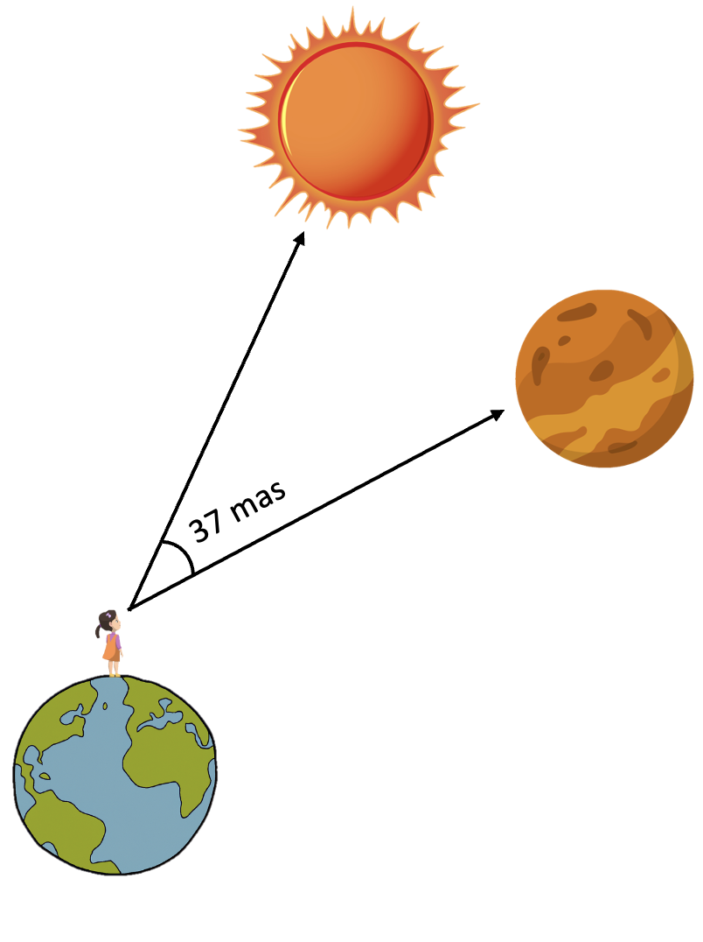
RISTRETTO: a high-contrast high-resolution spectrograph
Proxima Centauri
Primary science goal: reflected-light spectroscopy of nearby exoplanets in the visible regime
Driving science goal: atmospheric characterization of Proxima b
Design requirements:
Raw contrast < 2x10-4 @ 37 mas (~ 2 λ/D @ 750nm at VLT)
Strehl ratio > 70% in the visible
Proxima b
Notes:
As many of might be know that RISTRETTO is high-resolution spectrograph. The special thing about it is, that it combines high-constrast imaging with high-reslotion spectroscopy to reach extremely high contrast required to do reflected-light spectroscopy of nearby exoplanets in the visible regime.
Now the driving science goal for RISTRETTO is to characterize the atmosphere of Proxima b, which is a rocky planet oribiting in the habitable zone of our closet star Proxima Centauri.
Since it is located an angular separation of 37 mas from its host star, to be able to detect light from Proxima b, we need a raw contrast of less than 2x10⁻⁴ @ 37 mas, which is around 2 λ/D at 750nm for a 8m-class telescope like VLT. This is really close to the diffraction limit of the telescope. We also need a strehl ratio of greater than > 70%.

Slide 28
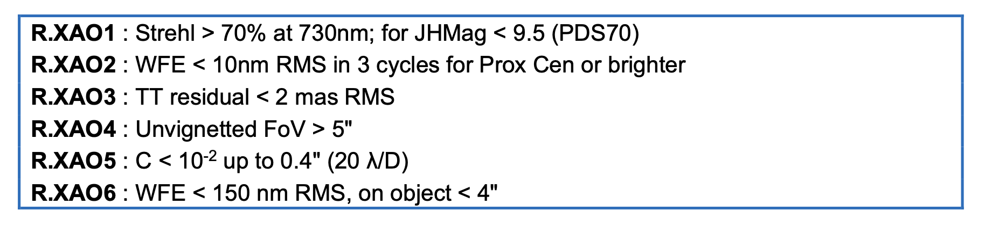
RISTRETTO AO Requirements
Strehl ratio > 70% in ﻿at 730nm for JHMag < 10
Wavefront error below 10nm RMS in 3 cycles for Prox Cen or brighter stars
﻿Contrast < 10⁻² up to 0.4" (20 λ/D)
Notes:
Now, to meet the performance requirements for RISTRETTO, a Strehl ratio > 70% in the visible.
Wavefront error needs below 10nm RMS for low spatial frequency aberrations.
To achieve this high sensitivity to low spatial order wavefront aberrations and petal modes is required, which will be limited by wavefront noise. Therefore the performance of the wavefront sensor would be driving factor for RISTRETTO AO system. And my part of the project is to work on this wavefront sensor.

Slide 29
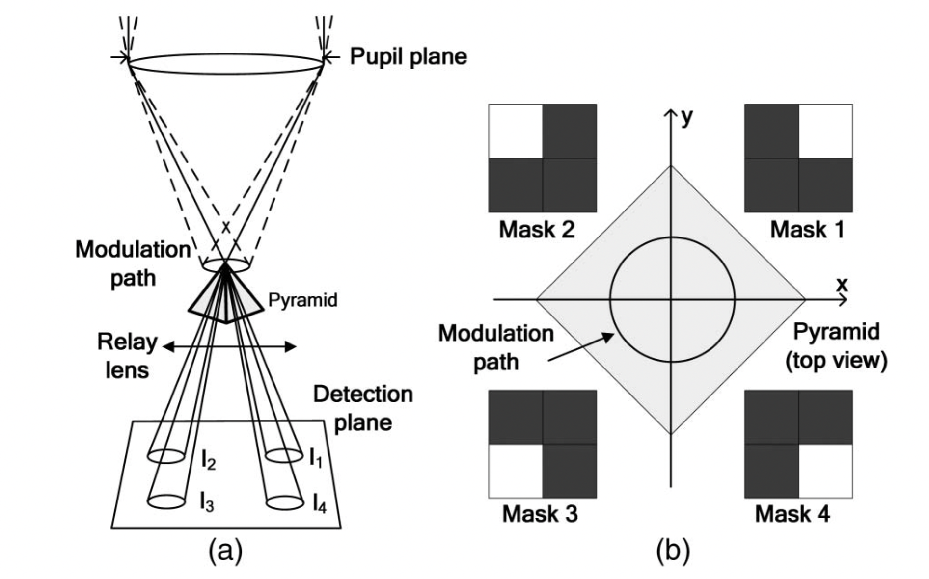
How to increase linearity? Modulation!
But…
Decreases sensitivity
Achieving loop speeds > 1 kHz difficult
Credit: Yao et al. 2015
Notes:
How can we increase the linearity of the PWFS? The classical way is to apply modulation. Here modulation is applied offseting the psf from the tip of the pyramid to the side, and moving in specific pattern around the pyramid. The most typical pattern for modulation is a circular modulation which is shown here. This modulation increase the linearity range but it also decreases the sensitivity of modes within the modulation radius. And achieving speeds greater than 1kHz is diffuclt because we are limited by the operation speed of the tip tilt mirror. So in the last few years there have been efforts to increase the linearity range of the PyFWS without implementing this modulation. This is what people call the unmodulated PyWFS. This unmodulated PyWFS is an active field of research, with people trying different appproaches to increase its linearity. We also tried various methods to increase the linearity range of the unmodulated PyWFS, and one that seemed to work with a simple linear system is going to longer wavelengths.

Slide 30
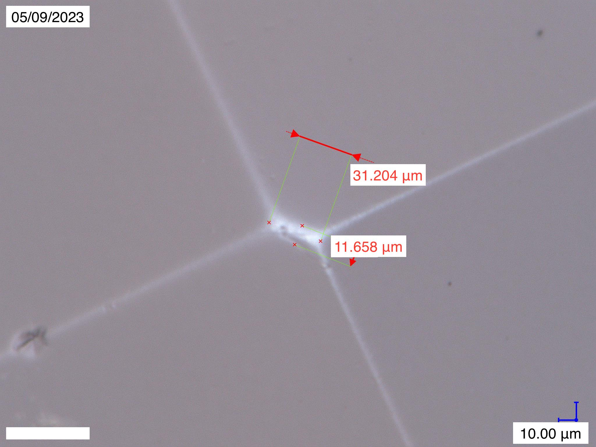
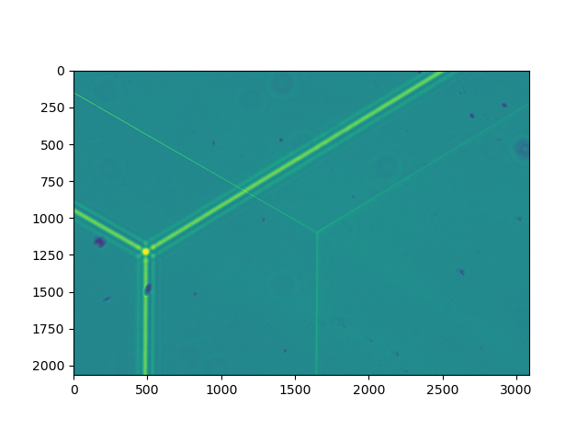
Infrared PWFS (> 1400nm)
unmodulated PWFS
extended dynamic range
less optical gains
less cross-talks
4-sided PWFS
3-sided PWFS
Notes:
So we did simulations to see the ability of this sensor unmodulated IR PWFS to close the AO loop which basically means provide an AO correction. An it was able to close the loop for seeing up to 1.5 arcsec, which is more than 90 % of observing conditions, which is great. And for this the AO system was needed to be operated speeds more than 2-3 kHz.
On the right you see map of the pyramid that is used in simulations, with perfect edges and tip. But in the real world, it’s not that easy

Slide 31
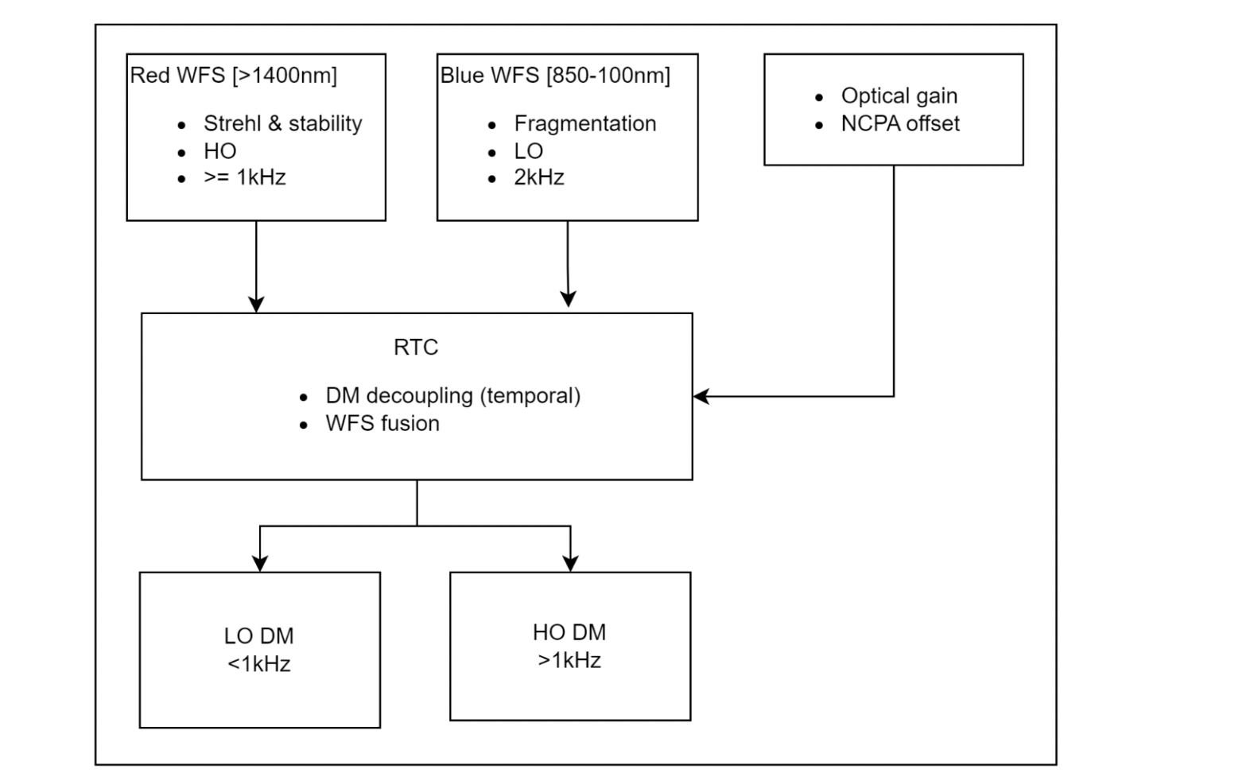
RISTRETTO AO Architecture

Slide 32
Closed Loop test
Wavelength = 1400 nm
Seeing = 2”
Loop speed = 1kHz

Slide 33
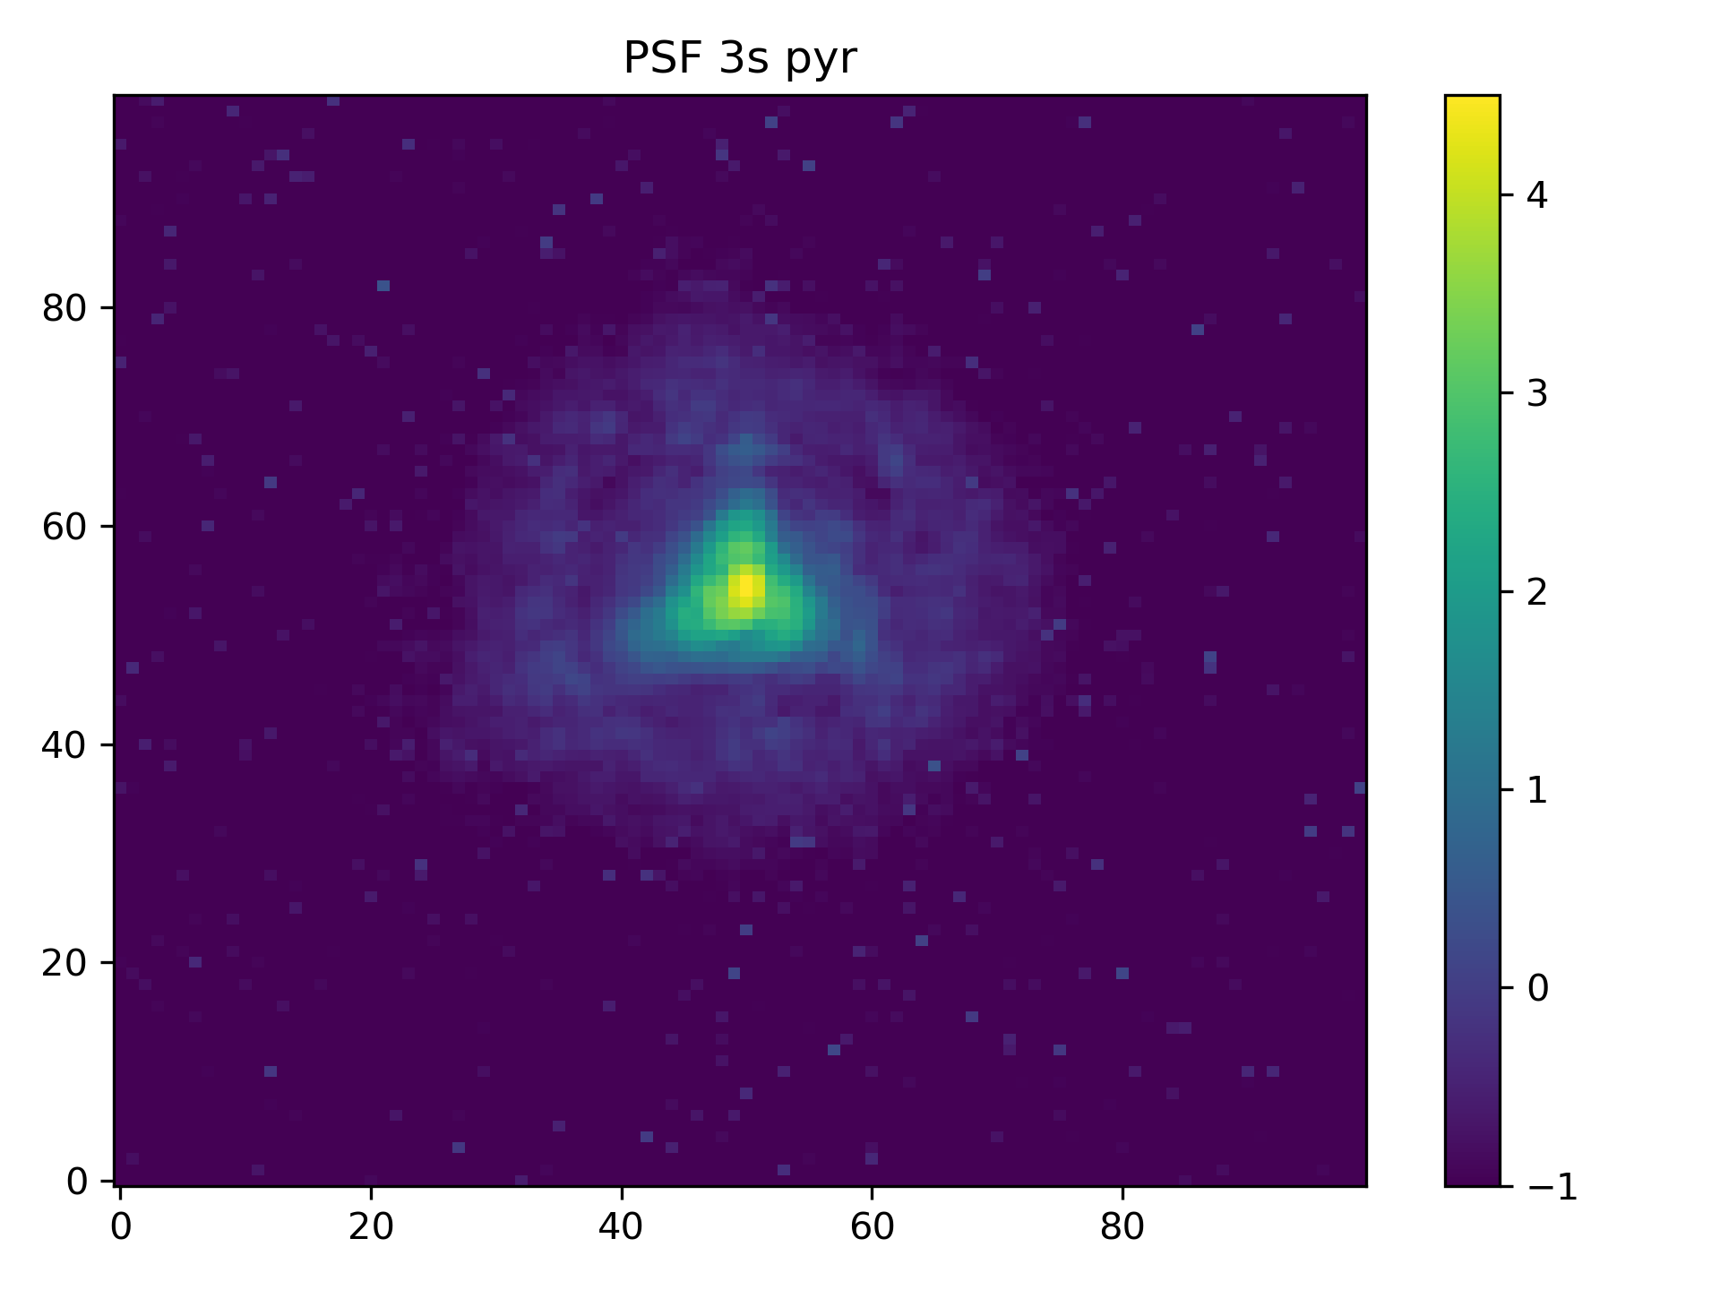
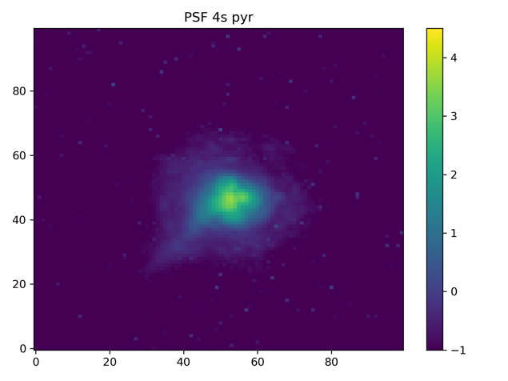
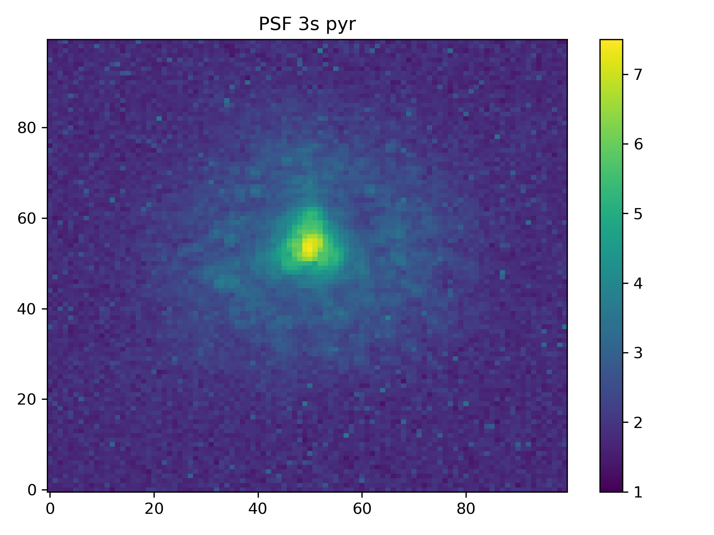
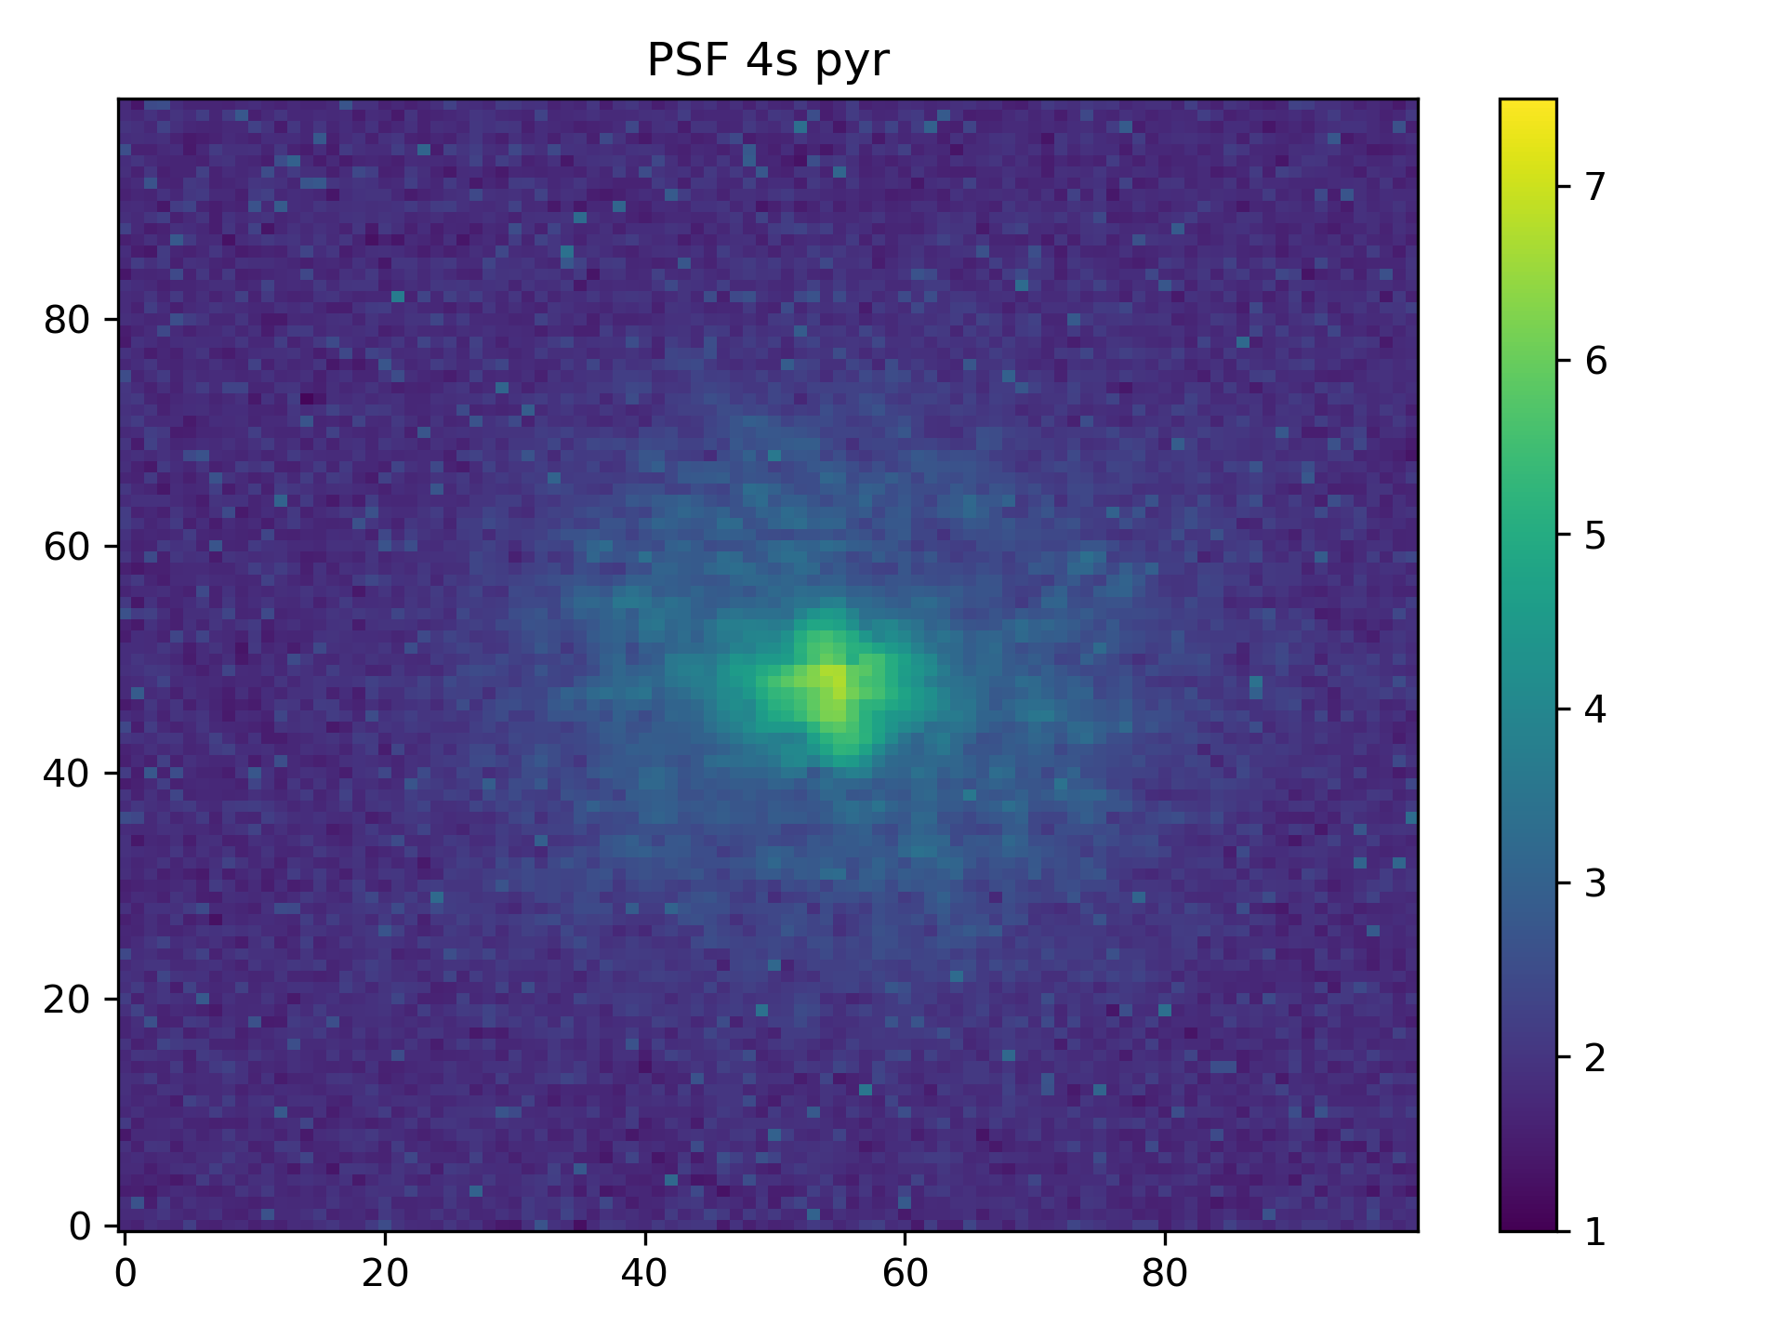
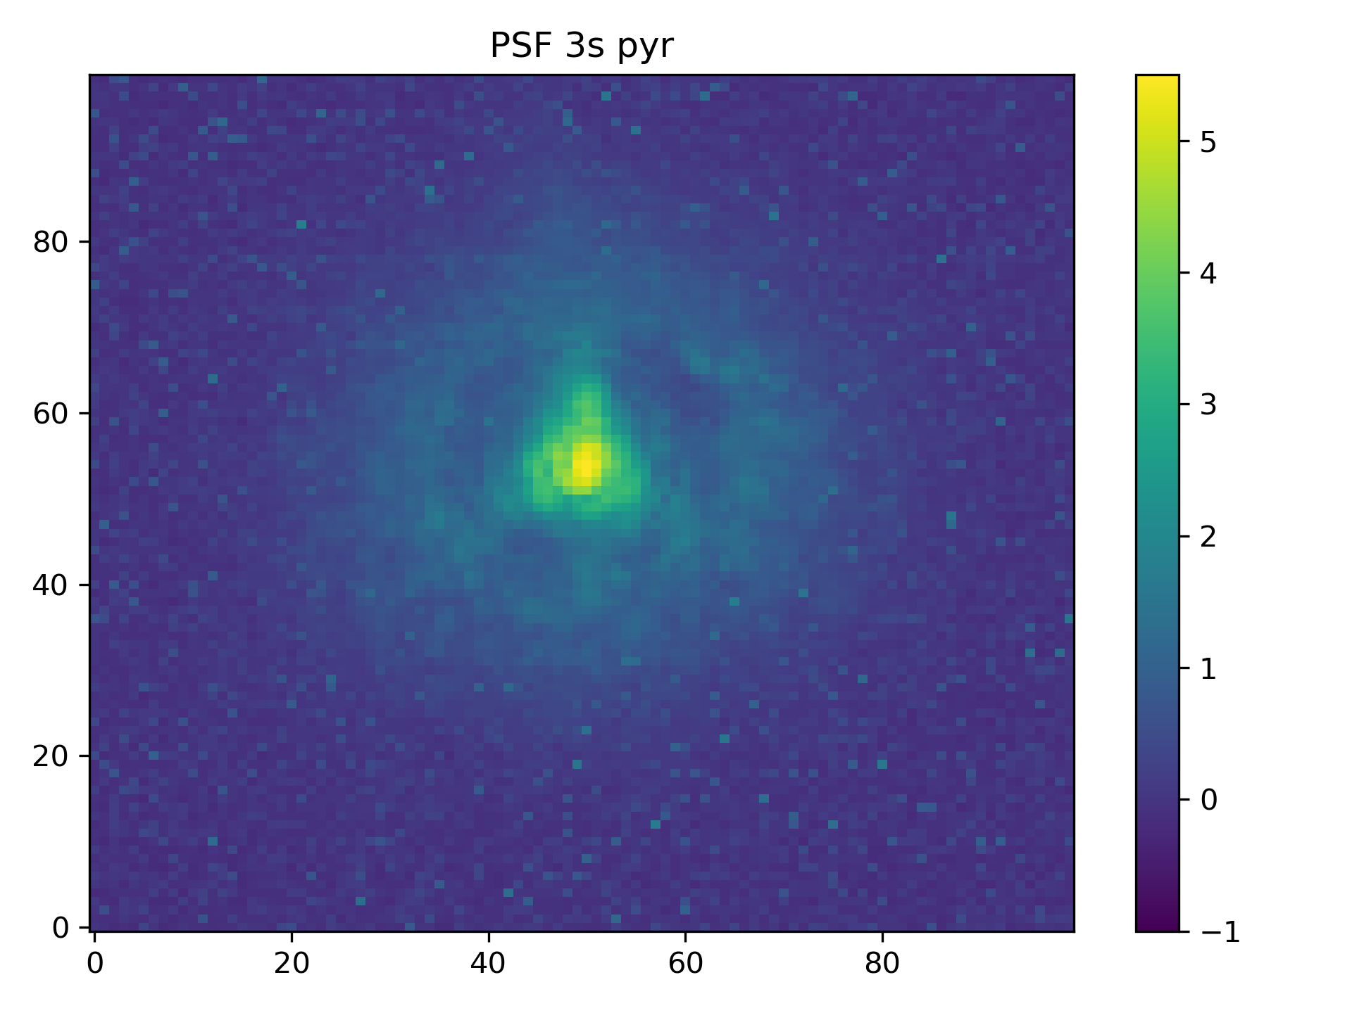

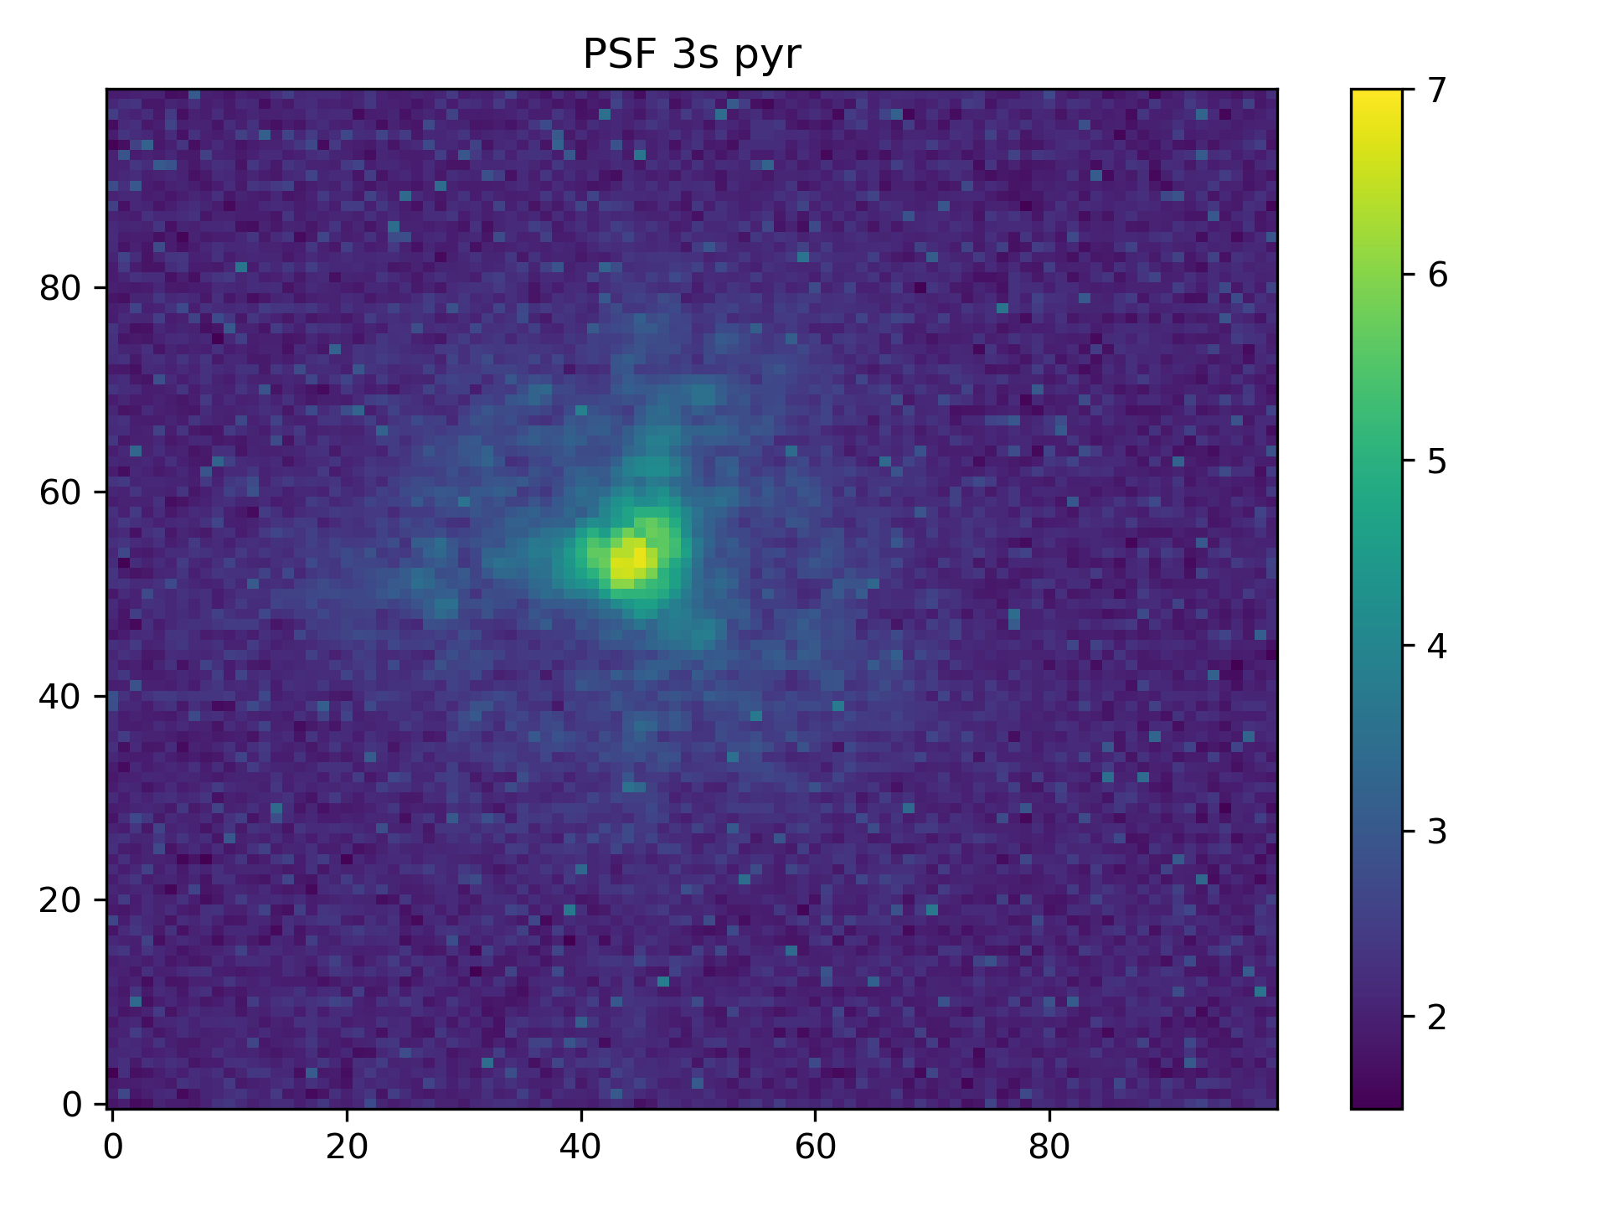
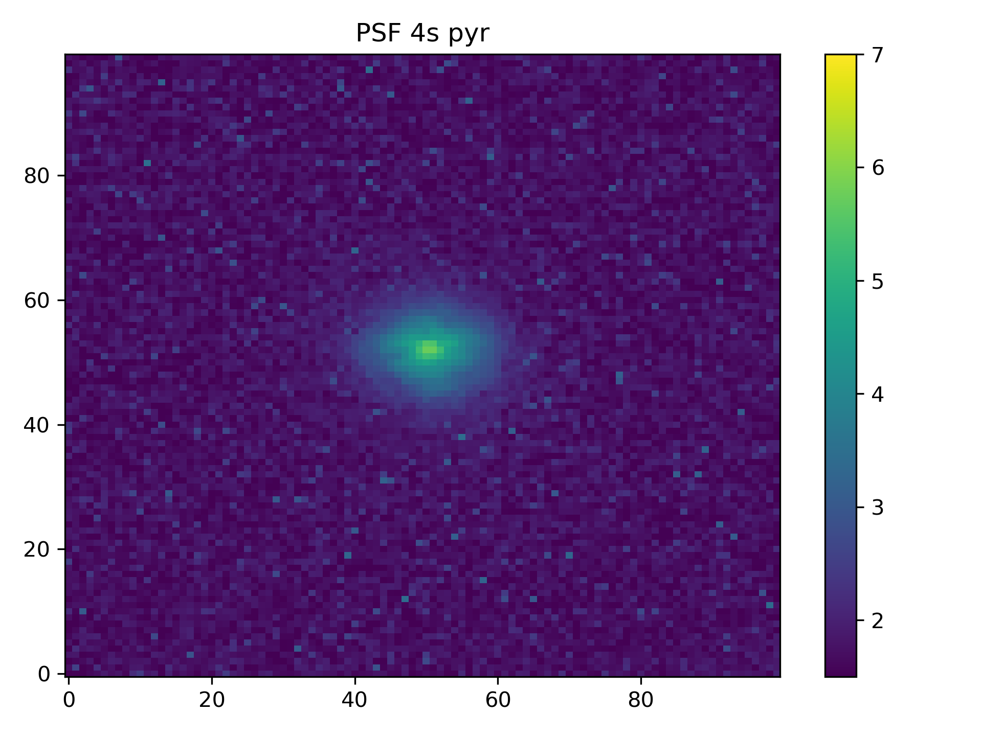
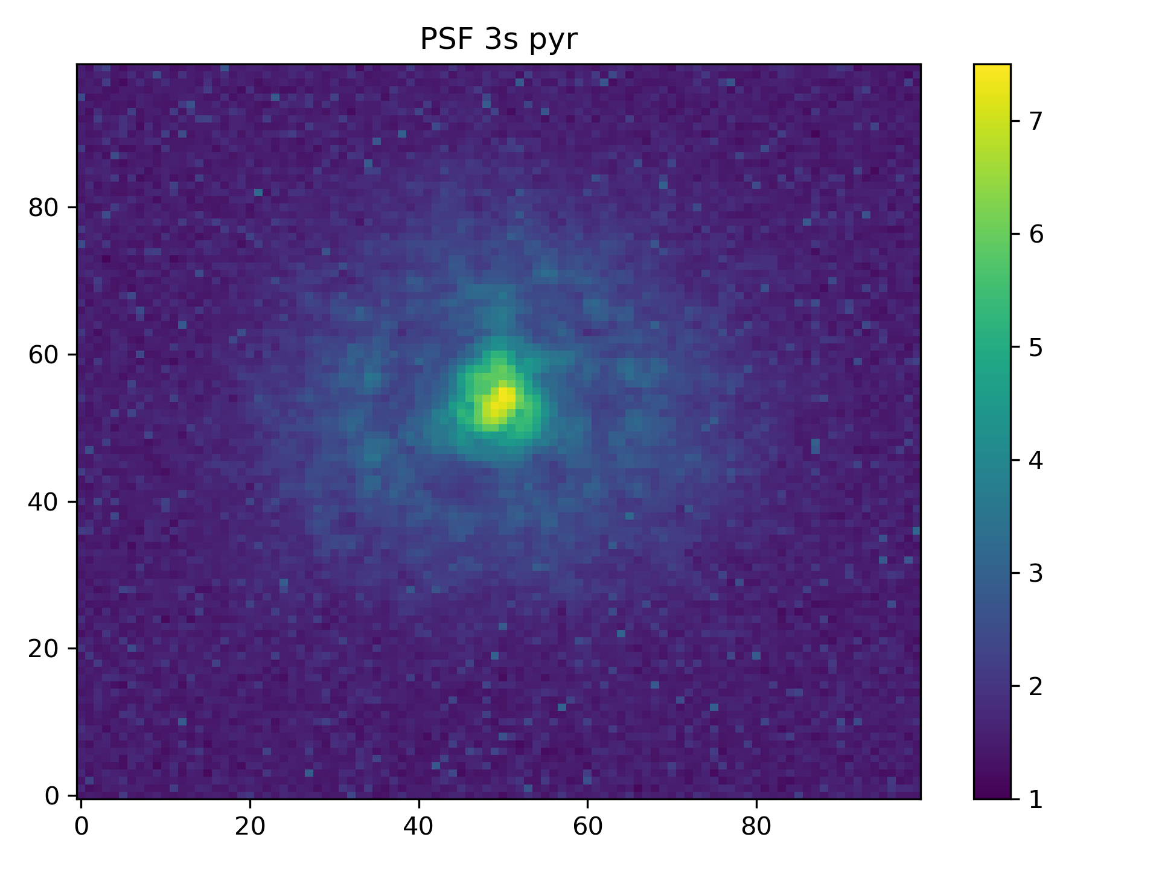
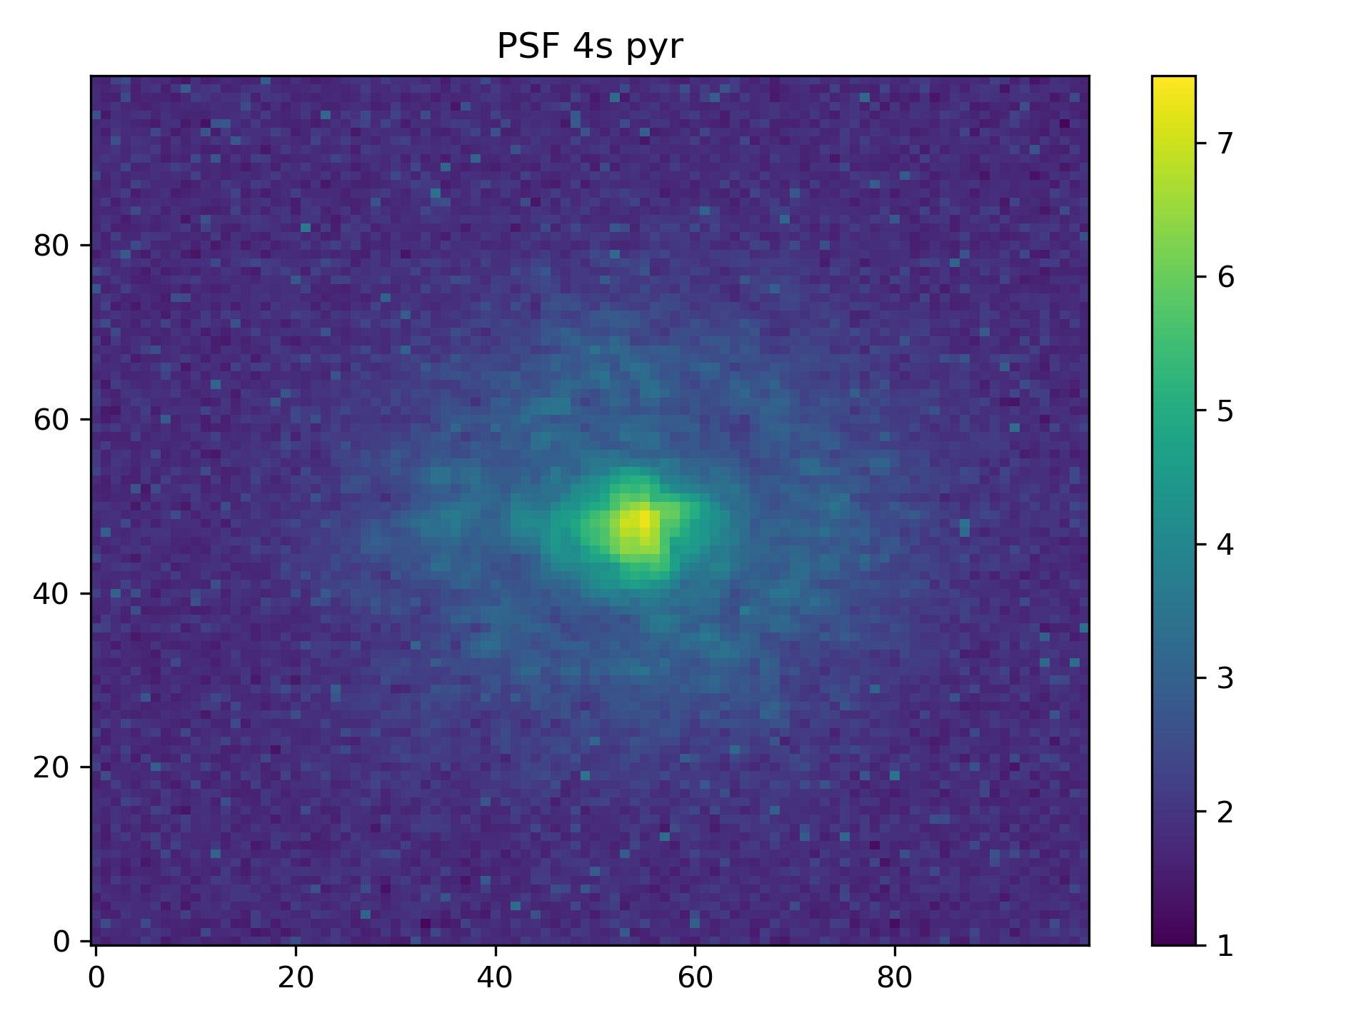
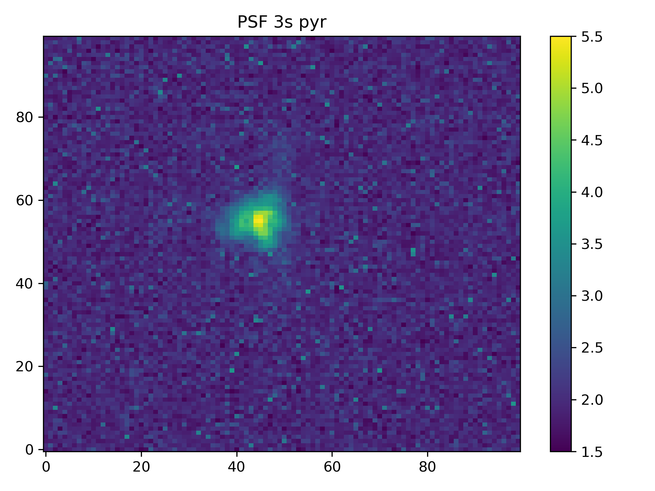
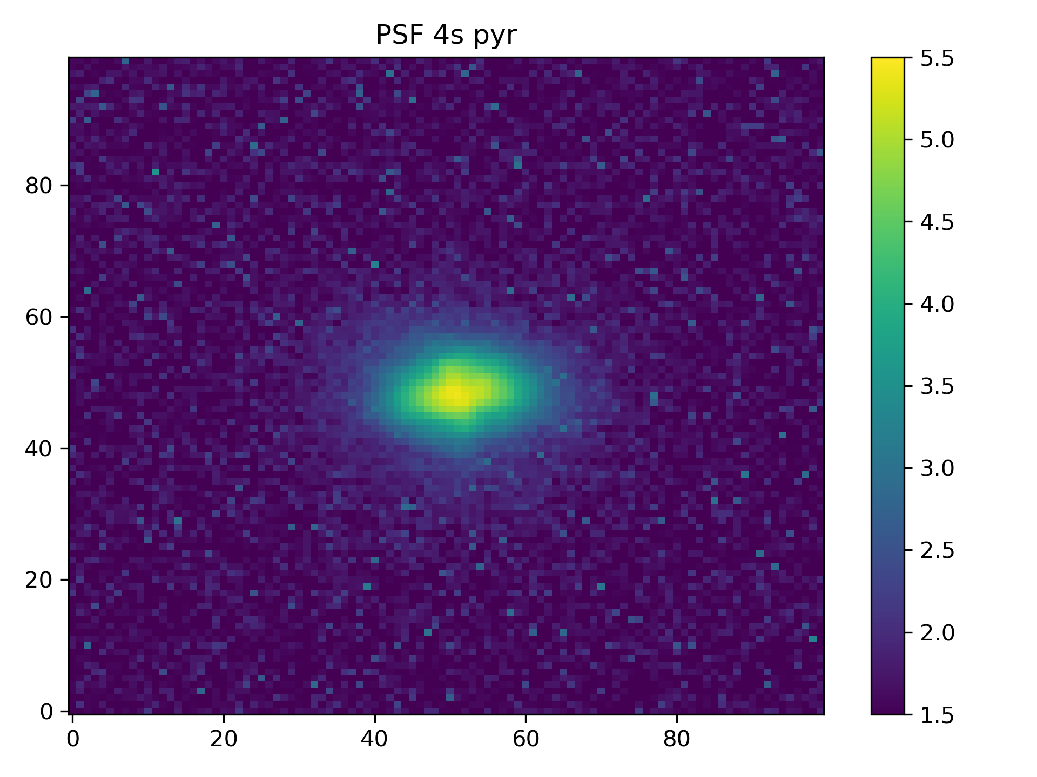
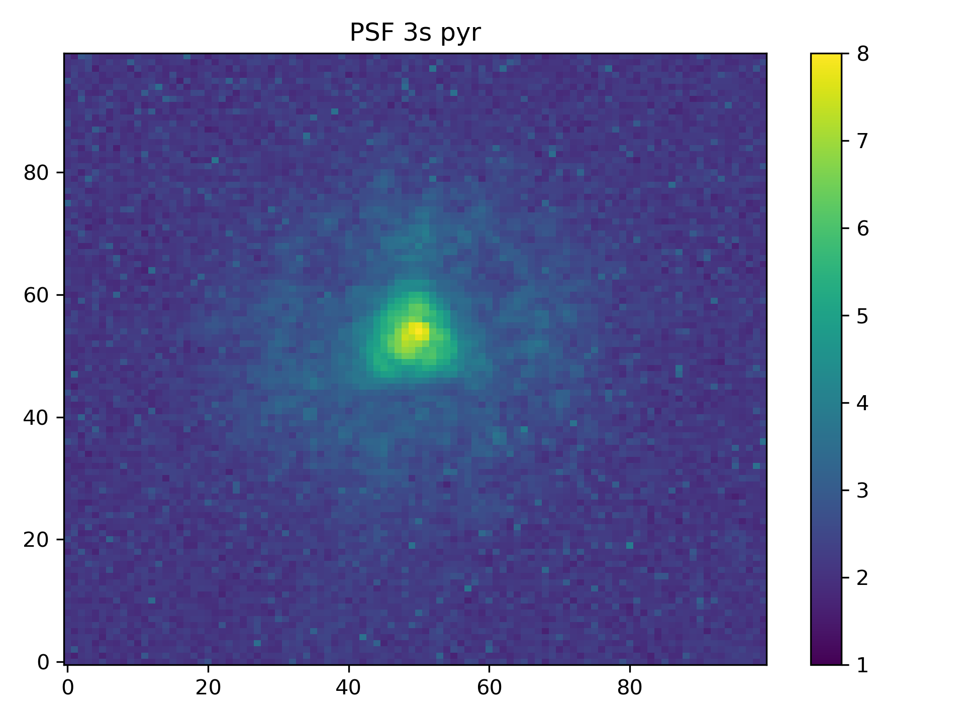

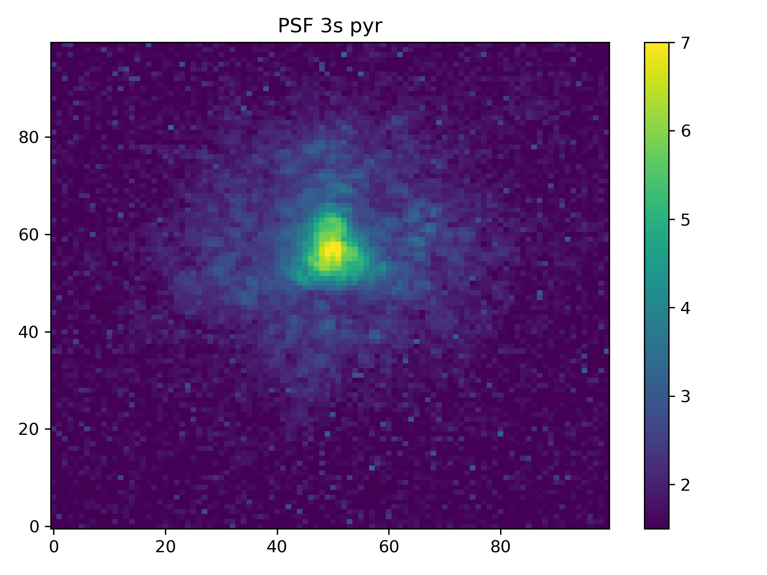
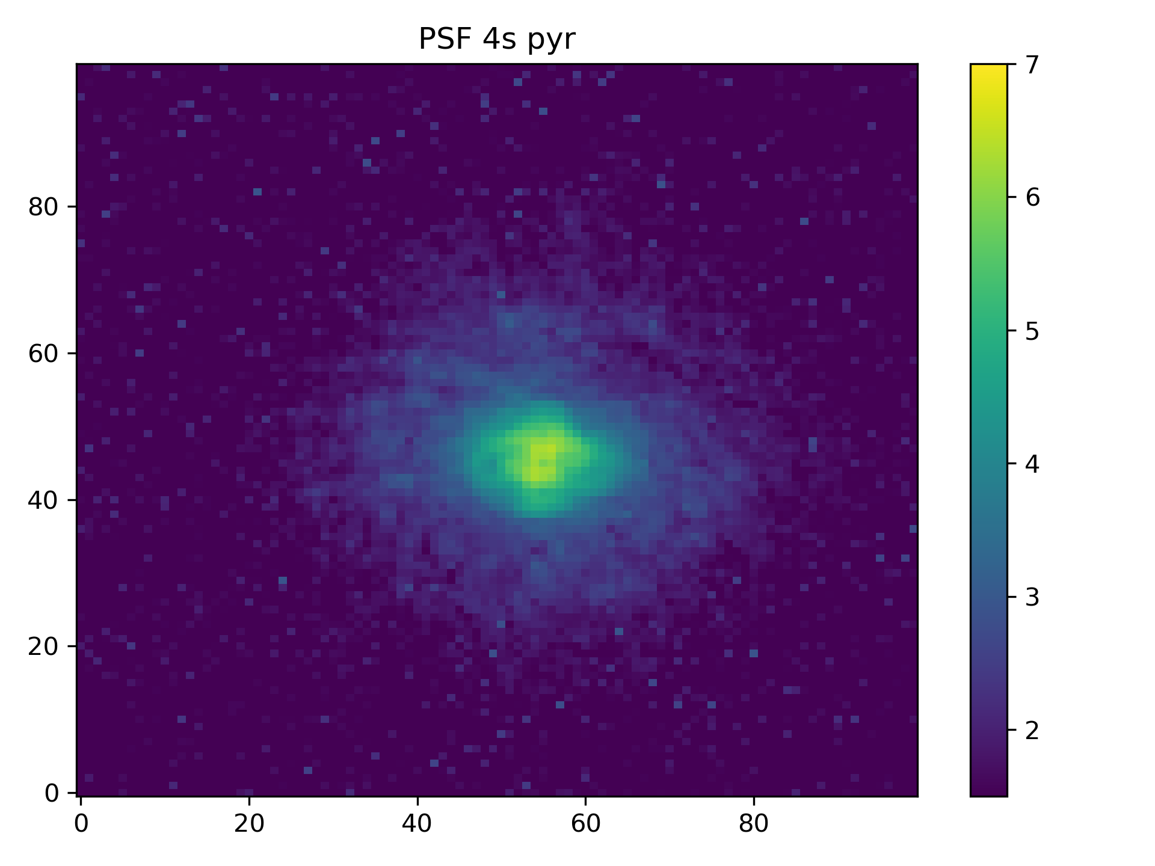
3-sided IR PWFS vs 4-sided VIS PWFS
The encircled energy for PSFs with 3PWFS is 1.65 ± 0.32 times higher than the 4PWFS on average.

