Slide 1
Artificial Intelligence
on Modern HPC Platforms
in Space
Tomasz Kacprzak, 20 January 2026, SIAPS Bern

Slide 2




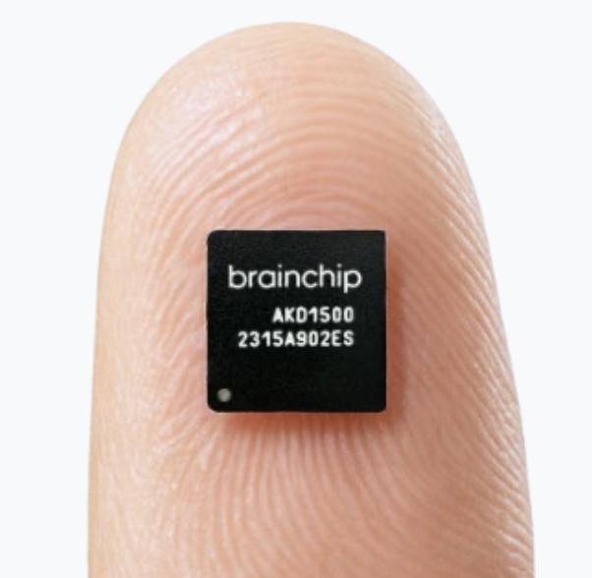
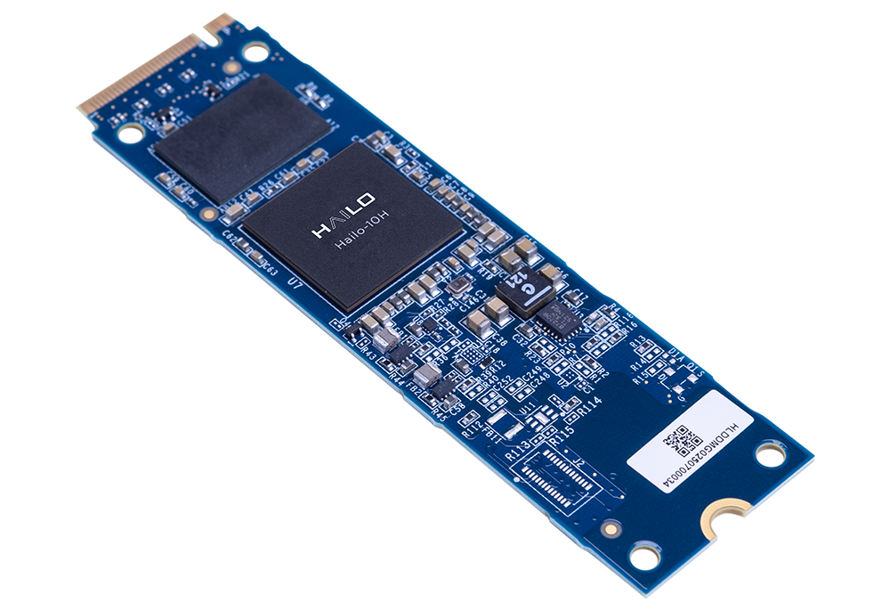
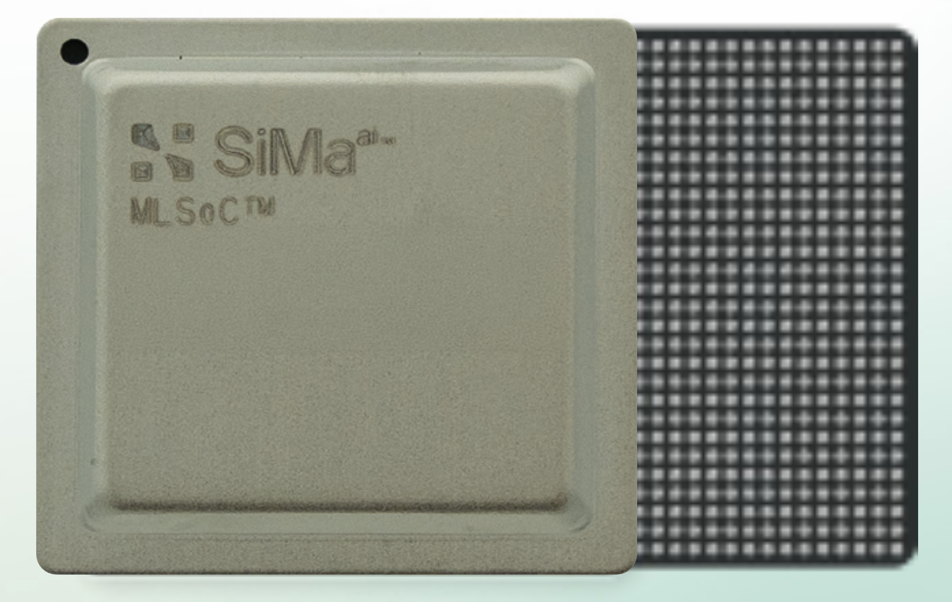
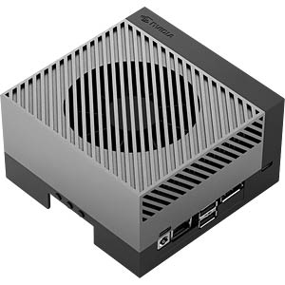
New Hardware Models for AI
Neural Processing Units (NPU), Tensor Processing Units (TPU), Application-Specific Integrated Circuits (ASIC), Machine Learning System-on-Chip (MLSoC), other names..
Dedicated accelerators for AI applications
Typically used only for inference (no model training)
Capable of hosting ~10+ m parameter models
Much lower energy consumption
High-throughput processing
Statically reprogrammable
Brainchip AKD1500
0.8 TOPS (INT8)
250 mW
Hailo-10H M.2
20 TOPS (INT8)
2.5 W
SiMa.ai MLSoC Modalix
50 TOPS (INT8)
5 W
NVidia Jetson Orin
275 TOPS (INT8)
60 W

Slide 3
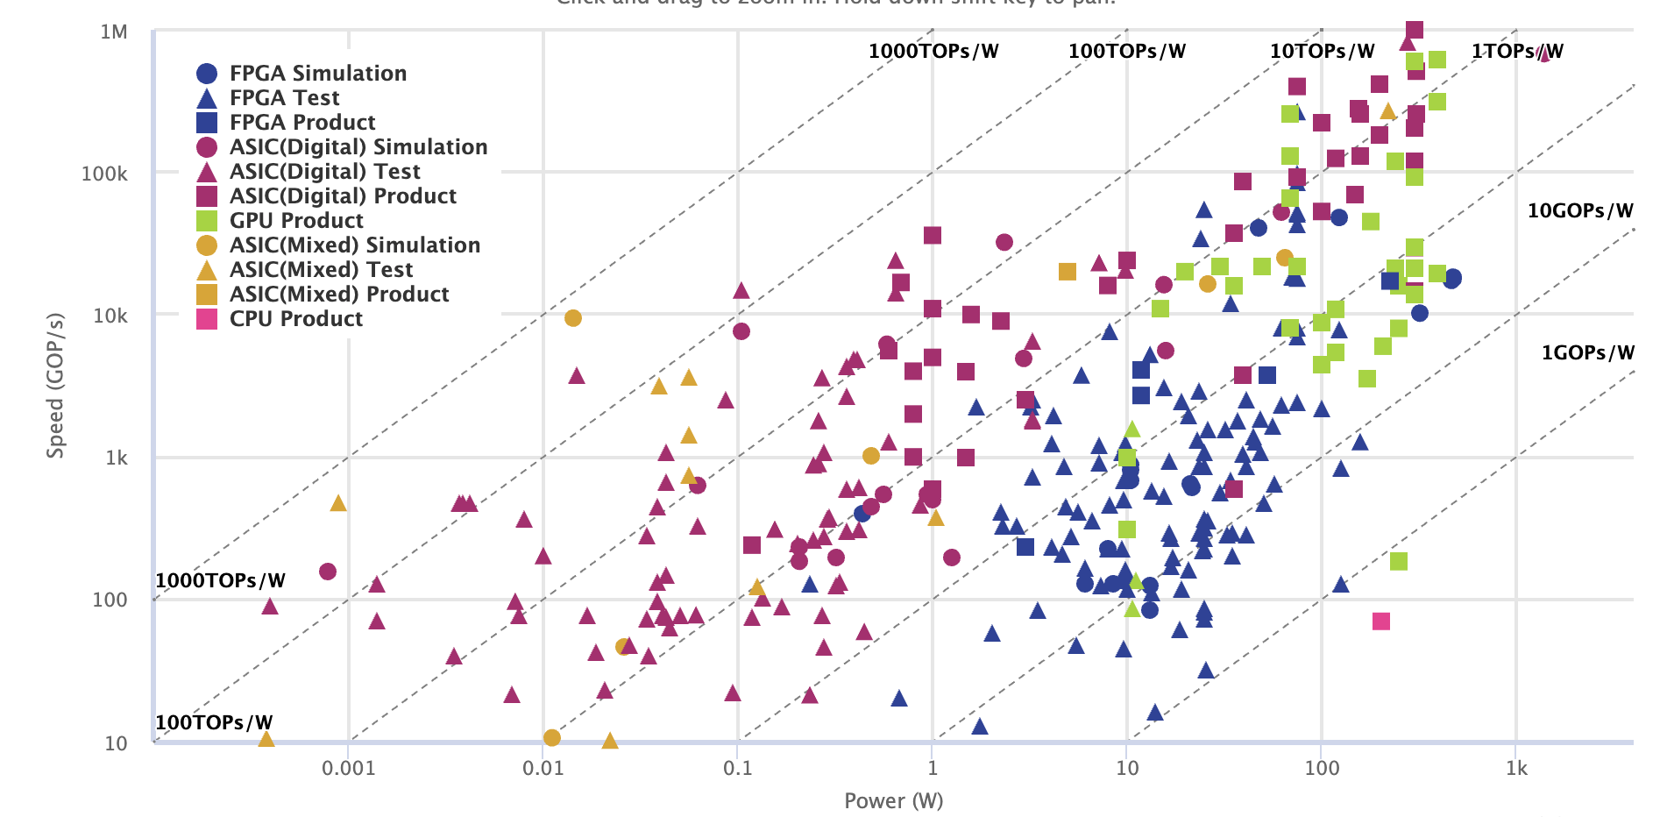
New Hardware Models for AI
Neural Processing Units (NPU), Tensor Processing Units (TPU), Application-Specific Integrated Circuits (ASIC), other names..
Massive expansion of the products in last 5 years
New computing models (in-memory computing, neuromorphic computing)
Increasing speed, lowering energy
Speed (GOP/s)
Neural Network Accelerator Comparison
Tsinghua University, 2020
Power (W)

Slide 4
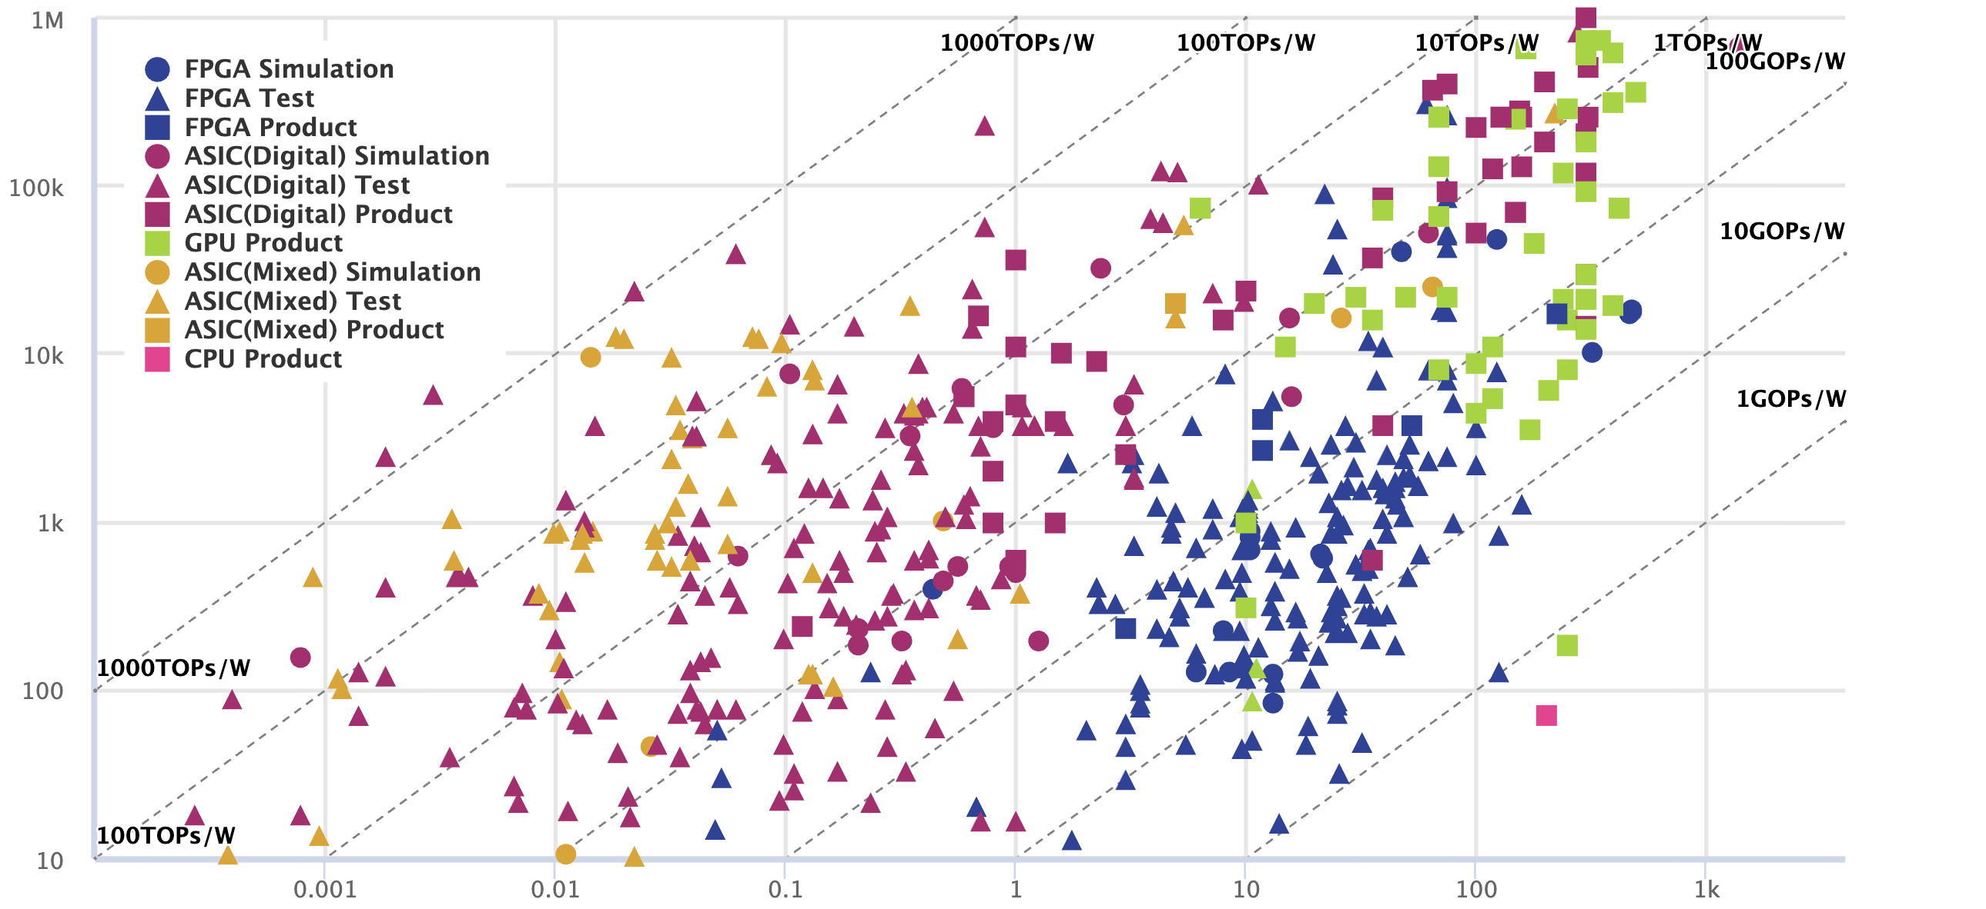
New Hardware Models for AI
Neural Processing Units (NPU), Tensor Processing Units (TPU), Application-Specific Integrated Circuits (ASIC), other names..
Massive expansion of the products in last 5 years
New computing models (in-memory computing, neuromorphic computing)
Increasing speed, lowering energy
Speed (GOP/s)
Neural Network Accelerator Comparison
Tsinghua University, Yesterday
Power (W)

Slide 5

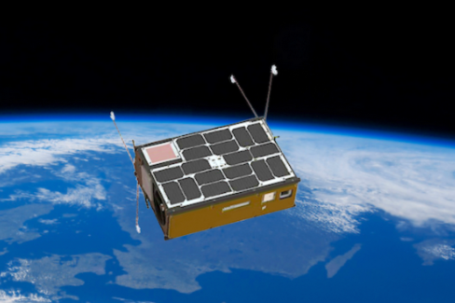

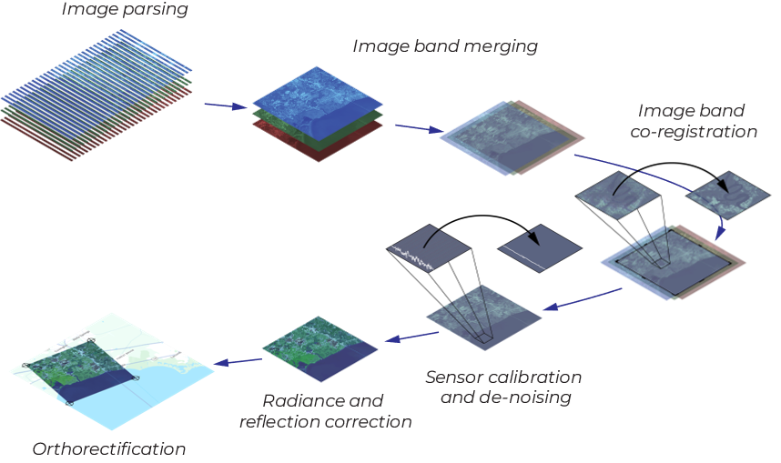
Computing in Space
Motivations:
High-volume data acquisition vs downlink bottleneck
Low latency and real-time processing
Energy and sustainability advantage
Example classical applications:
Onboard image processing and filtering (bottlenecks)
Filter out cloudy images before transmission
Real-time event detection and alerts (latency)
Monitor wildfires
First Cube-sats with AI hardware
ESA ɸ-Sat-1 6U 2020 CubeSat technology demonstrator among the first to use AI in orbit, earth observation
CogniSAT-6 (NASA JPL/Open Cosmos), 2023, dynamic targeting: autonomously decide where to make the best make science observations from orbit
Intel Movidius Myriad, 1-2W, ~1 TOPS
ESA PhiSat-1
On-board
Unibap Space Solutions (Sweden)

Slide 6
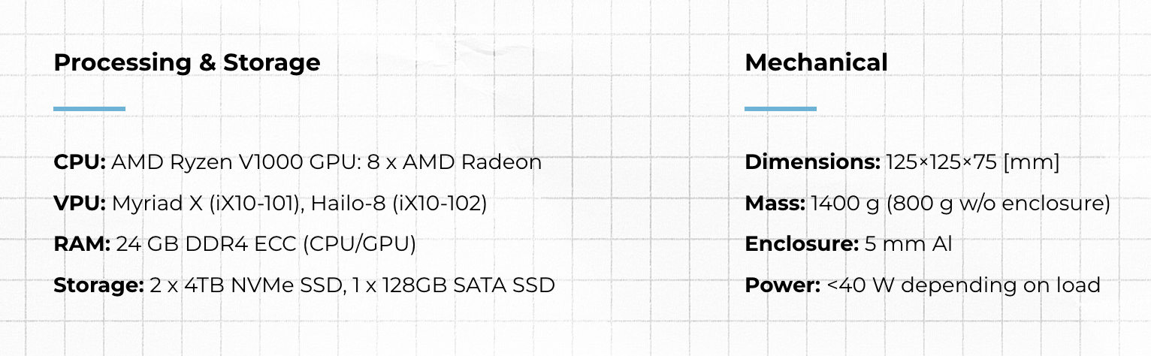
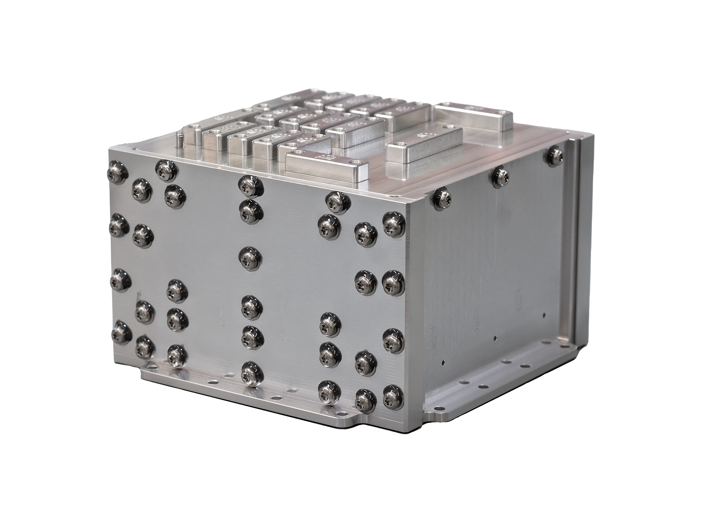
Computing in Space
Growing industry with multiple established companies
Examples:
iX10, Unibap Space Solutions (Sweden)
NuPod, Payload (Israel)
NewSat Mark-V, Stellogic (USA)
Stellogic iX10
ESA PhiSat-1

Slide 7

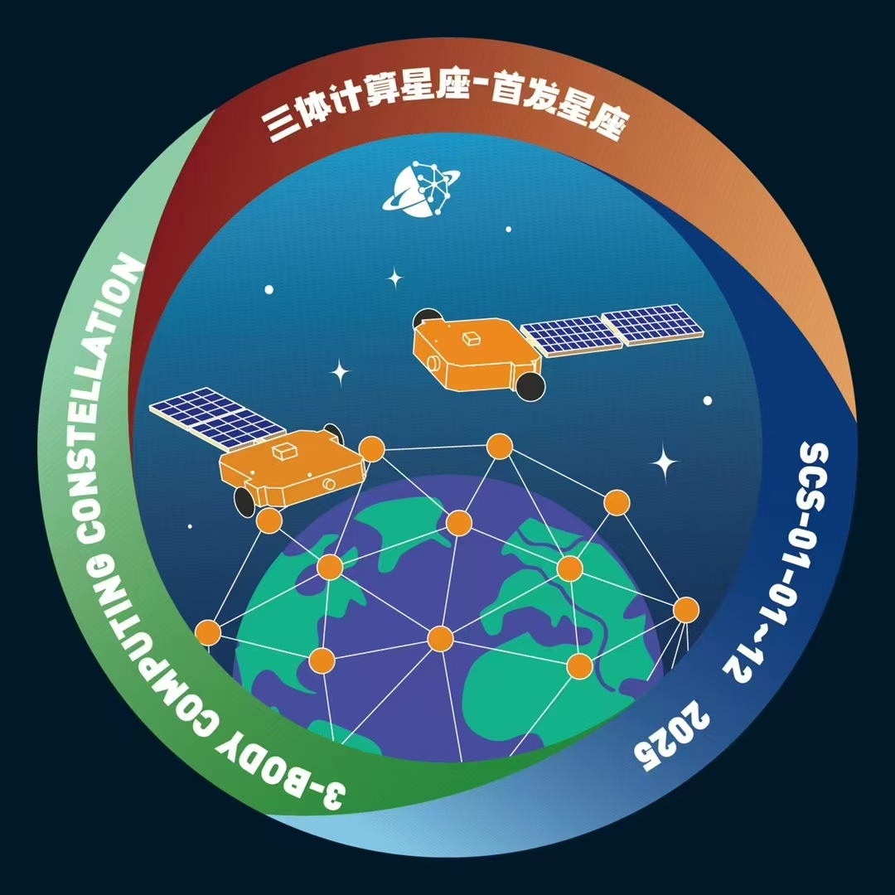

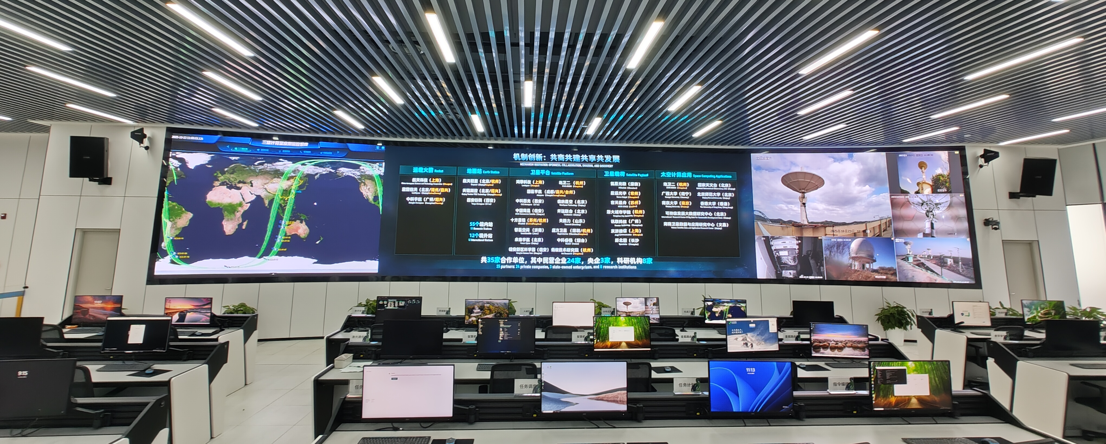

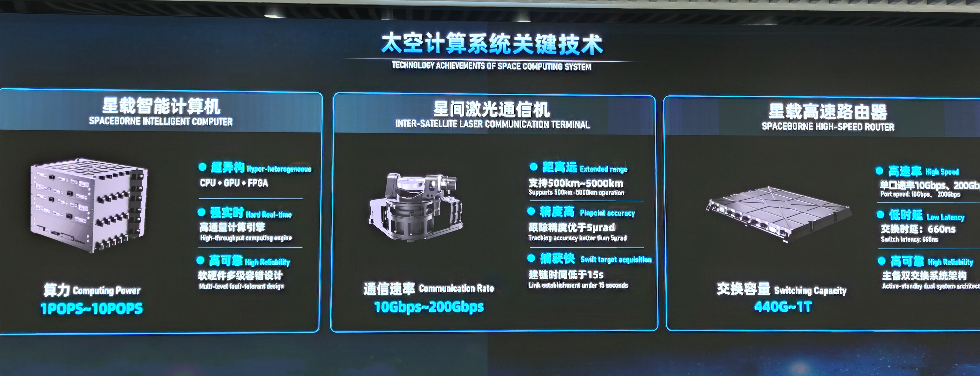
Data Centers in Space
First Cloud Computer in Space: “Three-body Constellation”, Zhejiang Lab, China
Developed and operated at Zhejiang Lab, which is focused on AI for Science
First 12 satellites launched in May 2025 by China Aerospace Science and Technology Corp
CPU+GPU+FPGA, ~700 TOPS per unit
Inter-satellite laser communication at 500-5000 km distances
Low latency 660 ns
Custom processors developed domestically
Target cloud of 2800 satellites to be reached before 2035
Open for collaborations in scientific applications
FHNW is building collaborations with Zhejiang Lab
ESA PhiSat-1

Slide 8
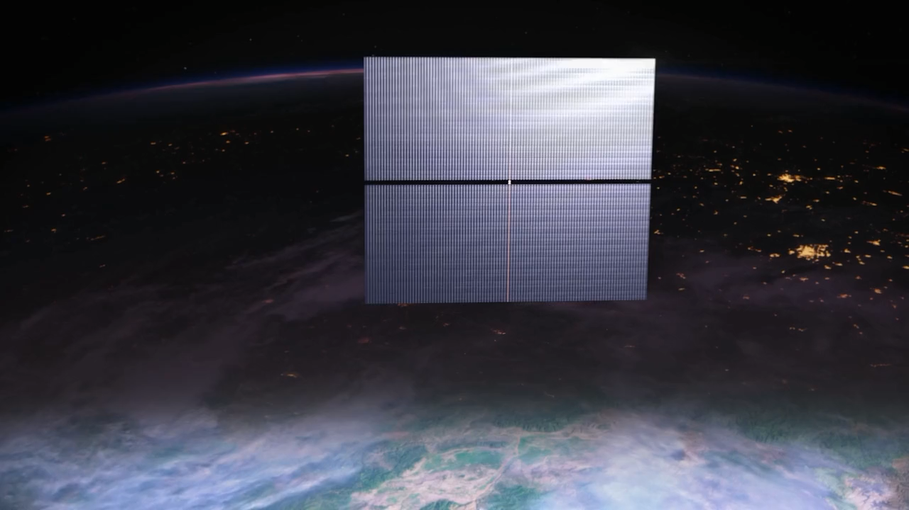
Data Centers in Space: Starcloud
Starcloud-1 NVIDIA H100 GPU launched November 2025
Prototype spacecraft successfully deployed
1kW at full power with batteries, duty-cycled operation
Total weight: 60 kg, lifetime: ~3 years
4km 4km solar array
Gigawatt-scale data center in space
Whitepaper: fewer than 100 launches, system construction in 2-3 months
Modular design, swapping new modules with better hardware when needed
ESA PhiSat-1

Slide 9

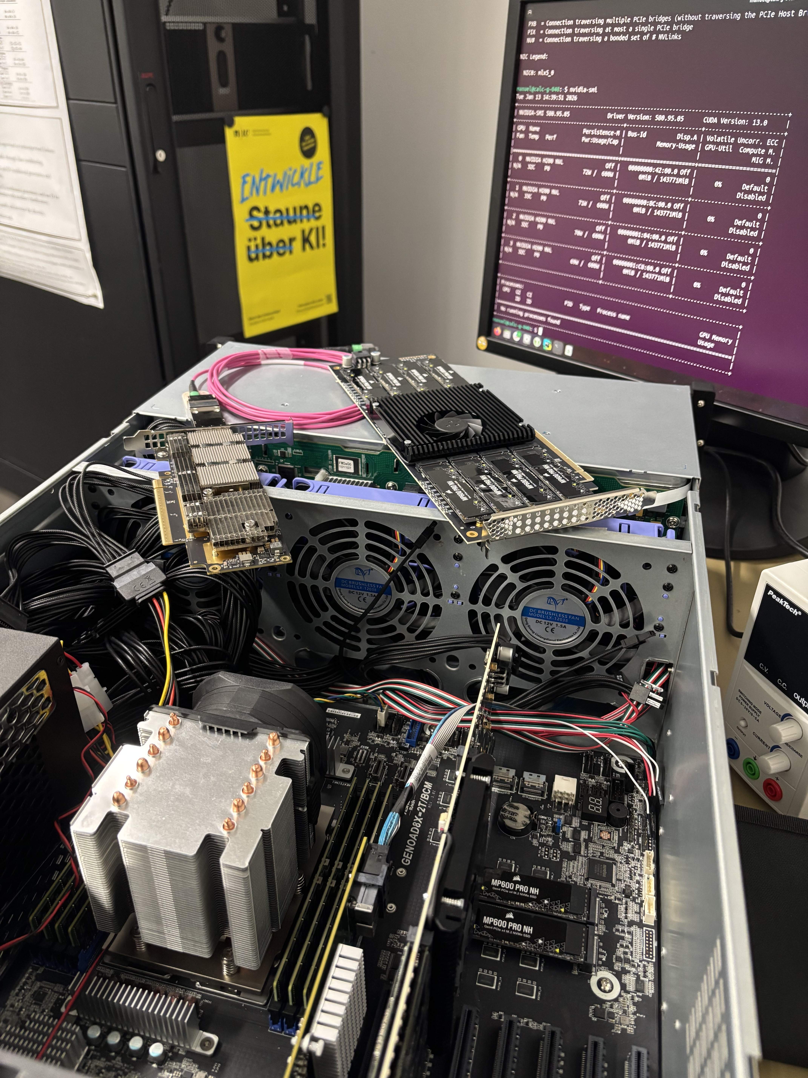
FHNW HPC Lab
Laboratory for novel experimental computing technologies:
Next-generation beyond-GPU computing
Dataflow, in-memory, neuromorphic computing models
Low-energy, AI-oriented edge computing
Hardware-algorithm co-design for custom applications in science and industry
Deploying own HPC cluster Calculon, expanding it with more next-generation systems
Teaching programs for BSc and MSc students
Opening: April/May 2026
Scientific collaborations within SKA, Euclid
Industry collaborations with HPC, AI, LLM companies
https://www.fhnw.ch/de/die-fhnw/hochschulen/informatik/hpc-lab

Slide 10

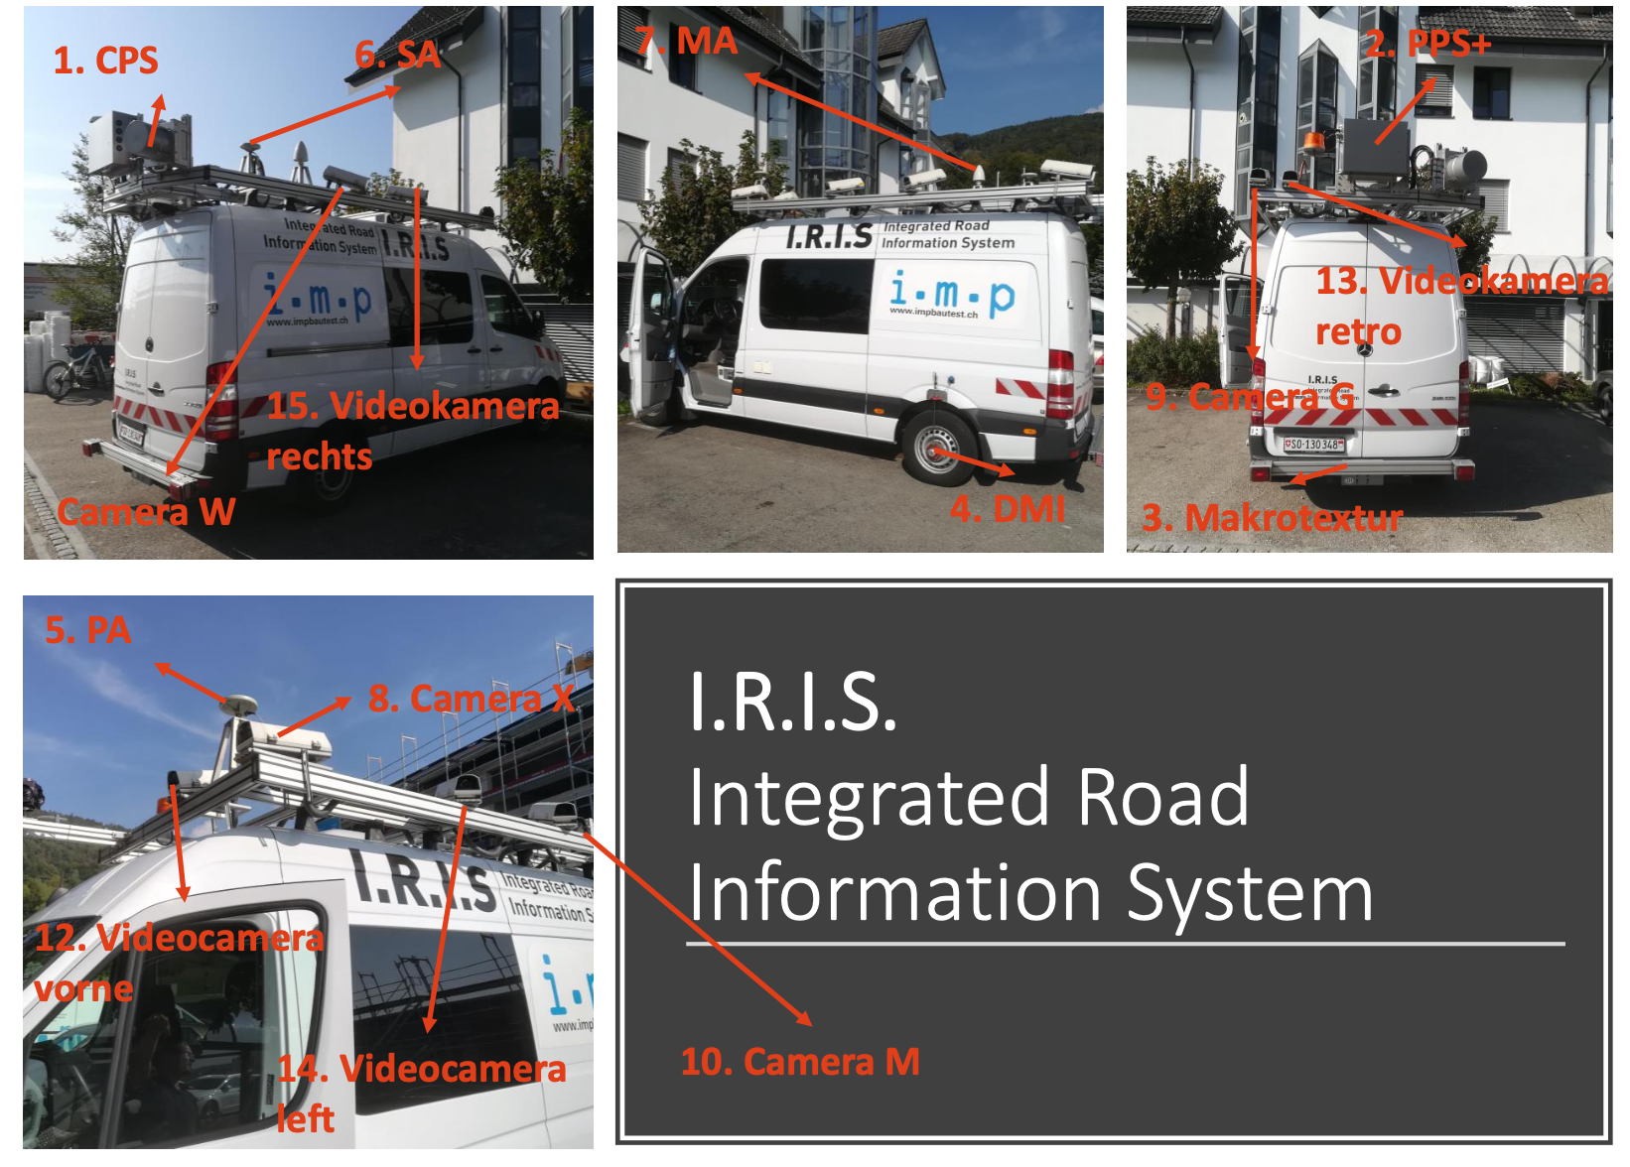

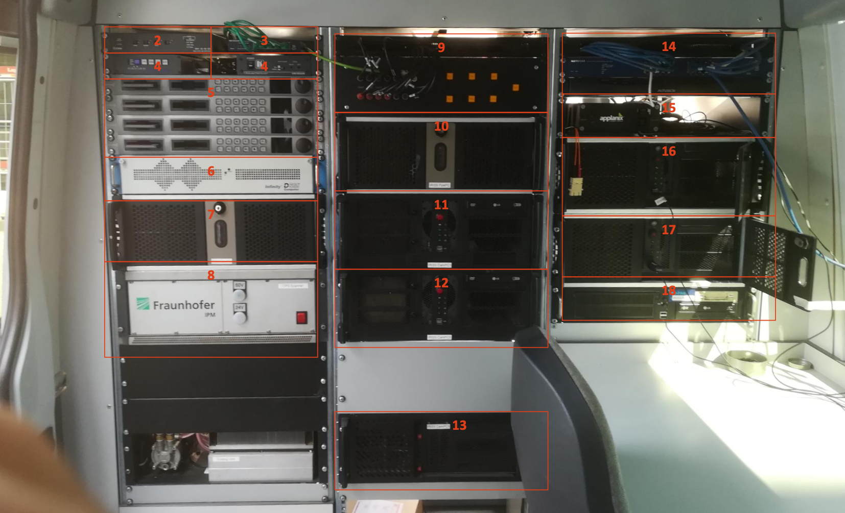
FHNW HPC Lab
Project Example
“Realtime Processing of LiDAR-Data for Road Condition Assessment”
Innosuisse 2025
Created “I.R.I.S: Integrated Road Information System”
Vehicle used for condition assessment and acceptance measurements of roads
Software and hardware optimized and migrated to a single physical server inside a van
Lower energy consumption for on-board real-time processing of two laser scanners and multiple cameras
On-board GPUs + high-throughput sensor integration
Total throughput of the system: 7 GB/s, improved from the previous legacy system of 0.3 GB/s
Support vehicle speeds of 40-50 km/h
Led by Manuel Stutz at FHNW
https://www.fhnw.ch/de/die-fhnw/hochschulen/informatik/hpc-lab

Slide 11
FHNW HPC Lab
Laboratory for novel experimental computing technologies:
Next-generation beyond-GPU computing
Dataflow, in-memory, neuromorphic computing models
Low-energy, AI-oriented edge computing
Hardware-algorithm co-design for custom applications in science and industry
Deploying own HPC cluster Calculon, expanding it with more next-generation systems
Teaching programs for BSc and MSc students
Opening: April/May 2026
Scientific collaborations within SKA, Euclid
Industry collaborations with HPC, AI, LLM companies
Interested in collaborations in the area of computing in space!
https://www.fhnw.ch/de/die-fhnw/hochschulen/informatik/hpc-lab

