Slide 1
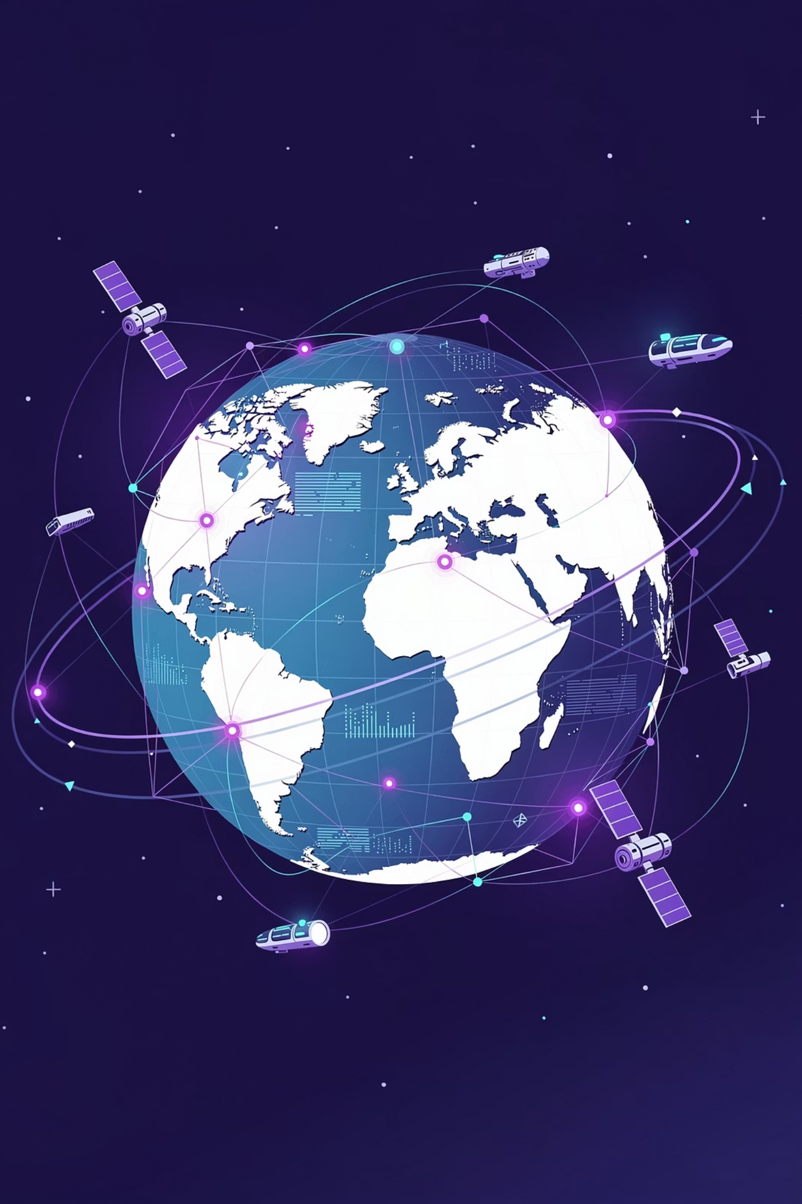


Scalable Data Management for Planetary Science
www.geodatasolutions.ch
Daniel Ribeiro
CEO
Austin Peel
Astrophysics Engineer
Swiss made software
Swiss digital service

Slide 2



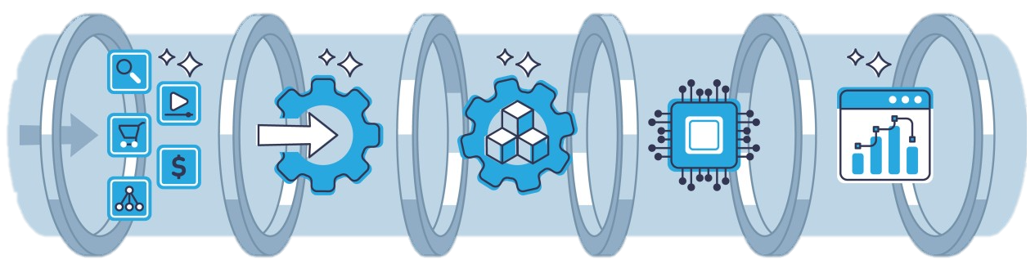


Challenges in Planetary (and Astrophysical) Sciences
Massive Heterogeneous Datasets
Coupled Multi-Instrument Pipelines
Weak-Signal and Precision Science
Multiple formats, scales, reference systems
Complex calibration, correction, modeling chains
Noise domination, instrumental drift, systematic effects
Reproducibility and Provenance
Long-Term Scientific Value
Data lineage across tools, teams, and time
Data must outlive instruments and projects

Slide 3
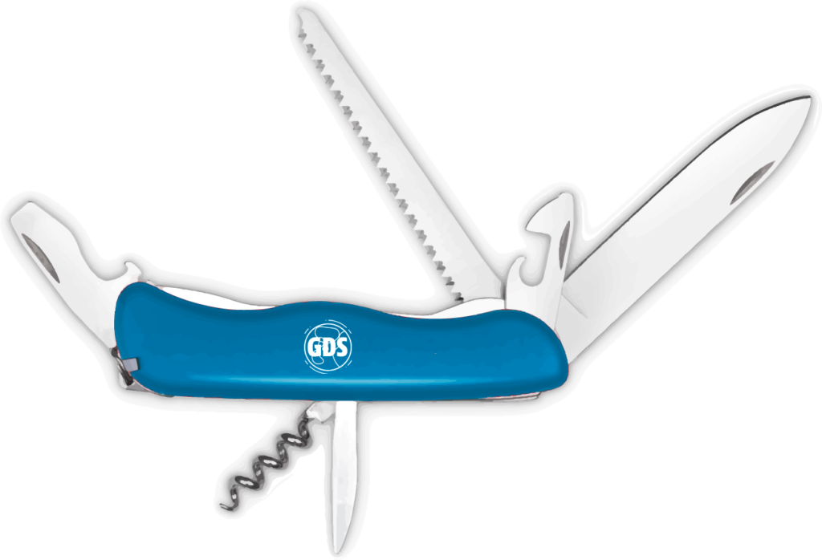






GeoDataSolutions | What We Do
Our data DNA
GIS
SPATIAL
Geodata, Geomatics
Geoinformatics, Cartography
Proficiency in several GIS solutions
Satellite data processing
GNSS, PNT, Earth Observation
Cosmology, Astronomy,
Architecture
Quality
Data design
Metadata
Storage
IT
IA & AI
Data
Governance
Repository
Processing
Development, Deployment
Hosting, Maintenance
Security & Pentests
ML, DL, LLM, SLM
Recognition, Geolocation
Acquisition, Automation
Authoritative
Data Source
Security
Single Source
of Truth
Interoperability
BA+UX
PROJECTS
Files &
contents
Business analysis
Work processes and data
Support
Management, Organization
Leadership, Steering
Hermes, Scrum Certifications

Slide 4
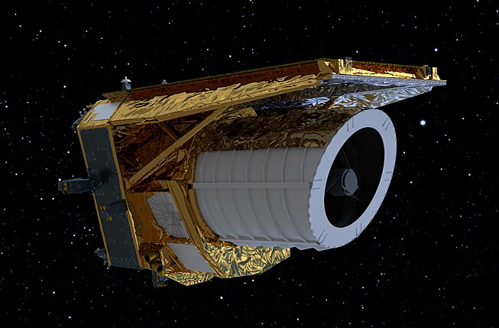

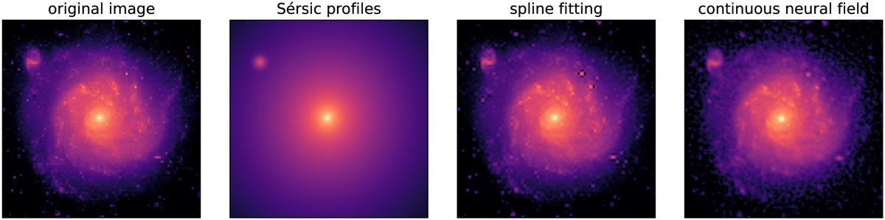
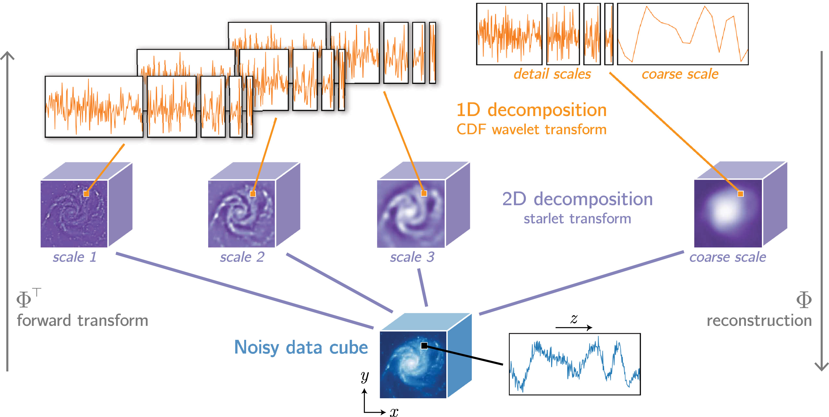
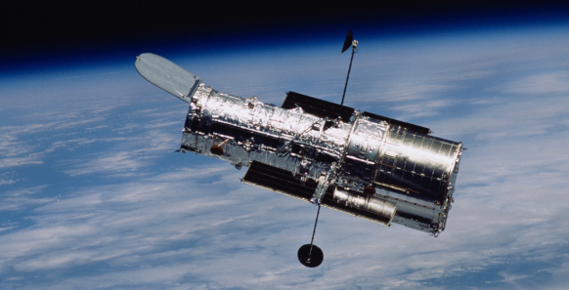


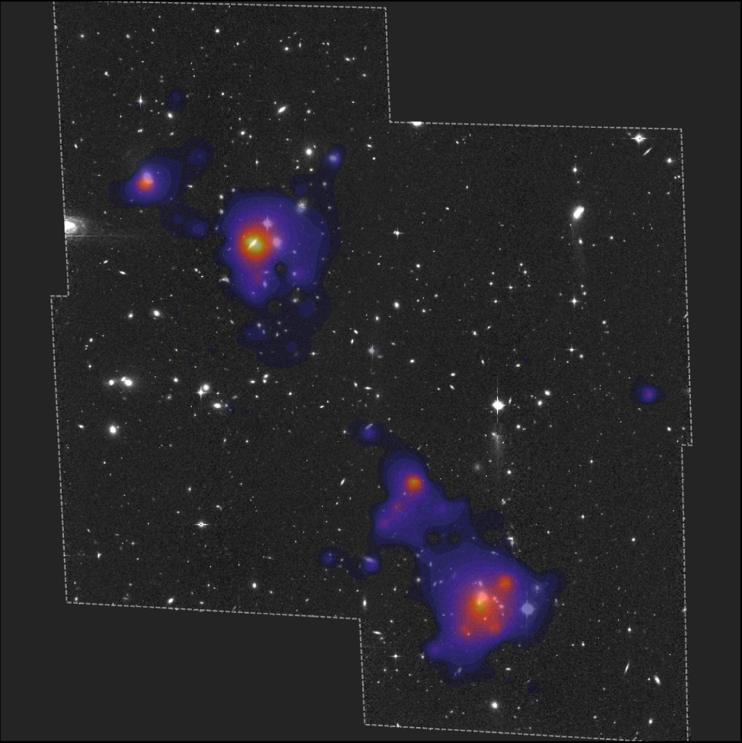
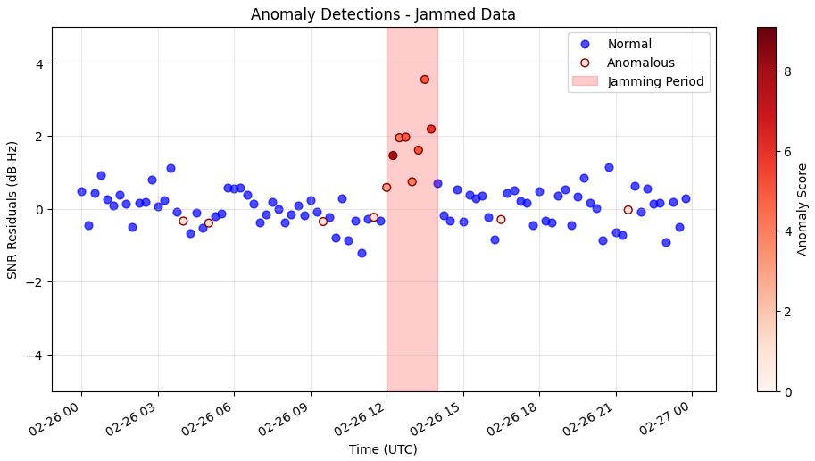

Data-Driven Challenges in Practice
Multi-Sensor Spatial Data
Aligning images, catalogs, reference frames
Signal Processing & Denoising
Extracting weak signals from structured noise
Image Reconstruction
Inverse problems, PSF deconvolution, inference
GNSS Interference Mitigation
Detection and correction of signal disruption
Notes:
1. Integration across platforms

Slide 5
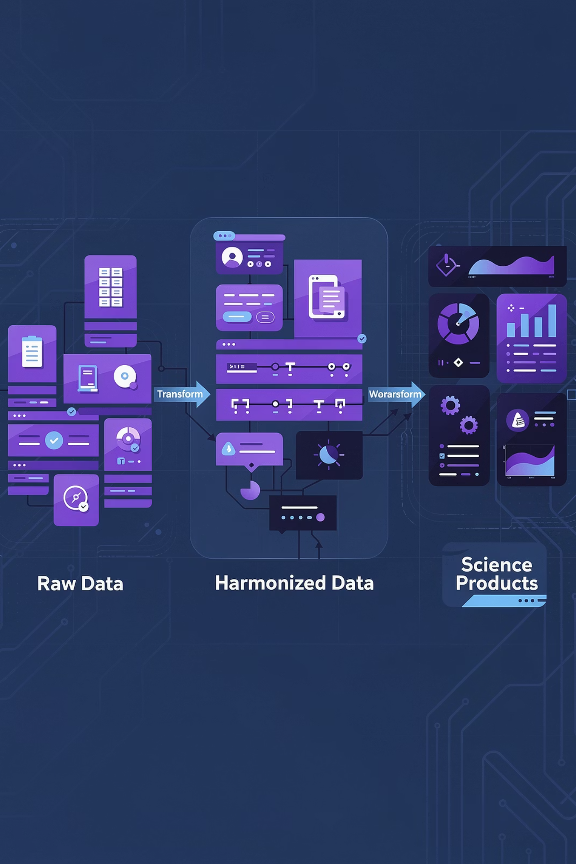
From Raw Data to Science
Raw Immutable Data
Single authoritative copy, never modified
Analysis Ready Data (ARD)
Harmonized standards: coordinates, time, units, formats
Science Products
Derived datasets, catalogs, models, AI features
Connected through ETL pipelines with traceability and versioning. No unnecessary duplication.
ESA – Earth Online
NASA – Earthdata
Microsoft Planetary Computer
ESA’s ESASky
GEODES – CNES Earth Observation Portal
NASA Open Data Portal
Copernicus Data Hubs & Services

Slide 6


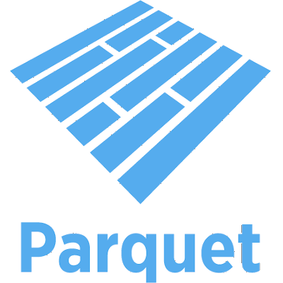


Scalable Data Structures for Science
Chunked, Analysis-Ready Data Structures
Used today in both GIS platforms and space data science systems (ESA, NASA, Copernicus)
Cloud Optimized GeoTIFF
Multi-dimensional data cubes
Efficient large-scale image access
Catalogues and
tabular data
What These Enable
Partial, region-of-interest access
Parallel and distributed computation
No duplication of raw data
On-premise and cloud compatible

Slide 7



If Data Is Not Catalogued,
It Does Not Exist
Essential Metadata
STAC
Standard
Source & responsible party
Time coverage
Initiated 2017, widely adopted 2018
Sensor & resolution
Integrated into OGC 2025
Format & quality
Public or private metadata
Update frequency
Automated discovery
Design cataloguing from the beginning. Retrofitting at 50–100× data volume becomes extremely difficult.
Copernicus Data Space Ecosystem Catalogs
ESA Earth Online Catalog
NASA Earthdata Catalog
NASA Open Data Portal Catalog
Microsoft Planetary Computer Catalog
ESA ESASky Catalog interface
NASA Infrared Science Archive (IRSA) Catalogs
ESO / ST-ECF Science Archive Catalogs
MAST (Mikulski Archive for Space Telescopes)
SIMBAD / VizieR (astronomical object catalogs)

Slide 8
Data Is Scientific Infrastructure
Structure
Preserve
Reuse
Organize for clarity
Ensure longevity
Maximise value
Scale
Discover
Handle growth
Enable access
"ETL and architecture are not IT — they are science."
Thank you — we are happy to discuss further.
contact@geodatasolutions.ch
www.geodatasolutions.ch

