Slide 1
IUPAP WG14 – Meeting #20
Approval of earlier Minutes
Christine Darve
May 2025
Tuesday May 13th at 4-5 pm CEST:
https://indico.global/event/14628/
Wednesday May 14th at 1-2 pm CEST https://indico.global/event/14629/

Slide 2
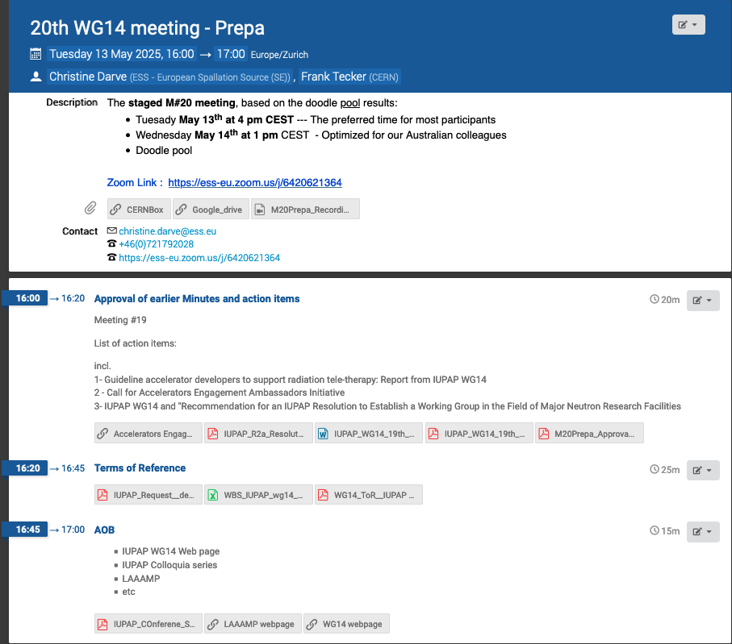
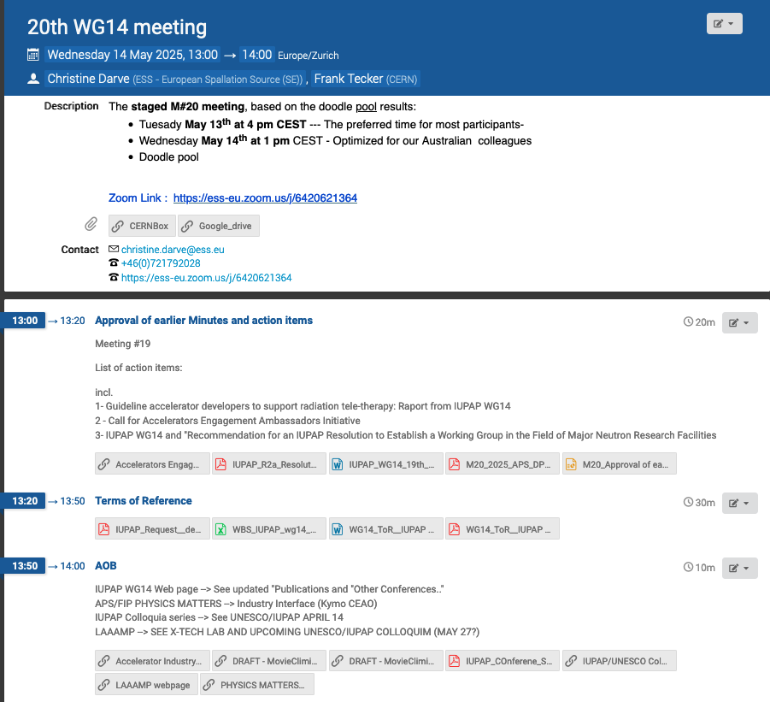
https://indico.global/event/14629/
https://indico.global/event/14628/
prepa

Slide 3
Details links on Meeting #20 AOB
#1) Accelerator Industry Permanent Forum (AIPF) - Public meeting - BSBF
#2) DRAFT - Movie Climate Change Part 1
#3) DRAFT - Movie Climate Change Part 2- Salama
#4) IUPAP support School/Conf.
#5) IUPAP Colloquia series --> See UNESCO/IUPAP April 14
#6) LAAAMP --> See X- Tech Lab, and upcoming UNESCO/IUPAP Colloquium (May 27?)
#7) APS/FIP PHYSICS MATTERS --> Industry Interface (Kymo CEO- Raffaella Geometrante)
“Accelerating Innovation: Industry & Research Creating Value Together" by Dr. Raffaella Geometrante
IPAC'25 - Insertion Devices for Future Light Sources Workshop (ID25)
Accelerator Science and Technology Industry Permanent Forum (AIPF)

Slide 4
Pending actions – from earlier Meetings
Meeting #19 (March 2025): https://indico.global/event/14301/
Action Item 1→ IUPAP-WG14 member to send their sections to Michael Moyer [MMoyersPaper]. → see CERNBOxfile ; GoogleDrivefile → WG14 member will send input by July 31, 2025 to Michael
Action Item 2→ Suzie S. to update the Call to include MSc candidates (revised to: “MSc, PhD, or <10 years post-PhD FTE”). → See update here
Action Item 3→ Simon C. to check with Danas R. on using the IAEA platform (Project INT0104) for the Ambassador program. → IAEA/Dana R. will support (admin) expansion of INT0104 to include Acc.
Action Item 4→ Suzie to share the timeline for inclusion as a WBS in the ToR → See WBS_13May2025
Action Item 5→ CD. to request the DPB slides from Mark Palmer and share them with WG14 members following the APS Global Physics Summit. –> see CERNBOxfile ; GoogleDrivefile
Action Item 6 → Yuan H to send link of interest to be added to WG14 webpage → see webpage “Publications”
NB: Meeting #14 (Dec. ‘23): Review of “Web Based Accelerator Science Content” - postponed
To be confirmed by IAEA : File

Slide 5
Open questions to complete ToR ?
Transversal activities vs. IUPAP Restructuration: WG under Commission C11 or C12 or else ?
Add Associated member: C13 interface by Joe Niemela or Thierry d’Almeida (Benin) ?
(replace Sekazi Mtingwa/LAAAMP)
→where feasible ,WG14 aims to organize or support the awarding of medals (award ) or other recognitions of excellence in the field of accelerator science. These initiatives may be developed in collaboration with other IUPAP Working Groups and Commissions to ensure broad engagement and alignment with the Union’s values
→ Budget : Create Value (See ToR, chapter 6: Resources and Budget)

Slide 6
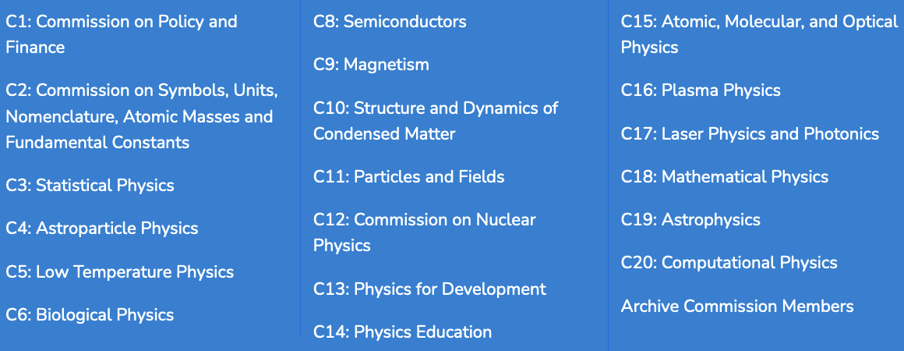
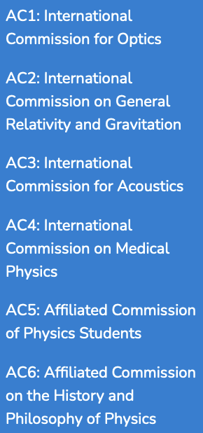
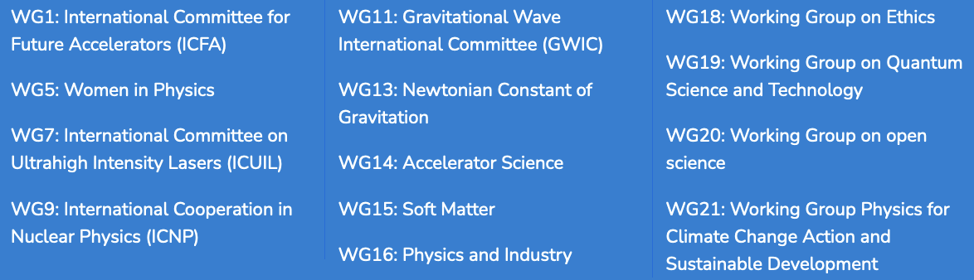
Reminder : other IUPAP Units (prior restruc.)

Slide 7
Storing data
WG14 - webpage
  International Union of Pure and Applied Physics (IUPAP) WG14 - Accelerator Science
WG14 Documents storage:
CERNBox : Access : https://cernbox.cern.ch/s/fzIlZ8y2Immi9vD
Google drive: https://drive.google.com/drive/folders/1gWm8WDKYApnhECyCRrLoi9Akq9KfveFa

