Slide 1
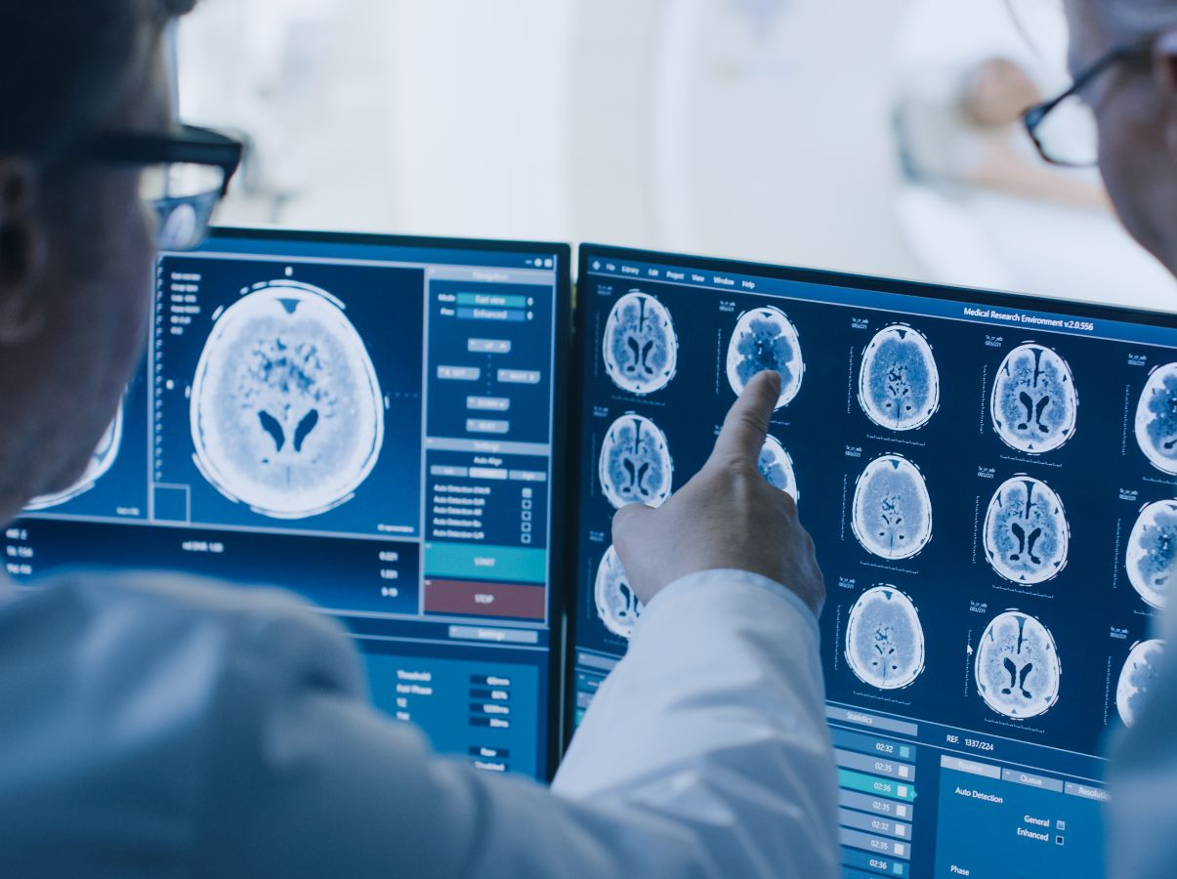



CERN'deki Dijital Teknolojiler
Alessandro Raimondo
CERN Knowledge Transfer Group

Slide 2
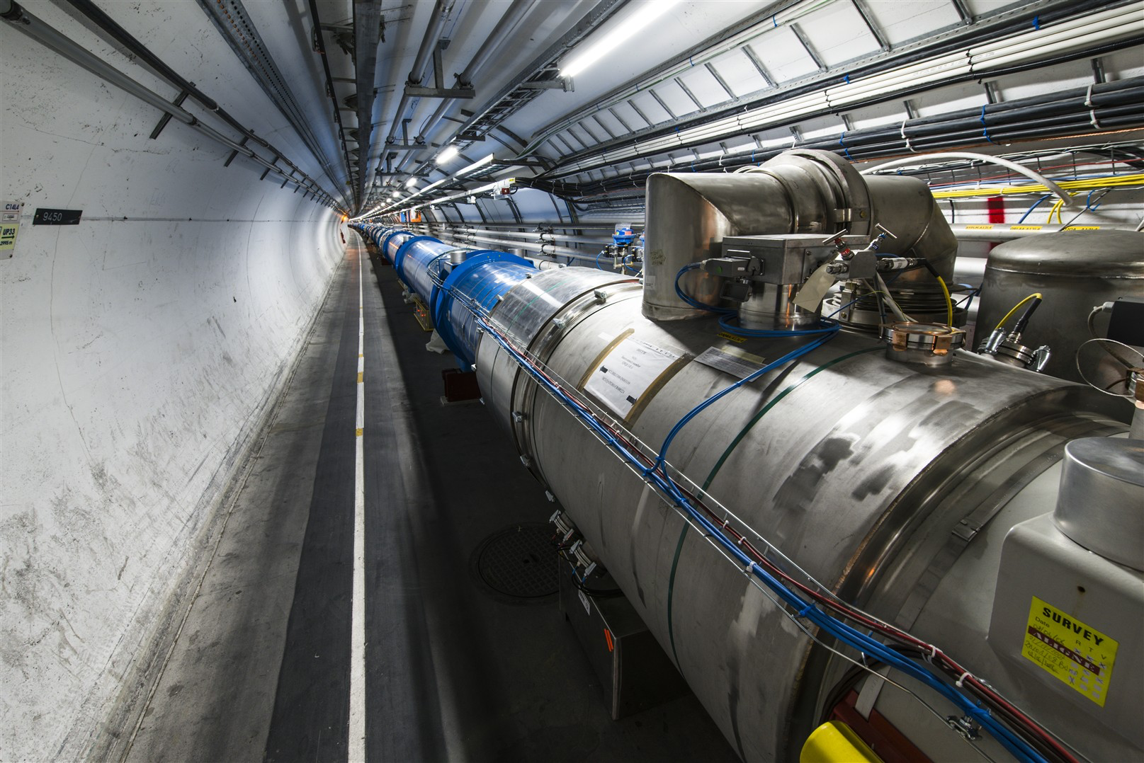
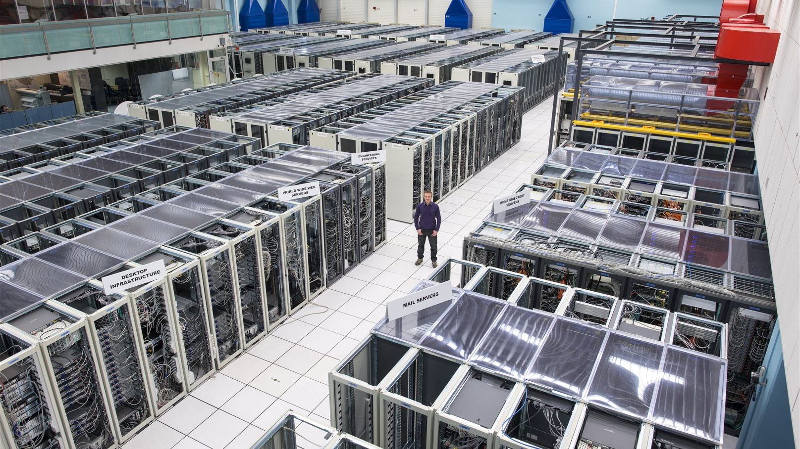
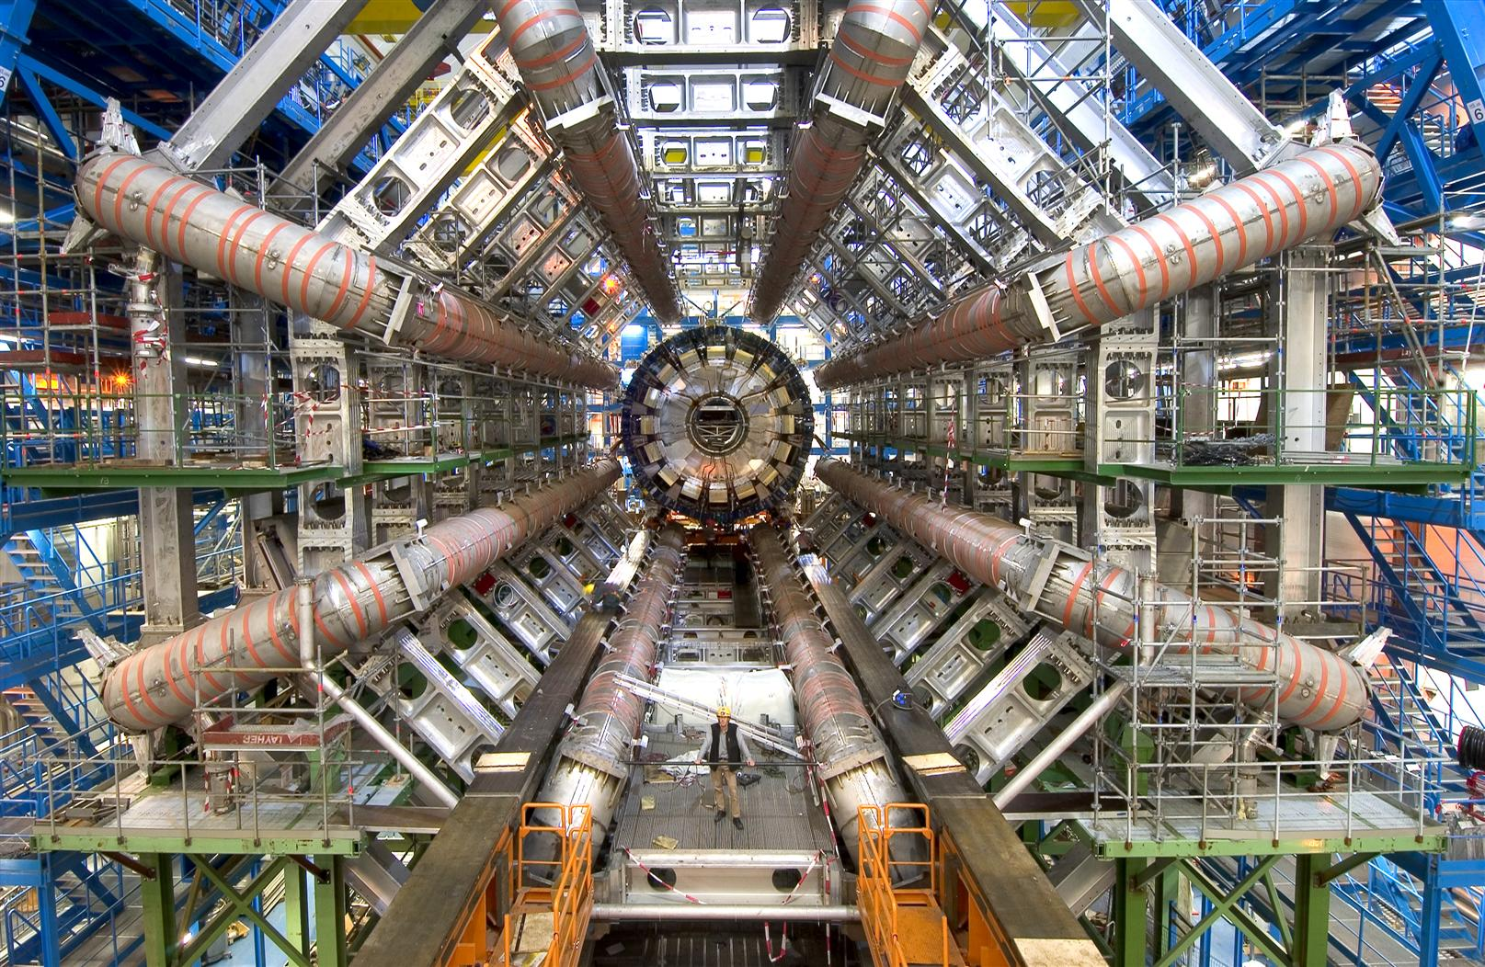
CERN Technology Pillars
Accelerators
Computing
Detectors

Slide 3
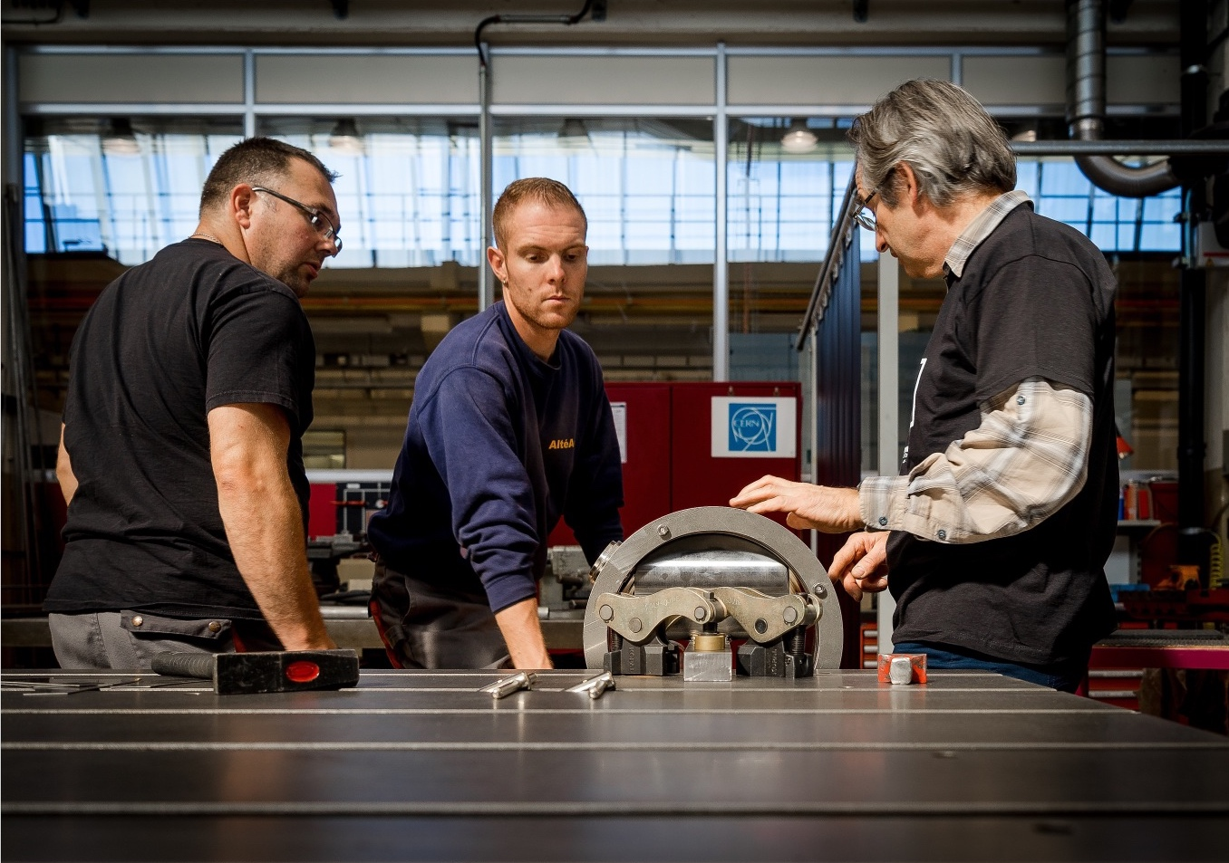
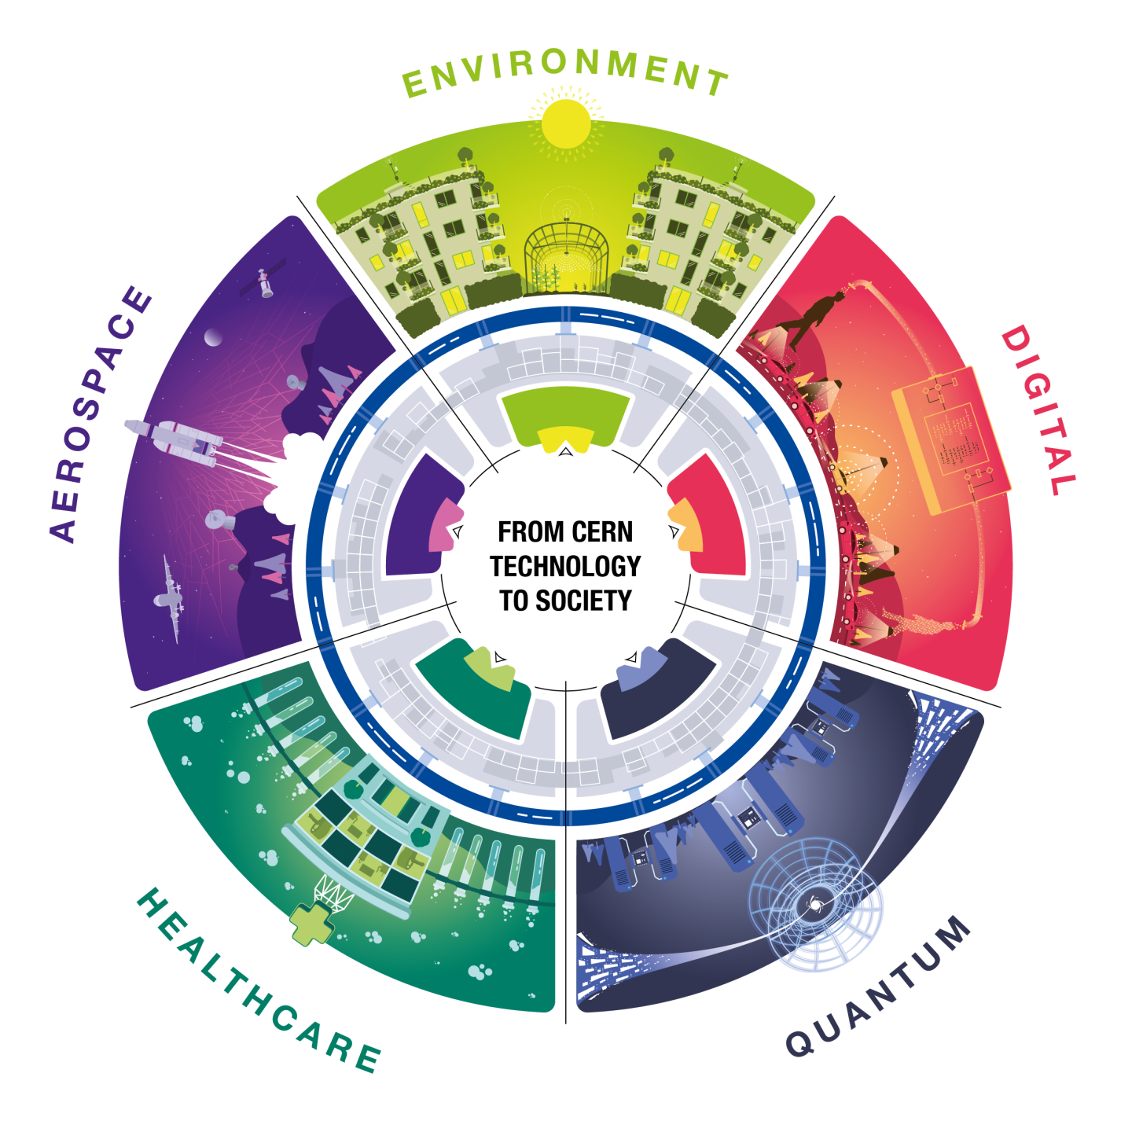
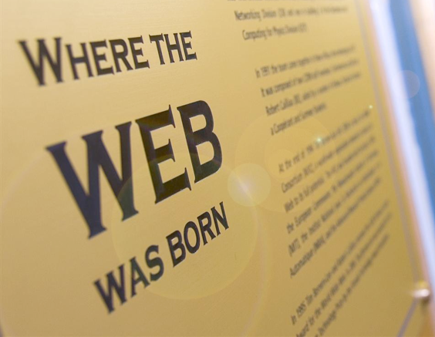
Knowledge Transfer

Slide 4
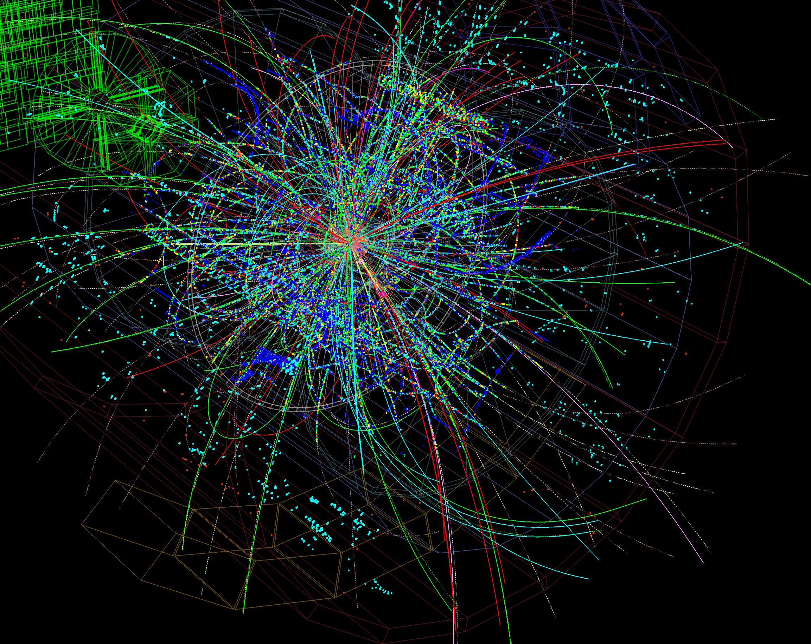
Computing
Processing LHC data
FACTS
The LHC collides protons at unprecedented energy, equivalent to 13,000 times their mass.
40 Million collisions/sec, one every 25 ns. About 40 collisions per event.
Thousands of particles emerge from each collision.
1 MB of data recorded by the detectors at each collision. Too much to be stored.
Only 5% of those are stored after filtering. About 80 Pb of derived data per run.

Slide 5
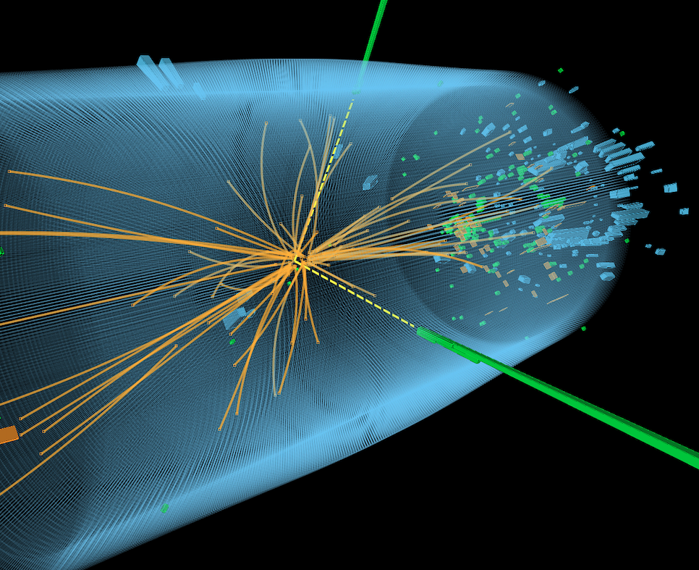
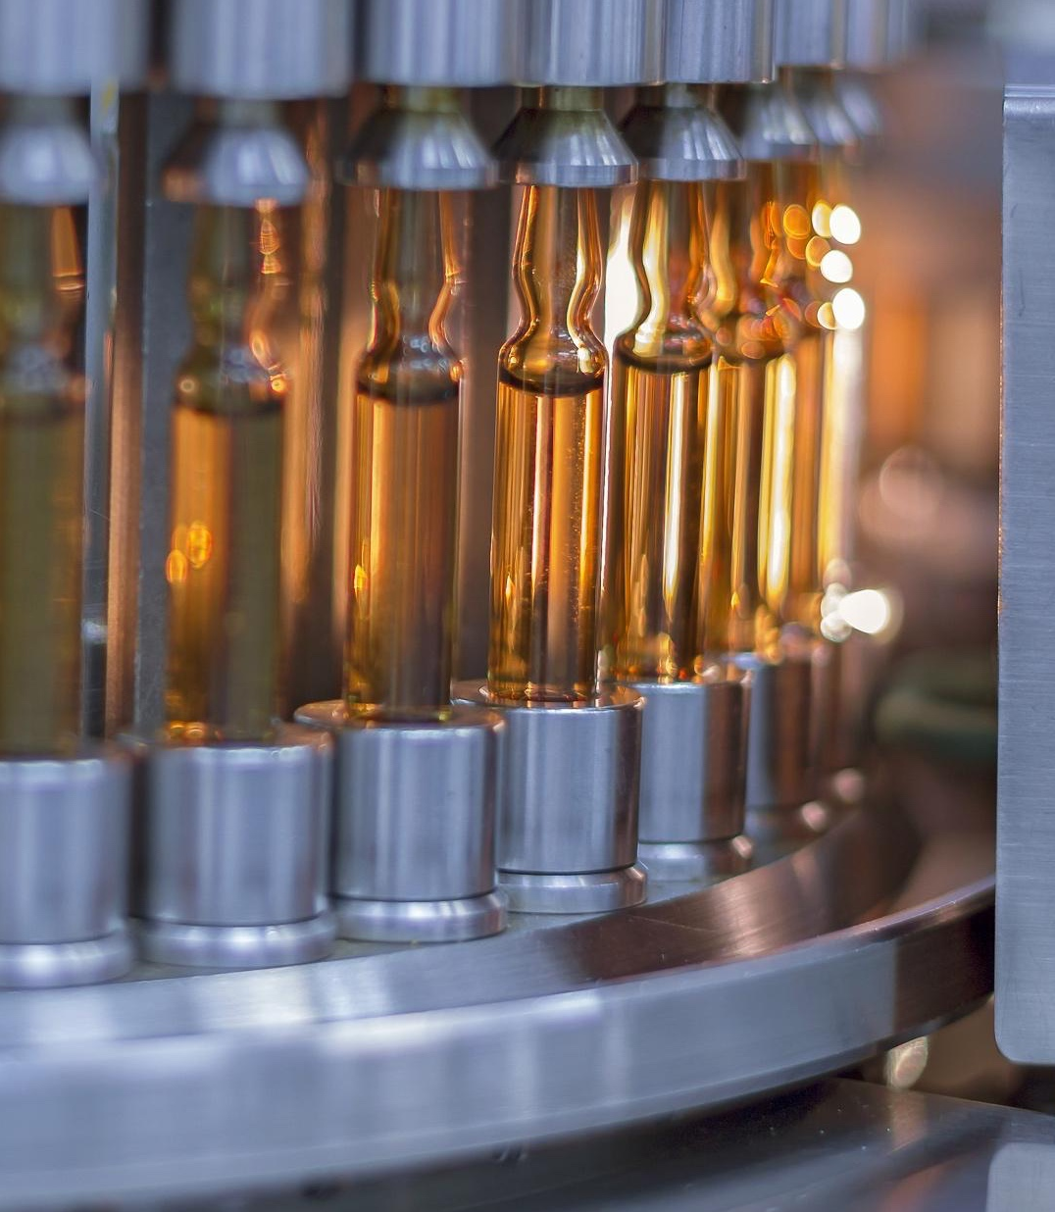
ROOT

Slide 6
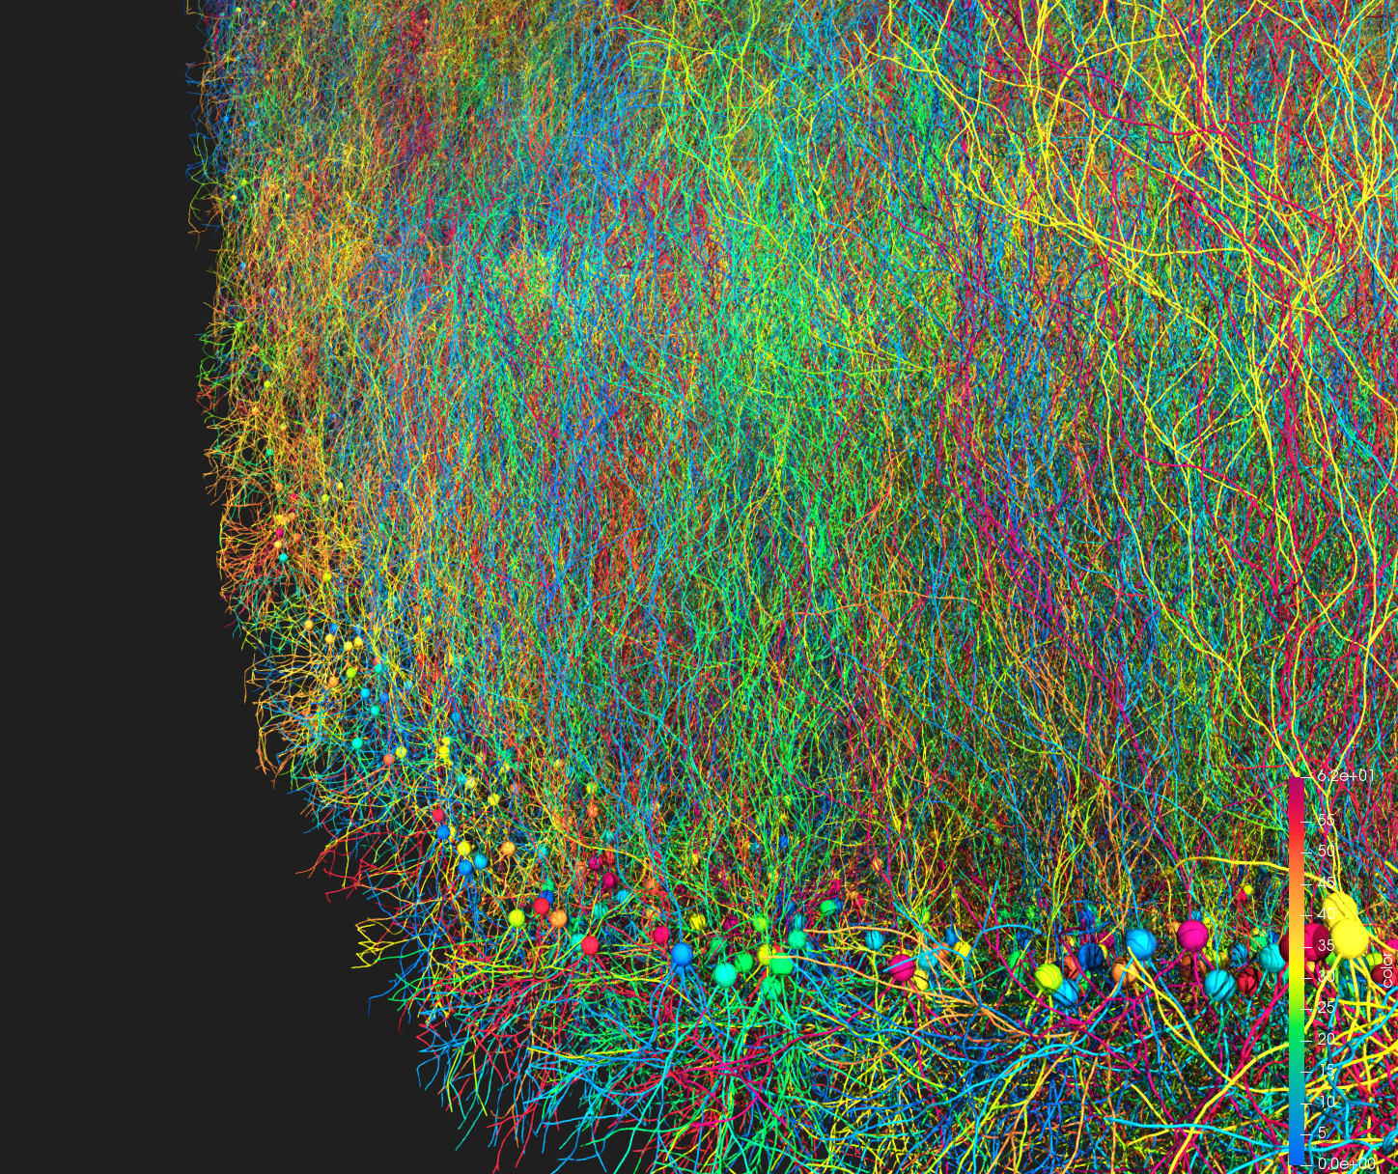

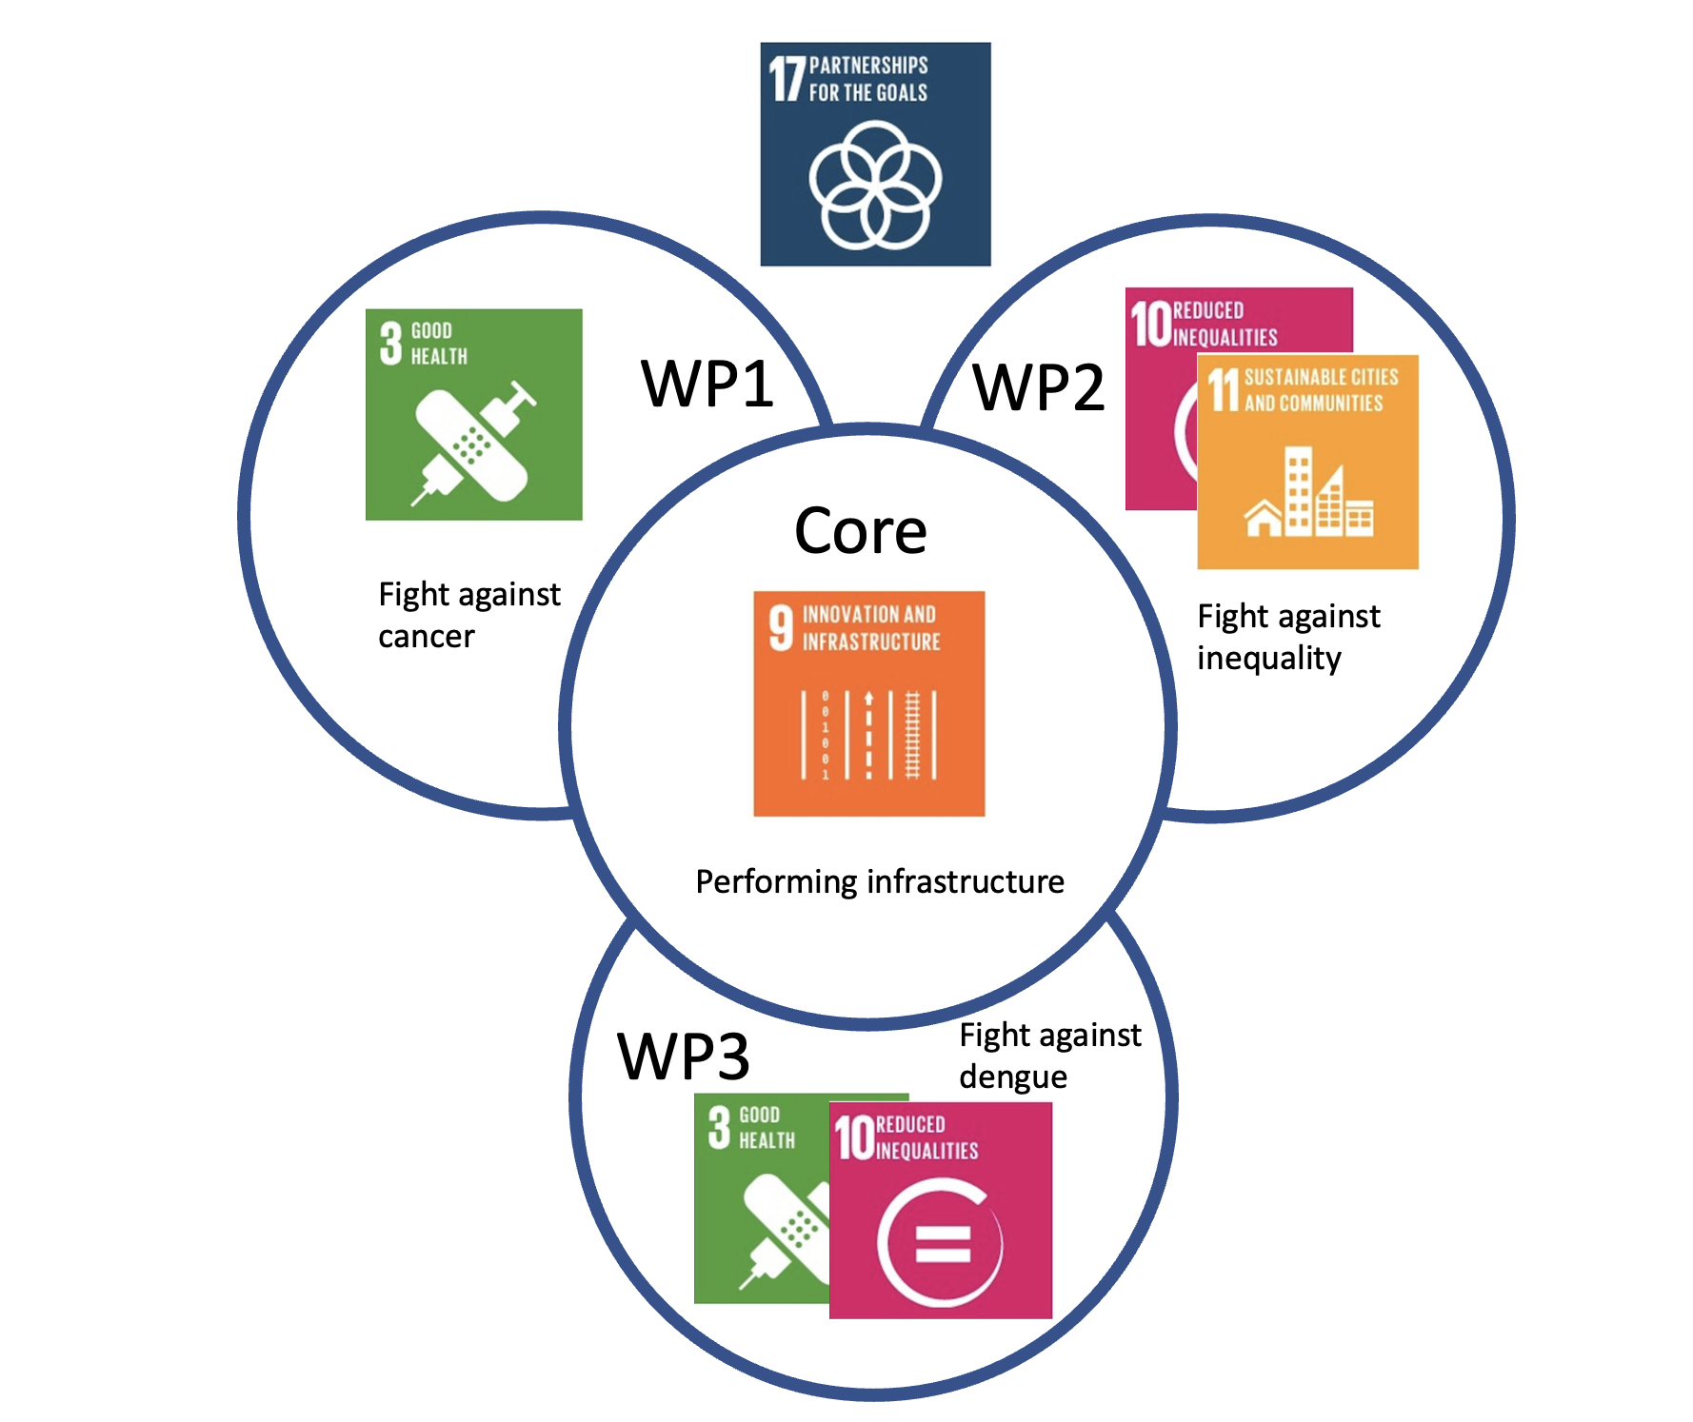
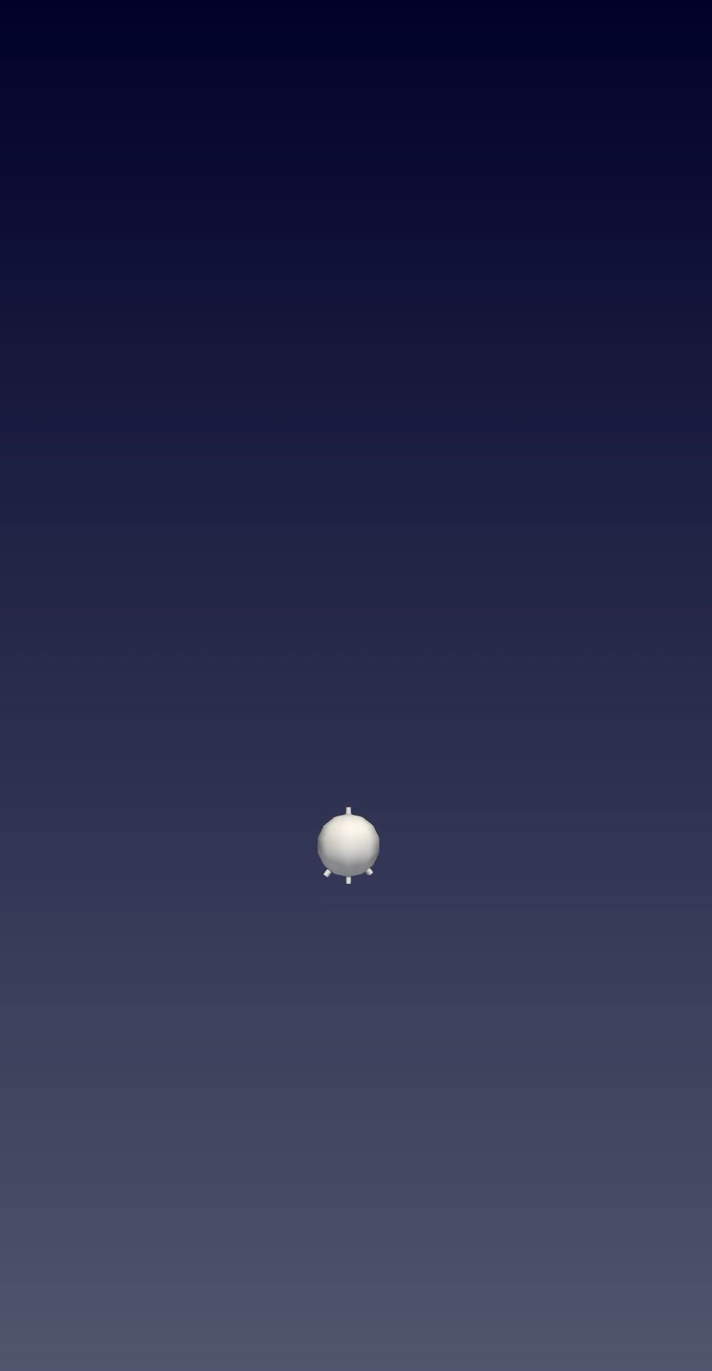
BioDynaMo

Slide 7
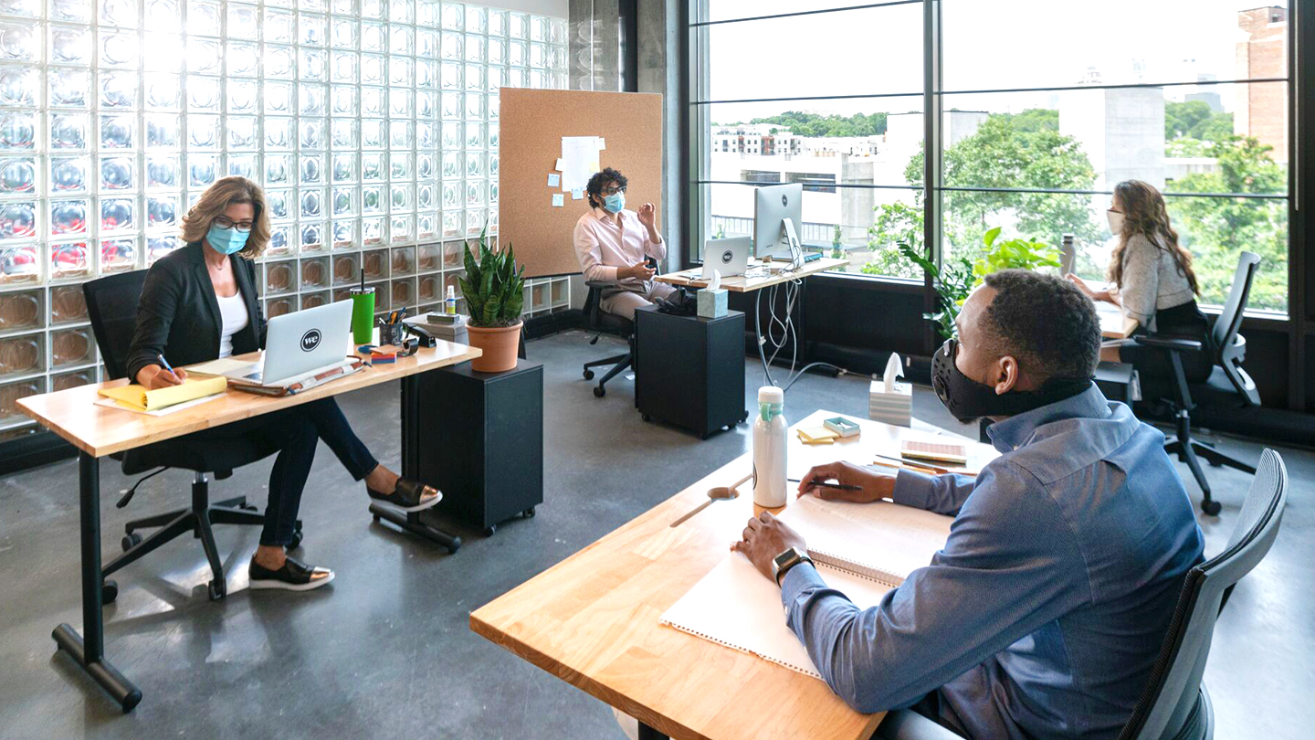
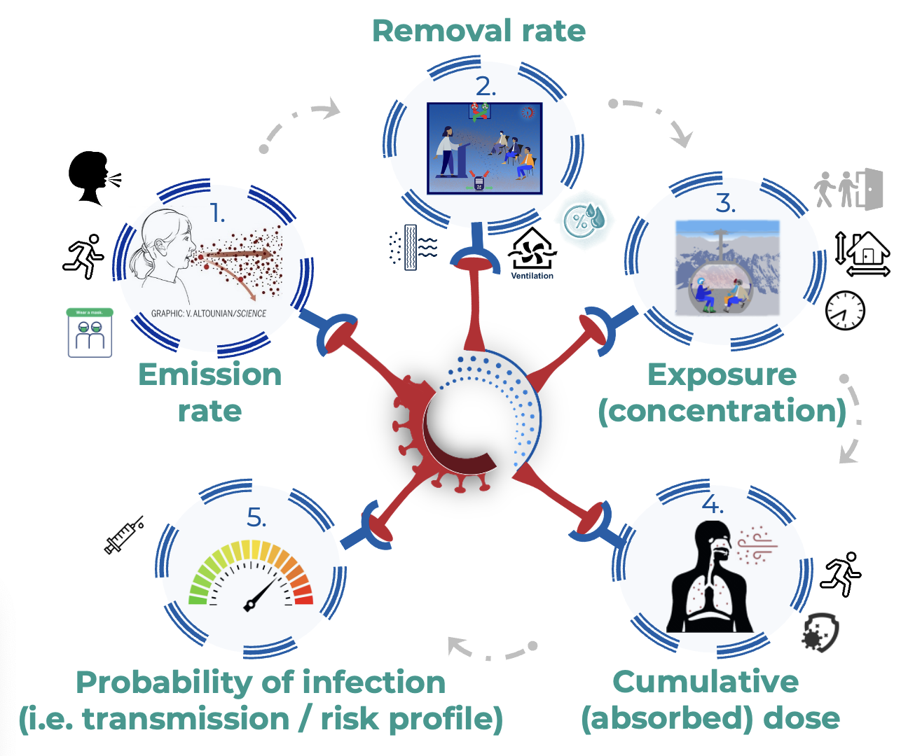
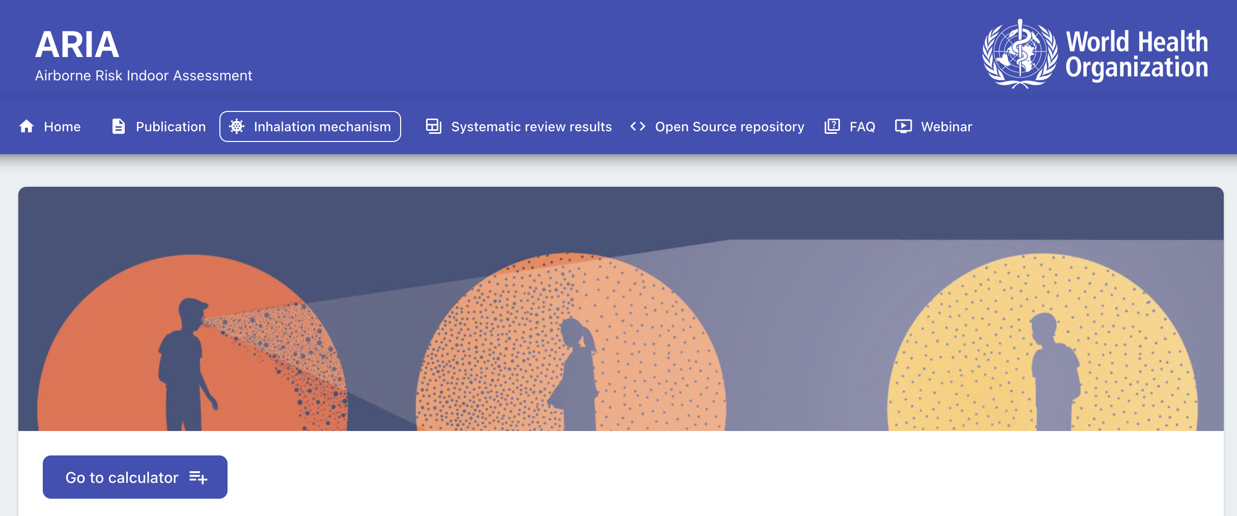

Slide 8



Slide 9
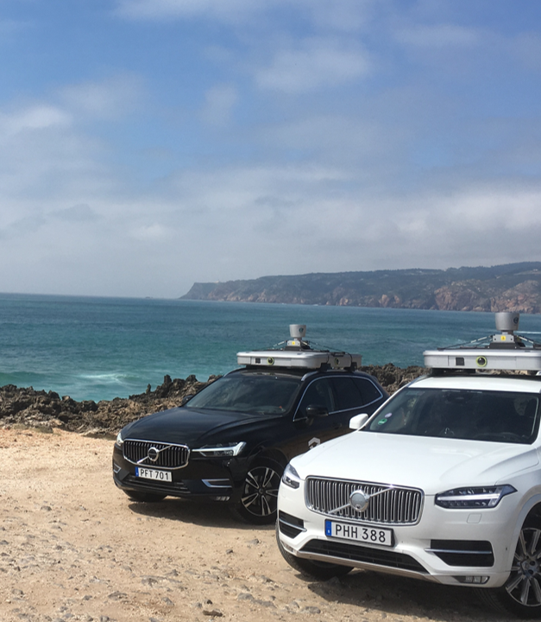


Slide 10

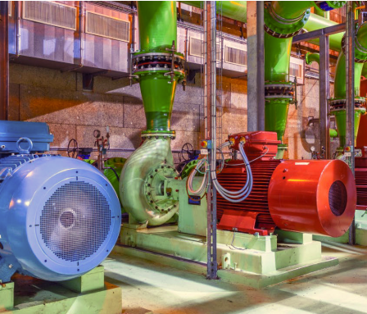
Digital Twins

Slide 11
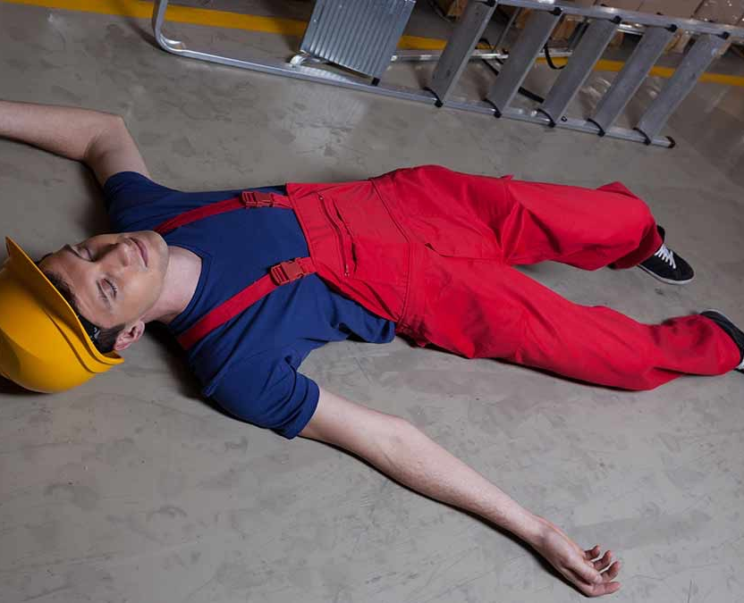
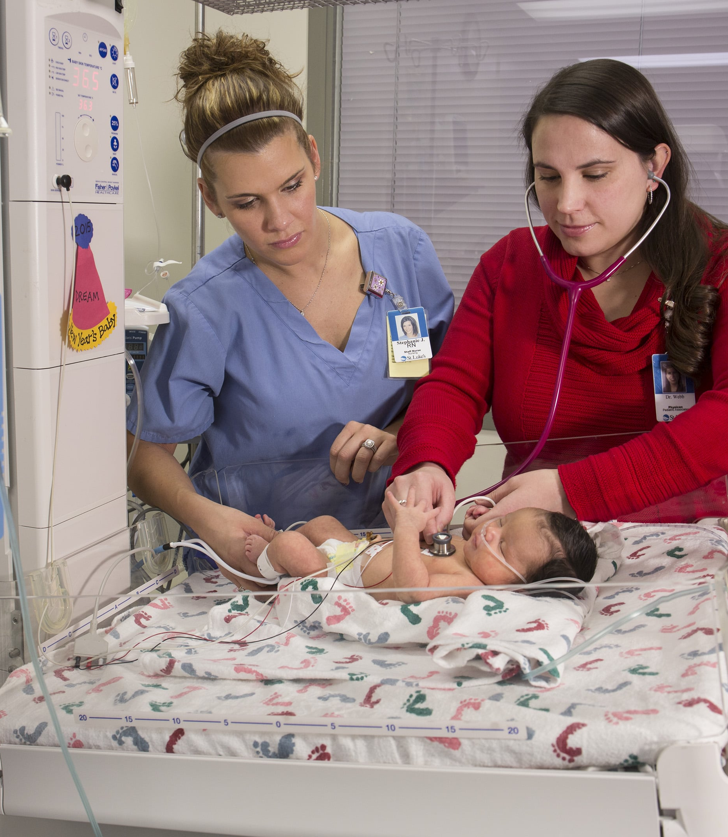
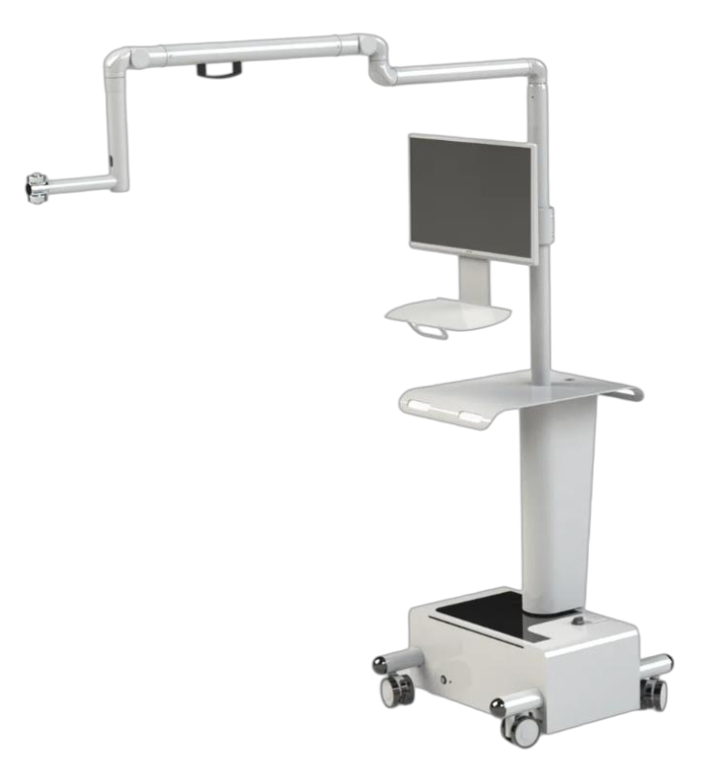
MARCHESE
Courtesy R. Cittadini, Mechatronics Group

Slide 12
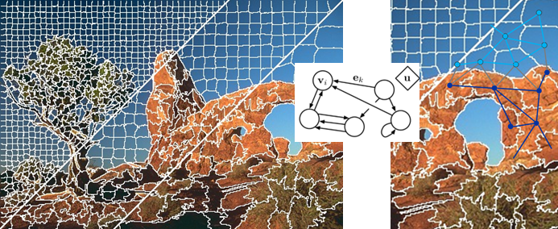
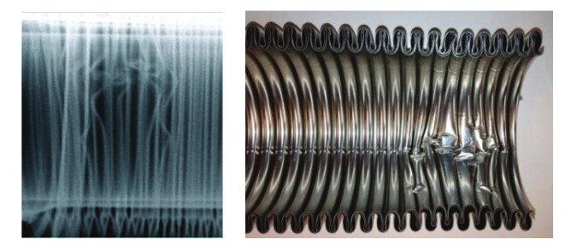
Images
Segmentation

Slide 13
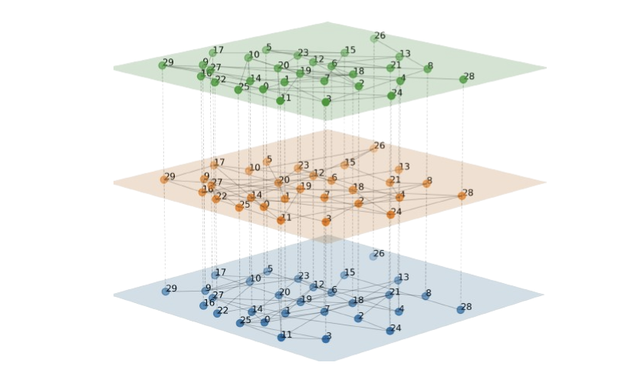
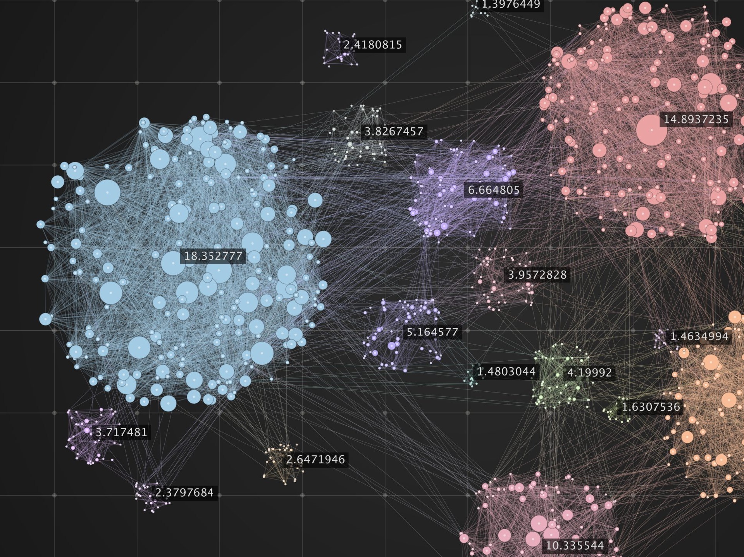
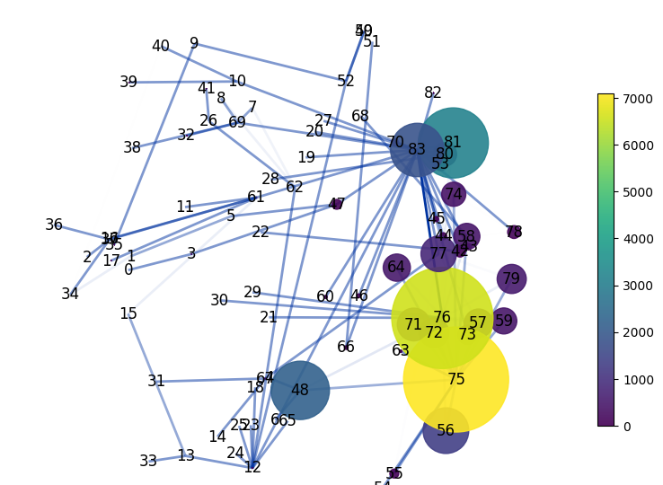
Graph Neural Networks

Slide 14
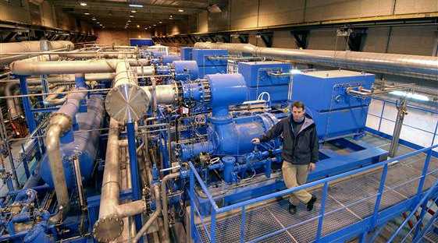
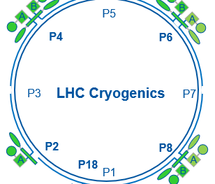
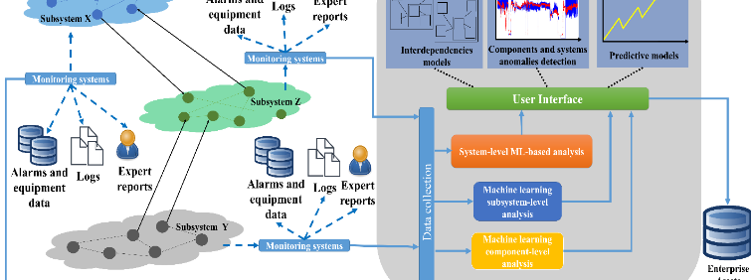
Predictive
Maintenance

Slide 15
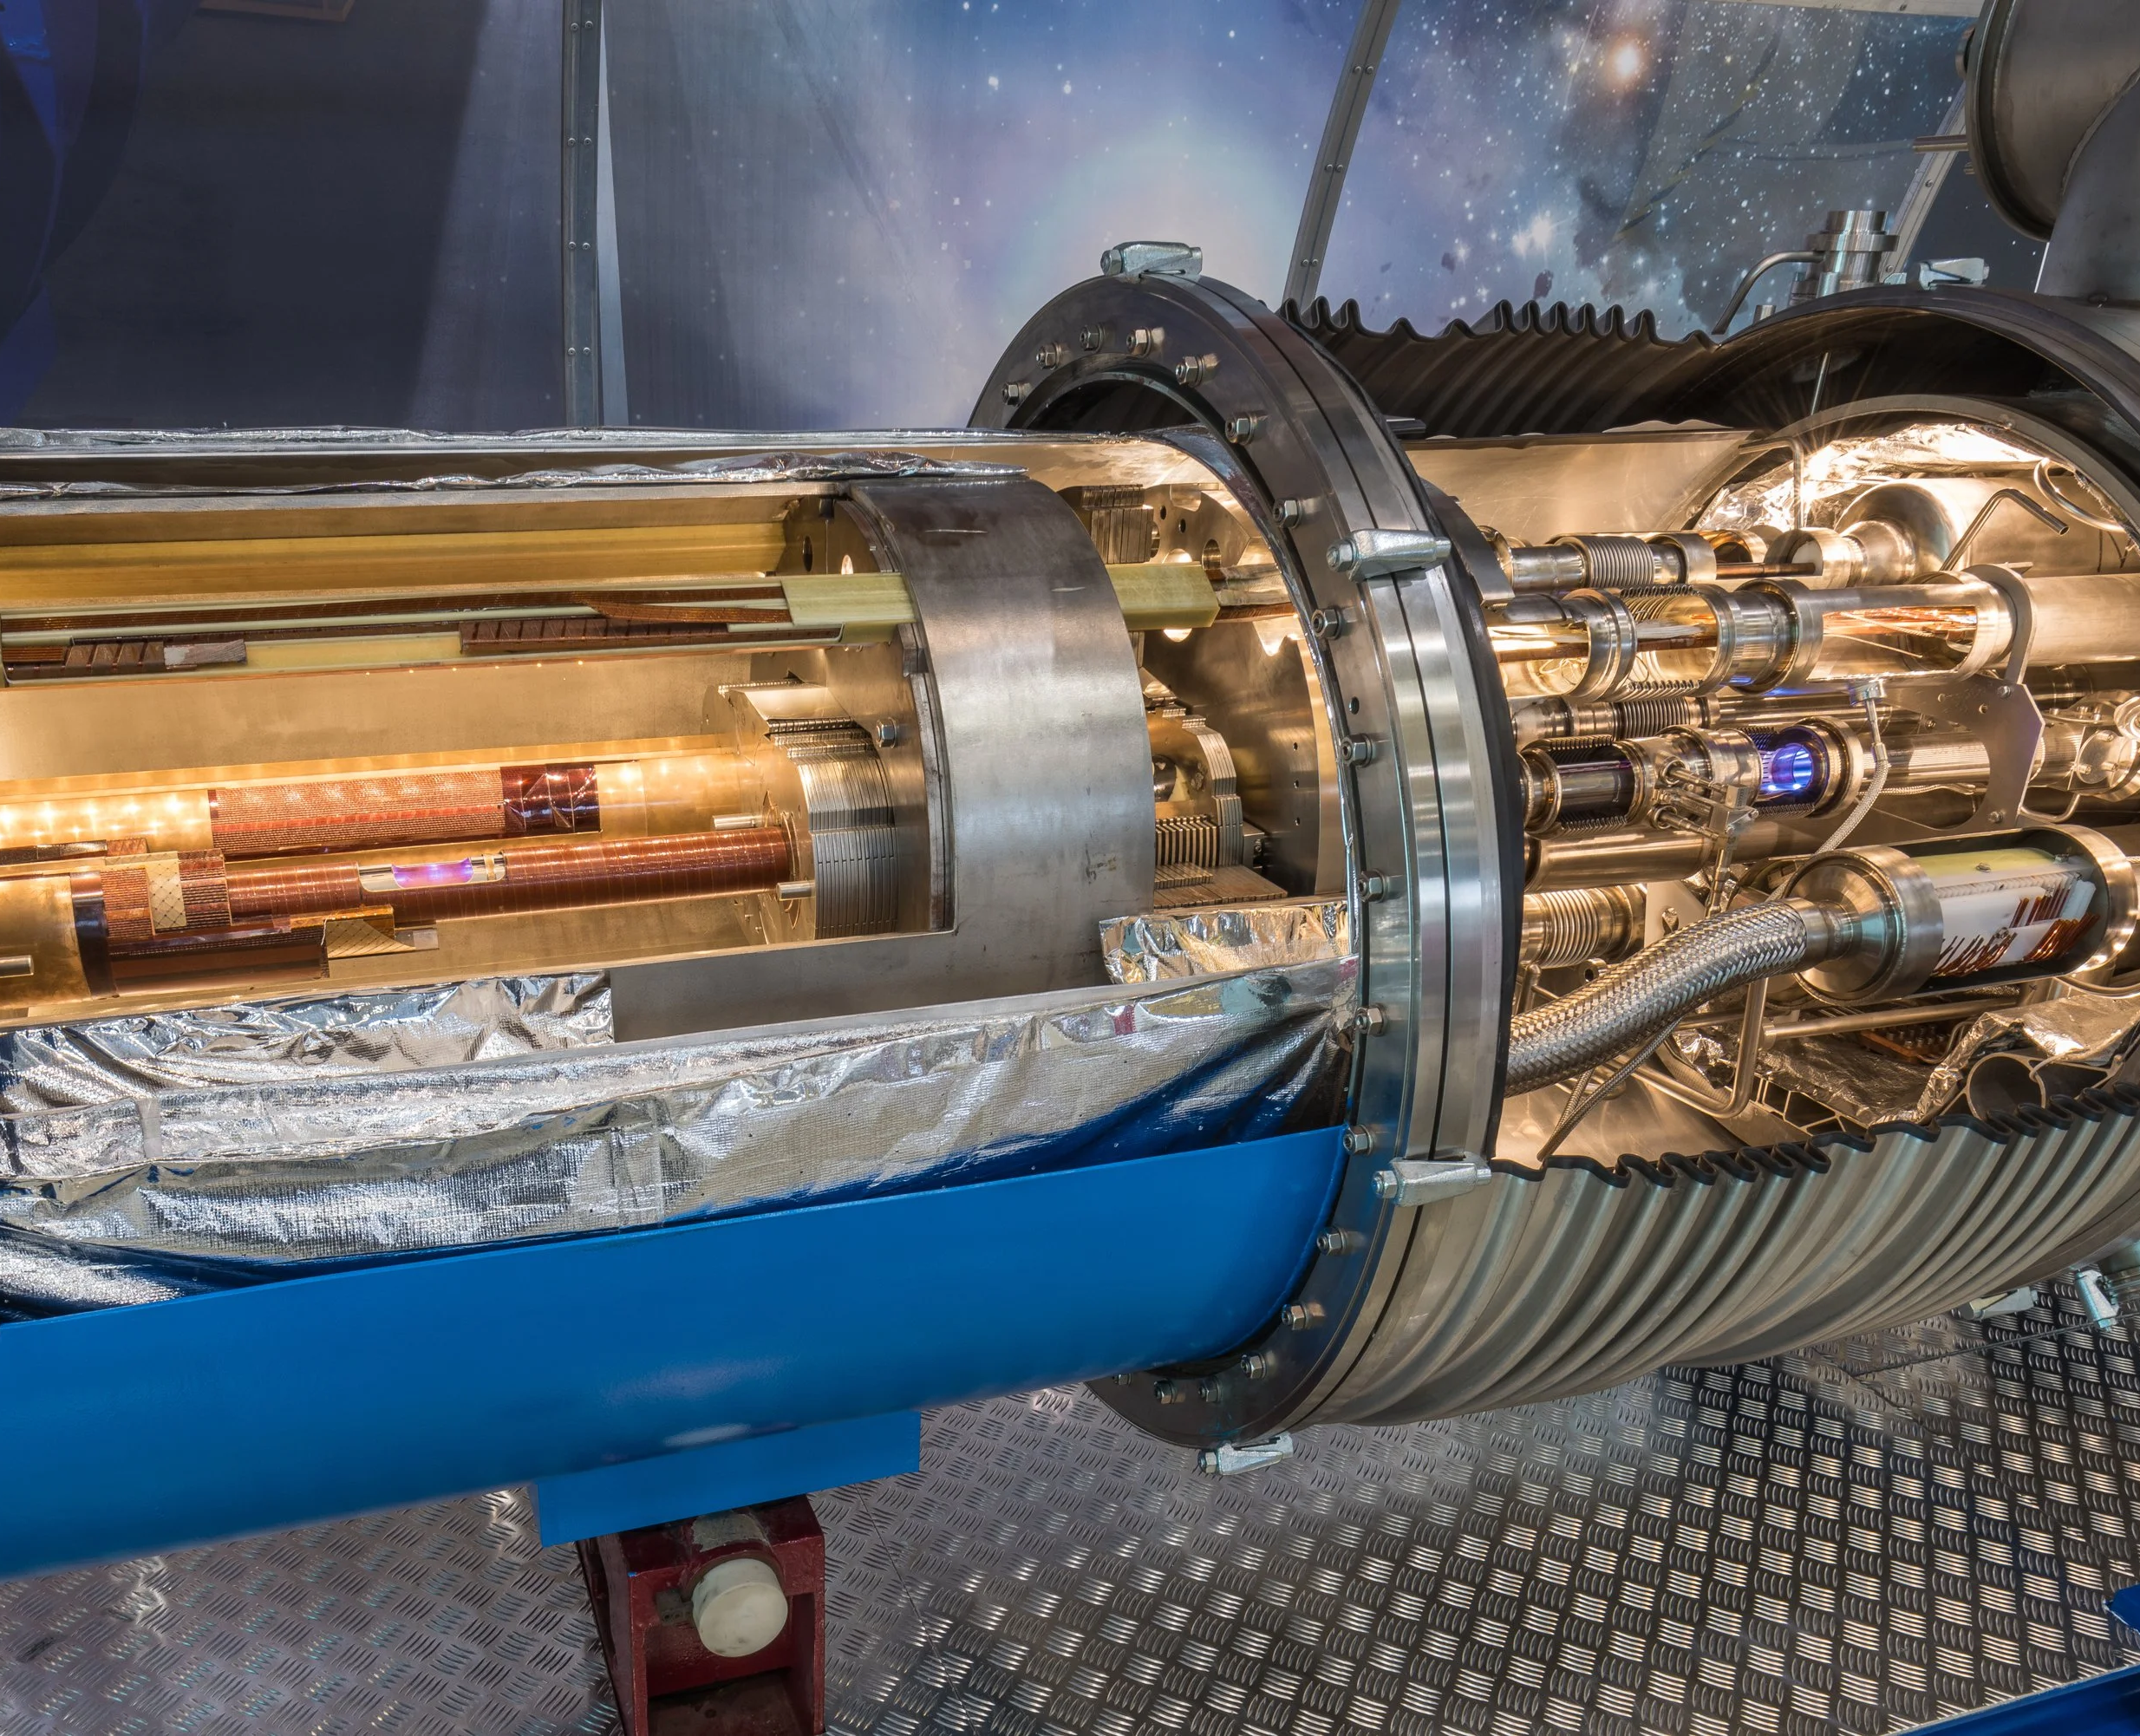
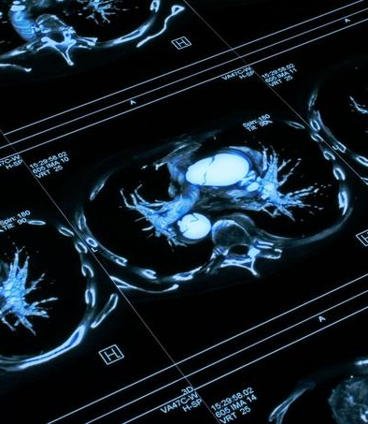
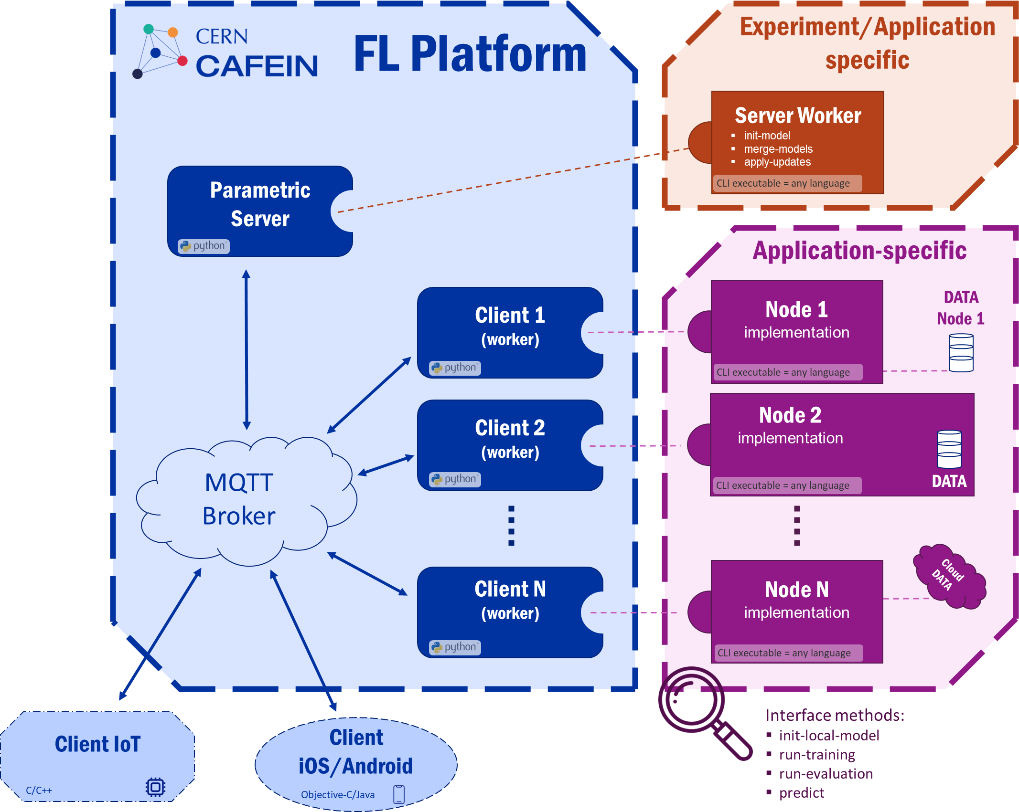



CAFEIN

Slide 16
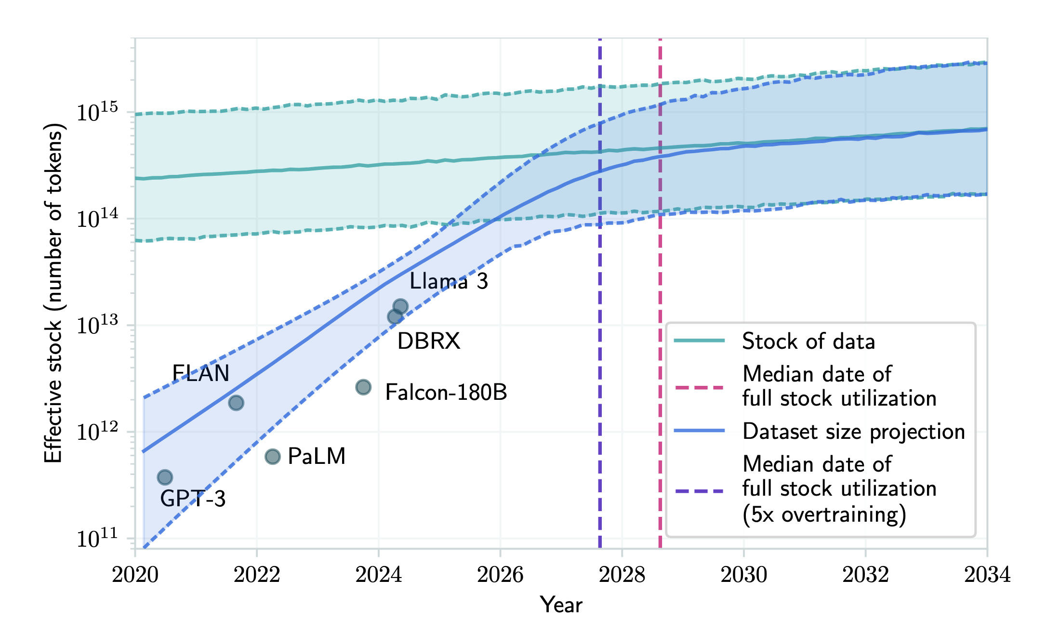
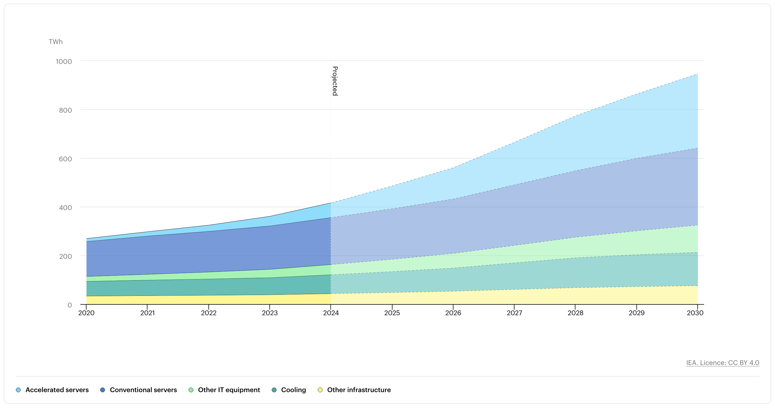
Projections of the effective stock of human-generated public text and dataset sizes used to train notable LLMs
P. Villabos et al., 2022
Limitations of the growing use of AI
Global data centre electricity consumption, by equipment, Base Case, 2020-2030
International Energy Agency, 2024

Slide 17



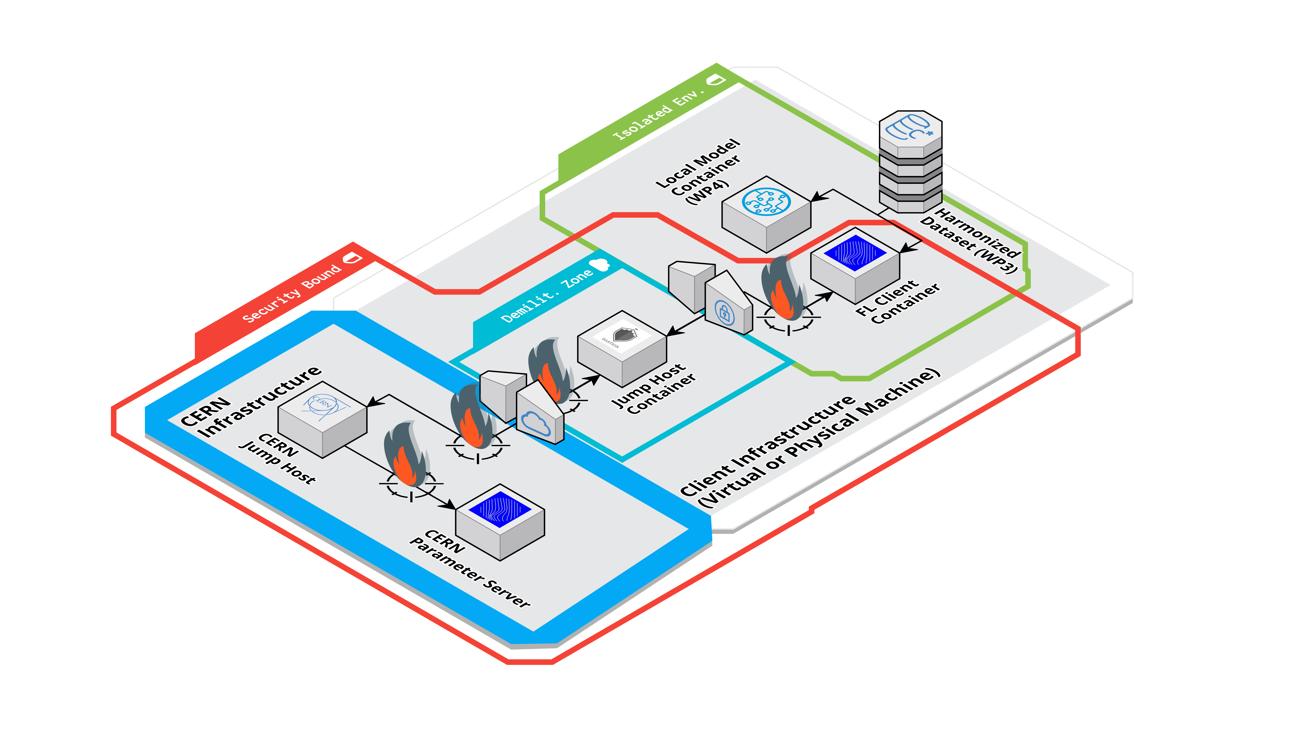


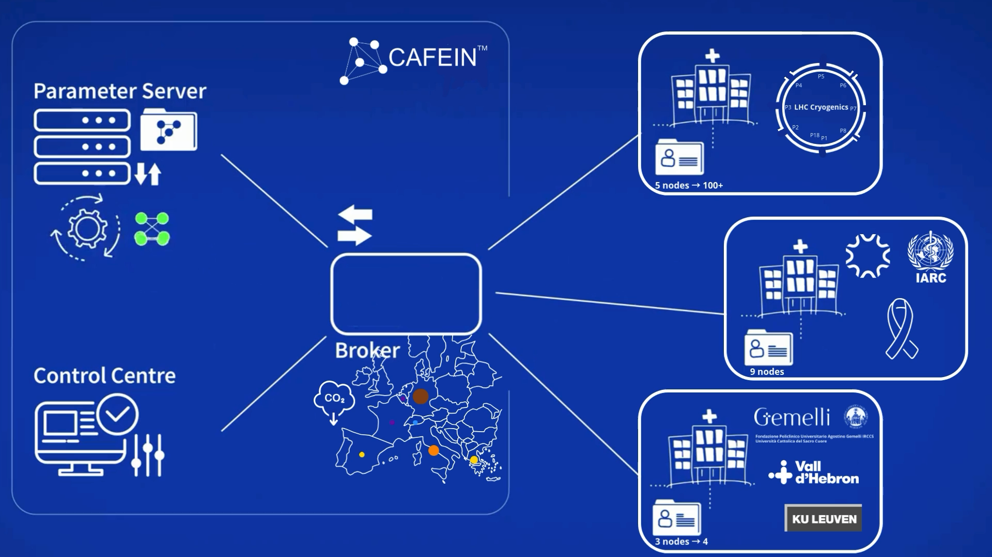
CERN CAFEIN®: privacy and security
PRIVACY BY DESIGN
State-of-the-Art cybersecurity measures identification and deployment
Solid methodology of threat modelling, risk assessment, and risk treatment

Slide 18
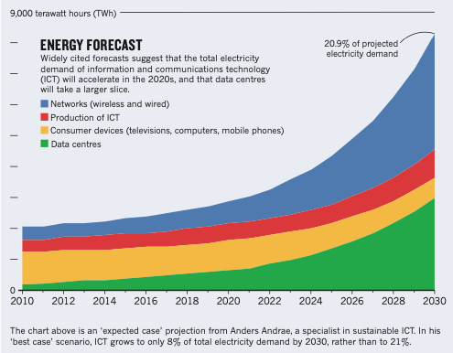
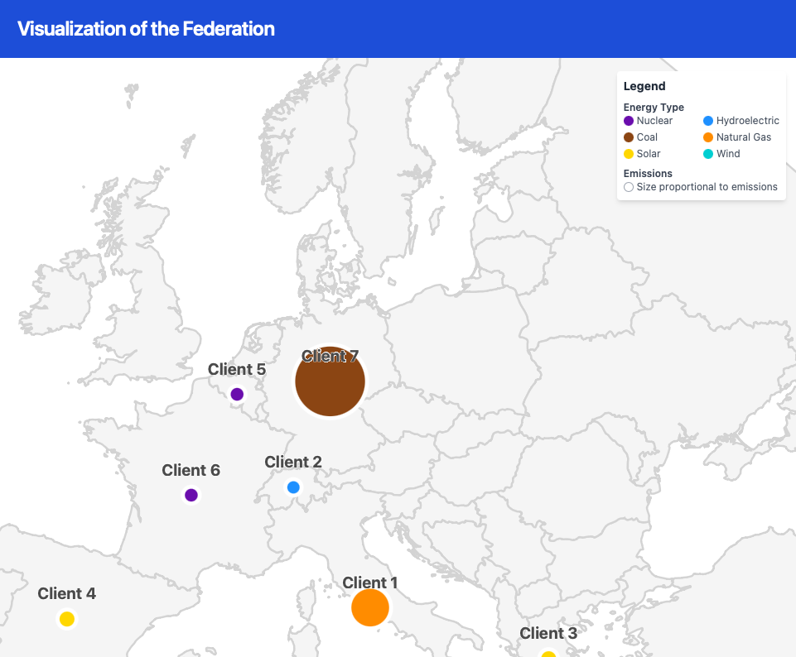
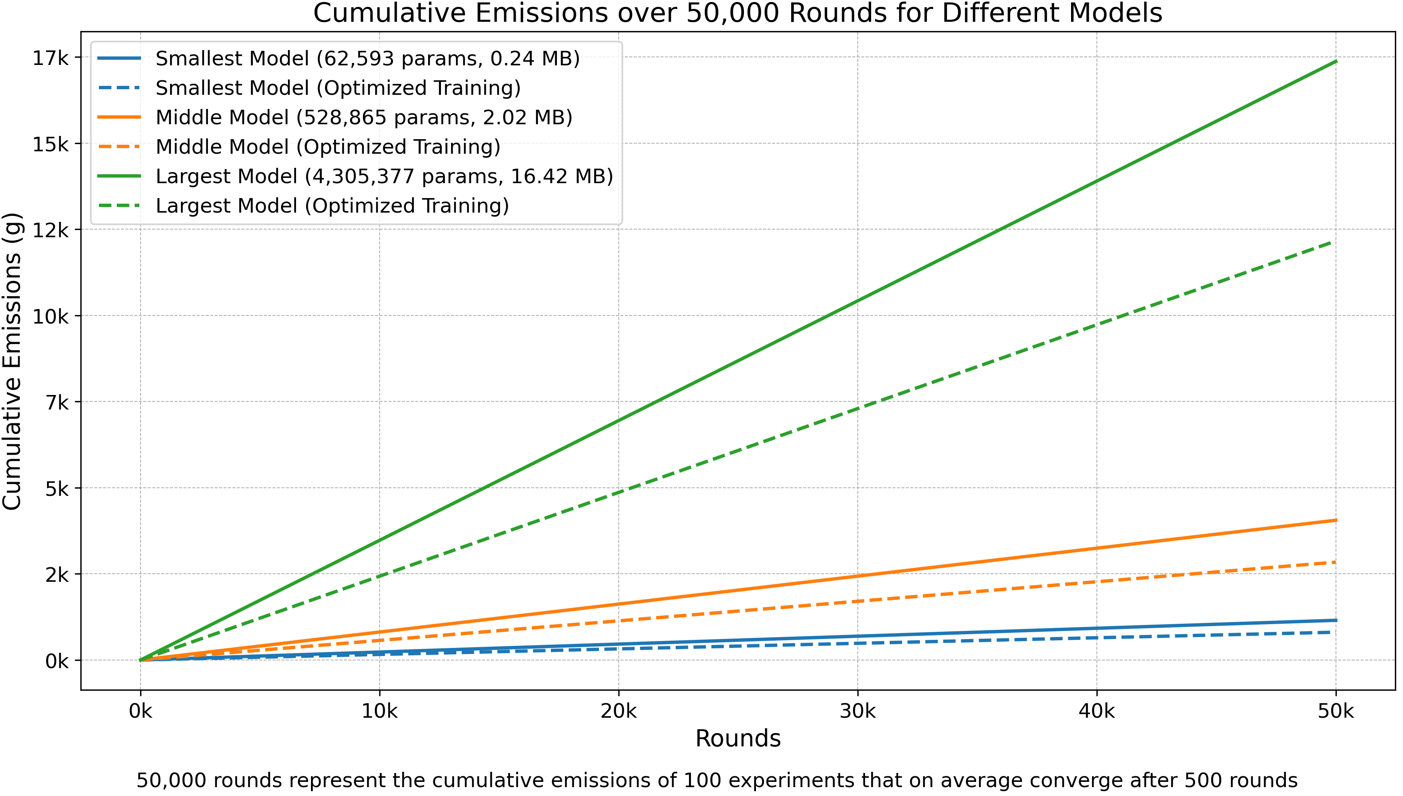
CERN CAFEIN®: CO2 tracker and optimiser
Large centralized data centers for AI and big-data analytics​
​
15% of the global Green House Gas (GHG) emissions of Information and Communication Technology ecosystem​
Contribute to about 0.3 % of global CO2 emissions

Slide 19


Slide 20


OSPO

Slide 21

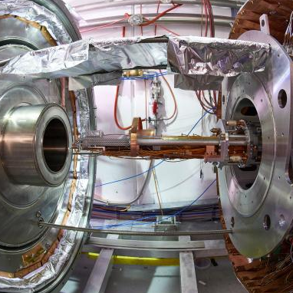
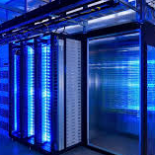
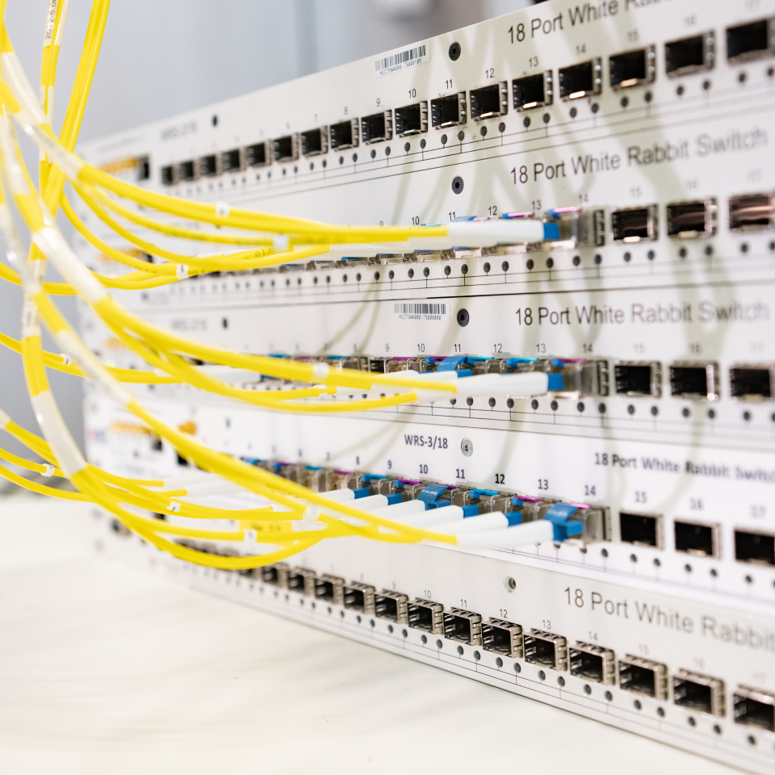
CERN QUANTUM TECHNOLOGY PLATFORMS
DISTRIBUTED QUANTUM COMPUTING AND ALGORITHMS
QUANTUM COMMUNICATIONS AND NETWORKS

Slide 22
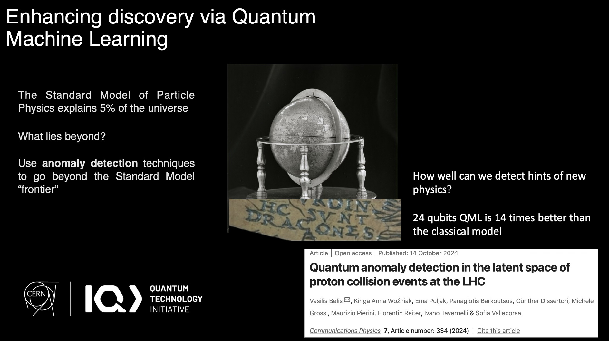

Slide 23
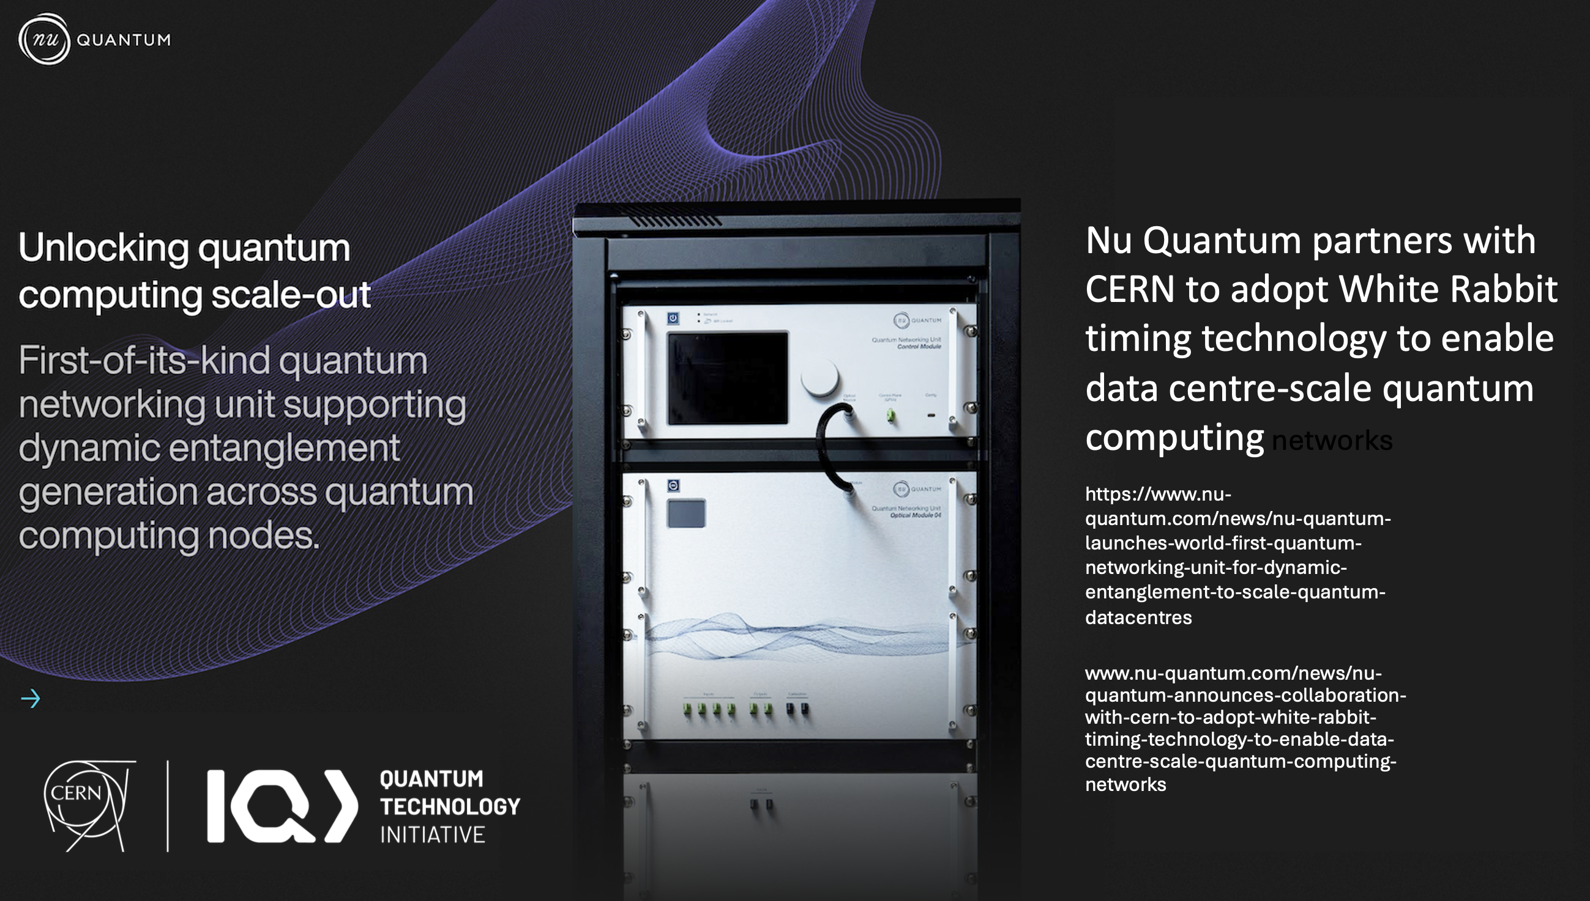

Slide 24
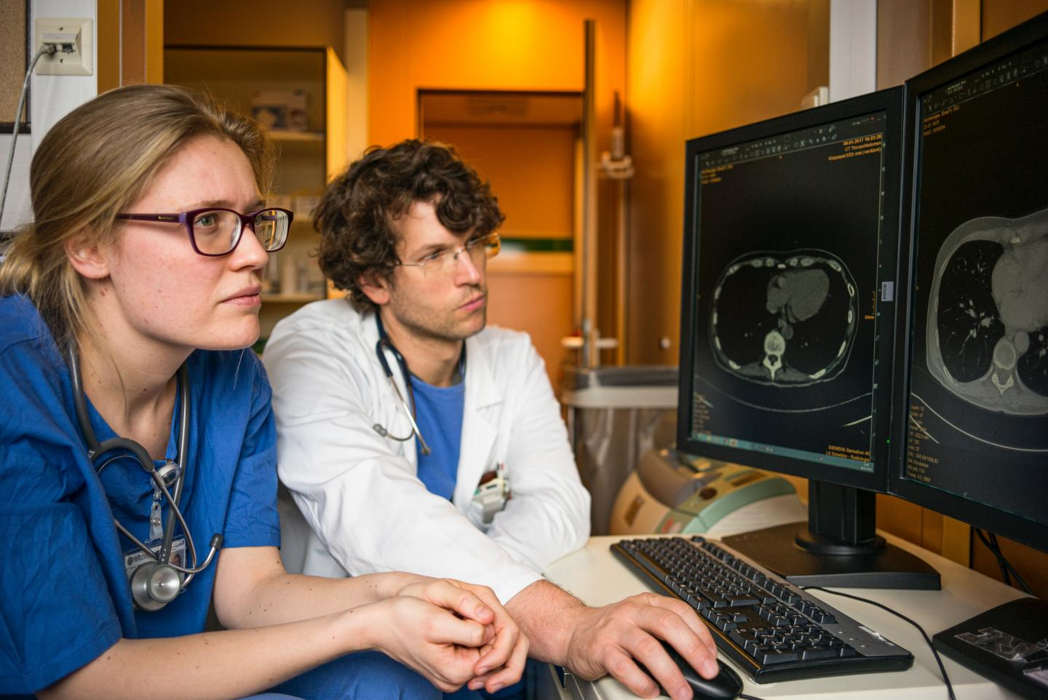
Partnership

Slide 25
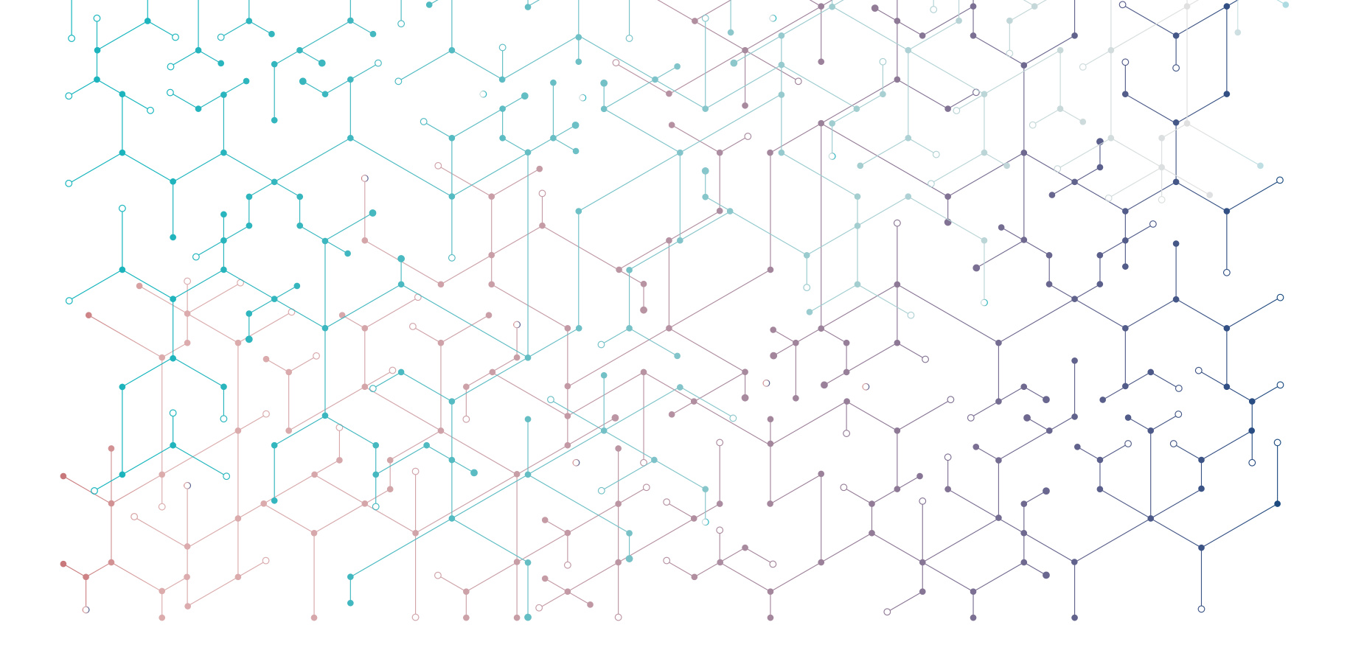


Thank you!
  Questions?
  a.raimondo@cern.ch
Subscribe the KT newsletter
@cern-innovation-partnerships
@CERNVenture
Find out more at kt.cern
Follow us on social media
#CERNKT

