Slide 2
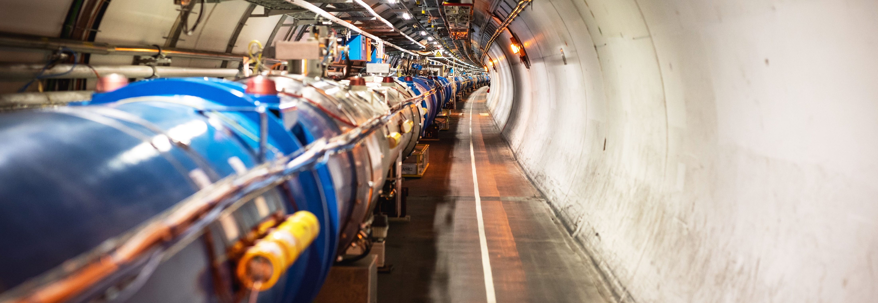
General Overview of CERN KT activities
Giovanni Anelli, Head of Knowledge Transfer Group, CERN

Slide 3
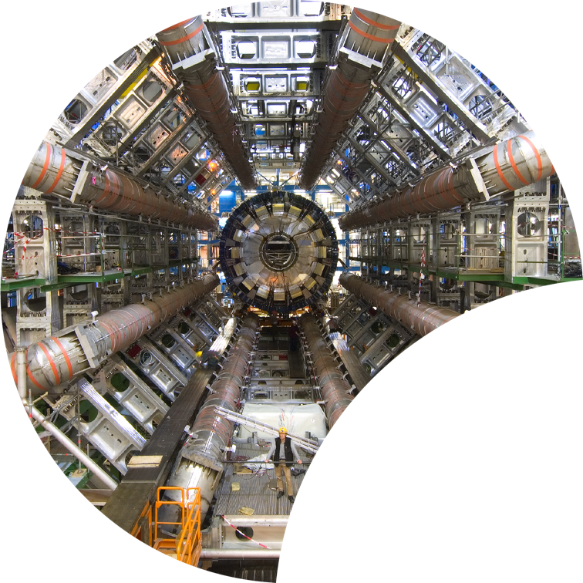
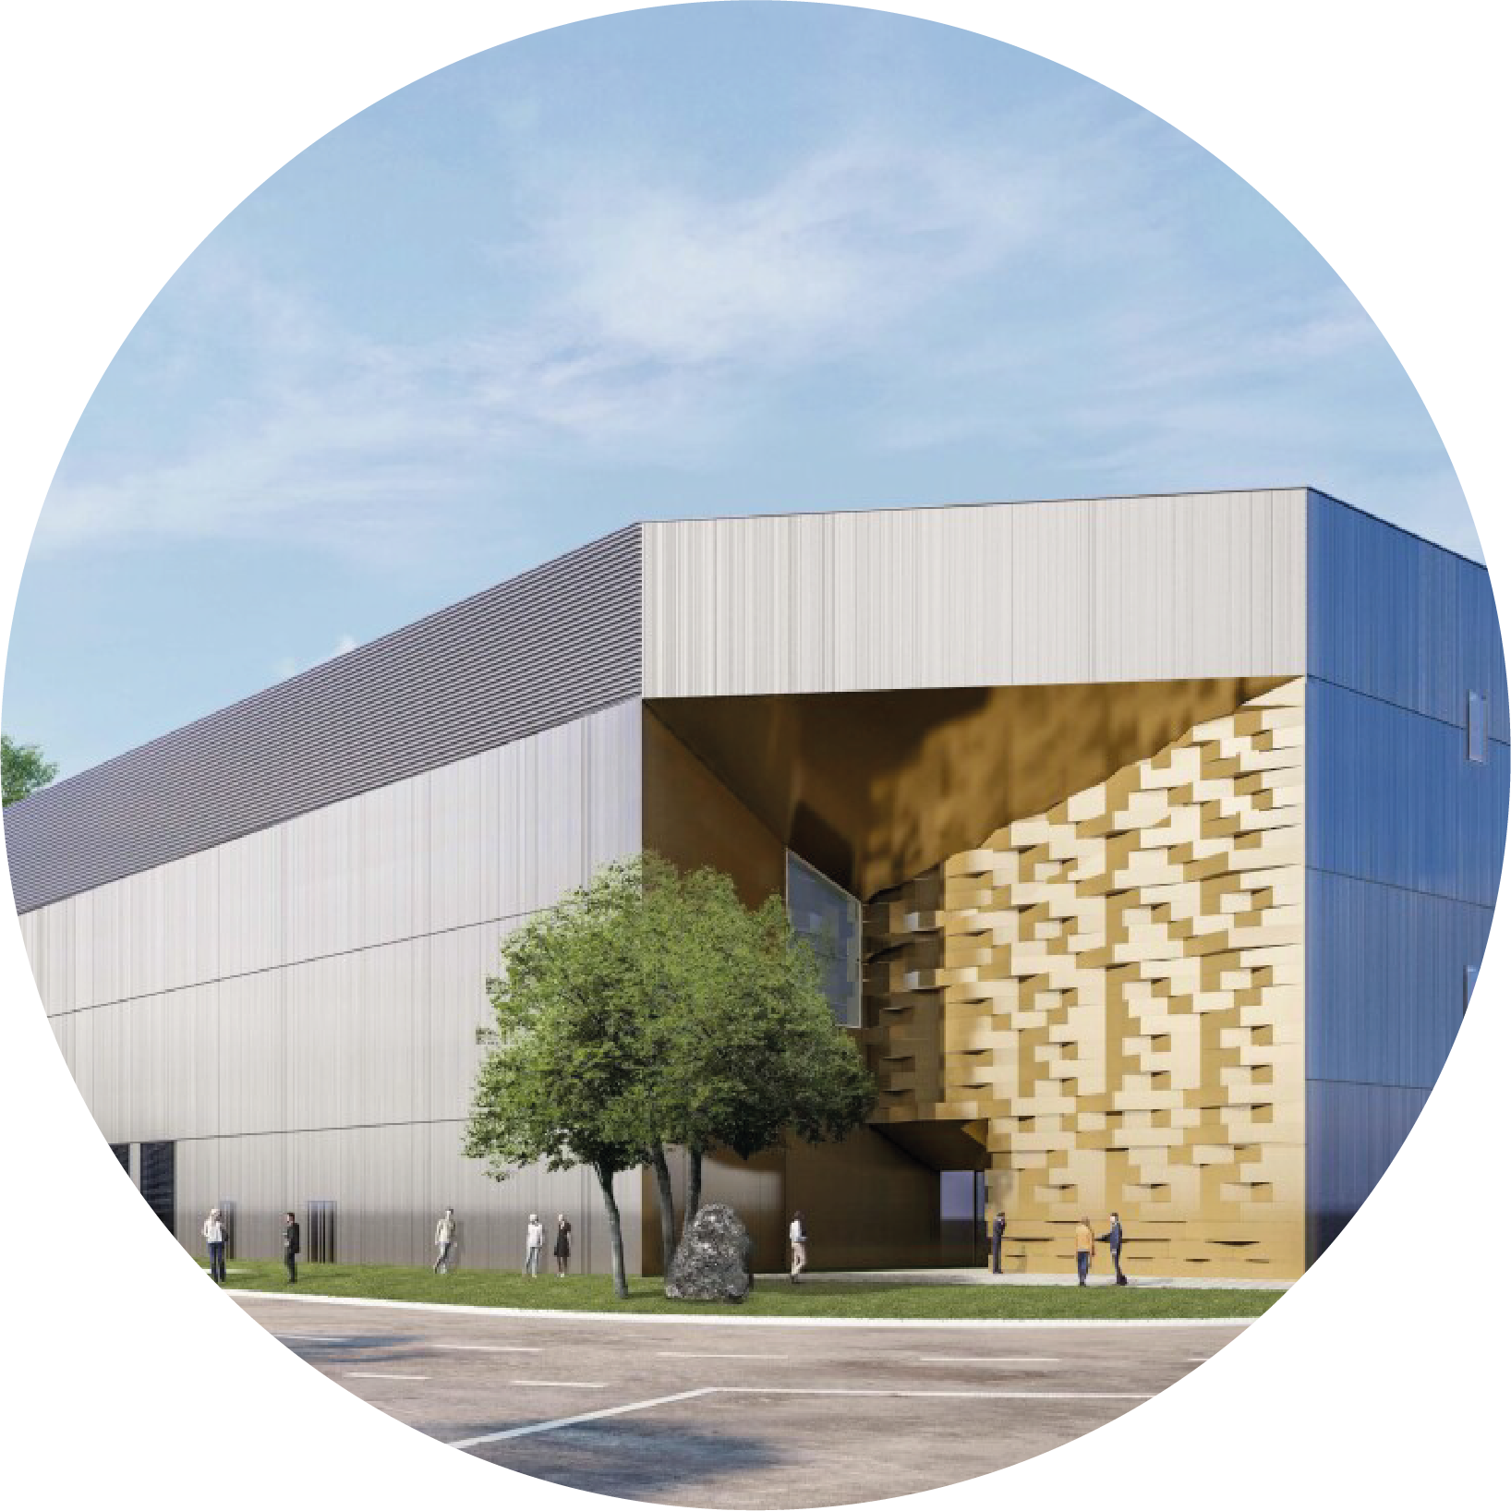
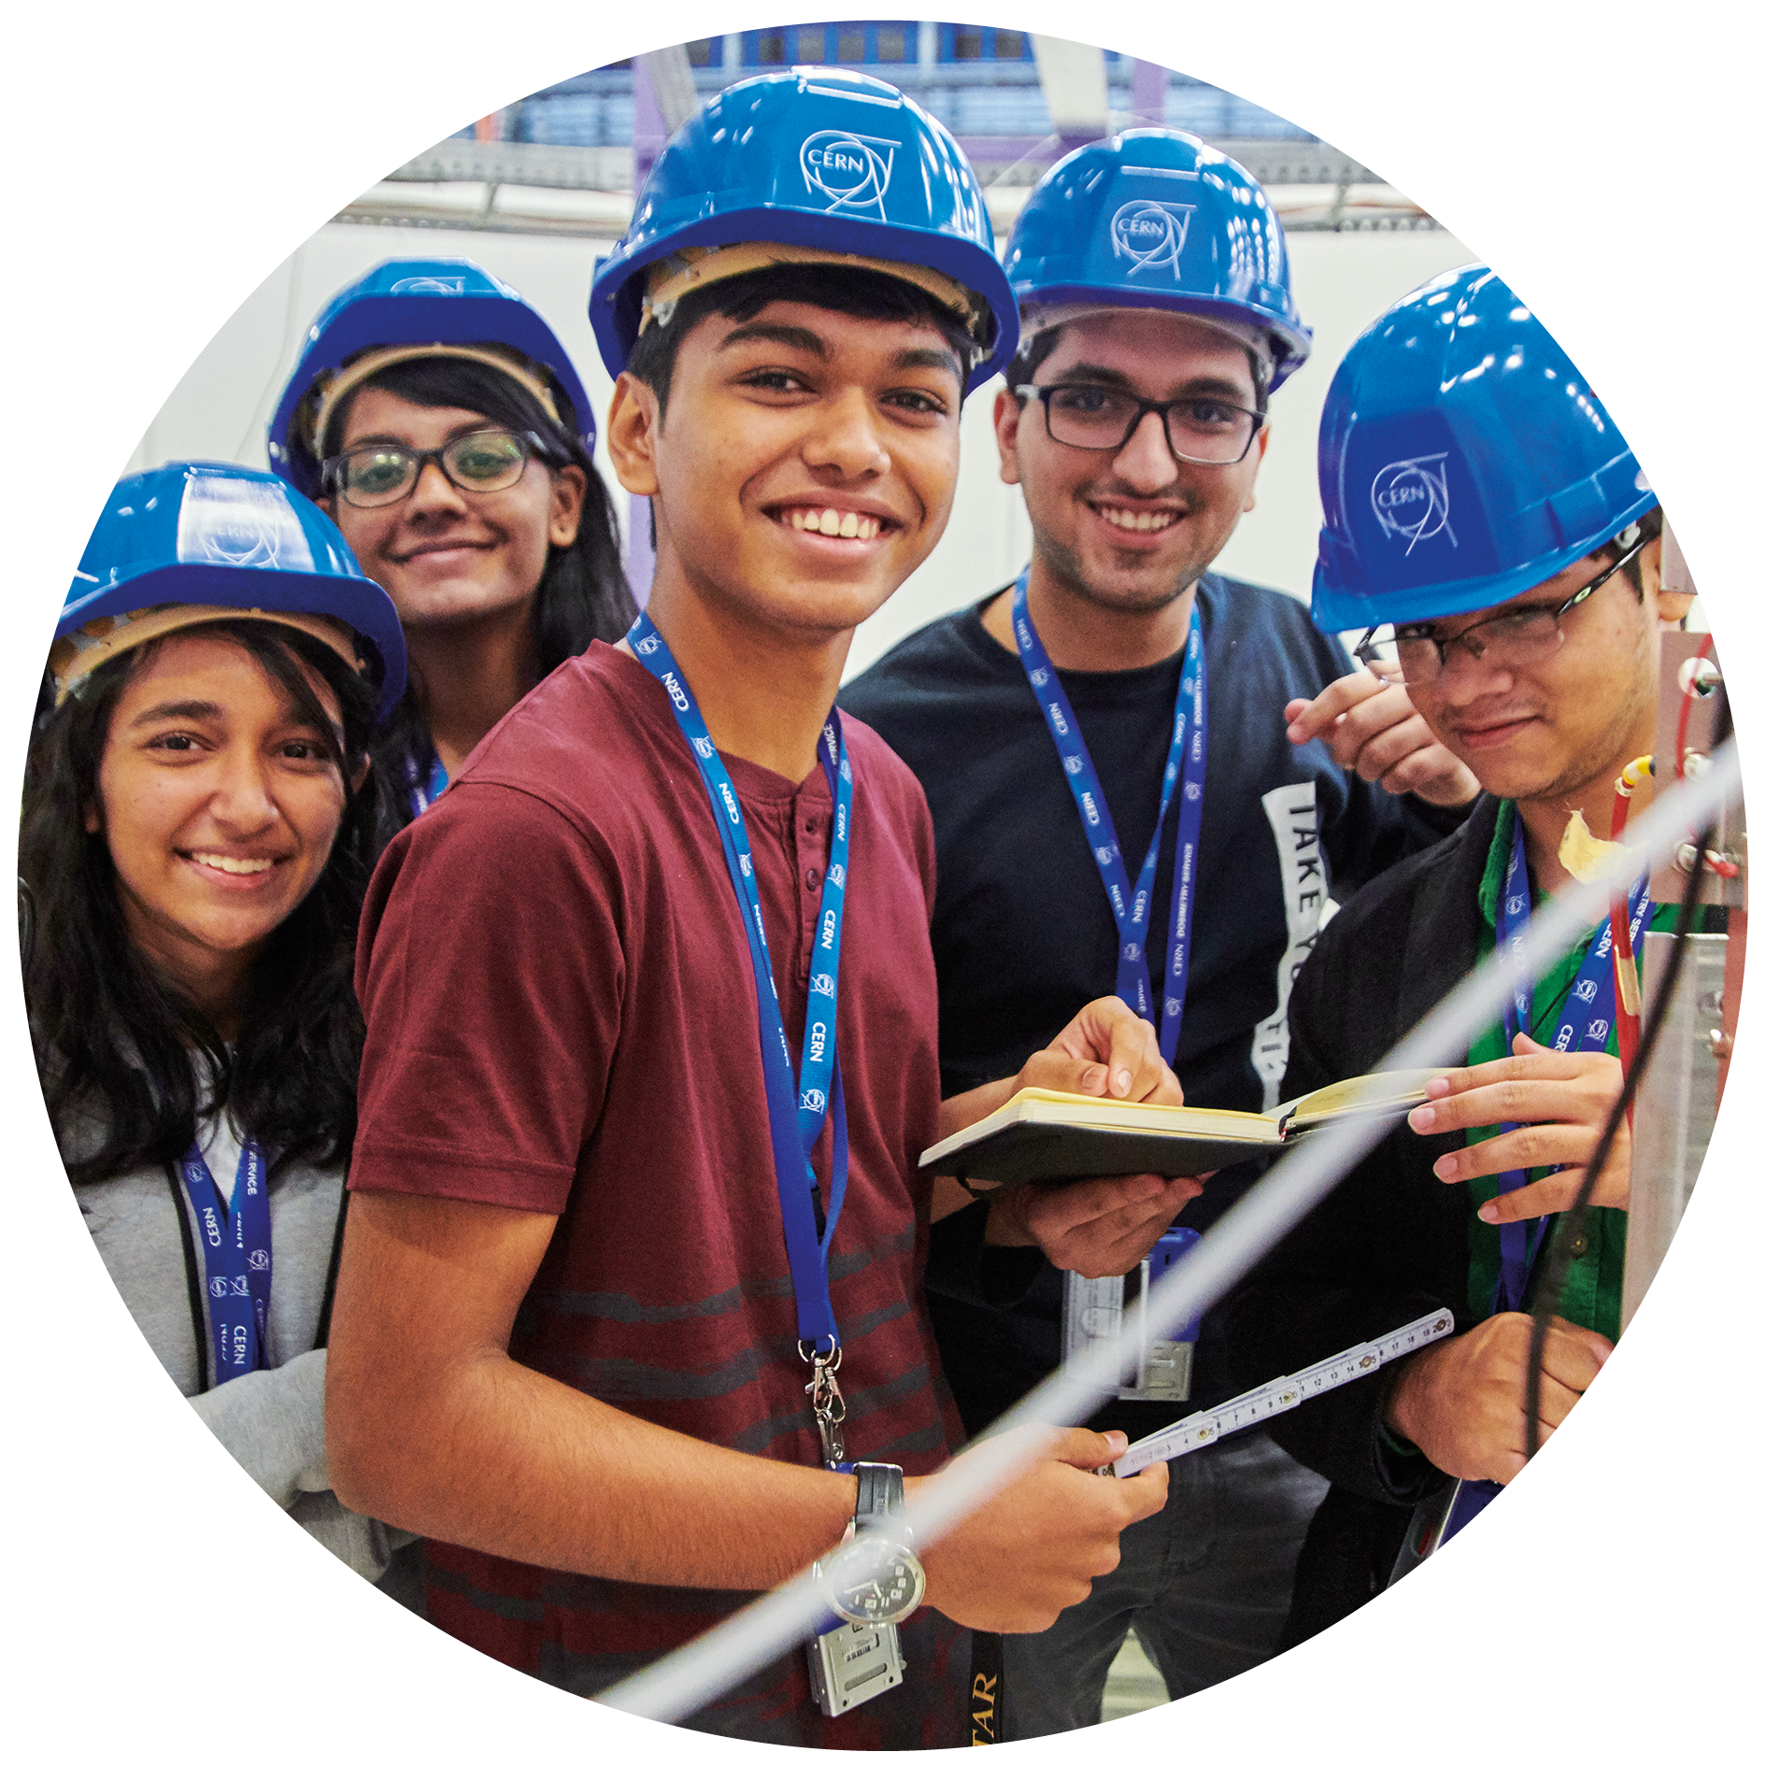

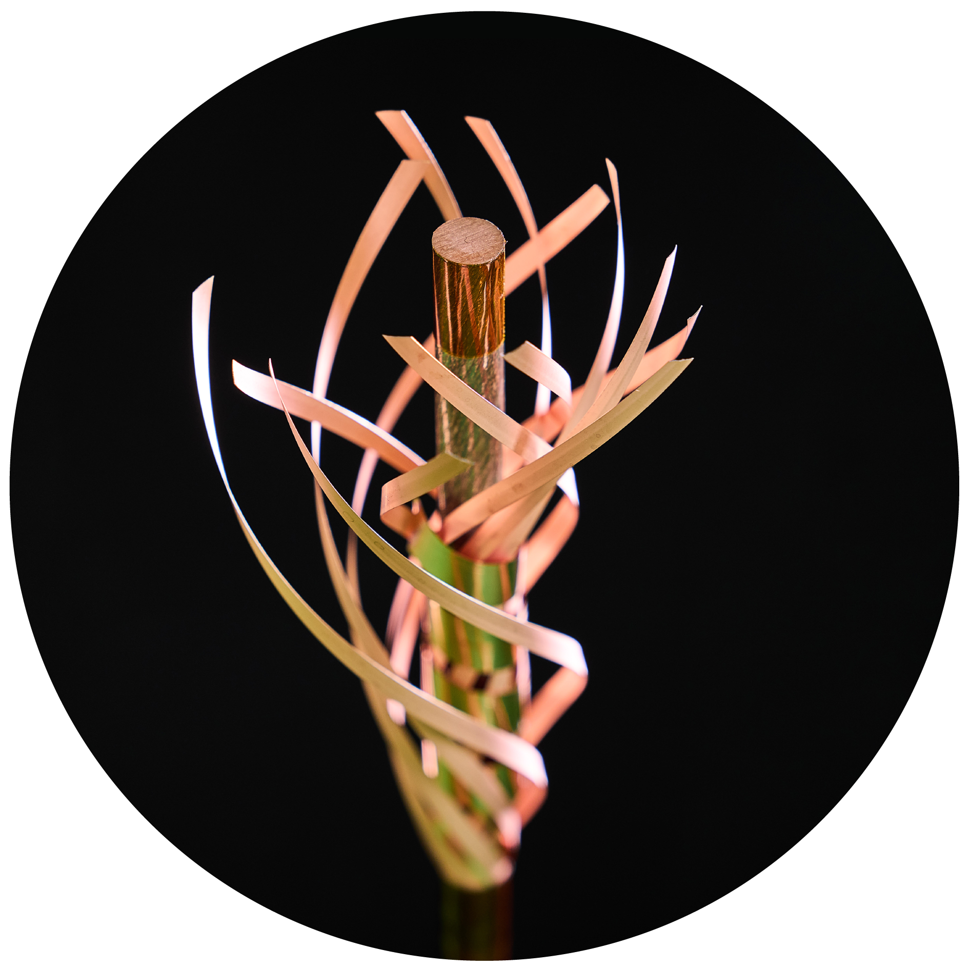

Four pillars underpin CERN’s mission
RESEARCH
EDUCATION & TRAINING
COLLABORATION
TECHNOLOGY & INNOVATION
Notes:
This slide introduces the four pillars that underpin CERN’s mission:
Research: To perform world-class research in experimental and theoretical particle physics; and to provide the particle physics community a range of accelerators that enable that research
Collaboration: To unite people from all over the world in the common goal of advancing the frontiers of human knowledge, in a spirit of equal collaboration and openness
Innovation: To push the technology underpinning accelerators, detectors and computing, to drive innovation in order to transfer knowledge to other scientific and technological areas, for the benefit of society
Education and Training: To train future physicists and engineers, to promote careers in science and engineering, and to foster citizens’ engagement in particle physics and in fundamental research.
FROM THIS POINT FORWARD, THE PRESENTATION IS DIVIDED INTO FOUR SECTIONS: ONE SECTION PER PILLAR

Slide 4
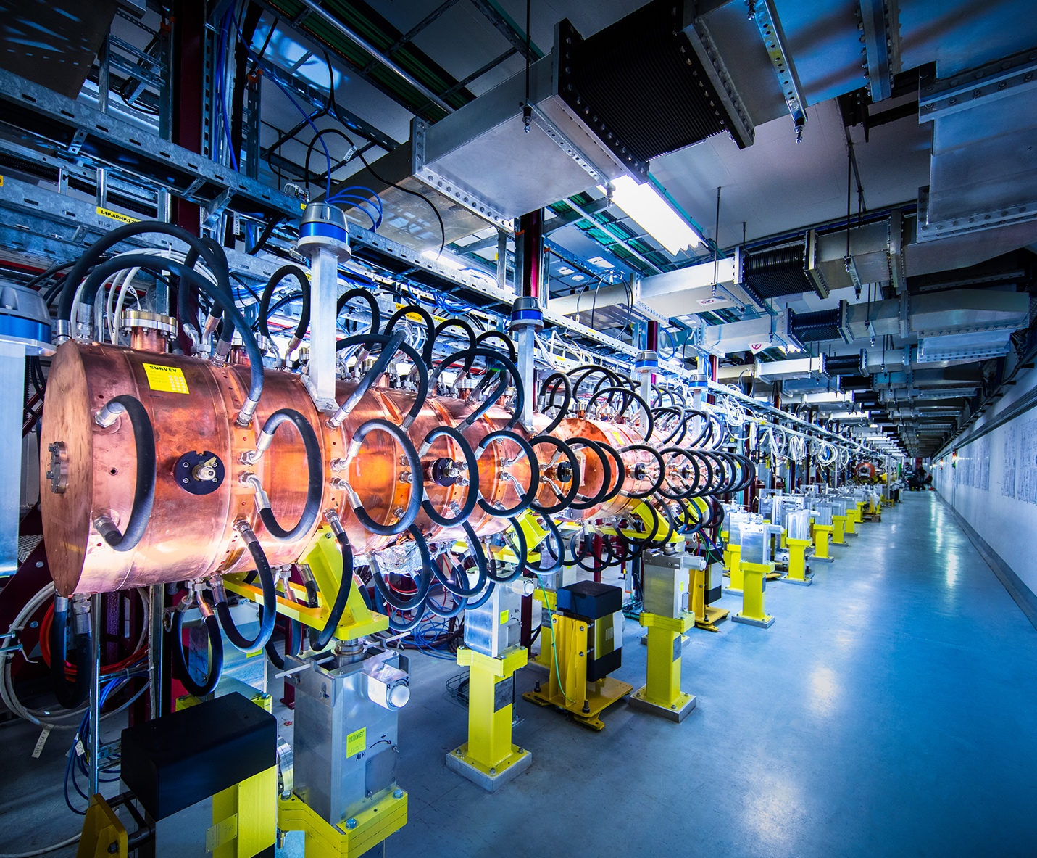
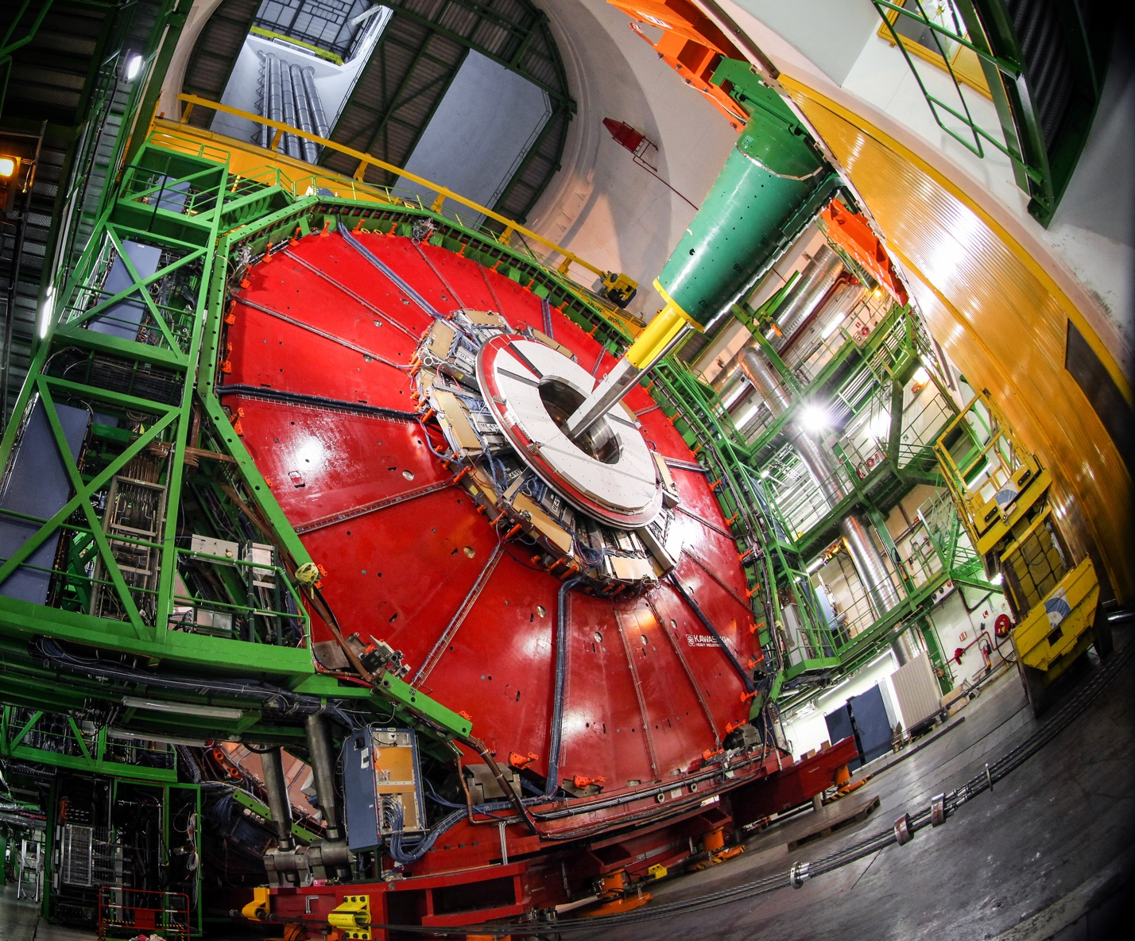
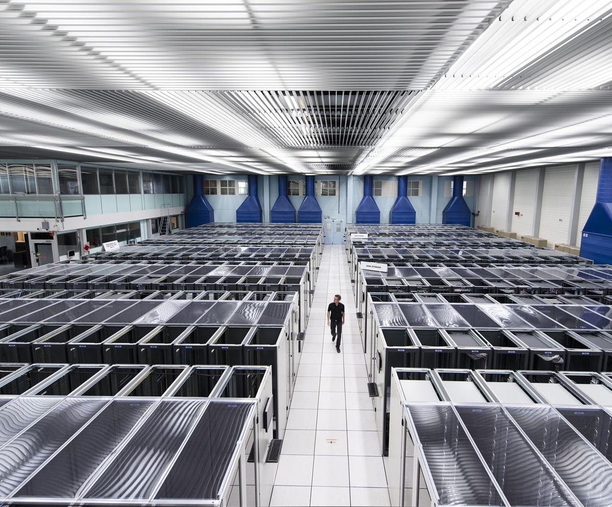
Key technological areas
ACCELERATORS
DETECTORS
COMPUTING
Notes:
This slide presents the three technological fields that allow CERN to answer the questions presented earlier.
The following slides focus on each of these fields, so here the speaker may give a 1-2 sentence description of each.
For example:
Accelerators - We build and maintain a range of particle accelerator facilities, where particles are accelerated to almost the speed of light
Detectors – built by consortia of physicists and engineers from across the globe, this is where collisions occur and where new, hitherto unknown particles may be formed, and new interactions between particles identified.
Computing – experiments at CERN generate enormous amounts of data. This data is collected at CERN and sent around the world to be processed and stored.

Slide 5
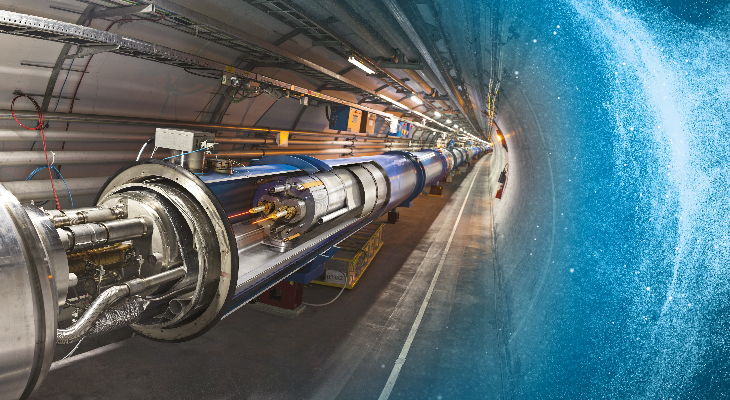
Large Hadron Collider (LHC)
27 km in circumference
About 100 m underground
Superconducting magnets steer the particles around the ring
Particles are accelerated to close to the speed of light
Notes:
The LHC is CERN’s flagship accelerator.
Possible additional information to complement what is on the slide (TIME PERMITTING):
It is the world’s largest and most powerful particle accelerator
Protons (and lead ions) circulate in two beams, which travel in opposite directions in two separate beam pipes
Protons are accelerated to 99.9999991% the speed of light (11 245 turns/second)
The beam pipes are under ultrahigh vacuum, to avoid collisions between the particles and gas molecules. The vacuum in the beam pipes is 10⁻¹³ atm – similar to the atmosphere on the moon (10⁻¹⁵ atm)
It is one of the coldest places in the Universe (1.9K; -271.3°C)
Superconducting magnets are used to focus the beam (quadrupole magnets) and bend the beam around the circular accelerator (dipole magnets)
The LHC is built in the same tunnel where CERN’s previous flagship accelerator was located – LEP, which accelerated electrons
Collaboration between CERN and European industry

Slide 6
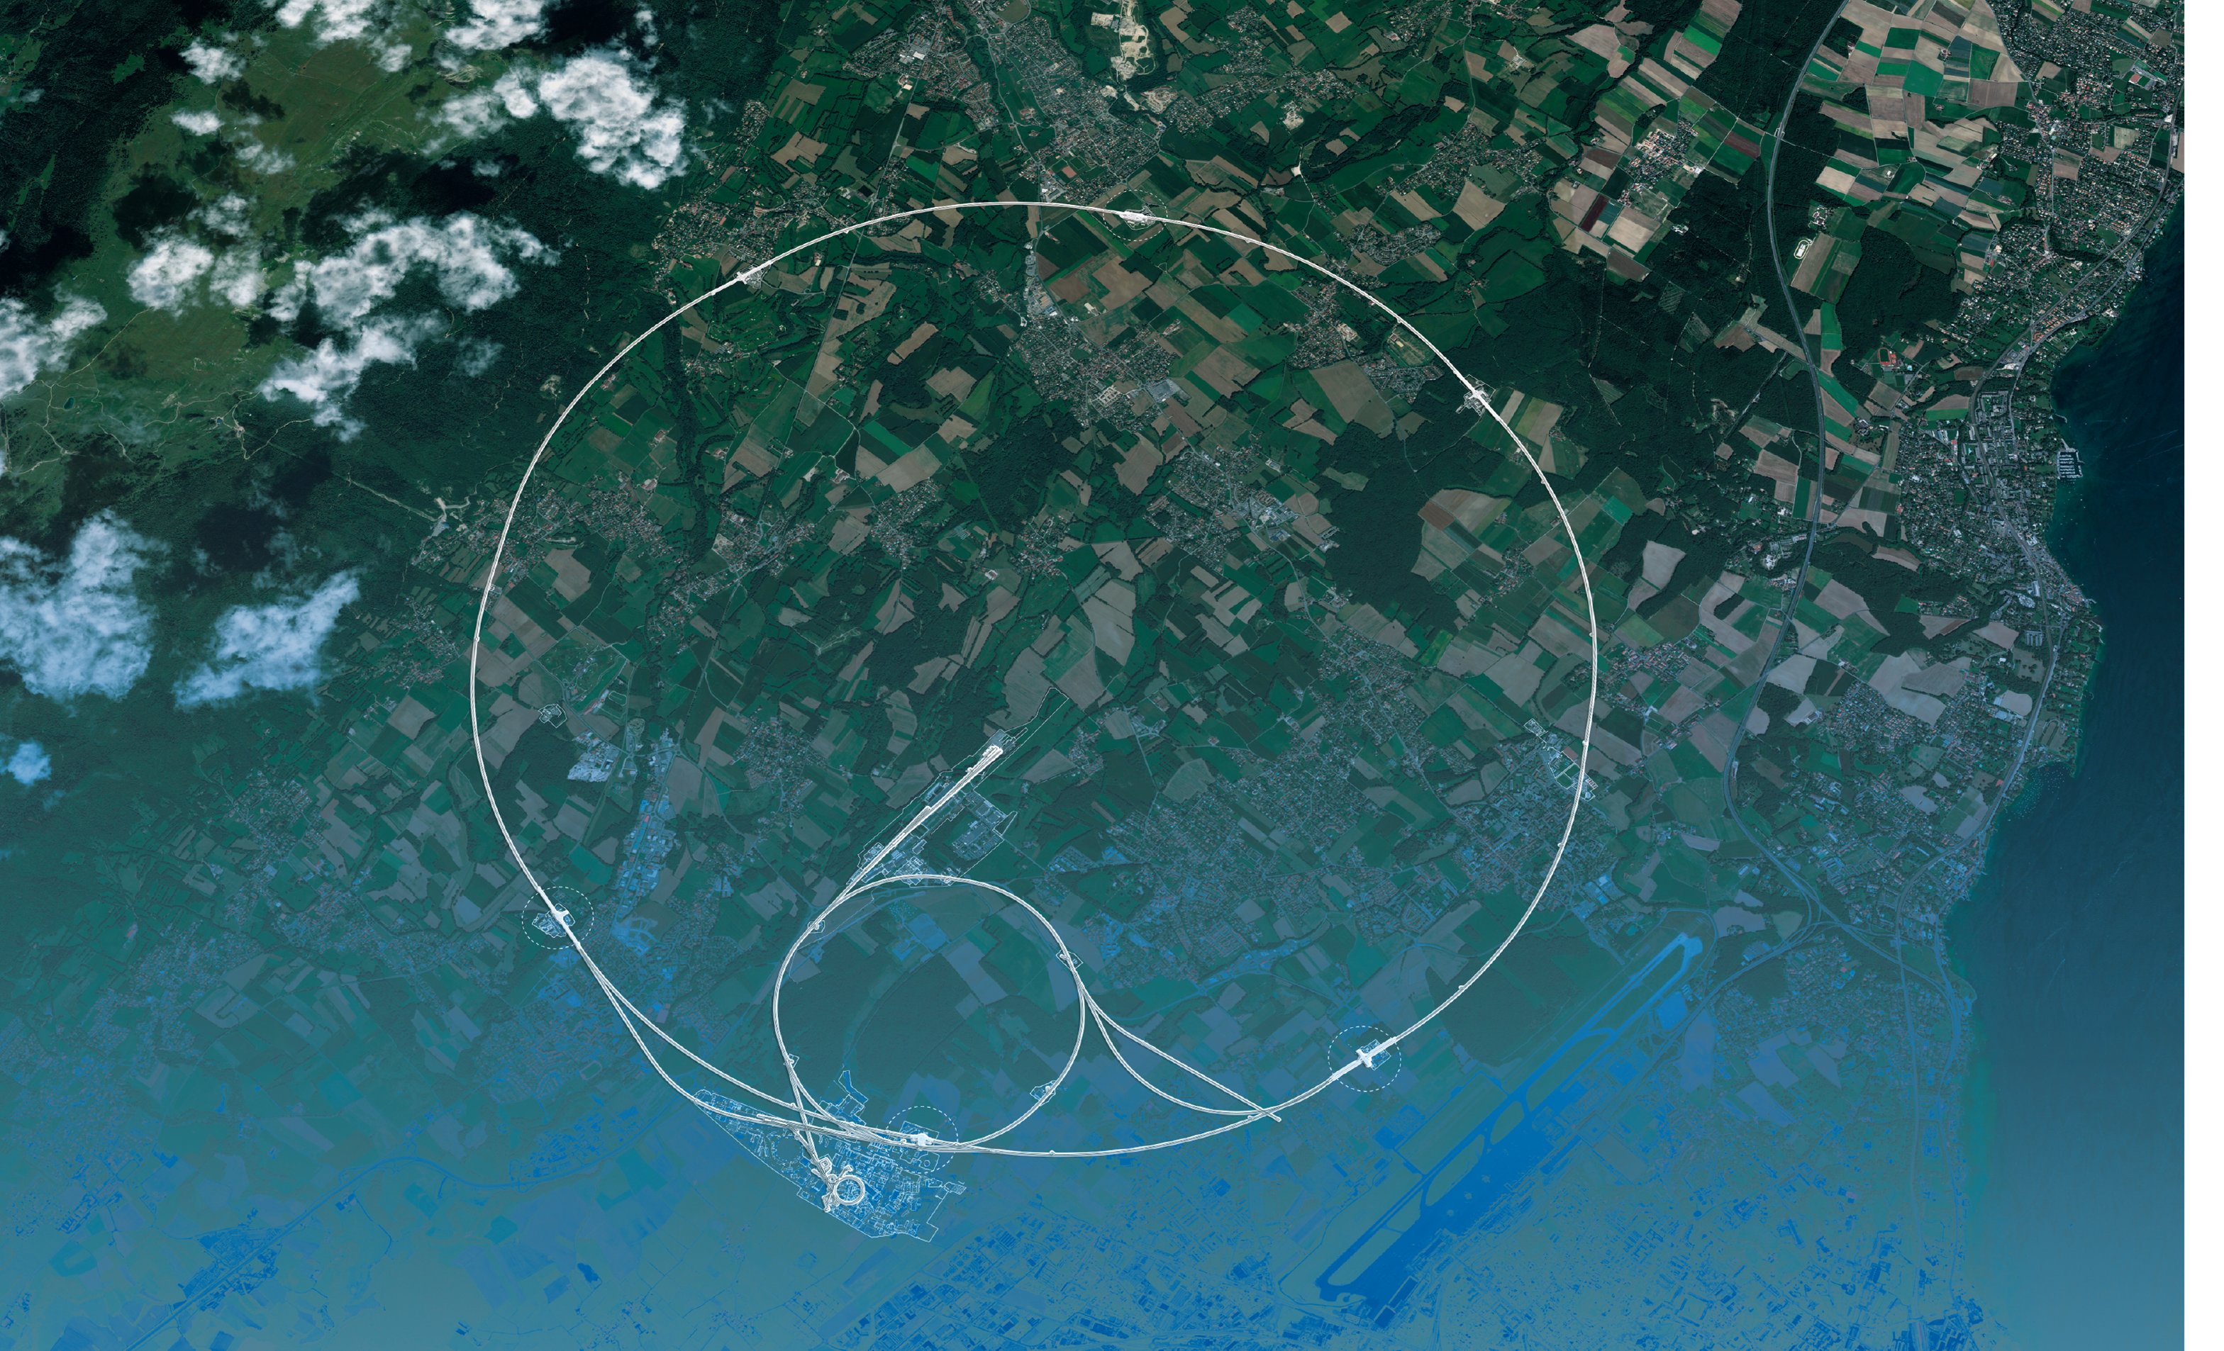
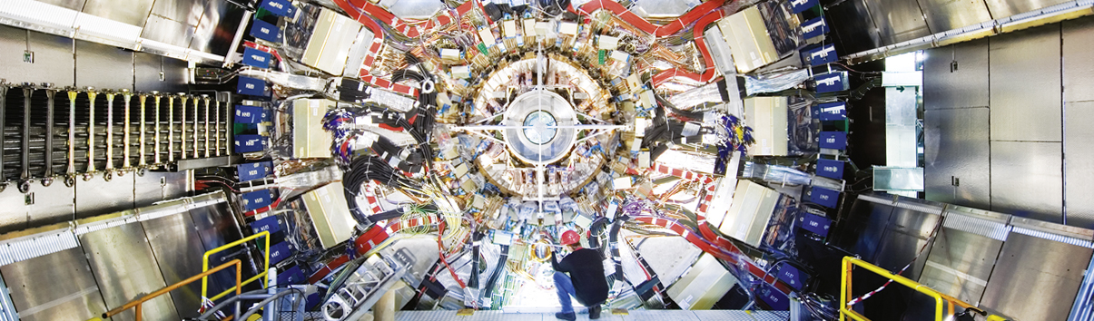
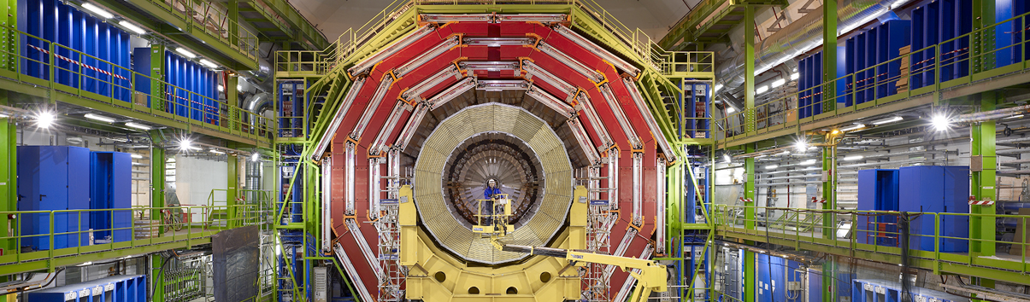
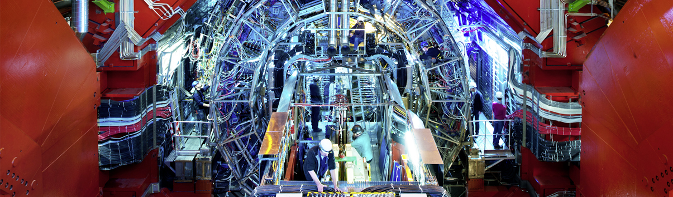
Giant detectors record the particles formed at the four collision points
ATLAS
CMS
CMS
ALICE
ALICE
ATLAS
LHCb
LHCb
Notes:
This slide allows the speaker to describe the accelerator complex and the four main LHC detectors.
About the accelerator complex (OPTIONAL)
The LHC is the last in a chain of particle accelerators, which gradually accelerate particles at increasing energy until they enter the LHC
Particles collide at four points on the LHC, where detectors register the collisions.
(ON CLICK)
About the four detectors, the speaker may give a 1-2 sentence description of the goal of each detector (TIME PERMITTING):
ATLAS – is a general-purpose detector, designed to carry out research ranging from precise measurements of the Higgs boson to searches for new physics beyond the Standard Model, similar to CMS. It is the largest collider-detector ever built (44m in length and 25m in diameter).
CMS - is a general-purpose detector, similar to ATLAS. It is one of the detectors, with ATLAS, where evidence for the Higgs boson was discovered and announced in 2012. It is the heaviest collider-detector (12.5 tonnes).
ALICE – studies the properties of the so-called quark-gluon plasma, a state of matter that probably existed just after the Big Bang, before protons and neutrons were formed.
LHCb – studies the asymmetry between matter and antimatter in interactions of particles containing the so-called b quark. This may help understand why our Universe is made up of only matter.

Slide 7
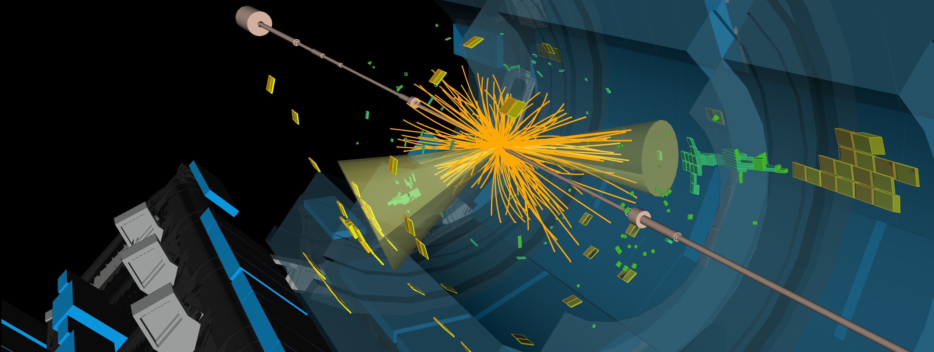
The LHC produces more than 1 billion particle collisions per second
The energy of the particles in collision is converted into new particles.
The detectors measure the energy, direction and charge of new particles formed.
They are analogous to 3D cameras taking 40 million pictures a second, of which 1000 are selected and recorded.

Slide 8
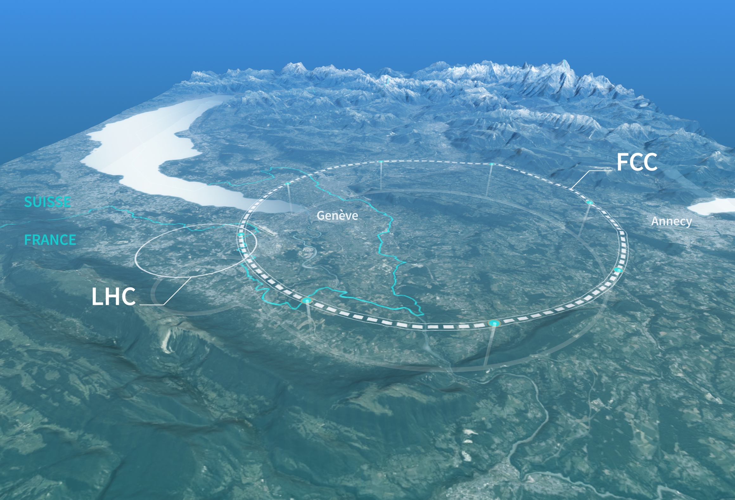
Preparing CERN’s future
Driven by the 2020 Update of the European Strategy for Particle Physics
Technical and financial feasibility study of a Future Circular Collider (Spring 2025)
Accelerator R&D to develop technologies for FCC and for alternative options
Detector and computing R&D
Maintain a diverse and compelling scientific programme
Continue to support other projects around the world
CERN Council has launched the next ESPP Update for 2026

Slide 9
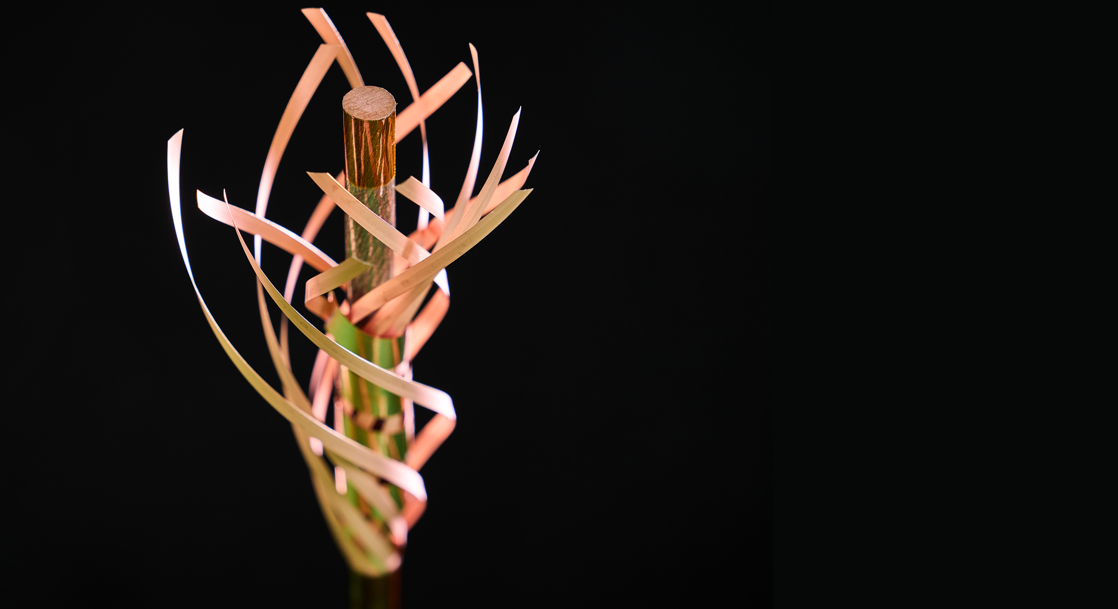
TECHNOLOGY & INNOVATION
Notes:
This is the title slide for the section on “Innovation” (Knowledge Transfer).
It should be shown for just enough time for the speaker to place it in the context of the four pillars mentioned at the start of the presentation (as a form of ”signposting”)
(THIS SECTION HAS 3 SLIDES)

Slide 10
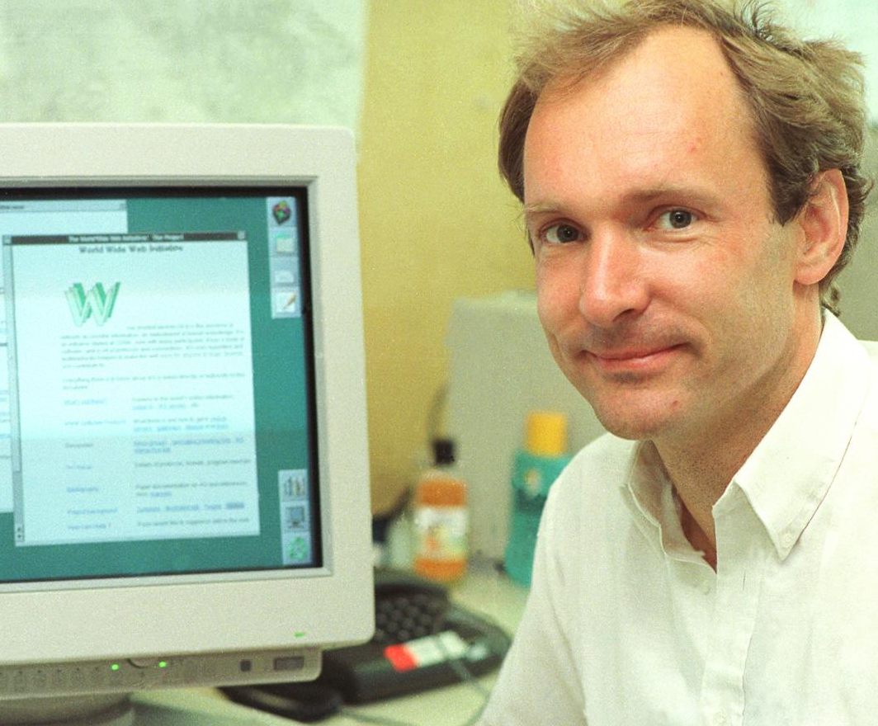
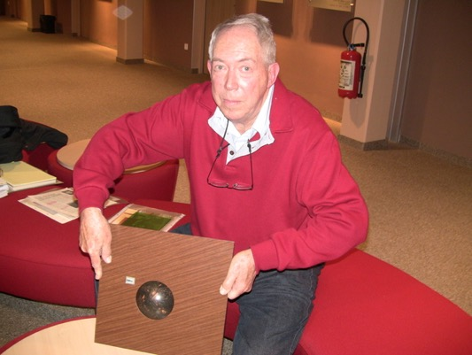
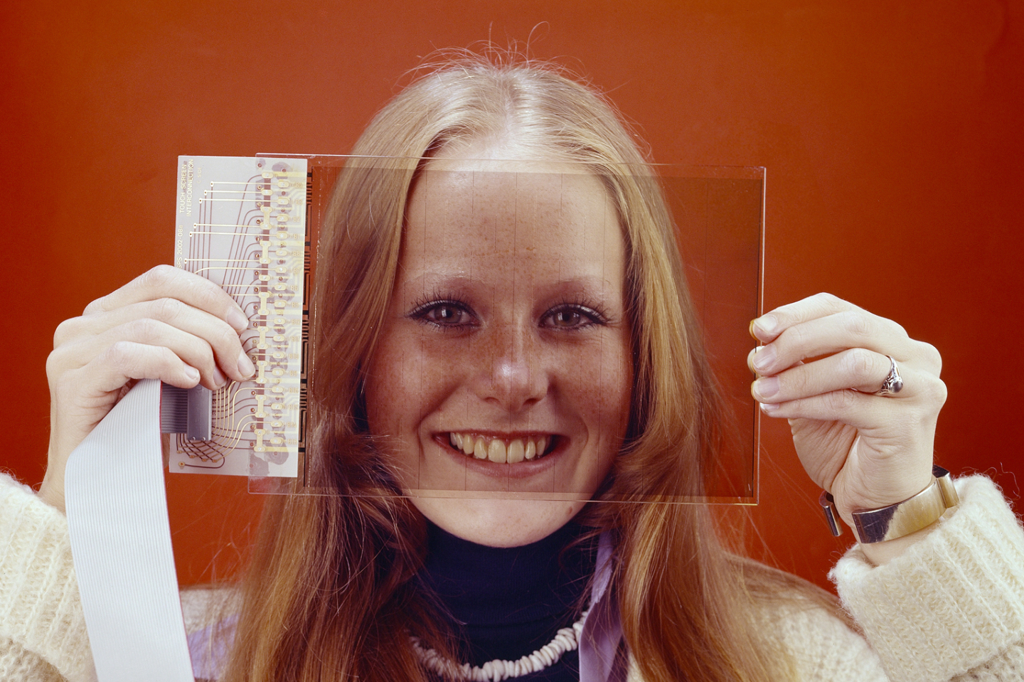
Some historic examples
WWW
TRACKERBALL
TOUCHSCREEN

Slide 11
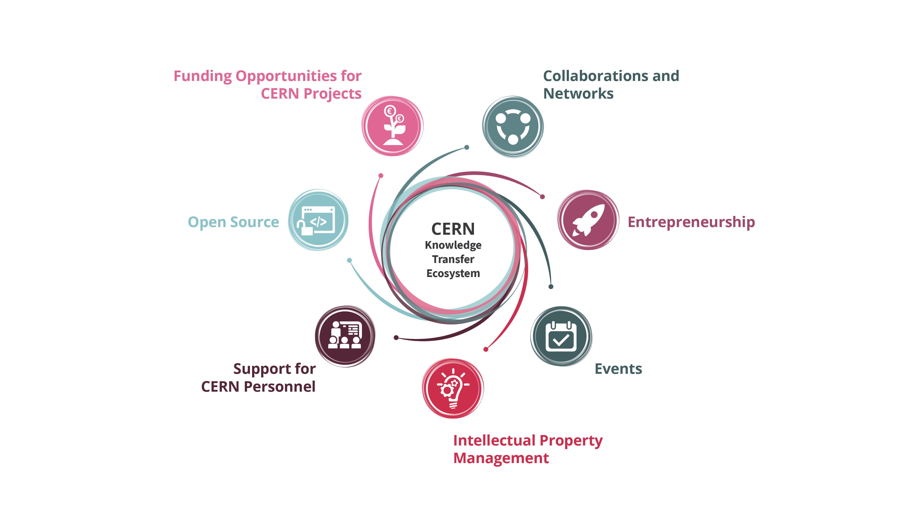
Our toolbox to accelerate innovation

Slide 12
Knowledge Transfer Channels
Dedicated actions to foster the transfer of technologies and know-how to other fields than particle physics (very often with the involvement of industry)
Technology-intensive procurement contracts
People (very hard to quantify but extremely impactful for particle physics)
12

Slide 13
Bridging the gap
Scout for technologies
Search unmet needs
Mobilize tech experts
Mobilize innovation partners
Create tech and IP dossiers
Create value propositions

Slide 14
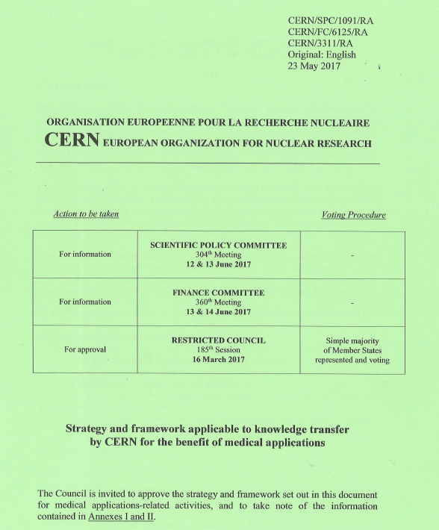
From CERN technologies
to medical and biomedical applications
Updated June 2023
https://cds.cern.ch/record/2864317/files/English.pdf

Slide 15
ICT for medical applications
Nuclear Medicine
Medical Imaging
Radiotherapy
Radiation Monitoring and Dosimetry
Robotics
Medical devices

Slide 16
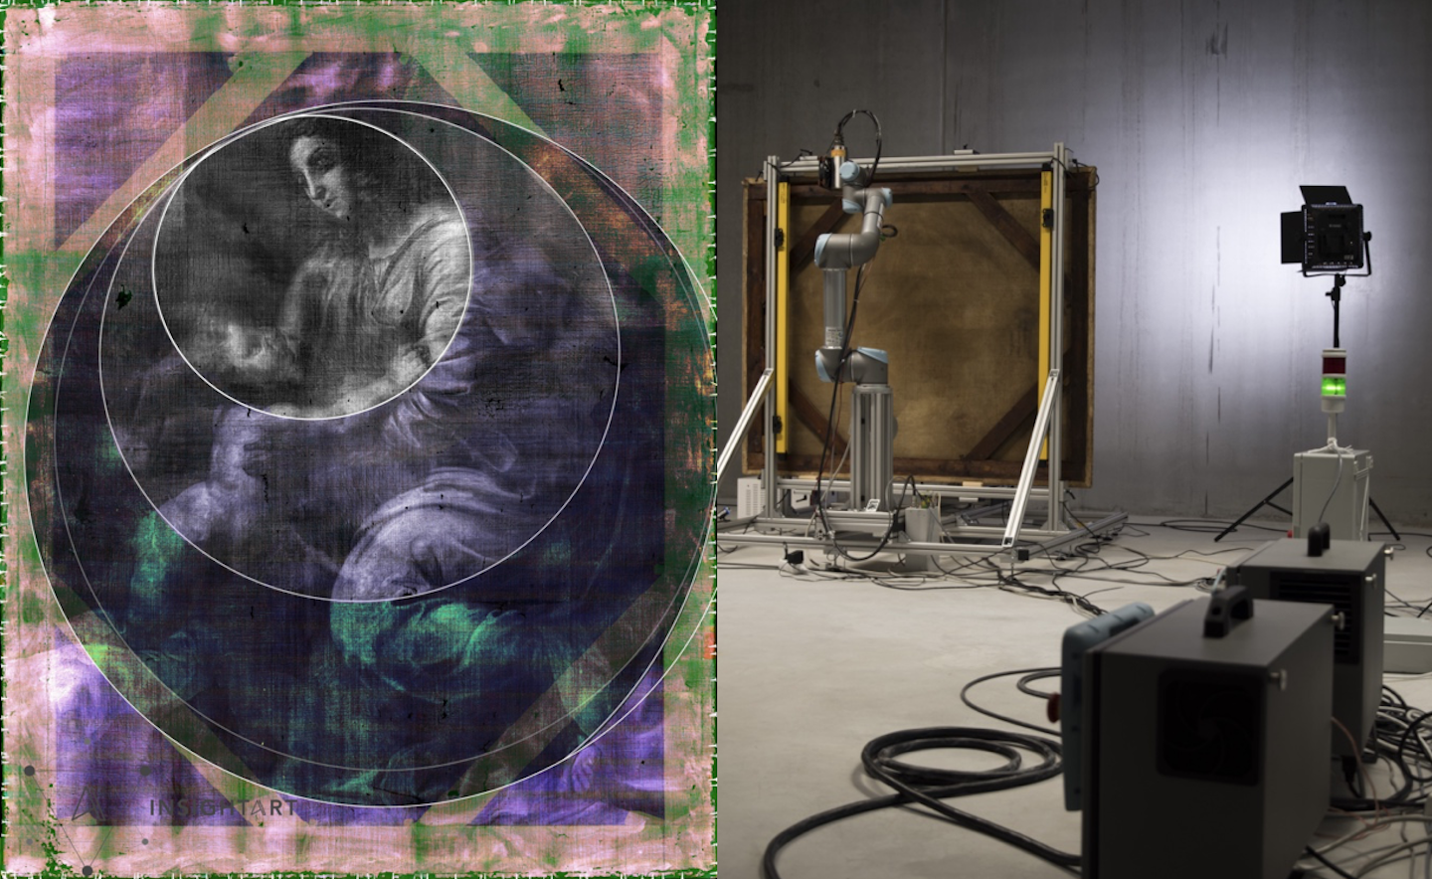
InsightArt Start-up using Medipix
X-ray eyes for cultural heritage
Notes:
For a long time, it was thought that The Madonna and Child, a painting on canvas from a private collection, was not created directly by the master himself. Property of Popes and later part of Napoleon's war treasure, the painting changed hands several times before arriving in Prague during the 1930’s. Due to its history and numerous inconclusive examinations, its authenticity was questioned for a long time. It has now been attributed to Raphael by a group of independent experts. One of the technologies that provided them with key information, was a robotic x-ray scanner using CERN-designed chips.

Slide 17
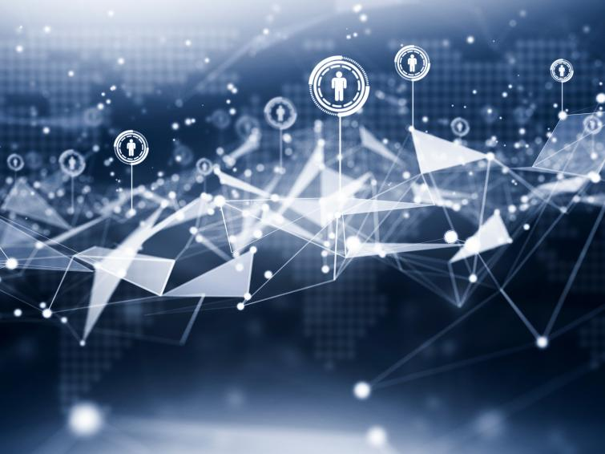
Bundesdruckerei (Berlin) works with CERN on next generation ideas for identity management and cryptography and data handling.
Consultancy

Slide 18
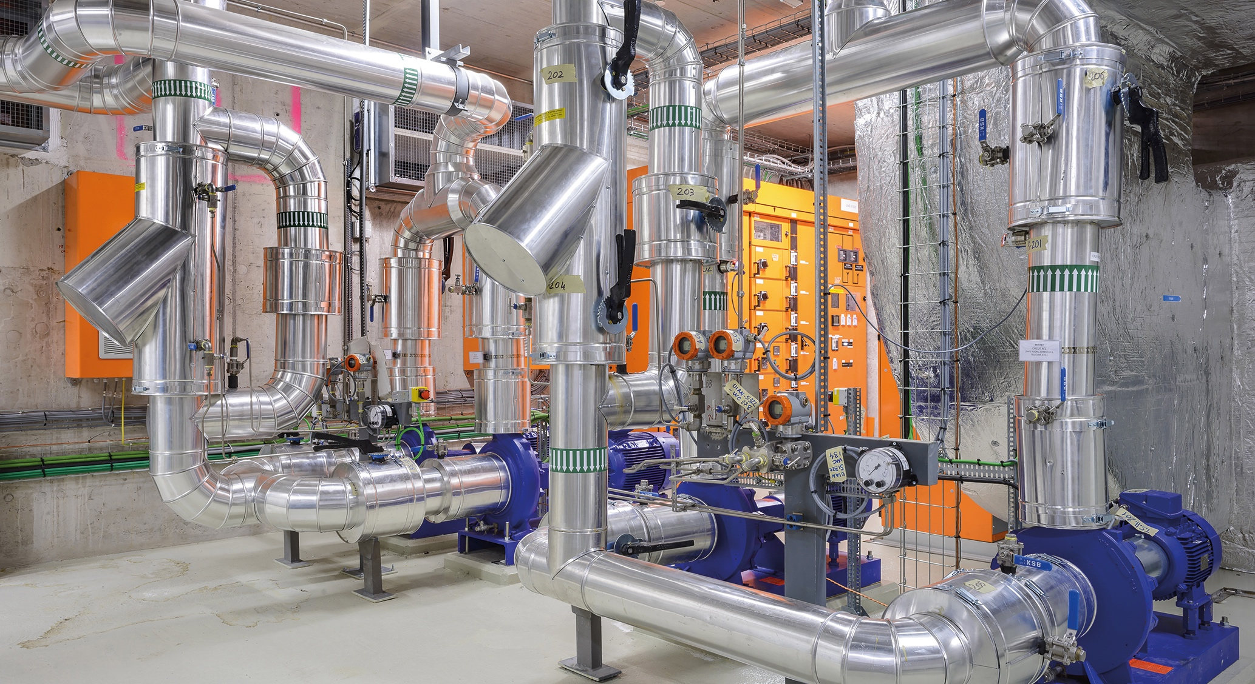
ZENSEACT (Volvo Cars Company) teams up with CERN on fast machine learning using FPGAs.
Collaborative R&D
Collaborative R&D
CERN and ABB team up on reducing electricity in cooling and ventilation.

Slide 19
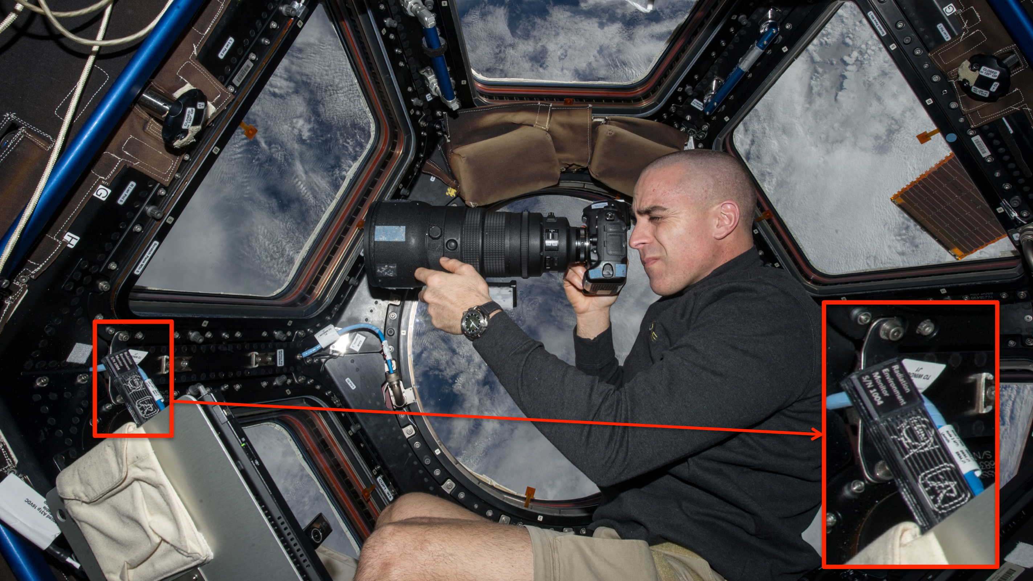
Timepix on the ISS
Courtesy of NASA, photo ref. no. iss036e006175

Slide 20
Shaping innovation partnerships
Discover
Discussion with Innovation / R&D management
Discovery day program at CERN
Shape
Define innovation ambitions and technical needs
Discuss expertise contributed by partners
Execute
Formalize partnership:
- Collaborative R&D - License - Consultancy - Contract Research
Find mutual interest
Timeline, resources, IP

Slide 21
Much more to discover
https://knowledgetransfer.web.cern.ch/technology-portfolio
Browse our value propositions
https://cernbox.cern.ch/files/link/public/yMzSQluMDeYObti?tiles-size=1&items-per-page=100%7C&view-mode=resource-table

Slide 22
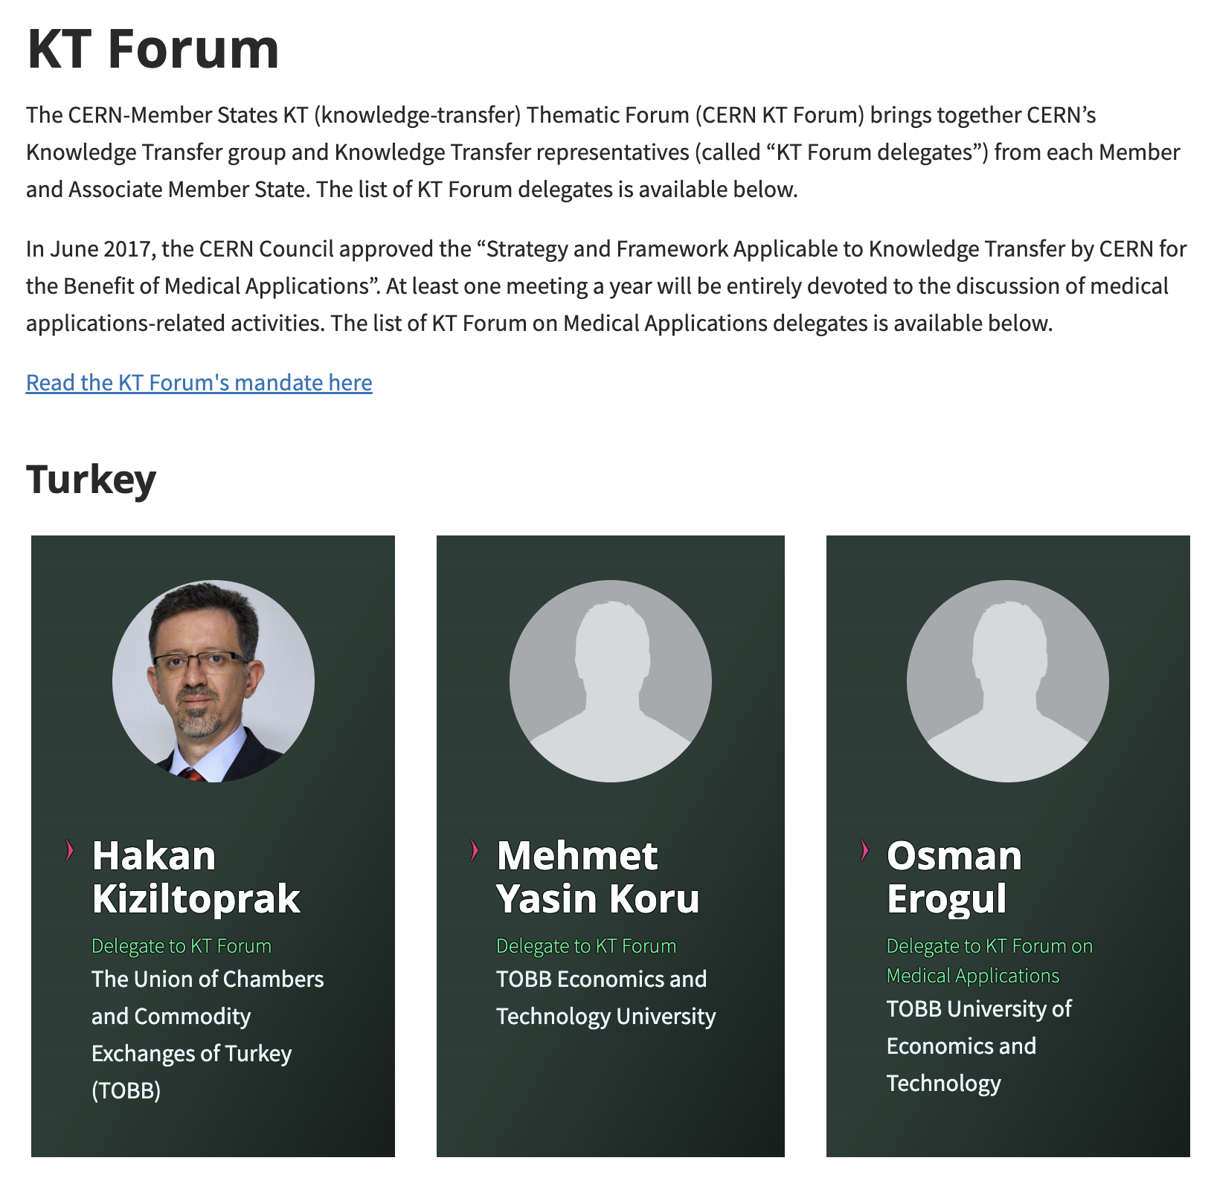
Who to contact in Türkiye

Slide 23
Many thanks for your attention!

