Slide 1

Enabling future detector technology within ePIC at the EIC
The Electron Ion Collider
Annalisa D’Angelo
University of Rome Tor Vergata and INFN Roma Tor Vergata
On behalf of the ePIC Collaboration
DPF/DPB Forum on US contributions to the European Strategy for Particle Physics

Slide 2
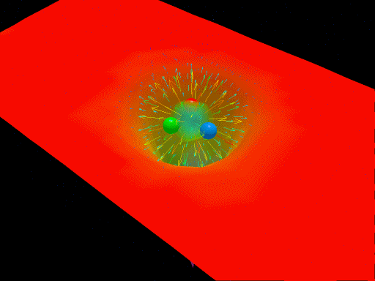
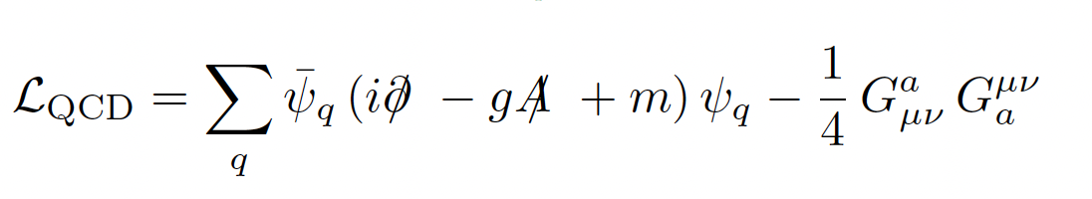
Critical QCD Questions Addressed
How do properties of colorless hadrons emerge from the confined dynamics of colored quarks and gluons?
QCD is the most complex part of the Standard Model
“Nucleons are the stuff of which our world is made.
As such they must be at the center of any discussion of why the world we actually experience has the character it does.”
Nathan Isgur, 2000
Derek B. Leinweber – University of Adelaide
At nucleon mass scale (1 GeV), dynamics is highly nonlinear and leads to confinement of partons.
How do Nucleon mass / size / spin emerge from these dynamics?

Slide 3
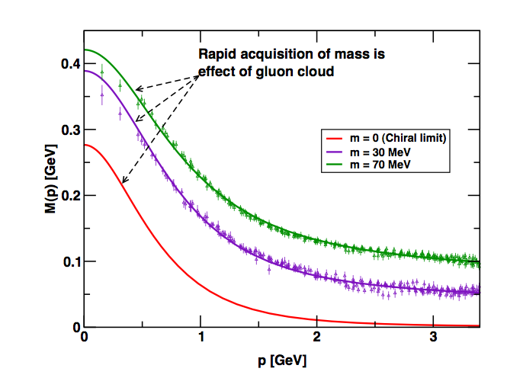
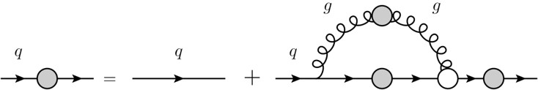

Critical QCD Questions Addressed
How do massless quarks acquire mass?
Effective quark mass depends on its momentum
M=M(p)
m₀=m_{HM}
numerical simulations
of unquenched lattice QCD
(Bowman et al.)
dressed quark
bare quark
dressing kernel
Dyson-Swinger equation
(Bhagwat et al.)
mass composition
<2% Higgs mechanism
>98% non-perturbative strong interaction
Almost all the nucleon mass comes from the energy spent to bind the quarks inside it!

Slide 4
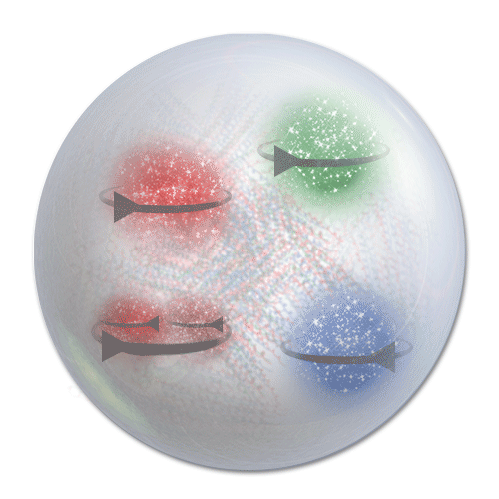
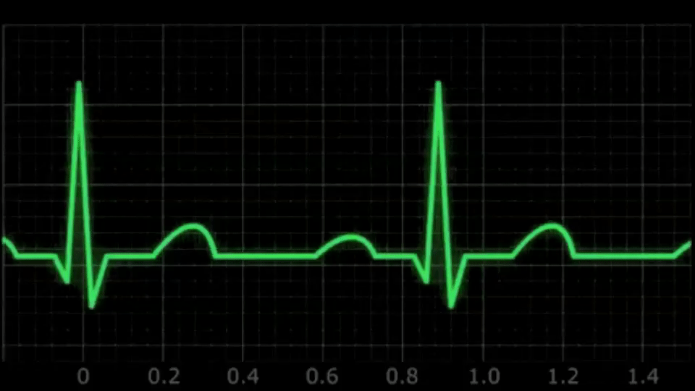
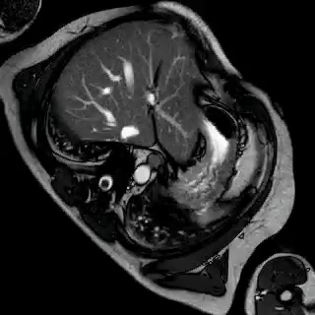
Critical QCD Questions Addressed
How are the quarks and gluons, and their intrinsic spins distributed in space & momentum inside the nucleon? What is the role of the angular momentum ?
SIDIS and TMDs measurements toward a 3D imaging of the proton

Slide 5

Critical QCD Questions Addressed
How is color confinement realized in the force and pressure distributions and stabilize nucleons?
Electro-magnetism
Vector
Tensor
Gravity
Q_{p} $μ$_{p}
M_{p} J_{p} D_{p}
PCAC
g_{A} g_{P}
Weak interaction
Study GPDs and their moments from DVCS

Slide 6
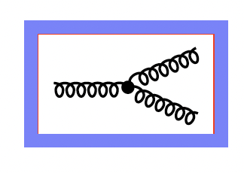
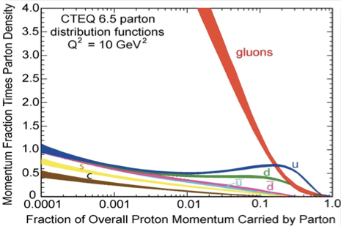
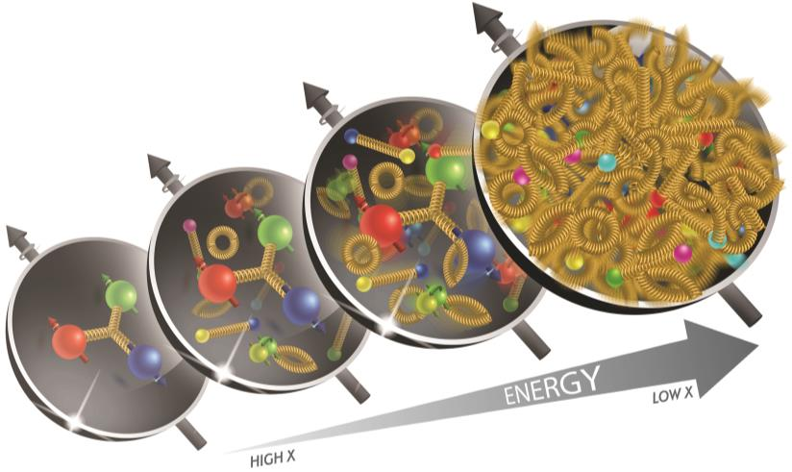
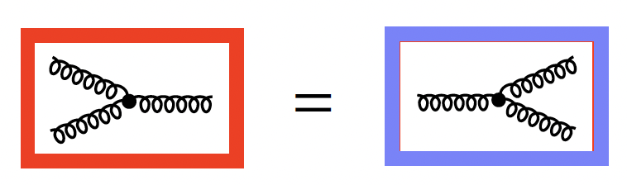
Critical QCD Questions Addressed
Where does gluon saturation set in ? Universal gluonic matter at high density ? quark-gluon interactions in nuclear matter ?
Gluon self-interaction leads to the proliferation of the number of gluons
x
Unitarity → gluons must recombine to balance splitting (saturation)

Slide 7
Critical QCD Questions Addressed
How do properties of colorless hadrons emerge from the confined dynamics of colored quarks and gluons?
Measure the Q² dependence of hadrons electrocouplings and form factors
How do massless quarks acquire mass?
Access the Energy - Momentum Tensor and the Gravitational Form Factors
How are the quarks and gluons, and their intrinsic spins distributed in space & momentum inside the nucleon? What is the role of the angular momentum ?
SIDIS and TMDs measurements toward a 3D imaging of the proton
How is color confinement realized in the force and pressure distributions and stabilize nucleons?
Study GPDs and their moments from DVCS
Where does gluon saturation set in?
Study deep processes on Nuclei
The EIC scientific program addresses all these questions

Slide 8
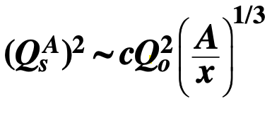
QCD exploration at EIC
REQUIREMENTS
Access to gluon dominated region and wide kinematic range in x and Q²
Access to spin structure and 3D spatial and momentum structure
Accessing the highest gluon densities
Studying observables as a function of x, Q², A, hadronic flavor, …
THE EIC COLLIDER PROVIDES
Large center-of-mass energy range:
√s = 30 -140 GeV
Polarized electron, proton and light nuclear beams
≥ 70%
Nuclear beams, the heavier the better
(from H to U)
High luminosity (100 x HERA): 10³³⁻³⁴ cm⁻² ^{s-1}

Slide 9
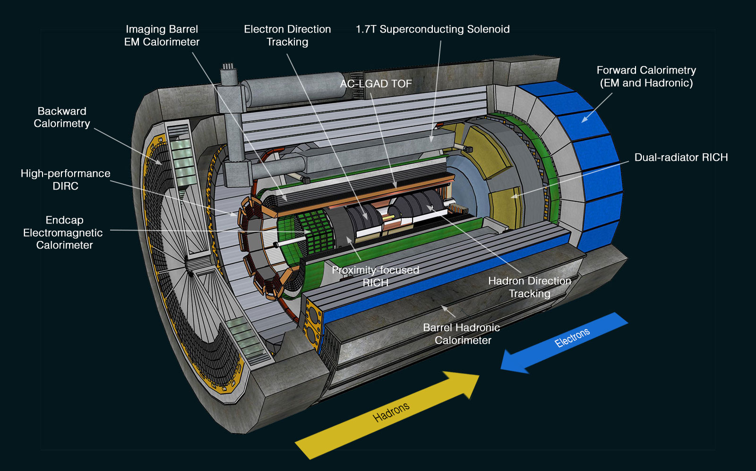
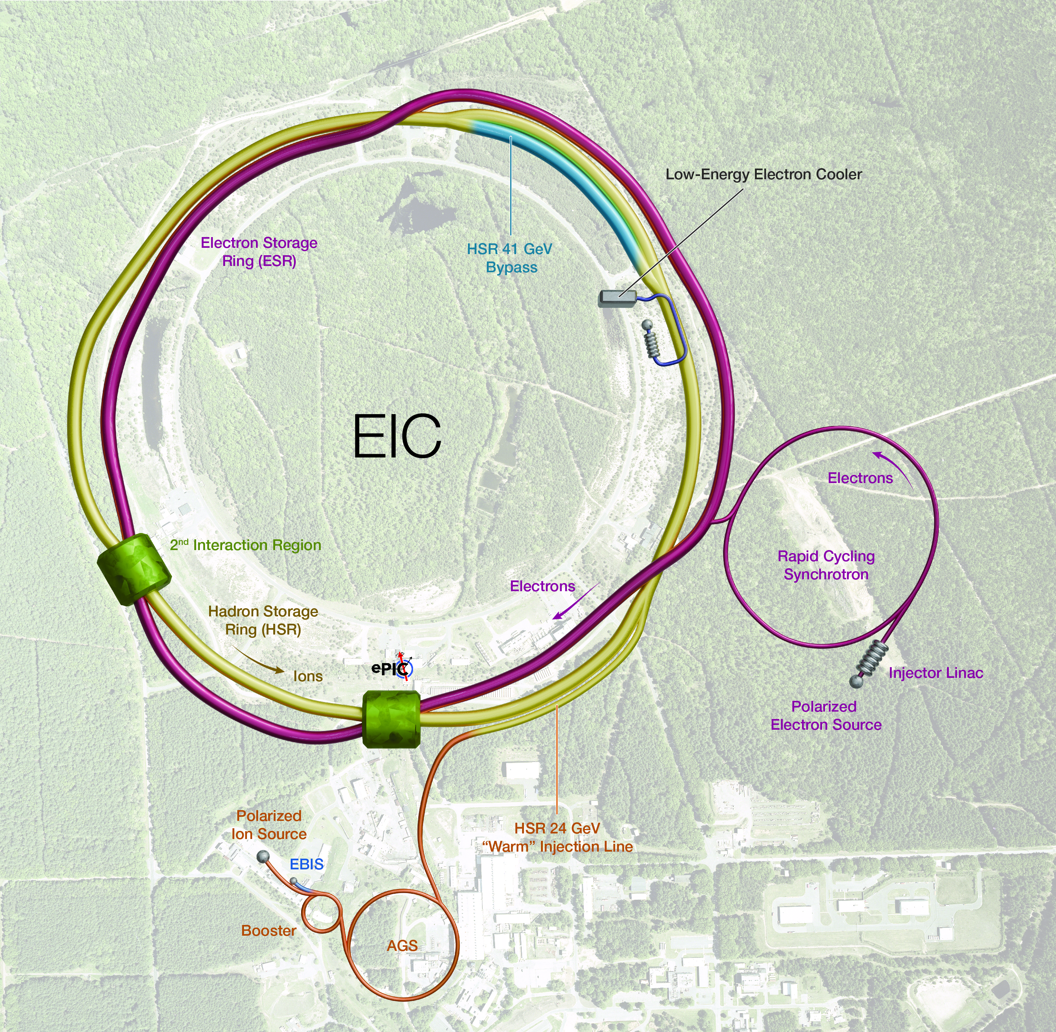

ePIC at EIC
Asymmetric, energy tunable, highly polarized electron and proton/ion beams
$$\sqrt{s}=30 −140 GeV$$
ePIC central detector
Electron-Ion Collider
ePIC

Slide 10
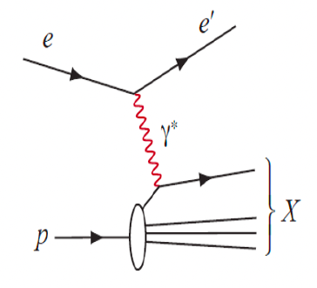
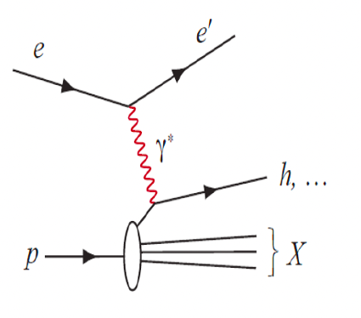
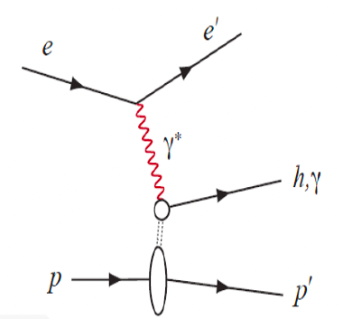
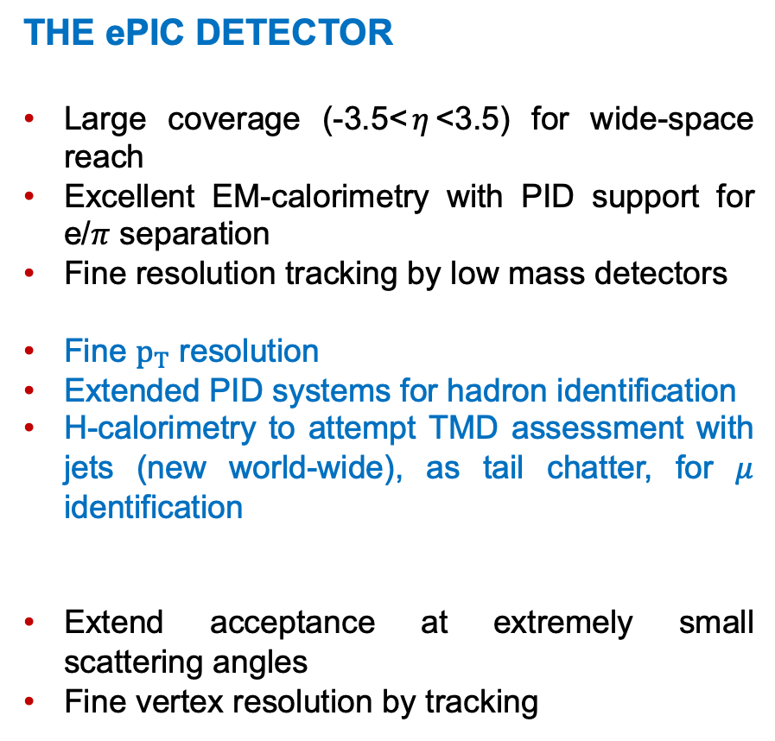
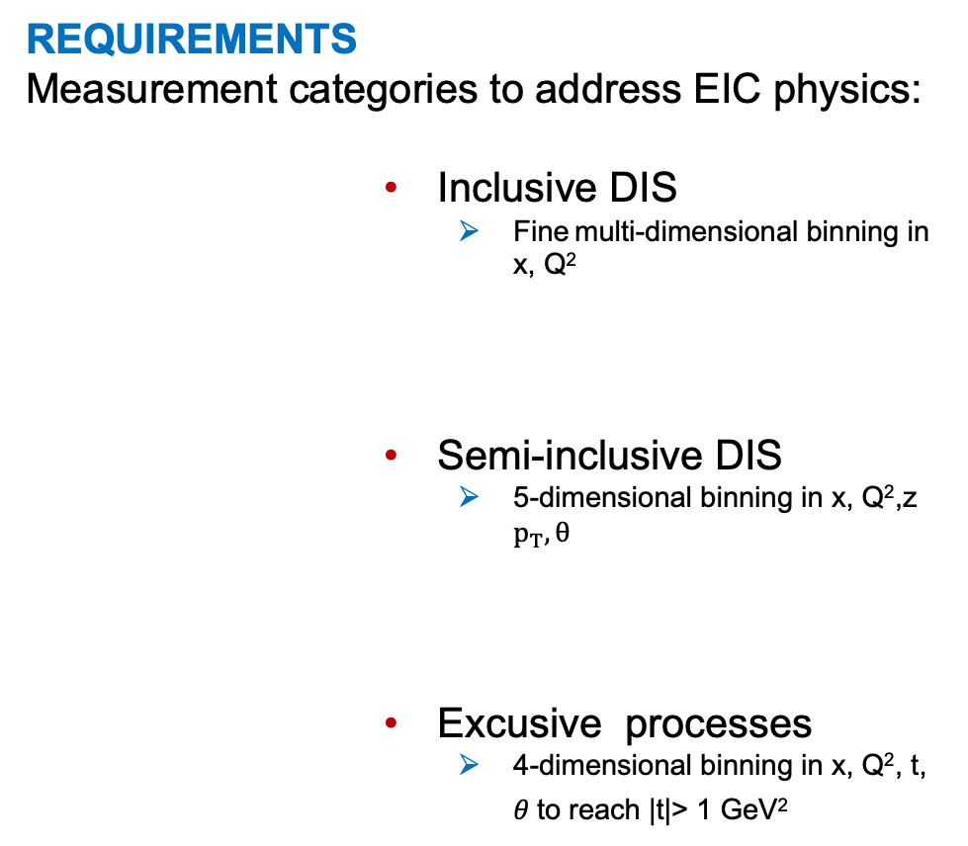
ePIC at EIC
REQUIREMENTS
Measurement categories to address EIC physics:
Inclusive DIS
  Fine multi-dimensional binning in x, Q²
Semi-inclusive DIS
  5-dimensional binning in x, Q²,z $p_{T}, θ$
Excusive processes
  4-dimensional binning in x, Q², t, $θ$to reach |t|> 1 GeV²
THE ePIC DETECTOR
Large coverage (-3.5<$η$<3.5) for wide-space reach
Excellent EM-calorimetry with PID support for e/$π$ separation
Fine resolution tracking by low mass detectors
Fine $p_{T}$ resolution
Extended PID systems for hadron identification
H-calorimetry to attempt TMD assessment with jets (new world-wide), as tail chatter, for $μ$ identification
Extend acceptance at extremely small scattering angles
Fine vertex resolution by tracking

Slide 11
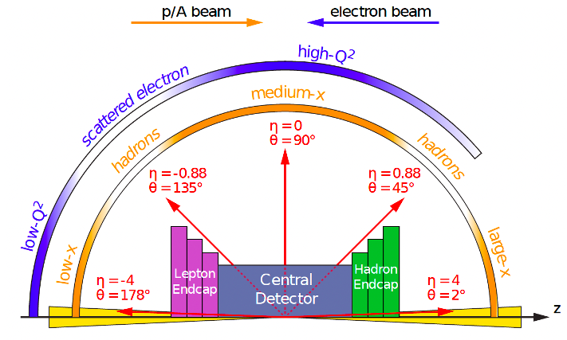
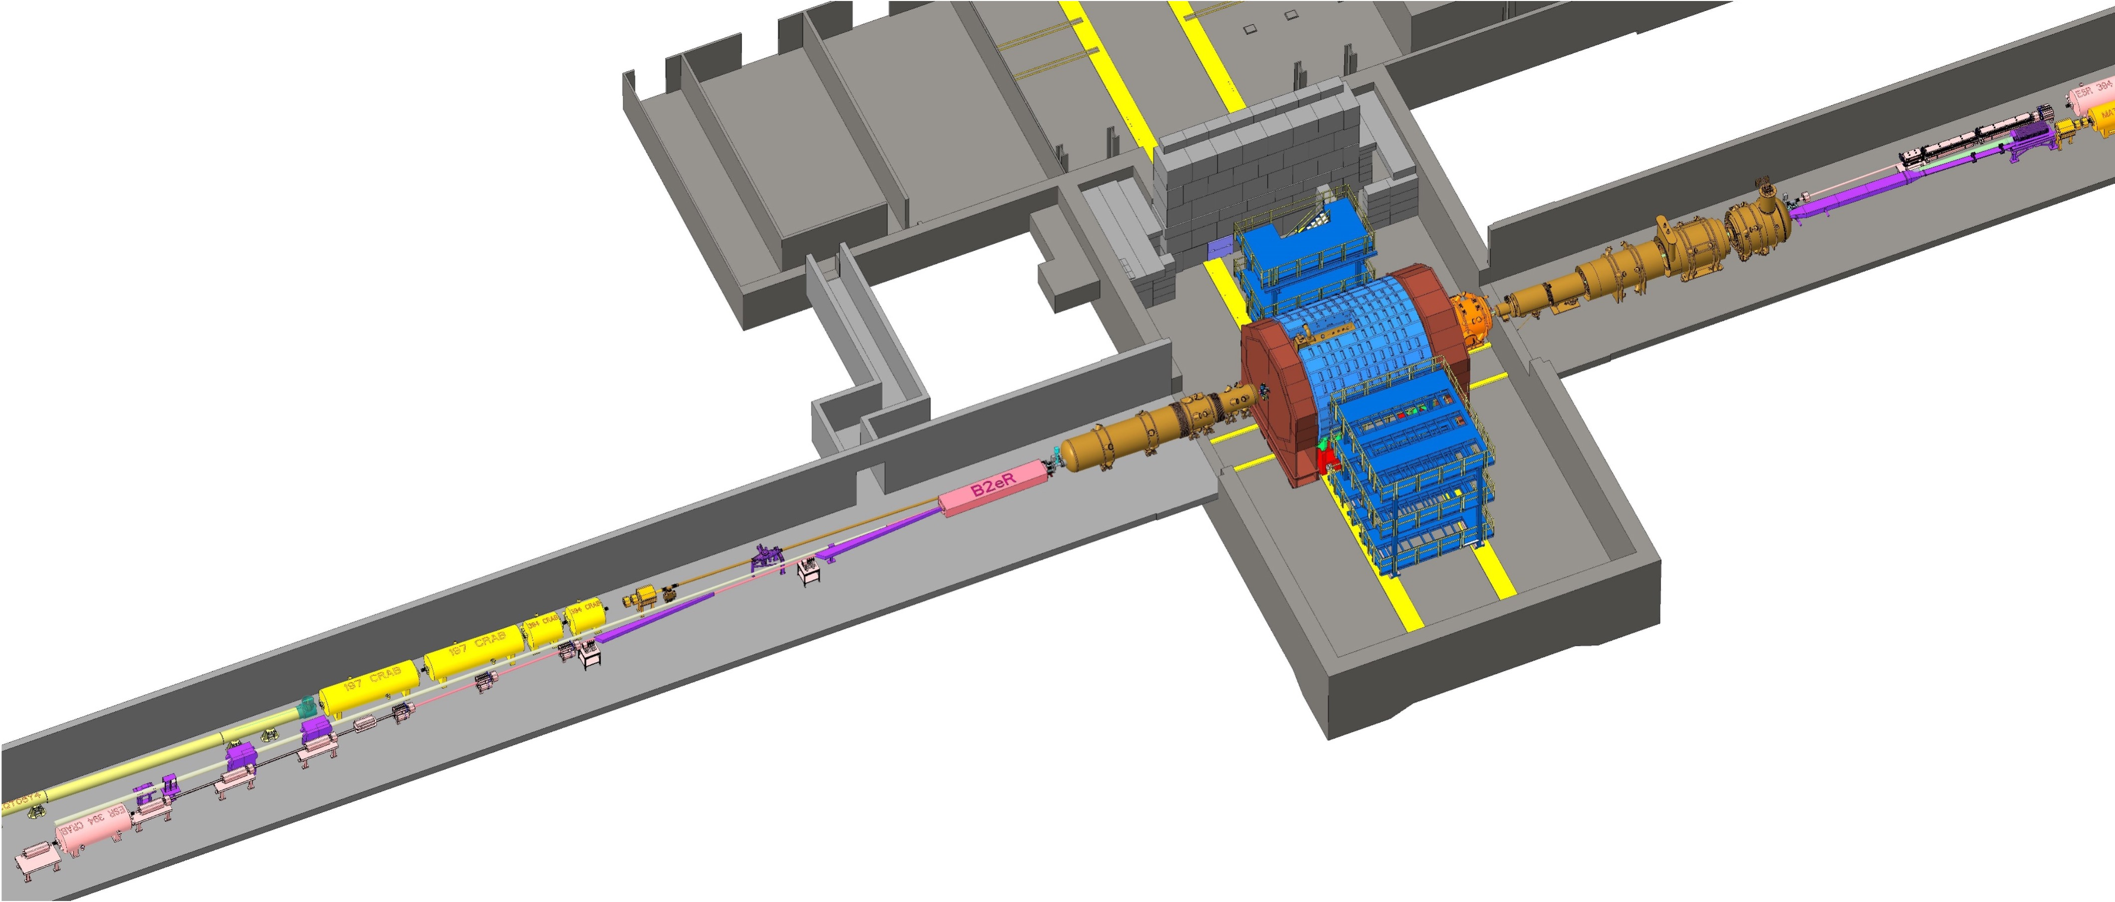

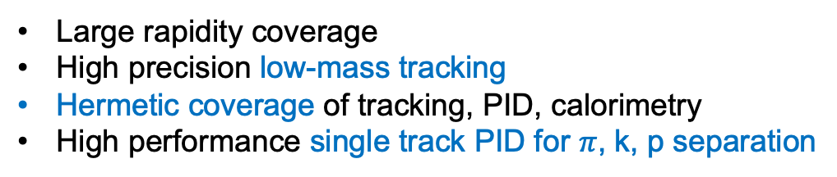




ePIC at EIC
Large rapidity coverage
High precision low-mass tracking
Hermetic coverage of tracking, PID, calorimetry
High performance single track PID for $π$, k, p separation
The Central
Detector
$$−3.5<η<3.5$$
The Far Forward and Far Backward Detector
Zero Degree
Calorimeter
$←$e beam
Luminosity System
Roman Pots and Off-Momentum Detectors
Specialized far-forward detectors for p kinematics measurements
Many auxiliary detectors integrated in the beam line: ZDC, Roman Pots, low-Q² taggers
High systematics control: luminosity monitors, polarimeters
p/ion beam $→$
$$η<−4$$
Low Q² Taggers
$$η>4$$

Slide 12
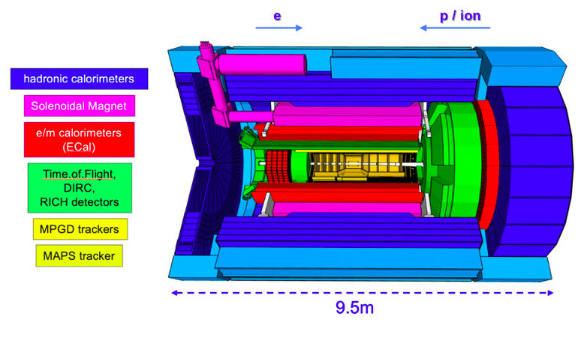
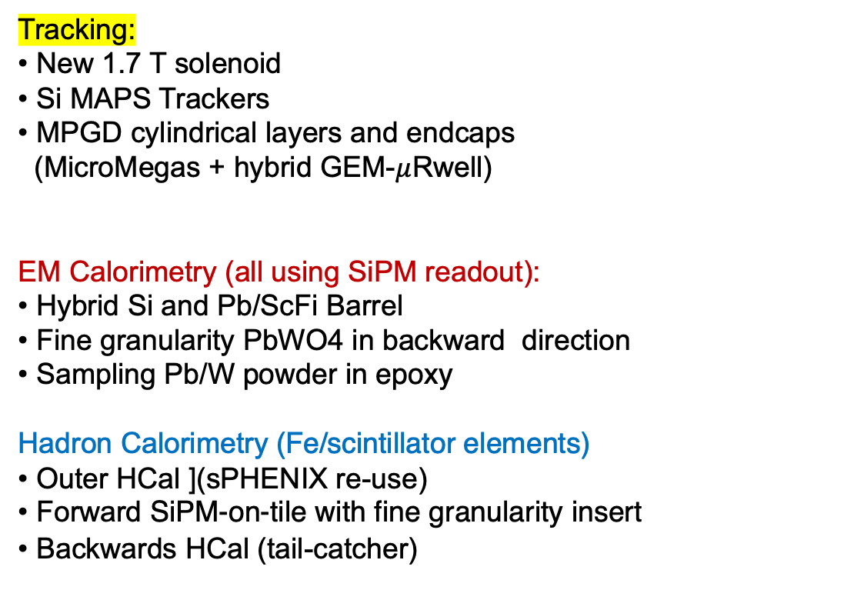
THE ePIC CENTRAL DETECTOR
Particle ID:
~30ps TOF using AC-LGAD
• High performance DIRC
• pfRICH
• dRICH
Tracking:
• New 1.7 T solenoid
• Si MAPS Trackers
• MPGD cylindrical layers and endcaps
(MicroMegas + hybrid GEM-$μ$Rwell)
EM Calorimetry (all using SiPM readout):
• Hybrid Si and Pb/ScFi Barrel
• Fine granularity PbWO4 in backward direction
• Sampling Pb/W powder in epoxy
Hadron Calorimetry (Fe/scintillator elements)
• Outer HCal ](sPHENIX re-use)
• Forward SiPM-on-tile with fine granularity insert
• Backwards HCal (tail-catcher)
p/ion
e

Slide 13
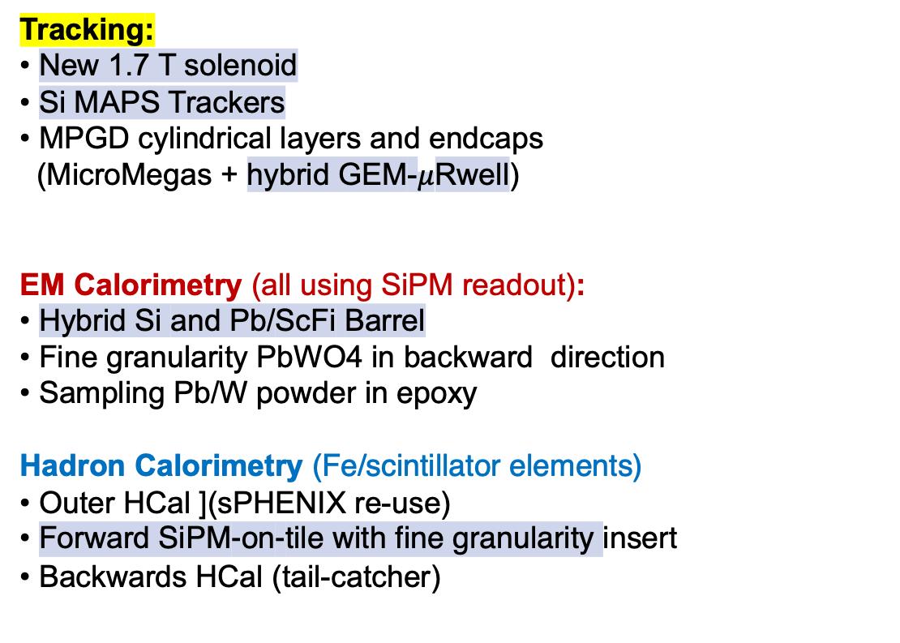
THE ePIC CENTRAL DETECTOR
Tracking:
• New 1.7 T solenoid
• Si MAPS Trackers
• MPGD cylindrical layers and endcaps
(MicroMegas + hybrid GEM-$μ$Rwell)
EM Calorimetry (all using SiPM readout):
• Hybrid Si and Pb/ScFi Barrel
• Fine granularity PbWO4 in backward direction
• Sampling Pb/W powder in epoxy
Hadron Calorimetry (Fe/scintillator elements)
• Outer HCal ](sPHENIX re-use)
• Forward SiPM-on-tile with fine granularity insert
• Backwards HCal (tail-catcher)
Particle ID:
~30ps TOF using AC-LGAD
• High performance fused silica DIRC using AC-LGAD
• pfRICH using AC-LGAD
• dRICH
p/ion
e
ePIC is a unique environment for enabling future detector technologies

Slide 14
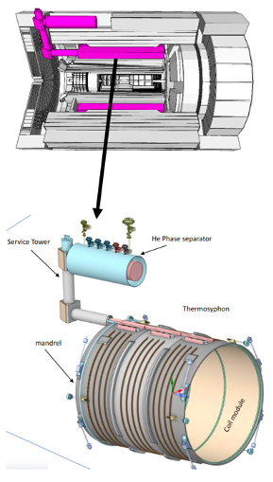
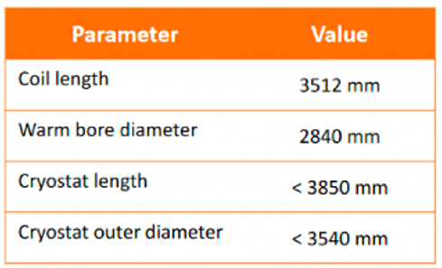
THE NEW MARCO SUPERCONDICTING SOLENOID
Requirements
Large warm bore (2.84 diameter)
Large solid angle (3.5 m coil length)

Slide 15
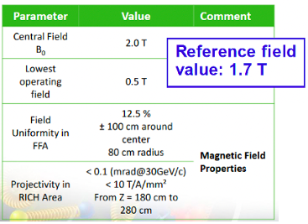
THE NEW MARCO SUPERCONDICTING SOLENOID
Requirements
Large warm bore (2.84 diameter)
Large solid angle (3.5 m coil length)
2T superconducting magnet
Uniform and flat field over 2 m length and 84 cm radius
Field parallel to tracks in the RICH region 1.5 < η < 3.5

Slide 16
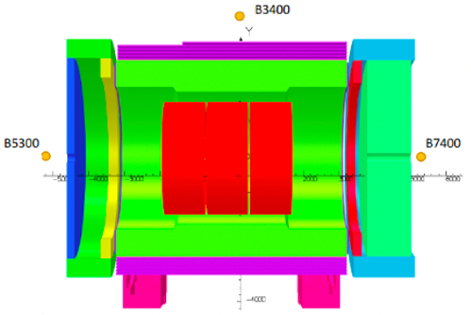
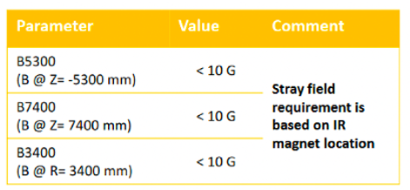
THE NEW MARCO SUPERCONDICTING SOLENOID
Requirements
Large warm bore (2.84 diameter)
Large solid angle (3.5 m coil length)
2T superconducting magnet
Uniform and flat field over 2 m length and 84 cm radius
Field parallel to tracks in the RICH region 1.5 < η < 3.5
Low stray field (<10 G) not to interfere with the interaction region magnets

Slide 17
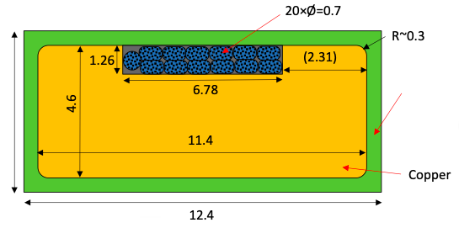
THE NEW MARCO SUPERCONDICTING SOLENOID
Requirements
Large warm bore (2.84 diameter)
Large solid angle (3.5 m coil length)
2T superconducting magnet
Uniform and flat field over 2 m length and 84 cm radius
Field parallel to tracks in the RICH region 1.5 < η < 3.5
Low stray field (<10 G) not to interfere with the interaction region magnets
Thermosyphon cooling scheme
Three identical modules:
6 layers, 556 turns, 2 fiber glass
insulators 0.2 mm between layers
Superconducting coil:
Cu- stabilized Nb/Ti Rutherford cable)
all distances are in mm
L = 5.847 H Stored energy = 45 MJ

Slide 18
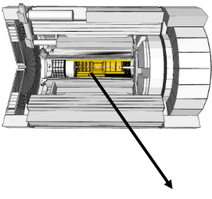
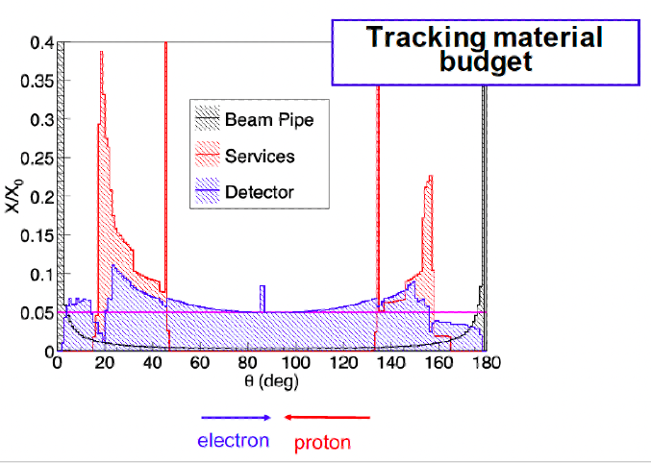
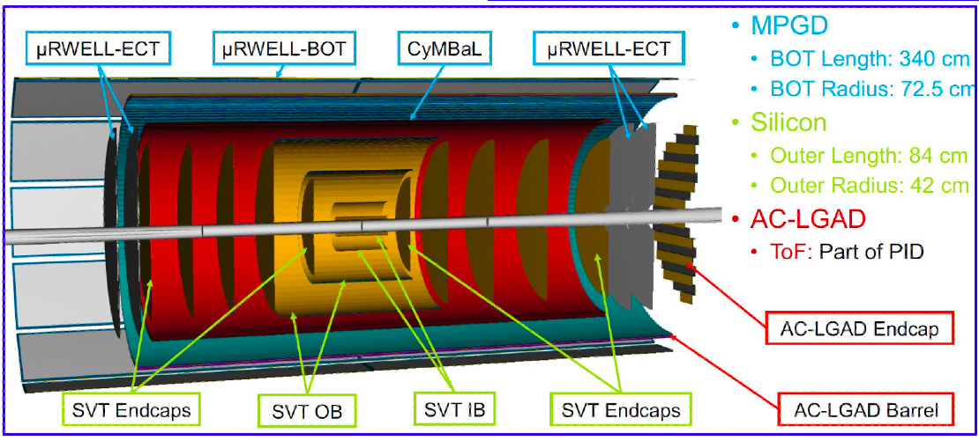
ePIC Tracking
Complementary tracking technologies characterized by low-mass materials
Silicon Vertex Tracker
MPGD trackers

Slide 19
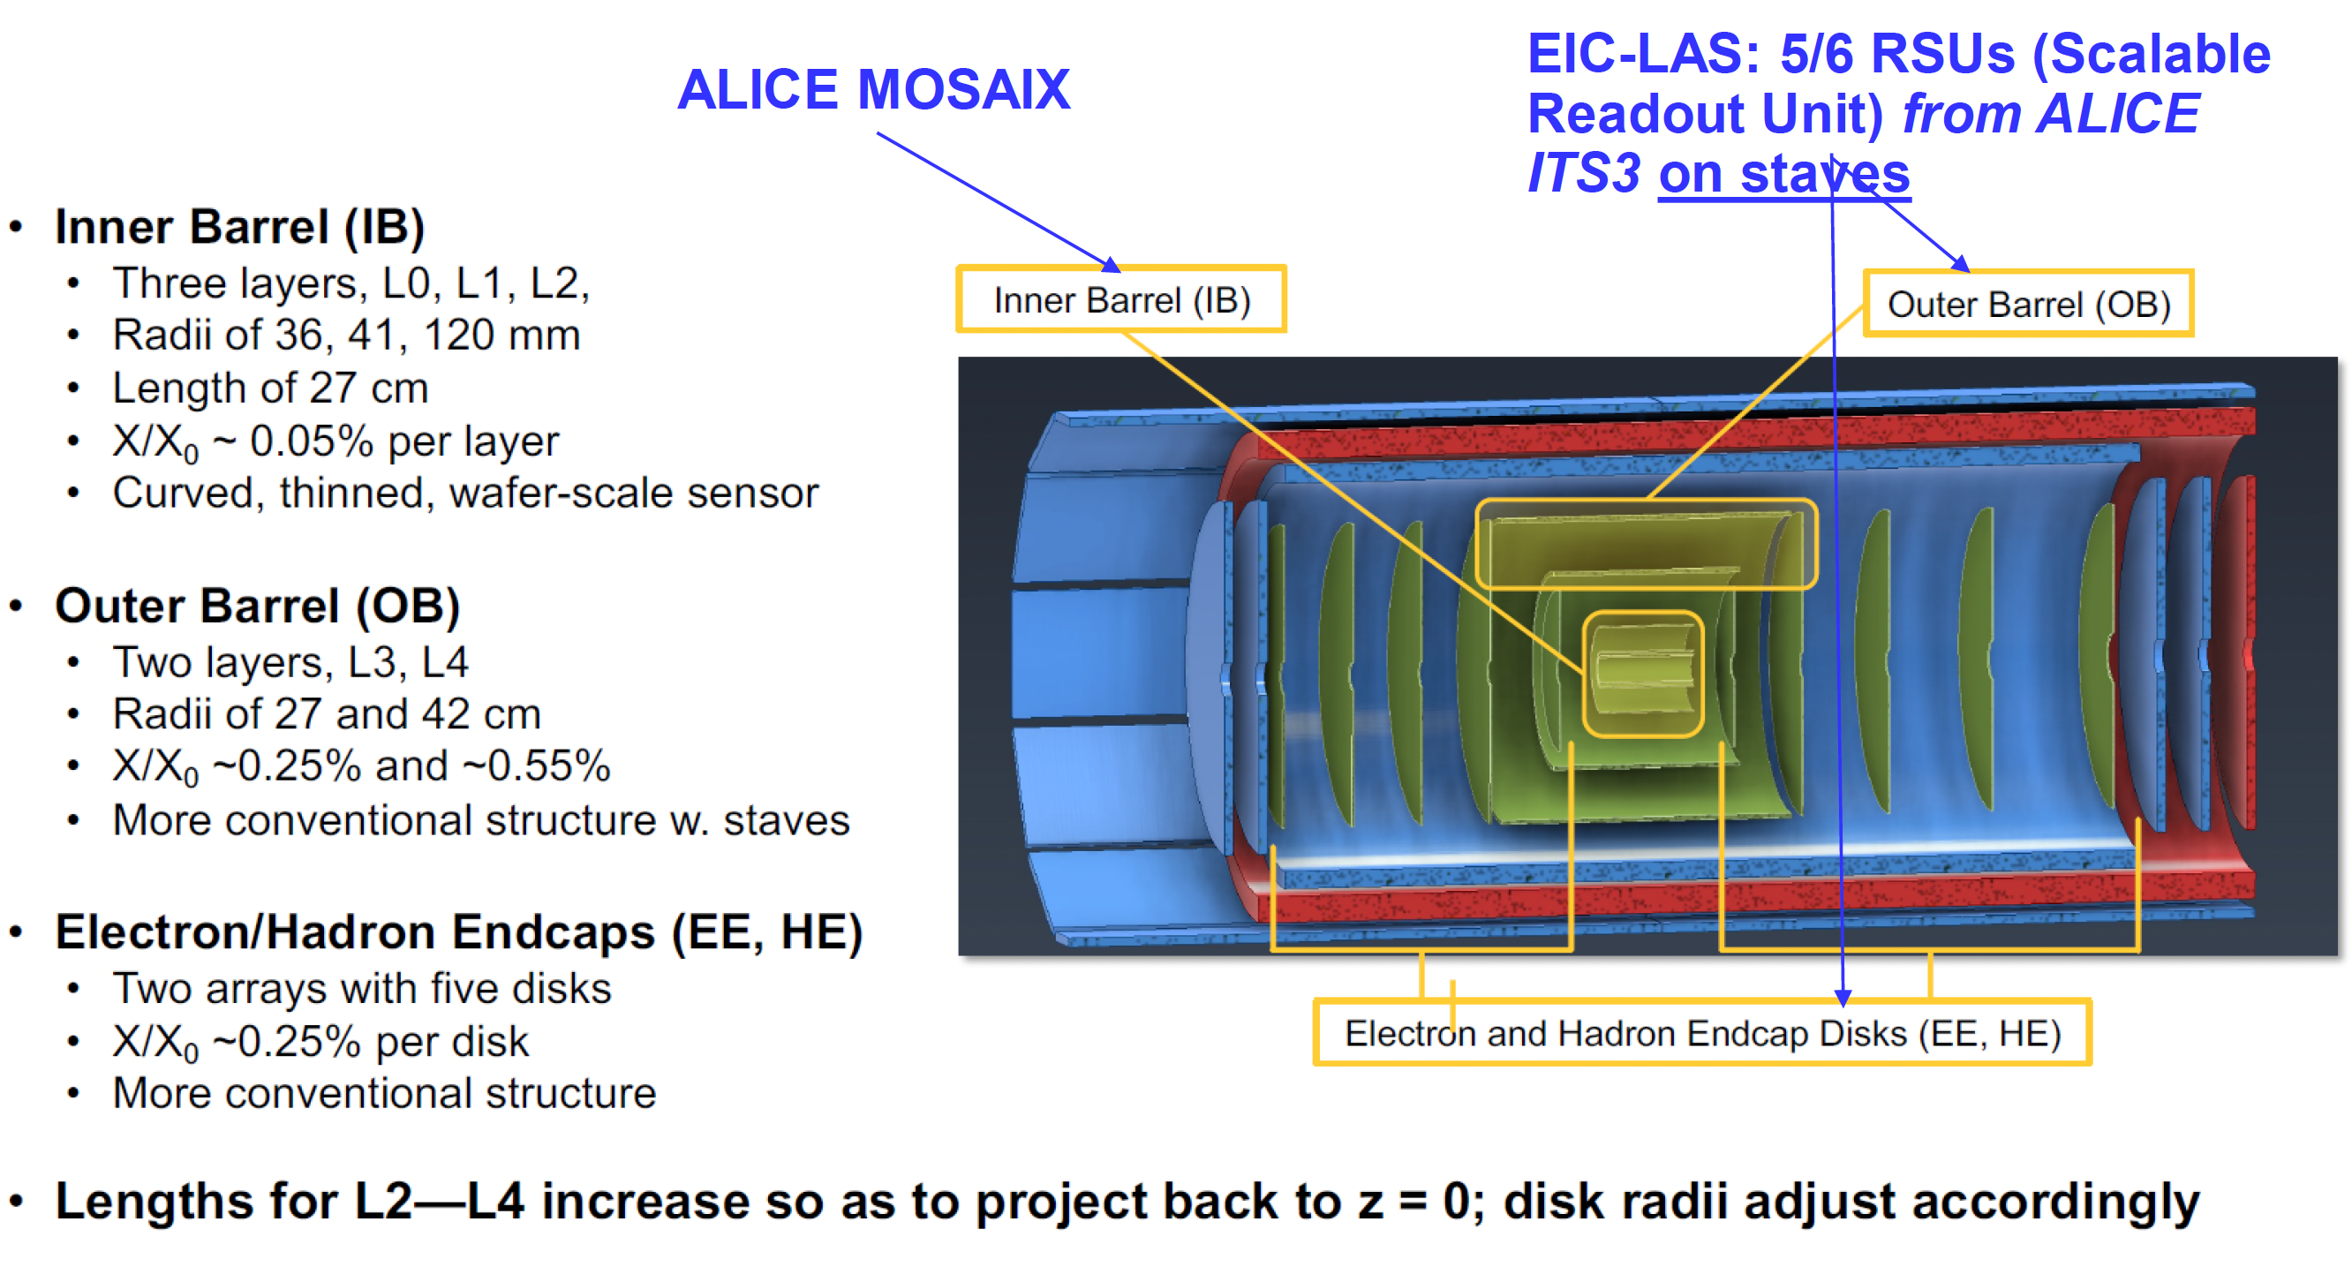
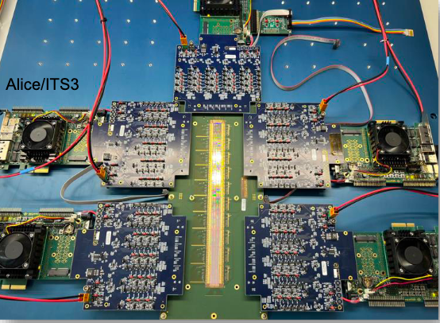

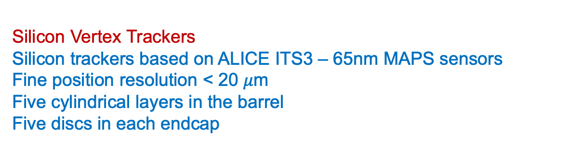
ePIC Tracking: SVT
Silicon Vertex Trackers
Silicon trackers based on ALICE ITS3 – 65nm MAPS sensors
Fine position resolution < 20 $μ$m
Five cylindrical layers in the barrel
Five discs in each endcap
The sensors will be thinned to 50 μm or less and bent to form a nearly self-supporting structure
high granularity
low power consumption design
stitching on 300 mm wafers
Repeated Sensor Units
Stitched together $→$matrixes/staves

Slide 20
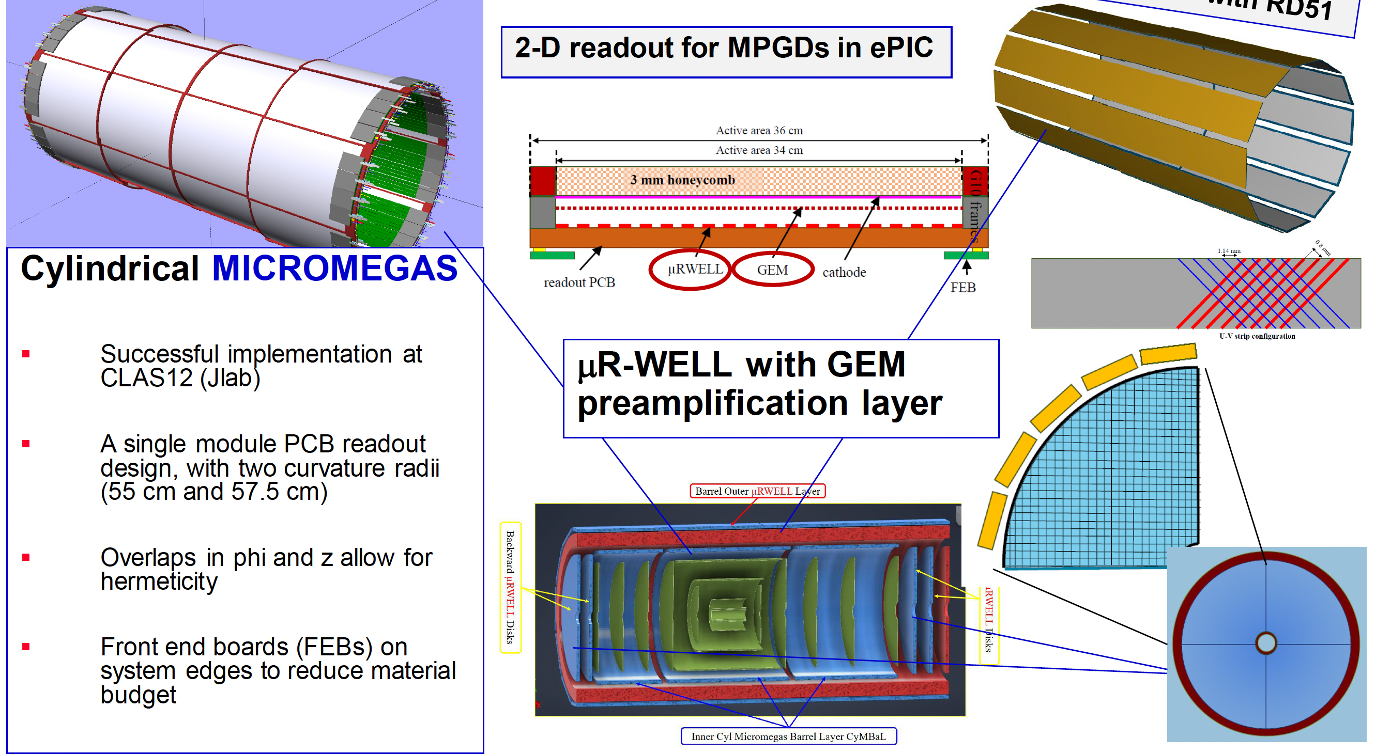
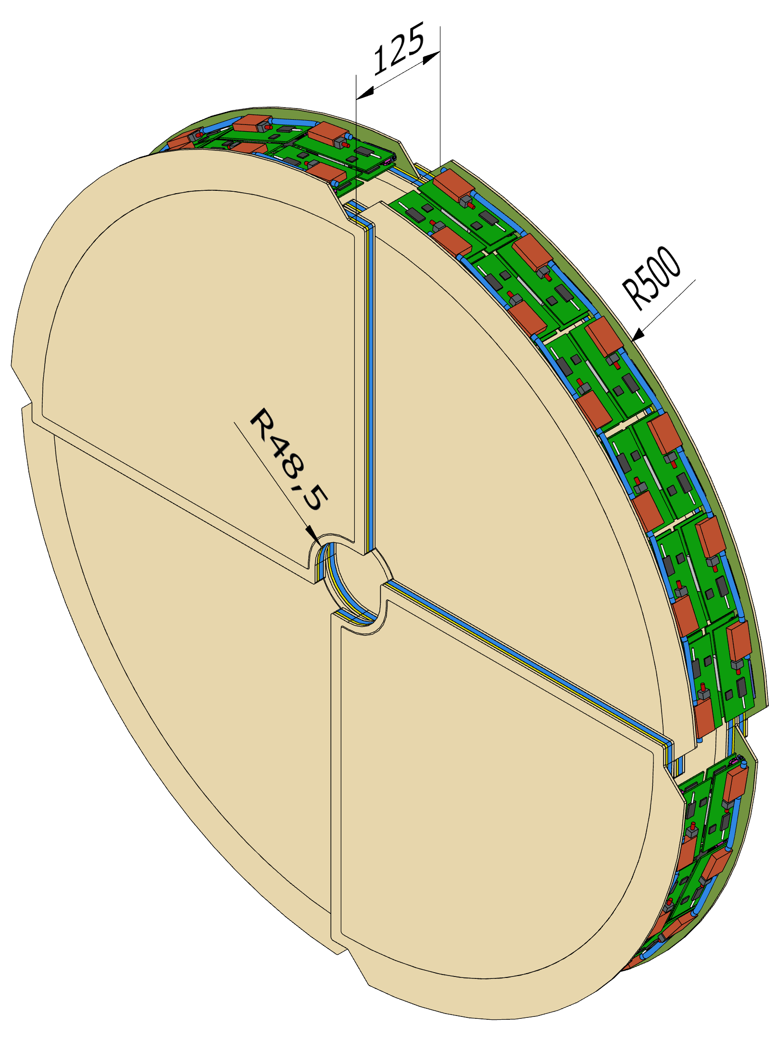
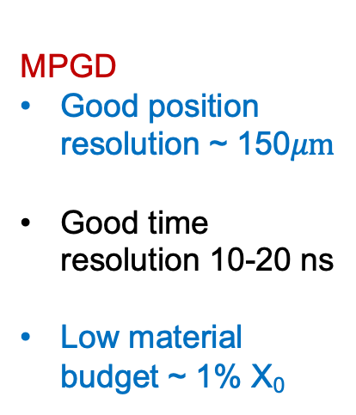
ePIC Tracking: MPGD
MPGD
Good position resolution ~ 150$μm$
Good time resolution 10-20 ns
Low material budget ~ 1% X₀

Slide 21
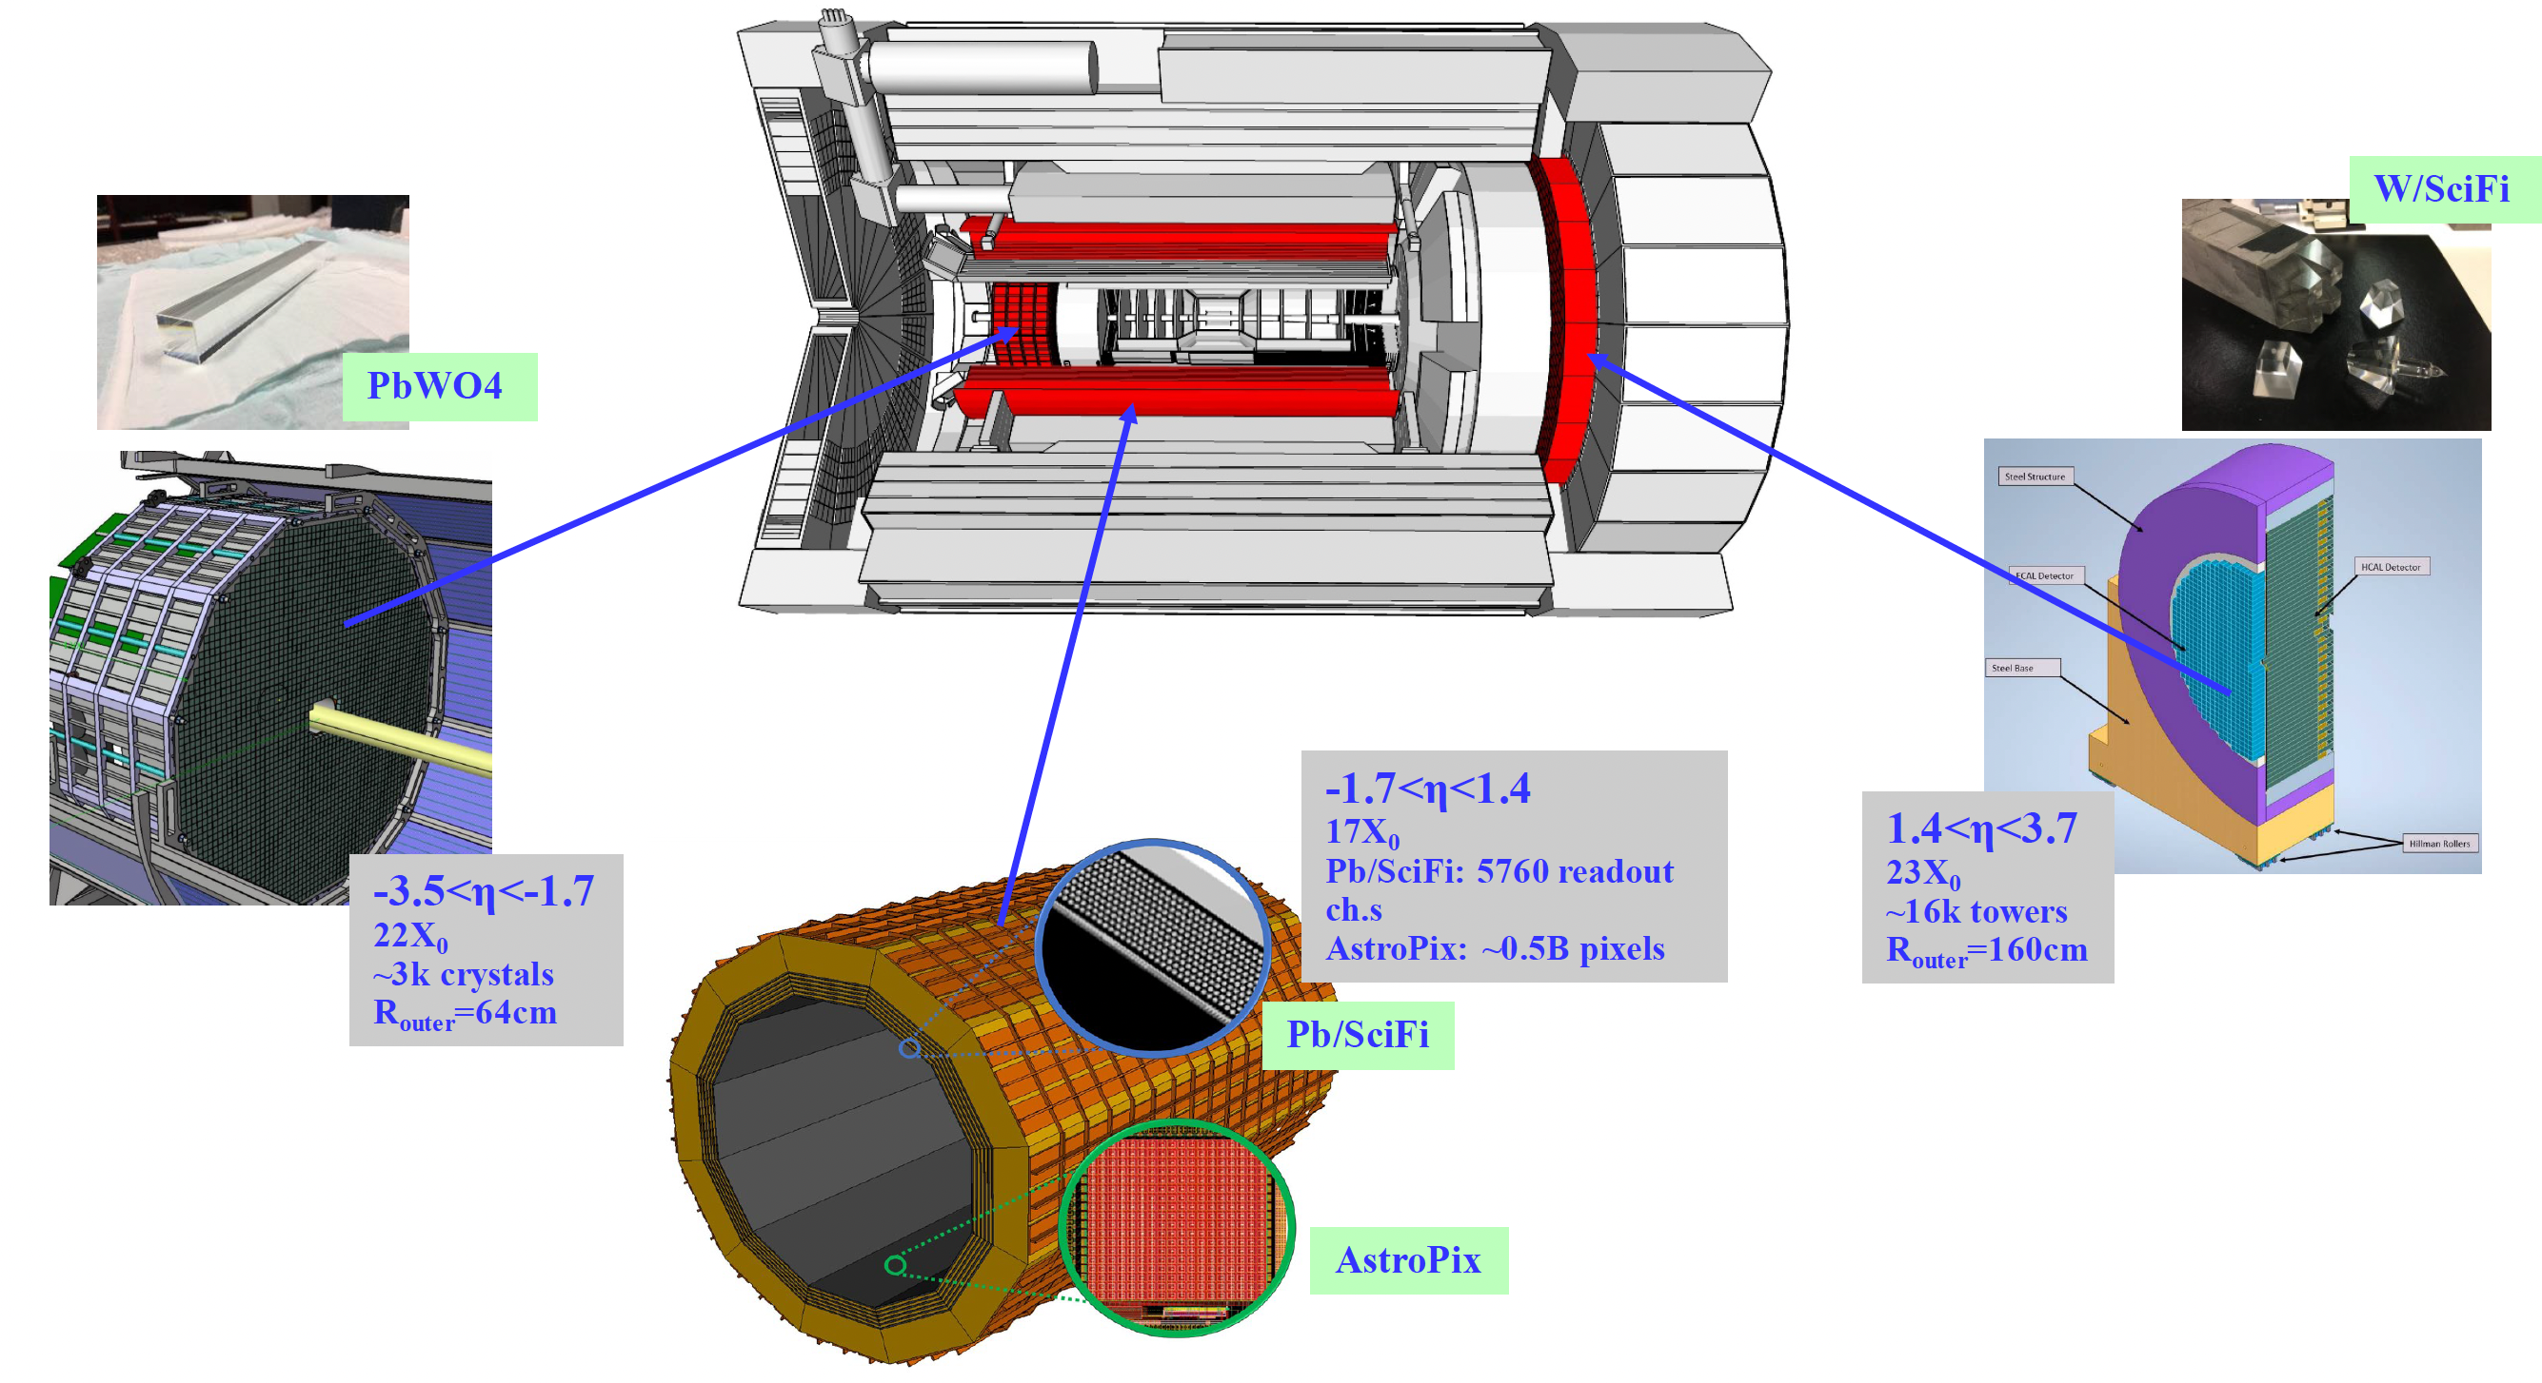
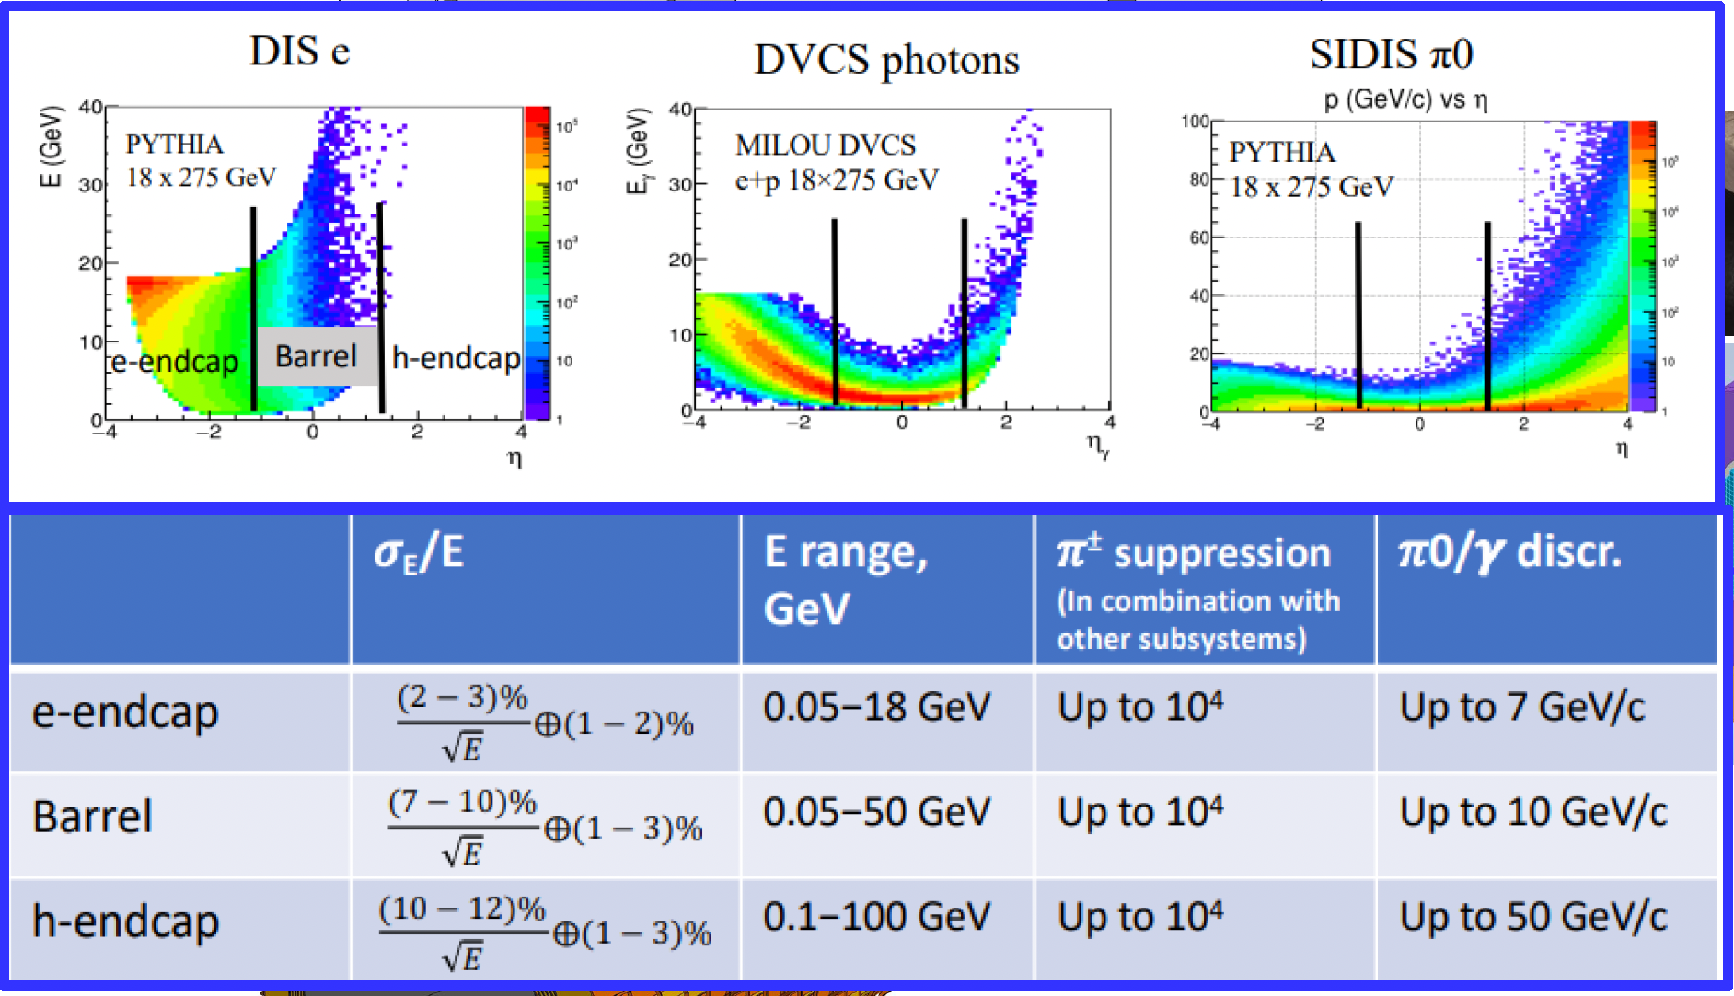
The ePIC Electromagnetic Calorimeters: read by Si PM
Sampling Pb/W powder in epoxy
Si PM Challenges:
size is relatively small compared to the radiator size
large dynamic range > 3 orders of magnitude
high rate of dark noise
performances depend on temperature
Radiation hardness
5
Barrel Imaging Calorimeter
Not sensitive to magnetic field
Cost effective
Very high density of pixels (10– and 15–μm pitch) provide linearity over several orders of magnitude
Hybrid imaging-sampling technologies

Slide 22
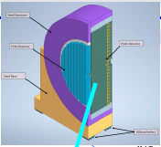
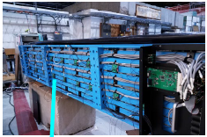
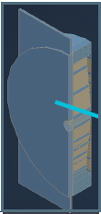
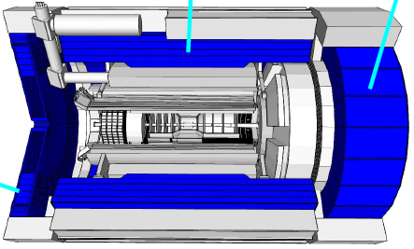
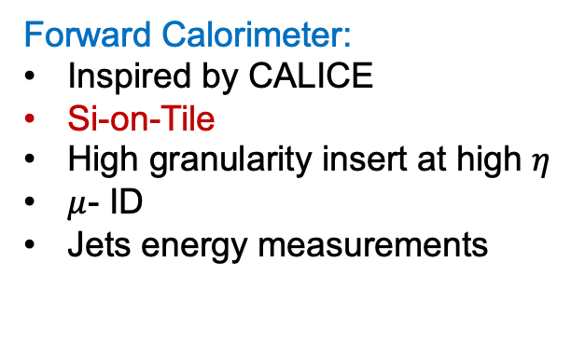
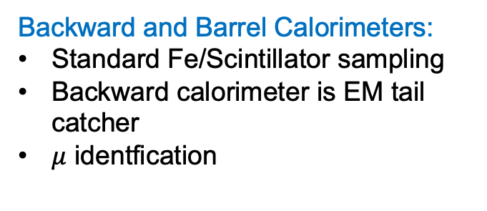
Hadron Calorimetry
Backward and Barrel Calorimeters:
Standard Fe/Scintillator sampling
Backward calorimeter is EM tail catcher
$μ$ identfication
Forward Calorimeter:
Inspired by CALICE
Si-on-Tile
High granularity insert at high $η$
$μ$- ID
Jets energy measurements

Slide 23
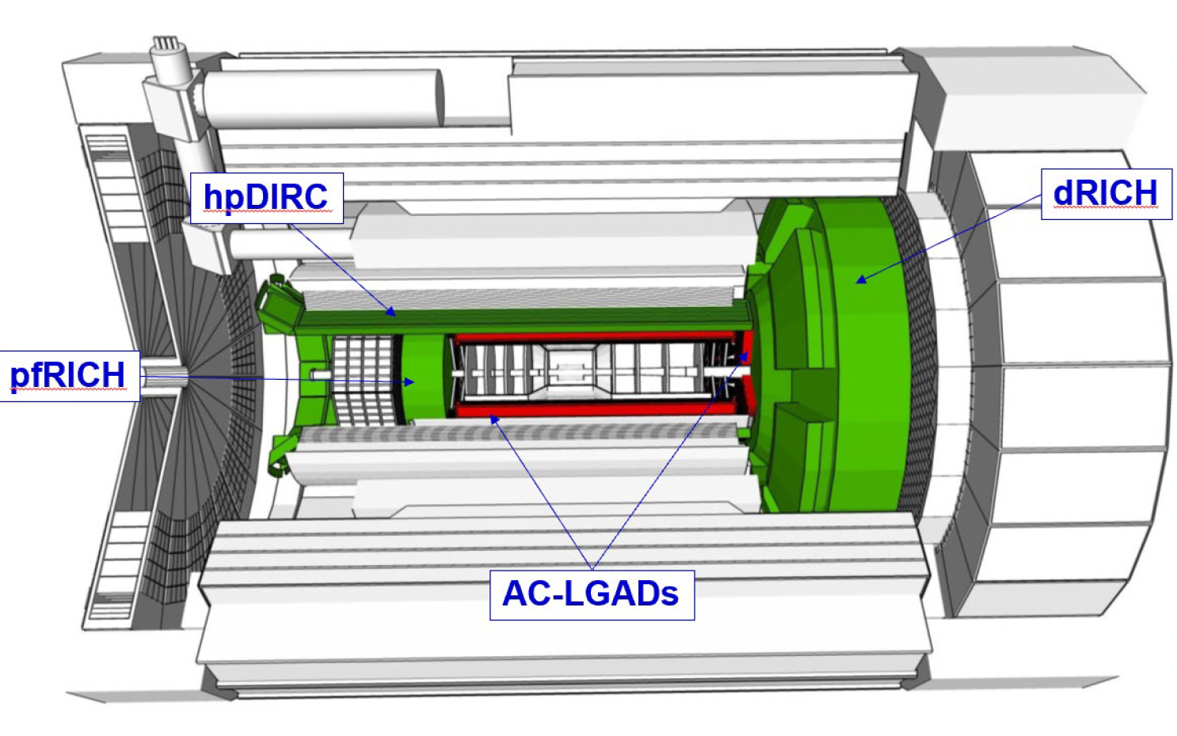
PID: TOF, hpDIRC, pfRICH, dRIC
Dual radiator RICH
(dRICH)
Aerogel and C₂F₆
HRPPD
proximity focusing RICH
High performance DIRC
thanks to focalization and fine photosensor pizelization
TOF with
Low Gain Avalanche Diode
n
The long proximity gap (~ 35 cm)
enhances the resolution

Slide 24
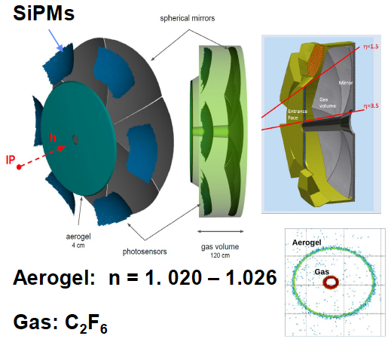
PID: TOF, hpDIRC, pfRICH, dRIC
Dual radiator RICH
(dRICH)
Aerogel and C₂F₆
TOF with
Low Gain Avalanche Diode
The long proximity gap (~ 35 cm)
enhances the resolution
~ 100% filling factor

Slide 25

World first at ePIC

Slide 26
FINAL CONSIDERATIONS
The EIC is a world unique project to understand the working of QDC
EIC has been approved and progressing according to schedule
Its scientific program is expected to start in the first years 2030
The ePIC collaboration involves 897 members from 177 Institutions in 25 countries who are highly committed:
  The ePIC detector design is dictated by the physics scope
  A number of novel technologies are necessary to match this scope
  ePIC TDR is in progress addressing both the scientific scope and the detector details
  ePIC is a unique environment for enabling future detector technologies providing exciting prospects for experimental developments and physics progress.

Slide 27

Far Forward and Far Backward detectors
systematics control: luminosity and polarimetry
detectors integrated in the beam line:
ZDC (SiPM-on tile), Roman pots, ..

Slide 28

ASIC & FE ePIC developments

