Slide 1


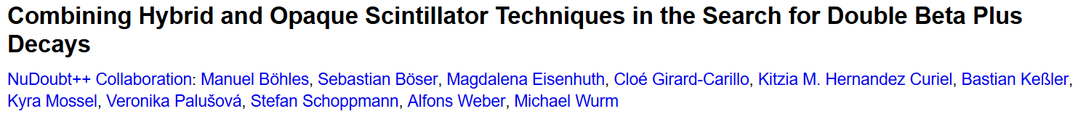
NuDoubt⁺⁺ Experiment
The search for neutrinoless double beta plus decay
Susie Wakely
NuDoubt⁺⁺ paper:

Slide 2
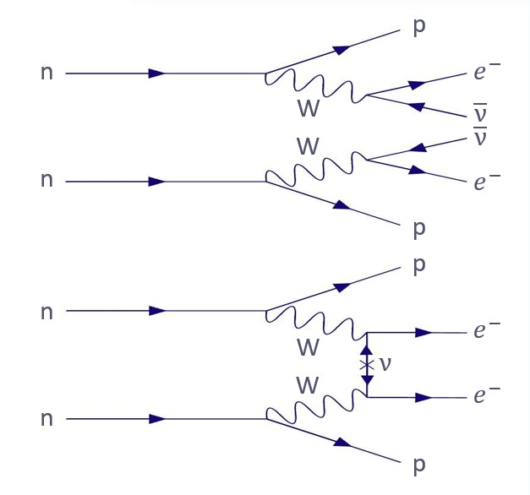
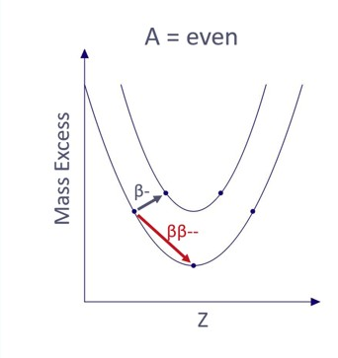
Double Beta Decay
2νββ
Occurs when single beta decay is energetically forbidden
Standard Model
0νββ
Beyond Standard Model

Slide 3
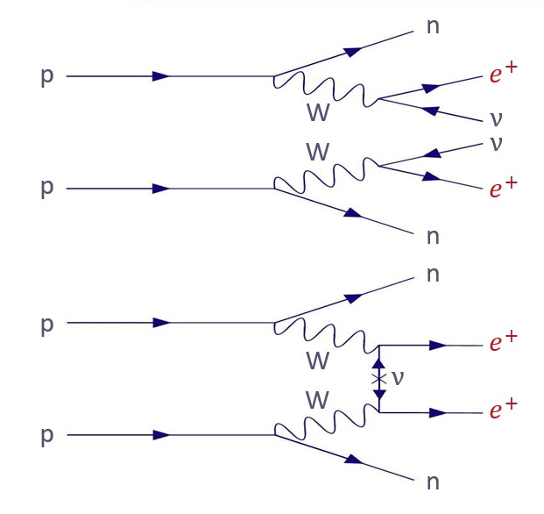
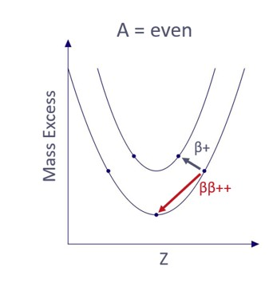
Double Beta Decay
Plus
^
2νββ++
Occurs when single beta decay is energetically forbidden
Standard Model
0νββ++
Beyond Standard Model

Slide 4
Double Beta Decay
Plus
^
Suppressed decay probabilities
Less favourable Q-values
Low natural abundances of nuclei
Challenging signatures

Slide 5
Double Beta Decay
Plus
^
Suppressed decay probabilities
Less favourable Q-values
Low natural abundances of nuclei
Challenging signatures
Also possible via:
double electron capture (ECEC)
electron capture single beta+ (ECβ+)

Slide 6
Double Beta Decay
Plus
^
Suppressed decay probabilities
Less favourable Q-values
Low natural abundances of nuclei
Challenging signatures
Also possible via:
double electron capture (ECEC)
electron capture single beta+ (ECβ+)
NuDoubt⁺⁺ will be sensitive to:
2νββ++ (0νββ++)
2νECβ+ (0νECβ+)

Slide 7
Double Beta Decay
Plus
^
Suppressed decay probabilities
Less favourable Q-values
Low natural abundances of nuclei
Challenging signatures
Also possible via:
double electron capture (ECEC)
electron capture single beta+ (ECβ+)
NuDoubt⁺⁺ will be sensitive to:
2νββ++ (0νββ++)
2νECβ+ (0νECβ+)
ie. Positron producing processes

Slide 8
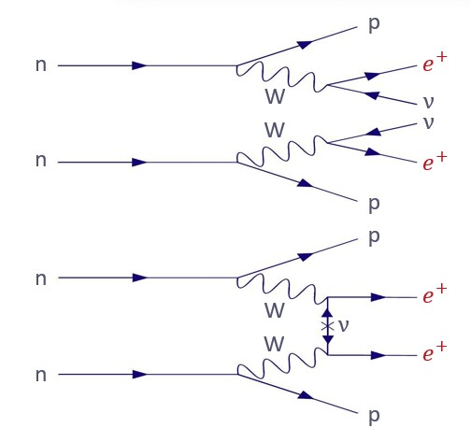
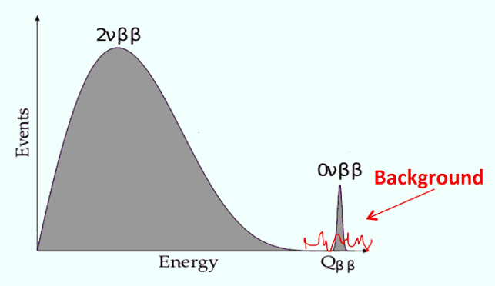
Double Beta Decay
Plus
^
0νββ++
Need to:
Identify positrons
Reconstruct positron energy
2νββ++

Slide 9
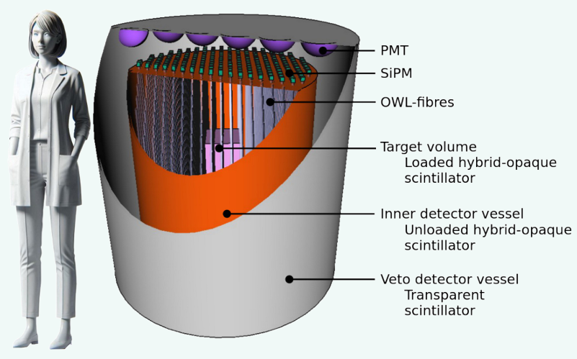
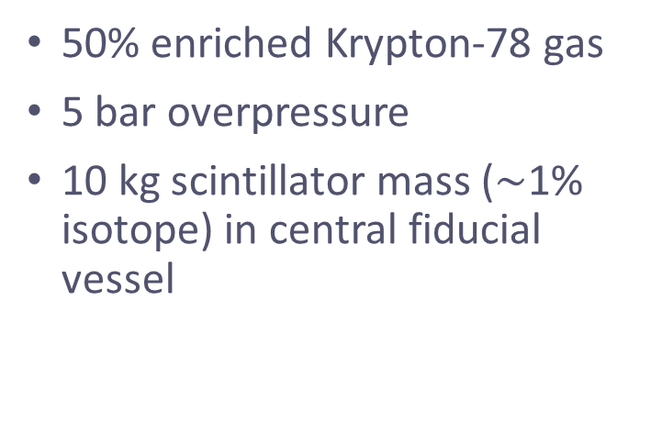
NuDoubt⁺⁺
First Prototype
50% enriched Krypton-78 gas
5 bar overpressure
10 kg scintillator mass ($\sim$1% isotope) in central fiducial vessel

Slide 10

NuDoubt⁺⁺
First Prototype
50% enriched Krypton-78 gas
5 bar overpressure
10 kg scintillator mass ($\sim$1% isotope) in central fiducial vessel
Combining 3 novel technologies

Slide 11
NuDoubt⁺⁺ Prototype
Combining 3 novel technologies

Slide 12
NuDoubt⁺⁺ Prototype
Combining 3 novel technologies
OWL-fibres
Based on WOMs (IceCube)
Wavelength shifter coated on fibre to maximise photon capture
Hybrid-Slow Opaque Scintillator
Separate Cherenkov and scintillation light in time
Stochastic confinement of light for improved PID

Slide 13
NuDoubt⁺⁺ Prototype
Combining 3 novel technologies
OWL-fibres
Based on WOMs (IceCube)
Wavelength shifter coated on fibre to maximise photon capture
Hybrid-Slow Opaque Scintillator
Separate Cherenkov and scintillation light in time
Stochastic confinement of light for improved PID

Slide 14
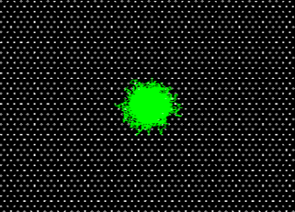
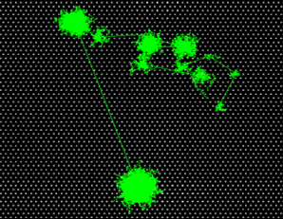
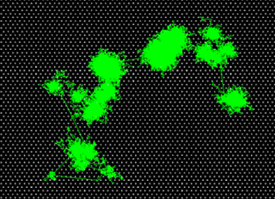
Opaque Scintillator
Short scattering length + Long absorption length = Stochastic light confinement
Particle ID from event topology (pattern of energy deposits)
Electron
Gamma
(Compton Scattering)
Positron
(electron-like + 2 x 511keV gammas)

Slide 15
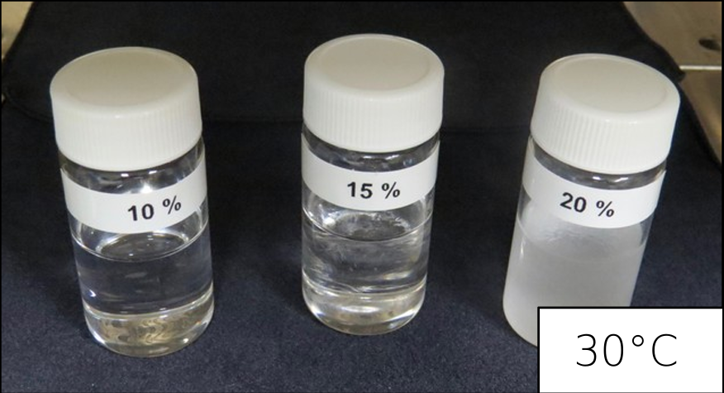
Opaque Scintillator
Short scattering length + Long absorption length = Stochastic light confinement
Particle ID from event topology (pattern of energy deposits)
First implementation of opaque scintillator: adding wax to LS (NoWaSH)
Positron
(electron-like + 2 x 511keV gammas)
Novel Opaque Scintillator for Neutrino Detection C. Buck et al., 2019

Slide 16
Opaque Scintillator
Short scattering length + Long absorption length = Stochastic light confinement
Particle ID from event topology (pattern of energy deposits)
First implementation of opaque scintillator: adding wax to LS (NoWaSH)
Additional properties:
Tuneable opacity
High fluor/isotope concentration is possible
Comparable light yield to transparent scintillators
Positron
(electron-like + 2 x 511keV gammas)
Novel Opaque Scintillator for Neutrino Detection C. Buck et al., 2019

Slide 17
NuDoubt⁺⁺ Prototype
Combining 3 novel technologies
OWL-fibres
Based on WOMs (IceCube)
Wavelength shifter coated on fibre to maximise photon capture
Hybrid-Slow Opaque Scintillator
Separate Cherenkov and scintillation light in time
Stochastic confinement of light for improved PID

Slide 18
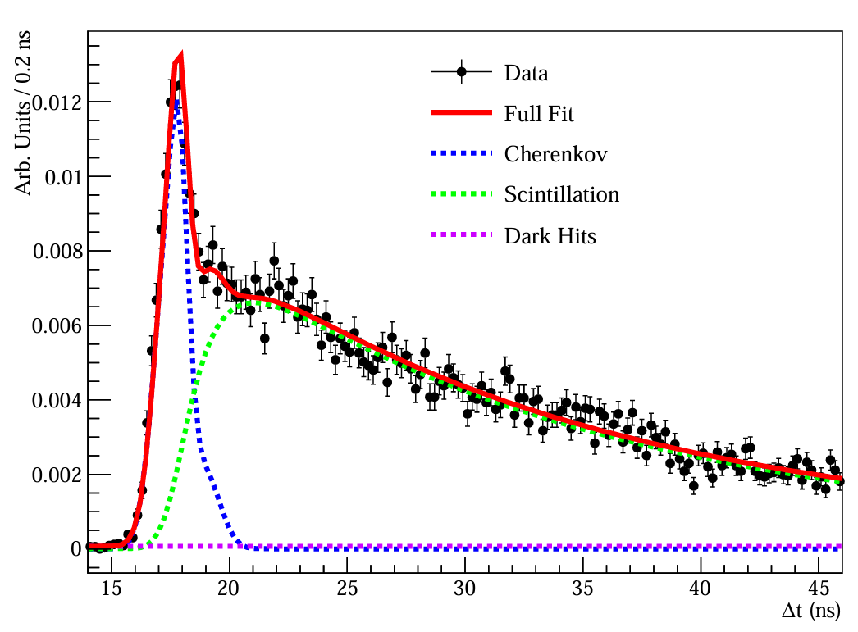
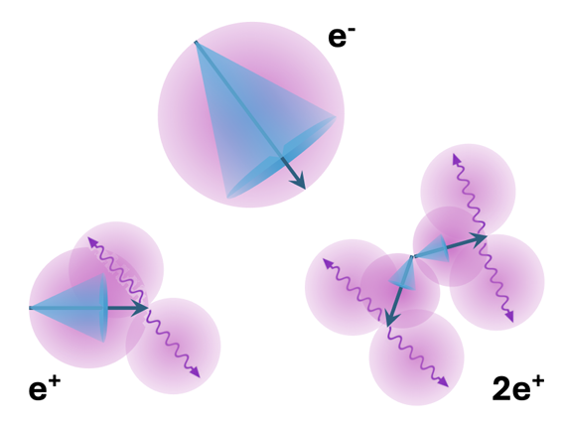
Hybrid-Slow Scintillator
Cherenkov/Scintillator ratio
Slow scintillator separates Cherenkov and scintillation signals
Development of a Bi-solvent Liquid Scintillator with Slow Light Emission, H.Th.J. Steiger et al., 2024

Slide 19
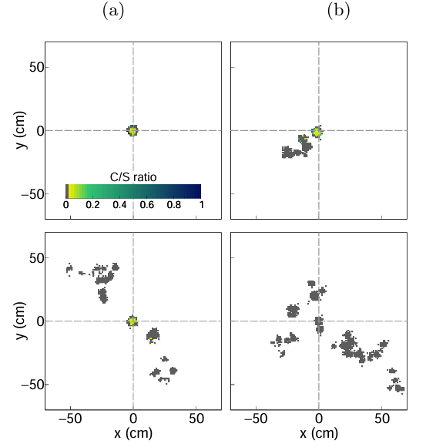




Hybrid-Slow Scintillator
C/S for 2.8 MeV deposited in detector
Cherenkov/Scintillator ratio
$$e^{−}$$
$$γ$$
Slow scintillator separates Cherenkov and scintillation signals
$$e^{+}$$
$${e^{+}e}^{+}$$
(1.78 MeV)
(0.38 MeV)

Slide 20



Hybrid-Slow Scintillator
C/S for 2.8 MeV deposited in detector
Cherenkov/Scintillator ratio
$$e^{−}$$
$$γ$$
Slow scintillator separates Cherenkov and scintillation signals
Ratio of Cherenkov to scintillation light depends on particle
=> Particle ID from C/S ratio
$$e^{+}$$
$${e^{+}e}^{+}$$
(1.78 MeV)
(0.38 MeV)

Slide 21
NuDoubt⁺⁺ Prototype
Combining 3 novel technologies
OWL-fibres
Based on WOMs (IceCube)
Wavelength shifter coated on fibre to maximise photon capture
Hybrid-Slow Opaque Scintillator
Separate Cherenkov and scintillation light in time
Stochastic confinement of light for improved PID

Slide 22


Hybrid-Opaque Scintillator
PID & Positron Energy
$$e^{−}$$
$$γ$$
Both Hybrid and Opaque Scintillator give PID
Positron
(electron-like + 2 x 511keV gammas)
$$e^{+}$$
$${e^{+}e}^{+}$$
(1.78 MeV)
(0.38 MeV)

Slide 23

Hybrid-Opaque Scintillator
$$e^{+}$$
PID & Positron Energy
$$e^{−}$$
$$γ$$
Both Hybrid and Opaque Scintillator give PID
Positron
(electron-like + 2 x 511keV gammas)
$$e^{+}$$
$${e^{+}e}^{+}$$
(1.78 MeV)
(0.38 MeV)

Slide 24
Hybrid-Opaque Scintillator
$$e^{+}$$
PID & Positron Energy
$$e^{−}$$
$$γ$$
Both Hybrid and Opaque Scintillator give PID
1st Compton scatter of γ
Positron
(electron-like + 2 x 511keV gammas)
$$e^{+}$$
$${e^{+}e}^{+}$$
(1.78 MeV)
(0.38 MeV)

Slide 25
Hybrid-Opaque Scintillator
$$e^{+}$$
PID & Positron Energy
$$e^{−}$$
$$γ$$
Both Hybrid and Opaque Scintillator give PID.
Compton scatters from annihilation gammas (511keV) don’t produce Cherenkov light.
1st Compton scatter of γ
Positron
(electron-like + 2 x 511keV gammas)
$$e^{+}$$
$${e^{+}e}^{+}$$
(1.78 MeV)
(0.38 MeV)

Slide 26
Hybrid-Opaque Scintillator
$$e^{+}$$
PID & Positron Energy
$$e^{−}$$
$$γ$$
Both Hybrid and Opaque Scintillator give PID
Compton scatters from annihilation gammas (511keV) don’t produce Cherenkov light.
Positron energy from Cherenkov signal
1st Compton scatter of γ
Positron
(electron-like + 2 x 511keV gammas)
$$e^{+}$$
$${e^{+}e}^{+}$$
(1.78 MeV)
(0.38 MeV)

Slide 27
NuDoubt⁺⁺ Prototype
Combining 3 novel technologies
OWL-fibres
Based on WOMs (IceCube)
Wavelength shifter coated on fibre to maximise photon capture
Hybrid-Slow Opaque Scintillator
Separate Cherenkov and scintillation light in time
Stochastic confinement of light for improved PID

Slide 28
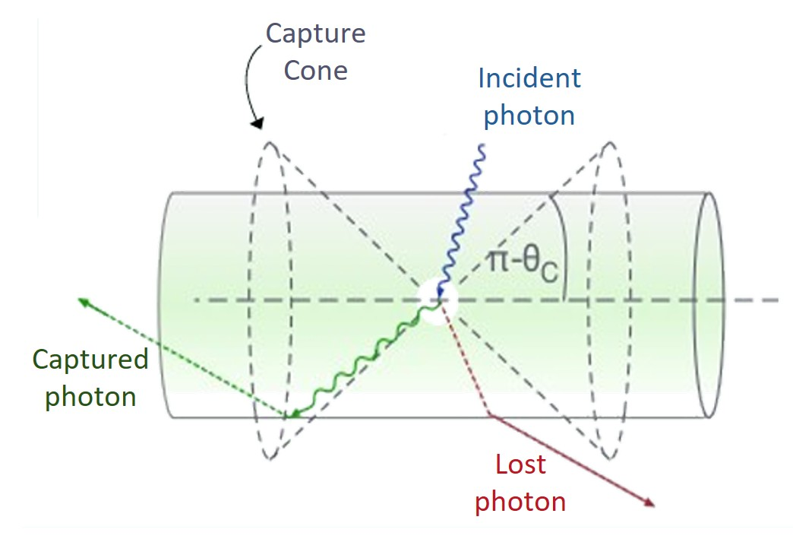
OWL-fibres
Based on IceCube’s WOMs
Traditional wavelength-shifting fibres:
  Wavelength shifter dispersed throughout the fibre core

Slide 29
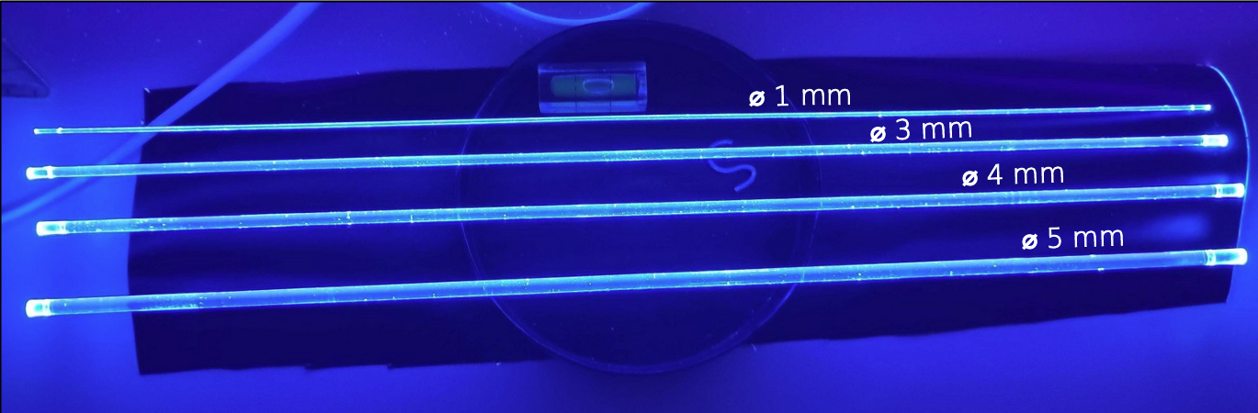
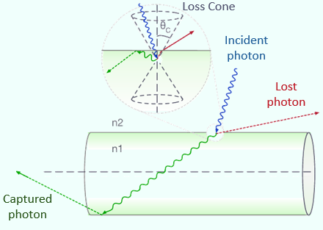
OWL-fibres
Based on IceCube’s WOMs
Wavelength-shifting paint coated on PMMA fibres
Traditional wavelength-shifting fibres:
  Wavelength shifter dispersed throughout the fibre core
OWL fibres:
  Wavelength shifter on the fibre’s surface only

Slide 30
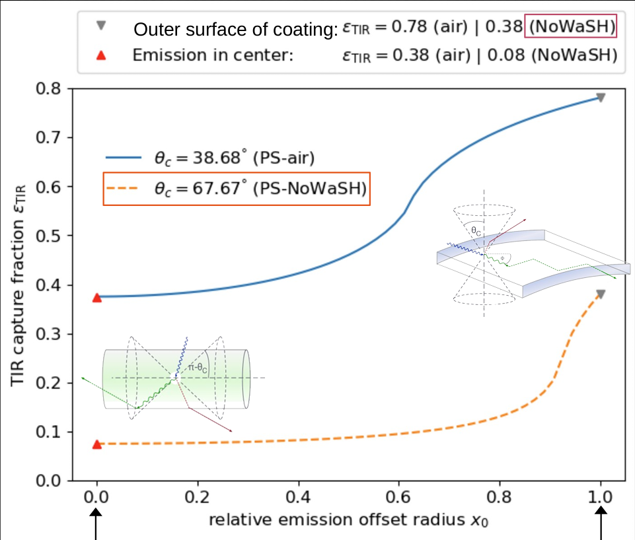
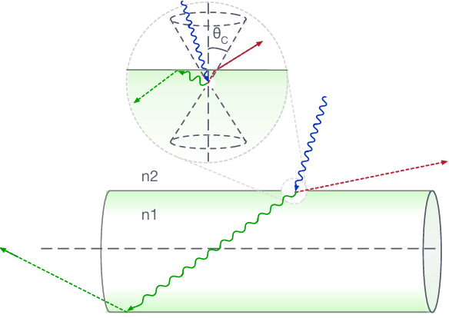
OWL-fibres
Based on IceCube’s WOMs
Wavelength-shifting paint coated on PMMA fibres
Traditional wavelength-shifting fibres:
  Wavelength shifter dispersed throughout the fibre core
OWL fibres:
  Wavelength shifter on the fibre’s surface only
Centre of fibre
Surface of fibre

Slide 31
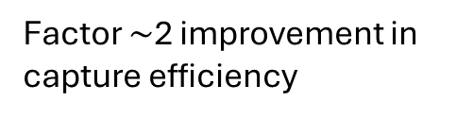
OWL-fibres
Based on IceCube’s WOMs
Wavelength-shifting paint coated on PMMA fibres
Traditional wavelength-shifting fibres:
  Wavelength shifter dispersed throughout the fibre core
OWL fibres:
  Wavelength shifter on the fibre’s surface only
Factor $\sim$2 improvement in capture efficiency
Centre of fibre
Surface of fibre

Slide 32
NuDoubt⁺⁺ Prototype
Combining 3 novel technologies
OWL-fibres
Based on WOMs (IceCube)
Wavelength shifter coated on fibre to maximise photon capture
Hybrid-Slow Opaque Scintillator
Separate Cherenkov and scintillation light in time
Stochastic confinement of light for improved PID

Slide 33
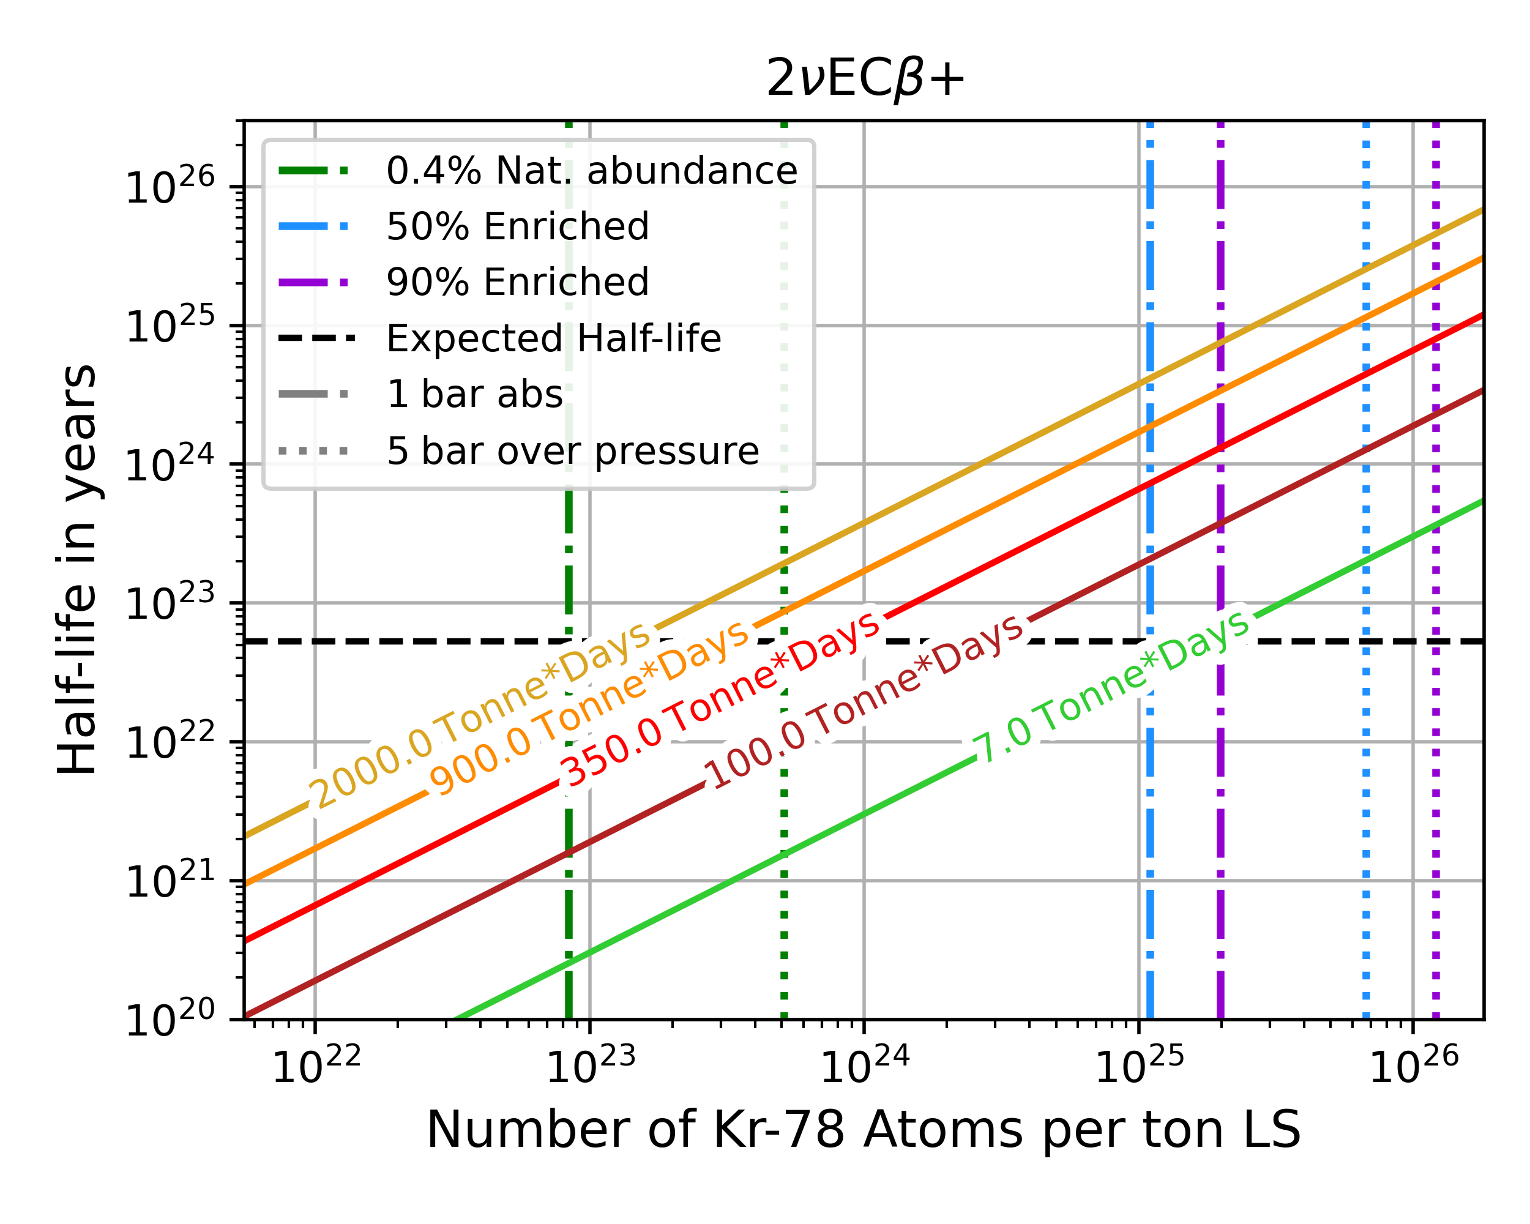
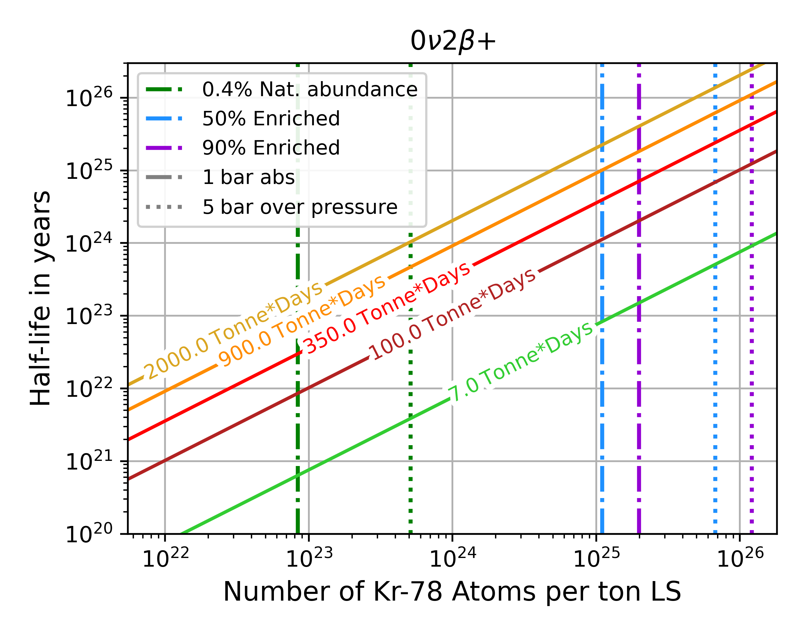
NuDoubt⁺⁺: Sensitivities
*Assuming Gran Sasso overburden
After 2 years of operation*:
2νββ++ (0νββ++)
2νECβ+ (0νECβ+)
Expected 5σ observation sensitivity
Expected 90% C.L. exclusion sensitivity
Notes:
4 sigma: first evidence
5 sigma: first discovery

Slide 34
NuDoubt⁺⁺: Sensitivities
*Assuming Gran Sasso overburden
After 2 years of operation*:
}
First 4σ evidence
2νββ++ (0νββ++)
2νECβ+ (0νECβ+)
Improvement of half-life limits by 3 orders of magnitude
First 5σ discovery
Expected 5σ observation sensitivity
Expected 90% C.L. exclusion sensitivity
Notes:
4 sigma: first evidence
5 sigma: first discovery

Slide 35
NuDoubt⁺⁺ Experiment
NuDoubt⁺⁺ paper:
Overview and Conclusion
2νββ++ (0νββ++)
2νECβ+ (0νECβ+)

Slide 36

NuDoubt⁺⁺ Experiment
NuDoubt⁺⁺ paper:
Overview and Conclusion
$$e^{+}$$
Using a Hybrid-Slow Opaque scintillator gives excellent particle ID and positron energy reconstruction
2νββ++ (0νββ++)
2νECβ+ (0νECβ+)

Slide 37
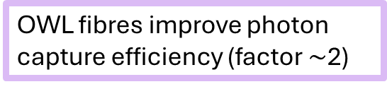
NuDoubt⁺⁺ Experiment
NuDoubt⁺⁺ paper:
Overview and Conclusion
$$e^{+}$$
Using a Hybrid-Slow Opaque scintillator gives excellent particle ID and positron energy reconstruction
OWL fibres improve photon capture efficiency (factor $\sim$2)
2νββ++ (0νββ++)
2νECβ+ (0νECβ+)

Slide 38
NuDoubt⁺⁺ Experiment
NuDoubt⁺⁺ paper:
Overview and Conclusion
$$e^{+}$$
Using a Hybrid-Slow Opaque scintillator gives excellent particle ID and positron energy reconstruction
OWL fibres improve photon capture efficiency (factor $\sim$2)
2νββ++ (0νββ++)
2νECβ+ (0νECβ+)
}
First 4σ evidence
Improvement of half-life limits by 3 orders of magnitude
First 5σ discovery

Slide 40

Back-up Slides
NuDoubt⁺⁺ paper

Slide 41
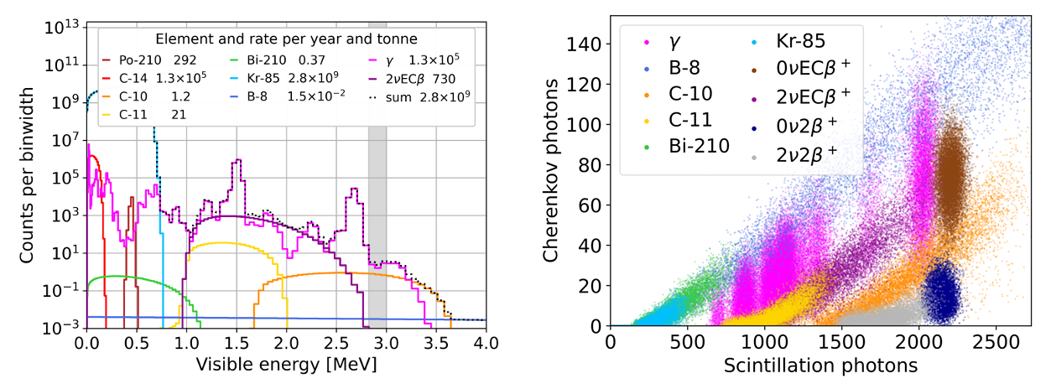
Backgrounds
NuDoubt⁺⁺ paper:
C/S ratio for background discrimination

Slide 42
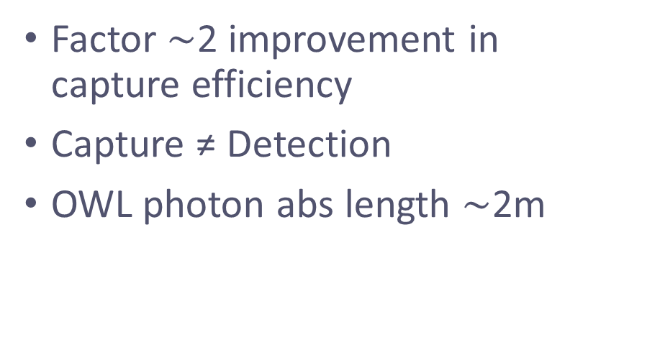
OWL-fibres
Based on IceCube’s WOMs
Factor $\sim$2 improvement in capture efficiency
Capture ≠ Detection
OWL photon abs length $\sim$2m
NuDoubt⁺⁺ paper:
Centre of fibre
Surface of fibre
Wavelength-shifting paint coated on PMMA fibres

