Slide 1
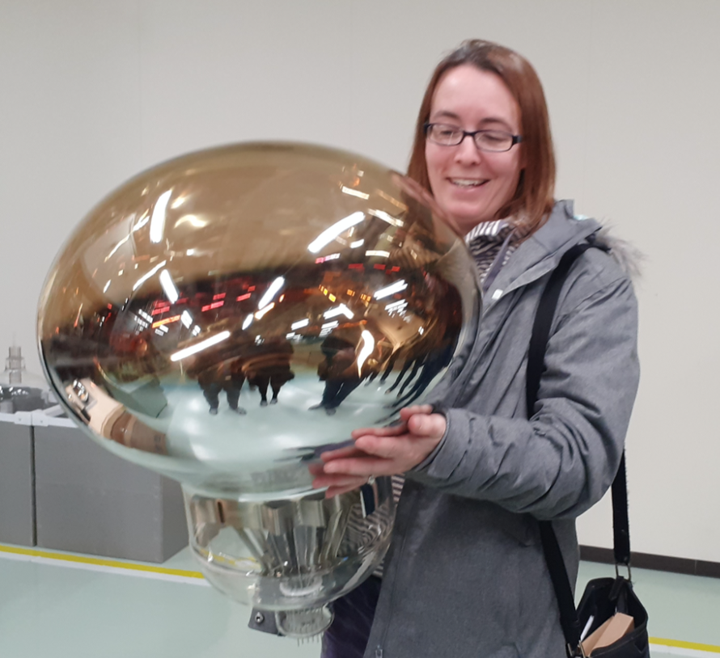


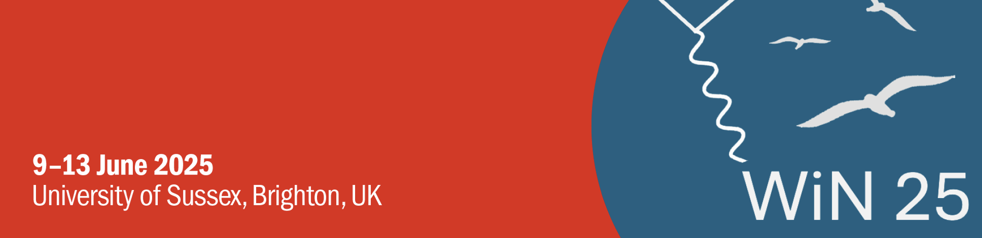
Non-Beam Physics at Hyper-Kamiokande
Jeanne Wilson
For the Hyper-Kamiokande Collaboration

Slide 2
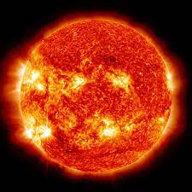
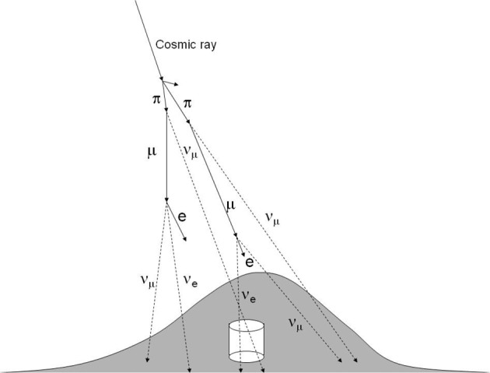
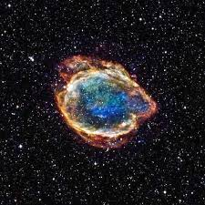
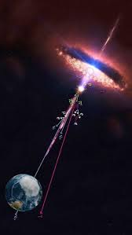

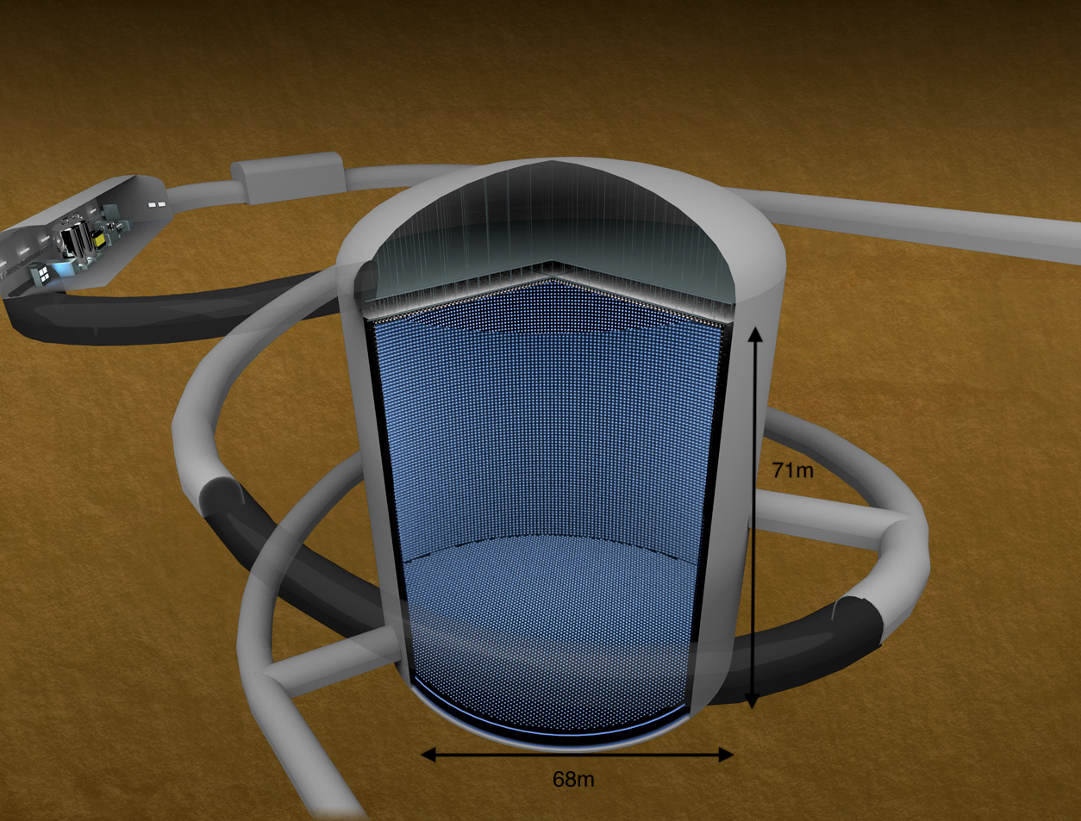
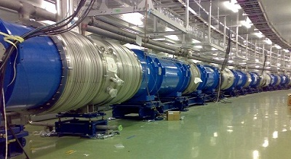
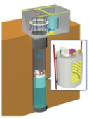
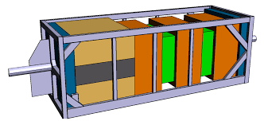



The Hyper-Kamiokande Project
High Energy Neutrinos
Atmospheric neutrinos:
$ν_{μ},{\overline{ν}}_{μ}$, $ν_{e}, {\overline{ν}}_{e}$
Solar neutrinos, $ν_{e}$
Supernova bursts
Diffuse Supernova Background Neutrinos
Mass Ordering
J-PARC neutrino beam: $ν_{μ},{\overline{ν}}_{μ}$
Proton Decay Search
CP violation, oscillation parameters
Near Detectors
Notes:
Hyper-K is a multi-purpose, next generation neutrino experiment.
The Hyper-K project as a whole encompasses both the huge water cherenkov far detector, and the neutrino beam from J-PARC.
Together these are needed for one of the major goal of Hyper-K - the measurement of CP violation and precision measurement of oscillation parameters with beam neutrinos, as you will hear about in Patricia Vahle’s plenary talk on Friday morning
But the large volume far detector means we can measure a lot of other non-beam sources.
Firstly, atmospheric neutrinos, which I'm not going to cover today as their power is in combination with the beam measurements to address the mass hierarchy - I'll leave that topic for the plenary talk too.
What I will focus on today is:
- Proton decay searches
- Solar neutrino measurements
- Supernova measurements
- and high energy neutrinos of astrophysical origin

Slide 3
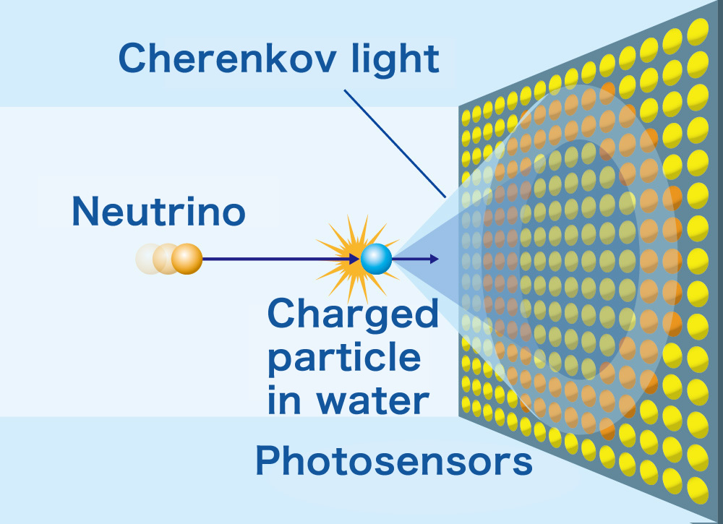
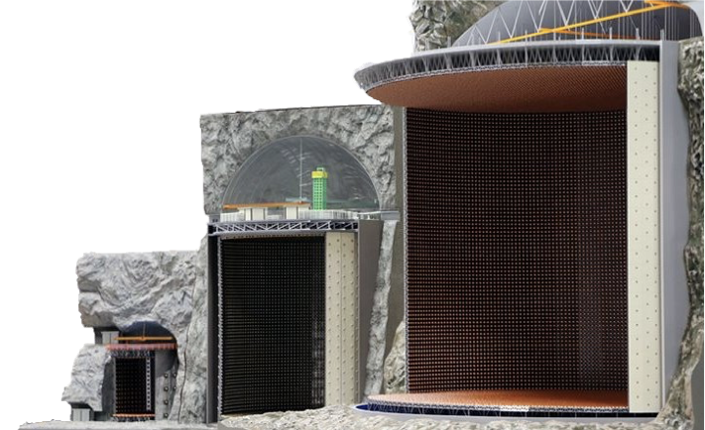
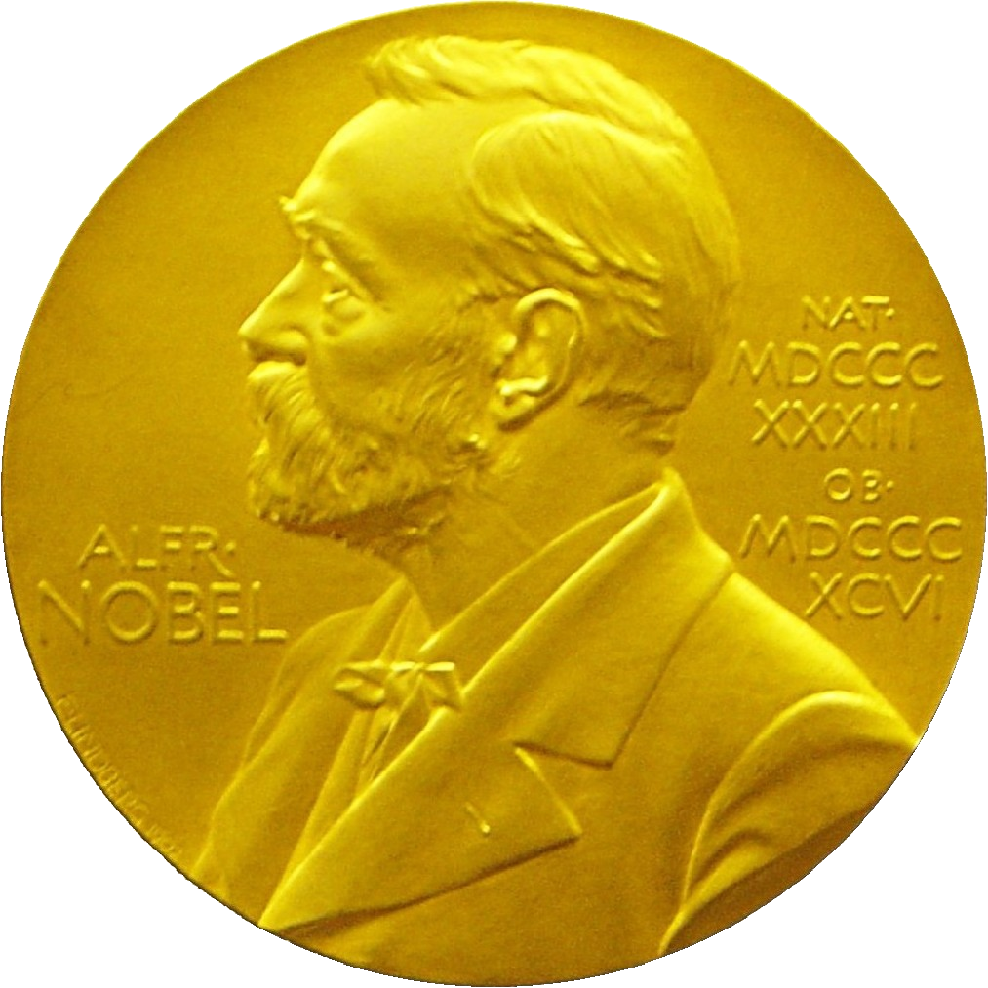
Kamioka Water Cherenkov Experiments
Hyper-Kamiokande
~2027 onwards
260 kton (188 kton FV)
X 8.4
Super-Kamiokande
1996 onwards
50 kton (22.5 kton FV)
2015
X 20
67m
Kamiokande
1983 – 1996
3 kton
2002
Notes:
Hyper-K of course builds on the very successful Japanese water cherenkov programme.
The Super-K detector, currently in operation is 50kton.
At ~70m high, the new Hyper-K far detector will be over 8 times the size of Super-K with a 188kton fiducial volume

Slide 4
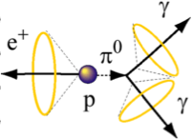
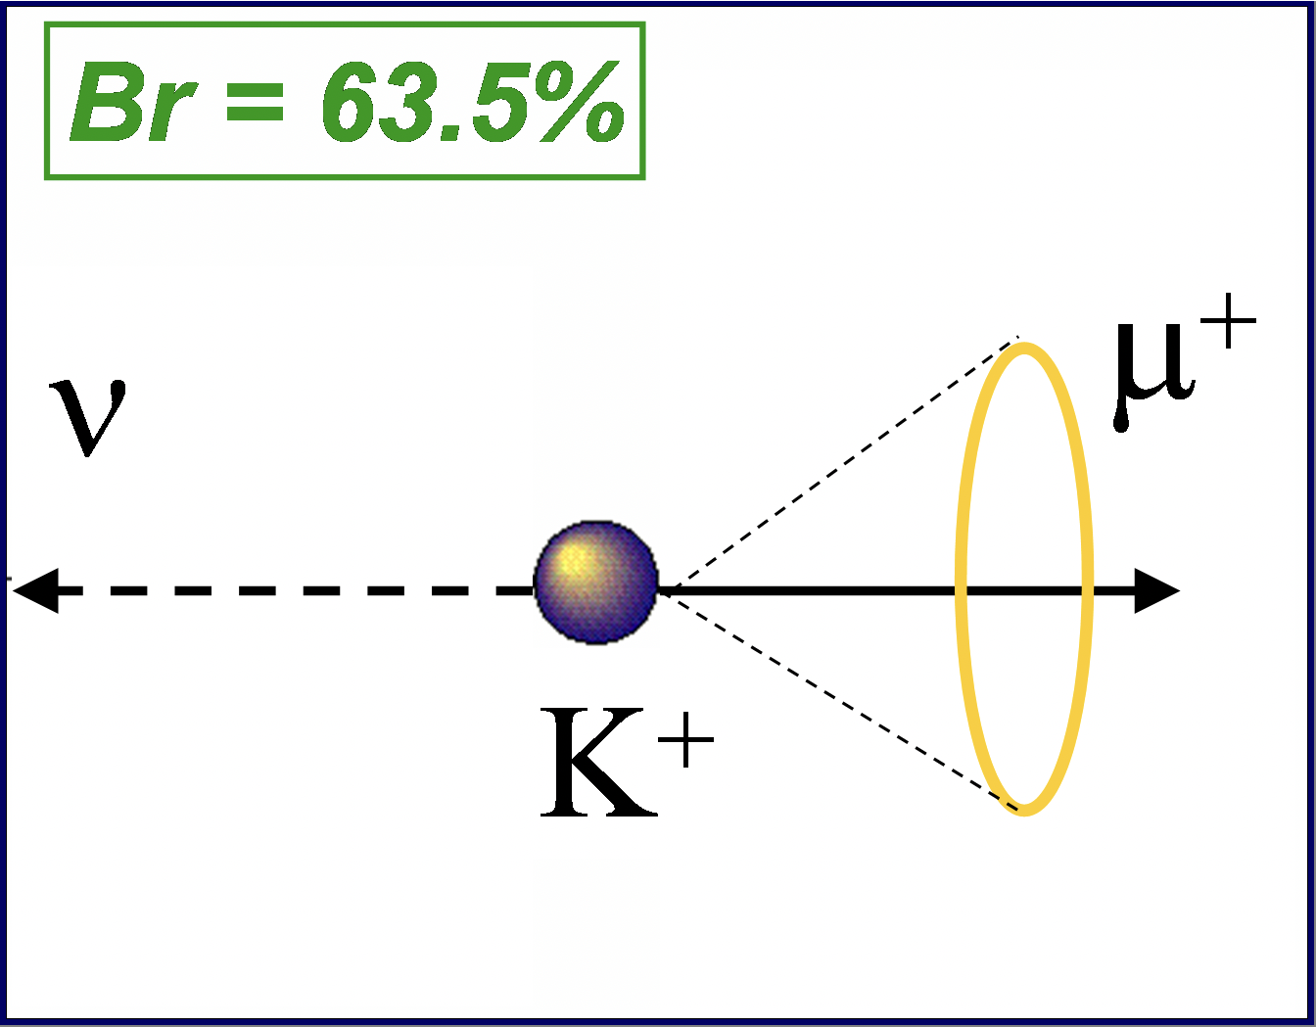
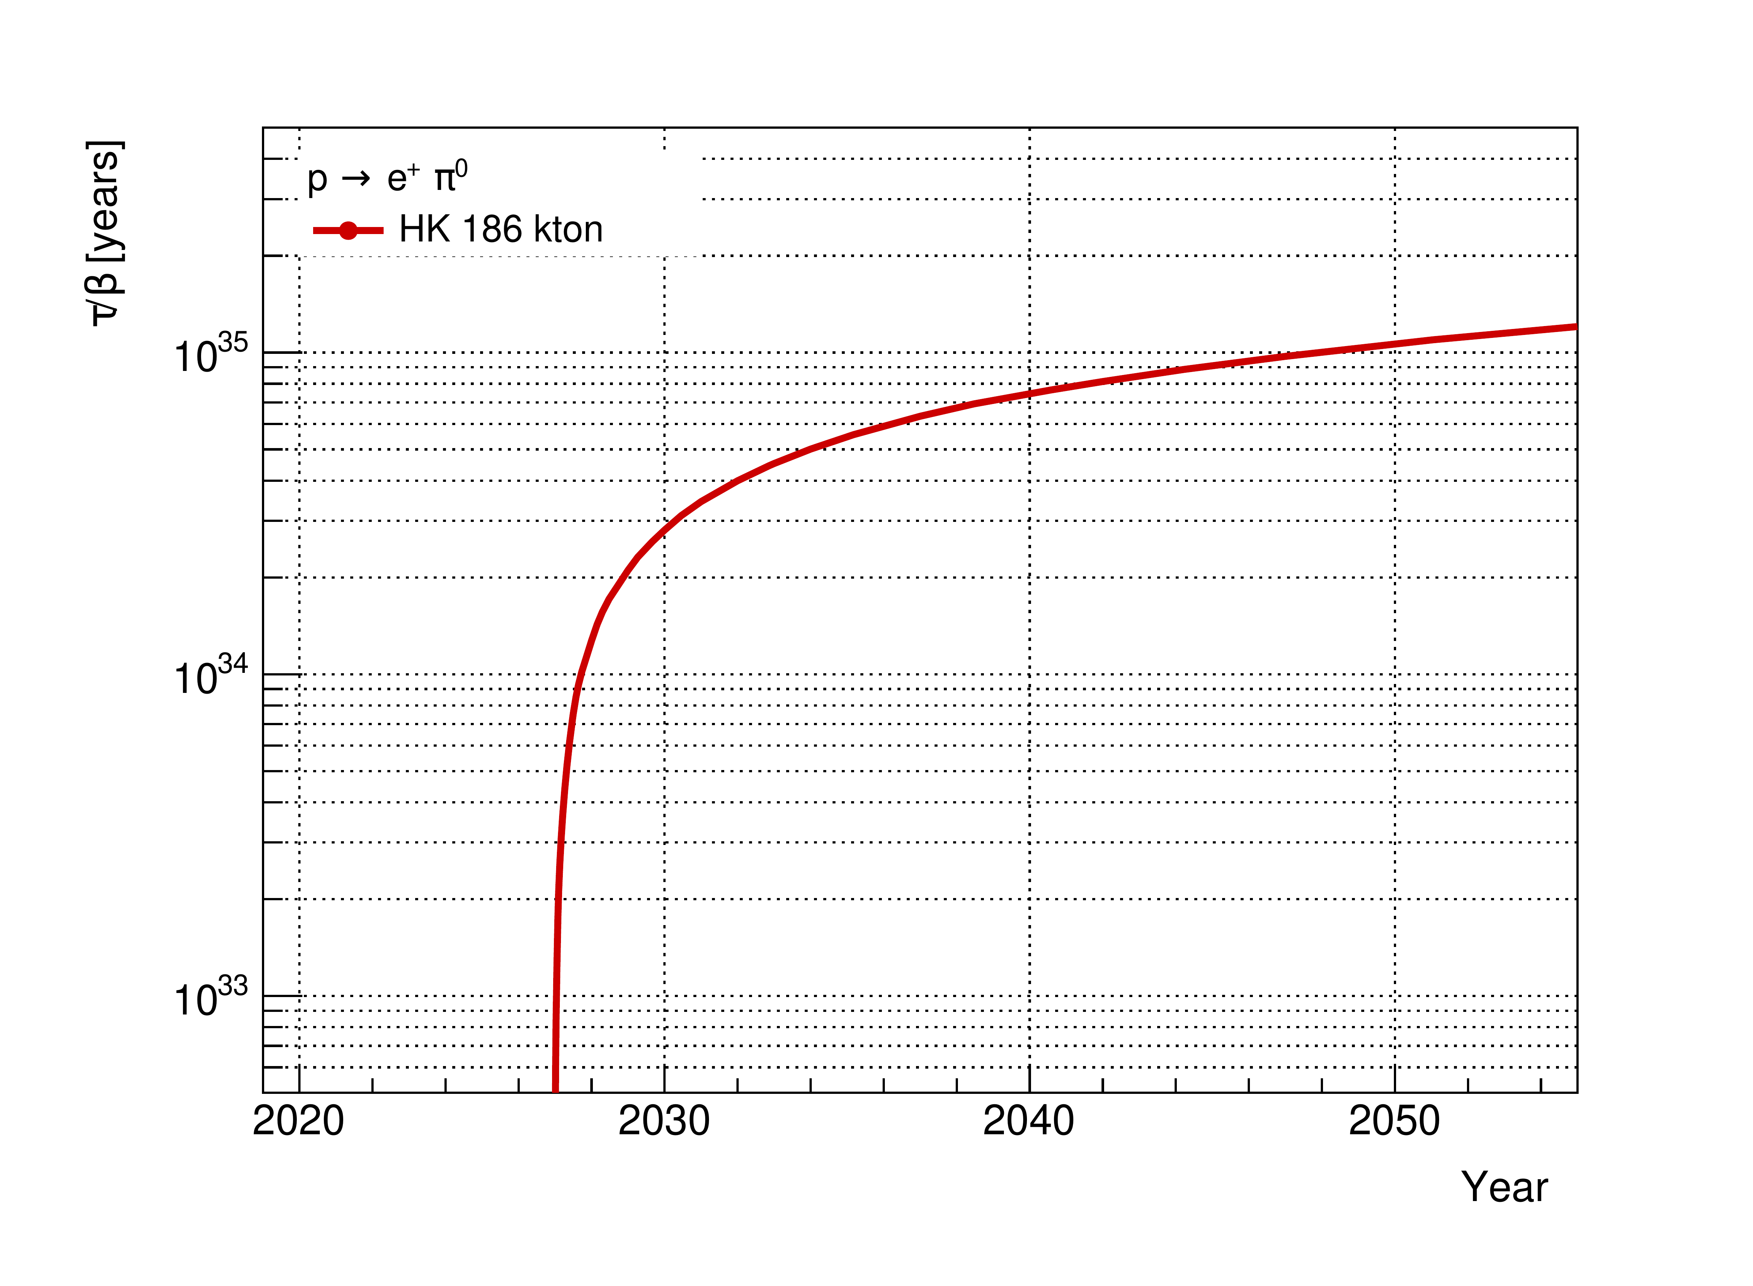
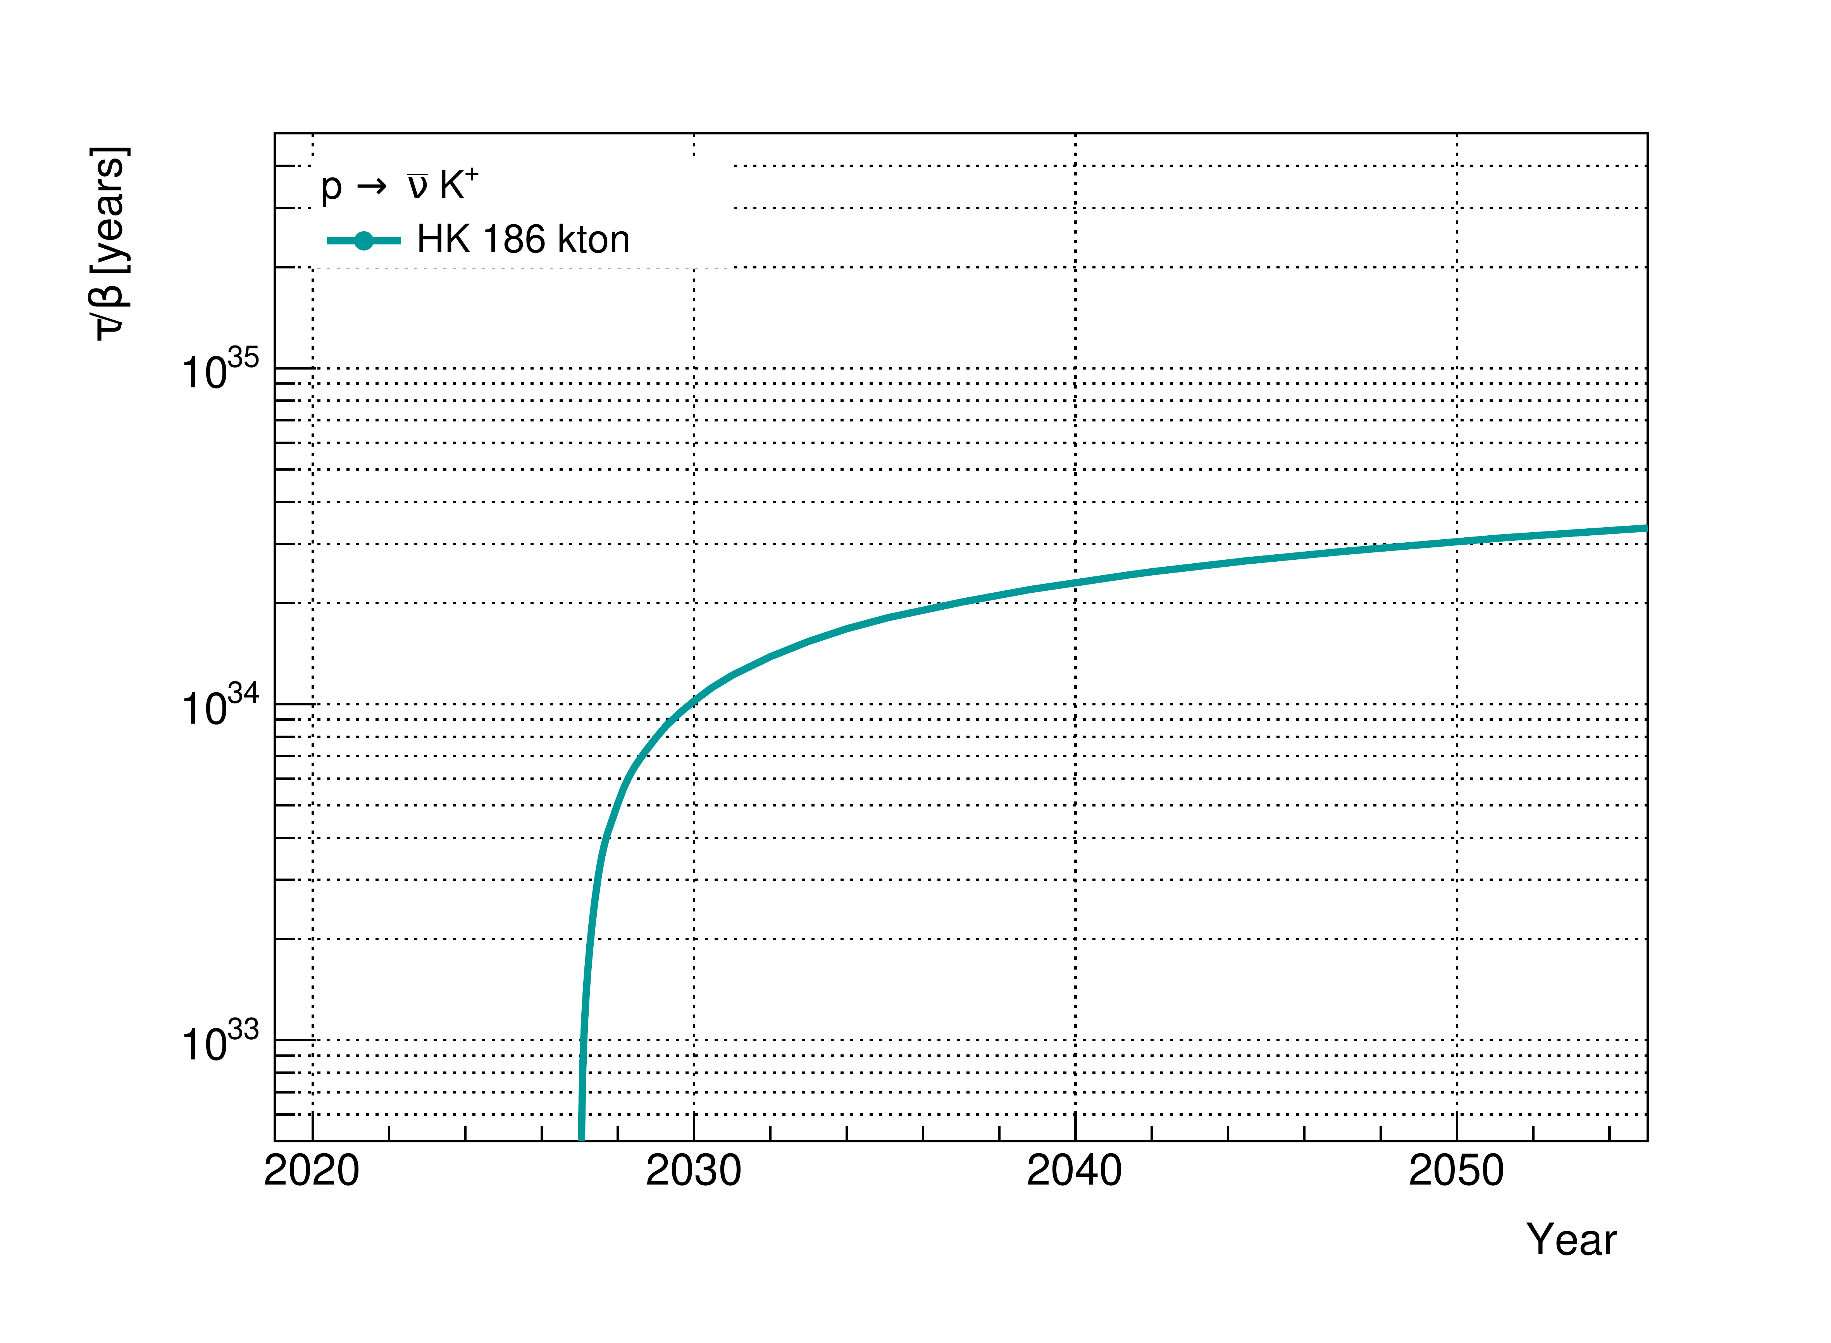
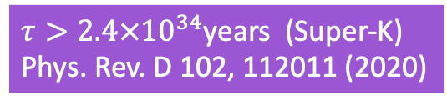

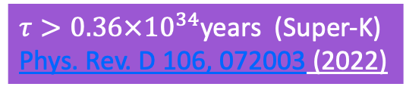
Proton Decay
Hyper-K far detector has many protons! (188kT = 8.4 $×$Super-K fiducial volume)
Can extend proton decay search by an order of magnitude beyond current limits
$τ>2.4×{10}^{34}$years (Super-K)
Phys. Rev. D 102, 112011 (2020)
$τ>0.36×{10}^{34}$years (Super-K)
Phys. Rev. D 106, 072003 (2022)
Notes:
Lets start with Proton decay - given its colossal size, Hyper-K has a lot of protons!
8.4 times as many as Super-K so has the capability to extend on many current limits by an order of magnitude.
HyperK can search for proton decay in various channels, I'm just showing two of the strongest here.
These are 3 sigma discovery potential curves.
First for the positron, pi-0 decay mode.
This is the cleanest signal in a cherenkov detector - we select on 3 rings (or 2 if the gammas overlap since the pion is boosted), reconstruct p mass (and pi0 mass) for selection.
Backgrounds from atmospherics – reject with michels and ns
And this is the current world limit from SK
The second mode I show here is P->K+nu-bar
This mode is a feature of many supersymmetic GUTs.
The K+ is below the cherenkov threshold (340MeV) but it decays to a muon (and nu).
And again SK produced the world leading limit on this mode, which HK should extend on by an order of magnitude
Three methods, each targeting different aspects of the K+ decay, are used to search for p → νK+ events [230]. The “prompt γ” method searches for a prompt nuclear de-excitation γ ray (6.3 MeV) occurring prior to and separated in time from a 236MeV/c muon. In the second method the same monochromatic muon is searched for but without the γ tag. Finally, the third method, or “π+π0 method”, searches for a monochromatic π0 with light from a backward π+.
12ns lifetime makes it possible to observe prompt gamma ray emission when proton hole left over in bound p decay is filled by another p

Slide 5


Proton Decay
JUNO 10 year sensitivity = 9.6 × 10³³ years Angel Abusleme et al 2023 Chinese Phys. C 47 113002
DUNE 400 kt-yr sensitivity = 1.3×10³⁴ years https://arxiv.org/pdf/2503.23291
* Caveat – Hand-drawn lines
DUNE
JUNO
Super-K
$τ>2.4×{10}^{34}$years (Super-K)
Phys. Rev. D 102, 112011 (2020)
$τ>0.36×{10}^{34}$years (Super-K)
Phys. Rev. D 106, 072003 (2022)
Notes:
I've also tried to put the Hyper-K sensitivities to the kaon mode into context with other experiments (they don't compete on the e+pi0 mode) - I include the references which I hope are the most up to date ones.
Firstly these are the JUNO projected limits in RED
And the DUNE projected sensitivity in BLUE
And as a caveat - these are not formal comparison plots - I drew those lines in power-point so they are just illustrative and presumably should in reality curve up towards these final values similar to the Hyper-K curve.

Slide 6
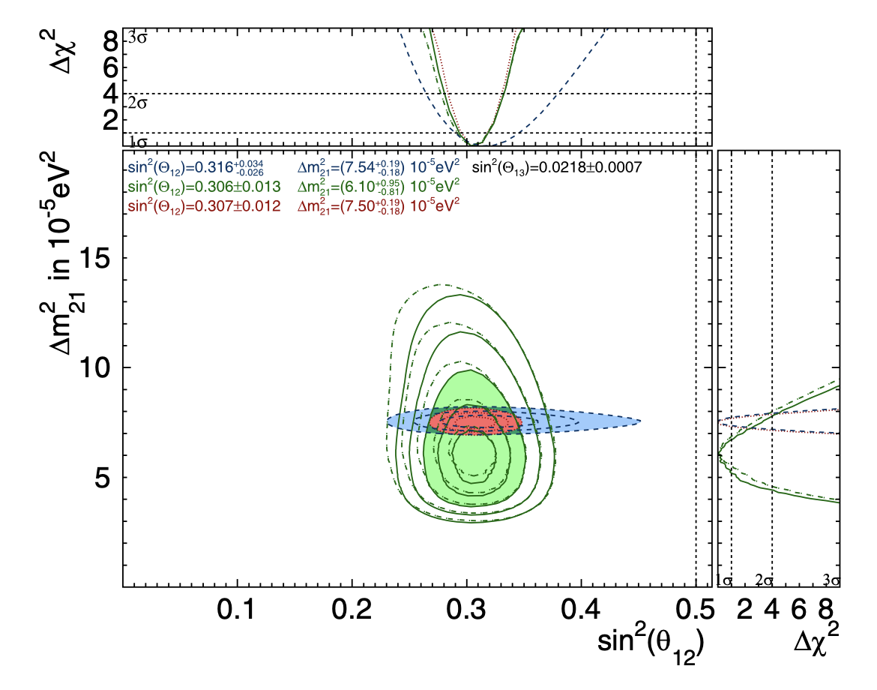
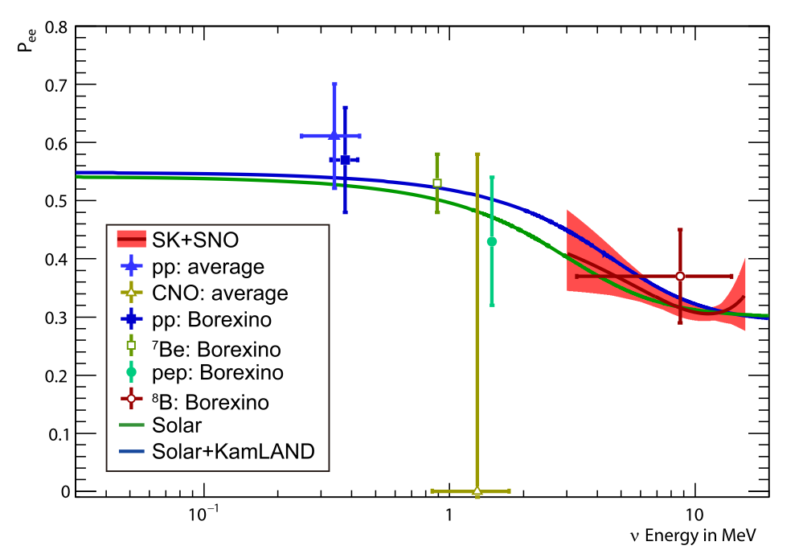

Solar Neutrinos – current status
Super-Kamiokande - PHYSICAL REVIEW D 109, 092001 (2024)
Global neutrino data (Green) prefer lower value of $Δm_{21}^{2}$ than KamLAND reactor experiment ~1.5$σ$ tension
Disagreement = CPT violation
Large Mixing Angle + MSW – expect upturn in solar ⁸B spectrum at low energies
SK spectrum measurement favours the existence of an “upturn” by 1.2σ
Notes:
Lets change topic and talk about solar neutrinos now, which are sensitive to the 1-2 mixing parameters.
To set the scene, here are two recent plots from Super-K. The first is the allowed parameter space for deltam^2 21 and sin^2 12 using fits to global neutrino data. The green shows the input from solar data, and the red/blue from the KamLAND reactor experiment. You can see they prefer slightly different values for delta-m squared. This tension is interesting as disagreement between the two measurements (solar neutrinos, reactor anti-neutrinos) would point to CPT violation.
This second plot is electron neutrino survival probability against the solar neutrino energy. Solar neutrino energies span from sub-MeV from the pp interaction, to over 10MeV from the 8B interaction.
The preferred large mixing angle oscillation parameters, in combination with the MSW effect in the Sun, predict an upturn in the 8B energy spectrum at low energies, around 2-4MeV, but as yet we don't have any clear measurement of that up-turn and therefore can't rule out various alternative BSM models.

Slide 7
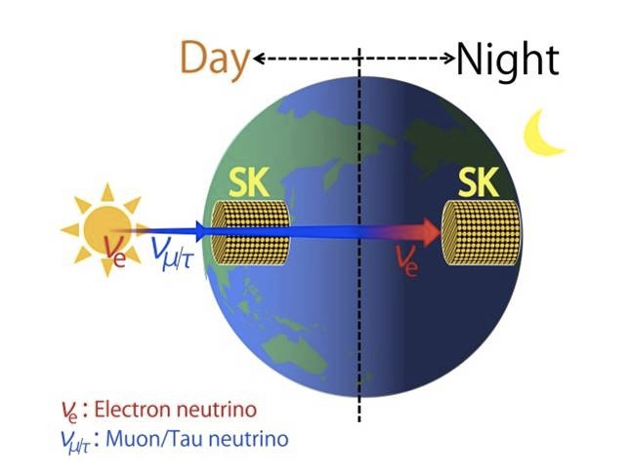
Solar Neutrinos – Day/Night Asymmetry
Larger survival probability expected at night due to MSW earth ‘regeneration’ effect
Size of effect driven by 1-2 mixing parameters
Super-K Day/Night asymmetry is higher than expected from the reactor constraint
Expect to see ~180 ⁸B Solar neutrinos (>5 MeV) / day in Hyper-K
Day-night asymmetry observation sensitivity
red line = sensitivity from no asymmetry
blue line = asymmetry expected by the reactor neutrino oscillation (Δm²₂₁ = 7.54 x 10⁻⁵ eV²)
Systematic from remaining background direction 0.3% (solid) 0.1% (dashed)
Hyper-K can reject no D/N asymmetry at >5σ with 10 years of data and can investigate this tension with increased statistics
Notes:
The main driver in the fit to delta-m^2 21 is day-night asymmetry.
Earth matter effects lead to a “regeneration” of electron flavour, i.e., the electron flavour survival probability Pee is larger during the night compared to the day, but the Day-night asymmetry you should get from KamLAND preferred oscillation parameters is smaller than that measured by Super-K.
Hyper-K can improve on the day-night measurements, expecting to see around 180 8B solar neutrinos above 5MeV per day.
This figure shows how accurately, in sigma, we can measure the asymmetry - for two different scenarios, against measurement time.
So Hyper-K can reject the no day-night asymmetry scenario at greater than 5 sigma with 10 years of data, and will investigate the solar-reactor tension with increased statistics.

Slide 8
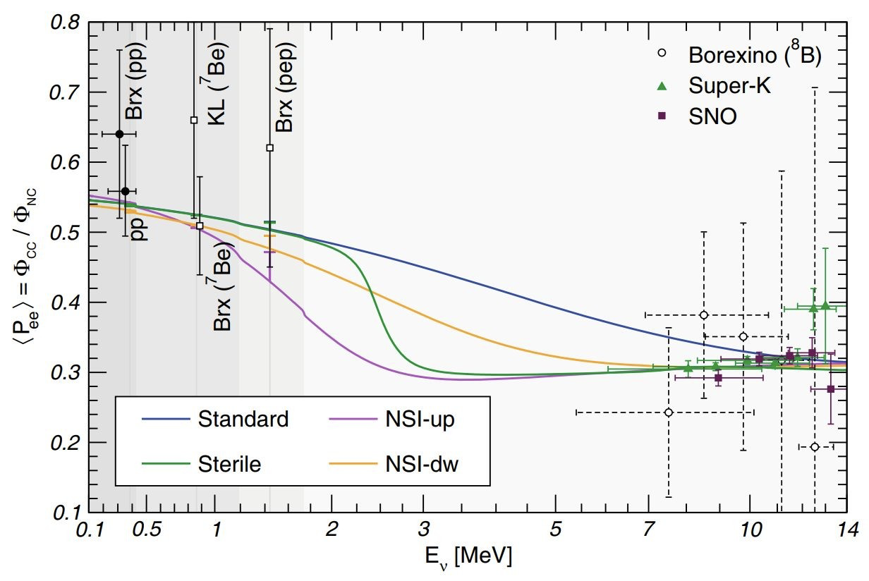
Solar Neutrinos - 8B Spectrum Upturn
Measurement of upturn could distinguish standard neutrino oscillations from several different exotic models
Low energy spectrum upturn sensitivity as a function of observation time for two different detection thresholds
Sensitivity of 3-5σ for upturn discovery after 10 years of Hyper-K running
Notes:
Moving on to the spectrum upturn
- this figure shows the predicted spectral shape for various alternative models alongside the existing measurements of solar neutrino survival probabilities from Borexino, SNO and Super-K
- You can see there is plenty of variation in this region, so pushing the 8B measurements to lower energies could help distinguish them, though the challenge for the water cherenkov approach is the low energy backgrounds from radioactivity around 3MeV.
This figure shows the low energy spectrum upturn sensitivity as a function of observation time for two different detection thresholds.
Hyper-K has a sensitivity of 3-5 sigma for upturn discovery in 10 years.

Slide 9
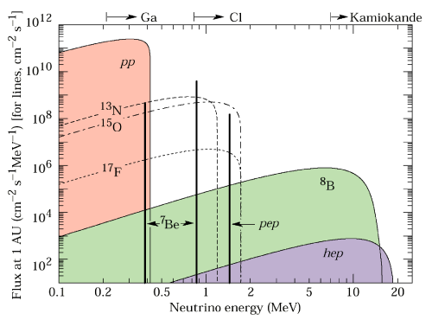

Solar hep Flux
${}_{}^{3}{He}+p → {}_{}^{4}{He}+ e^{+}+ ν_{e}$
Flux never been observed
  Upper limits from SNO and SK
Chance to perform first observation in Hyper-K
  Challenge is separation from atmospheric spallation backgrounds
Look in this energy window
Notes:
A final point on solar neutrinos - this is the solar neutrino spectrum, all of these components have now been measured by Super-K, SNO and Borexino, except the hep component shown in purple here where we only have upper limits.
This is the interaction - it produces neutrinos up to nearly 20MeV (not the log-x scale)
With its high statistics, Hyper-K could have a chance to perform the first observation of this component, an important test of the solar model. However, the challenge is separating these events from atmospheric spallation backgrounds.

Slide 10
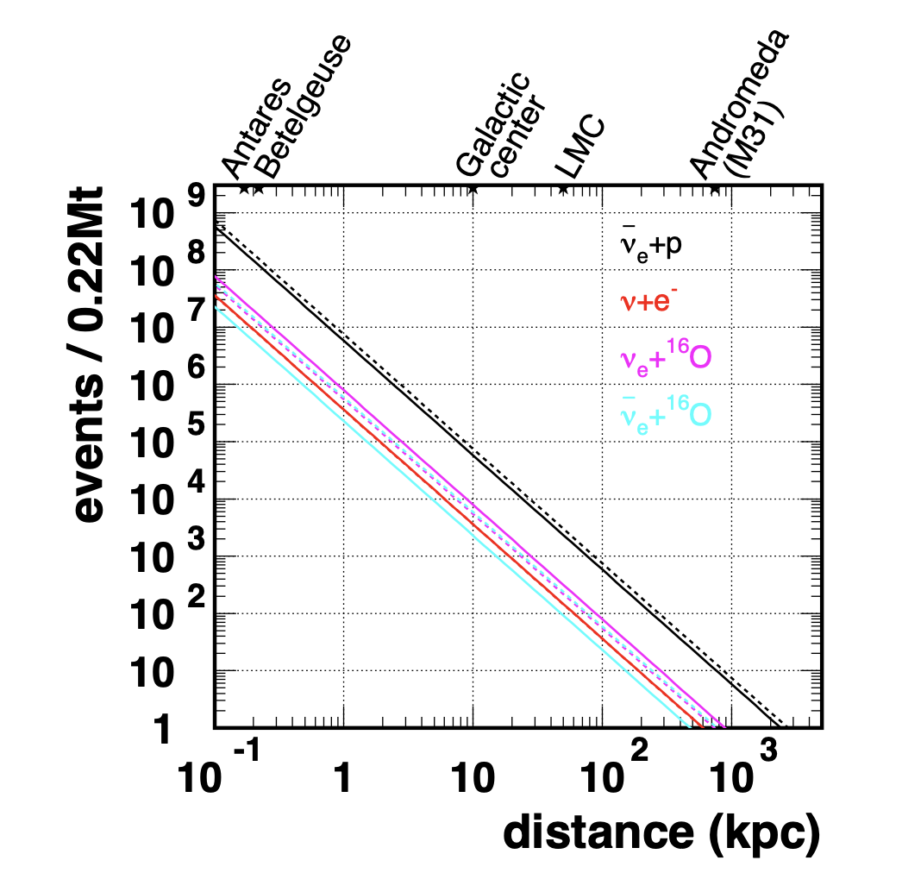

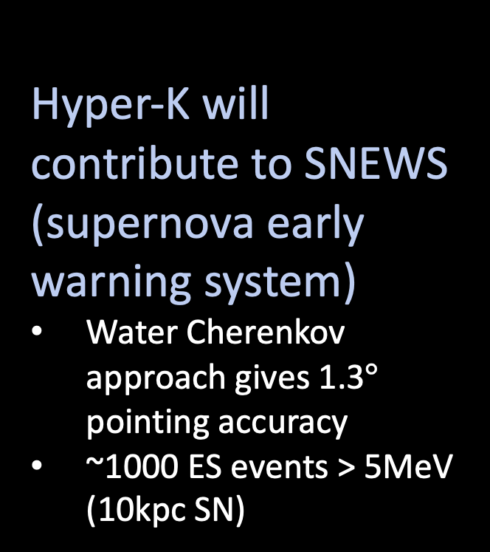
Supernova Bursts
DAQ designed to cope with peak data rates from very close SN (eg. Betelgeuse)
Hyper-K will contribute to SNEWS (supernova early warning system)
Water Cherenkov approach gives 1.3$°$ pointing accuracy
~1000 ES events > 5MeV (10kpc SN)
Expected number of events at Hyper-K as a function of Supernova distance
Using Totani et al model
Astrophys.J. 916 (2021) 15
Notes:
Stepping now to super-nova bursts.
This plot shows the expected number of events in Hyper-K in different interaction channels against super-nova distance.
So maybe focus on the galactic centre here at 10kpc - we expect to see around 10^5 inverse beta decay events, and 5000 elastic scattering events - in just a few seconds.
And even beyond out Galaxy, out to Andromeda, Hyper-K has potential to see similar numbers of neutrinos as from 1987A
So obviously, we are designing the Hyper-K DAQ to cope with these very high rates, even for a very close super-nova like Betelgeuse.
Hyper-K will contribute to the super-nova early warning system - not only being able to give a swift alert when a burst happens, but also using the directionality of elastic scattering events in water cherenkov detectors - we would see a thousand above 5MeV from a 10kpc supernova - we can also give a pretty accurate direction estimate - about 1.3degrees accuracy, which is great for astronomers to point their telescopes!
DUNE (4.3 degrees https://journals.aps.org/prd/abstract/10.1103/PhysRevD.111.092006):
- HK ~1000 e- elastic scattering events (1.7-2.5% of the total)
- DUNE ~ 300 e- elastic scattering events (8-15% of the total)

Slide 11
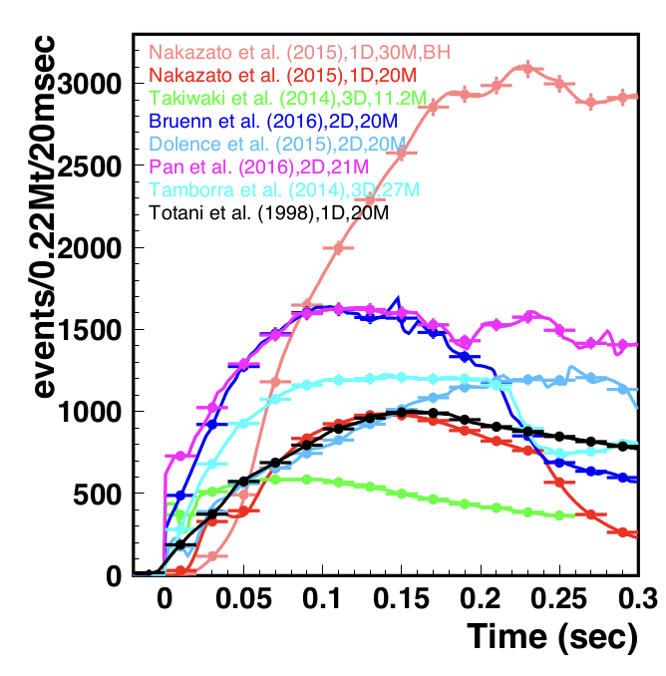
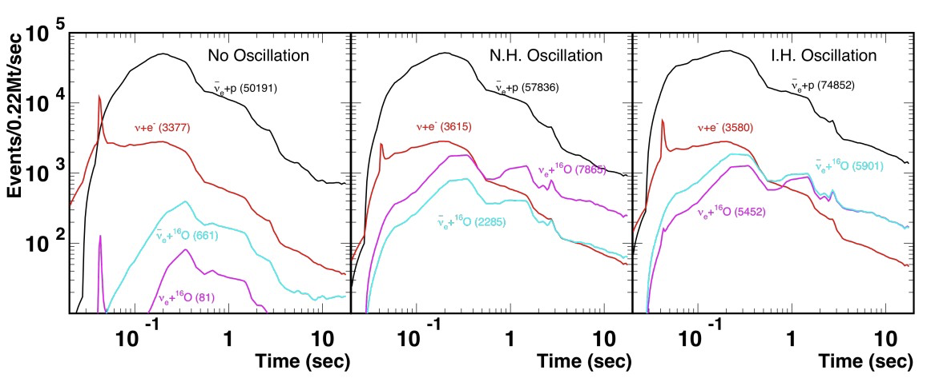
Neutrino Astrophysics – Supernova Bursts
Astrophys.J. 916 (2021) 15
Expected time profile and event numbers in HK for a supernova at 10 kpc (Livermore simulation)
  numbers in brackets are total interactions integrated over the 10 s burst
  peak event rate of inverse beta decay events (black) reaches ~50 kHz
  Model discrimination
Notes:
With these high statistics, we can also provide valuable information for super-nova modelling.
These figures show the expected time profile and event numbers in Hyper-K for a 10kpc supernova using the Livermore model.
The numbers in brackets are the total numbers integrated over the 10s burst but notice the time structure of the burst .
This plot on the right shows different model predictions, and as you can see that time structure is very model dependent so we can really test this if when we measure a SN burst in Hyper-K.
DUNE (4.3 degrees https://journals.aps.org/prd/abstract/10.1103/PhysRevD.111.092006):
- HK ~1000 e- elastic scattering events (1.7-2.5% of the total)
- DUNE ~ 300 e- elastic scattering events (8-15% of the total)

Slide 12
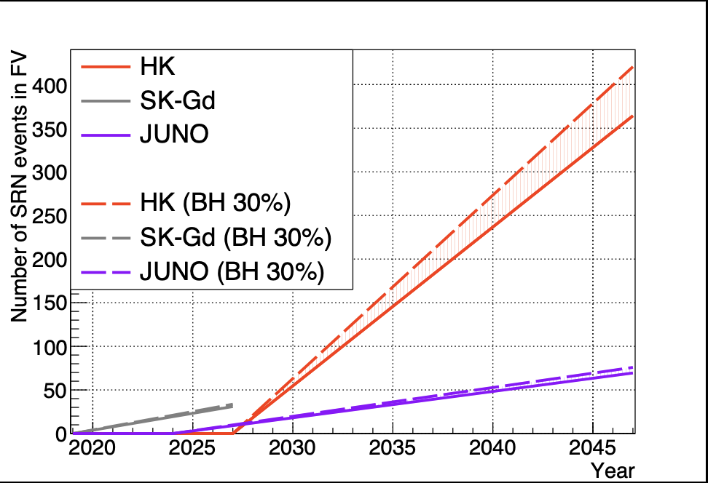
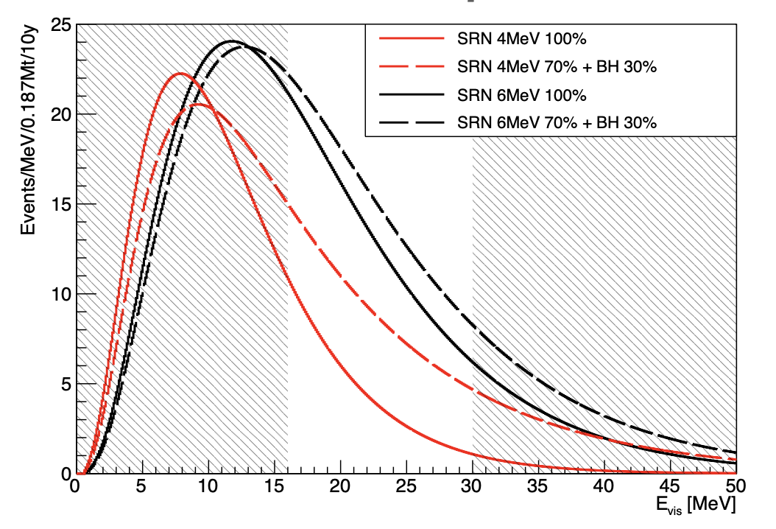
Diffuse Supernova Neutrino Background (DSNB)
Expected number of DSNB IBD reactions as a function of year
Dashed lines corresponds to the case, in which 30% of the supernovae form black holes and emit higher energy neutrinos corresponding to the neutrino temperature of 8 MeV
Or Supernova Relic Neutrinos (SNR)
Diff DSNB models
Look in this energy window
Challenge is separation from atmospheric spallation backgrounds
4.2 (5.7) sigma discovery potential after 10 (20) years, with 70 (140) signal events
Notes:
As well as super-nova bursts, which we just have to wait and hope for, we can also probe the diffuse supernova neutrino background – sometimes called supernova relic neutrinos which are just the distributed background from all the past supernovae in the universe.
There are different models for the energy distribution of these DSNB neutrinos - the plot on the left uses the red solid curve model shown here. (alternative models assume some fraction of SN form BHs)
So this plot on the left shows the expected events in the HK fiducial volume per year (and compares to JUNO - though I point you to the dedicated talk later in this session for that!)
We expect ~7 events / year in Hyper-K, though that depends on local relic density
We look in this energy region 16-30 MeV where the challenge is separation from atmospheric spallation backgrounds.
Hyper-K projects a 4.2sigma discovery potential after 10 years from 70 signal events.
Caveat –old analysis with 40k PMTs (we now have 20k)
Lower end of event window driven by atmospheric bgs at lower energy
DUNE – no published info about DSNB

Slide 13
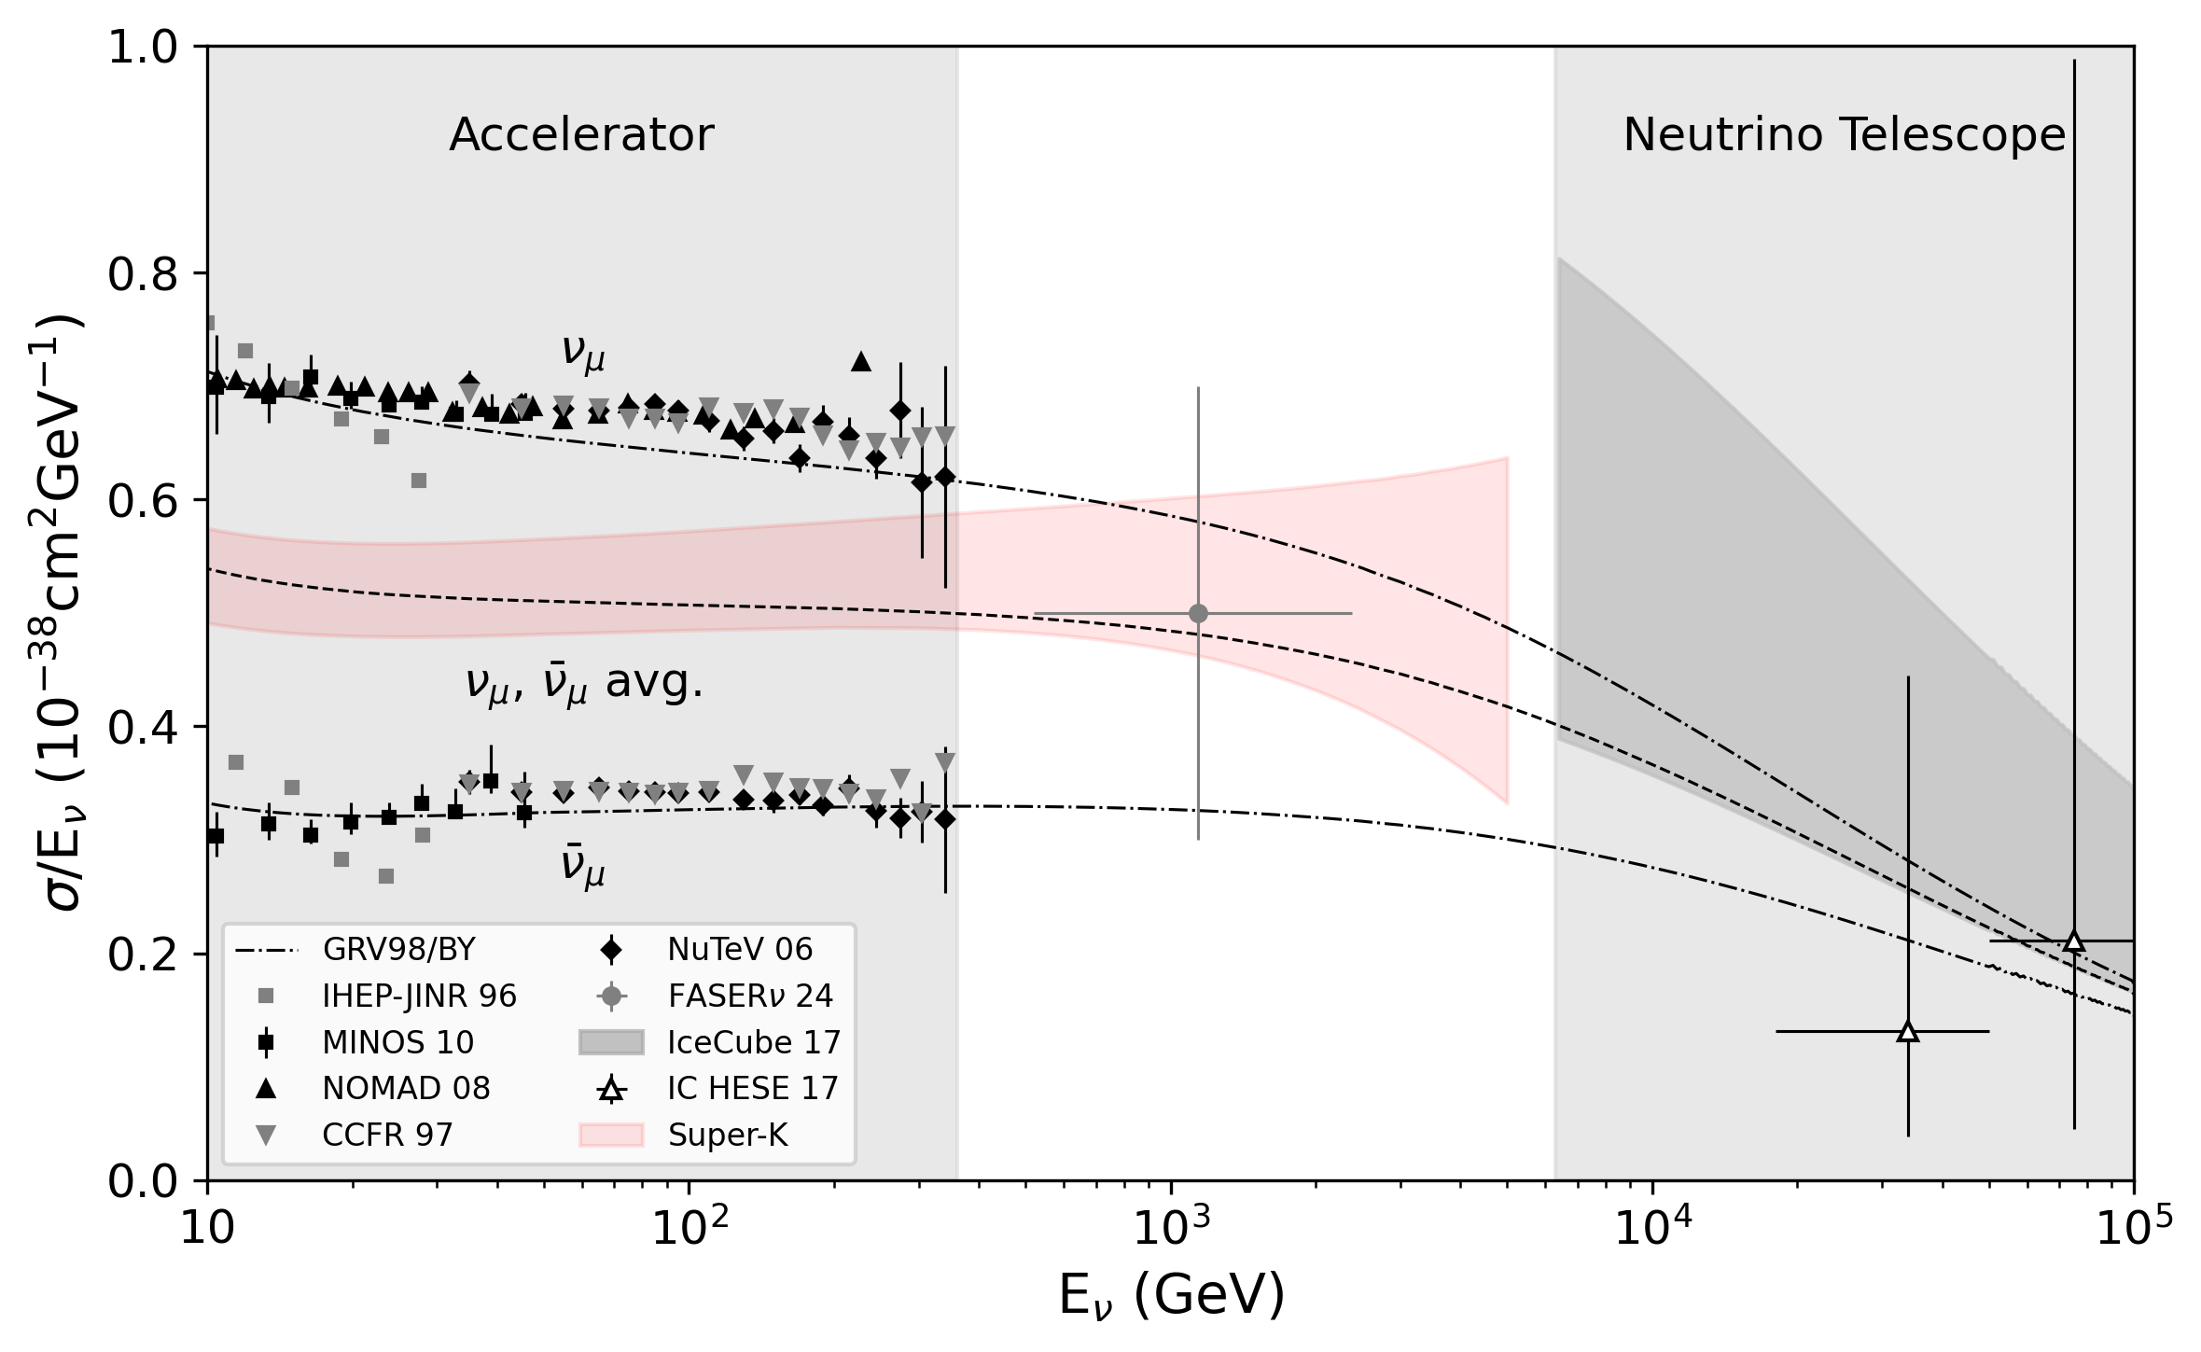
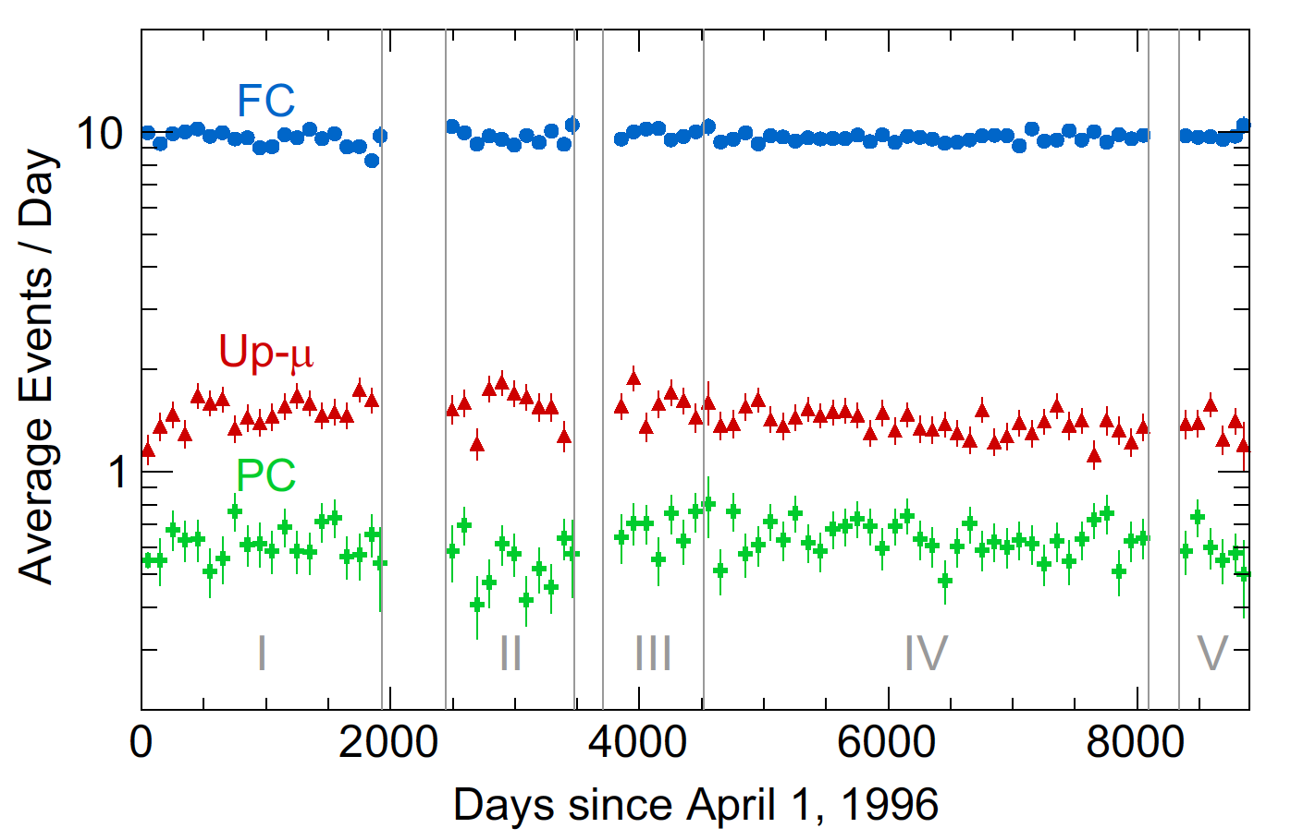
High Energy Astrophysical Neutrinos
Partially Contained (PC)
Fully Contained (FC)
- ~1000 events/yr in TeV region from upgoing muon sample
- Fill the “gap” between accelerator neutrinos and neutrino telescopes
- Prompt neutrinos, galactic plane neutrinos, etc
Through-going Up-going muon
(Up-mu)
Super-Kamiokande
Hyper-Kamiokande (sensitivity)
Super-K event rates
Notes:
This is my last topic - Hyper-K's ability to measure high energy neutrinos of astrophysical origin.
In particular - we can look at the up-going muon sample - these come from interactions of high energy neutrinos in the Earth below the detector - if you look at through-going ones, they fill in this gap in energies between accelerator neutrinos and neutrino telescopes like IceCUBE and KM3net.
We expect around 1000 upgoing muon events per year from this TeV neutrino region probing for example galactic plane neutrinos. This is projected from the Super-K event rates shown here in the right.

Slide 14

Summary
In addition to the Hyper-K long-baseline programme to address CP violation and neutrino oscillation physics - with beam + atmospheric neutrinos - Hyper-K has a vibrant non-beam programme:
Proton Decay – world-leading sensitivities in many channels
Solar Neutrinos – potential to measure day-night asymmetry, MSW low energy upturn and hep-neutrinos, probe tension with reactor measurements and test for new physics
Supernova burst – potential to observe SN 0.1 $→$ ~10³ kpc and discriminate between different models
DSNB – discovery potential
Notes:
To conclude,

Slide 15
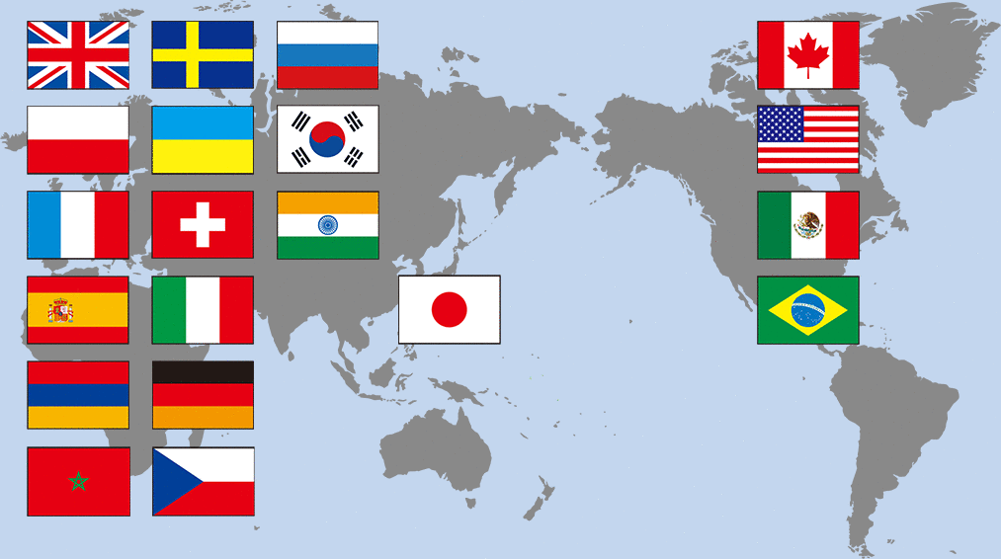
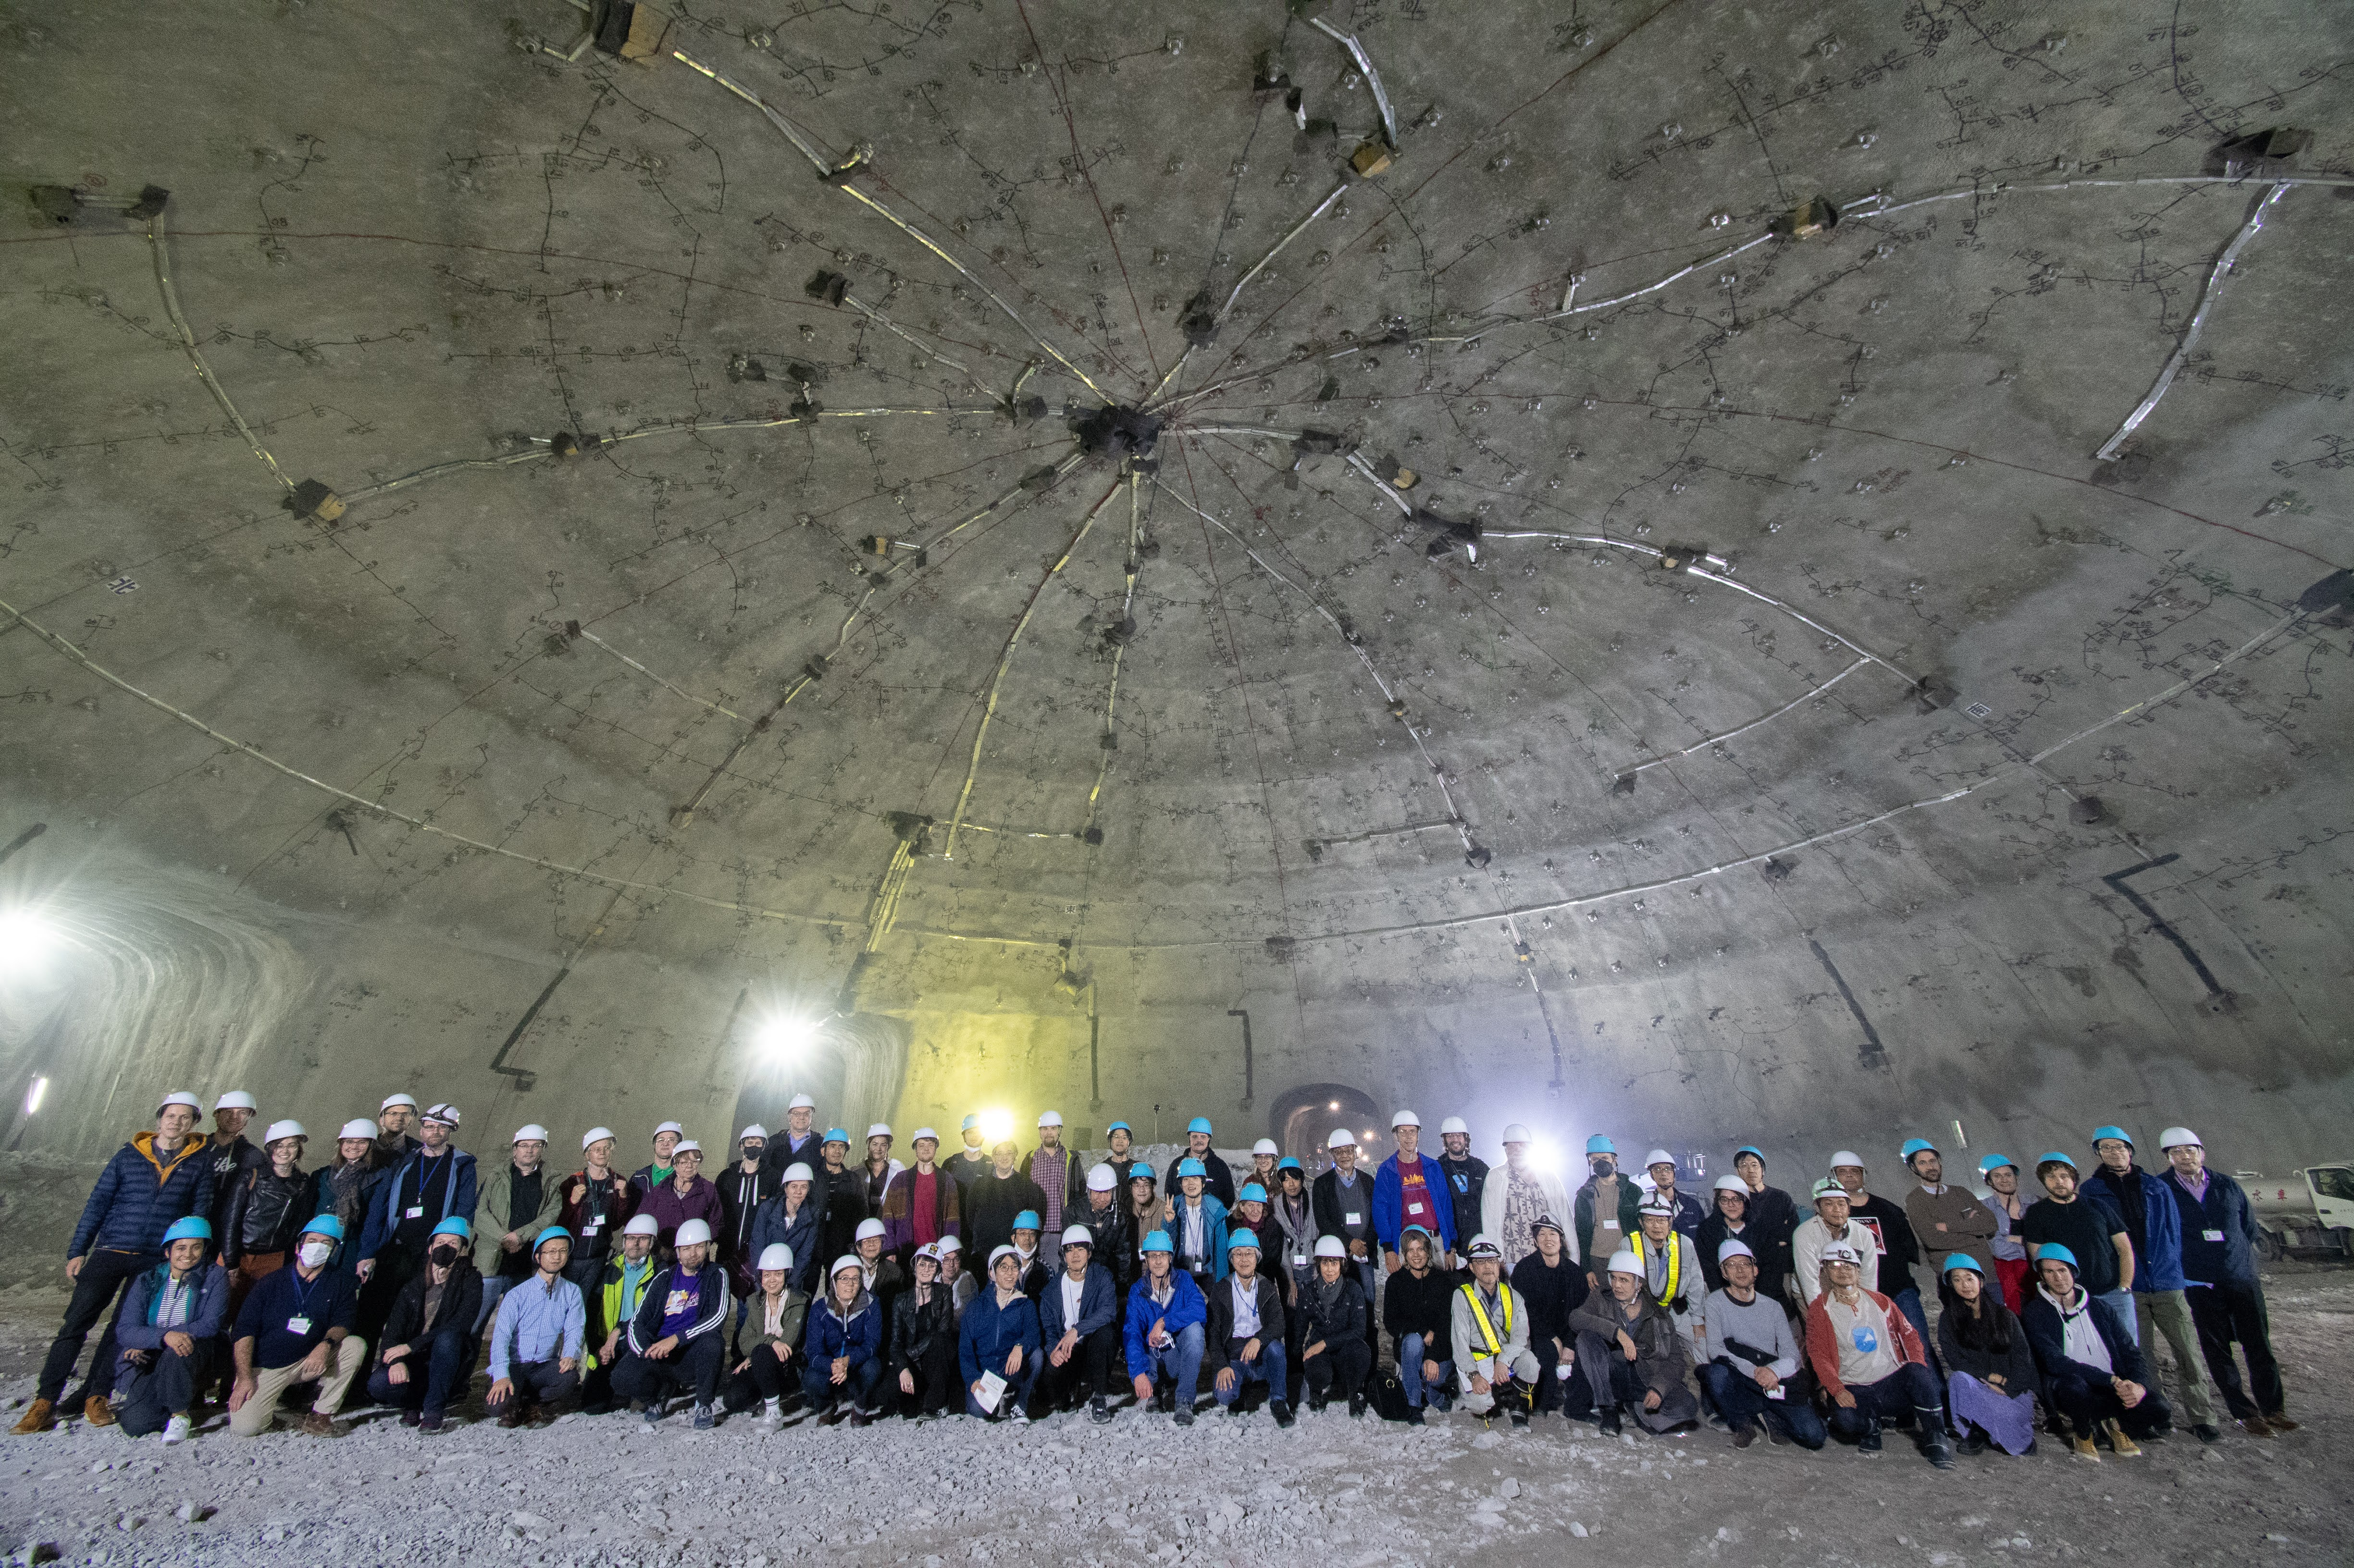


Hyper-Kamiokande Collaboration
22 countries, 104 institutes, 583 members as of 1/4/2024
Still increasing
Hosts:
University of Tokyo
  Hyper-K far detector
KEK/JPARC
  Beam and Near Detectors
October 2023
Notes:
After a quick introduction to the Hyper-K collaboration, currently consisting of over 20 countries, over 100 institutes and around 600 members.
There are two hosts for the project - the University of Tokyo which is responsible for the far detector, and KEK/JPARC who are responsible for the near detectors and beamline
This is a collaboration photo from October 2023 - at the top of cavity excavation - in a couple of weeks, at our next collaboration meeting, we'll be taking a similar photo in the completed cavity.

Slide 16
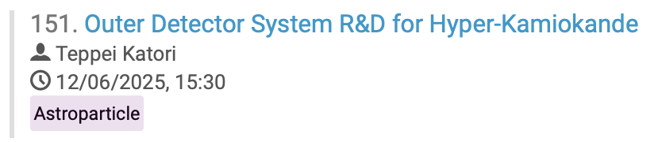
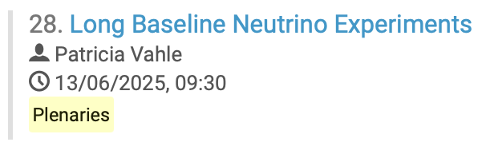
Other Hyper-K talks

