Slide 1
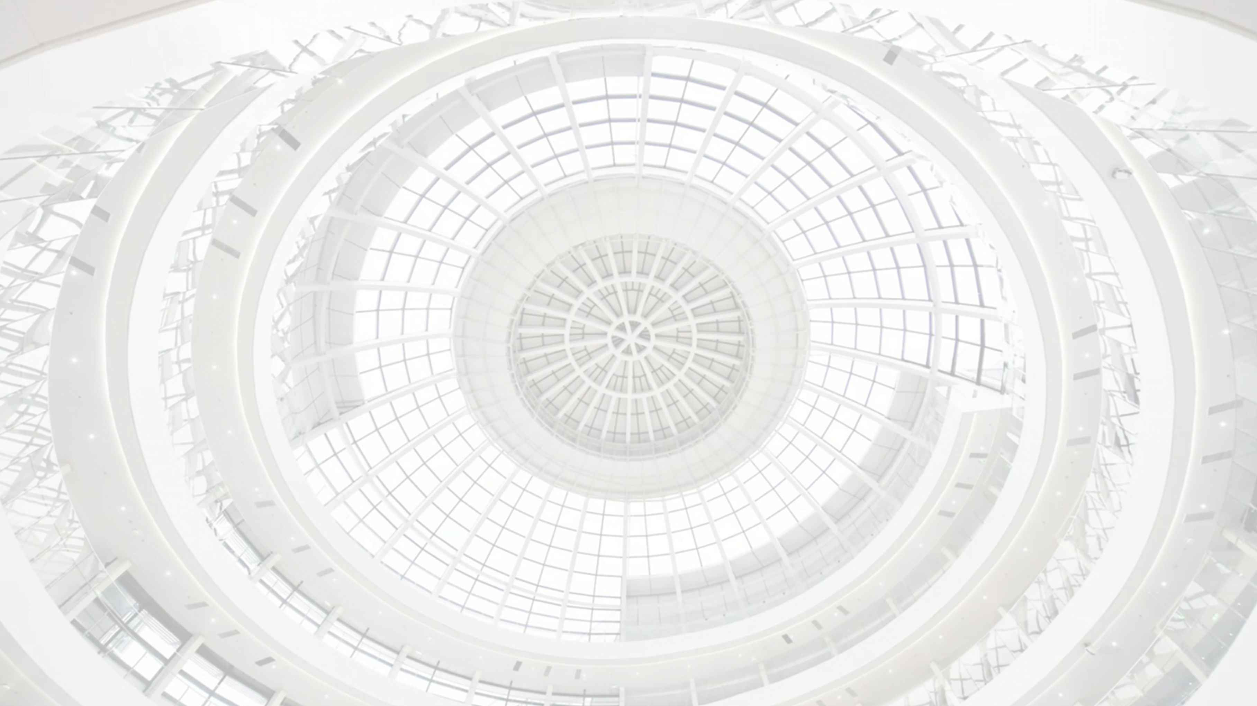
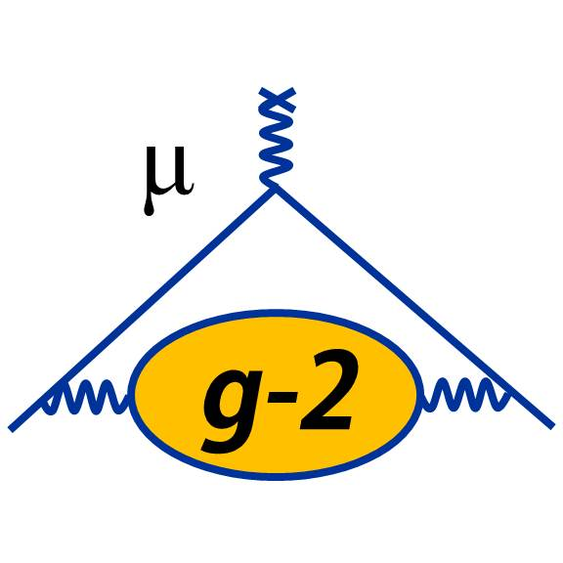



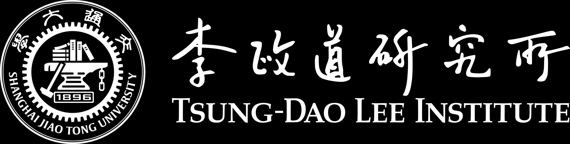
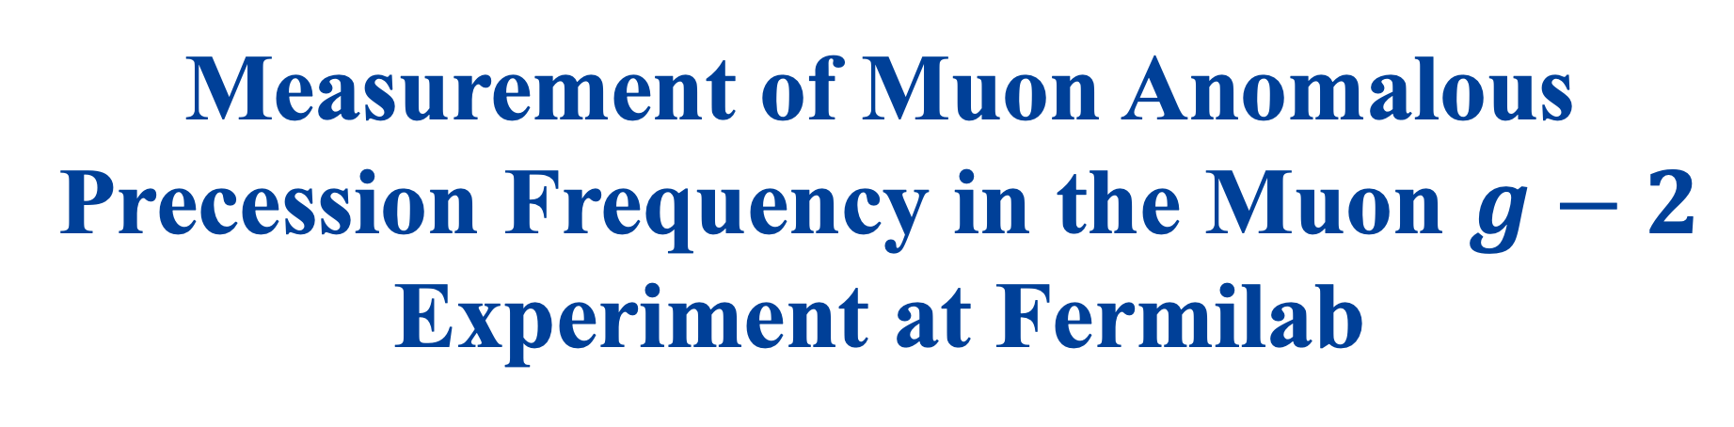
Measurement of Muon Anomalous Precession Frequency in the Muon $g−2$ Experiment at Fermilab
Yonghao Zeng, on behalf of the Muon $g−2$ collaboration
June 10, 2025 | WIN 2025 | University of Sussex, Brighton, UK

Slide 2
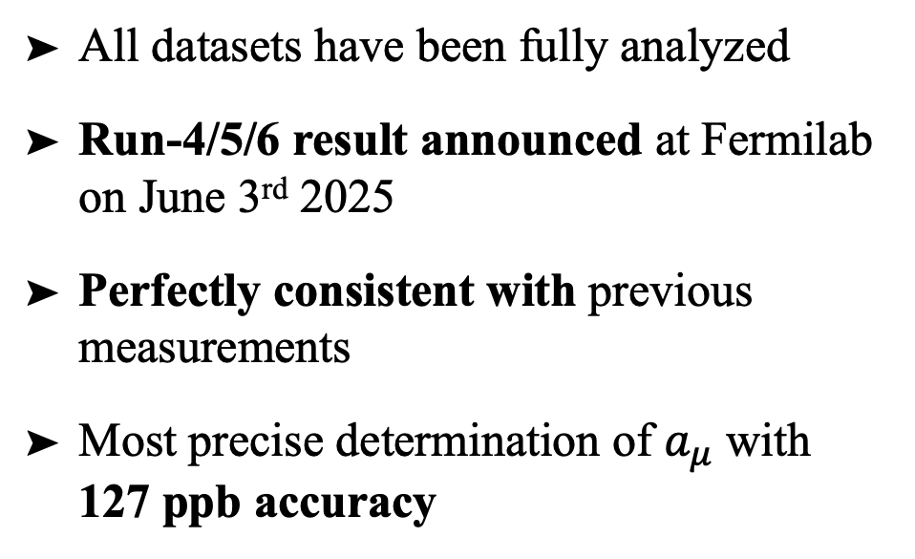
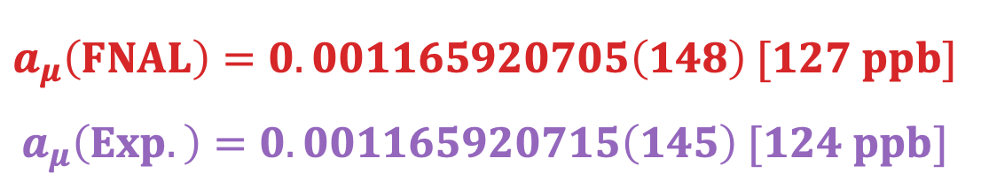
Final Results of Muon g-2 from Fermilab
All datasets have been fully analyzed
Run-4/5/6 result announced at Fermilab on June 3rd 2025
Perfectly consistent with previous measurements
Most precise determination of $a_{μ}$ with 127 ppb accuracy
$$a_{μ}\left(FNAL\right)=0.001165920705\left(148\right) [127 ppb]$$
$$a_{μ}\left(Exp.\right)=0.001165920715\left(145\right) [124 ppb]$$
Presented in the previous talk by Joe Price

Slide 3
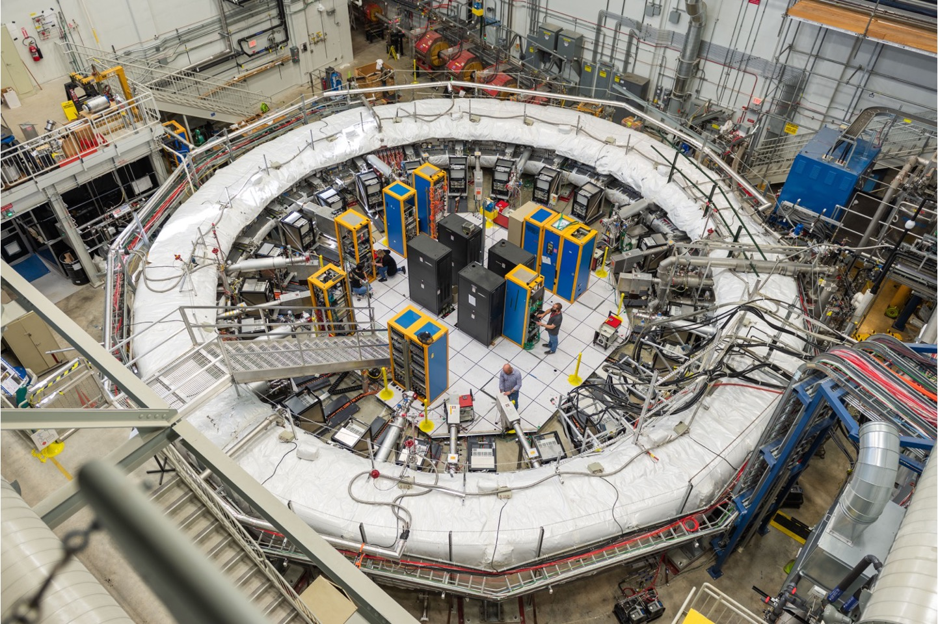
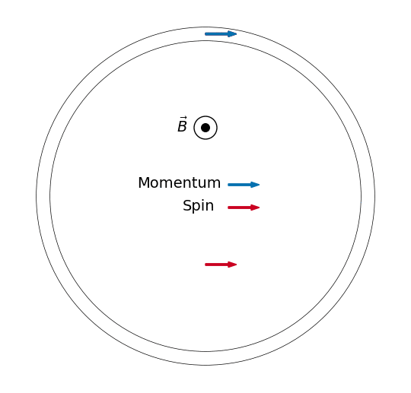
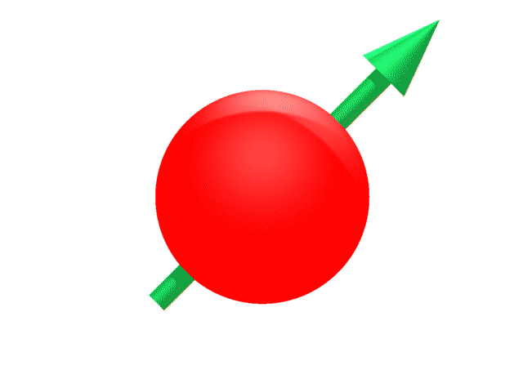
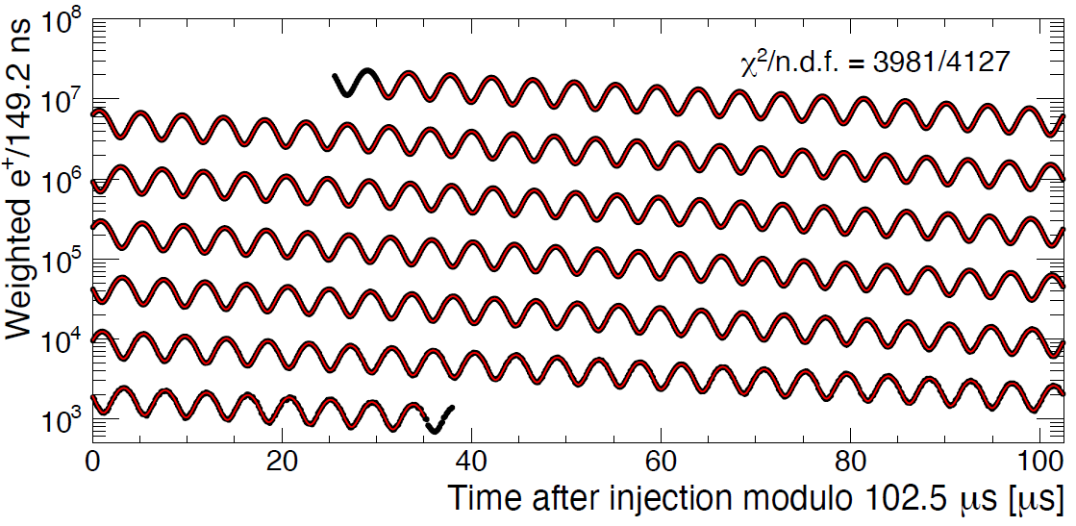

Outline
B
Anomalous precession frequency $ω_{a}$ measurement at FNAL
  Principles
  Analysis flow
Analyses combination
Systematic uncertainties
Summary

Slide 4







Spin Precession in a Magnetic Storage Ring
Lab Frame
Rest Frame
$$\overset{⃑}{p}$$
$$\overset{⃑}{S}$$
$$\overset{⃑}{B}$$
$$\overset{⃑}{S}$$
$$\overset{⃑}{p}$$
$$g>2$$
$${\overset{⃑}{ω}}_{a}={\overset{⃑}{ω}}_{c}−{\overset{⃑}{ω}}_{s}$$
Rate of spin precession with respect to momentum

Slide 5
Spin Precession in a Magnetic Storage Ring
Lab Frame
Rest Frame
$$\overset{⃑}{p}$$
$$\overset{⃑}{S}$$
$$\overset{⃑}{B}$$
$$\overset{⃑}{S}$$
$$\overset{⃑}{p}$$
$$g>2$$
$${\overset{⃑}{ω}}_{a}={\overset{⃑}{ω}}_{c}−{\overset{⃑}{ω}}_{s}$$
Rate of spin precession with respect to momentum

Slide 6
Spin Precession in a Magnetic Storage Ring
Lab Frame
Rest Frame
$$\overset{⃑}{p}$$
$$\overset{⃑}{S}$$
$$\overset{⃑}{B}$$
$$\overset{⃑}{S}$$
$$\overset{⃑}{p}$$
$$g>2$$
$${\overset{⃑}{ω}}_{a}={\overset{⃑}{ω}}_{c}−{\overset{⃑}{ω}}_{s}$$
Rate of spin precession with respect to momentum

Slide 7
Spin Precession in a Magnetic Storage Ring
Lab Frame
Rest Frame
$$\overset{⃑}{p}$$
$$\overset{⃑}{S}$$
$$\overset{⃑}{B}$$
$$\overset{⃑}{S}$$
$$\overset{⃑}{p}$$
$$g>2$$
$${\overset{⃑}{ω}}_{a}={\overset{⃑}{ω}}_{c}−{\overset{⃑}{ω}}_{s}$$
Rate of spin precession with respect to momentum

Slide 8
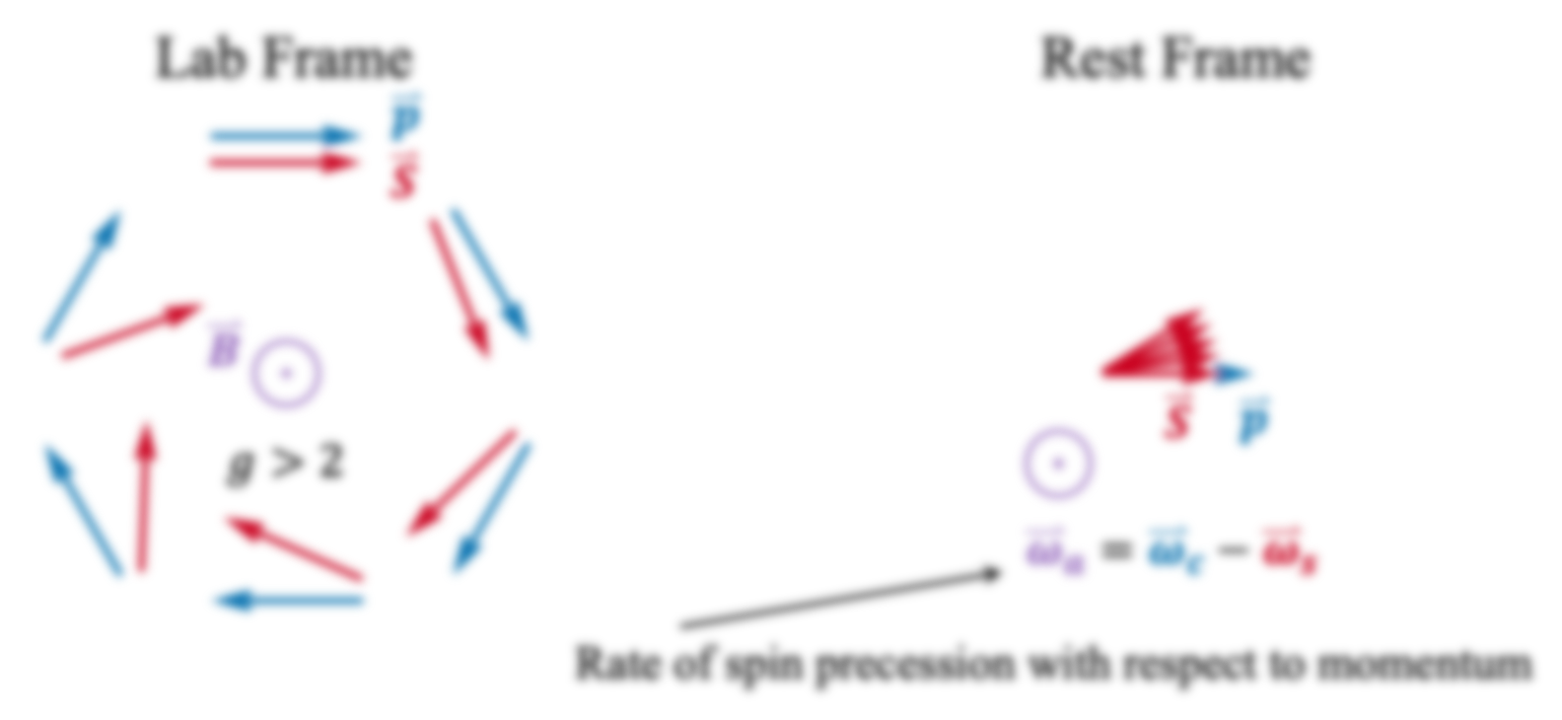


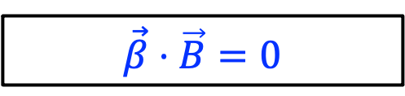
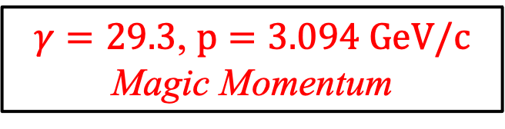
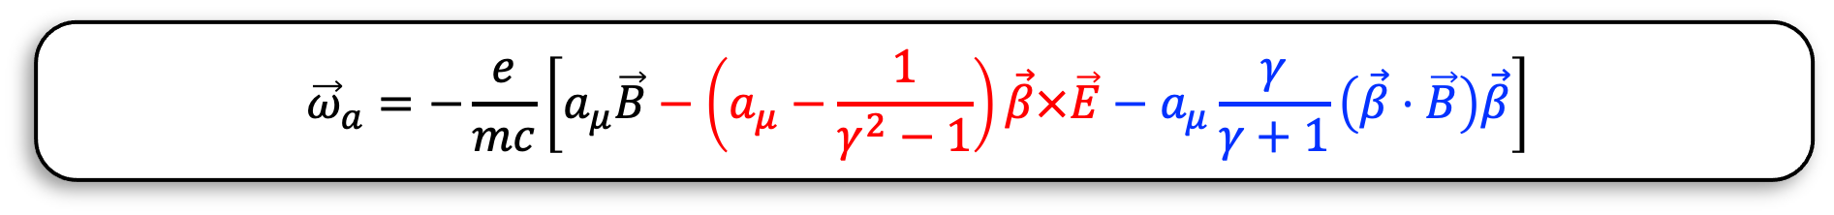
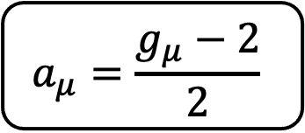
Spin Precession in a Magnetic Storage Ring
Next talk by René Reimann
$$a_{μ}=\frac{g_{μ}−2}{2}$$
This talk
Master Formula
$${\vec{ω}}_{a}=−\frac{e}{mc}\left[a_{μ}\vec{B}−\left(a_{μ}−\frac{1}{γ^{2}−1}\right)\vec{β}×\vec{E}−a_{μ}\frac{γ}{γ+1}\left(\vec{β}⋅\vec{B}\right)\vec{β}\right]$$
$${\vec{ω}}_{a}$$
$$\vec{B}$$
$γ=29.3$, $p=3.094 GeV/c$
Magic Momentum
$$\vec{β}⋅\vec{B}=0$$

Slide 9
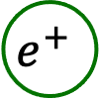
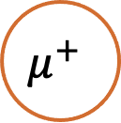


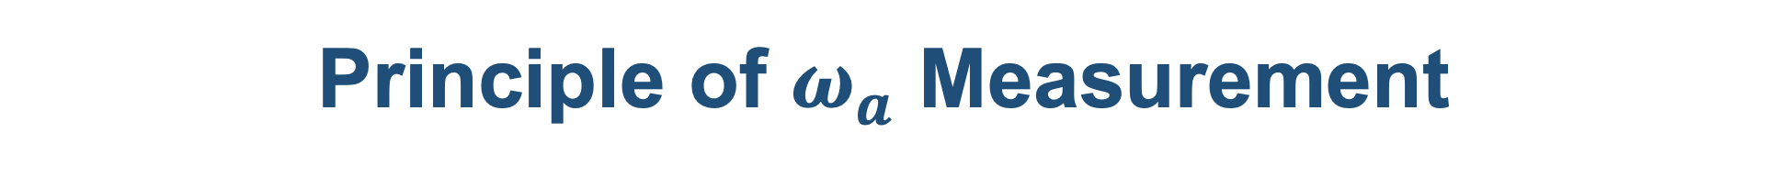
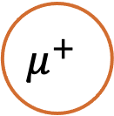
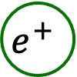
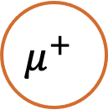
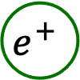
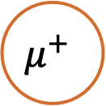
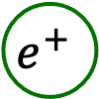
Principle of $ω_{a}$ Measurement
Weak decay violates parity symmetry
  Positrons are preferentially emitted along the direction of anti-muon spin
$${\overset{⃑}{p}}_{e}$$
$$e^{+}$$
$$\overset{⃑}{S}$$
$$μ^{+}$$
$$μ^{+}$$
$$e^{+}$$
$$e^{+}$$
$$μ^{+}$$
$$μ^{+}$$
$$e^{+}$$

Slide 10
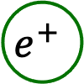
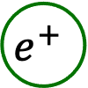

Principle of $ω_{a}$ Measurement
Positron energy spectrum encodes muon spin-momentum correlation
  The most energetic positrons are those emitted along the muon’s momentum
$${\overset{⃑}{p}}_{e}$$
$${\overset{⃑}{p}}_{μ}$$
$$e^{+}$$
$$\overset{⃑}{S}$$
$$μ^{+}$$
$$μ^{+}$$
$$e^{+}$$
$$e^{+}$$
$$μ^{+}$$
$$μ^{+}$$
$$e^{+}$$

Slide 11

Principle of $ω_{a}$ Measurement
Positron energy spectrum encodes muon spin-momentum correlation
  The most energetic positrons are preferentially emitted along the direction of muon spin
$${\overset{⃑}{p}}_{e}$$
$${\overset{⃑}{p}}_{μ}$$
$$e^{+}$$
$$\overset{⃑}{S}$$
$$μ^{+}$$
$$μ^{+}$$
$$e^{+}$$
$$e^{+}$$
$$μ^{+}$$
$$μ^{+}$$
$$e^{+}$$

Slide 12
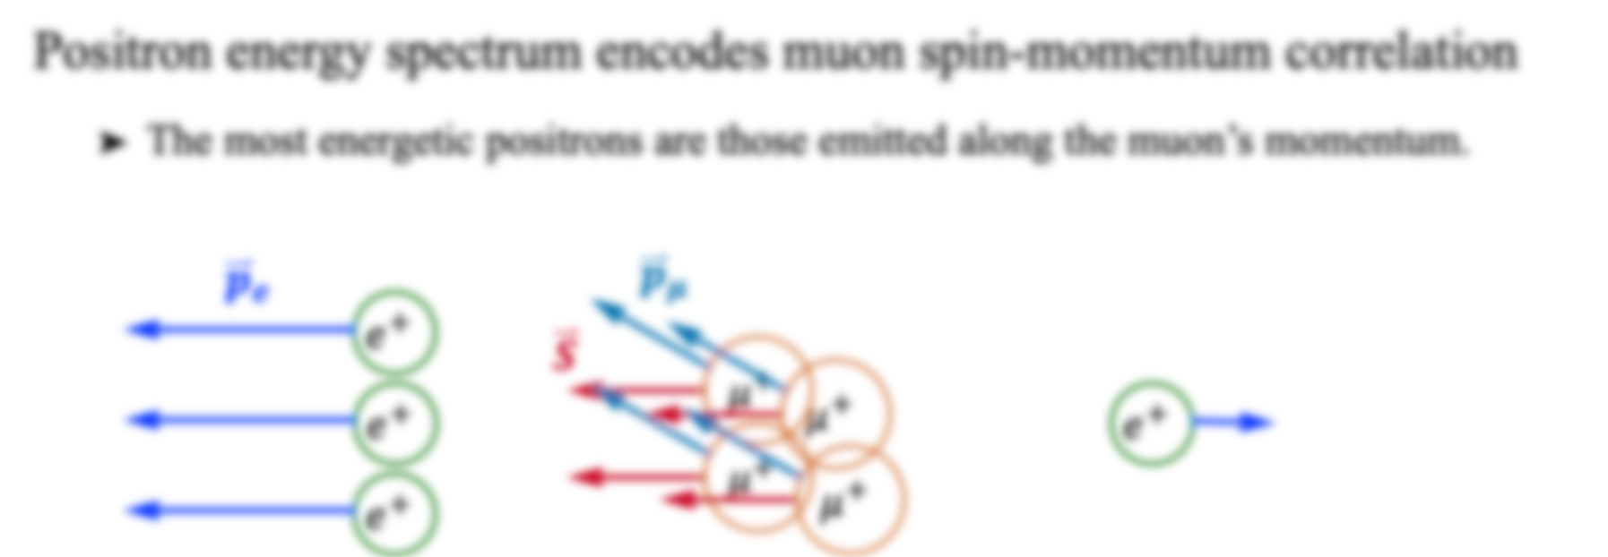
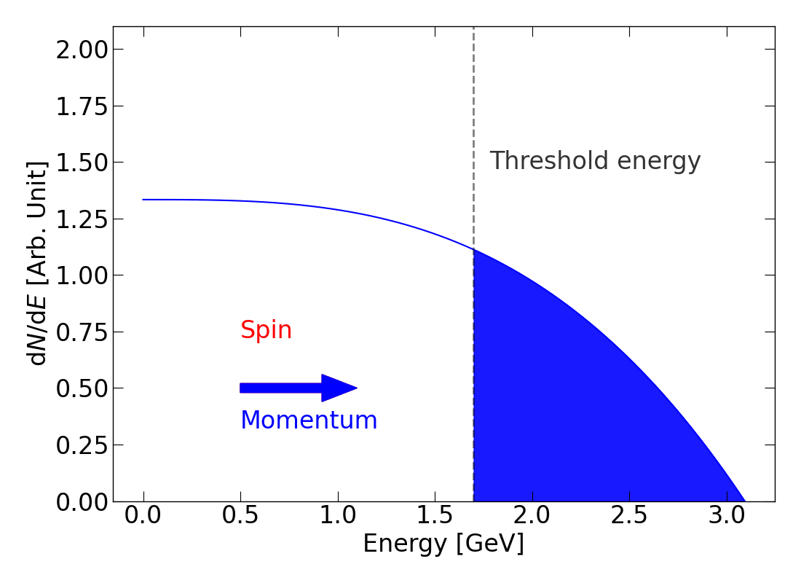
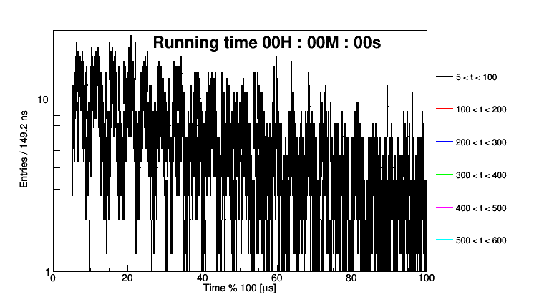
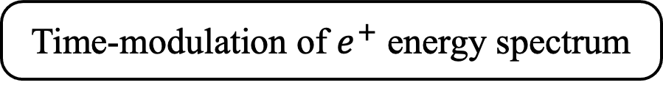
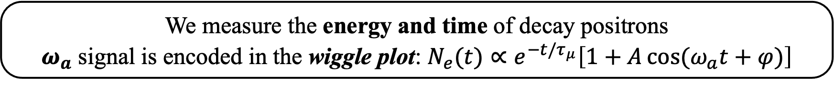
Principle of $ω_{a}$ Measurement
Time-modulation of $e^{+}$ energy spectrum
We measure the energy and time of decay positrons
$ω_{a}$ signal is encoded in the wiggle plot: $N_{e}(t)∝e^{−t/τ_{μ}}\left[1+A\cos{(ω_{a}t+φ)}\right]$

Slide 13
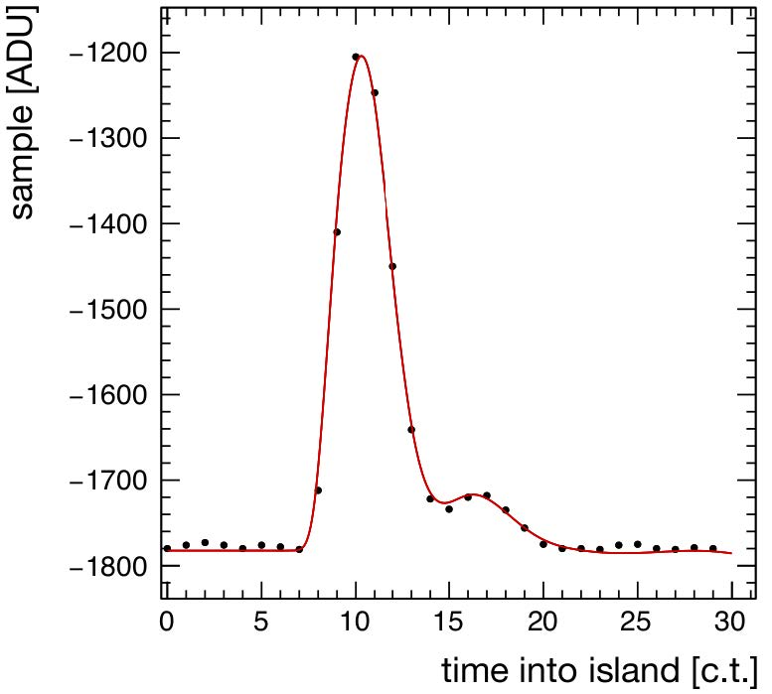
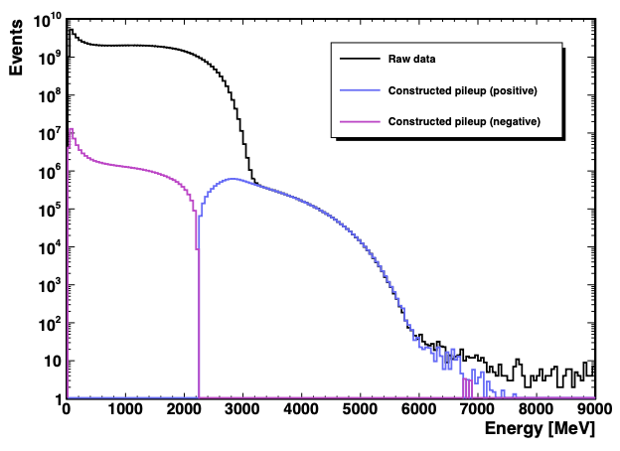
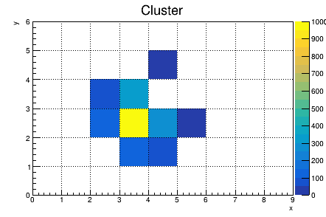
Analysis Flow
Data Acquisition
Reconstruction
Reconstruction
Data Weighting
Wiggle Fitting
Pulse Fitting
Time Correction
Gain Correction
Clustering
Pileup Correction
E, t
E’, t’
Pilup only

Slide 14
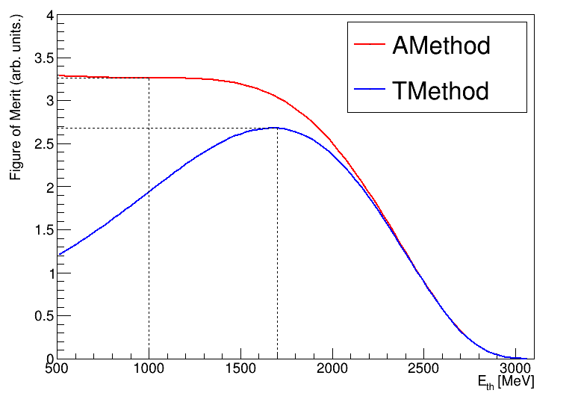

Analysis Flow
Data Acquisition
Reconstruction
Data Weighting
Wiggle Fitting
Enhancing statistical power through asymmetry-weighted events
T-methed
  A(E) = 1
  With a threshold of 1.65 GeV
A-method
  Extract A(E) from energy bin scan (50 MeV bin size)
  With a lower cut of 1 GeV
$$\frac{1}{σ_{ω_{a}}^{2}}$$

Slide 15
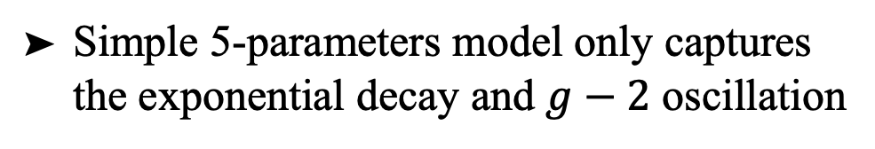

Analysis Flow
Data Acquisition
Reconstruction
Data Weighting
Wiggle Fitting
Simple 5-parameters model only captures the exponential decay and $g−2$ oscillation
$$N_{e}\left(t\right)=N_{0}e^{−t/τ_{μ}}\left[1+A\cos{(ω_{a}t+φ)}\right]$$
Must account for beam oscillations, detector effects and muon losses

Slide 16
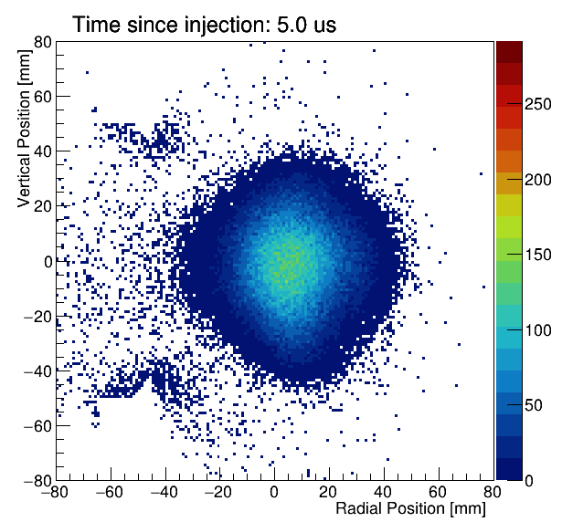
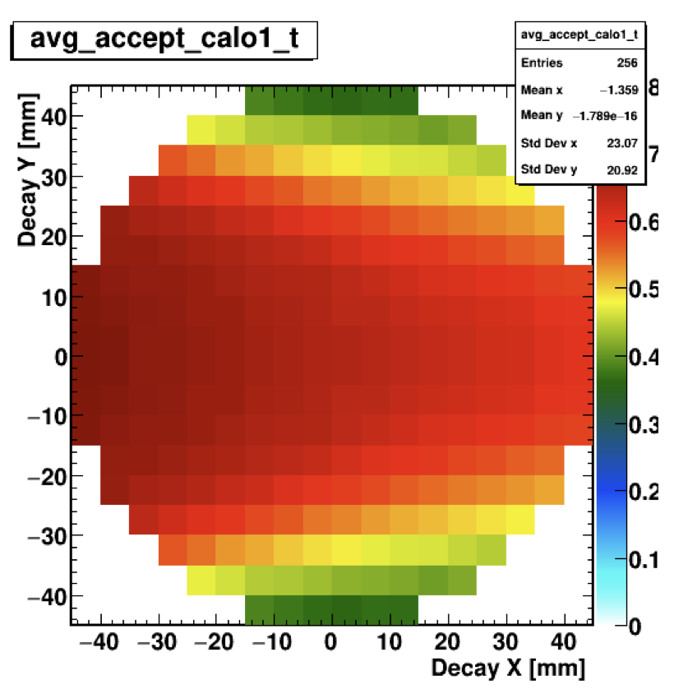
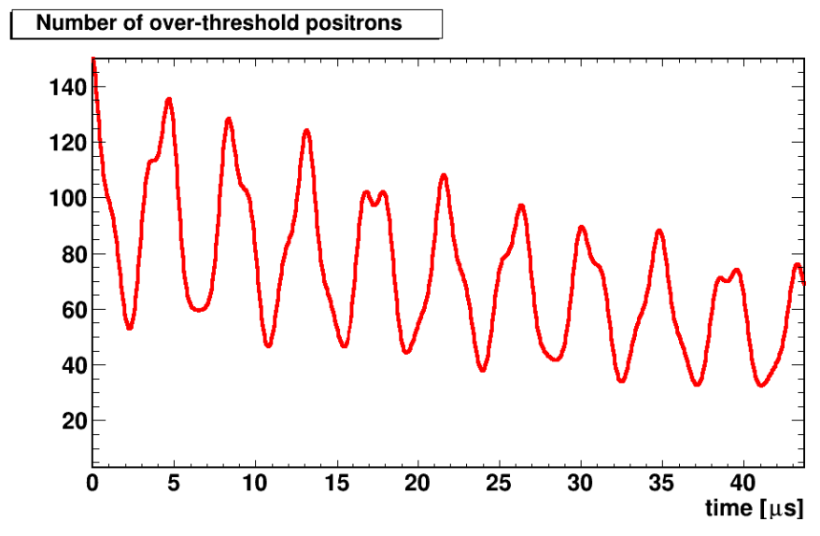
Coherent Betatron Oscillation (CBO)
CBO enters the data through coupling between detector acceptance and muon decay position. It dominated Run-1/2/3 systemactic uncertainty
Beam Motion
Detector Acceptance
Distorted Wiggle Plot

Slide 17
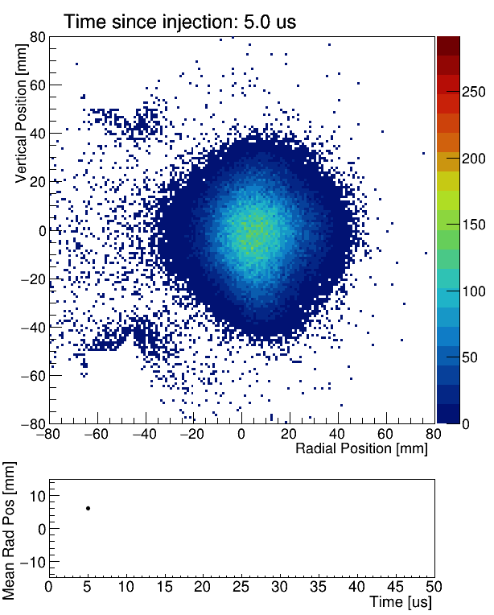
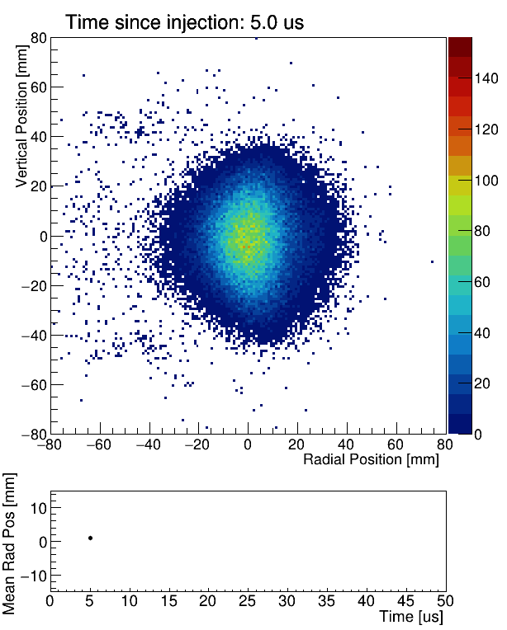
Coherent Betatron Oscillation (CBO)
CBO enters the data through coupling between detector acceptance and muon decay position. It dominated Run-1/2/3 systemactic uncertainty
No Additional RF on ESQ
Additional RF on ESQ
A radio-frequency (RF) was applied to the electrostatic quadrpole plates to suppress CBO effect in Run-5/6
New!

Slide 18
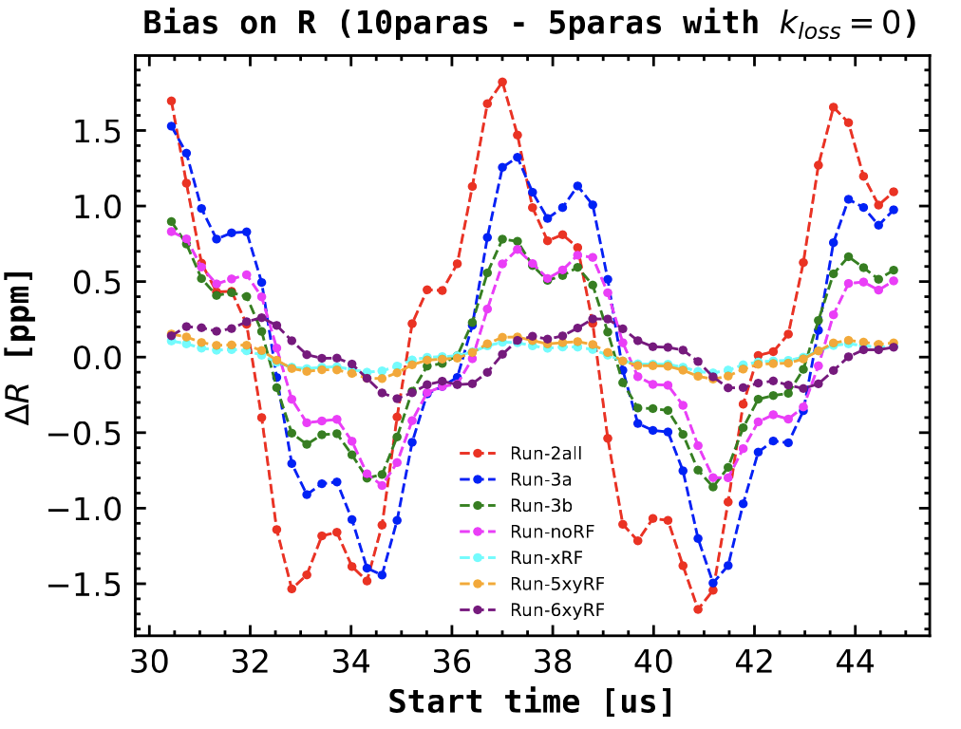
Coherent Betatron Oscillation (CBO)
CBO enters the data through coupling between detector acceptance and muon decay position. It dominated Run-1/2/3 systemactic uncertainty
CBO-induced bias as a function of fit start time
A radio-frequency (RF) was applied to the electrostatic quadrpole plates to suppress CBO effect in Run-5/6
New!
The CBO-induced bias: 1.7 ppm (Run-2) → 0.1 ppm (Run-xyRF)

Slide 19
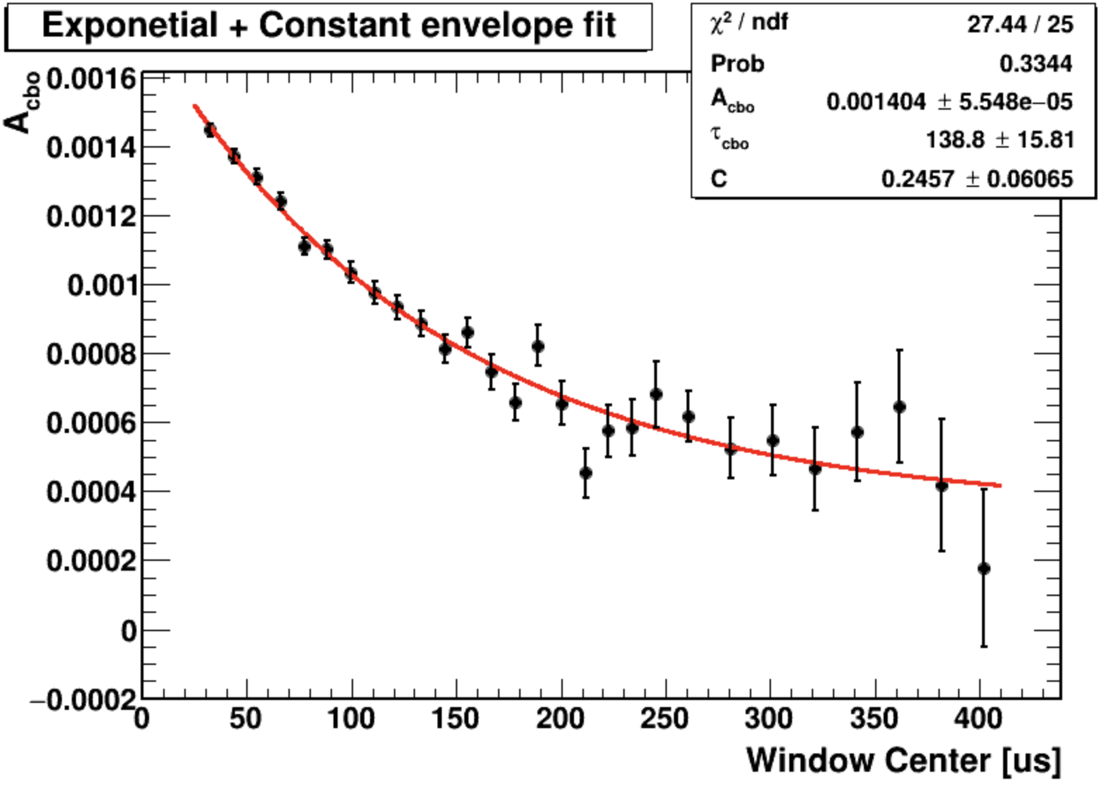
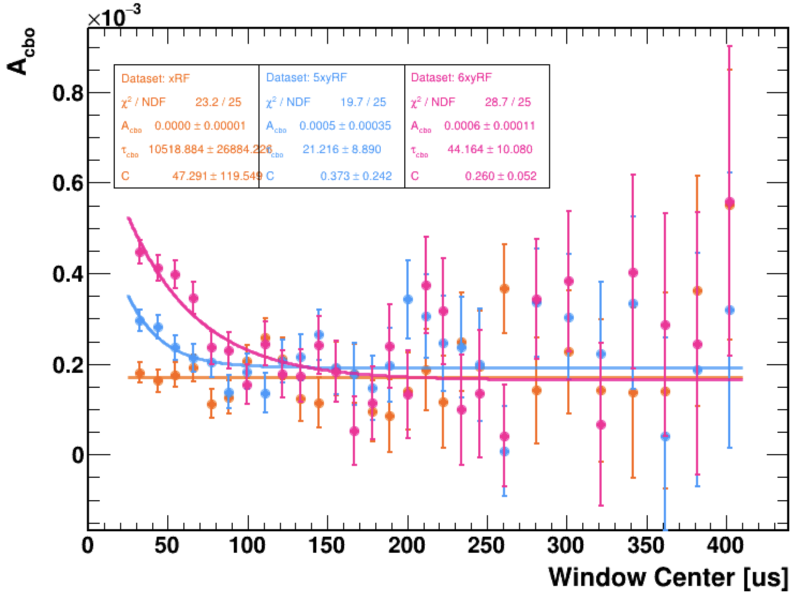
Coherent Betatron Oscillation (CBO)
A large CBO (thus a large bias) that can be well modeled, vs. a small CBO (thus a small bias) that is harder to model accurately
CBO separation via sliding window technique
VS.
No-RF
RF

Slide 20
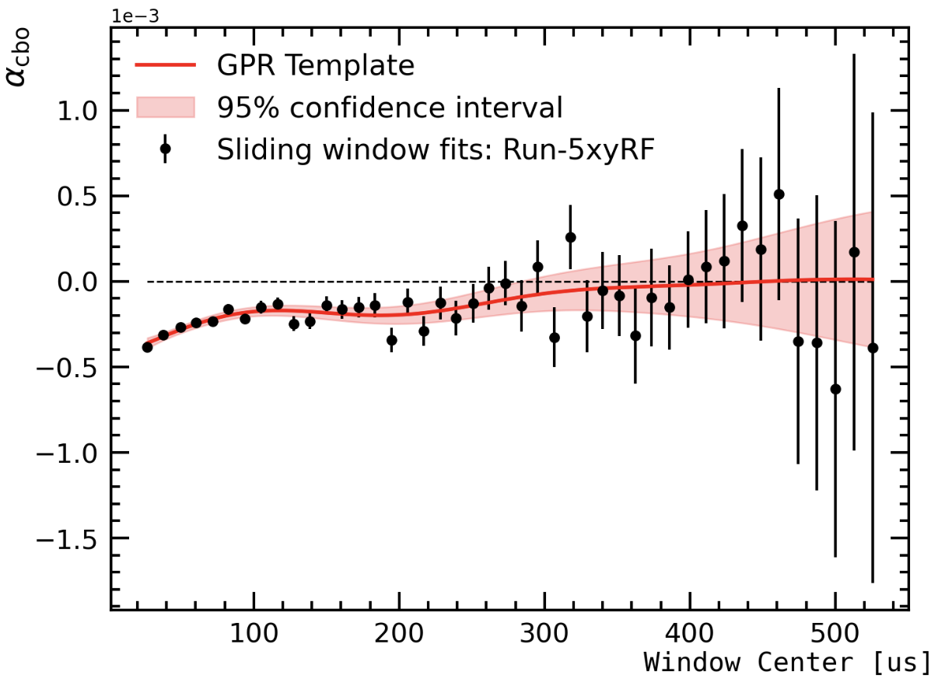
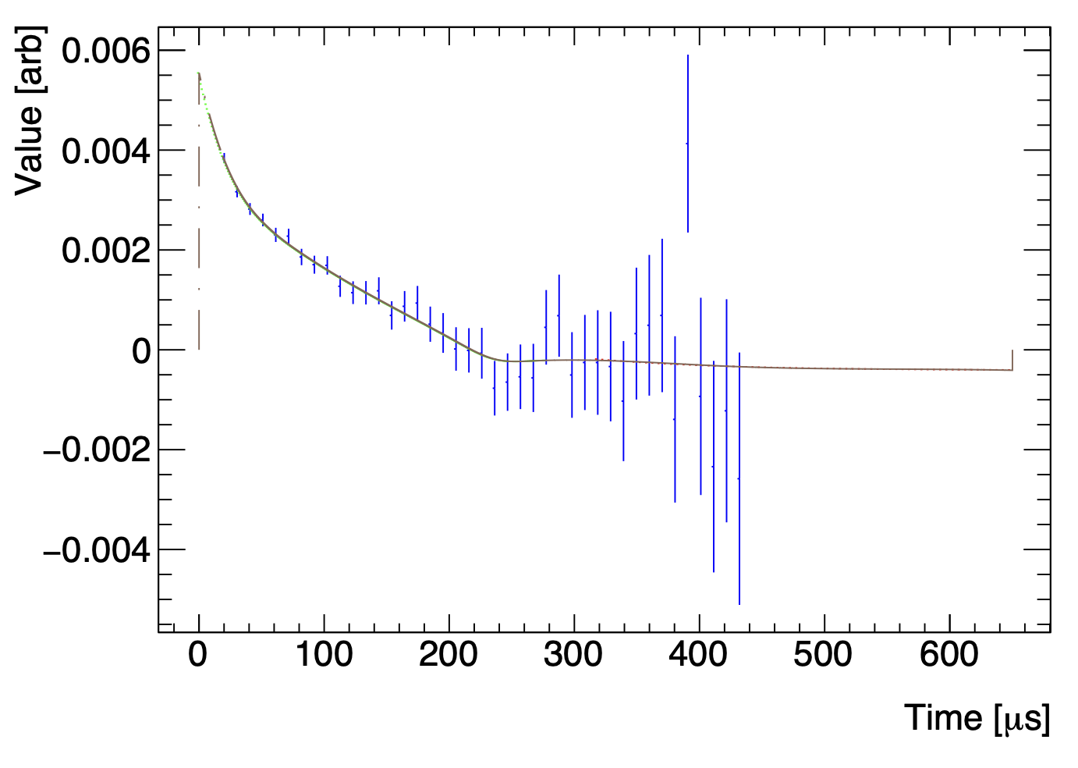
Coherent Betatron Oscillation (CBO)
A large CBO (thus a large bias) that can be well modeled, vs. a small CBO (thus a small bias) that is harder to model accurately
Non-parametric approaches developed: Gaussian Process Regression (GPR), Spline
New!
GPR
Spline

Slide 21
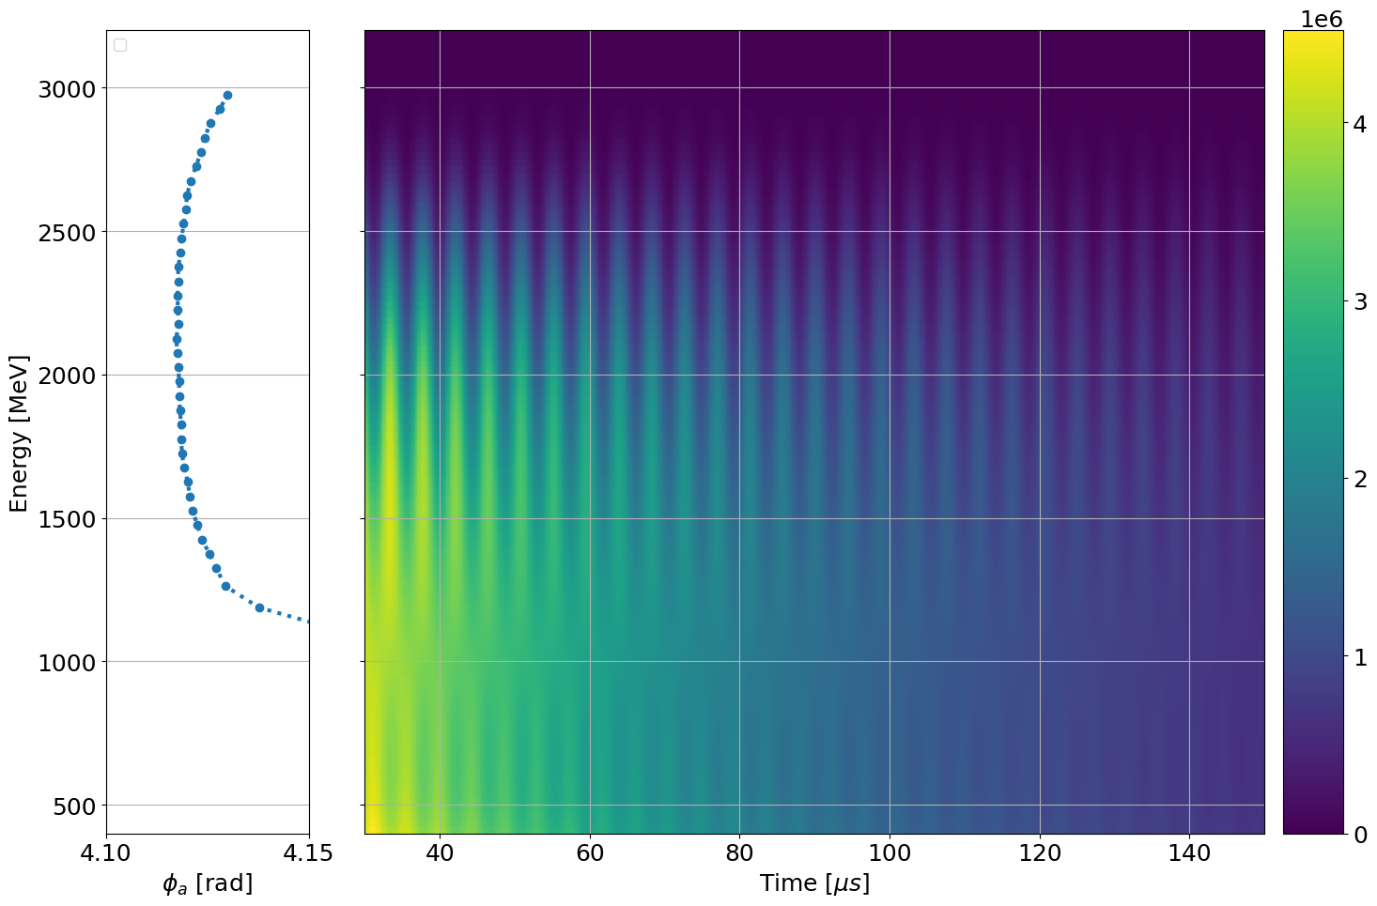
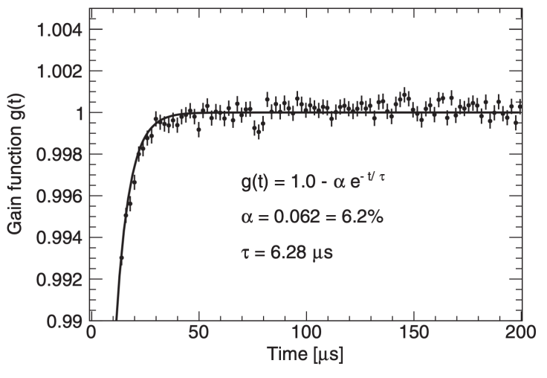



Residual Slow Effect
Early-to-late
Time-dependent phase change leads to a bias: $ω_{a}t+φ→ω_{a}t+φ\left(t\right)=(ω_{a}+\frac{dφ}{dt})t+…$
The detector effect because of SiPM gain sag
Energy-dependent Phase
Gain Correction in Run-1/2/3:
  In-Fill Gain (IFG): caused by initial flash
  Short-Term Double Pulse (STDP): caused by single pulse
IFG, recovery time ~ $6 μs$
STDP, recovery time ~ $15 ns$

Slide 22






Residual Slow Effect
Still remained in Run-4/5/6
New!
Identified: Intermediate-Term Double Pulse (ITDP)
  Similar to STDP, but longer time scale, recovery time ~ $6 μs$
  Specialized hardware study
20 ppb ~ 40 ppb effect on $ω_{a}$, 10 ppb ~ 20 ppb uncertainty

Slide 23
Analysis Flow
Data Acquisition
Reconstruction
Data Weighting
Wiggle Fitting
Simple 5-parameters model only captures the exponential decay and $g−2$ oscillation
$$N_{e}\left(t\right)=N_{0}e^{−t/τ_{μ}}\left[1+A\cos{(ω_{a}t+φ)}\right]$$
Must account for beam oscillations, detector effects and muon losses
The function expands to between 7 and 50 parameters

Slide 24


Analyses Combination
Acquisition clocks are hardware blinded, analysis is software blinded
Four major datasets based on the presence or absence of RF: Run-noRF, Run-xRF, Run-5xyRF, and Run-6xyRF
5 analysis groups, 20 methods in total
7 analyses are used in the average

Slide 25

Systematic Uncertainties
With respect to Run-2/3:
  Largest uncertainties are still CBO and Residual Slow Effect
  Rest of the systematics are stable over datasets
  Total systematic uncertainty for Run-4/5/6 is 30 ppb with 114 ppb statistical uncertainty

Slide 26

Summary
The most precise determination of $a_{μ}$ is given with an unprecedented precision of 124 ppb
I’ve presented the analysis flow of $ω_{a}$ and improvements on CBO and Residual Slow Effect
Next, you will hear about magnetic field measurement from René Reimann

Slide 27



THANK YOU FOR YOUR ATTENTION!
$g−2$ collaboration meeting @ July 2023, Liverpool, UK

Slide 28
Backup

Slide 29



Muon g-2 Experiment at Fermilab
$$μ^{+}$$
8 GeV protons on target for pion production
Transport line for $μ$ collection from $π→μ+υ_{μ}$ decay
$μ$ stored in a magnetic storage ring
Presented in the previous talk by Joe Price

Slide 30
Spin Precession in a Magnetic Storage Ring
Lab Frame
Rest Frame
$$\overset{⃑}{p}$$
$$\overset{⃑}{S}$$
$$\overset{⃑}{B}$$
$$\overset{⃑}{S}$$
$$\overset{⃑}{p}$$
$$g>2$$
$${\overset{⃑}{ω}}_{a}={\overset{⃑}{ω}}_{c}−{\overset{⃑}{ω}}_{s}$$
Rate of spin precession with respect to momentum

Slide 31





Calorimeters
24 calorimeters uniformly placed around the inner side of the storage ring
Each calorimeter has 6x9 PbF₂ crystals coupled with SiPMs
SiPMs collect Cerenkov light from decay positrons
Extract energy and time from pulse fitting
$$μ^{+}$$
$$e^{+}$$

Slide 32
Analysis Flow
Data Acquisition
Reconstruction
Data Weighting
Wiggle Fitting
Pulse Fitting
Time Correction
Gain Correction
Clustering
Pileup Correction
E, t
E’, t’
Pilup only

Slide 33
Analysis Flow
Data Acquisition
Reconstruction
Data Weighting
Wiggle Fitting
Raw Data
Pulse Fitting
Time Correction
Gain Correction
Clustering
Pileup Correction
Raw ADC pulses are fitted with empirical pulse templates. Each positron generates a pulse in one or more SiPMs
E, t
Two approaches:
  Local fitting: ﻿fit each individual crystal pulse separately
  Global fitting: fit ﻿multiple crystal traces ﻿simultaneously

Slide 34

Analysis Flow
Data Acquisition
Reconstruction
Data Weighting
Wiggle Fitting
Raw Data
Pulse Fitting
Time Correction
Gain Correction
Clustering
Pileup Correction
1296 SiPMs are time aligned with a laser pulse sent before beam injection, with ~50 ps accuracy
E, t’
Sync Laser
Time
Beam Injection
$$700 μs$$
End of Beam

Slide 35
Analysis Flow
Data Acquisition
Reconstruction
Data Weighting
Wiggle Fitting
Raw Data
Pulse Fitting
Time Correction
Gain Correction
Clustering
Pileup Correction
1296 SiPMs gain are calibrated by Laser Calibration System in different time scale
E’, t’
Sync Laser
In-Fill Laser
Out-of-Fill Laser
Time
Beam Injection
$$700 μs$$
End of Beam

Slide 36

Analysis Flow
Data Acquisition
Reconstruction
Data Weighting
Wiggle Fitting
Raw Data
Pulse Fitting
Time Correction
Gain Correction
Clustering
Pileup Correction
Cluster SiPM pulses into individual positron candidate for Local approach
Time resolution as a function of cluster energy
Goal: reduce the dead-time of clusters, thus reduce pileup events
Considered energy-dependent resolution
Reduced the level of pileup by a factor of four

Slide 37


Analysis Flow
Data Acquisition
Reconstruction
Data Weighting
Wiggle Fitting
Raw Data
Pulse Fitting
Time Correction
Gain Correction
Clustering
Pileup Correction
Pileup occurs when two or more positrons arrive too close in time/space
Empirically construct pileup spectrum from data
Trigger
$$149.2 ns$$
Shadow
P(ileup) = T+S
Pilup only
$$5 ns$$

Slide 38



A-method Weights
$$\frac{σ_{ω_{a}}}{ω_{a}}=\sqrt{\frac{2<w(E)^{2}>}{N<w(E)A>^{2}γ^{2}τ^{2}ω_{a}^{2}}}$$
Optimal: $w(E)=A(E)$

Slide 39

Sliding Window for Individual Calorimeter

Slide 40




Intro to GPR
A Gaussian Process is a collection of random variables (indexed by continuous time or space), of which, any finite number have a joint Gaussian distribution
$$f\left(x\right) \sim G(μ\left(x\right), K(x, x^{′}))$$
Regression is described as given some observed data (training dataset), finding a function that represents the data as close as possible, then using the function to make predictions at new data points
A GP can help to make predictions, by inputing the prior assumption and observed data, then generating posterior prediction

Slide 41



GPR
$$N_{CBO}\left(t\right)=1−A_{CBO}(t)\cos\left(ω_{CBO}(t)t+φ_{CBO}\right)$$
Alpha-beta representation: model $A(t)$ and $ω_{CBO}(t)$ ➔ model $α(t)$ and $β(t)$
$$N_{CBO}\left(t\right)=1−[α_{CBO}\left(t\right)\cos\left(ω_{CBO}t\right)+β_{CBO}\left(t\right)\sin{(ω_{CBO}t)}]$$
A Gaussian Process is a collection of random variables (indexed by continuous time or space), of which, any finite number have a joint Gaussian distribution.
200 bootstrap wiggle plots provide 200 times sliding window fits. Each specific sliding window point has a Gaussian distribution, and joint distribution between points follow a joint Gaussian distribution.

Slide 42





Residual Slow Effect
Evidence of residual slow term:
The fitted muon lifetime will drift with energy and fit start time
In Run-4/5/6, we found that most residual slow term are caused by the Intermediate-Term Double Pulse (ITDP effect).
What we have:
In-fill gain (IFG) effect: caused by initial flash, recovery time ~6 us
Short-term double pulse (STDP) effect: caused by single pulse, recovery time ~15 ns
What we miss:
Intermediate term double pulse (ITDP) effect: caused by single pulse, recovery time ~6 us (same as IFG)
$𝒪\left(μs\right)$

Slide 43





Residual Slow Effect
Validation and measurement of residual slow effect
Systematics uncertainty
Specialized hardware study
for measuring the ITDP effect (gain sag amplitude and recovery time).
Laser gain monitor data
Use existed in-fill laser data to validate the hardware measurement result
dataset | $ΔR$ (correction on/off, in ppb) | Systematics (in ppb)
noRF | 38.5 | 20.6
xRF | 38.7 | 19.2
xyRF-5 | 35.3 | 16.8
xyRF-6 | 27.3 | 11.0
Summary of residual slow term correction effect on $ω_{a}$ and systematics uncertainty.

Slide 44


Dependency on Energy
Gain sag mostly occurs at early-time
High energy events are underestimated: low energy event becomes more, high energy event becomes fewer

Slide 45

Muon Losses
Muon Losses: a fraction of muon drifts out of storage ring over time and hit multiple calorimeters

Slide 46

Mutiple Parameters

Slide 47



Consistency Checks
Calo Scan
Start Time Scan
Energy Bin Scan

Slide 48
Spin Precession in a Magnetic Storage Ring

Slide 49
Spin Precession in a Magnetic Storage Ring
Lab Frame
Rest Frame
$$\overset{⃑}{p}$$
$$\overset{⃑}{S}$$
$$\overset{⃑}{B}$$
$$\overset{⃑}{S}$$
$$\overset{⃑}{p}$$
$$g>2$$
$${\overset{⃑}{ω}}_{a}={\overset{⃑}{ω}}_{c}−{\overset{⃑}{ω}}_{s}$$
Rate of spin precession with respect to momentum

