Slide 1


Delayed Electron Mitigation in the RELICS Experiment with Deep Neural Network based Position Reconstruction
Xiaoran Guo（University of Science and Technology of China）
RELICS Collaboration
2025/6/10
xiaoran_guo@mail.ustc.edu.cn

Slide 2
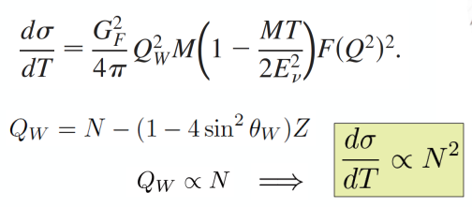
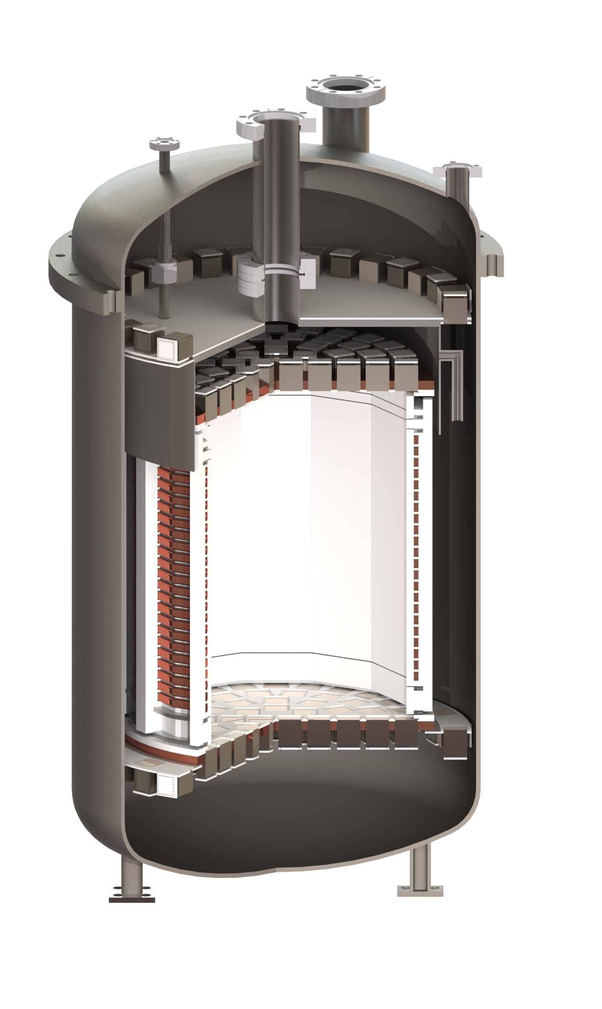
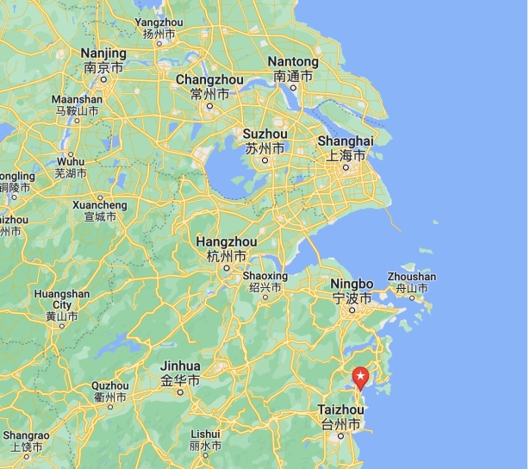
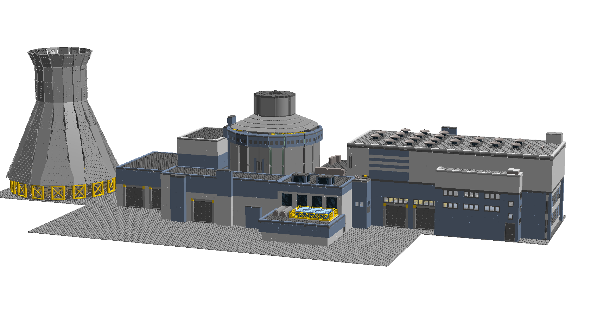









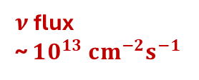
RELICS
REactor neutrino LIquid xenon Coherent Scattering experiment
Constrain on θw
Explore: Nonstandard neutrino interactions
Potential application: Nuclear reactor monitoring
D 28cm
$$e$$
H 24cm
$$e$$
$$ν$$
$$e$$
Liquid Xenon Time Projection Chamber (LXeTPC) technology
AP1000 Heat power ~ 3GW
$$ν$$
$$Z^{0}$$
~25 m
3D vertex reconstruction
Background reduction
Low energy threshold
$$ν$$
$$Xe$$
$$ν$$
$$q$$
$ν$ flux
~ $10^{13} cm^{−2}s^{−1}$
(nuclear recoil energy ~1keVnr)

Slide 3
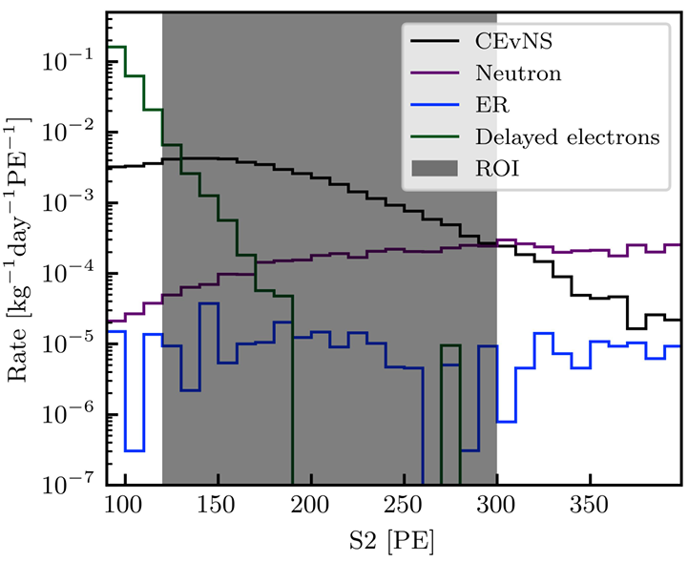
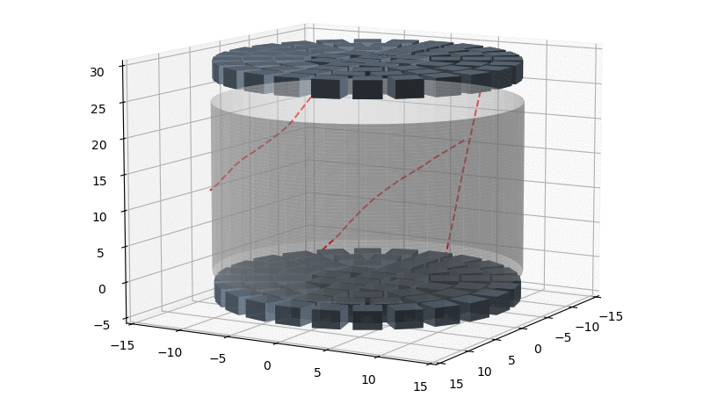
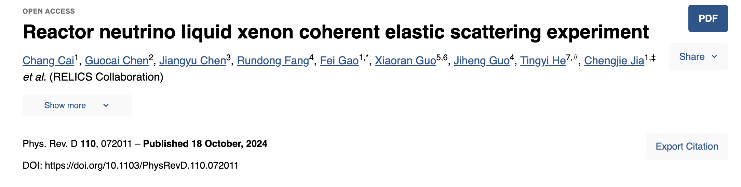
Delayed Electrons(DEs) from Cosmic Muon
Major challenge: DE caused by High Rate of Cosmic Muon Events
Muons passing through the LXeTPC : Large energy deposition

Slide 4
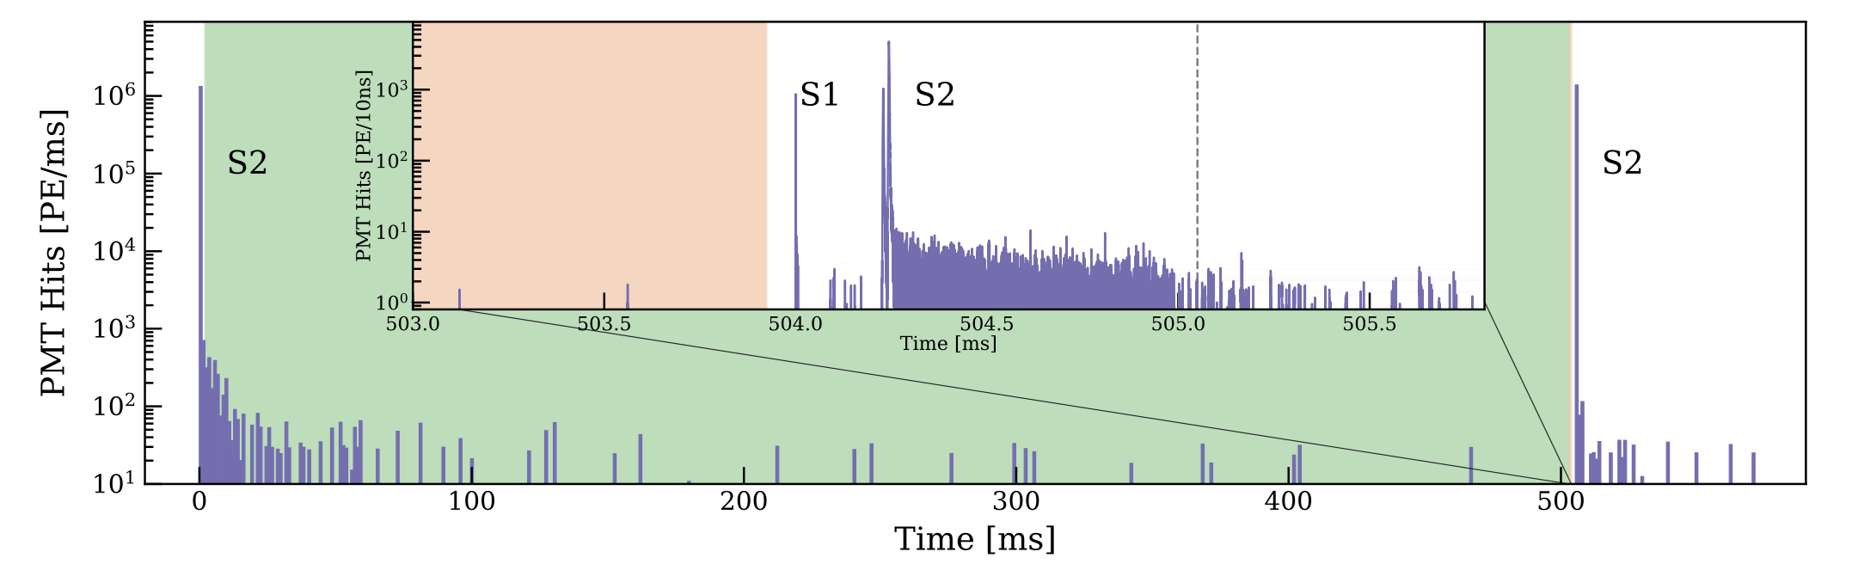
Delayed Electrons(DEs)
--- XENONnT Collaboration
Such background has been observed
by large LXeTPCs experiments searching for dark matter particles
XENON1T: https://doi.org/10.1103/PhysRevD.106.022001
PandaX 4T: https://doi.org/10.1103/PhysRevLett.130.261001
LUX: https://arxiv.org/abs/2004.07791
Notes:
This background is caused by a high emission rate of delayed electrons after S2 signals in the TPC, which could be incorrectly identified as CEνNS candidate in “S2-only” analysis.

Slide 5
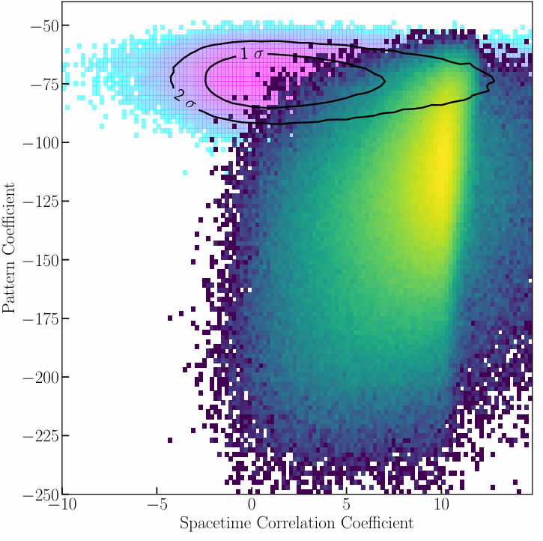
Pile-up DEs and CEνNS
Muon tracks and DEs:
Strongly correlated in: (x, y) and t (emission time)
CEνNS within ROI
46.5%(scores over 0 )
Pile up DEs within ROI
0.005%
Expected (x, y) resolution: 20mm

Slide 6
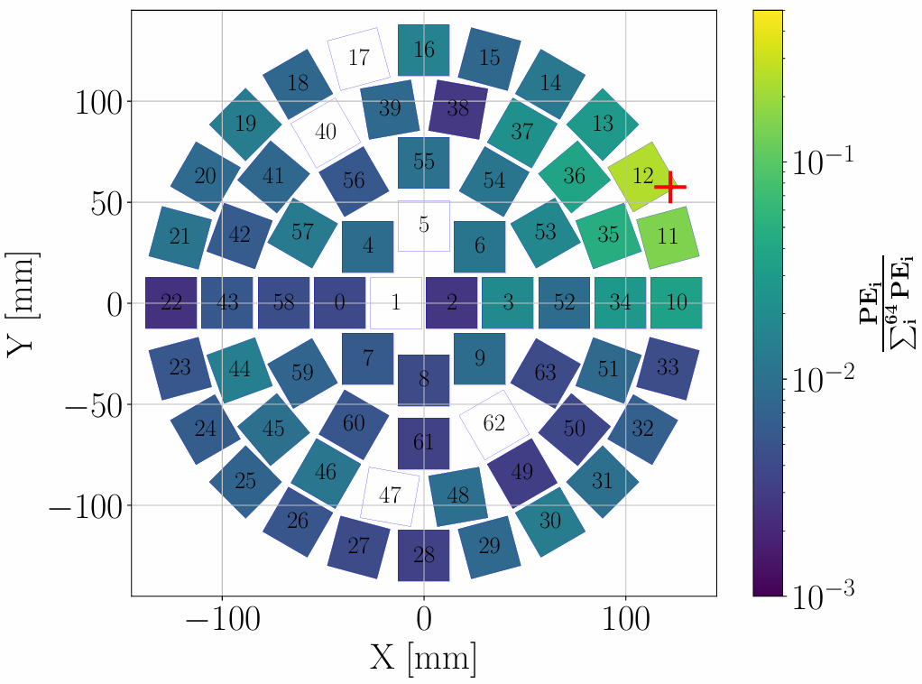
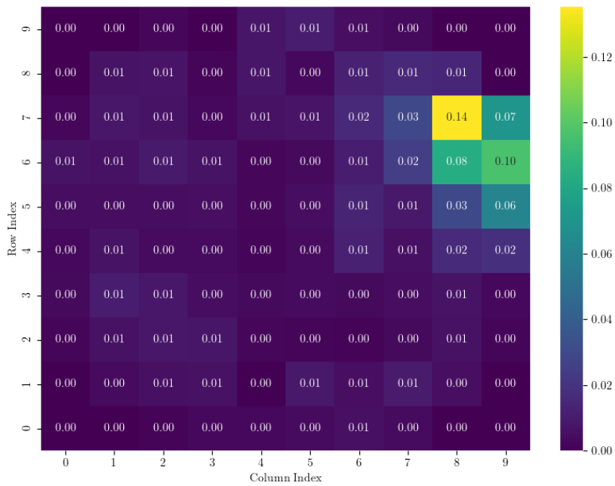
Position Reconstruction
Convert simulated PMT pattern into 10*10 matrix
Deep Residual Network for Position Reconstruction
Use the Real Position (x, y) as training label
Regression Task: Input Matrix → Predicted (x, y)

Slide 7
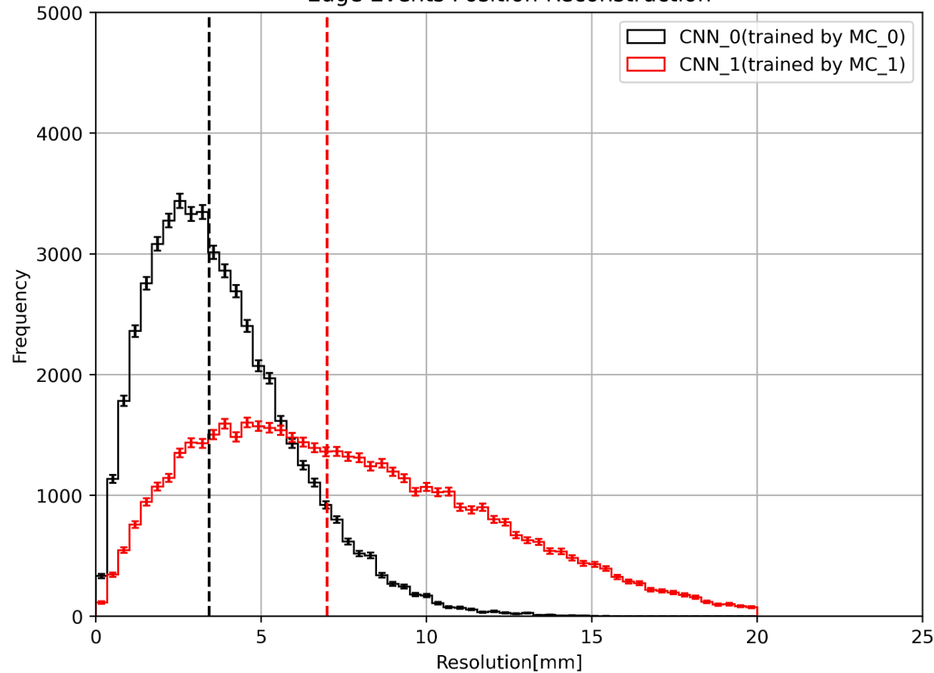
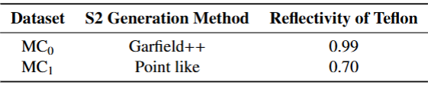

Problems with MC-based Simulations:
Neural network training heavily relies on simulated data
  Apply Unsupervised Domain Adaptation(DA) to align the distribution of simulated data with that of real data.
Dataset used for training | Resolution [mm]
MC0: Pseudo-data domain | 2.626
MC1: Simulated domain | 7.729
The resolution is calculated by:
Preliminary

Slide 8
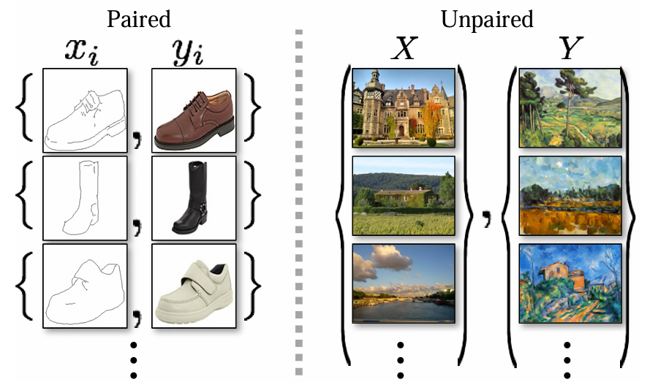
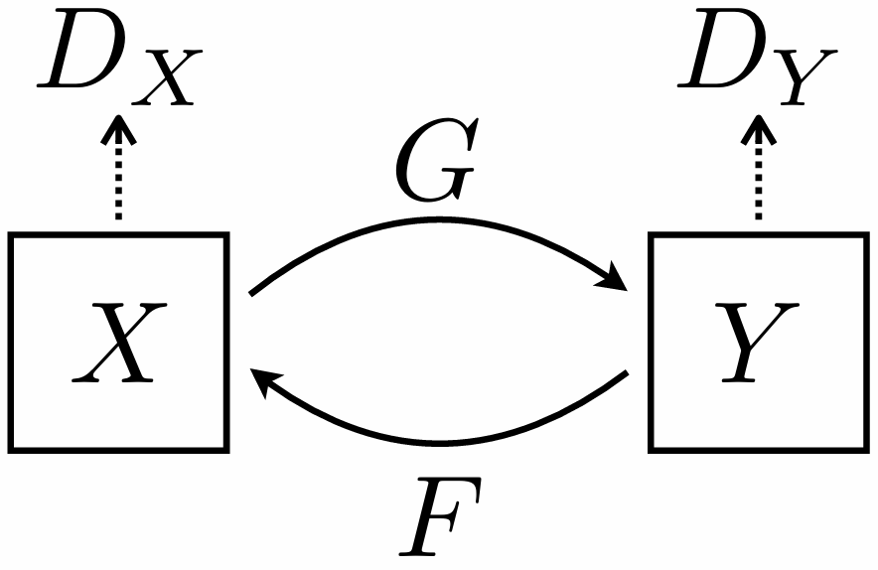
Cycle-GAN
Two generators:
G: X → Y（simulated domain -> data domain）
F: Y → X（ data domain-> simulated domain ）
Two discriminators：
DY： Are the input matrices from data domain?
DX： Are the input matrices from simulated domain?
Cycle consistency loss:
Constrain the GAN to:
x → G(x) → F(G(x)) ≈ x

Slide 9
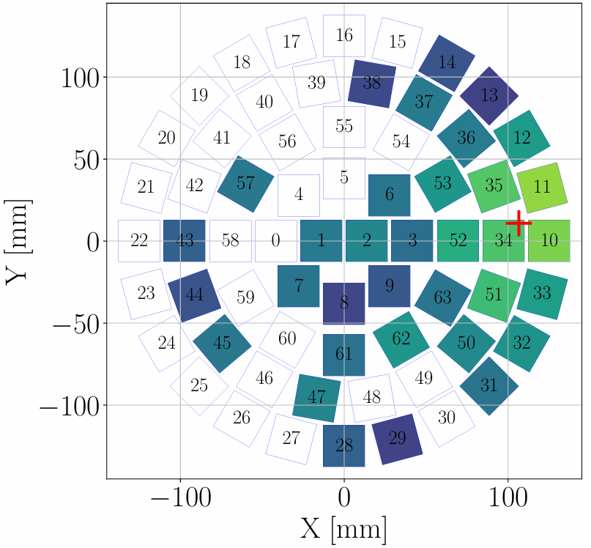
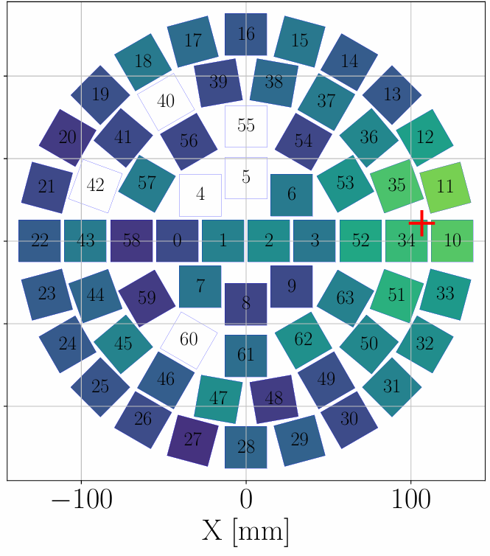
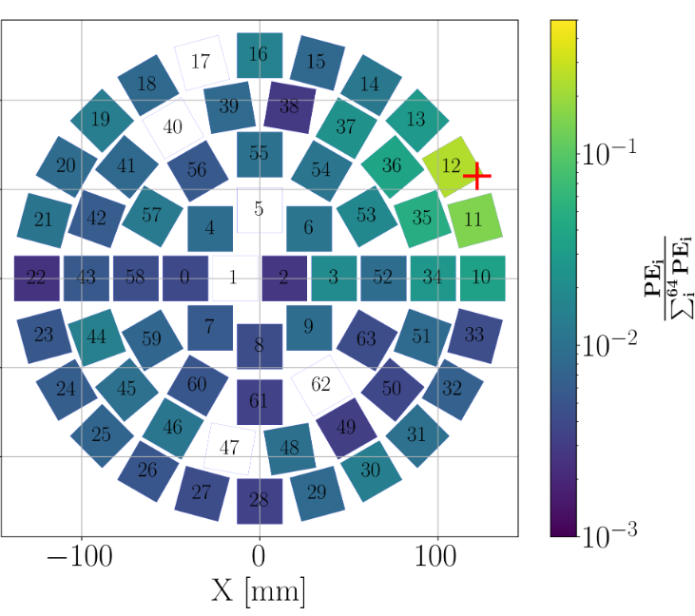
Domain Adaptation(DA)
Preliminary
（a）: Pattern From MC1
MC1: Simulated domain
（b）：Pattern After DA
Using the trained generator G
to generate a new Dataset G(MC1)
（c）： Pattern From MC0
MC0: Pseudo-data domain

Slide 10
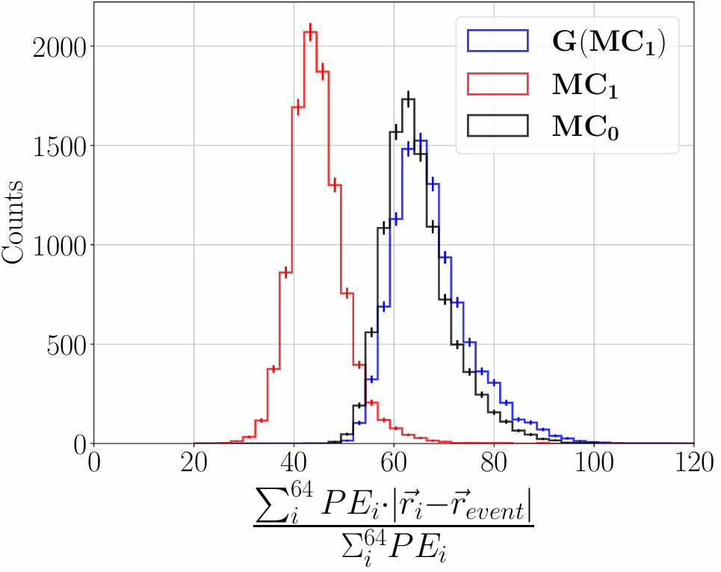
Data Distribution Before and After DA
PMT center Position
Real Position(simulated)
Preliminary

Slide 11
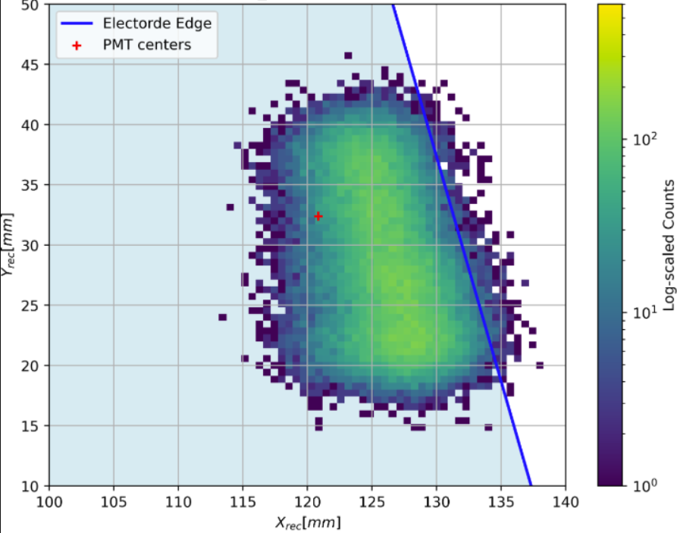
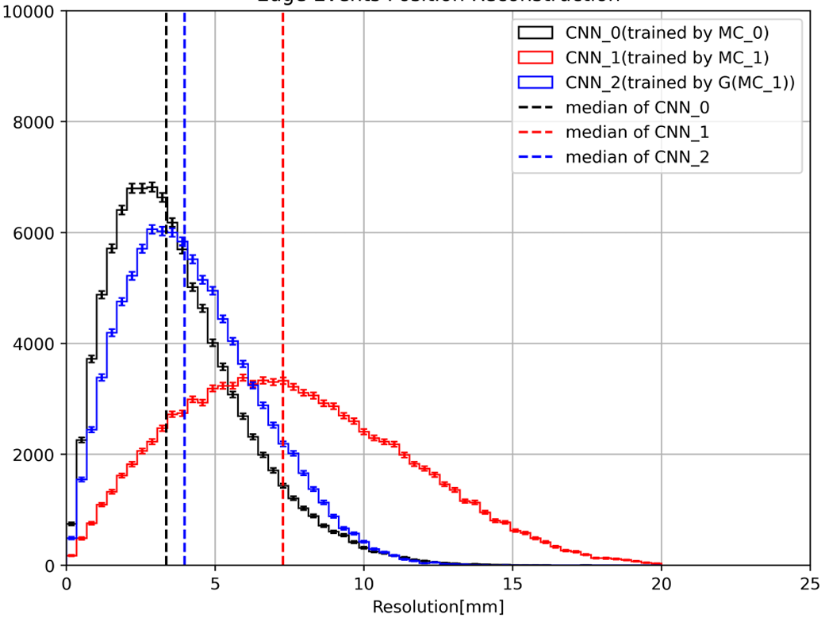
RELICS TPC
Events reconstruction near the TPC edge
The resolution is calculated by:
Different models validated on Pseudo-data domain (MC0)
Dataset used for training | Resolution [mm]
MC0: Pseudo-data domain | 2.626
MC1: Simulated domain | 7.729
G(MC0): MC1 → MC0 | 2.857
Preliminary
Preliminary
Distribution of reconstructed events
Distribution of resolution
in 100<R<140[mm]

Slide 12
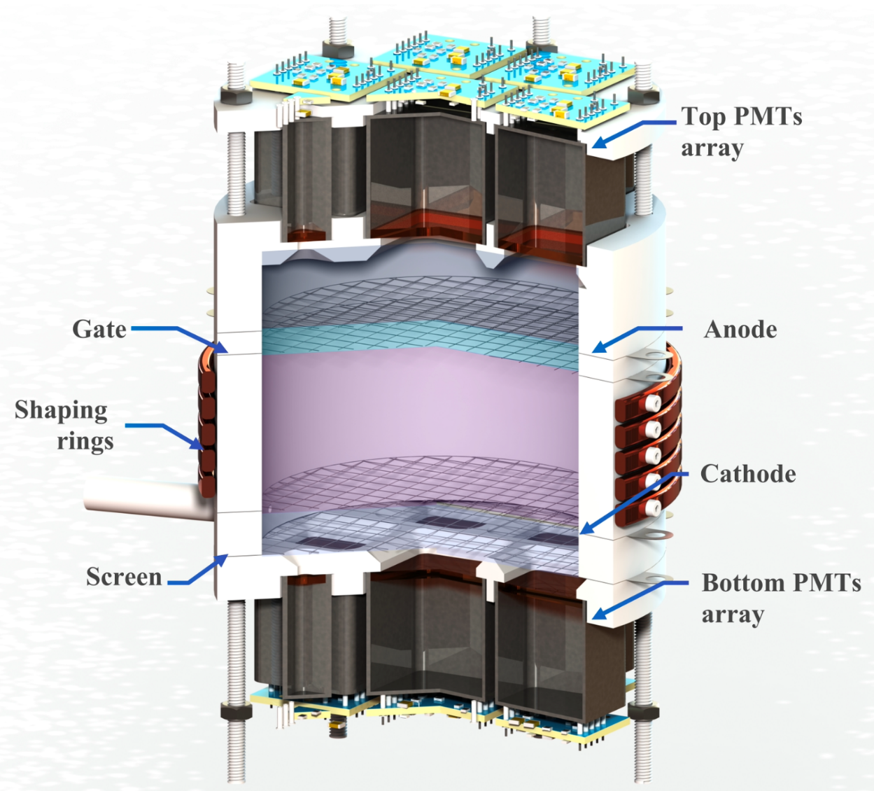
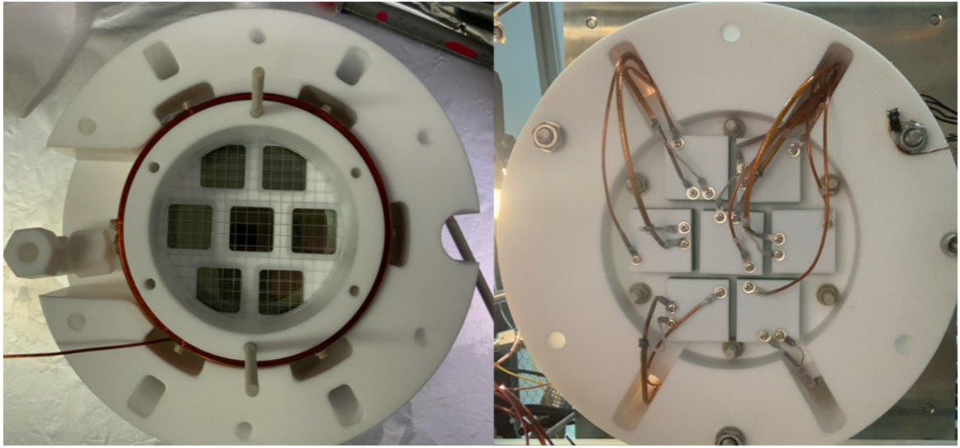
RELICS Prototype
The prototype for RELICS is a more compact TPC.
Two arrays of 7 PMTs(R8520-406 PMTs) for each on top and bottom

Slide 13
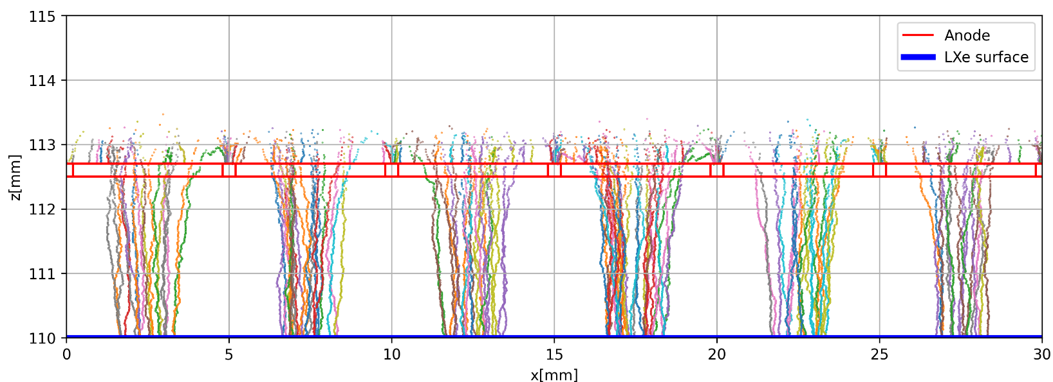
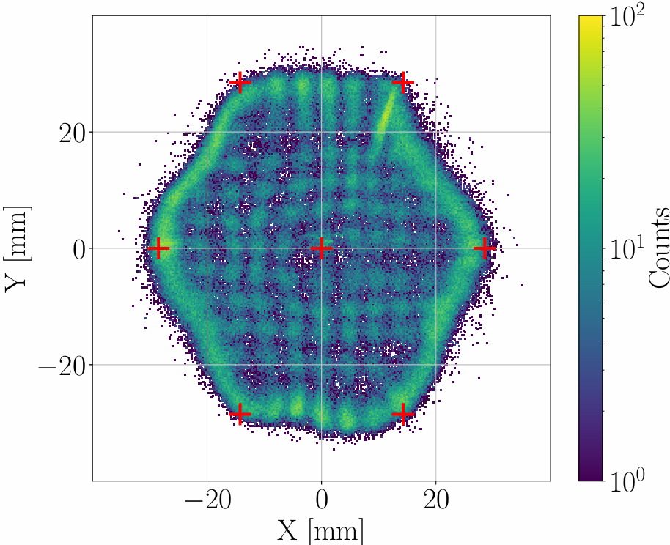
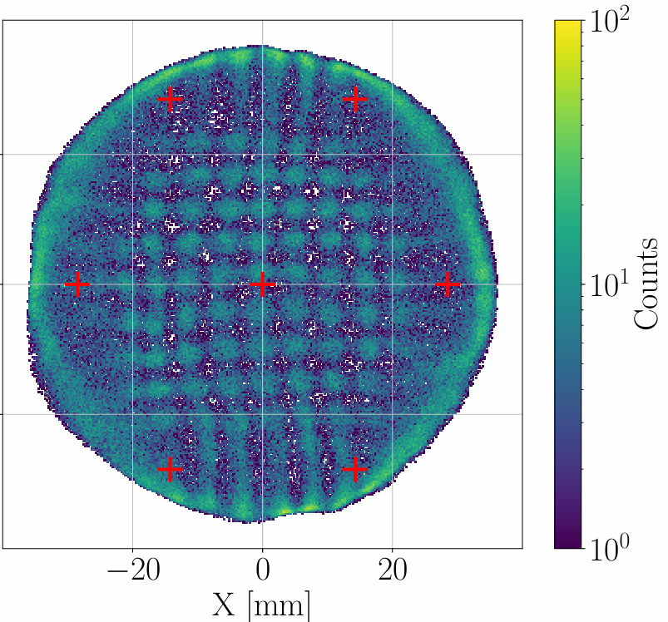

Distribution of Ar37 Events After Reconstruction
Calibration source: Ar37
Injected into the gas circulation system, considered to be a uniform distribution
Hot Spot: Higher electric field in the center of electric grid, matches the pitch(5 mm)
Better performance: Edge events tend to be distributed nearer to the boundary of the cylindrical TPC
Preliminary
Reconstructed with DNN
trained with simulated domain
Reconstructed with DNN
trained with simulated domain after DA

Slide 14
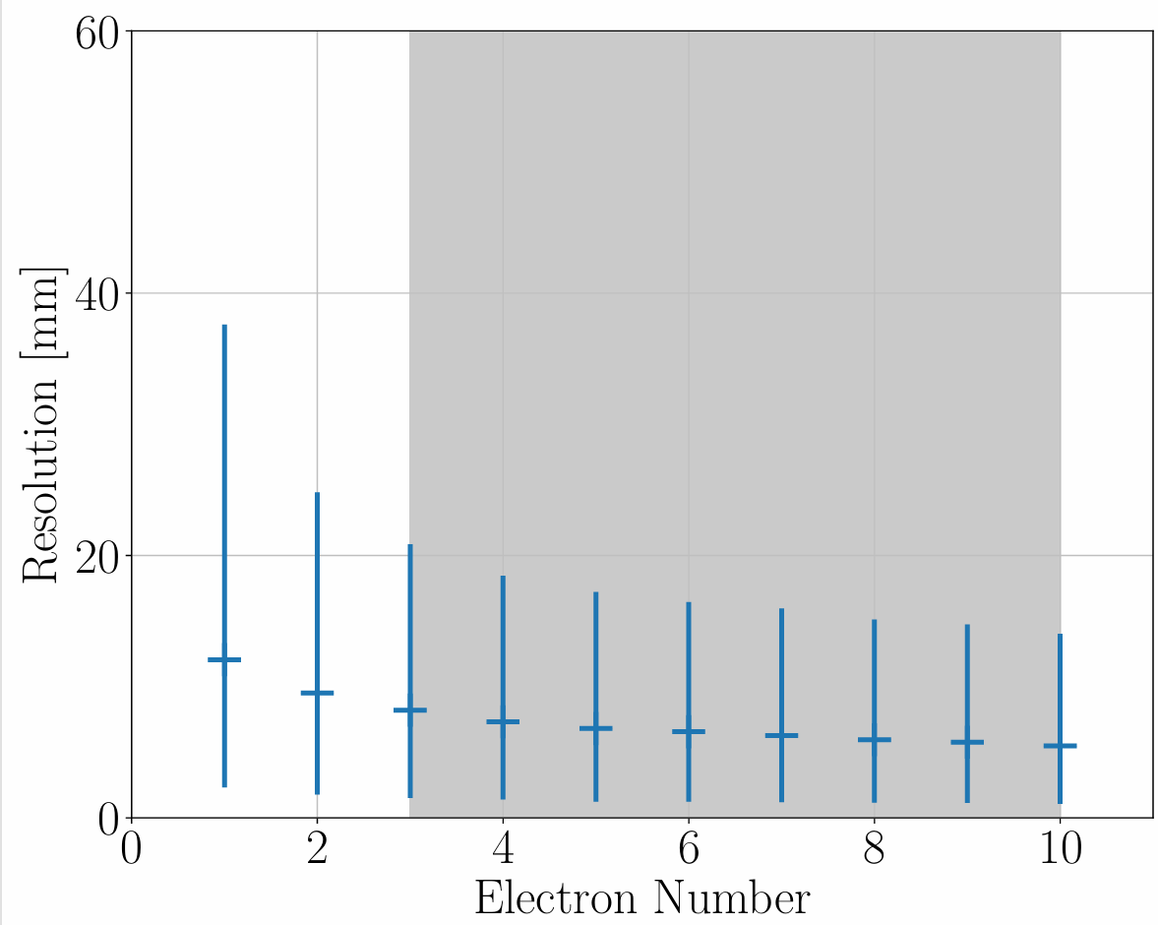
Reconstruction Resolution in ROI
RELICS region-of-interest(ROI) :
[3, 10] electrons
Shaded in gray
An average resolution of
6.478 mm
with [3.106, 11.117] mm as the 1σ region.
is obtained
Error bar representing the 1σ region
Preliminary

Slide 15
Summary
Under the assumption of a 20 mm spatial resolution, the DE signal was suppressed by 4-orders of magnitude.
Training-testing bias caused by discrepancies between simulated and actual detector optical parameters can lead to reduced reconstruction accuracy.
After applying CycleGAN for domain adaptation, the position resolution near the edge of the TPC is improved by 63%
An average Resolution of 6.478 mm for Position Reconstruction is achieved

Slide 16
Thank you for your attention!

Slide 17
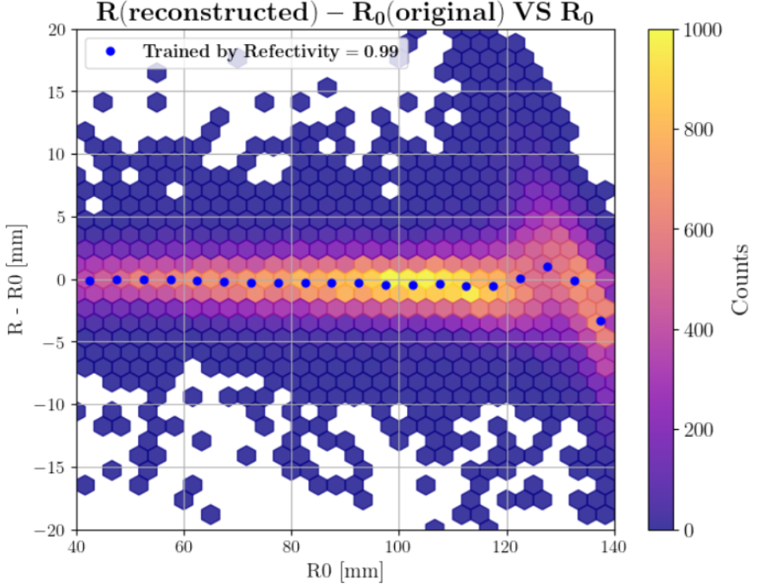
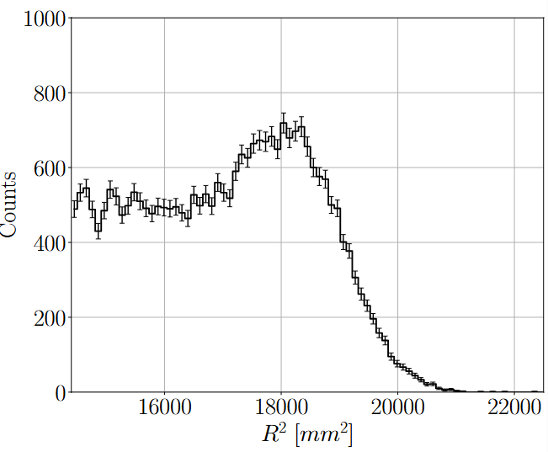
Back up
Bias
Events Reconstructed form a uniform distribution
Preliminary
Preliminary

Slide 18
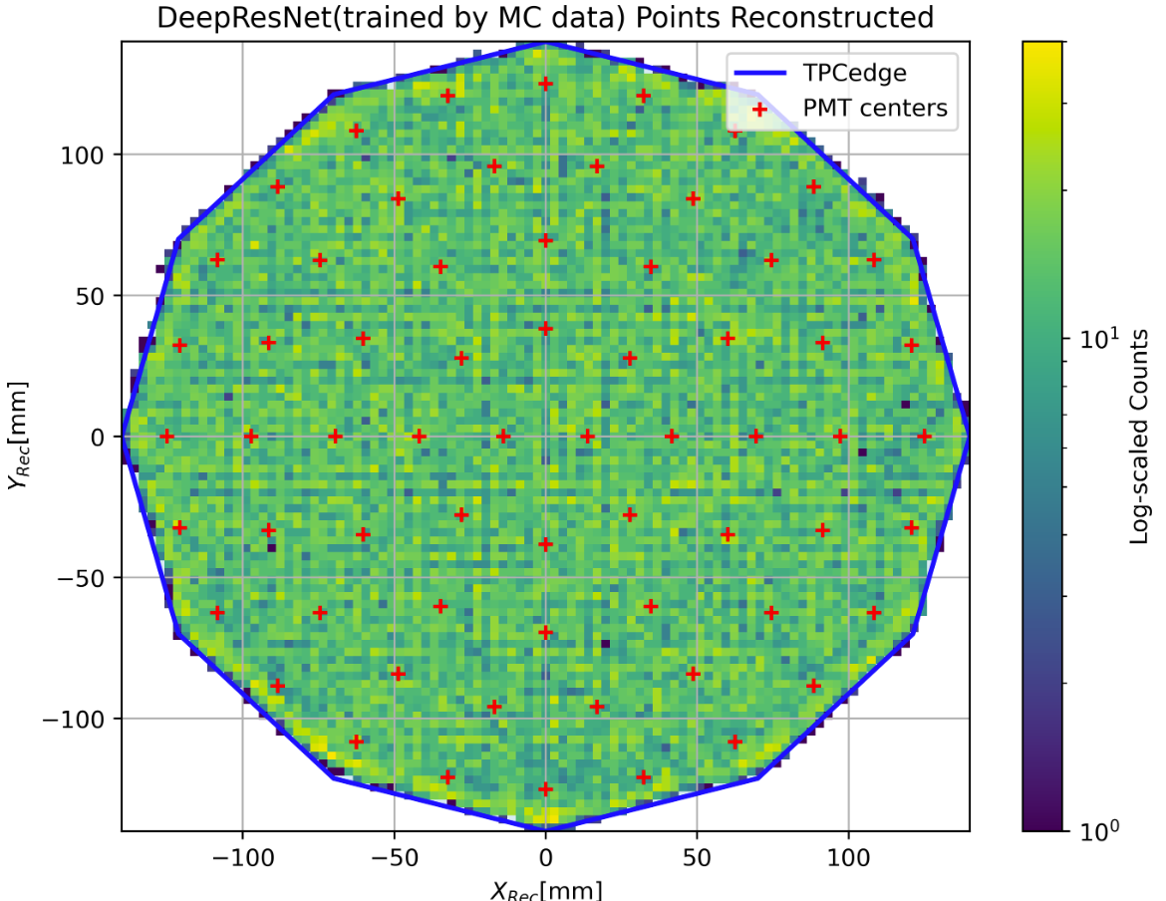
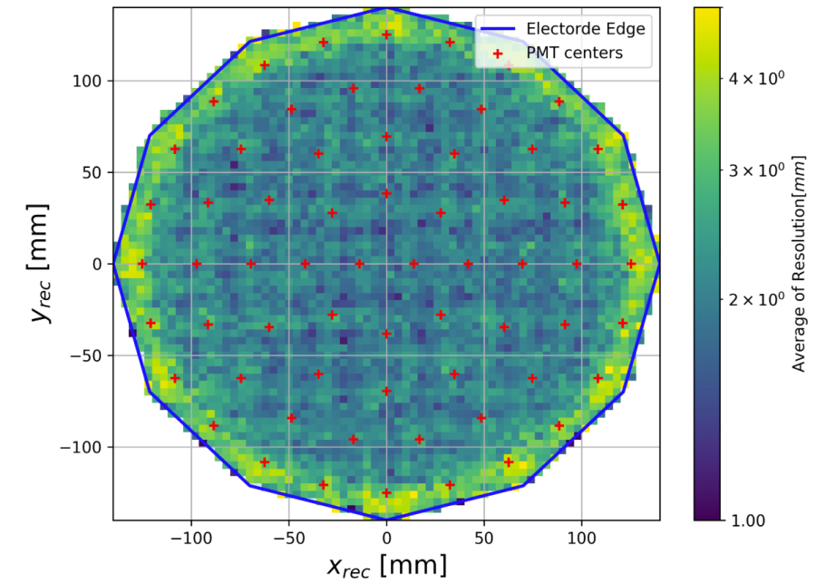
Reconstruted from a uniform distribution
Preliminary
Preliminary
The reconstructed position distribution in the XY plane
The total deviation distribution in the XY plane

Slide 19
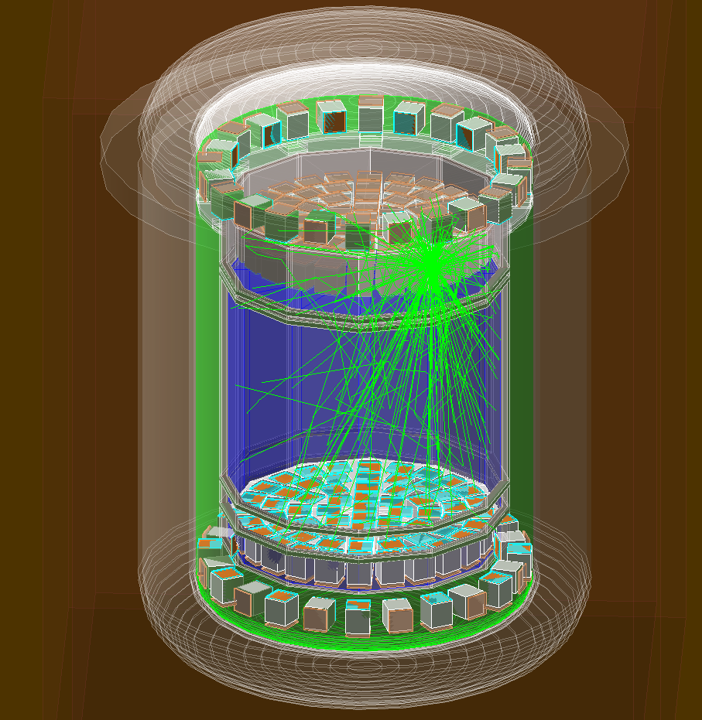
S2 simulation
Preliminary

Slide 20
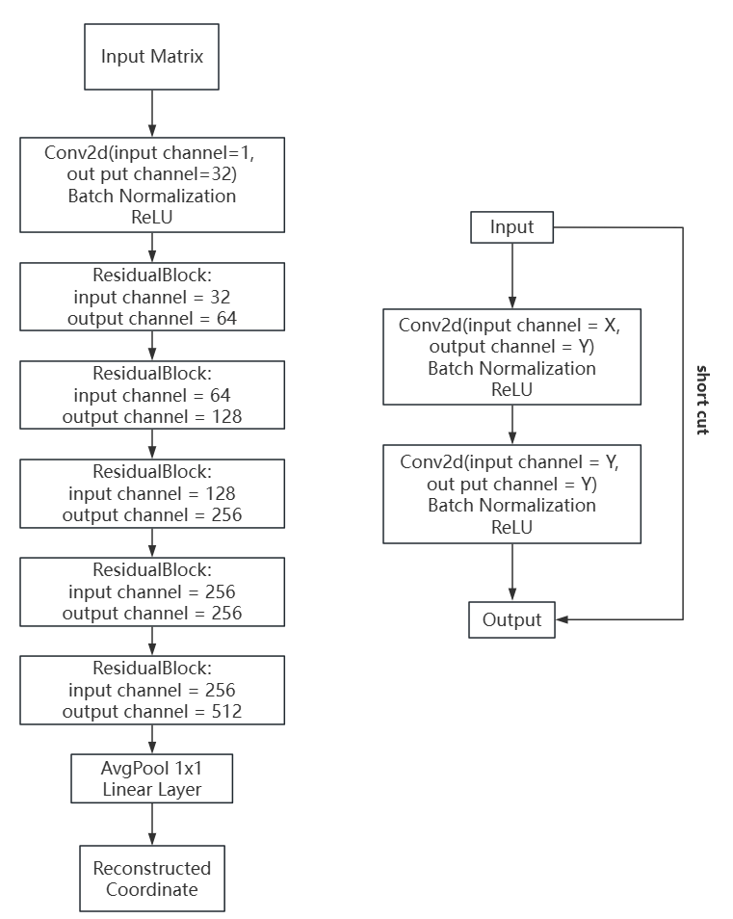
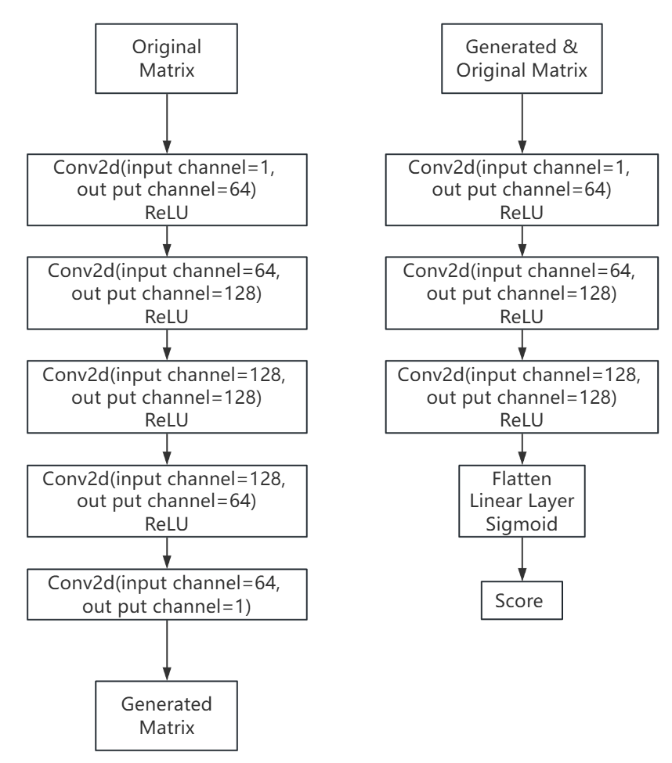
Network structure

Slide 21
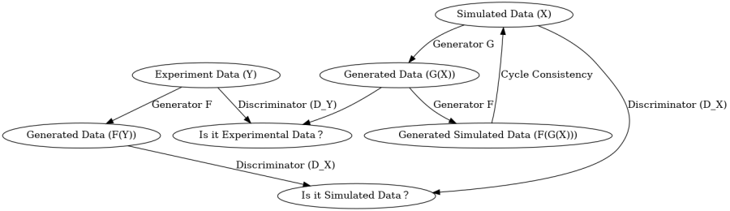
CycleGAN

Slide 22
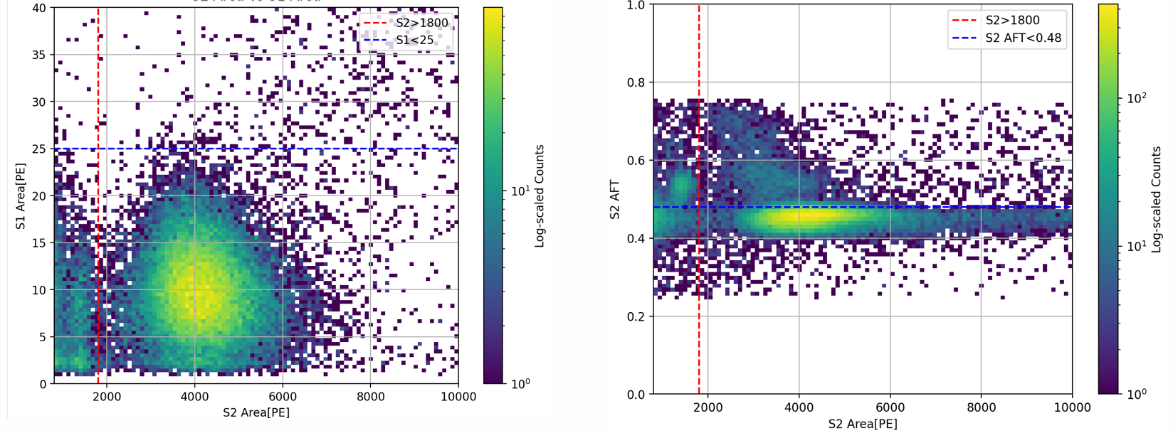
Ar37 Events
S1 VS S2
S2 AFT VS S2 Area

Slide 23
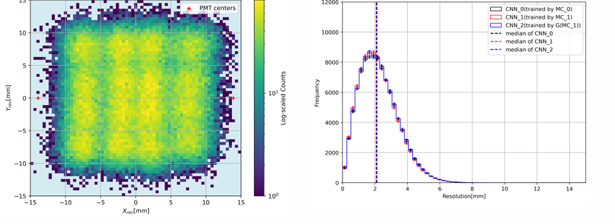
RELICS TPC (center area)
The total deviation is calculated by:
Preliminary
Preliminary
Distribution of reconstructed events
Distribution of total diviation

Slide 24
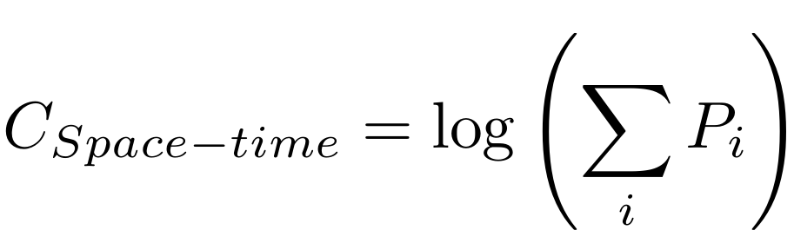
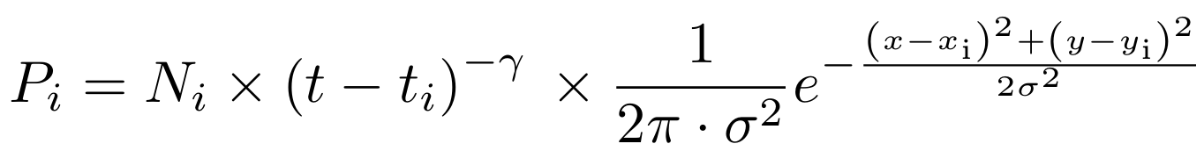
Space-time Correlation
Muon tracks and DEs:
Strongly correlated in: (x, y) and t (emission time)
PDF of DEs:
Assumed : power law
LUX: https://arxiv.org/abs/2004.07791
Distribution considered as Gaussian
σ is the resolution of Reconstructed Position

Slide 25
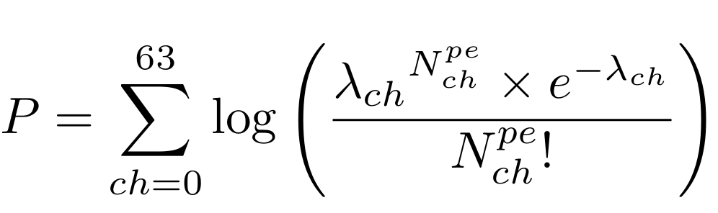


Pile-up DEs and CEνNS
CEνNS within ROI
46.5%(scores over 0 )
Pile up DEs within ROI
0.005%

Slide 26
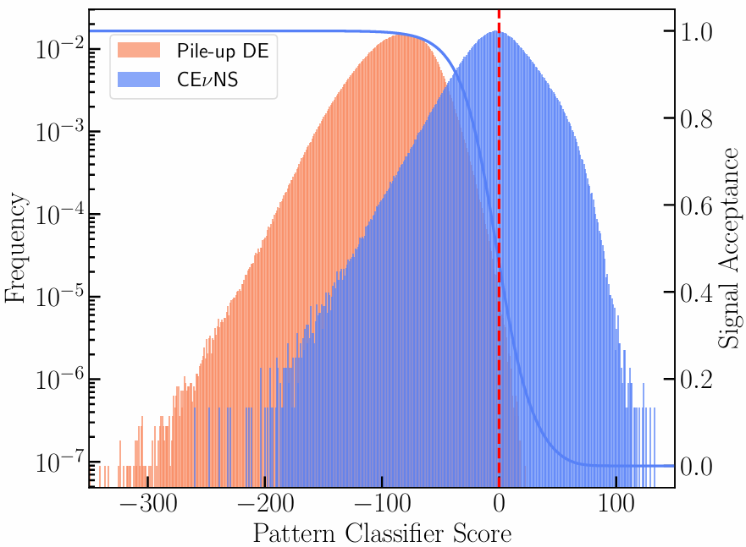
Score the events
Distribution of scores from pattern classifier Survival rate:
CEνNS within ROI
46.5%(scores over 0 )
Pile up DEs within ROI 0.005%
5.6
0.8
-37.42
Parameter space scanned
While restricting the acceptance of Pile-up DE events lower than 0.005%

