Slide 1
Testing Bell inequality and probing quantum entanglement at future colliders
Alim Ruzi
School of Physics, Peking University
Weak Interactions & Neutrinos 2025
June 9-13, 2025
In collaboration with Qiang Li, Andrew Levin, Ruobing Jiang, Youpeng Wu et al.
Based on JHEP 10 (2024) 211 & Phys.Rev.D 111 (2025) 3, 036008

Slide 2
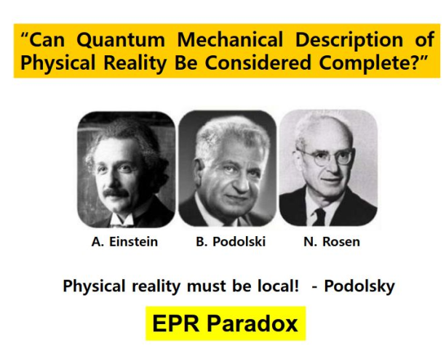
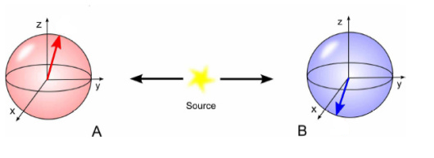
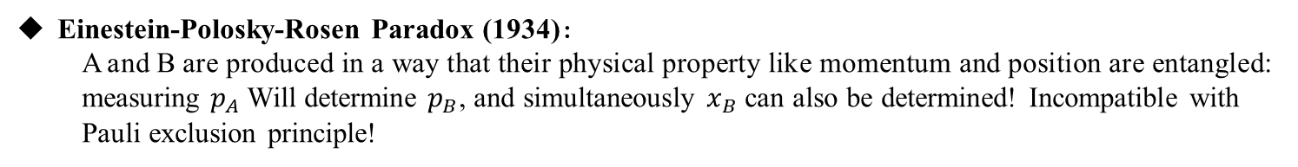
A short review on quantum Entanglement
Einestein-Polosky-Rosen Paradox (1934):
  A and B are produced in a way that their physical property like momentum and position are entangled: measuring $p_{A}$Will determine $p_{B}$, and simultaneously $x_{B}$ can also be determined! Incompatible with Pauli exclusion principle!
Spooky action!
Quantum Mechanical Description of physics reality described wave function is not complete without a “hidden-variable theory”

Slide 3
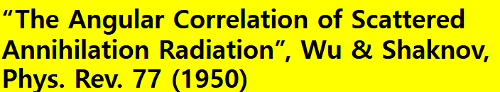
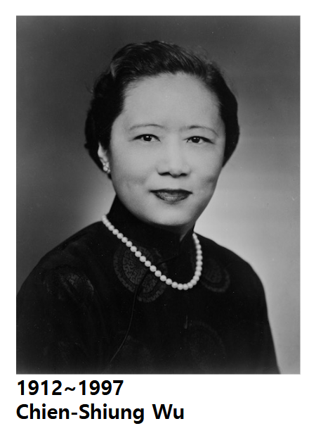
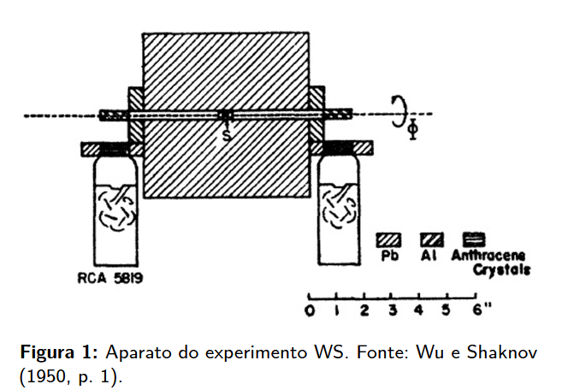
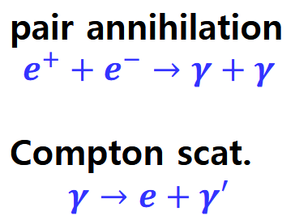
Wu-Sakhnov experiment (1949)
Observed entangled state in experiment!
The Little-Known Origin Story behind the 2022 Nobel Prize in Physics
In 1949 physicist Chien-Shiung Wu devised an experiment that documented evidence of entanglement. Her findings have been hidden in plain sight for more than 70 years
Ref. Sientific Ameican

Slide 4
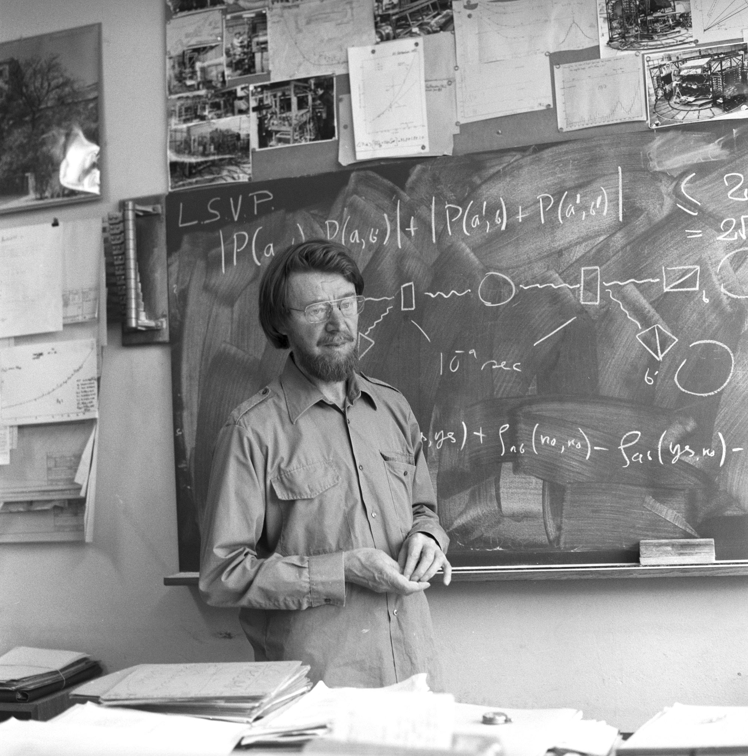
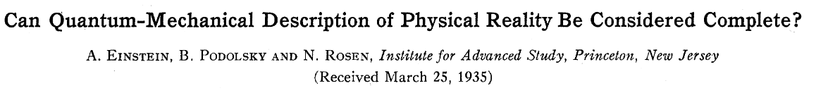
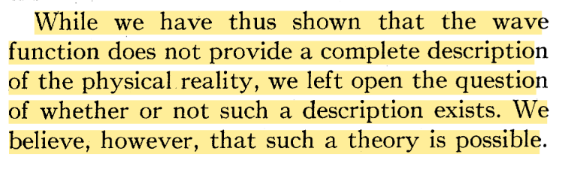

Formulation of Bell inequality
A mathematical formulation of EPR paradox by Jhon Bell shown to be incompatible with statistical prediction of quantum mechanics

Slide 5
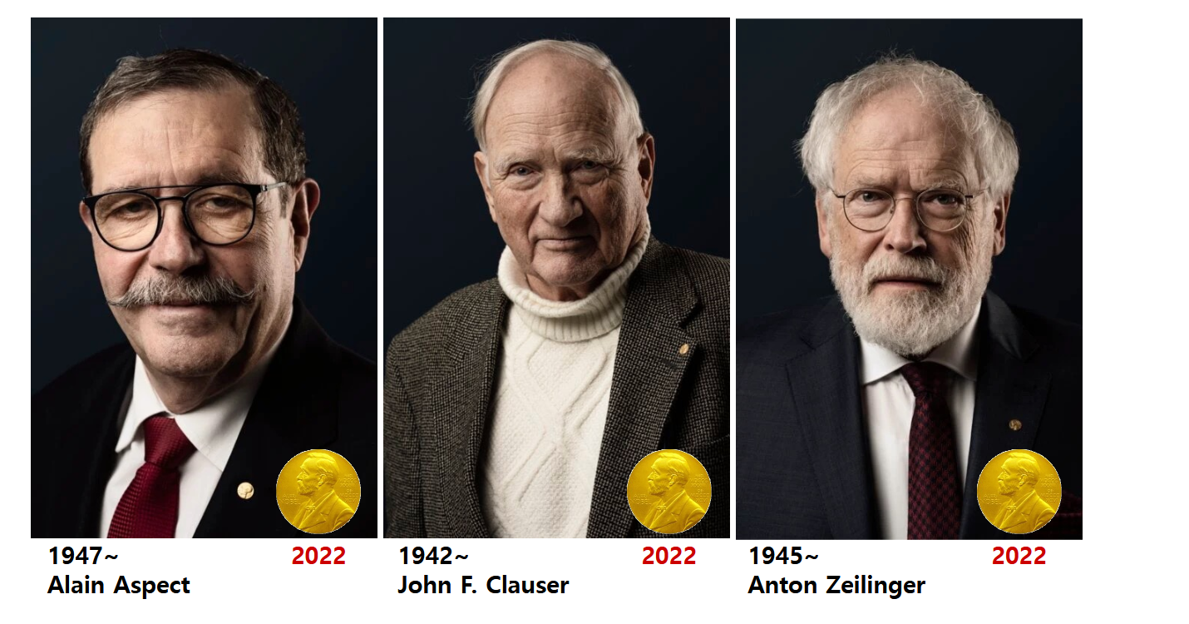
Tests on Entangled states
Ending of Hidden Variable Theory
Quantum Mechanical description of physical reality is incompatible with HVT
Quantum Mechanics is non-local theory!

Slide 6
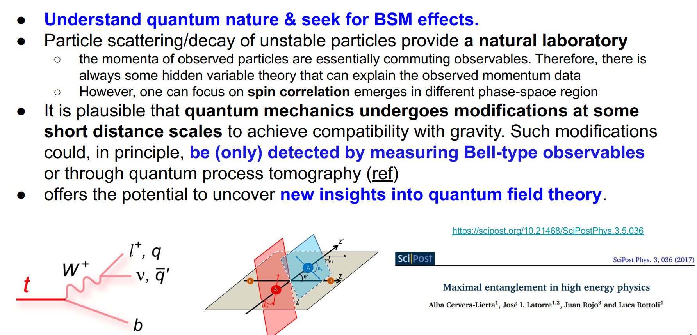
Why QE study at High Energy Physics

Slide 7
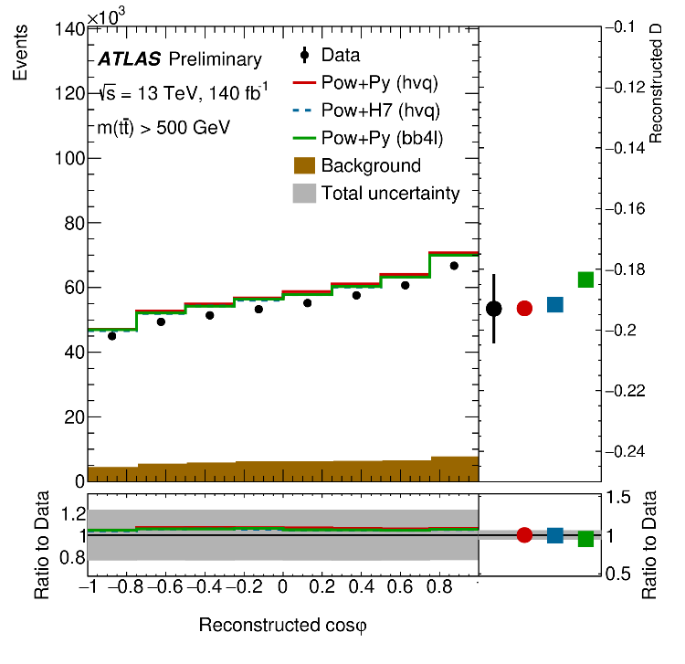
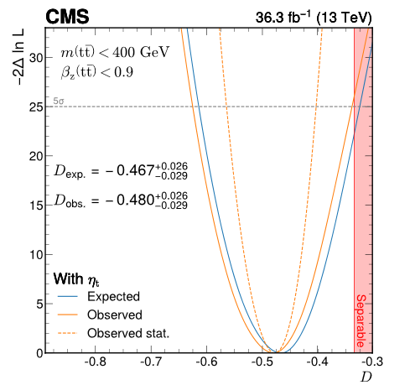
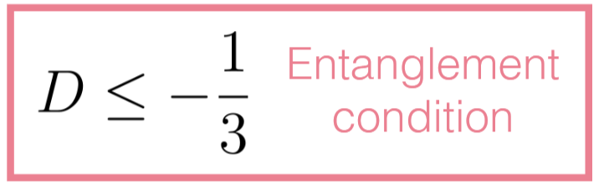
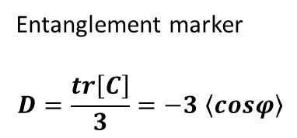
Observation by LHC experiments
ATLAS & CMS
ATLAS collaboration
CMS collaboration
Entanglement marker
$$D=\frac{tr\left[C\right]}{3}=−3 \left\langle cosφ\right\rangle$$

Slide 8
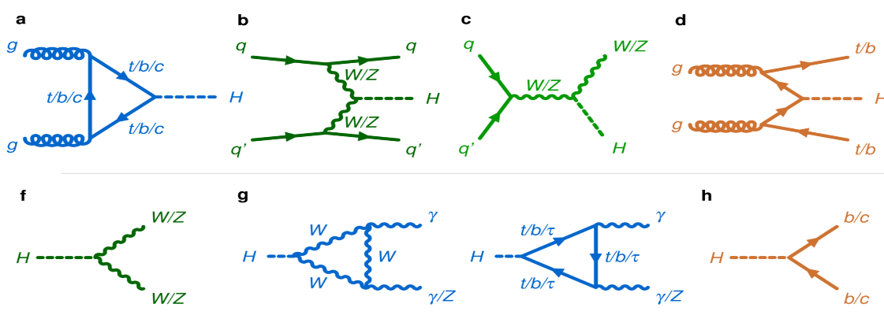
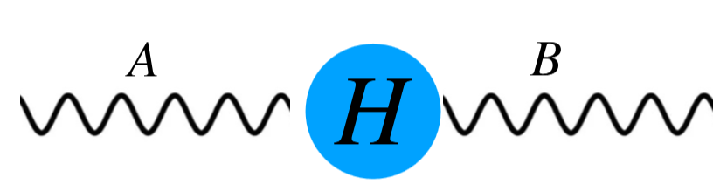
Higgs boson for QE
Higgs boson decay: generator of entangled particles
Entangled singlet state
Plenty of two-qubit, two-qutrit systems, providing maximally entangled states!

Slide 9
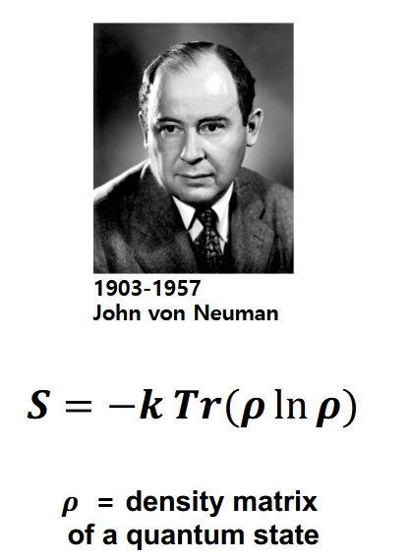

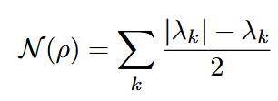
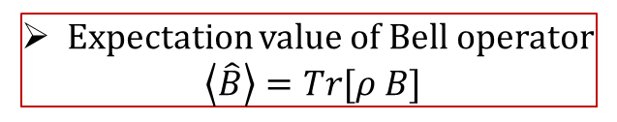
QE observables
Negativity: the absolute sum of the negative eigenvalues of a partially transposed density matrix
Concurrence: an entanglement witness used generally (pure state)
Expectation value of Bell operator
$$\left\langle \hat{B}\right\rangle =Tr[ρ B]$$
Spin density matrix (? Polarization density matrix) is the most important quantity！

Slide 10

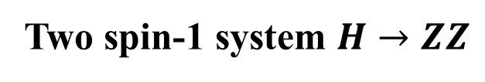
Two spin-1 system $H→ZZ$
Bell-type inequality（CGLMP）
Local theory predicts
Spin density matrix (SDM)
Gell-Mann Parameterization
Irreducible Tensor Parameterization
J.A Aguilar et.al PhysRevD.107.016012
A.J. Barr et.al, Prog.Part.Nucl.Phys. 139 (2024) 104134

Slide 11
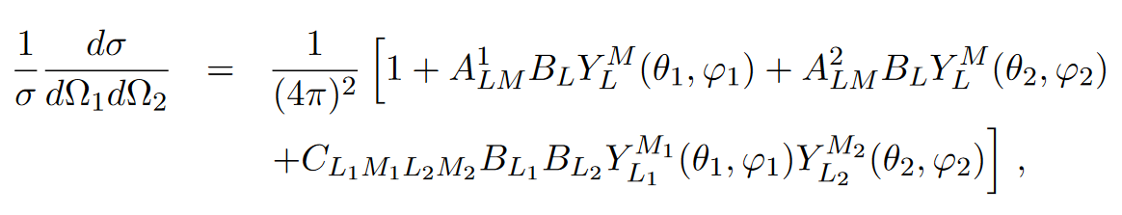
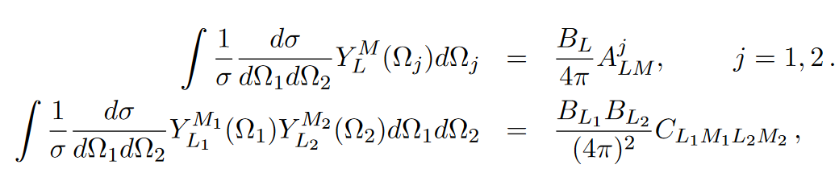
Reconstruction of PDM
Differential Cross section: $zz→ℓ_{1}^{+}ℓ_{1}^{−}ℓ_{2}^{+}ℓ_{2}^{−}$ (parent particle’s rest frame)
J.A Aguilar et.al PhysRevD.107.016012
Statistical average over events gives the polarization and correlation coefficients
Entanglement criterion:
Any non-zero value of coefficient C indicates the presence of entanglement

Slide 12
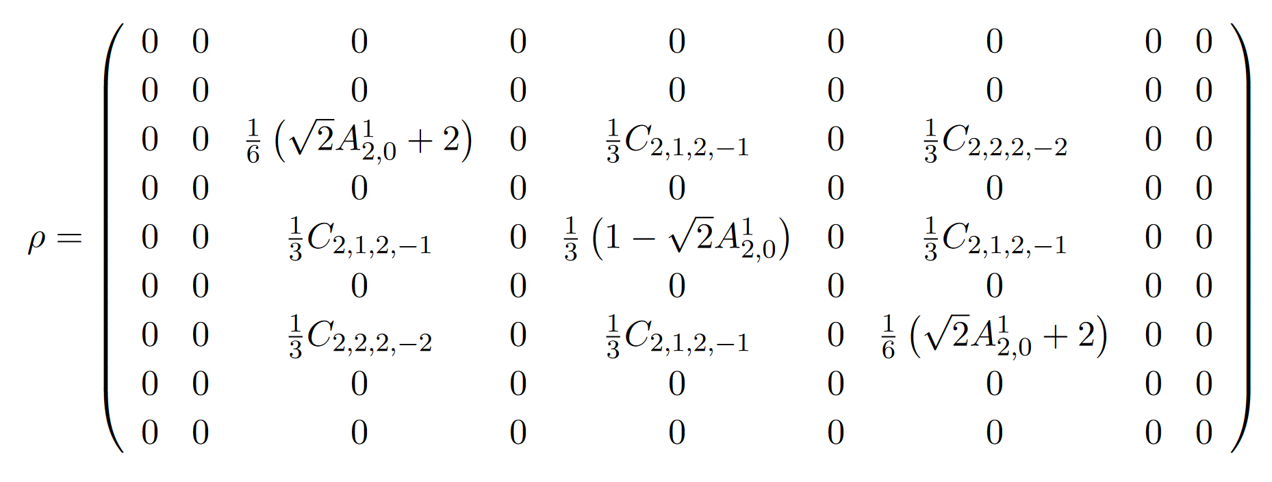
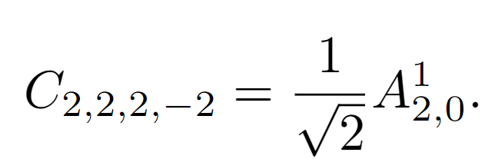

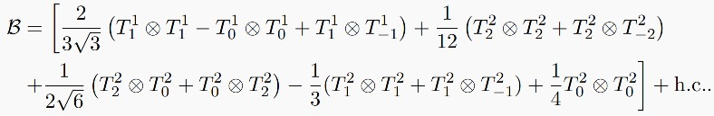

Exact form of$ρ$ and observables

Slide 13
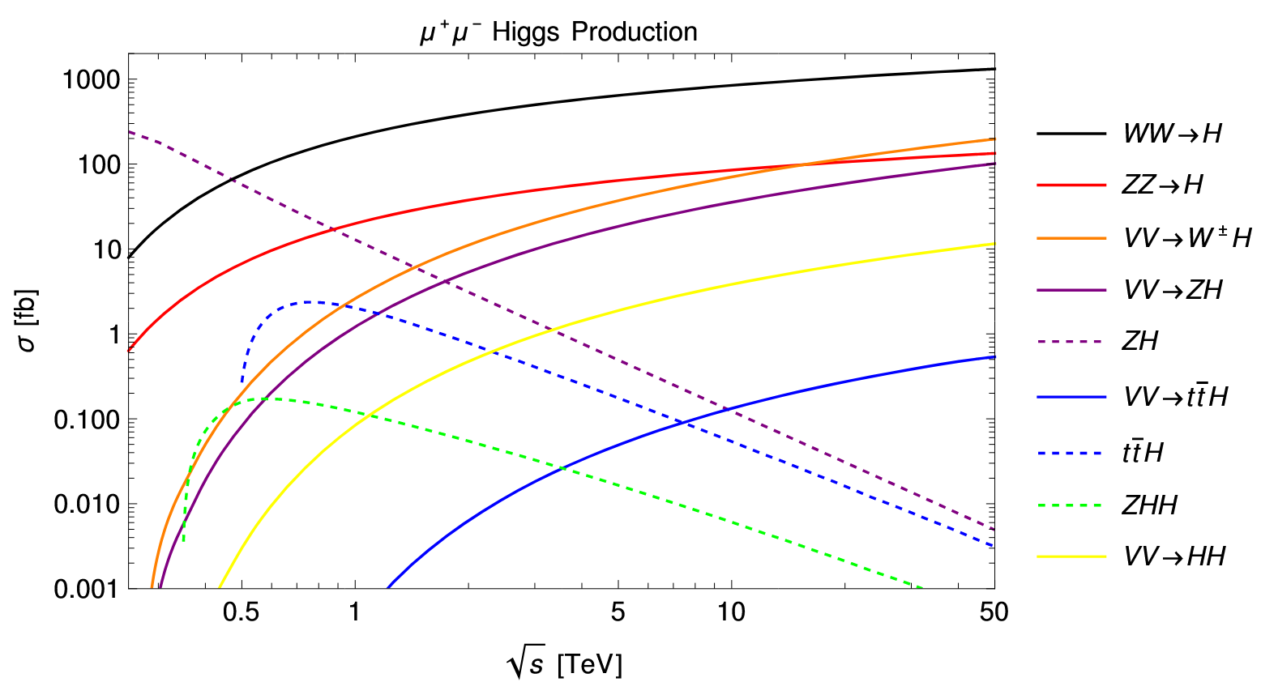
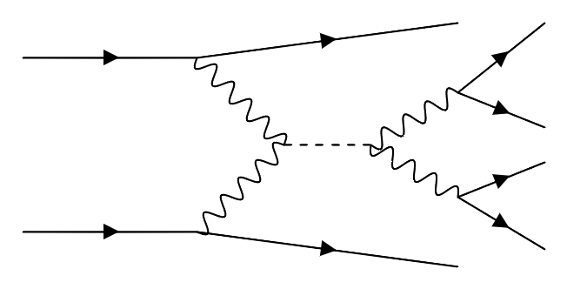












Search for at a Muon Collider
Large number of Higgs events from Vector Boson Fusion (VBF)
$${\overline{ν}}_{μ}$$
$$ℓ^{−}$$
$$μ^{+}$$
$$Z_{1}$$
$$W^{+}$$
$$ℓ^{+}$$
H
$$ℓ^{−}$$
$$W^{−}$$
$$Z_{2}$$
$$μ^{−}$$
$$ℓ^{+}$$
$$ν_{μ}$$
Muon Collider Forum Report

Slide 14
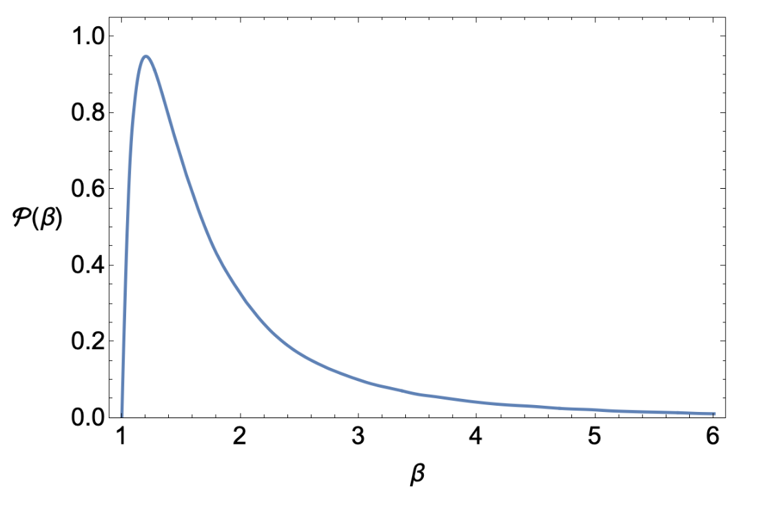
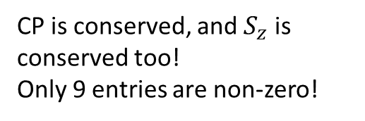
Quantum State of ZZ
CP is conserved, and $S_{z}$ is conserved too!
Only 9 entries are non-zero!

Slide 15
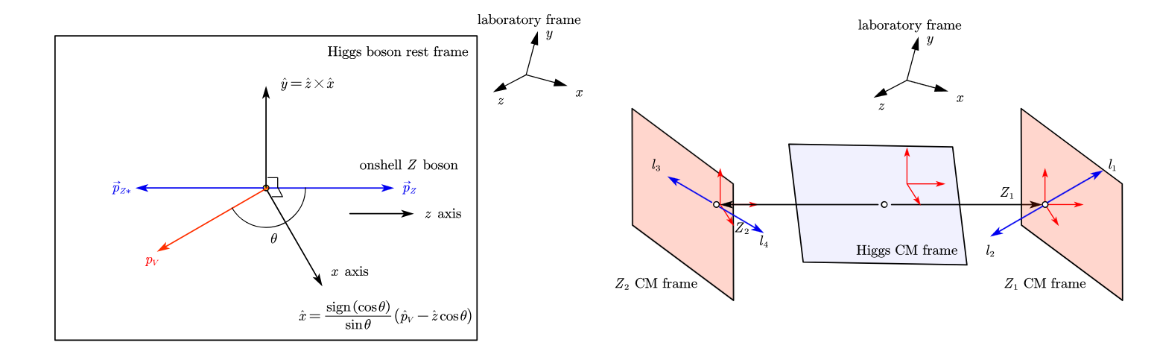
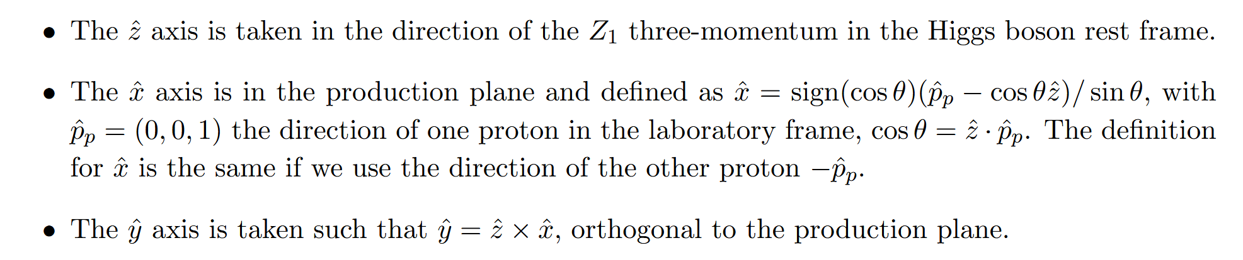
Reference frame
Boos into H rest frame,
Boost into Z boson rest frame.
Rotation in Z boson rest frame

Slide 16
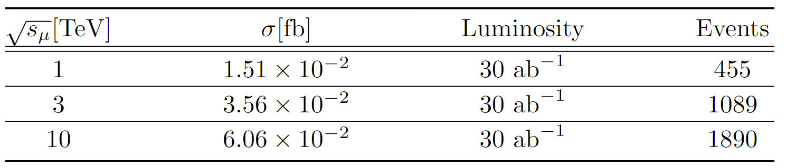
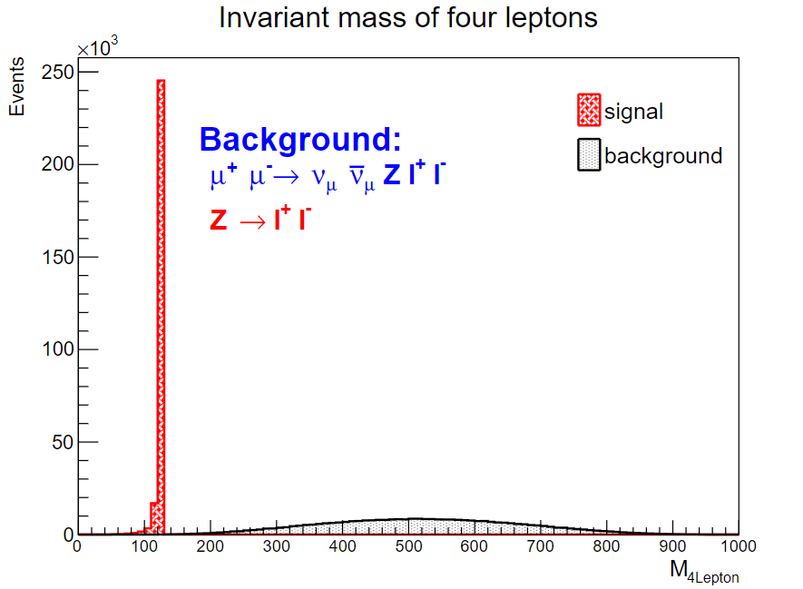

Numerical results
$μ^{+}μ^{−}→H→4ℓ$ Events
Simulation Results from Madgraph
On-shell and off-shell bosons are identified based on the invariant mass of the lepton pairs.
Almost background free.

Slide 17
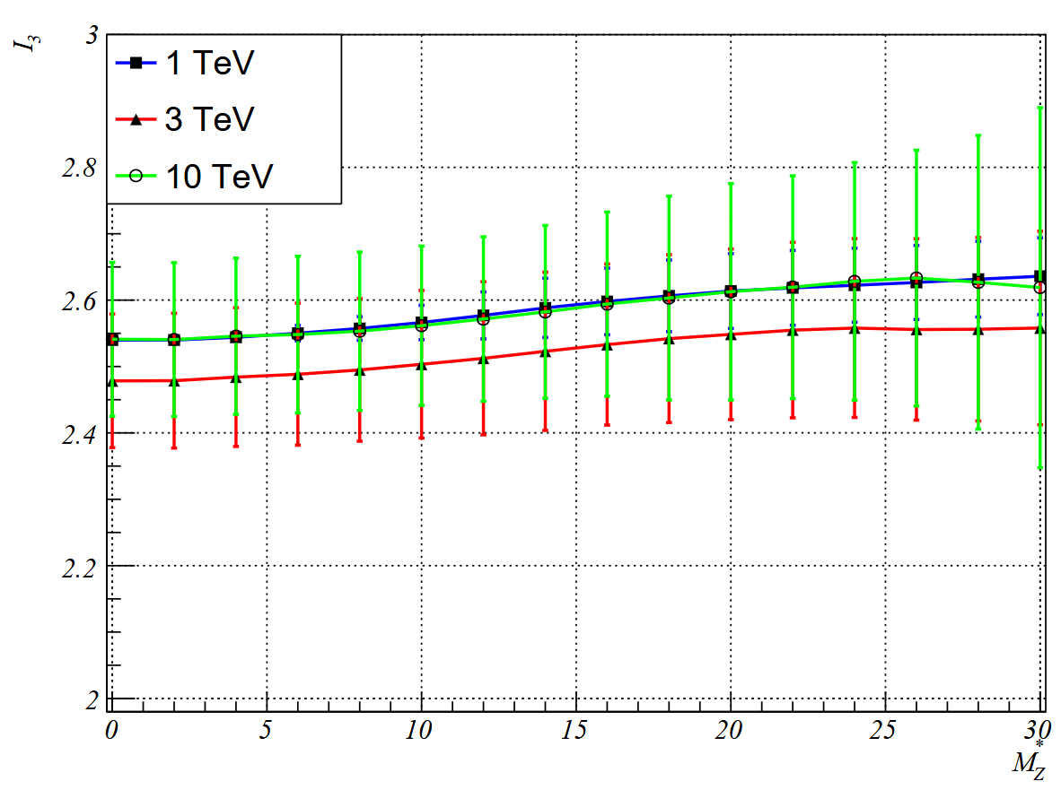
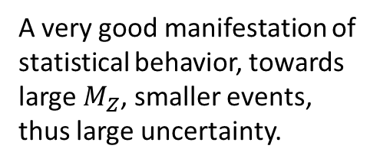
Numerical Results
$μ^{+}μ^{−}→H→4ℓ$ Events
A very good manifestation of statistical behavior, towards large $M_{Z}$, smaller events, thus large uncertainty.
The expectation value of $I_{3}$as function of the off-shell Z mass $M_{Z}^{∗}$ .

Slide 18
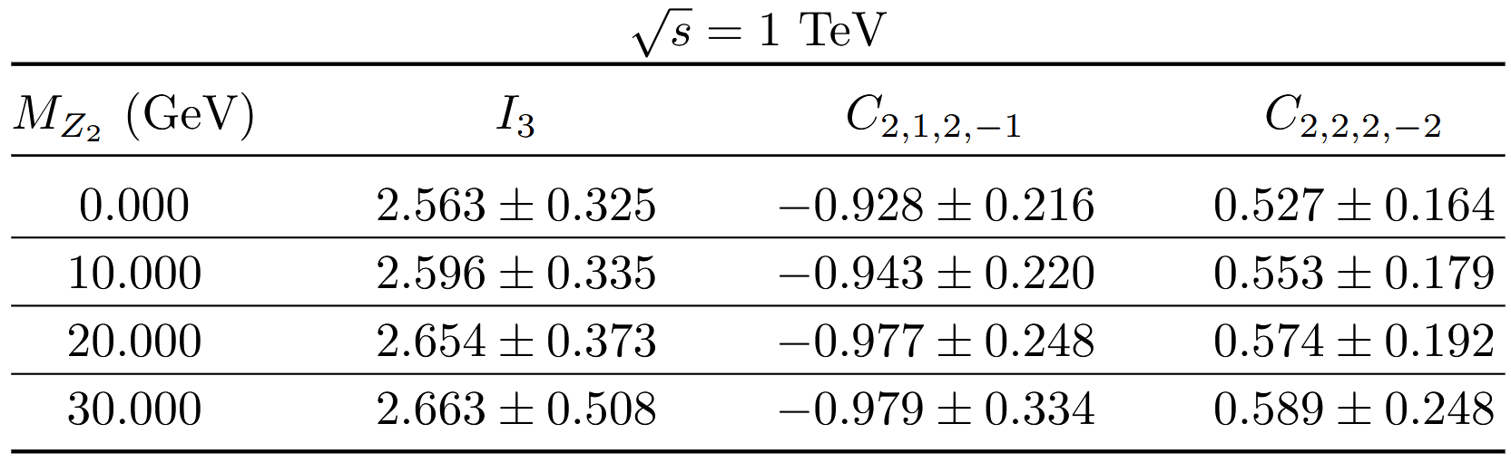
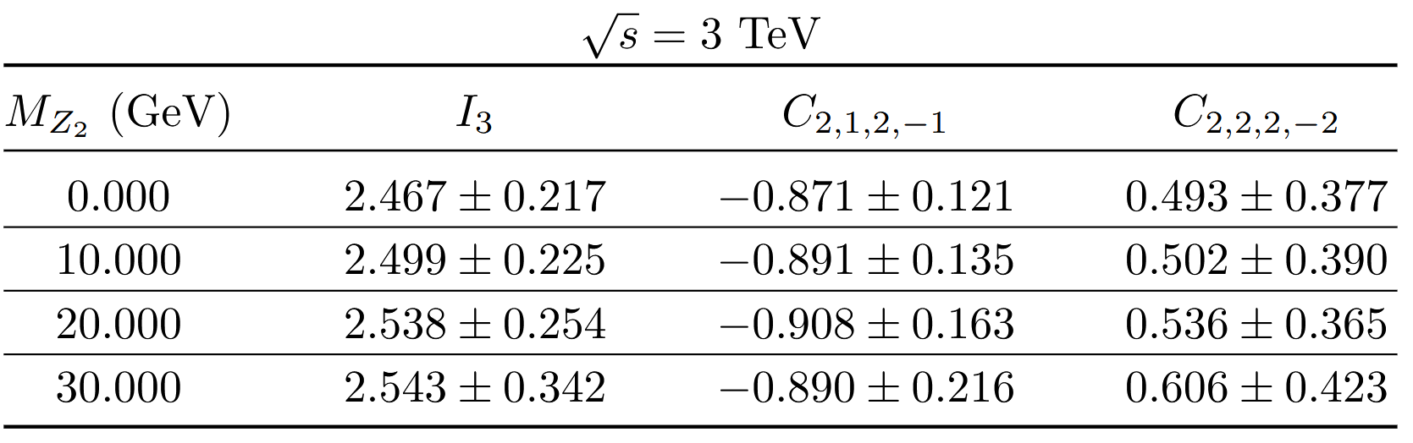
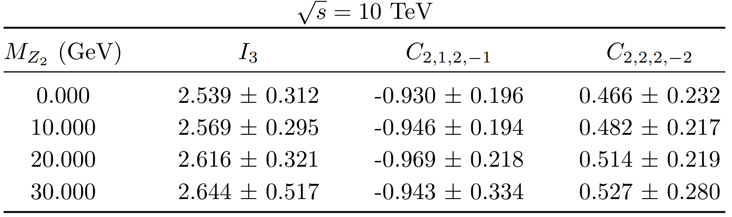
Numerical Results
Entanglement criteria:

Slide 19
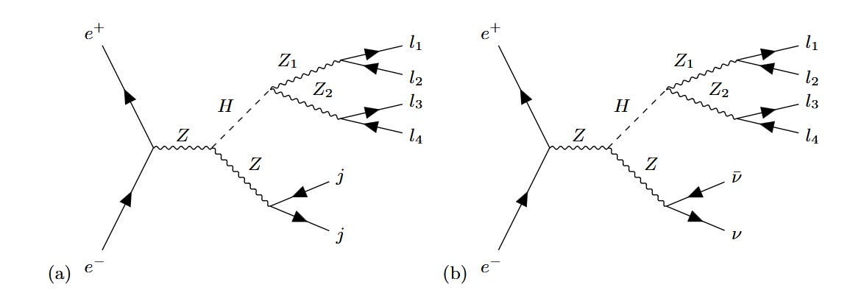
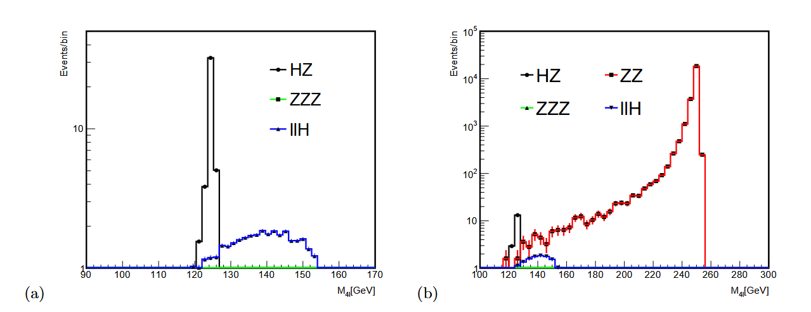
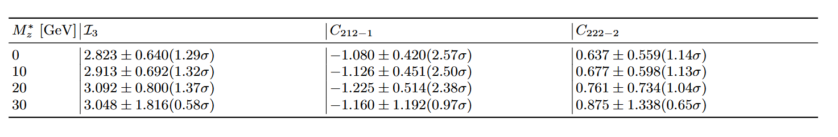
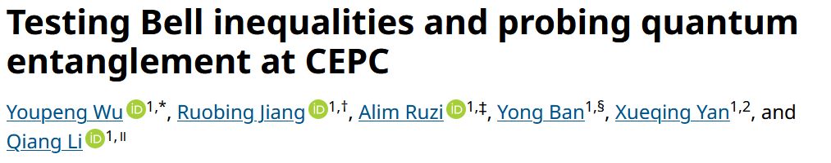
Application in CEPC

Slide 20
Summary
Quantum mechanics is non-local
No local hidden variable theory is compatible with quantum theory
Higgs decay can provide maximally entangled bipartite system
Quantum entanglement is still present at extremely relativistic environment.

