Slide 1


CLOUD fundamental reactor antineutrino physics using the novel LiquidO detection technology
Nicolò Tuccori
On behalf of the CLOUD collaboration
WIN 2025
10th June – Brighton, UK
n.tuccori@sussex.ac.uk

Slide 2
Let’s start from the name..

Slide 3
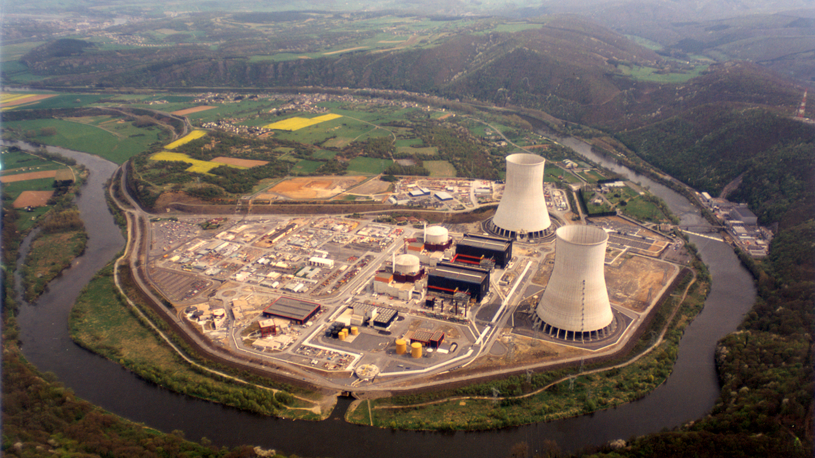
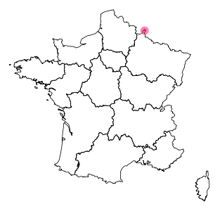

CLOUD: Chooz LiquidO Ultra-near Detector
France
Europe’s most powerful reactor site
${10}^{21} ν/s$ per core
Home of Chooz / Double Chooz experiments
Eur. Phys. J. C 27, 331–374 (2003)
Nat. Phys. 16, 558–564 (2020)
Meuse river
© EDF

Slide 4

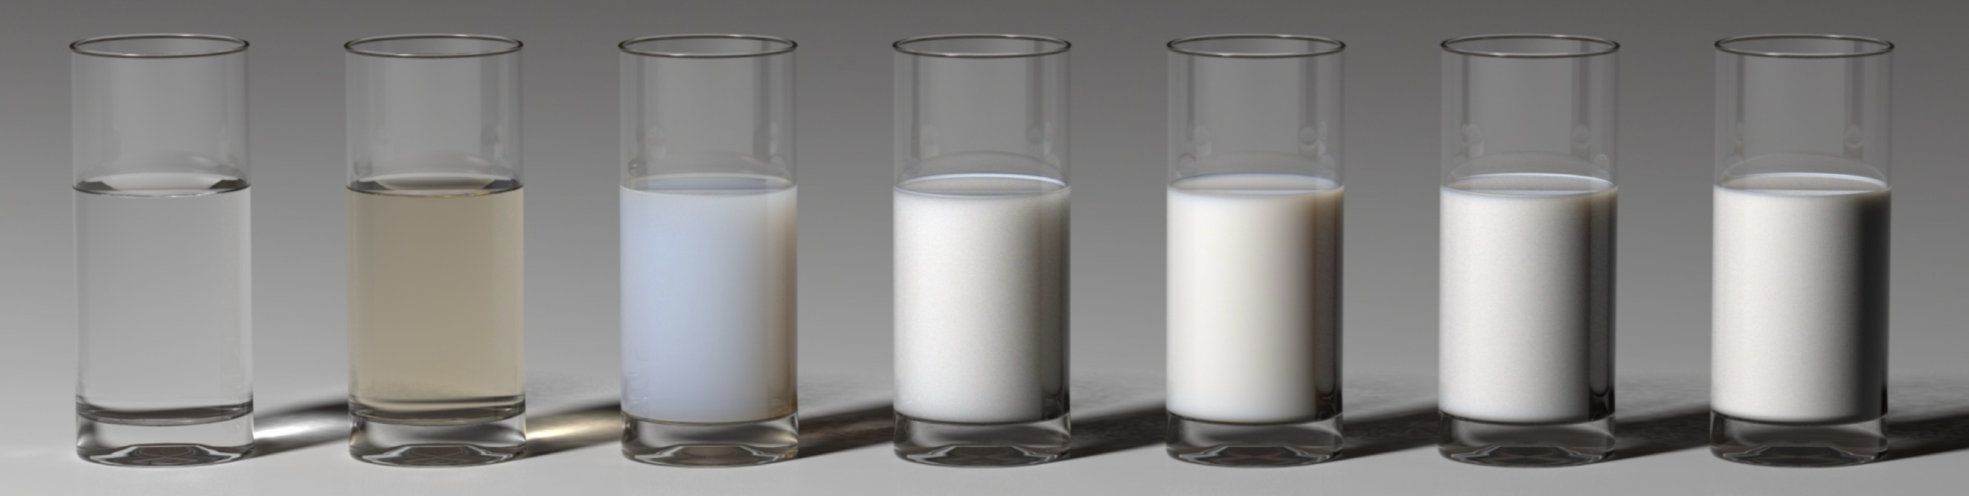
CLOUD: Chooz LiquidO Ultra-near Detector
For more details..
D. Navas talk on Thursday at 12
Posters from: J. Lock, A. Wong, M. Generowicz, B. Cattermole, P. Lasorak
[1] LiquidO Collaboration, Commun Phys 4, 273 (2021)
[2] LiquidO Collaboration, arXiv (2025)
[3] LiquidO Collaboration, DRD2 meeting (2025).
[4] LiquidO Collaboration, NIM A 1071 (2025) 170075
© EDF

Slide 5

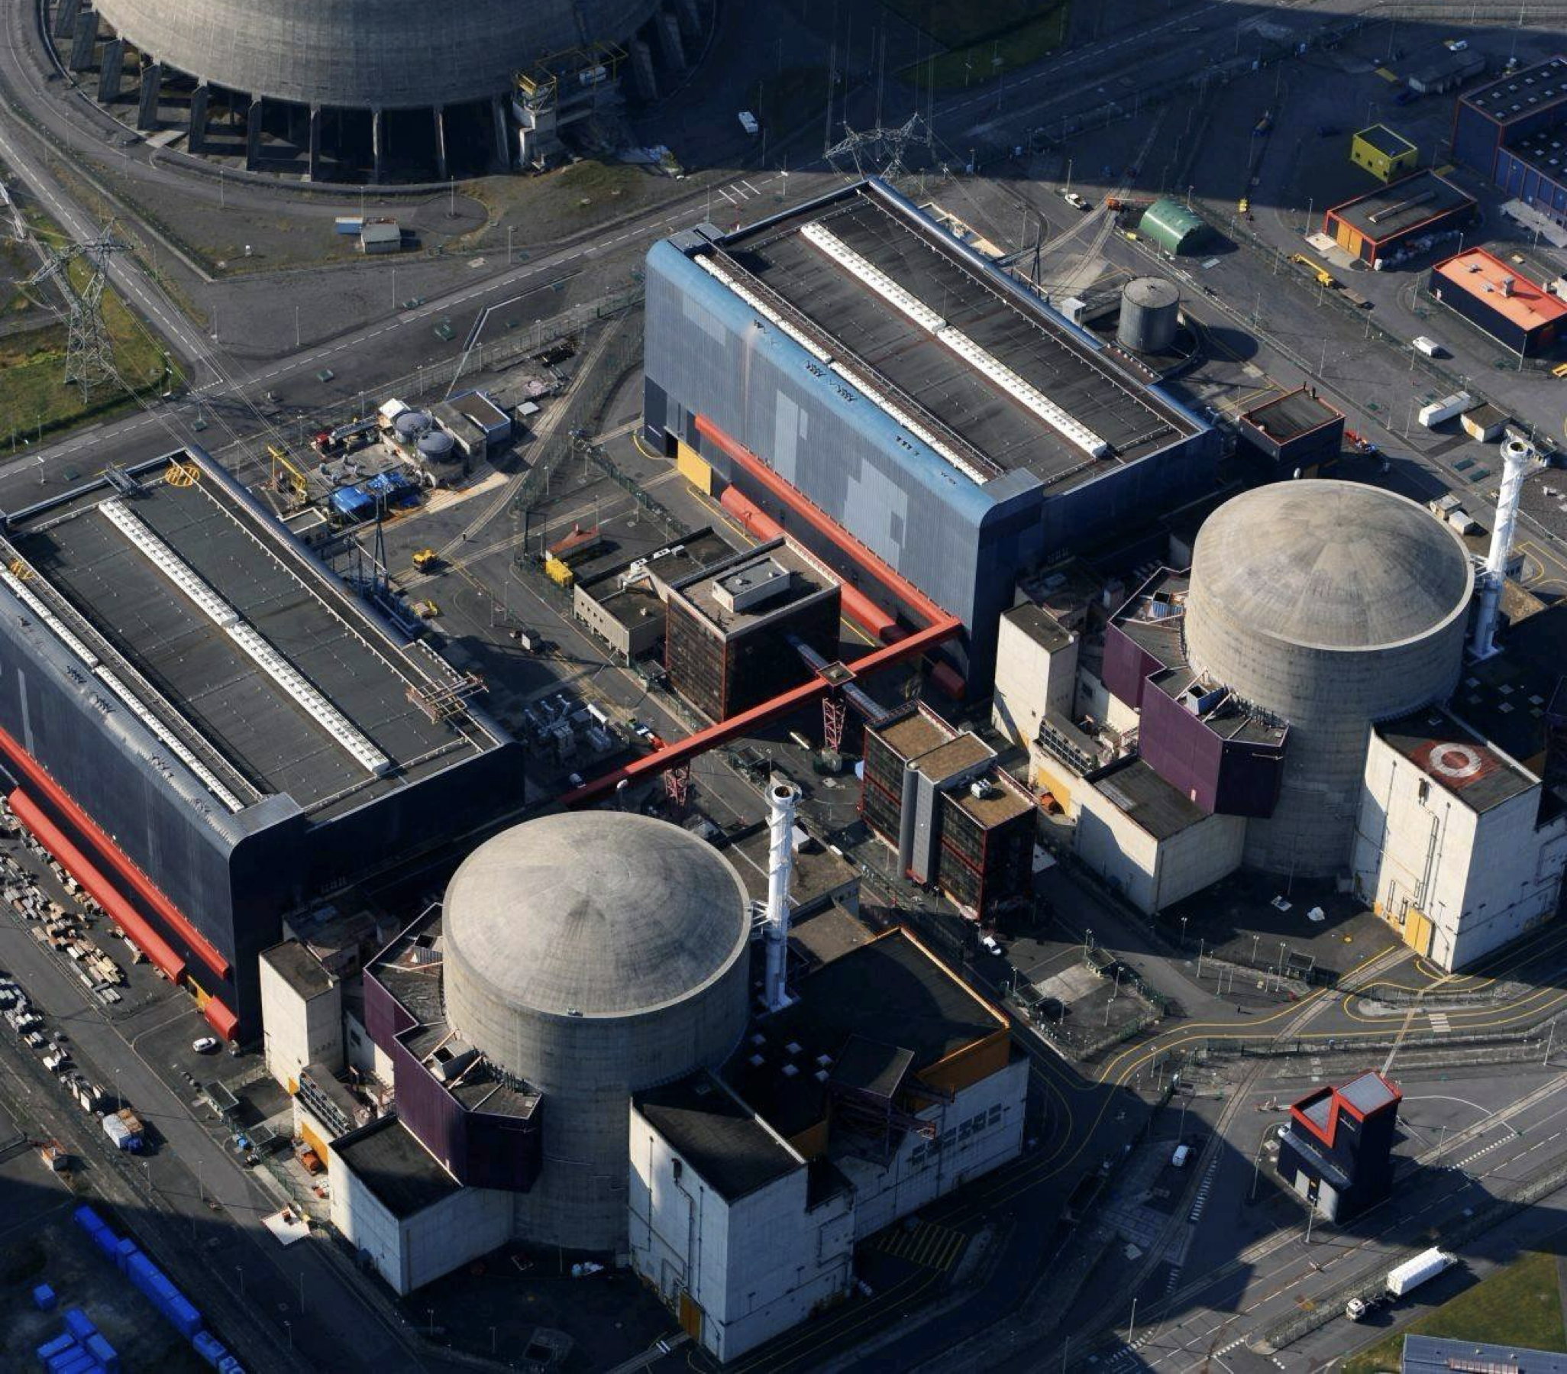
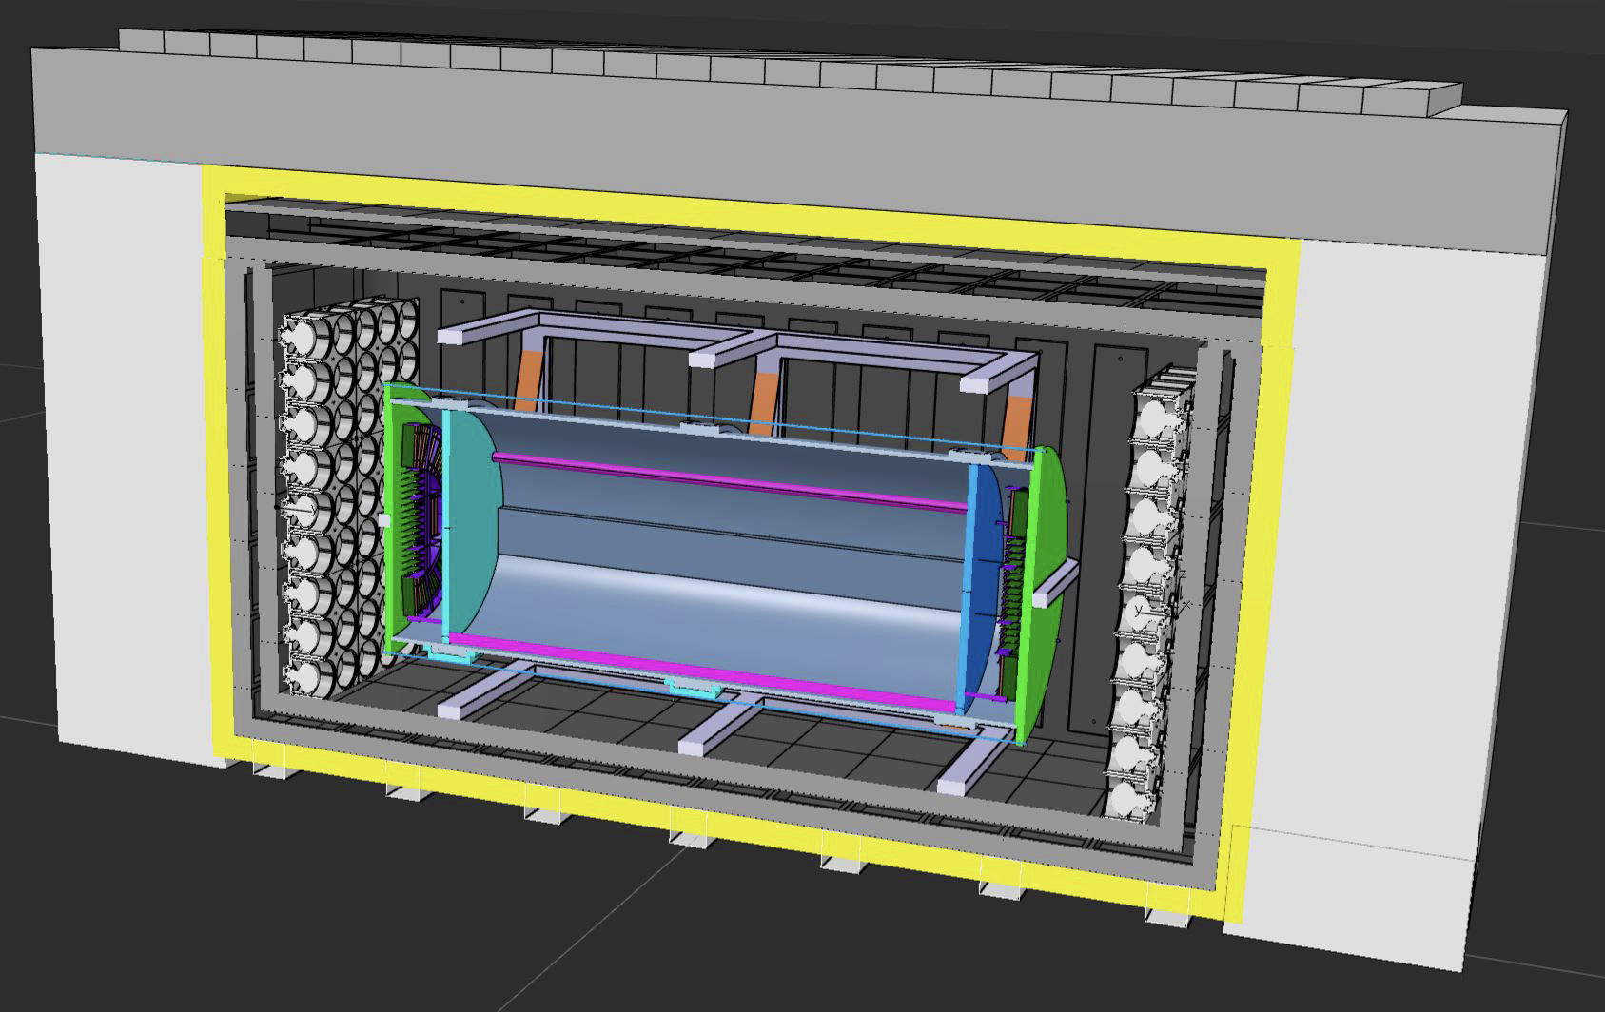

CLOUD: Chooz LiquidO Ultra-near Detector
DESIGN UNDER REVIEW
Reactor
~35 m
Reactor
https://antimatter-otech.ijclab.in2p3.fr/
5-10 tons LiquidO Inner Detector
10,000 WLS fibres + SiPMs dual read-out
1.8 m diameter, >200 PE/MeV design
© EDF

Slide 6
CLOUD: Chooz LiquidO Ultra-near Detector
Reactor (anti)-neutrino fundamental physics program using data from a ton-scale LiquidO detector
in an ultra-near site to the reactor core
and on surface.
  Why LiquidO?
  What are the physics goals of CLOUD?
© EDF

Slide 7

Why Liquido for Cloud?

Slide 8
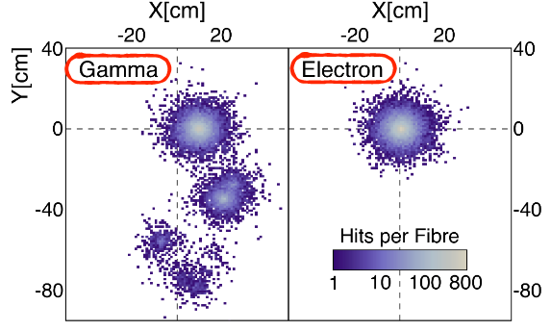
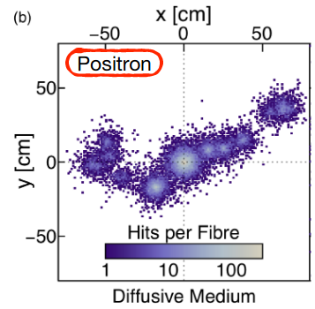
LIQUIDO: high-resolution imaging..
..Without physical segmentation
See D. Navas talk on Thursday
LiquidO Consortium, Commun Phys 4, 273 (2021)
Notes:
Why LiquidO? in transparent scintillators the precious topological information is usually lost, unless the detector is physically segmented..
On the contrary, Thanks to its stochastic light confinement, LiquidO enables the imaging of fundamental particle energy deposition(s) without the need for any mechanical segmentation.
Here for example you see the (simulated) footprint of 3 ~MeV different particles.
What you are seeing here is the number of photons collected by a grid of fibres, and every point in the display is a fibre.
Just by looking at these event displays it is straightforward to discriminate gamma, electron and positron!
PID is just one of the many advantages that the LiquidO technology can offer thanks to its intrinsic ability to self-segment the sensitive region of the detector.

Slide 9

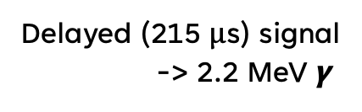
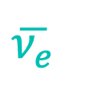







LIQUIDO:
high-resolution imaging..
..For CLOUD!
Prompt signal -> $e^{+}$ + $γγ$
The main detection channel for anti-neutrinos $\overline{{\text{ν}}_{e}}$produced by the reactor is inverse beta-decay (IBD)
Delayed (215 μs) signal
-> 2.2 MeV $γ$
$$e^{+}$$
$$γ$$
$$n$$
$$γ$$
$$γ$$
$$\overline{{\text{ν}}_{e}} \text{+ }\text{p} →e^{+}+n$$
$$\overline{{\text{ν}}_{e}}$$
Cross-section view of the detector
reactor core

Slide 10
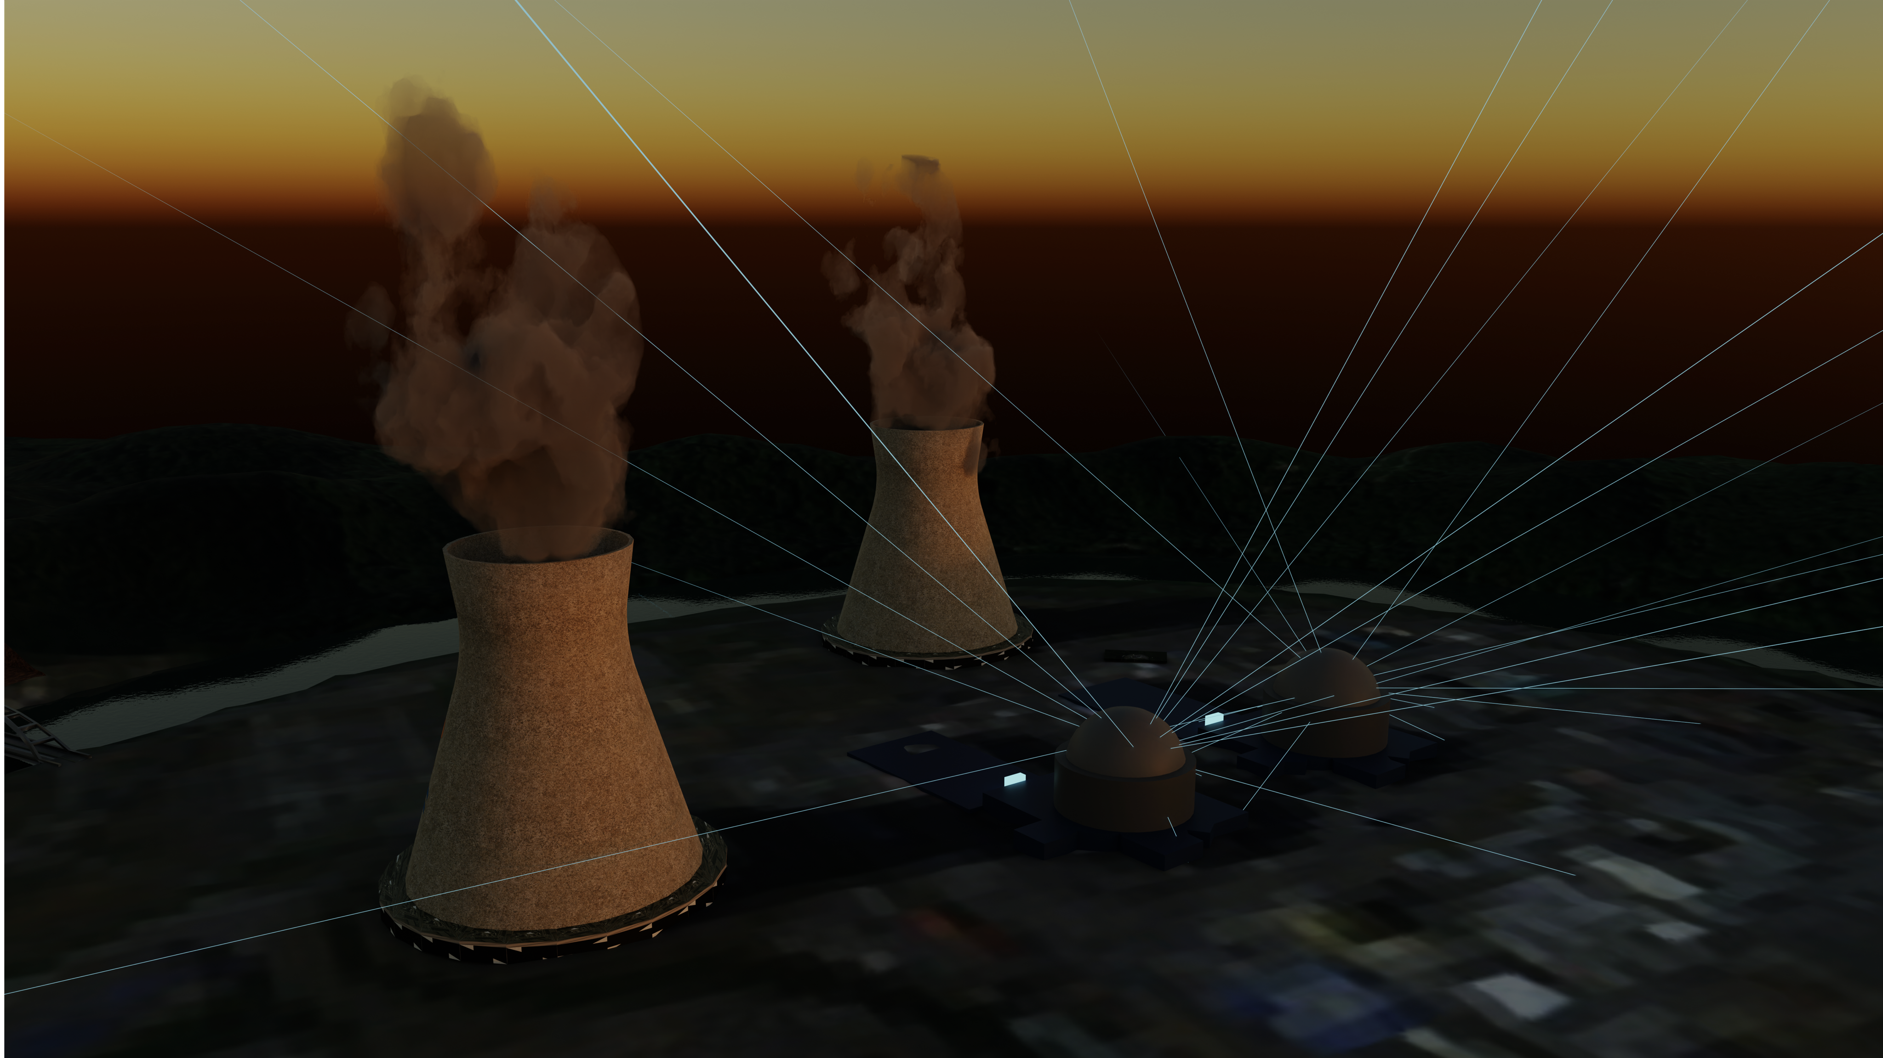


CLOUD-I PHYSICS: reactor antineutrinos
Plan to use data (for fundamental physics)
from the AntiMatterOTech innovation project
-> technology demonstrator
-> neutrino-based reactor monitoring
© EDF
https://antimatter-otech.ijclab.in2p3.fr/

Slide 11
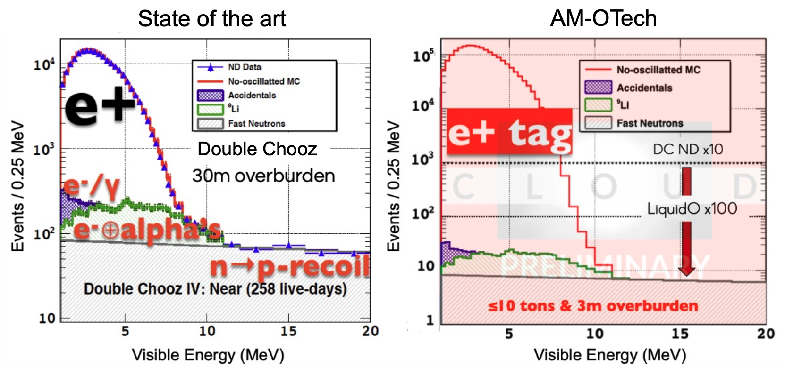




CLOUD-I
CLOUD
LiquidO: improve 3x today’s best S/BG ?
Reactor antineutrinos physics (IBD@p)
Chooz ⊕ ultra-near site
≥10,000 $\overline{{\text{ν}}_{e}}$ IBD per day [10 tons detector]
Assuming 50% selection efficiency
LiquidO
PID + vertex precision
powerful background rejection
=
REACTOR
Demonstrate S/BG >100 (unprecedented)

Slide 12
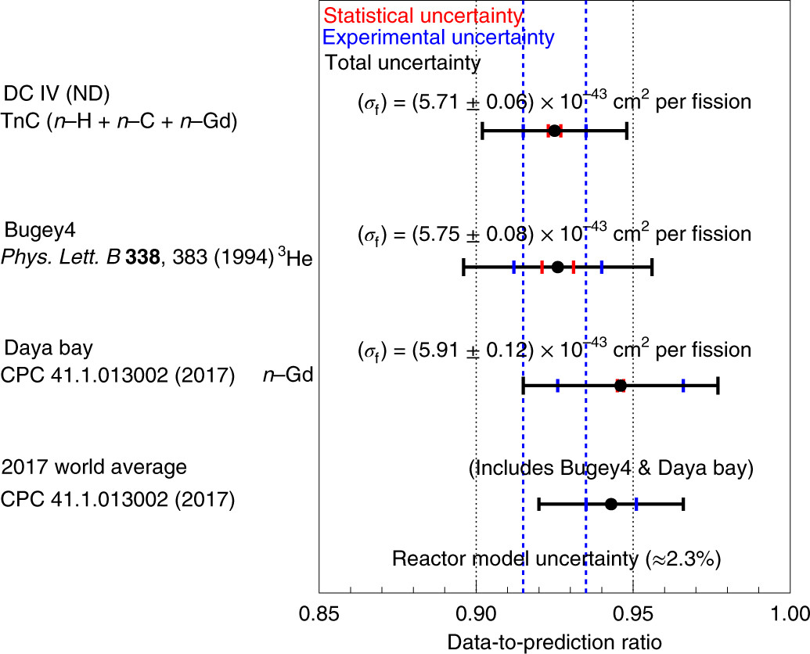

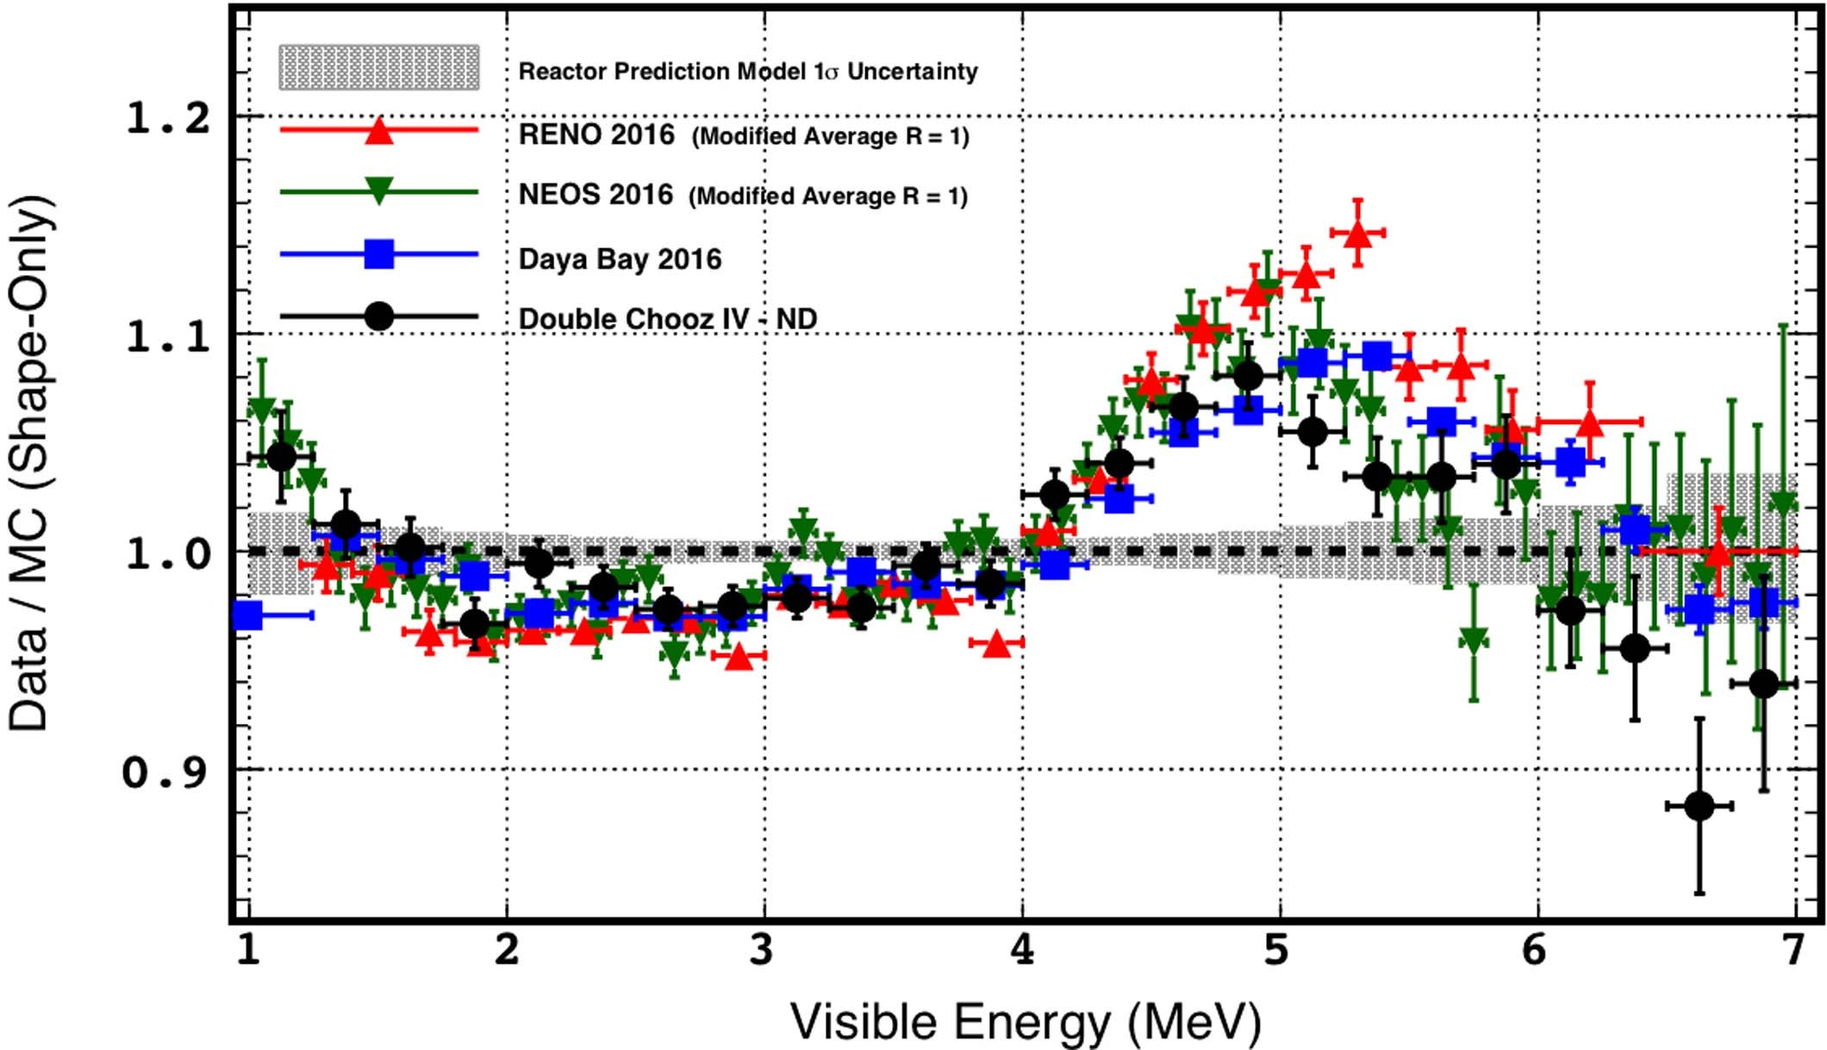
CLOUD-I
< 1% absolute antineutrino flux measurement
Reactor antineutrinos physics (IBD@p)
Chooz ⊕ ultra-near site
≥10,000 $\overline{{\text{ν}}_{e}}$ IBD per day [10 tons detector]
Assuming 50% selection efficiency
LiquidO
PID + vertex precision
powerful background rejection
=
Nat. Phys. 16, 558–564 (2020)
REACTOR
Demonstrate S/BG >100 (unprecedented)
High precision (<1%) characterisation of reactor anti-neutrinos flux

Slide 13
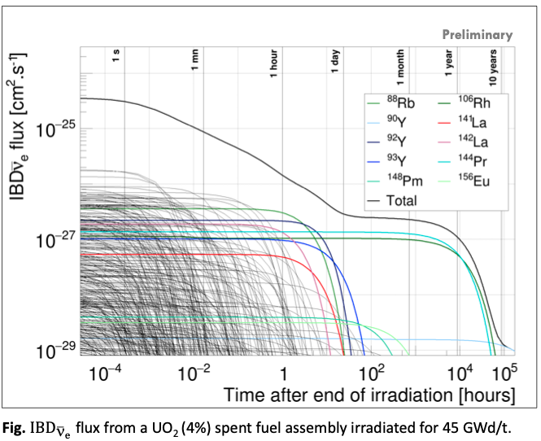

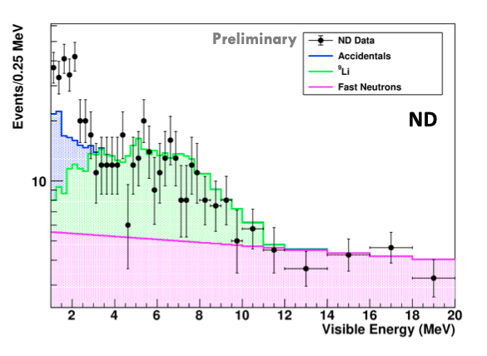

CLOUD-I
IAEA TM on Antineutrino Spectra (2023).
Reactor antineutrinos physics (IBD@p)
Chooz ⊕ ultra-near site
≥10,000 $\overline{{\text{ν}}_{e}}$ IBD per day [10 tons detector]
Assuming 50% selection efficiency
LiquidO
PID + vertex precision
powerful background rejection
=
DOUBLE CHOOZ PRELIMINARY
REACTOR
What can we learn with more statistics ?
S/BG~1 (unprecedented on surface)
ON-OFF-ON transitions
Unique reactor prediction model information

Slide 14
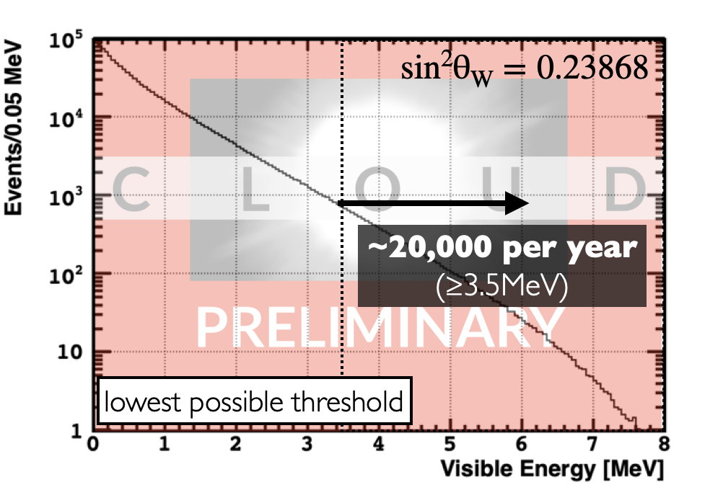
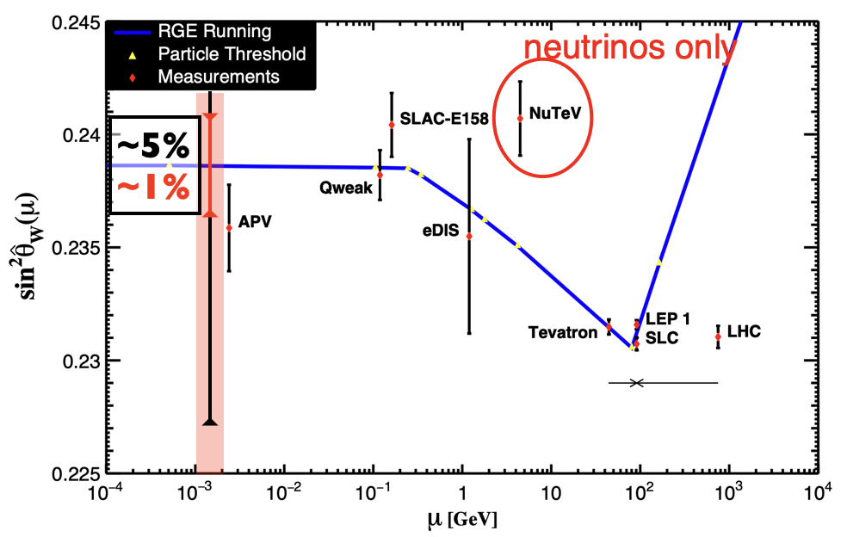

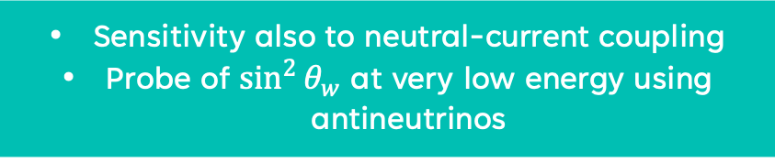

CLOUD-I
ES@e Spectrum (1 year exposure)
Reactor antineutrinos physics (ES@e)
$$\overline{{\text{ν}}_{e}} \text{+ }e^{−}→\overline{{\text{ν}}_{e}}\text{ +}{ e}^{−}$$
Chooz ⊕ ultra-near site
≥5,000 $\overline{{\text{ν}}_{e}}$ electron elastic scattering per day [10 tons detector]
~ 20000/year for E > 3.5 MeV
“Reactor Rate Modulation” technique
LiquidO
PID + vertex precision
powerful background rejection
=
Sensitivity also to neutral-current coupling
Probe of $\sin^{2}{θ_{w}}$ at very low energy using antineutrinos

Slide 15
CLOUD II proposal
EXPLORING THE Unexplored

Slide 16
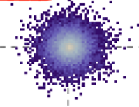
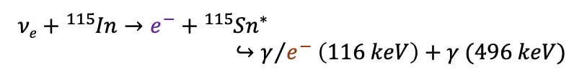

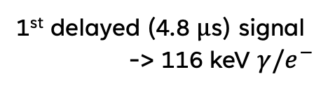



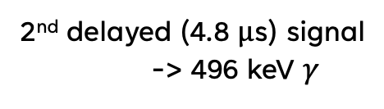
LIQUIDO:
high-resolution imaging..
..For CLOUD II!
Prompt signal -> $e^{−}$
2nd delayed (4.8 μs) signal
-> 496 keV $γ$
Indium loading for neutrino CC interaction
$$e^{−}$$
$${}_{}^{115}{Sn^{∗}}$$
$$γ$$
Phys. Rev. Lett. 37, 259 -262 (1976)
1st delayed (4.8 μs) signal
-> 116 keV $γ/e^{−}$
$${\text{ν}}_{e}$$
Cross-section view of the detector

Slide 17
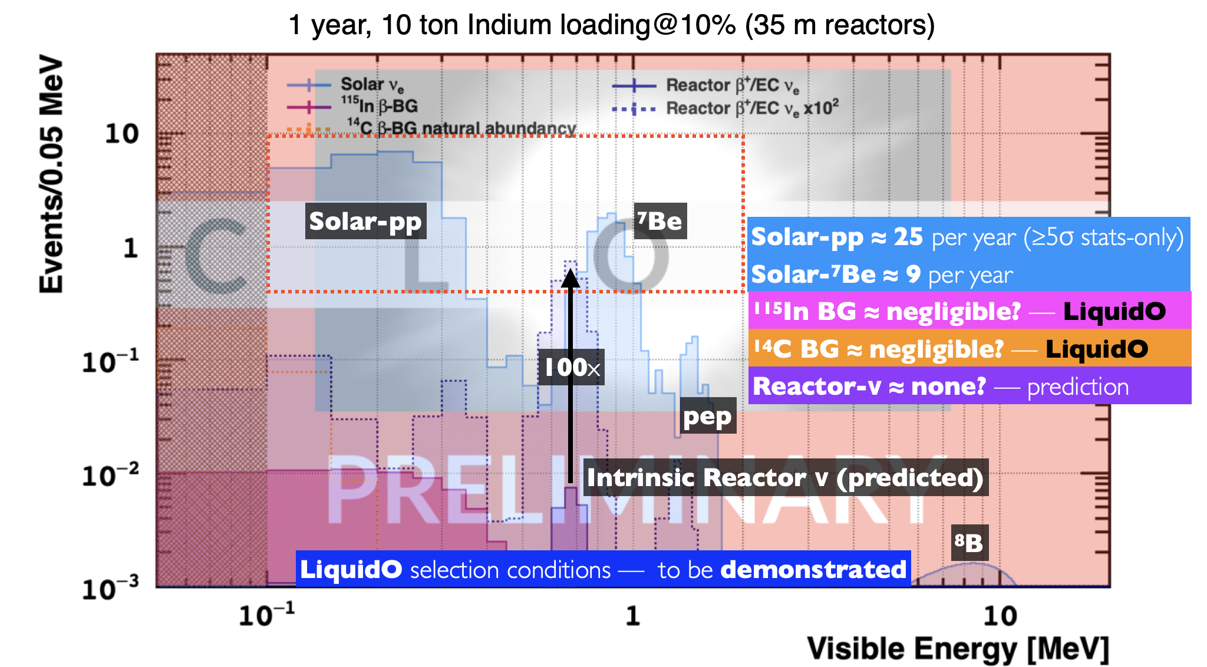
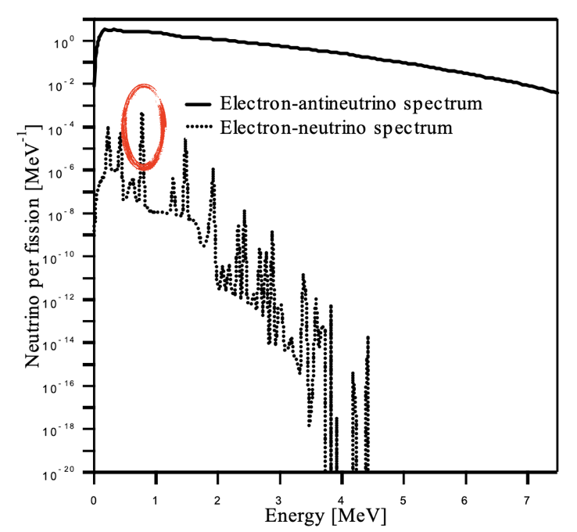


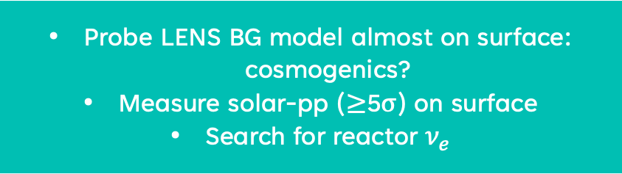
CLOUD-II
Electron neutrino CC physics
Indium loading
Phys. Rev. Lett. 37, 259 -262 (1976)
LiquidO
tag ${\text{ν}}_{e}$interaction on ${}_{}^{115}{In}$ looking at multi-fold coincidence
loading does not affect performance
=
114keV
Very low threshold
reactor ${\text{ν}}_{e}$ ?
LENS background model
Plot uses expected BG from LENS
Does it apply for CLOUD?
Probe LENS BG model almost on surface: cosmogenics?
Measure solar-pp (≥5σ) on surface
Search for reactor ${\text{ν}}_{e}$
Phys. Rev. D 75, 093006 (2007)
T. Nishimura et al., AIP Conference Proceedings 769, 1702 (2005)

Slide 18
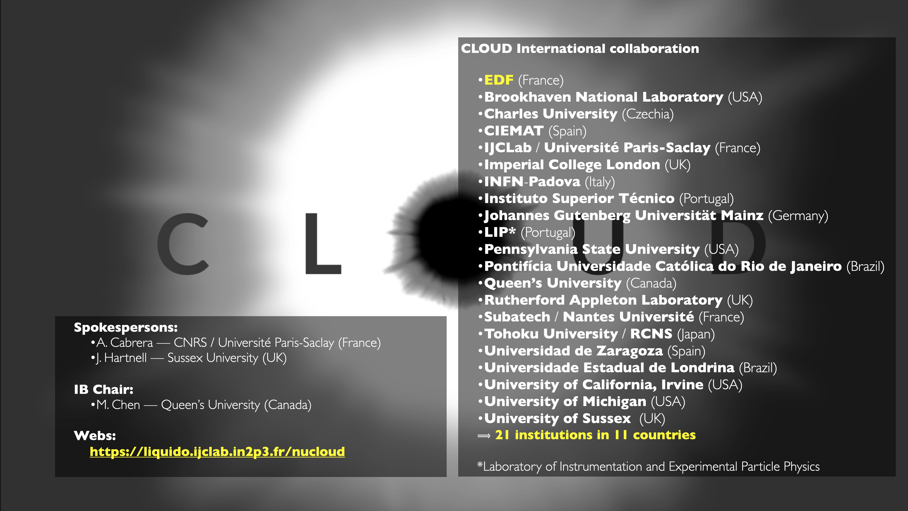
Thank you

Slide 19
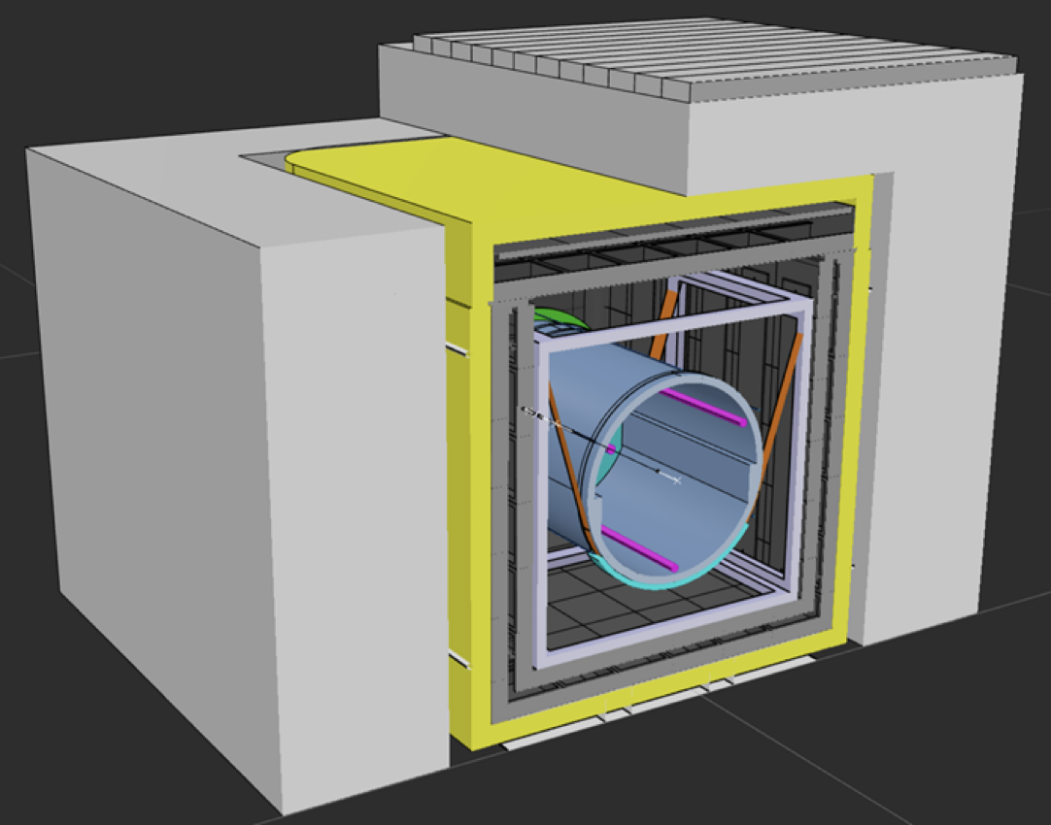
Side-section view
IGLOO [~3mwe]
Concrete bunker
DC’s iron steel shield (15cm thick)
Water Pool thick and/or PE tank
4π shield & neutron moderator
DESIGN UNDER REVIEW
Cross-section view
5-10 tons LiquidO Inner Detector
10,000 WLS fibres + SiPMs dual read-out
1.8 m diameter, >200 PE/MeV design
ARMOUR (or outer-detector) [~0.5m thickness]
transparent scintillator
≤180 DC-PMTs & highly reflecting walls

Slide 20
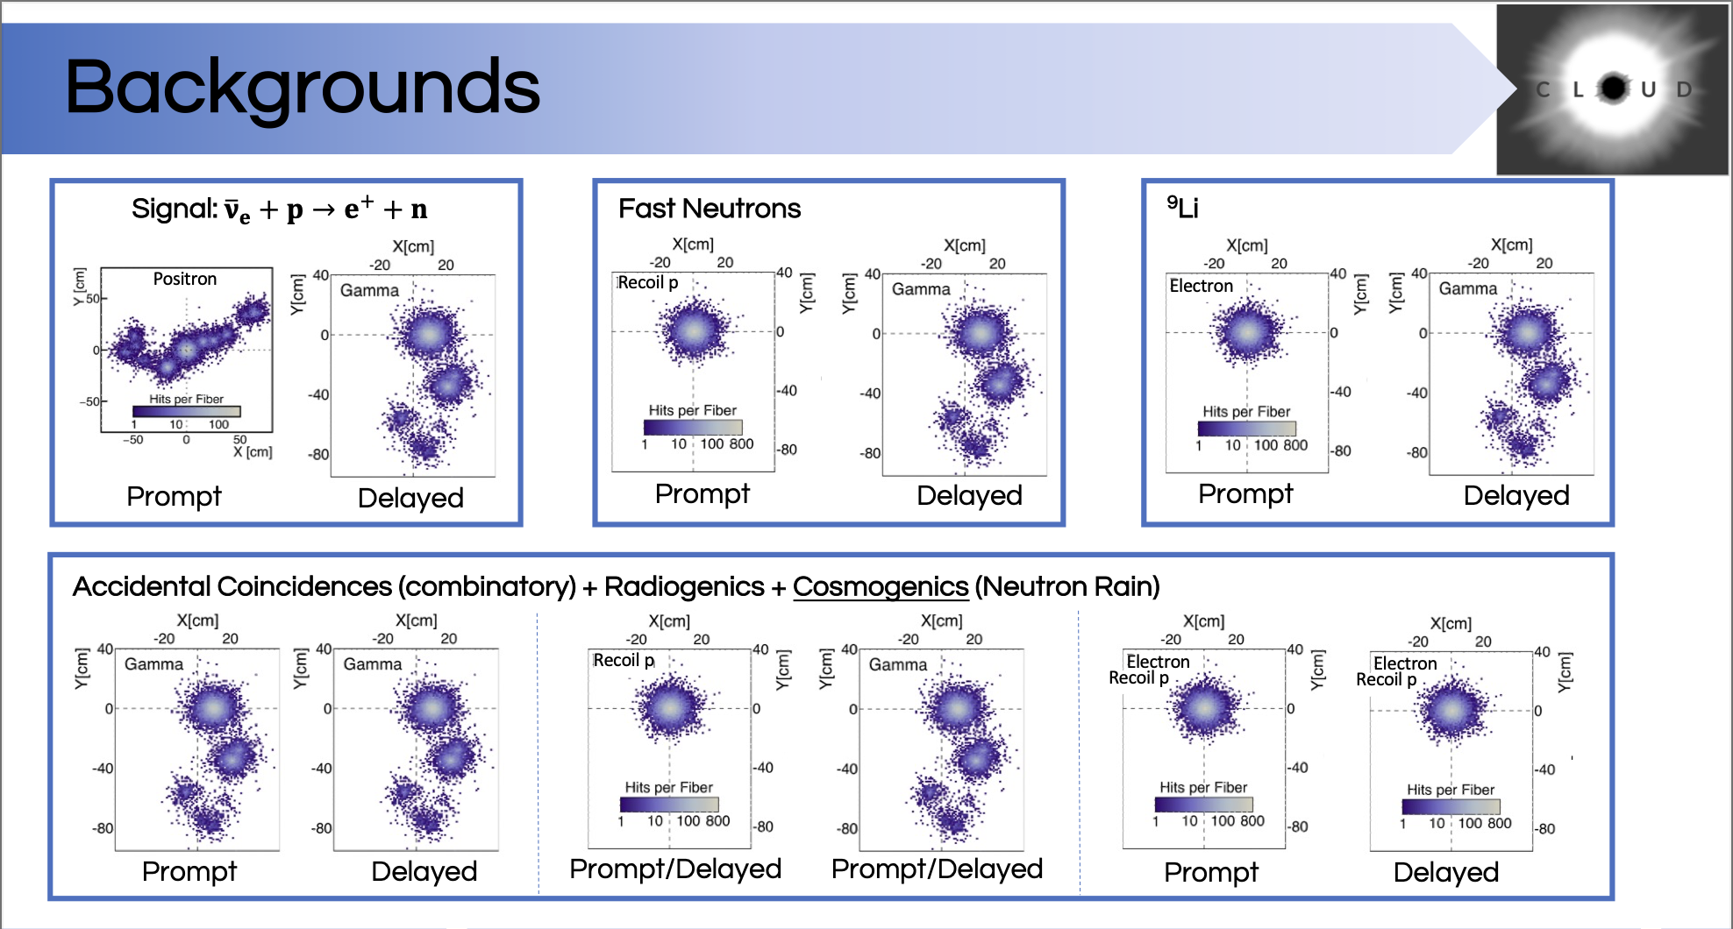

Slide 21
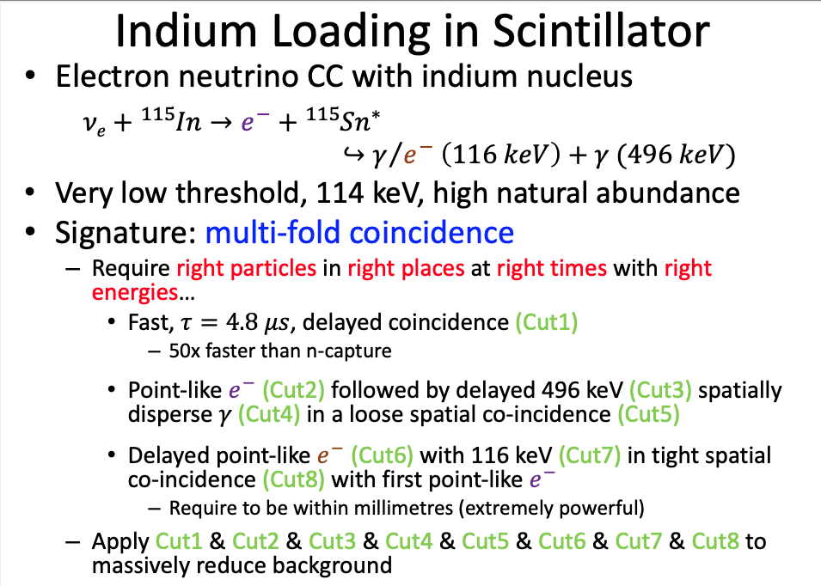
CLOUD-II PHYSICS - Indium

Slide 22
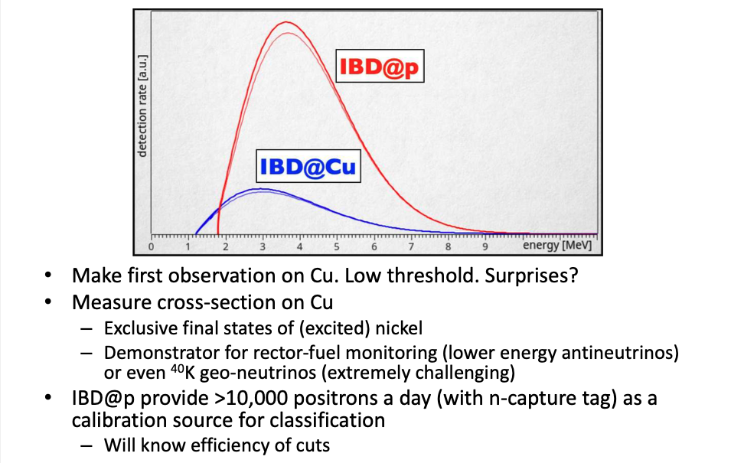
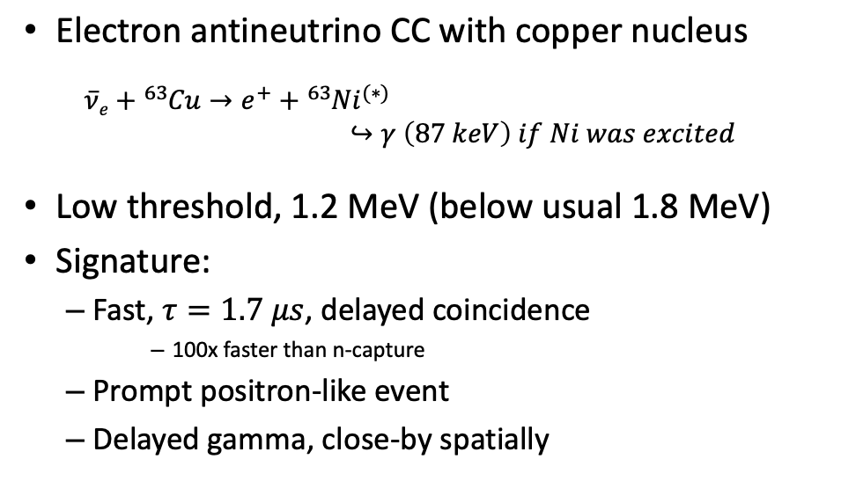
CLOUD-III PHYSICS - COPPER
arXiv:2308.04154

