Slide 1

REactor neutrino LIquid xenon Coherent Scattering experiment (RELICS)
Chang Cai (Tsinghua University)
On behalf of the RELICS collaboration
2025.6.10

Slide 2
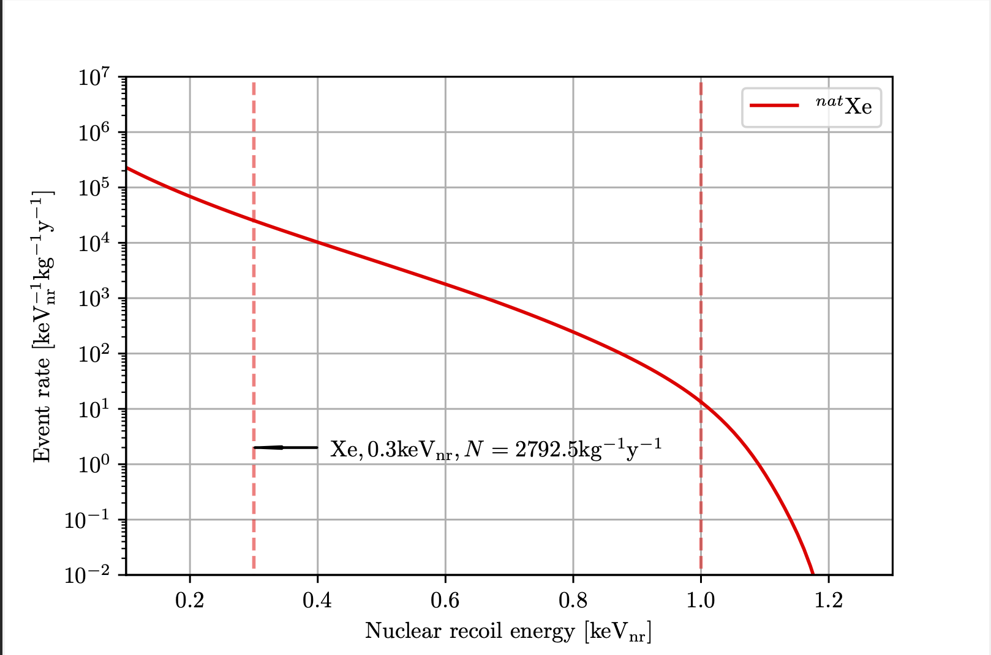
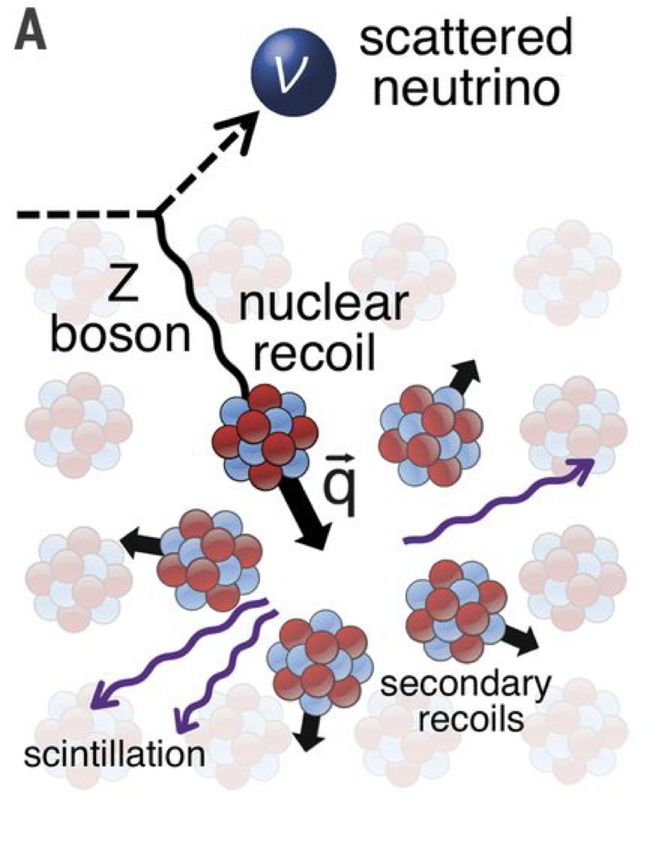
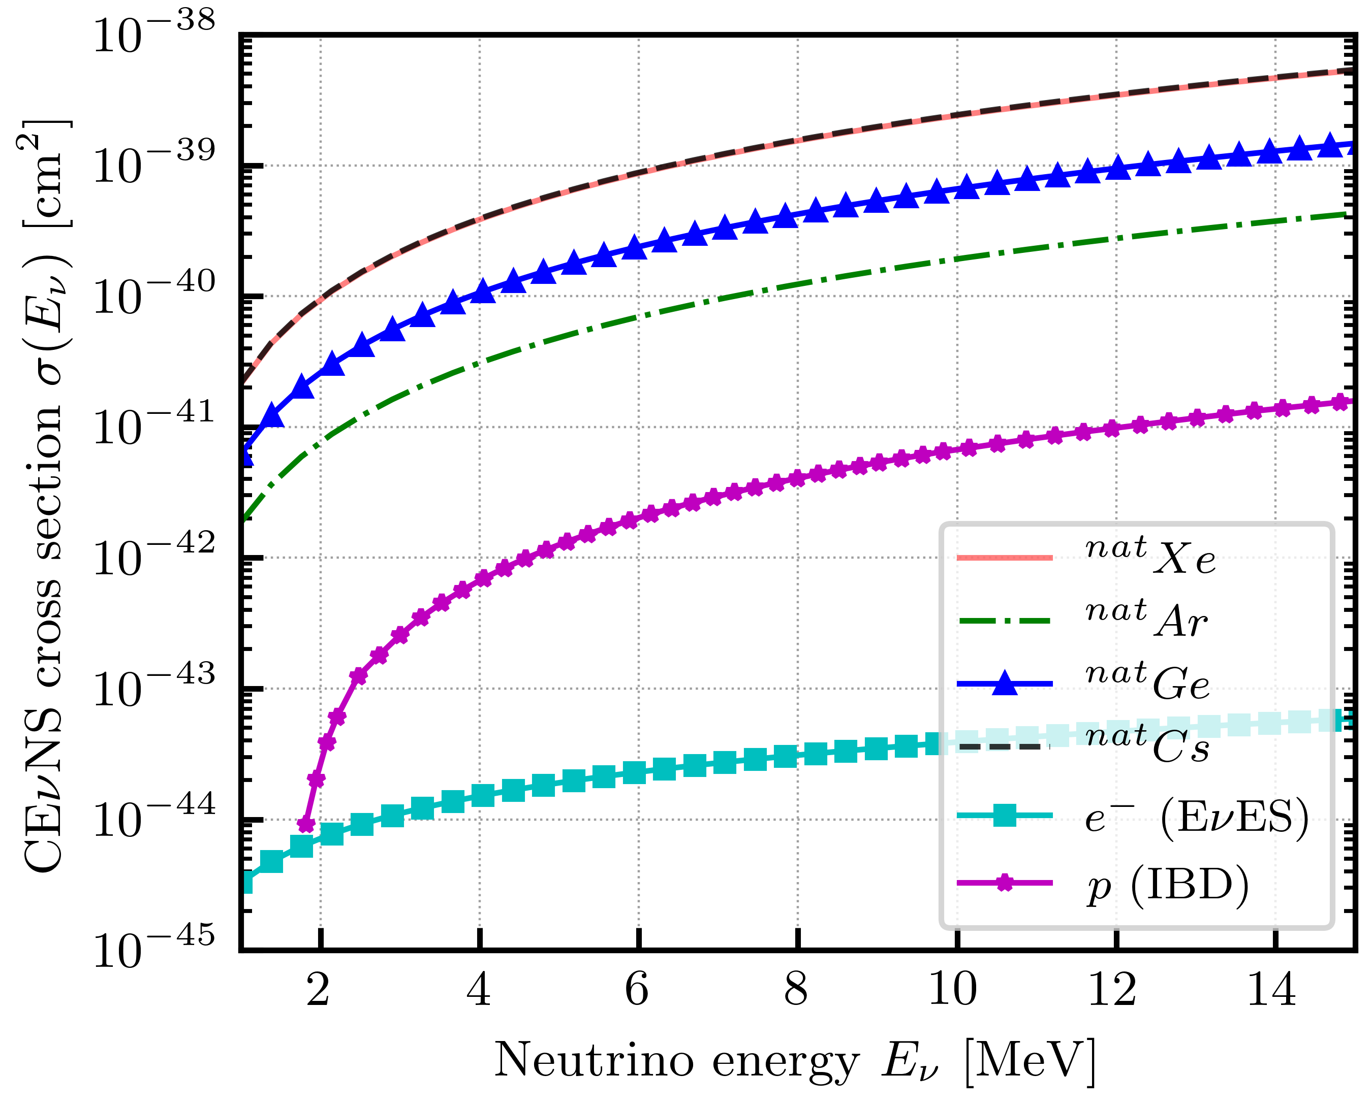
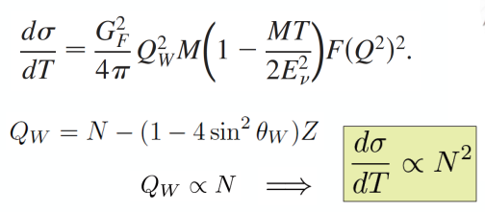
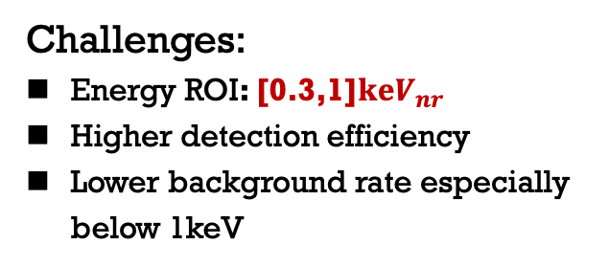
Coherent Elastic Neutrino-Nucleus Scattering: CE$v$NS
Opportunities:
Cross section proportional to the square of the number of nucleons
Larger cross section compared with IBD
Smaller neutrino detectors
Challenges:
Energy ROI: [0.3,1]$keV_{nr}$
Higher detection efficiency
Lower background rate especially below 1keV
Notes:
The incoming neutrino sees the nucleus as a whole during scattering with a cross-section proportional to the nucleon number squared
As the scattering energy increases, Cross Section drops sharply.

Slide 3
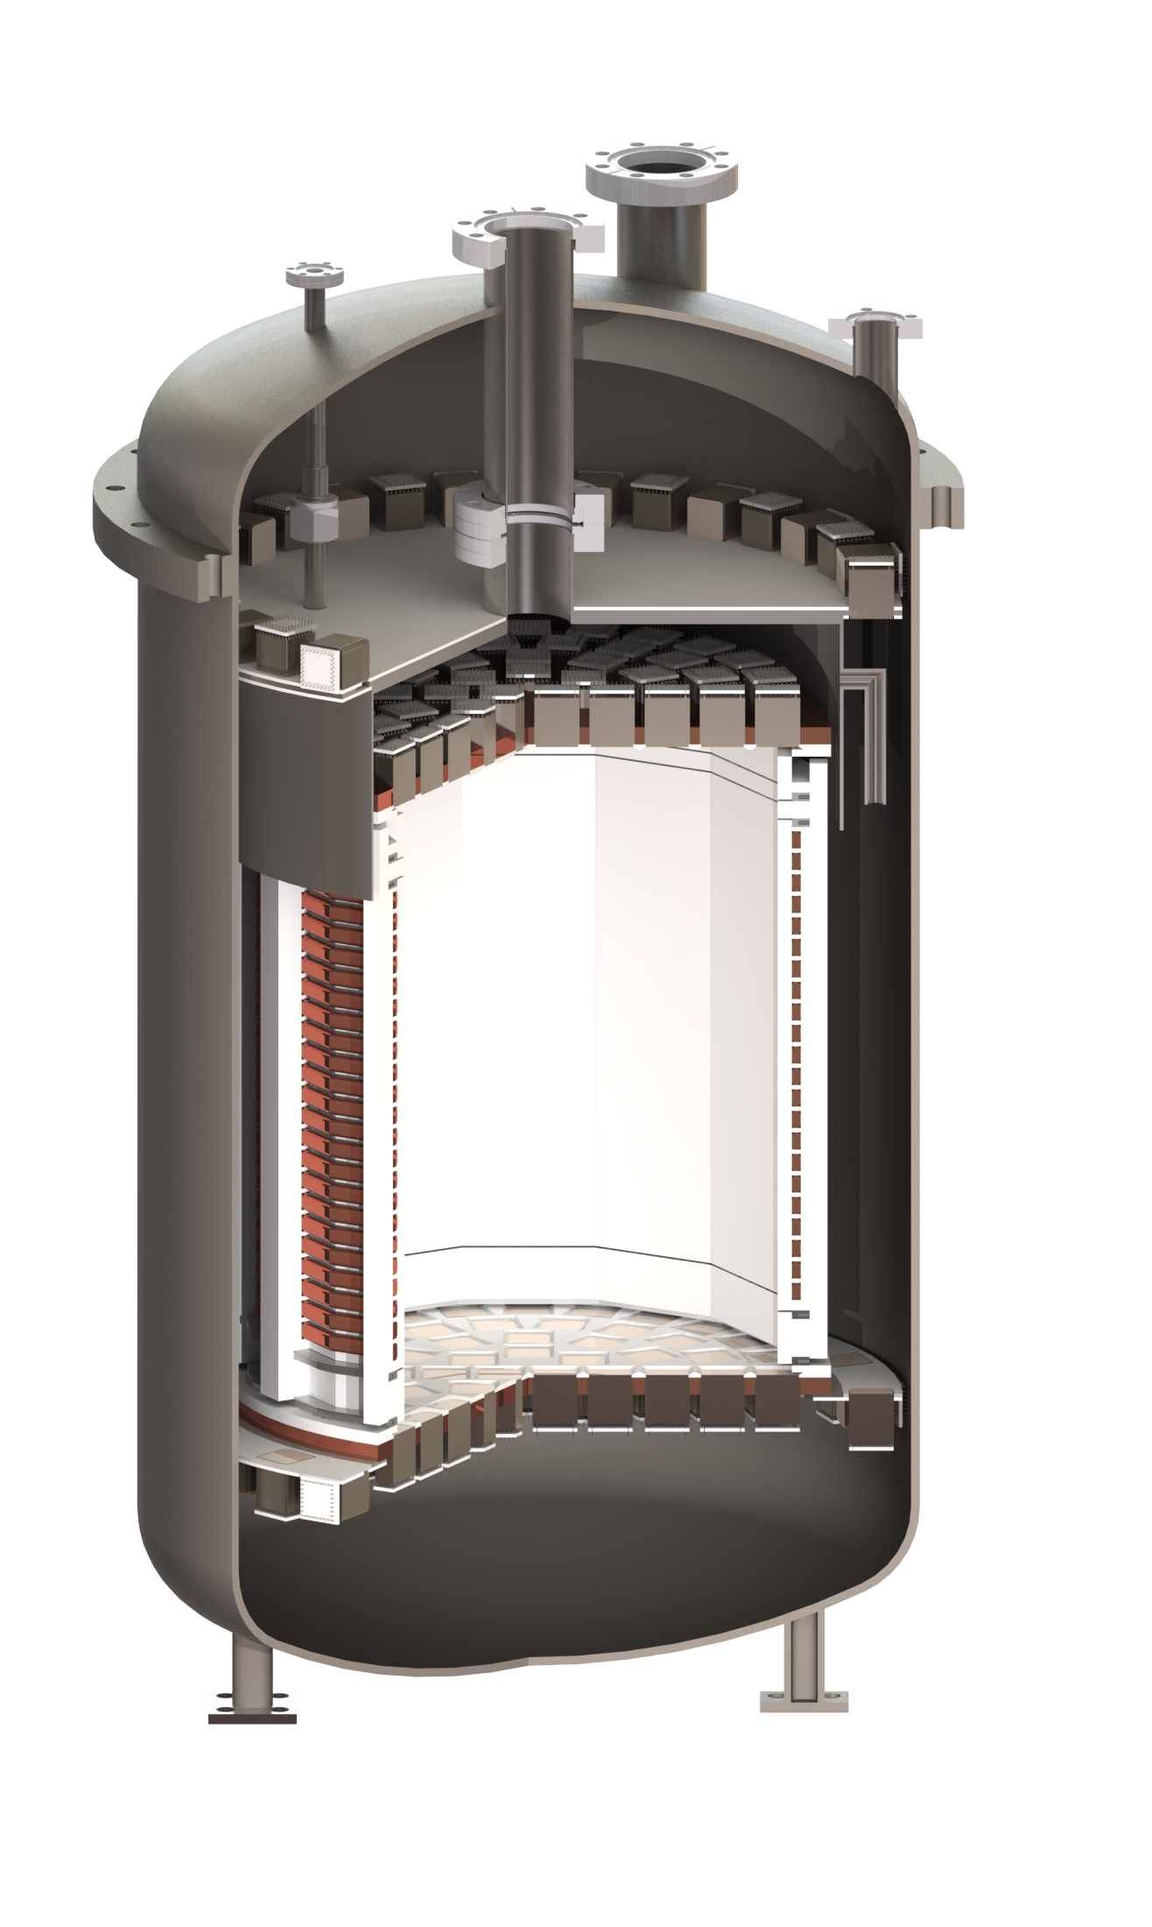

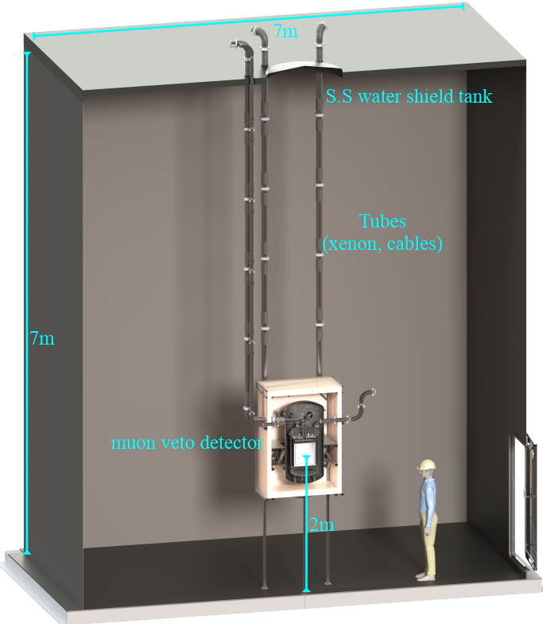
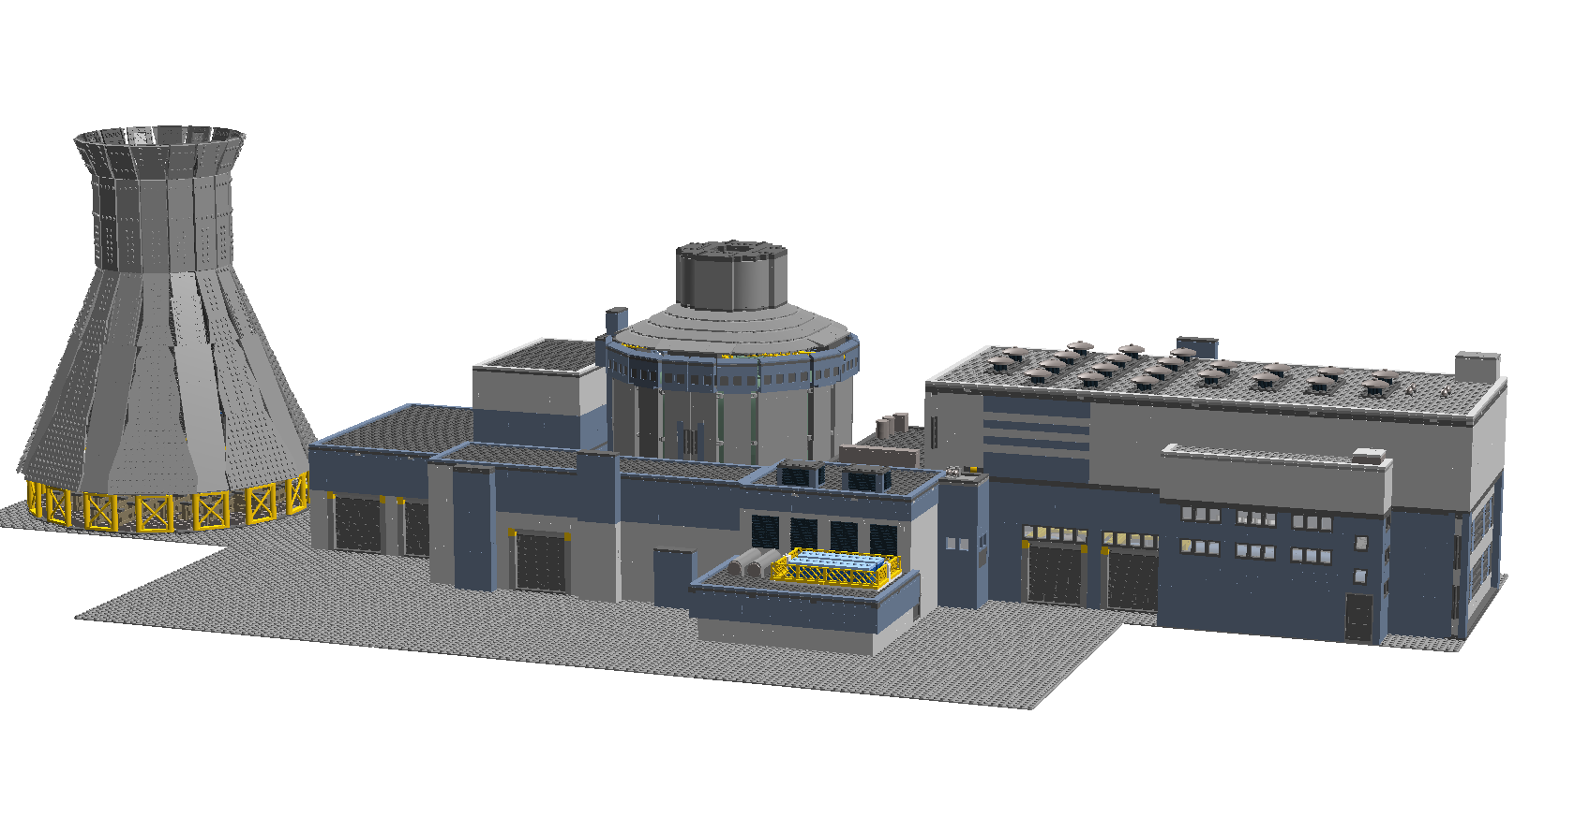










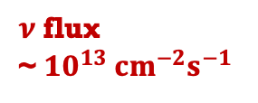
RELICS Experimental Design
D 28cm
$$e$$
H 24cm
$$e$$
$$ν$$
$$e$$
$$ν$$
AP1000 Heat power ~ 3GW
~25 m
$$Z^{0}$$
$$Xe$$
$$ν$$
$$q$$
$$ν$$
$ν$ flux
~ $10^{13} cm^{−2}s^{−1}$
Notes:
加Bulletin

Slide 4
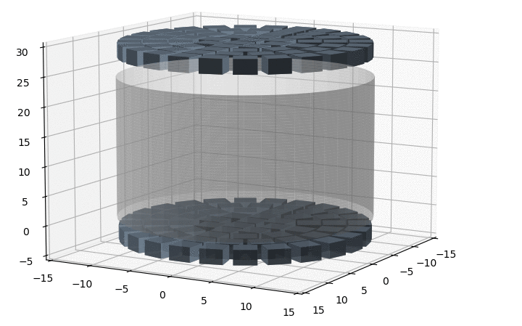
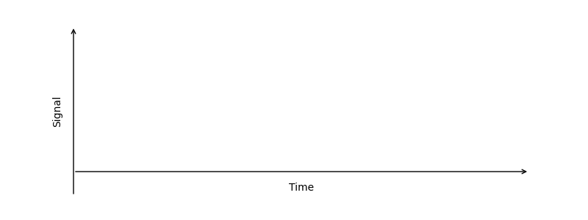
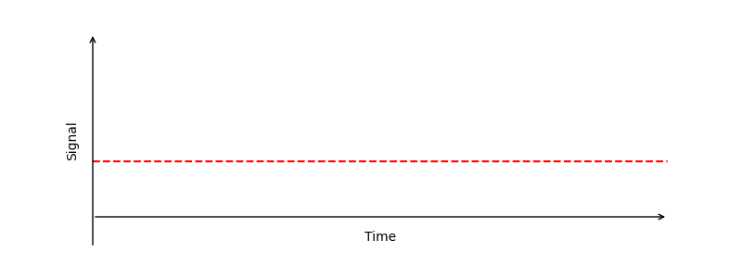
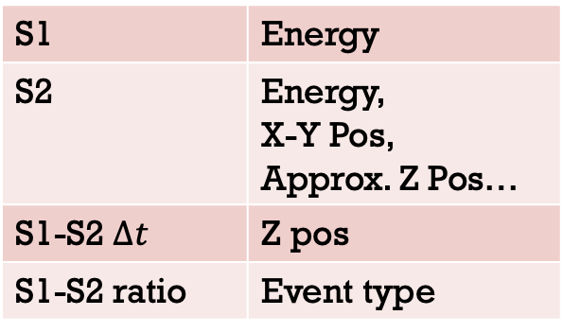

CE$v$NS in LXe-TPC
S1-S2 Pair Signal
S1 | Energy
S2 | Energy, X-Y Pos, Approx. Z Pos…
S1-S2 $∆t$ | Z pos
S1-S2 ratio | Event type
CE𝒗NS“S2 Only”Signal
For CE𝒗NS signals：
  Mostly below 1keV_nr
  O(10) Photons, S1 hardly to be detected
  S2 signals composed of discrete electrons
Notes:
表格错误

Slide 5
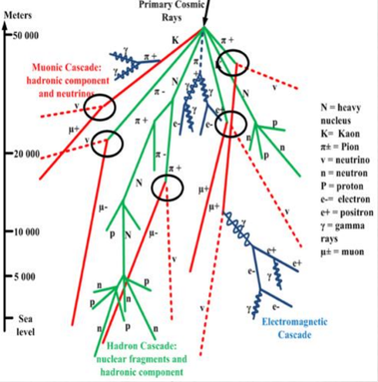
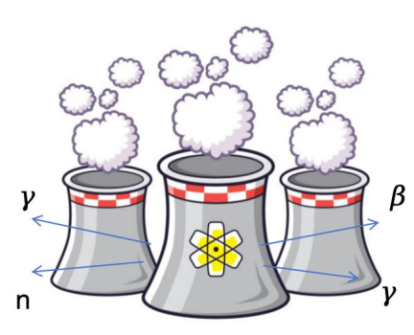
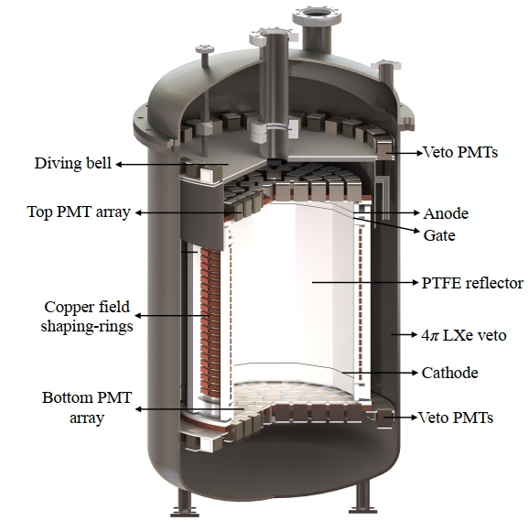
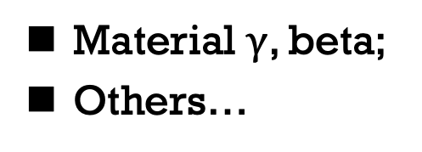
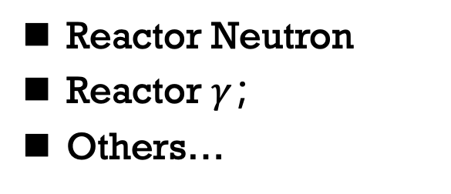
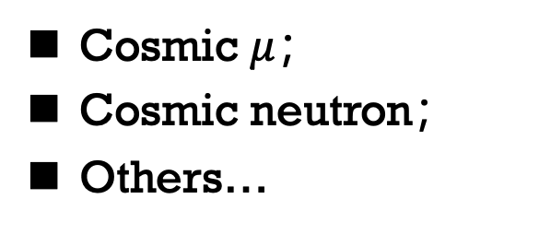
Background Sources
  Cosmic Ray Particles
Reactor
  Detector Material
Cosmic $μ$；
Cosmic neutron；
Others…
Reactor Neutron
Reactor $γ$；
Others…
Material $γ$, beta;
Others…

Slide 6
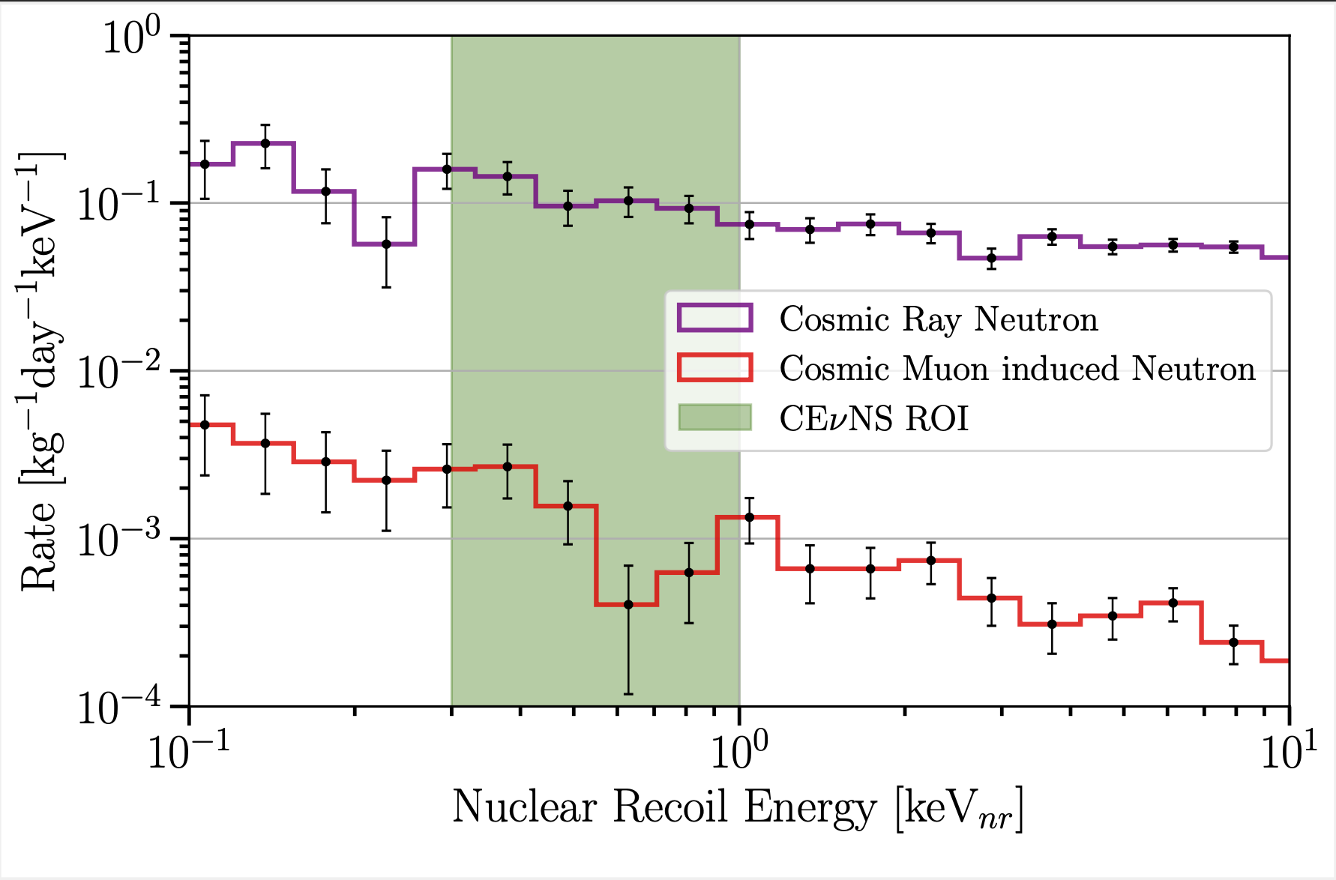
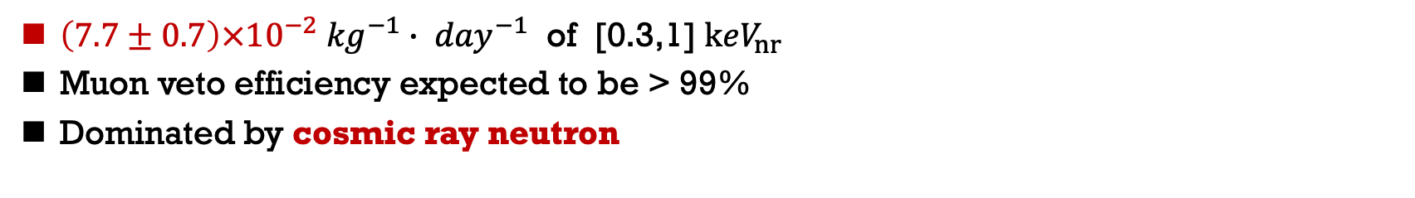
NR Background
$\left(7.7±0.7\right)×{10}^{−2} {kg}^{−1}∙ {day}^{−1}$ of [0.3,1]$keV_{nr}$
Muon veto efficiency expected to be > 99%
Dominated by cosmic ray neutron
Notes:
加数据来源，CRY

Slide 7
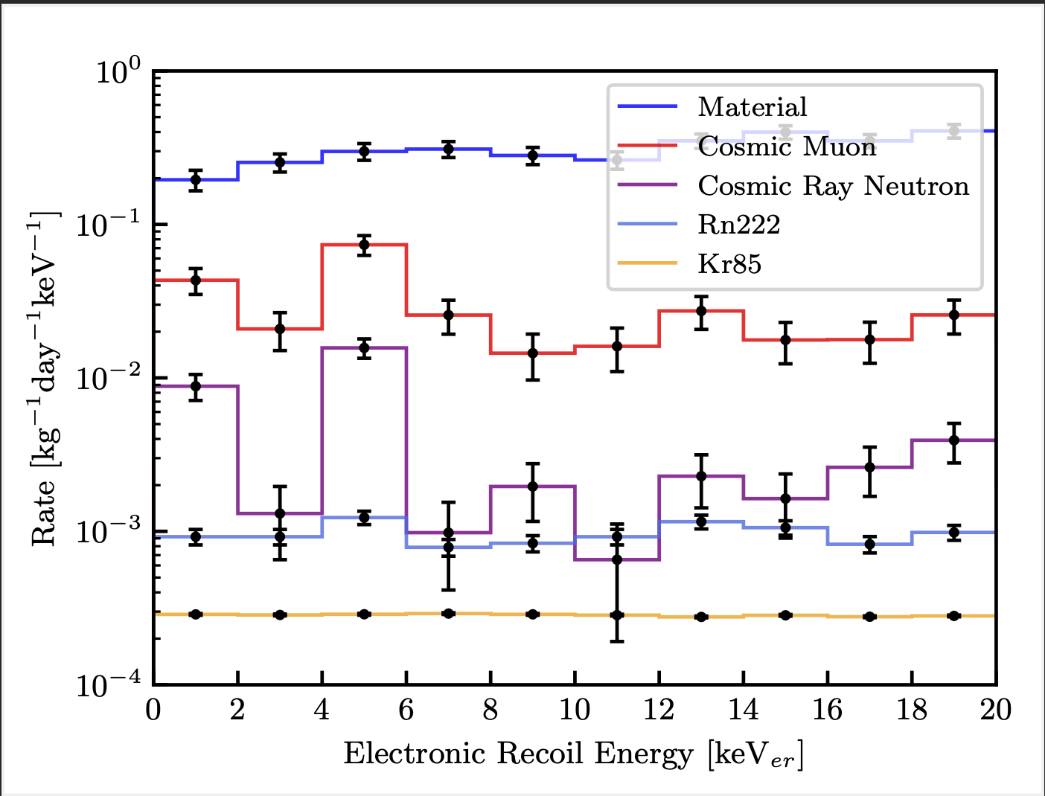
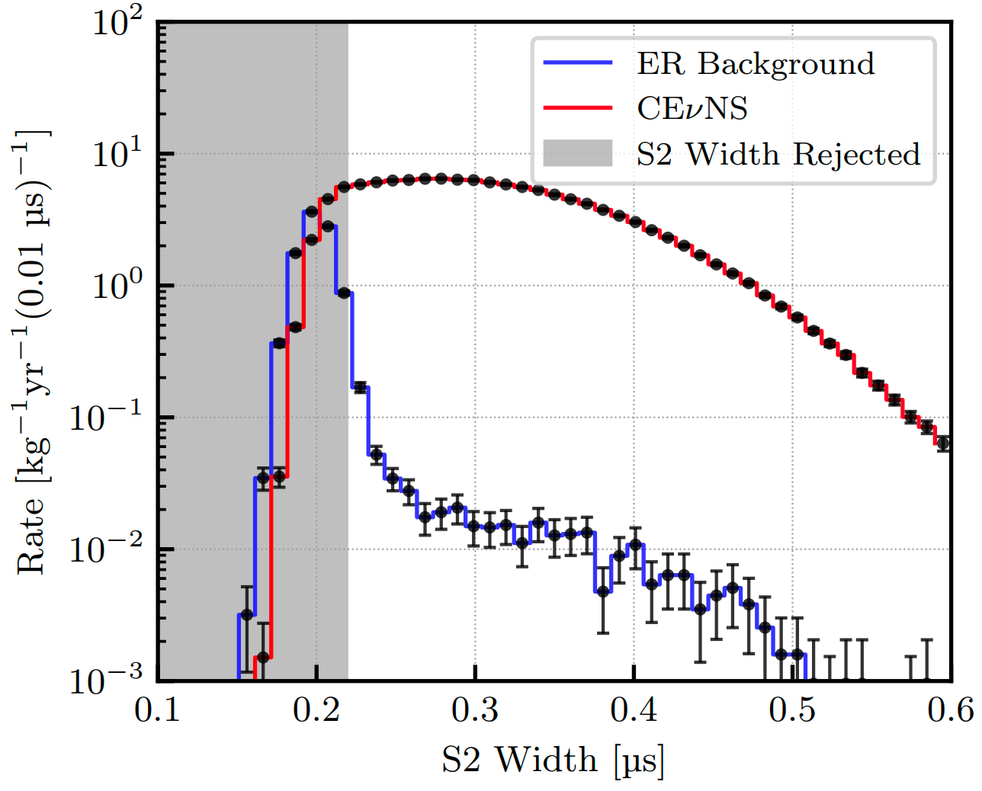
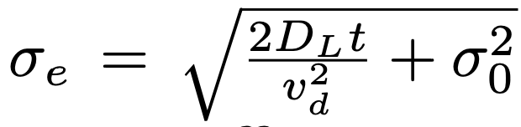
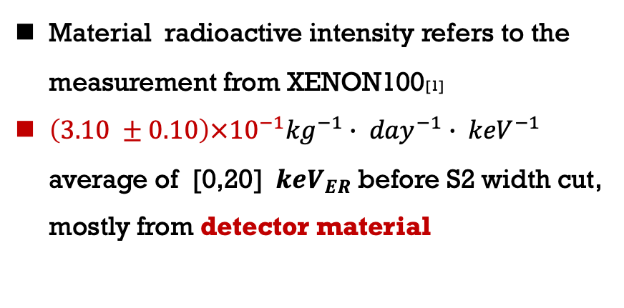
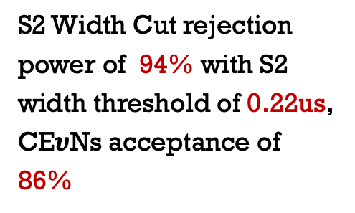
ER Background
Mostly from Top PMT bases
S2 Only?
No Z position?
Material radioactive intensity refers to the measurement from XENON100[1]
$\left(3.10 ±0.10\right)×{10}^{−1}{kg}^{−1}∙ {day}^{−1}∙ {keV}^{−1}$ average of [0,20] $keV_{ER}$before S2 width cut, mostly from detector material
S2 Width Cut rejection power of 94% with S2 width threshold of 0.22us, CE$υ$Ns acceptance of 86%
P. SorensenarXiv:1102.2865 [astro-ph.IM].
[1] Aprile, E., et al. "Study of the electromagnetic background in the XENON100 experiment." Physical Review D 83.8 (2011): 082001.
Notes:
放射性参考依据

Slide 8
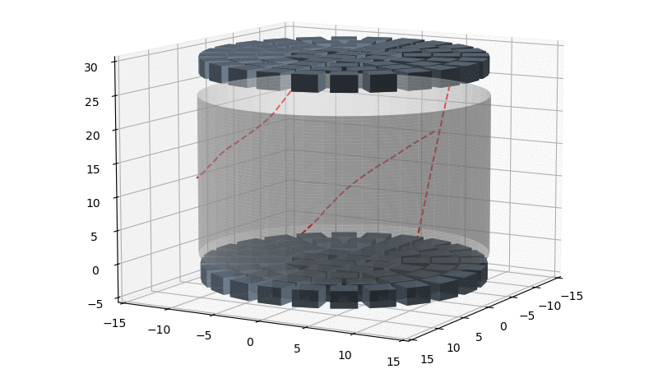
Delayed Electrons Background
Muon Signal ~10 Hz
Delayed Electrons
  Delayed Electrons:
  Position correlated, power law decay
  Strongly correlated with impurities in LXe, weakly with the extraction field [2]
  Major challenge for RELICS in suppressing background
[2] Phys. Rev. D 106, 022001
Notes:
说明XENON的延迟电子特性来源。

Slide 9
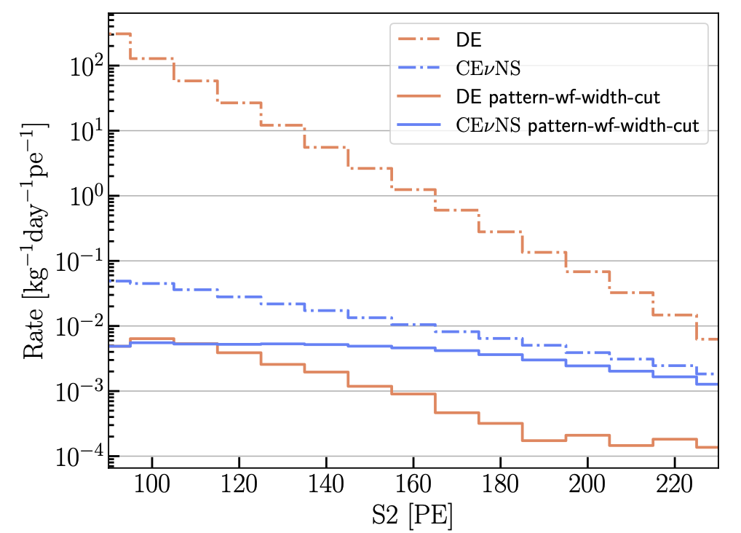
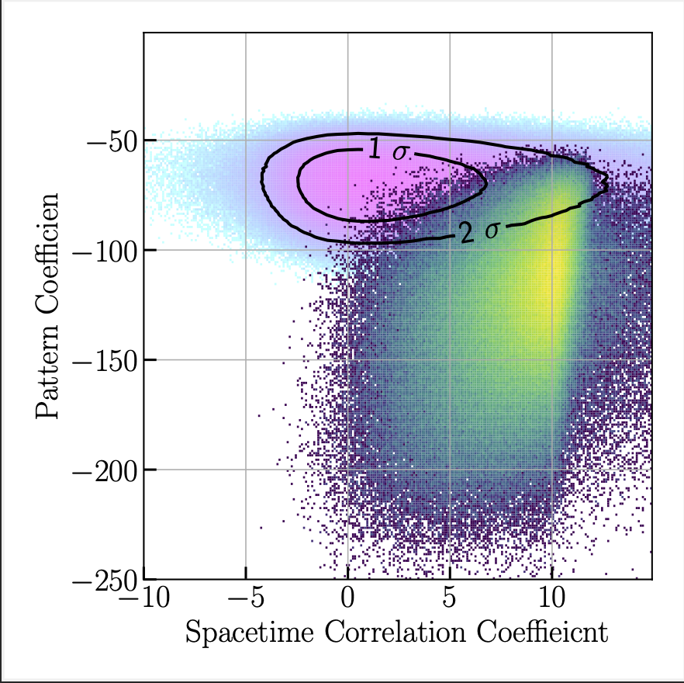
Delayed Electrons Background
 | Acceptance | Background remaining
Waveform Cut | ~80% | ~10%
S2 Pattern Cut | ~52% | <5/1e5
Notes:
没有方法，分数代替成说明图

Slide 10
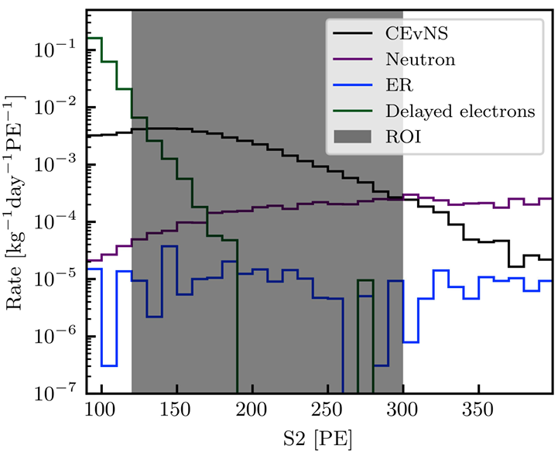
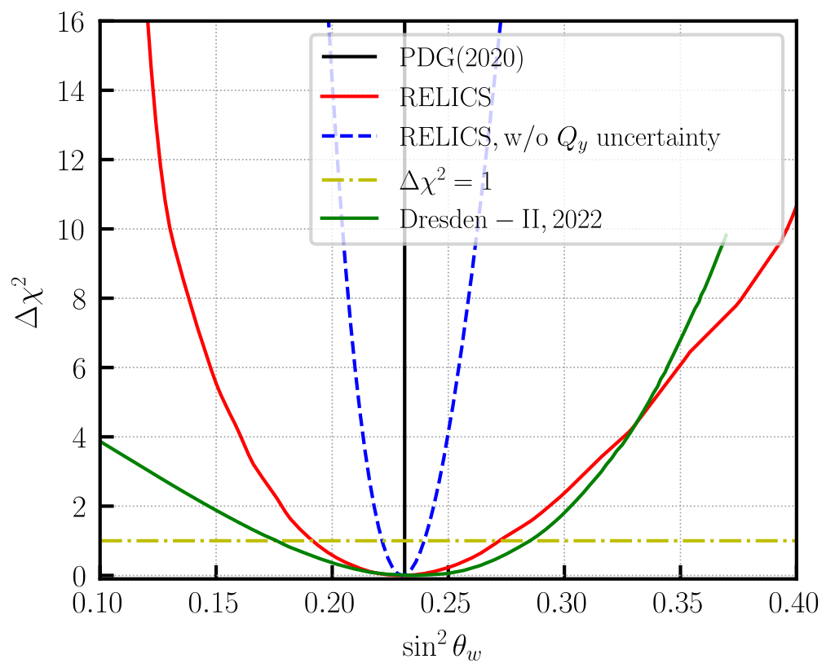
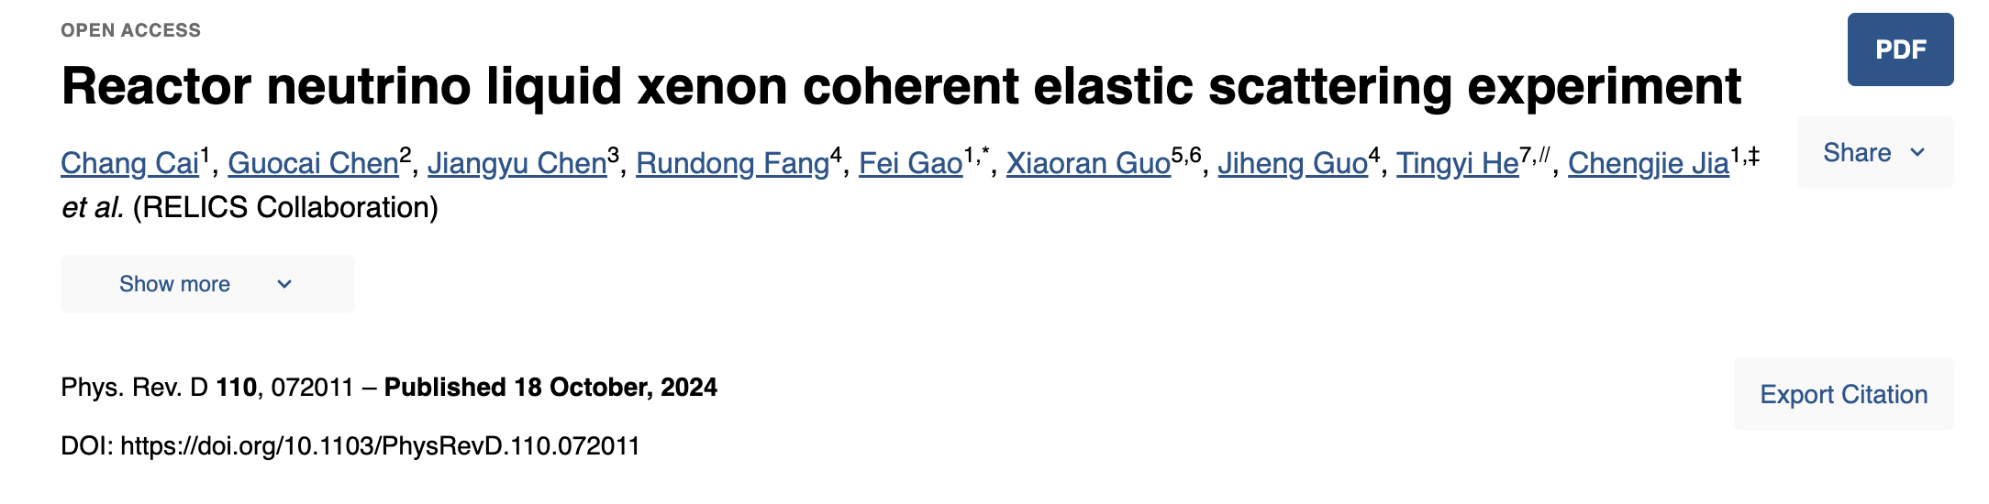
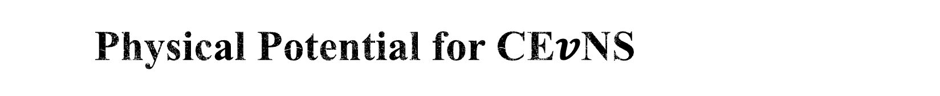
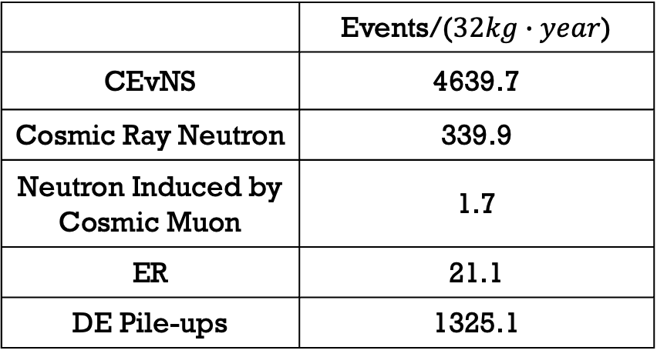
Physical Potential for CE$v$NS
CEvNS ROI: [120, 240] PE
 | Events/($32kg∙year$)
CEvNS | 4639.7
Cosmic Ray Neutron | 339.9
Neutron Induced by Cosmic Muon | 1.7
ER | 21.1
DE Pile-ups | 1325.1
Notes:
强调是projection，预期的结果

Slide 11
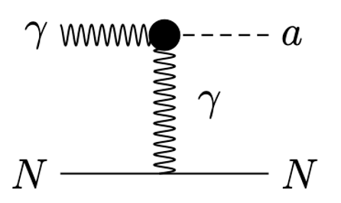
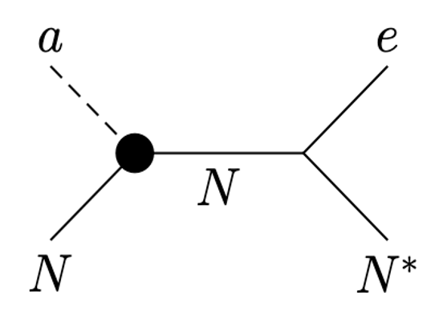
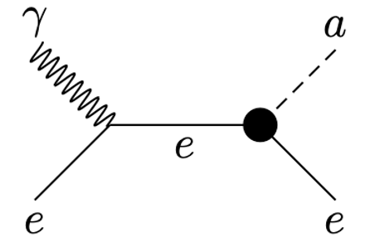
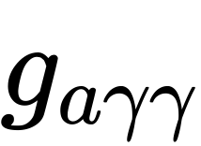
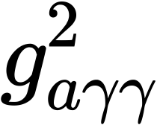
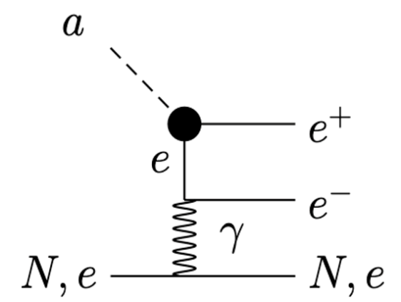
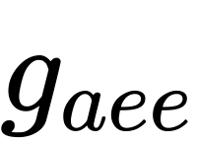
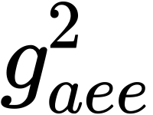
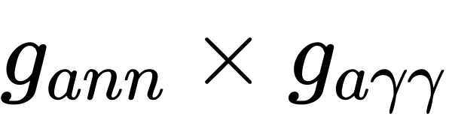
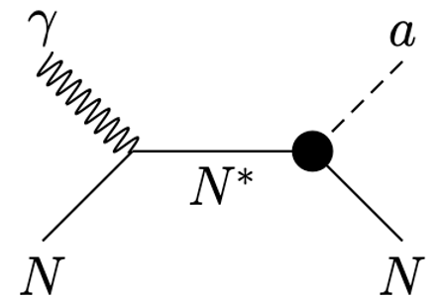
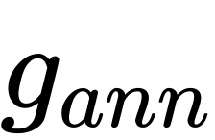
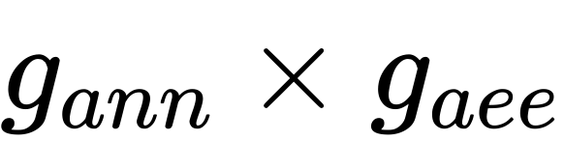
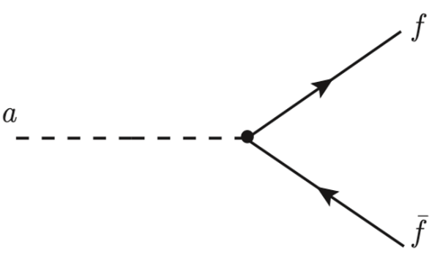
Physical Potential for Axion-like Particles
Production | Signals | Constraints
Primakoff Process ( ) | Inverse Primakoff Process…( )
Compton-like Scattering ( ) | Inverse Compton-like Scattering…( )
De-excitation of nucleus( ) | Inverse Primakoff Process…( ) Inverse Compton-like Scattering…( )

Slide 12
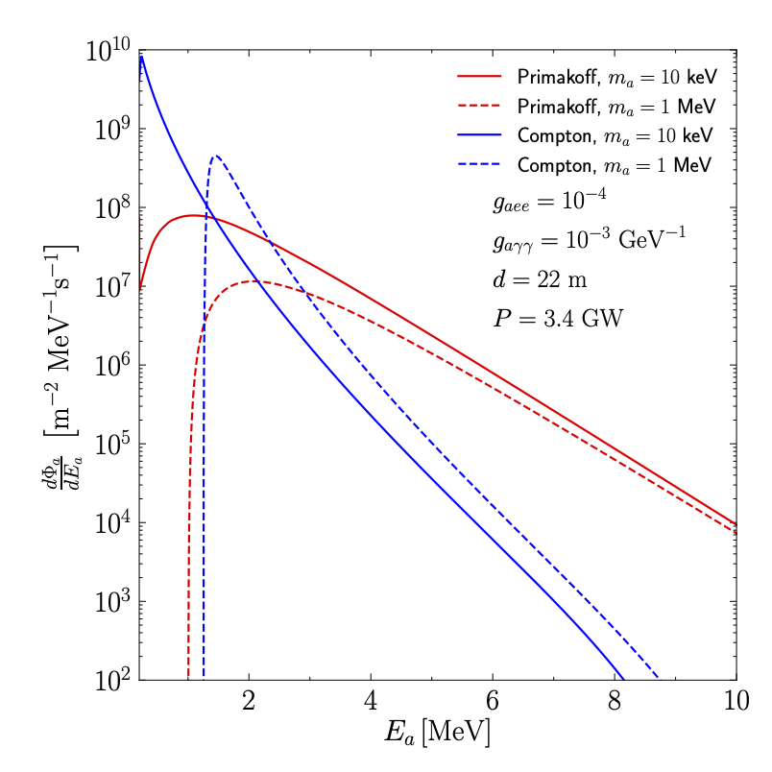
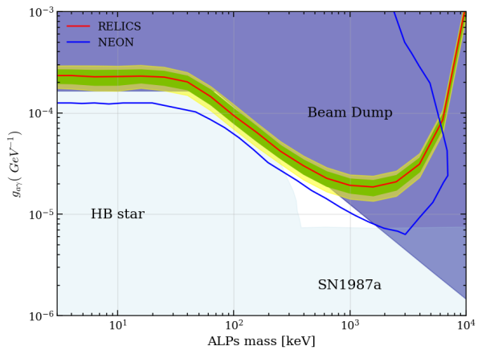
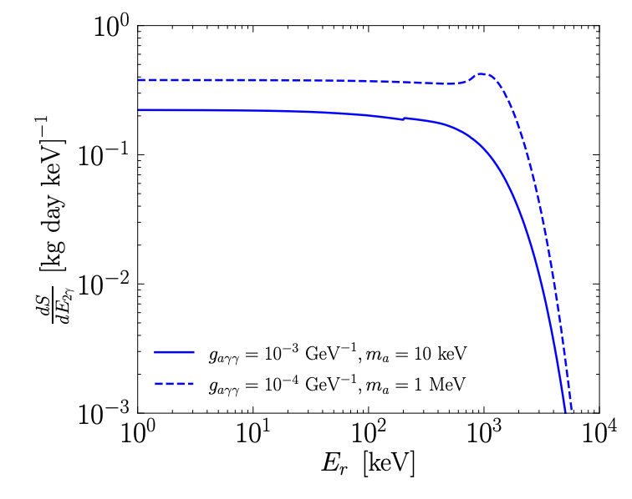
Physical Potential for Axion-like Particles
Preliminary

Slide 13




Relics Prototype
Slow Control
Cooling System
TPC
DAQ
Calibration Sources
Circulation and Getter

Slide 14




Relics Prototype
Active Volume with 0.56 kg LXe
Hamamatsu R8520-406 PMT×14
Ar37
2.82 keV
Kr83m
41.5 keV
Run7
~45 PE
@5000V
Single PE trigger rate > 90%
Sufficient Single-Electron detection efficiency
Ar-37 2.82 keV and Kr-83m 41.5 keV calibrated

Slide 15

Summary
RELICS is designed to detect CE$v$NS signals from reactor neutrinos using LXe-TPC detector
Energy ROI will be [0.3,1] keV, which poses a challenge to the detection capability of few-electrons events, especially under the S2-only signal mode
Delayed-electrons pile-up events will be the dominant background, but can be suppressed by waveform and pattern-spacetime cuts.
The prototype has verified the feasibility of each sub-system for the RELICS experiment and the capability to detect single-electron signals and signals from calibration sources in the low-energy region.

Slide 16








Slide 17
Back Up
Selection 1):Waveform Cut
~80% of the signal acceptance
~90% of rejection power for DE pile-ups

Slide 18



Back Up
Selection 2): Pattern vs Space-time correlation Cut
Higher Pattern Coefficient:
Looks like a point pattern
DE pile-up signal S2 pattern
CEvNS signal S2 pattern
Higher SC-Coefficient:
Closer to previous muon track

Slide 19



Back Up
Pattern Coefficient Calculation:

