Slide 1






The NOvA Test Beam Program
Emerson Bannister
On behalf of the NOvA collaboration
10th June 2025
Test beam uni logos
NOvA logo (all over slides)

Slide 2
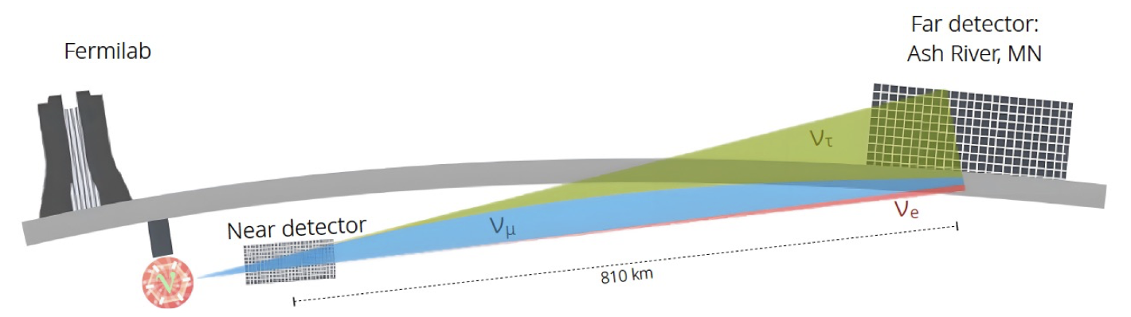
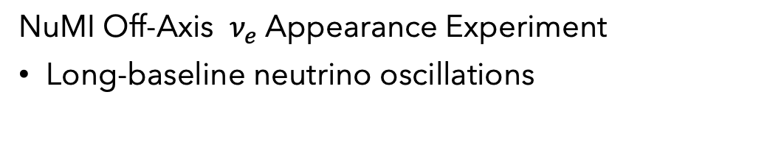
The NOvA Experiment
NuMI Off-Axis $ν_{e}$ Appearance Experiment
Long-baseline neutrino oscillations
14 kton
300 ton
10th June 2025 – WIN 2025 – Emerson Bannister
Notes:
I will start with a brief overview of the nova experiment to set the context for my talk. NOvA is a long-baseline neutrino oscillation experiment. Our neutrino source is the numi beam at Fermilab. We have two functionally identical scintillator detectors, the 300 ton near detector located at Fermilab in Ilinois and the 14,000 ton far detector 810km away in Minnesota.

Slide 3
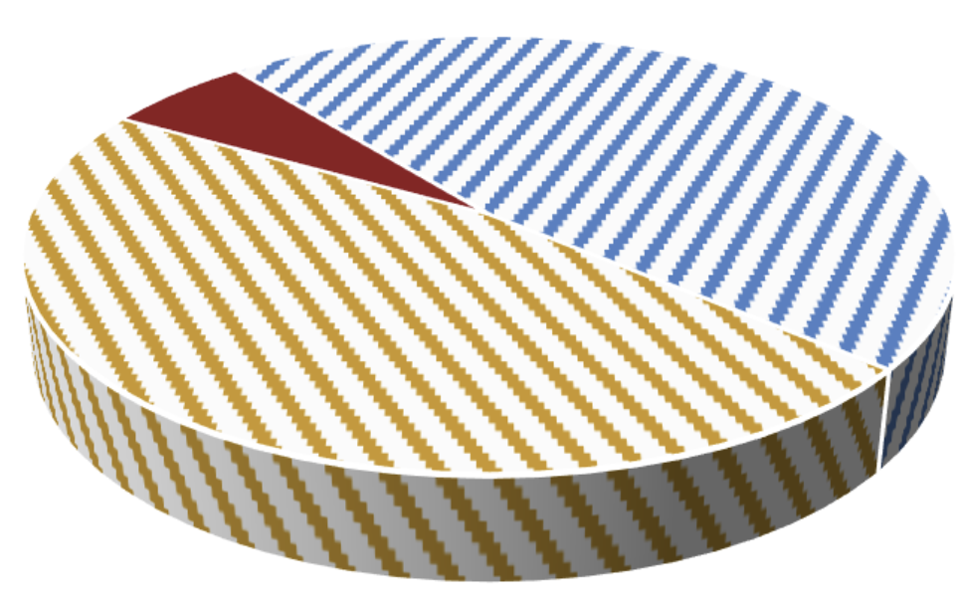
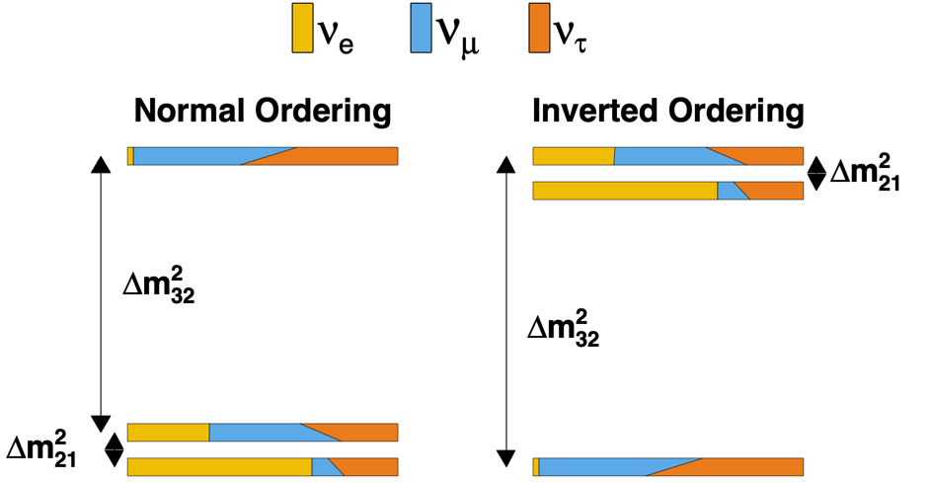
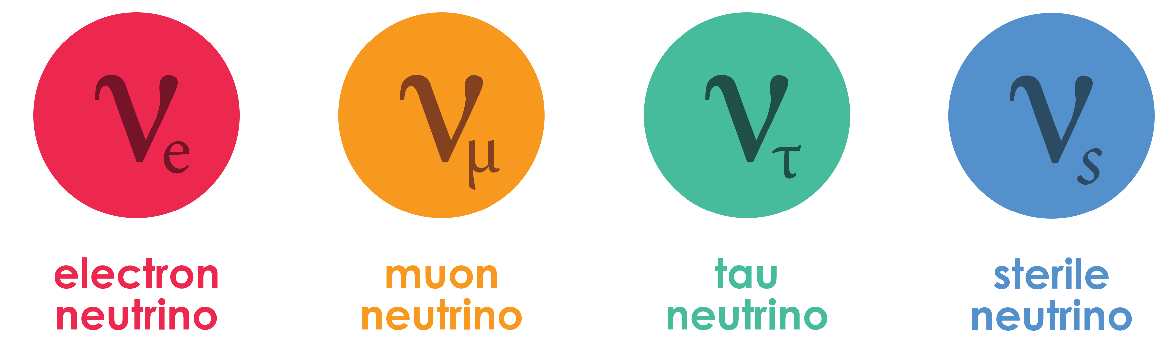





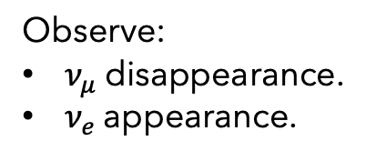
The NOvA Experiment
NOvA Three Flavour Neutrino Oscillation results
Thiago Bezerra
Is $θ_{23}$ maximal?
Observe:
$ν_{μ}$ disappearance.
$ν_{e}$ appearance.
Neutrino mass hierarchy:
Inverted or normal ordering?
$ν_{μ}=ν_{τ} in ν_{3}?$
More analyses:
Sterile neutrino search.
Neutrino cross-sections.
Exotics, ...
$δ_{CP}$: Do neutrinos violate CP?
Matter
Antimatter
3
10th June 2025 – WIN 2025 – Emerson Bannister
Notes:
NOvA aims to make measurements to answer some of the key questions that remain open around neutrino oscillations.

Slide 4
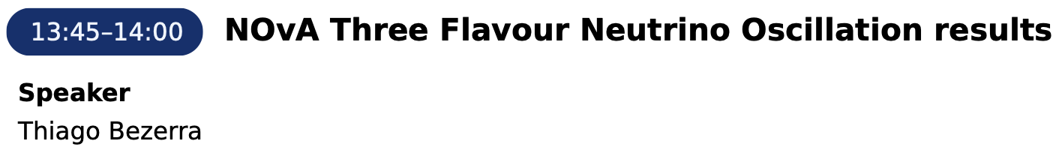




The NOvA Experiment
Tuesday
Is $θ_{23}$ maximal?
Observe:
$ν_{μ}$ disappearance.
$ν_{e}$ appearance.
Neutrino mass hierarchy:
Normal or inverted ordering?
$ν_{μ}=ν_{τ} in ν_{3}?$
More analyses:
Sterile neutrino search.
Neutrino cross-sections.
Exotics, ...
$δ_{CP}$: Do neutrinos violate CP?
Matter
Antimatter
4
10th June 2025 – WIN 2025 – Emerson Bannister
Notes:
Firstly, we've observed muon neutrino disappearance and electron neutrino appearance.

Slide 5

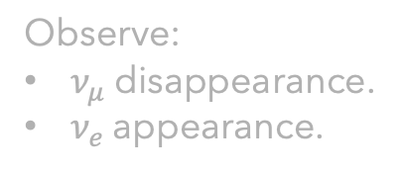
The NOvA Experiment
Tuesday
Is $θ_{23}$ maximal?
Observe:
$ν_{μ}$ disappearance.
$ν_{e}$ appearance.
Neutrino mass hierarchy:
Normal or inverted ordering?
$ν_{μ}=ν_{τ} in ν_{3}?$
More analyses:
Sterile neutrino search.
Neutrino cross-sections.
Exotics, ...
$δ_{CP}$: Do neutrinos violate CP?
Matter
Antimatter
5
10th June 2025 – WIN 2025 – Emerson Bannister
Notes:
We are making a precise measurement of the theta 23 mixing angle.
Is theta 23 maximal? Are nu mu and nu tau equal in nu 3? If not, which way is the balance?

Slide 6
The NOvA Experiment
Tuesday
Is $θ_{23}$ maximal?
Observe:
$ν_{μ}$ disappearance.
$ν_{e}$ appearance.
Neutrino mass hierarchy:
Normal or inverted ordering?
$ν_{μ}=ν_{τ} in ν_{3}?$
More analyses:
Sterile neutrino search.
Neutrino cross-sections.
Exotics, ...
$δ_{CP}$: Do neutrinos violate CP?
Matter
Antimatter
6
10th June 2025 – WIN 2025 – Emerson Bannister
Notes:
What is the neutrino mass hierarchy? Is the ordering normal or inverted?

Slide 7

The NOvA Experiment
Tuesday
Is $θ_{23}$ maximal?
Observe:
$ν_{μ}$ disappearance.
$ν_{e}$ appearance.
Neutrino mass hierarchy:
Normal or inverted ordering?
$ν_{μ}=ν_{τ} in ν_{3}?$
More analyses:
Sterile neutrino search.
Neutrino cross-sections.
Exotics, ...
$δ_{CP}$: Do neutrinos violate CP?
Matter
Antimatter
7
10th June 2025 – WIN 2025 – Emerson Bannister
Notes:
Do neutrinos violate CP symmetry? Lepton CP violation could provide a path forward towards explaining matter-antimatter asymmetry in the early universe.

Slide 8
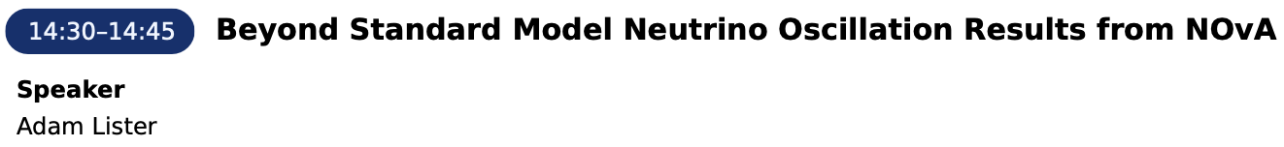
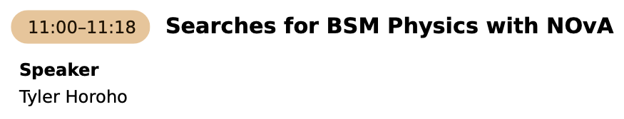
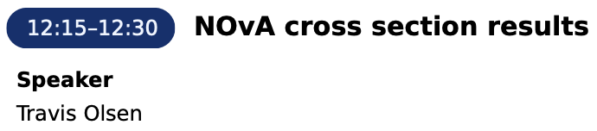
The NOvA Experiment
Tuesday
More analyses:
Sterile neutrino search.
Neutrino cross-sections.
Exotics, ...
Wednesday
Wednesday
8
10th June 2025 – WIN 2025 – Emerson Bannister
Notes:
NOvA has a wide physics program outside of 3 flavour analyses such as a sterile neutrino search, neutrino cross sections, and exotics.

Slide 9
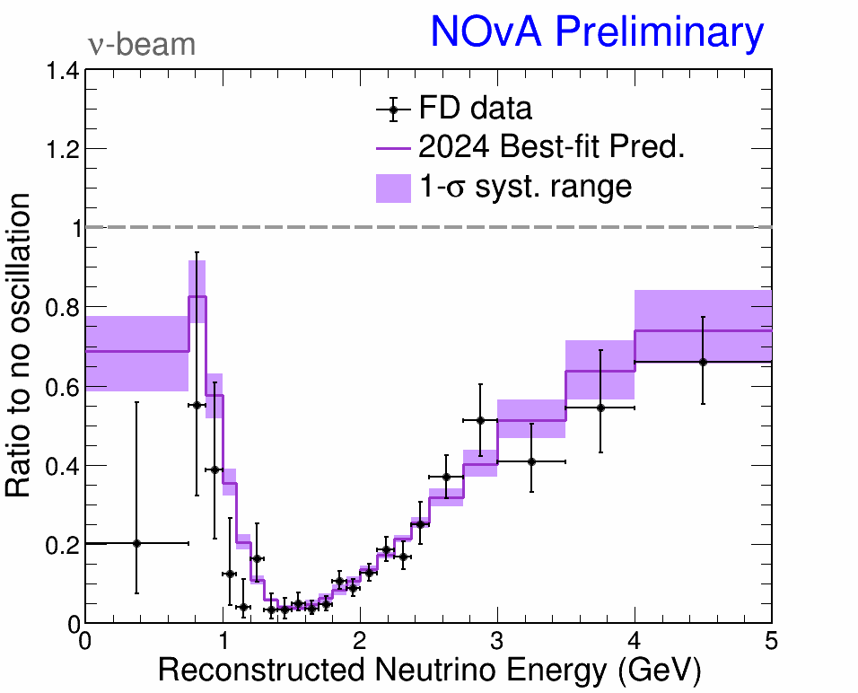
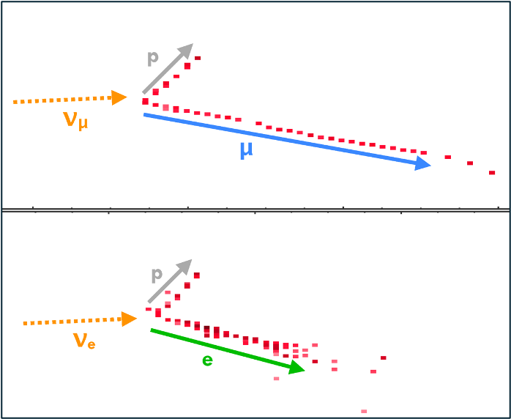
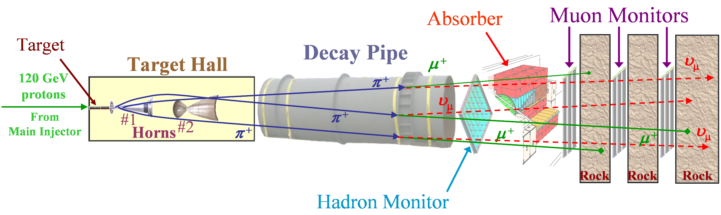
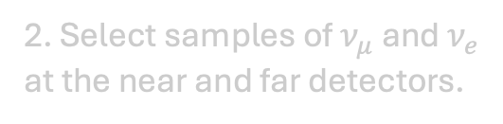
The NOvA Experiment
2. Select samples of $ν_{μ}$ and $ν_{e}$ at the near and far detectors.
3. Fit neutrino energy spectra.
1. Produce a beam of muon (anti)neutrinos.
9
10th June 2025 – WIN 2025 – Emerson Bannister
Notes:
A beam of muon neutrinos or antineutrinos is produced at fermilab

Slide 10
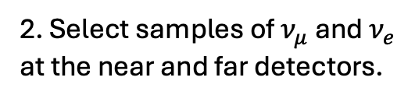
The NOvA Experiment
2. Select samples of $ν_{μ}$ and $ν_{e}$ at the near and far detectors.
3. Fit neutrino energy spectra.
1. Produce a beam of muon (anti)neutrinos.
10
10
10th June 2025 – WIN 2025 – Emerson Bannister
Notes:
We select samples of muon neutrinos and electron neutrinos at the near and far detectors respectively

Slide 11
The NOvA Experiment
2. Select samples of $ν_{μ}$ and $ν_{e}$ at the near and far detectors.
3. Fit neutrino energy spectra.
1. Produce a beam of muon (anti)neutrinos.
11
11
10th June 2025 – WIN 2025 – Emerson Bannister
Notes:
We fit the neutrino energy spectra at the far detector, and take the ratio of muon neutrinos in our data to the non-oscillation predictions

Slide 12
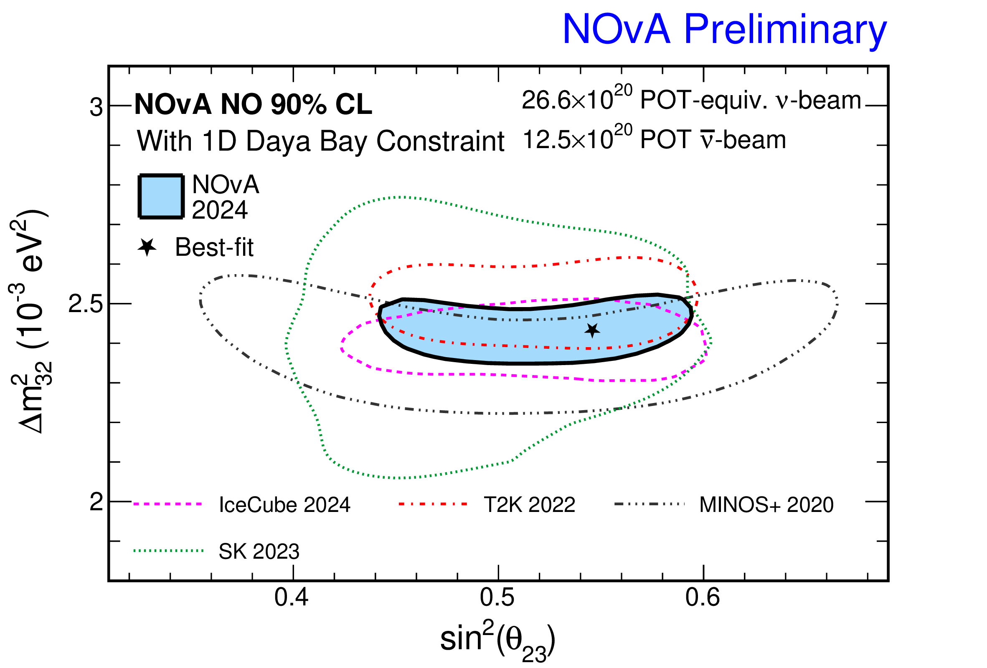


The NOvA Test Beam Program: Motivation
Fit neutrino energy spectra
Extract oscillation parameters
$$Δm_{32}^{2}$$
Version Thiago used without the other experiments?
$$θ_{23}$$
12
12
10th June 2025 – WIN 2025 – Emerson Bannister
Notes:
From that fit, we can extract the oscillation parameters: the theta 23 mixing angle, and the 32 mass splitting. On the right are our latest results from our 2024 analysis showing our best fit values for sin squared theta 23 and delta m squared 32 with our 90% confidence level limits and a comparison with other neutrino experiments.
The motivation for nova’s test beam program is to shrink the uncertainty region by reducing systematic uncertainties.

Slide 13
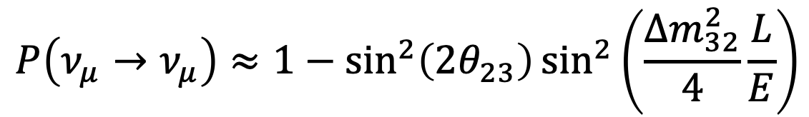
The NOvA Test Beam Program: Motivation
Fit neutrino energy spectra
$$P\left(ν_{μ}→ν_{μ}\right)≈1−\sin^{2}\left(2θ_{23}\right)\sin^{2}\left(\frac{Δm_{32}^{2}}{4}\frac{L}{E}\right)$$
$$Δm_{32}^{2}$$
Version Thiago used without the other experiments?
$$θ_{23}$$
Fixed L: Distance between near and far detectors.
Need to know E.
13
13
10th June 2025 – WIN 2025 – Emerson Bannister
Notes:
The parameters we are measuring depend on L over E. The distance travelled by the neutrino over it’s energy. L is fixed, it’s the distance between the near and far detectors. So we need to know E as well as possible. This motivates the test beam program – to improve our understanding of the detector’s response to neutrinos.

Slide 14
The NOvA Test Beam Program: Motivation
The Test Beam Program can reduce the largest systematic uncertainty on NOvA measurements.
Goals:
Improve NOvA detector calibration.
Improve detector response and energy reconstruction.
Notes:
Here is the breakdown of NOvA’s systematic uncertainties on the measurements of sin squared theta 23, delta m squared 32 and delta CP. You can see that our largest systematic uncertainty is from our detector calibration. The test beam program can help to reduce the size of the detector calibration uncertainty. So the main goals of the test beam program are to improve NOvA detector calibration, and improve the characterization of the detector response and energy reconstruction.

Slide 15
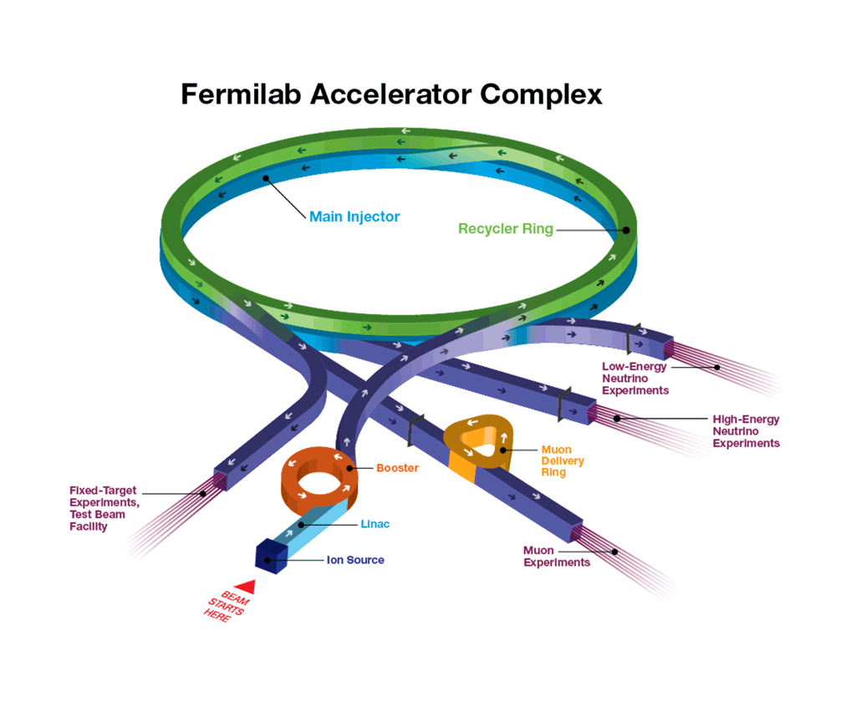

Is this needed?
MCenter Beam
120 GeV/c protons from the Main Injector interact with a primary target.
Secondary beam of 64 GeV/c protons and pions.
Second copper target.
Fixed target experiments, Test Beam facility
Beam of $e,μ,π,K, p$.
15
10th June 2025 – WIN 2025 – Emerson Bannister
Notes:
Now onto the test beam experiment itself, which took data between 2020 and 2022. It used the Fermilab test beam facility. It start withs 120 GeV protons from the main injector that interact with a primary target (copper?) which produces a secondary beam of 64 GeV protons and pions which are incident on a second copper target produce a beam of electrons, muons, pions, kaons and protons. This is the beam used for our test beam experiment.

Slide 16
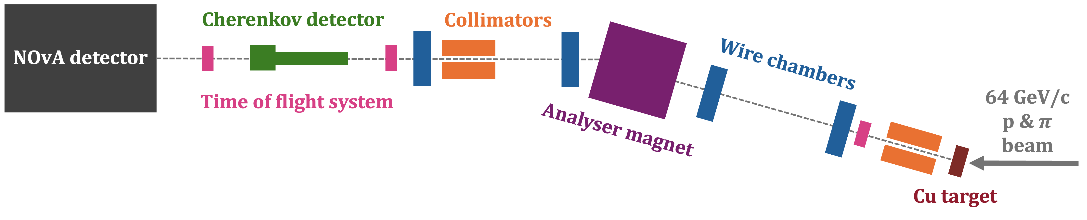
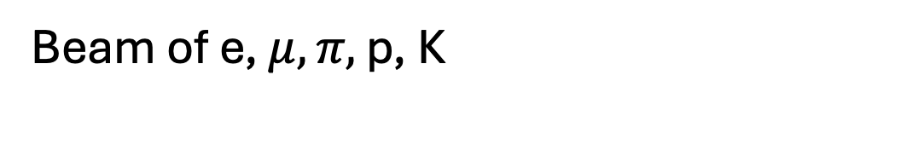
Instrumentation
Beam of e, $μ, π,$ p, K
16
10th June 2025 – WIN 2025 – Emerson Bannister
Notes:
So that beam of electrons, muons, pions, kaons and protons are produced here after the secondary beam hits the copper target. This is the instrumentation used for particle identification and selection.

Slide 17
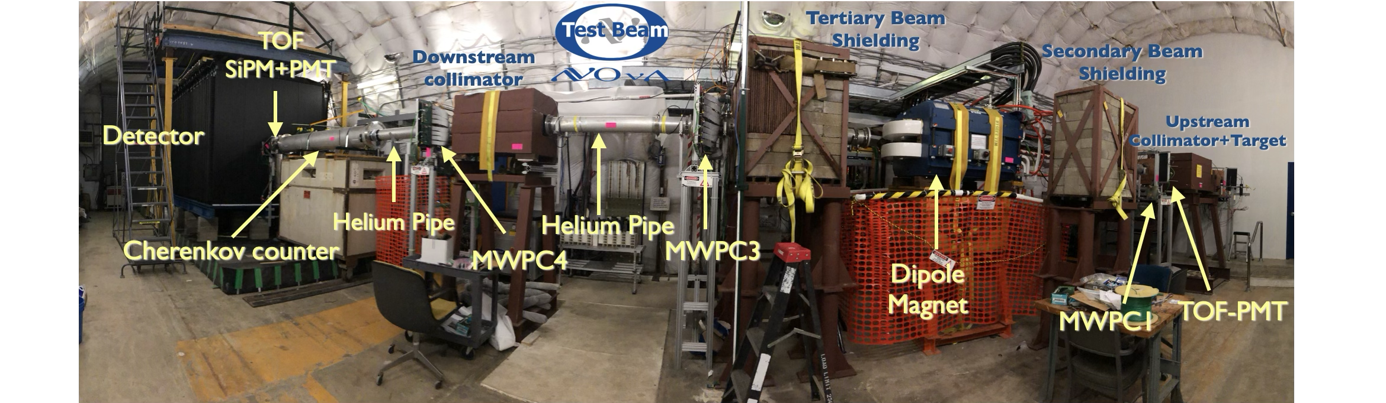
Instrumentation
17
10th June 2025 – WIN 2025 – Emerson Bannister
Notes:
So that beam of electrons, muons, pions, kaons and protons are produced here after the secondary beam hits the copper target. This is the instrumentation used for particle identification and selection.

Slide 18
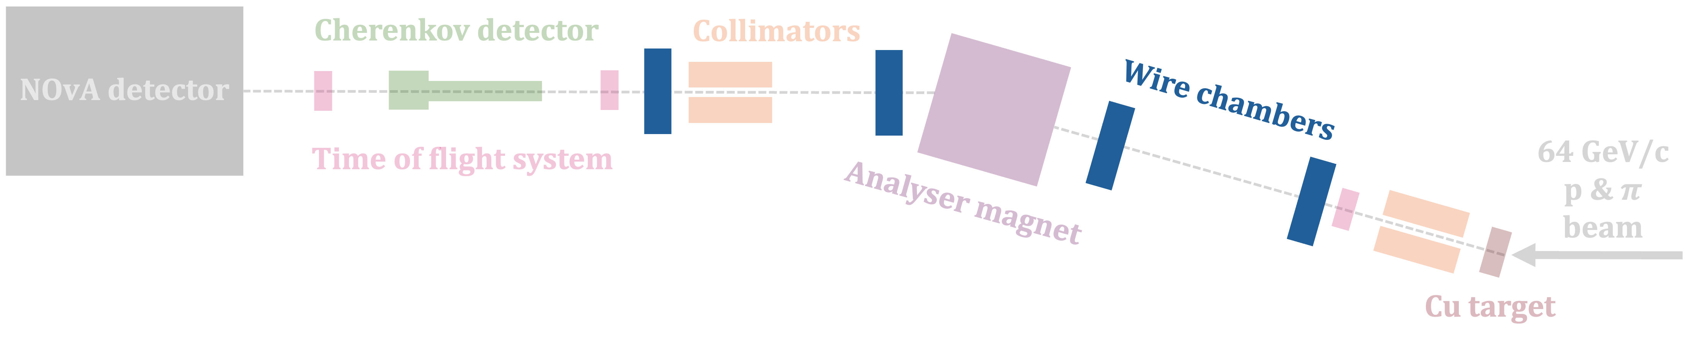
Instrumentation
Multiwire proportional chambers: Particle tracking and momentum reconstruction.
  Ionisation detector.
  85% argon, 15% isobutane gas mixture.
  Gold-tungsten wires.
Photo? Diagram?
Look at LArIAT
18
10th June 2025 – WIN 2025 – Emerson Bannister
Notes:
There are four multiwire proportional chambers along the beamline, which are ionisation detectors containing an argon gas mixture, with gold-tungsten wires. The wire chambers are used for particle tracking and momentum reconstruction.

Slide 19
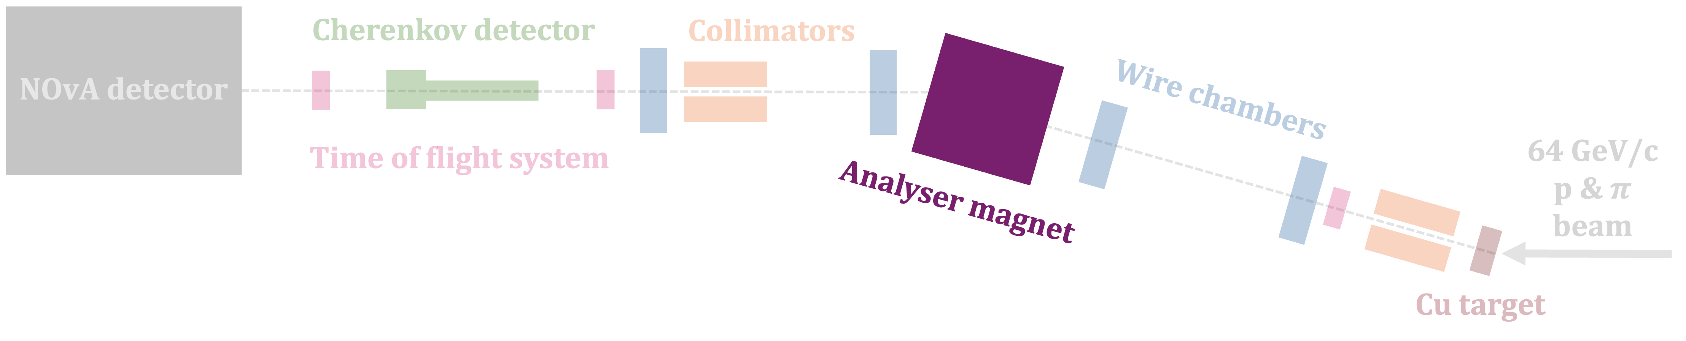
Instrumentation
±1000 A
Analyser magnet: To select the particle momentum and charge of interest.
0.4 – 1.5 GeV/c
±500 A
±750 A
±1250 A
19
10th June 2025 – WIN 2025 – Emerson Bannister
Notes:
The spectrometer magnet selects the momentum range of particles entering the downstream instrumentation.
Data was taken with the magnet current at 4 different levels, in both polarities in order to look at positively and negatively charged particles.
This plot shows the reconstructed momentum of our candidate events for all particles in the beam. Each momentum peak corresponds to the different magnet currents we took data with.

Slide 20
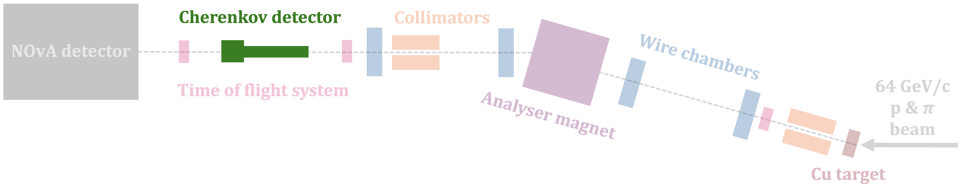
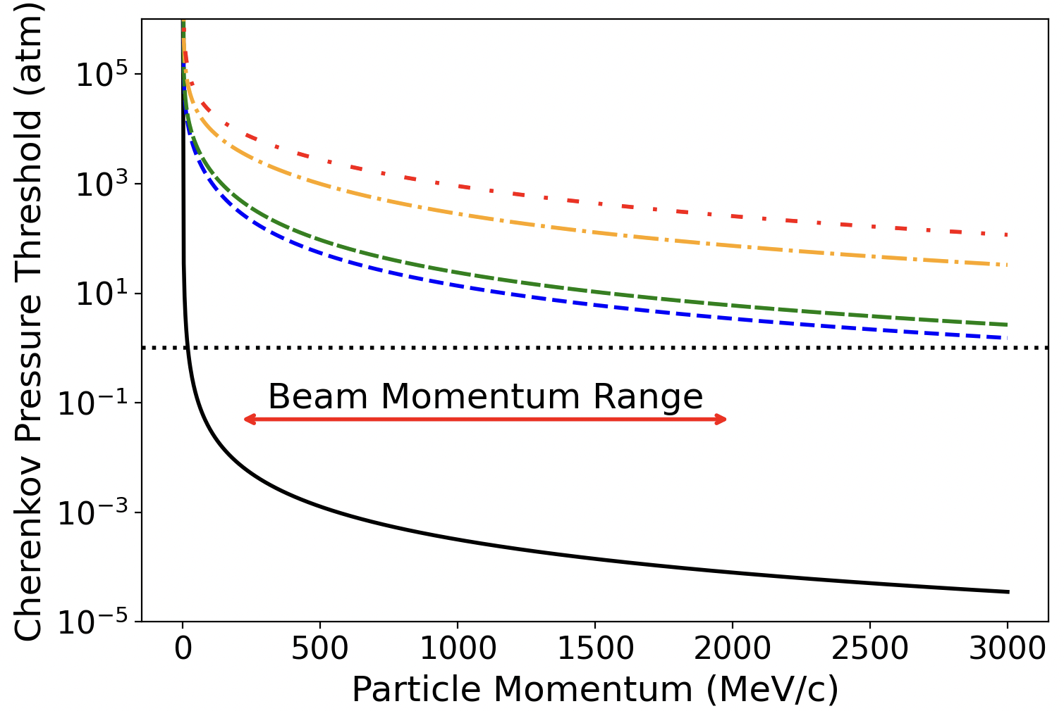
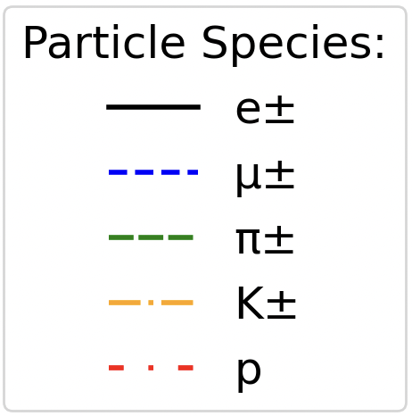
Instrumentation
Cherenkov detector: Electron tagging.
20
10th June 2025 – WIN 2025 – Emerson Bannister
Figure 14: Relationship between momentum and Cherenkov pressure threshold for the particle species produced in the NOvA TB experiment. The dashed black line is the 1atm. pressure line at which the Cherenkov Counter operated. This value is only above the threshold pressure for e± in the expected beamline momentum range (shown with the red arrow).
Notes:
A Cherenkov detector allowed us to identify electrons. This plot shows the relationship between momentum and Cherenkov pressure threshold for the particles in the beam. The dashed line is the pressure that the detector operated at, so you can see that the pressure is only above the threshold for electrons in the beam momentum range, so we know if there is Cherenkov light, it came from an electron.

Slide 21
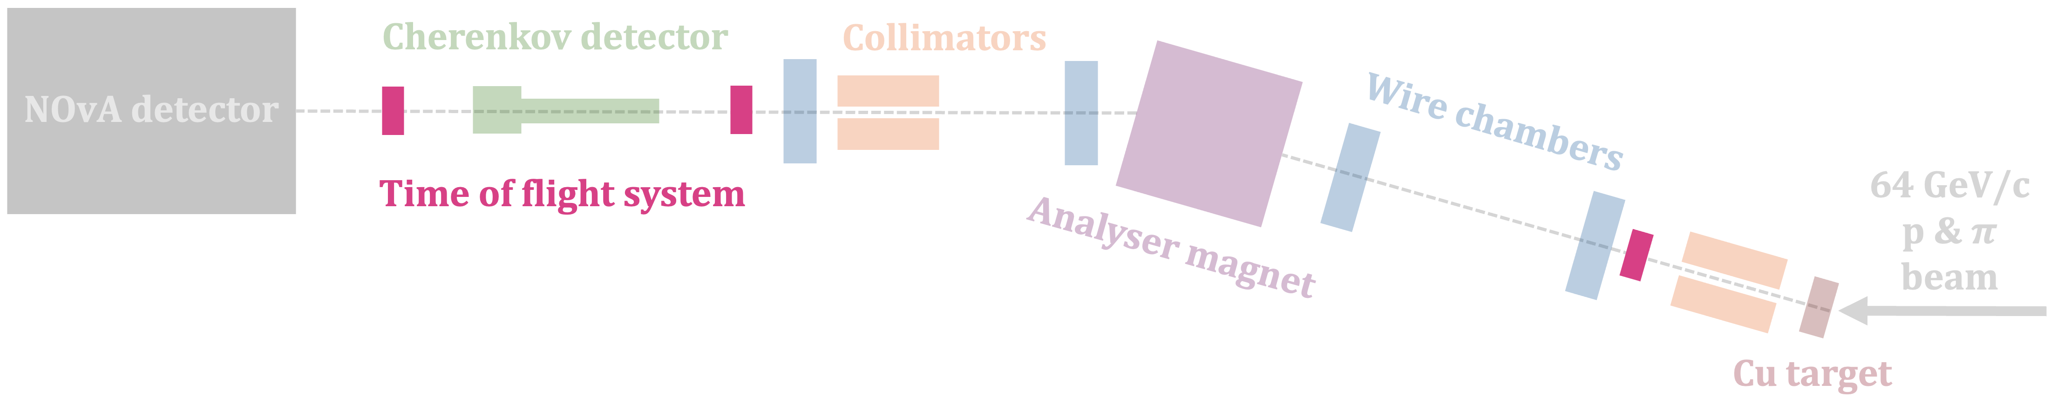
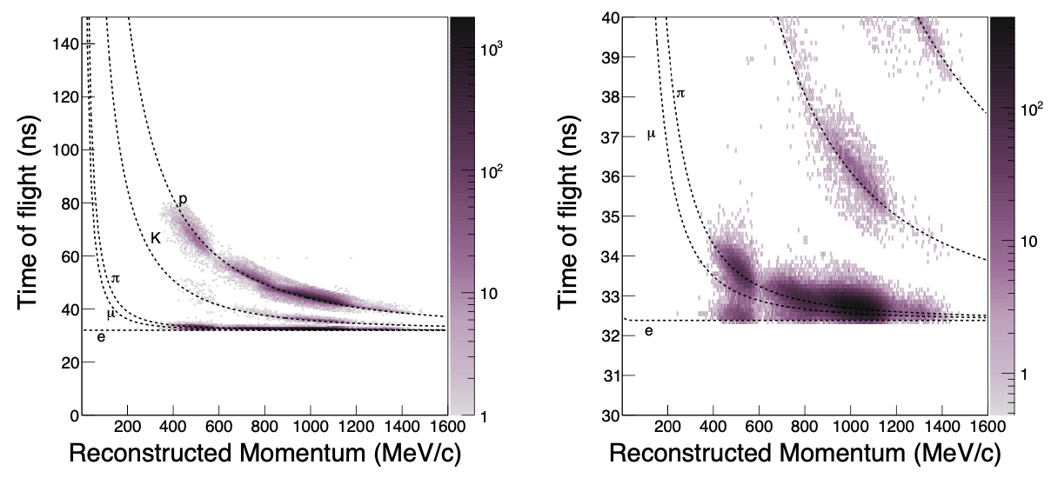
Instrumentation
Time of flight system: Identification of heavier particles (protons and kaons).
21
10th June 2025 – WIN 2025 – Emerson Bannister
Figure 33: The reconstructed time-of-flight versus momentum in data after applying beamline data quality and particle ID selections on mass and time-of-flight, described in the text, left: the full range of phase space, right: zoom in on low time-of-flight region, highlighting the difficulty we would have in separating electrons from muons and pions without the inclusion of a Cherenkov detector in the tertiary beamline.
Notes:
There was a time of flight system spanning the beamline. This plot shows the reconstructed time of flight versus momentum in data, after applying data quality particle ID selections on mass and time of flight. So you can see how we are able to use the time of flight and momentum to identify the heavier particles, protons and kaons. We are unable to separate electrons from muons and pions, hence the need for the Cherenkov detector for electron tagging.

Slide 22

Instrumentation
Reconstructed momentum and time of flight.
Reconstructed mass of particles.
Used to ID protons and kaons.
Sets upper bound for pion mass.
Electrons separated by Cherenkov detector.
22
10th June 2025 – WIN 2025 – Emerson Bannister
The reconstructed mass of particles passing the preliminary selections in Tab. 6 using the reconstructed momentum and time of flight as per Eq. 13. The mass of light particles using this technique does not reproduce the particle mass because the calculation relies on time-of-flight measurements that cannot be resolved between pions and electrons - they differ by only a fraction of a nanosecond over the distance of ∼9.7m used in this experimental setup. Because of this, only an upper bound of 300MeV is used for the pion selection criteria. The reconstructed masses of protons and kaons are however a decent proxy for the mass of the particle, and are therefore used for particle ID
Notes:
Finally, we use all components of the instrumentation that have provided the reconstructed momentum and time of flight of the beam particles to reconstruct the mass of the particles. This plot shows those reconstructed masses. These are used to identify protons and kaons, and to set an upper bound for pion mass. We don’t have the time of flight resolution to reconstruct the electron mass so electrons are separated from pions by the Cherenkov detector.

Slide 23
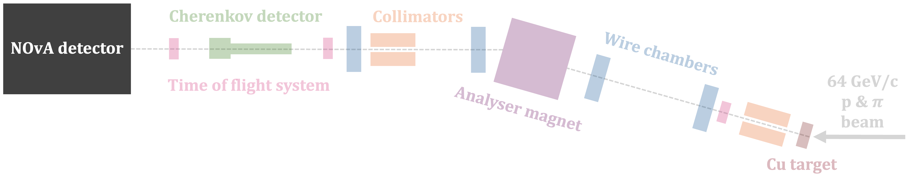
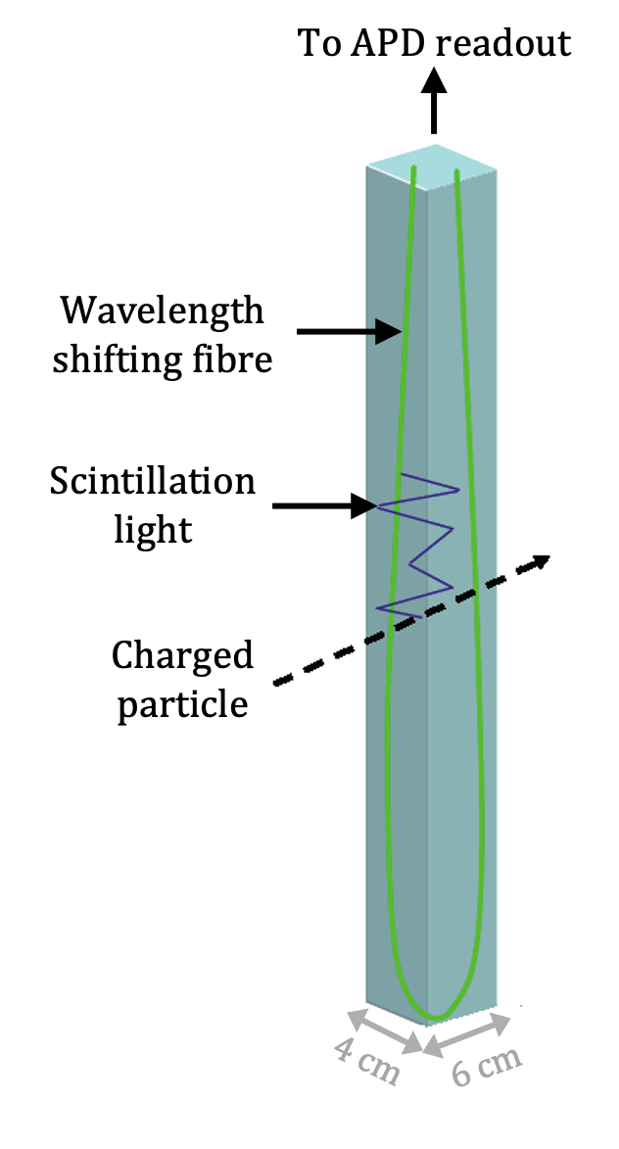
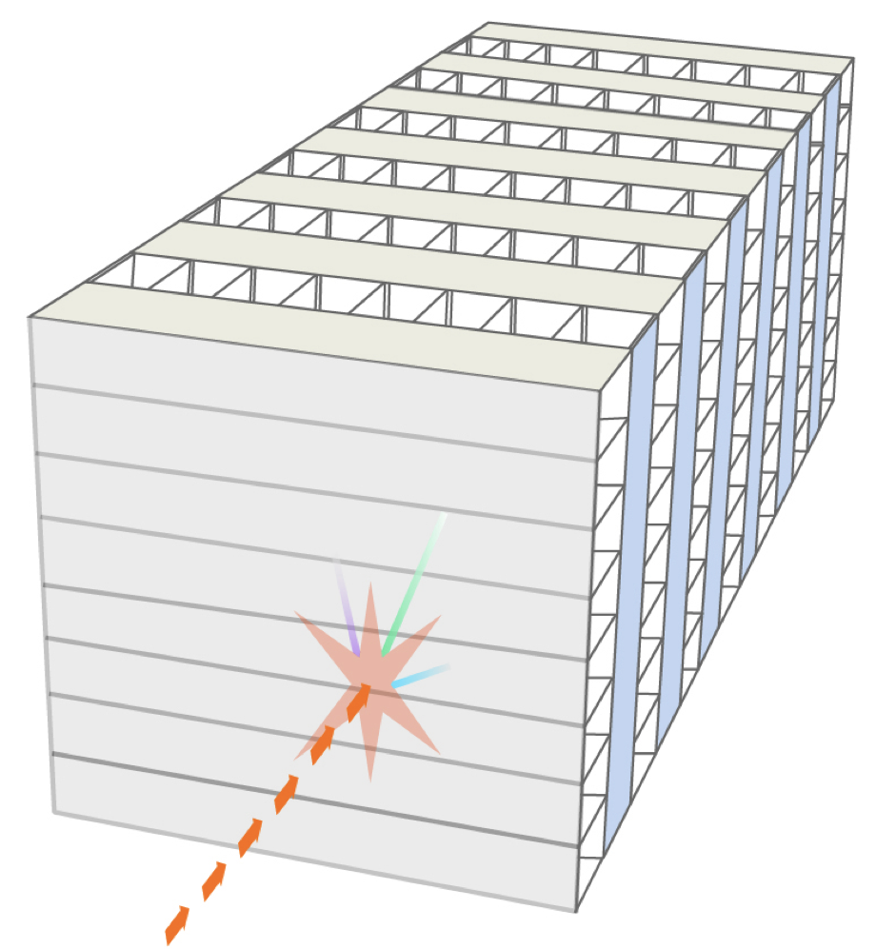
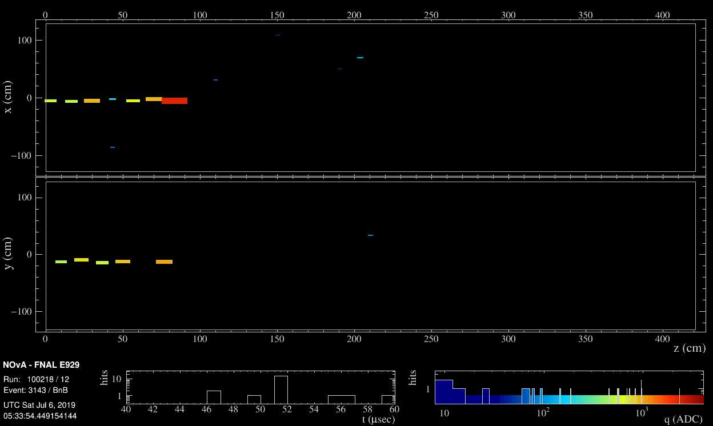
Instrumentation
30 ton scaled-down NOvA detector.
  Liquid scintillator.
  Segmented.
Know the number of planes and cells in TB detector and dimensions
PROTON
23
10th June 2025 – WIN 2025 – Emerson Bannister
Notes:
Then, most importantly, the particles enter our scaled down nova detector. The test beam detector was 30 tons, DIMENSIONS. NOvA detectors are segmented liquid scintillator detectors. They consist of these long PVC cells filled with liquid scintillator and have a wavelength shifting fibre looped inside. These cells are arranged in planes in alternating perpendicular directions, which allows 3D reconstruction. Here is an example event display showing a proton track in the test beam detector.

Slide 24
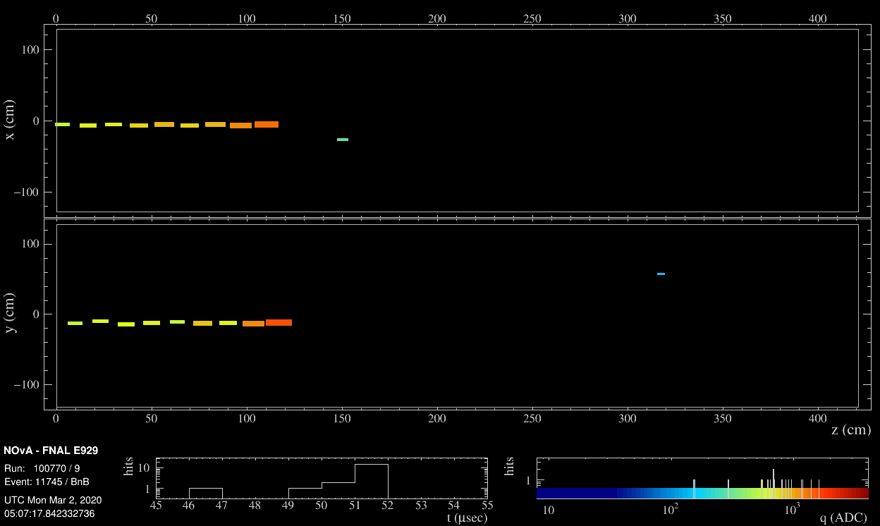
Event Displays
1.0 GeV/c PROTON
Know the number of planes and cells in TB detector and dimensions
24
10th June 2025 – WIN 2025 – Emerson Bannister
Notes:
Then, most importantly, the particles enter our scaled down nova detector. The test beam detector was 30 tons, DIMENSIONS. NOvA detectors are segmented liquid scintillator detectors. They consist of these long PVC cells filled with liquid scintillator and have a wavelength shifting fibre looped inside. These cells are arranged in planes in alternating perpendicular directions, which allows 3D reconstruction. Here is an example event display showing a proton track in the test beam detector.

Slide 25
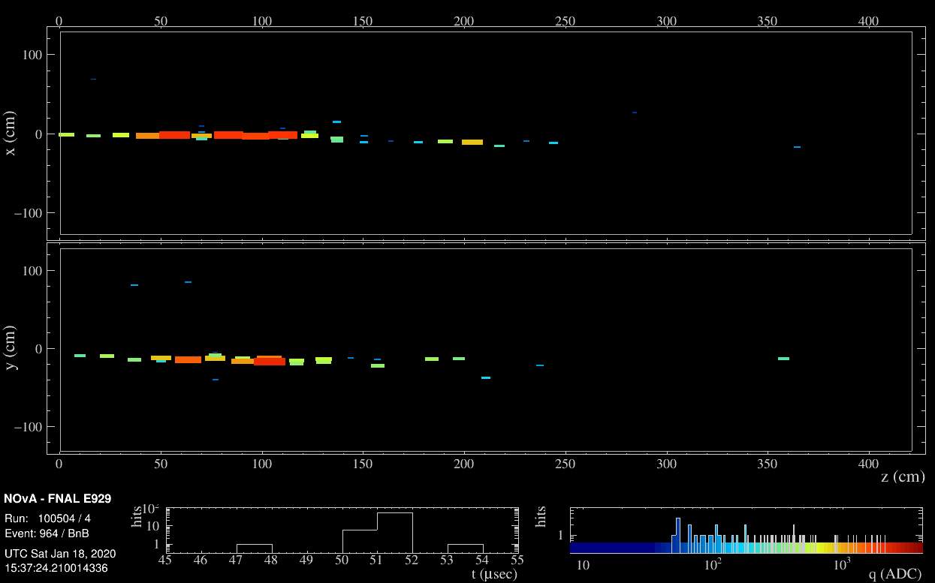
Event Displays
1.3 GeV/c ELECTRON
Know the number of planes and cells in TB detector and dimensions
25
10th June 2025 – WIN 2025 – Emerson Bannister
Notes:
Then, most importantly, the particles enter our scaled down nova detector. The test beam detector was 30 tons, DIMENSIONS. NOvA detectors are segmented liquid scintillator detectors. They consist of these long PVC cells filled with liquid scintillator and have a wavelength shifting fibre looped inside. These cells are arranged in planes in alternating perpendicular directions, which allows 3D reconstruction. Here is an example event display showing a proton track in the test beam detector.

Slide 26
Summary and Outlook
NOvA’s Test Beam Program: To reduce NOvA’s detector calibration and detector response systematic uncertainties.
Instrumentation for particle momentum and time of flight reconstruction → particle mass reconstruction → particle ID.
26
10th June 2025 – WIN 2025 – Emerson Bannister
Notes:
To summarise, I have shown NOvA’s test beam program which aims to reduce NOvA’s detector calibration and detecto response systematic uncertainties.
I showed the instrumentation we used for particle momentum and time of flight reconstrctuion that is used for particle pass reconstruction and ultimately particle identification.

Slide 27
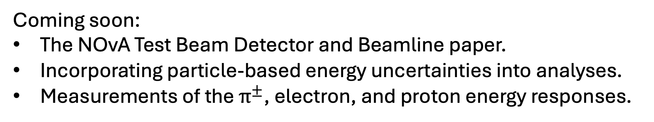
Summary and Outlook
NOvA’s Test Beam Program: To reduce NOvA’s detector calibration and detector response systematic uncertainties.
Instrumentation for particle momentum and time of flight reconstruction → particle mass reconstruction → particle ID.
Coming soon:
The NOvA Test Beam Detector and Beamline paper.
Incorporating particle-based energy uncertainties into analyses.
Measurements of the $π^{±}$, electron, and proton energy responses.
27
10th June 2025 – WIN 2025 – Emerson Bannister
Energy response = reconstructed energy / incident energy
Notes:
Soon we will be submitting the NOvA test beam detector and beamline paper to journal.
We are incorporating particle-based energy uncertainties into the software framework for 3-favour and other analyses.
And measurements of the pion and proton energy responses will soon be public.

Slide 28
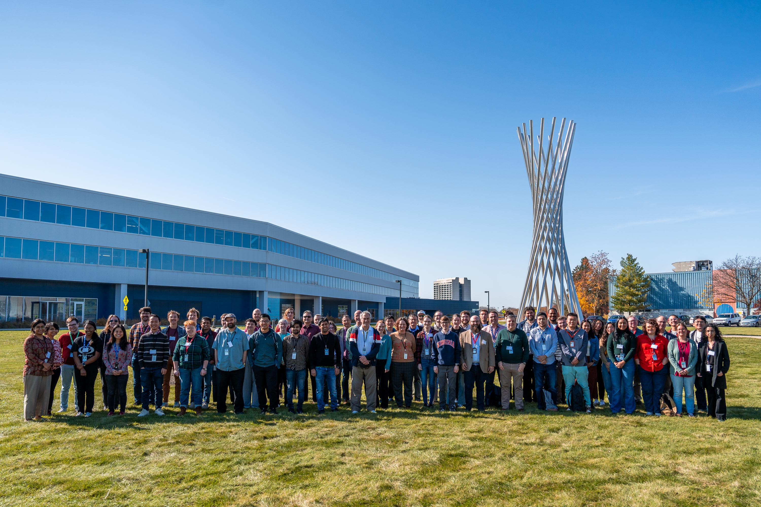
Thank you!
28
10th June 2025 – WIN 2025 – Emerson Bannister
Notes:
Soon we will be submitting the NOvA test beam detector and beamline paper to journal.
We are incorporating particle-based energy uncertainties into the software framework for 3-favour and other analyses.
And measurements of the pion and energy responses will soon be public.

Slide 29
Backup

Slide 30
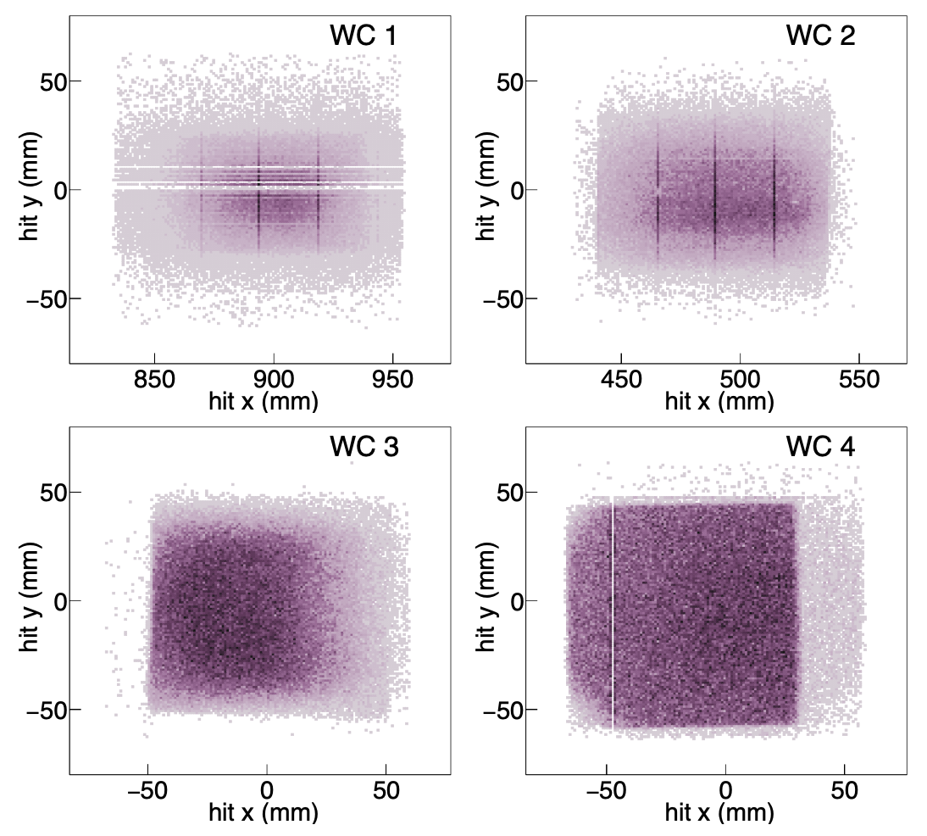
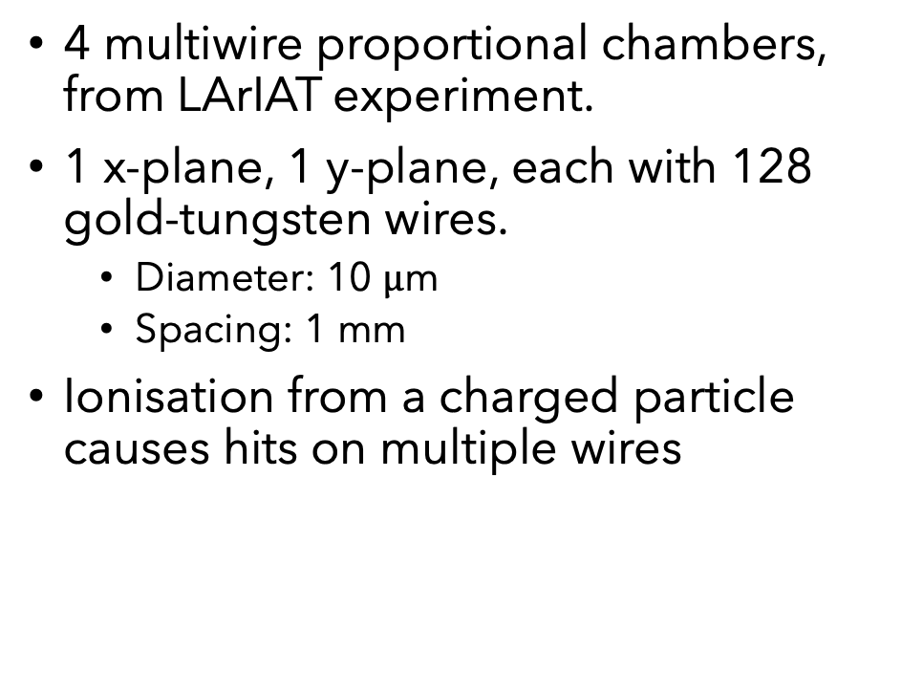
MWPC
4 multiwire proportional chambers, from LArIAT experiment.
1 x-plane, 1 y-plane, each with 128 gold-tungsten wires.
  Diameter: 10 $μ$m
  Spacing: 1 mm
Ionisation from a charged particle causes hits on multiple wires
Notes:
The NOvA Test Beam used four multiwire proportional chambers (MWPCs), provided by
230 FTBF, and previously used by the LArIAT [12] experiment. Each wire chamber consisted
231 of one x-plane and one y-plane, each with 128 sense wires. The gold-tungsten sense wires
232 were 10 μm in diameter and spaced at 1 mm.
FTBF? Fermilab test beam facility?
The chambers were filled with 85% argon,
238 15% isobutane gas mixture that was flowed constantly.
Liquid argon?
The Wire Chamber Track best hit position in each of the four wire chambers, relative to the center of the front face of the NOvA TB detector. The best hit is the hit that was attributed to the best track fit, where the fit required all four wire chambers have a hit. These figures represent the state of the MWPCs in the final period (Period 4) of data taking, and illustrate the missing wires in MWPC1, noisy vertical wires in MWPC1 and MWPC2, a slight rotation in MWPC3, and one missing wire in MWPC4.

Slide 31
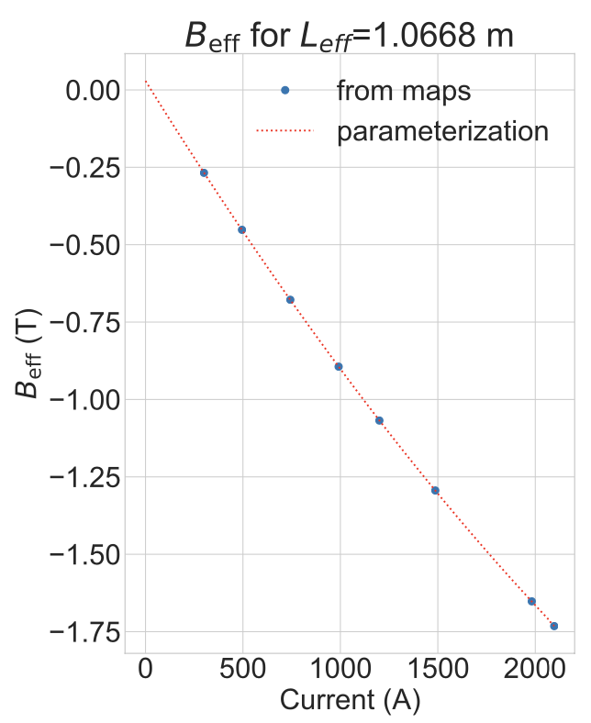

Magnet
Notes:
The NOvA Test Beam used four multiwire proportional chambers (MWPCs), provided by
230 FTBF, and previously used by the LArIAT [12] experiment. Each wire chamber consisted
231 of one x-plane and one y-plane, each with 128 sense wires. The gold-tungsten sense wires
232 were 10 μm in diameter and spaced at 1 mm.
FTBF? Fermilab test beam facility?
The chambers were filled with 85% argon,
238 15% isobutane gas mixture that was flowed constantly.
Liquid argon?
The Wire Chamber Track best hit position in each of the four wire chambers, relative to the center of the front face of the NOvA TB detector. The best hit is the hit that was attributed to the best track fit, where the fit required all four wire chambers have a hit. These figures represent the state of the MWPCs in the final period (Period 4) of data taking, and illustrate the missing wires in MWPC1, noisy vertical wires in MWPC1 and MWPC2, a slight rotation in MWPC3, and one missing wire in MWPC4.

Slide 32
Time of Flight (ToF)
Identification of heavier particles (protons and kaons).
  Cherenkov detector needed to separate electrons from muons and pions.
We don’t manage to separate muons and pions do we?
Figure 33: The reconstructed time-of-flight versus momentum in data after applying beamline data quality and particle ID selections on mass and time-of-flight, described in the text, left: the full range of phase space, right: zoom in on low time-of-flight region, highlighting the difficulty we would have in separating electrons from muons and pions without the inclusion of a Cherenkov detector in the tertiary beamline.
Notes:
zoom in on low time-of-flight region, highlighting the difficulty we would have in separating electrons from muons and pions without the inclusion of a Cherenkov detector in the tertiary beamline.

Slide 33
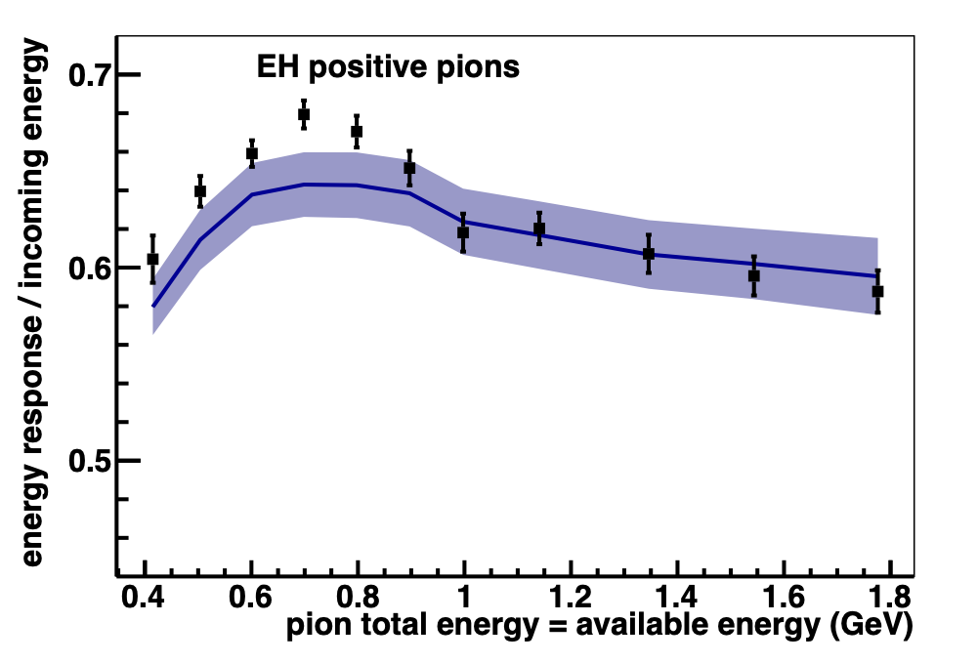
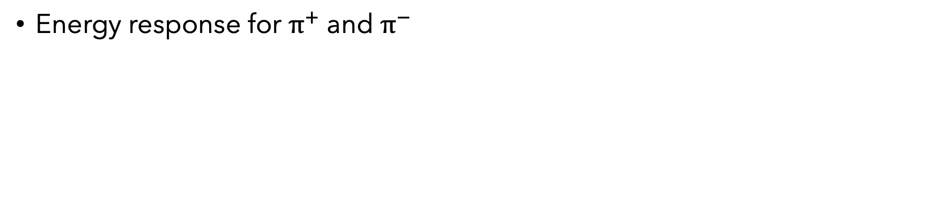
Electrons
ML to increase number of candidates
High energy loss through beamline
Energy response
Protons
Measuring the Birks quenching parameter for protons
Energy response
Pions
MINERvA
https://arxiv.org/abs/1501.06431
Energy response for $π^{+}$ and $π^{−}$
Plans for measurement:
Pions analysis is in paper writing stage, will show the energy response for pi+ and pi- similar to the Minerva TB paper
Electrons are fewer in number and we are employing ML techniques to identify electrons with catastrophic energy loss in the instrumentation prior to encountering the nova detector.
Protons: we are measuring the quenching (Birks) parameter for protons identified using their reconstructed mass and other variables in a simple NN, and will also publish the energy response measurement for protons (and electrons)
We don't have enough kaons (or people!) to do anything there at the moment.

