Slide 1
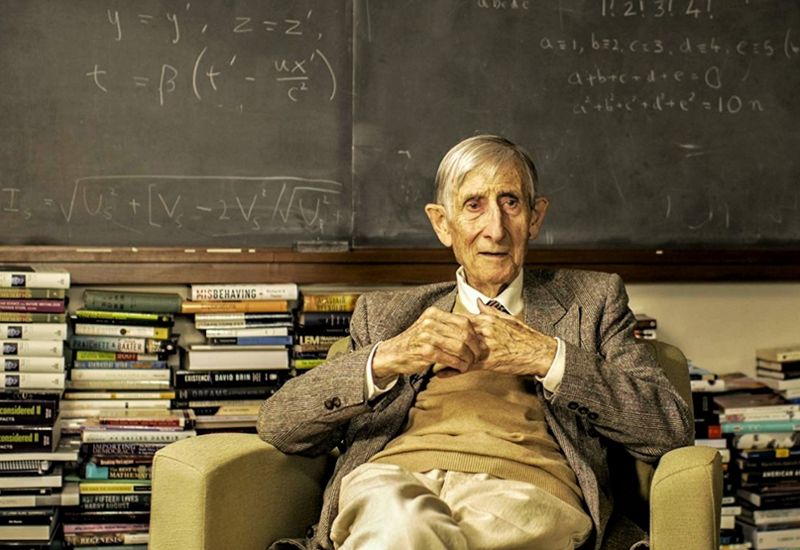
Quantum Technologies for Particle and Astro-Particle Physics
“New directions in science are launched by new tools much more often than by new concepts”
-- Freeman Dyson
Ruben Saakyan (UCL)
13-June-2025
WIN-2025
Brighton

Slide 2
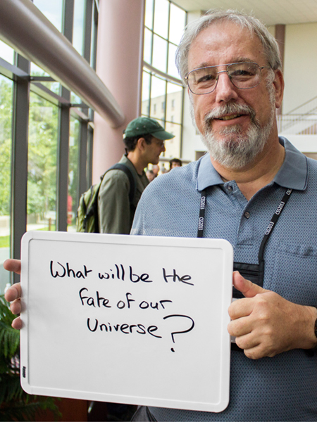
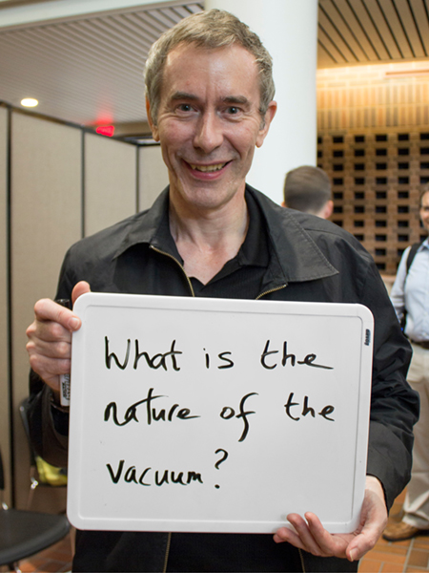
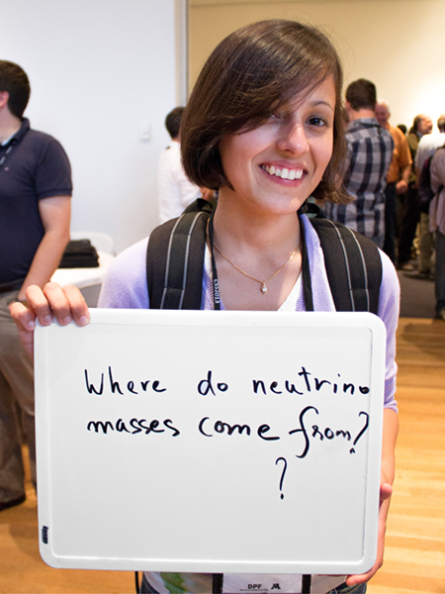
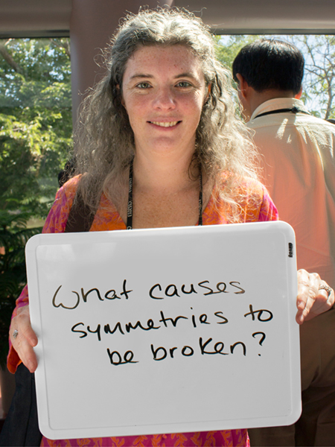
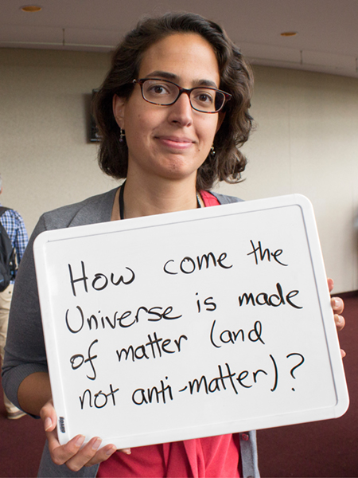
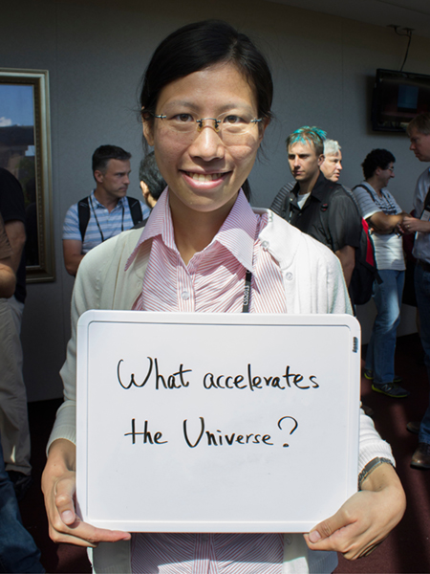
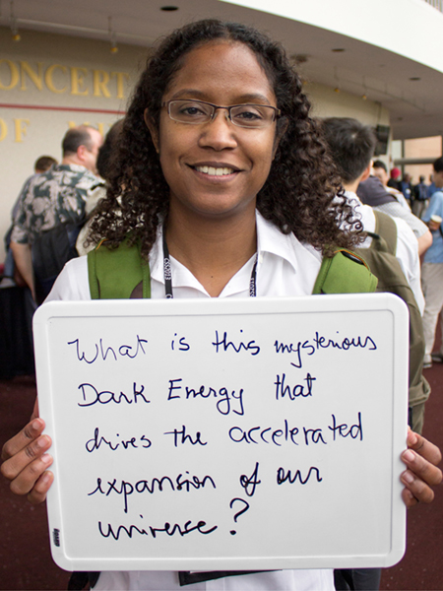
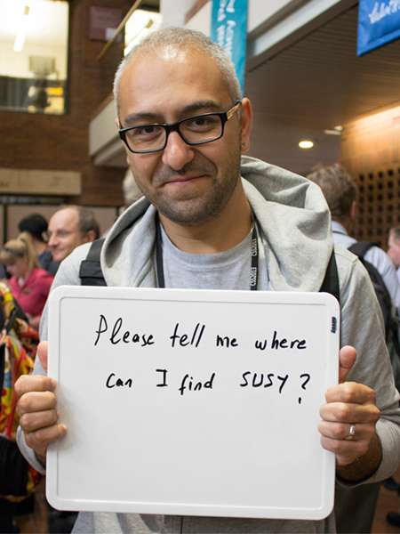
Open questions in fundamental physics
From Symmetry Magazine

Slide 3

To answer biggest questions, one must measure the smallest signals with the greatest precision
“Quantum” is good at that…

Slide 4
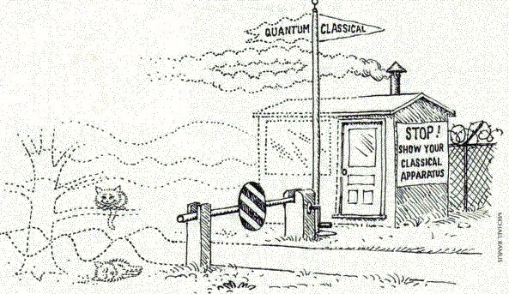

When technologies become “quantum” (personal view)
When intrinsically quantum phenomenon is part of technology:
  Qubits in Quantum Computing
  Quantum sensors exploiting,
    Quantum states superposition
    Entanglement
    Quantum “squeezing”
    Sensors requiring quantum modelling for their design and fabrication (e.g. quantum amplifiers)
    …
Or more succinctly, when your measurement requires
$$hν≥k_{B}T$$

Slide 5
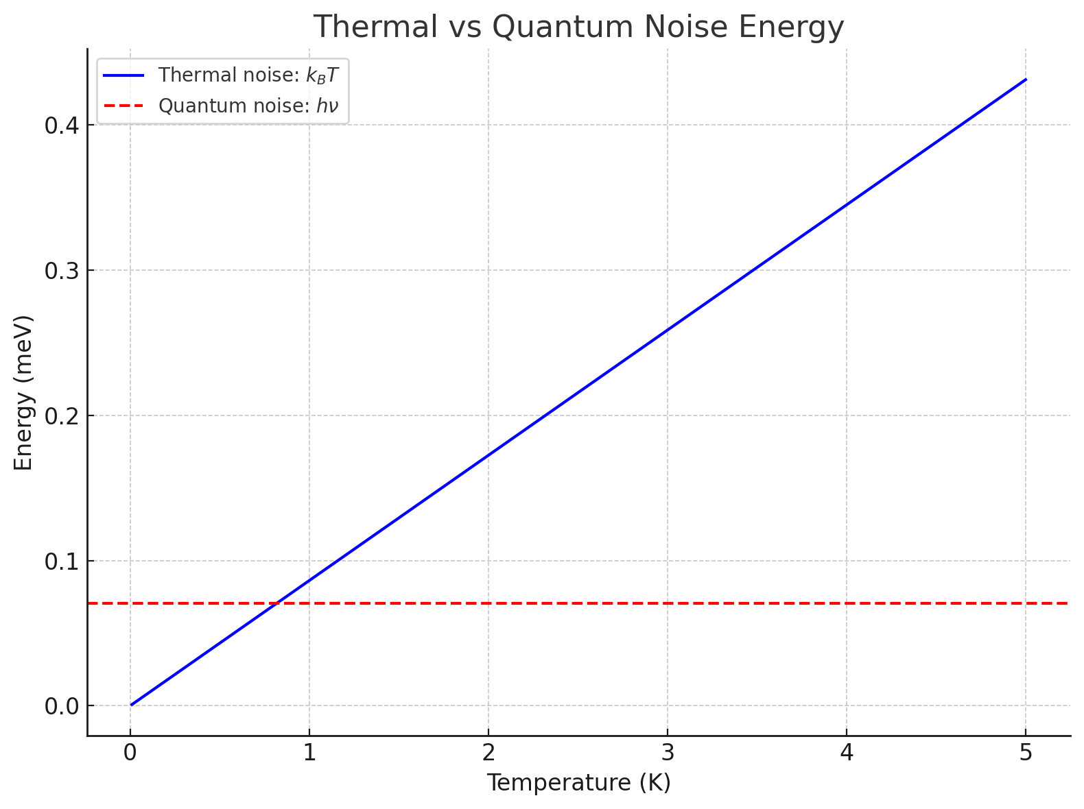


Example QTNM (Quantum Technologies for Neutrino Mass): measure cyclotron radiation of 18.6 keV electrons in 0.7T magnetic field .
$$ν=17GHz, hν≈0.07 meV$$
$$k_{B}T≈0.086 meV at T=1K$$

Slide 6

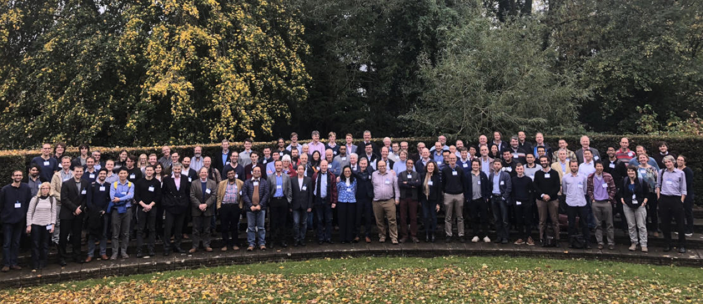
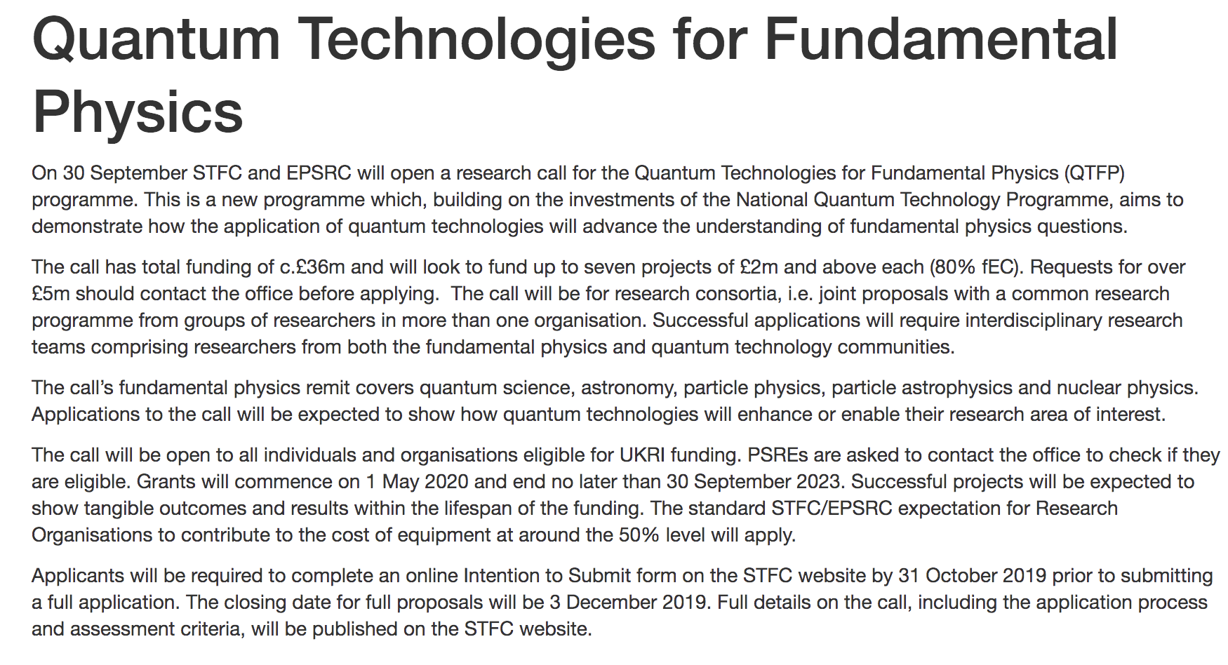
QTFP
Community-driven process from 2018 to explore application of quantum tech for fundamental physics.
Experts from particle and cold atom physics, AMOPP, quantum electronics, etc
£40M investment in 2019 from new UKRI money
Funding started in 2021 following competitive process
7 large projects funded in Wave 1
Further 17 smaller projects funded in 2022
https://uknqt.ukri.org/our-programme/qtfp/

Slide 7
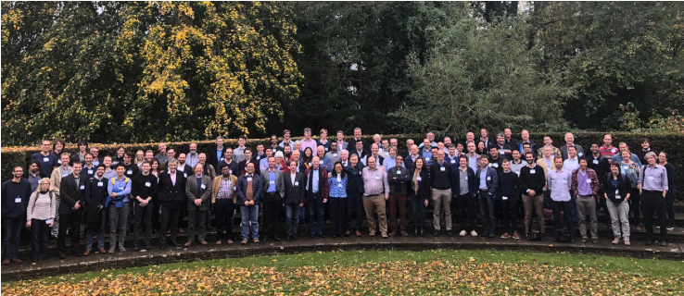
QTFP 7 Large Consortia
Over 200 academics, senior researchers, early-career scientists, engineers, technicians and doctoral students
AION, atom interferometer observatory and network. Gravitational waves, dark matter
Quantum Interferometry (QI), space-time quantisation, dark matter
Quantum Technologies for Neutrino Mass (QTNM), measure absolute neutrino mass
Quantum Sensors for the Hidden Sector (QSHS), wave-like dark matter, axions
Quantum Simulations for Fundamental Physics (QSimFP), early universe and dark matter
Quantum Sensors Network (QSNET), variations of fundamental constants
QUEST-DMC, superfluid technologies for dark matter and cosmology.

Slide 8
Diverse programme with 17 smaller projects funded by QTFP in 2022
Quantum sensing for antimatter gravity
Institution: UCL
Principal investigator: D. Cassidy
MeVQE: A world-leading centre for MeV scale entanglement physics
Institution: University of York
Principal investigator: D. Watts
Development of levitated quantum optomechanical sensors for dark matter detection
Institution: UCL
Principal investigator: P. Barker
Simulating high energy physics with quantum photonics
Institution: University of Bristol
Principal investigator: A. Laing
ParaPara: A quantum parametric amplifier using quantum paraelectricity
Institutions: Lancaster University, UCL
Principal investigator: E. Laird, E. Romans
Quantum computing for nuclear physics
Institution: University of Surrey
Principal investigator: P. Stevenson
Supercooled cosmological simulator
Institution: Newcastle University
Principal investigator: T. Billam
Testing theories of dark energy using atom interferometry
Institutions: Imperial College London, The University of Nottingham
Principal investigator: E. Hinds, E. Copeland
Differential atom interferometry and velocity selection using the clock transition of strontium atoms for AION
Institutions: Imperial College London, University of Oxford, STFC laboratories, University of Birmingham, University of Cambridge
Principal investigator: O. Buchmueller, C. Foot, P. Majewski, M. Holynski, U. Schneider
Penrose processes in an analogue black hole formed in hybrid light-matter (polariton) superfluid
Institution: The University of Sheffield
Principal investigator: D. Krizhanovskii
Synthesising quantum states of sound and listening to what they tell us about the universe
Institution: Imperial College London
Principal investigator: M. Vanner
Quantum simulation algorithms for quantum chromodynamics
Institution: University of Cambridge
Principal investigator: S. Strelchuk
Accelerating the development of novel clocks for measuring varying fundamental constants
Institutions: University of Birmingham, Imperial College London
Principal investigator: G. Barontini, M. Tarbutt
A quantum jump sensor for dark matter detection
Institution: Imperial College London
Principal investigator: J. Devlin
Increasing the science reach for quantum enhanced interferometry
Institutions: Cardiff University, University of Strathclyde, University of Birmingham, University of Warwick, University of Glasgow
Principal investigator: H. Grote, S. Reid, D. Martynov, A. Datta, R. Hadfield
Trapped electron for neutrino mass measurement
Institution: University of Sussex
Principal investigator: J. V. Galiana
Levitated Quantum Diamonds
Institutions: University of Warwick, UCL
Principal investigator: G. Morley, S. Bose

Slide 9

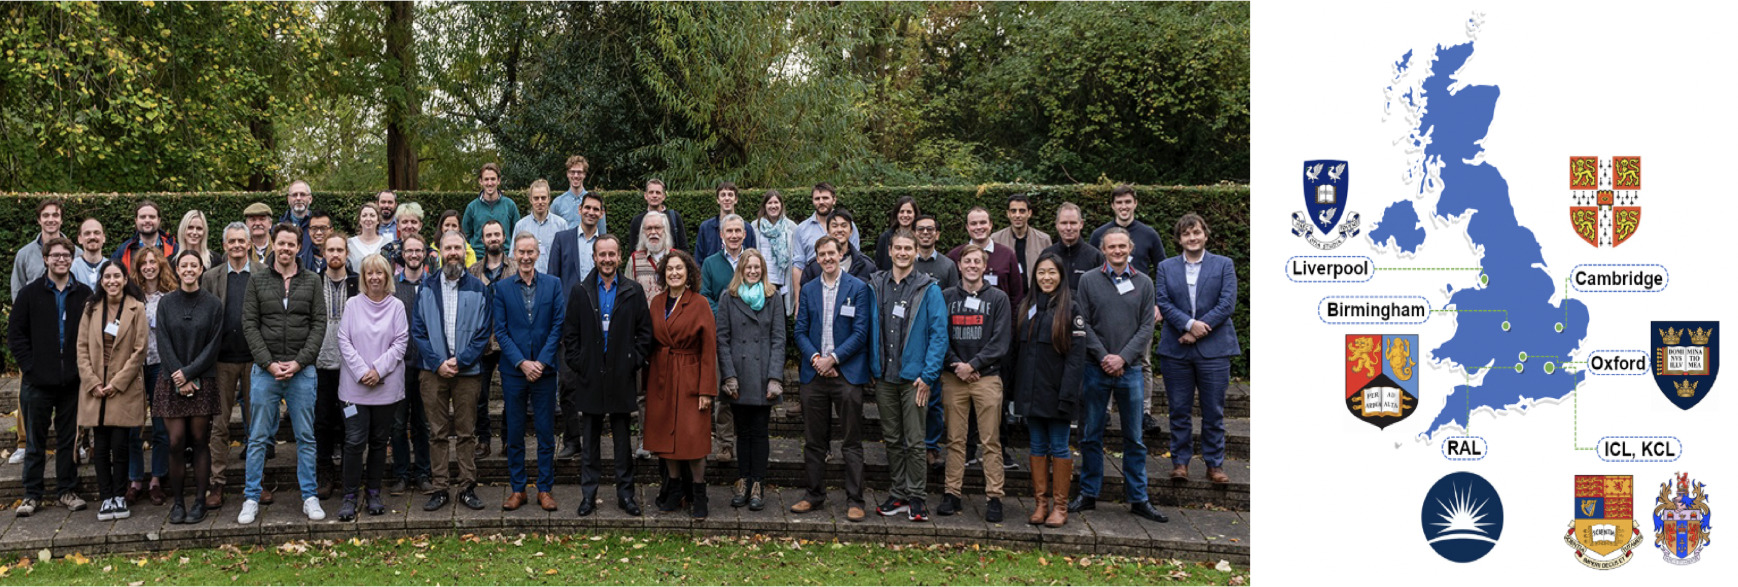
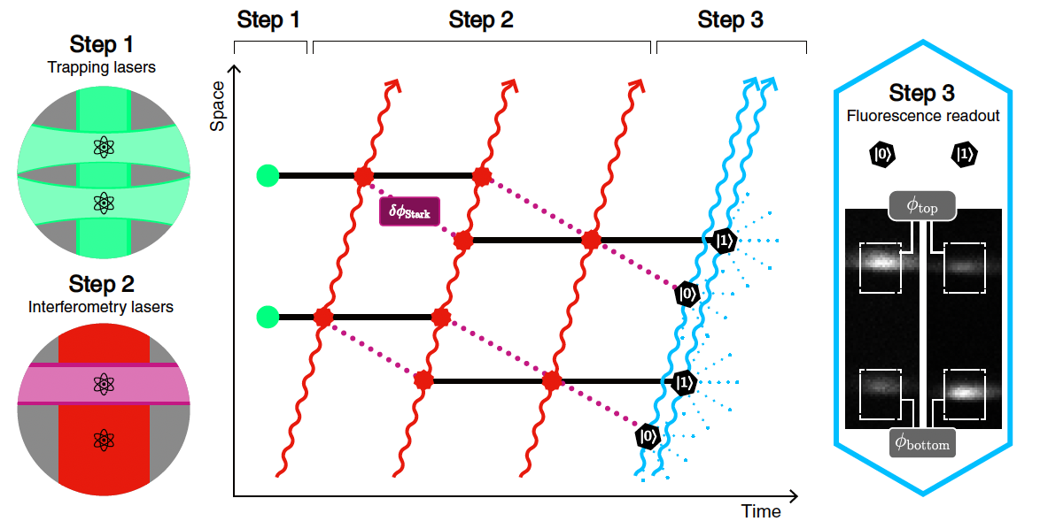
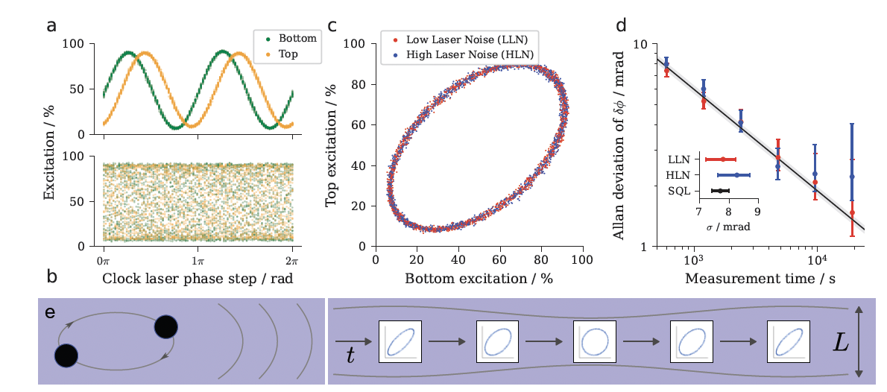
Credit: O. Buchmuller
Atom Interferometer Observatory and Network
Primary objectives:
Develop atom interferometry network to probe fundamental physics with staged baseline scaling over decades
Build supporting R&D infrastructure and highly-trained scientists and engineers
Partnership with MAGIS (USA)
Research highlight
First demonstration of gradiometer measurement on the ⁸⁷Sr clock transition (key to scaling baseline!)
Tabletop demonstrator: differential measurement between two spatially-separated atom clouds
Demonstrated cancellation of laser phase noise
Crucial proof-of-principle of mechanism for detection of gravitational waves and other physics goals
Manuscript accepted for peer-review by Nature [arXiv:2504.09158 (2025)]

Slide 10
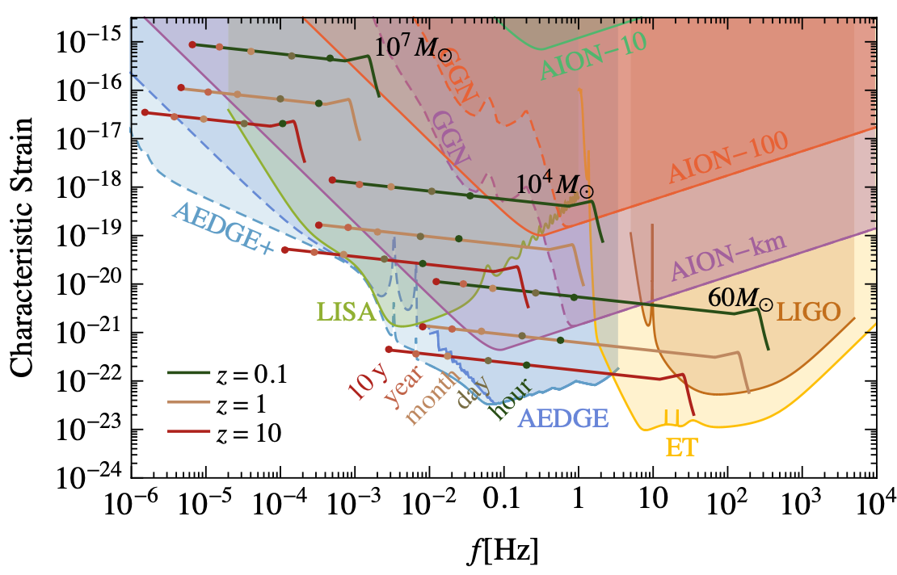
Credit: O. Buchmuller
Science case:
Decihertz gravitational waves [1]
Fine-structure constant measurements [2]
Probing dark energy models [3]
Ultralight (wavelike) dark matter [4]
Equivalence principle tests [5,6]
Earth science and seismology [7]
Technology development:
High-precision quantum control
  Atom flux and interferometer repetition rate
  Atom kinematics, temperature, collimation
  Laser frequency, phase, and pointing stability
  Quantum enhancements to measurement: squeezed states
  Interferometer readout
  Temperature, vacuum, stray magnetic fields, and vibrations
  Gravitational static gradients and moving masses
  Subsampling instrument, aliasing L. Badurina et al., Phys. Rev. D 108, 083016 (2023)
Mitigation of environmental noise sources
  Seismic and atmospheric gravity gradient noise L. Badurina et al. Phys. Rev. D 107, 055002 (2023); J. Mitchell et al., J. Inst., 17, 01 (2022)
  Random anthropogenic and synanthropic noise J. Carlton and C. McCabe, Phys. Rev. D 108, 123004 (2023)
Scaling baseline
  High power laser sources; optics stability and ruggedisation
  Shaft and environment engineering
[1] P.W. Graham et al. Phys. Rev. Lett. 110, 171102 (2013).
[2] J. Schelfhout et al. Phys. Rev. A 110, 053309 (2024).
[3] B. Elder et al., Phys. Rev. D 94, 044051 (2016).
[4] L. Badurina, et al. Phys. Rev. D 107, 055002 (2023).
[5] G. Rosi et al. Nat. Commun. 8, 15529 (2017).
[6] P. Asenbaum et al. PRL 125, 191101 (2020).
[7] J. Mitchell et al., J. Inst., 17, 01 (2022).

Slide 11







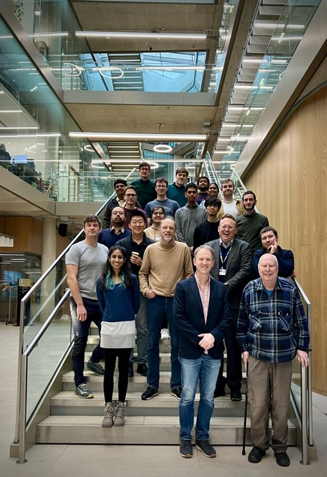
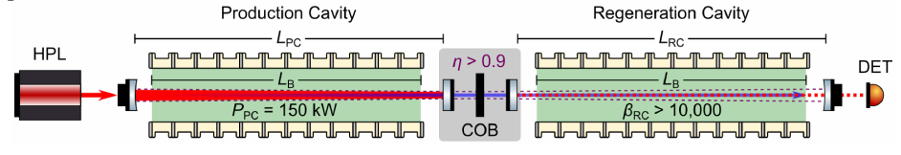
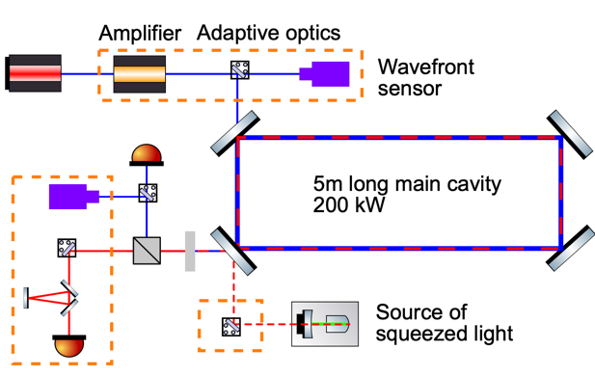
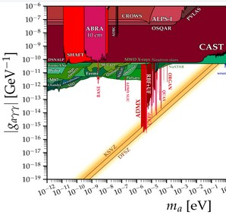
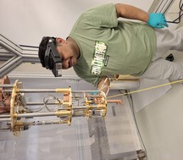
QI: Quantum Enhanced Interferometry for New Physics
4 Projects, covering dark matter and quantum gravity:
Search for Axion particles with ALPS II (at DESY)
Search for Axion dark matter with interferometry
Search for Quantum Gravity with interferometry
Search for semi-classical gravity with interferometry
+ Theory and Advanced Coatings facility EPOC
Credit: H. Grote
LIDA: an axion haloscope interferometer using squeezed states of light
ALPS II at DESY:
A novel TES single photon detector
International partners:
Max Planck, DESY, NIST, U Chicago, MIT

Slide 12
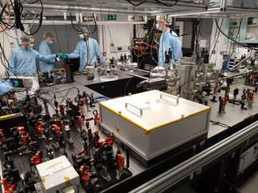
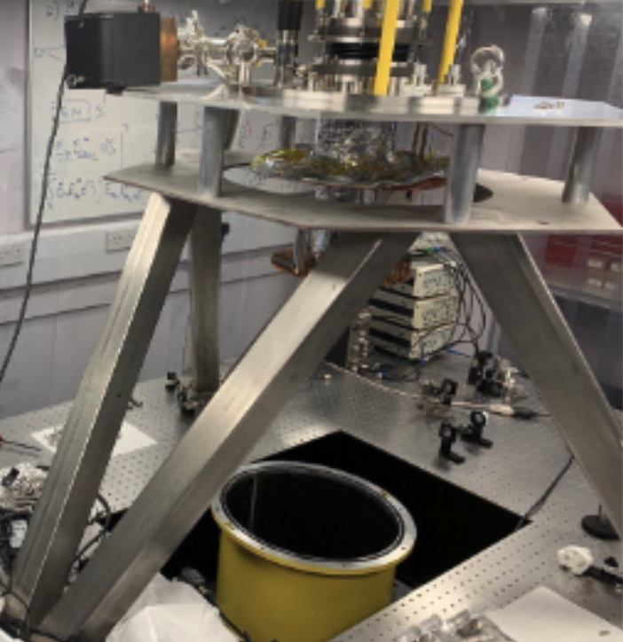
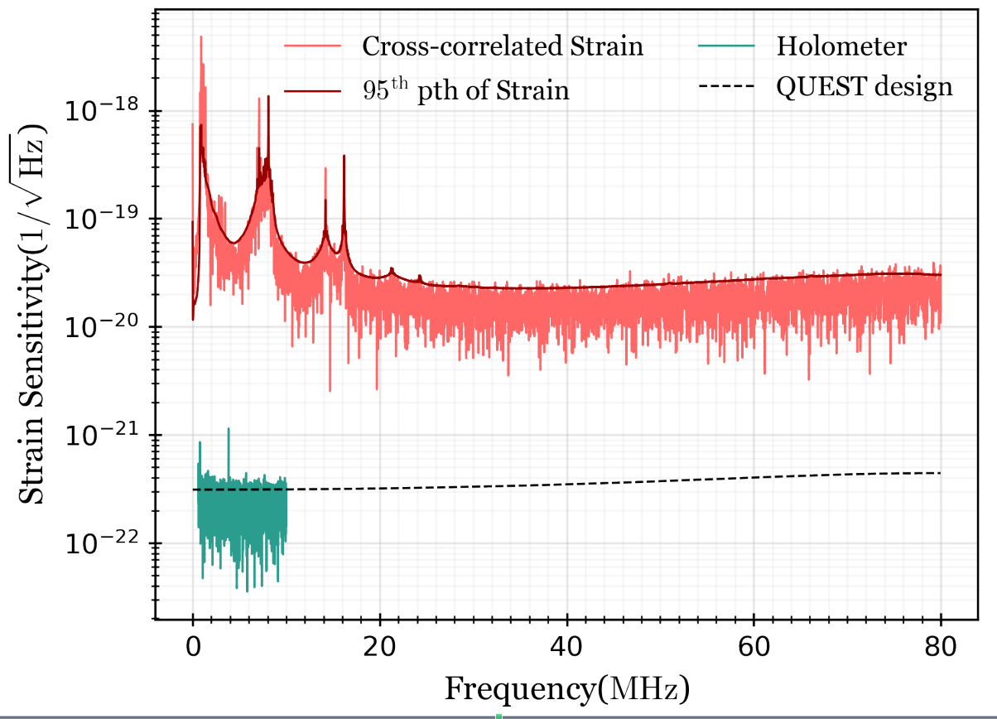
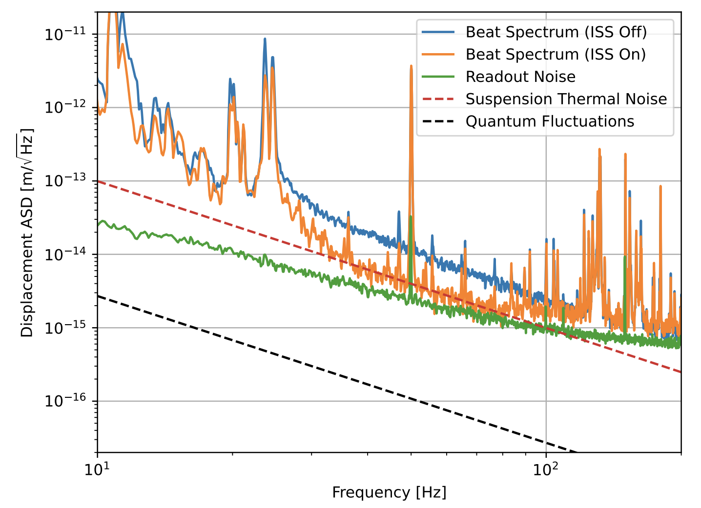
4 Projects, covering dark matter and quantum gravity:
Search for Axion particles with ALPS II (at DESY)
Search for Axion dark matter with interferometry
Search for Quantum Gravity with interferometry
Search for semi-classical gravity with interferometry
+ Theory and Advanced Coatings facility EPOC
Credit: H. Grote
QUEST: QUantum-Enhanced Space-Time experiment
Searches for Semi-Classical gravity
World’s only table-top co-located interferometer
Main science target is quantum gravity, but also sensitive to dark matter and VHF gravitational waves
Motion of oscillators at their quantum limit may show deviations from the standard quantum mechanics
Study space-time evolution in classical spacetime with suspended cavities and a torsion balance
Squeezed light source
Most stringent limits on VHF gravitational waves from 13 to 80 MHz
Sub-shot-noise sensitivity from cross-correlation of two interferometers
ArXiv: 2410.09175 (2024);
Nature 600, 424-428 (2021)
Sensors 24(7), 2375 (2024); ArXiv: 2411.17817 (2024)

Slide 13



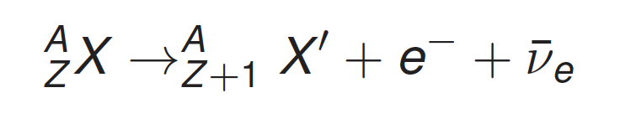

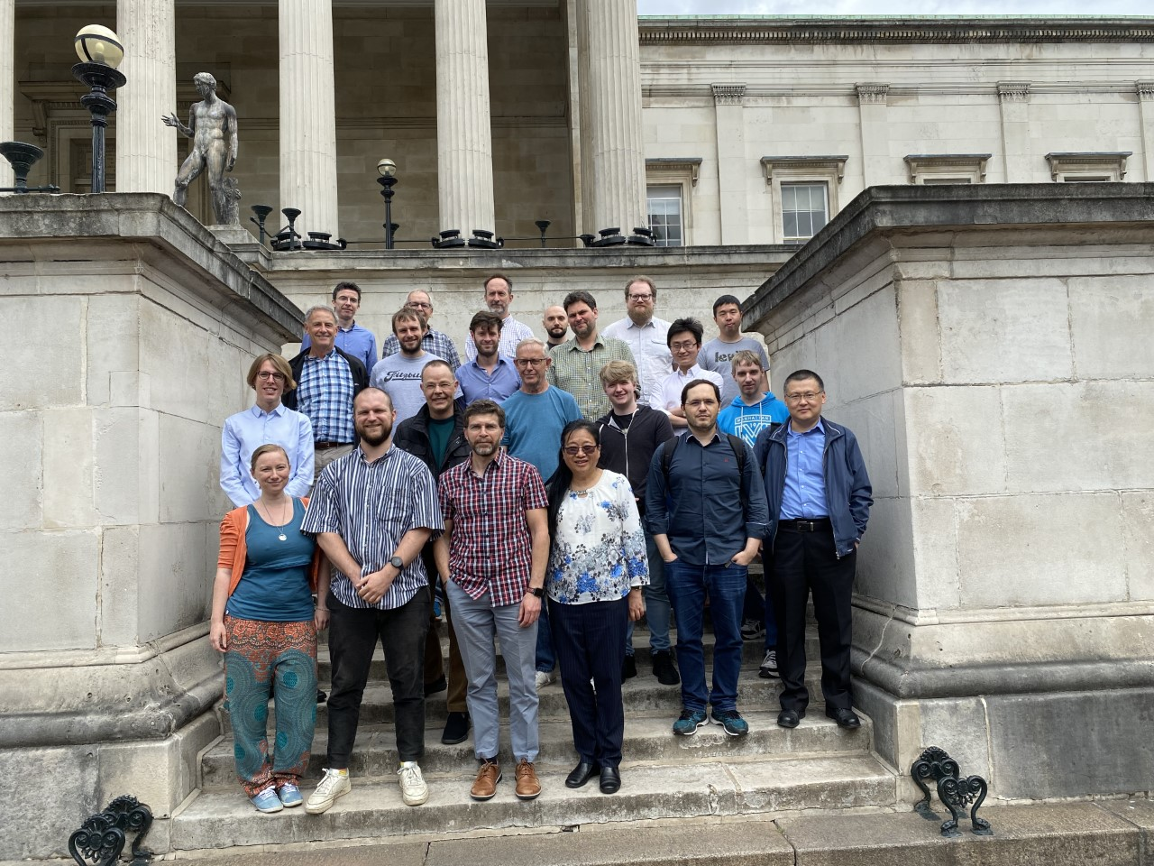
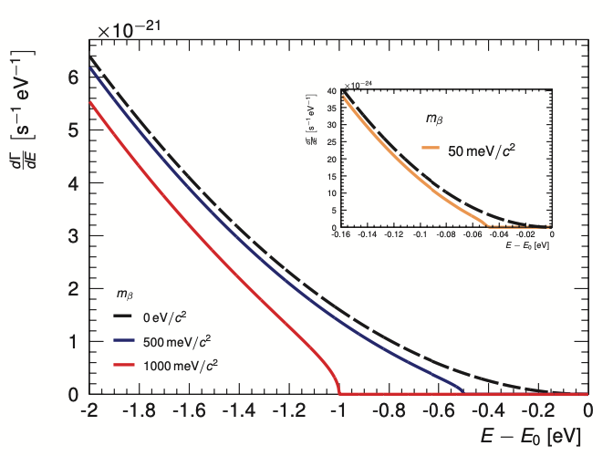
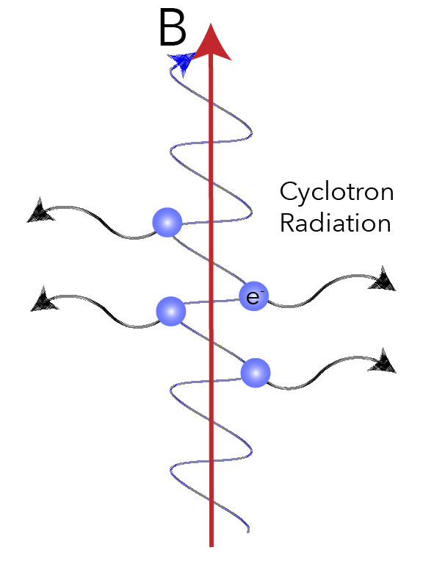

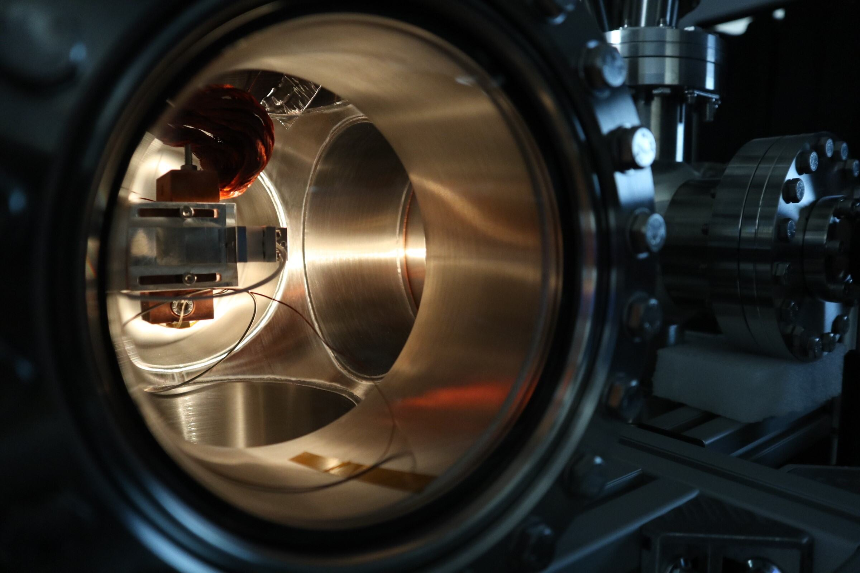
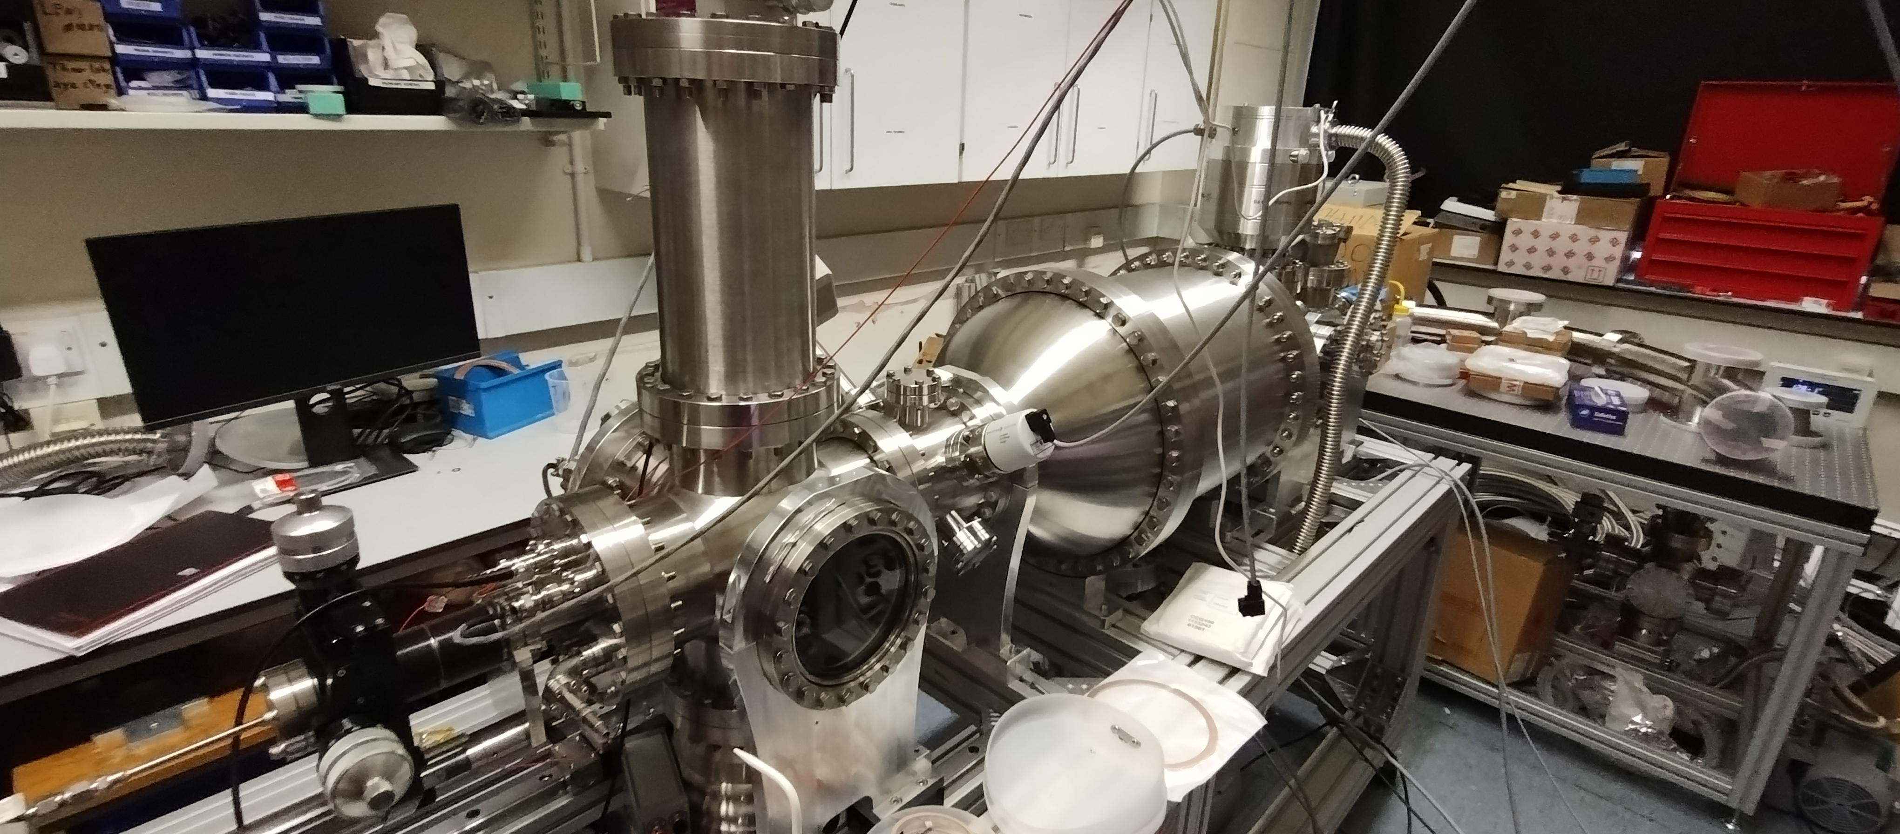
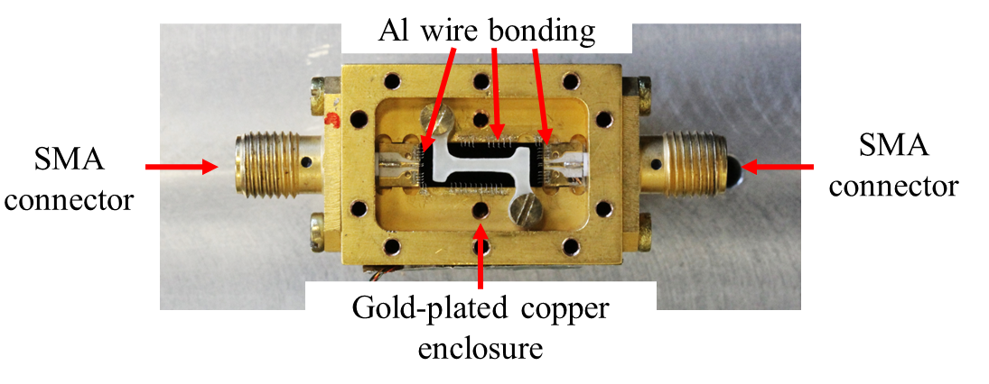
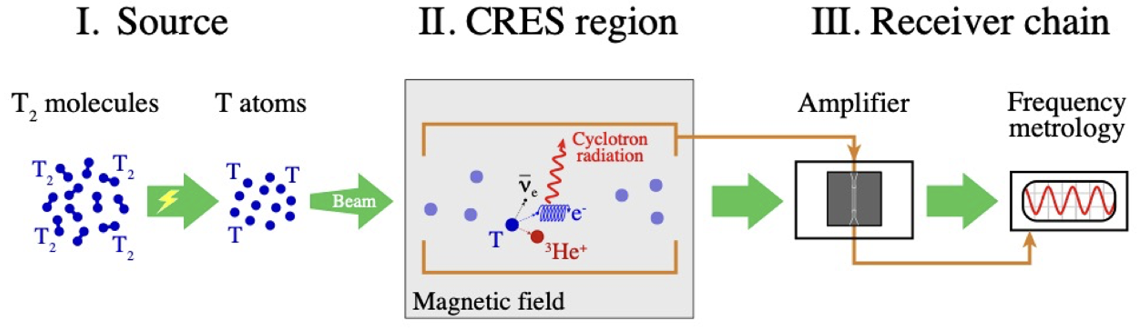

Quantum Technologies for Neutrino Mass
$$B=0.7T →f≈17 GHz$$
CRESDA-0 (CRES Demonstrator Apparatus):
from ¹H/²H to ³H. Demonstrating key technologies
Quantum noise limited microwave sensors at high TRL for CRES at ~17 GHz
3D B-field mapping with 1 uT precision, using H-atoms as quantum sensors (Rydberg Magnetometry)
Production and confinement of H-atoms 10¹² cm-3
Modelling tools for CRES and neutrino mass

Slide 14
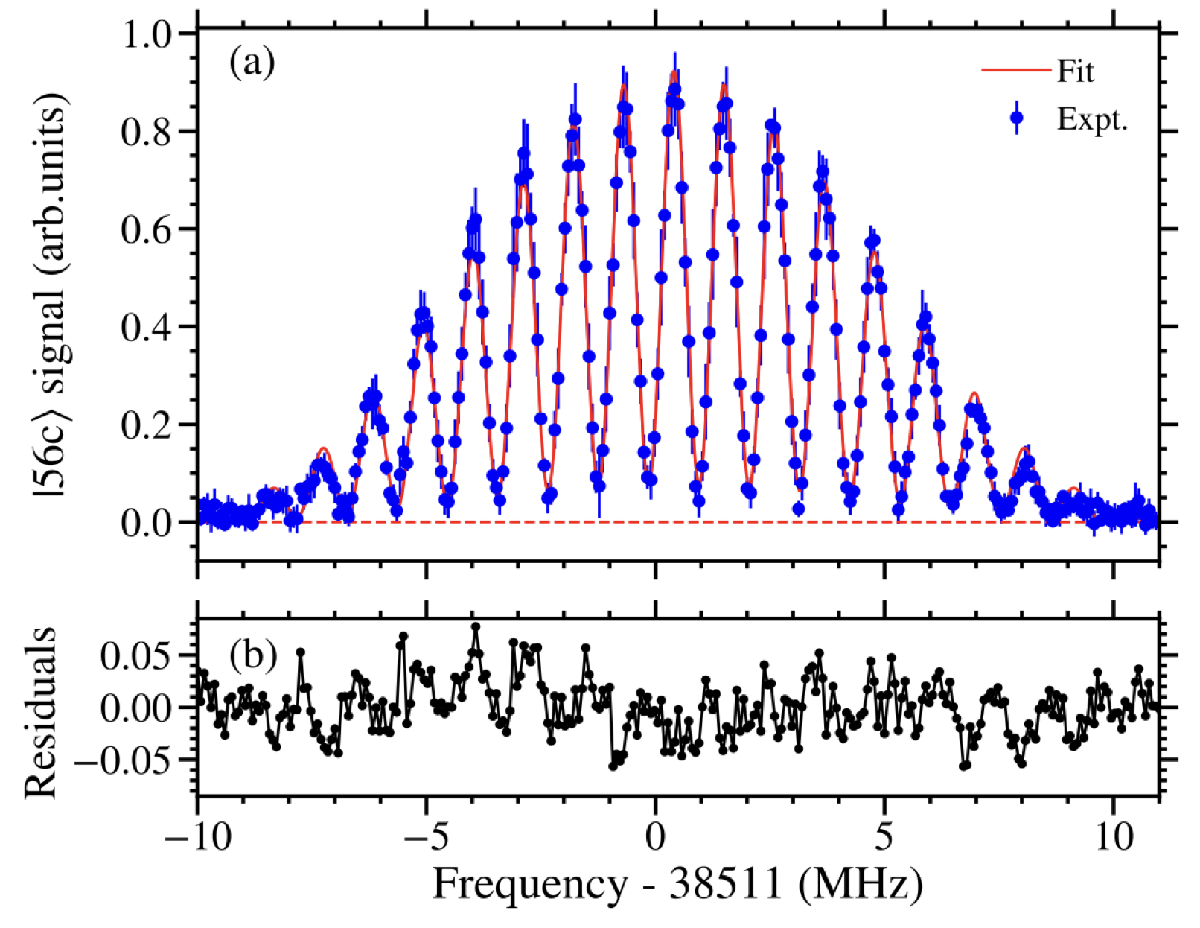
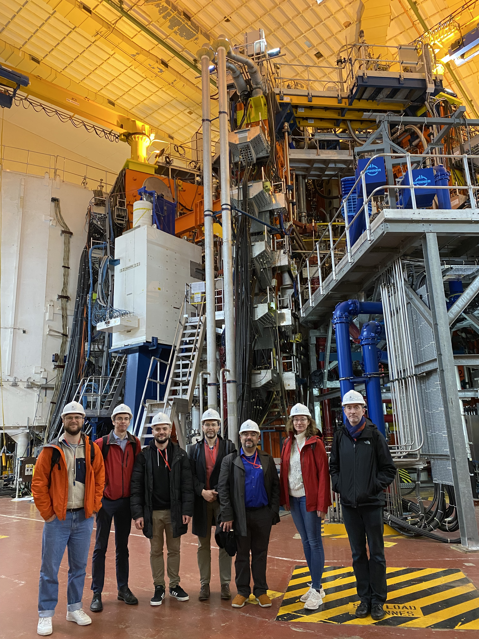
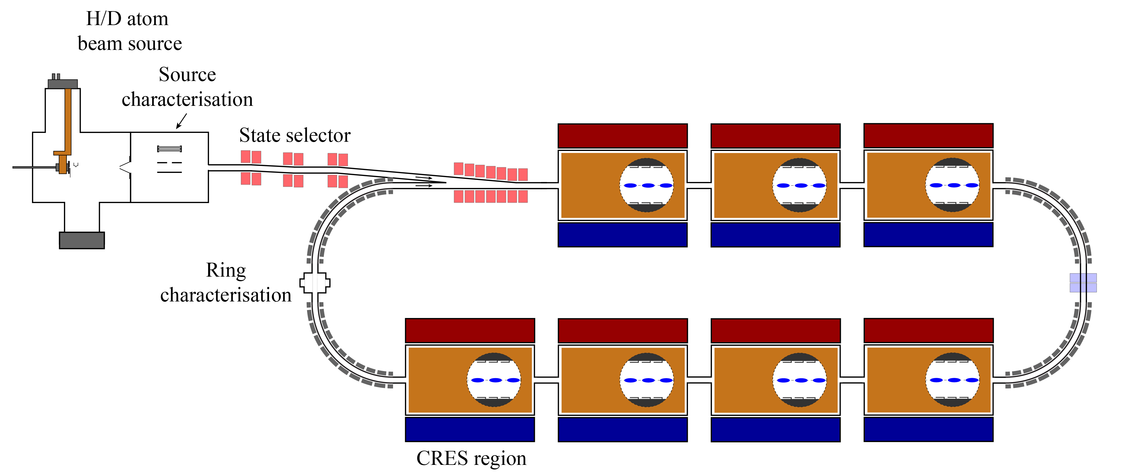
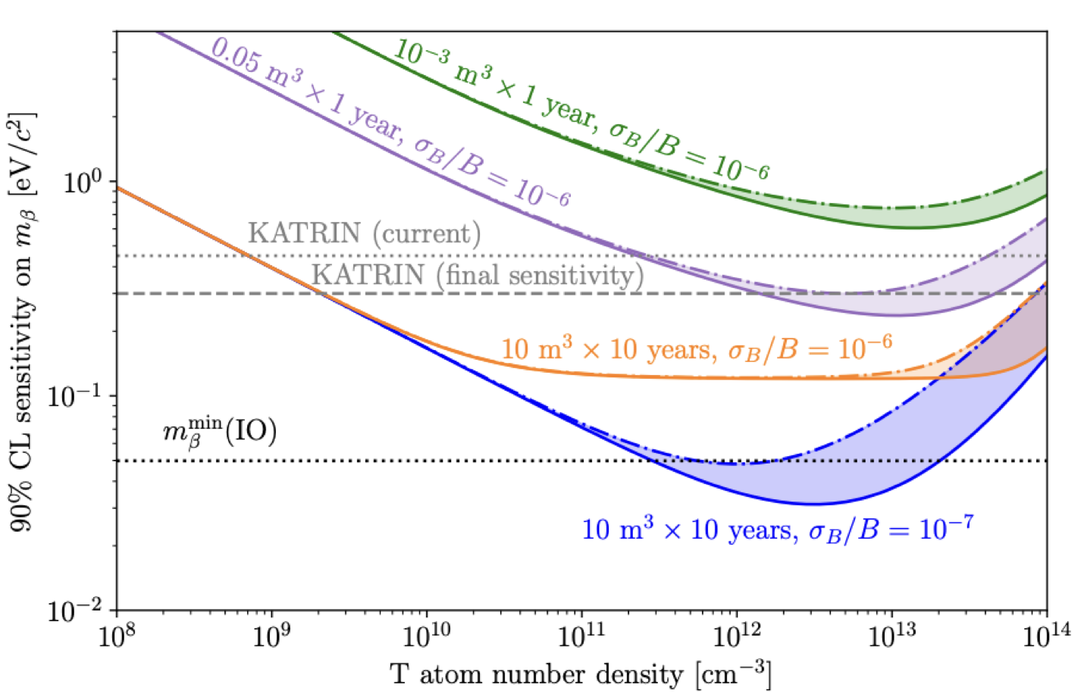
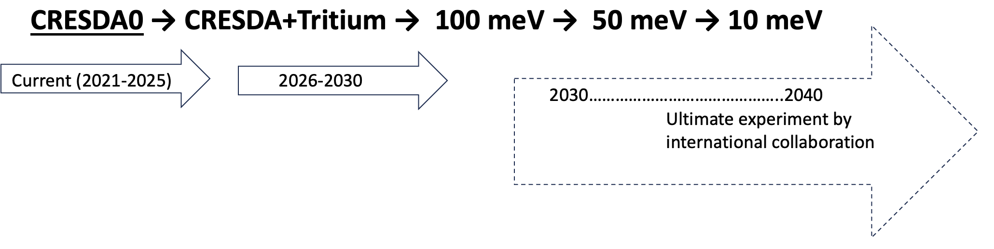


Technology and Impact
Phys. Rev. A 107, 062820
Potential future particle physics experiment at Culham
Non-linearity in superconducting amplifiers — applicable to qubits + more
Sub-ppm cryogenic magnetic and electric field sensing, enabling applications from brain activity monitoring to nanoscale device diagnostics
Highest phase-space density atomic hydrogen source — opens new frontiers in precision fundamental physics
Future Outlook
Project Partners
50 meV
New Journal of Physics, DOI 10.1088/1367-2630/abc624

Slide 15

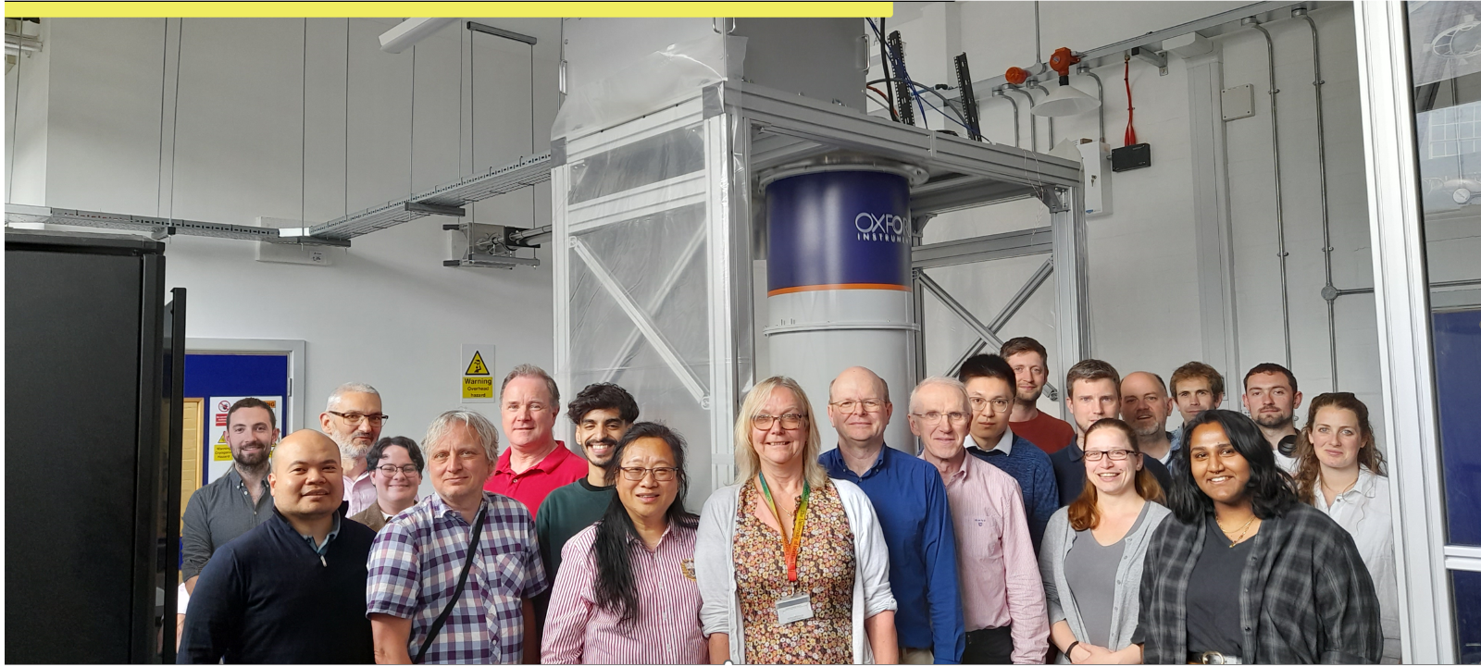
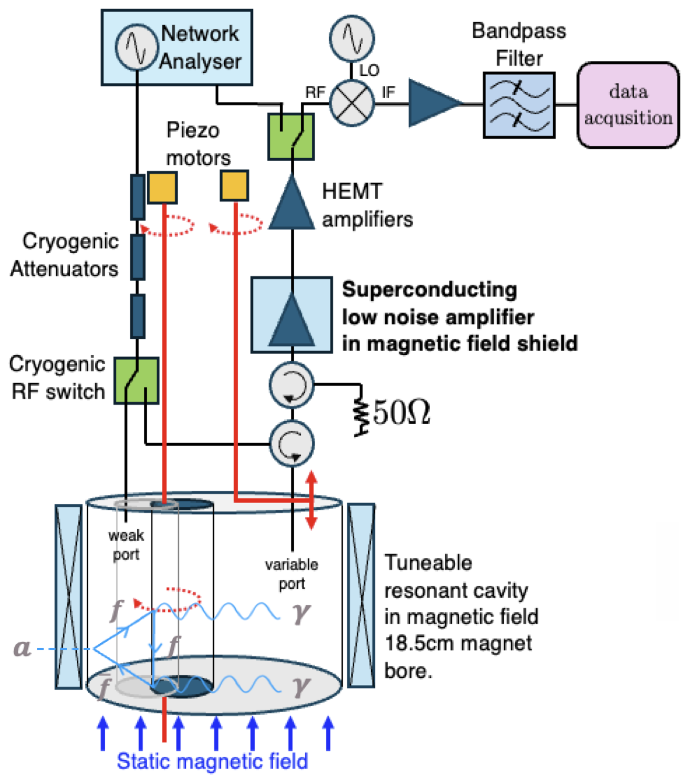
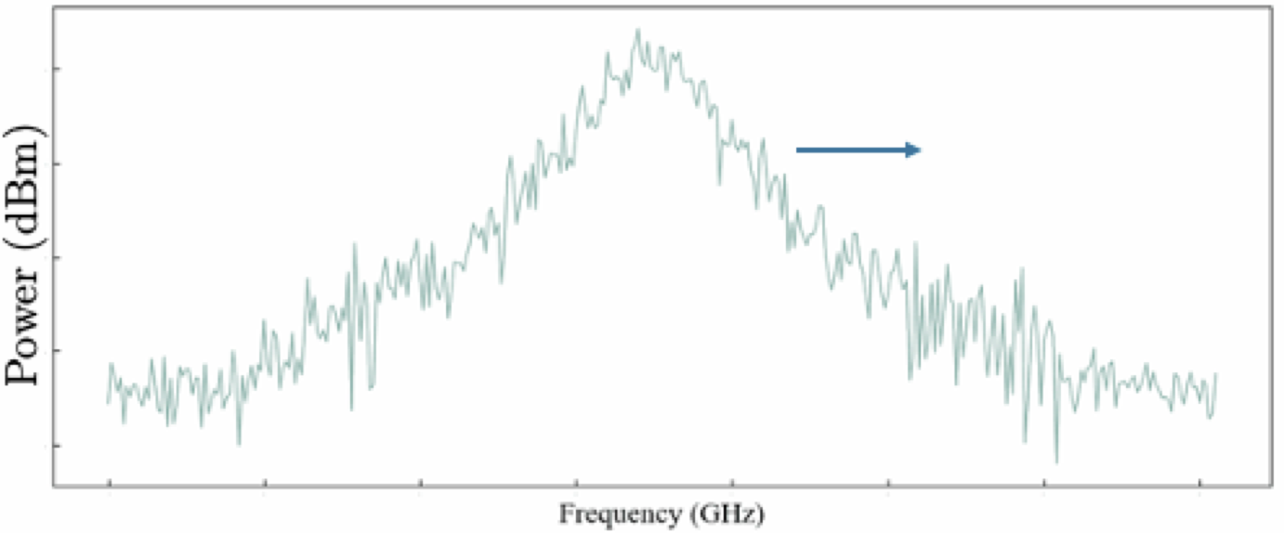
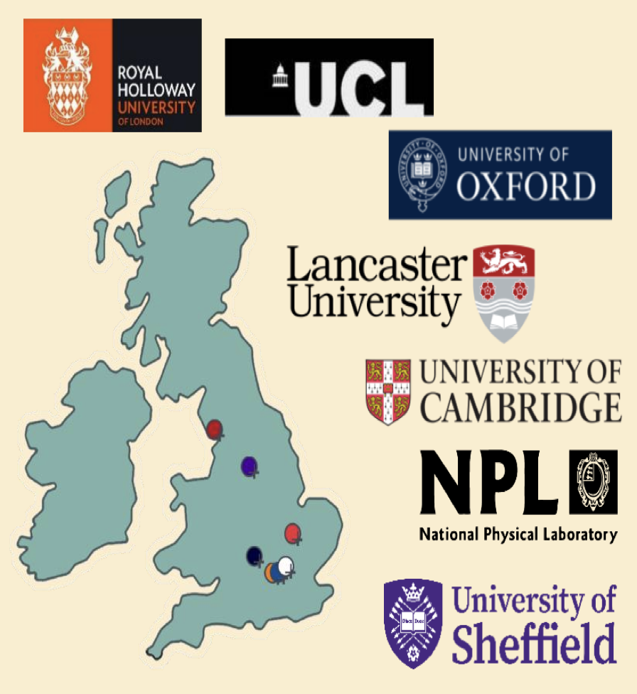
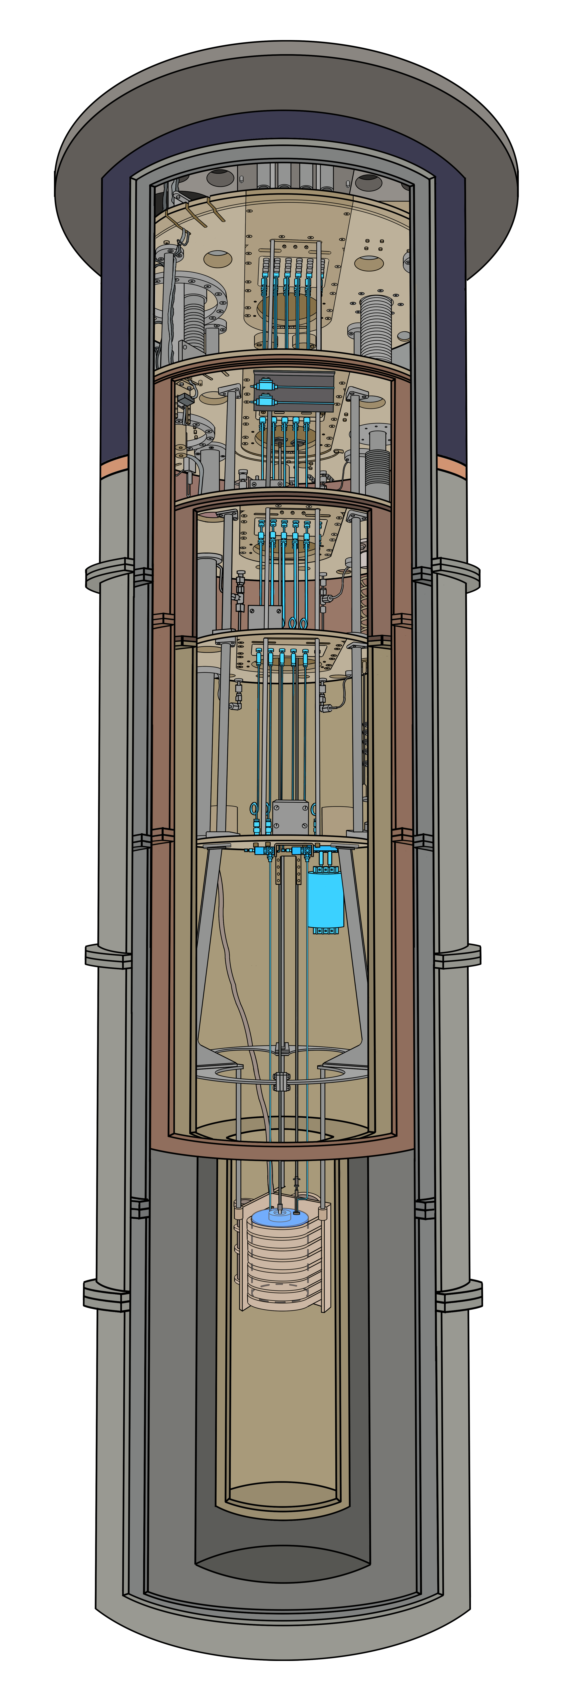

Quantum Sensors for Hidden Sector
Credit: E. Daw
International Partner
Science Goals
Technology and impact
Axion searches, hidden sector theory, quantum devices
Develop and test quantum and high-sensitivity electronics for axion dark matter and other hidden sector particle searches
Drive operating temperature of cavity searches down to ~10 mK: enable single photon detection operation.
Perform first search for galactic halo axion dark matter at ~μeV mass scale
New quantum transducers for use in physics experiments
Tuneable digital resonant filters developed for resonant feedback
Field-tolerant superconducting RF cavities
Public engagement: Royal Society Summer Science Exhibition 2024:
https://www.lancaster.ac.uk/physics/outreach/royal-society-summer-science-exhibition/

Slide 16
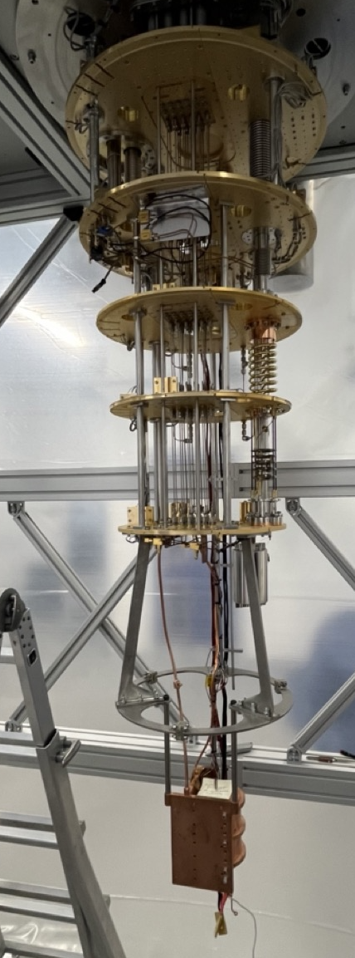
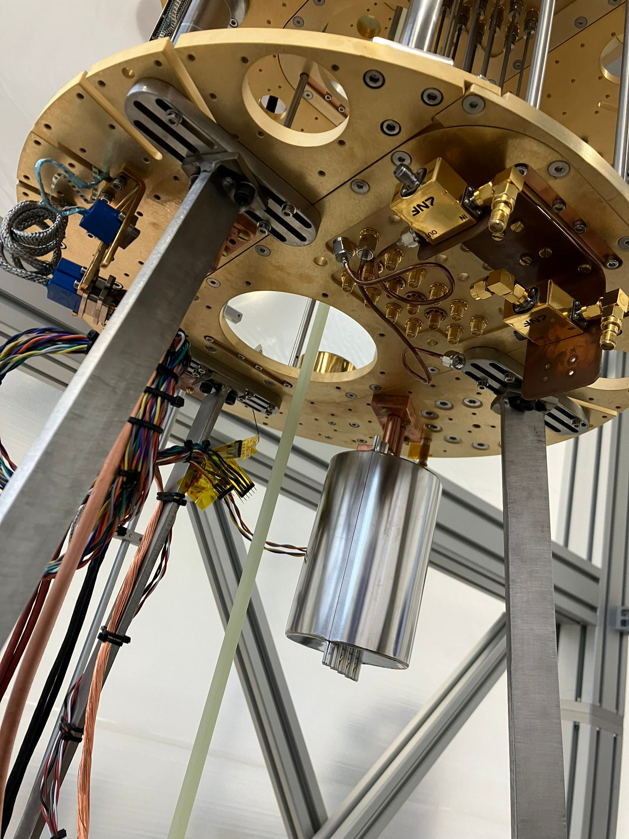
Credit: E. Daw
Updates and Outlook
QSHS instrument paper submitted to New Journal of Physics.
https://arxiv.org/html/2504.12257v1
Study of unloaded Aluminum ‘sidecar’ cavity also submitted to New Journal of Physics. https://arxiv.org/abs/2503.22637
Magnet achieved full field of 8T in the Sheffield lab in April 2025
Cryogenic tests, including superconducting TWPA underway
First science data from QSHS this summer.

Slide 17

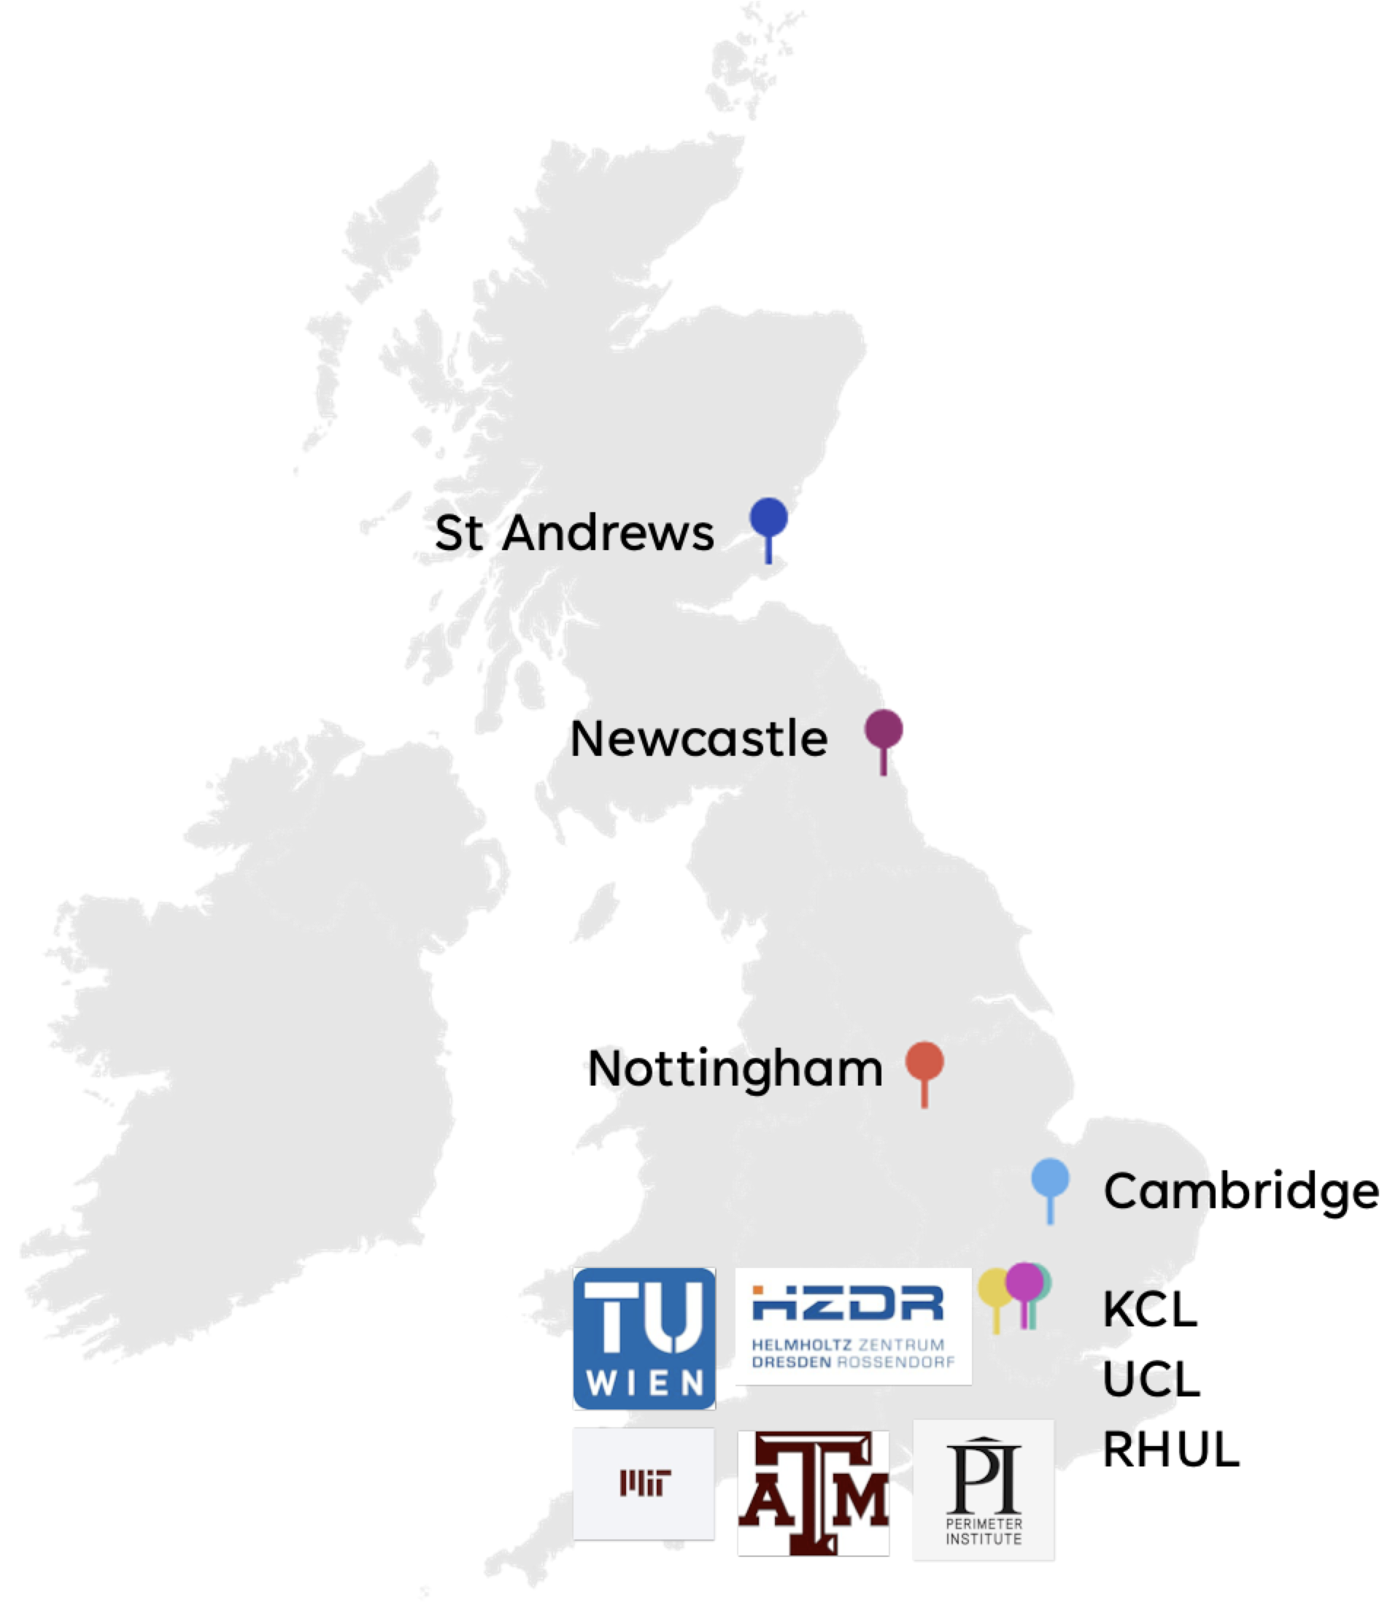
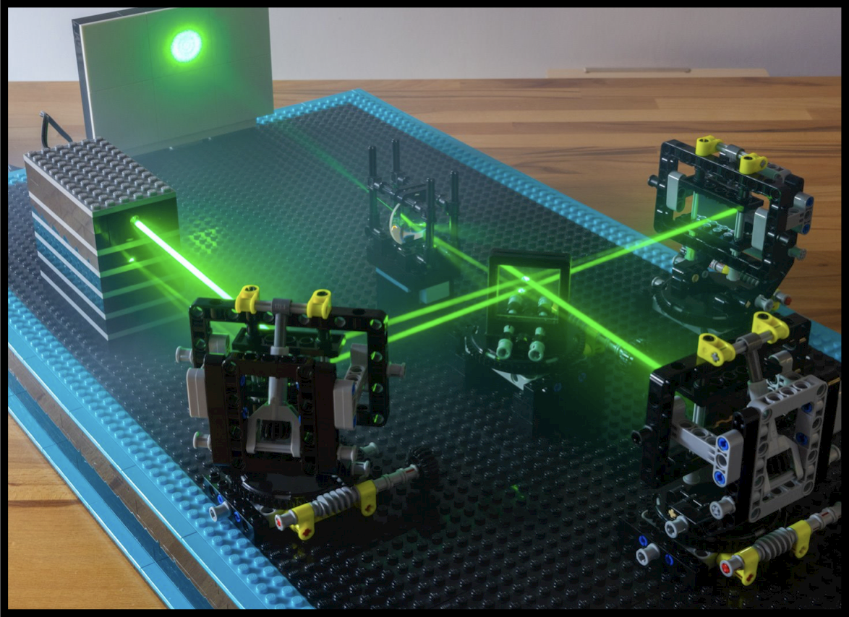




Quantum Simulators for Fundamental Physics
Credit: S. Weinfurtner
LEGO LIGO (!)
Primary objective:
Establish quantum field theory simulators using quantum gases, liquids, and optical systems
Particle physics-inspired cosmological theories exhibit false vacuum decay via bubble nucleation: first-order phase transitions
Spectral properties of black holes
Giant quantum vortex flows in superfluid ⁴He
Validate advanced mathematical frameworks. for fundamental physics
Explore genuine relativistic quantum process
Translate abstract concepts into reality
Simulate the uncalculatable

Slide 18






Credit: S. Weinfurtner
Research highlight: Quantum Black-Hole Simulator
Principle: Waves propagating on a moving fluid perceive an effective, curved spacetime metric akin to rotating black holes
Theory: Modelling techniques of wave propagation to improve understanding of experimental data and uncover new phenomena in field theory on curved spacetimes
Superfluid Helium as a laboratory analogue for black-hole ringdown
Experiment: Fully transparent helium cryostat: facilitates space/time-resolved detection of ripples on superfluid interface
Establishes experimental platform for black-hole simulation
Superfluid helium:
Strongly-interacting quantum liquid with well-defined interface
1) arXiv preprint arXiv:2406.11013 (2024)
Under review in Phys. Rev. Lett
2) arXiv preprint arXiv:2502.11209 (2025).

Slide 19




Credit: G. Barontini
Quantum Sensors Network
Search for variations of fundamental constants of the Standard Model using a network of clocks
Physics
Tests of quantum gravity and grand unification theories
Detection of transient events
Search for variations in fine structure constant ⍺ and electron-to-proton mass μ
Comparison between two clocks to search for time variation of ⍺ and set constraints on ultralight dark matter
$$\frac{δf}{f}=K_{α}\frac{δα}{α}+K_{μ}\frac{δμ}{μ}+…$$
Technology
Optical clock development (neutral atoms, ions, highly charged ions, molecules)
Measure ratio of frequencies from different pairs of optical clocks (10⁻¹⁸ level)
TRL
[EPJ QT 9, 12 (2022) ]

Slide 20







Credit: G. Barontini
Results
NPL clocks & Sussex theory
▪ World-leading results: new constraints on ultra-light dark matter
[New J. Phys. 25 9, 093012 (2023)]
▪ Most accurate clock in Europe
▪ More than 30 theory papers
Imperial
▪ Achieved cooling and trapping of molecules in an optical lattice
▪ Vibrational transition spectroscopy
▪ Advanced laser systems
Birmingham
▪ First compact electron beam ion trap in UK
▪ Coulomb crystal of Ca+ in cryogenic trap
▪ Production and slow down of highly charged ions
Sussex experiment
▪ Coulomb crystal with cold N2+ molecule
▪ Quantum logic spectroscopy

Slide 21






Credit: A. Casey, A. Kemp
QUantum Enhanced Superfluid Technologies for Dark Matter and Cosmology
Two major physics goals linked experimentally through combining quantum sensors with superfluid ³He at ultra-low temperatures:
Superfluid ³He provides quantum analogue of cosmological first-order phase transition predicted ~10 ps after Big Bang in BSM models
Search for sub-GeV dark matter with spin-dependent interactions with quantum tech :
Superfluid ³He
Nanomechanical resonators (NEMS)
Superconducting Quantum Interference Device (SQUID) readout
How did the early universe evolve?
What is the nature of Dark Matter?

Slide 22





Credit: A. Casey, A. Kemp
Eur. Phys. J. C (2024) 84:248
Operated up to 4 bolometers at <300 μK with smallest nanowires ever made
Underpinning of multiple technologies critical for achieving goal of world-leading sensitivity to sub-GeV dark matter candidates.
Demonstrated calibration down to femtowatt scales (~few keV)!
31 eV (0.51 eV) threshold for conventional (SQUID) readout, operating 5 x 0.03g cells for 6 months
RHUL: 400nm heater wire; SQUID readout; keV calibration

Slide 23

Quantum Technologies for Fundamental Physics
QTFP Phase I (2021-2025) Science Review 2024, Headline Findings
High standard and transformational
Industry connection → quantum economy
Clear evidence for world-leading results
Cross-disciplinary Community building has been exemplary
Did particularly well in attracting and training ECR
UK set the standard with QTFP but it will require a concerted effort to maintain that lead

Slide 24


QTFP Community
QTFP Community Workshop, Glasgow, 21-22 Jan 2025, https://indico.stfc.ac.uk/event/1182/
Early Career Researchers Community

Slide 25
Concluding Remarks
The Standard Model works (almost) for ~5% of the universe — quantum tools may reveal what lies beyond.
  Neutrino mass, dark matter, gravitational waves: all demand radical sensitivity.
A unique opportunity to unite disciplines, train a new generation, and lead globally.
QTFP programme gave UK a head start as global leader.
  Community driven roadmap and whitepaper
  Integral part of DRD-Collaboration: DRD5 “Quantum Sensors”.
Ongoing uncertainties risk not only delaying progress, but derailing the programme entirely

Slide 26
Prof. Ian Shipsey (1959 – 2024)
Thank you, Ian, for making QTFP possible!

