Slide 1

Forward Neutrinos
Using collider neutrino beams for science
Alan Barr
With thanks to colleagues in the FASER, SND and FPF collaborations

Slide 2

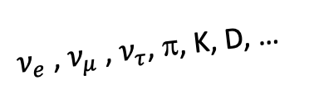
Hadron decays lead to intense columnated beams of neutrinos
(and BSM particles…?)
top, Higgs, susy …
A’, a, mCPs, DM, …
$ν_{e}$ , $ν_{μ}$ , $ν_{τ}$, π, K, D, …
Highest-energy neutrinos produced from laboratory source
  1% of pions with E > 10 GeV are produced in the forward 0.000001% of the solid angle (ƞ > 9.2)

Slide 3
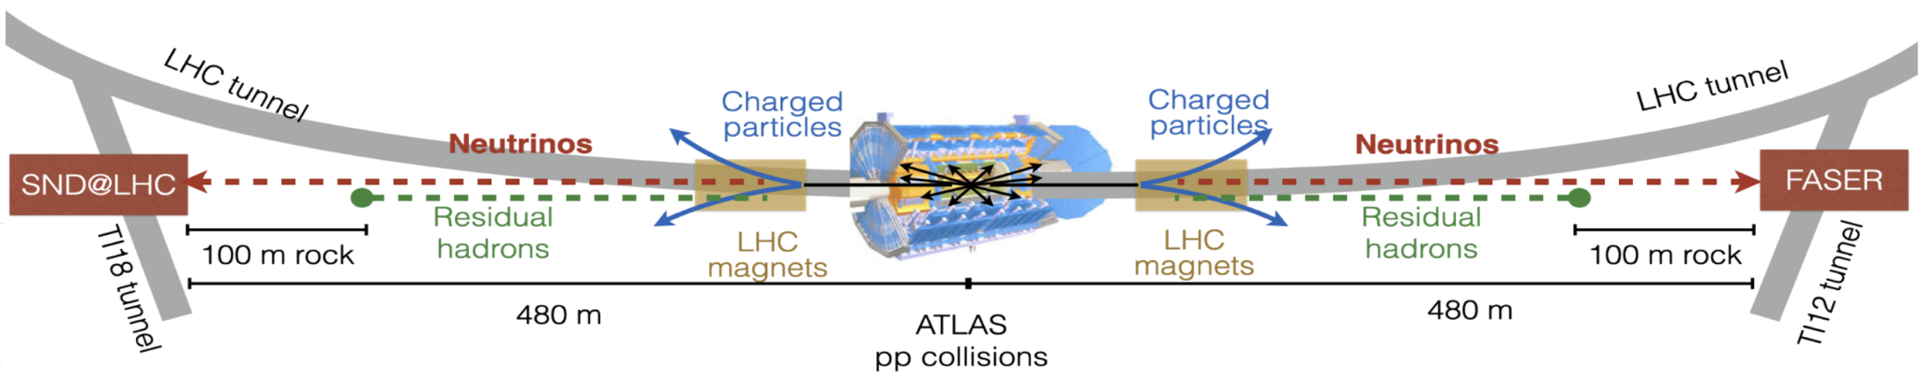
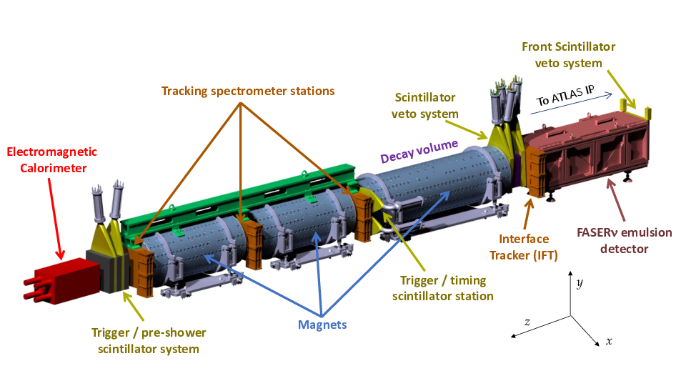
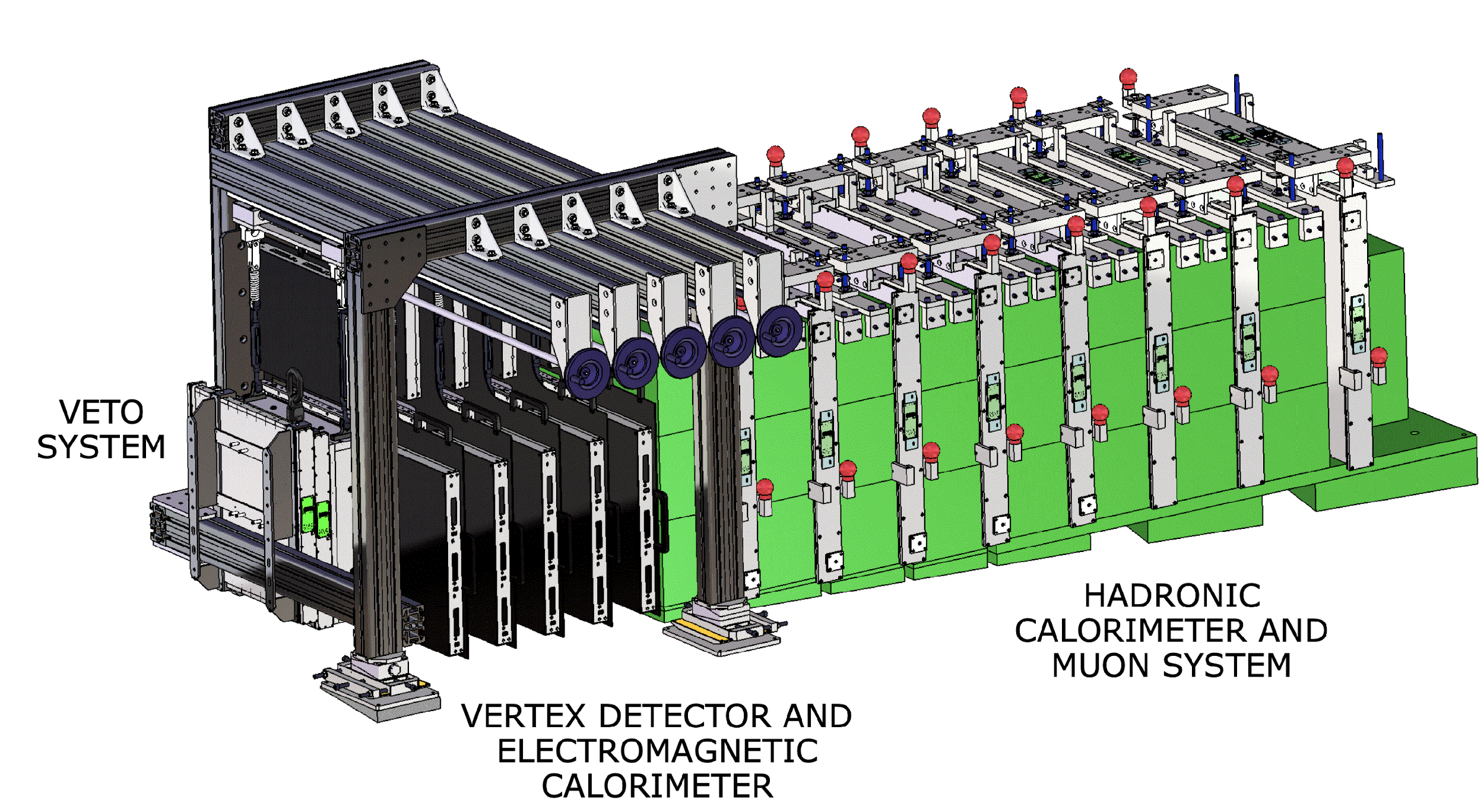
First detectors at the LHC
Scattering and Neutrino Detector @LHC
ForwArd Search ExpeRiment

Slide 4
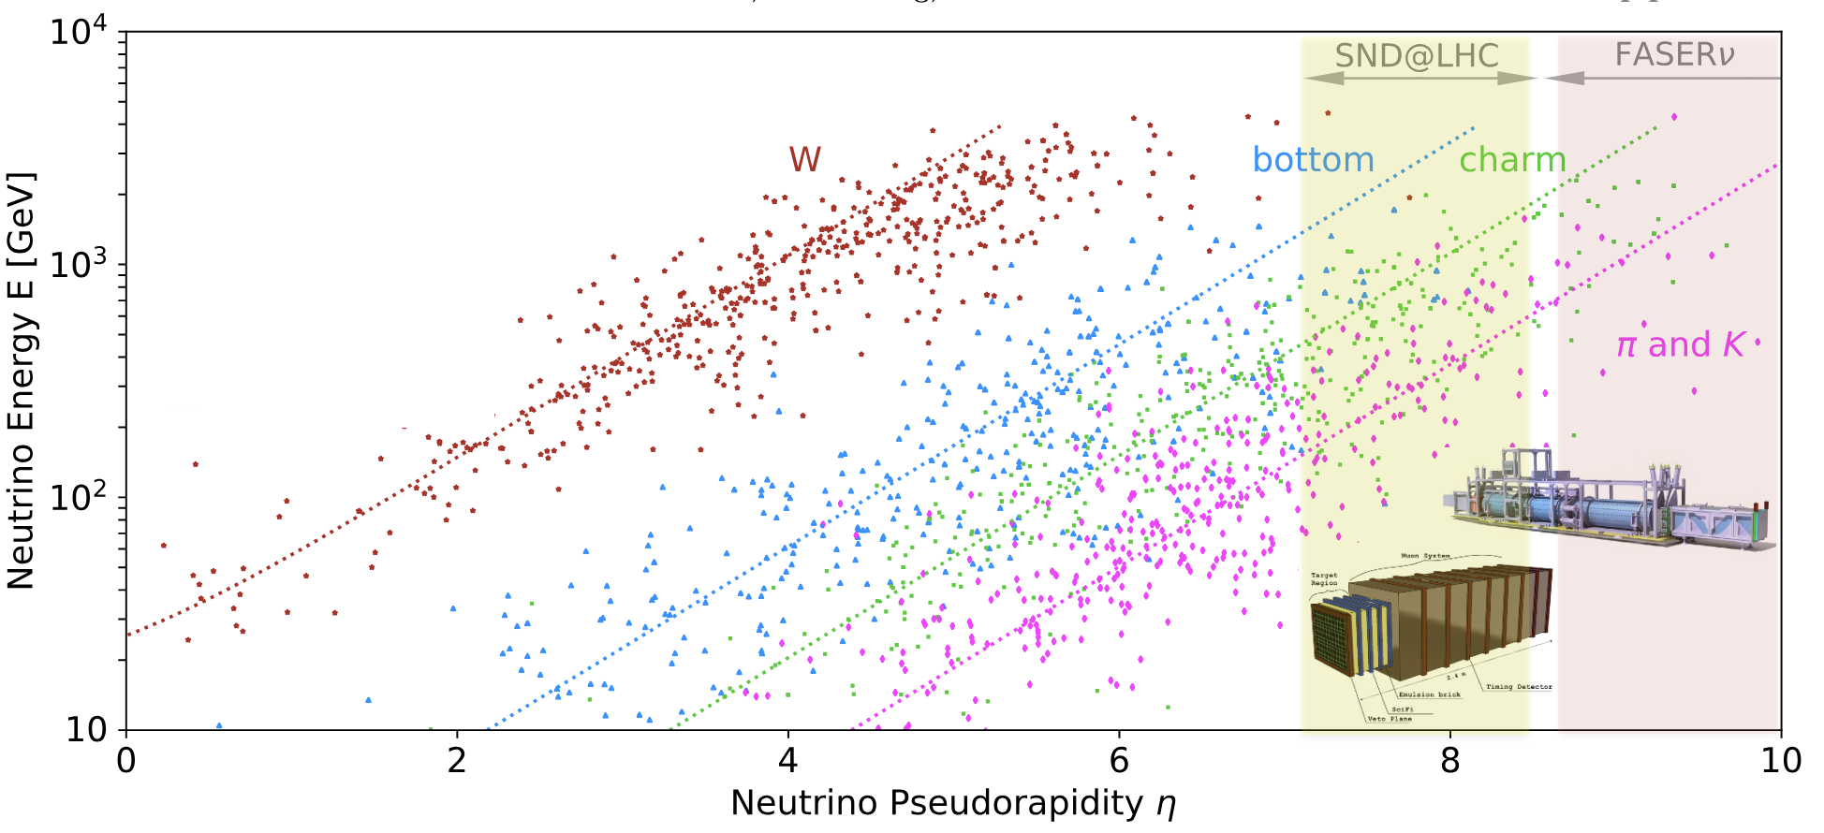
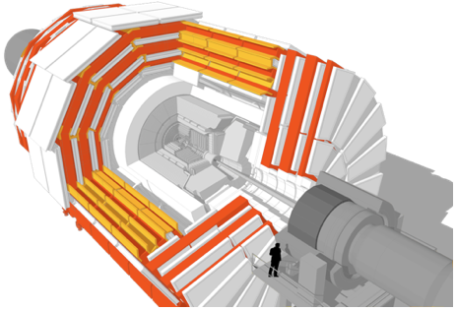
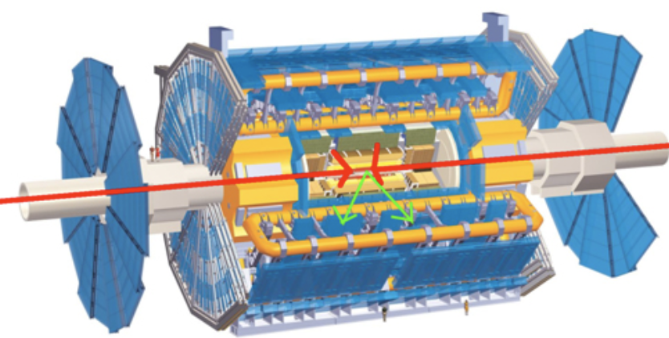
adapted from
PRD 104 (2021) 113005
Neutrino sources
Neutrinos produced by hadron decay:
  ν_{e}: mostly from kaon decay and at high energy from charm
  ν_{𝜇}: mostly from pion decay, at high energy kaons
  ν_{𝜏}: from charm (some B)
η = - ln tan θ/2

Slide 5
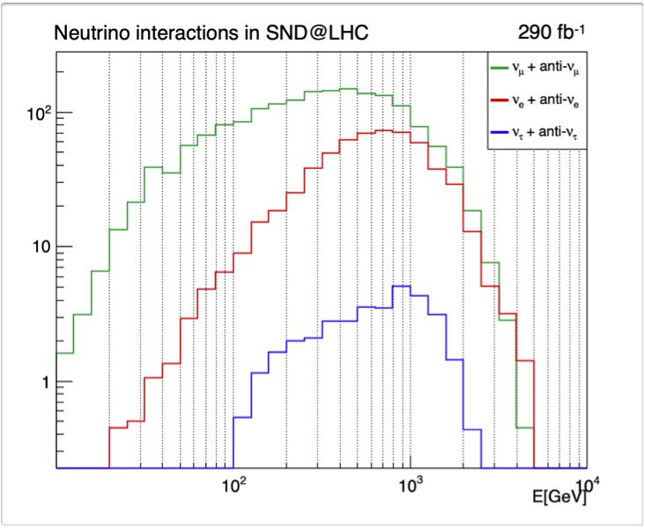
Neutrino energies
Accelerator ν
In LHC Run 3 FASER2 expects:
~1700 ν_{e} interactions
~8500 ν_{𝜇} interactions
~30 ν_{𝜏} interactions
Astro ν
100 GeV
1 TeV
10 TeV
Interactions for different neutrino flavours (SND)
Notes:
Forward production of light mesons (π/K) can not be calculated in pQCD, rather rely on phenomenological models used for cosmic ray physics (validated with LHCf data)

Slide 6

FASER Detector
arxiv: 2207.11427
Beam
10cm radius of active region of detector (<0.2 mrad, ƞ > 9.2)
1.5m long decay volume
2.5m long tracking spectrometer (0.6T dipole field)

Slide 7
SND@LHC detector
Veto system
2 (2022–2023) / 3 (2024–) scintillator planes
Off-axis location: 7.2 < η < 8.4
↪︎ enhances ν flux from charm
Target, vertex detector and ECAL
830 kg tungsten instrumented target
5 walls x 59 layers = 1200 emulsion films
+ 5 scintillating-fibre (SciFi) stations
84 X₀, 3 λ_{int}
HCAL and muon system
Eight 20 cm Fe blocks
+ scintillator planes
Last 3 planes have finer granularity to track muons
9.5 λ_{int}
Beam
arXiv:2210.02784

Slide 8
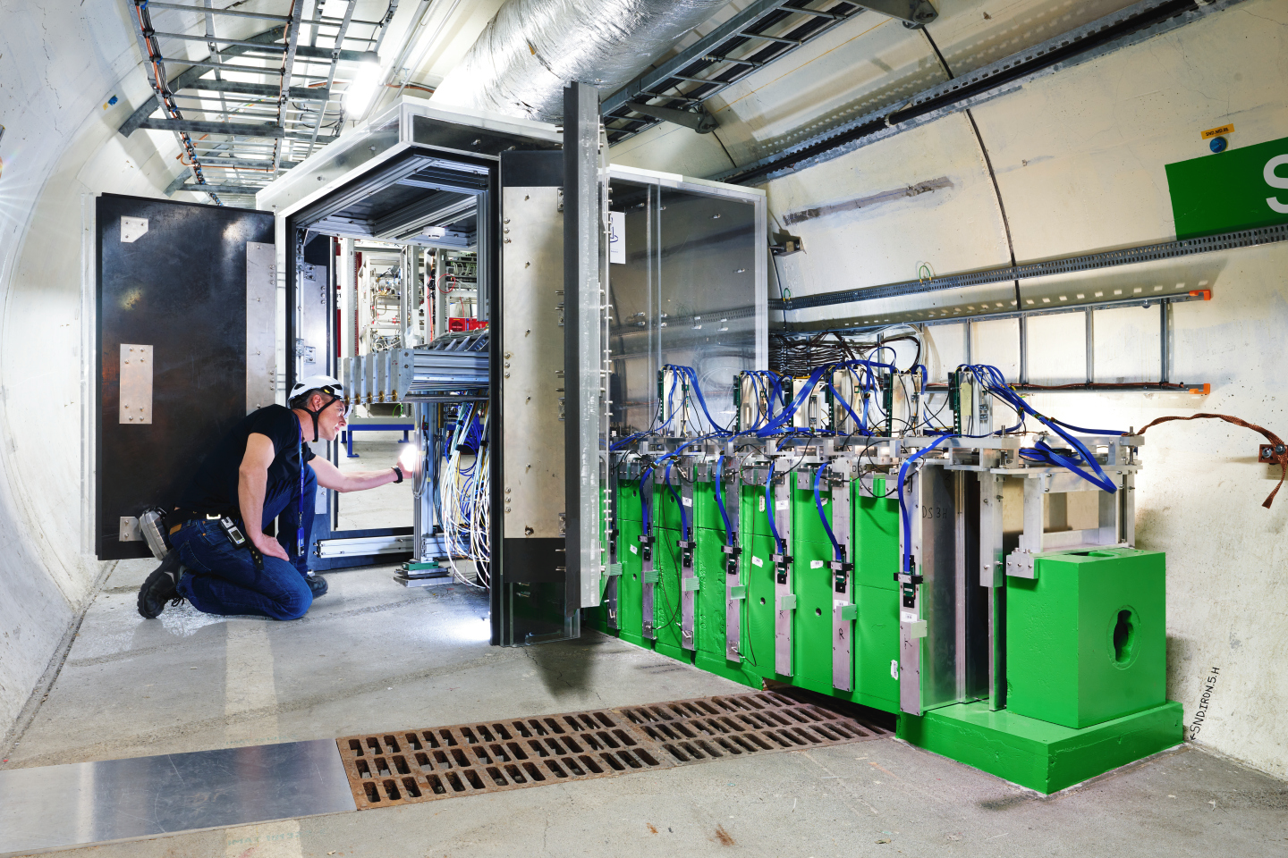
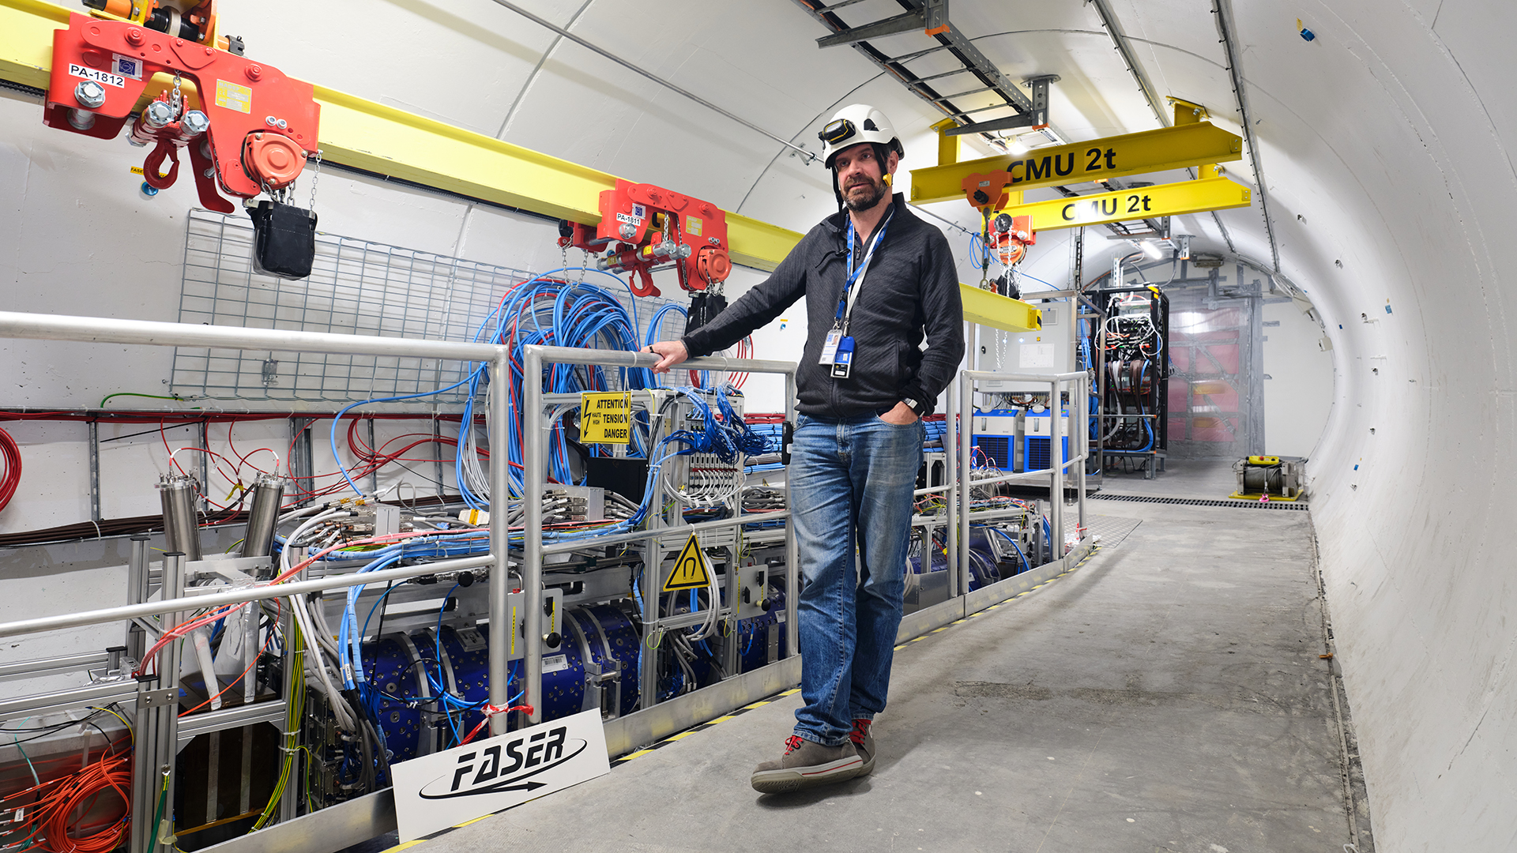
SND@LHC
FASER

Slide 9
Observations of
Collider Neutrinos

Slide 10
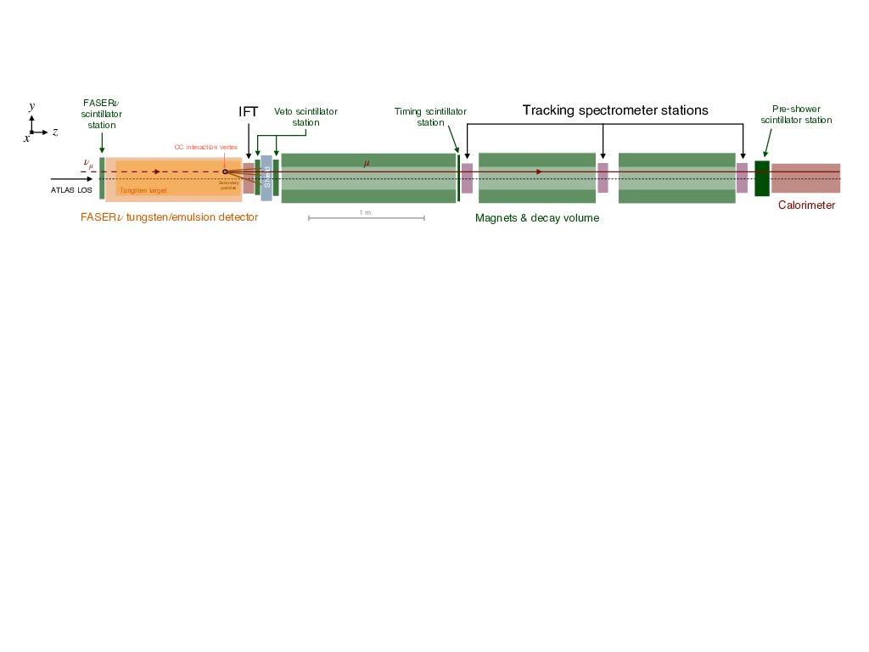
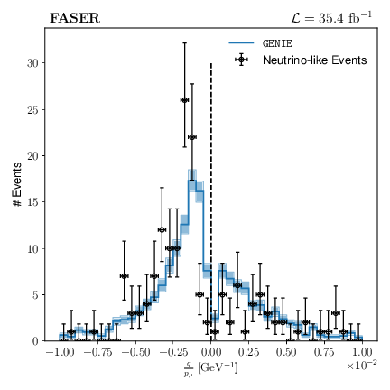
First observation of collider Neutrinos
Phys. Rev. Lett. 131 no. 3, (2023) 031801
2303.14185
Using 2022 dataset (35/fb). Only for ν_{𝜇} CC.
Simple/robust event selection:
No signal in front veto scintillators
Reconstructed charged particle track
  P > 100GeV
  Within central region of scintillators when extrapolated to the veto
Backgrounds considered:
Scintillator inefficiency
Large angle muons that miss the veto
Neutral hadrons produced by upstream muon interactions in rock
Basically background free
Neutrino
Anti-neutrino
Observe 150 events
(expected neutrino signal 151+/-41 )

Slide 11

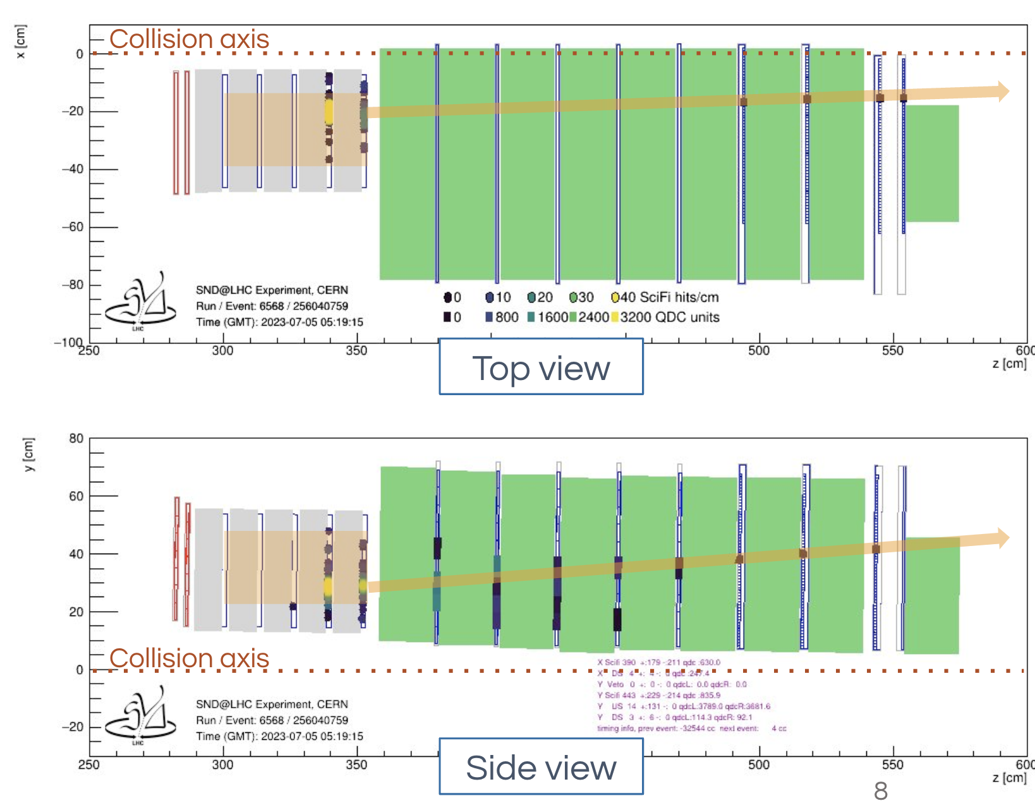
PRL 131 (2023) 031802
Display of a νμ CC candidate event at SND@LHC
Uses data from the
electronic detectors
8 ν_{μ} interaction candidate events
Background: 0.086 events,
Significance of about 7σ

Slide 12
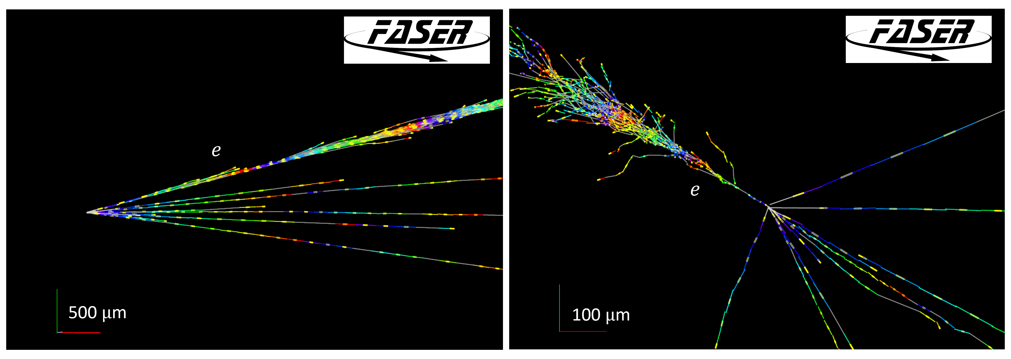
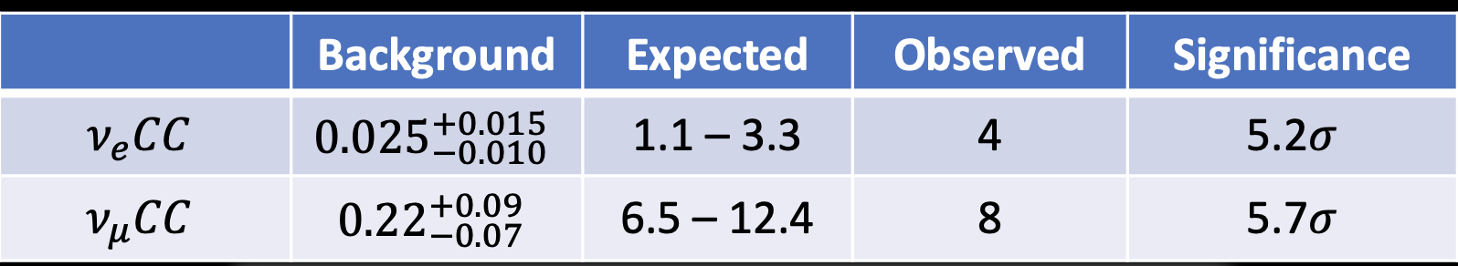
First FASERν measurements
Phys. Rev. Lett. 133, 021802
arxiv: 2403.12520
Electron neutrino candidate (electron energy estimated at 1.5 TeV)
First observation of electron neutrinos produced at a collider
Notes:
Search for electron and muon neutrino CC interactions in 129 kg subsection of FASERν, exposed to 9.5/fb of pp collisions in 2022

Slide 13
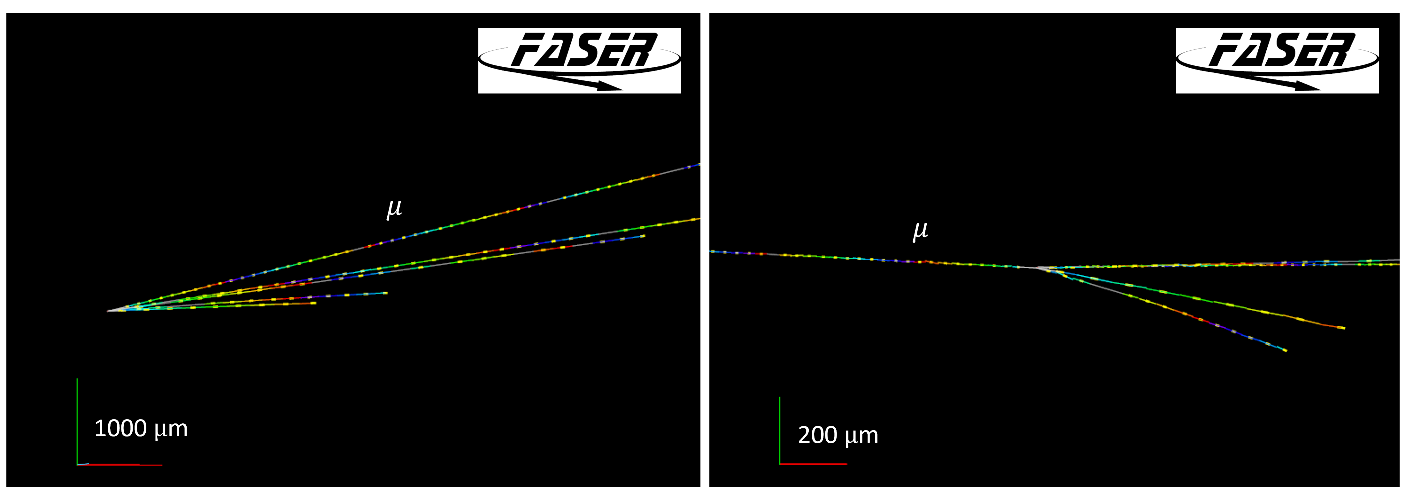
First FASERν measurements
Phys. Rev. Lett. 133, 021802
arxiv: 2403.12520
Muon neutrino candidate (muon energy estimated at 860 GeV)

Slide 14

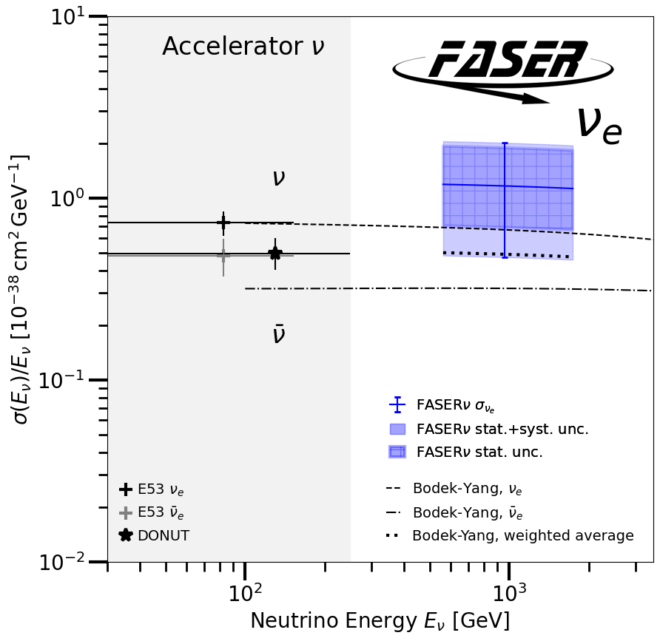
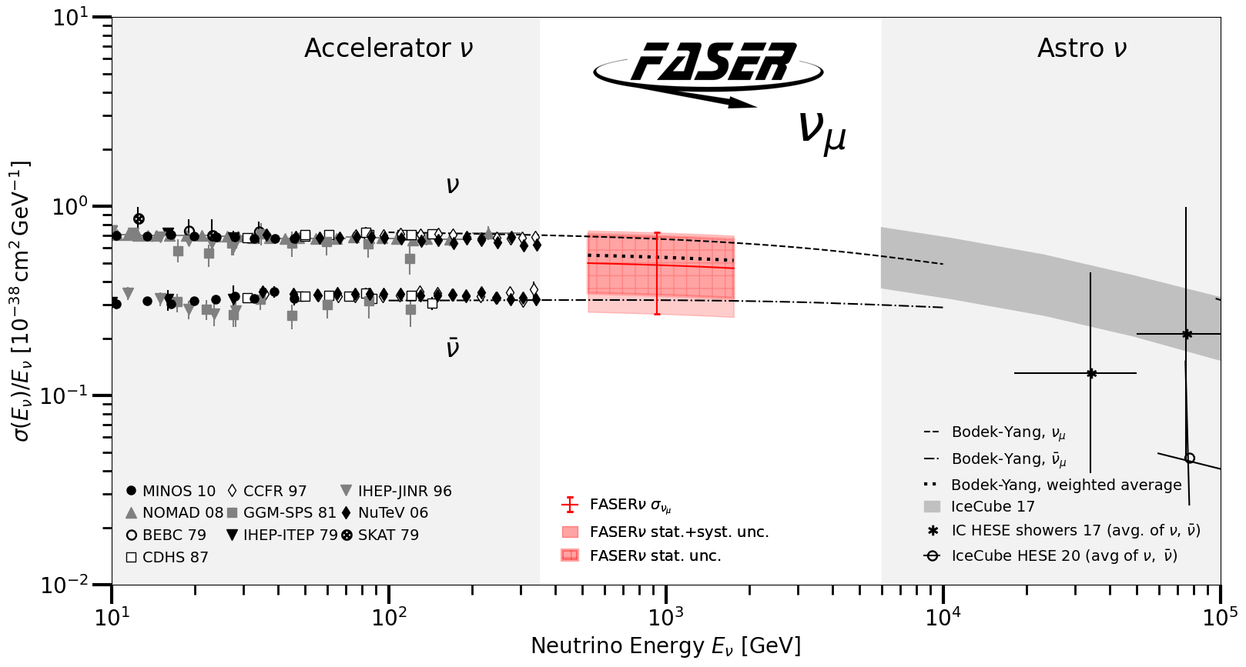
First FASERν measurements
Phys. Rev. Lett. 133, 021802
arxiv: 2403.12520
First neutrino interaction cross section measurements in this energy regime
Relative measurement with respect to theoretical curve (from GENIE)
Using only 2% of FASERν data already collected

Slide 15
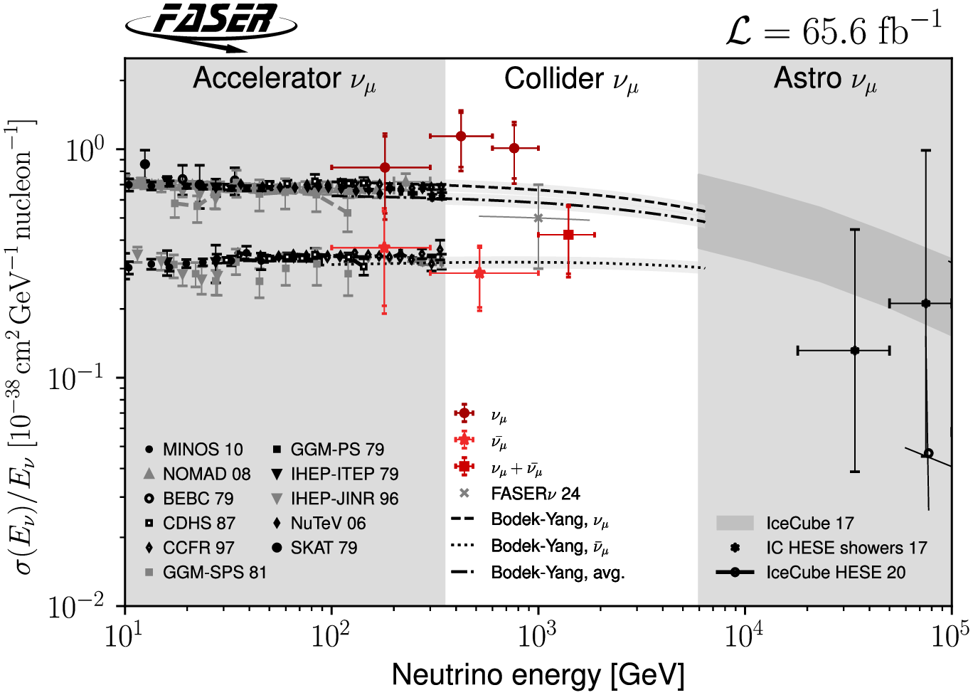
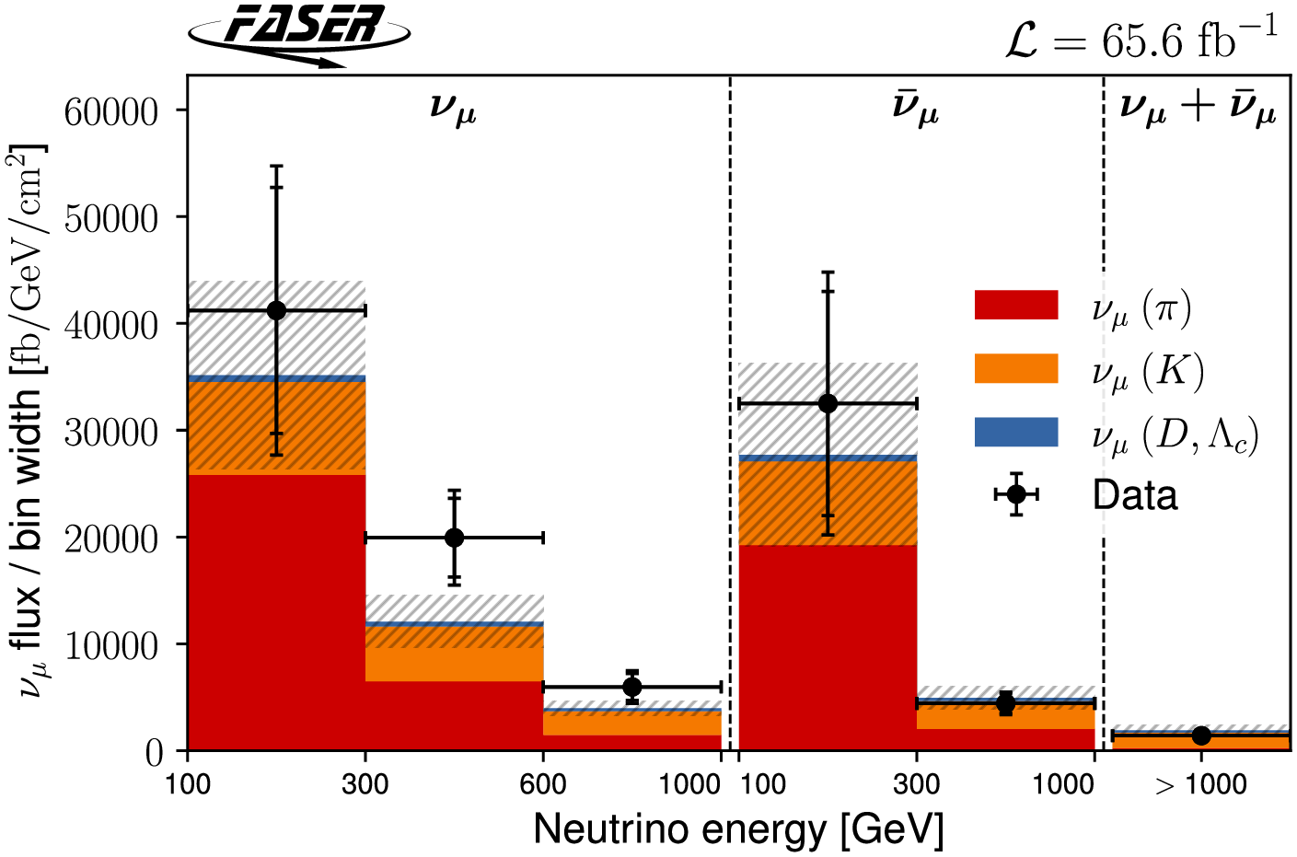
First differential measurements
arXiv:2412.03186
Result interpreted in 2 ways:
Assume neutrino flux, and measure cross section
Assume theoretical cross section and measure the neutrino flux

Slide 16
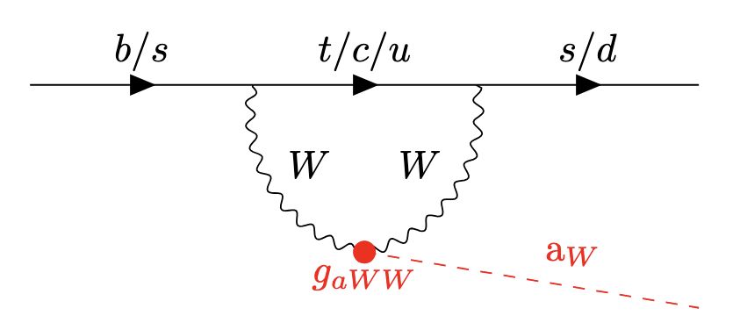
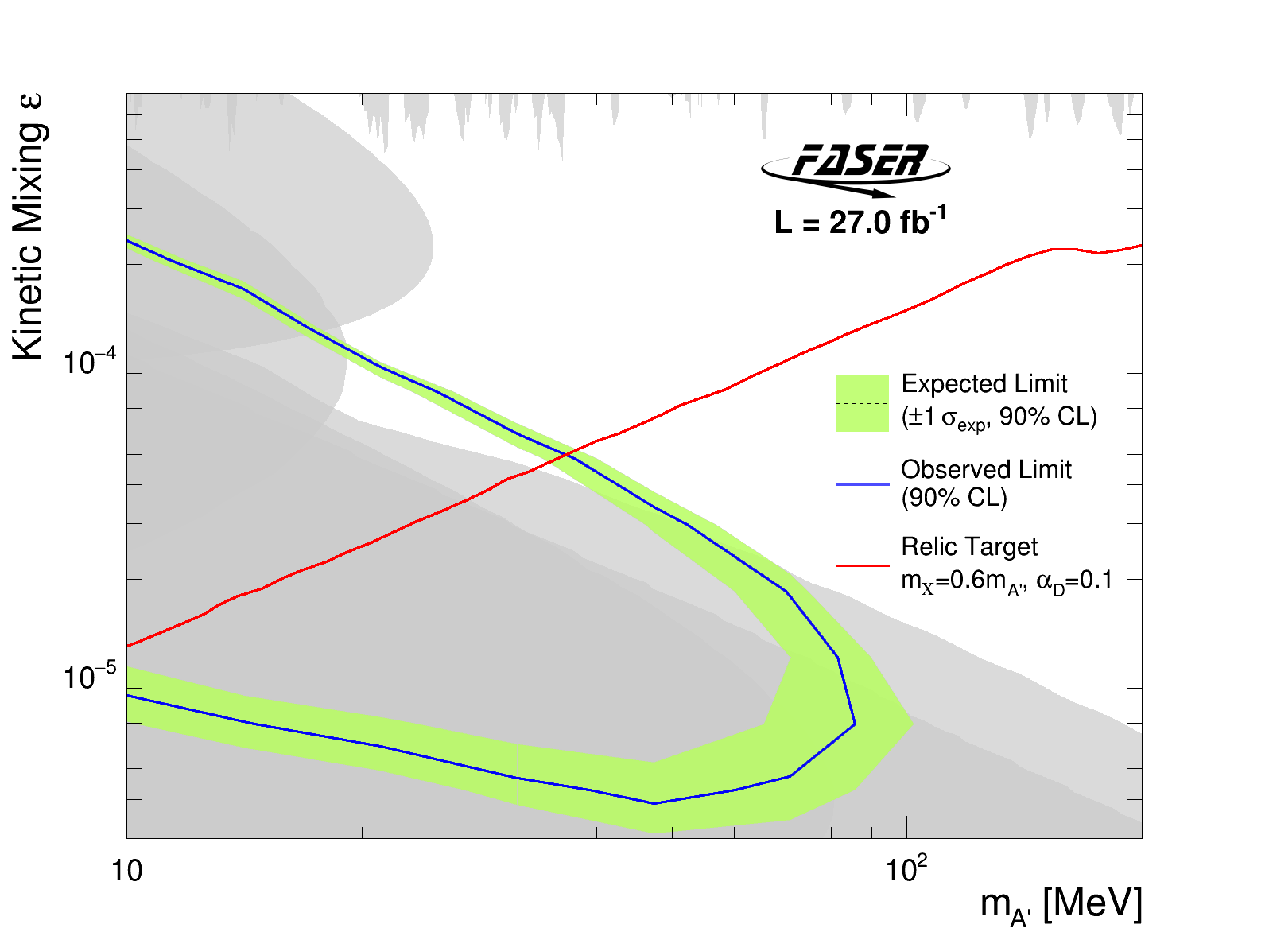
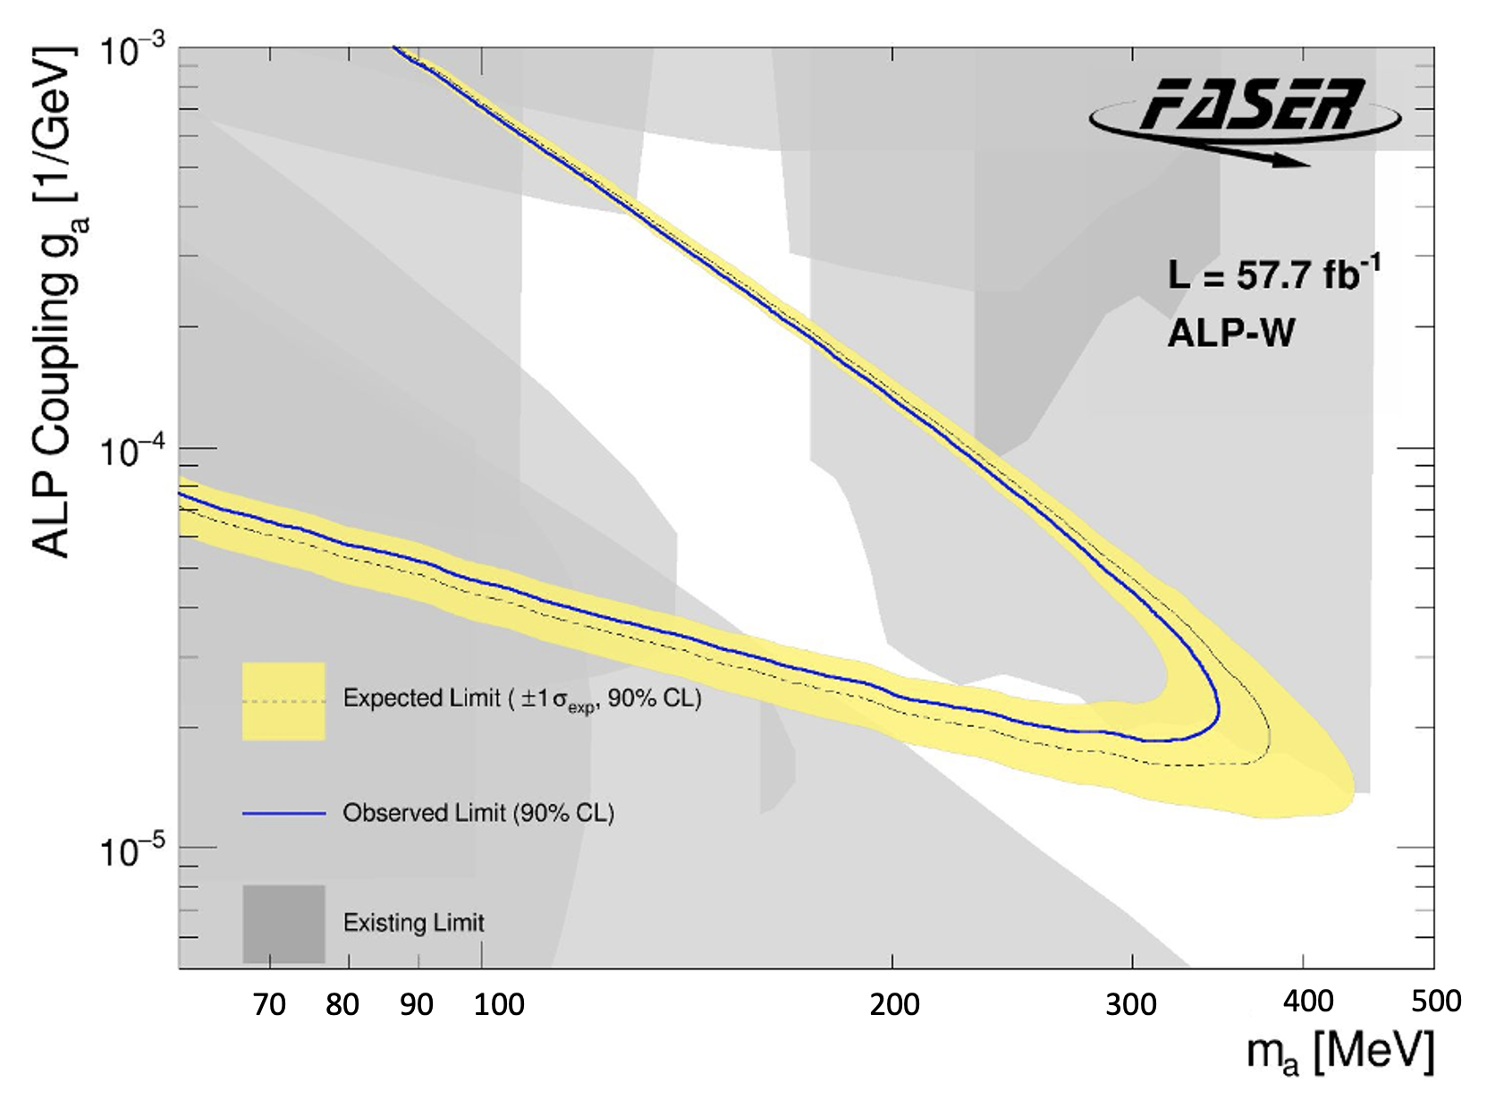
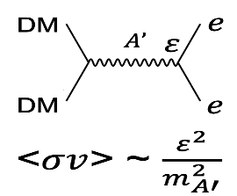
Strong BSM search programme
arxiv:2308.05587
PLB, 848, 138378, 2024
arXiv:2410.10363
JHEP, 2025, 199 (2025)
Dark Photons
Axion-Like-Particles
LLP -> γ γ
LLP -> ee
16

Slide 18
The Forward Physics Facility
FPF working group under CERN/PBC

Slide 19
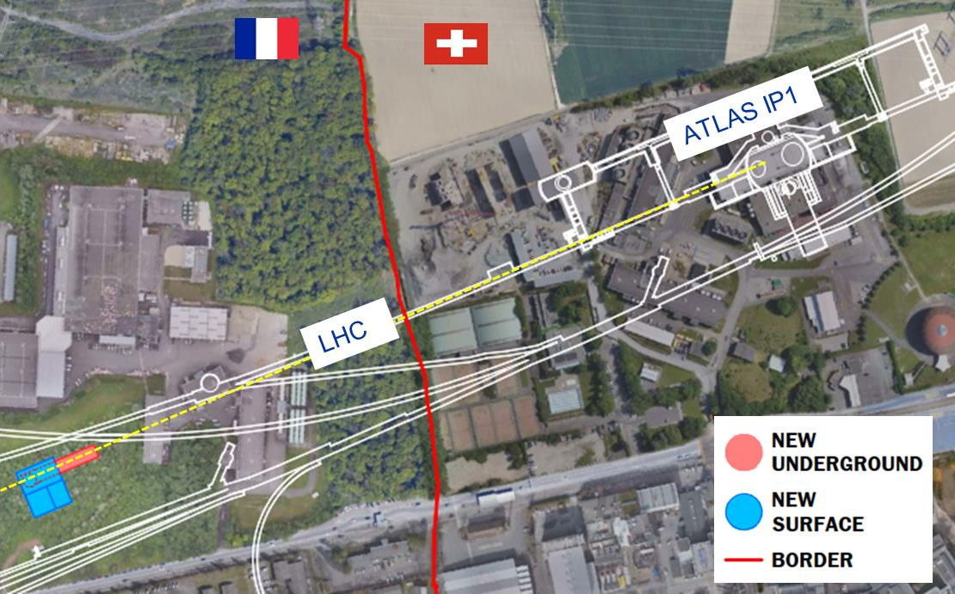
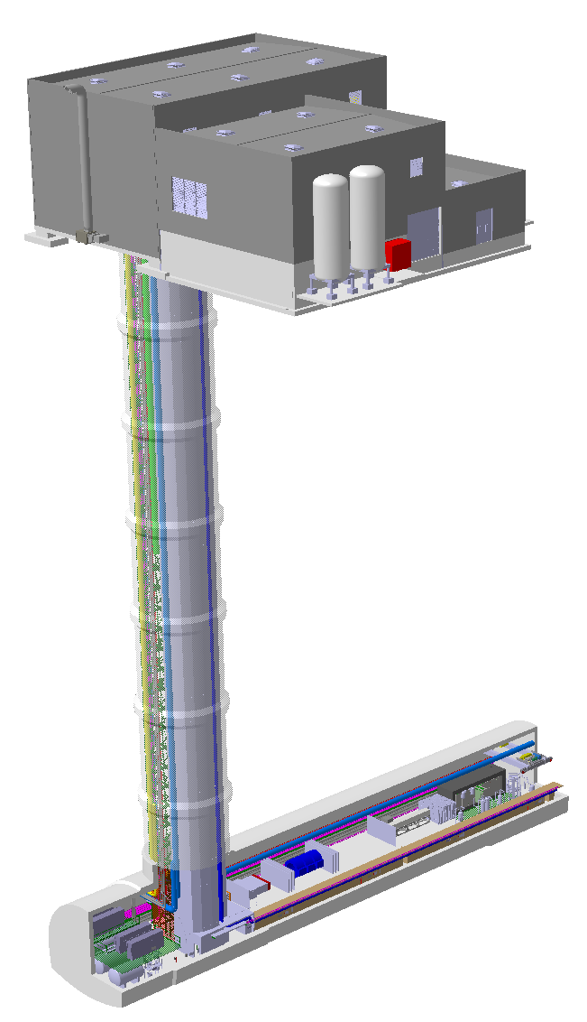
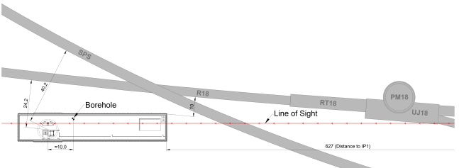
Site selection:
627m from ATLAS IP1
90m deep; 75m long; 21m wide
10m away from LHC tunnel
Shielding > 200m rock/concrete
Surface buildings
Shaft
LHC tunnel
FPF
Cavern

Slide 20
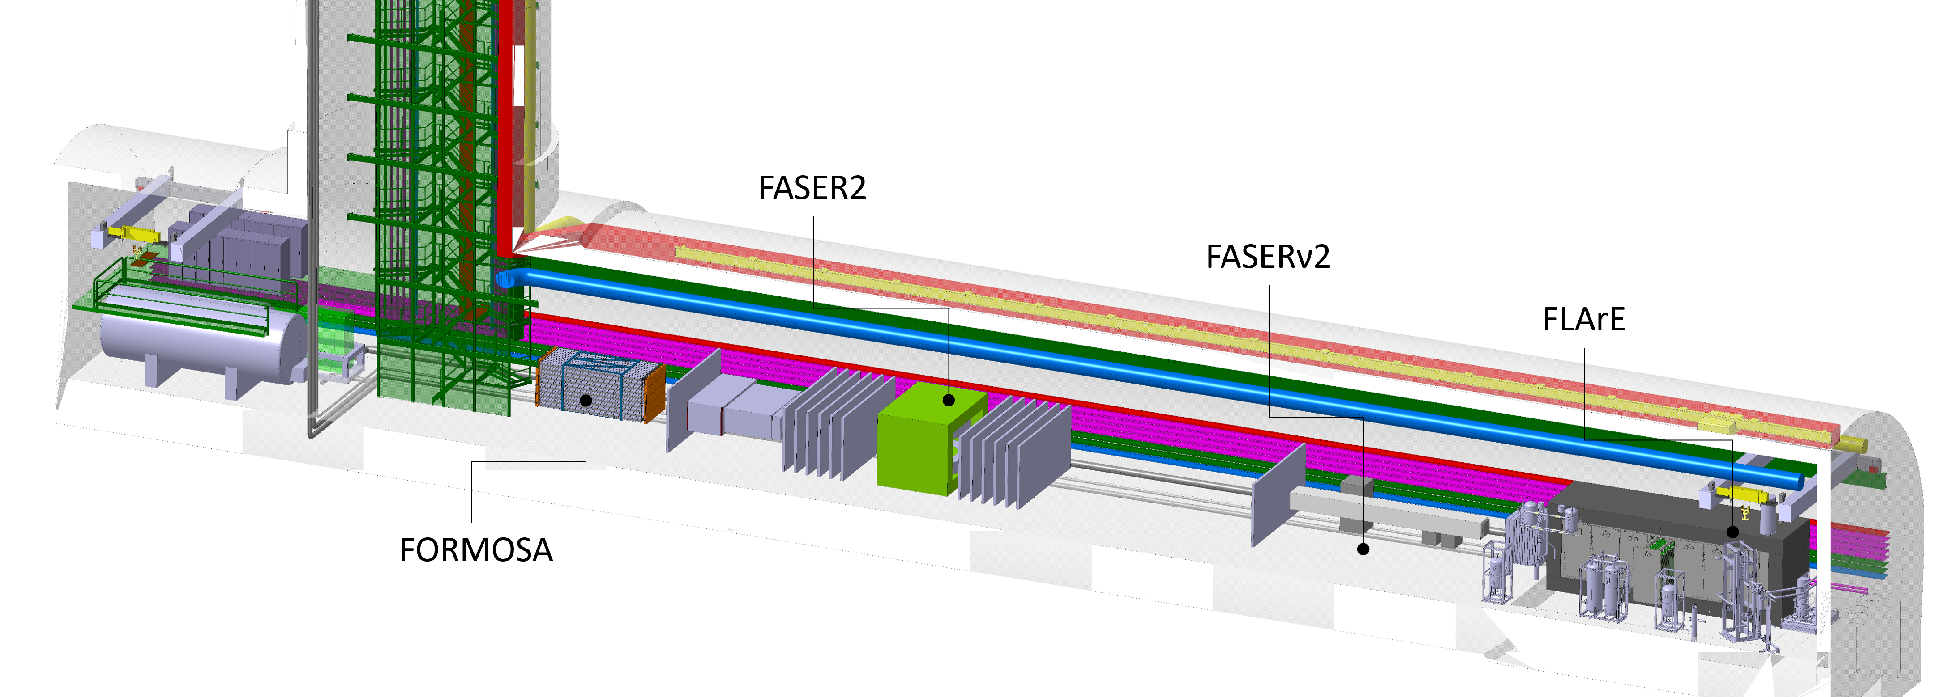
FPF: Complementary technologies
Baseline design
Complementary technologies & capabilities maximise scientific reach
Tungsten/Emulsion
High spatial resolution
for tau/charm
Liquid Argon TPC
broad-purpose detector,
wide dynamic range, 10 ton
Service alcove
(Turbo-Brayton, storage, electronics)
Scintillator detector
4 ton
Magnetic spectrometer
+ calorimeter
Emulsion/tungsten 20 ton
~600m from ATLAS IP
Good energy containment (high density), high spatial resolution (for 𝜏 neutrinos) and low threshold (for DM scattering)
FPF covers η > 5.5, experiments on LOS cover η ≳ 7
Notes:
This shows the layout of the experiments in the facility and also various services that must be included.
Detailed technical notes for each detector are in draft form.
Starting from the upstream. Flare would be a liquid argon TPC. It is designed to be a broad purpose detector. It would have a high resolution readout, either pixels or optical or both. We have put a lot of effort into conceptual design of the cryogenics and cryostat. The main cryogenics is placed at the other end of the cavern so that it does not create noise or obstruction for the rest of the systems. The detector also has a steel/scintillator hadronic calorimeter to provide excellent containment of events.
Second detector in the line is FASERnu2 which will be a tunsgten/emulsion detector with very high resolution of < 1 micron specifically designed for identification of tau neutrinos.
This is followed by FASER2 which is a large magnetic spectrometer with much larger acceptance than the current FASER2 spectrometer. Overall FASER2 will be many orders of magnitude more sensitive than FASER2.
FASER2 has an electronmagnetic calorimeter and it is followed by FORMOSA which is a high resolution plastic scintillator stack conventional detector. By using plastic with high quantum efficiency PMT readout FORMOSA is able to achieve very high dE/dx resolution.

Slide 21
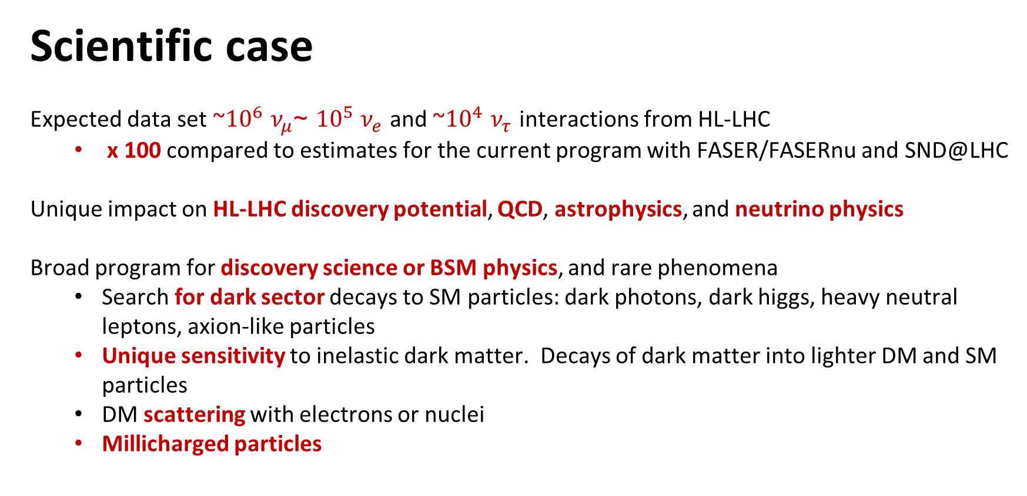
Scientific case
Expected data set ~${10}^{6}$ $ν_{μ}$ ~${10}^{5}$ $ν_{e}$ and ~${10}^{4}$ $ν_{τ}$ interactions from HL-LHC
  x 100 compared to estimates for the current program with FASER/FASERnu and SND@LHC
Unique impact on HL-LHC discovery potential, QCD, astrophysics, and neutrino physics
Broad program for discovery science or BSM physics, and rare phenomena
  Search for dark sector decays to SM particles: dark photons, dark higgs, heavy neutral leptons, axion-like particles
  Unique sensitivity to inelastic dark matter. Decays of dark matter into lighter DM and SM particles
  DM scattering with electrons or nuclei
  Millicharged particles

Slide 22
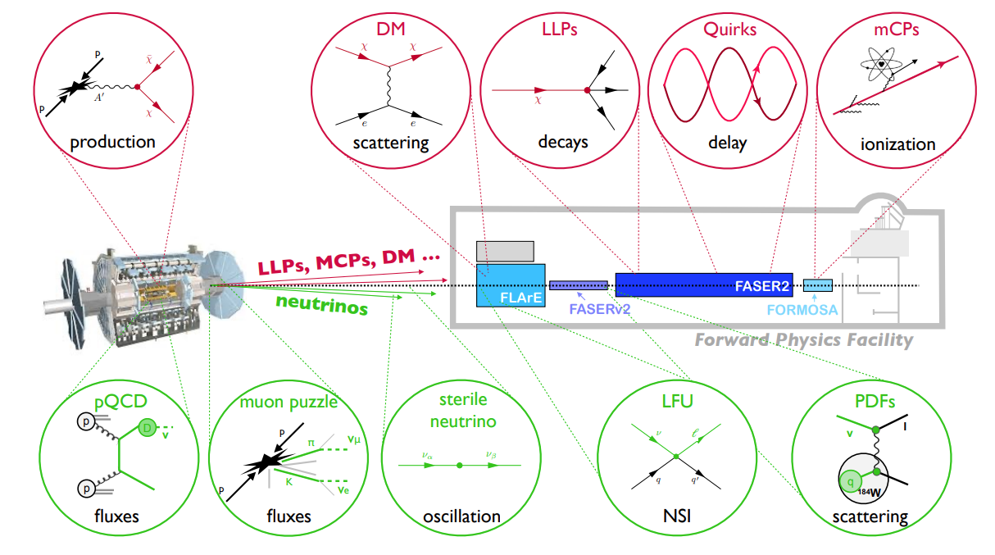

Slide 23
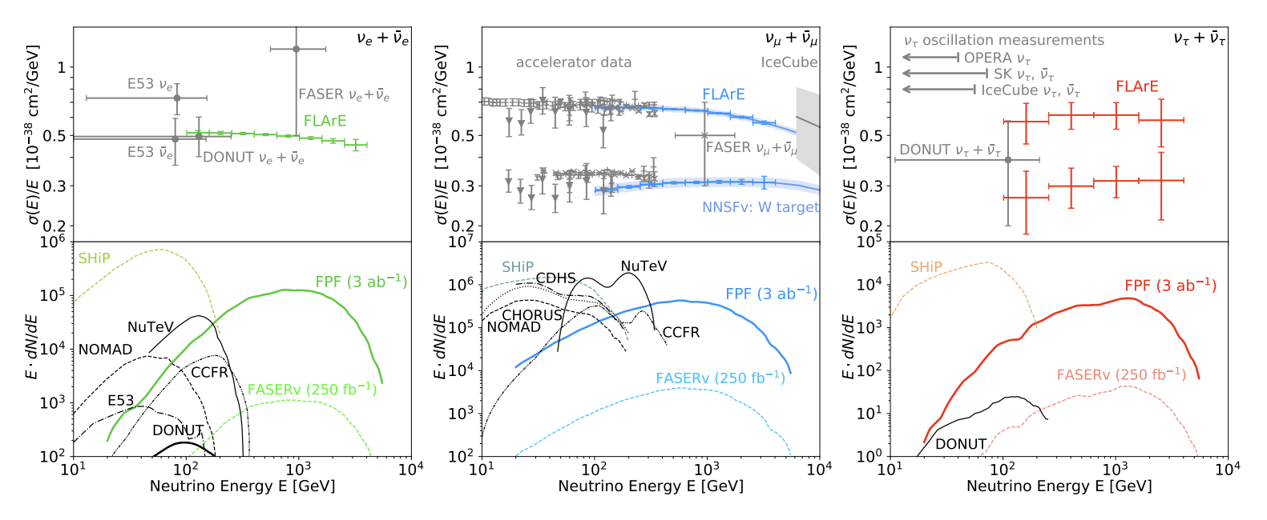
Electron neutrino
Muon neutrino
Tau neutrino
FPF experiments have potential to detect:
O(10⁶) muon neutrinos, O(10⁵) electron neutrinos, O(10⁴) tau neutrinos
➔ Flavour universality, non-standard interactions, neutrino tridents, sterile neutrinos, …
Notes:
Neutrino yields and cross sections at the FPF. The expected precision of FLArE measurements of neutrino interaction cross sections (top, statistical errors only) and the spectra of neutrinos interacting in the FPF experiments (bottom) as a function of energy, for electron (left), muon (middle), and tau (right) neutrinos. Separate measurements of muon and tau neutrinos and anti-neutrinos can be performed using muons passing through the FASER2 spectrometer. Existing data from accelerator experiments [9], IceCube [10], and the recent FASERν result [11] are also shown, together with the prospects for SHiP [12].

Slide 24
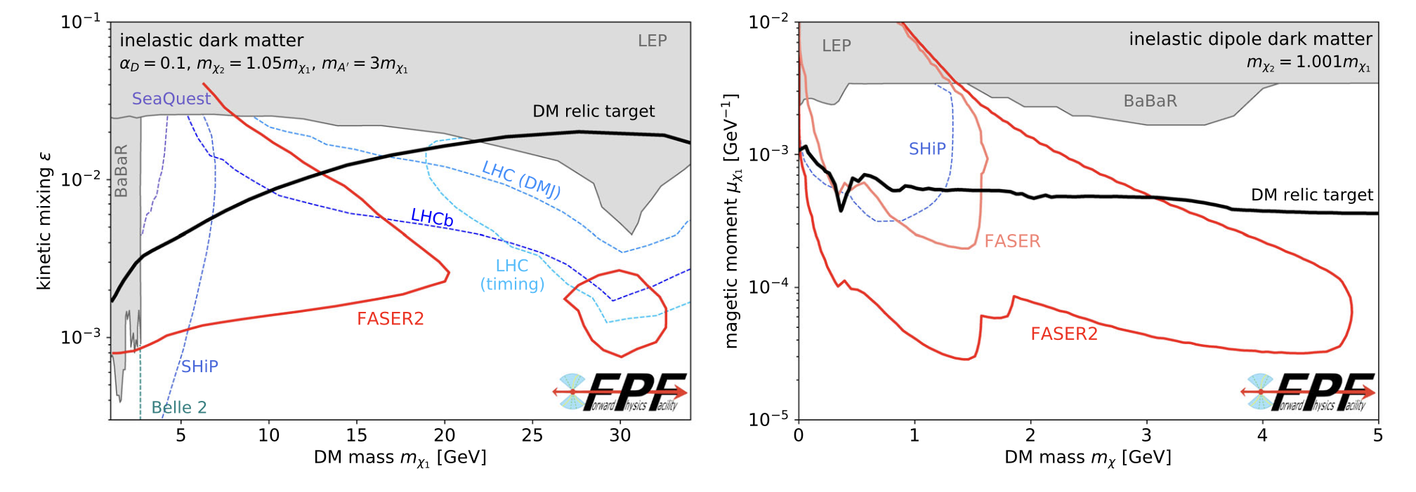
Dark sector searches
Unique FPF sensitivity
Heavy inelastic dark matter
Inelastic to be above threshold to produce
Light inelastic DM → need energy/boost to observe
The FPF can discover a wide variety of new particles that cannot be discovered at fixed target facilities or other LHC experiments.
Notes:
LHS: heavy inelastic DM interacting via a dark photon portalwhere the high energy of the LHC allows FASER2 to probe masses up to tens of GeV
RHS: light inelastic DM with very small mass splittings that is mediated by a dipole portal where the large LHC energy boosts the signal to observable energies.

Slide 25
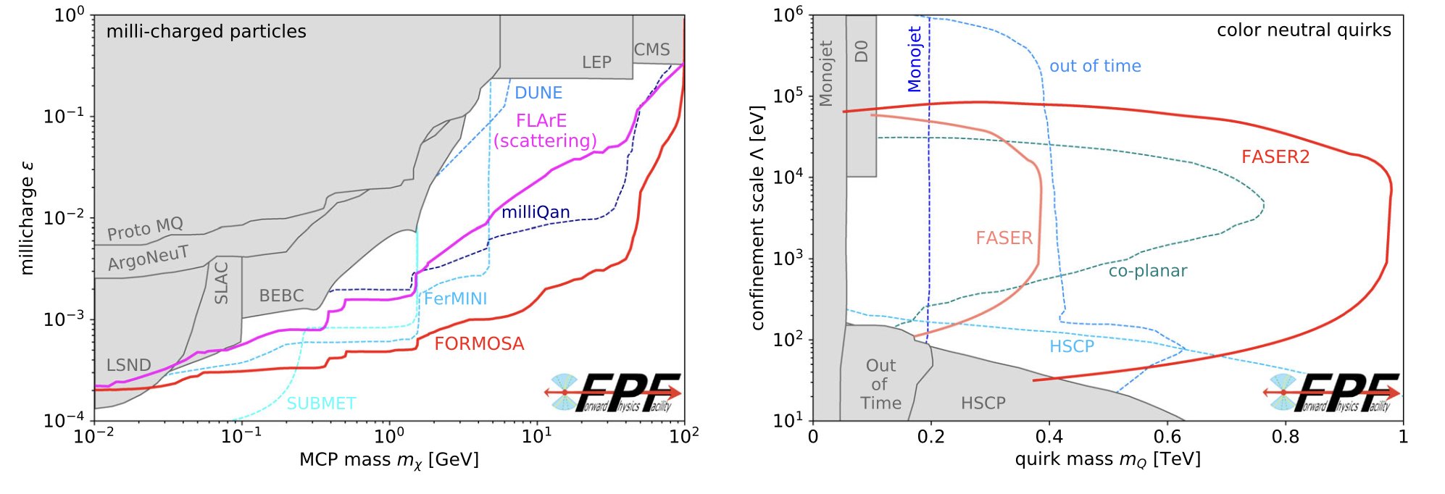
Milli-charged particles and quirks
FORMOSA will have leading sensitivity
to milli-charged particles
Unique sensitivity to Quirks
coloured under non-SM gauge group
Just some examples from very broad BSM programme
Notes:
FORMOSA, a proposed scintillator-based experiment at the FPF, will have world-leading sensitivity to mCPs [38]. Leveraging the high energy of the LHC collisions and the enhanced mCP production rate in the forward region, it will provide the most sensitive probe in the 100 MeV–100 GeV mass range compared to existing bounds and projections from several ongoing or proposed experiments.

Slide 26


Neutrinos as a probe
TeV Energy Neutrino Interaction
l
intrinsic
charm
neutrino DIS at TeV scale
large x PDFs: x~1
charm
fragmentation
color transparency
p
g,q
D
hadronization in nuclear medium
v
cc
BFKL dynamics
forward charm
¹⁸⁴W
q
p
g,q
ultra low-x
PDFs: x~10⁻⁷
color glass condensate
strangeness
nuclear PDFs
shadowing
EMC effect
Forward Particle Production

Slide 27
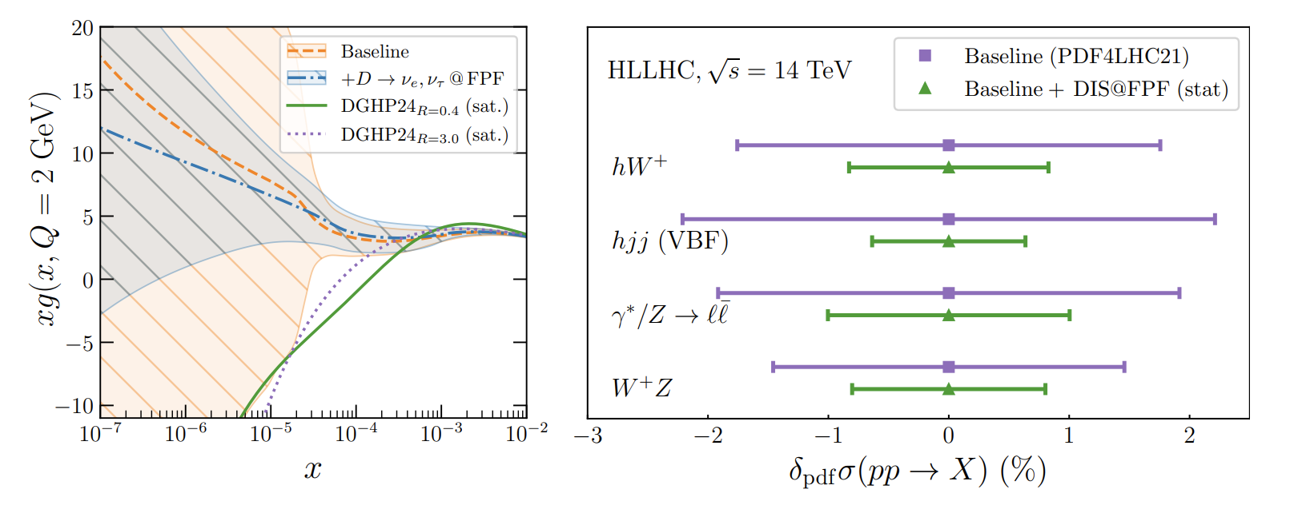
Enhancing HL-LHC discovery potential
FPF measures the gluon probability
(PDF) at low momentum fractions
Improves predictions of Higgs- and weak gauge- boson cross sections at the HL-LHC

Slide 28




Improving astroparticle physics
Unique laboratory validation of extreme scattering processes in APP
$$t$$
$$E_{beam}=7 TeV (CoMframe)$$
$$\overline{t}$$
Collider counterpart of high-energy cosmic rays interactions, including prompt neutrino flux
$$E_{beam}∼{10}^{5} TeV (fixed target frame)$$
Auger, IceCube, KM3NET, GRAND, …
Cosmic ray muon anomaly
Notes:
For many years, the experimental measurements of the number of muons in high- and ultra-high-energy cosmic-ray air showers have appeared to be in tension with model predictions [118–123]. This conundrum has been dubbed the cosmic-ray muon puzzle. Various airshower models [72, 124–129] can be tested under controlled experimental conditions at the FPF, because the ratio of the low-energy electron and muon neutrino fluxes is a proxy for the charged kaon to pion production rate.
Measurements of the neutrino flux at the FPF provide access to both the very high-x and the very low-x regions of the colliding protons. These measurements yield information about high-x PDFs, in particular intrinsic charm, as well as novel QCD production mechanisms, such as BFKL effects and non-linear dynamics, well beyond the coverage of other experiments and providing key inputs for astroparticle physics. FPF measurements will constrain the underlying PDFs and therefore provide stringent constraints on the prompt atmospheric neutrino flux, contributing to the scientific program of large-scale neutrino telescopes

Slide 30
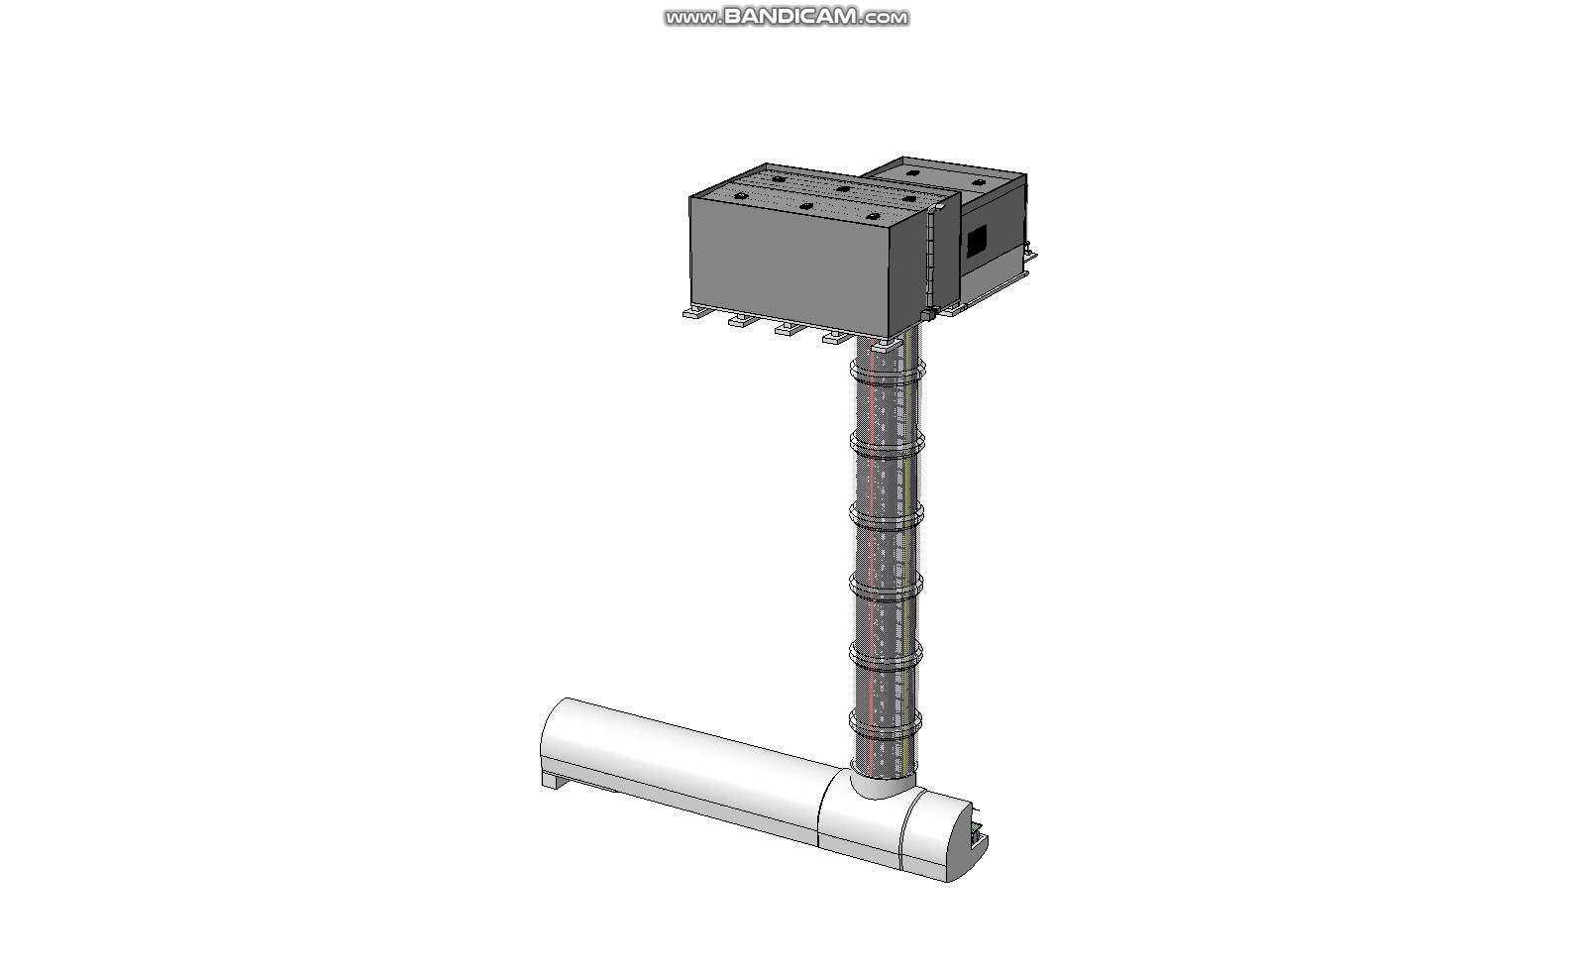

Status of Technical Studies and Integration
CERN beam physics group: Vibration/tunnel movement are not expected to be an issue either during construction or operation.
CERN radioprotection group: Can access cavern for trained personnel during beam operations.
Muon backgrounds: CERN fluke team, muon flux will be < 1 Hz/cm^2 in a region 1 meter around LOS. Generally acceptable for experiments.
CERN site investigation: Geological conditions appear good for proposed excavation.
CERN safety: Addition of over-pressure safety corridor allows a single access point (no physical connection to LHC).
The cryo system to be separated underground; has an industrial cooler(Turbo Brayton), LAr and LN2 storage ; all sized to be installed thru shaft.
Conceptual installation plan for all services and detectors developed at FPF8
Engineering Department
Notes:
I will play this short video while going through the list of technical studies that have resulted in this design.

Slide 31
Achievability & practicality:
  Makes use of the existing HL-LHC beams
  The detectors deliverable with existing detector technologies
    Allowance for future technologies and upgrades
  Can be constructed and operated in parallel with the operation of the LHC
Timescale:
  The FPF needs to operate within the HL-LHC running window
    Collect as much of the HL-LHC luminosity as possible
    Constraints from scheduling and approval requirements can be accommodated
  Step-change in the capability of the FPF
    factors of order 100 larger active volumes beyond the pathfinder experiments
    that the sensitivity will world-leading almost as soon as the experiments are operational
In all scenarios it should be the scientific goal to fully exploit the physics potential of the HL-LHC, including the collider neutrino and forward dark sector programmes - which can be added at modest marginal cost.

Slide 32
EXTRAS

Slide 33
FPF Information Sheet
Effort Name: Forward Physics Facility and Experiments at the High Luminosity LHC.
Short Abstract: The Forward Physics Facility (FPF) is a proposed new underground cavern at the Large Hadron Collider (LHC) that will host a suite of new experiments during the High-Luminosity LHC (HL-LHC) era. The existing large LHC detectors have un-instrumented regions along the beam line, and so miss the rich physics opportunities provided by the enormous flux of particles produced in the far-forward direction. A diverse set of experiments are planned to detect millions of neutrinos and a wide range of new physics possibilities.
Contact: https://fpf.web.cern.ch/
Useful Link: https://pbc.web.cern.ch/ , https://pbc.web.cern.ch/fpf-resources
White papers: https://arxiv.org/abs/2411.04175

Slide 34
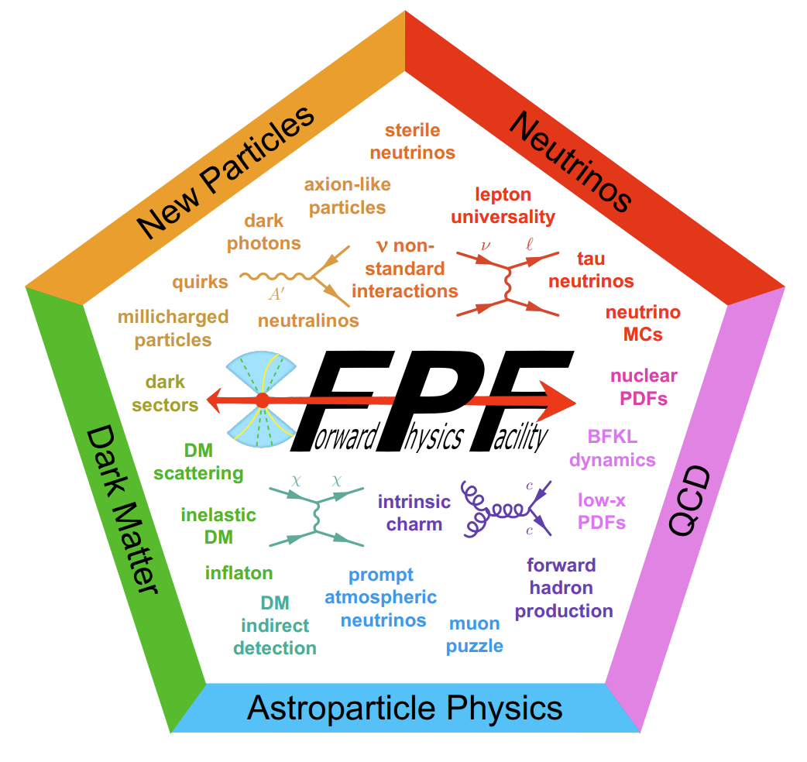

Slide 35


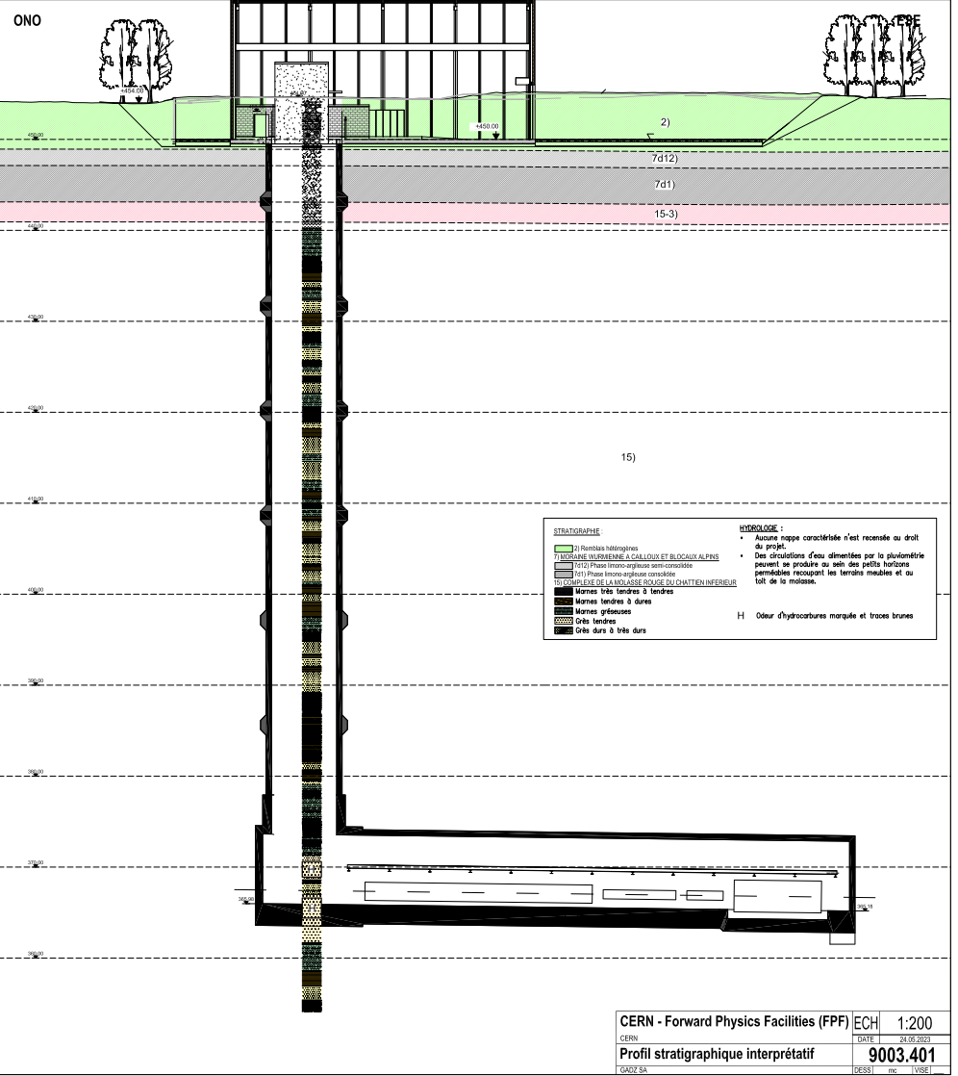
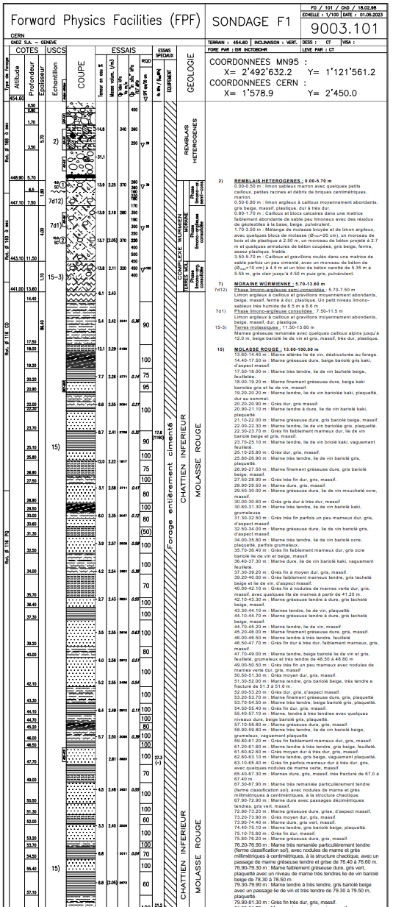
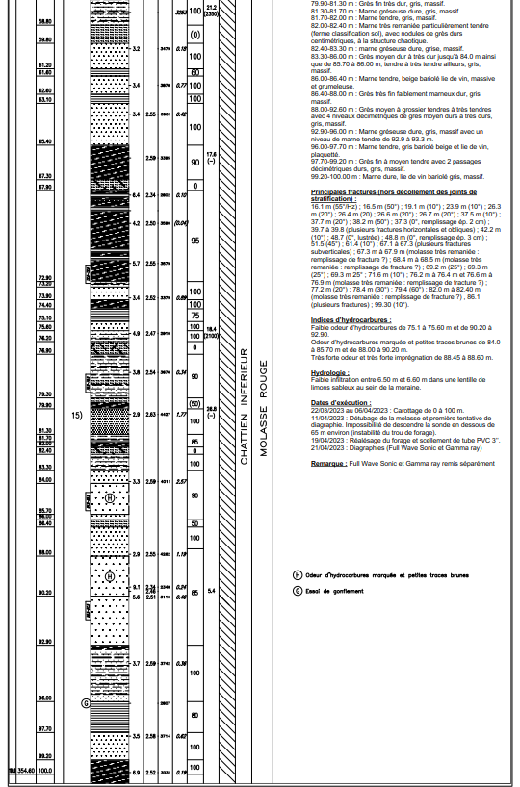
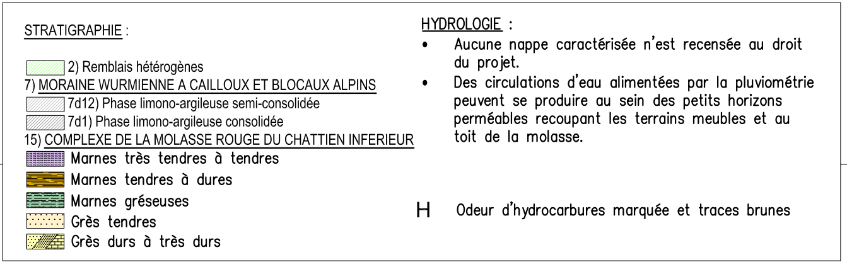
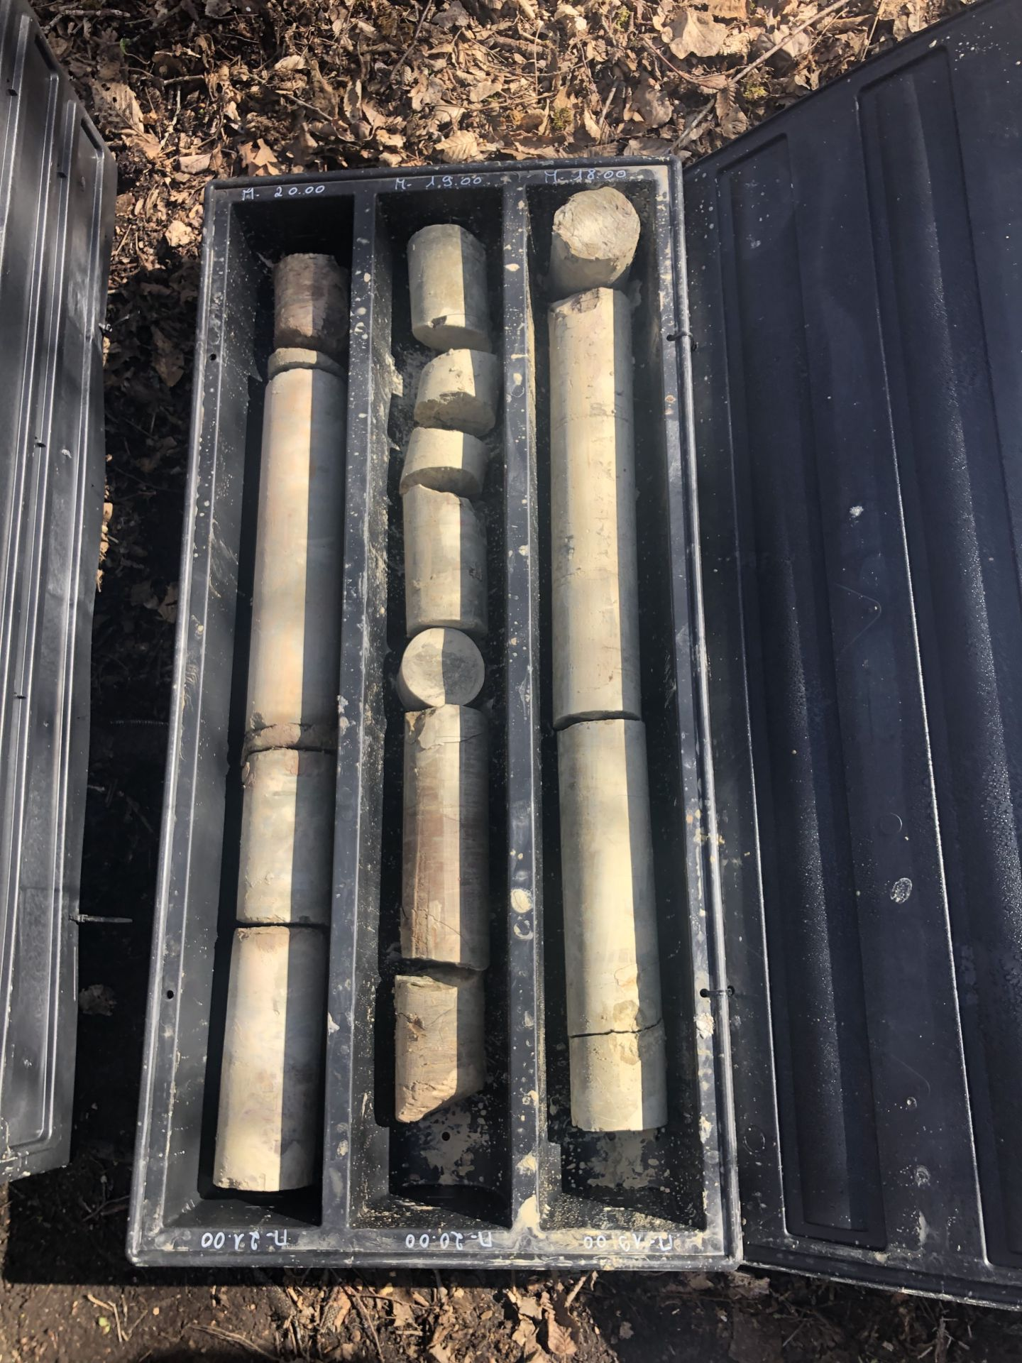
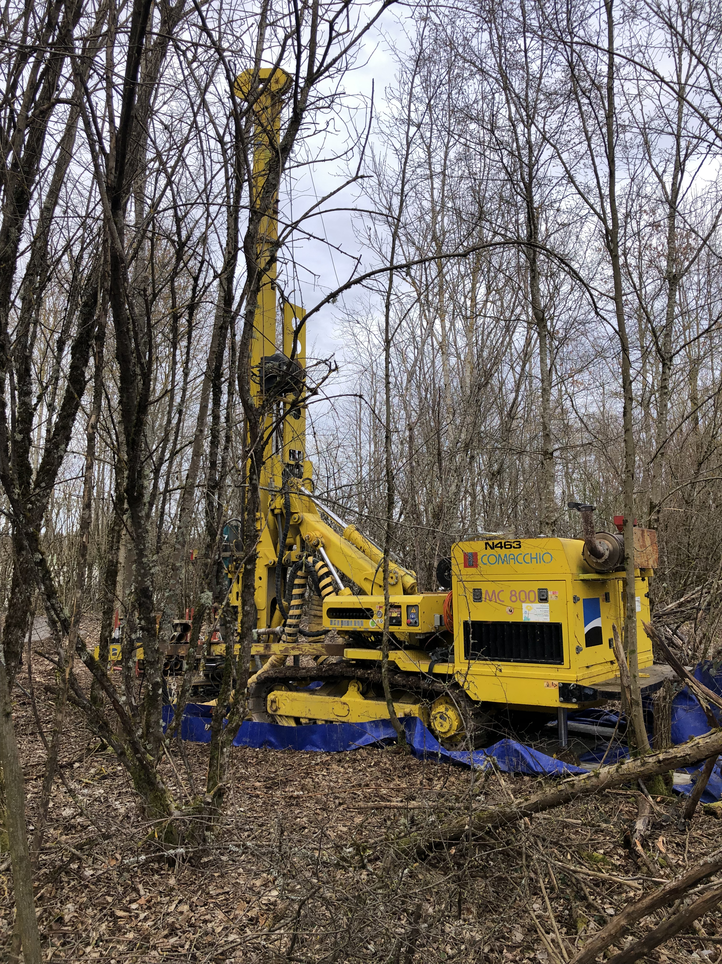
FPF CE Site Investigation Works
20cm diameter core taken to 100m depth at proposed FPF location
Detailed geological study of core carried out
  No showstoppers identified
  Area looks good for excavation
35
35

Slide 36
FPF Detector parameters and physics (summary)
Detector | Design/Parameter | Standard Model Physics | Discovery and Rare Phenomena Physics
FLArE | Liquid argon TPC/10 ton active target/~ns timing/Fe-Scin hadronic calorimeter(40 ton) | High eff. Muon/Electron neutrino spectrum. wider eta coverage, Low purity Tau neutrinos spectrum | LLP interactions with low threshold. Inelastic DM, DM scattering, mCP interactions. Neutrino Tridents
FASERnu2 | Tungsten/emulsion/20 ton/high spatial resolution <1micron. | High eff Tau neutrino detection. Charm detection. Muon/electron neutrino spectra at high eta | DM scattering, Neutrino Tridents
FASER2 | Magnetic Spectrometer/SciFi/~4 T-meter/aperture ~ 3mx1m; dp/p ~ 5% @ TeV | High acceptance Muon spectrometer for FLArE and FASERnu2 | Dark sector decays of neutral LLPs, Inelastic DM, Quirks
FORMOSA | Plastic Scintillator Array/high resolution dE/dx (4 layers, 4 tons) | — | Millicharged particles with sensitivity q~10⁻³ Quirks
Each detector is designed to have unique scientific reach. System of detectors enhance the scientific case for the facility. Simulations are in progress to evaluate acceptances and resolutions.
Notes:
On this slide, I have attempted to summarize the detector technologies and their standard model and beyond standard model targets.
Each detector is designed to have unique scientific impact, but it is also located and designed to support the entire ensemble of experiments. And so together the system should have much broader sensitivities.
FLARE is a broader purpose detector with sensitivity for neutrino physics. It will have high energy resolution and excellent coverage over a broad range of pseudo-rapidity. It has timing and will be able to stay live continuously. For DM, liquid argon has low threshold and due to its completely live nature it has sensitivity to DM and millicharged particle scattering as well as neutrino tridents.
FASERnu2 is specifically designed to have extremely high spatial resolution using emulsion and can select tau events with very low backgrounds using decay kinks. Because of the tungsten heavy target it provides additional constraints of neutrino events apart from argon. Particularly, we are evaluating sensitivity to neutrino tridents with both FLARE and FASERnu2 which is sensitive to the target nucleus.
FASER2 is a high resolution magnetic spectrometer; the nominal design is with a 4 tesla-meter dipole, but we are also examining commercial approaches to magnets. FASER2 will serve as the muon spectrometer for FLARe and FASERnu2. This is a crucial function that requires careful design of the geometry. However, FASER2 is also designed with a minimum 5 meter decay length for excellent sensitivity for Dark sector decays, unique sensitivity to inelastic DM,
And finally FORMOSA is a plastic scintillator array with 4 layers of scintillators.
We have just started examining how to look at the physics in combination of all detectors, but as a first task, the acceptance of the spectrometer has been analyzed and designed to have >50% acceptance for neutrino generated muons.

Slide 37
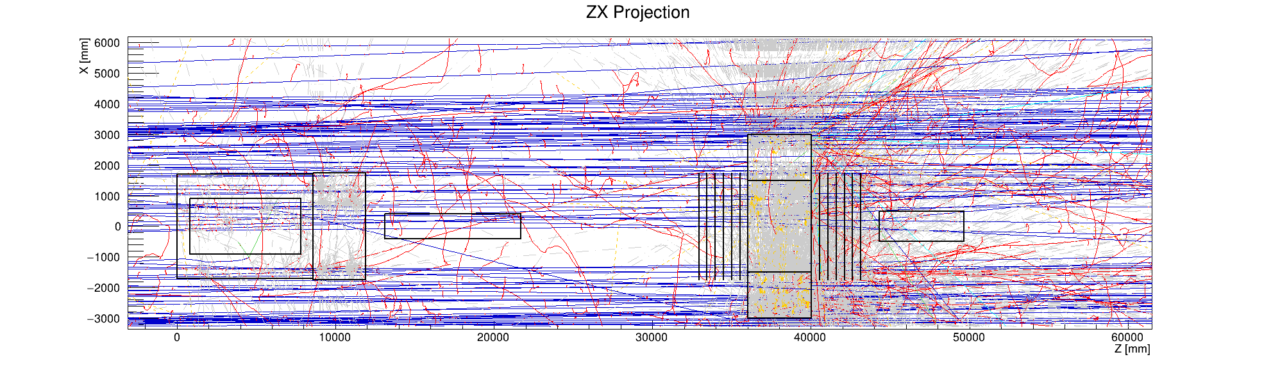
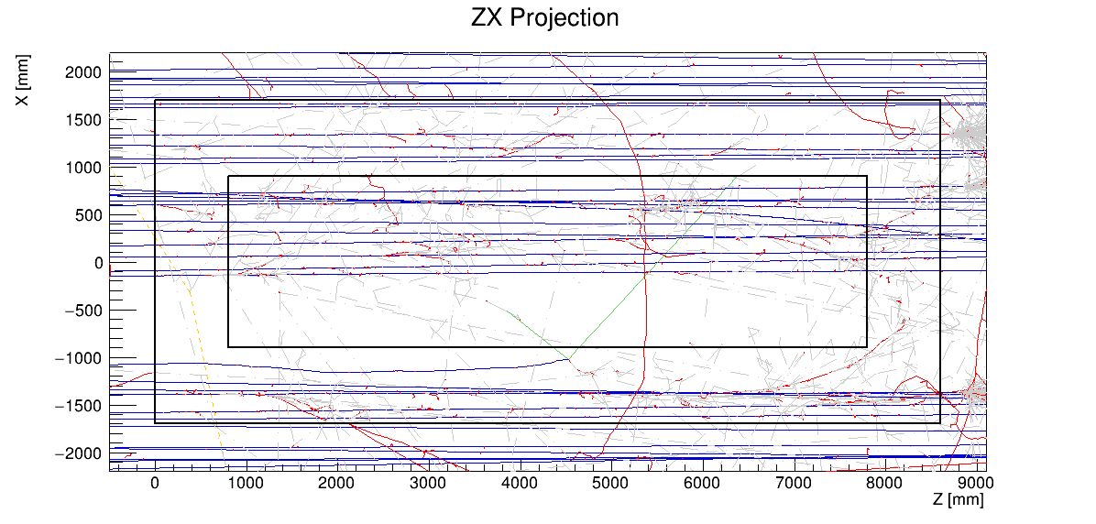
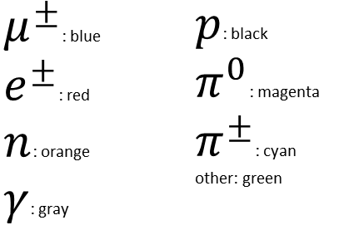


Full simulation of muon backgrounds shows that detector background rates on LOS are manageable
Overlayed background events in 187.5 us (FLArE acquisition window)
Event display from G4 simulations
$$μ^{−}$$
$$μ^{+}$$
Mu- band
from IP
Mu+ band
FLArE
FASERnu2
FASER2
FORMOSA
$μ^{±}$: blue
$e^{±}$: red
$n$: orange
$γ$: gray
$p$: black
$π^{0}$: magenta
$π^{±}$: cyan
other: green
Zoom on FLArE volume
The muon rates (0.5 Hz/cm^2) and space charge effects are manageable around the line of sight.
Notes:
As an experimental note, we have put some effort into making sure the background rates in the FPF detectors are reasonable through excellent FLUKA simulations of the beam interactions. This is a full simulation of the muon rates from the IP. You can see the mu+ and mu- bands, but the rates on the line of sight are quite reasonable around about 0.5 Hz/cm^2. This has been verified. The detector designs have incorporated this information in particular for the any space charge effects in the liquid argon TPC.

Slide 38
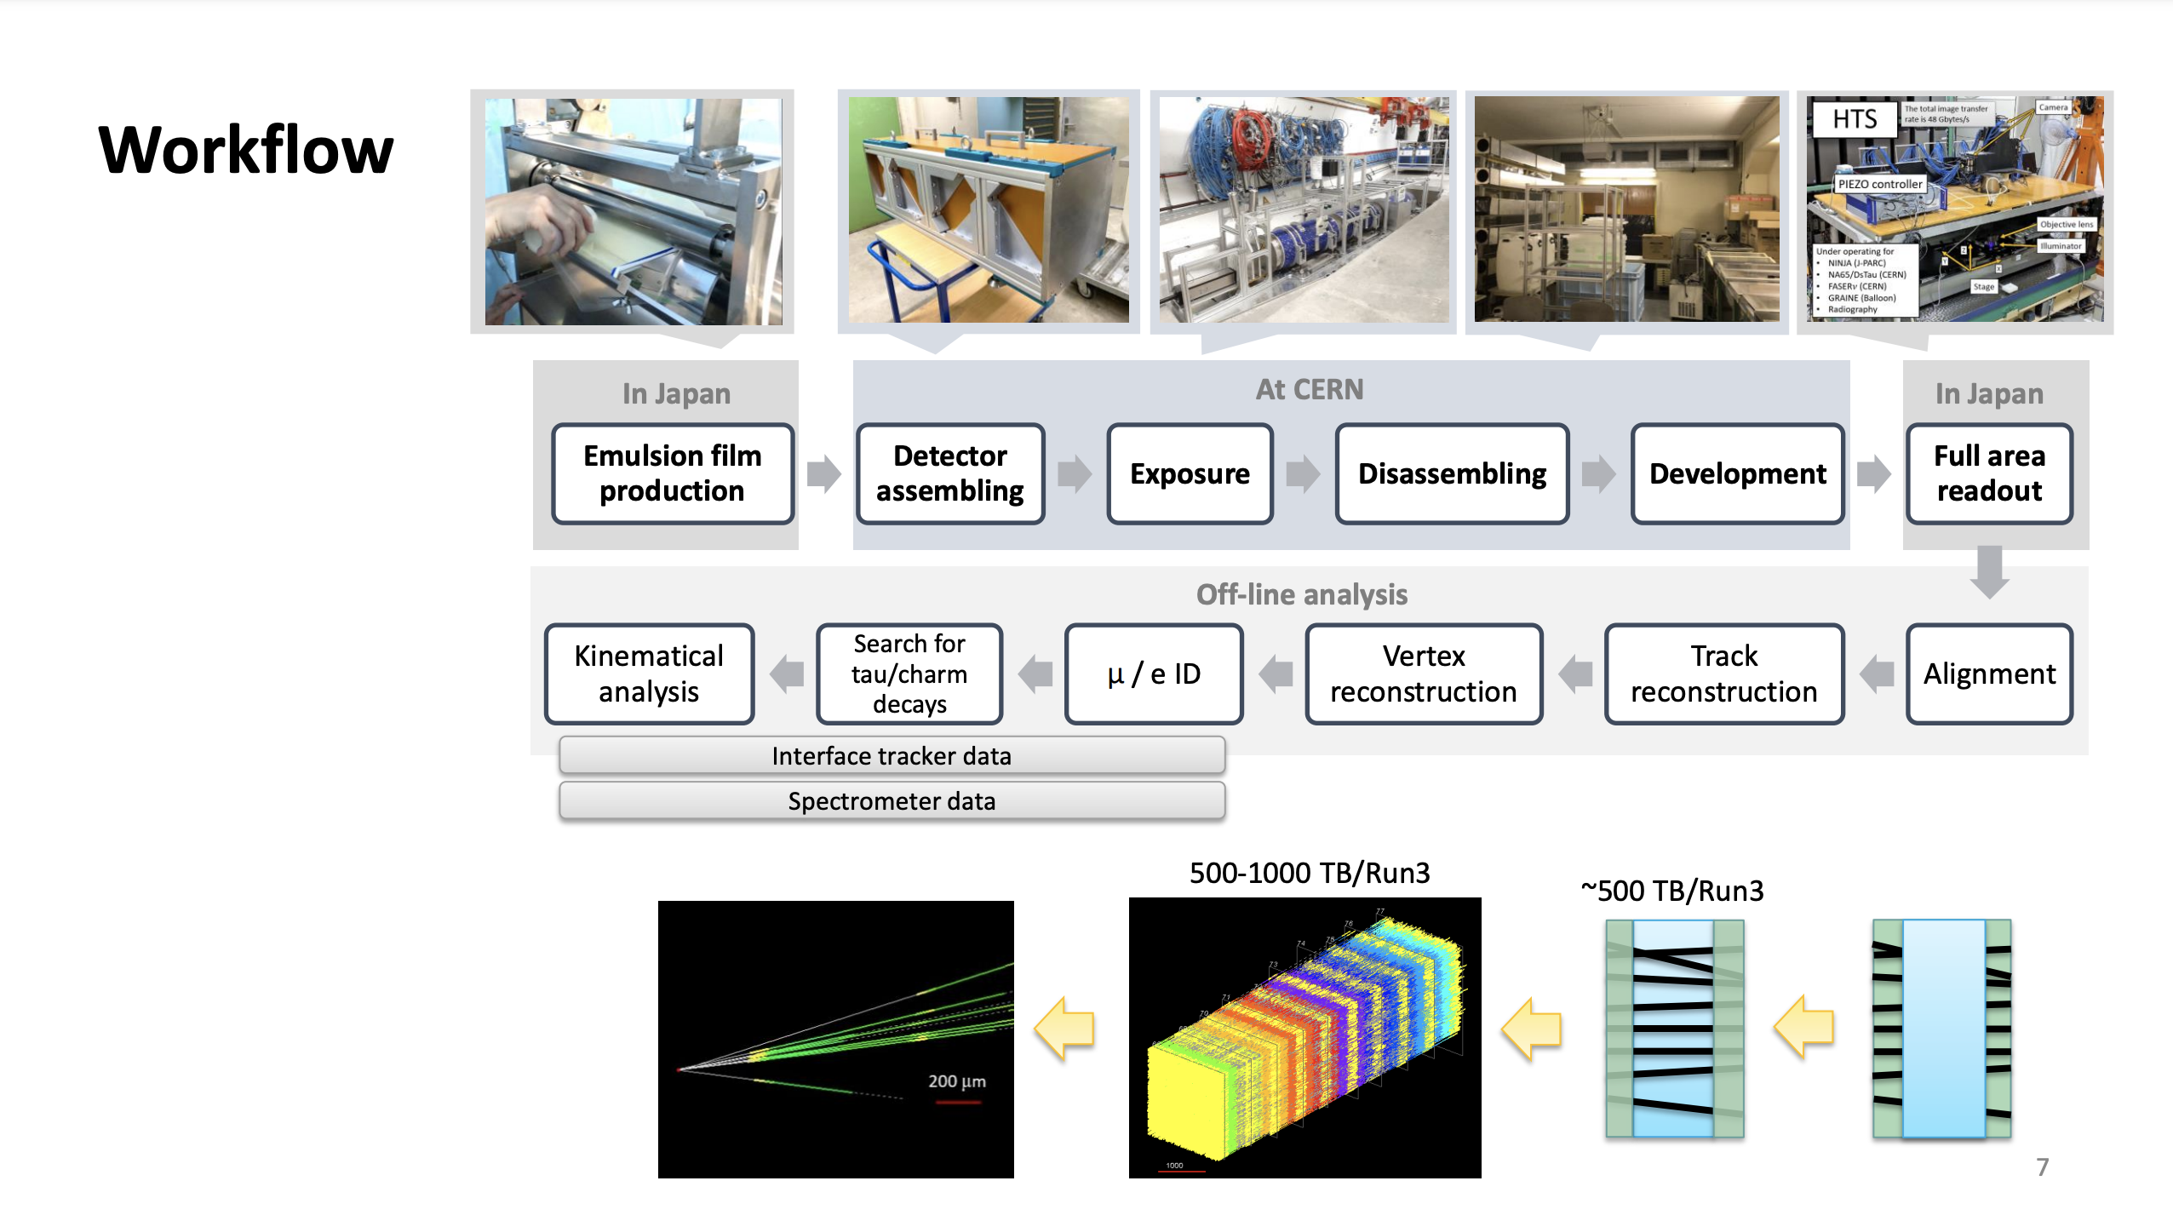
FASERν

Slide 39
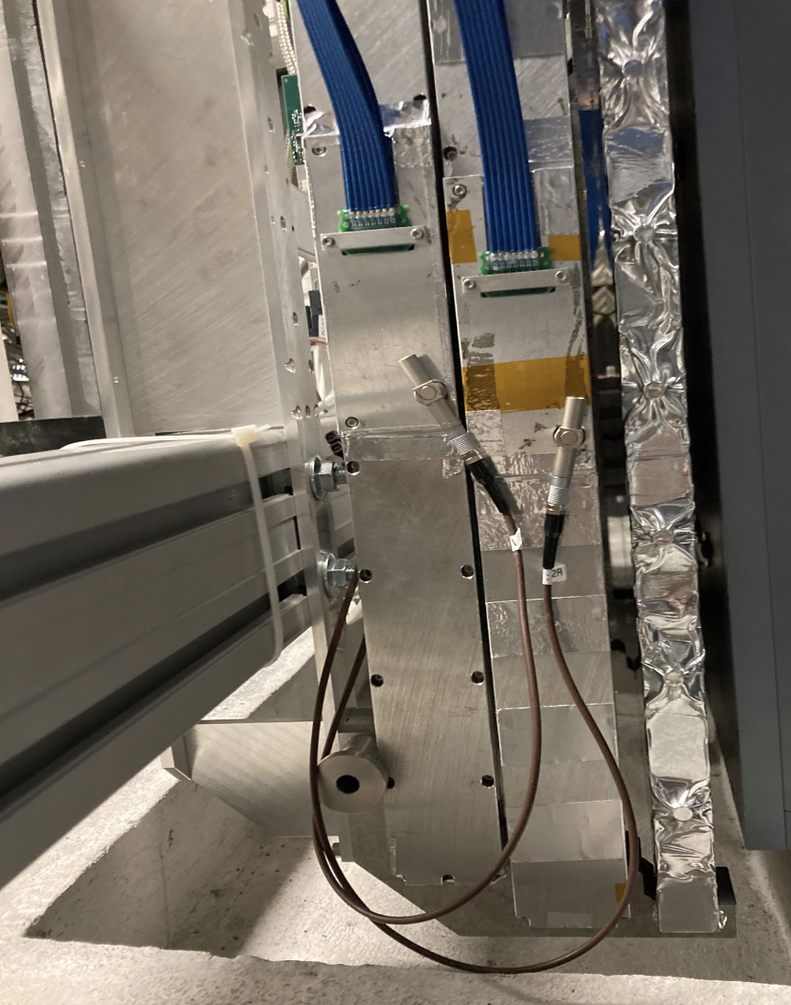
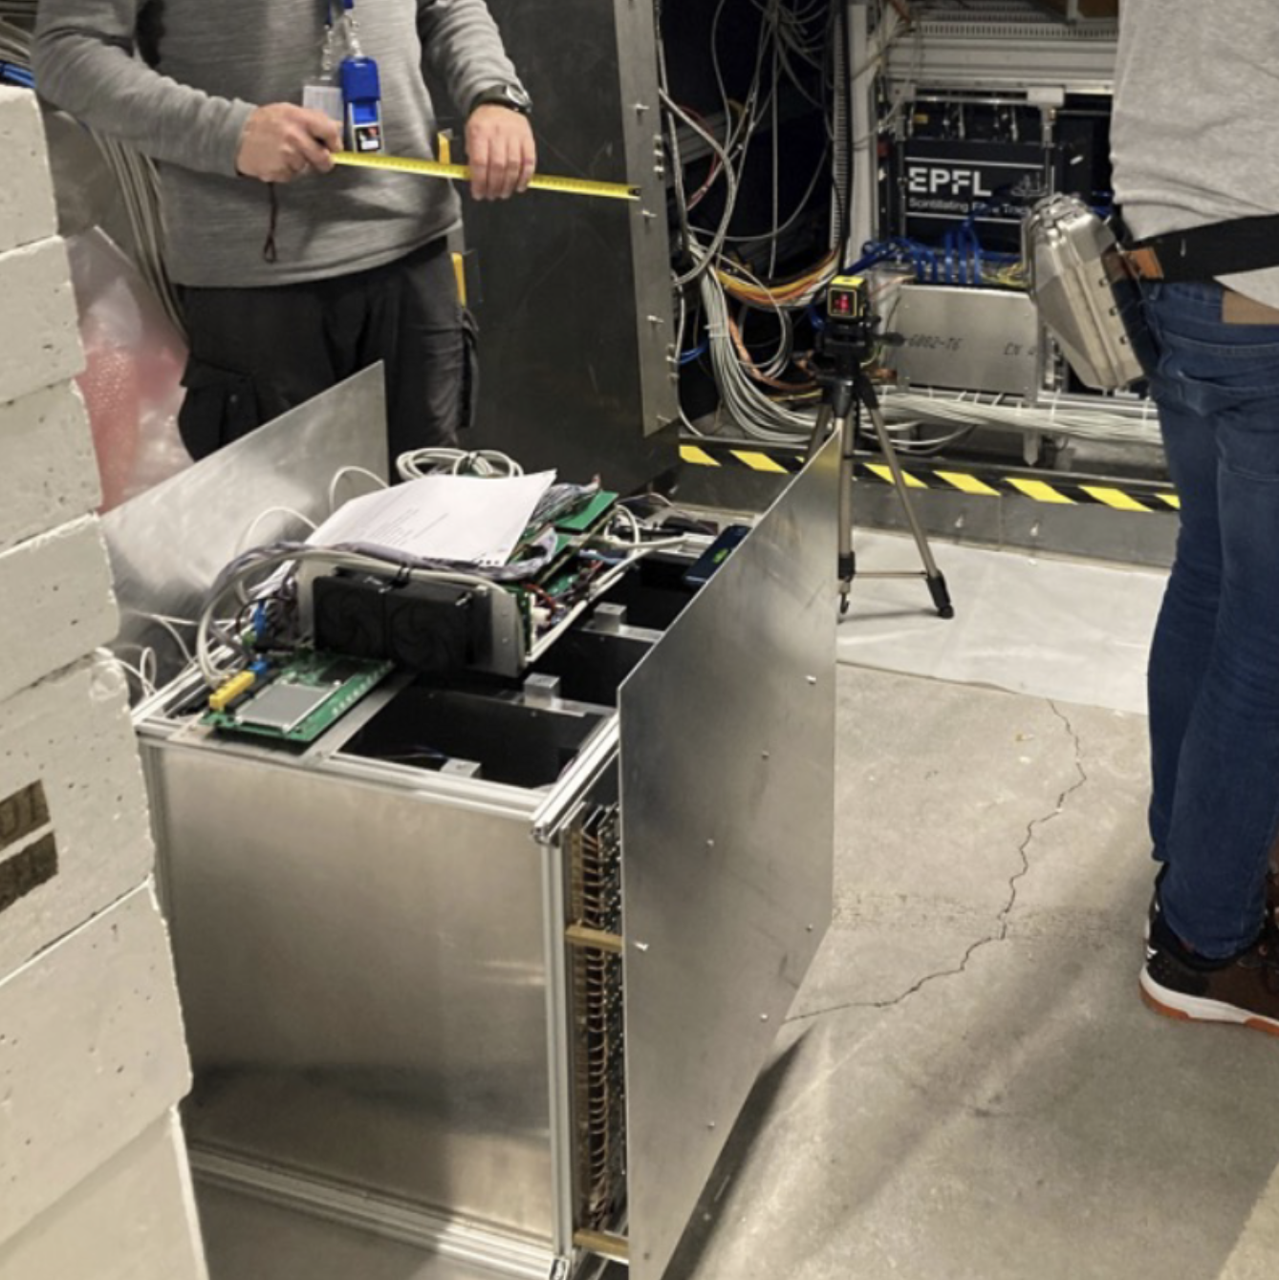
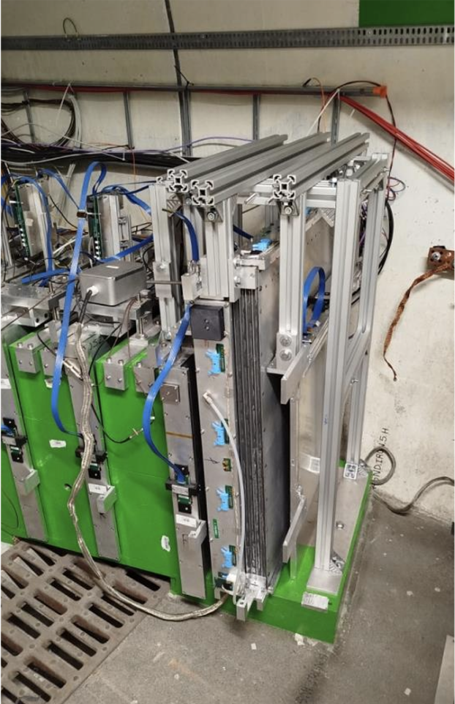
SND Detector upgrades (Run3)
Veto detector upgrade (2024)
Third veto plane installed
Additional redundancy to improve detector acceptance and efficiency
~10cm floor excavation to lower the whole Veto system
Significant increase of the fiducial volume used in neutrino analyses
New muon telescope (2024)
Technology demonstrator: sealed resistive-plate chambers
Measurement of the muon flux beyond nominal SND@LHC acceptance
Further validation of the background model
Muon system upgrade (2025)
Two Drift Tube chambers installed
Improve muon tracking
Improve track extrapolation to the vertex
Resolution: cm ⤻ 0.1mm

Slide 40
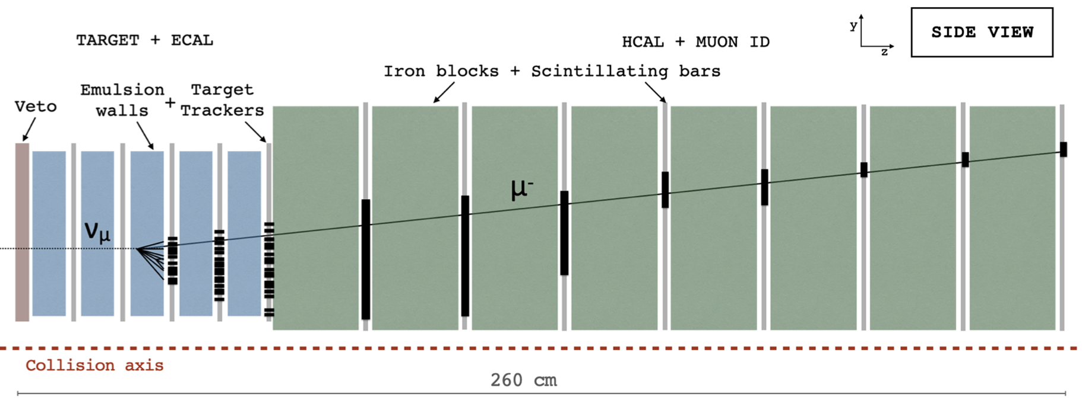


Neutrino identification at SND
ν
phase 1:
electronic detectors
phase 2:
emulsions

Slide 41

FASER Detector
arxiv: 2207.11427
Nuclear emulsion neutrino detector
10cm radius of active region of detector (<0.2 mrad, ƞ > 9.2)
1.5m long decay volume
2.5m long tracking spectrometer (0.6T dipole field)
41

Slide 42


First FASERν measurement
Phys. Rev. Lett. 133, 021802
arxiv: 2403.12520
  Search for electron and muon neutrino CC interactions in 129 kg subsection of FASERν, exposed to 9.5/fb of pp collisions in 2022
  Require reconstructed high-energy neutral vertex with associated high-energy (E>200GeV) lepton(e,𝜇) candidate
    e-candidate: EM shower, with E measured from number of segments at shower max
      ~25% energy resolution – validated in testbeam
    𝜇 –candidate: Long track with p measured from multiple columb scattering
      ~30% resolution – validated in testbeam
  Background from neutral-hadron (e,𝜇) or neutral-current neutrino interactions (𝜇-only)
    From simulation, validated comparing low-energy vertices (which are dominated by neutral-hadrons) between data and simulation

Slide 43







SND@LHC Emulsion data analysis
excellent tracking resolution achieved
μ flux in agreement with electronic detectors
position
angular
charged/neutral vertex reconstruction
muon DIS event
EM shower search, based on detection of high-density spots

Slide 44




FLArE
Design evolving considering physics, installation and operation constraints!
Design changed from TPCs being top-loaded to side-installed “filling cabinet” design
Considering an alternative design using an ARIADNE-style (ARgon ImAging DetectioN chambEr) optical readout

Slide 45

https://arxiv.org/abs/2411.04175

Slide 46
Physics motivation for studying LHC neutrinos
Neutrino physics:
Measure neutrino interaction cross section in unexplored energy region
Test Lepton Flavour conservation in the neutrino sector
Study charm production in neutrino interactions
Search for non-standard interactions
QCD:
Deep inelastic scattering of high energy neutrinos in target (constrain PDFs)
Measure forward hadron production (light hadrons and charm)
Constrain gluon PDF at very low-x from forward charm (high energy ν_{e})
Astroparticle:
Provide insight into the cosmic-ray muon puzzle by studying forward strange production (ν_{e} / ν_{𝜇} ratio)
Constrain dominant prompt neutrino-background for astrophysical neutrino studies by ICECUBE (high energy ν_{e})
There is also an extensive LLP & BSM programme

Slide 47


