Slide 1

Long-Baseline Neutrino Experiments
Patricia vahle
WIN, June, 2025

Slide 2
Neutrinos Have Mass!
ν_{e}, ν_{μ}, ν_{τ}↔ ν₁, ν₂, ν₃
  Flavor States: creation and detection
  Mass States: propagation
A neutrino created as one flavor can later be detected as another flavor, depending on:
  distance traveled (L) and neutrino energy (E)
  difference in the squared masses (Δm²_{ij}=m²_{i}-m²_{j})
  The mixing amplitudes (U_{αj})
Seagull art created by MihiMihi
From Noun Project

Slide 3
The PMNS Mixing Matrix
3
What we know
All known to a few %

Slide 4
The PMNS Mixing Matrix
4
Is it really 45°?
Is there CP violation?
What we don’t know
The Mass Ordering
Can CP violation in neutrinos help understand the matter-antimatter asymmetry?
How do massive neutrinos fit into the Standard Model?
Does PMNS Mixing tell the whole story?
Are there 2 light and 1 heavy?
Or 1 light and 2 heavy?

Slide 5
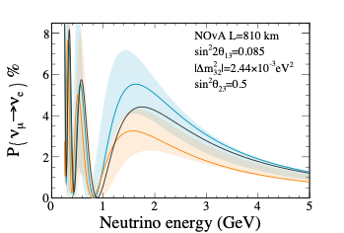
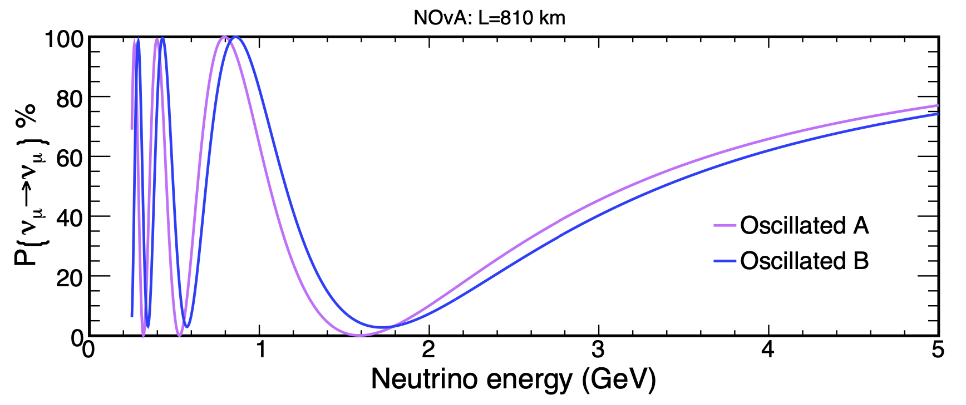
Long-Baseline Observables
Oscillation probabilities at L/E~500km/GeV are sensitive to most of the remaining unknowns
Muon Neutrinos disappear
Electron Neutrinos appear
sin²2θ₂₃
|Δm²₃₂|
Depends on Mass Ordering (NO, IO),
δ_{cp} (bands), and octant of θ₂₃

Slide 6
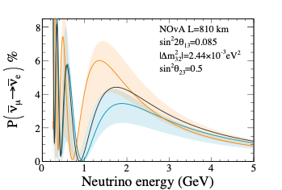
Long-Baseline Observables
Oscillation probabilities at L/E~500km/GeV are sensitive to most of the remaining unknowns
Muon Neutrinos disappear
Electron Neutrinos appear
sin²2θ₂₃
|Δm²₃₂|
AND could be different between neutrinos and antineutrinos!

Slide 7

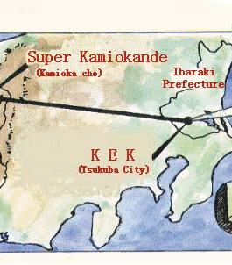
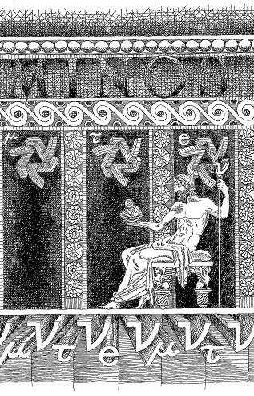
Three Generations of Accelerator Long-Baseline Experiments

Slide 8





Three Generations
Past
~2000-2015
Present
2015-2025
Future
2030+
K2K
Opera

Slide 9

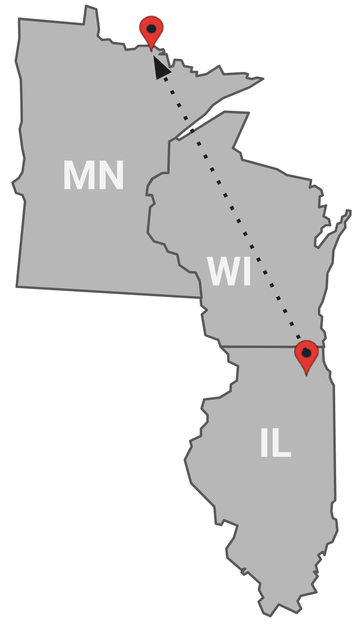

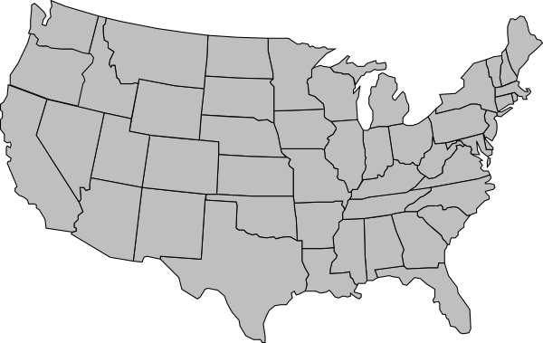
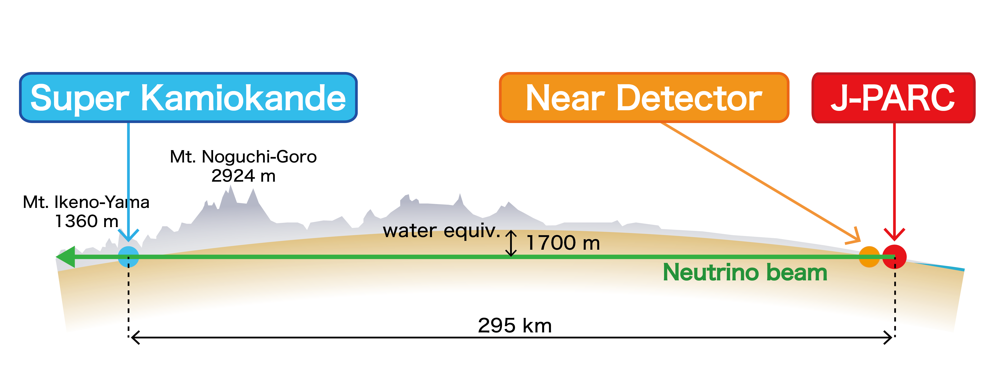
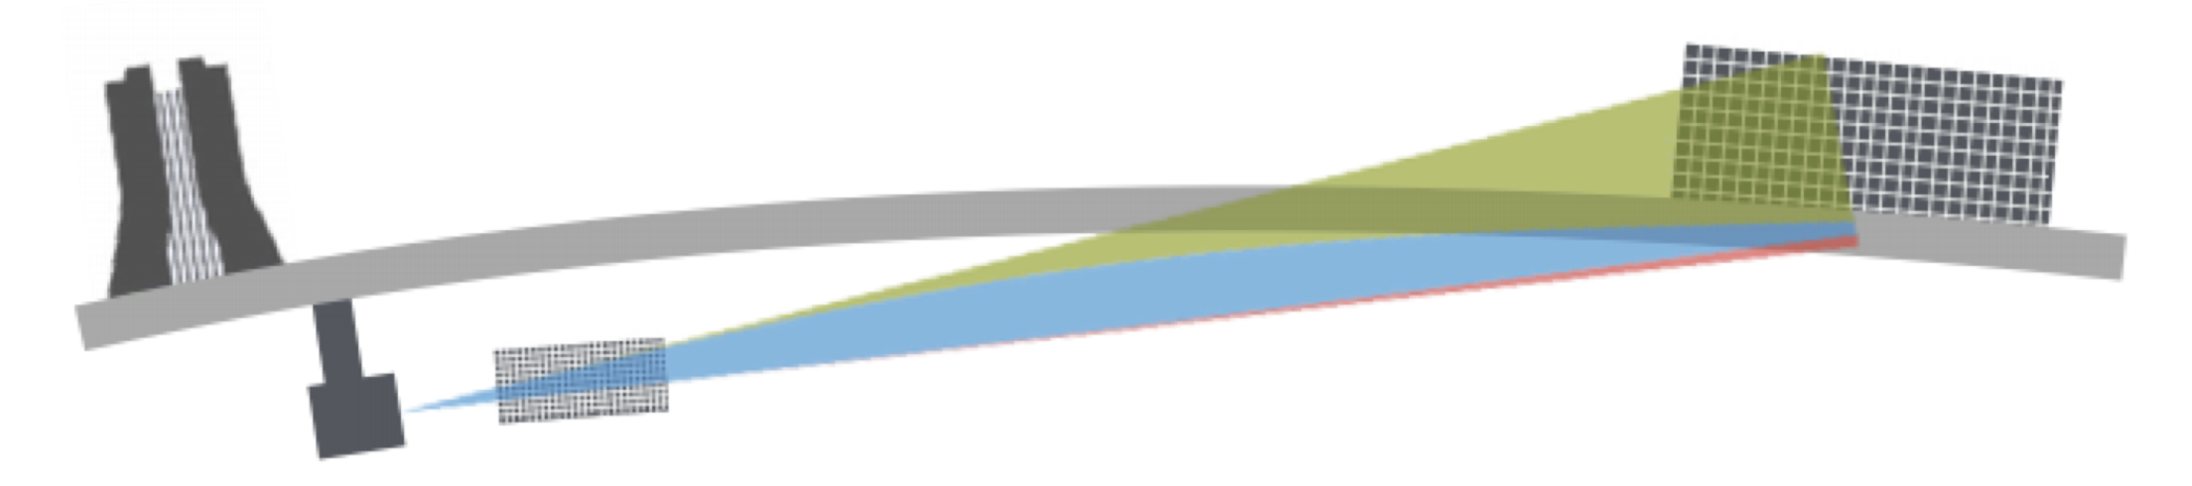
Long-baseline experiments
Ash River, MN
Two experiments at different baselines and energies compliment each other and could help resolve degeneracies in parameters
810 km
Tokai
Fermilab
Kamioka
295 km
NOvA
T2K
Fermilab
Far Detector
Far Detector
Near Detector

Slide 10
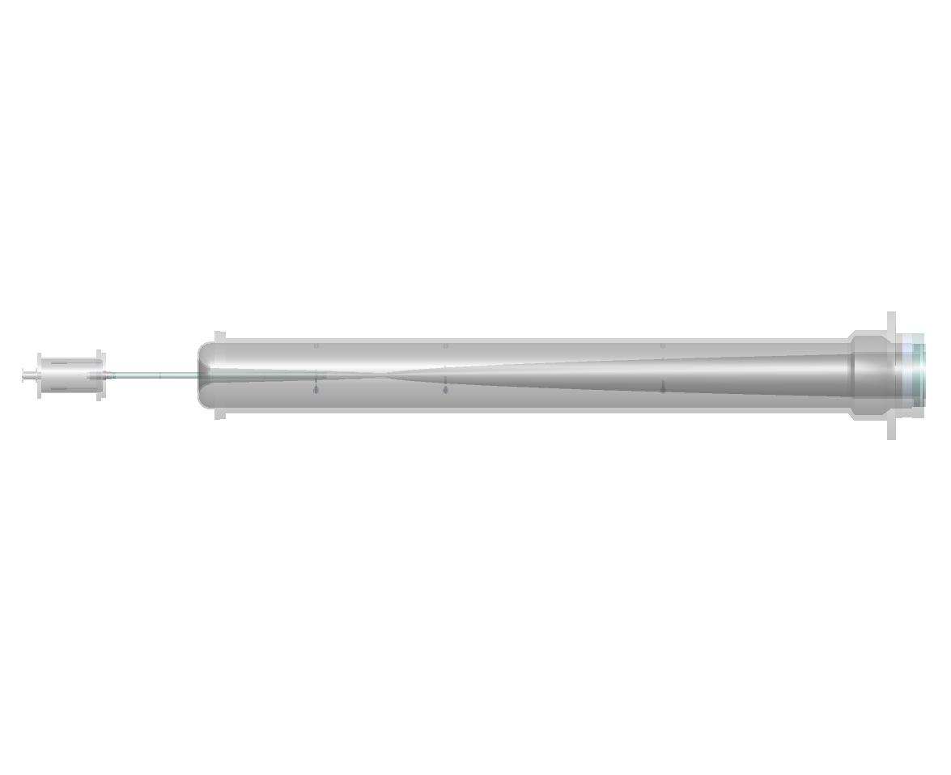
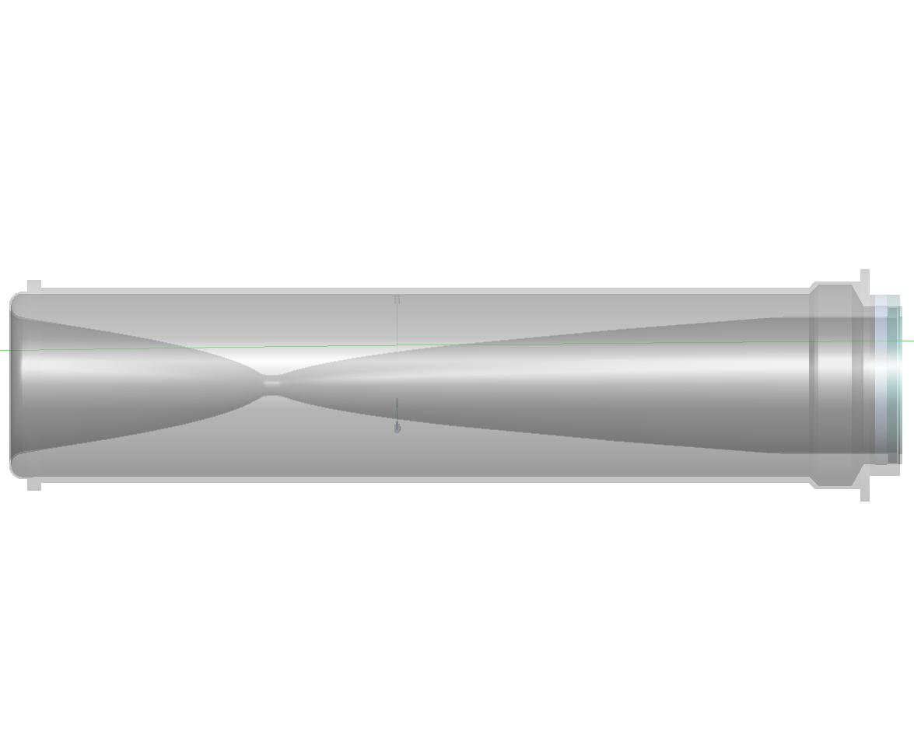
Making a Neutrino Beam
Target
Focusing Horns
π⁻
2 m
ν_{μ}
120 GeV p⁺ from MI
ν_{μ}
π⁺
Both experiments use conventional, horn focused neutrino beams and have achieved high power:
T2K uses 30 GeV protons, achieved 760 kW in 2024
NOvA uses 120 GeV protons, set new neutrino beam power record of 1MW in 2024

Slide 11
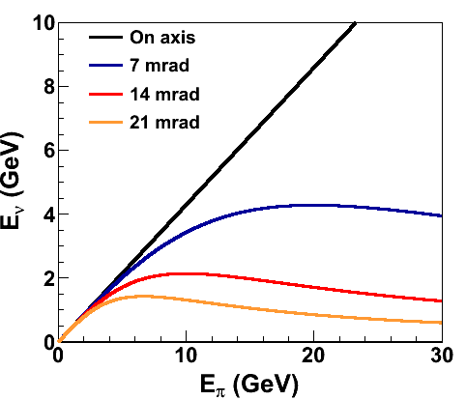
Making a Neutrino Beam
Flashlight
Torch
Target
Focusing Horns
π⁻
2 m
ν_{μ}
120 GeV p⁺ from MI
ν_{μ}
π⁺
Off-axis beam means less neutrino energy dependence on parent energy
Neutrino spectrum becomes a narrow peak
  NOvA: 14 mrad, sees 2GeV beam
  T2K: 2.5º (43mrad), sees 600 MeV beam
Suppressed high energy tail: fewer neutral current backgrounds at low visible energy

Slide 12
Making a Neutrino Beam
Flashlight
^anti-
Torch
Target
Focusing Horns
π⁺
2 m
ν_{μ}
120 GeV p⁺ from MI
ν_{μ}
π⁻
Off Axis the experiments see high purity muon neutrino/antineutrino beams:
~1% electron neutrino contamination
Wrong sign flux less than 10% in both neutrino and antineutrino beams

Slide 13
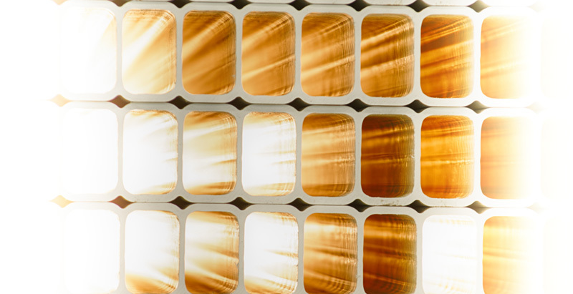
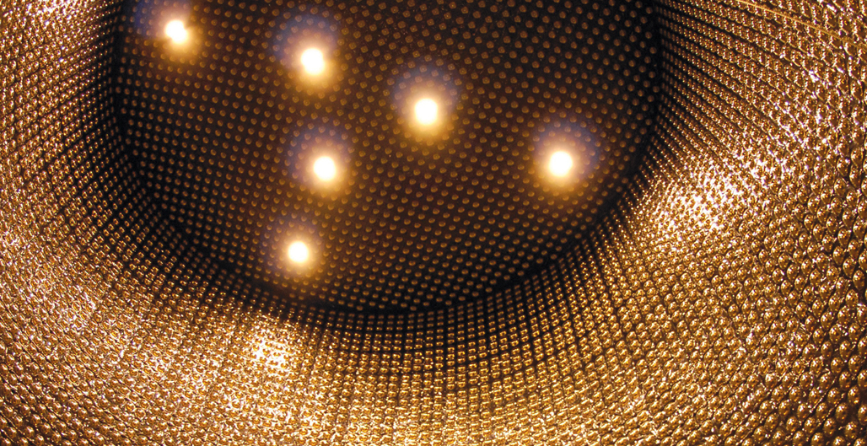
Far Detectors
T2K uses SuperK detector
  50 kton Water Cherenkov
NOvA FD
  14 kton PVC and liquid scintillator

Slide 14
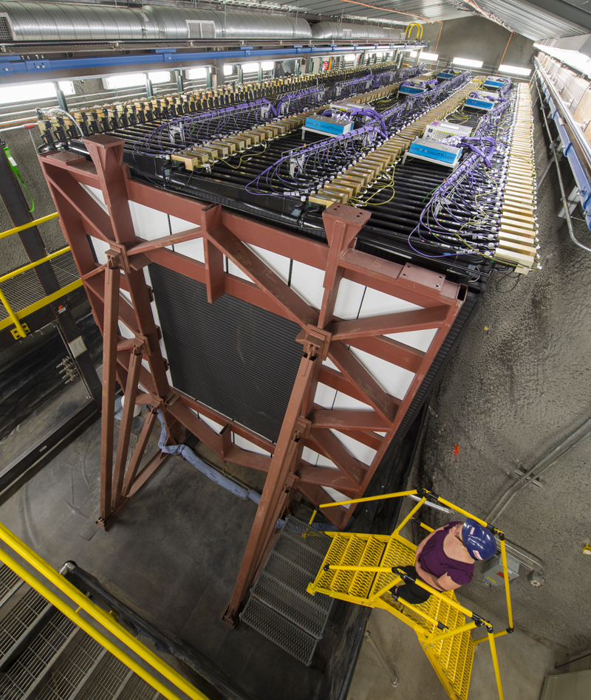
Two detector technique
T2K ND Suite
Near detectors used to predict far detector expectations and control systematics
NOvA ND is functionally identical to FD. Same technology and materials, smaller size
To make FD prediction:
Adjust flux and cross section models guided by external data, then further adjust to account for multi-nucleon processes
extrapolate remaining discrepancies in bins of energy resolution and transverse momentum using F/N ratio
Systematic uncertainties cancel in F/N ratio
NOvA ND

Slide 15
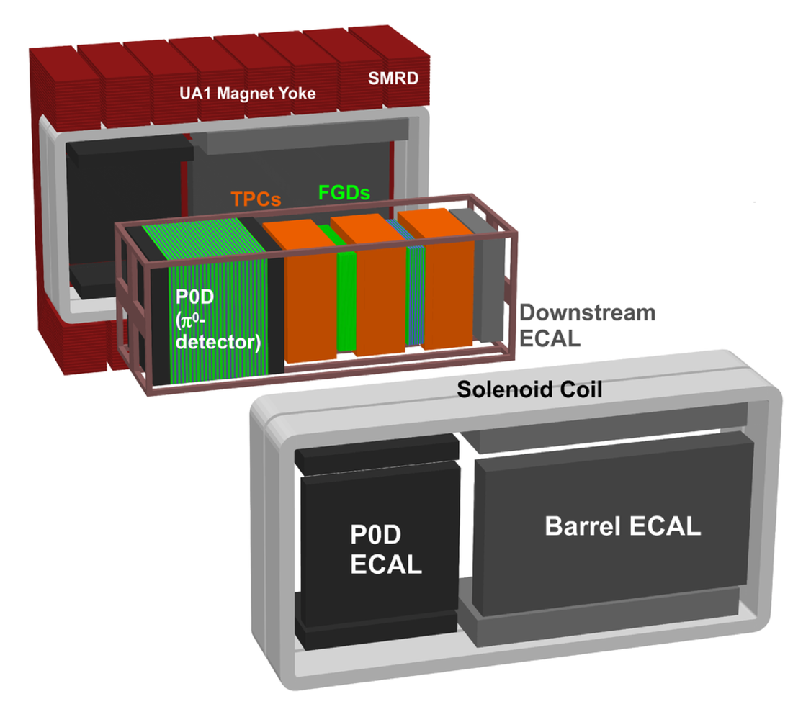
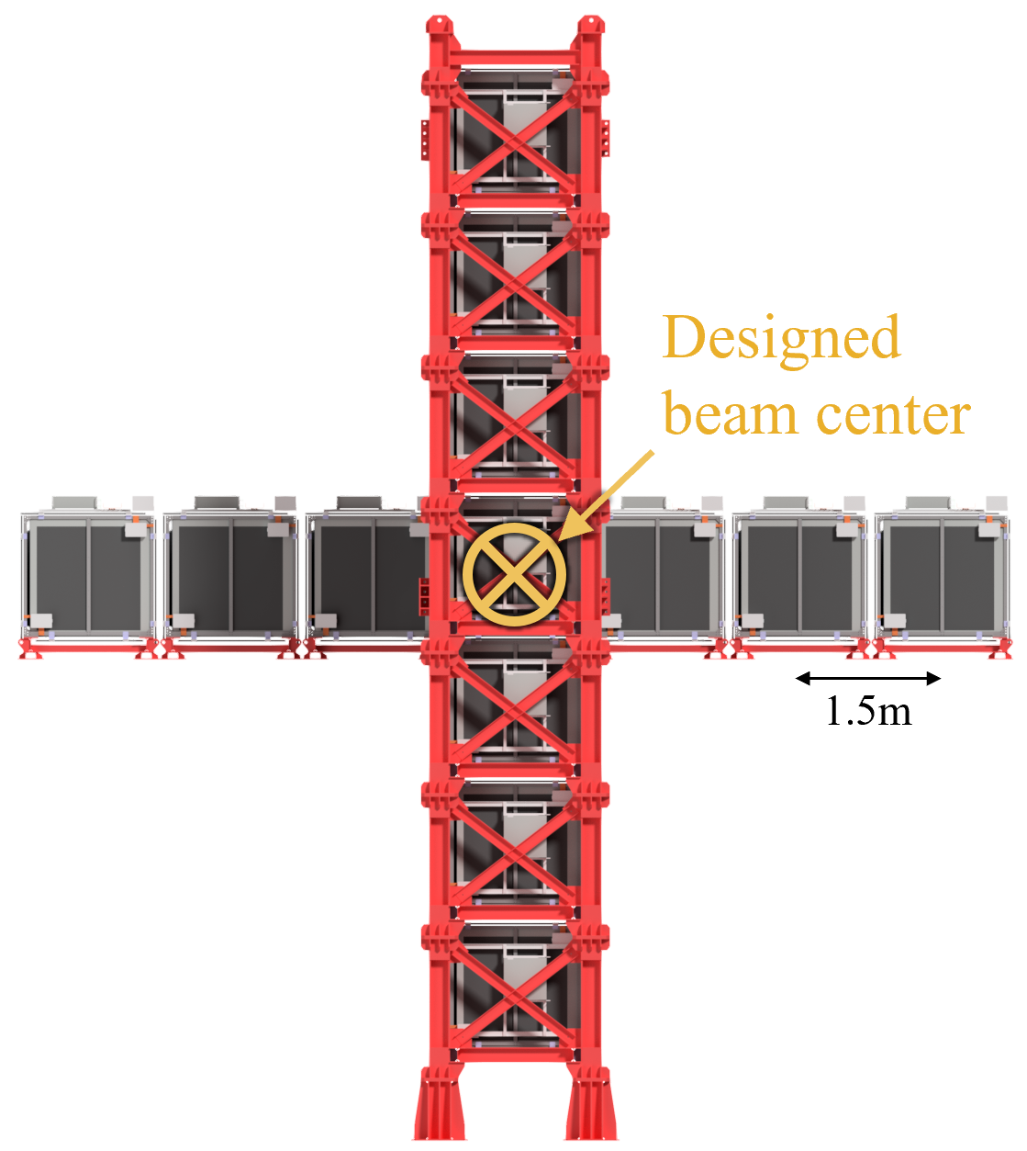
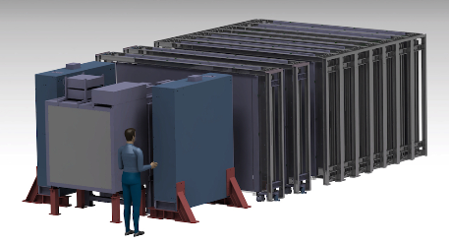
Two detector technique
T2K ND Suite
T2K ND Suite
C. Giganti, Neutrino 2024
Near detectors used to predict far expectations and control systematics
ND-280:
Fine grained
Off-axis
T2K has ND suite (on axis + 2 off-axis)
To make FD prediction:
Using external data constraints, build parameterized model of flux, cross section and detector response
Simultaneously fit 22 different ND280 samples and FD samples for model parameters and oscillations
The fit makes sure the model is “right,” and high stat ND samples constrain systematics.
Ingrid
On-axis
WAGASCI+BabyMIND
Bottom line: ~15% errors on FD predictions are reduced to ~4% in both experiments

Slide 16
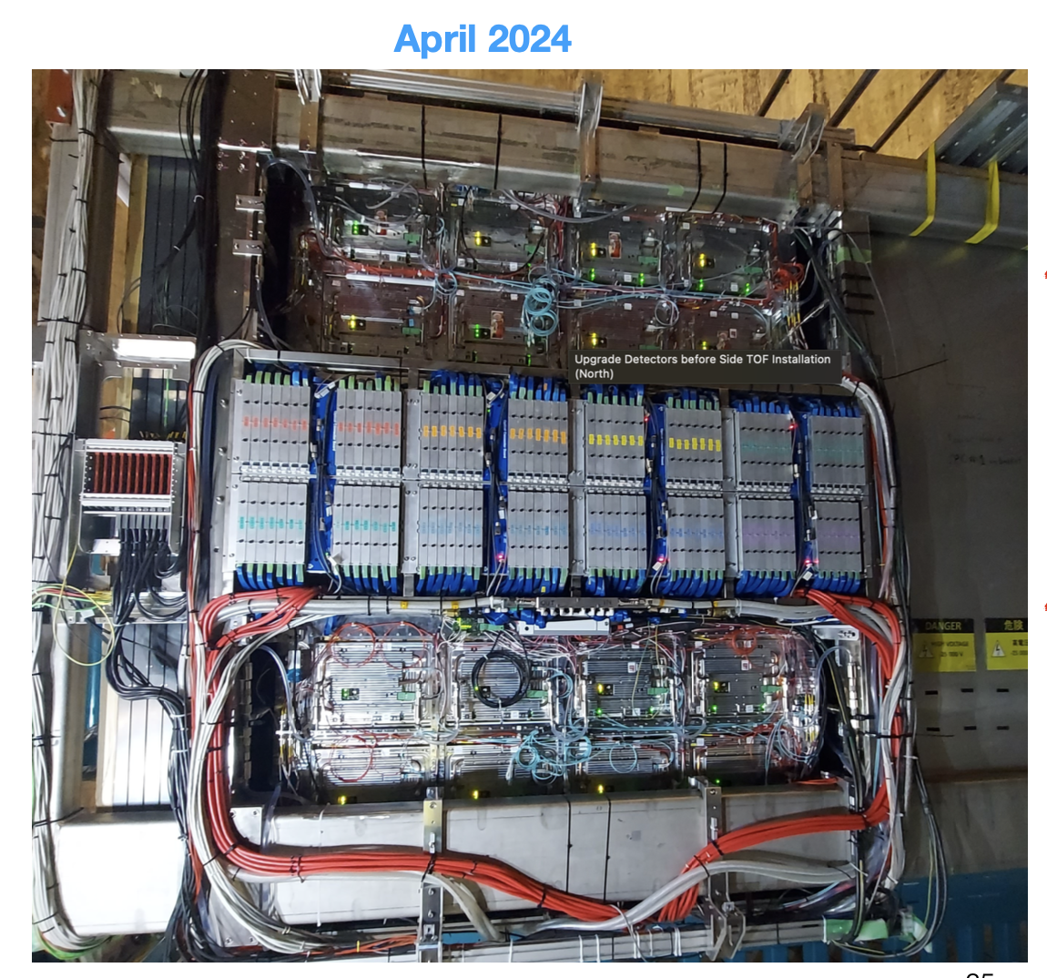
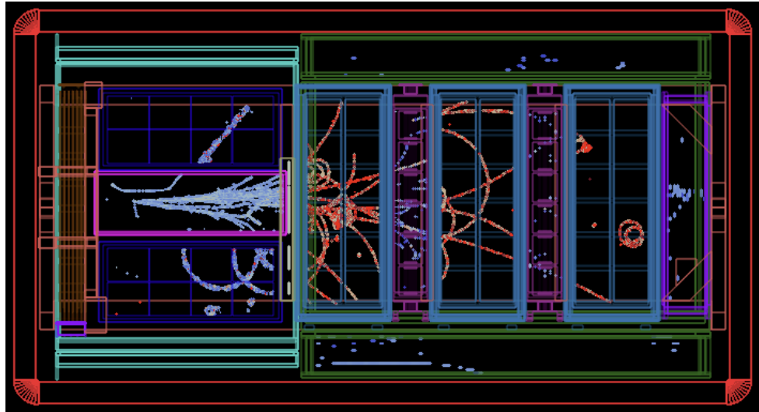
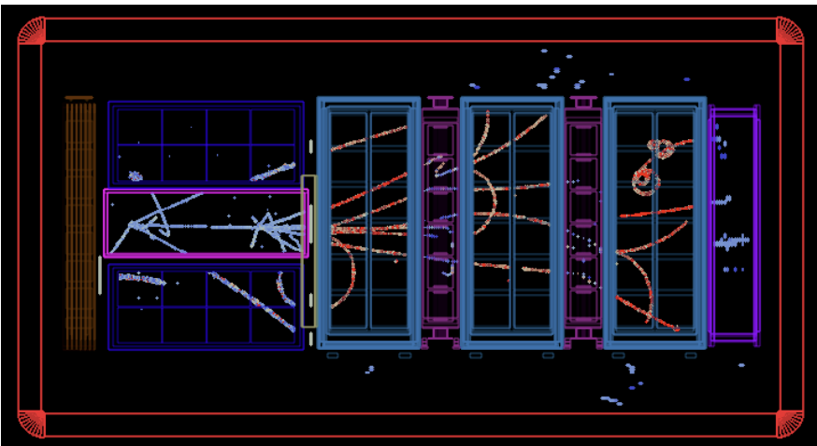
TWO Detector Technique
New T2K ND online!
Improves low energy proton and neutron reco
Increased angular acceptance to better match SK
Better e/γ discrimination
arXiv:1901.03750
T. Vladisavljevic, J-PARC Symposium, Oct. 2024

Slide 17


3 Flavor Oscillation Analysis
Image Credit: Symmetry Magazine

Slide 18
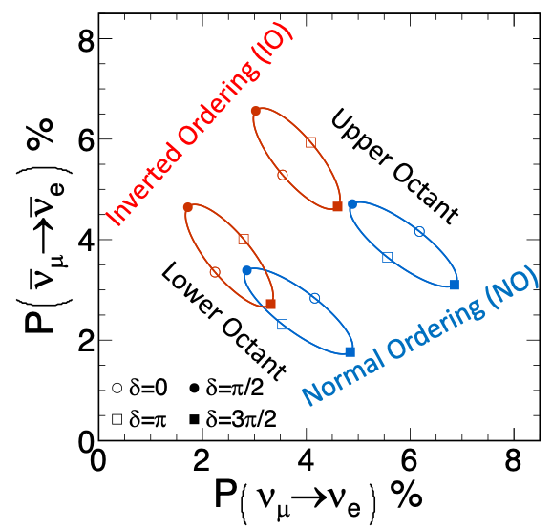
Analysis Basics
Compare electron-neutrino appearance probability in neutrinos to antineutrinos
In vacuum with no CP violation, neutrino and antineutrino appearance probabilities the same
CP violation enhances appearance probability for neutrinos while suppressing it for antineutrinos, or vice-versa
Matter effects also introduce mass ordering dependent neutrino vs. antineutrino differences
Upper octant enhances both neutrino and antineutrino appearance probability, while lower octant suppresses both

Slide 19
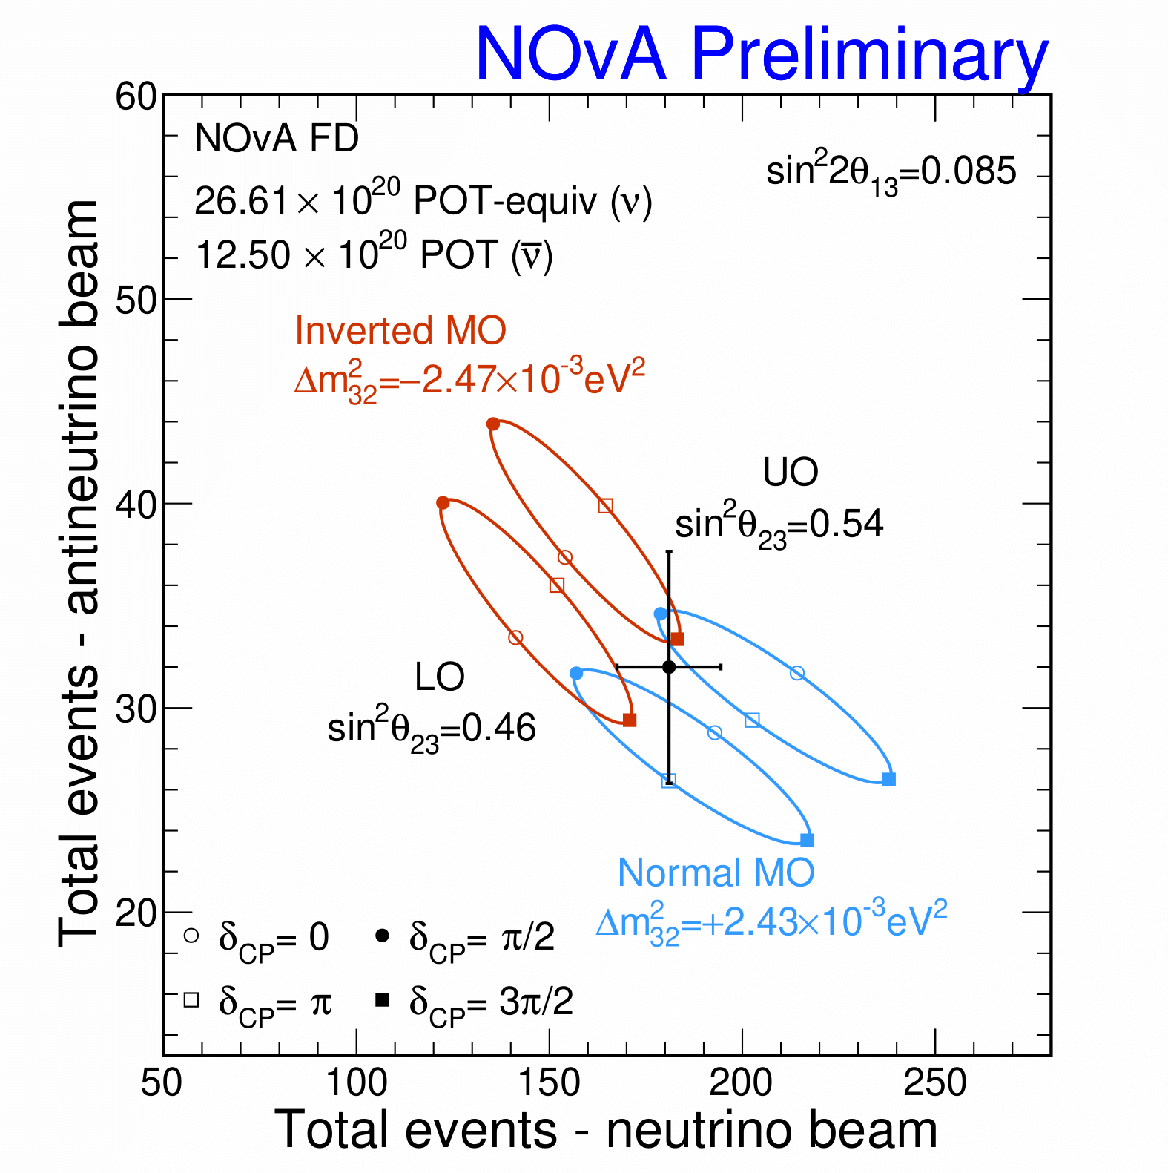
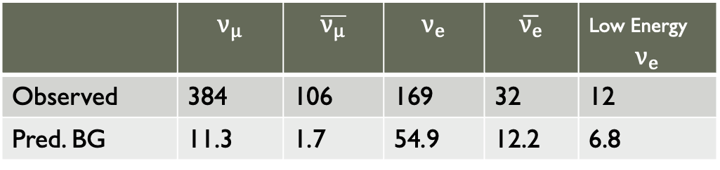
NOvA Results
J. Wolcott, Neutrino 2024
Results feature double the exposure of previously published neutrino data set.
  Exposure: (26.6, 12.5)x10²⁰ POT (neutrinos, antineutrinos)
  New low energy electron neutrino sample enhances mass ordering sensitivity, among other analysis updates.
10 years of NOvA FD Data
 | $$ν_{μ}$$ | $$\overline{ν_{μ}}$$ | $$ν_{e}$$ | $$\overline{ν_{e}}$$ | Low Energy $$ν_{e}$$
Observed | 384 | 106 | 169 | 32 | 12
Pred. BG | 11.3 | 1.7 | 54.9 | 12.2 | 6.8
Data land in region of overlap, meaning either ordering with different values of δ_{CP} can adequately describe data

Slide 20
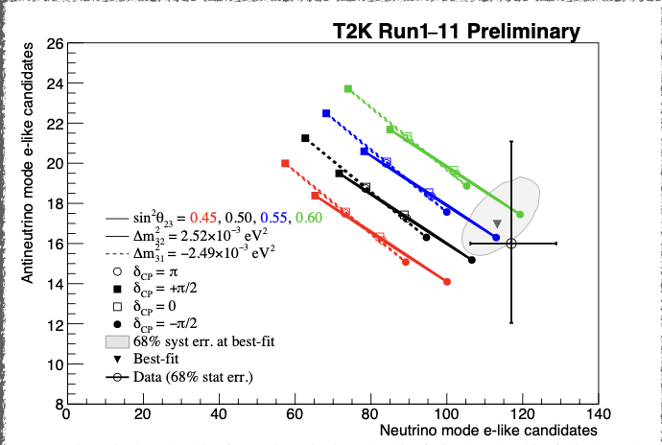
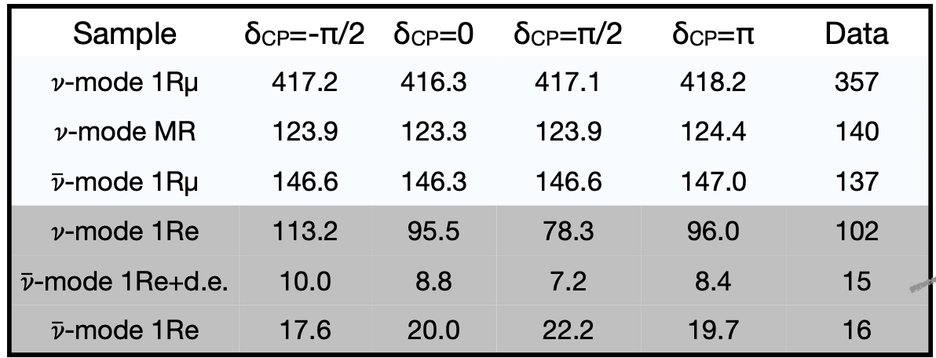
T2K Results
C. Giganti, Neutrino 2024
Results feature ~38e20 POT
11 years of data
SK doped with Gd in last run period
ND280 only
Neutrino
Disappearance
Anti-neutrino
Neutrino
Appearance
Anti-neutrino

Slide 21
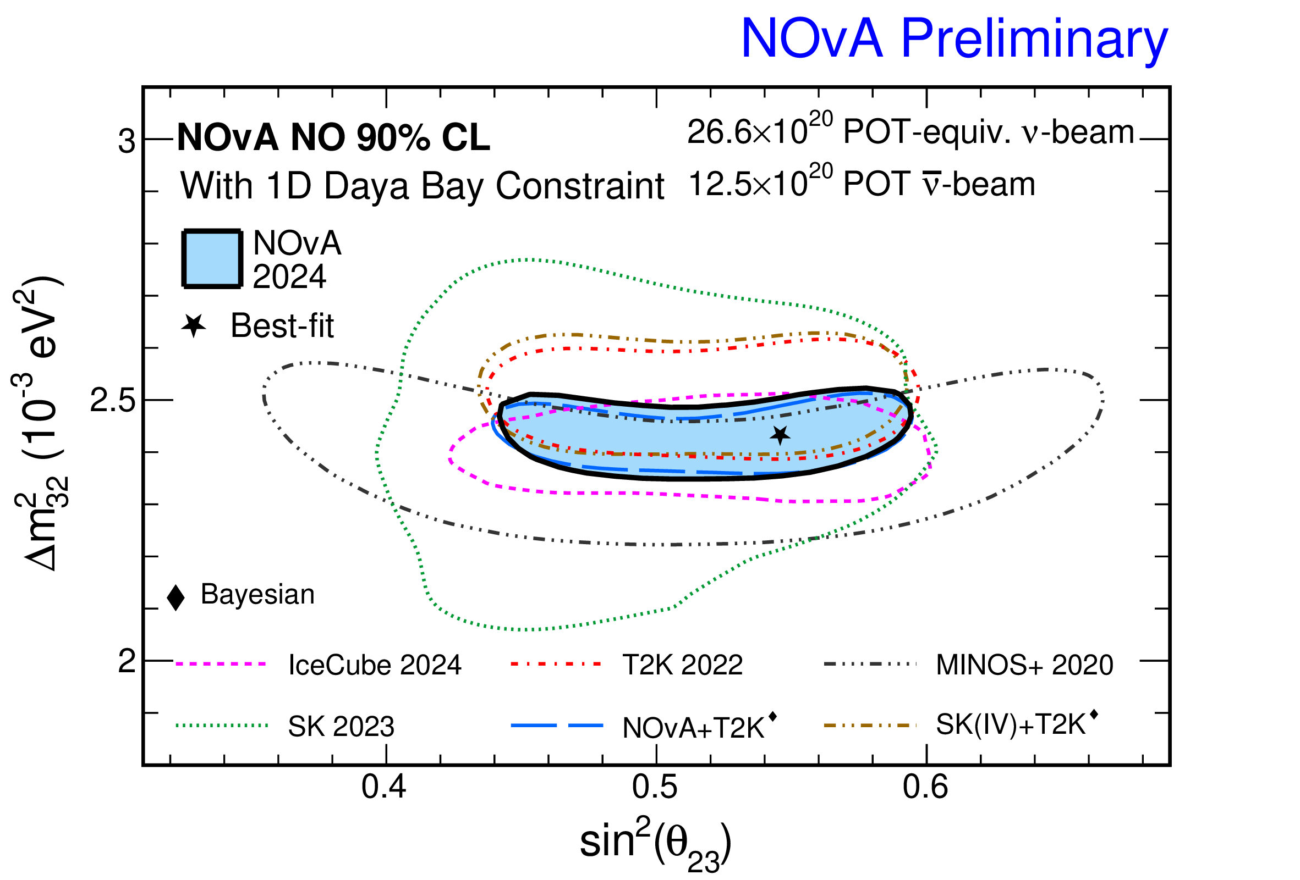
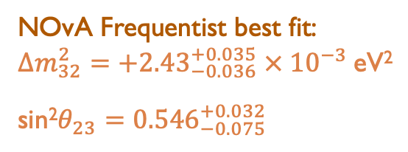
32 Sector Results
J. Wolcott, Neutrino 2024
Good agreement among experiments in the 32-sector
NOvA Frequentist best fit:
$∆m_{32}^{2}=+{2.43}_{−0.036}^{+0.035} ×{ 10}^{−3}$eV²
sin²$θ_{23}={0.546}_{−0.075}^{+0.032}$

Slide 22
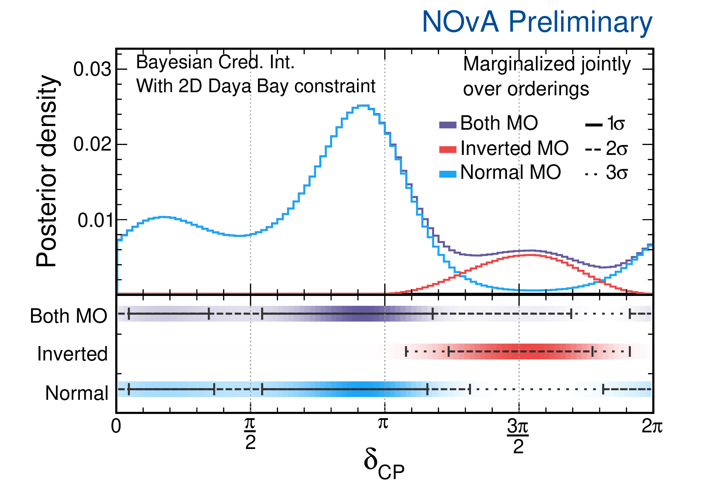
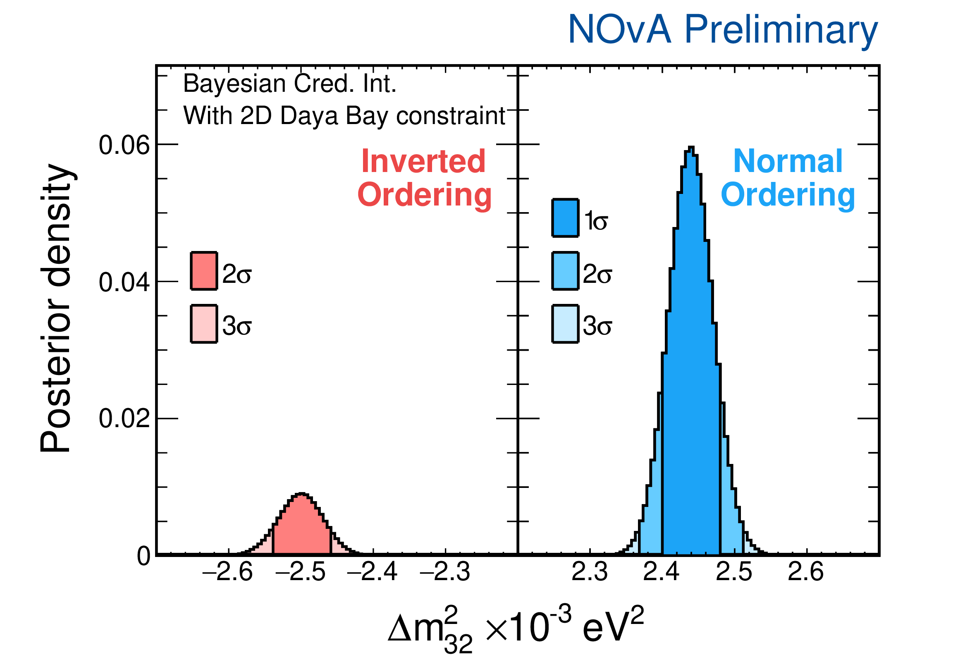
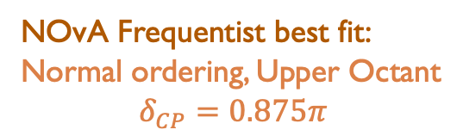
NOvA Results—MO and CP
J. Wolcott, Neutrino 2024
Normal MO: data prefer CP-conserving δ_{CP} values
Inverted MO: data prefer maximal CP-violation,
δ_{CP}=0,π not in 3σ allowed interval
Using Daya Bay to constrain both θ₁₃ and Δm², NOvA data favor Normal MO by ~7:1 odds (Bayes factor of 6.8).
NOvA Frequentist best fit:
Normal ordering, Upper Octant
$$δ_{CP}=0.875π$$
Disfavors Inverted MO at 1.6σ
Maximal mixing allowed at ~1σ

Slide 23
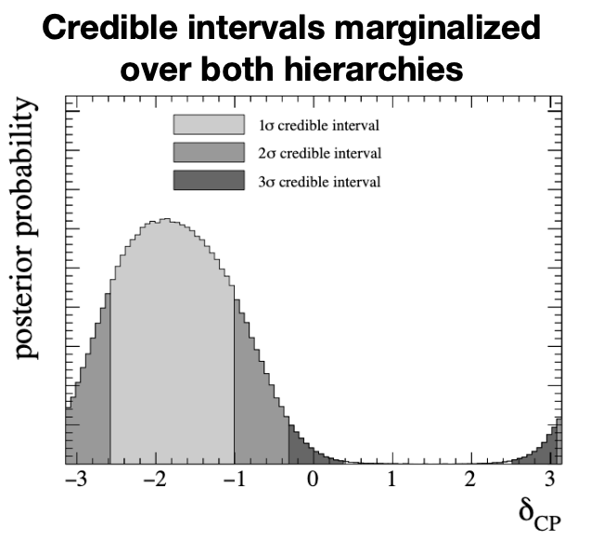
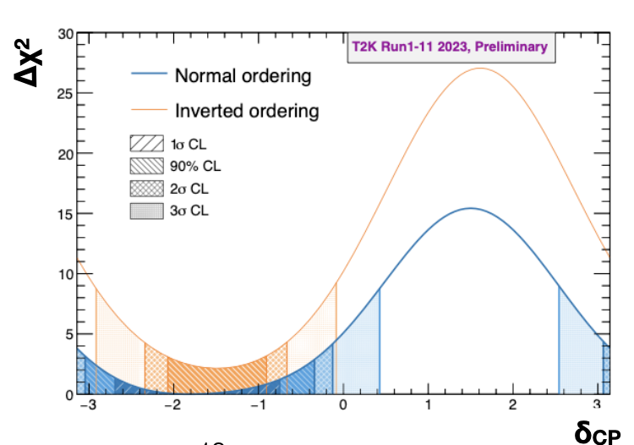
T2K Results—CP
C. Giganti, Neutrino 2024
†N. Latham, WIN 2025
T2K prefers maximal CP violation (-π/2, aka 3π/2), but CP conserving values are allowed at 2σ
After conducting pseudo—data studies, T2K quotes CP conservation is allowed at just below 90% C.L.†
Note change in δ convention!
T2K also prefers normal ordering and upper octant, at low significance
Bayes Factor NO/IO = 3.3
Bayes Factor UO/LO = 2.6

Slide 24

Joint fit
Complimentary experiment design break degeneracies
NOvA/T2k have different:
Benefits of Joint fit:
L/E
Amounts of matter effect
Interaction processes
  T2K mostly QE/2p2h
  NOvA a mix of QE/2p2h/RES/DIS
Detector technologies
Systematic uncertainties
Analysis approaches
Fit includes full details of
  Energy reconstruction and detector response
  Likelihood in all fitted dimension
  Consistent statistical inference
Together we conducted an in-depth review of the models, systematics, and correlations

Slide 25
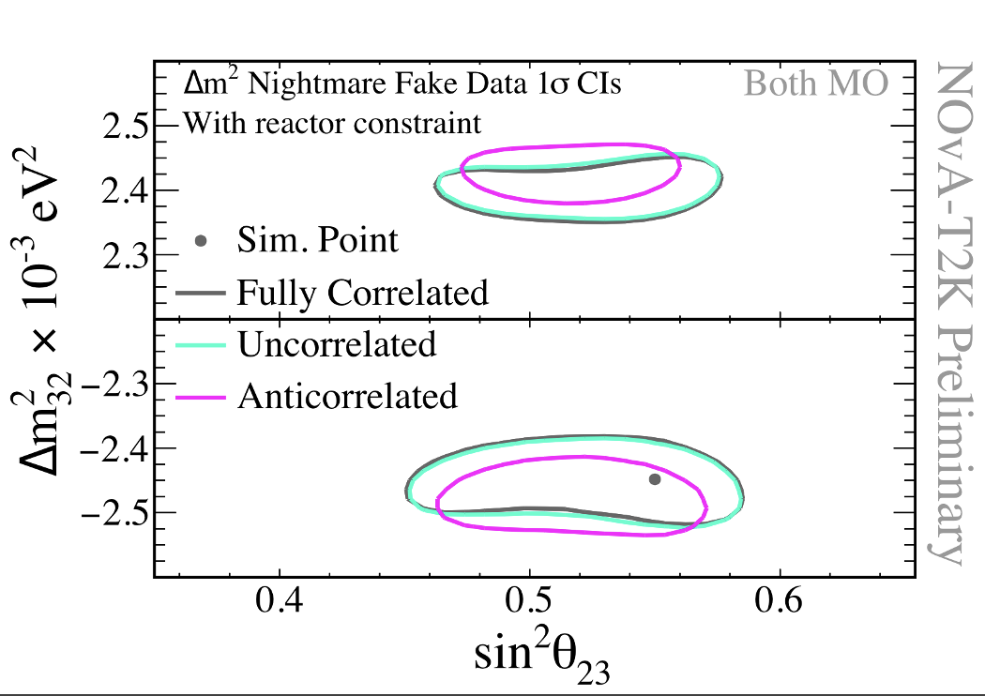
Joint fit
Z. Vallari, JETS, Feb. 2024
Detector response and flux systematic uncertainties have no correlation between the experiments
Cross section uncertainties likely are correlated, but there is no direct mapping between the model parameters from each experiment
Constructed extreme scenarios where artificially large systematic uncertainties induce an effect like oscillations
Leaving parameters uncorrelated is a better strategy than getting the correlation wrong
After extensive studies, both experiments were satisfied that leaving systematics uncorrelated was appropriate for the exposure of the first analysis

Slide 26
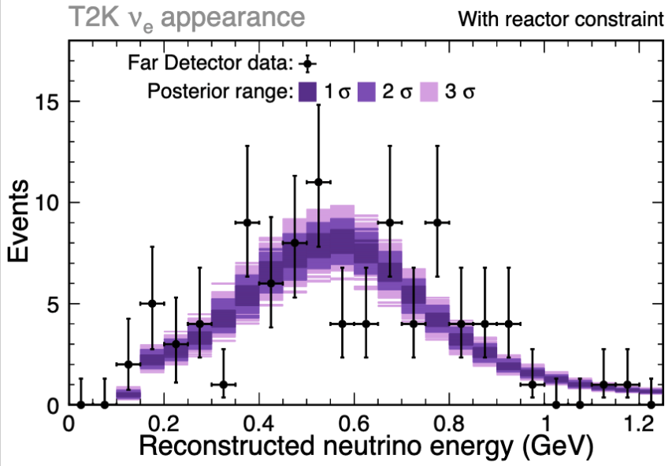
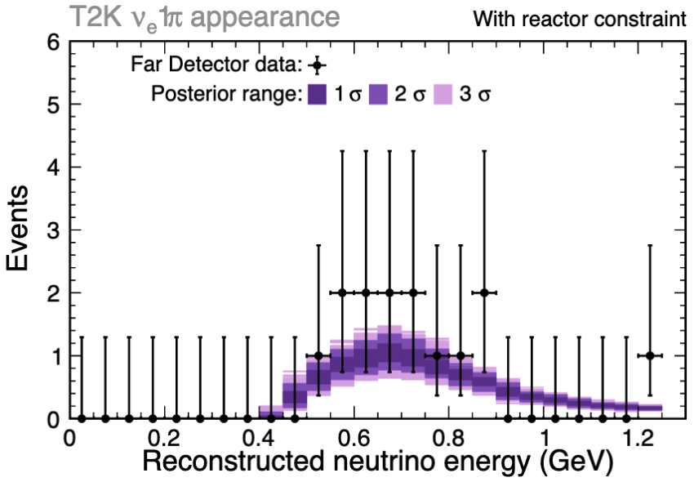
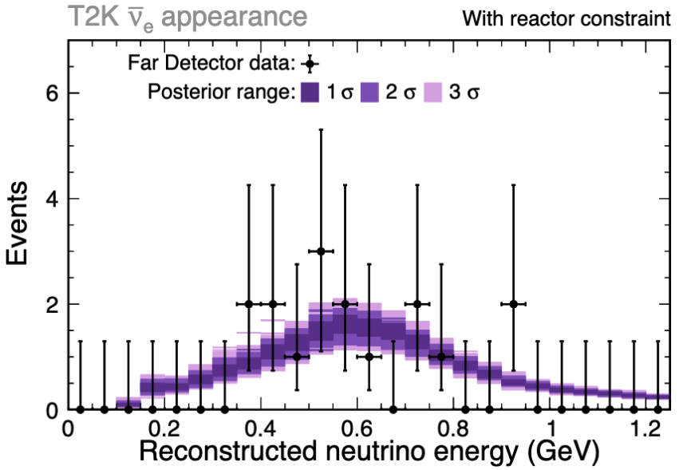
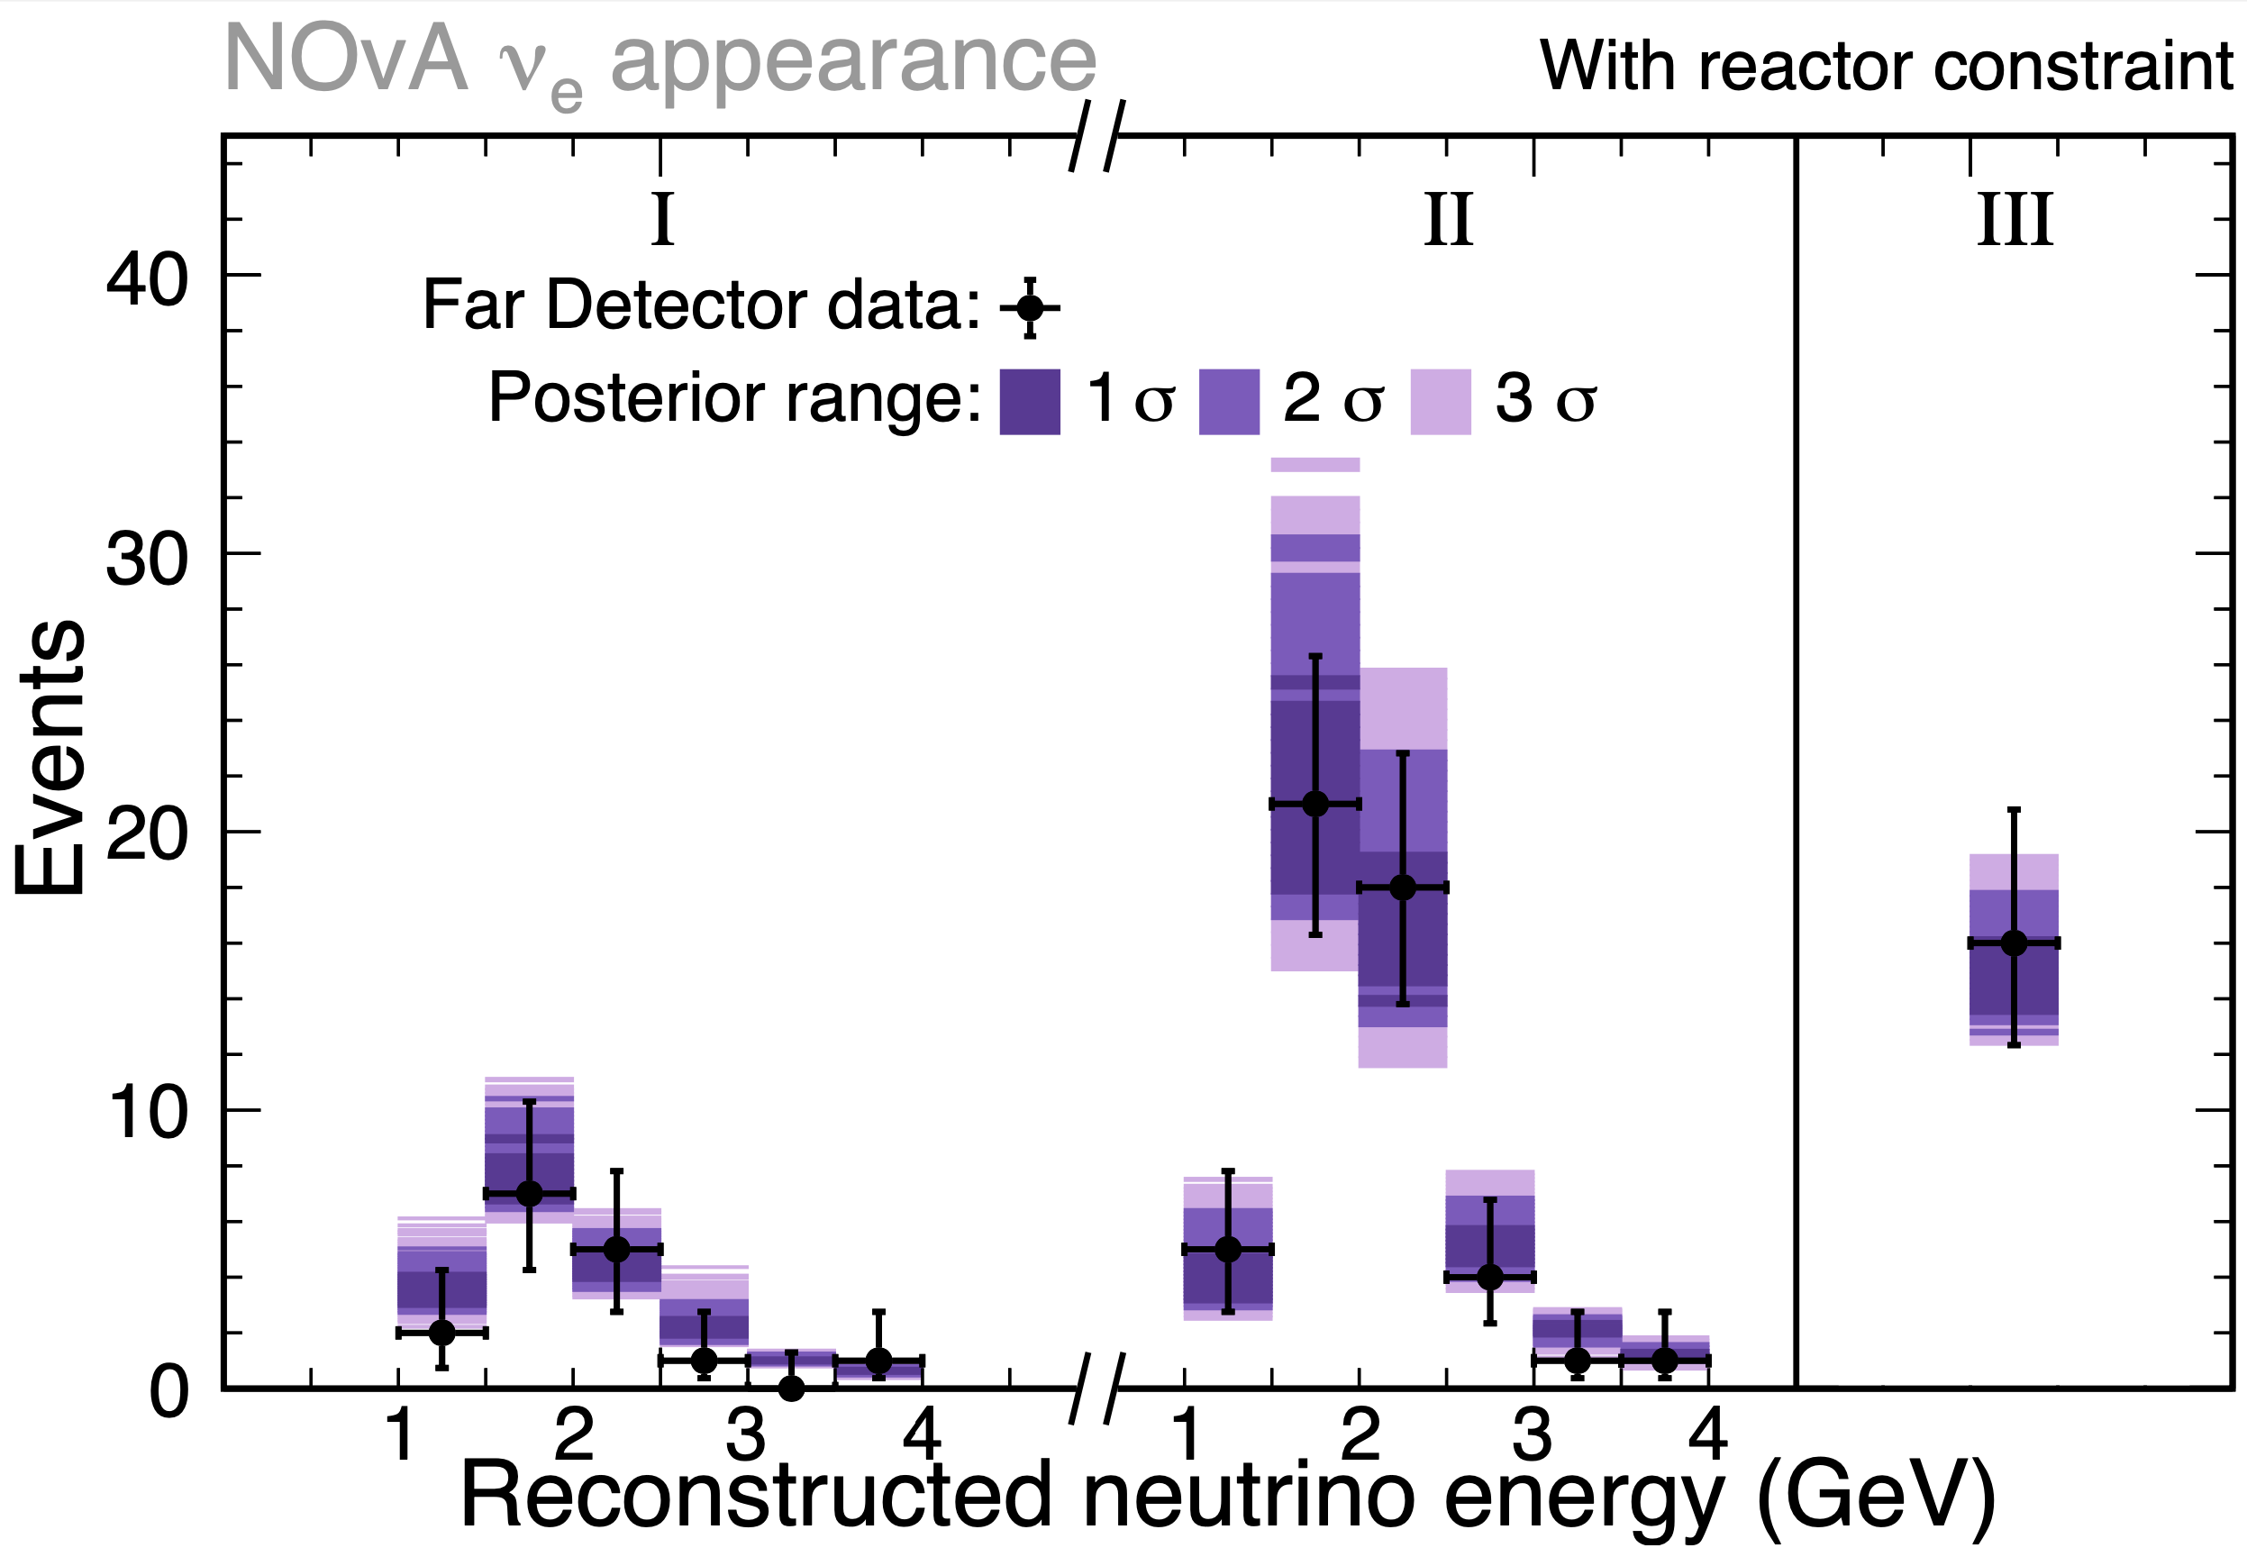
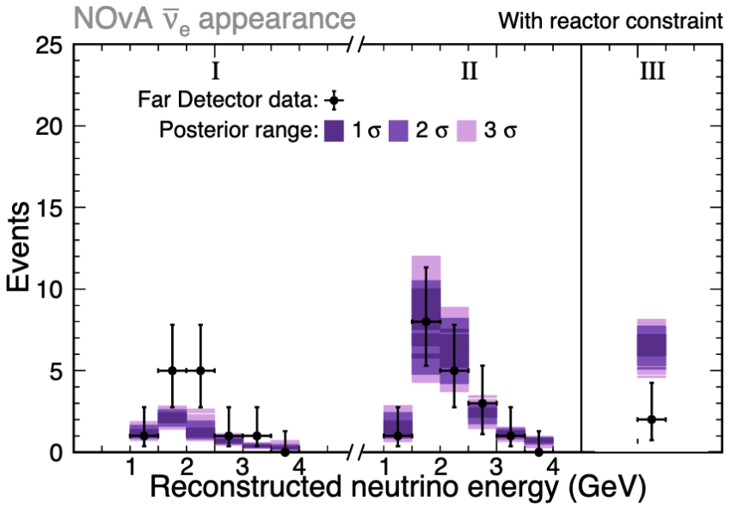
Joint Fit Results
Z. Vallari, JETS, Feb. 2024
Note: Joint fit results based on smaller data sets than the individual results
 | NOvA | T2K | Combined
ν_{e} | 0.90 | 0.19 (ν_{e}) 0.79 (ν_{e}1π) | 0.62
ν_{e} | 0.21 | 0.67 | 0.40
ν_{μ} | 0.68 | 0.48 | 0.62
ν_{μ} | 0.38 | 0.87 | 0.72
Total | 0.64 | 0.72 | 0.75
Posterior predictive p-value
(~0.5 is good compatibility)

Slide 27
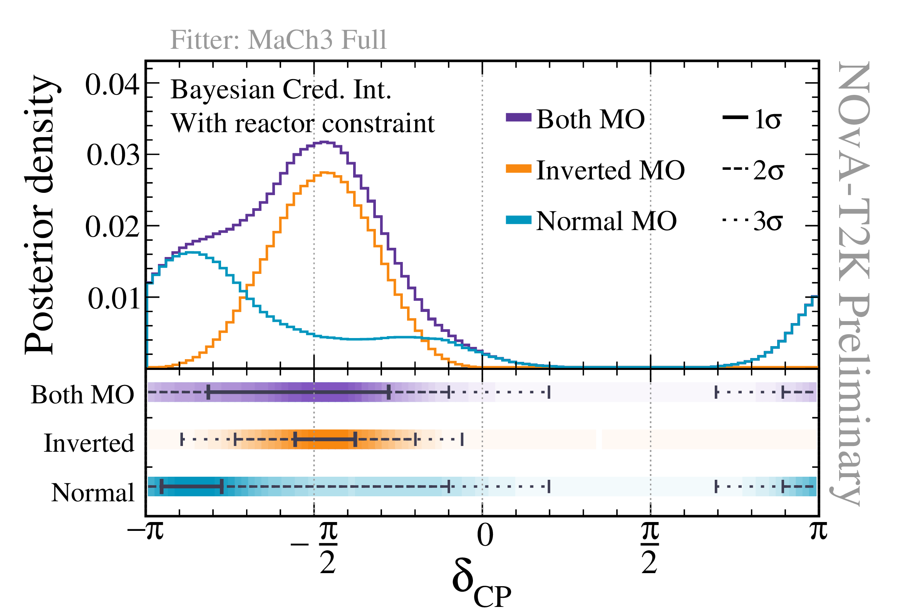
Joint Fit—CP
Z. Vallari, JETS, Feb. 2024
For both mass orderings, δ_{CP} = π/2 lies outside 3-sigma credible interval.
Normal Ordering allows for a broad range of permissible δ_{CP}
For the Inverted Ordering, CP conserving values of 𝛿_{CP} (0, π) lie outside the 3-sigma credible interval.
Note change in δ convention!

Slide 28
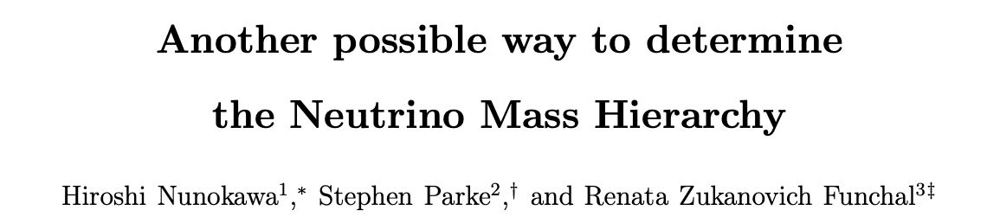
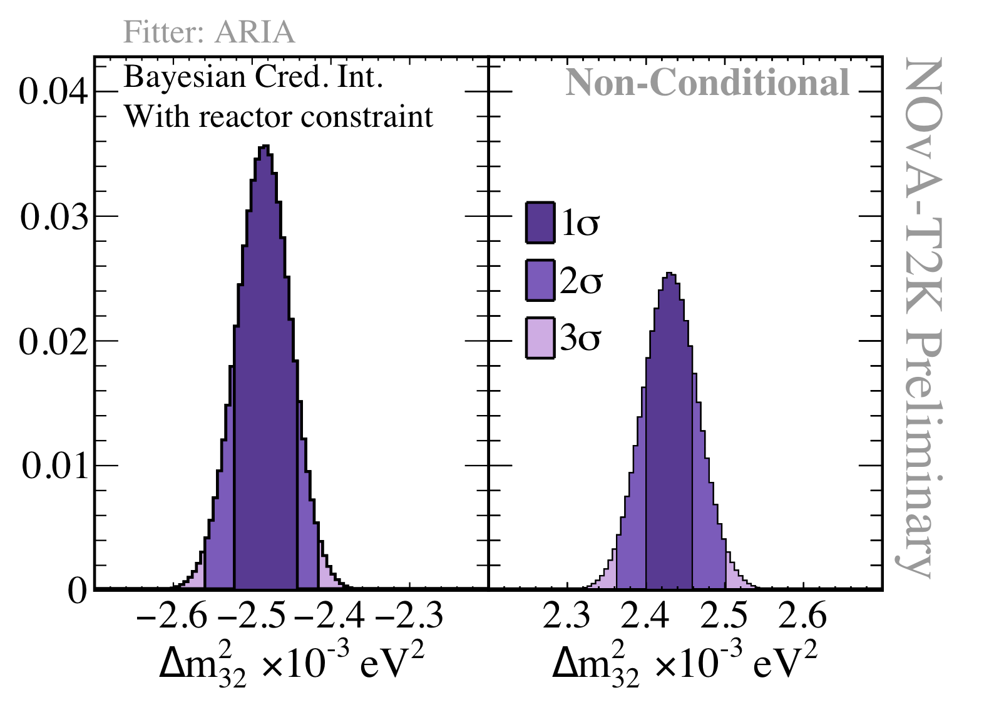

Joint Fit—MO
Z. Vallari, JETS, Feb. 2024
Inverted MO
Normal MO
In the true mass ordering, reactor extraction of Δm₃₂² should be consistent with long-baseline value
 | Preferred Ordering | Bayes Factor | Odds
No Reactor | Inverted | 2.47 | 71% : 29%
Daya Bay θ₁₃ | Inverted | 1.34 | 57% : 43%
Daya Bay 2D | Normal | 1.44 | 59% : 41%
NOvA+T2K Joint fit has a modest preference for the Inverted Ordering, but flips depending on what reactor constraints are used.

Slide 29
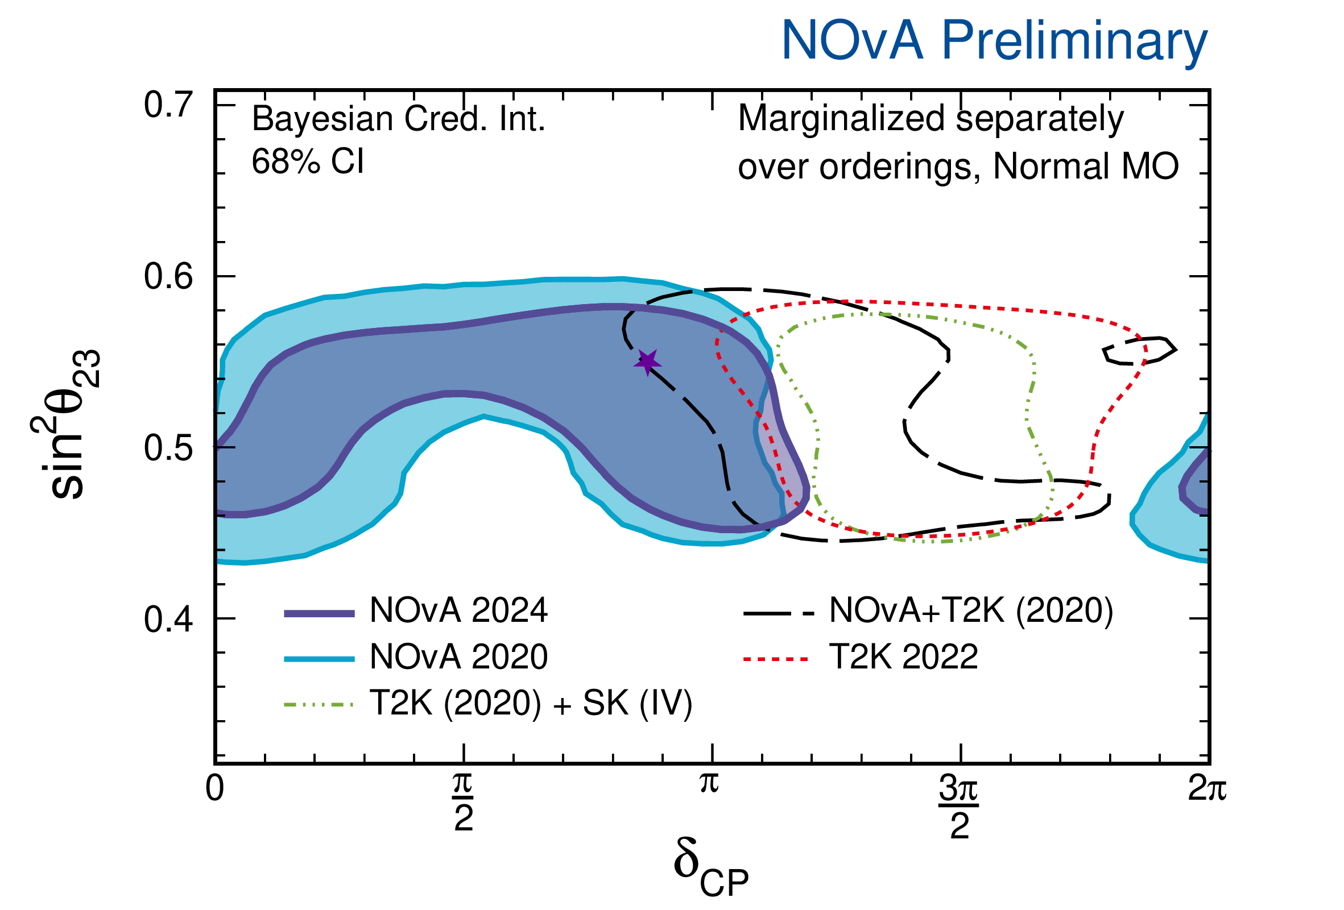
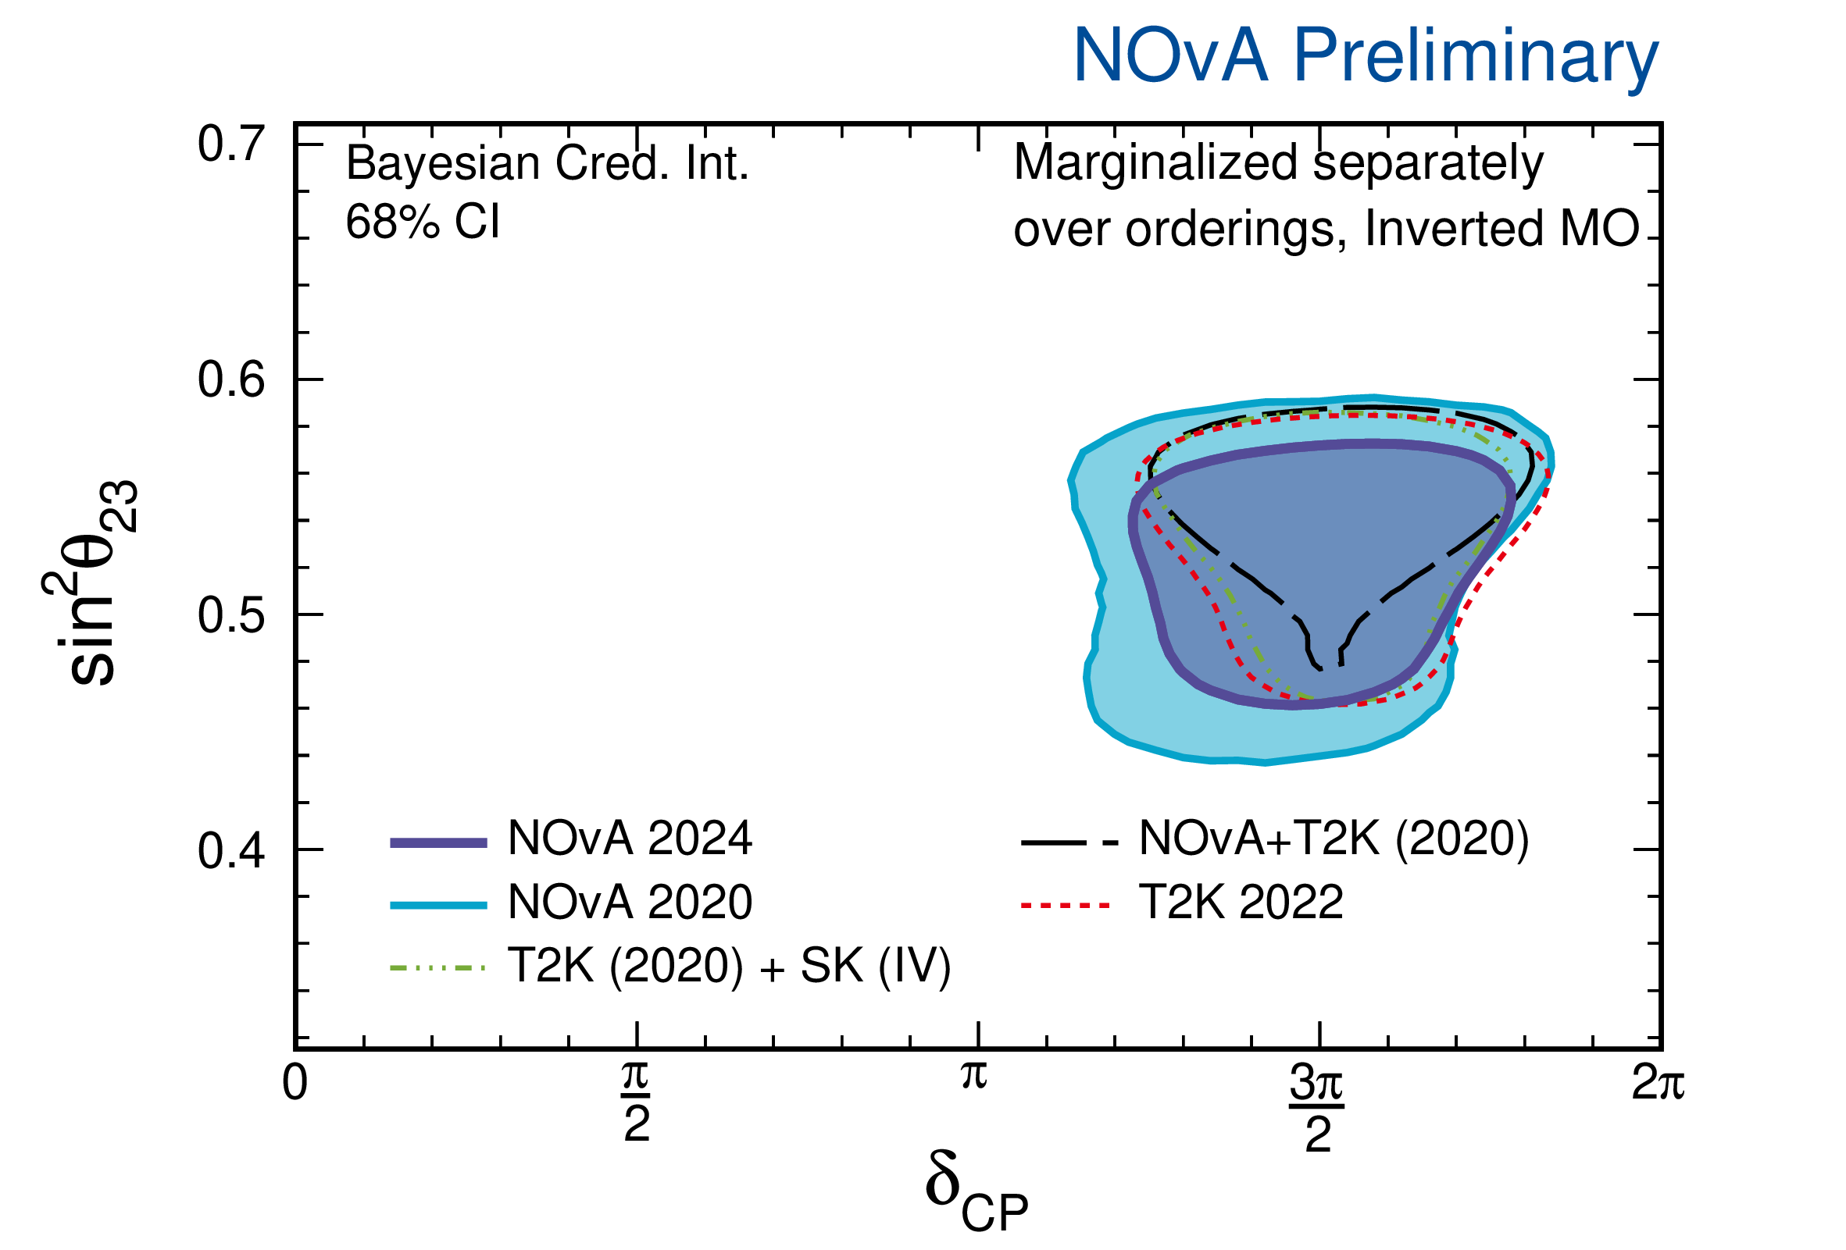
Final Comparisons
T2K also does joint fit with SK
Phys.Rev.Lett. 134 (2025) 1, 01180
Prefers NO with 1.2σ exclusion of IO
1.9σ exclusion of CP conservation (J_{cp}=0)
External Global fits see similar trends
(I. M. Soler, WIN2025, JHEP 12 (2024) 216)
Fit to LBL+Ice Cube+Reactor falls in NO, but fit is almost equally good in either ordering
Adding SK Atmospherics disfavors IO with Δχ²=6.3
Consistent with CP conservation at 1σ
Stay tuned for more joint NOvA+T2K results

Slide 30
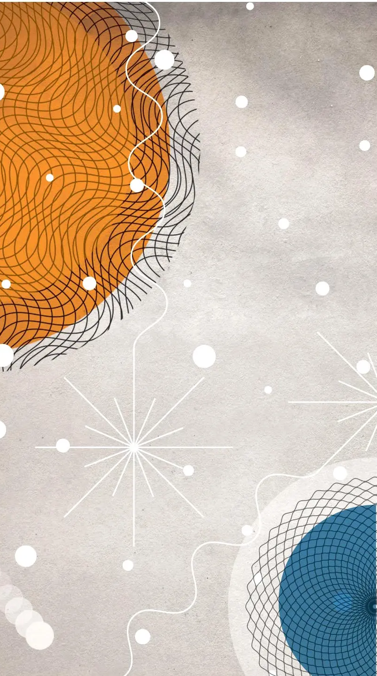
Future long-baseline experiments
Image Credit:
New York Times

Slide 31
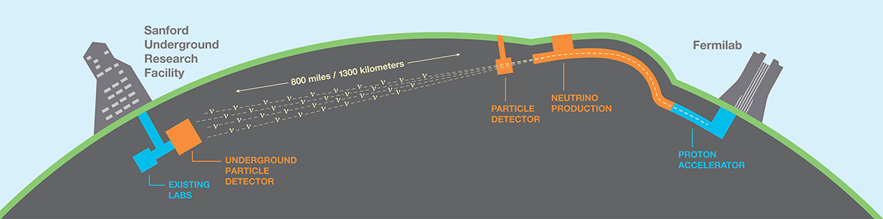
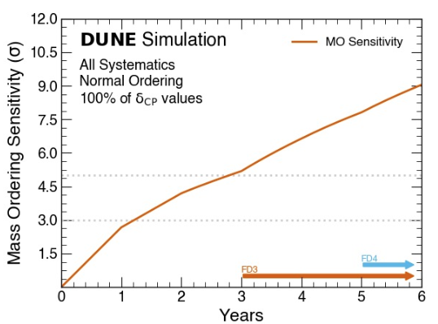
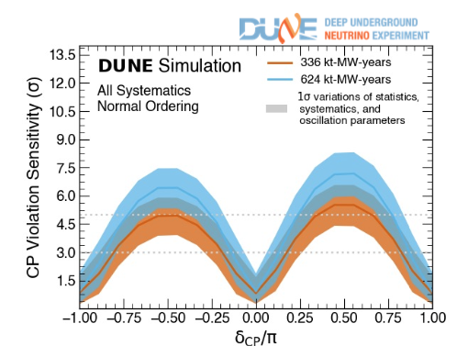
The Future Long-baselines
1.2 MW neutrino beam
Upgradable to 2.4MW
PIP-II project baselined
5 sigma mass ordering resolution after 3 years running with nominal detector design and beam configuration
CP violation for 50% of delta values
  3 sigma in 5 years
  5 sigma in 10 years
Expected start 2031

Slide 32
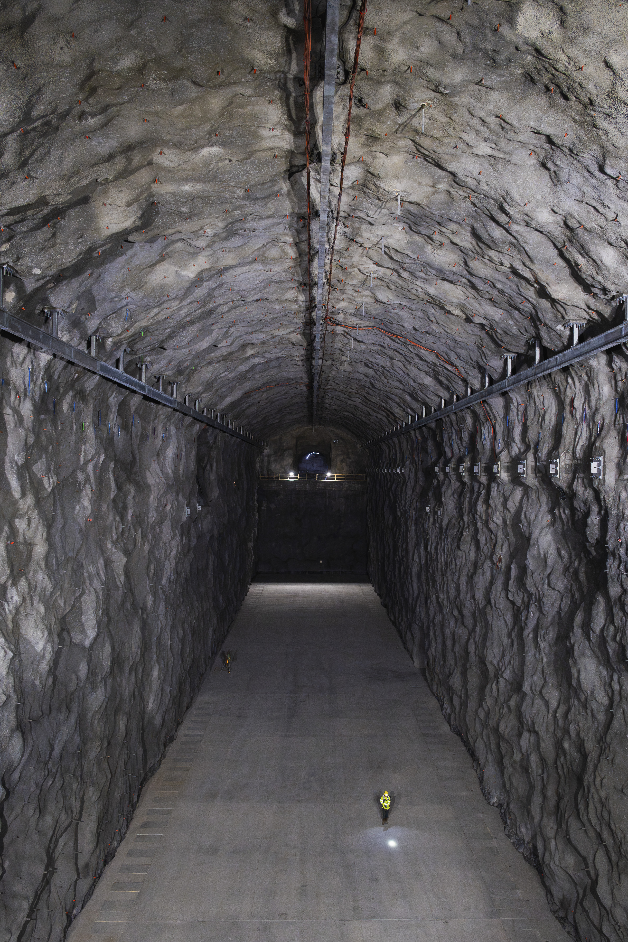
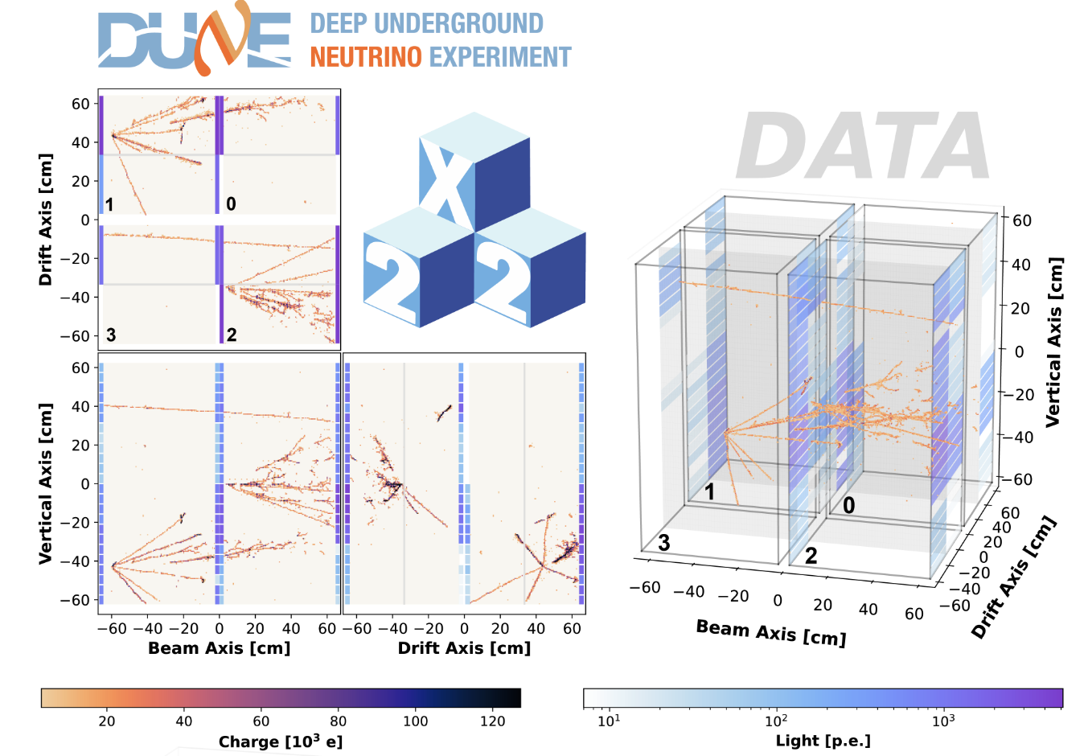
DUNE Status
Excavation of FD Caverns completed April 2024
Cavern occupancy expected in Jan 2026
Cryostat steel in South Dakota
Vertical drift prototype commissioning at CERN
2x2 LAr det. w/ pixelated readout run in NuMI in 2024

Slide 33



Hyper-K
F. Di Lodovico, Lomonscov 2021
Gigantic neutrino and nucleon decay detector—10x SuperK
MW beam from upgraded JPARC complex
Data taking in 2027

Slide 34

Hyper-k Status
T. Katori, JETS May, 2025
Operation start expected 2028
Site excavation completed
R&D is concluding
10K+ of 20K PMTs are delivered and have had QA tests
Working towards 1.3 MW beam in 2028 by reducing cycle time

Slide 35

Summary
In 25+ years of long-baseline accelerator neutrino oscillations, we’ve measured many parts of PMNS mixing of massive neutrinos.
Important open questions remain:
  Individual experiments tend to favor the NO at 1-2σ, but combinations weaken the significance or even flip the preference!
  CP conserving values of δ_{cp} are allowed by T2K data at 2σ, 1σ in NOvA
  In T2K+NOvA joint fit, the CP conserving values are outside the 3σ interval in the IO.
The 2nd generation long-baseline experiments are nearing end of data taking.
DUNE and Hyper-K promise exciting results just over the horizon!

Slide 36
Backup

Slide 37


Slide 38

Long-Baseline Observables
Oscillation probabilities at L/E~500km/GeV are sensitive to most of the remaining unknowns
Muon Neutrinos disappear
Electron Neutrinos appear

Slide 39

Making a Neutrino Beam
Flashlight
^anti-
Torch
Target
Focusing Horns
π⁺
2 m
ν_{μ}
120 GeV p⁺ from MI
ν_{μ}
π⁻
Anti-
neutrino
Mode
NOvA
Wrong sign flux less than 10% in both neutrino and antineutrino beams
T2K
1-5 GeV
6% ν_{μ}
93% anti-ν_{μ}
1% ν_{e}

Slide 40

Flux Spectra
P. Dunne, Neutrino 2020
L. Berns, Moriond EW 2021
External Hadron Production data constrains flux uncertainty to ~10%
Wrong sign flux less than 10% in both neutrino and antineutrino beams
Small electron neutrino contamination
Neutrino
Mode
Anti-
neutrino
Mode
1-5 GeV
95% ν_{μ}
4% anti-ν_{μ}
1% ν_{e}
1-5 GeV
6% ν_{μ}
93% anti-ν_{μ}
1% ν_{e}

Slide 41



Two detector technique
Z. Vallari, JETS, Feb. 2024
Near detectors used to predict far expectations and control systematics
T2K
T2K: Systematic uncertainty on number of expected 1-ring e-like FD events drops from 13% to 5%
NOvA: Systematic uncertainty on predicted number of FD electron neutrino events drops from 15% to 4%

Slide 42

MINOS/MINOS+
MINOS+
PRL 125, 131802 (2020)

Slide 43




NOvA+T2K Disappearance Data samples:

Slide 44


T2K Results—
23 sector
C. Giganti, Neutrino 2024
T2K prefers normal ordering and upper octant, at low significance
Bayes Factor NO/IO = 3.3
Bayes Factor UO/LO = 2.6

Slide 45



Mixing angles: θ₂₃ & θ₁₃
Without any external constraint from reactor experiments, long-baseline measurements have a degeneracy in $\sin^{2 }θ_{23}$and $\sin^{2 }{2θ}_{13}$parameters.
Using the average constraint on $\sin^{2 }{2θ}_{13}= 0.085 ±0.0027$[PDG 2020], restricts us to a narrow posterior in θ₁₃ and lifts this degeneracy.

Slide 46


Mixing angles: θ₂₃ & θ₁₃
Modest preference for lower octant from the joint-analysis.
This preference shifts to a small preference for the upper octant when the reactor constraint on θ₁₃ is applied.
 | NOvA - T2K w/o reactor | NOvA – T2K – w/ reactor
Bayes factor | 1.17 Lower Octant/Upper Octant ~54% : ~46% posterior | 3.59 Upper Octant/Lower Octant ~78% : 22% posterior

Slide 47



Three Generations
Dune Groundbreaking, 2017
MINOS Groundbreaking, 1999
Past
~2000-2015
Present
2015-2025
Future
2030+
NOvA Groundbreaking, 2009

Slide 48


Analysis Basics
Z. Vallari, JETS, Feb. 2024
T2K’s L/E optimizes CP violation differences: ±30% T2K compared to ±22% NOvA (NOvA runs a bit above oscillation max to optimize MO determination)
NOvA’s longer baseline means mass ordering makes a big difference: ±20% NOvA compared to ±10% T2K

Slide 49

NOvA Results in all Parameters
With 2d reactor constraint

Slide 50

Tension?
NSI in Matter?
NSI in Production?
Sterile Neutrinos
Non-unitarity?
Lorentz Invariance?
Are NOvA and T2K hinting at different conclusions about δ_{CP}?
Significance of differences is <2σ
Also see NOvA NSI analysis in A. Lister, WIN2025

Slide 51


Joint fit—MO
Z. Vallari, JETS, Feb. 2024
In the true mass ordering, reactor and long-baseline measurements of Δm₃₂² should be consistent
2-d Daya Bay result (Δm_{ee}² vs. θ₁₃ ) adds additional information on the mass ordering
 | Preferred Ordering | Bayes Factor | Odds
No Reactor | Inverted | 2.47 | 71% : 29%
Daya Bay θ13 | Inverted | 1.34 | 57% : 43%
Daya Bay 2D | Normal | 1.44 | 59% : 41%

