Slide 1
Shaping Scientific Futures: The Journey of the African School of Physics
Christine Darve
European Spallation Source, ERIC
(incl. Afterwork: ASP, APS/FIP, IUPAP, CERN)
on behalf of the ASP-IOC
https://cdarve.web.cern.ch/
Friday June 13, 2025
WIN 2025
University of Sussex
https://iop.eventsair.com/win-2025
Notes:
A project reflecting initiative from world wide scientists to transcend geographical boundaries and share our knowledge with African students

Slide 2
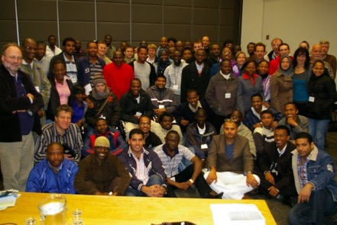




African School of Fundamental Physics and Applications (ASP)
A proof of concept to build a strategic partnership and collect financial support from Global organizations universities, institutions, and more donations
The aim of the school is to build capacity in African countries, to harvest, interpret, and exploit the results from physics experiments with particle accelerators, and to increase proficiency in related applications and technologies
A non-profit organization created by a small group of worldwide scientists to stimulate and include more African talented physics students in the world scientific community
Contribute to a world w/ equal access to knowledge
Support financially up to 85 African students for 2-3 week classes attendance
Establish a biennial educative program to be hosted across Africa
Provide high quality classes by international re-known Scientists
Notes:
Based on the experience of few European and American scientists, we have created a network, an organization, to stimulate and include more African talented physics students in the world scientific community.
Our mission is to help increase the number of African students acquiring higher education.
We have felt that American and European big science programs, have a lot to share in order to improve the world condition, hence science transcending boundaries…
“Everything “ pass by knowledge, and education is the pillar of well-being, and a peaceful world. Our goal was also to contribute to limiting the brain drain, by increasing capacity within African universities and promote spin-off for large scale activities IN Africa (see SKA, Af LS)
---
This is achieved through an outreach effort, an increased awareness of the potential of high quality training offered by large scale experiments in context in various scientic disciplines, and a system of networking on the international scale.
There is a strong alignment between the mission and the vision of African governments and policy makers on education and capacity building and their programs with the goals of the ASP.

Slide 3
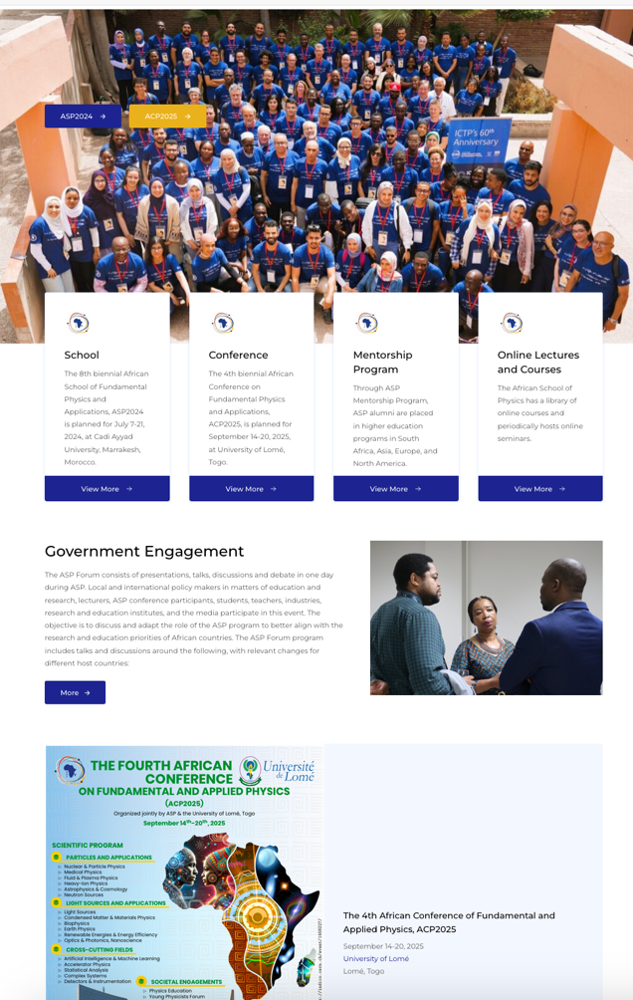
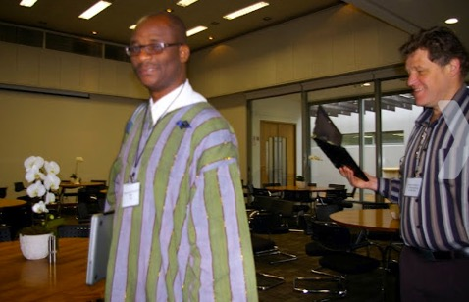
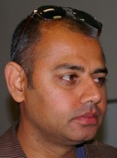
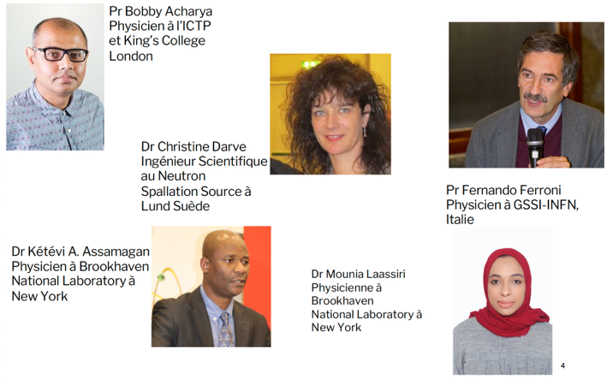
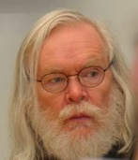
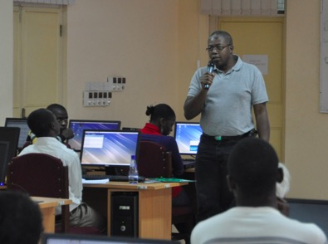
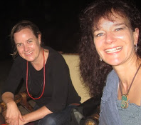
from ASP2010 until now
Conceptual thinking by Steve Muanza and John Ellis in 2001 and IN2P3 to trigger.
International Center for Theoretical Physics (ICTP), Bobby Acharya, as incubator and greatly encouraged by CERN and Fermilab.
Preparation teams leaded by Christine Darve ASP2010 and since then by Ketevi Assamagan & Mounia Laassiri
Notes:
What are the magic ingredients beyond ideals definition??
The right People + Financial supports, and dedication in order to build-up an organization that “worth fighting for..”
From the concept in 2001, to the realization of the first school in 2010, the road has been long, and filled with challenges (for scientists that we are…). This became possible with the financial and logistics support of CNRS, ICTP, CERN and Fermilab (or US HEP laboratories?).

Slide 4
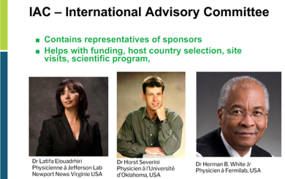
ASP Organization
International Advisory Committee (IAC)
Local Organizing Committee (LOC) in the host country
Representatives of funding agencies
Advise on the program
Advise of the host country selection
Local logistics
Liaise with Education and Research branches of host country government
Board of Trustees
IOC
Legal Responsibilities
Fund raising
Assess Management's
Program management
Fund raising
Coordination of activities
Activity reports to Funding agencies
Assessment of Impact
Survey of students
Survey of their Professors
Follow academic developments
Spin-Offs
ASP Mentorship/ Coaching Program Networking and sharing of information
Align ASP with educational priorities Improve future editions of ASP
Promote research collaborations Promote research consortia
International Lecturers (IL)
Design the scientific Program
Help with the student selections
Mentor and Coach students continuously
Notes:
Unfortunately, in our conjuncture, Nothing can be done without financial support..
The approximate budget is 160 kE per edition, shared between 15-20 different institutes, embassies and foundation across the world.
Beyond its financial support, ICTP support the logistics necessary for events preparation (CERN too).
Host country shall guarantee significant In-Kind support e.g. accommodation, catering.
Lecturers are paying for their fee.
The example of the ASP2018 sponsors are shown. Sponsors will vary largely between editions.
The supporting institutes since the first edition are ICTP and CERN, BNL, Fermilab, J-Lab, IUPAP, PSI then joined INFN, DESY, EPS, the Shui-Chin Lee foundation for basic science , Theorem Holdings Corporation, Metatron Global SA;
African contribution represents about 50 % of the income, with a continuous support from SA NRF and DST
The IOC is coordinating the whole process by writing proposal for fund raising, deciding on the whole program.

Slide 5
ASP - Topics of Interest
Particles and related applications
Nuclear physics,
Particle physics,
Medical physics,
(Particle)astrophysics & cosmology,
Fluid & plasma physics,
Complex systems
Light sources and their applications
Light sources
Condensed matter & materials physics
Atomic & molecular physics
Optics & photonics
Earth science
Cross-cutting fields
Accelerator physics
Computing
Instrumentation & detectors
Quantum computing & quantum information
Machine learning & artificial intelligence
Societal engagement
Physics education
Community engagement
Women in physics
Early career physicists
The ASP program is adapted to the interests of the host country, and to the academic majors and levels of the participants! e.g. South Africa: Light Sources (and Neutron Sources)
Notes:
Example of ASP timetable:
ASP2018: https://indico.cern.ch/event/656460/timetable/?view=standard

Slide 6
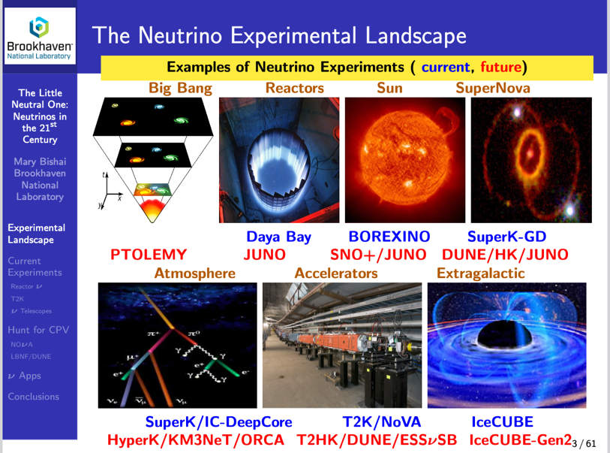
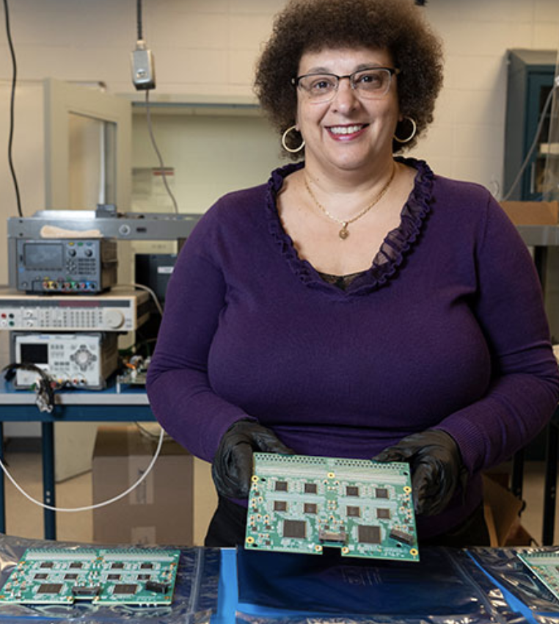
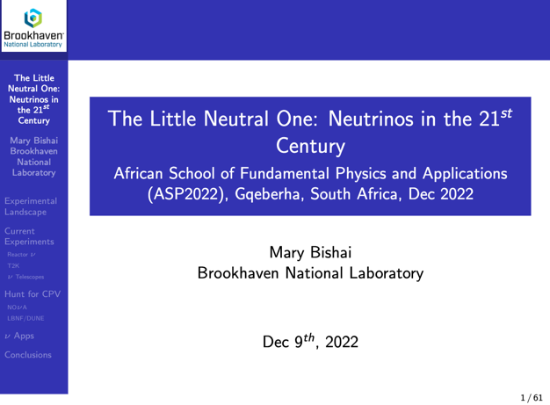
ASP and Neutrino !
Course by Mary Bishai (BNL)
2024 Distinguished Scientist Fellow
Mary mentored several ASP alumni who have been accepted into Ph.D. programs in the U.S. and Europe
ASP has offered lectures on neutrino oscillations, detectors, and cosmological relevance.
Neutrino physics education is expanding in Africa, aligning with global efforts to broaden participation in major neutrino and astroparticle experiments like DUNE, Hyper-Kamiokande, and KM3NeT
Notes:
Neutrino physics education is gaining momentum in Africa, aligning with global efforts to broaden participation in major neutrino and astroparticle experiments.
ASP editions have featured specialized lectures on neutrino topics such as oscillations, detectors, and their role in fundamental physics.
The “Neutrino for Africa” initiative aims to boost training, research collaboration, and infrastructure in neutrino science across the continent.
African students and institutions are increasingly being connected to international projects like DUNE, Hyper-Kamiokande, and KM3NeT, fostering long-term engagement and visibility.

Slide 7
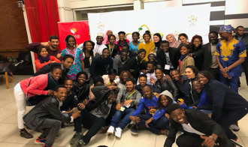
ASP Program Expansion
High School Teachers Program
1-week intensive workshop
Train High School Teachers for improved physics teaching
Share learning scenario and tools with teachers
Student Program
2-3-week intensive school
3rd year of University to Ph.D.
Mostly African Students
70-80 Students:
total > 614 in-person + 200 online
ASP Conference
1-week International Conference
Participation of ASP Alumni
Part. Research Faculties
Networking & collaborations
Forum and Outreach
Involve Regional policy makers
Promote spin-off activities in Africa
Introduce students to policy
Learners Program
1-week learners Outreach
10-12th grade learners
Encourage learners to develop and maintain interests in Physics and Applications
Mentorship/ Coaching Program
Connect Students w/ Researchers
Place students at Labs
Support students & help address their academic needs
Notes:
Activites list
Since 2010, the core of the program, includes the academic lectures and exercises for the students and the Forum and outreach activities to involve the regional policy makers.
To improve the events, we have added more discussion sessions with the students (in French and English) so that they can digest the lecture content.
Since 2016, we have expanded our program by preparing in parallel to the students courses, a workshop for high-school teachers.
In order to further foster the interest of physics in the African world, we have added visits and teaching to local high-schools.
The introduction of a Conference to include more scientists, and encourage networking among alumni students and professionals.
Finally, the expansion includes, as well, a well-defined process for coaching Alumnin students.

Slide 8
ASP Editions in figures
Reports:
ASP2010
ASP2012
ASP2014
ASP2016
ASP2018
ASP2020 (ONLINE)
ASP2022 (HYBRID)
ASP2024 (HYBRID)
ACP2025 (HYBRID)
ASP | Host Country | Applicants | Students | African Countries | Mentorship | Teachers | Pupils | Conf.
ASP2010 | South Africa 🇿🇦 | 125 | 65 | 17 | Continuously, even when there is no formal school
ASP2012 | Ghana 🇬🇭 | 138 | 50 | 15
ASP2014 | Senegal 🇸🇳 | 330 | 70 | 21
ASP2016 | Rwanda 🇷🇼 | 429 | 75 | 28 | Program formalized in 2016. Runs continuously | 20 | 150
ASP2018 | Namibia 🇳🇦 | 523 | 85 | 26 |  | 63 | > 1200 | +60
ASP2021 | Morocco 🇲🇦 Online | N/A | 94 |  |  |  |  | +649
ASP2022 | South Africa 🇿🇦 | >416 | ~82: In person ~97: Online | 40 |  | ~80 | ~230 | +601 60: In-person
ASP2024 | Morocco 🇲🇦 | 534 | ~93: In person ~102: Online | 50 |  | ~80 | >1000 | ACP2025 🇹🇬
ASP2026 | Kenya 🇰🇪 | Coming up!

Slide 9
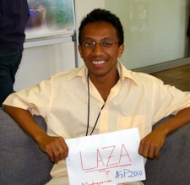

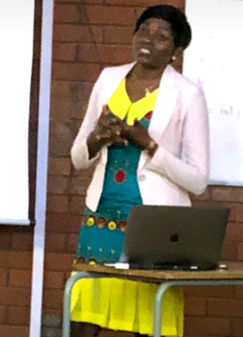
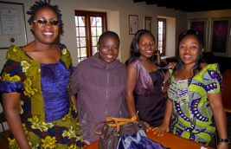
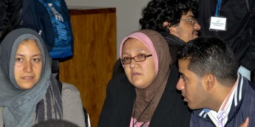
ASP Students
Provide partial or full financial support to students and create a scientific melting pot of cultural diversity
Diversity of academic levels
  Mainly Master and PhD students
Diversity of education background
  From theoretical physics to engineering sciences
Diversity of the countries of origin
  Priority to Sub-Saharan African students
Women participation (~32% - 50%)
  Role of women in LDC.
Local Universities
  Involve students and professors

Slide 10
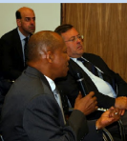
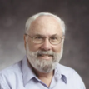
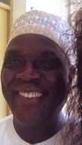
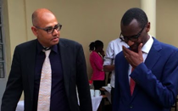

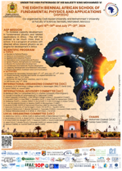
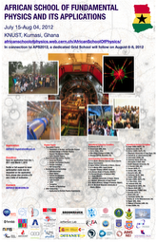
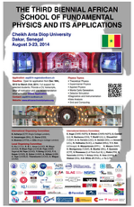
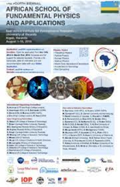
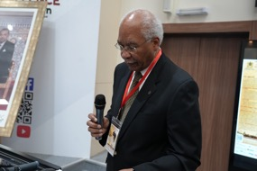
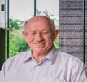
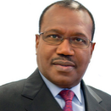
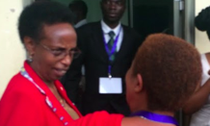
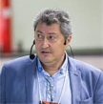
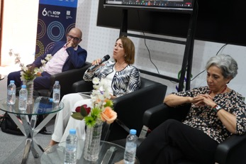

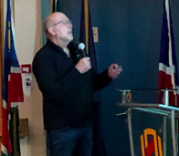
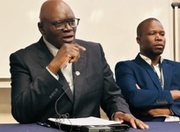
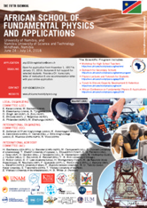
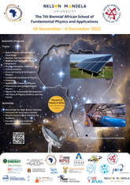
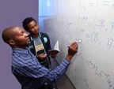
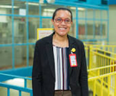
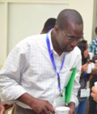
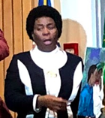
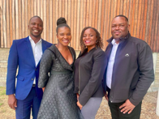
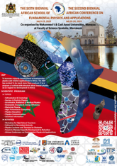
ASP Forum
One day. Objective:
Align ASP with the research and education priorities of African countries
ASP2010
Stellenbosch,
South Africa
ASP2024
Marrakesh, Morocco
ASP2012
Kumasi, Ghana
ASP2014
Sakar, Senegal
ASP2016
Kigali, Rwanda
ASP2016
Kigali, Rwanda
Dedicated to Knowledge and Transfer of Technology
Dr. D. ADAMS, chief director: Emerging Research areas & Infrastructure, Human Capital and Knowledge Systems.
AfLS and compact acc.
Prof. H. WINICK, Prof. Emeritus, SLAC
and Prof. L. SERAFINI (INFN, IT)
UN support
Dr. H. TOURE, UN ITU Secretary General.
Prof. A. WAGUE and O. KA M. NGOM - US
Embassy rep.
East Afr. Science and New ICTP Center
Rwandan Ministry of Education
ASP2018
Windhoek, Namibia
ASP2022
NMU, SA
LINK
ASP2020/21
Marrakech, Morocco
Strategic engagement with African policymakers in science education and research
2 panel discussions
“The road to critical skill development for Africa’s growth”
  With pan-African and international panelists
Physics outreach efforts by ASP alumni
  Demonstrate the impact of ASP Consolidate outreach efforts and support .
Physics education and research roadmap development and implementation in Africa
Prof. A. Muronga (Nelson Mandela University, SA)
Dr. Raissa Malu (Investing In People (IIP) ASBL)
Oumar Ka (Cheikh Anta Diop University, Senegal)
Education and capacity building in Namibia and Africa in general
Dr T. TJIVIKUA, Vice-Chancellor, Namibia University of Science and Technology (Namibia), Dr. R. ADAM (SKA, SA)
Sustainability of ASP and capacity development & retention in Africa, with the participation of policymaker representatives from Morocco, Senegal, Ivory Coast, Burkina Faso, Benin and South Africa (DSI, NRF, SAIP, SANSA, NMU), and international delegates from Africa, Europe and the U.S.

Slide 11
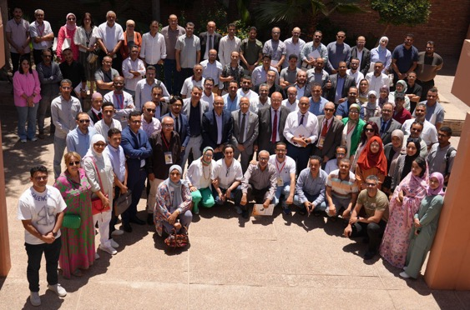
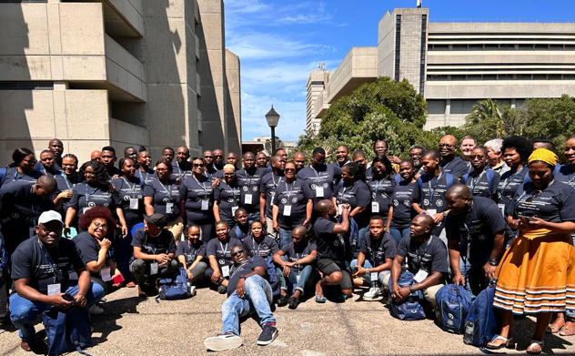
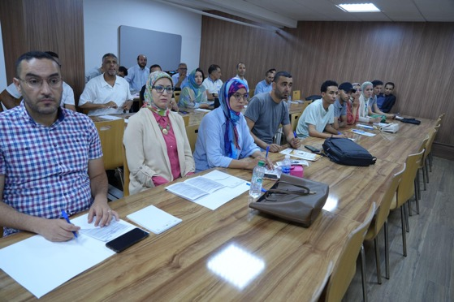
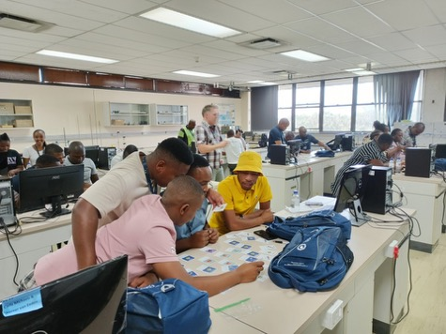
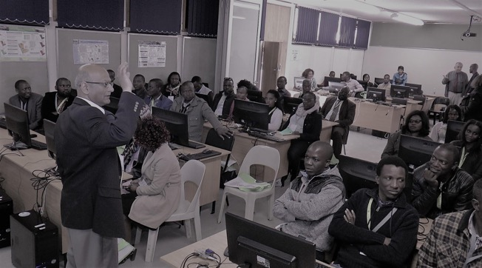
ASP High School Teachers
Objective
Support teachers' growth in the planning and delivery of physics instructions
1-week intensive workshop:
ASP2024: 80 teachers
ASP2022: ~80 teachers
ASP2018: 63 teachers

Slide 12
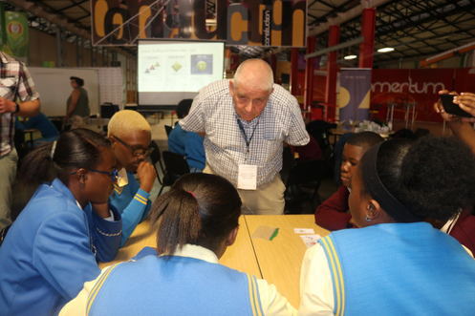
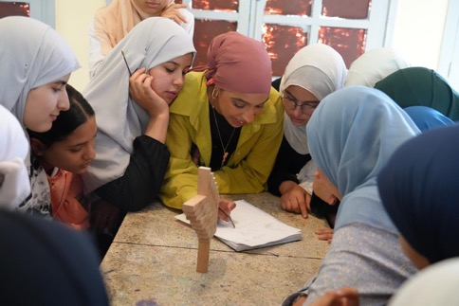
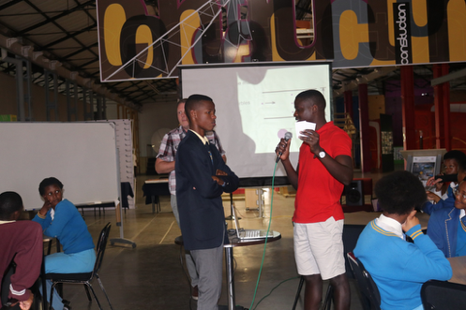
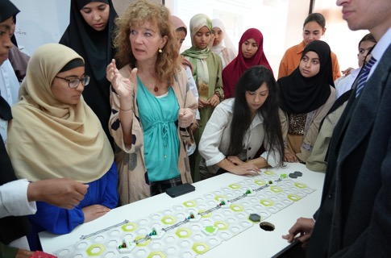
ASP High School Learners
Objective
Motivate high school pupils to develop and maintain interest in Physics.
1-week learners Outreach:
ASP2024: 5 high schools (as venues), 1038 pupils
ASP2022: 10 high schools, 230 pupils
ASP2018: 39 high schools, 1500 pupils
Program designed such that the lecturers that are not lecturing to students can help with the learners' program
ASP2024
The period of April 15–19, 2024, was chosen to maximize learner attendance while they are still in school.

Slide 13




















Ex. “Introduction to accelerator science:”
1) Les Particules
Sanae SAMSAM –INFN
Christine DARVE- ESS
(Part 1 and Part 2)
April 15-19 2024
"ASP2024 Learners program - Summary Report", - arXiv:2408.01464
MOOC: Pedagogical tools
2) L’énergie
Scientist Stories
3) Un control
Race to Space
4) Collision
Learning Scenarios
5) Detection
by Suzie Sheehy
Notes:
https://www.cea.fr/comprendre/Pages/matiere-univers/accelerateurs-de-particules.aspx?Type=Chapitre&numero=1
Trailers
Descriptions
Using large scale Research Infrastructure to teach:
Forces
Magnetism
Structure of an atom
Light
ElectroMagnetism…

Slide 14



Massive Open Online Courses
[Accelerate your Teaching]
[Nordic Particle Accelerator Project]
From 2015, 3 Summer Schools to develop capacity in Northern Europe with emphasize MAX IV and ESS ➔ Tools to reach out across frontiers
Can Serve as Training and Education Towards an African Synchrotron ?
→ AfLS: African Light Source and its Conceptual Design Report (CDR)
Erasmus+ / Strategic Partnership European Commission grant
NPAP reached ~ 21,000 NPAP learners across 104 countries!

Slide 15

Online Lectures since the Pandemic
The following series have been captured in Indico
Series 1 (May7-Nov19, 2020): ASP lecturers, see the topical version by LINXS
Series 2 (Nov24-Jan02, 2021): Photons and Neutrons, see LINXS version
Series 3 (since Feb 16, 2021): ASP Alumni
More organizational lectures:
  International Association for Physics Student (IAPS)
  ASP Mentorship Program
NB: Most videos are available on the given Indico and gathered in a Video_PlayList.

Slide 16





ASP2024 Statistics
534 Applications from
50 countries
By an international selection committee of 25 members, with selection rules set by IOC, considering funding agency requirements
A few students selected for in-person participation did not travel because of visa issues. They ended up online.
In the in-person participants, there were more female students than male students.

Slide 17
ASP2018 Statistics
Notes:
We select local students based their academical results.
A representation of the major African countries are well represented in our schools.
Different categories representation for each edition depending the the strength/interest of the host country.
The age and levels may vary depending on the editions, e.g. in 2018, we tune the program and encourage younger students to pursue their career in physics.

Slide 18
ASP Mentorship
At all times:
It runs continuously even when there is no school;
Open to ASP student alumni in Ph.D. programs;
Pairing of students to lecturers. Lecturers to mentor and coach them;
  Not a replacement of academic advisors, rather in addition to / in collaboration with it
Helps IOC track students after the school;
Helps answer the questions, "Where are they now?", "What happens to them after they’ve attended ASP?"
  These are legitimate questions
  Mentorship program supplemented by periodic of surveys
Program formalized soon after ASP2016;
Through this program, we place ASP alumni in high education programs in South Africa, Asia, Europe and North America.
Participants in the 2018 African School of Physics, which took place in Namibia. Credit: Glibert Tékouté

Slide 19




ACP Conference
One week:
The physics topics taught at the school form the core of the ASP conference.
Objectives
Attract ASP alumni
Attract African research faculties
Attract international participants not part of ASP
Foster new research collaborations
ACP2023 @ George Campus, SA
Number of registrants: 601
Number of in-person participants: 60
Peak Zoom connections: ~50
The ratio Female : Male in the registration is 4:10
Peer-reviewed conference proceedings published by the African Review of Physics.
ACP2021, Online
Participants from Africa: 563
Participants from outside Africa: 86

Slide 20












Next : ACP2025
Registration and abstract submission : https://indico.cern.ch/event/1458227/

Slide 21


More ASP / APS
2024 Satellite Meeting:The Tale of 2 organizations:APS, ASP & beyond..using MOOC as a prototype

Slide 22


More ASP / APS
2023: International Perspective for Young Physicists from Particle to Materials
“African Physics Strategy” by Mounia Laassiri
2024: Partnership for Education Across Continents:
“Building International partnership for Africa” by Ketevi Assamagan
2012 : Science Diplomacy: Africa and the Middle East
→ “Fundamental Physics and Accelerator Sciences in Africa” by Christine Darve
2025: The Global University: Expanding the Reach of Science Education through Satellite Campuses Across the World
→ "Beyond the African School of Physics (ASP): a model of Global University in Africa” by Christine Darve

Slide 23



More EDI for Physics in Africa…
Reminder: “Diversity and Outreach in High Energy Physics” by Kate Shaw
Digital learning:
  Science in School – EIROForum e.g. "Accelerators are everywhere, perhaps closer than you think..)
  "Forum to accelerate a global digital world", by Christine Darve, Stephane Kenmoe - PHYSICS MATTERS
International Union of Pure and Applied Physics (IUPAP) WG14-Accelerator Science
IUPAP/UNESCO International Colloquia on Physics For Society
  "Celebrate World Quantum Day with Prof. Anne L’Huillier - April 14! ”
  “Illuminating Innovation: Synchrotron Science, Quantum Frontiers, and Africa’s Scientific Future", May 27
"Quantum mechanics with patterns of light by Prof. Andrew Forbes, (SA) June 16
Info and Register Here

Slide 24


Synergy EDI “PHYSICS MATTERS”
Colloquium series for development @ Forum on International Physics (FIP) at APS
> 50 popular science events since Nov.2020!
Connect up to 35 countries at once!
Audience: from 70 to 477 persons
20-40 min colloquium
Q&A session engaging w/ esteemed speakers
This series is open to everyone!
Watch
trailer
YouTube webinars
Examples:
Sept ‘22: Momentum grows for the African Light Source by S. Connell
Oct ‘ 22: Physics for Development and International Cooperation by Kate Shaw
Feb. ’24: Roadshow on synchrotron science and X-ray imaging techniques in Zimbabwe” by Kudakwashe Jakata
Stay tuned for more colloquia !
July 31: “Materials science and socioeconomic challenges in Africa" by Thierry d’Almeida (REGISTER HERE)
➔ Oct. 2025: The African Strategy on Fundamental Physics and Applications - Forum
Notes:
https://youtu.be/YhszrScmyMM?si=GT9udVmy0eAbxJOD China America and Europe
A structured program designed to foster professional growth, interdisciplinary learning, and innovative thinking within a specific community or organization. Here’s a framework for such a series:
Objectives
Promote knowledge sharing across disciplines.
Highlight cutting-edge research, trends, or methodologies.
Create opportunities for networking and collaboration.
, so feel free to share!
and help spreading the word to build a curious and educated international connected Global Physical Society!

Slide 25





More potential for Neutrino ?
Reminder: “Detection of an Ultra-High-Energy Neutrino Event with KM3NeT” by Meriem Bendahman
Courtesy: Ernst-Jan Buis
“Acoustic detection of ultra-high energy neutrinos”
TNO, Delft
Nikhef, Amsterdam
Next: “Fiber optic hydrophones for acoustic neutrino detection” by Ernst-Jan Buis (TNO / NIKHEF)
➔ Monday June 16, at 11:15 – Zoom access to Lund University Science cafe

Slide 26



Eco-System
INDUSTRIAL
(Economy - Revolution)
INFORMATION
MOLECULAR
(NBIC)
Organization
(society)
The Adaptive
Enterprise
Nanotechnology
Biotechnology
Information technology
Cognitive science
Materials
Business
(maturity)
New media
IT services
Portals
Economic value added
Chips
Operating systems
WWW
Technology
(growth)
Science
(gestation)
Solid state physics
Information theory
Year
1750s
1850s
1950s
2050s
Courtesy Luca Serafini
ASP-2012 Forum, (Ghana), 28-07-2012
It's Alive - The Coming Convergence of Information, Biology, and Business Christopher Meyer 2003
Notes:
Nanotechnology, Biotechnology, Information technology, and Cognitive science

Slide 27










Thanks for listening
Concluding comments
ASP empowers the next generation of African physicists through top-tier training and global collaboration!
ASP lays the groundwork for Africa’s sustained contribution to global neutrino and frontier science!
christine.darve@ess.eu
Notes:
ASP is empowering the next generation of African physicists through world-class training, international collaboration, and a growing role in global science
Initiative such as ASP and other efforts are building a strong foundation for Africa’s long-term role in global neutrino science!

Slide 28
Back-up slides

Slide 29

Scattering Community
Global University to prepare the African Light Source ?
4
AfLS: African Light Source and its Conceptual Design Report (CDR)
>
Lightsources for Africa, the Americas, Asia, Middle-east and Pacific (LAAAMP)
LAAAMP brochure: “Advanced Light Sources and Crystallography: Tools of Discovery and Innovation“. → 5 languages
e.g. X-Tech Lab and Seme City in Benin
Notes:
Global University: Expanding the Reach of Science Education through Satellite Campuses Across the World

Slide 30
[International Union of Pure and Applied Physics (IUPAP) WG14-Accelerator Science]
Scope Summary
Global collaboration and knowledge sharing.
Resources and content to inspire and inform.
Mapping accelerator impacts on SDGs.
Promoting sustainable accelerator facilities.
Supporting workshops and professional events.
Current activities:
IPAC sponsoring & endorsement
Call for Ambassadors
Short recordings
Notes:
Scope: The working group consists of international experts committed to promoting these objectives on a global scale, utilizing local expertise and networks. The group’s activities include:
Developing resources and communication channels for sharing accelerator science and applications
Creating engaging content to inform and inspire both scientific and public audiences
Mapping and reviewing accelerator applications and requirements in addressing the SDG, such as life science & healthcare, scientific research & technology
Enabling and promoting sustainable accelerator facility over its full life cycle
Supporting workshops, conferences, and professional gatherings on accelerator technologies and

Slide 31

[International Union of Pure and Applied Physics (IUPAP) WG14-Accelerator Science]
[IUPAP]
Union of 22 international experts from 18 countries committed to promoting these objectives on a global scale, utilizing local expertise and networks.
Mandate - Advancing Particle Accelerators for Science & Society in key areas:
Applications: Industrial, medical, energy, environmental.
Science: Light sources, neutron sources, HEP, heavy ion research.
Future Facilities: Laser, plasma, compact neutron sources.
Innovation: Accelerator principles, sustainability.
Engagement: Education, workshops, global collaboration.
IUPAP Rejuvenation: Include scope for Major Neutron Research Facilities
Notes:
Scope: The working group consists of international experts committed to promoting these objectives on a global scale, utilizing local expertise and networks. The group’s activities include:
Developing resources and communication channels for sharing accelerator science and applications
Creating engaging content to inform and inspire both scientific and public audiences
Mapping and reviewing accelerator applications and requirements in addressing the SDG, such as life science & healthcare, scientific research & technology
Enabling and promoting sustainable accelerator facility over its full life cycle
Supporting workshops, conferences, and professional gatherings on accelerator technologies and

