Slide 1
Circular Colliders
Present and Future
Jon Butterworth
University College London
WIN 2025
11/6/2025
Leaning heavily on European Strategy Inputs, including the Future Colliders Comparative Evaluation - Working Group Report
Necessarily “high level” (ie misses out a lot!).
Will focus on physics capability and timescales.
Notes:
Experiments.
Would we have found it anyway?
DIS
4l
Roman villa/cms. Traces of the SM will exist as long as there is a civilisation.

Slide 2
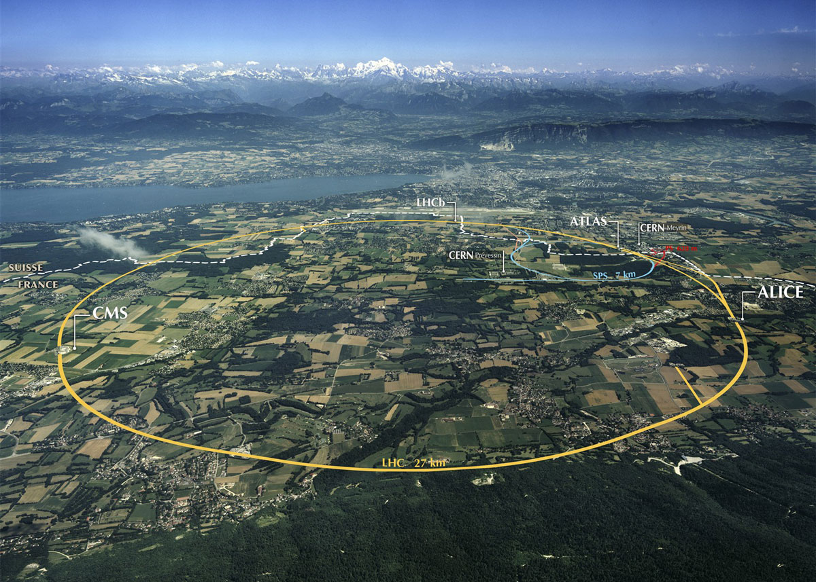
Outline
This tunnel
  Hadrons
  Electrons
New tunnels
  Electrons
  Hadrons
  Muons
Electroweak scale and above…

Slide 3

Why?

Slide 4
Conventional Wisdom
Hadrons for exploration
Leptons for precision
Lepton-hadron for QCD
e⁺e⁻ Higgs factory next (c.f. ESPP 2020)
Hadrons in half a century or so
ep … not high priority
Muons one day. Maybe.
Circular colliders will reach the point of diminishing returns (synchrotron radiation, magnetic field strength)

Slide 5
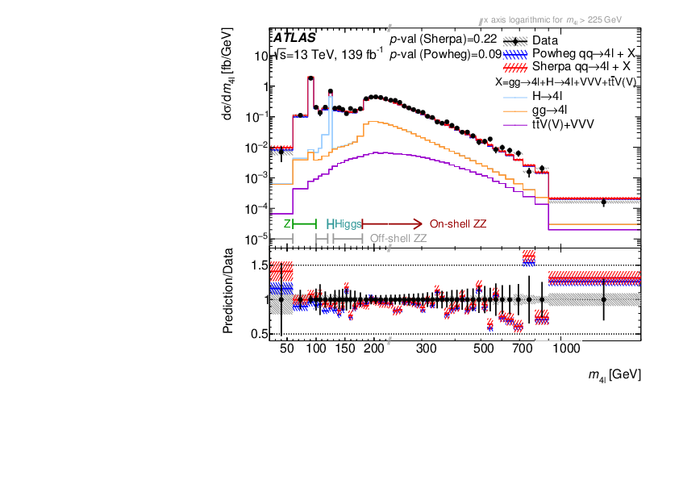
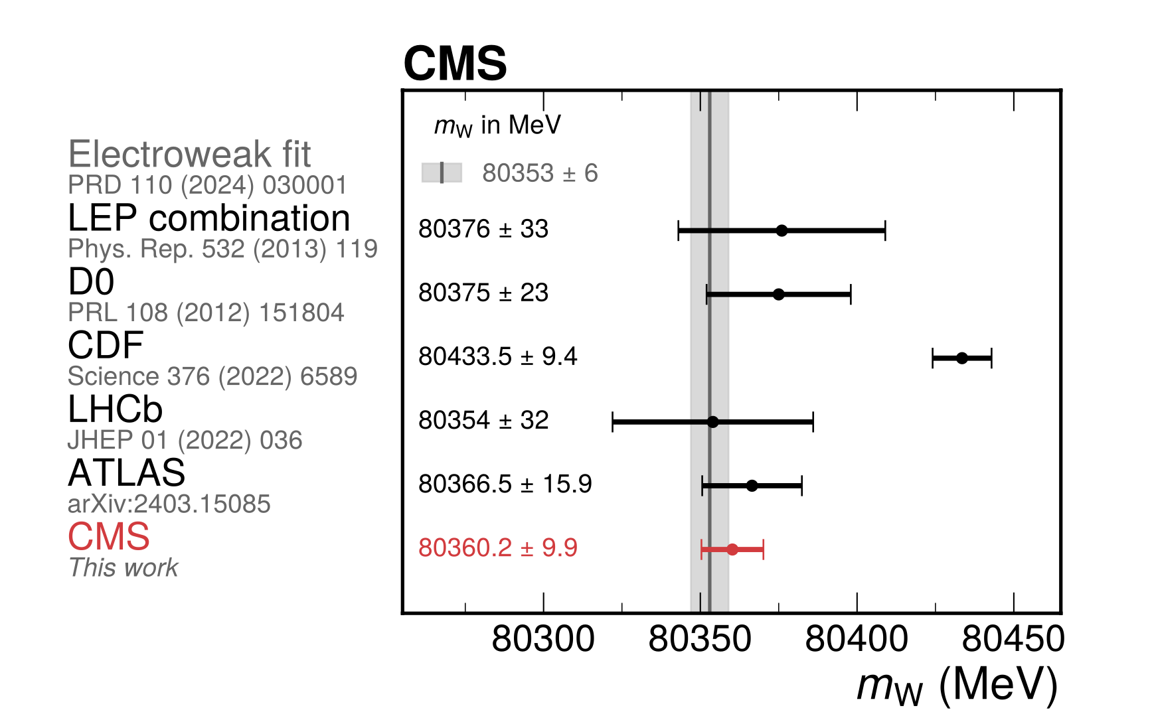
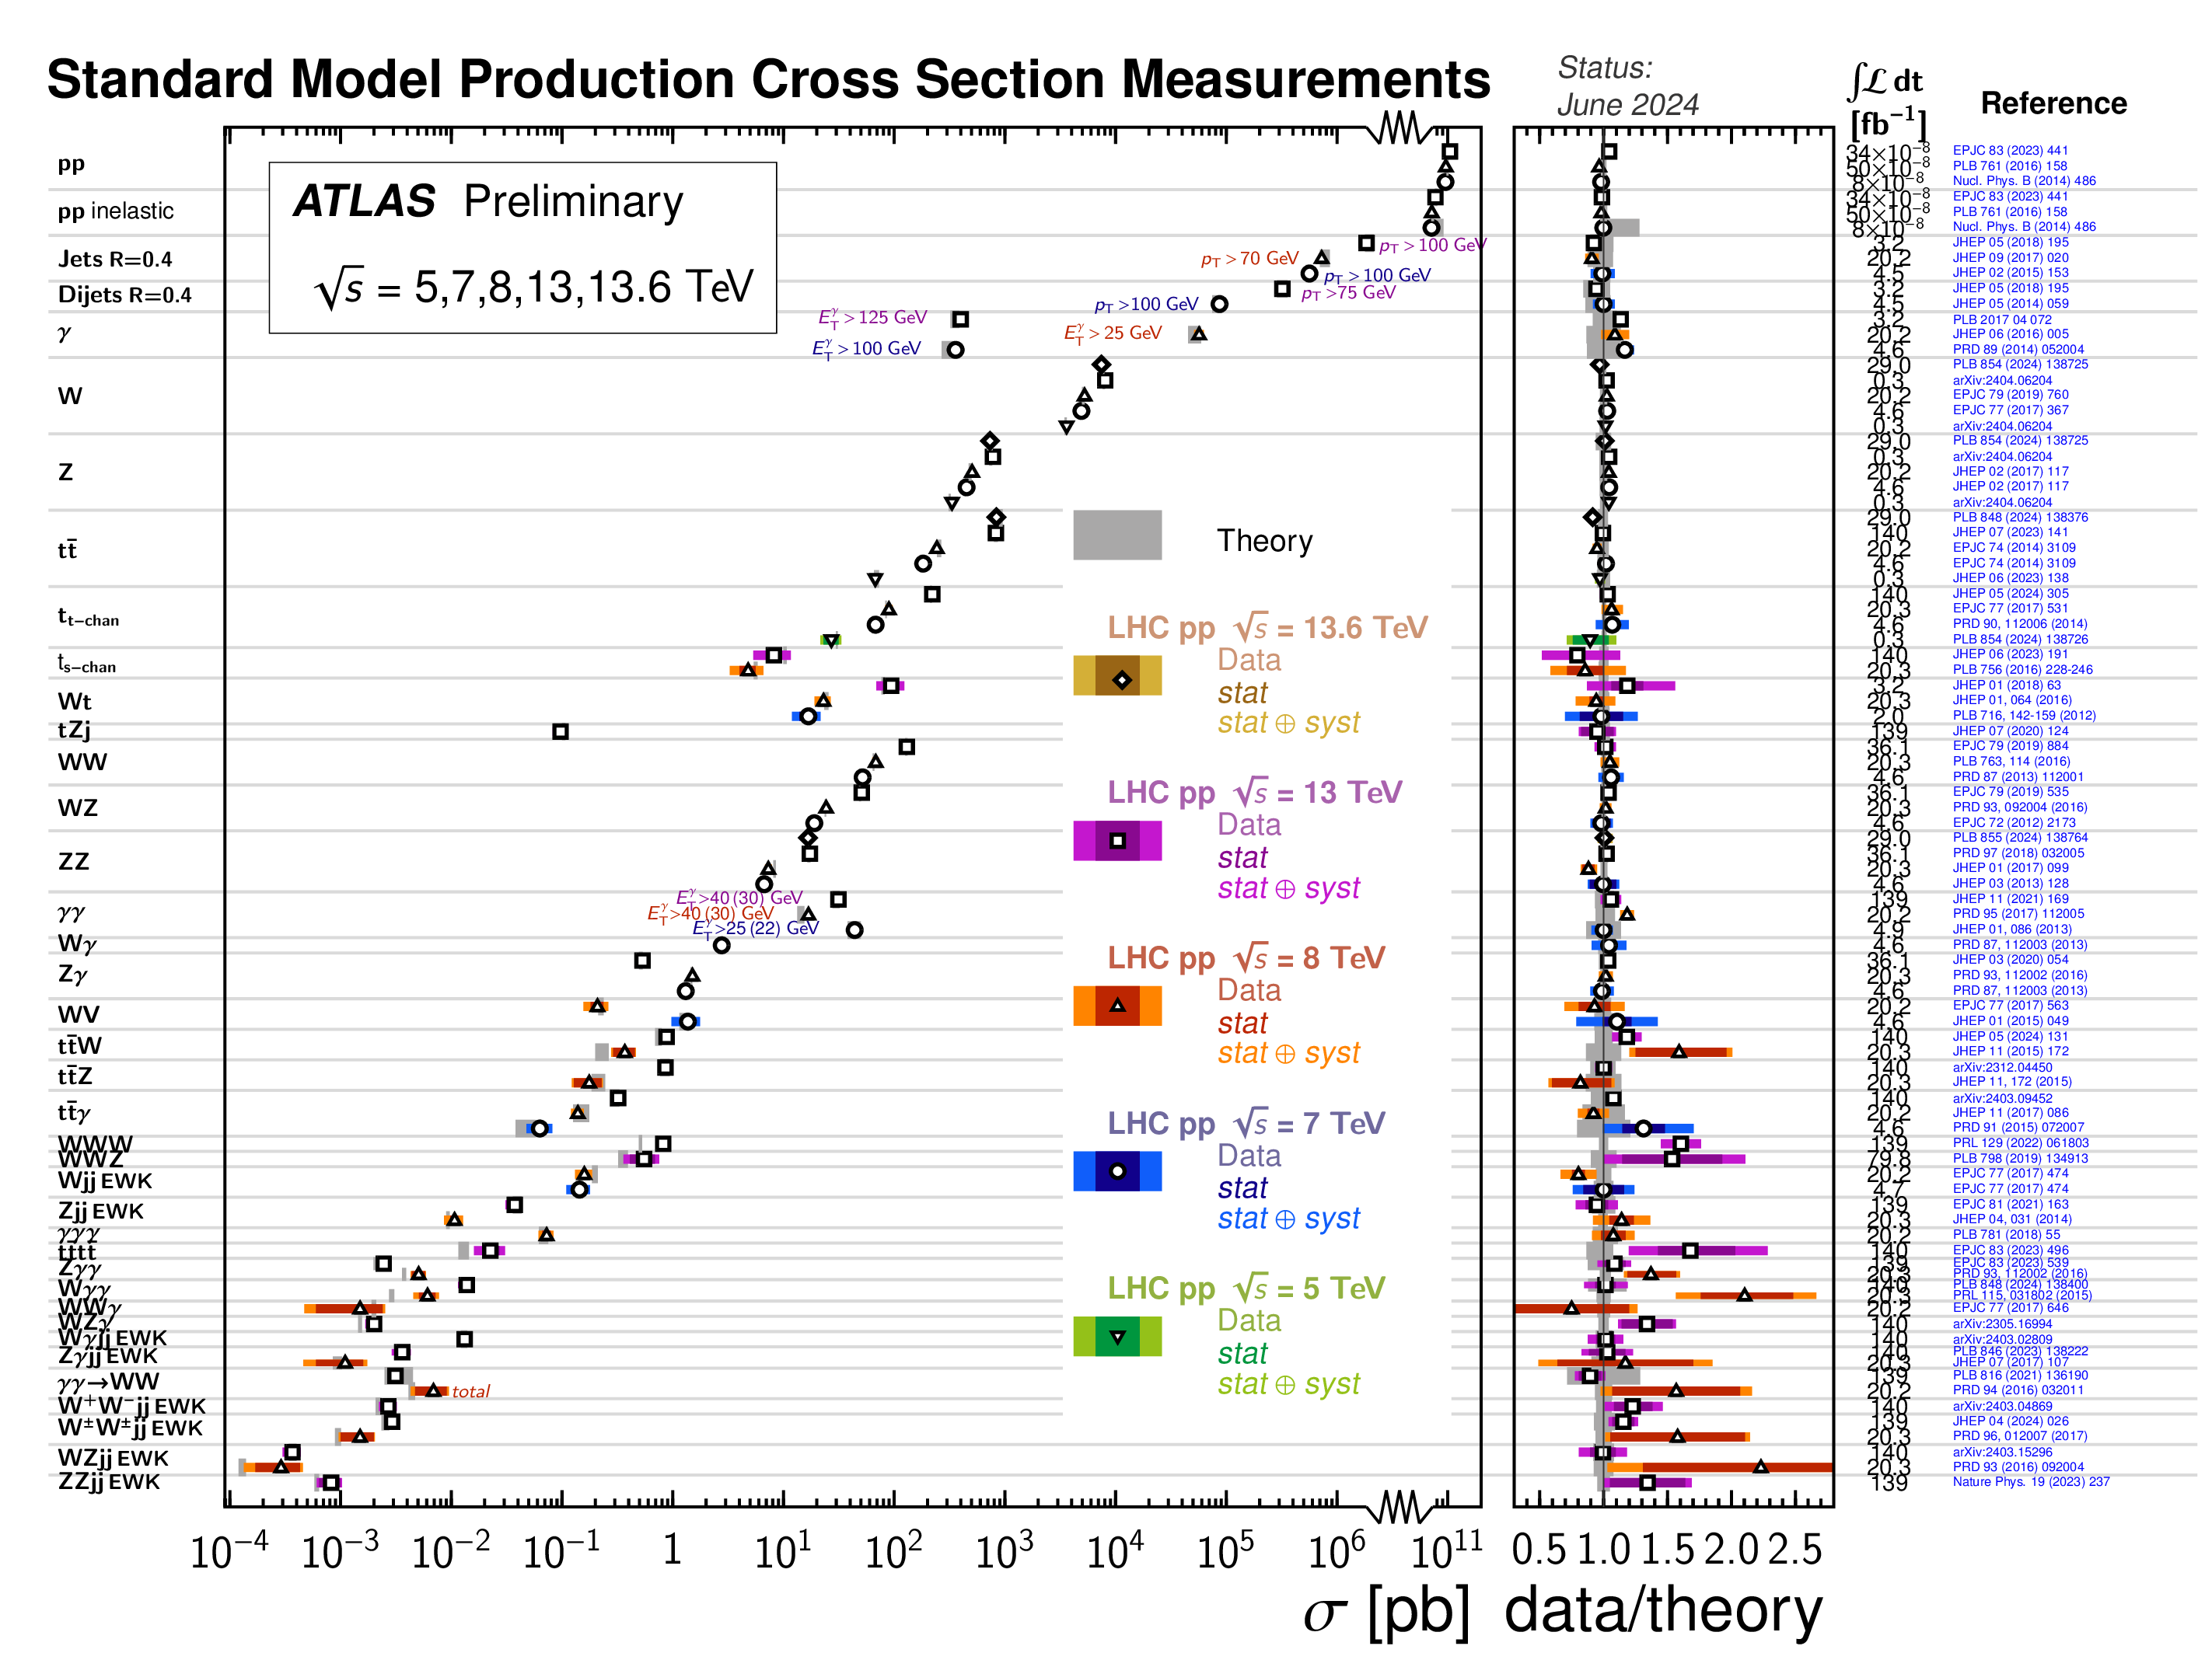
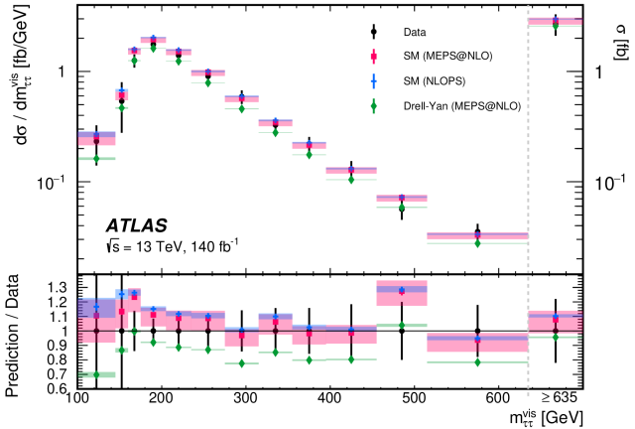
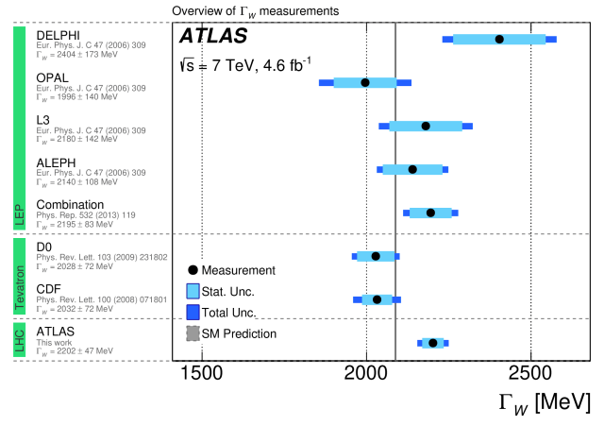
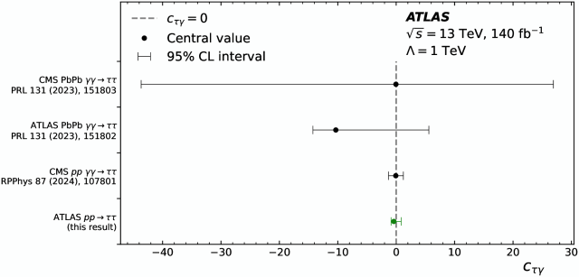
LHC: A precision Machine

Slide 6
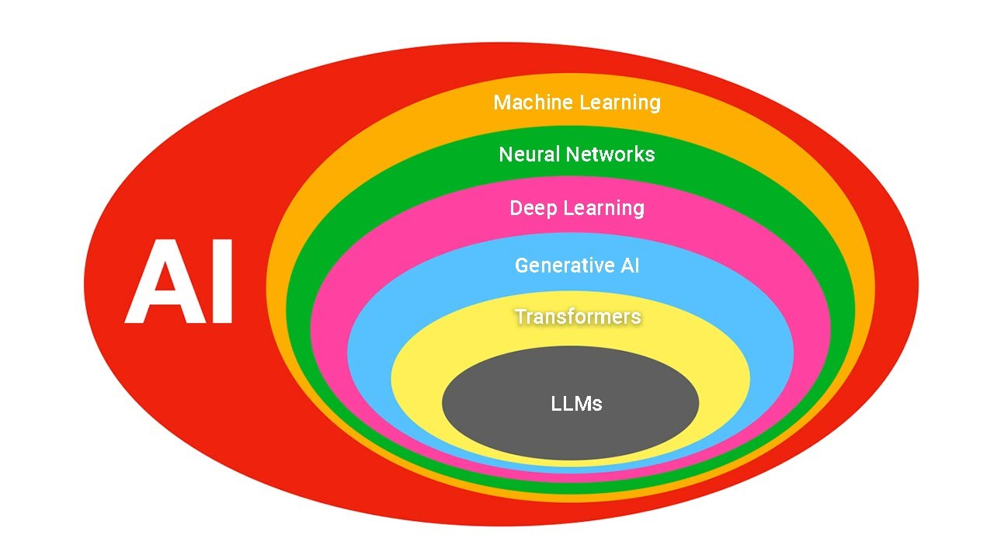
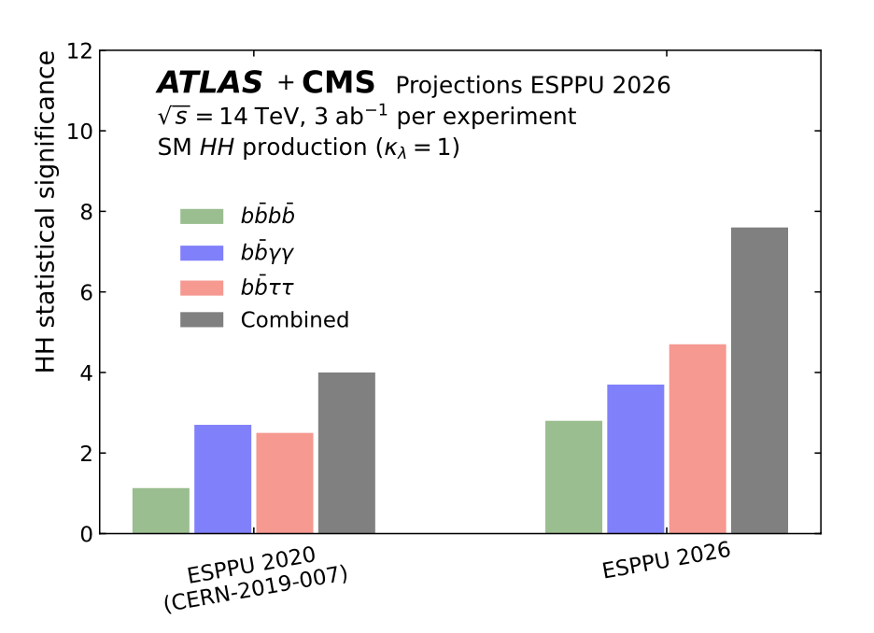
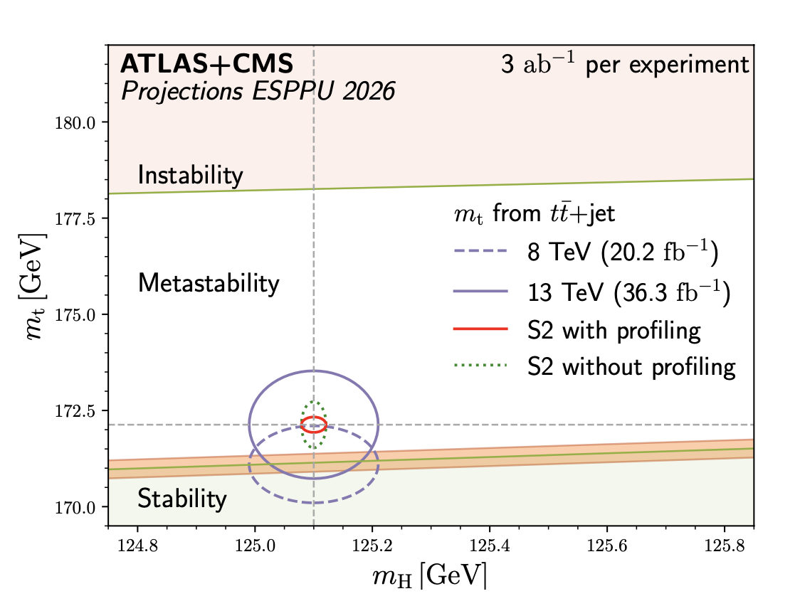
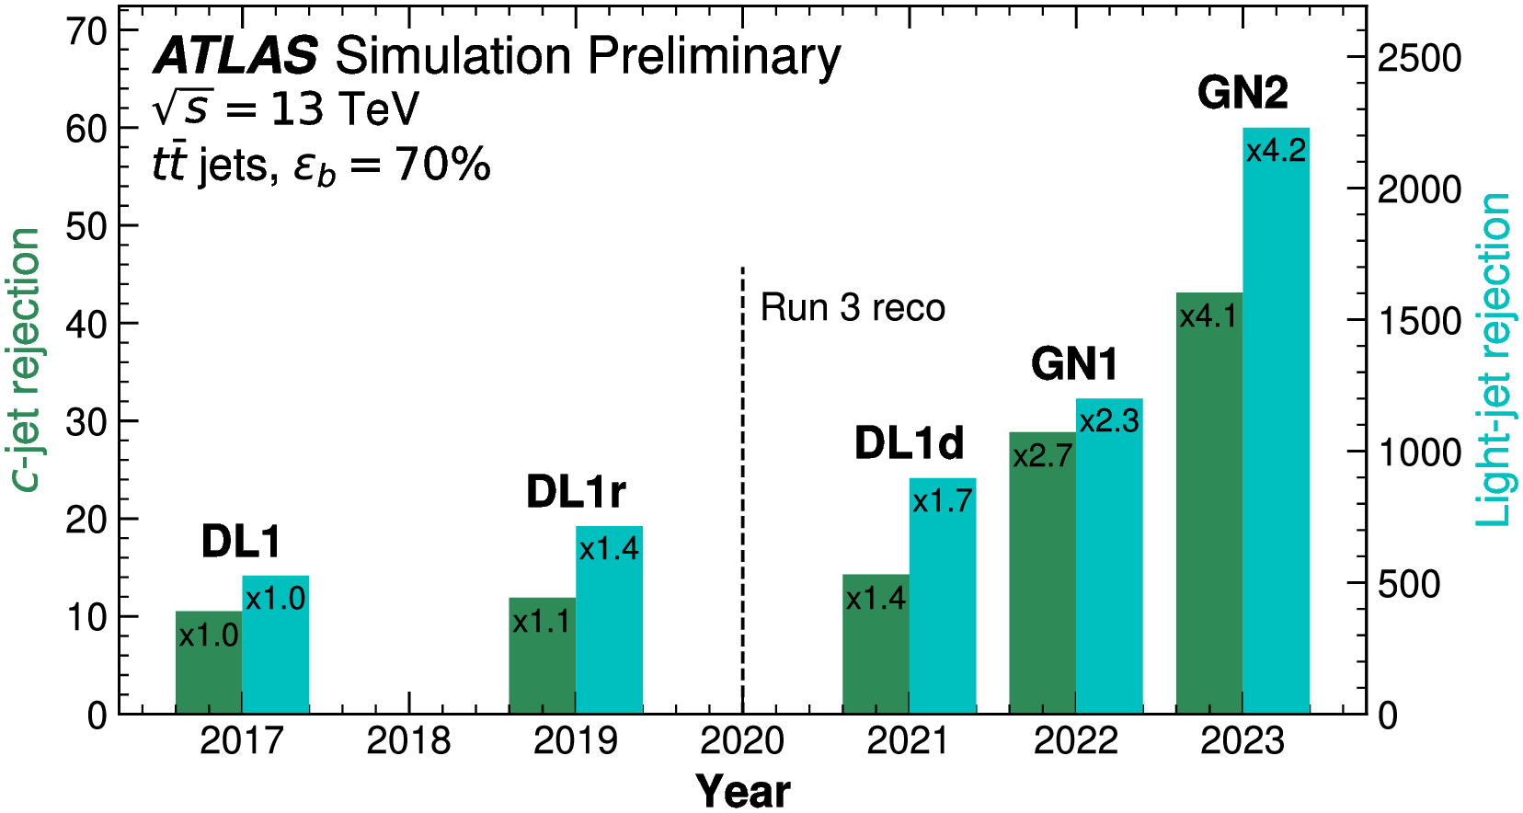
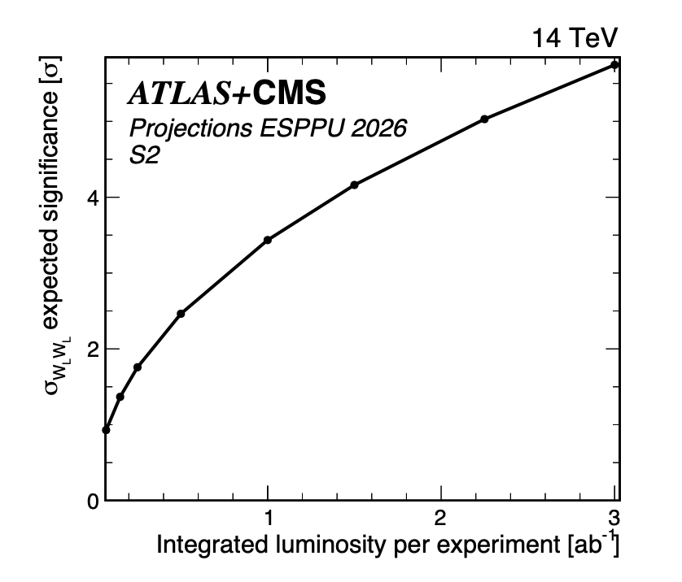
HL-LHC: A precision machine
Big - largely ML-led - improvements in performance
4-top cross section @ 6%
CharmYukawa @1.5 x SM
ATLAS & CMS, arXiv:2504.00672

Slide 7
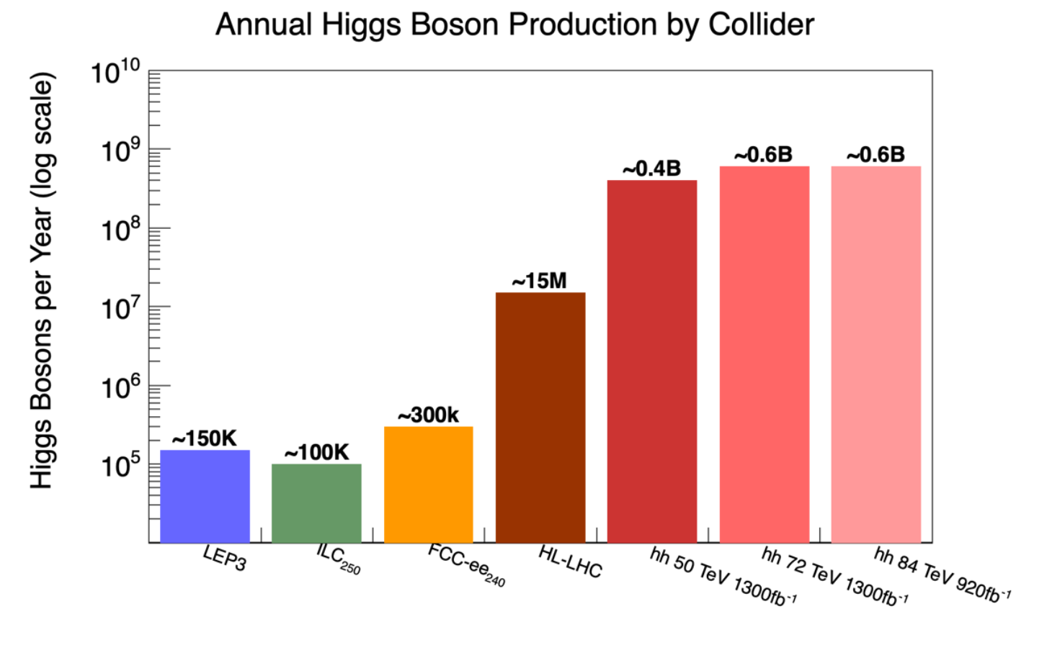
Higgs “Factories”?

Slide 8
LEP3
New e⁺e⁻ collider in the LEP/LHC tunnel
CM energy range 91.2 – 230 GeV
  Not possible to interleave low and high energy
Two interaction points
2045 earliest start of operation
Synchrotron power loss 50MW per beam
  Consumption similar to FCC-ee
Detailed accelerator design work required
Current cost estimate 3.9BCHF
Estimated precision mostly taken from FCC-ee (see next slides),
  Scaling statistical uncertainty up by 1.9.
  No top-antitop threshold running

Slide 9
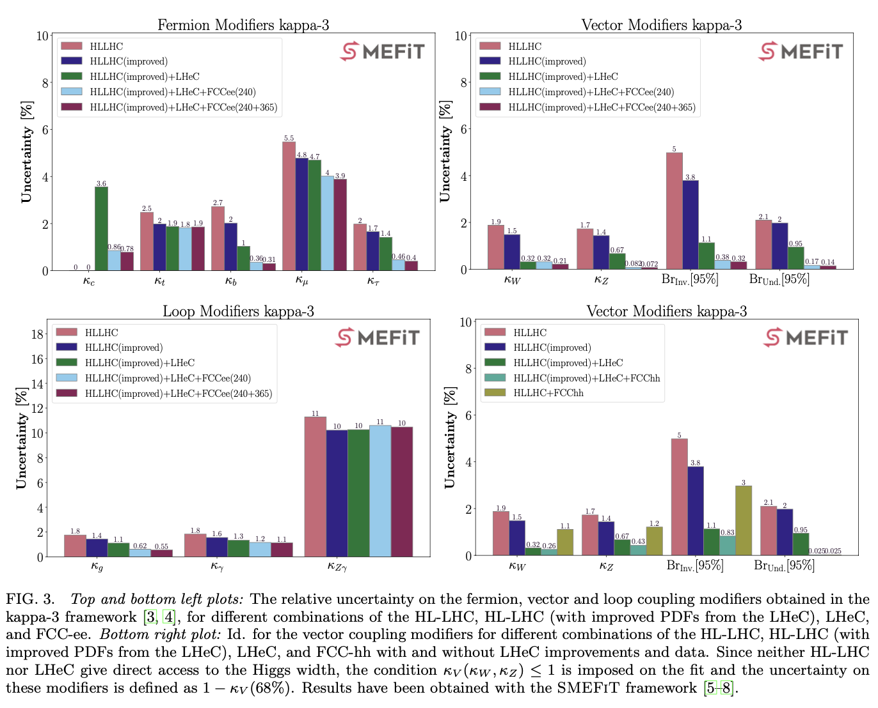
LHeC
Electrons vs LHC protons
  ERL 1/3 circumference of LHC tunnel
Likely post-LHC running.
Current cost estimate 2.4BCHF
“… LEP3 or LHeC, would entail major infrastructure investments and operating costs and therefore delay the implementation of a next-generation collider by at least one to two decades. For this reason, they cannot be considered as “bridges”, but rather as alternative options to other proposed colliders”
From FCCE Working Group Report

Slide 10
HE-LHC
In currently proposed form, energy max 34 TeV, only achievable in the 2070s.
Current cost estimate 7.2 BCHF (excluding experiments)
(24 TeV earlier?)
“based on the current physics landscape emerging from the LHC and other results, the HE-LHC offers a very limited physics reach.”
From FCCE Working Group Report

Slide 11
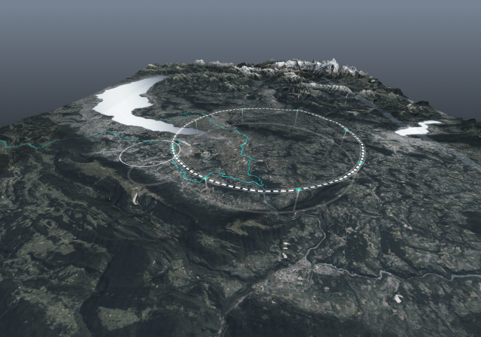
A new tunnel
FCC feasibility study
91km circumference
Very significant civil engineering, geology, legal, safety, sustainability, societal preparation and studies undertaken already

Slide 12
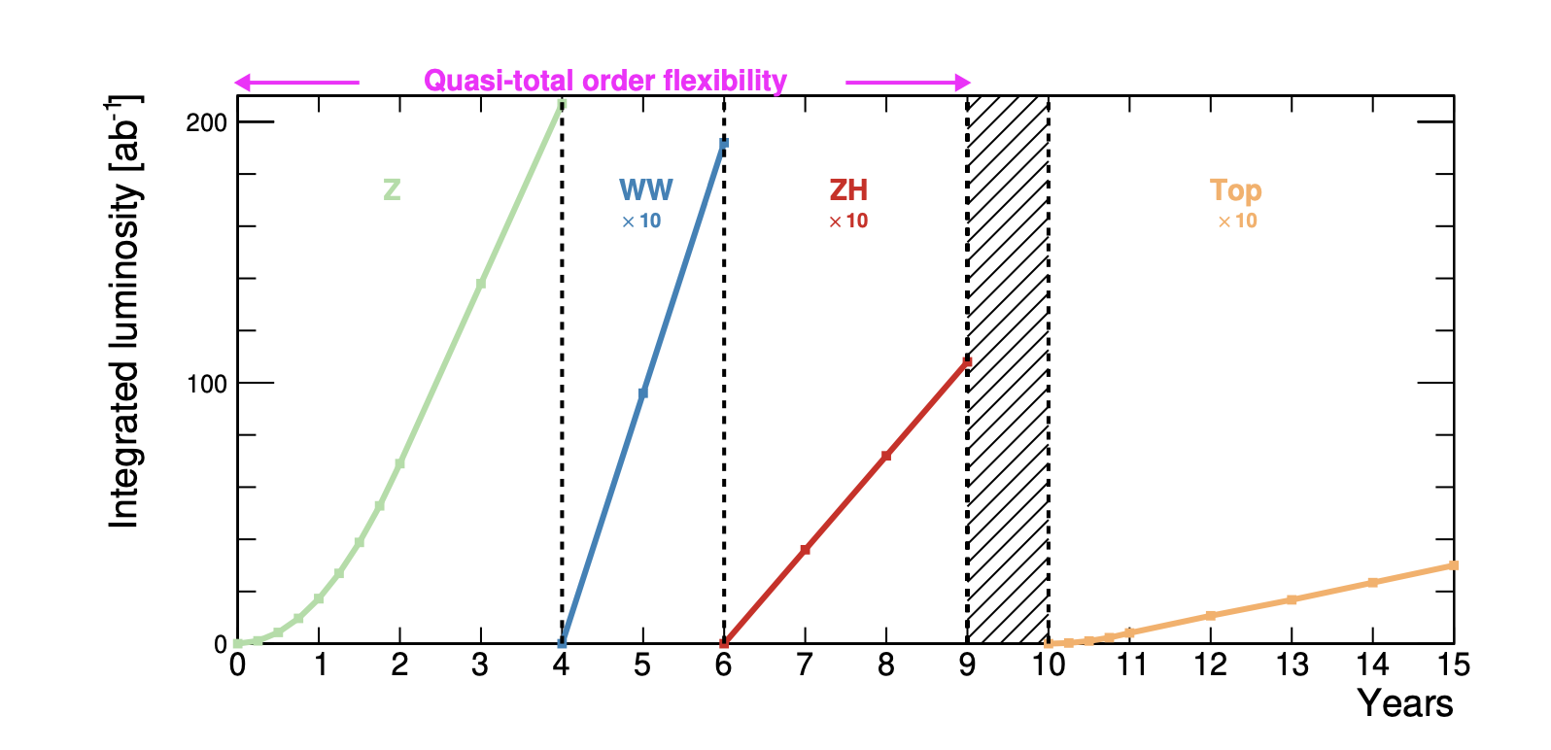

Electrons and positrons
FCC-ee
  Z-pole running 2048
  then WW, Higgs, top
  Four interaction points
  Current cost estimate 15.3BCHF (inc 6BMCH tunnel)
CEPC
  Similar science case
  Related technologies
  (Different politics)

Slide 13
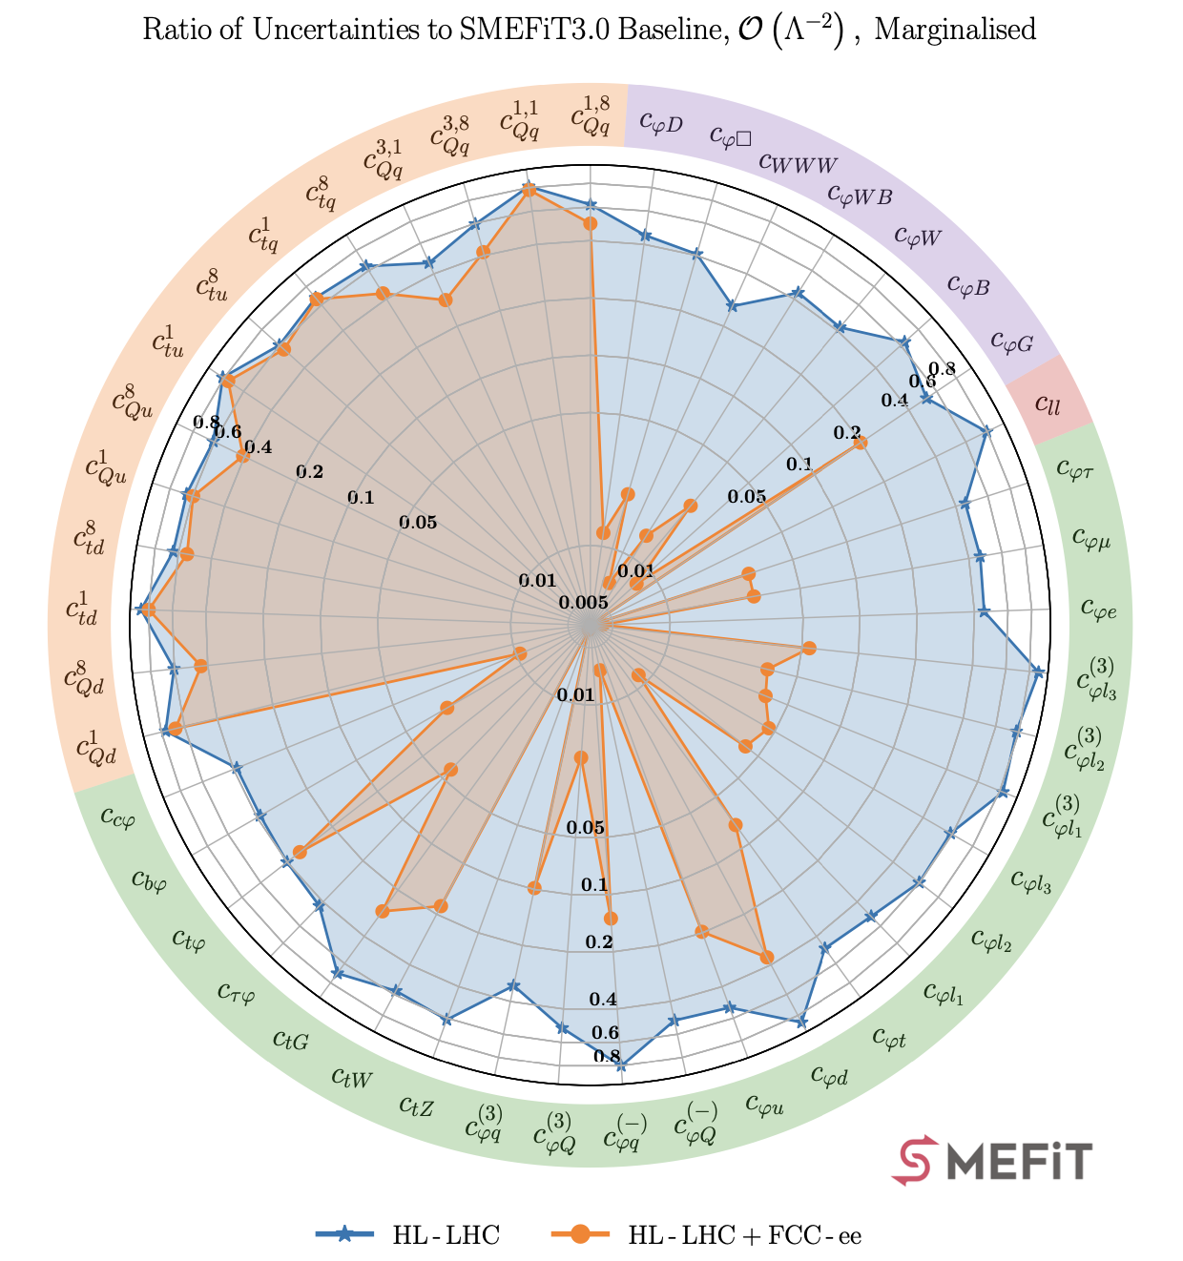
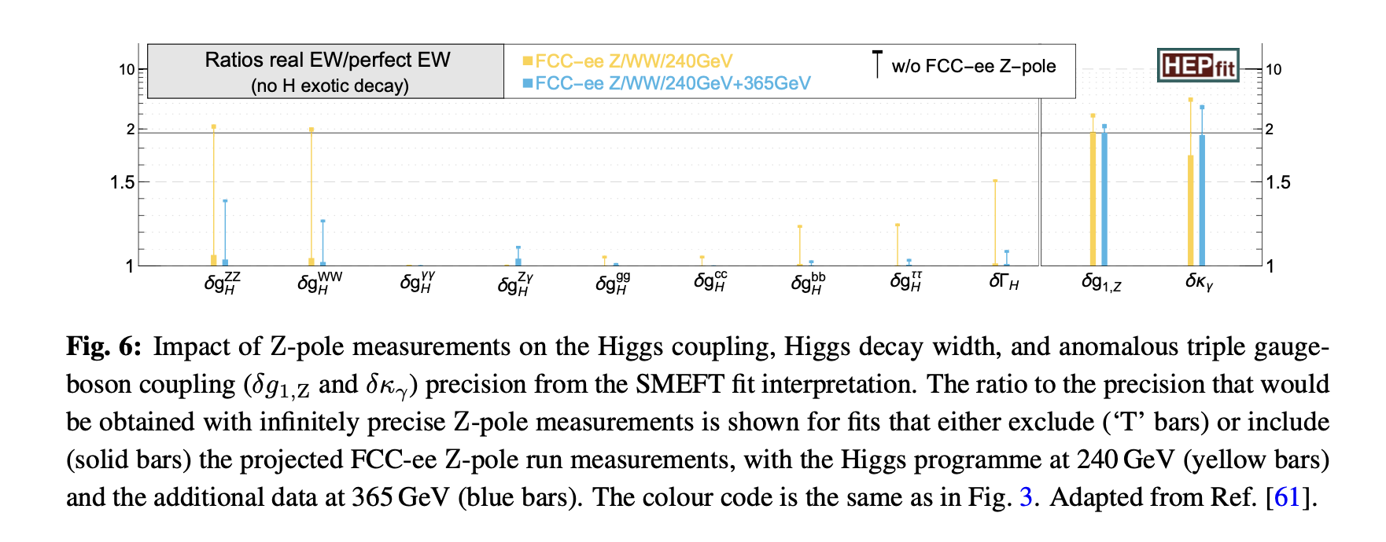
FCC-ee physics
Major (roughly order of magnitude) impact on 22/50 of SMEFT operators
Significant impact of Z –pole and 356 GeV measurements on Higgs parameters from WW+ “Higgs factory” configurations
Celada et al

Slide 14
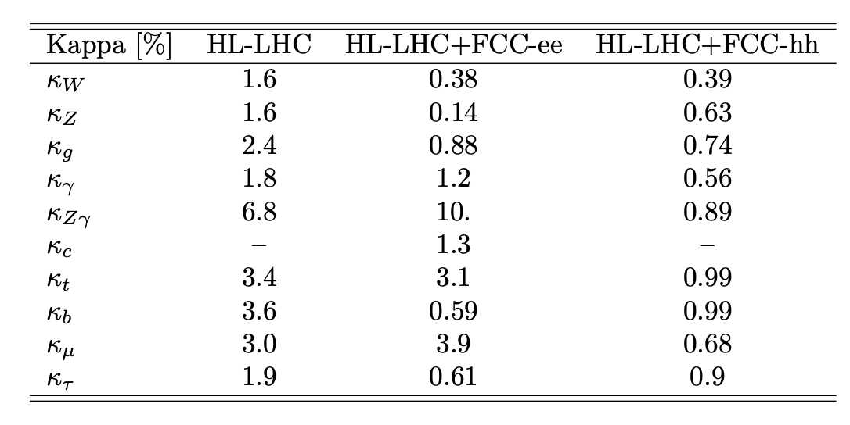
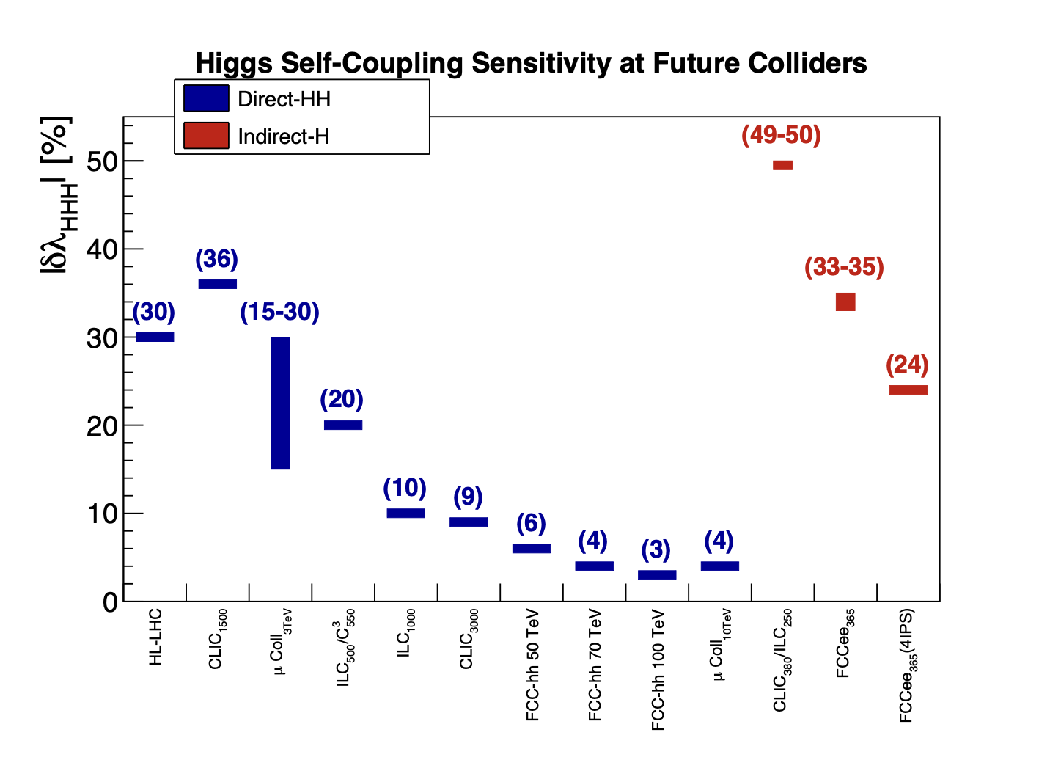
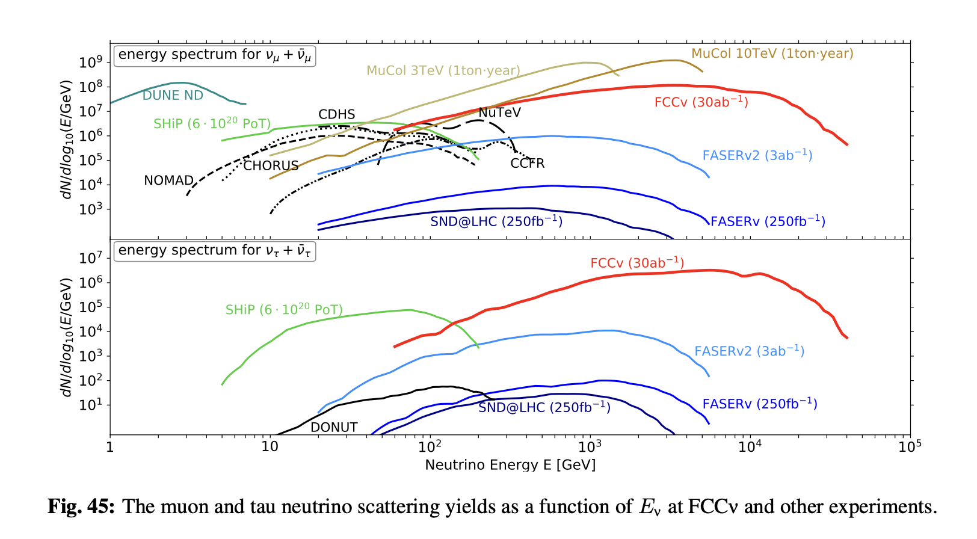
Next-generation Hadron Collider
2025
2019
2019
The “ambition” Europe should have
  cf ESPP 2020.
Current FCC-hh baseline 85 TeV in 2074.
Current cost estimate 19BCHF (post FCC-ee)
Or 2055 if skip FCC-ee.
Intermediate energy 50-70 TeV? Sooner?
Relevant “detail”: Forward neutrino flux

Slide 15
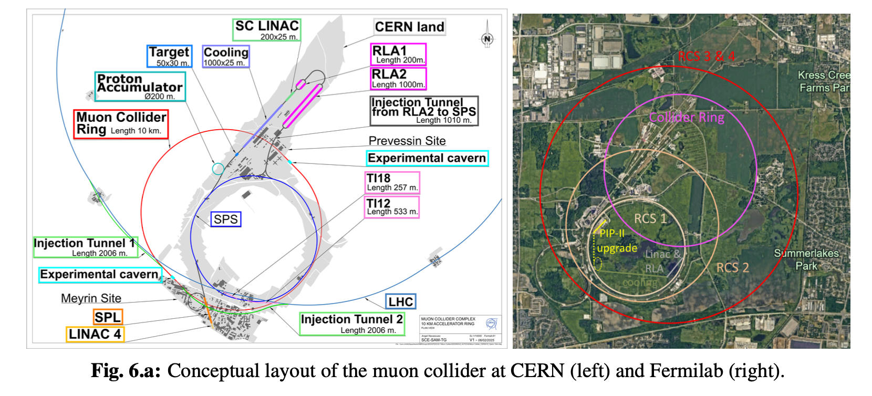
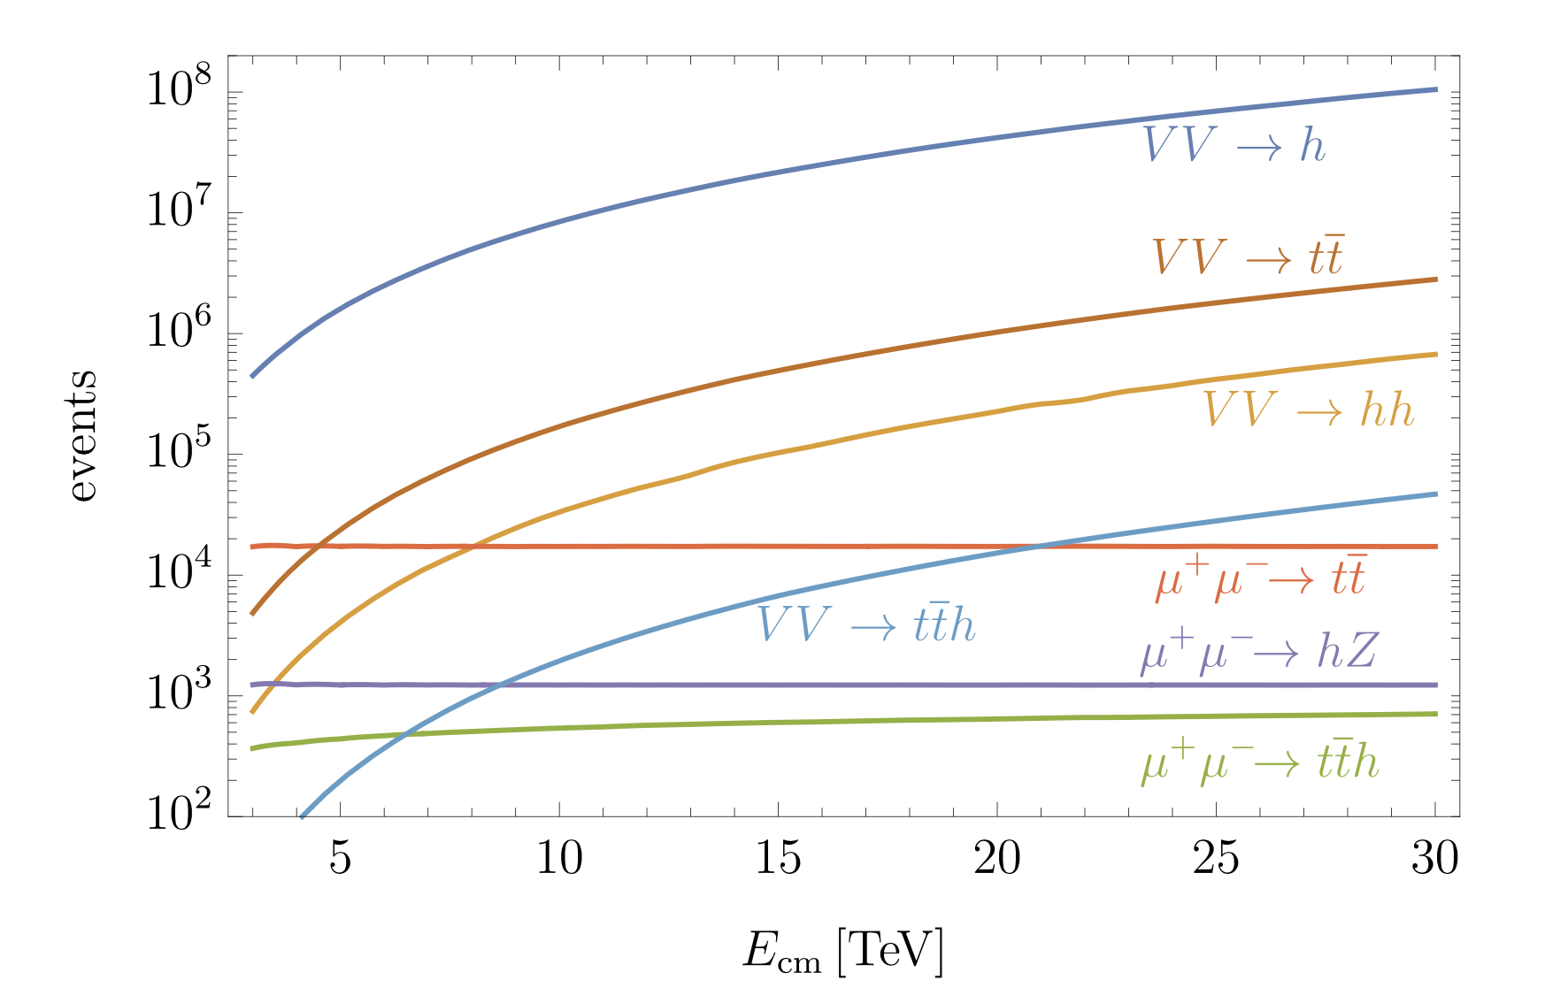
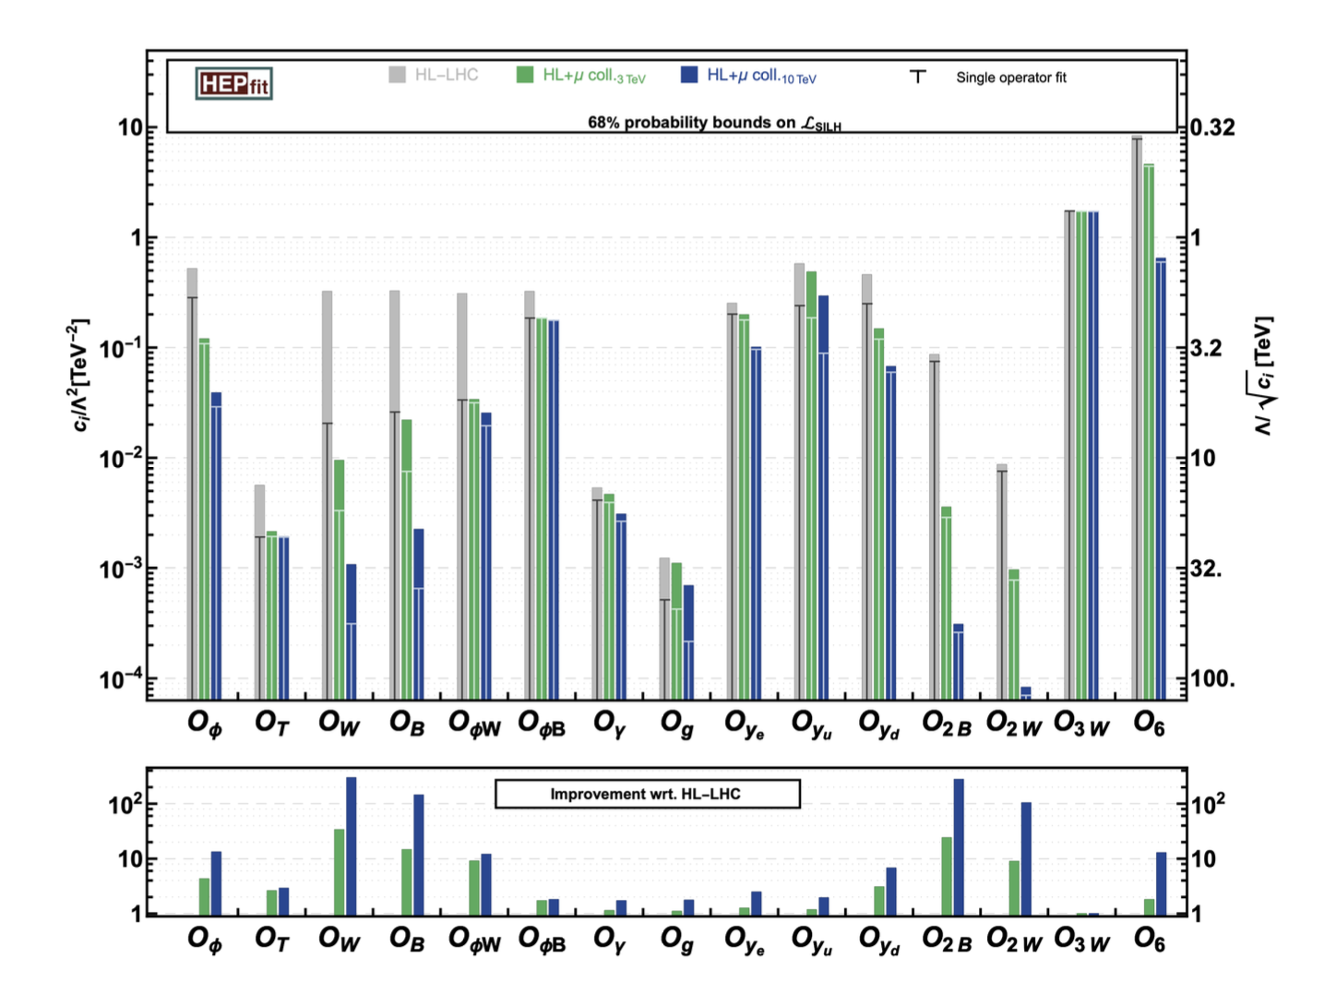
Muon collider
Smaller tunnel etc ✓
Neutrino background ⨯
125 GeV, 3 TeV, 10 TeV CoM energy studied at some level.
  Main focus still on accelerator feasibility (see DS talk yesterday)
  Energy spread a challenge for Higgs pole running
  Staging/reuse of cooling and injection for energy upgrades
  Current cost estimate 10-25BCHF
At 10 TeV, electroweak bosons are “partons” inside the beam particle (e, μ or p)
  though the ”remnant” will be very different!

Slide 16

Conventional Wisdom
And precision. How far will this go?
Hadrons for exploration.
Leptons for precision.
Lepton-hadron for QCD.
e⁺e⁻ Higgs & electoweak factory next (c.f. ESPP 2020)
Hadrons in half a century or so
ep … not high priority
Muons one day. Maybe.
Circular colliders will reach the point of diminishing returns (synchrotron radiation, magnetic field strength)
Theory permitting. And muons also explore.
… and Higgs/electroweak
Top too? Linear or circular? Where?
Or maybe within 10 years of HL-LHC?
Also a ”factory”.
But a versatile “Plan B”?
Dependent on priority, and results, of the R&D
Well, that day may come…

