Slide 1





Muon Collider
D. Schulte
On behalf of the International Muon Collider Collaboration
Funded by the European Union (EU). Views and opinions expressed are however those of the author(s) only and do not necessarily reflect those of the EU or European Research Executive Agency (REA). Neither the EU nor the REA can be held responsible for them.
WIN, Brighton, June , 2025

Slide 2
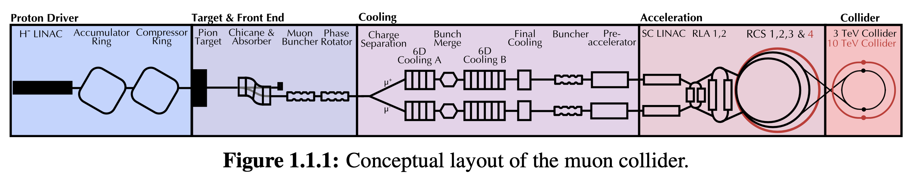
Muon Collider Concept
The main challenge is the short muon lifetime τ = γ x 2.2 μs
Up to 100 ms at collision energy
Protons produce pions which decay into muons which are captured
Ionisation cooling of muon in matter
Acceleration to collision energy
Short, intense proton bunch
Collision
2

Slide 3

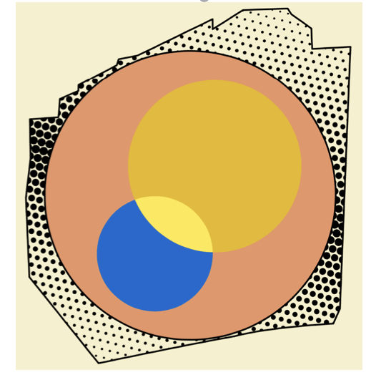
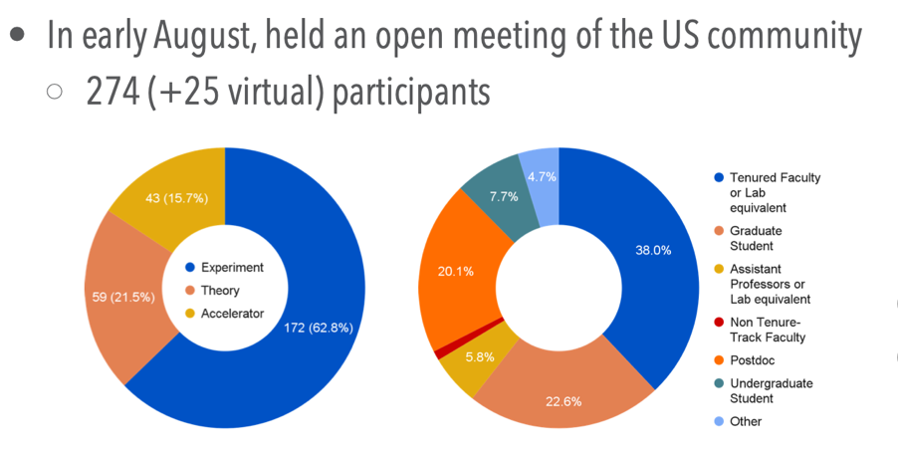

IMCC
International Muon Collider Collaboration
Collaboration formed 2022, currently hosted by CERN
61 full partner institutes, more in the process
From all regions
EU co-funded design study MuCol started 2023
Strong recommendation from P5 «This is our muon shot»
Interest in hosting at FNAL
US partners are in the process of joining
US Muon Collider Inauguration Meeting in August 2024 at Fermilab (about 300 participants)
Forming national organisation to participate
Addendum to CERN-DoE agreement in preparation
Already strong US contribution to IMCC ESPPU documents
Work at universities started
Obtained several grants also at labratories
IMCC will carry out the R&D together and develop options to host the collider at CERN or at Fermilab and potentially also other sites
3

Slide 4
IMCC Partners
IEIO | CERN
FR | CEA-IRFU
 | CNRS-LNCMI
 | Ecoles des Mines St-Etienne
DE | DESY
 | Technical University of Darmstadt
 | University of Rostock
 | KIT
UK | RAL
 | UK Research and Innovation
 | University of Lancaster
 | University of Southampton
 | University of Strathclyde
 | University of Sussex
 | Imperial College London
 | Royal Holloway
 | University of Huddersfield
 | University of Oxford
 | University of Warwick
 | University of Durham
 | University of Birmingham
 | University of Cambridge
NL | University of Twente
IT | INFN
 | INFN, Univ., Polit. Torino
 | INFN, LASA, Univ. Milano
 | INFN, Univ. Padova
 | INFN, Univ. Pavia
 | INFN, Univ. Bologna
 | INFN Trieste
 | INFN, Univ. Bari
 | INFN, Univ. Roma 1
 | ENEA
 | INFN Frascati
 | INFN, Univ. Ferrara
 | INFN, Univ. Roma 3
 | INFN Legnaro
 | INFN, Univ. Milano Bicocca
 | INFN Genova
 | INFN Laboratori del Sud
 | INFN Napoli
Mal | Univ. of Malta
EST | Tartu University
PT | LIP
SE | ESS
 | University of Uppsala
FI | Tampere University
 | HIP, University of Helsinki
LAT | Riga Technical University
CH | PSI
 | University of Geneva
 | EPFL
 | HEIA-FR
BE | Univ. Louvain
AU | HEPHY
 | TU Wien
ES | I3M
 | IFIC/CSIC
 | ICMAB
China | Sun Yat-sen University
 | IHEP
 | Peking University
 | Inst. Of Mod. Physics, CAS
 | University of CAS
KO | Kyungpook National University
 | Yonsei University
 | Seoul National University
India | CHEP
CA | Université Laval
US | Iowa State University
 | University of Iowa
 | Wisconsin-Madison
 | University of Pittsburgh
 | Old Dominion
 | Chicago University
 | Florida State University
 | RICE University
 | Tennessee University
 | MIT Plasma science center
 | Pittsburgh PAC
 | Yale
 | Princeton
 | Stony Brook
 | Stanford/SLAC
 | …
DoE labs | FNAL
 | LBNL
 | JLAB
 | BNL
Brazil | CNPEM
4
Signed MoC (61), requested MoC, contributor

Slide 5
ESPPU Submission Content
Assessment
Present green field designs and technologies
International collaboration
Parameters, lattice and component designs, beam dynamics, cost, …
Back-up document (406p, 450 signatories)
R&D plan
Including scenarios and timelines
Magnets, muon cooling, detector, …
The muon cooling technology and test facility is critical for this
Implementation Considerations
Civil engineering studies/considerations (for CERN and for FNAL)
Cost and power consumption scales
Parameter tables, scaled from green field
  Will develop detailed lattice designs after ESPPU
Schedule (strongly linked to R&D Plan)
Aim for initial stage by around 2050
5

Slide 6
Key Parameters
Param. | Unit | Site independent |  | CERN 2 tunnels |  | CERN 1 tunnel
Sqrt(s) | TeV | 3 | 10 | 3.2 | 7.6 | 3.2 | 7.6
L/IP | 10³⁴ cm⁻²s⁻¹ | 1.8 | 17.5 | 2 | 10 | 0.9 | 7.9
Int L | ab⁻¹ | 1 | 10 | 1 | 10 | 1 | 10
Accumulation time | years | 2+2.8 | 2+2.9 | 2+2.5 | 2+5 | 2+5.6 | 2+6.3
C | km | 4.5 | 11.4 | 4.8 | 8.7 | 11 | 11
B_{dipole} | T | 11 | 14 | 11 | 14 | 4.8 | 11
Collider dipole technology |  | Nb3Sn | HTS | Nb3Sn | HTS | NbTi | Nb3Sn or HTS
Accumulation time: Time to obtain the integrated luminosity with two IPs.
Ramp-up over the first three years 5%, 205%, 70% of nominal.
6

Slide 7
Muon Collider CTEs
Protons produce pions which decay into muons which are captured
Short, intense proton bunch
Ionisation cooling of muon in matter
Acceleration to collision energy
Collision
- Pulsed magnets and
power converters
- RCS RF system
- Proton pulse accumulation and compression
- Graphite target
- Target solenoid
- Muon cooling design
- 6D cooling solenoids
- 6D cooling RF cavities
- Final cooling solenoids
Identified and prioritized with community
Other areas need now also to be addressed
(some work started)
- Collider ring dipoles
- Final focus quadrupoles
- Machine-detector interface
- Neutrino flux
7

Slide 8
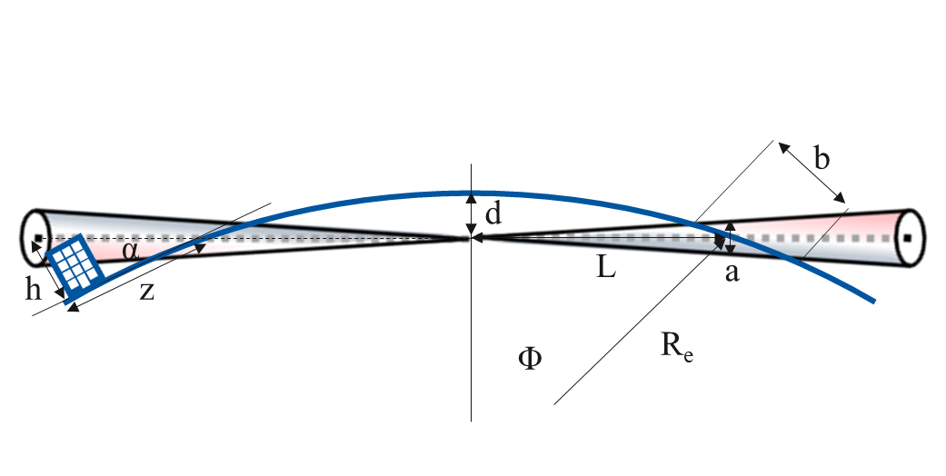
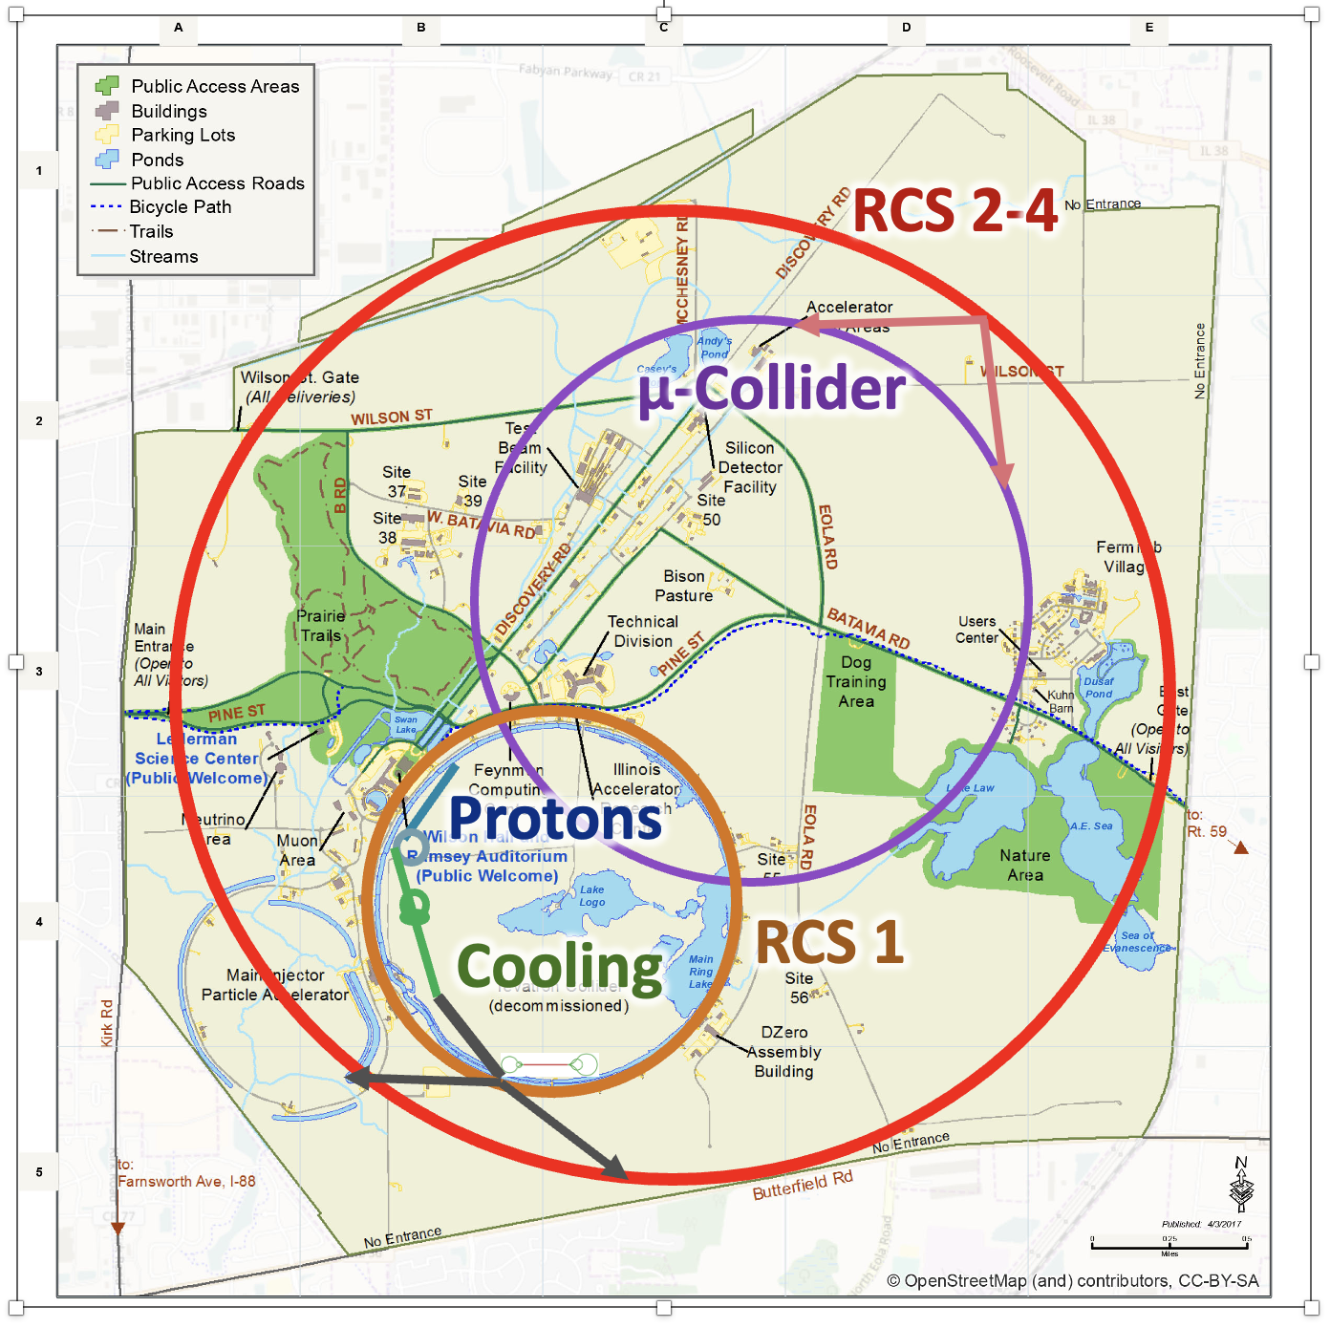
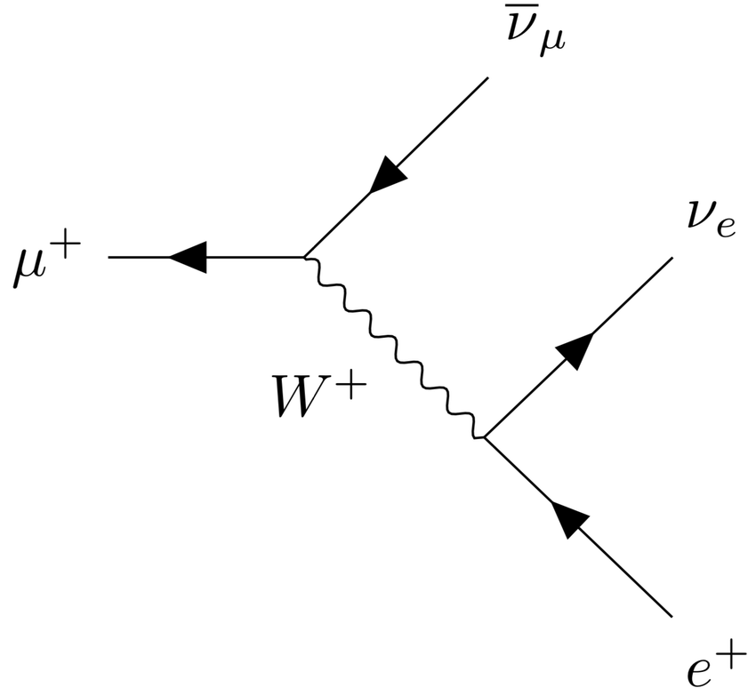
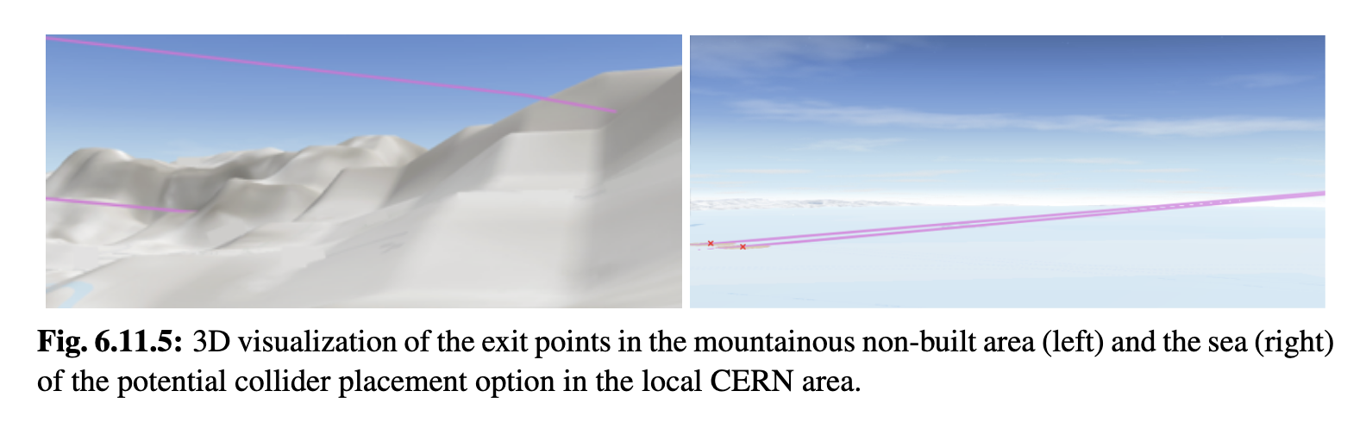
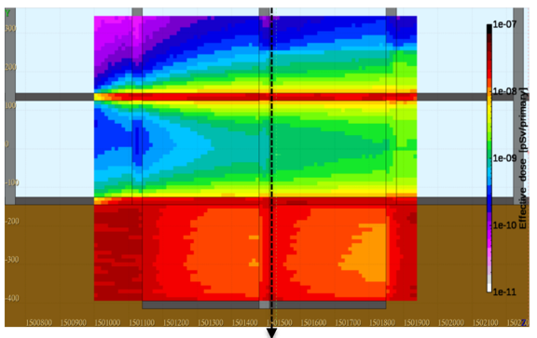
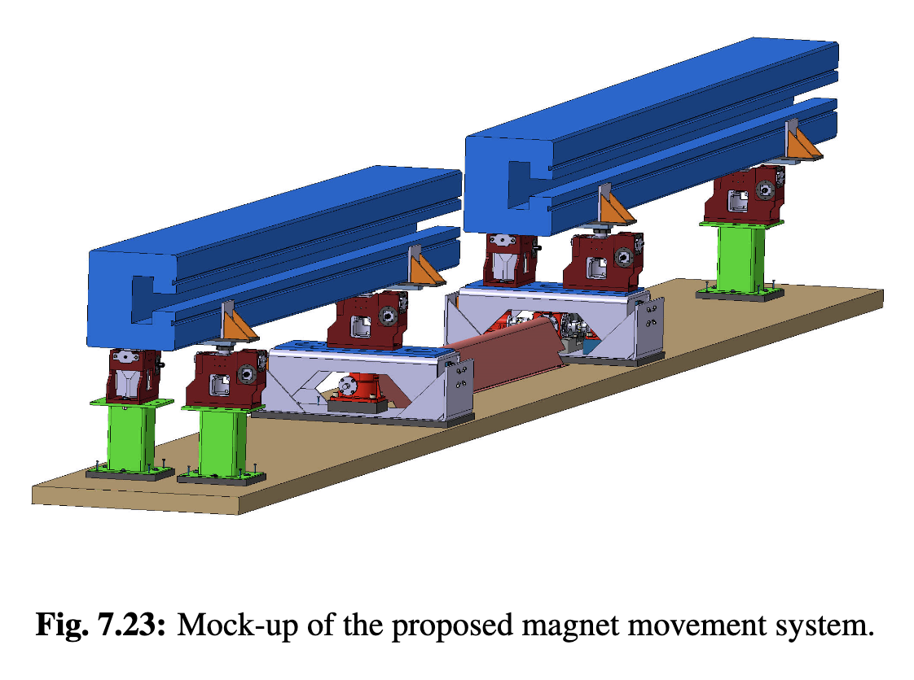
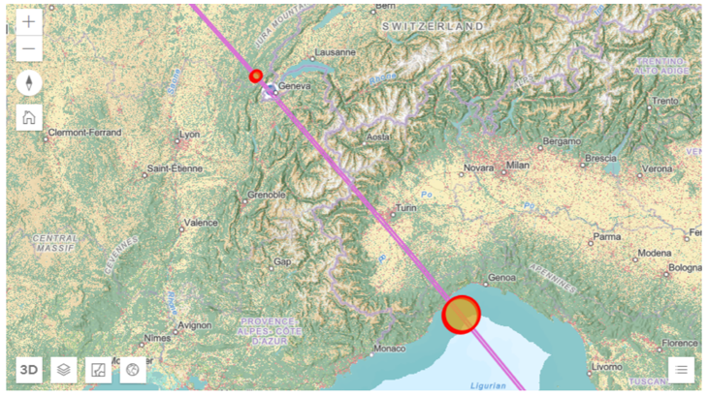
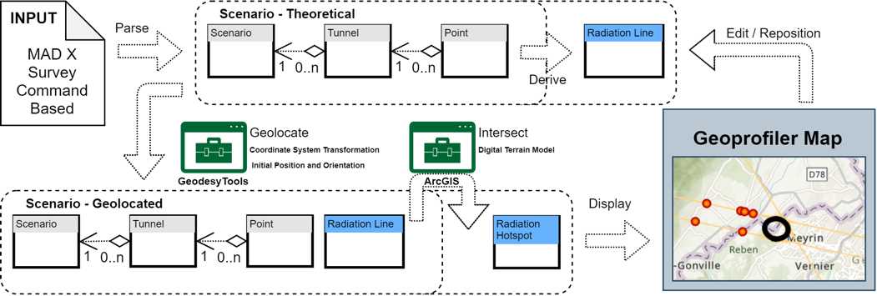
Site
Challenge:
Obtain negligible neutrino flux
Achieved:
Detailed modelling
First good orientation found
Mover system concept
Fermilab site study
t₁
t₂
Arc mitigation concept
FLUKA and RP studies
Mover system design
Key conclusions:
Are close to a solution
More work to be done
Site study at CERN for experimental insertion

Slide 9
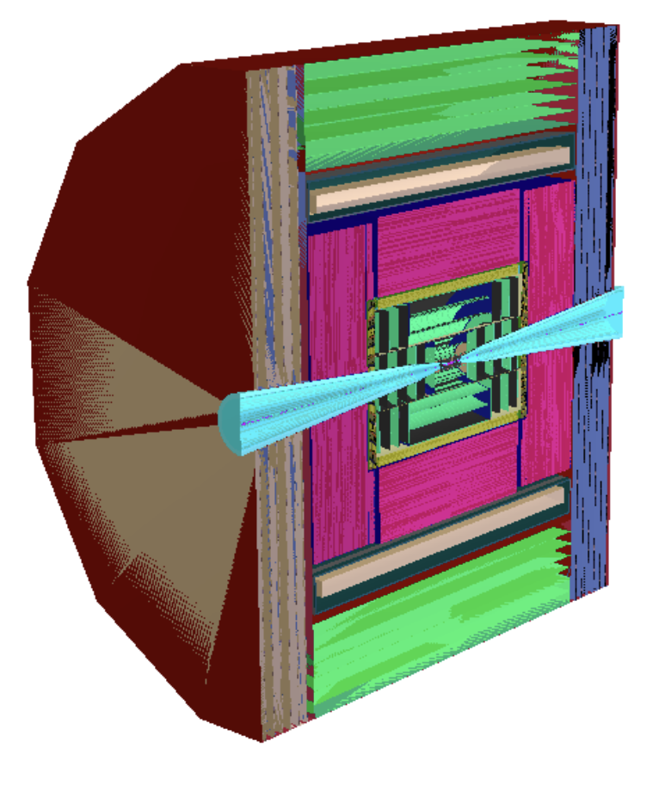
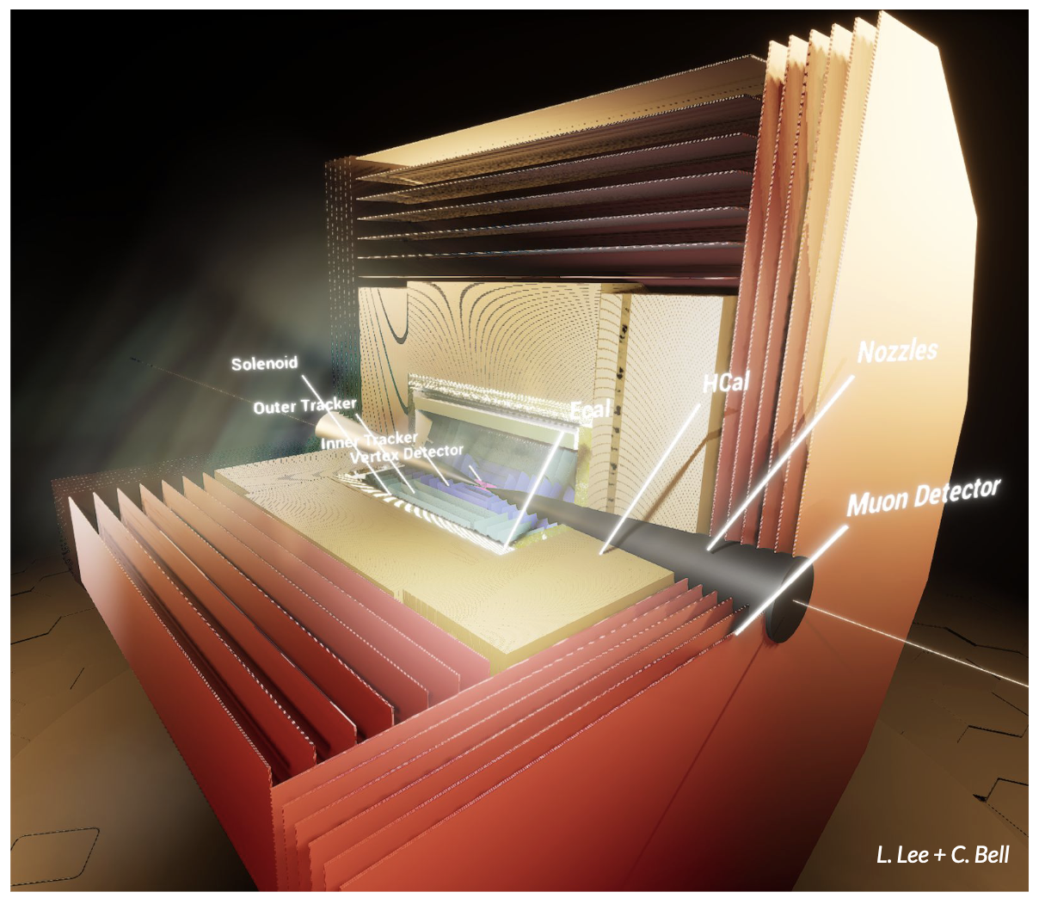
Physics and Detector Concepts
Two detector concepts are being developed
MUSIC
(MUon Smasher for Interesting Collisions)
MAIA
(Muon Accelerator Instrumented Aperatus)

Slide 10
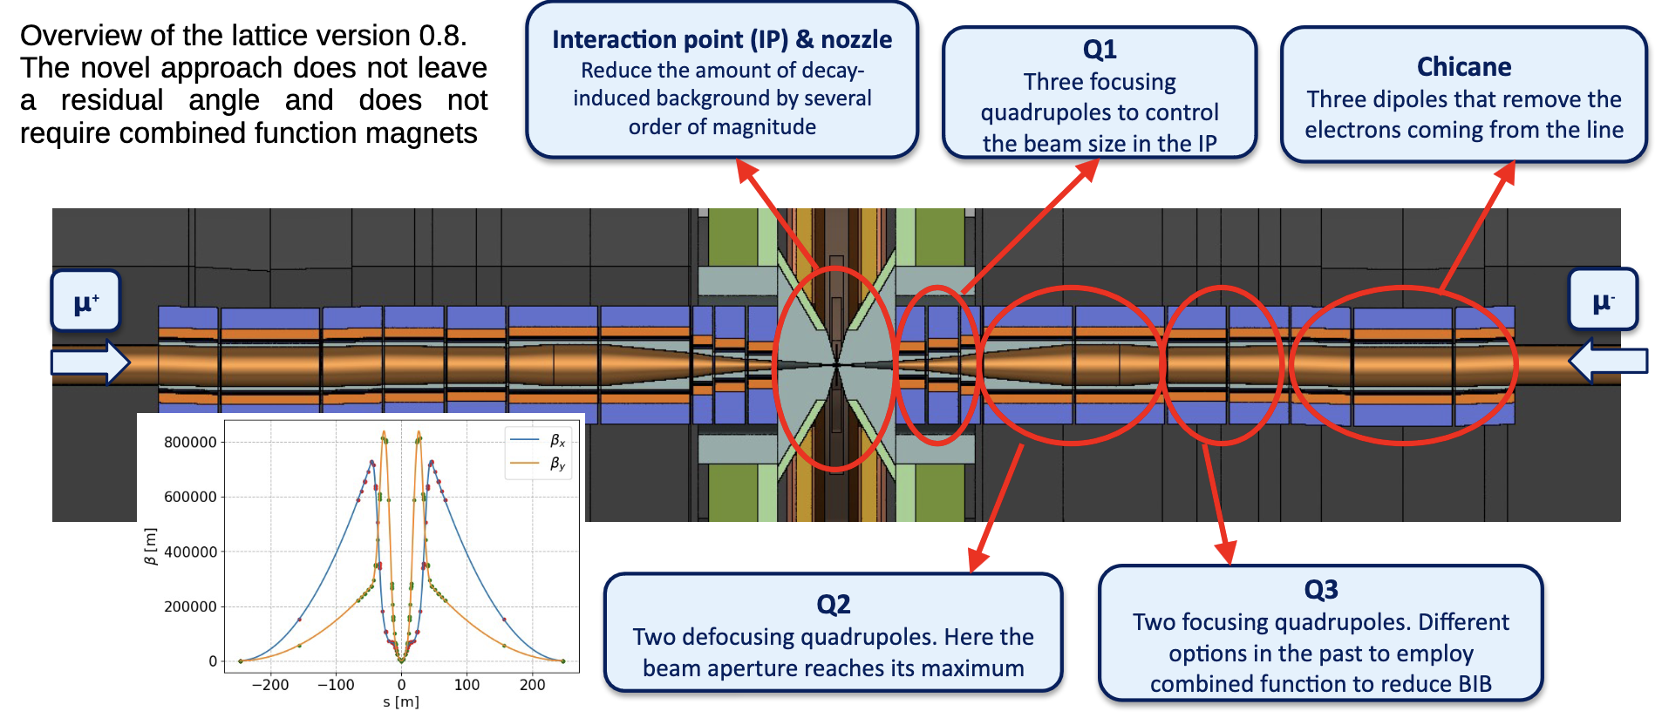
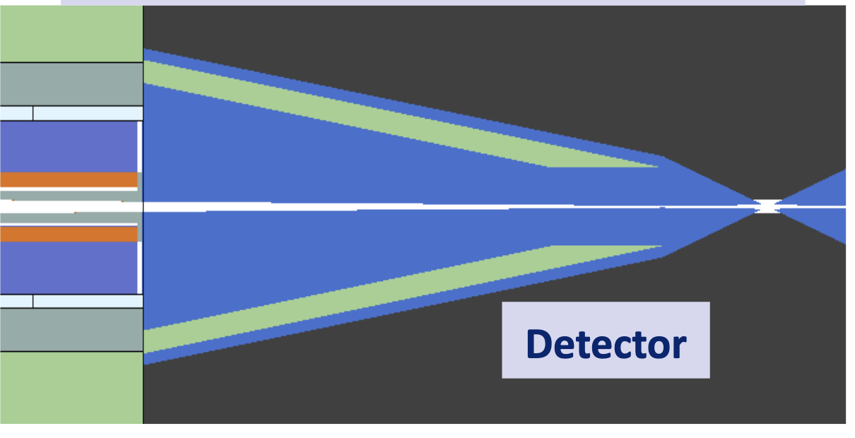
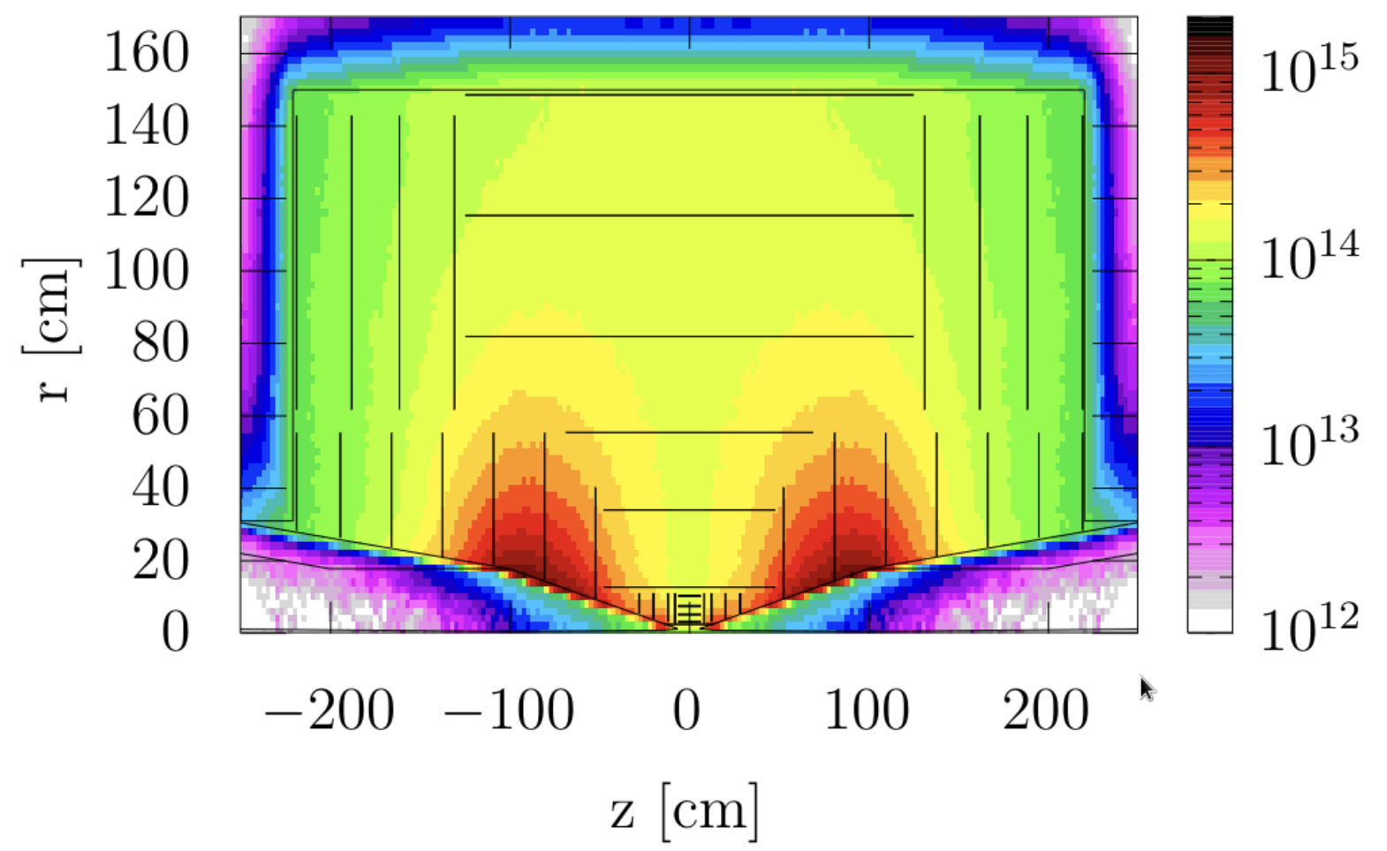
Beam-induced Background
Challenges:
Muon decay can give important background
40 000 muons/m/bunch crossing
1/3 of energy in electrons and positrons
Detailed studies with FLUKA
Achievements:
Two conceptual detector designs
Simulation studies with background also from machine
Studies of different lattices
Reconstruction algorithms
Physics studies
Conclusions:
Can do the physics
  Also thanks to HL-LHC technology
But room for improvement
Radiation level similar to HL-LHC

Slide 11
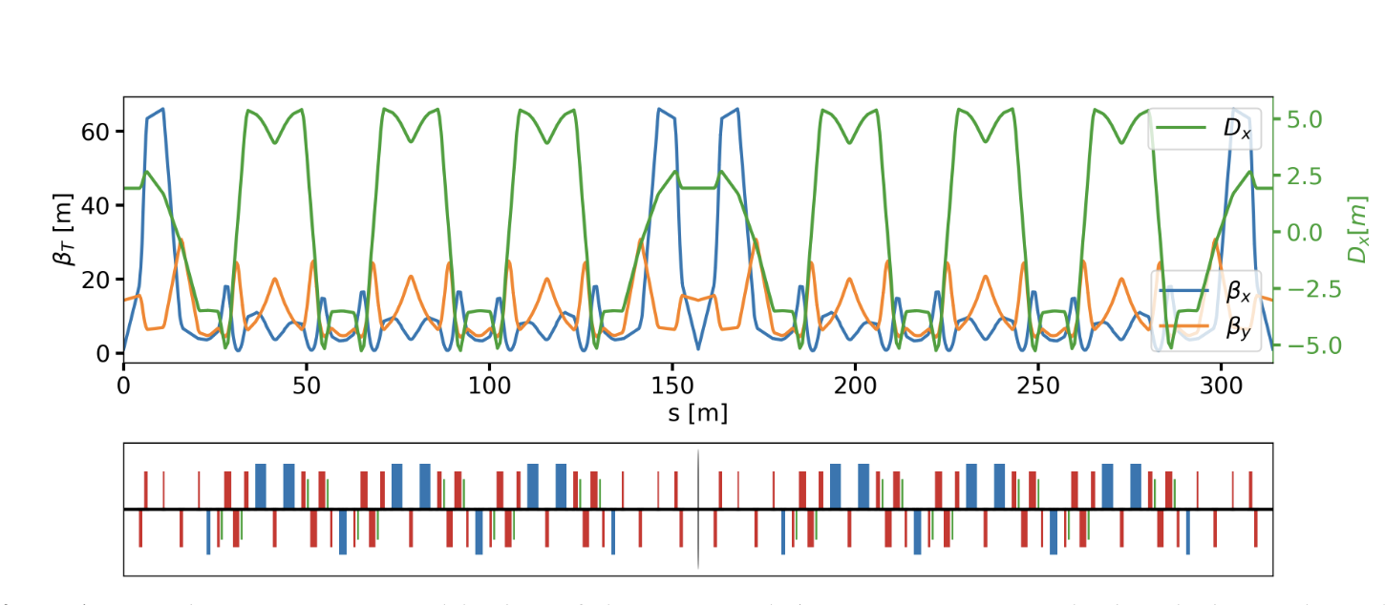
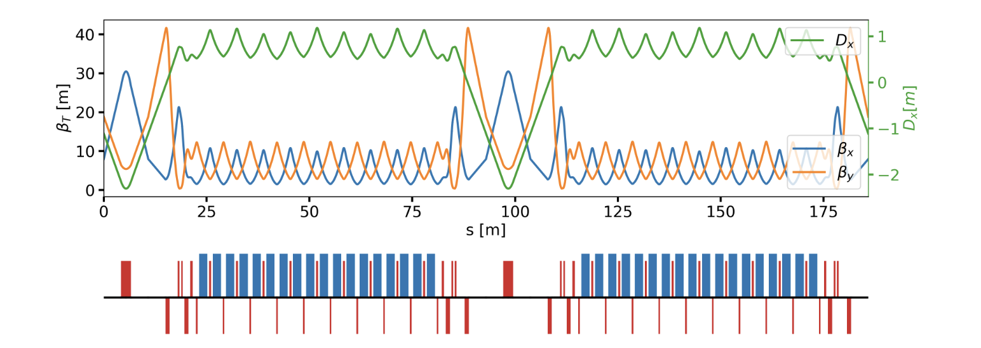
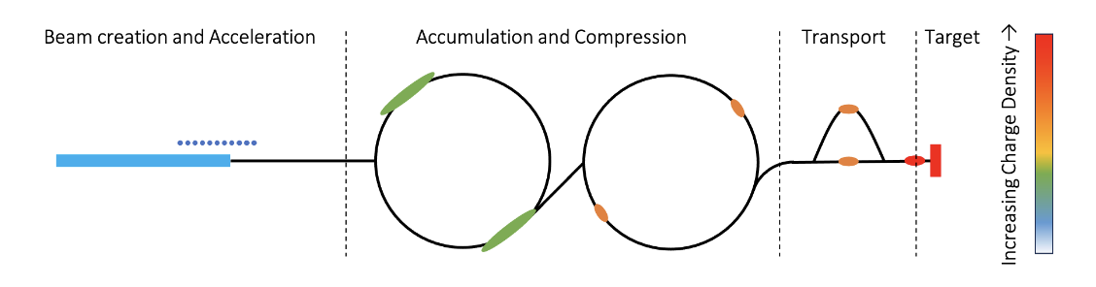
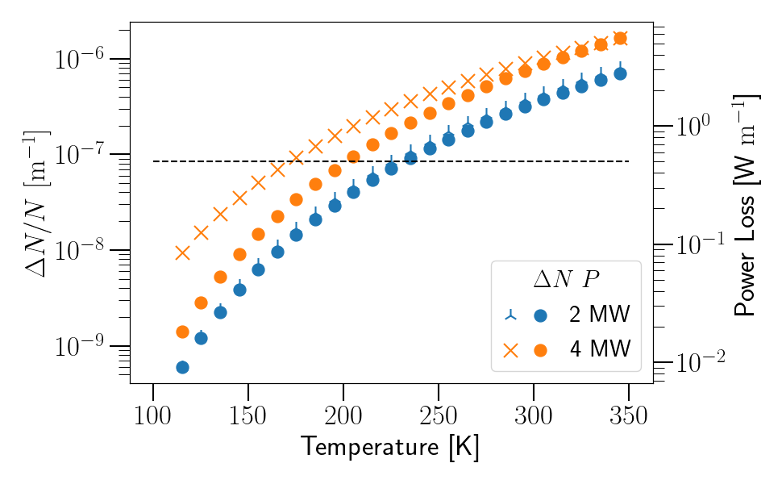
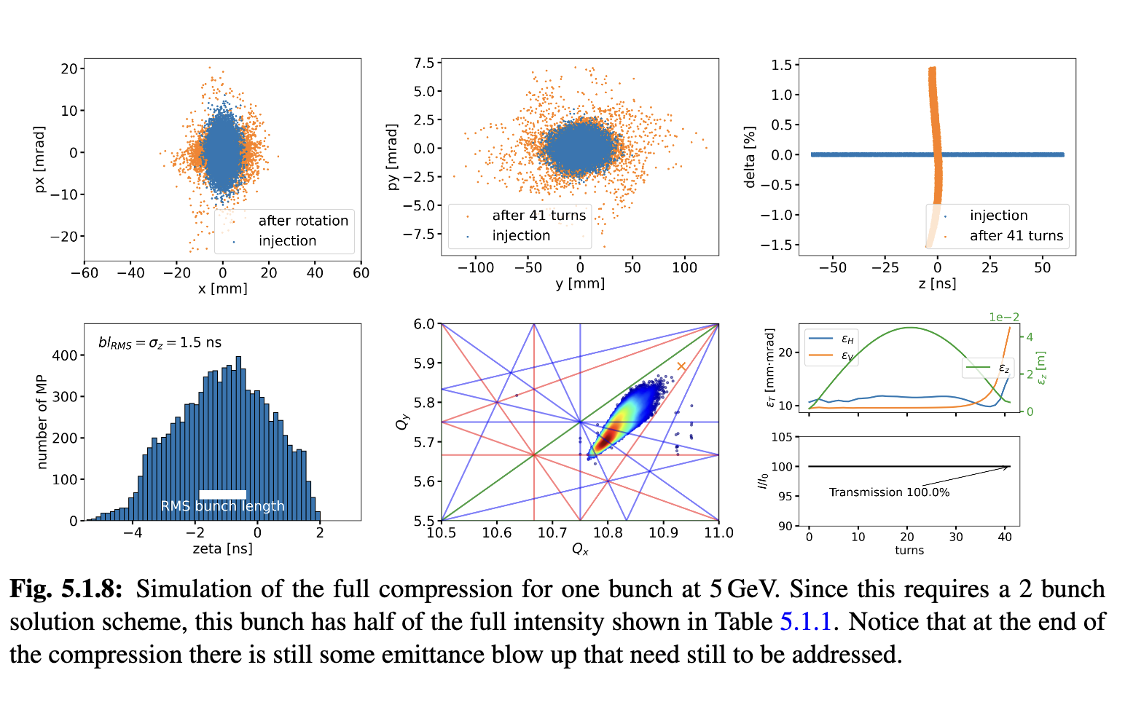
Proton Complex
Challenge:
2 MW, 5 GeV, 5 Hz,
5 x 10¹⁴ protons/pulse
Proton pulse accumulator and compressor rings
Achieved:
Accumulator and combiner ring lattices
First collective effects studies promising
One or two bunches in compressor, to be decided
Key conclusions:
Can compress 2 MW, 5 GeV proton beam to two 2 ns bunches, then merge them
  Optimisation in compressor ring for collective effects ongoing
For 4 MW need 10 GeV beam
Cool beamline to avoid ion loss from black body radiation

Slide 12
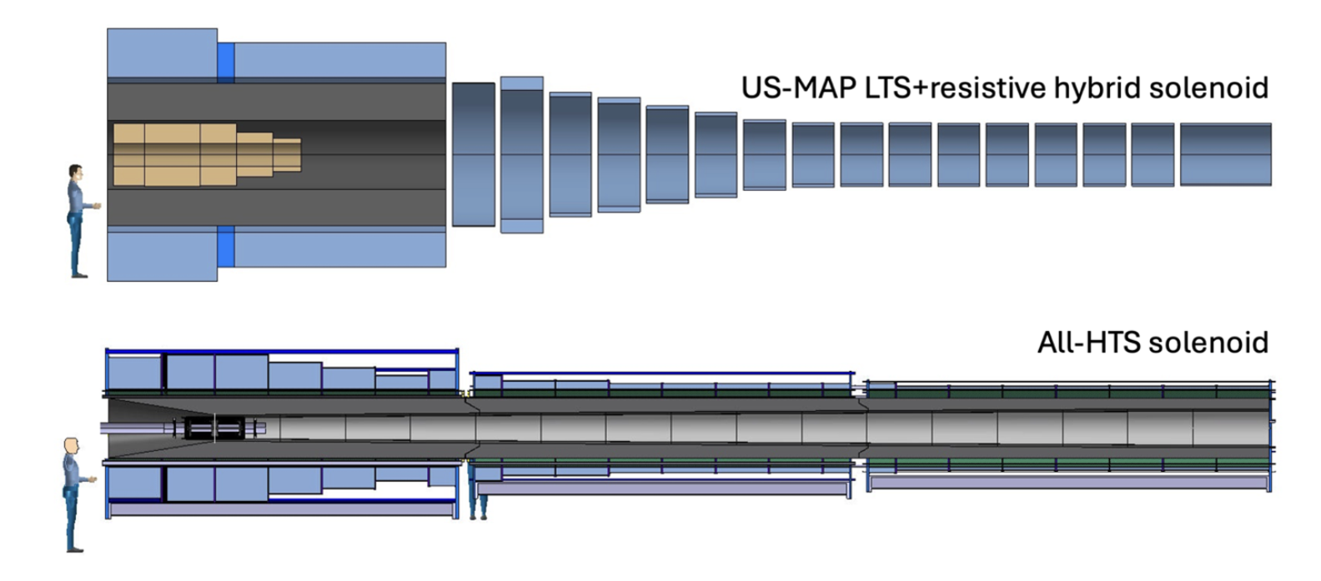
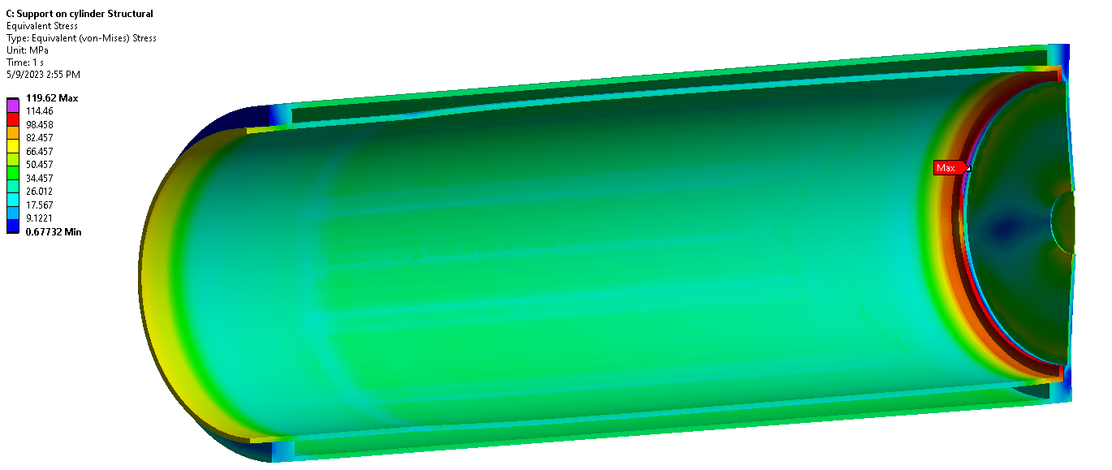
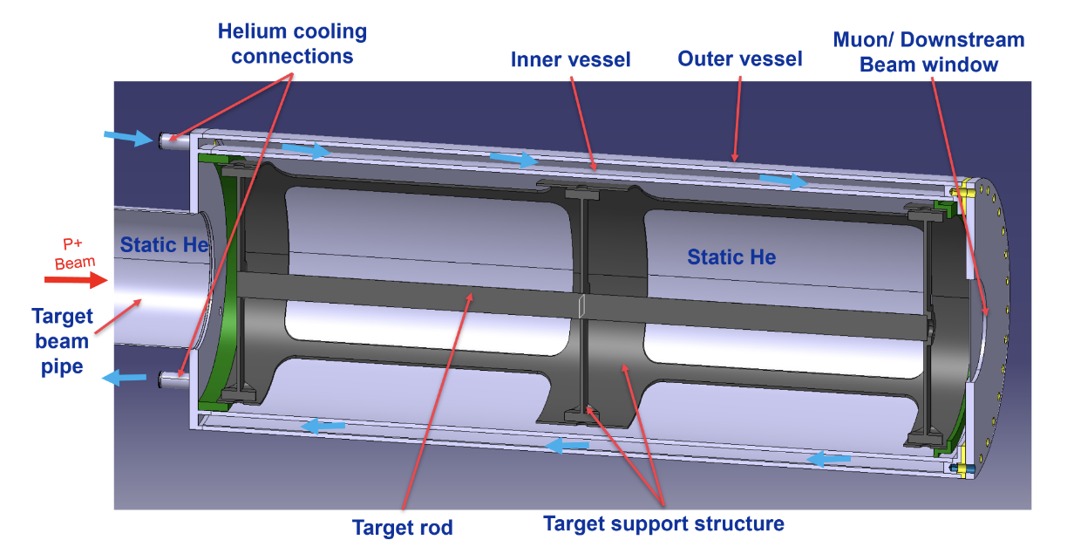
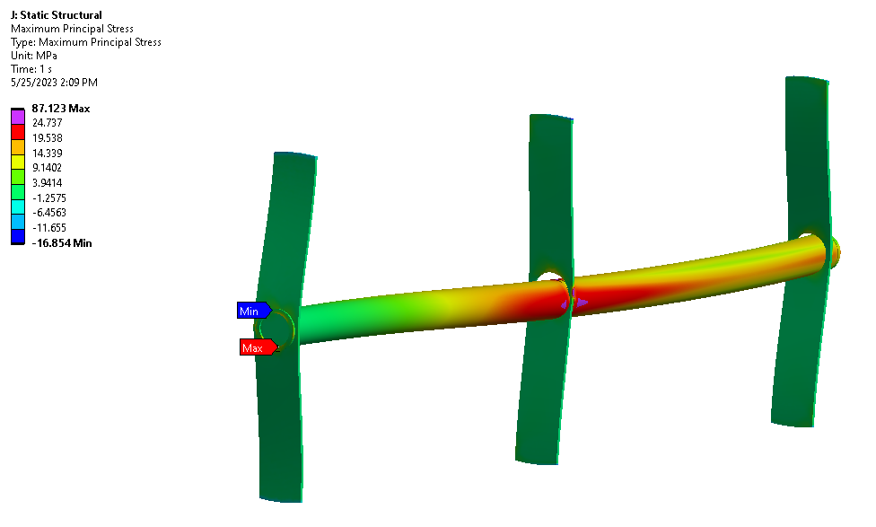
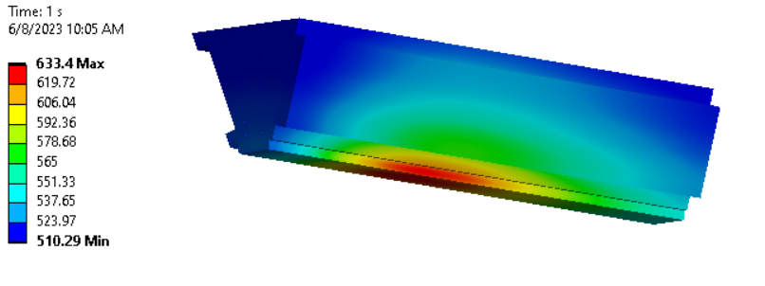
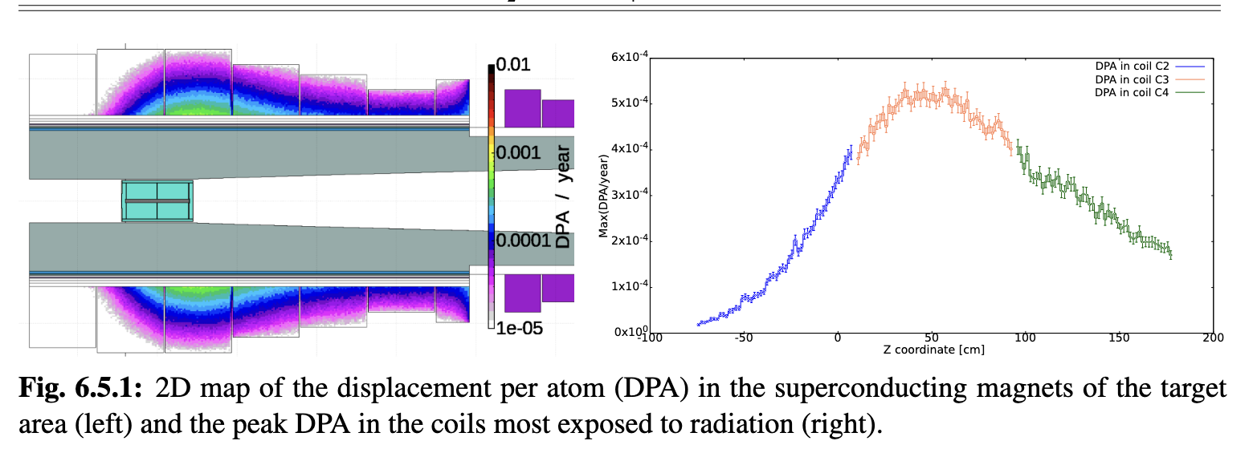
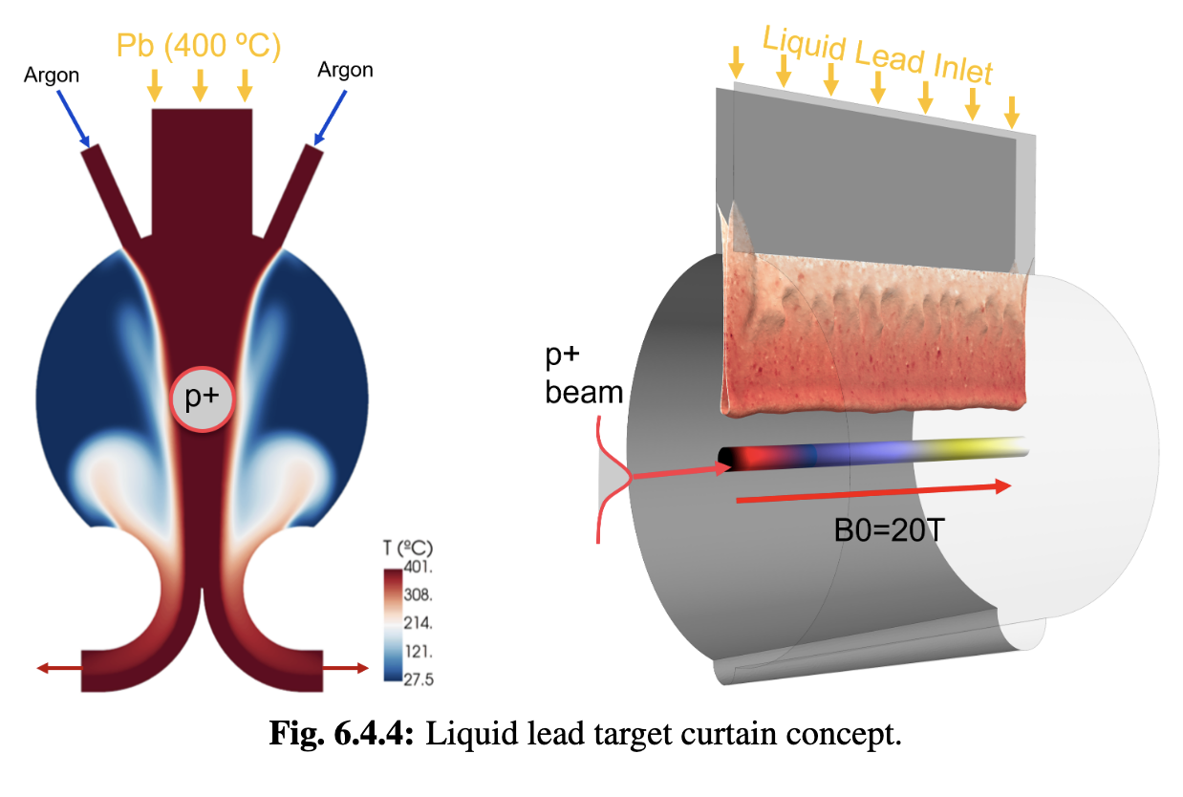
Target
Challenges:
2 MW, 5 Hz, 400 MJ/pulse target
Can we replace mercury with graphite?
Achieved:
Initial 2 MW graphite target conceptual design, pion yield optimised
HTS solenoid and shielding concept developed
Study of proton removal ongoing
Key conclusions:
Yield, magnet shielding, target stress, cooling, radiation are OK
Components survive 2 MW beam
Higher power alternatives to study:
  Graphite
  Liquid metal

Slide 13

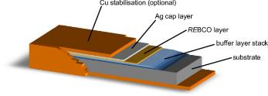
High-field Magnet Technology
Superconducting magnets reach highest fields, three main technologies for the cables
NbTi (niob-titanium, operating at 2-4 k)
is standard, used in LHC limited to O(8 T)
Nb₃Sn (niobium-tin, operating at 2-4 K)
Can reach O(16 T)
Difficult technology, needs to mature further
Expensive
Used in some points for HL-LHC
Foreseen for FCC-hh also in arcs
HTS (high-temperature superconductor, operating up to 20 K)
Different options exist, e.g. REBCO
In solenoids > 30 T demonstrated
Still expensive and technology challenges
Applications in other fields, e.g. medical, fusion reactors, power generators for wind energy, engines, …
Cut through a cable with superconductor embedded in copper, so some remains conductivity in case of a quench
REBCO Tape

Slide 14
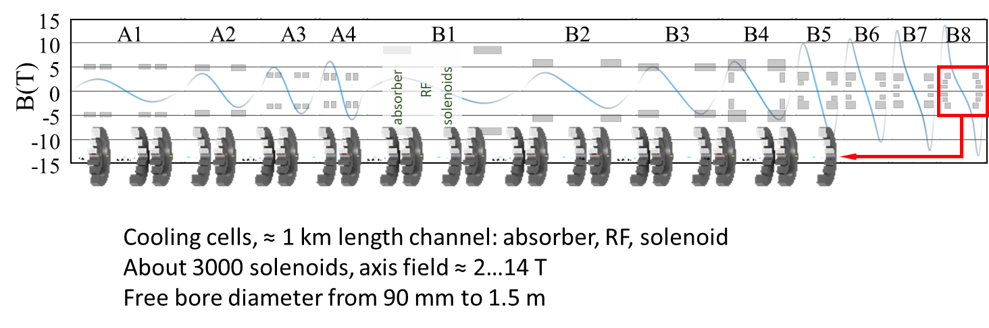
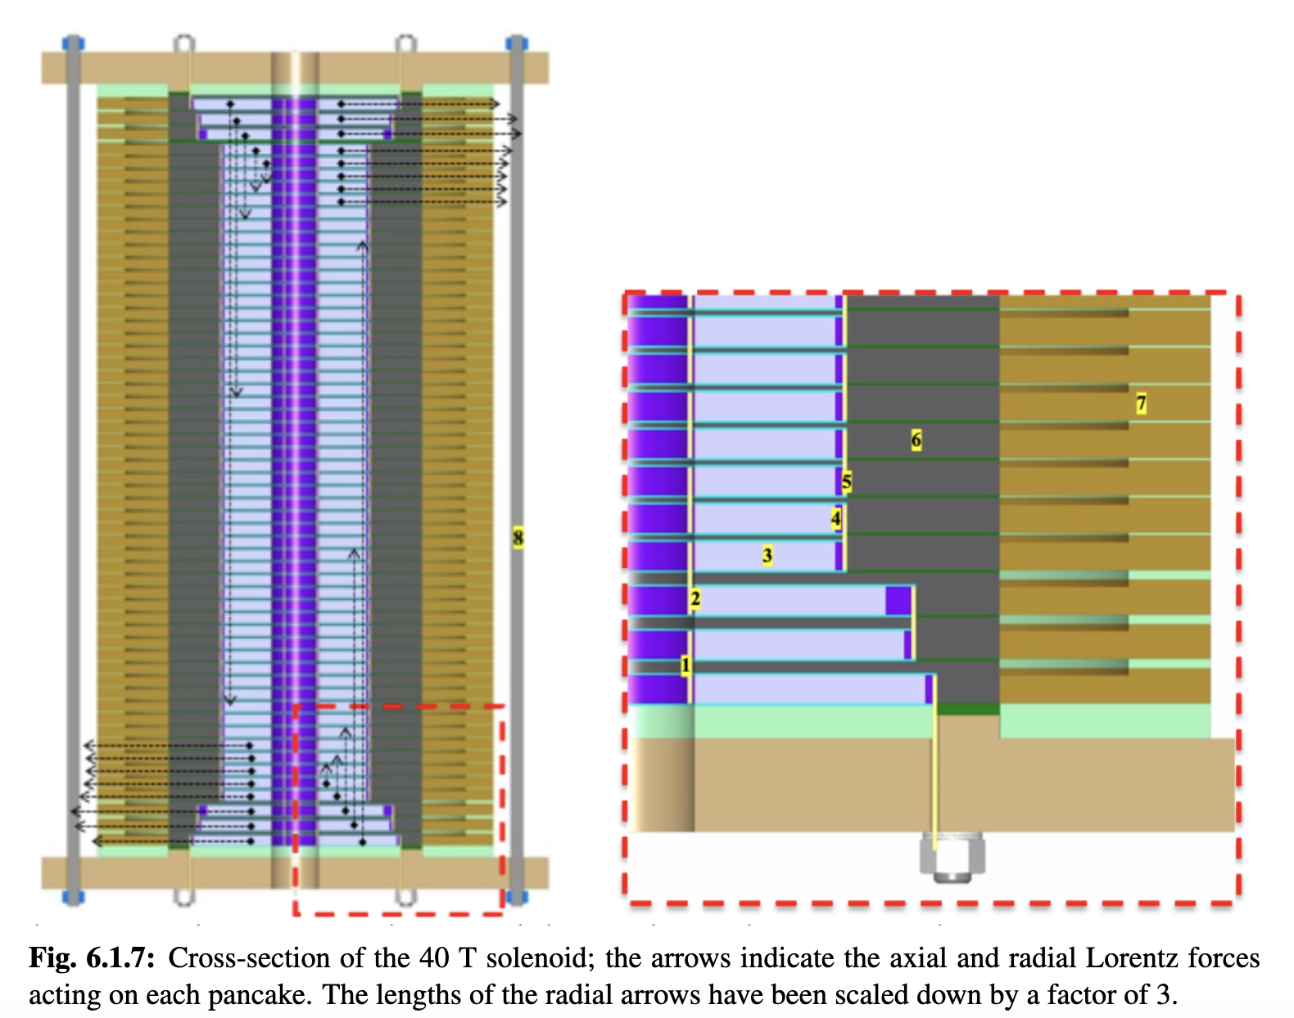
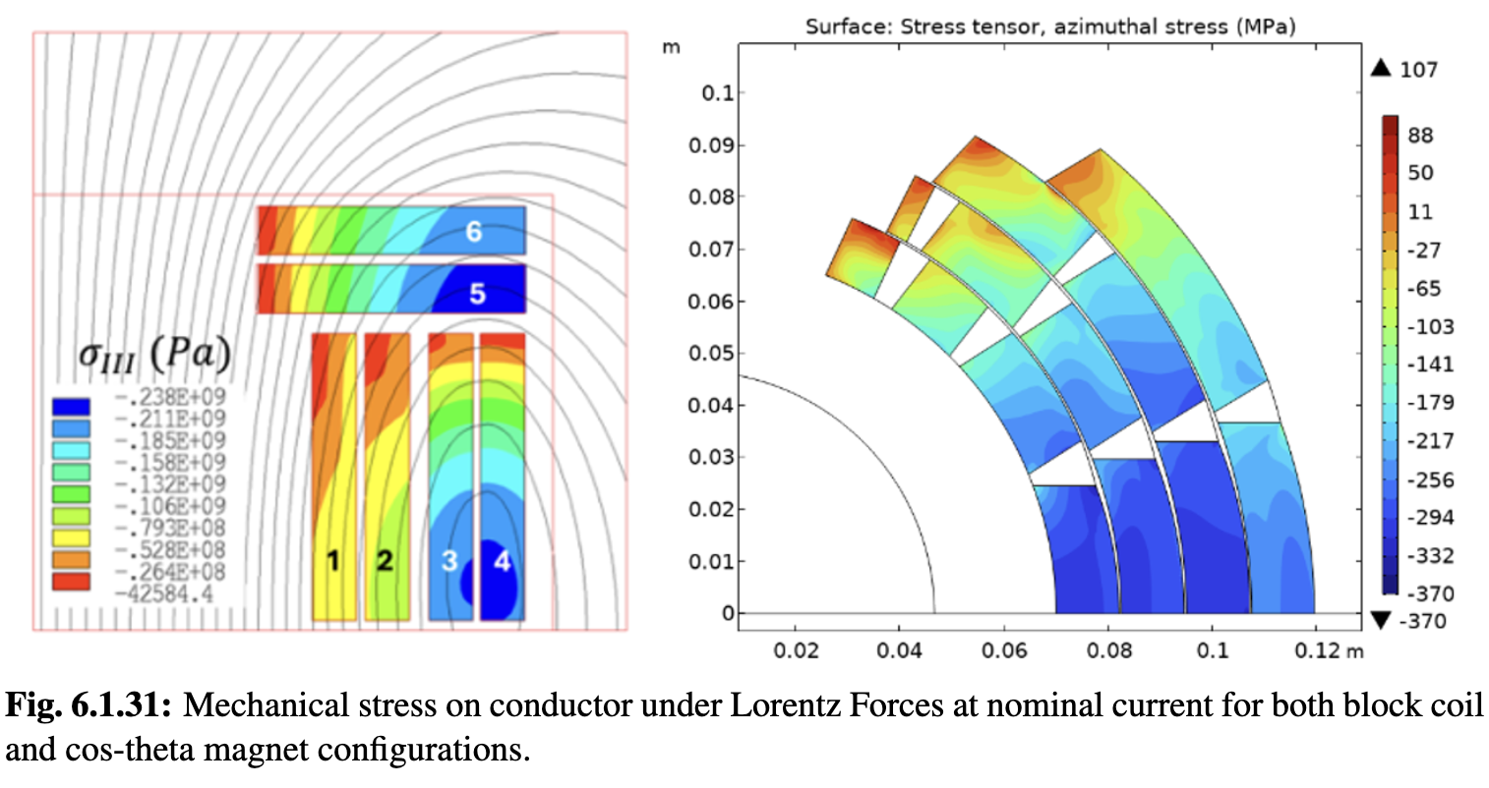
Magnets
6D cooling solenoids
- Pulsed magnets and
power converters
20 T large aperture target solenoid
14 T, 14 cm HTS collider ring dipoles
40 T small aperture final cooling solenoids
14

Slide 15
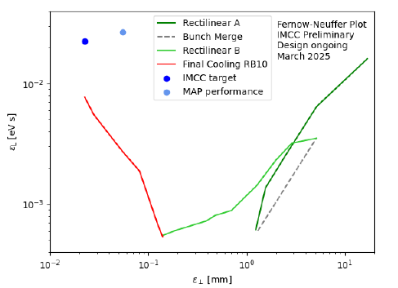
Muon Cooling Lattice Design
Challenge:
Novel, complex lattice with cavities and absorbers in solenoids
Previous design (MAP)
Goal
Achieved
better
Achieved:
Much improved lattice design
Improved simulation tools: BDSIM and RFtrack
Key conclusions:
Can in principle reach or exceed performance target
Much improved longitudinal, may be useful for collider ring
Study of collective effects important
better

Slide 16
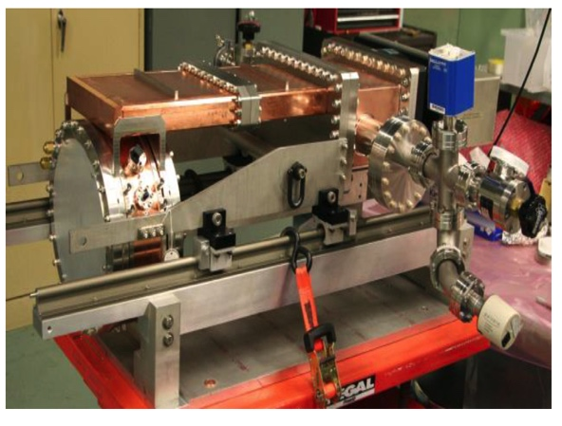
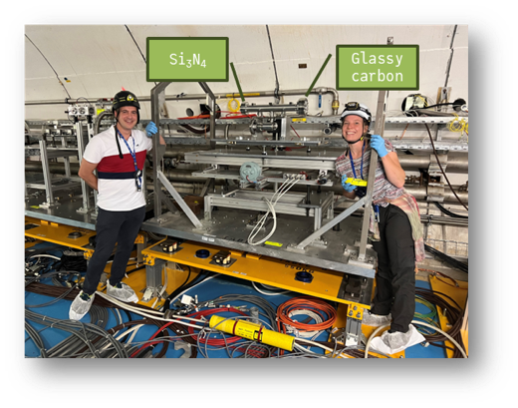
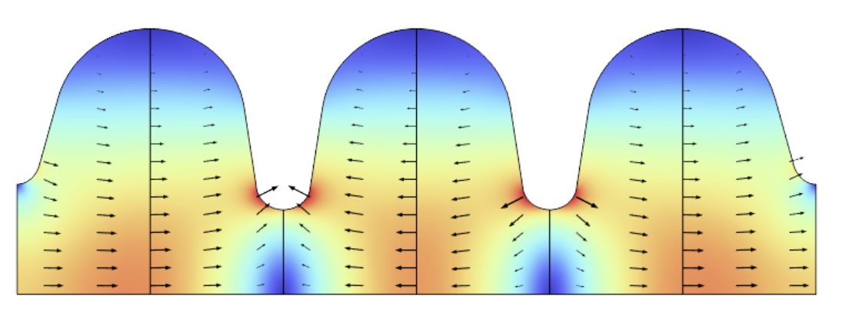
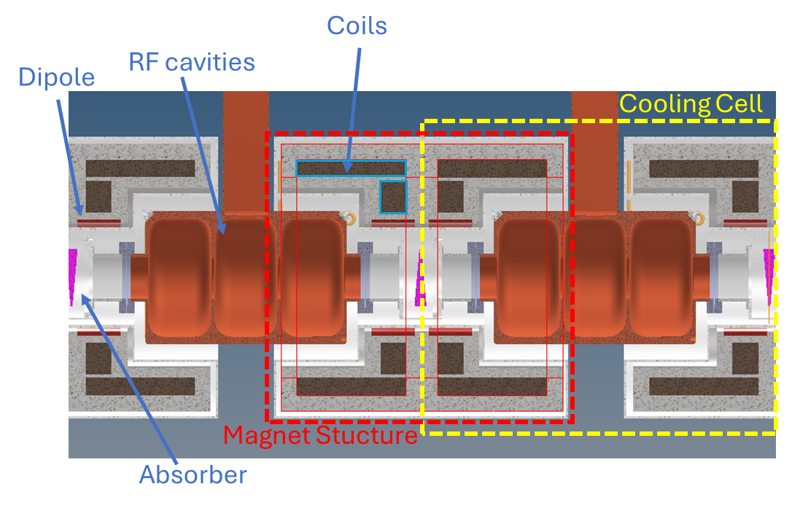
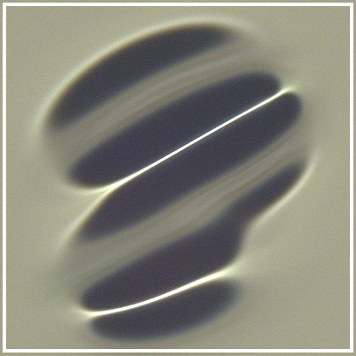
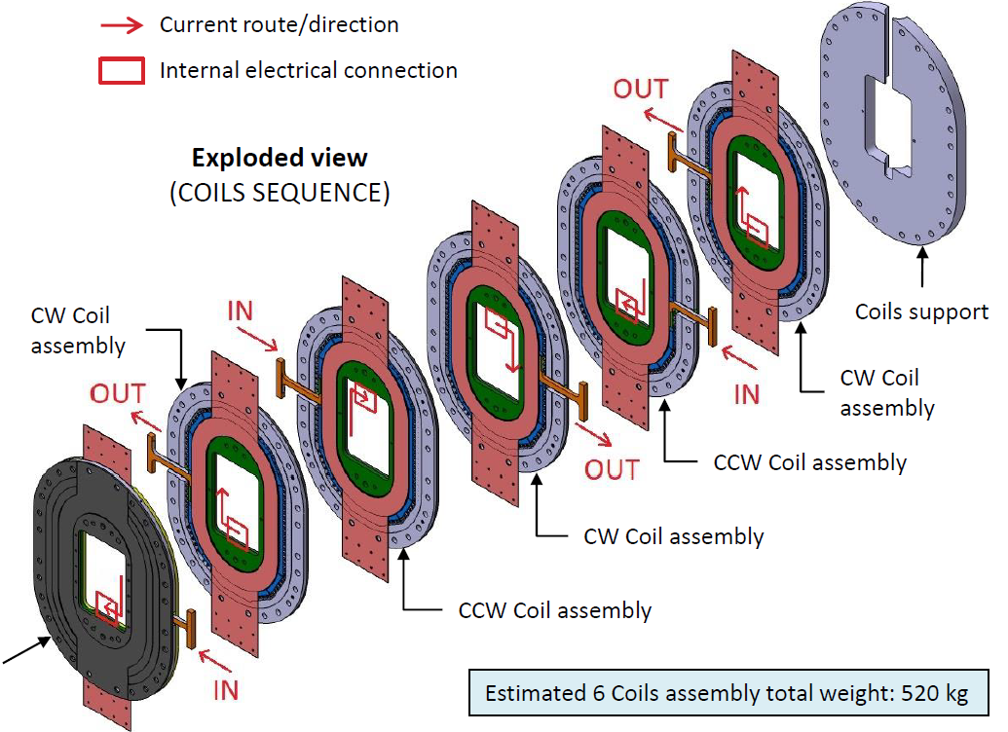
Muon Cooling Technology
Challenges:
NC RF cavities in magnetic field (30 MV/m)
HTS magnets (up to 40 T in final cooling)
Bright beam hard on absorbers and windows
  Can evaporise liquid hydrogen
MuCool demonstrated >50 MV/m in 5 T
H2-filled copper
Be end caps
MAP proved gradient
Initial RF designs
More RF design ongoing
First window tests performed with protons
Use of H2 gas where required
Key conclusions:
Ready to ramp-up effort, in particular prototyping and experimental work, also beamdynamics

Slide 17
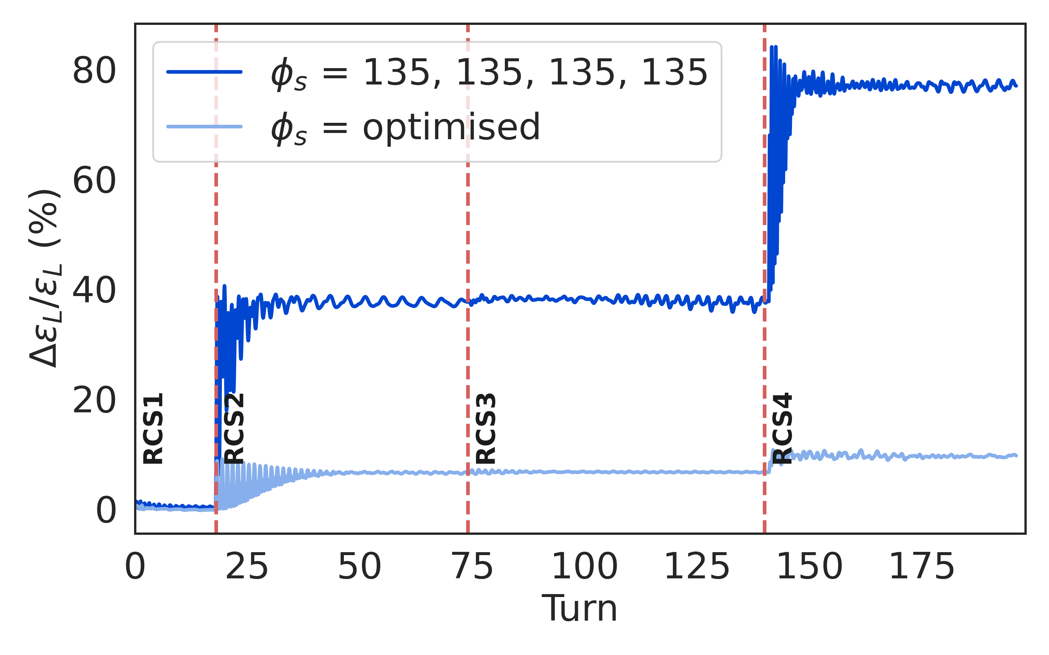
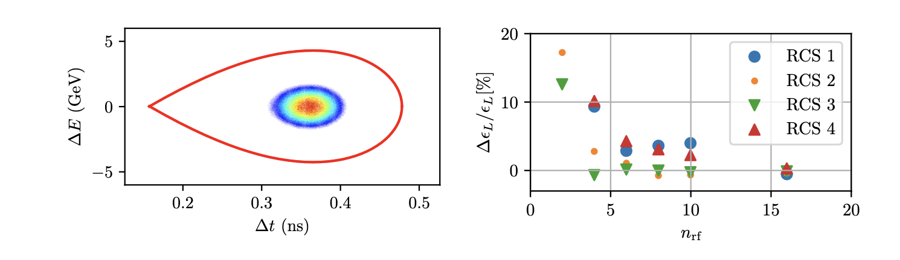
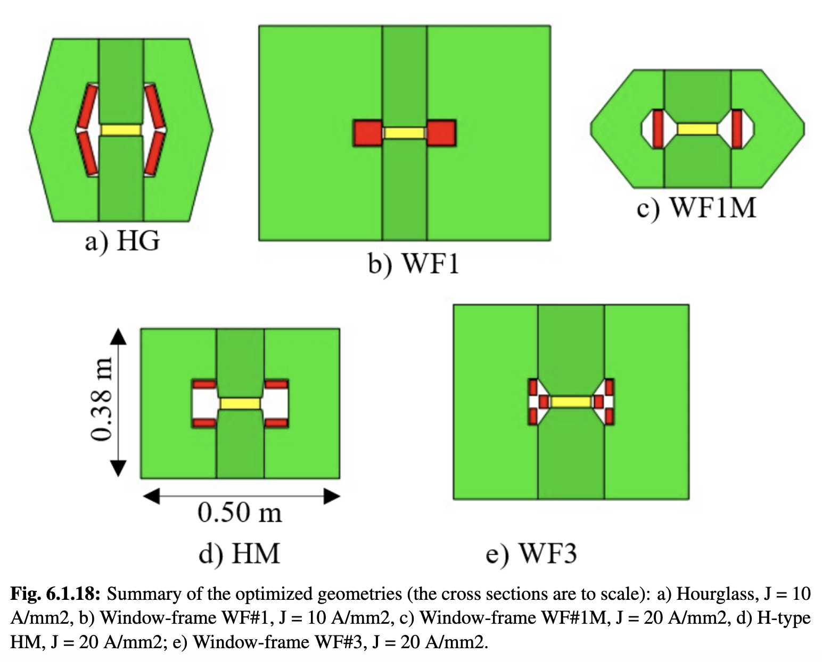
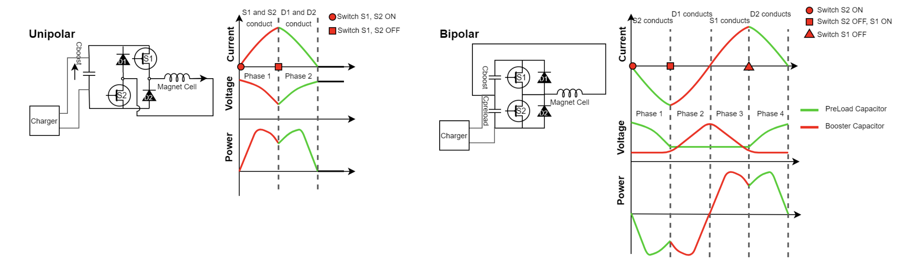
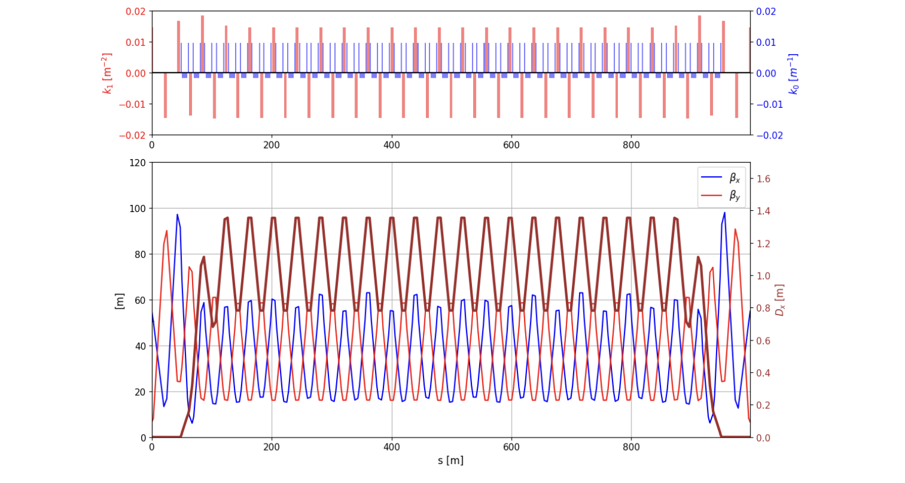
RCS Designs
Challenge:
Uses fast-pulsed normal magnets
5 Hz pulses of O(1-10ms)
6-35 km circumference
Cost
Recover energy from magnetic field
High bunch charge
Maintain beam quality
Achieved:
Lattices for all site independent RCSs
Beam propagation through complex
Conceptual design of magnets and power converters
Optimised design together with RF
RCS | E [J/m] | Loss [%] | P [MW]
SPS 1 | 5447 | 1.1 | 1.9
LHC 1 | 5678 | 1.6 | 12.8
LHC 2 | 5752 | 6.3/2 | 26.6
Key conclusions:
1.3 GHz TESLA-type cavities work
Emittance transport is OK
Cost and power is OK
Need to connect to initial linacs

Slide 18
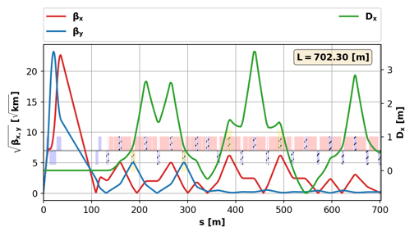
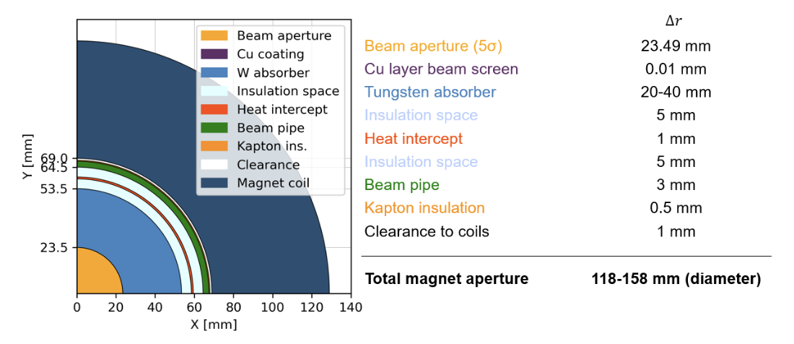
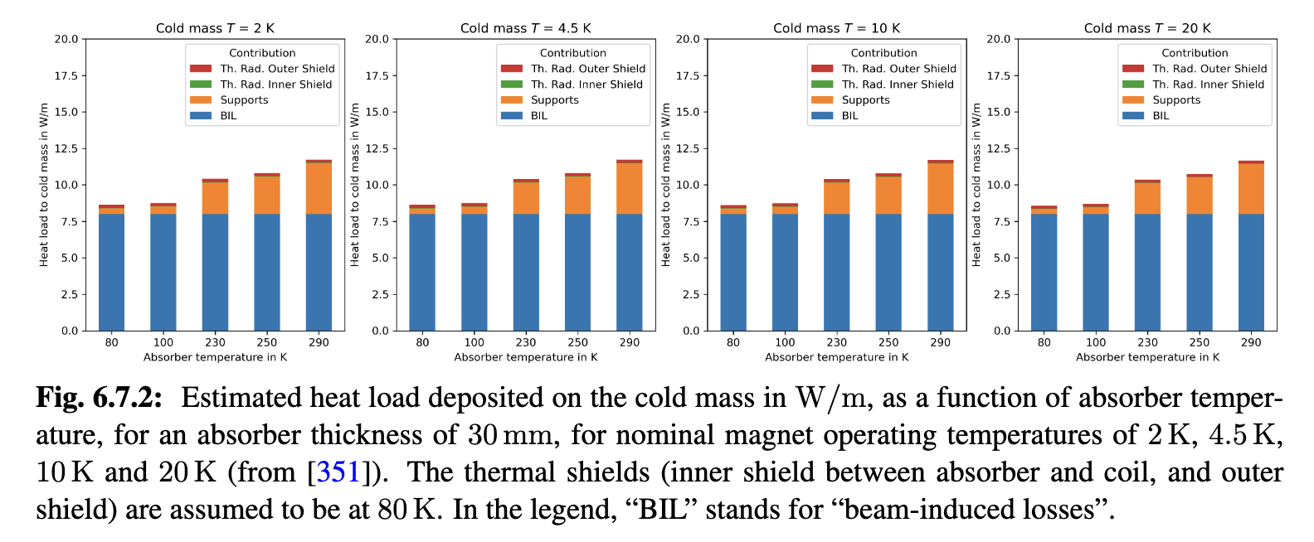
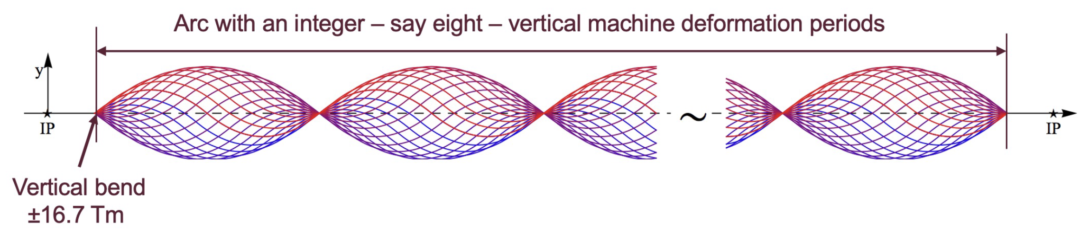
Collider Ring
Challenges:
500 W/m loss, magnet strength, lattice design with beta 1.5-5 mm, 0.1% beam energy spread
Shielding (30-40 mm)
Achieved:
Magnet shielding design
Magnet conceptual designs
Cryogenics concept
Lattice reaches target beta-functions but not yet full target energy acceptance
First studies of mover system impact on beam
Cryogenic loads at different temperatures
Key conclusions:
Should improve energy acceptance should somewhat
OK with energy spread predicted in muon cooling
Mover system does not compromise beam in regular arcs

Slide 19
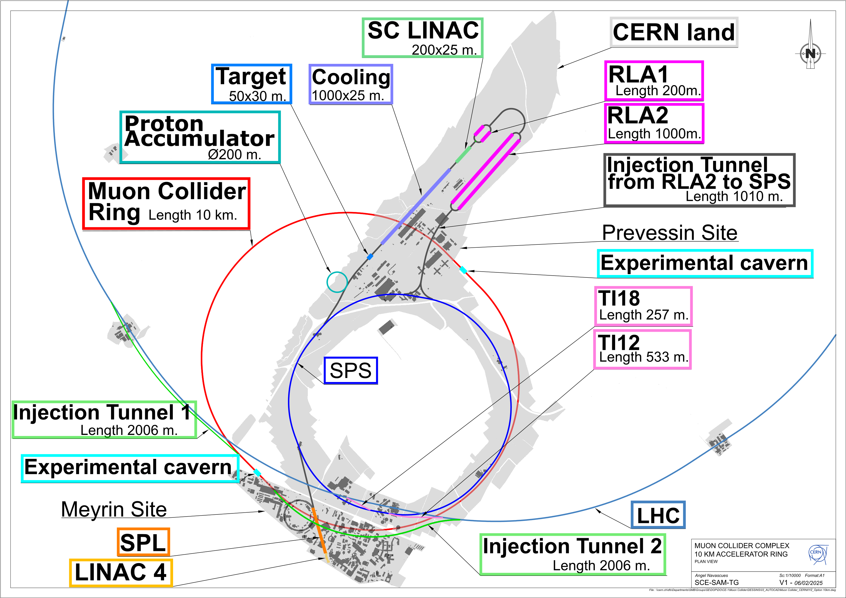
Site Specific Designs
Started studies for concrete site at CERN and Fermilab, looks very promising
CERN:
One RCS in SPS and two in LHC
Construct facility on CERN land
Adjusted parameters (3.2 and 7.6 TeV, 10 TeV maybe possible)
Fermilab:
One RCS in Tevatron tunnel,
three RCS in one site-filler tunnel

Slide 20
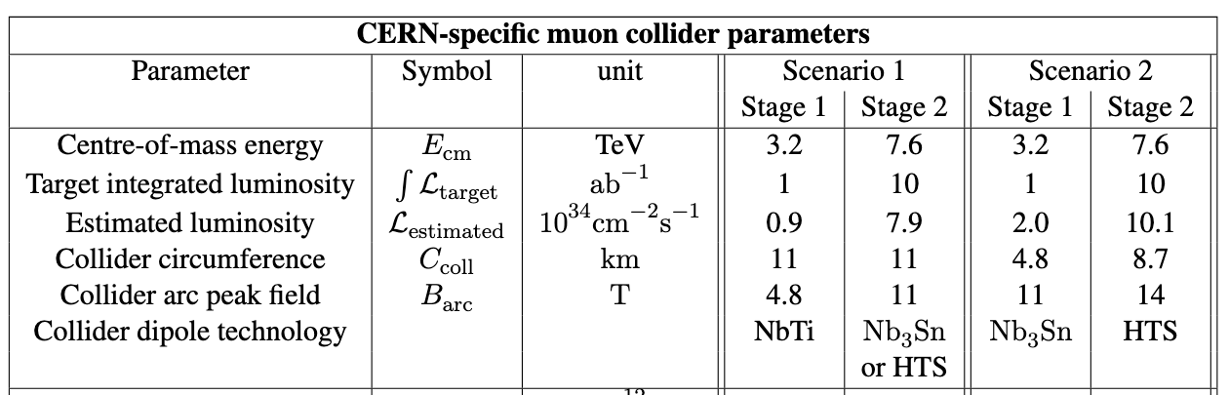


Cost and Power Scale
Design of many collider areas/components has progressed
but uncertainties remain
No overall optimisation
HTS cost model
Power estimate based on conceptual designs and scaling from know components, e.g.
Simulations of fast-ramping magnets and power converter
Detailed scaling for RCS cavities

Slide 21
Timeline and R&D Programme Proposal
Decision on demonstrator
Initial final demonstrator
Timeline is driven by R&D
Most ambitious example to define R&D programme priorities
Muon collider next flagship after HL-LHC
Other options
In Europe after a higgs factory
In the US to become leader at the energy frontier
R&D timeline drivers
Superconducting magnets
  Collider ring with no HTS dipoles for first stage
Muon cooling demonstration
  RF cavities, solenoids, absorbers, integration, demonstration with beam

Slide 22


R&D Plan Deliverables and Resources

Slide 23




Muon Cooling Demonstrator
Challenge:
Demonstrate muon cooling technology in stages
Critical for timeline
Achieved:
Defined the scope and concept, made initial cost estimate, investigated three promising locations at CERN
Staged timeline to implement demonstrator
SLAC is moving forward building a 3/1.3 GHz test stand
Key conclusions:
Installation of demonstrator at CERN appears possible with limited cost (O(10kW)) proton beam
Expensive solution with O(80 kW) would allow future upgrade
Fermilab has approved a study
RF test stands are critical and urgent
Consistent with implementation timeline
R&D plan
Project
preparation
Construction

Slide 24










Magnets
Achieved:
Systematic dipole/solenoid performance prediction (LTS and HTS)
  Aperture, field, cost, stress, loadline, protection, …
HTS solenoid designs (6D cooling, final cooling, target)
Normal-conducting fast-pulsed dipoles (HTS as alternative)
Technically limited R&D timeline developed
MuCol HTS conductor
Operating current: 61 kA
Did adjust collider ring field
HTS final cooling solenoid mechanical design
REBCO, 20 K
First HTS winding tests
Target HTS solenoid
Key conclusions:
Design work is basically done
Opportunity to ramp up effort (engineering designs, building models, …)
With sufficient resources HTS solenoids and Nb₃Sn dipoles could be ready for decision in 10-15 years, consistent with implementation timeline
HTS dipoles likely take longer
HTS pancakes 4 mm tape
Normal-conducting RCS pulsed magnets
24

Slide 25








Way Forward
Continue to execute the Design Study
Defined R&D plan, with deliverables and resources estimates for the next 10 years
Identify resources, sharing of work between partners
Synergy with other particle physics and accelerators
Muons, neutrinos, …
Strong synergy with societal applications exist
HTS magnets for fusion reactors, wind power generators, motors, material science, health applications
Power converter
RF in magnetic field can be relevant for fusion
…
Design of 10 MW HTS wind generator
Examples:
Collaboration on target solenoid/fusion with F4P, ERUOFusion, GaussFusion, ENI
Common EU request with Infineon for power converter
Early career experts are very motivated by the required and possible innovations

Slide 26
Conclusion
Muon collider has a compelling physics case
R&D progress is increasing confidence that the collider is a unique, sustainable path to the future
Much improved design, no showstopper identified, but more work to be done
Need to ramp up the momentum globally
Full start to end modelling
Actual hardware development
HTS solenoid and other magnet development
Preparation of the muon cooling demonstrator
Strong synergies with other fields ranging from particle physics to societal application exist
Fusion reactors
High-field solenoids
Power converter
…
Many thanks to the collaboration for all the work
Our web page: http://muoncollider.web.cern.ch
If you want to join: muon.collider.secretariat@cern.ch

Slide 27
Reserve

Slide 28
R&D Plan Deliverables and Resources
Totals:
Duration 10 years
Accelerator: 300 MCHF material, 1800 FTEy
Detector: 20 MCHF material, 900 FTEy

Slide 29

Magnet R&D Impact
L. Bottura

Slide 30
Practical Examples
Fusion for Energy (ITER EU Domestic Agency)
  Framework agreement and first addendum in final negotiation
  Contribution to the design of the HTS target solenoid, relevant to the central solenoid of DTT
EUROFusion (next step European fusion reactor)
  Framework agreement signed in 2023, first addendum signed in 2024
  Contribution to the design of the HTS target solenoid, relevant to the magnets of a Volumetric Neutron Source proposed as next step in the European fusion strategy
Gauss Fusion (one of the leading EU fusion start-ups)
  Consultancy agreement signed in 2023
  CERN contribution to the design of the LTS/HTS GIGA stellarator magnets, based on advances in the HTS target solenoid
ENI (oil and gas energy giant)
  Framework agreement and first addendum signed in 2024
  Collaboration on the conceptual design and project proposal for the CERN construction of a large bore HTS solenoid (20@20 model coil) relevant to the muon collider and fusion
IFAST-2 proposal to INFRA-2025-TECH-01-02 (CERN, INFINEON, PSI)
  Proposal of fast pulsed power cell + magnet system sent to IFAST-2 coordination for ranking at TIARA
  Industrial interest in rapidly pulsed and large energy/power supplies
L. Bottura

Slide 31
European Accelerator R&D Roadmap
Reviews in Europe and the US found muon collider promising
Requires important innovation
European Strategy for Particle Physics Update (ESPPU) supported muon collider R&D in 2020
CERN Council charged Laboratory Directors Group (LDG) to develop Accelerator R&D Roadmap
Directors of institutes, e.g. INFN Frascati, PSI, DESY, RAL, CERN, …
LDG formed five panels, one on Muon Collider
Muon Collider panel developed an R&D Roadmap with the help of the global community until end of 2021
31
http://arxiv.org/abs/2201.07895

Slide 32
Muon Collider Roadmap CT
Protons produce pions which decay into muons which are captured
Short, intense proton bunch
Ionisation cooling of muon in matter
Acceleration to collision energy
Collision
- Proton driver
bunch compression
- Graphite target
- Target solenoid
- Muon cooling design
- 6D cooling solenoids
- 6D cooling RF cavities
- Final cooling solenoids
- Pulsed magnets and
power converters
- RCS RF system
Identified and prioritized with community
Other areas need now also to be addressed
(some work started)
- Collider ring dipoles
- Final focus quadrupoles
- Machine-detector interface
32

Slide 33
MuCol Timeline
LDG anticipated input to next ESPPU by 2026
The ESPPU has been advanced to early 2025
2023
2024
2025
2026
2027
ESPPU submission
ESPPU recommendation

Slide 34
Muon Cooling Challenges
High field solenoids minimise beta-function and impact of multiple scattering
Energy loss = cooling
Multiple scattering = heating
34

Slide 35
ESPPU Submission March 2025
Collaboration produced ESPPU input:
Short, ten-page report (10p)
Addendum to answers specific questions from ESPPU (18p)
Back-up document (406p, 450 signatories)
  Assessment of collider status based on progress of R&D
  R&D Plan
  Final polishing is ongoing, you Urgently sign up to support

Slide 36
IMCC
International Muon Collider Collaboration
Develop high-energy muon collider as option for particle physics:
Implement globally defined accelerator R&D roadmap (2022) to justify CDR phase
Mid-term roadmap review found 75% of goal achieved
Param. | Unit | 3 TeV | 10 TeV
L/IP | 10³⁴ cm⁻²s⁻¹ | 1.8 | 17.5
Int L | Ab⁻¹ | 2.2 | 1.8
f_{r} | Hz | 5 | 5
C | km | 4.5 | 11.4
B_{dipole} | T | 11 | 14
Collider techn. |  | Nb3Sn | HTS
Focus on feasibility of 10 TeV with 10 ab⁻¹ (site independent)
Explore initial stage by 2050, maybe around 3 TeV with 1 ab⁻¹ or lower luminosity 10 TeV
Explore implementation at specific sites reusing infrastructure
Provided ESPPU with
Assessment of muon collider concept, technologies and work progress
An R&D plan for the next 10 years
Implementation considerations (including site, timeline, …)
Back-up document (406p, 450 signatories)
Will inform other strategy processes
Roadmap: http://arxiv.org/abs/2201.07895
36

Slide 37

Muon Cooling Technology
Challenges:
NC RF cavities in magnetic field (30 MV/m)
HTS magnets (up to 40 T in final cooling)
Bright beam hard on absorbers and windows
  Can evaporise liquid hydrogen
MuCool demonstrated >50 MV/m in 5 T
H2-filled copper
Be end caps
MAP proved gradient
Initial RF designs
More RF design ongoing
First window tests performed with protons
Use of H2 gas where required
40 T final cooling solenoid conceptual designs exist
55 T might be possible
Key conclusions:
Ready to ramp-up effort, in particular prototyping and experimental work, also beamdynamics

Slide 38



Muon 6D Cooling Cell
Challenge:
Integrated 6D cooling cell
HTS solenoid designs
Achieved:
Cooling cell engineering design almost ready
Solenoid models for use in beamdynamics optimisation
STEP 6: Connect 6x Coils with pins (half Cold Mass)
L. Rossi et al.
L Bottura et al.
Key conclusions:
Key challenge is force from magnetic field
Concept to connect flanges developed
Iterations to improve overall and components design also considering beam dynamics is required/ongoing
Conceptual design ready in a few months

Slide 39


RCS Designs
Challenge:
Uses fast-pulsed normal magnets
5 Hz pulses of O(1-10ms)
6-35 km circumference
Cost and power efficient acceleration
High bunch charge
Maintain beam quality
Achieved:
Lattices for all site independent RCSs
  Strong synchrotron motion
  Including hardware specifications
Beam propagation through complex works
Lattice: A. Chance et al.
Long. dynamics: H. Damerell et al.
RF: Alexej Grudiev et al.
Power converter: F. Boattini et al.
Magnets: L. Bottura et al.
Key conclusions:
1.3 GHz TESLA-type cavities work
Emittance transport is OK
Need to connect to initial linacs

Slide 40

Fast-ramping RCD Dipoles
Challenge:
Fast ramping normal magnets (1-10 ms) with efficient energy recovery in power converter (200 MJ stored in magnets)
Achieved:
Conceptual design of magnets and power converters
Optimised design together with RF
Power converters can switch sign of magnets without changing direction of voltage on capacitors
Power converter: F. Boattini et al.
Magnets: L. Bottura et al.
RCS | E [J/m] | E_{iron} [J/m] | E_{copper} [J/m] | Loss [%] | P [MW]
SPS 1 | 5447 | 10 | 52 | 1.1 | 1.9
LHC 1 | 5678 | 9.2 | 80.6 | 1.6 | 12.8
LHC 2 | 5752 | 63.4 | 298 | 6.3/2 | 26.6
Key conclusions:
High recovery efficiency for RCSs (98-99%)
Ready for experimental optimization/models/protoypes
Energy in magnets, losses per cycle and total power at 5 Hz including cooling

Slide 41






Collective Effects
Goal:
Identify collective effects intensity bottlenecks
Achieved:
Initial studies for proton complex
Assessed impedances (beam screen and RF cavities) in RCSs and collider ring
  Studying counter-rotating beam impedance
Studies started on muon cooling
Key conclusions:
Impedances in RCSs and collider ring can be taken care of by design
Beam-beam can be handled by 20 turn feedback
Resistive wall in muon cooling is OK
Further key detailed studies: beam loading, longitudinal and transverse space charge in 6D cooling, impedance of cooling absorbers

Slide 42
Lattice Designs
Lattice design is progressing well
42

Slide 43



Collider Ring Magnets
Challenge:
High-field collider ring magnets with large aperture
Achieved:
New method developed to identify field limit, depending on technology, temperature, cost, aperture, considering current, stress and protection (quadrupoles, dipoles, combined function magnets)
Different conceptual dipole designs (block coil, cos-theta)
Combined function design ongoing
Key conclusions:
Dipoles appear feasible:
  NbTi at 4 K, 4.8 T, 16 cm aperture
  Nb3Sn at 4 K, 11 T, 16 cm aperture
  HTS at 20 K, 14 T, 14 cm aperture
Quad in dipole best combined solution
Experimental programme is now essential

